Slide 1
Topographic Evolution of Heat-Treated Nb Upon Electropolishing for SRF Applications
Work presented is based on our paper in Physical Review Accelerators and Beams:
https://doi.org/10.1103/PhysRevAccelBeams.26.103101
Eric M. Lechner

Slide 2
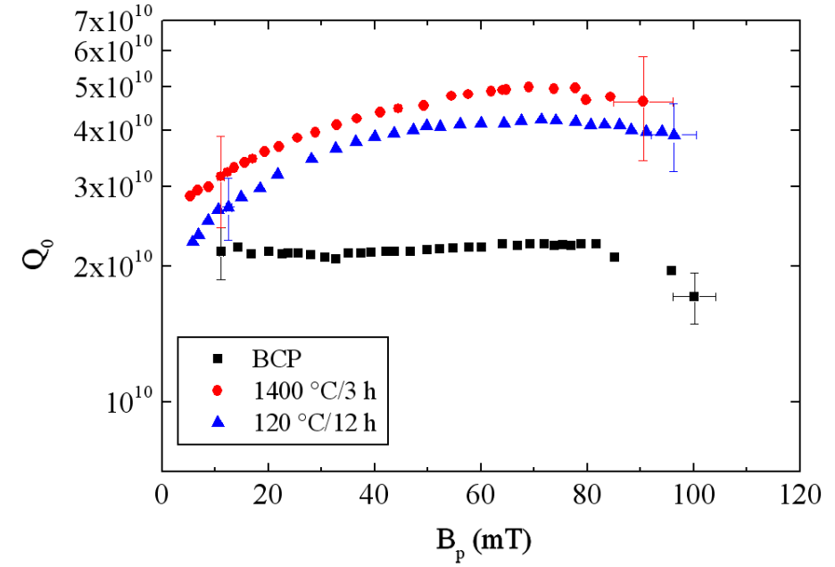
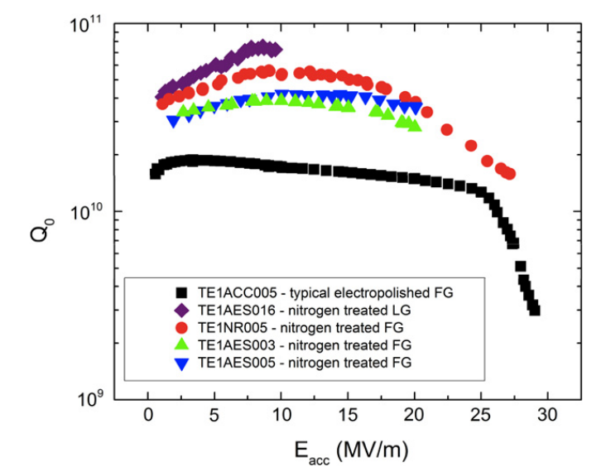
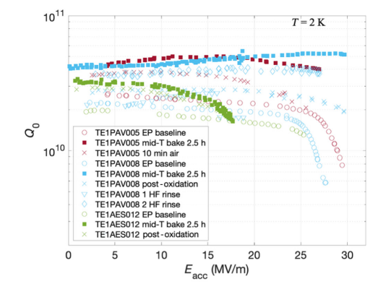
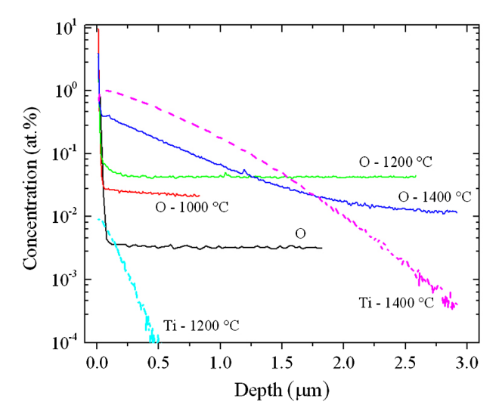
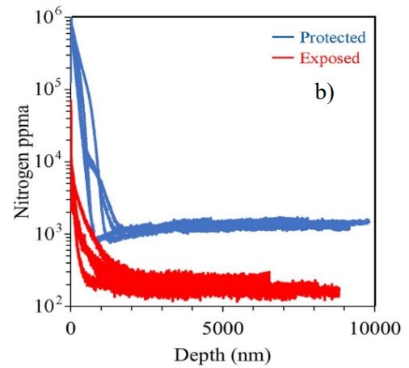
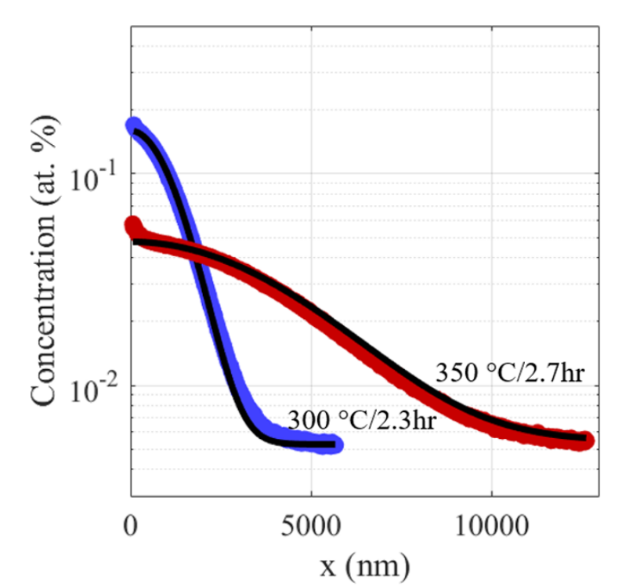
Introduction – Importance of Impurities
[1]
[2]
[4]
Introducing impurities has been an effective method for reducing the surface resistance at moderate accelerating gradients.
N-doping successfully implemented in LCLS-II
[3]
[5]
Ti impurities
N impurities
O impurities
[1] Dhakal, P., et al. Physical Review Special Topics-Accelerators and Beams 16.4 (2013): 042001.
[2] Grassellino, Anna, et al. Superconductor Science and Technology 26.10 (2013): 102001.
[3] Reece, Charles, et al. Challenges to Reliable Production Nitrogen Doping of Nb for SRF Accelerating Cavities. IPAC2022, 2022.
[4] Posen, S., et al. Physical Review Applied 13.1 (2020): 014024.
[5] Lechner, E. M., et al. Applied Physics Letters 119.8 (2021).

Slide 3
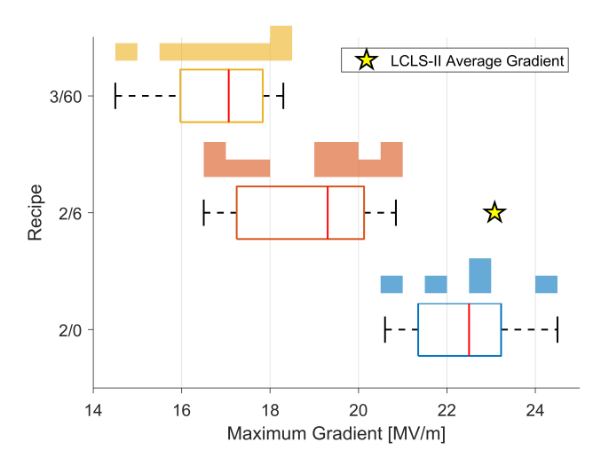
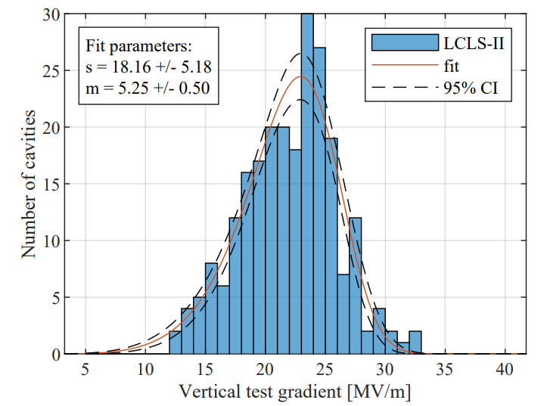
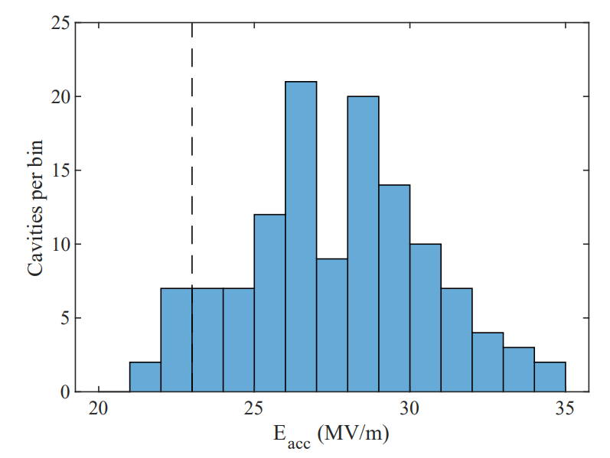
Introduction – LCLS-II
[1]
LCLS-II HE R&D
[2]
LCLS-II Cavities (2N6)
[3]
LCLS-II HE Cavities (2N0)
<E_{acc}> = 22 MV/m
<E_{acc}> =27 MV/m
Differences in max gradients observed in LCLS-II HE R&D
What are the differences between the N doping heat treatments?
[1] Gonnella, Daniel, et al. The LCLS-II HE high q and gradient r&d program. SRF’19, 2019.
[2] Maniscalco, James, et al. Statistical Modeling of Peak Accelerating Gradients in LCLS-II and LCLS-II-HE. SRF’21, 2021.
[3] Maniscalco, James, et al. LCLS-II-HE CAVITY QUALIFICATION TESTING. SRF’23, 2023

Slide 4
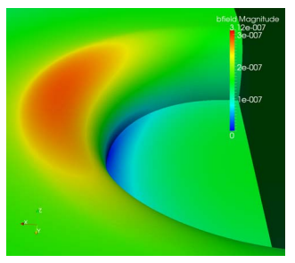
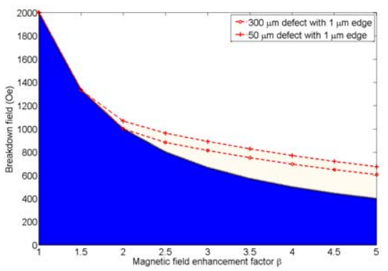
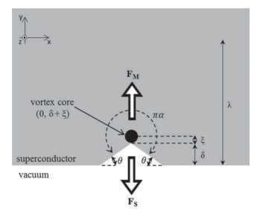
Introduction – Topographic Defects
[1]
[2]
[3]
In N doped Nb, EP reveals topographic defects within grains.
Topographic defects produce local field enhancements due to the nature of the Meissner current. This may turn some regions of the cavity normal conducting and lead to thermal instabilities.
Topographic defects can reduce the local superheating fields. This reduces the field required to nucleate dissipative vortex semiloops and may help trigger thermal instabilities.
[1] Spradlin, J.K., et al. The LCLS-II HE high q and gradient r&d program. SRF’19, 2019.
[2] Xie , et al. Quench Simulation Using a Ring-Type Defect Model SRF’11, 2011
[3] Kubo, Takayuki, Progress of Theoretical and Experimental Physics 2015.6 (2015): 063G01.

Slide 5
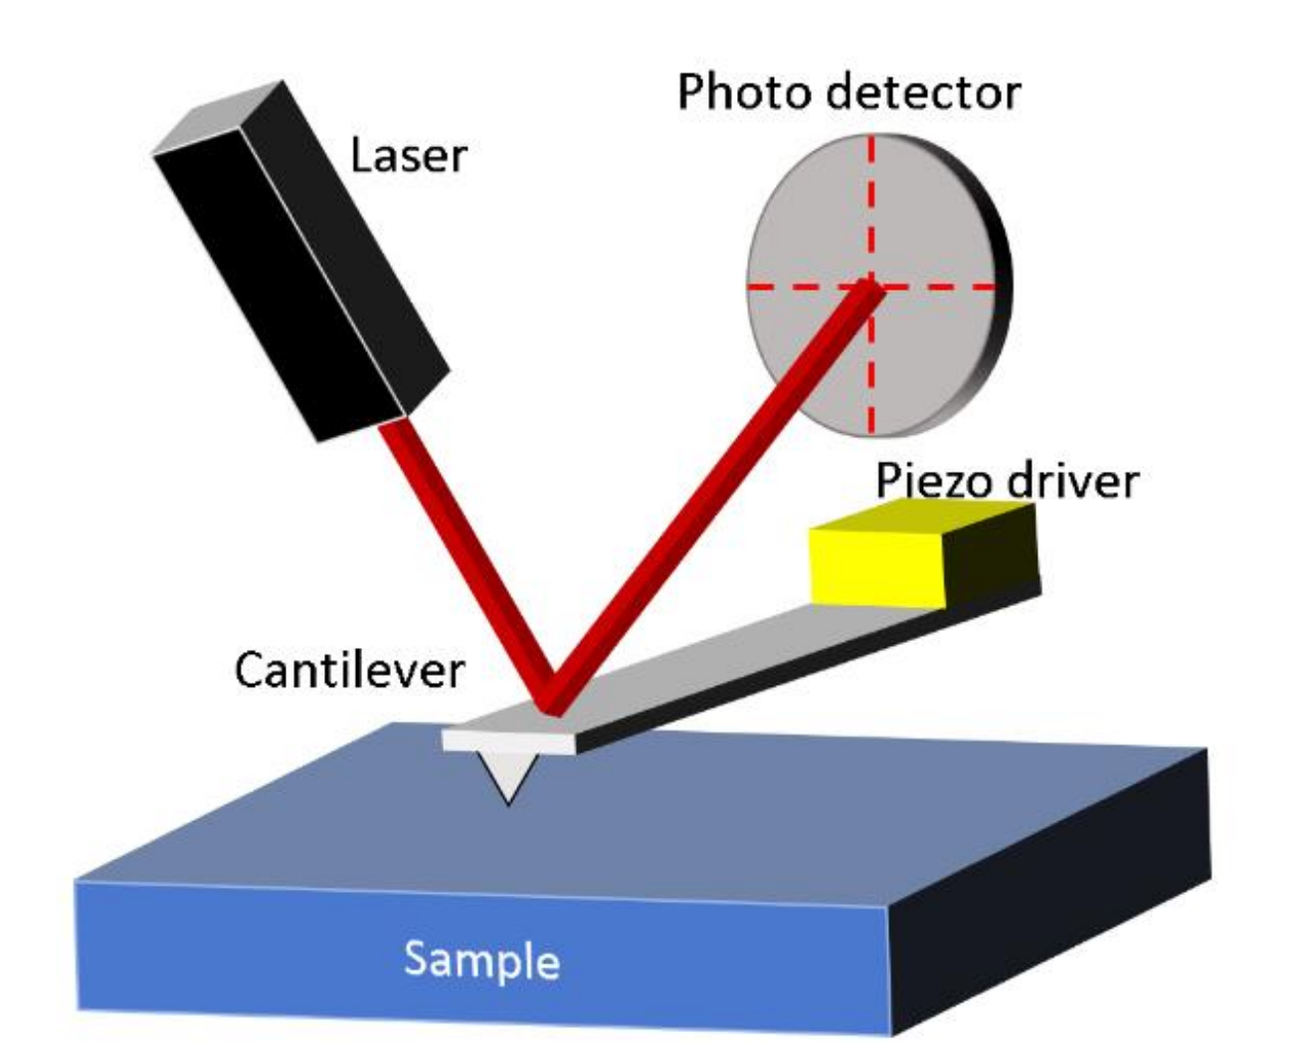
Atomic Force Microscopy
Pros
< 10 nm tip radius allowing fantastic x-y spatial resolution on length scales relevant for SRF. Substantially better lateral resolution than WLI or LSCM
Cons
Relatively slow.
Limited to few-micron high and ~100 um wide scan areas.

Slide 6
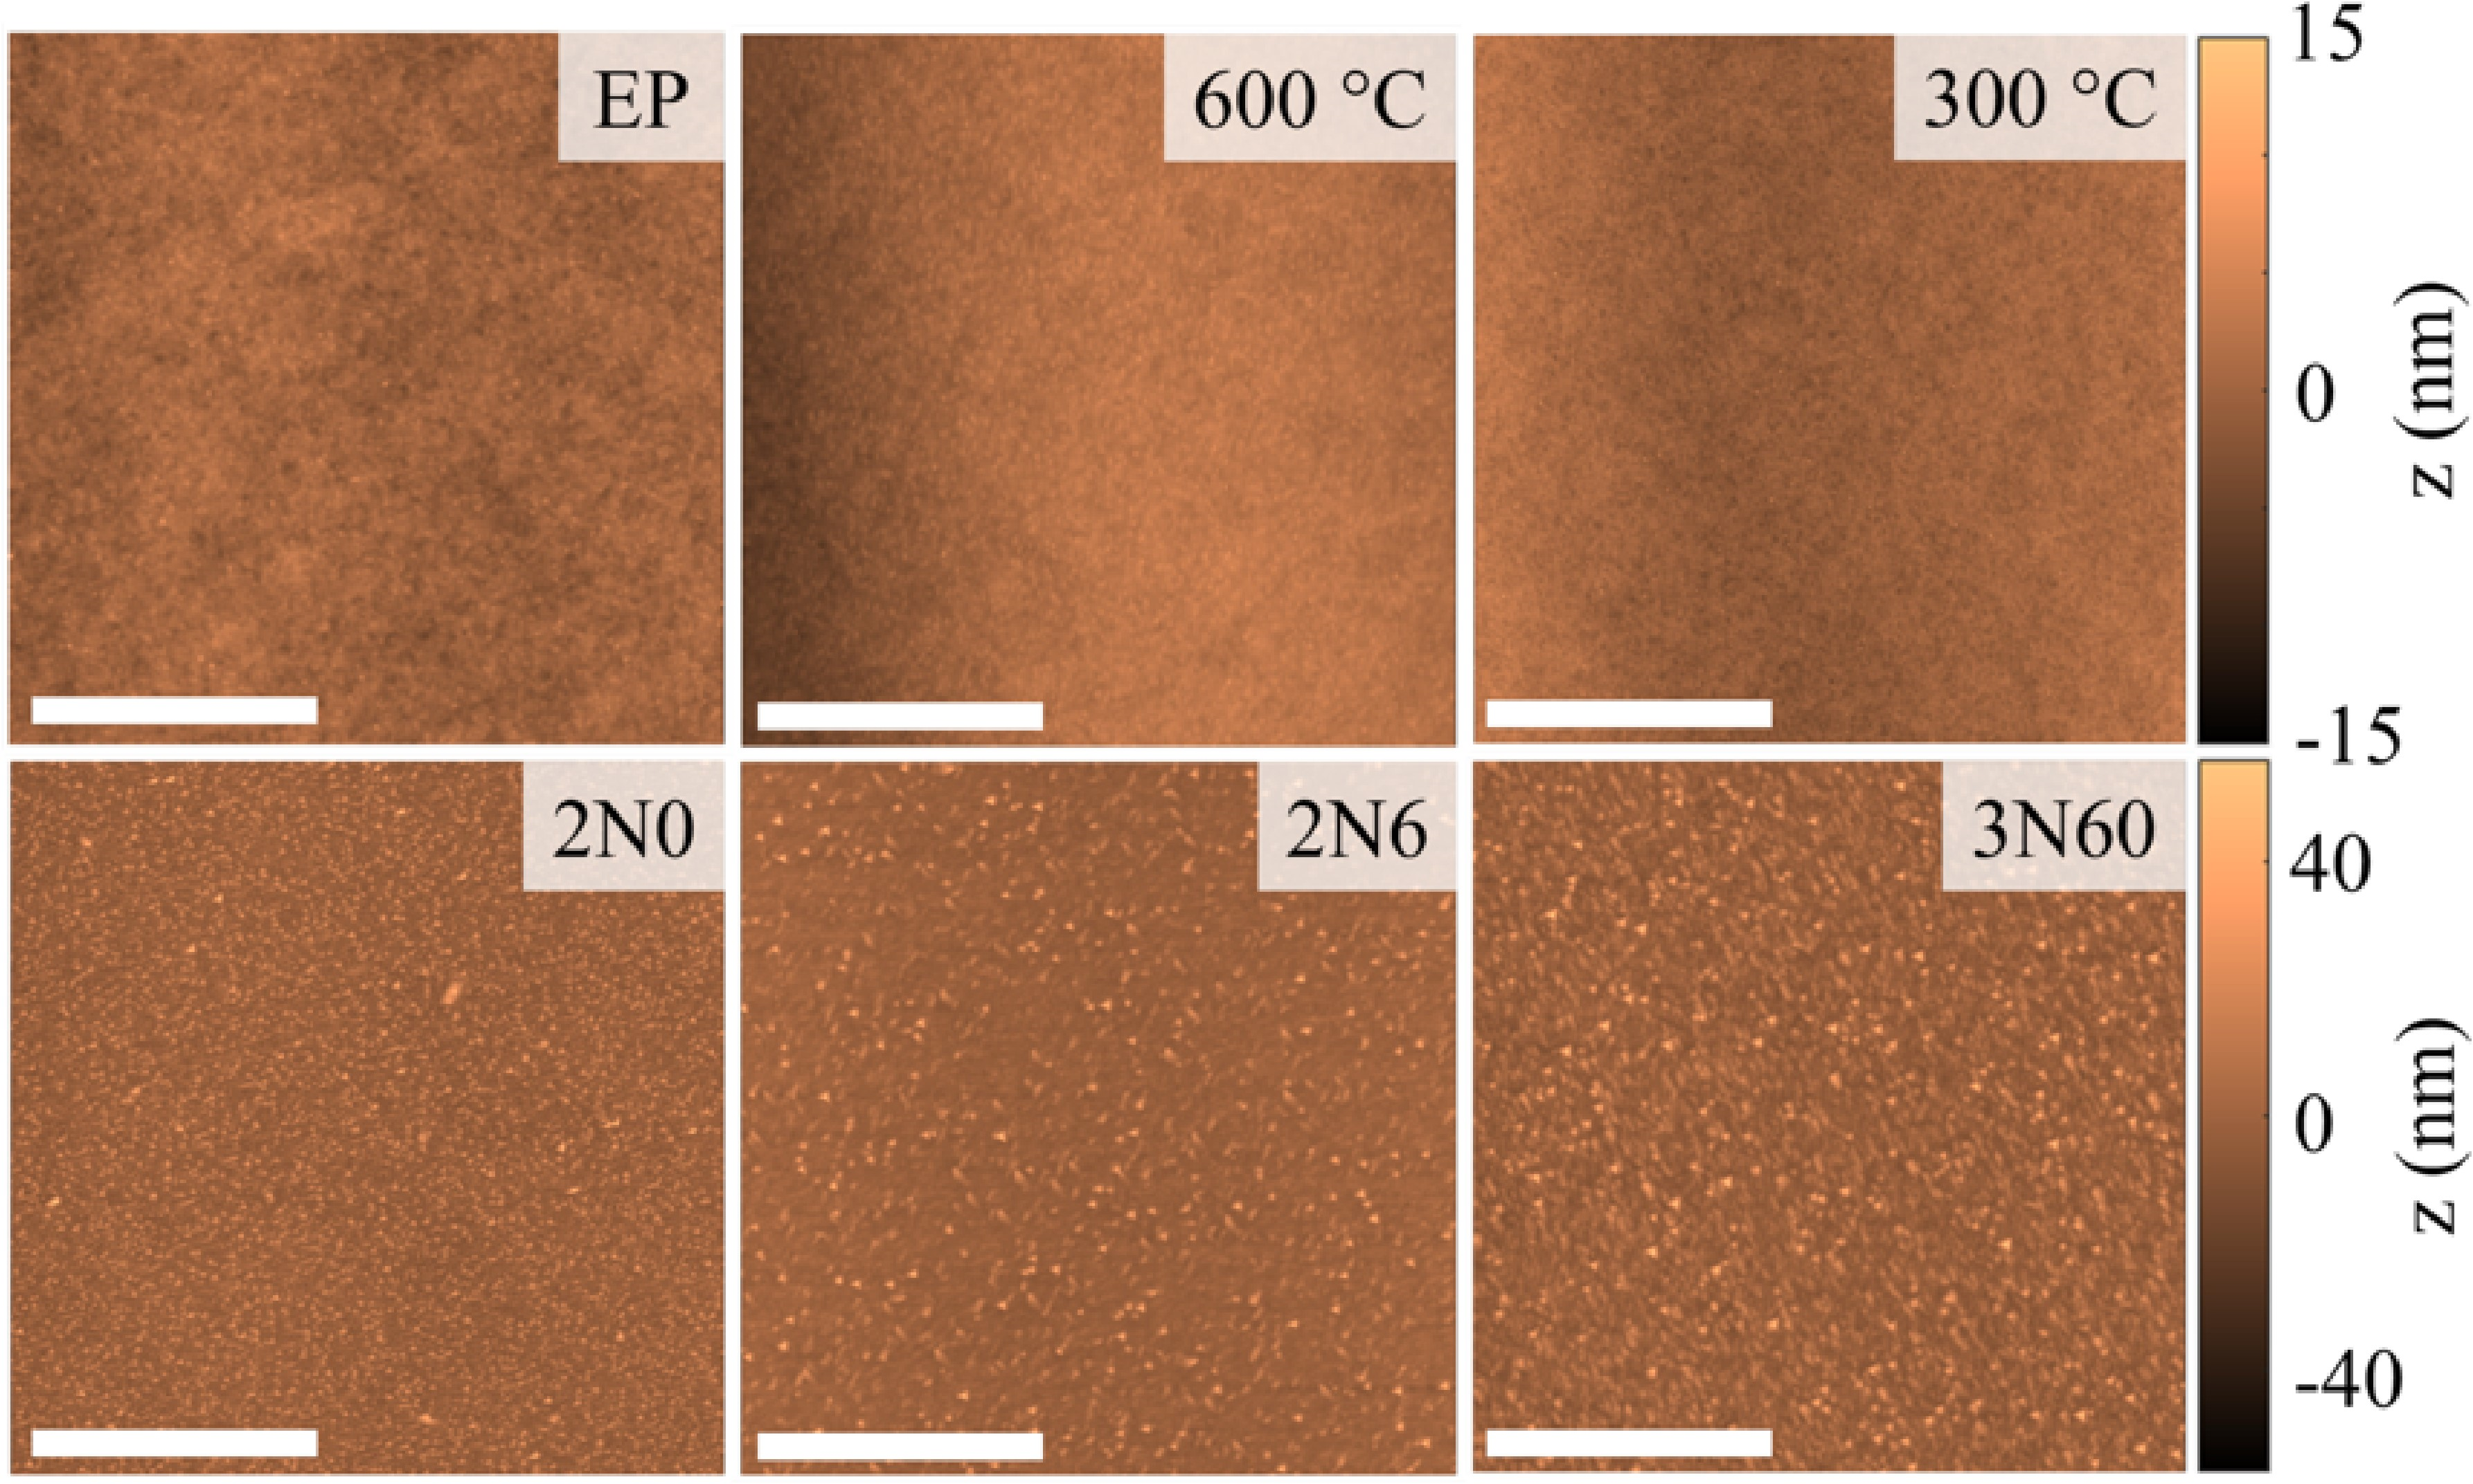
Native Surface After Heat Treatment
Nitrides may form within, and continuously along some grain boundaries
Niobium nitrides show sharp interfaces between surrounding doped Nb and nitride. Bad for magnetic field enhancement and superheating field suppression.

Slide 7
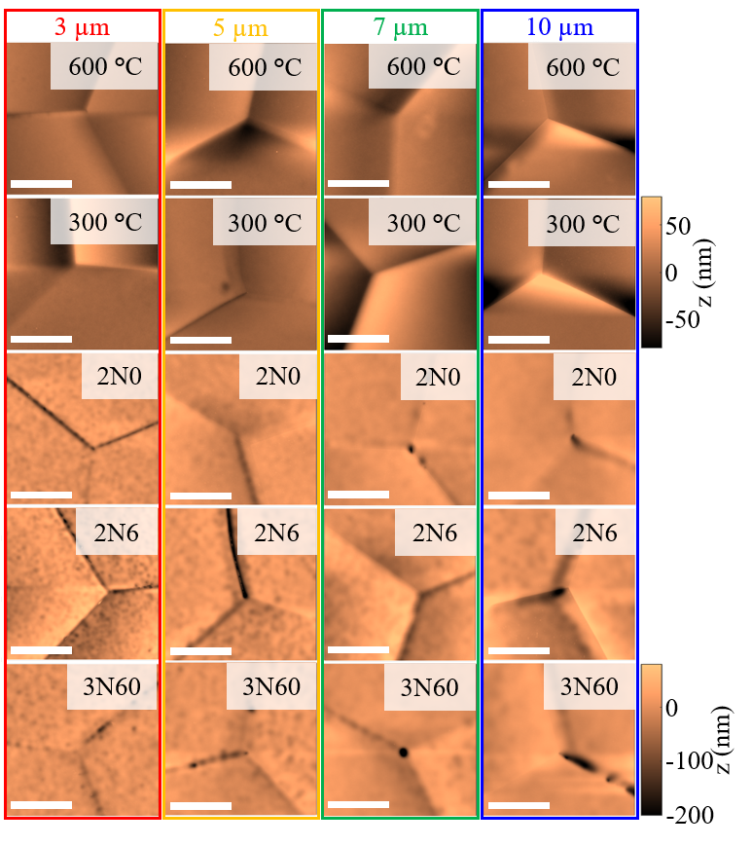
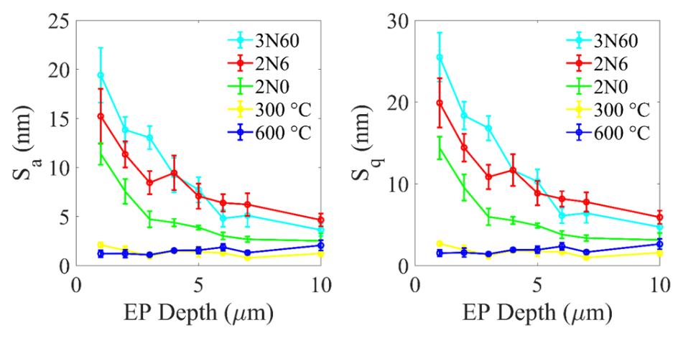
Effect of EP on Heat-Treated Nb
2N0 Before EP
2N0 After EP
Intragranular Roughness
When precipitates are present, electropolishing will attack the precipitate first which roughens the surface.
Precipitates are worst in the N-doped samples especially at grain boundaries and triple junctions.
Further EP smoothens the surface as expected.

Slide 8
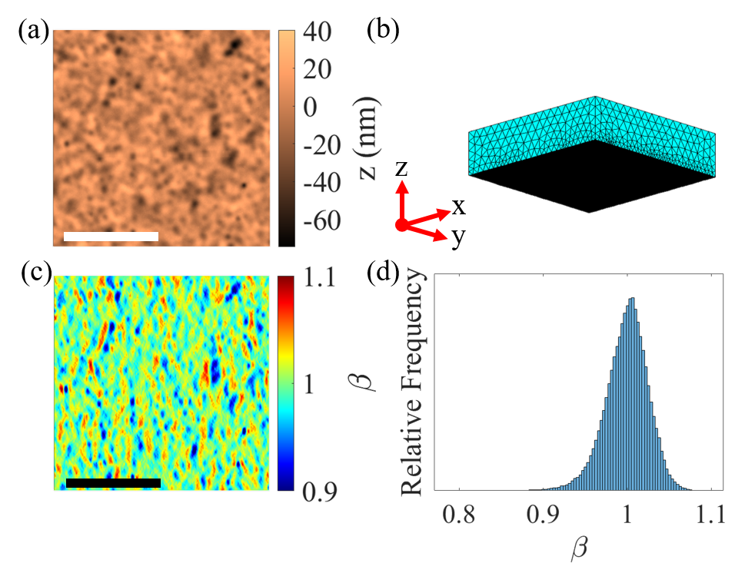
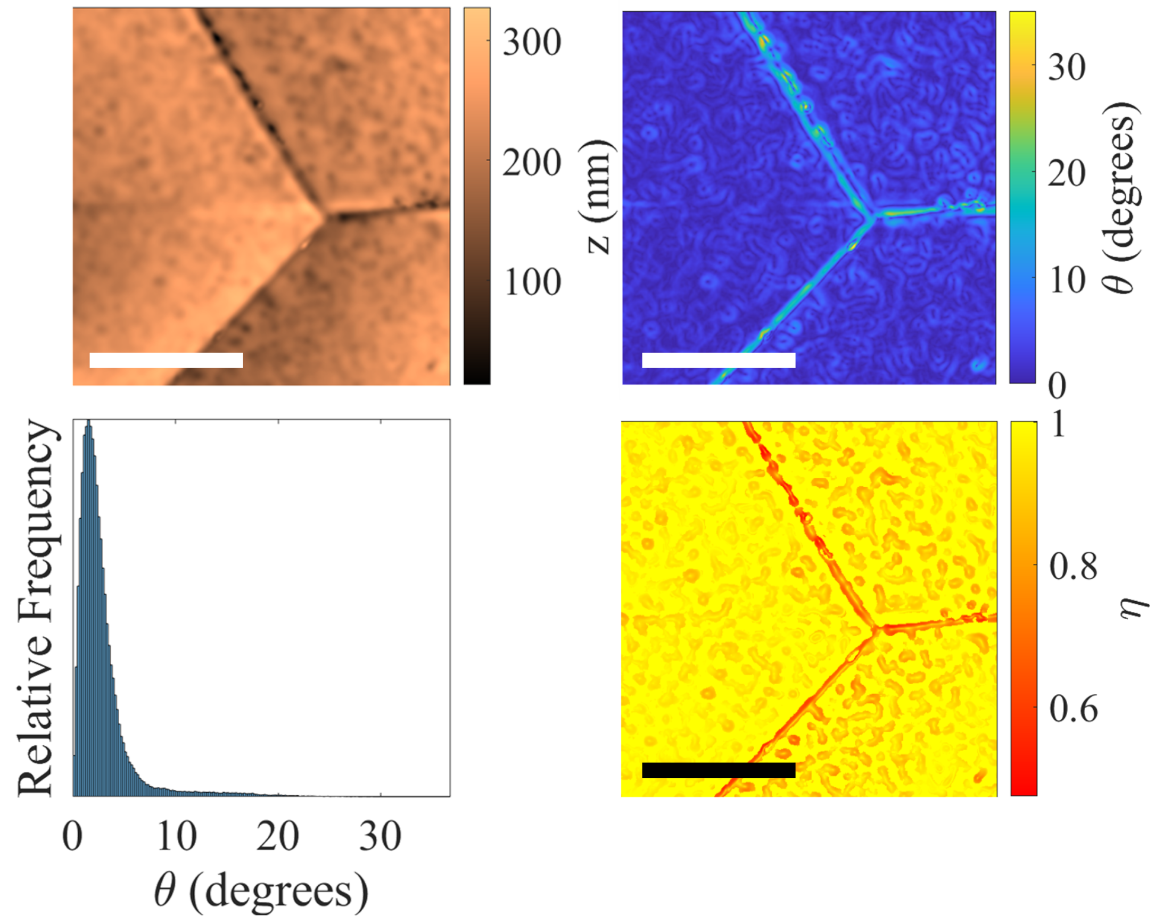
Topographic Magnetic Field Enhancement & Superheating Field Suppression
Magnetic Field Enhancement Factor
Superheating Field Suppression Factor

Slide 9
Topographic Superheating Field Suppression Factors
Superheating Field Suppression Factor Maps
Intergranular Distribution
Intragranular Distribution
Intragranular superheating field suppression is ameliorated first. With values of 0.9 at 7-10 μm EP
The intergranular superheating field suppression factors are the most severe topographic defect which takes the longest to ameliorate with electropolishing. Even by 7-10 μm, values as low at 0.6-0.7 are observed.

Slide 10
Topographic Magnetic Field Enhancement Factors
Magnetic Field Enhancement Factor Maps
Intergranular Distribution
Intragranular Distribution
Intragranular magnetic field enhancement factors are ameliorated first. With max values of 1.05 at 7-10 μm EP.
The intergranular magnetic field enhancement factors are the found to be 1.1-1.2 between 7-10 μm, but this occurs for all samples examined. One would like to minimize intergranular steps from electropolishing.
Between magnetic field enhancement and superheating field suppression, superheating field suppression values are substantially lower and may account for differences in performance for N-doped cavities.

Slide 11
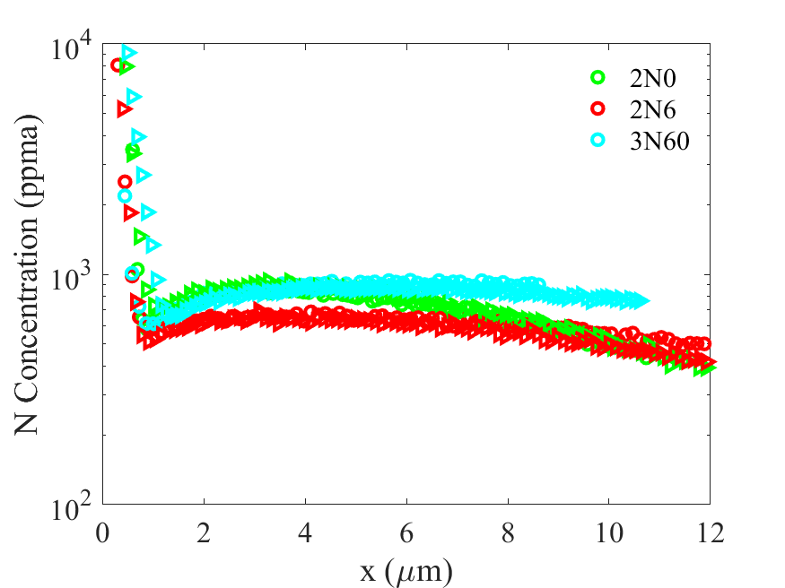
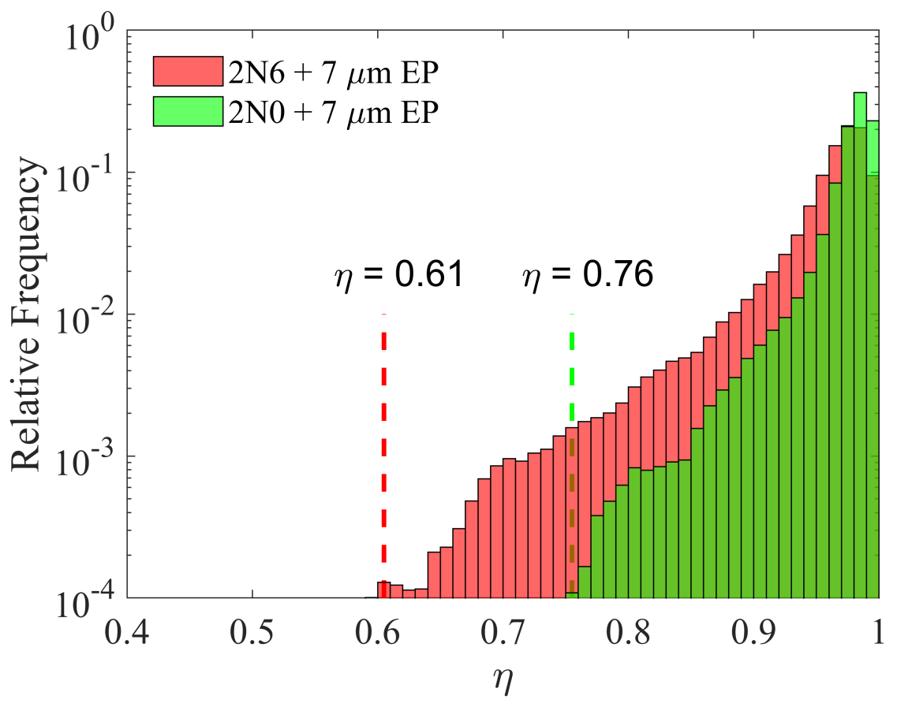
Effect of Impurities on the Superheating Field
[1]
Negligible difference expected from change in $κ$
The N impurity content in Nb between the different N doping surface treatments is small, at the target removal of 5-7 μm and 7μm for LCLS-II and LCLS-II HE the difference is negligible, pointing toward other sources of peak field degradation.
The difference between superheating field suppression factors of 0.61 and 0.76 yield accelerating gradients of 23MV/m and 29MV/m before these loss mechanisms present themselves. This is in approximate agreement with the average quench fields observed in LCLS-II and LCLS-II HE.
[1] Transtrum, Mark K., Gianluigi Catelani, and James P. Sethna. Physical Review B 83.9 (2011): 094505.

Slide 12
Conclusions & Future Work
Conclusions
Highlighted severity of topographic defects within grains and along grain boundaries and investigated their topographic evolution with electropolishing.
Small differences in N content between surface treatments indicates that perhaps differences impurity content plays a negligible role in peak field.
Grain boundaries host the most severe topographic defects, both with magnetic field enhancement and superheating field suppression.
Our topographic measurements may point to the mechanism behind the differences observed in the 2N0 and 2N6 processes for LCLS-II.
In the vacuum heat treated samples, both magnetic field enhancement and superheating field suppression remain low which may allow the oxide dissolution process to achieve higher accelerating gradients (assuming carbides do not form).
The topographic analysis methods presented here can be used to characterize the quality of various polishing methods and severity of topographic defects in materials beyond Nb.

Slide 13
Acknowledgments
Coauthors
C.E. Reece
M.J. Kelley
J.W. Angle (Now at PNNL)
C. Baxley
Others
G. Ciovati
O. Trofimova
R. Overton
T. Harris

