Slide 1

Update on Traveling Wave Cavity Progress at Fermilab
Presenter : Fumio Furuta
TTC meeting
December 6th, 2023

Slide 2
Contents
Introduction
TW SRF cavity development
Recent progresses
Summary

Slide 3
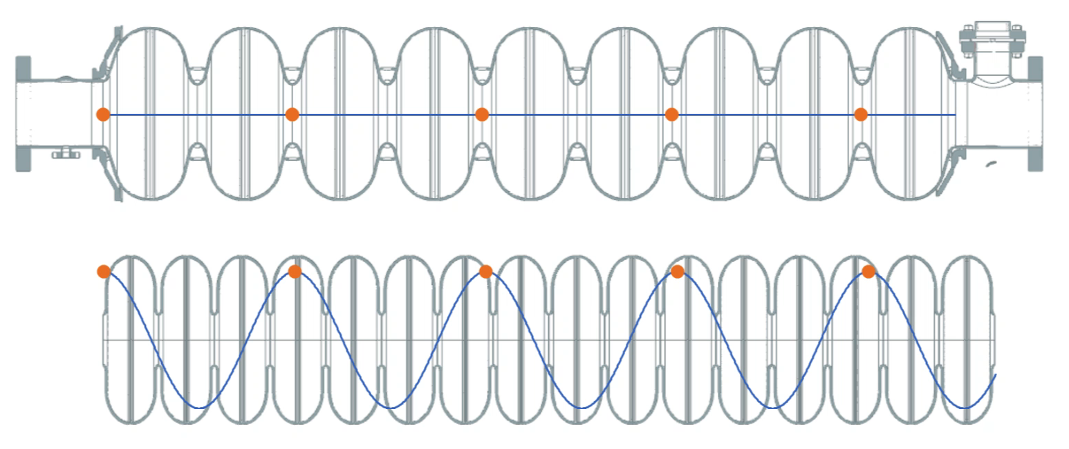
Introduction; Standing Wave and Traveling Wave
Standing Wave
in 9-cell structure
Traveling Wave
in 16-cell structure
Animations of accelerating field gradient profile in SW mode (Top, 9-cell structure) and TW mode (bottom, 16-cell structure). The points identify the amplitude of the field acting on the particle in sequential time-steps.

Slide 4
Motivations
TW enables:
  >20% increase in acceleration/cavity with higher transit time factor T (SW ~0.7, TW ~0.9 ^{[1]}).
  >20% increase in acceleration/CM with longer cavities (more acceleration field).
Overall 50% higher accelerating efficiency than SW structures is feasible.
Cost reductions per TW regime rely on mature, industry-standard practices.
Well-developed TW technology brings a range of exciting high-energy compact linear collider concepts within the realm of possibility.
An example, the proposed TW-based linear collider HELEN ^{[2]} can achieve a 250 GeV center-of-mass energy in only 7.5 km, in stark contrast to the 30-km scale of the SW ILC structure.
[1] P. Avrakhov et al., "Traveling Wave Accelerating Structure for A Superconducting Accelerator", Proceedings of the PAC2005, pp. 4296-4298
[2] S. Belomestnykh et al., “Superconducting radio frequency linear collider HELEN,” JINST 18, P09039 (2023)

Slide 5

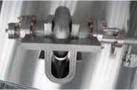
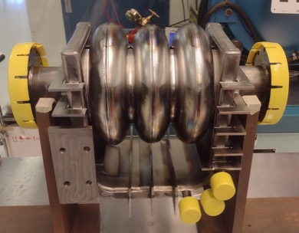
TW SRF cavity development
✓
Conceptual design
Superconducting Traveling-Wave accelerating structure with feedback waveguide to circulating RF power from the structure output to the structure input.
Conceptual design by Pavel Avrakhov
✓
Feasibility study
a single-cell cavity w/ feedback waveguide to demonstrate high gradient operation and conduct RF field measurements.
1-cell w/ WG
A proof-of-principle
3-cell TW cavity and a special tuner fabricated
Demonstrated TW excitation at room temp.
The 1st cold test to demonstrate TW resonance excitation in 2K liquid is ongoing at IB1 VTS.
✓
✓
In progress
A proof-of-principle 3-cell TW cavity
New Project
FY23 US-Japan “Developing high-gradient traveling wave SRF accelerating cavity” in collaboration between KEK-Jlab-FNAL is awarded for 1-year which focuses on EBW optimization for the iris joint within the narrow gap.
In progress
The early stages of the 3-cell developments had been funded by SBIR grant to Euclid Techlabs (DOE SBIR Grant # DE-SC0006300).

Slide 6
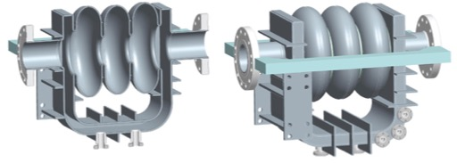
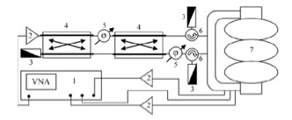
RF feed and measurement scheme for the 3-Cell TW cavity
Three monitoring couplers
Forward wave signal
Calibration signal
Backward wave signal
Two Input coupler
RF feed and measurement scheme for the 3-Cell TW^{[3]}
1 –Vector Network Analyzer (VNA);
2 – power amplifier;
3 – matched load;
4 – 3dB hybrid;
5 – phase shifter;
6 – circulator;
7 – resonator
[3] R. Kostin et al. “Progress towards 3-cell super-conducting traveling wave cavity cryogenic test,” Journal of Physics: Conf. Series 941 (2017) 012100

Slide 7
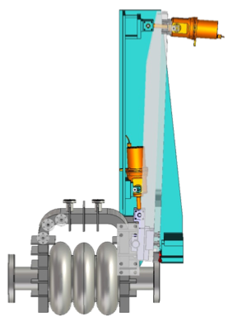
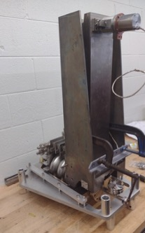
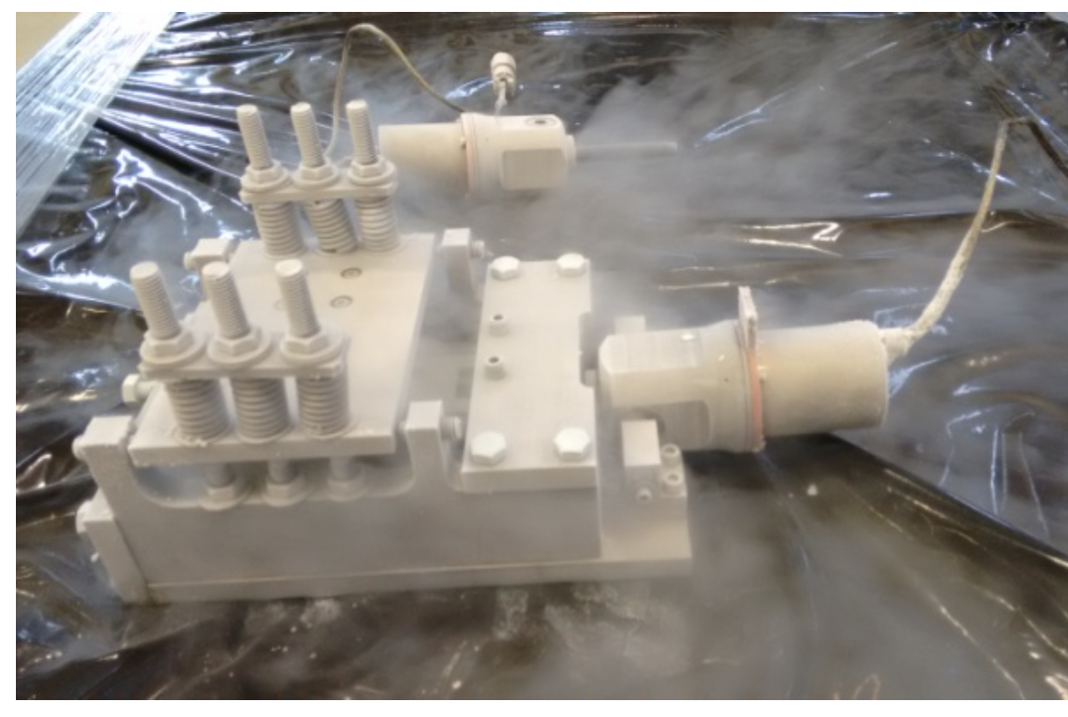
Special tuner (Matcher) for the 3-cell TW cavity
designed and fabricated to compensate Lorentz force and maintain the TW resonance at 2 K VTS conditions.
will deform the waveguide wall and decouple partial modes to compensate the Lorentz force.
The preliminary test on the matcher test assembly at room and liquid nitrogen temperatures indicated the feasibility of achieving TW resonance in 2 K.
Matcher for the 3-cell tested in liq. N2 temp ^{[4]}
Model of the 3-cell with one Matcher.
Assembly test
[4] R. Kostin et al., "A tuner for a superconducting traveling wave cavity prototype,” Journal of Instrumentation 10.10 (2015): P10038

Slide 8
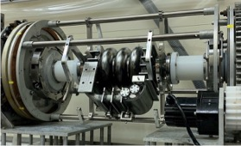
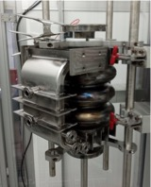
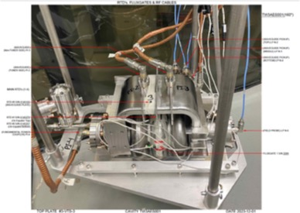
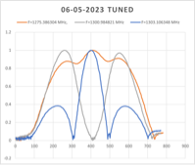
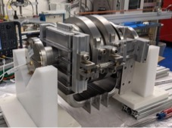
TW 3-cell VTS preparations
BCP at ANL
HPR at IB4, FNAL
VTS instrumentations
Tuning hardware on the 3-cell and the field profiles (SW mode) post tuning.

Slide 9
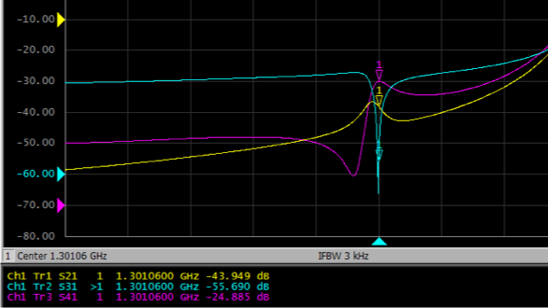
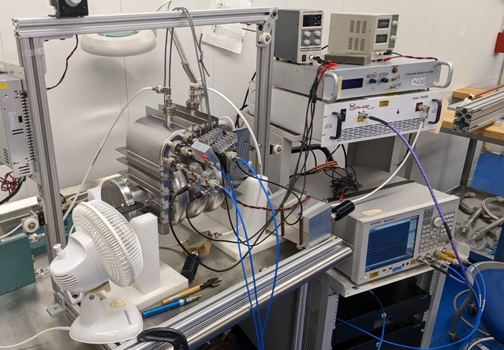
TW demonstration; Cavity with air, room temp. at RF test bench
Forward wave
Backward wave
The 3-cell on RF test bench
An example of TW at 1301.06 MHz excited at room temperature after cell tuning
Magenta; a forward wave signal
Blue; a suppressed backward wave signal (~30dB less than forward)
Yellow; a signal from the calibration pick up.

Slide 10
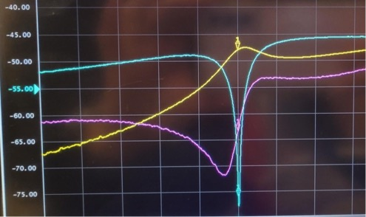
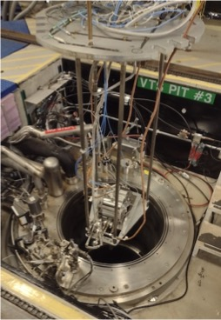
TW demonstration; Cavity under vacuum, at room temp. in VTS
Forward wave
Backward wave
An example of TW at 1301.100 MHz excited at room temperature
Yellow; a forward wave signal
Blue; a suppressed backward wave signal (~30dB less than forward)
Purple; a signal from the calibration pick up.
The 3-cell installation into VTS pit

Slide 11
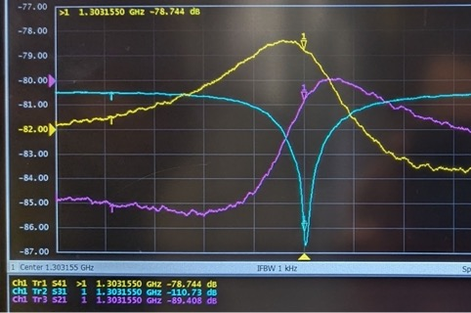
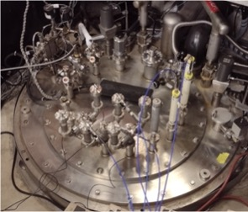
TW demonstration; Cavity under vacuum, in 2K liquid helium, VTS
Forward wave
Backward wave
Top plate in VTS pit with TW test arrange.
An example of TW at 1303.155 MHz being tuned at 2K
Yellow; a forward wave signal
Blue; a suppressed backward wave signal (>30dB less than forward)
Purple; a signal from the calibration pick up.

Slide 12
Summary
SRF TW cavity development through the 3-cell has been progressing at Fermilab in collaboration with Euclid Techlabs.
Preliminary TW resonance excitation in the 3-cell structure in 2K liquid helium was demonstrated.
More hardware improvements and TW study with the 3-cell will be continued at Fermilab.
Next stage of development toward a half-meter scale TW cavity fabrication has been discussing.
A preliminary 7-cell TW cavity RF design and configurations being proposed in Fermilab (not presented during this TTC).

Slide 13
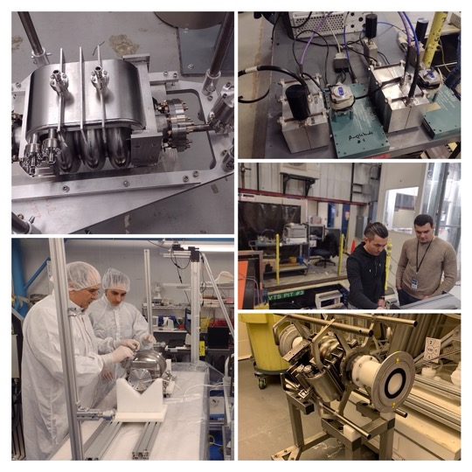
Acknowledgment
Thank to all colleagues supported the 3-cell TW works!!
Co-PIs
Kellen McGee
Vyacheslav Yakovlev
Roman Kostin
Pavel Avrakhov
Engineering Consultant
John Rathke
RF support
Timergali Khabiboulline
Gennady Romanov
Cavity support
Damon Bice
Chad Thompson
Thomas Reid
Ben Guilfoyle
VTS support
Alexandr Netepenko
Abraham Diaz
David Burk
Paul Dubiel
Man Kwan (Trista) Ng
Cryo support
Dan Marks
and more,,,

Slide 14
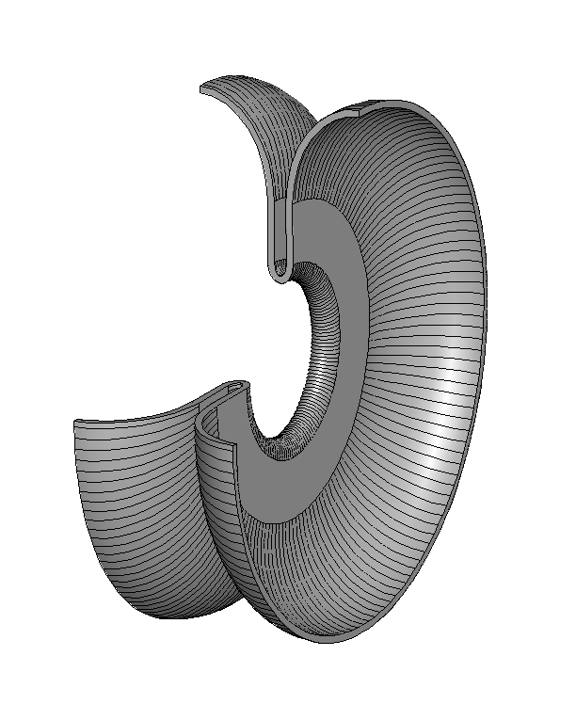
Appendix; 3-cell TW cavity inner cell shape
The cell shape has been optimized to reach the maximum accelerating gradient while keeping the magnitude of surface magnetic and electric fields less than the experimentally verified limits.
105º phase advance
24 % gradient gain

