Slide 1
TESLA Technology Collaboration Meeting, 2023, Fermilab
Recent Progress of Nb₃Sn Thin Film SRF Cavity Coated by Vapor Diffusion Method at IMP
Ziqin Yang (yzq@impcas.ac.cn), Yuan He
Jiankui Hao (Peking University, On behalf of Ziqin Yang)
Institute of Modern Physics, Chinese Academy of Sciences
Notes:
“

Slide 2
Outlines
1
Background
2
Coating process optimization
3
Conclusion

Slide 3
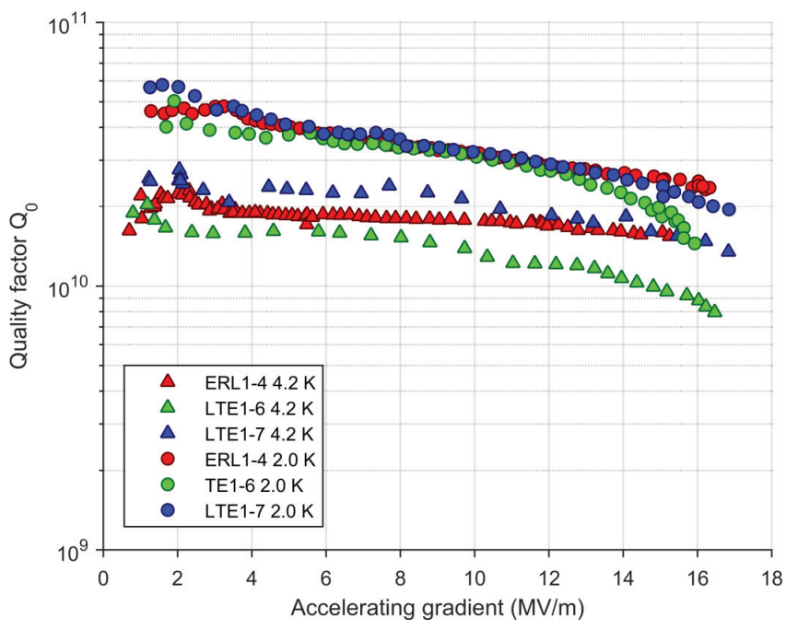
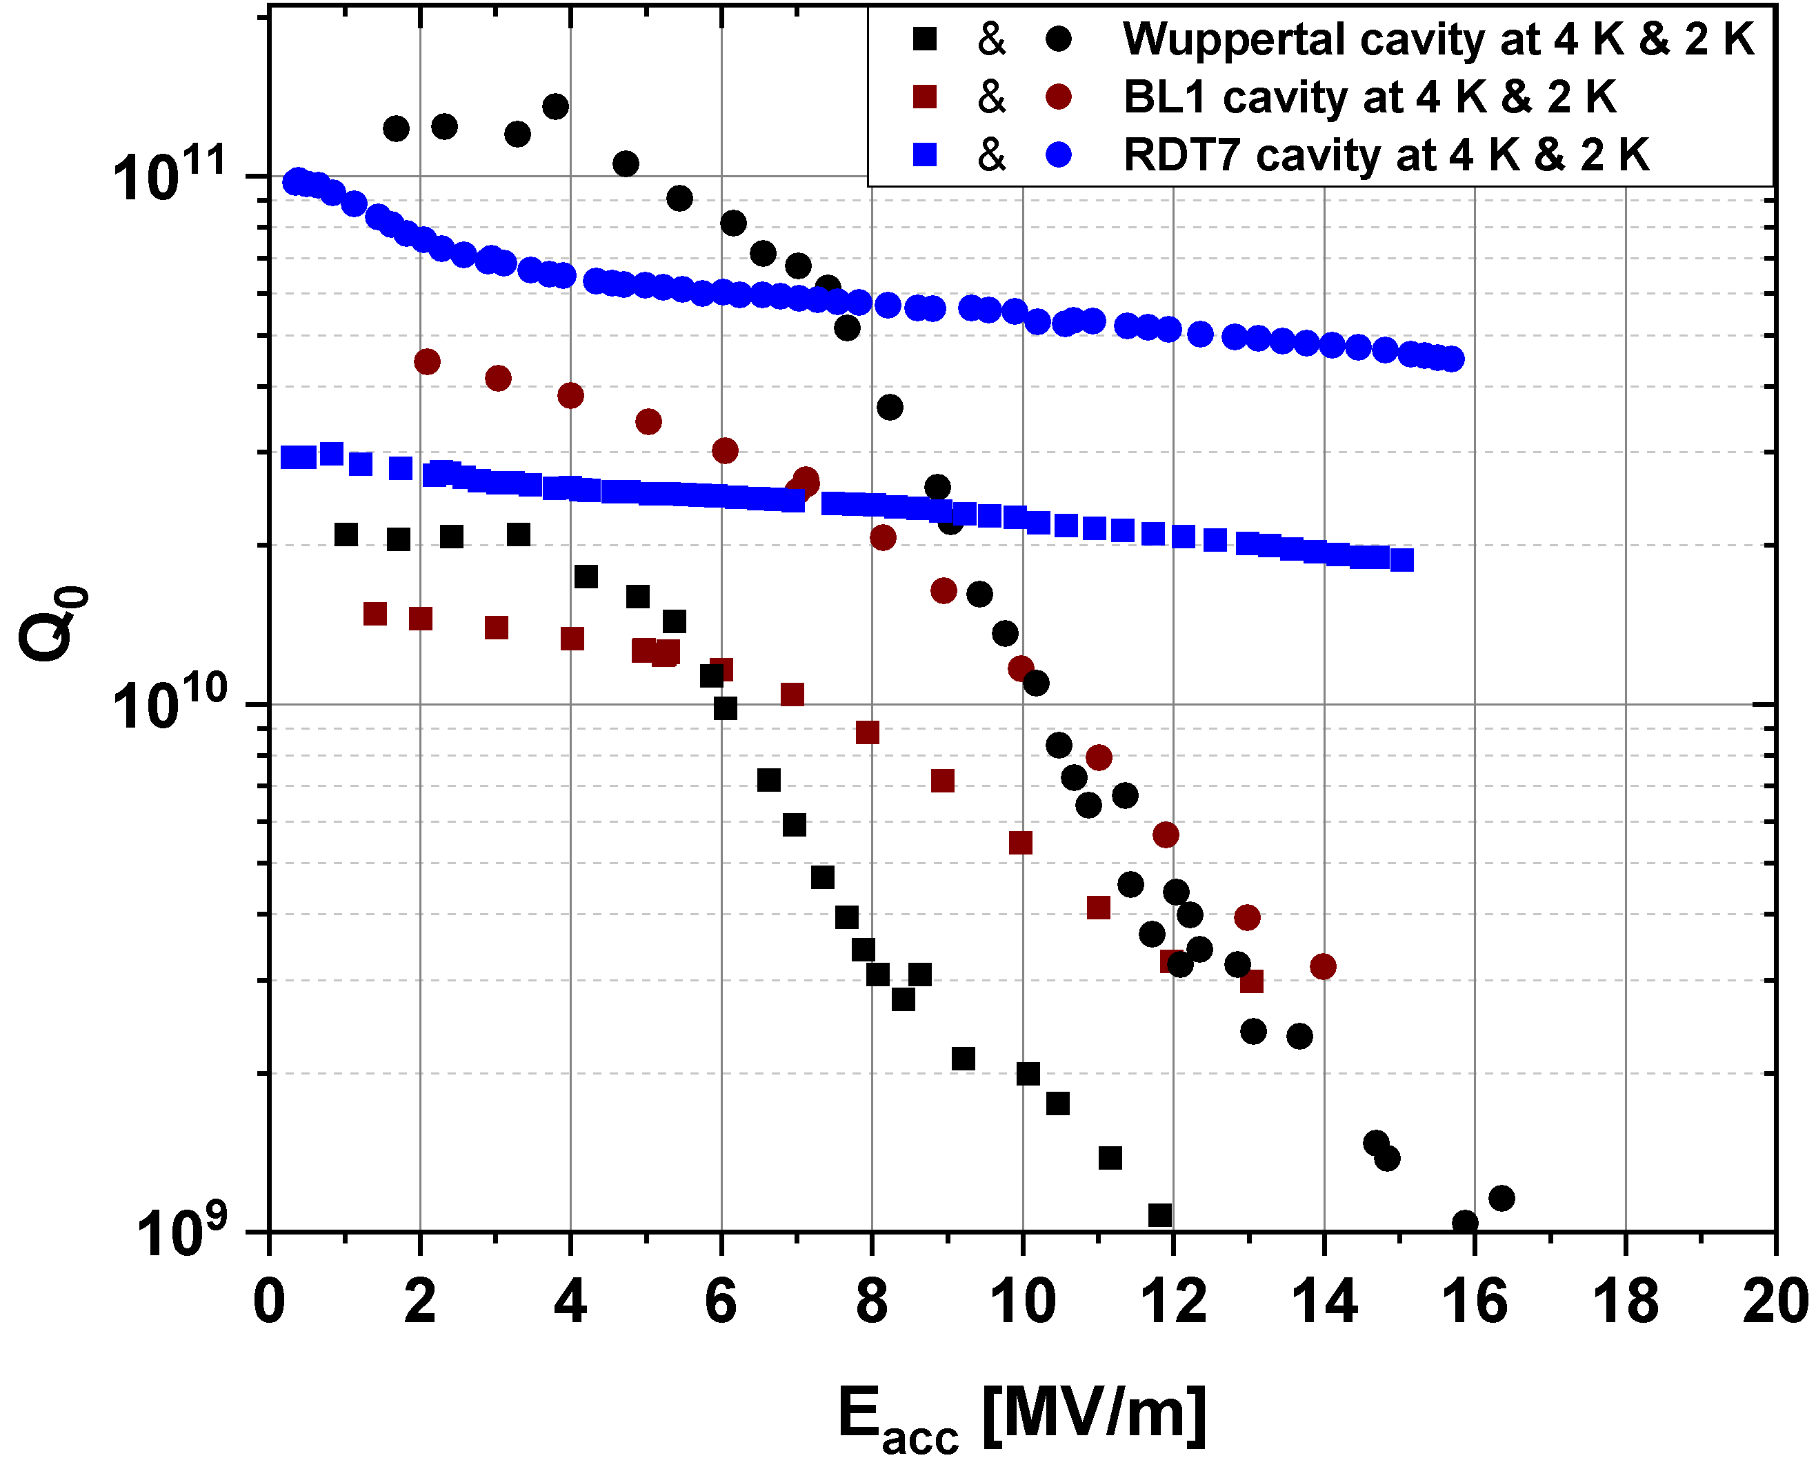
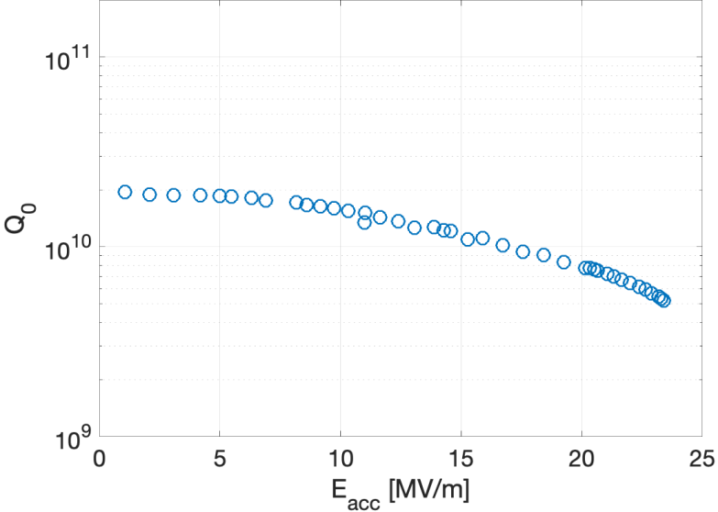
Background
Amongst the research activities conducted since the 1970s, only Cornell University, JLab, and FNAL have managed to successfully coat high-performance Nb₃Sn SRF cavities by the vapor diffusion method
Further investigations and optimizing the coating process of high-performance Nb₃Sn SRF cavities using the vapor diffusion method remains an essential research problem for further studies
Cornell results
JLab results
FNAL results

Slide 4
Outlines
1
Background
2
Coating process optimization
3
Conclusion

Slide 5
Research approach
Upgradation of the cavity deposition system
Initial understanding based on research status
Initial selection of the coating conditions
Sample characterization
Vertical test
Comparative analysis
Feedback and iterative optimization between coating process and film quality
Limiting factor identification and deepen understanding of coating process
Exploration and verification of the targeted optimization

Slide 6
Differences and optimizations of the subsequent 7 coating processes
Coating process | Sn source Temperature/℃ | Growth stage time / Minute | Exploration of methods for adsorbing residual Sn vapor
 |  |  | Sn power¹ | Valves² | Mo belt³ | Ceramics⁴
1 | 1310 | 180 | On | Closed | On | Without
2 | 1200 | 180 | On | Closed | On | Without
3 | 1200 | 180 | Off | Closed | On | Without
4 | 1200 | 180 | On | Opened | On | Without
5 | 1200 | 180 | On | Closed | Bottom On | Without
6 | 1200 | 180 | On | Closed | On | With
7 | 1233 | 120 | Off | Closed | Bottom On | With
¹The condition of the Sn source power supply immediately after the film growth stage.
²The condition of the valves between the Nb coating chamber and the vacuum pump.
³The condition of the Mo heating belts surrounding the Nb coating chamber throughout the coating process.
⁴Whether or not to hang high-purity absorbent ceramic bricks above the cavity.

Slide 7
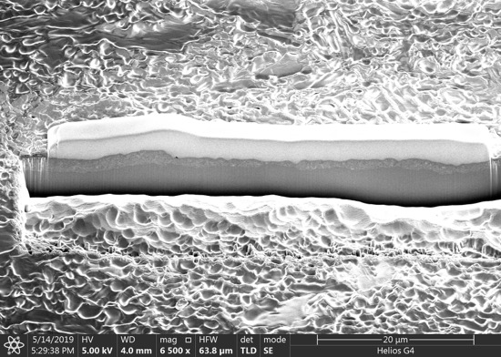
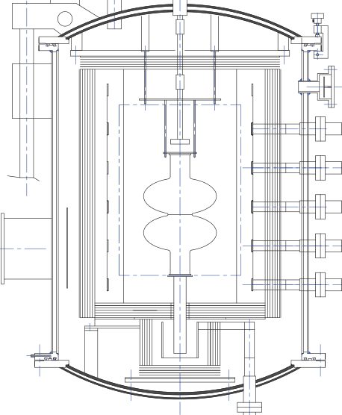
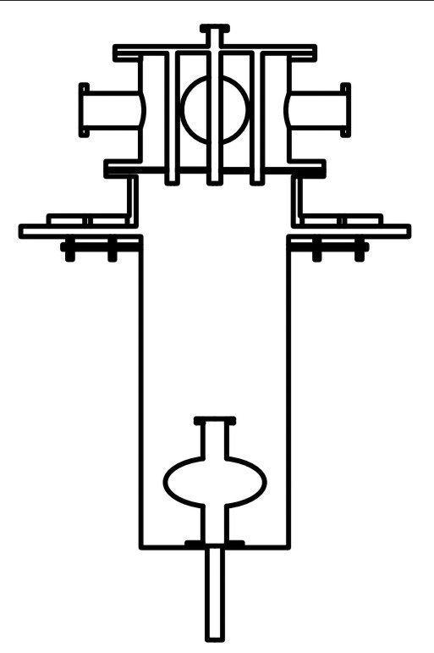
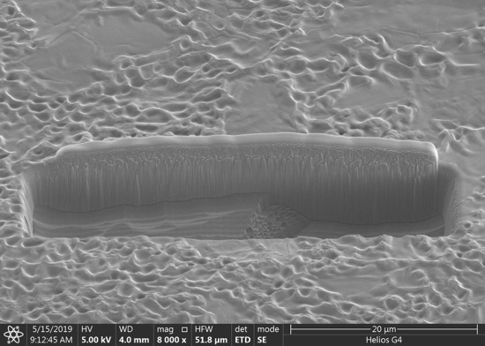
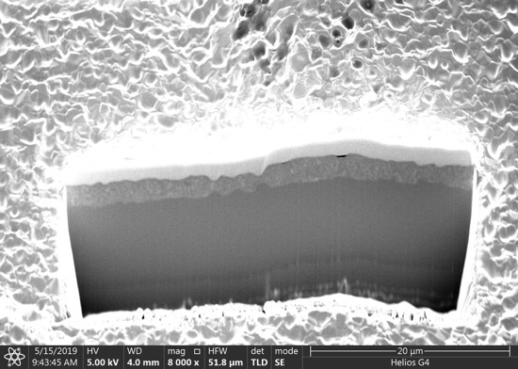
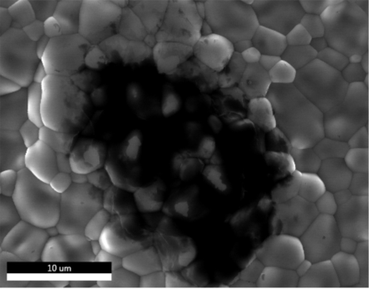
The deposition system
Initial Design without Nb chamber
Upgrading of the deposition system
Long distance between Sn and cavity
Nb chamber
Carbon contamination
Initial design: C contamination from absence of Nb chamber, non-uniform growth of Nb₃Sn films from the distance of Sn and cavity
Upgradation: Nb chamber to prevent contamination, heat transfer along the chamber wall to reduce the distance of Sn and cavity

Slide 8
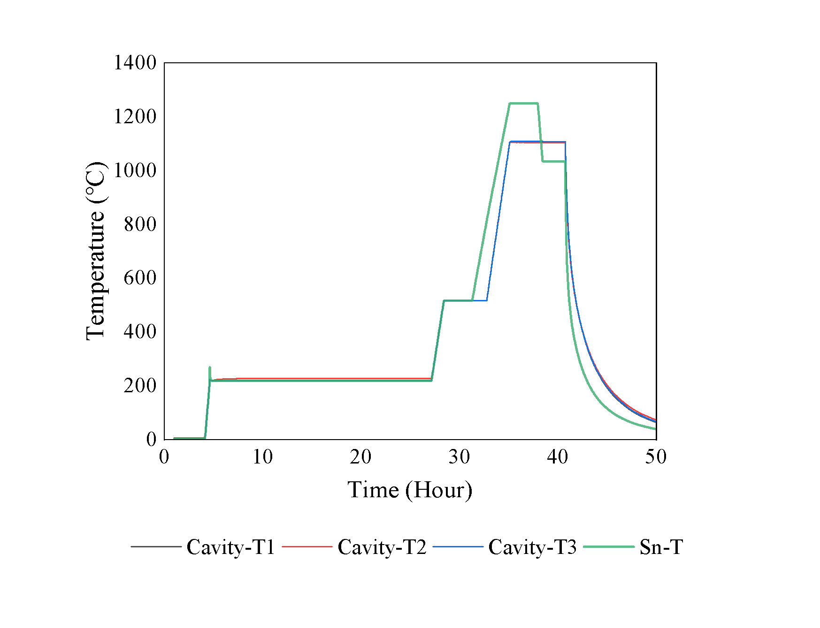
Coating process optimization
Coating Process (1)
ICP-OES test results of the Sn content in the HNO₃ solution
Reagents | Sn (ppm) | Conditions
1# | 0.26 | Background
2# | 0.47 | Immersed with Nb₃Sn sample
XPS surface analysis results of the Nb₃Sn sample before and after immersion in HNO₃ solution
Samples | Nb Atomic % | Sn Atomic % | Sn/Nb
Original | 45.22 | 54.78 | 1.21
HNO₃ rinse | 71.03 | 28.97 | 0.41
Surface Sn content of samples measured by AES before and after immersion in HNO₃ solution
Samples | Nb Atomic % | Sn Atomic % | Sn/Nb
Original | 54.39 | 45.61 | 0.84
HNO₃ rinse | 67.90 | 32.10 | 0.47
Temperature profiles of coating process (1)
Nanometer-scale white spots on the surface
The nanometer-scale white spots are Sn droplets that are formed by condensation of the residual Sn vapor on the film surface during the natural cooling process
Coating conditions of process (1)
Sn source Temperature/℃ | Growth stage time / Minute | Exploration of methods for adsorbing residual Sn vapor
 |  | Sn power | Valves | Mo belt | Ceramics
1310 | 180 | On | Closed | On | Without

Slide 9
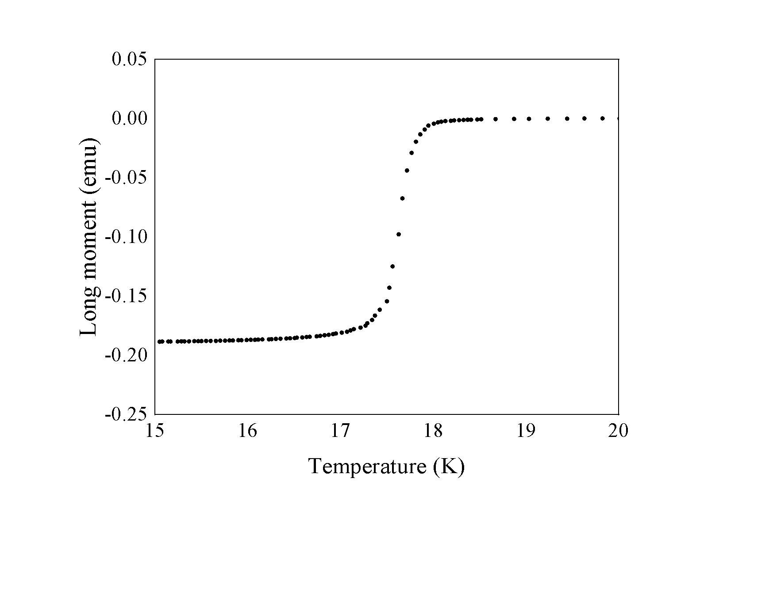
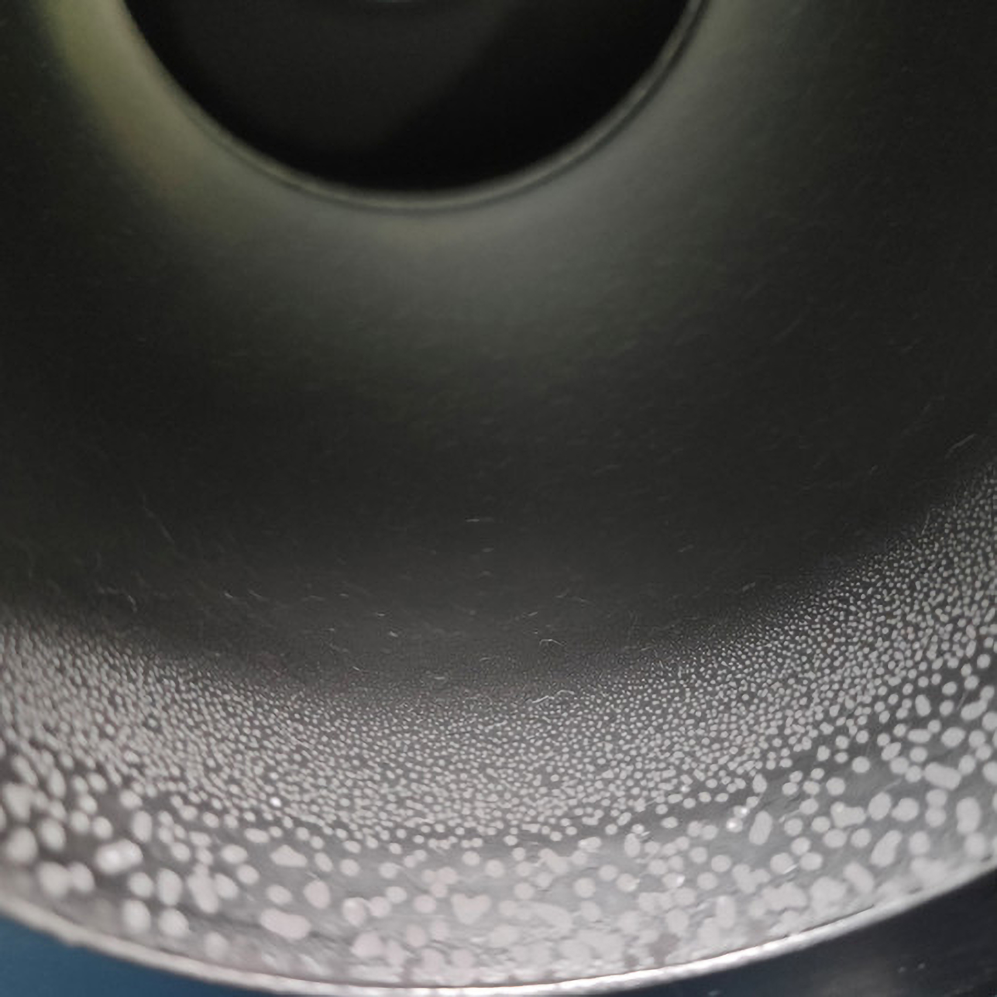
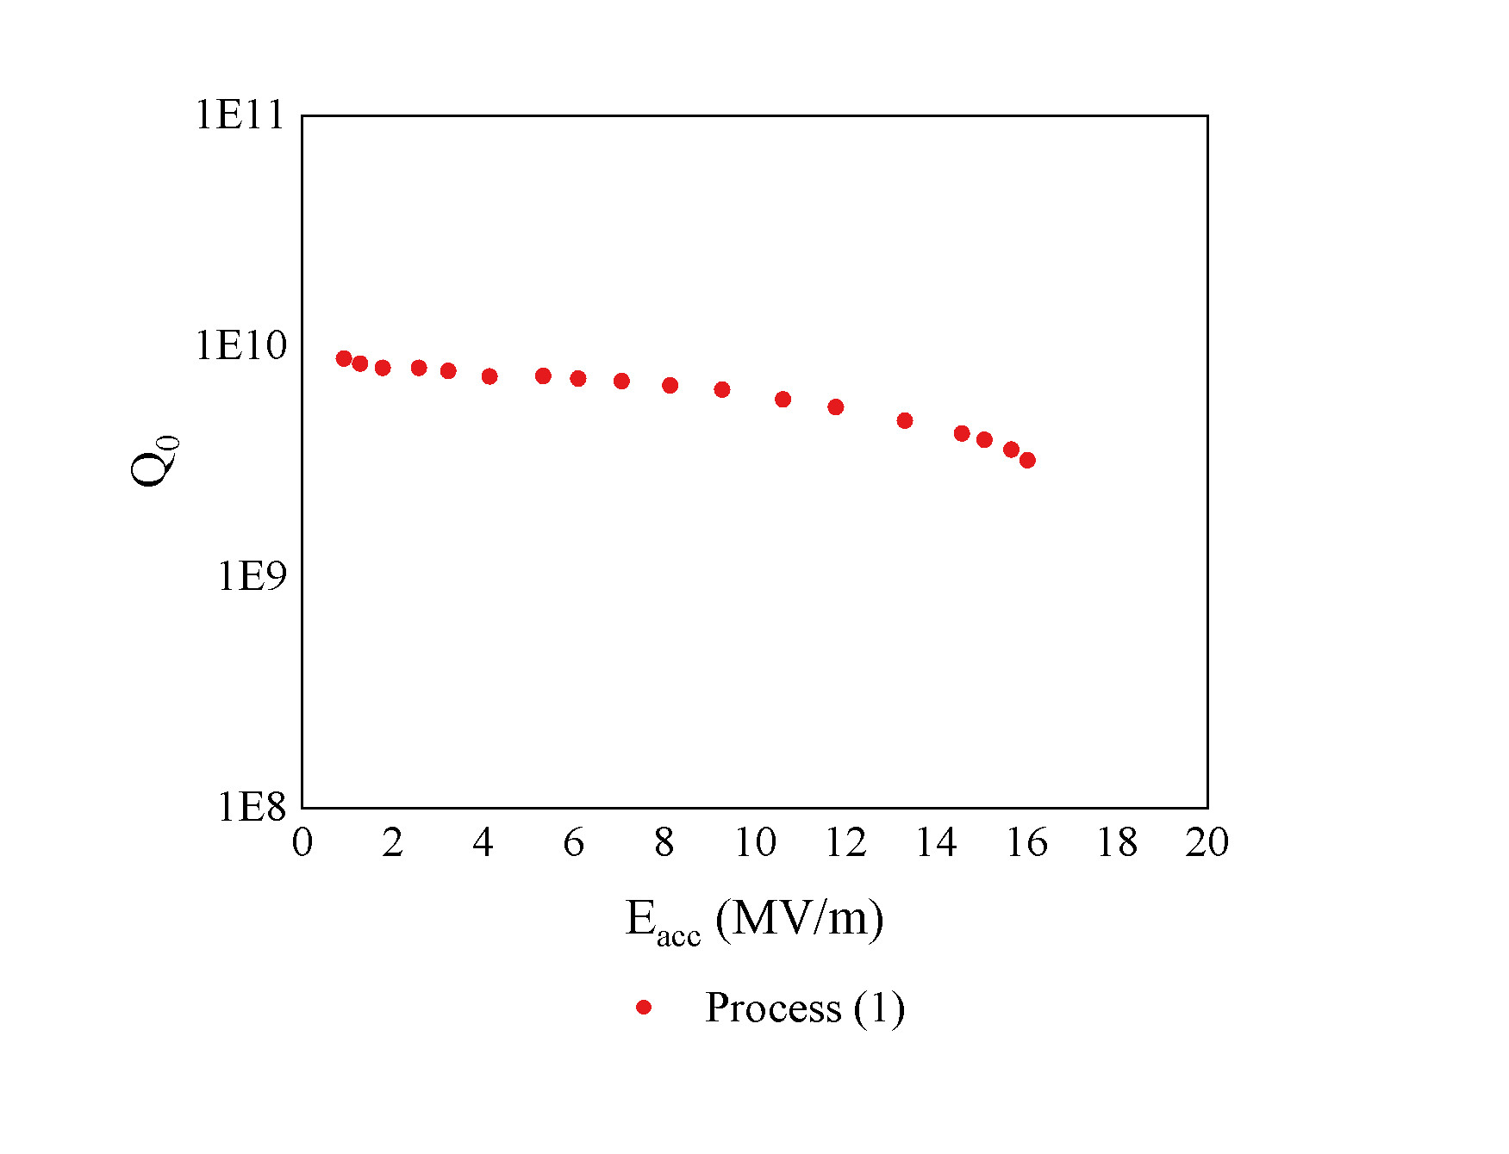
Coating process optimization
Coating Process (1)
M-T measurements: T_{c}>18K
Visible millimeter-scale Sn spots near the bottom flange, where the temperature was about 10⁰C lower than the rest of the cavity
EDS composition of the Nb₃Sn films by Coating Process (1)
Cavity RF performance by Coating Process (1)
Position | 1 | 2 | 3
Sn content(at. %) | 25.94 | 26.57 | 26.69
Average Sn content | 26.40
The Q₀ of this Nb₃Sn SRF cavity at low field reaches 8.8×10⁹, degrading to 3.1×10⁹ at the quench field of E_{acc,max}=16.11 MV/m.
The Sn source temperature of 1310⁰C is rather excessive for our deposition system

Slide 10
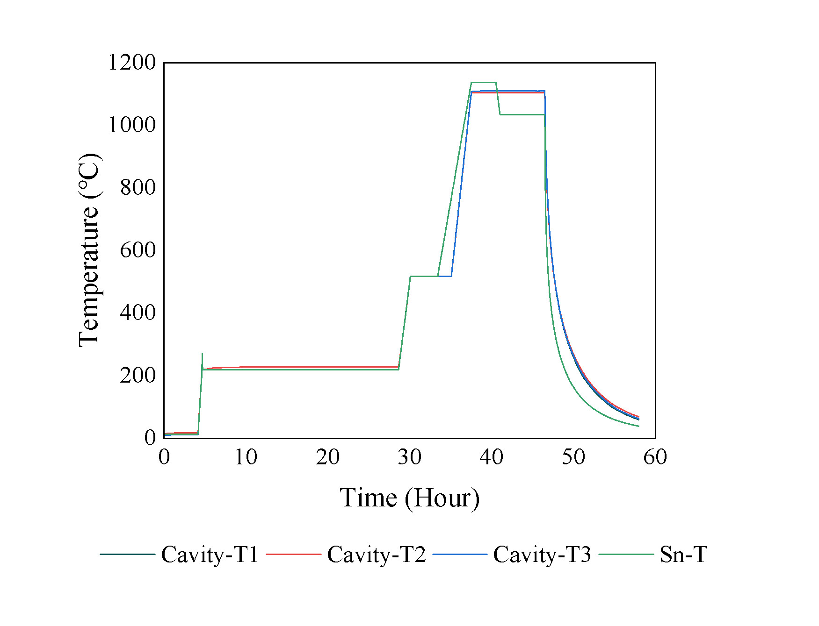
Coating process optimization
Coating Process (2)
The Sn source temperature was lowered to 1200⁰C to decrease the Sn vapor pressure and the Sn evaporation rate. This is to reduce or avoid the formation of Sn droplets and spots from the residual Sn vapor.
Temperature profiles of coating process (2)
Coating conditions of process (2)
Sn source Temperature/℃ | Growth stage time / Minute | Exploration of methods for adsorbing residual Sn vapor
 |  | Sn power | Valves | Mo belt | Ceramics
1200 | 180 | On | Closed | On | Without

Slide 11
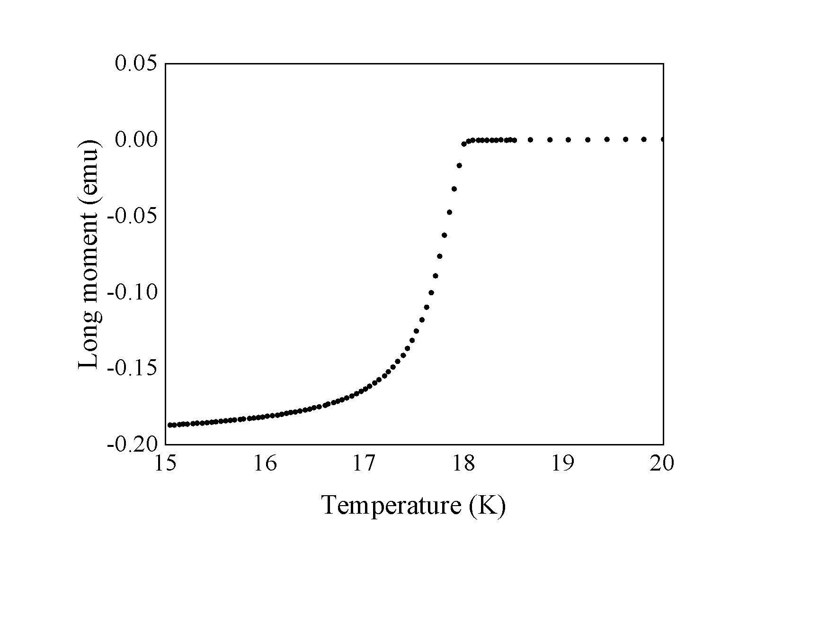
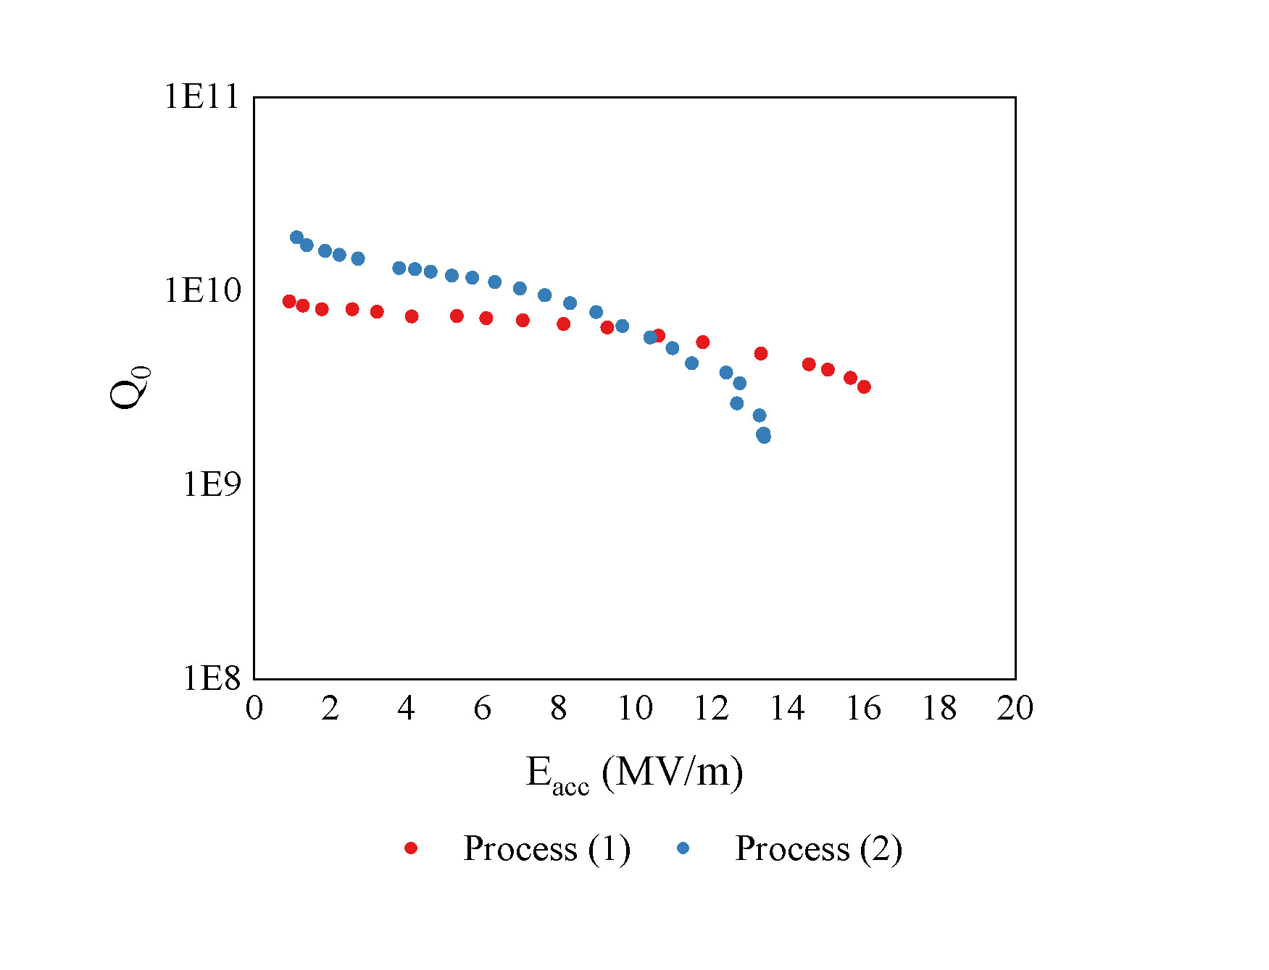
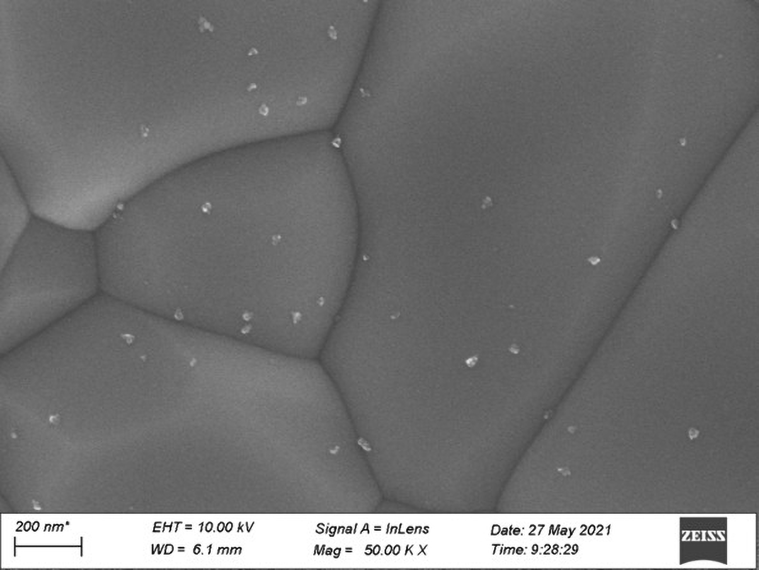
Coating process optimization
Coating Process (2)
Nanometer-scale Sn droplets still exist on the surface of the Nb₃Sn film coated this time
M-T measurements: T_{c}>18K
Cavity RF performance by Coating Process (2)
EDS composition of the Nb₃Sn films by Coating Process (2)
The Q₀ of the Nb₃Sn SRF cavity by Process (2) reaches 1.9×10¹⁰ at 4.2 K in the low field region. The cavity quenches at E_{acc,max}=13.39 MV/m while the corresponding Q₀ drops to 2×10⁹.
Position | 1 | 2 | 3
Sn content(at. %) | 26.46 | 26.32 | 26.31
Average Sn content | 26.36
Despite the reduced gradient, the nanometer-scale Sn droplets still indicates tin vapor is in excess?

Slide 12
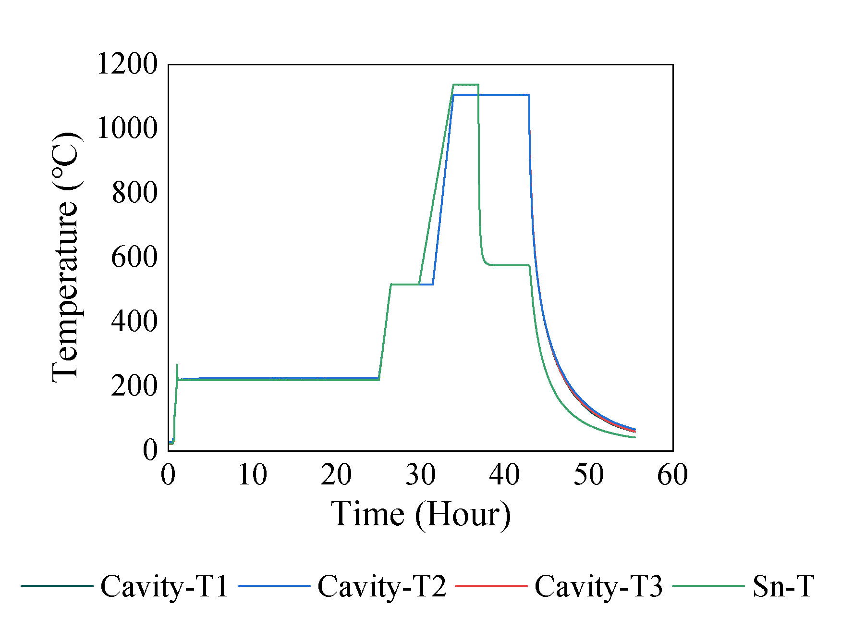
Coating process optimization
Coating Process (3)
The conditions of the Coating Process (3) at the film growth stage were the same as those of the Coating Process (2). However, the Sn source of the Coating Process (3) was powered off immediately after the film growth stage to prevent additional Sn evaporation in the annealing stage. It is also expected that the lower temperature Sn source region adsorbs some Sn vapor during the annealing stage, hence reducing the Sn droplet density during the cooling stage.
ΔT ~530⁰C
Temperature profiles of coating process (3): the temperature of the Sn source heater drops rapidly to about 570⁰C after the film growth stage
Coating conditions of process (3)
Sn source Temperature/℃ | Growth stage time / Minute | Exploration of methods for adsorbing residual Sn vapor
 |  | Sn power | Valves | Mo belt | Ceramics
1200 | 180 | Off | Closed | On | Without

Slide 13
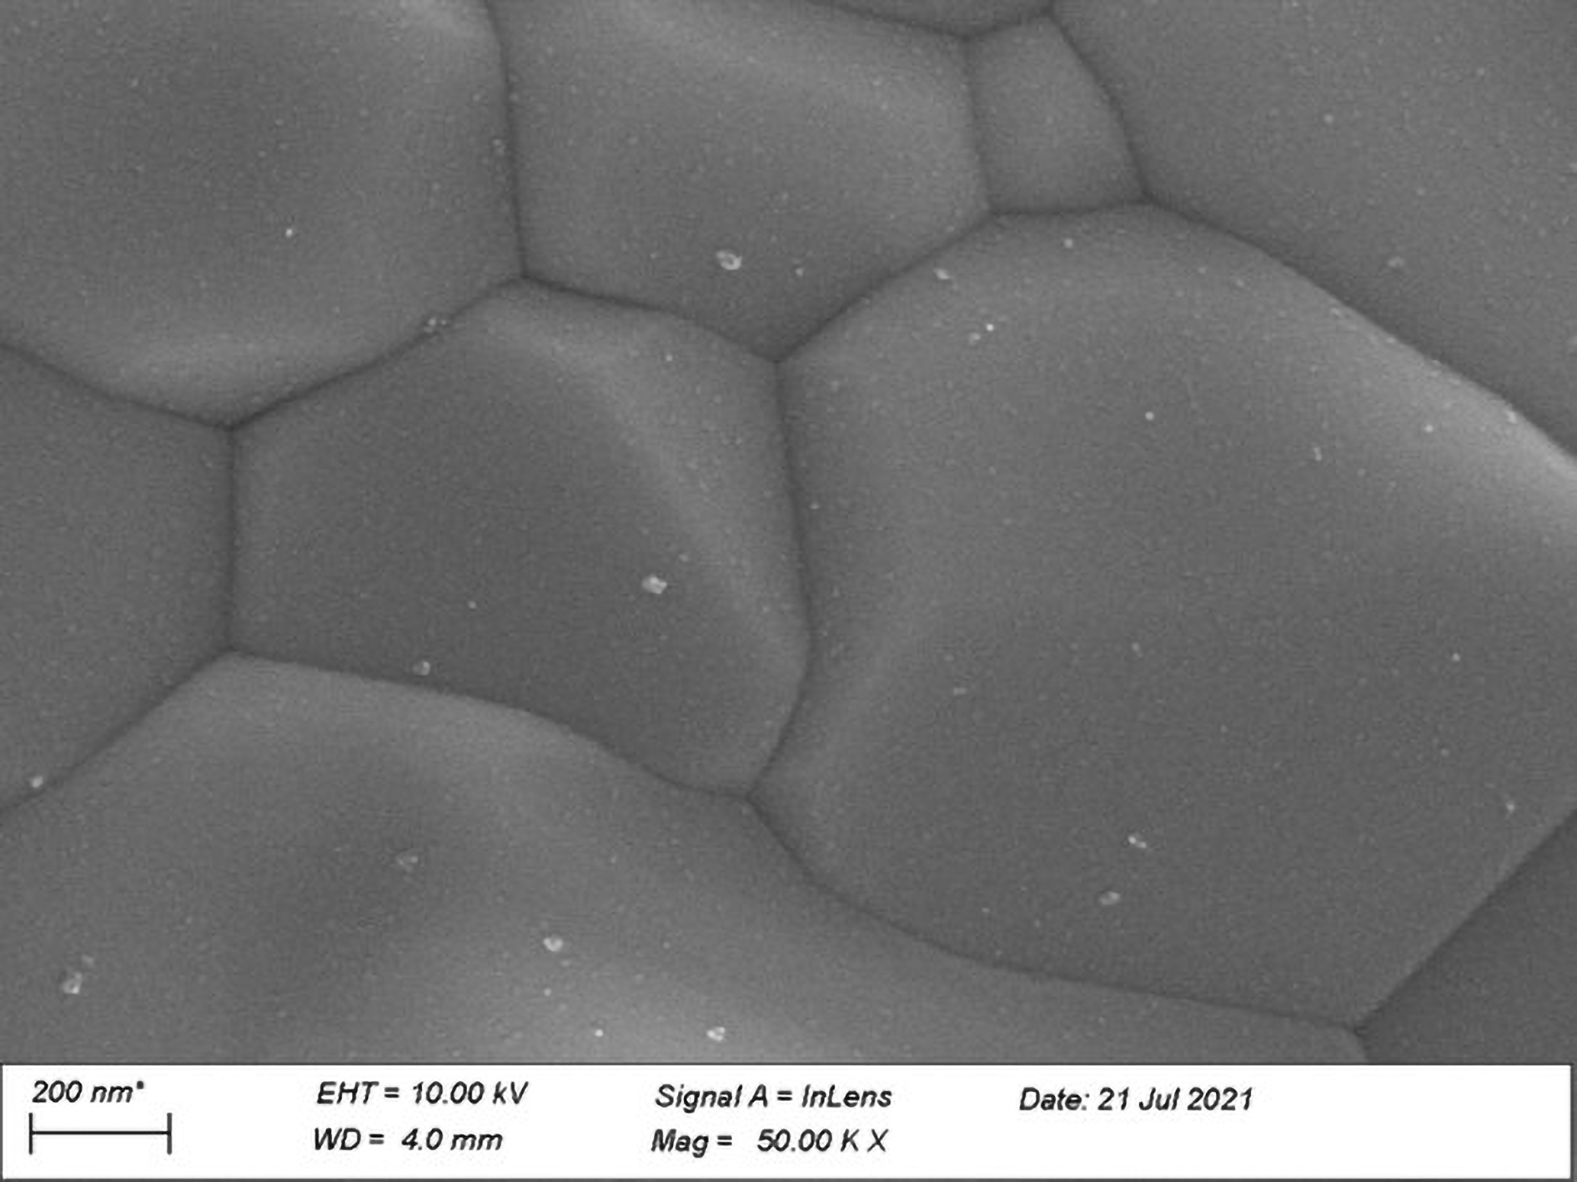
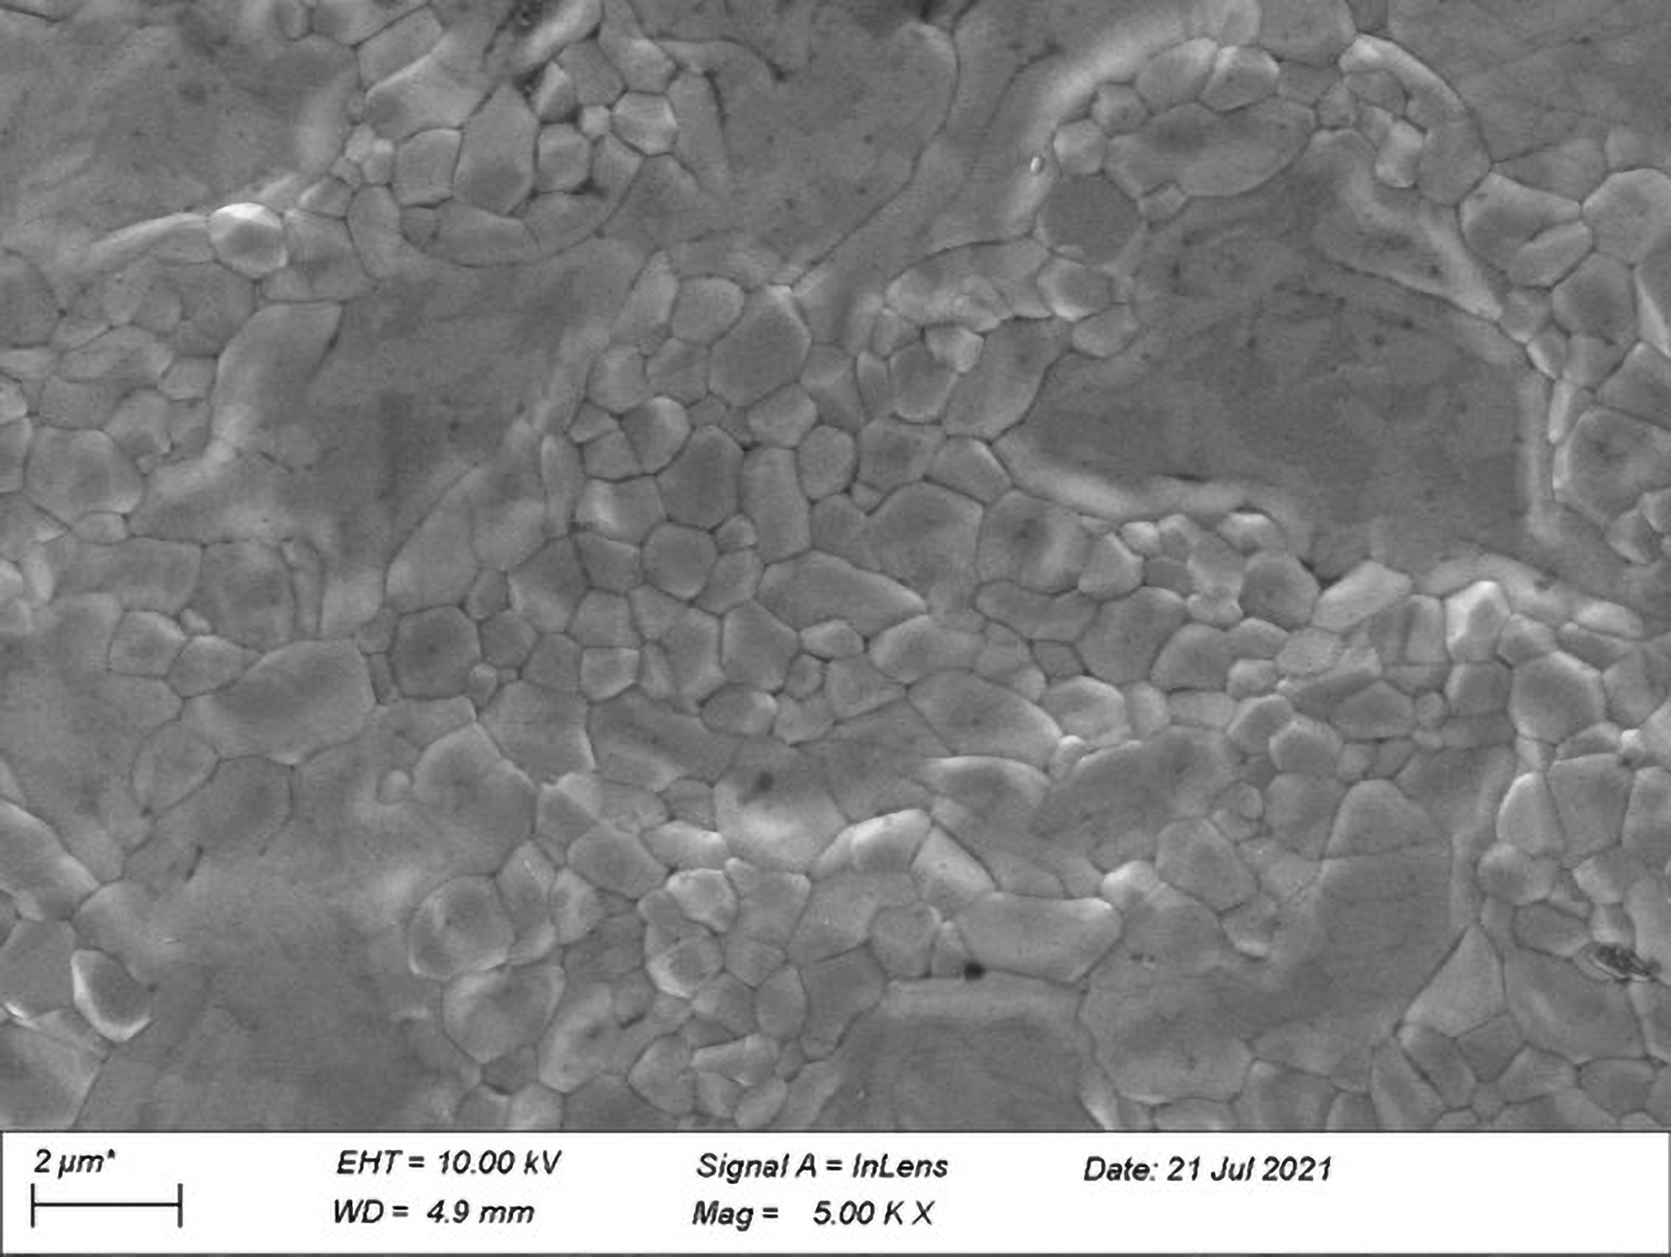
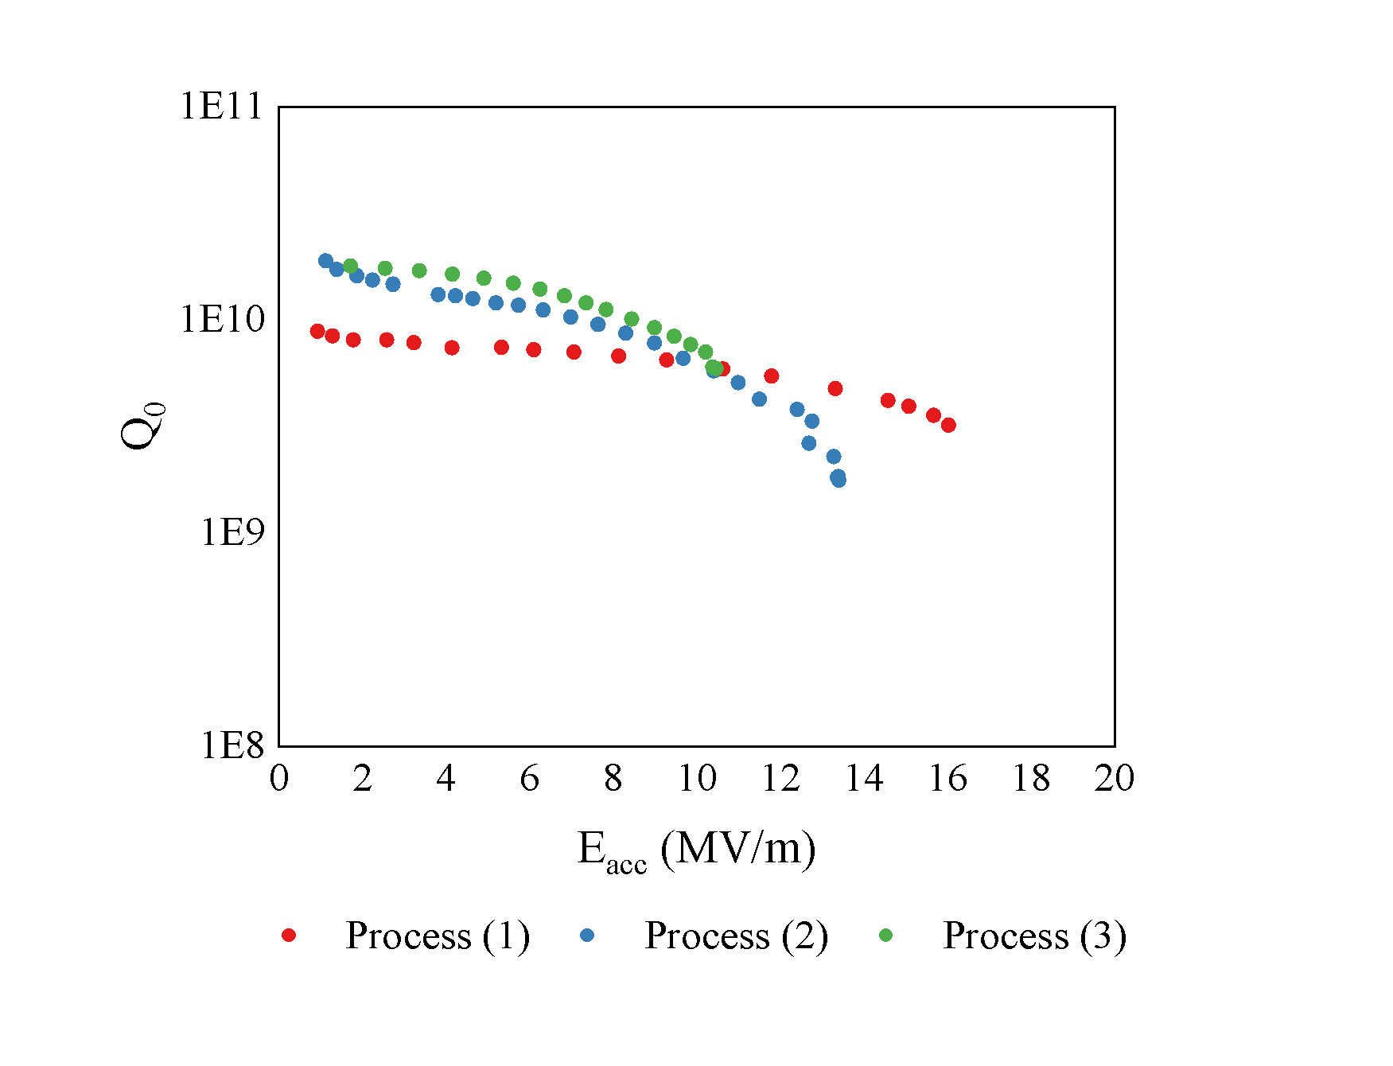
Coating process optimization
Coating Process (3)
Nanometer-scale Sn droplets with significantly reduced density (left) and patchy areas (right) on the Nb3Sn film surface coated by the Coating Process (3). This confirms the effectiveness of the adsorption in reducing the formation of Sn droplets
Cavity RF performance by Coating Process (3)
EDS composition of the Nb₃Sn films by Coating Process (3)
The Q₀ of the Nb₃Sn SRF cavity by Process (3) reaches 1.8 × 10¹⁰ at 4.2 K in the low field region. The cavity quenches at E_{acc,max} = 10.46 MV/m because of the patchy areas found on the surface.
Position | 1 | 2 | 3
Sn content(at. %) | 26.23 | 26.50 | 25.96
Average Sn content | 26.23
Q-slope of process 3 is more gentle than process 2 at E_{acc} < ~5MV/m, but at E_{acc}>5MV/m Q-slope of process 2 becomes more precipitous and the Q₀ drops to the same level of process 3.
Nanometer-scale Sn droplets mainly affect the RF performance in the low-field region. patchy areas have a more pronounced impact on the RF performance in the higher-field region, leading to a precipitous Q-slope and early quench.

Slide 14
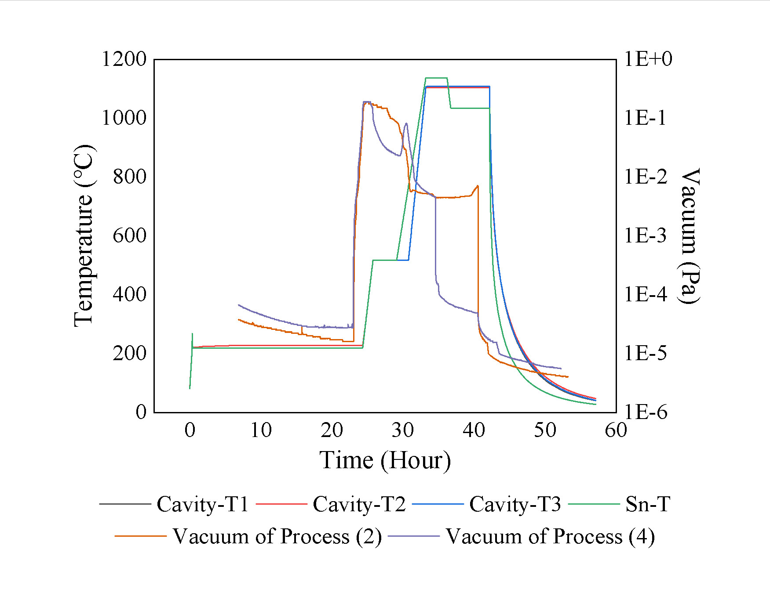
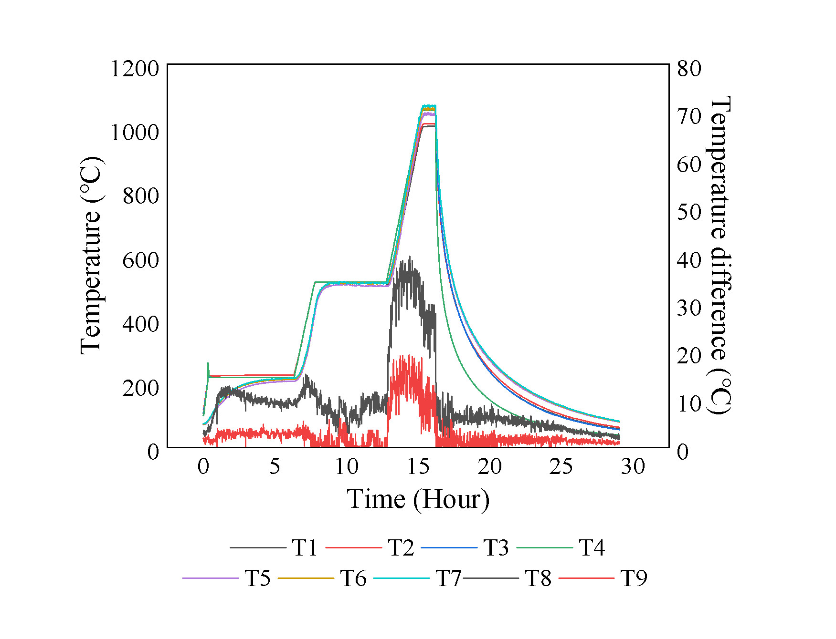
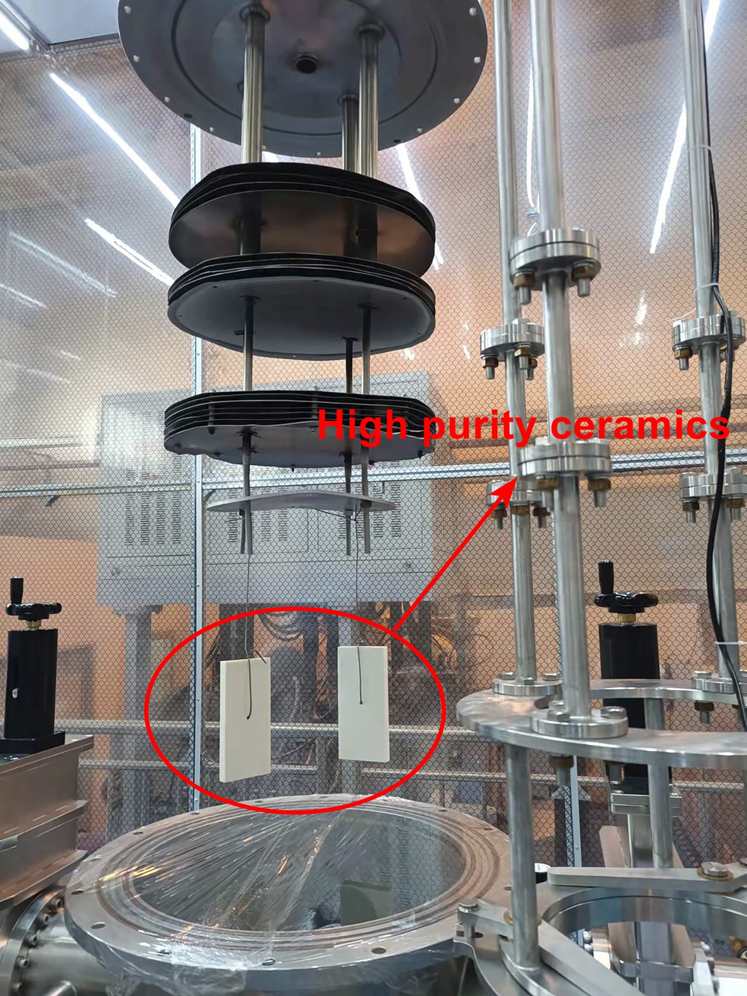
Coating process optimization
Adsorption effect confirmation : Coating Process (4),(5) and (6)
Coating conditions of process (4), (5) and (6)
Sn source Temperature/℃ | Growth stage time / Minute | Exploration of methods for adsorbing residual Sn vapor*
 |  | Sn power | Valves | Mo belt | Ceramics
1200 | 180 | On | Open | On | Without
 |  | On | Closed | Bottom On | Without
 |  | On | Closed | On | With
Process (4): Attempt at vacuum pumping by opening the valves between the coating chamber and the vacuum pump immediately after the film growth stage to pump away the residual Sn vapor(×)
*The Sn source temperature and growth stage time of coating process (4), (5), (6) are the same as that of process (2)
Process (5): Manufacture of cold trap of ~27⁰C by keeping the middle and upper Mo heating belts powered off all the process (√)
Process (6): High-purity ceramic bricks are suspended above the cavity to increase the adsorption of residual Sn vapor (√)
By creating lower-temperature cold traps and suspending high-purity ceramic bricks, the adsorption of Sn vapor can be effectively enhanced to prevent the condensation of Sn droplets on the film surface.

Slide 15
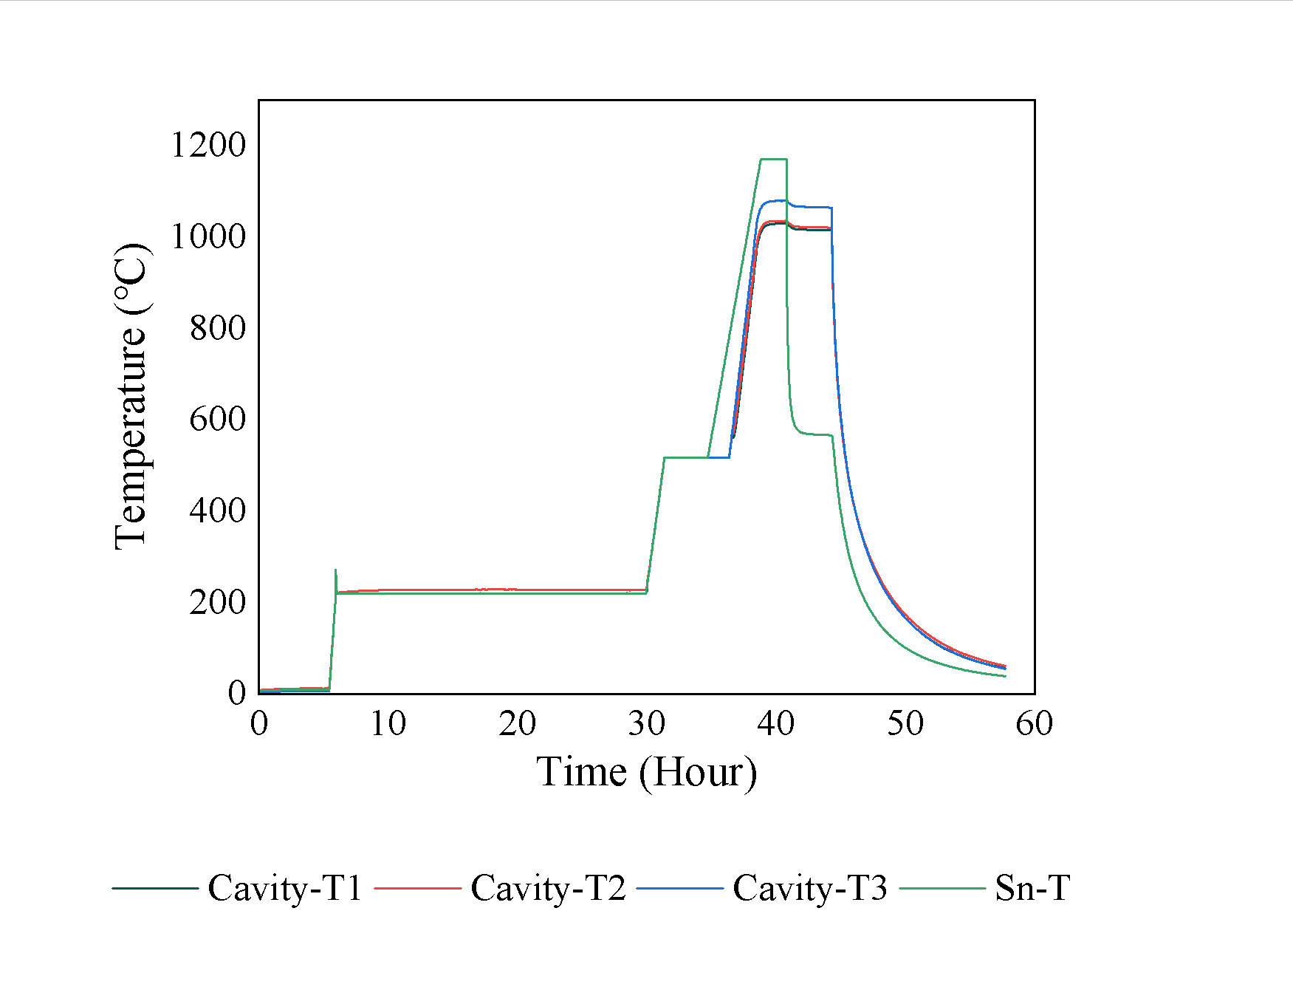
Coating process optimization
Coating Process (7)
Optimization idea: under the premise of effectively inhibiting the condensation of Sn droplets, the Sn source temperature can be safely increased.
Targeted modifications to the Coating conditions:
During the film growth stage, the temperature of the Sn source was kept at 1233⁰C, but the duration was shortened to 2 hours.
Keeping the bottom Mo heating belts powered on while turning off the middle and upper Mo heating belts during the whole coating process.
The Sn source heater was turned off immediately after the film growth stage.
Two pieces of high-purity ceramic bricks were suspended above the cavity to further increase the adsorption of residual Sn vapor.
Recipe of the Coating Process (7) with the Nb cavity at 1100⁰C and the Sn source at 1233⁰C
Coating conditions of process (7)
Sn source Temperature/℃ | Growth stage time / Minute | Exploration of methods for adsorbing residual Sn vapor
 |  | Sn power | Valves | Mo belt | Ceramics
1233 | 120 | Off | Closed | Bottom On | With

Slide 16
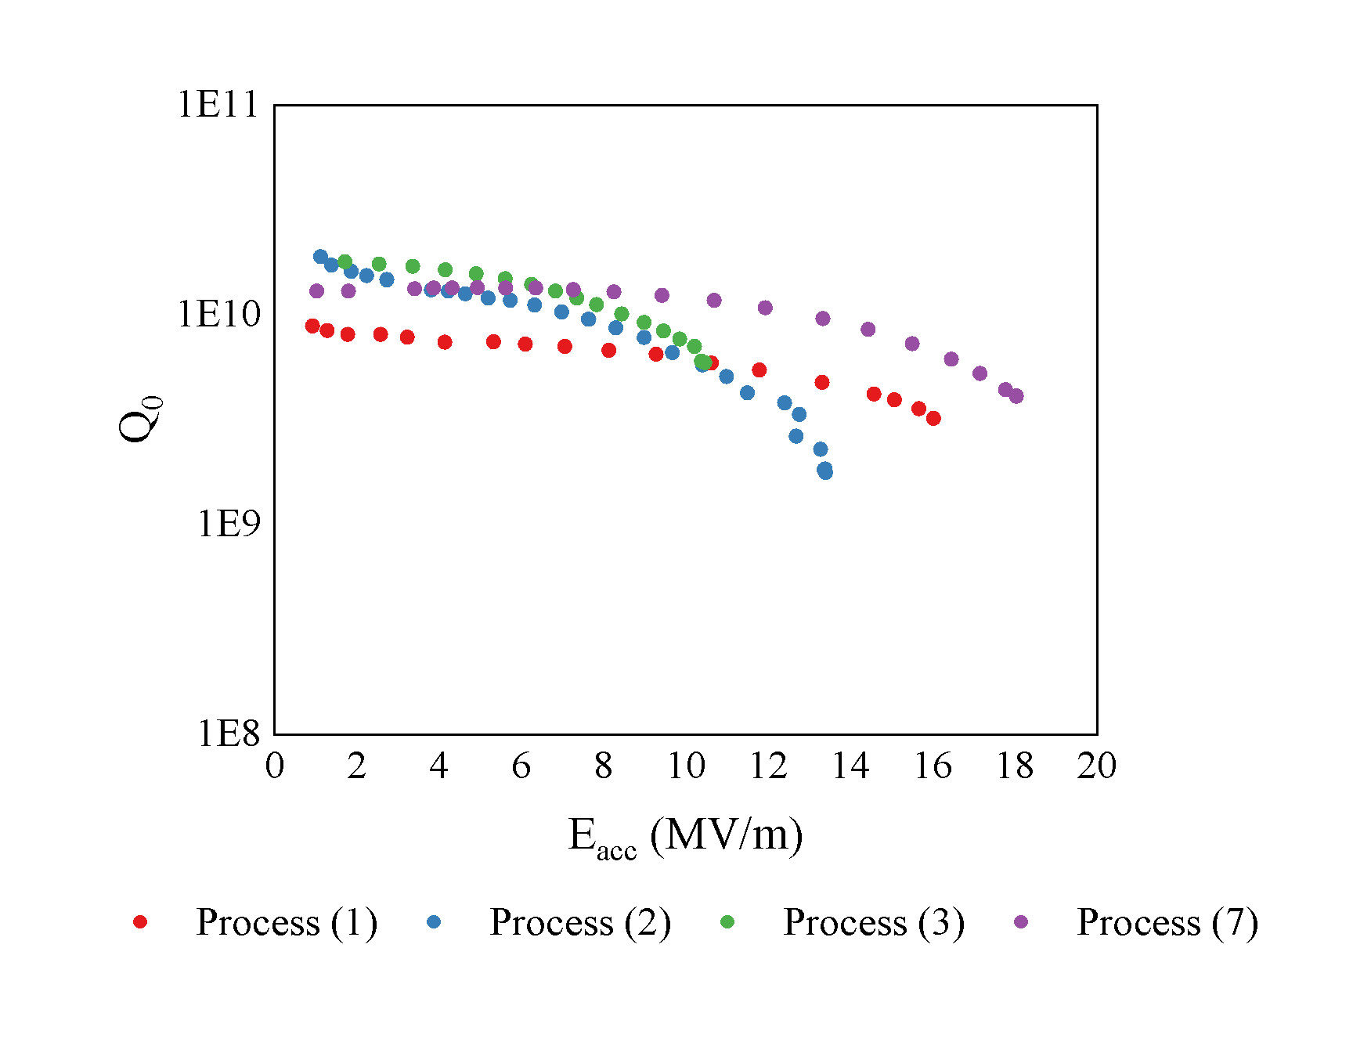
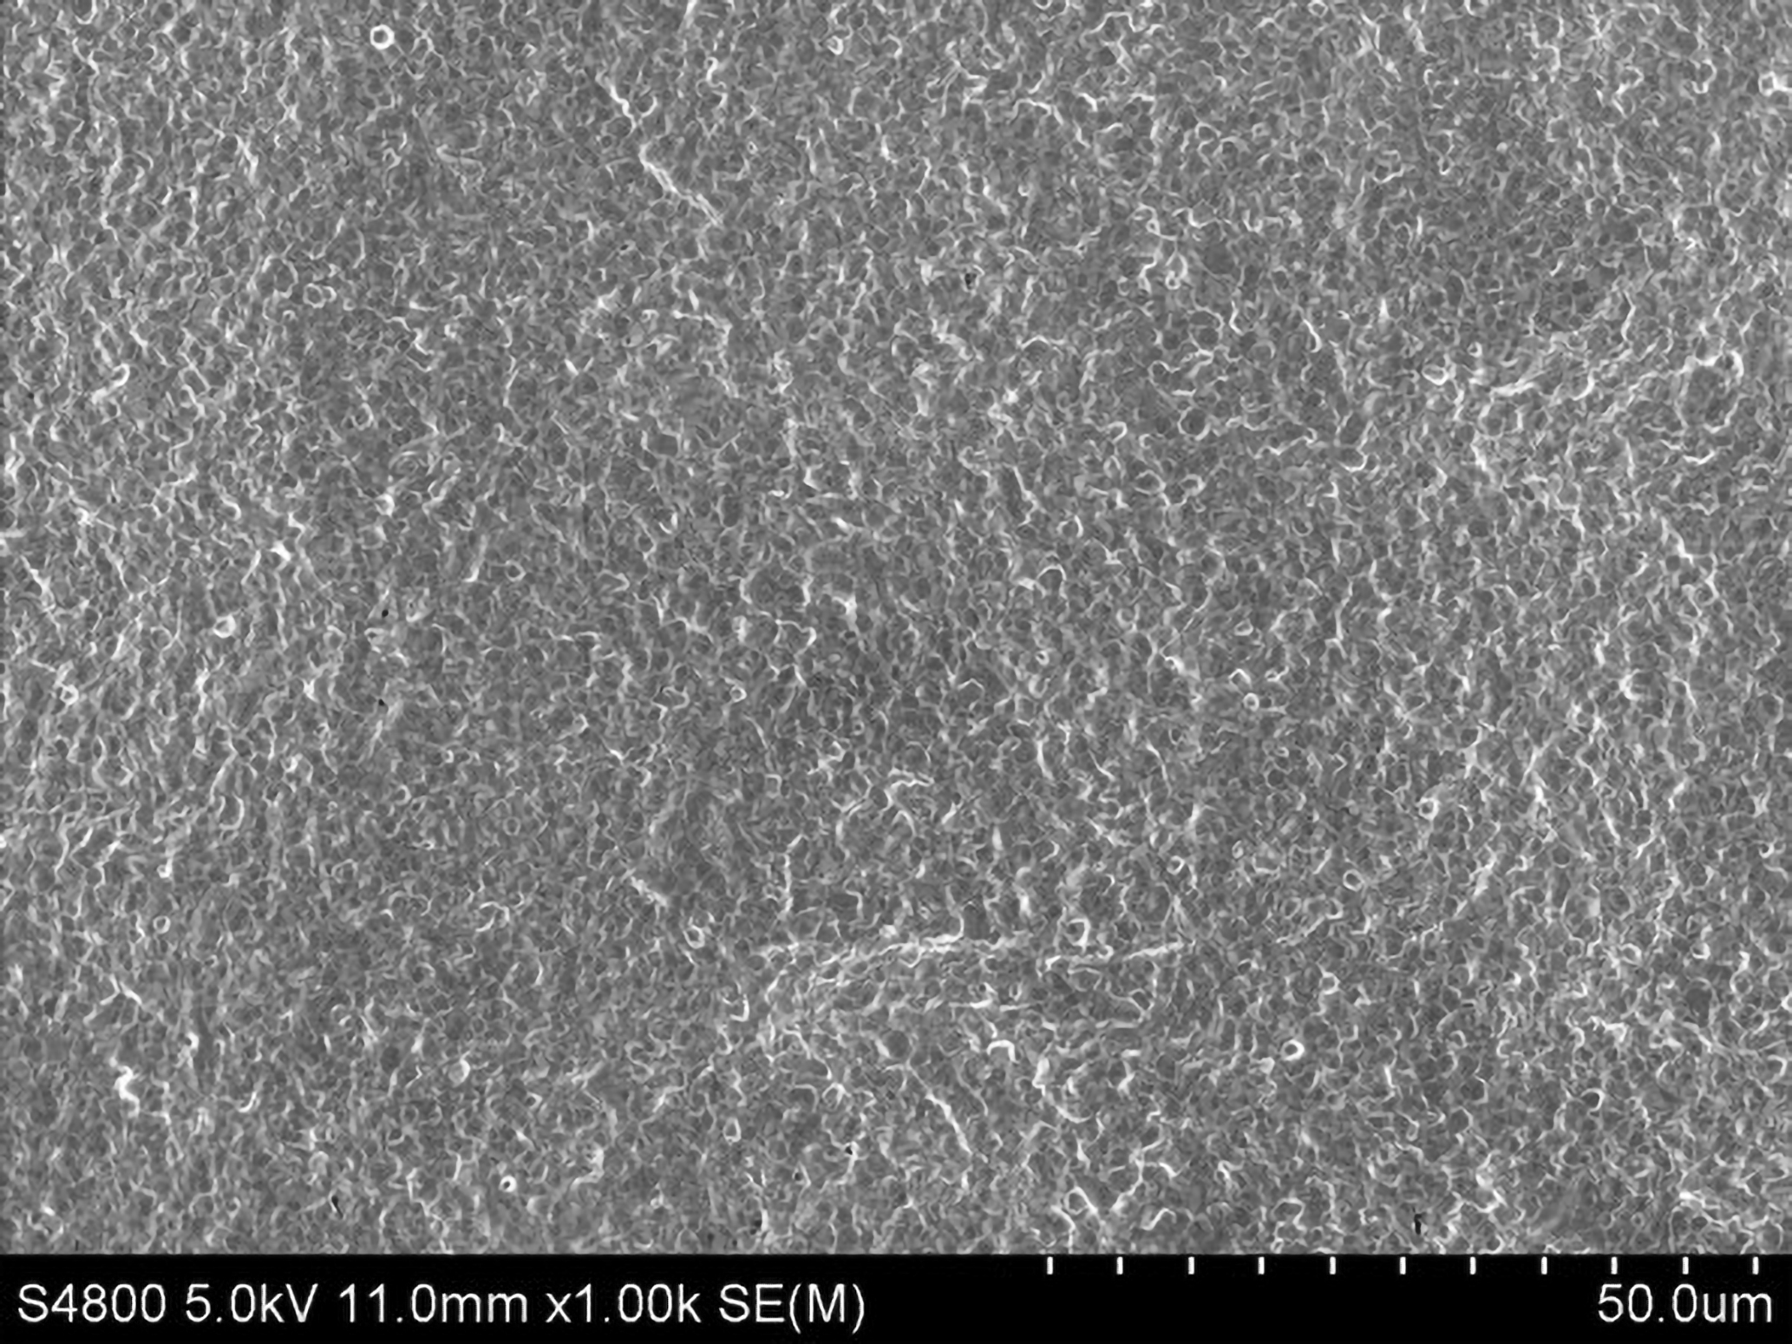
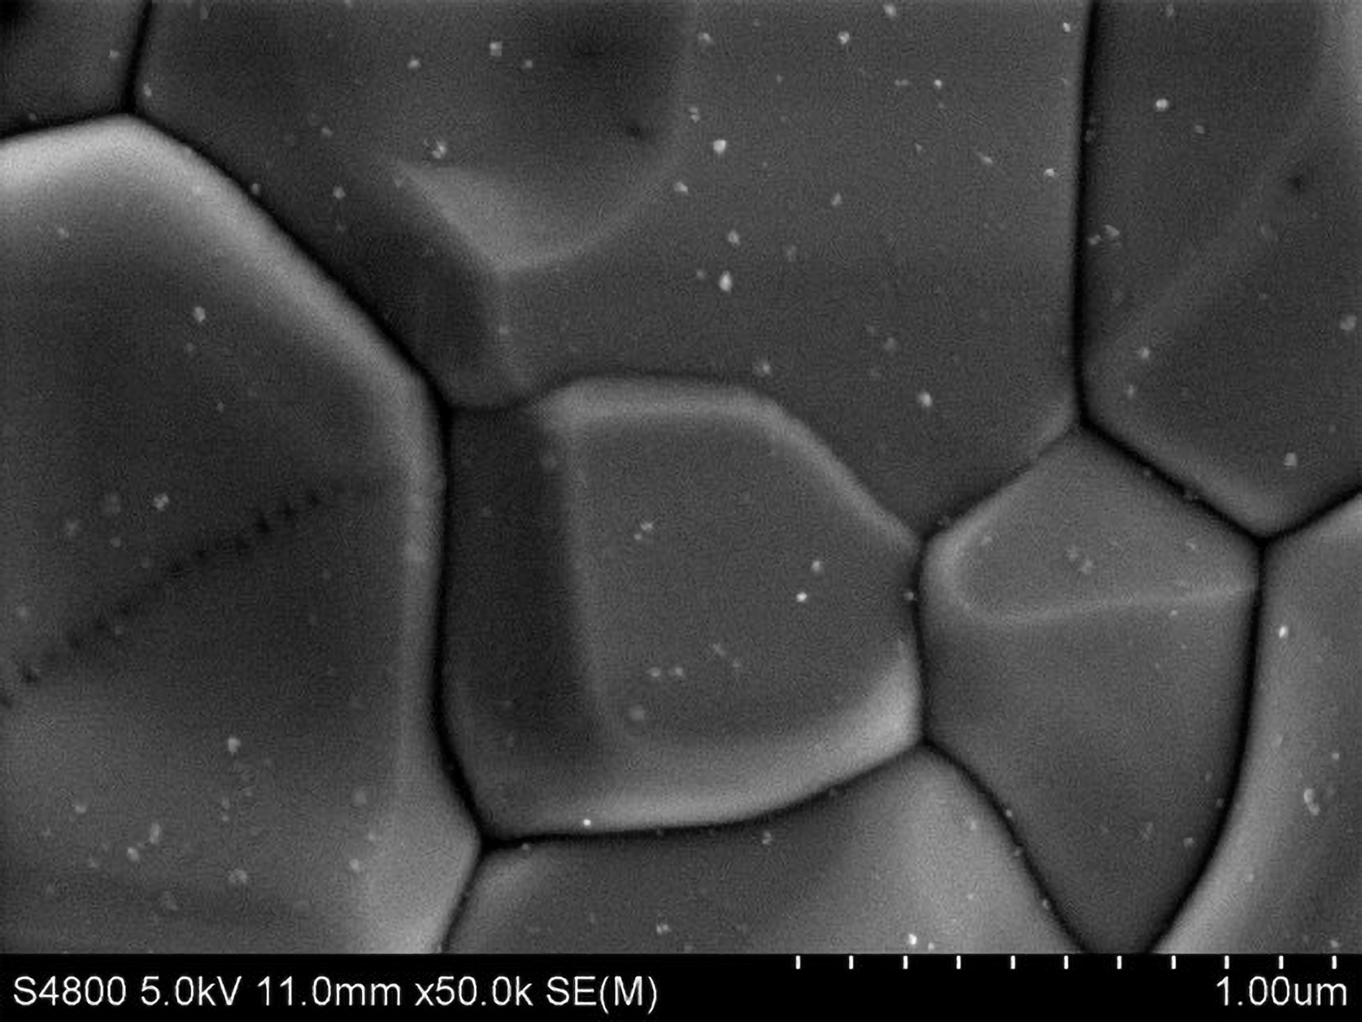
Coating process optimization
Coating Process (7)
SEM images of the Nb₃Sn film coated by the Coating Process (7): no patchy areas are found in the 125 μm by 125 μm area (left) and nanometer-scale Sn droplets on the surface of the Nb₃Sn film (right)
EDS composition of the Nb₃Sn films by Coating Process (7)
Position | 1 | 2 | 3
Sn content(at. %) | 25.60 | 25.86 | 25.75
Average Sn content | 25.74
The Q₀ of the Nb₃Sn SRF cavity by Process (7) at 4.2 K in the low field region is about 1.4×10¹⁰ and the E_{acc,max} reaches 18.03 MV/m. Moreover, despite the condensed Sn droplets, the Q-slope is relieved with the Q₀ larger than 1×10¹⁰ at E_{acc} = 12 MV/m and 4.2 K.

Slide 17
Outlines
1
Background
2
Coating process optimization
3
Conclusion

Slide 18
Film characterization and RF performance comparison
Coating process | Sn droplets | Sn spots | Patchy aera | Q₀ at low field | E_{acc,max} | Onset of precipitous Q-slope
1 | Yes | Yes | No | 8.8E9 | 16.11MV/m | ~12MV/m
2 | Yes | No | Doubtful | 1.9E10 | 13.39MV/m | ~7MV/m
3 | Yes | No | Yes | 1.8E10 | 10.46MV/m | ~5MV/m
4 | Yes | No | Doubtful | No test | No test | No test
5 | No | No | Doubtful | No test | No test | No test
6 | No | No | Doubtful | No test | No test | No test
7 | Yes | No | No | 1.4E10 | 18.03MV/m | ~12MV/m
The composition and causes of nanometer-scale Sn droplets, millimeter-scale Sn spots, and locally extremely thin patchy areas on the surface of Nb₃Sn films were confirmed.
The impact of nanometer-scale Sn droplets, millimeter-scale Sn spots, and patchy areas on the RF performance of Nb₃Sn SRF cavities, such as Q₀, E_{acc,max}, and Q-slope, were also distinguished and clarified.
The method of achieving high-quality Nb₃Sn films by increasing the adsorption of residual Sn vapor to suppress the generation of nanometer-scale Sn droplets was explored under the premise of ensuring uniform film growth by increasing the Sn vapor flux.
Details in Applied Surface Science 643 (2024) 158708 : https://doi.org/10.1016/j.apsusc.2023.158708

Slide 19
Thanks for your attention.
Welcome worldwide cooperation!

