Slide 1
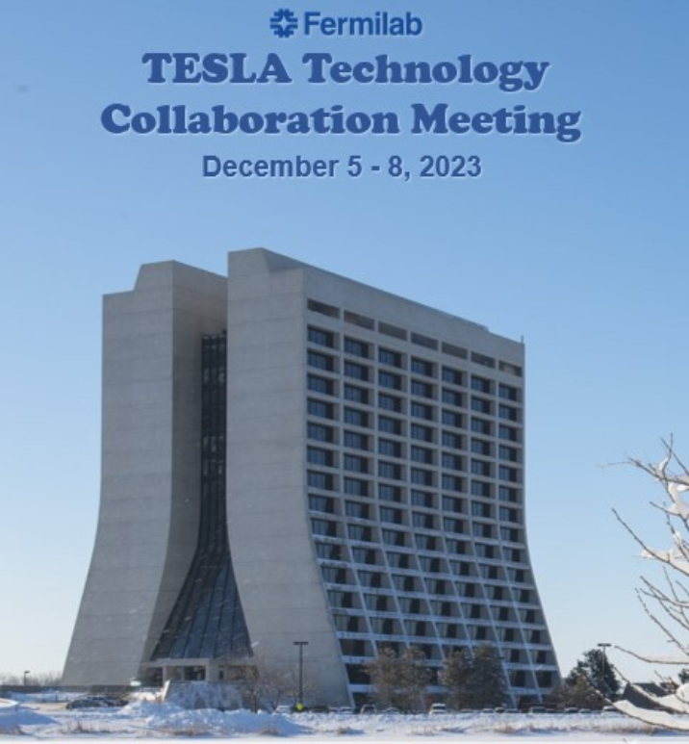
WG-3:Novel clean assembly techniques, in-situ mitigation, and recovery processes
Conveners: Naruhiko Sakamoto (RIKEN),
Martina Martinello (SLAC), Enrico Cenni (CEA)
TTC2023 Fermilab Dec. 5 -8

Slide 2
WG-3 Objectives
Novel clean assembly techniques including robotics and semi-automated procedures to prevent dust particle contaminations and migrations.
Methods to carefully install “clean” cryomodules into existing “dirty” facilities or techniques to reduce particulate migration to maintain on-line performance.
Diagnostics of field emission to understand where and how field emission is occurring.
Off-line techniques like high pressure rinsing to mitigate field emission in various types of cavities and cryomodules.
In situ cleaning techniques like pulsed RF conditioning, plasma processing, and helium processing.
TTC2023 Fermilab Dec. 5-8

Slide 3
WG-3 Sessions
10/14 minutes presentation with quick questions
Comprehensive discussion follows at the end of each sessions
TTC2023 Fermilab Dec. 5-8

Slide 4
Let’s start!
We hope you enjoy the program we have prepared

