Slide 1
High Pressure Rinse Simulation Tool
Applied to the SSR2 Cavity
Blake Gower
SRF Process Engineer
gower@frib.msu.edu
5 December 2023

Slide 2
Overview
Why HPR for SRF?
HPR at FRIB
HPR Simulation Technique
HPR Simulation of SSR2 Cavity

Slide 3
Why HPR for SRF?
RF fields strongest at the interior SRF cavity surface (~100s nm skin depth)
Interior surface finish dictates ultimate performance of SRF cavity
To produce high surface quality, interior cavity surface typically undergoes processes of
  Mechanical polishing
  Degreasing
  Chemical etching
    Buffered chemical polishing
    Electropolishing
  Degassing/baking
Final step is HPR with Ultra-high Purity Water
  Remove chemical residues
  Remove residual particulates

Slide 4
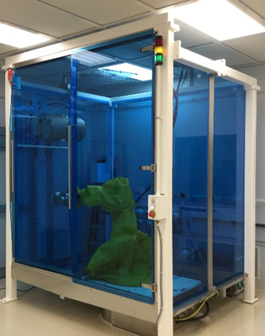
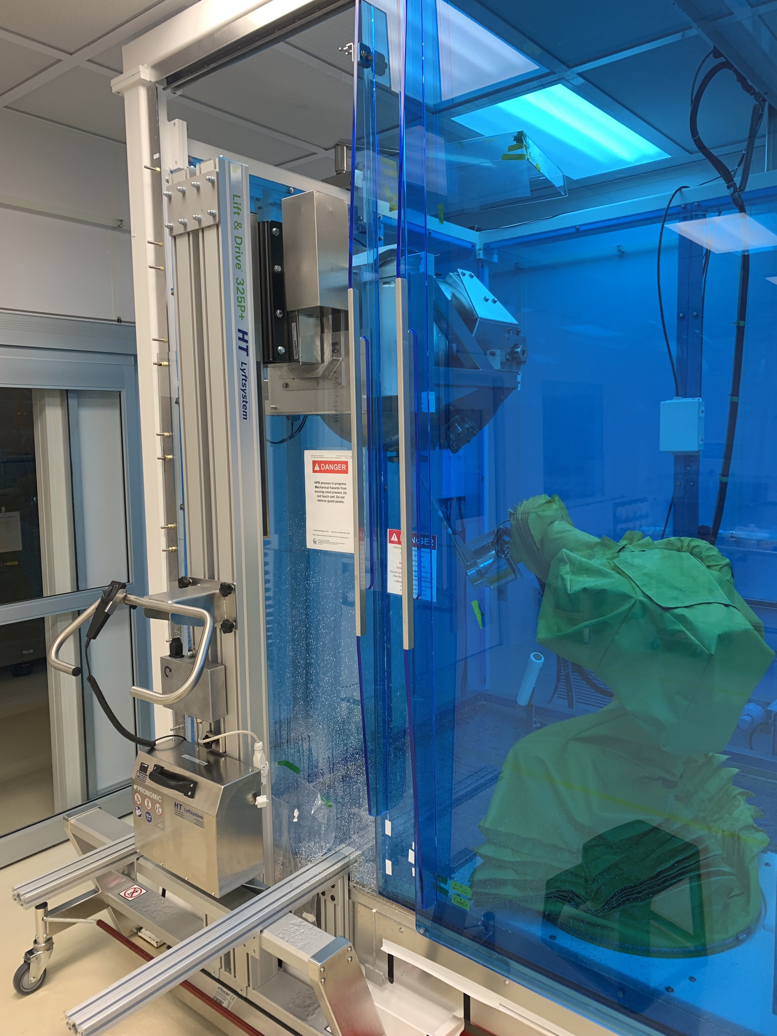
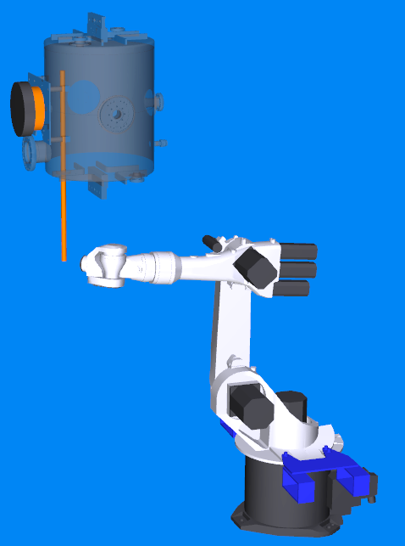
Robotic HPR at FRIB
7-Axis KUKA Robot
14 L/min UPW (3.7 gpm)
69-83 bar (1000-1200 psi)
Rinse booth located in ISO 5 cleanroom
Images courtesy of L. Popielarski, E. Metzgar

Slide 5
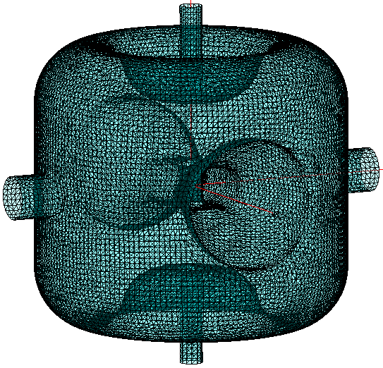
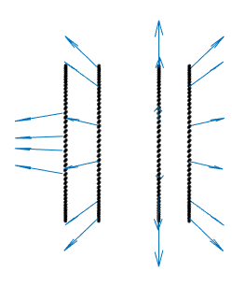
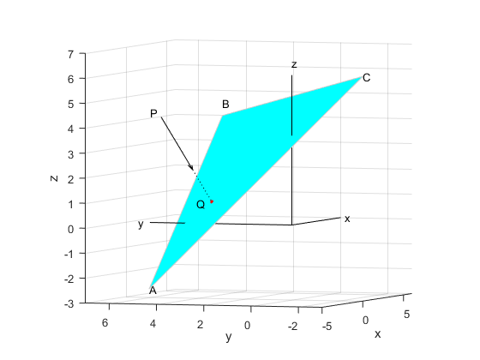
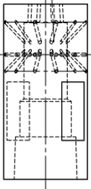
Simulation Method: Ray Casting and Ray-Triangle Intersection
Cavity interior as triangular mesh
Nozzle jets as rays

Slide 6
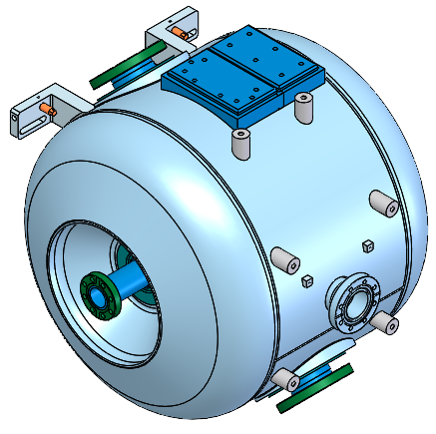
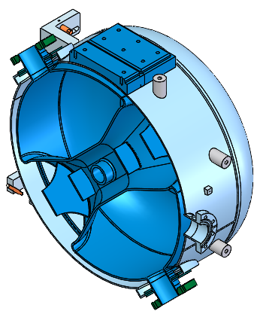
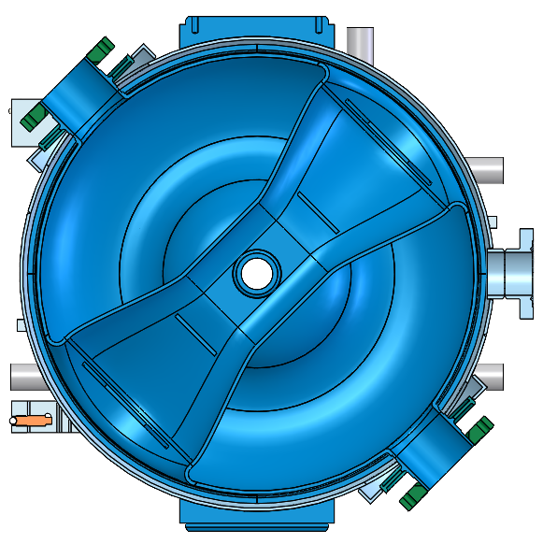
PIP-II SSR2 Cavity Geometry
Begin with full mechanical model

Slide 7
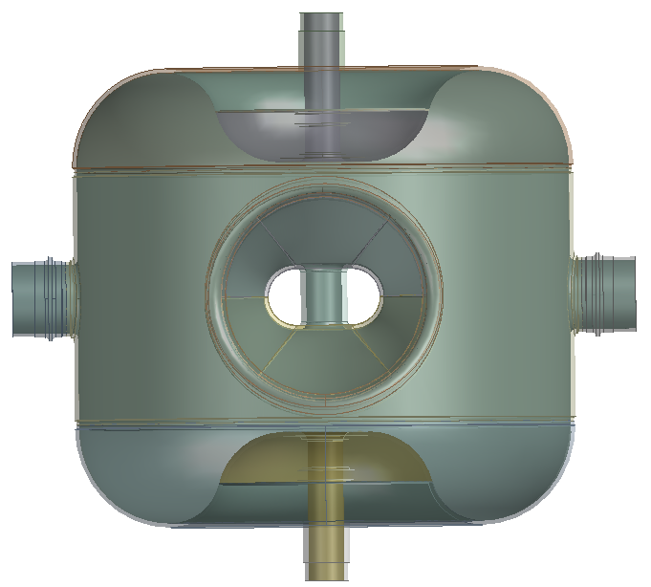
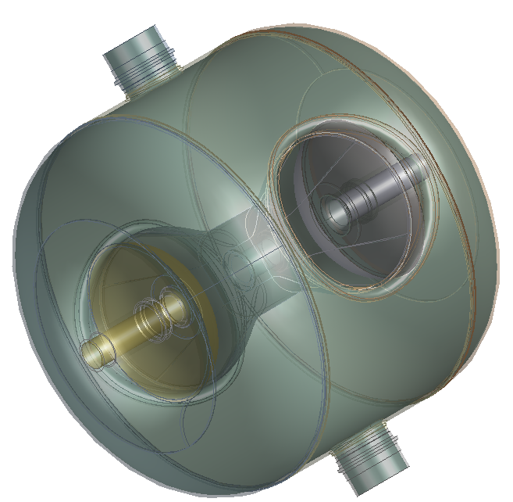
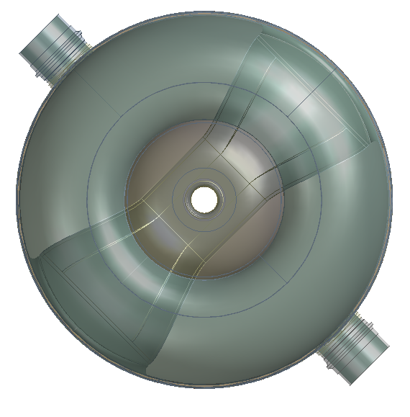
PIP-II SSR2 Cavity Geometry
Remove helium jacket and other exterior features

Slide 8
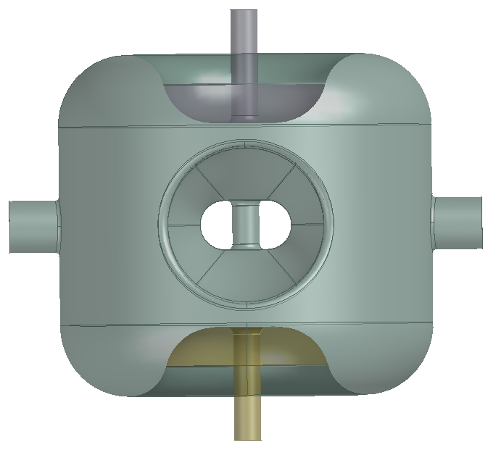
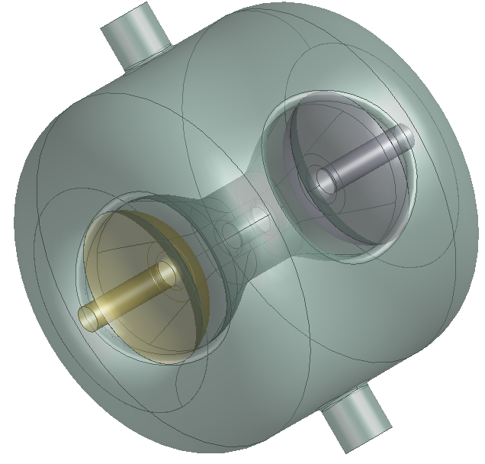
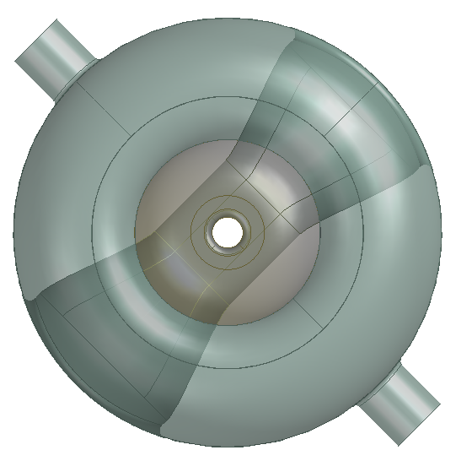
PIP-II SSR2 Cavity Geometry
Isolate interior cavity surface

Slide 9
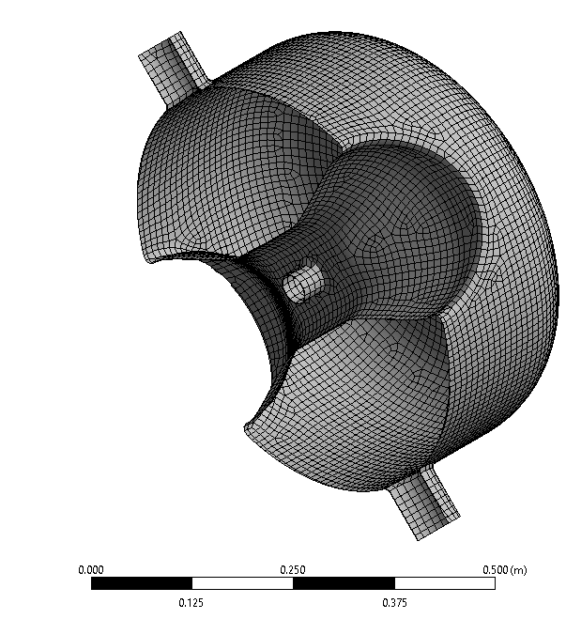
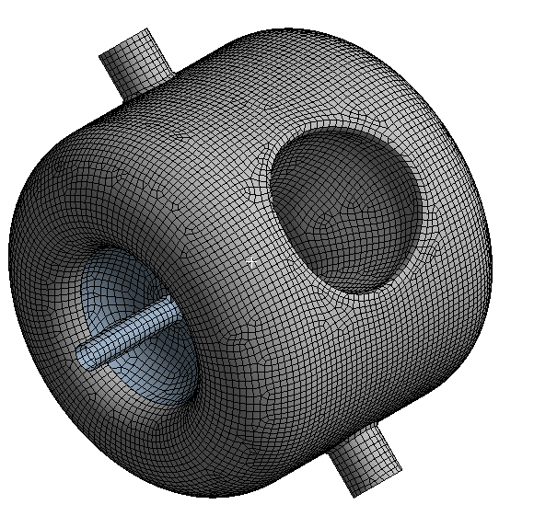
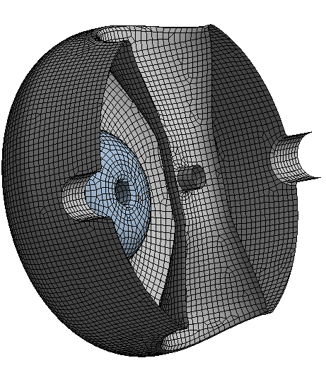
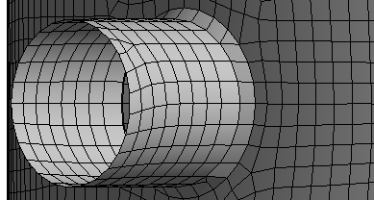
PIP-II SSR2 Cavity Geometry
Create mesh of interior cavity surface (ANSYS Mesh)
  Element Edge Size: 0.0095 m
  Nodes: 16769
  Elements: 16674

Slide 10
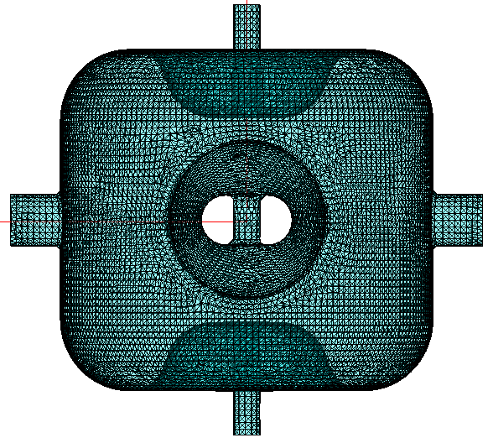
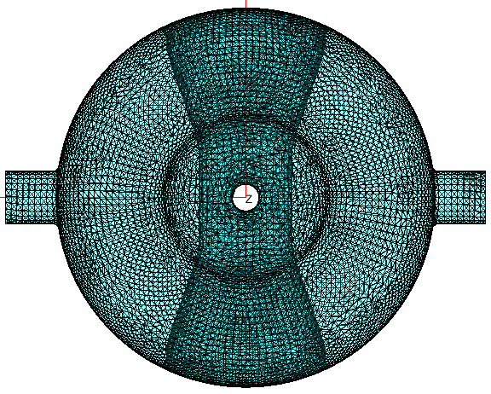
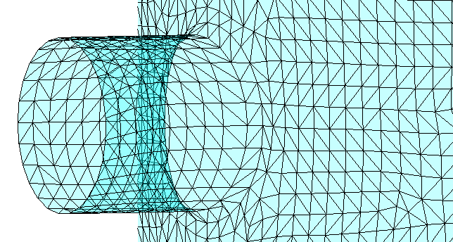
PIP-II SSR2 Cavity Geometry
Split mesh into triangles
  Element Edge Size: 0.0095 m
  Nodes: 16769
  Elements: 33162

Slide 11
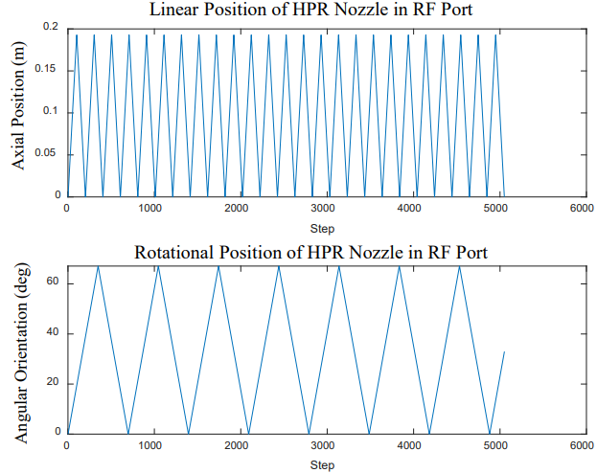
HPR Nozzle Modeling
Nozzle geometry and motion define each ray
Simulation parameters
  Nozzle geometry
    Number of jets
    Jet outlet locations
    Jet directions
  Nozzle motion
    Linear speed
    Rotational speed
    Maximum linear position
    Maximum rotation angle
    Linear step size (increment/resolution)**
    Number of passes
    Port entry coordinate
    Travel angle relative to port axis
    **Defining linear step size along with linear and rotational speeds fixes angular step size

Slide 12
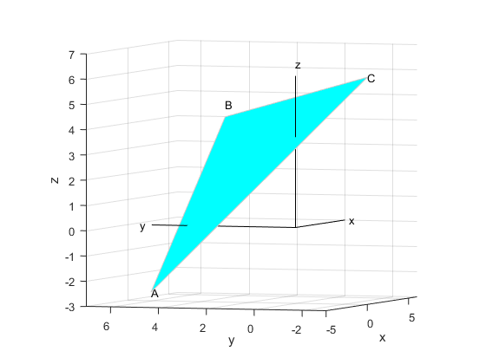

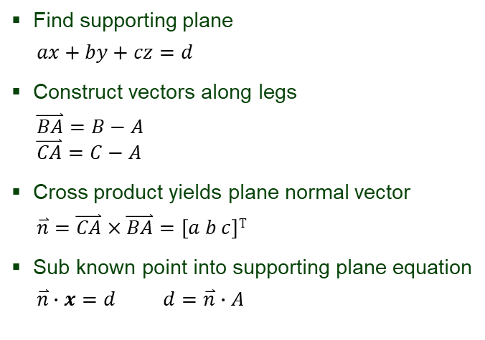
Ray Casting
Determine Ray-Triangle Intersection
Find supporting plane
  $$ax+by+cz=d$$
Construct vectors along legs
  $$\overset{⃑}{BA}=B−A$$
  $$\overset{⃑}{CA}=C−A$$
Cross product yields plane normal vector
  $$\overset{⃑}{n}=\overset{⃑}{CA}×\overset{⃑}{BA}=\left[a b c\right]T$$
Sub known point into supporting plane equation
  $$\overset{⃑}{n}∙x=d d=\overset{⃑}{n}∙A$$
  $$\overset{⃑}{n}$$
  $$\overset{⃑}{n}$$

Slide 13


Ray Casting
Determine Ray-Triangle Intersection
Find supporting plane
  $$ax+by+cz=d$$
Construct vectors along legs
  $$\overset{⃑}{BA}=B−A$$
  $$\overset{⃑}{CA}=C−A$$
Cross product yields plane normal vector
  $$\overset{⃑}{n}=\overset{⃑}{CA}×\overset{⃑}{BA}=\left[a b c\right]T$$
Sub known point into supporting plane equation
  $$\overset{⃑}{n}∙x=d d=\overset{⃑}{n}∙A$$
  $$\overset{⃑}{d}$$
Definition of a cast ray
  Origin at P in direction $\overset{⃑}{d}$ intersecting plane at Q
  $$\overset{⃑}{PQ}=P+\overset{⃑}{d}\left\|\overset{⃑}{PQ}\right\|$$
Substitute into plane equation
  $$\overset{⃑}{n}∙\overset{⃑}{PQ}=d$$
Find length of intersecting ray
  $$\left\|\overset{⃑}{PQ}\right\|=\frac{d−P∙\overset{⃑}{n}}{\overset{⃑}{n}∙\overset{⃑}{d}}$$
  $$\overset{⃑}{n}$$
  $$\overset{⃑}{n}$$

Slide 14
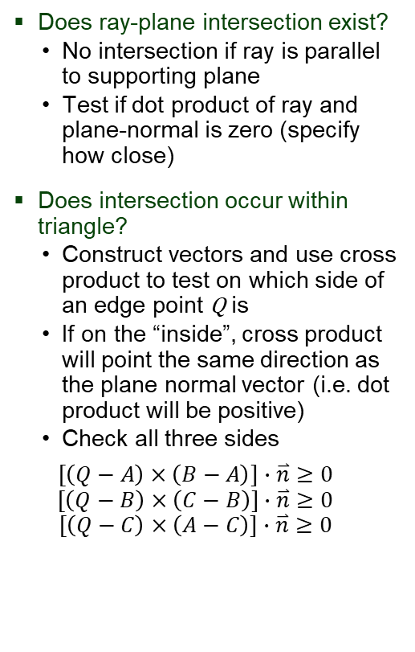
Ray Casting
Determine Ray-Triangle Intersection
Find supporting plane
  $$ax+by+cz=d$$
Construct vectors along legs
  $$\overset{⃑}{BA}=B−A$$
  $$\overset{⃑}{CA}=C−A$$
Cross product yields plane normal vector
  $$\overset{⃑}{n}=\overset{⃑}{CA}×\overset{⃑}{BA}=\left[a b c\right]T$$
Sub known point into supporting plane equation
  $$\overset{⃑}{n}∙x=d d=\overset{⃑}{n}∙A$$
Does ray-plane intersection exist?
  No intersection if ray is parallel to supporting plane
  Test if dot product of ray and plane-normal is zero (specify how close)
Does intersection occur within triangle?
  Construct vectors and use cross product to test on which side of an edge point Q is
  If on the “inside”, cross product will point the same direction as the plane normal vector (i.e. dot product will be positive)
  Check all three sides
  $$[\left(Q−A\right)×\left(B−A\right)]∙\overset{⃑}{n}≥0$$
  $$[\left(Q−B\right)×\left(C−B\right)]∙\overset{⃑}{n}≥0$$
  $$[\left(Q−C\right)×\left(A−C\right)]∙\overset{⃑}{n}≥0$$
  $$\overset{⃑}{d}$$
Definition of a cast ray
  Origin at P in direction $\overset{⃑}{d}$ intersecting plane at Q
  $$\overset{⃑}{PQ}=P+\overset{⃑}{d}\left\|\overset{⃑}{PQ}\right\|$$
Substitute into plane equation
  $$\overset{⃑}{n}∙\overset{⃑}{PQ}=d$$
Find length of intersecting ray
  $$\left\|\overset{⃑}{PQ}\right\|=\frac{d−P∙\overset{⃑}{n}}{\overset{⃑}{n}∙\overset{⃑}{d}}$$
  $$\overset{⃑}{n}$$
  $$\overset{⃑}{n}$$

Slide 15
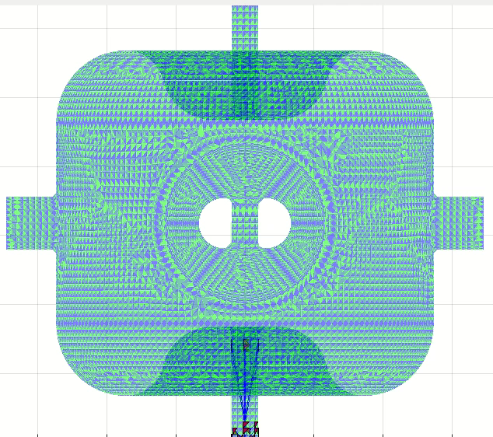
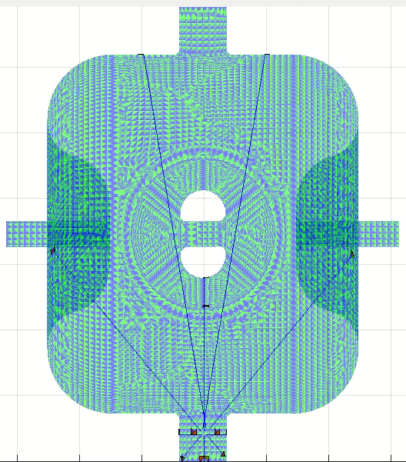
Nozzle Motion and Ray-Triangle Intersection in SSR2 Cavity
Side/Rinse Port
Beam Port

Slide 16
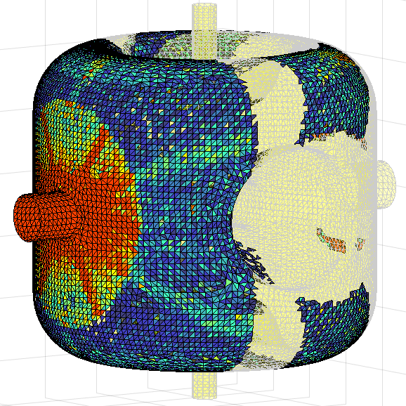



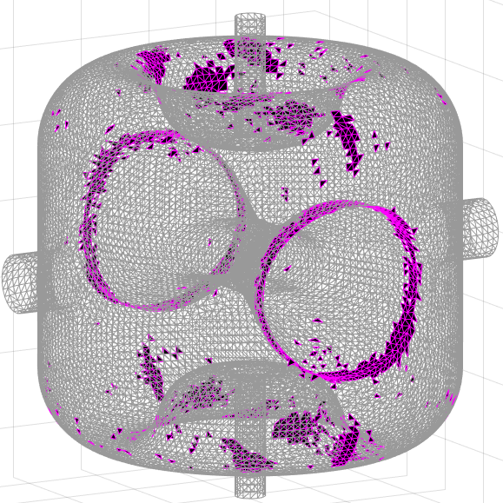
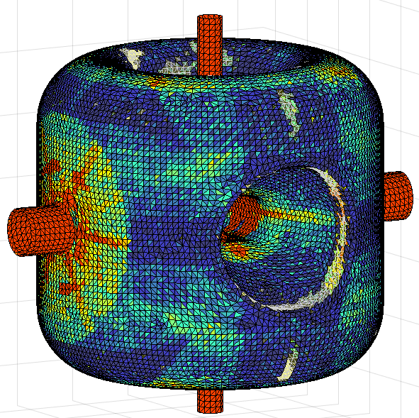
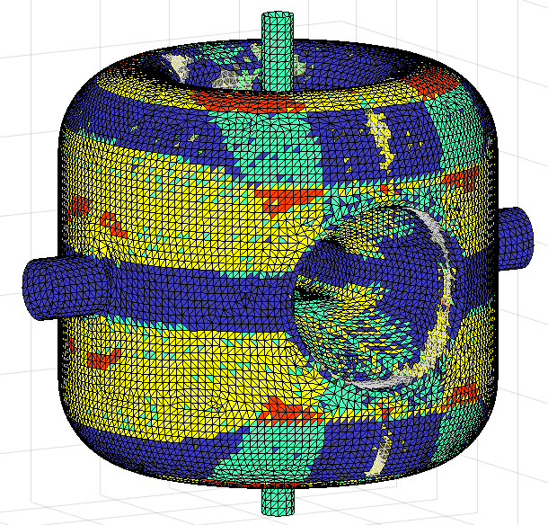
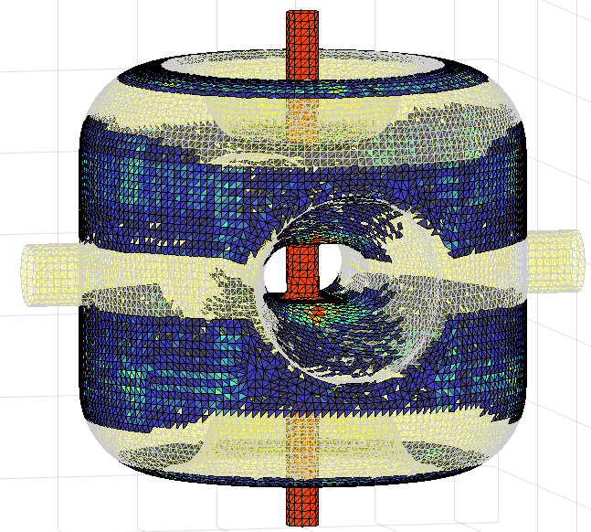
Result of Simple Rinsing Simulation
Side Port Rinse
100 Passes per Port
1 mm/s linear
1 deg/s rotation
Missed Coverage
6.5% Elements Missed
Total Rinse
93.5% Elements Hit
Wash Accessibility
Beam Port Rinse

Slide 17
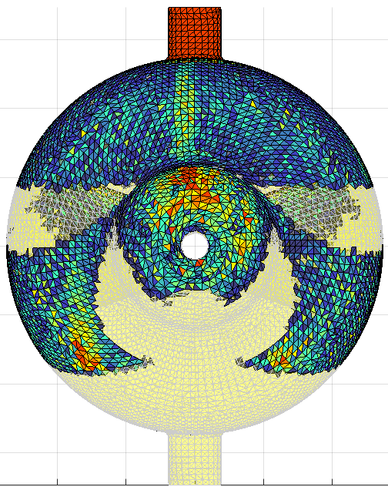
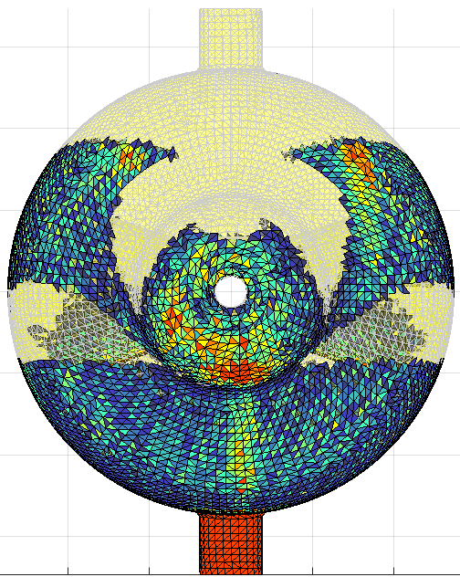
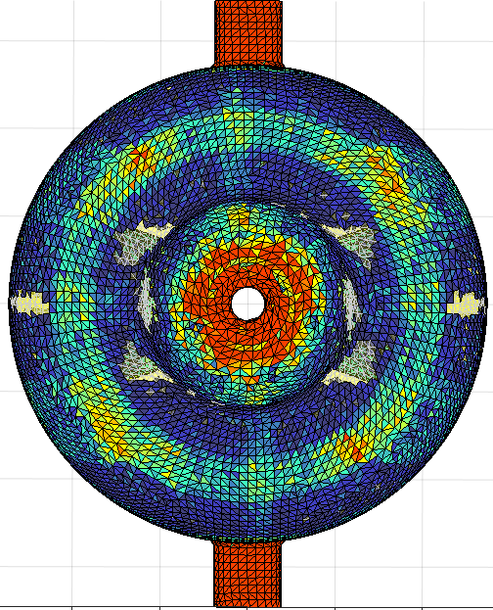
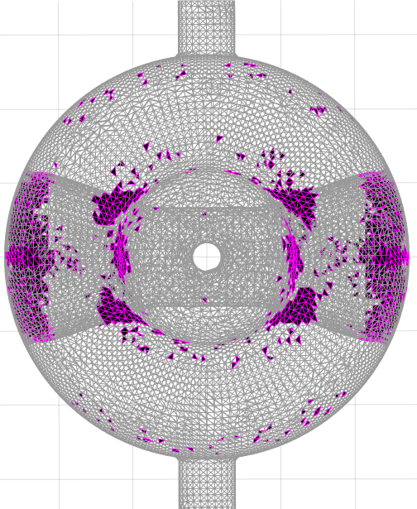
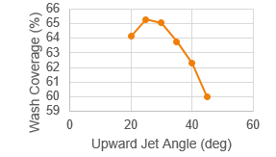
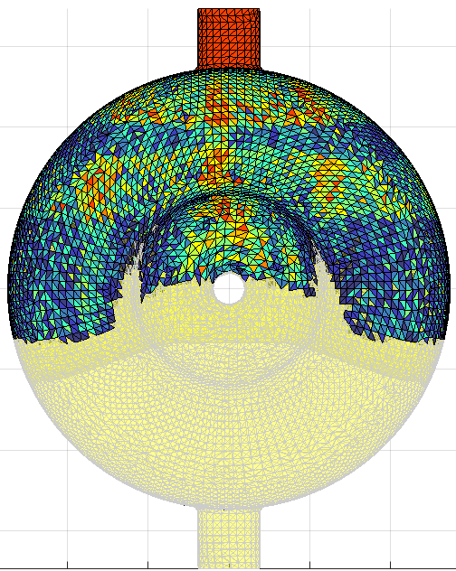
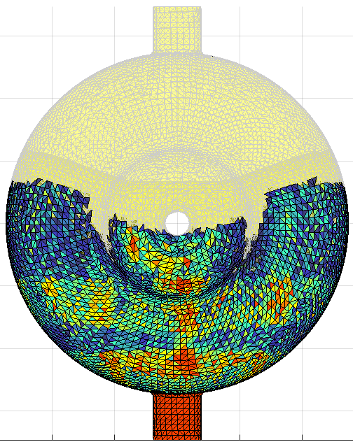
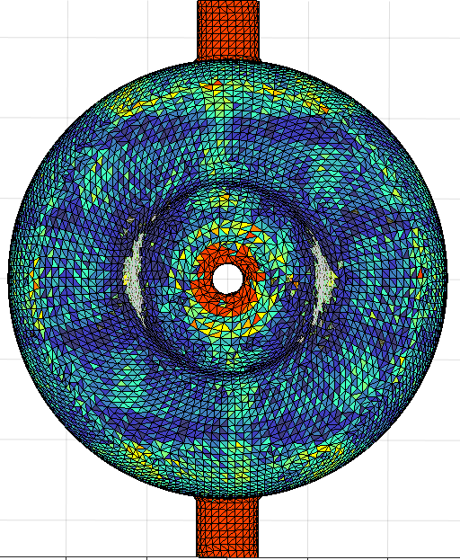
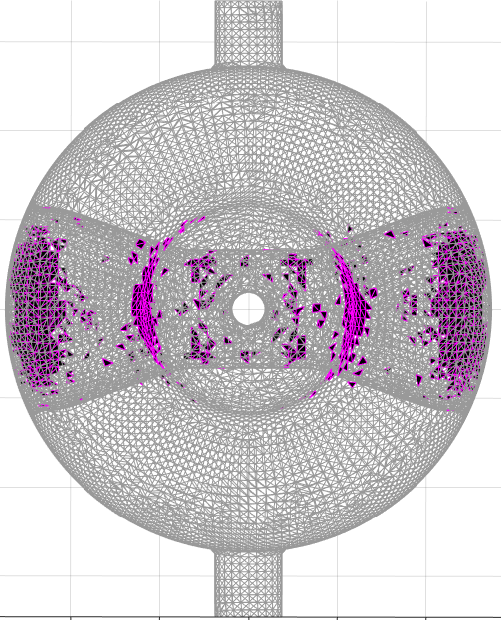
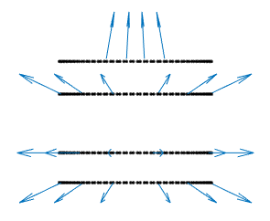
Improvements to Basic Rinse Routine
Change nozzle jet angles
45°
100 Passes/Port
Coverage: 93.5%
12 Passes per Port
25°
100 Passes/Port
Coverage: 95.9%

Slide 18
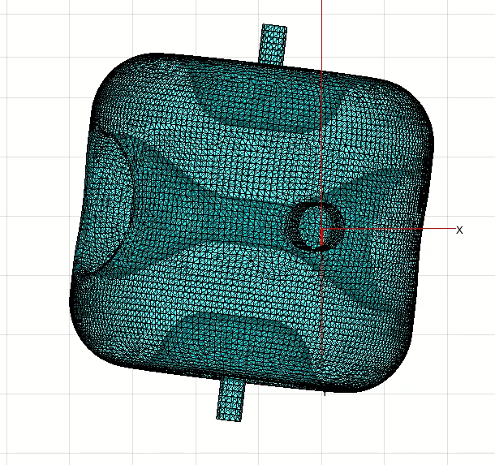
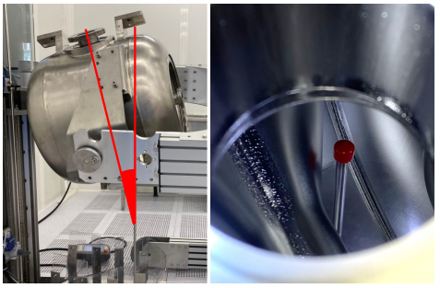
Improvements to Basic Rinse Routine
On-axis motion in side/rinse ports limited by cavity spoke
Ports are large enough in diameter to allow for off-axis entry
  Greater cavity ingress
  Line-of-sight to unreached areas
Rotate 20°about each non-port axis
Orient to each “quadrant”
Both side/rinse ports
8 Travel paths instead of 2
[2] M. Parise et al., “PIP-II Cavities Fabrication and Processing Experience,” SRF2023 Paper TUPTB045

Slide 19
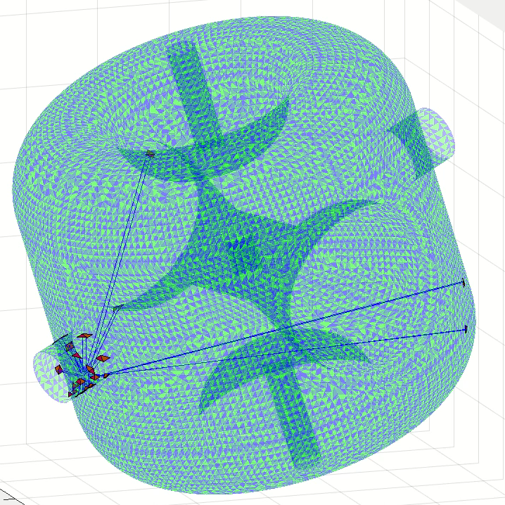
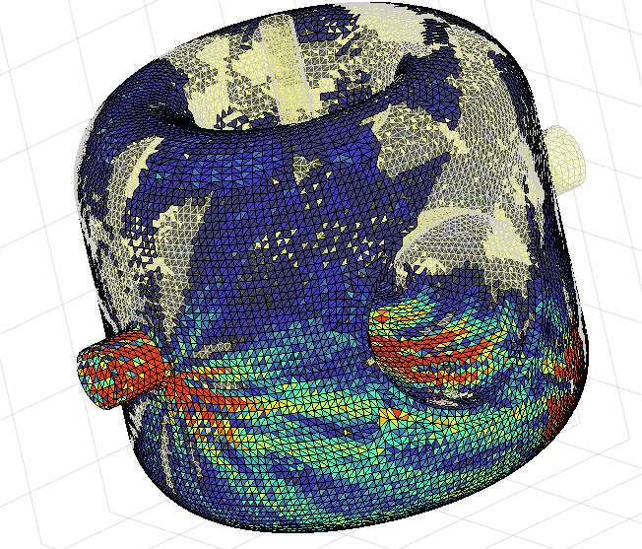

Off-Axis Rinse Simulation

Slide 20
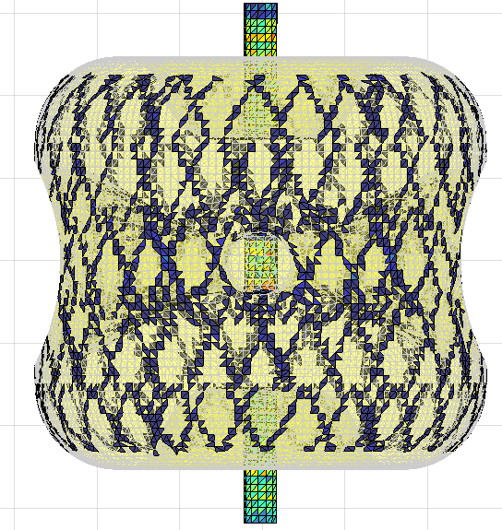









Full Rinse Simulation Results
On-Axis Beam Port
Total Coverage > 99.6%
Missed Coverage < 0.4%
On-Axis Rinse Port
Wash Intensity
Wash Accessibility
Off-Axis Rinse Port

Slide 21

Send Rinse Program to Robot
When wash intensity and coverage deemed satisfactory, a tabulated list of linear and angular coordinates is generated to be input to the robot control software. Shown here graphically.
Rinse Port – On-axis – 4 Passes
Beam Port – On-axis – 10 Passes

Slide 22
Send Rinse Program to Robot
When wash intensity and coverage deemed satisfactory, a tabulated list of linear and angular coordinates is generated to be input to the robot control software. Shown here graphically.
Rinse Port – Off-axis – 50 Passes

Slide 23
Future HPR Simulation Enhancements
Account for accumulated energy deposition
  Go beyond wash intensity by considering
    Conservation of momentum
    Impulse-momentum
    Incidence angle
    Residence time
    Jet spread, breakup
Avoid surface oxidation
  Too much HPR with UPW can leave an oxide layer on cavity surface
  Experiment to determine relationship between time, distance, incidence angle
  Put upper limit on rinse time and/or nozzle proximity in a given area based on energy deposition

Slide 24
Summary
HPR Simulation code can be used to
Predict rinse coverage
Predict relative wash intensity
Inform nozzle design
Inform nozzle motion path

Slide 25
References
[1] B. Gower, K. Elliot, E. Metzgar, T. Xu, “Simulation of high pressure rinse in superconducting radio frequency cavities,” in Proc. 21st Intl. Conf. on Radio-Frequency Superconductivity (SRF2023), Grand Rapids, USA, June 2023, Paper TUPTB039
[2] M. Parise, D. Passarelli, P. Berrutti, “PIP-II SSR2 Cavities fabrication and processing experience,” in Proc. 21st Intl. Conf. on Radio-Frequency Superconductivity (SRF2023), Grand Rapids, USA, June 2023, Paper TUPTB045

Slide 26
Questions?
Thank you!

Slide 27
Backup Slides

Slide 28
Code Construction in MATLAB
Script
Function
Sub-Function
Triangular Cavity Mesh (Node and element connectivity matrices)
Linear speed
Rotational speed
Step size (resolution)
Port location (which port)
Number of passes
Start of linear travel path
End of linear travel path
Rotational limits (if any)
Nozzle geometry parameters
Construct nozzle geometry (jet location, direction)
Construct nozzle motion path (linear and rotational)
Loop for rays and triangles
Ray-Triangle Intersection?
Number of unique elements intersected (and which ones)
Number of intersections per unique element
Store
Next Port?
Finished?
Aggregate coverage
Missed elements/coverages
Data summary

Slide 29


Use Case: Simulate Previously Completed HPR
Different nozzle geometries
Different travel paths
When cavity test results in failure after HPR completion due to field emission, simulate the rinse and use resulting missed coverage areas as inputs to multipacting simulation
64 particle sources, Gaussian emission with space charge effect
15.6% Missed Coverage
Image and details courtesy of J. Brown

Slide 30


Use Case: Simulate Previously Completed HPR
$E_{acc}=5.2996\frac{MV}{m}:〈SEY〉=1.010, I_{coll}=151.03 mA$
Video and details courtesy of J. Brown

