Slide 2
Strategy and installation experience for ESS SRF linac
On behalf of SRF, Cryo and Vacuum team at ESS
Installation activities are supported by IFJ-PAN and WUST ESS IK partners
PRESENTED BY Paolo PIERINI

Slide 3
Outline
1 The ESS linac
2 Handling of main CM NCRs after reception and testing
3 Pilot installation and cooldown
4 CM Series installation
5 Linac Warm Units
6 Conclusions

Slide 4
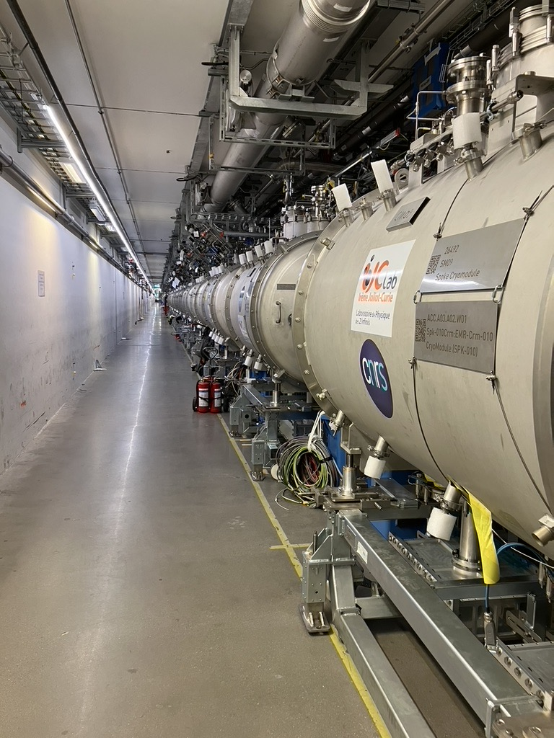
1
The ESS SRF LINAC

Slide 5
ESS SOUP: 2 MW (capability)
82 Individual cavities (and associated RF systems), 27 CMs
352 MHz
704 MHz
SOUP/EOC
ISrc
LEBT
RFQ
MEBT
DTL
SPK
MBL
HBL
HEBT
13
9
5
571 MeV
870 MeV
Cavities
1
3
4/5
26 SPK
36 MB
20 HB
TS2 operation until 2026/06
Full ESS scope: 5 MW beam, in phases (43 CMs: 13+9+21)
2 MW for End Of Construction and Start Of User Ops 2027
All infrastructure prepared for 3 MW capability
  Requires +6 CM (+procure 24 RF Systems)
  Cryomodules delivered by IK partners up to the full 5 MW scope, but 5 MW operation not in current project plan
  Not all infrastructure in place (RF cells in gallery)
Test Stand 2 operation
We still have 15 HB CM to test
Vertical integration test stand before operation
Coupler/Cavity conditioning
Calibration
Site Acceptance Test for SRF and Cryo performances
See M.Zhvoner for SPK tests
See C. Maiano for ELL tests

Slide 6
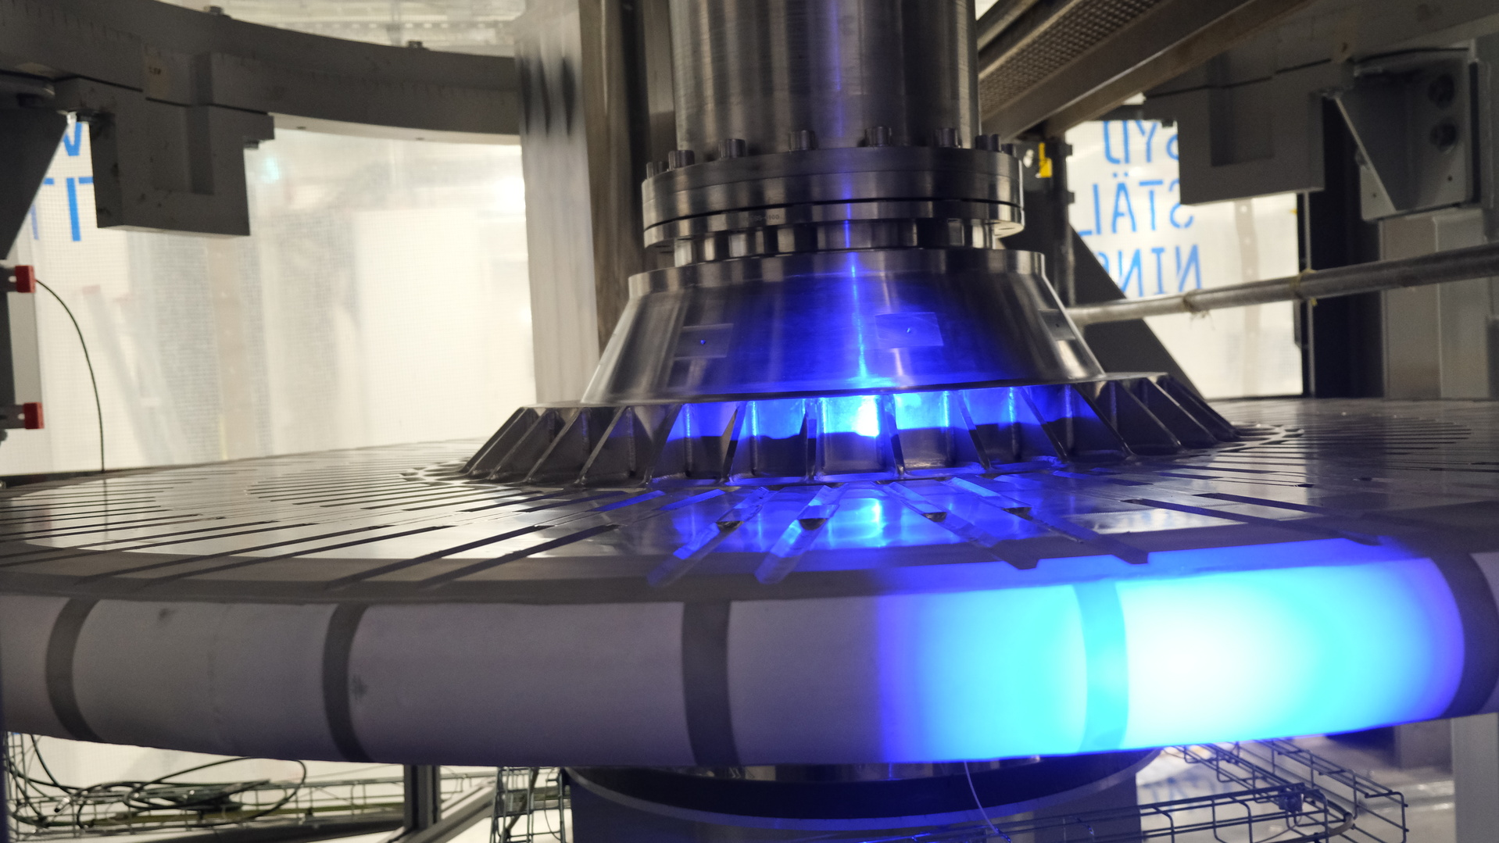
ACC Timeline to BOT
October 2023 Update
SRR4
Facility RBOT
23 Oct '24
19 May '25
SAR4
ACC RBOT
BOT
8 Oct '24
27 Jan '25
19 Jun '25
Q3
Q4
Q1
2024
Q2
Q3
Q4
Q1
2025
Q2
Q3
Q4
Today
1 Nov '23 - 8 May '24
CM/CDS/DTL5/RF/BI/LWU/Infra/ICS Installation and Testing
13 May '24 - 18 Jun '24
PSS FIT
Where are we now?
13 SPK installed
5 MB in tunnel
Beamline connection in progress
19 Jun '24 - 12 Jul '24
CM Warm Conditioning
2024 Summer Holiday
CM Warm Conditioning
15 Aug '24 - 11 Sep '24
CDS and CM Cooldown/Testing
12 Sep '24 - 23 Oct '24
CM Cold Conditioning
25 Sep '24 - 8 Oct '24
SAR4
Licensing process (Beam)
Partial Beam Dump
Limited power
10 Oct '24 - 23 Oct '24
SRR4
24 Oct '24 - 13 Jan '25
Beam Commissioning to Dump
14 Jan '25 - 27 Jan '25
ACC SAR5
Target wheel installed
in monolith
Solid W target
12 Mar '25 - 25 Mar '25
Facility SAR5
Licensing process (neutron)
26 Mar '25 - 8 Apr '25
Facility SRR5
20 May '25 - 19 Jun '25
Beam Commissioning to Target
Beam Commissioning to Target
23 Jun '25 - 25 Sep '25

Slide 7
Large In Kind model (Greenfield org)
All accelerator components come from collaboration partners
SPK 0.5
ELL 0.67
ELL 0.86
1
2
3
4
5
1
2
3
4
5
6
7
8
9
10
11
12
13
1
2
3
4
5
6
7
8
9
1
2
3
4
5
6
7
8
9
10
11
12
13
14
15
16
17
18
19
20
21
Assembly Exceptions @ CEA
@IK
ISrc
LEBT
RFQ
HEBT
MEBT
DTL
SPK
MBL
HBL
@ESS
Preparation to test
ISrc
LEBT
RFQ
MEBT
DTL
SPK
MBL
HBL
HEBT
TS2/FREIA
DTL-W
ISrc
LEBT
RFQ
MEBT
DTL
SPK
MBL
HBL
HEBT
Under test
RFI
ISrc
LEBT
RFQ
MEBT
HEBT
Ready 4 Install
Cold leak 1 CM
DTL
SPK
MBL
HBL
HBL-010
HBL-090
Target
HBL-020
HBL-030
HBL-040
HBL-050
HBL-060
HBL-070
HBL-080
HBL-100
HBL-110
HBL-120
HBL-130
HBL-140
HBL-150
HBL-160
HBL-170
HBL-180
HBL-190
HBL-200
MBL-010
HBL-210
MBL-020
MBL-030
MBL-040
MBL-050
MBL-060
MBL-070
MBL-080
SPK-110
MBL-090
SPK-100
SPK-090
SPK-120
SPK-050
SPK-080
SPK-050
SPK-040
SPK-030
SPK-020
SPK-010
SPK-070
SPK-130
Tunnel
ISrc
LEBT
RFQ
MEBT
DTL
SPK
MBL
HBL
HEBT
Dump
75 keV
3.6 MeV
90 MeV
216 MeV
571 MeV

Slide 8
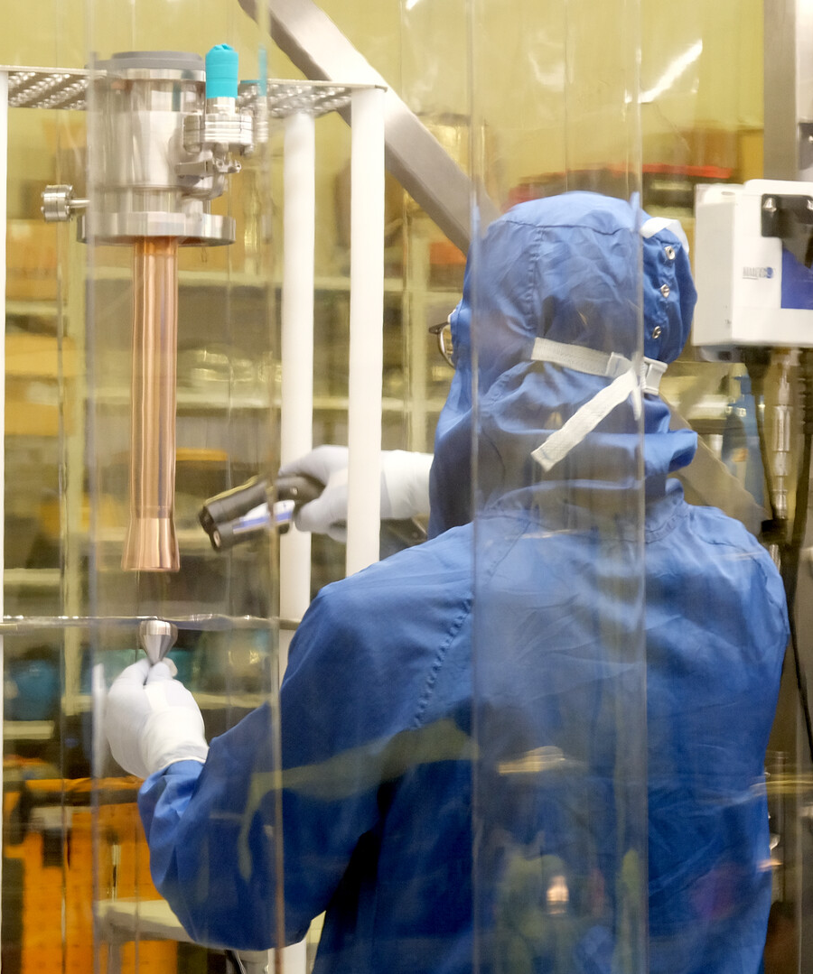
2
Handling of main CM NCRs after reception and testing

Slide 9
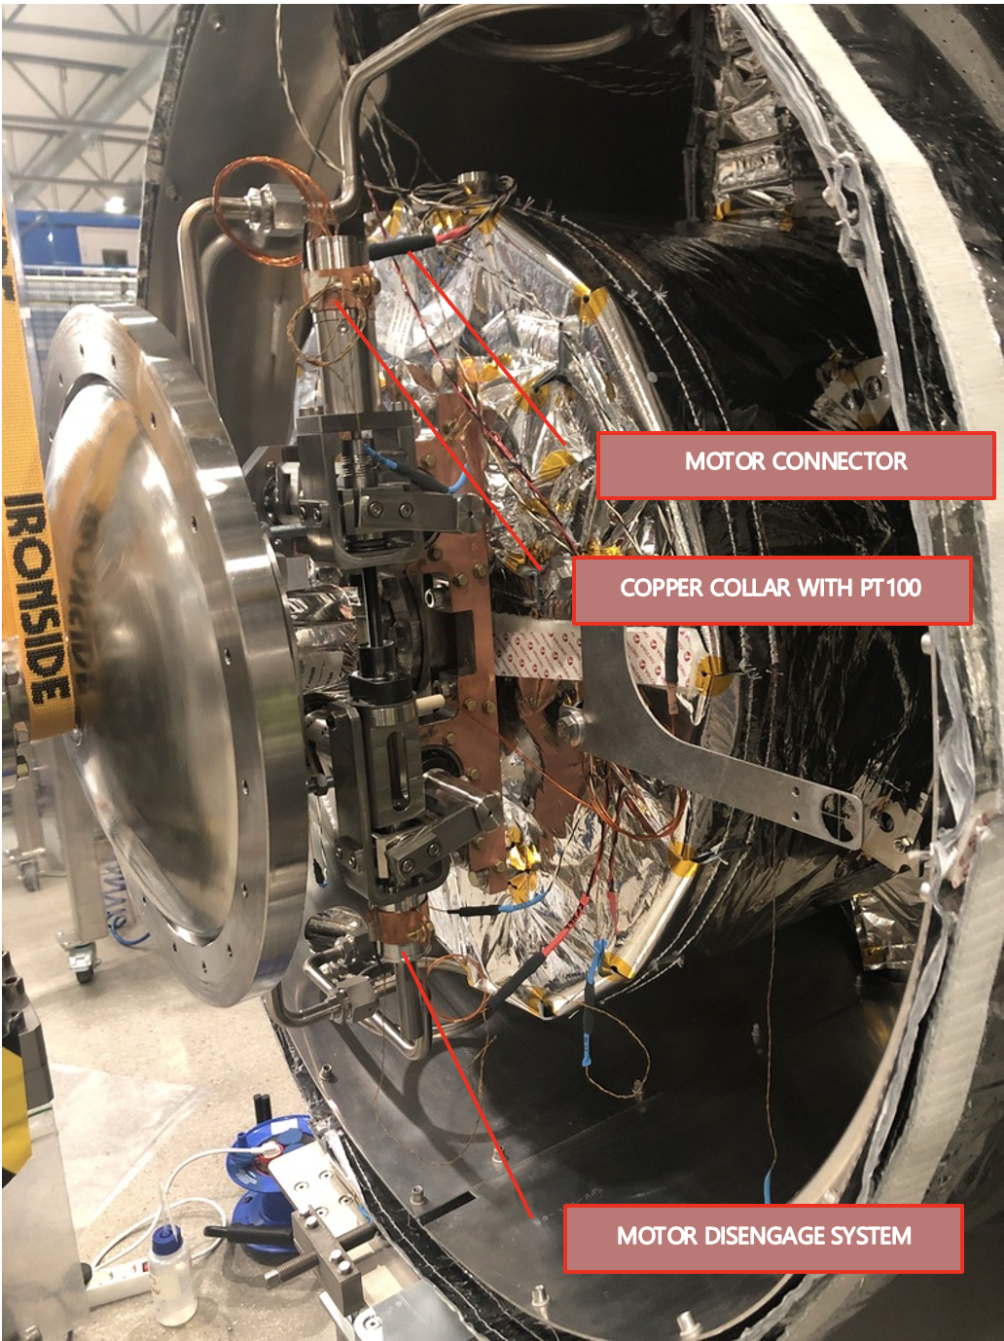
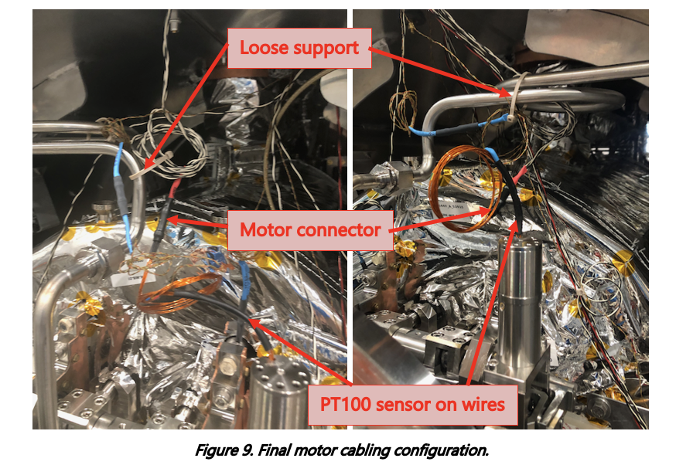
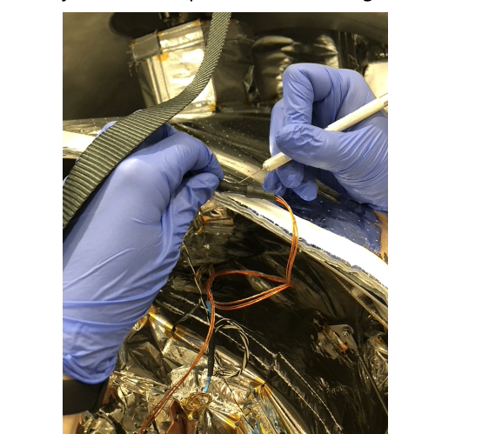
The SPK CTS issue
Main root cause: gearbox coating, enhanced by mechanical “squeeze”
Failures during Uppsala tests lead to perform accelerated lifetime tests
Even after removing the thermalization from the motor body motors in the test bench fail after 20-40 full tuning cycles of the cavities
Concern for the operational reliability
Unfortunately motor access ports were descoped at early project stage before performing EOL testing

Slide 10
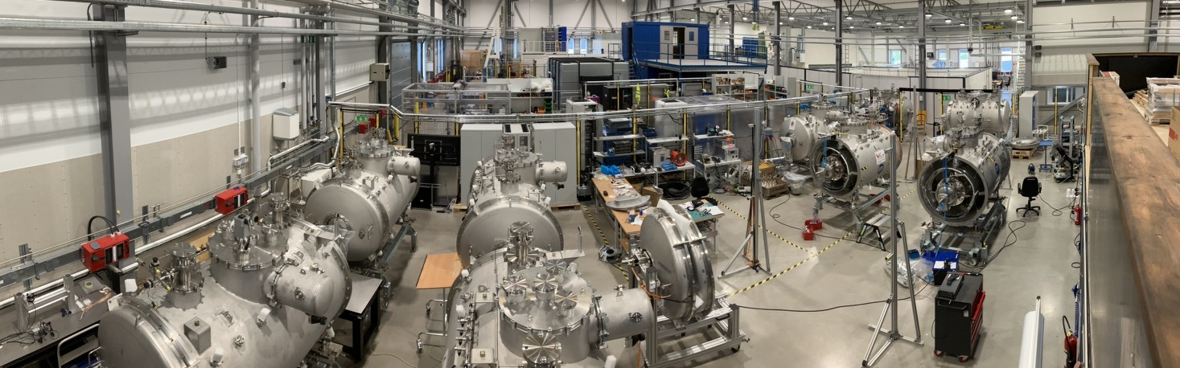
Mitigation strategy
Actions on the tuner motors, at ESS: short and long term
We opened 11/13 SPK cryomodules in lab area to perform actions on the cold tuner systems
  To mitigate chances of early failures in the tunnel
  Developed an in-situ repair tooling for performing action in tunnel (for long term solution)
    Still, an invasive procedure requiring long downtimes if needed

Slide 11
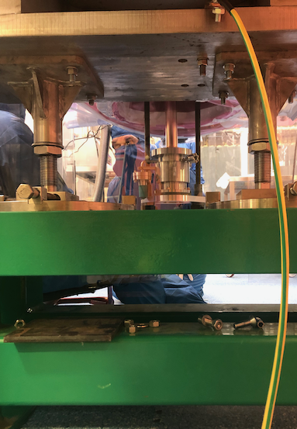
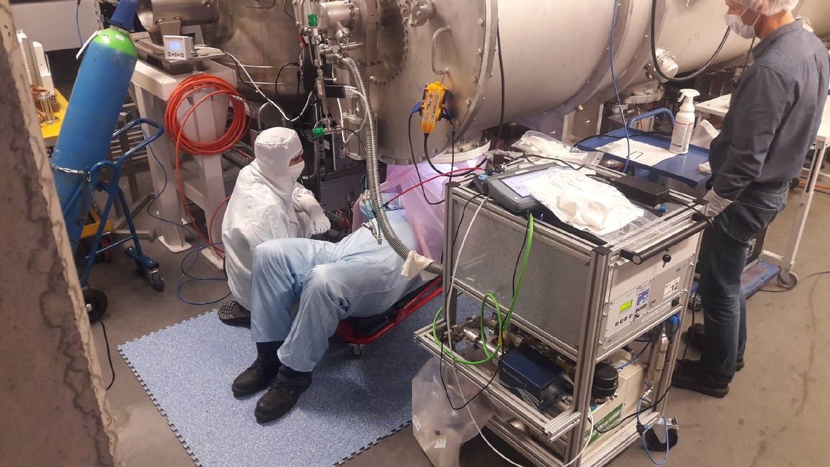
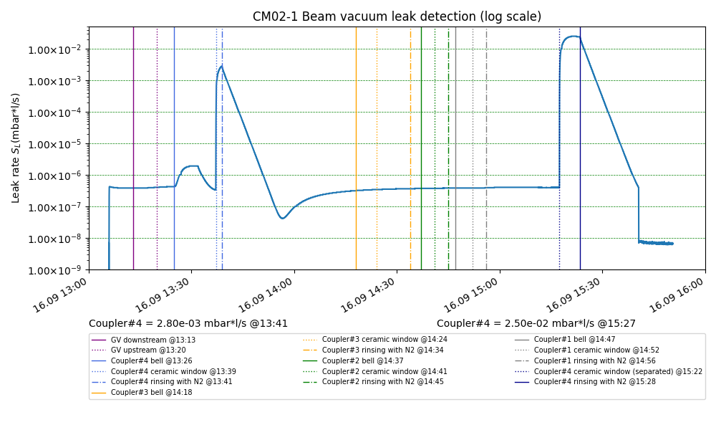
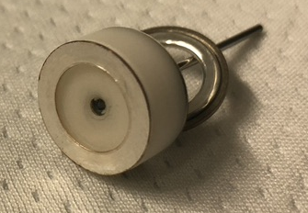
ELL repairs
CM03 Gauge and CM02-1 in-situ coupler exchange
February 2023
November 2021
See C. Madec contribution
Leak after DK
assembly:
cracked
ceramic
Very successful operations, at the max of ESS current repair capabilities: Under discussion the need of a facility for decryostating the cold mass

Slide 12
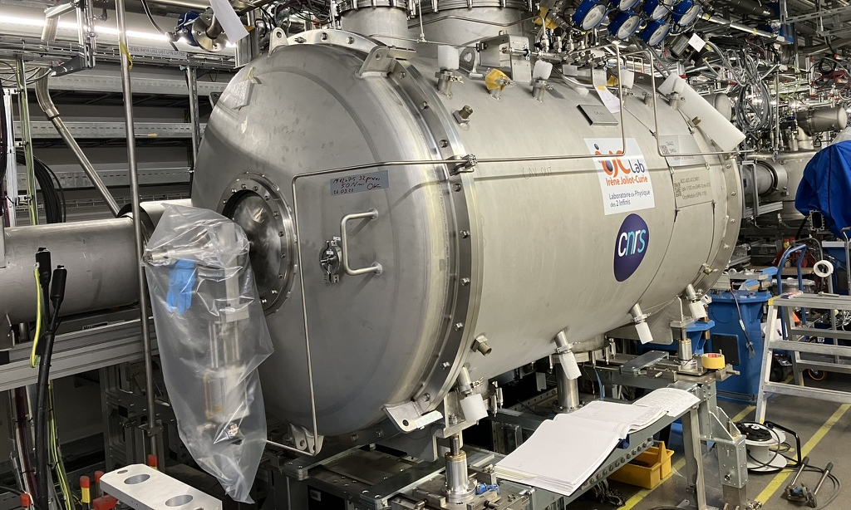
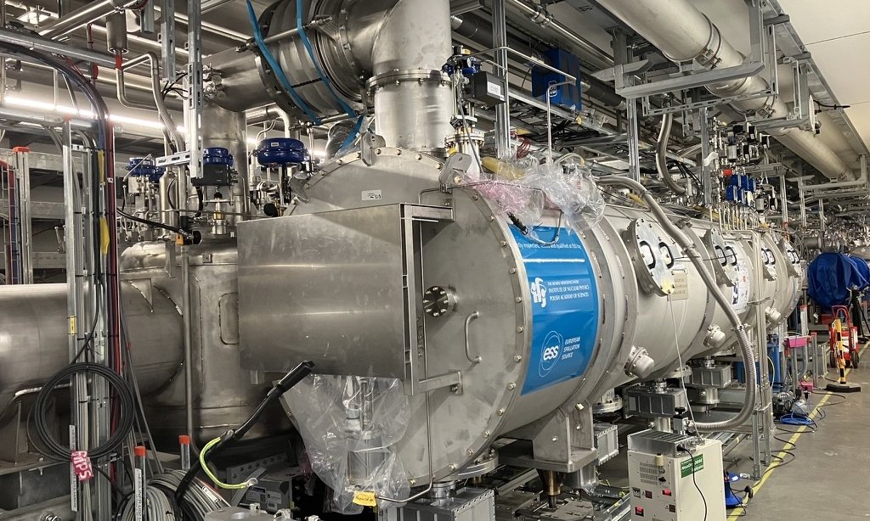
2
Pilot Installation and cooldown

Slide 13
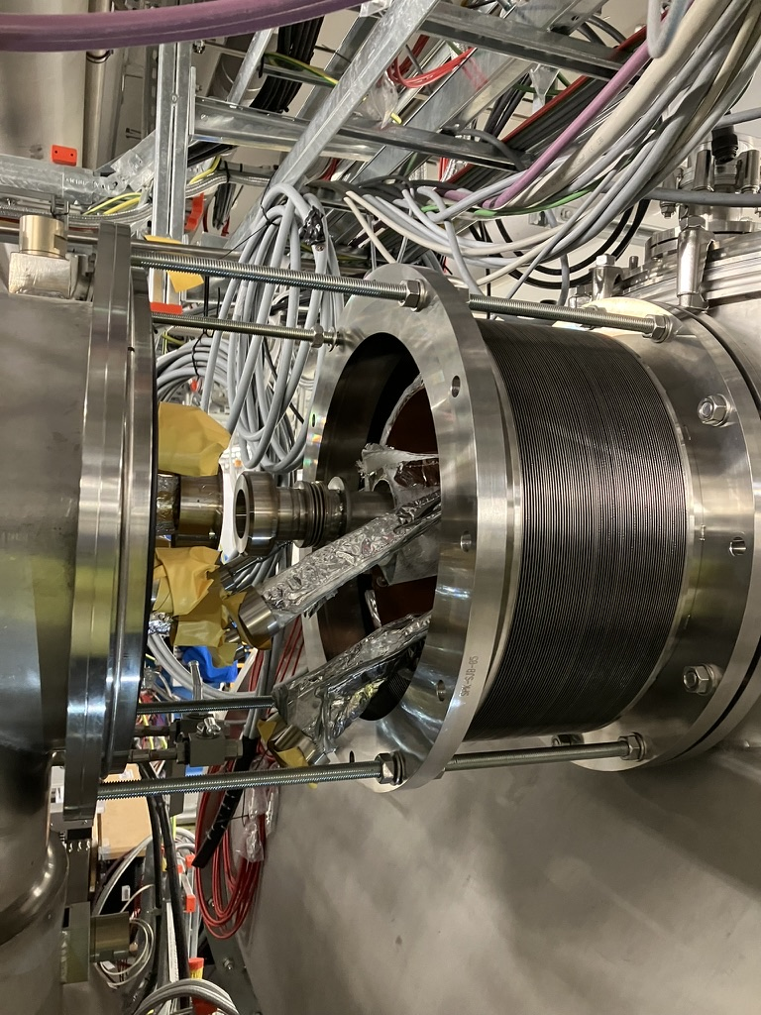
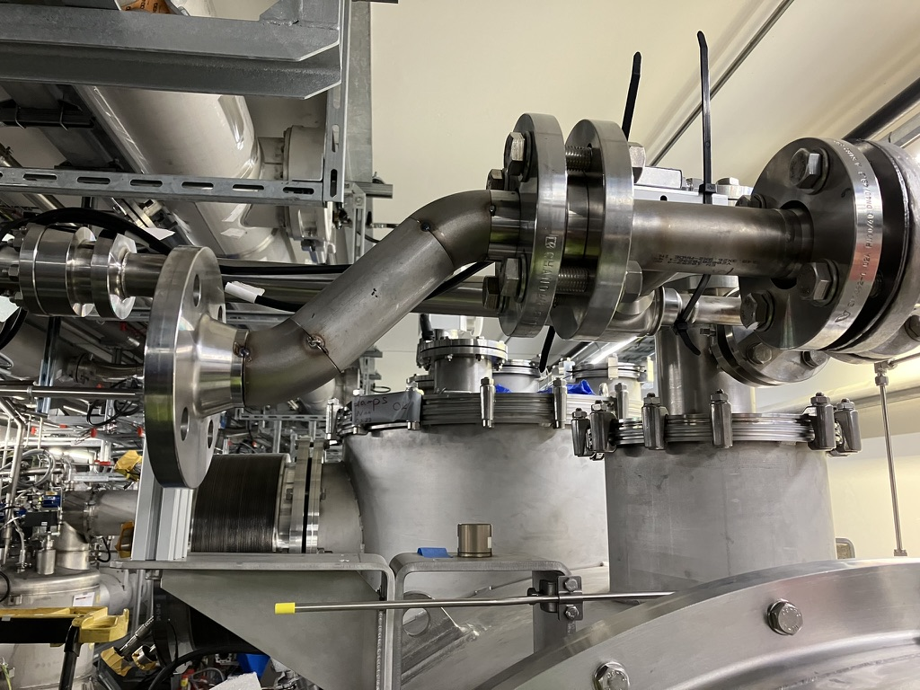
Pilot installation
Credits: H. Przybilski
Setting of installation procedures
From March to June one SPK and one ELL CM were fully installed in the tunnel
  Alignment
  Welding of the CM to VB
  Installation of all support infrastructure
    Connection to RFDS
    Auxiliary He piping (vent lines from burst disk into collector, coupler cooling, He guards
    Water cooling manifolds
    Compressed air
    Cabling
Usual findings
  Collision resolution
  Improve tools/procedure
  Identify correct sequence of assembly operations

Slide 14
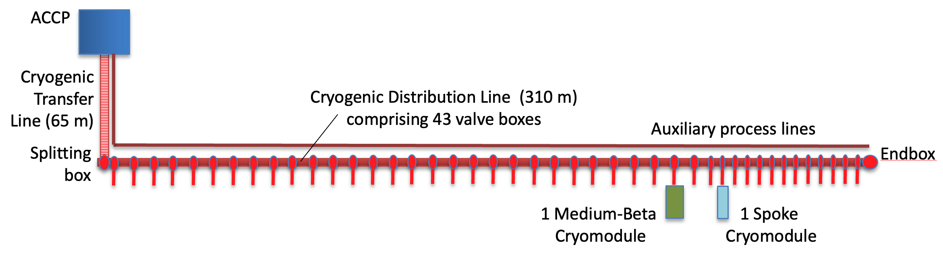
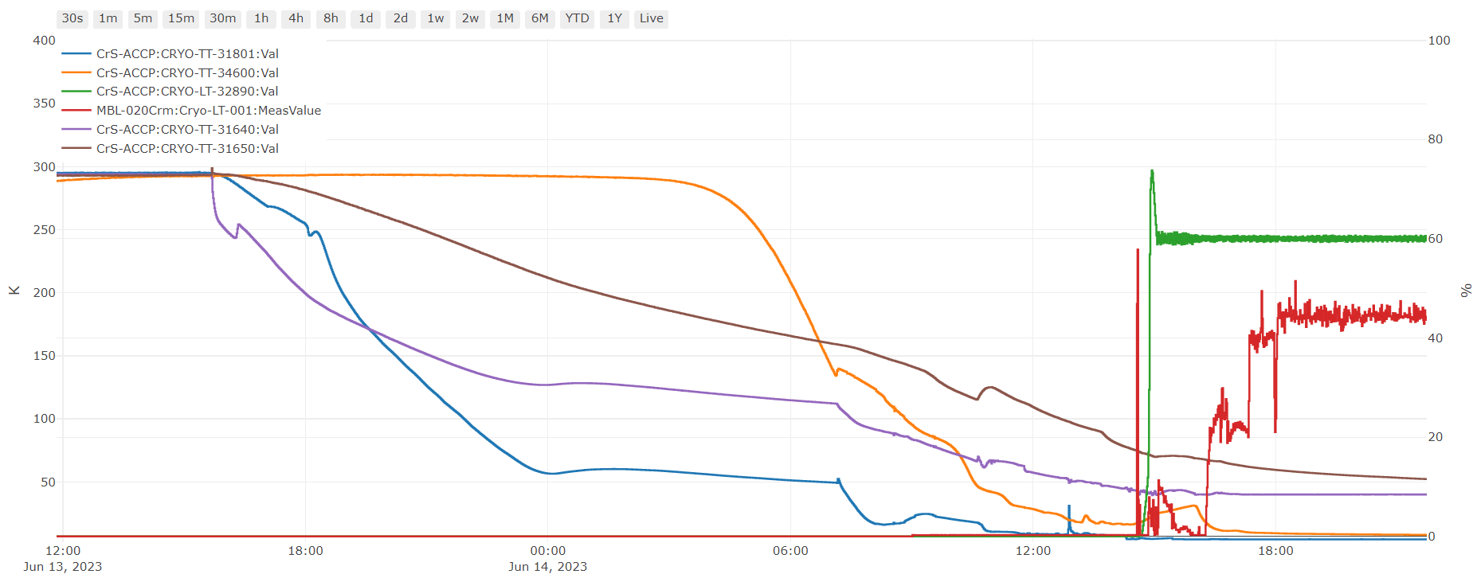
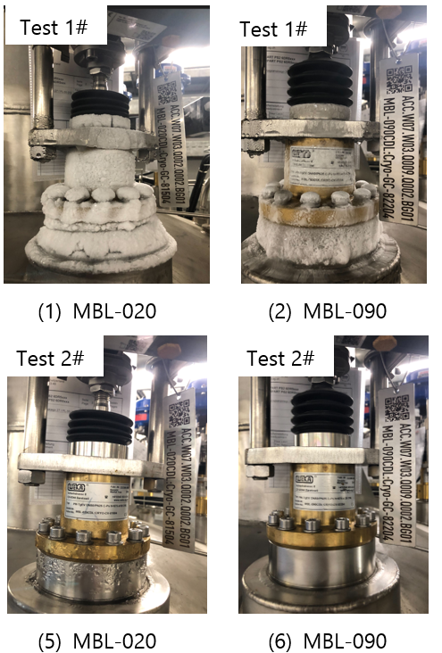
2nd cooldown
ACCP, CDS and two Cryomodules
Configuration at the 2nd cooldown
It took 26 hours to cool down ACCP-CDS
and 2 Cryomodules together
Nominal HL achieved, TAO observed in 1st CD suppressed
VLP return temperature for CDS
Endbox LHe level
TS return temperature for CDS
MBL020 LHe level
TS supply temperature for CDS
26 hours
4K supply temperature for CDS
Temperature trends of 2nd cooldown
Credits: J.Frydrich/P. Arnold

Slide 15
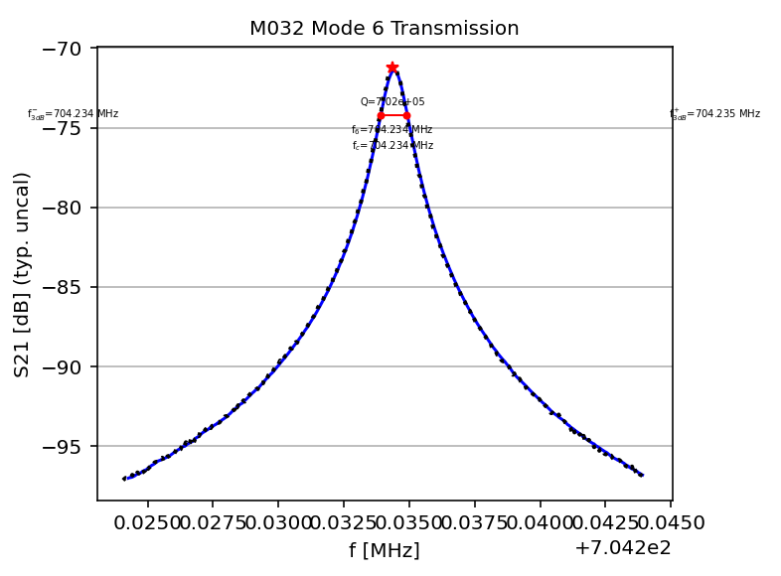
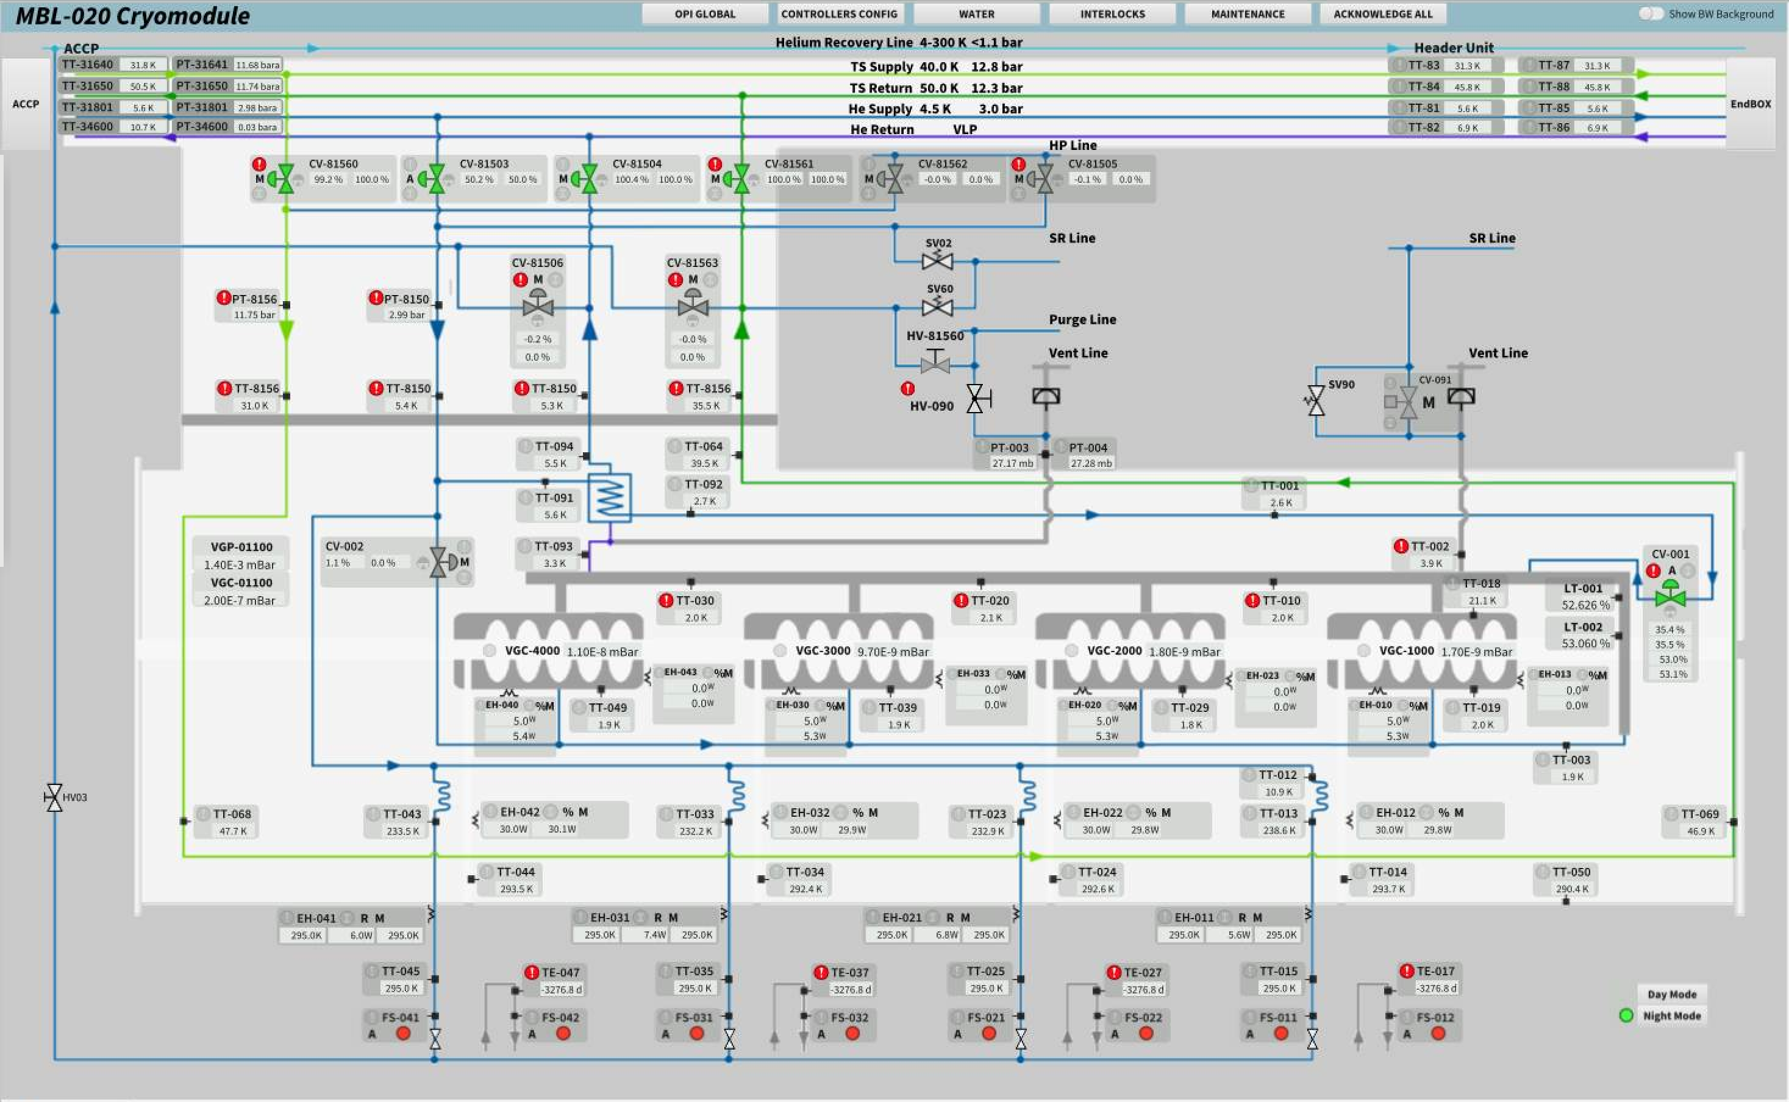
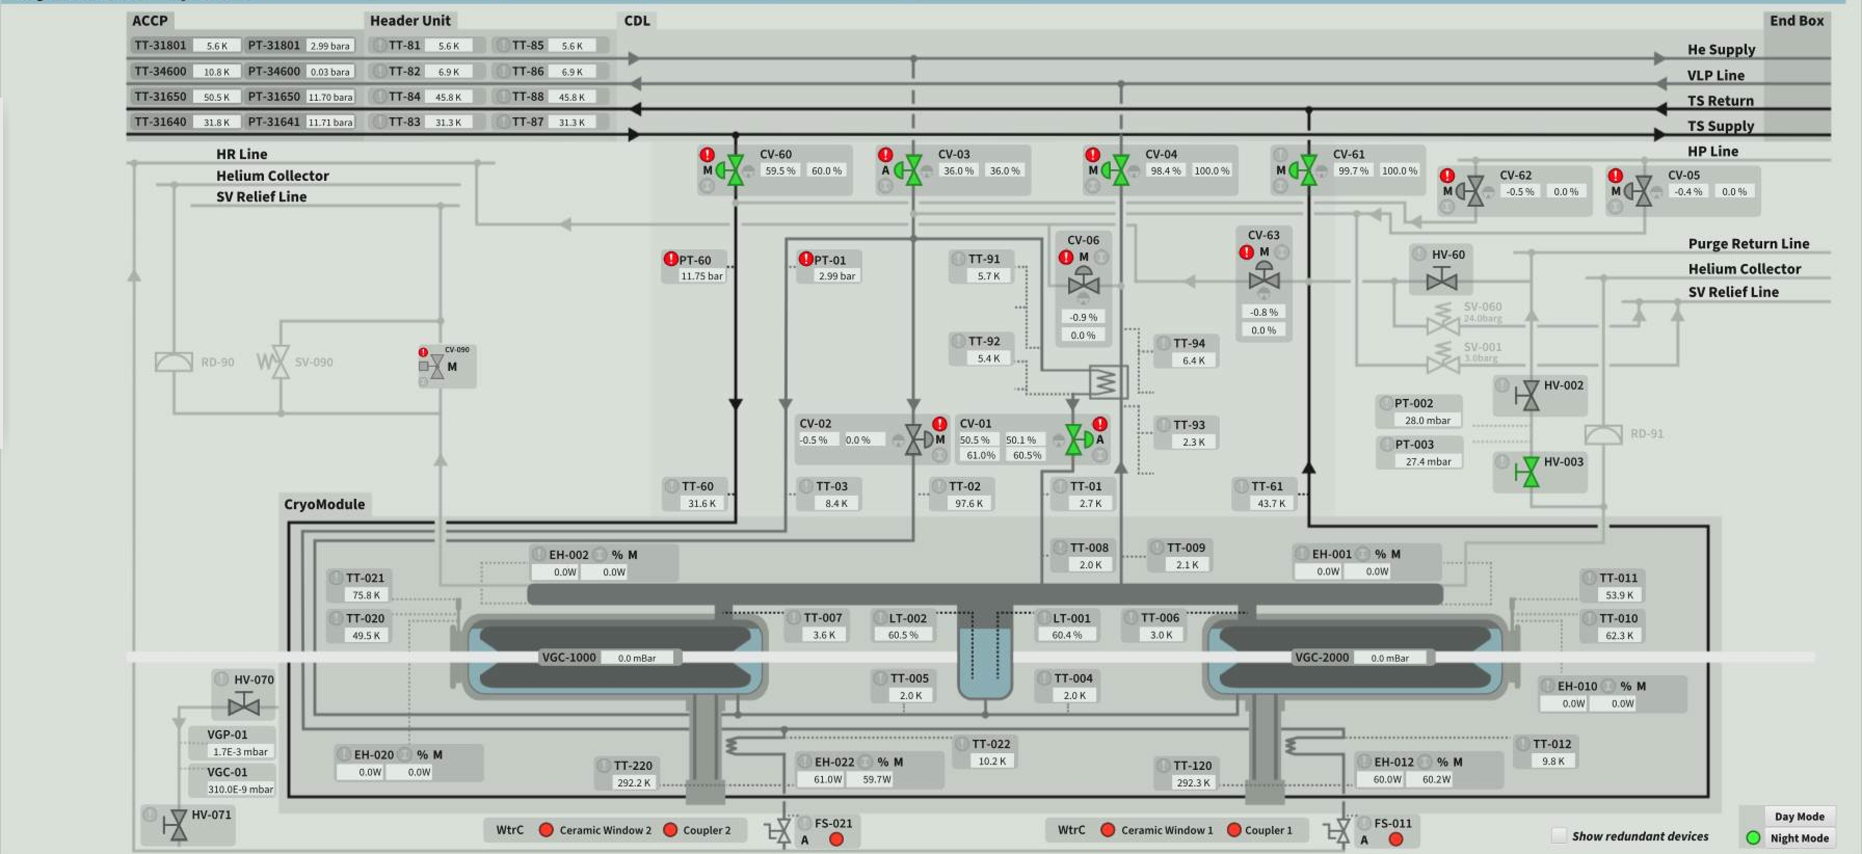
Vertical integration across systems
Credits: N. Elias
Main scope for pilot installation (without license for HP RF)
Building on the experience of TS2 operation
  Achieved 2 K He level control in both SPK and MBL
  Flawless readout of all internal sensors, operation of heater
  Implemented fault tolerance on level sensors
Q_{L}=7.02 10⁵
Cold cavity transmission from klystron gallery
FWHM=1 kHz
MBL-020Crm
SPK-110Crm

Slide 16
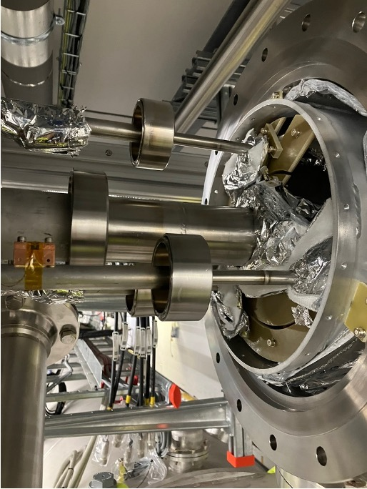
3
CM Series Installation

Slide 17
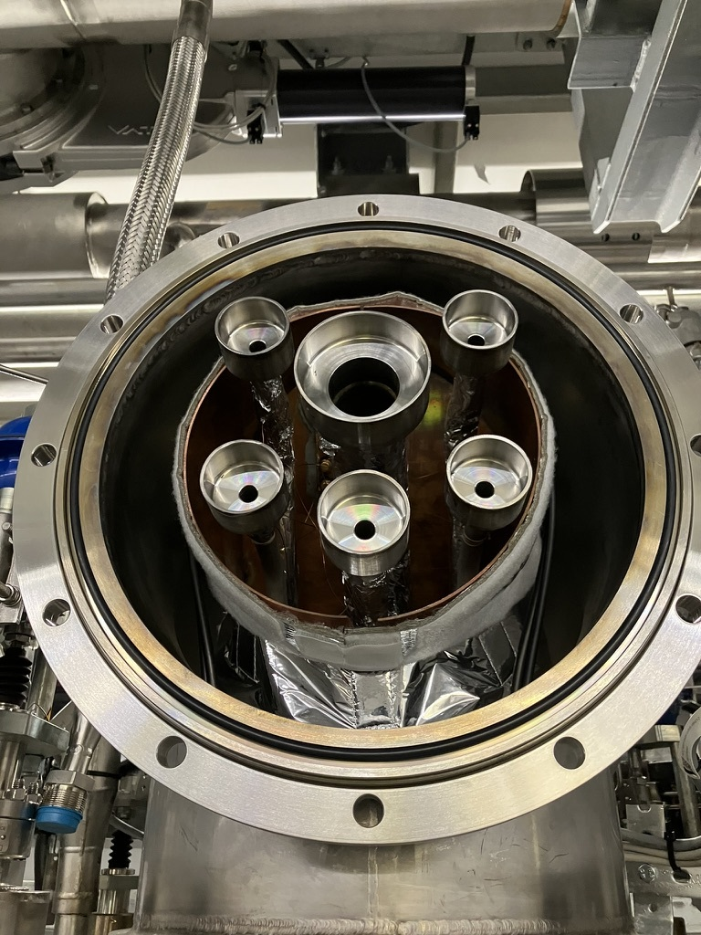
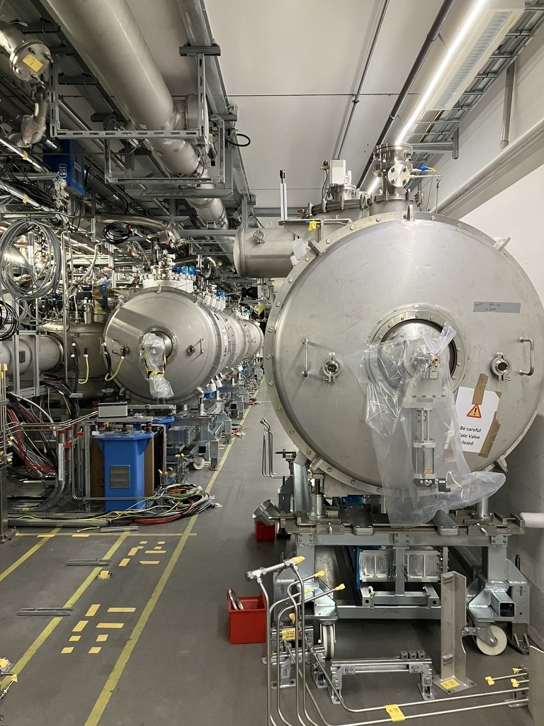
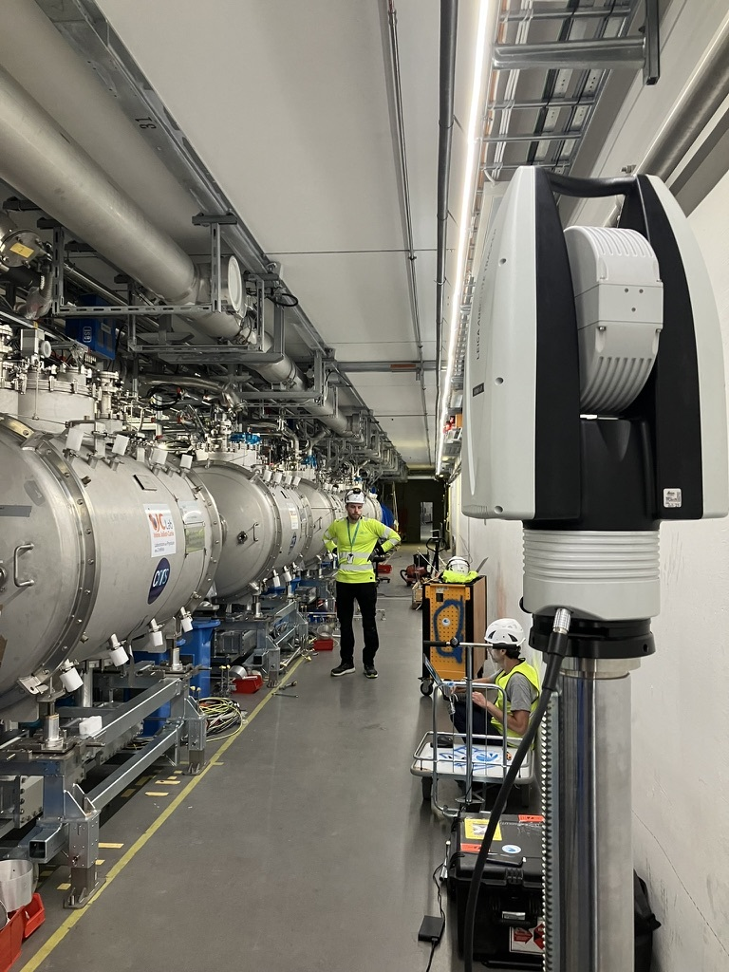
CDS Preparation
Credits: H. Przybilski
Area prepared/cleared, loops opened, module in nominal position

Slide 18
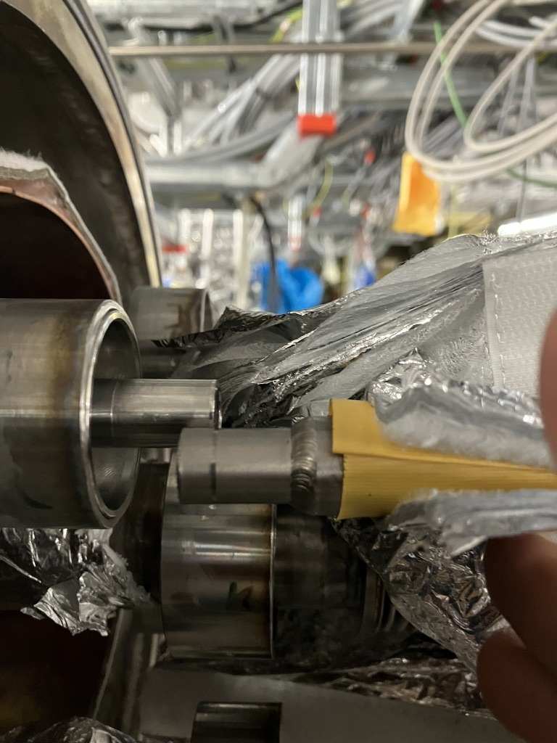
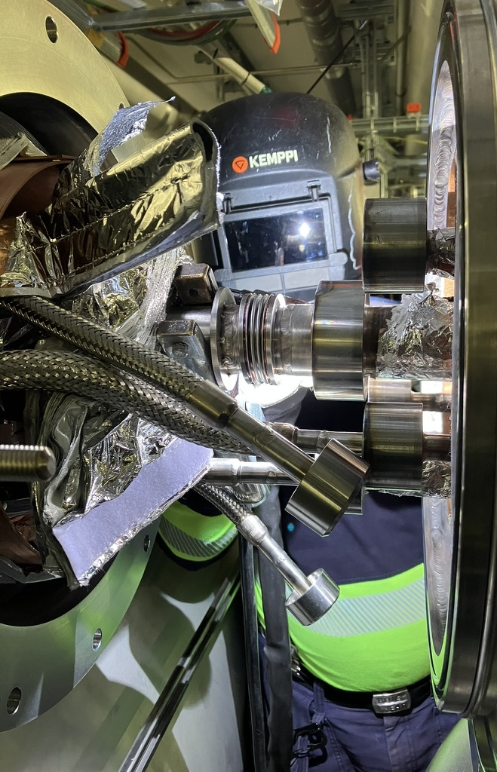
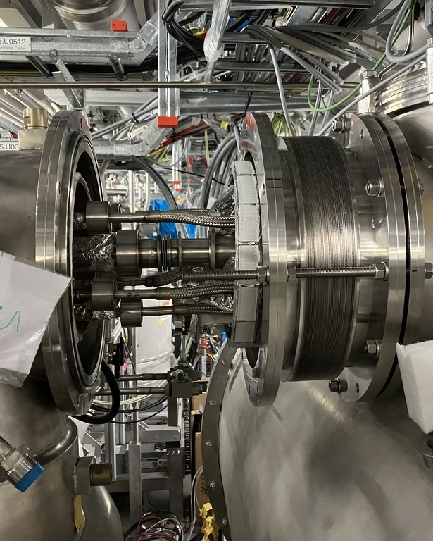
Weld of CM to CDS
Credits: H. Przybilski
Individual “tailoring” of each process line
Additional work to compensate
for a misalignment of the CDS
Additional work to compensate for the CDS misalignment

Slide 19
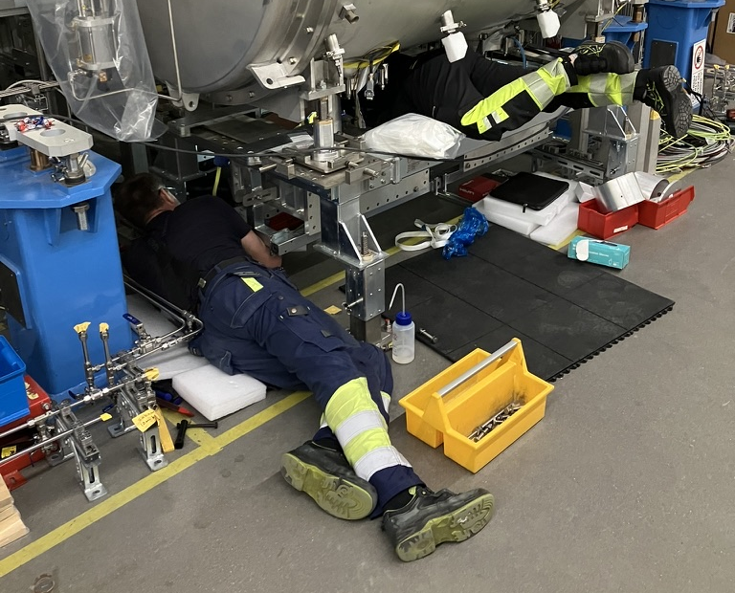
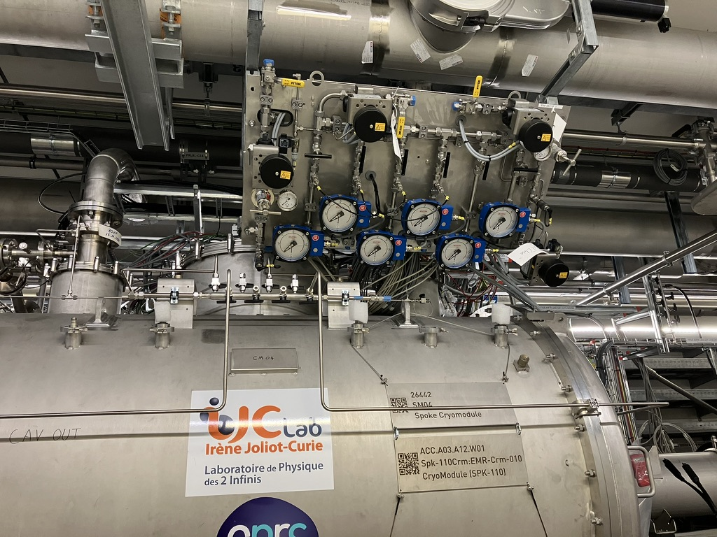
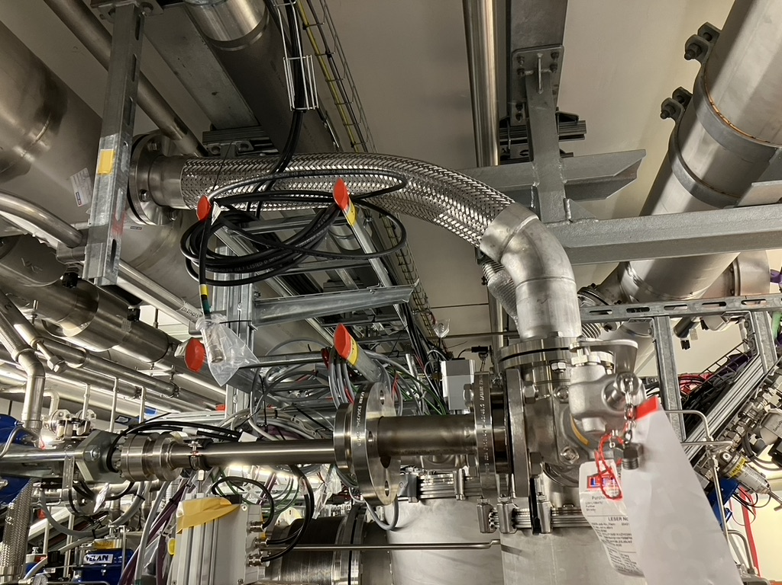
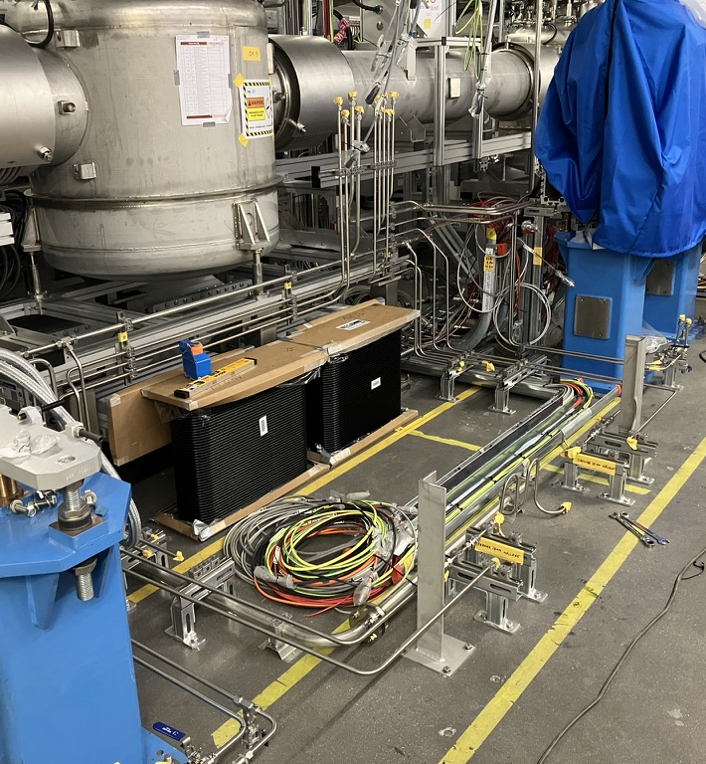
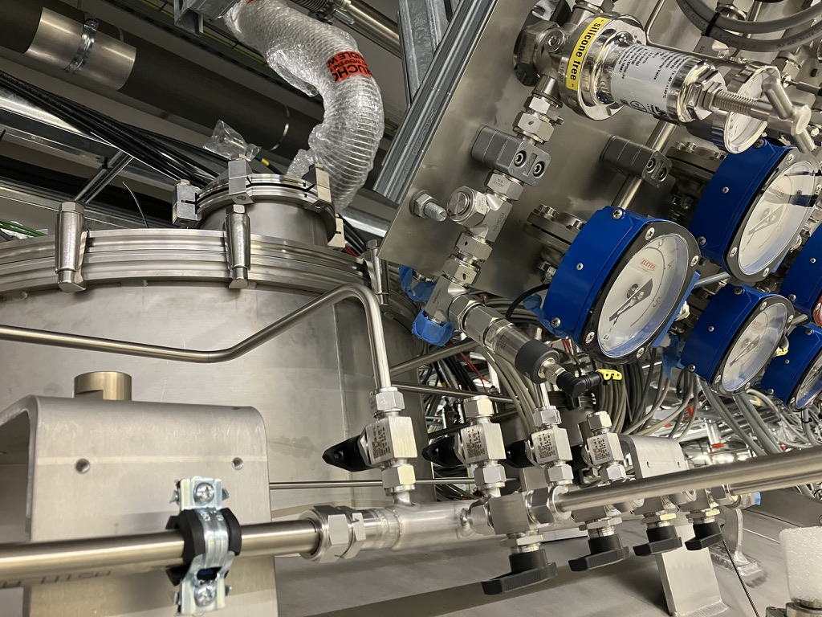
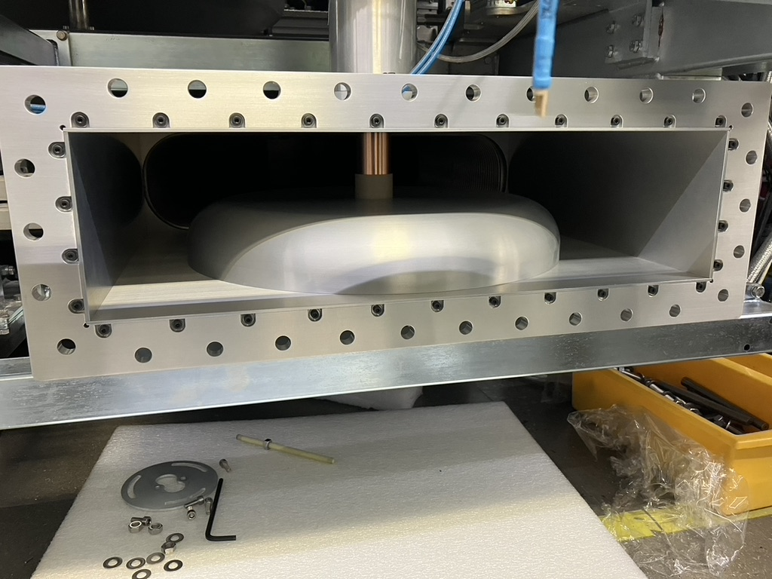
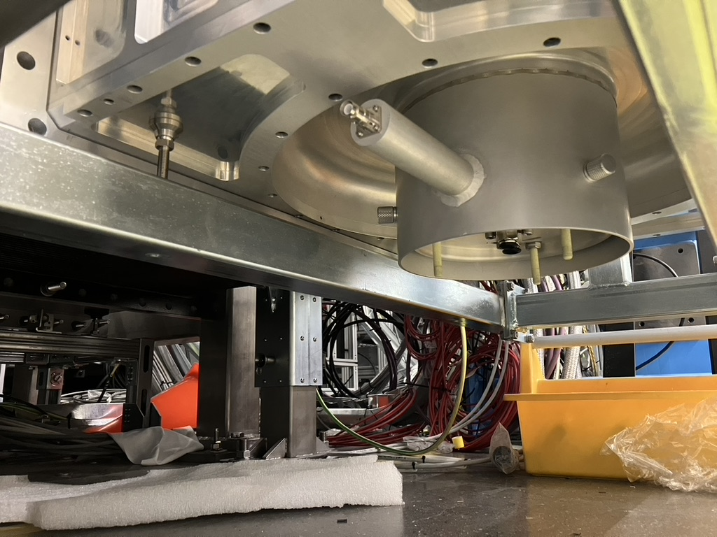
Ancillary completion
Credits: H. Przybilski
To water, compressed air, vacuum manifolds, He collector line, rf
Water manifold
Cryo connections from RD
Pilot installation was extremely important
Pilot: 2 months
12 CM: 5 months
Full scope in Jan 2024
Vacuum-Isovac angle valve
Doorknob assembly
Coupler bias feed/rf choke

Slide 20
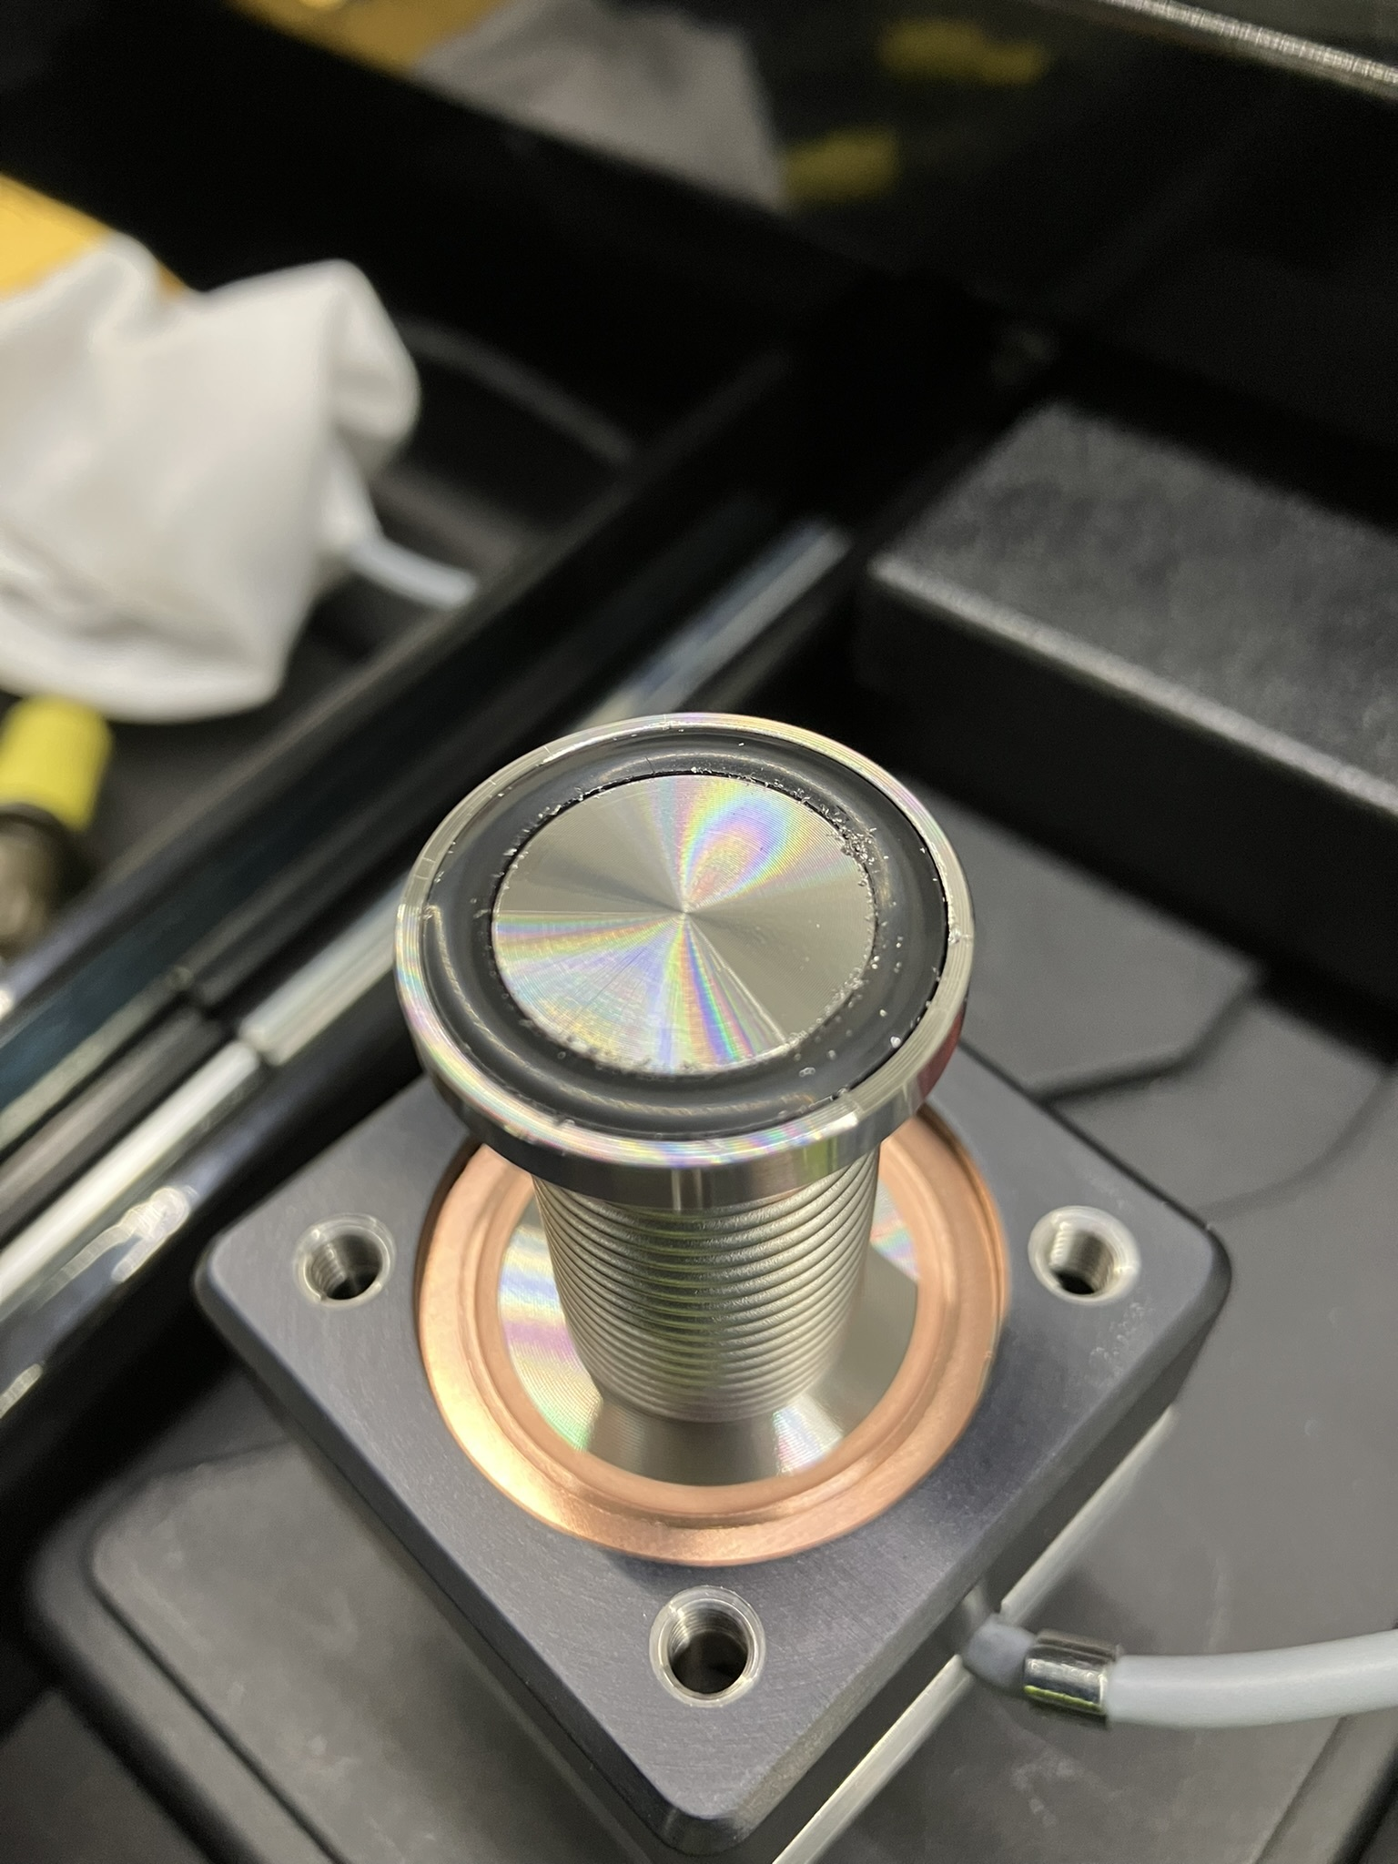
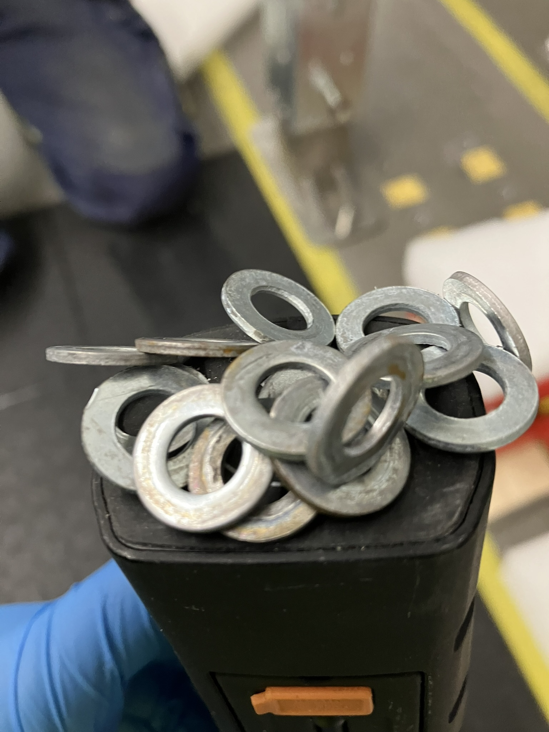
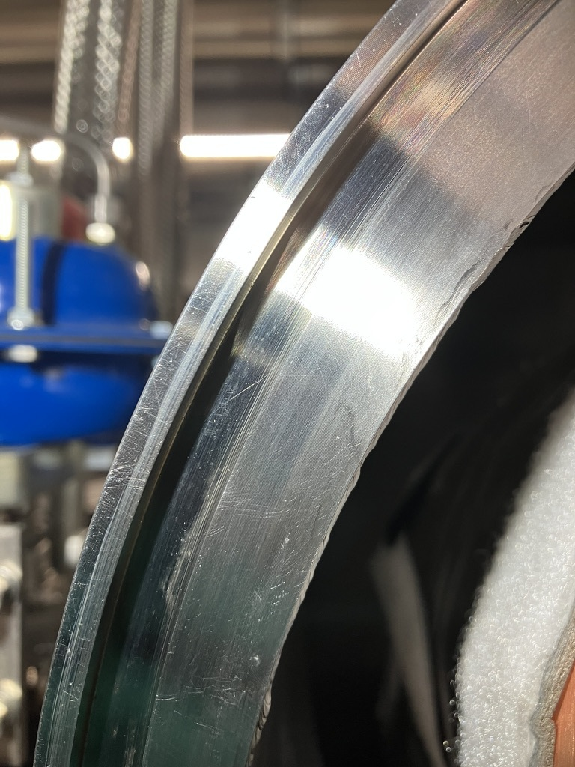
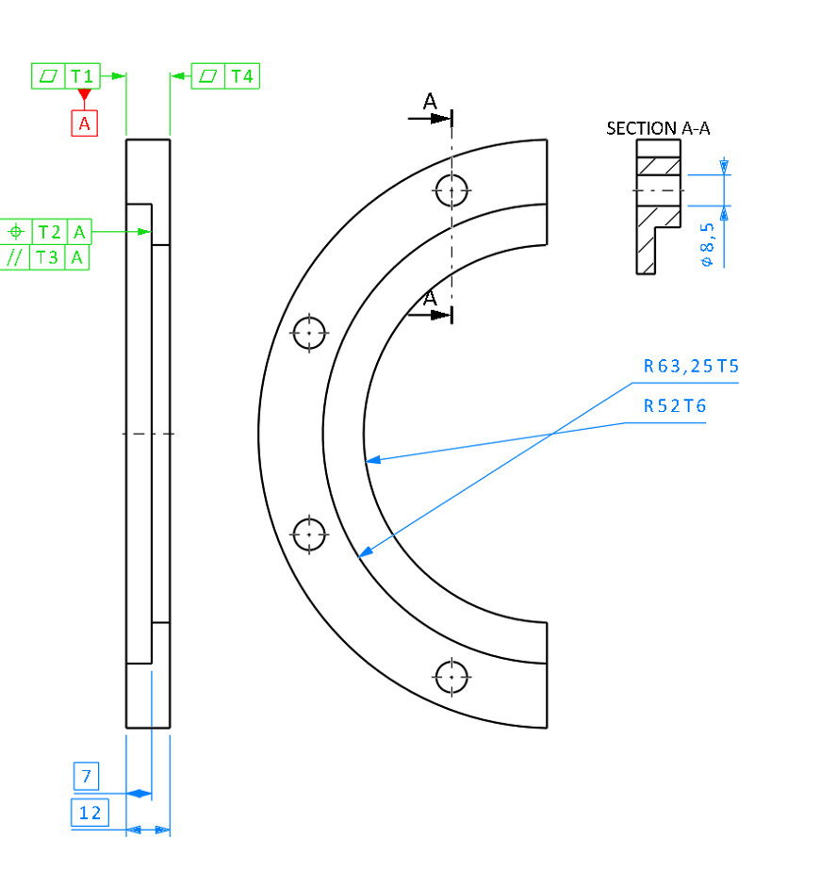
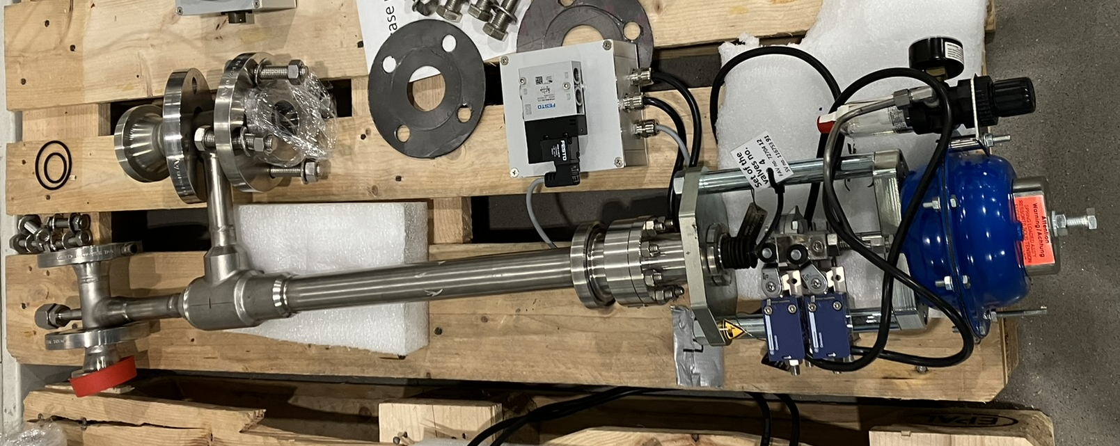
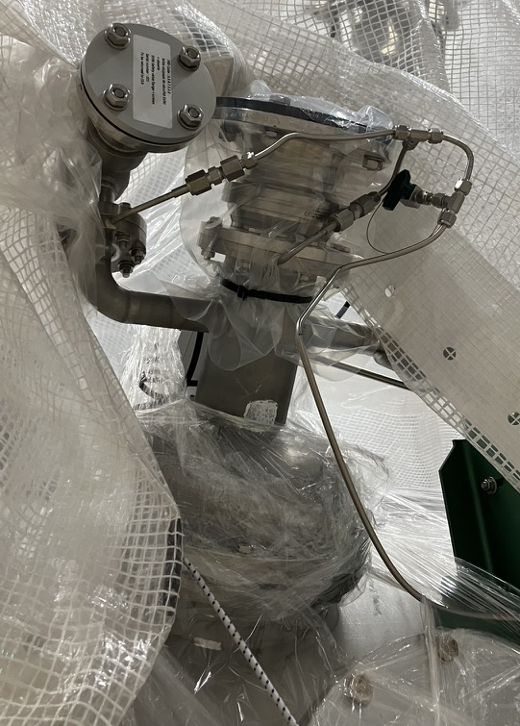
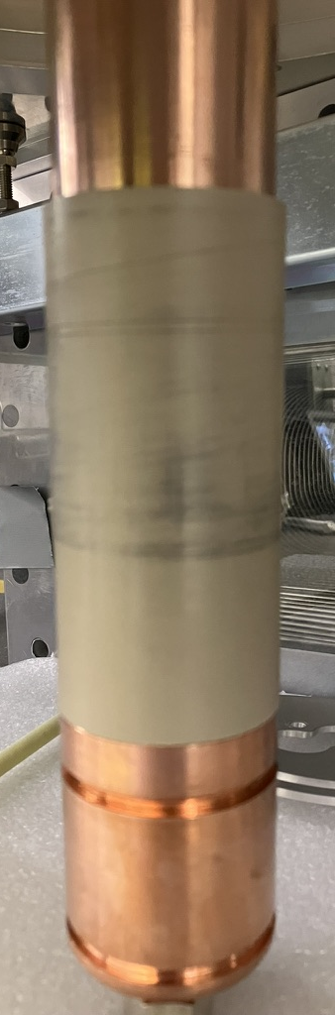
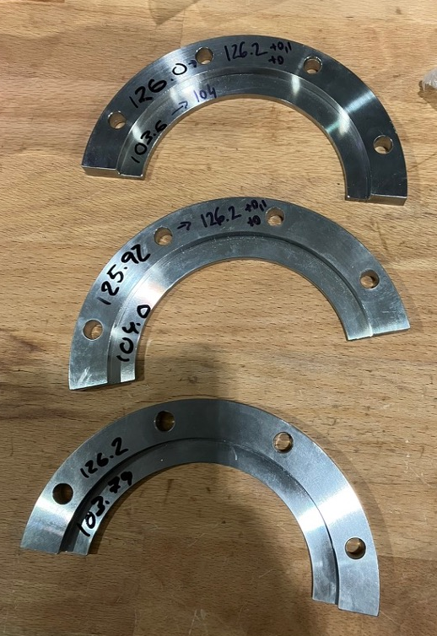
Non conformities during assembly
Credits: H. Przybilski
Usual amount, requiring corrective actions due to lack of QA handover
Dirty Valves
Wrong material
grade(rust)
Damage to He Guard piping due to collision with scissor lift by contractor
Workshop
machining on
components
that were
integrated for
the first time
at ESS, e.g. DK to allow stress-free installation
Scratches
Cleaning and refurbishing of all 2K environment protection valves (leaky)

Slide 21
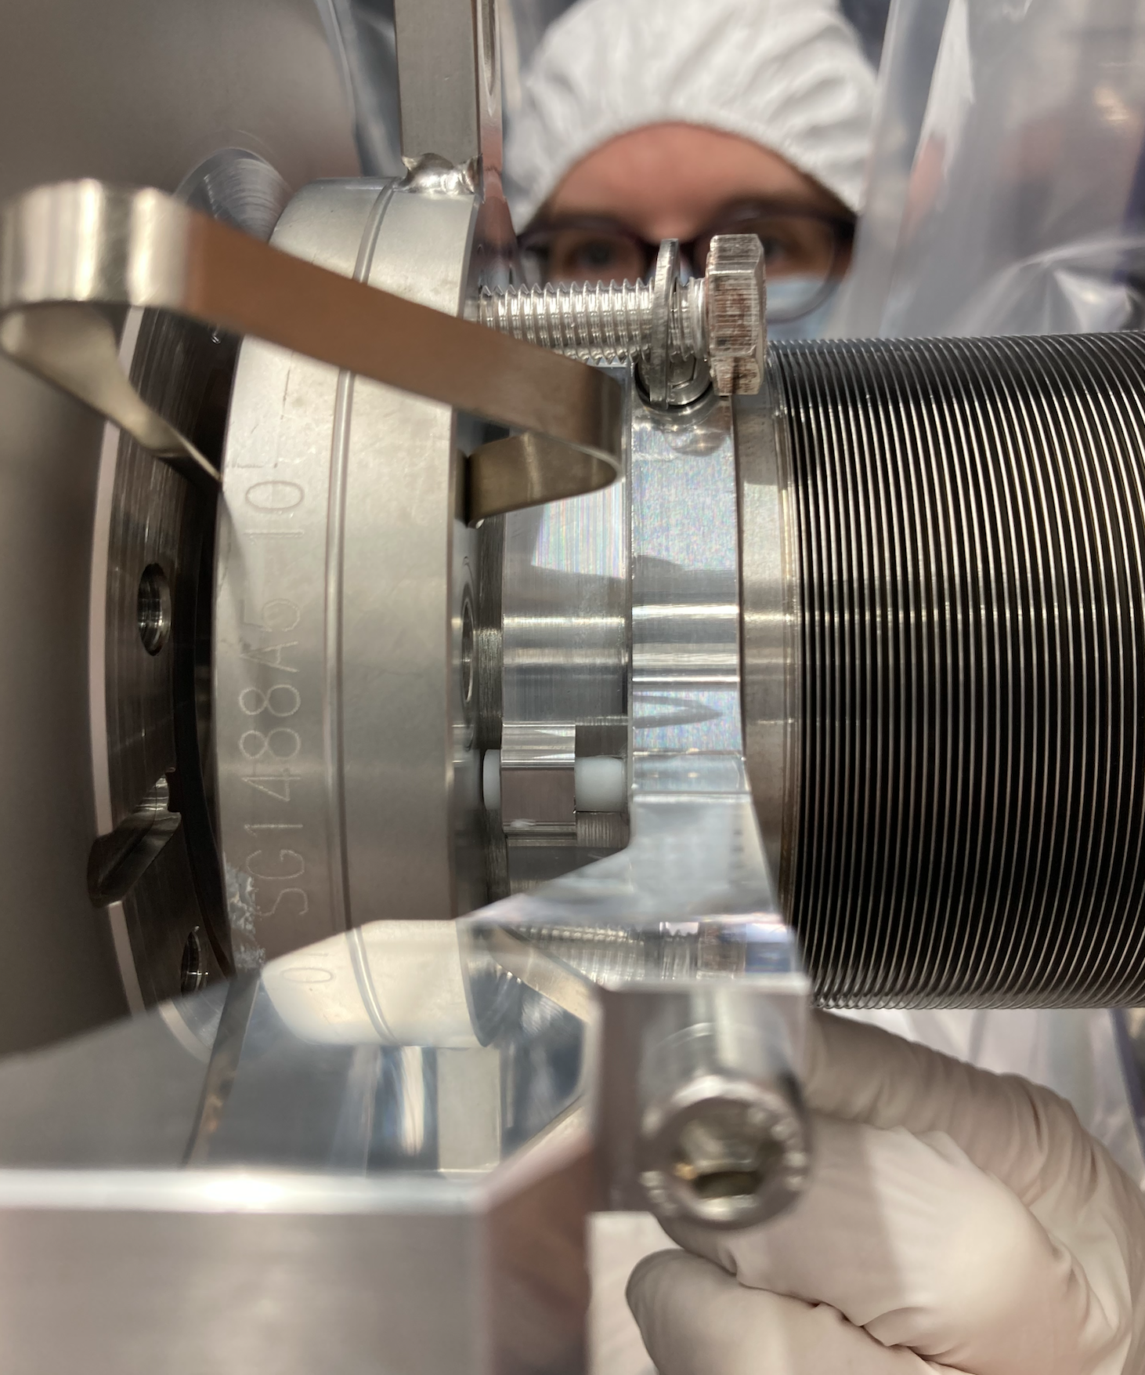
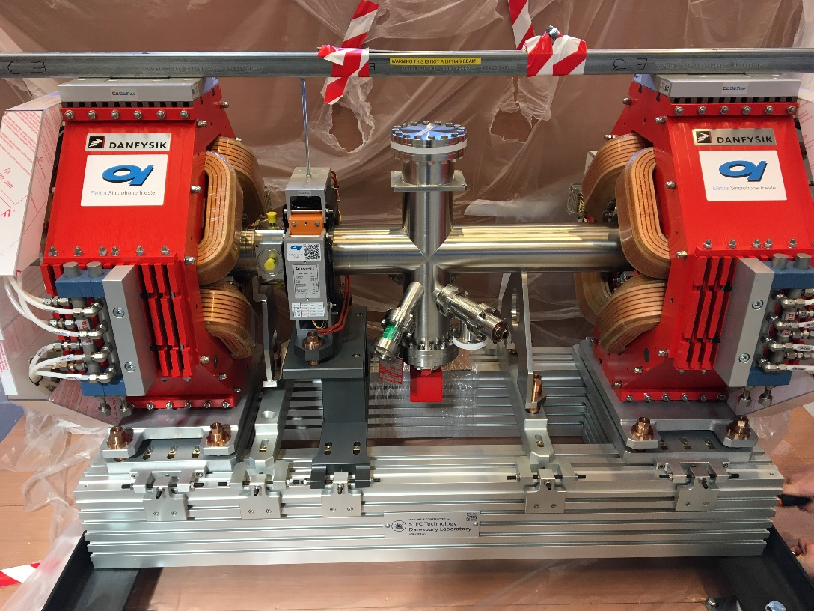
4
Linac Warm Units

Slide 22
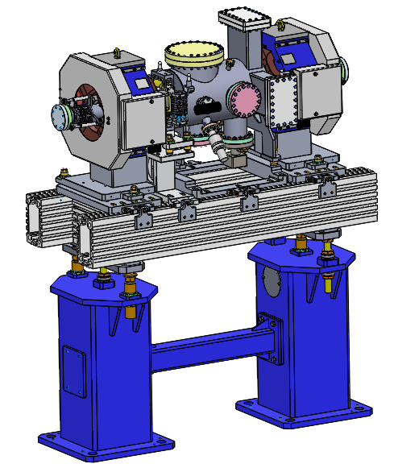
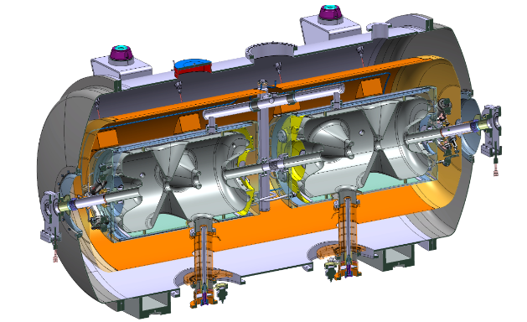
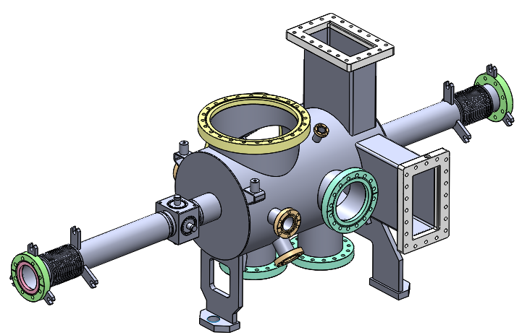
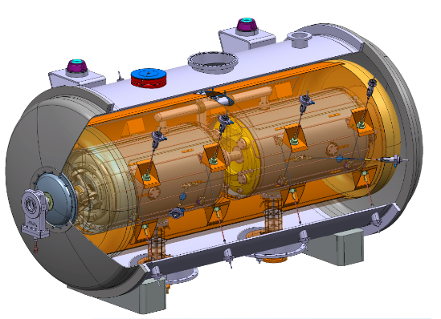
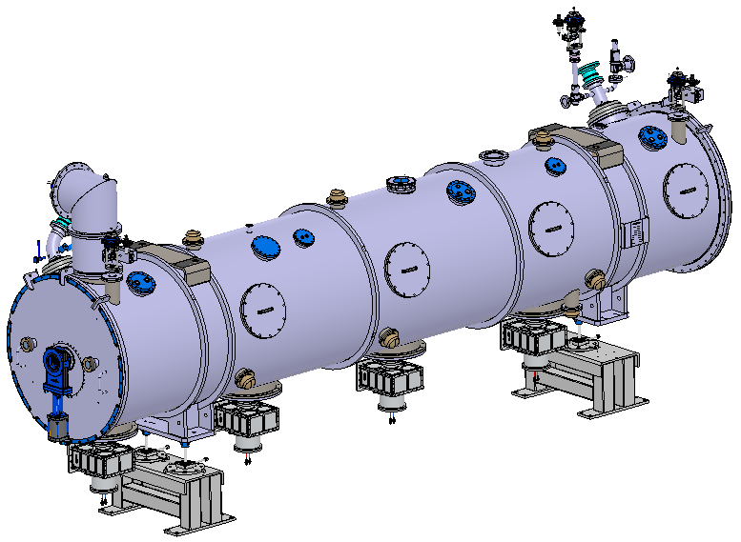



Particle free systems
Credits: A. Gevorgyan
In spoke and elliptical, the LWU beam pipes follow particle free workflow
Linac
Warm
Units
Doublet, steerer, BPM and Beam Diagnostics
Cleaning and assembly in ISO 4 clean room!
Cleaning and assembly in ISO 5 clean room!
(And some include wire scanners and insertable beam stops)

Slide 23




Procedures for all metal gate valves
Credits: A. Gevorgyan
From testing and handling
ISO 5 cleanroom equivalent
Test
@ESS
ISO 2 cleanroom equivalent
Inspect valves before
integration
Early issue!
Coupling nuts were removed during cryo module assembly
They are unique for each valve, although they look the same
Block of the rod during long-term transportation
Photos by Pierre Bosland,
CEA, Saclay.

Slide 24







Use of NEG pumps in LWU (ZAO alloy)
Credits: A. Gevorgyan
CM volume is pumped through LWU
Cleaned and assembled in ISO 4
ISO 6 equivalent. As received before activation
ISO 6 equivalent. After 1st Activation
Images by D. Hardion and T. Cornes. ESS
ISO 3 equivalent. After 4th Activation
2nd and 3rd activation show ISO 6 compatibility

Slide 25


NEG ZAO Transport test
Credits: A. Gevorgyan
Uncontrolled transport (no damping, no shock monitoring)
Before transport test, cleaned for ISO 4
After transport test ISO 4 is preserved
In-vacuum transport is better than N2. Van der Waals forces help.
Even though the NEG pump generates particles, in vacuum, they will fall down (gravity) and do not move …orientation and location of pump is important. Note: severe vibration is still a problem.
Only laminar gas flow during venting or pumping vacuum systems. Maximum flow 3l/m. Delta P=1mbar.

Slide 26
Qualification of assembly conditions
Credits: A. Gevorgyan
Tunnel setup, with concurrent operations during major piping assembly
High numbers of particles are due to the
counter installation (multiple entering/exiting the room).
Particles settling slowly …yes, a day or two is needed!
Major impact, due to welding, grinding, cutting activities.
Source is 5-8 meter far from the clean room.
Barrier off the zone at least a day before…
Running cleanroom is important… to maintain the cleanliness
Cover with plastic dirty parts.

Slide 27


Installation ongoing
Credits: A. Gevorgyan
9 LWU in SPK area, 4 connected and pumping currently CM
Achieved 1E-8 mbar vacuum conditions in a couple of days from static conditions of CMs at 1E-2 mbar
Wire
scanner
unit
NEG
ZAO
NEG
ZAO

Slide 28
Summary
Delivering 2 MW beam capability (870 MeV, 62.5 mA) in 2024
The installation of the SRF linac is ongoing at a fast pace
Presently: 13 SPK,5 MB CM and 9 LWU are being integrated in the tunnel
Installation of all 13 SPK, 9 MB and 5 HB, and all LWU between them, to achieve a 2 MW capability, will be complete by May 2024
Cooldown of the entire linac is scheduled for August 2024
Beam commissioning on the beam dump (BOD) is foreseen in October 24 after
  Conditioning and technical commissioning of all SRF equipment
  Fullfilling all administrative steps to obtain beam licence from authorities
Beam commissioning to the target (BOT) is foreseen in Mid 2025, after obtaining the licence for Intentional Neutron Production from authorities

