Slide 1
LCLS-II Installation Experience and Lessons Learned
Dan Gonnella
LCLS-II SC Linac Commissioning Lead
LCLS-II-HE Installation & Commissioning System Manager
On behalf of the LCLS-II Collaboration
5 December 2023

Slide 2
FACET-II

Slide 3
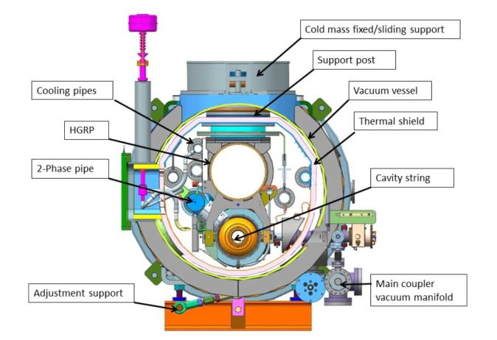
General Installation Flow
6 Major Install Phases
Unloading
Receiving / acceptance testing
Physical installation / alignment
Welding cryogenic pipes
Particle free beamline install
Insulation vacuum / cryogenic equip.

Slide 4
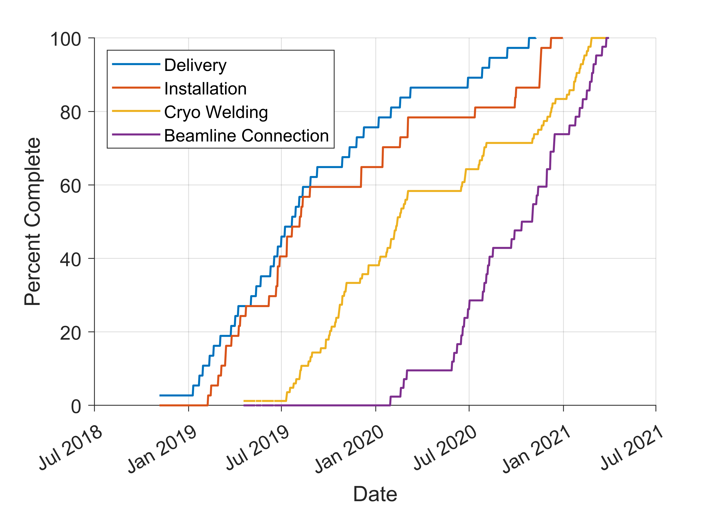
Installation Over Time

Slide 5
Enhanced Work Planning & Control
Category 1: Minimum Work Planning Quality Control Requirement
1. Design/Process FMEA (with key actions/mitigations integrated into the design and/or process as needed)¹
2. Assess Hierarchy of Controls to ensure defense in depth (to avoid overreliance on Administrative controls alone)
3. Version-controlled procedures (in CDMS)
4. Roles and Responsibilities Documented
5. Personnel Identified and Qualified (including Authorized Worker and Authorized Oversight person)
6. Area Preparation Checklist
7. Tool/Fixture/Material Checklist
8. Practice Run with test plan
9. Job Specific Travelers (e.g. per Serial No.)
10. Evaluation, review and approval of items #1 through #9 by LCLS-II System Manager, LCLS-II Installation Manager, LCLS-II Installation Coordinator and SLAC Contractor and Quality Assurance, Respective Functional Administrative Manager
11. Pre-Task Readiness Kickoff Meeting (prior to each first unique instance)
12. Notify LCLS-II Project Director or LCLS-II Project Manager one day in advance of start of work
13. Current SLAC Permits, Work Release & Tailgates applied
14. Human Performance Error Pre-Cursor review at Tailgate
15. Post-Task Debrief Memo (after first unique instance)
Over the last 5 years, SLAC has had a paradigm shift to “enhanced work planning & control” – increased rigor on high consequence activities, identification of risks (to workers and equipment), etc.
As part of this, “Categories” were defined based on potential impact of issues
CM Installation was defined “Category 1” – the level requiring the most rigor
Apply FMEA methods (1) in several places to mitigate risks:
Vacuum system component selection and placement
Vacuum system controls sequencing for startup, shutdown, operations, service, off-normal events
Operational Procedures for linac vacuum system startup, shutdown, operations, service, off-normal events
Address FMEA findings in design and/or process (1)

Slide 6
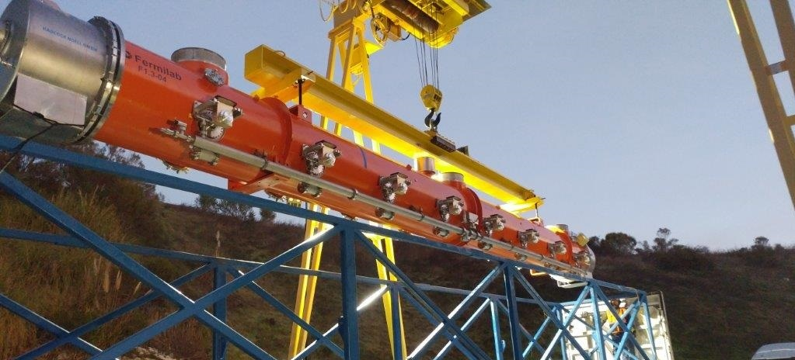
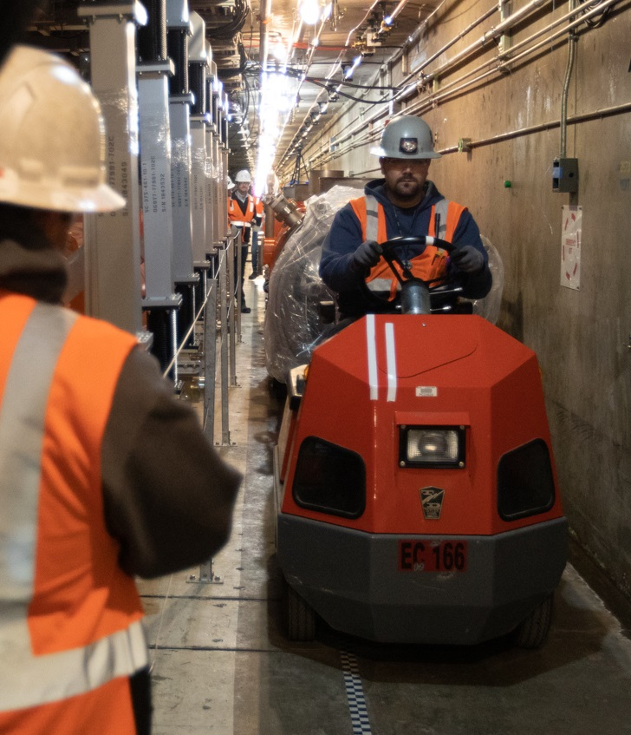
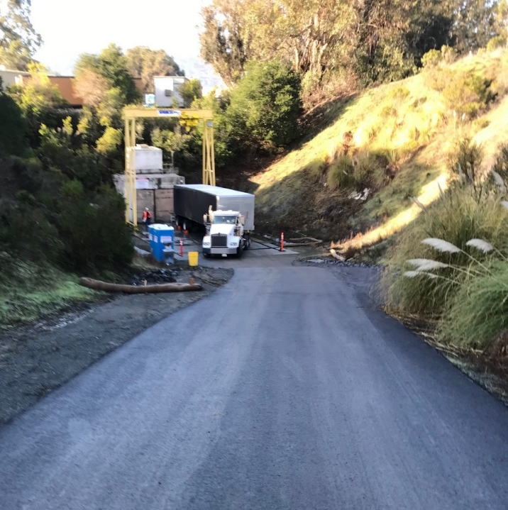
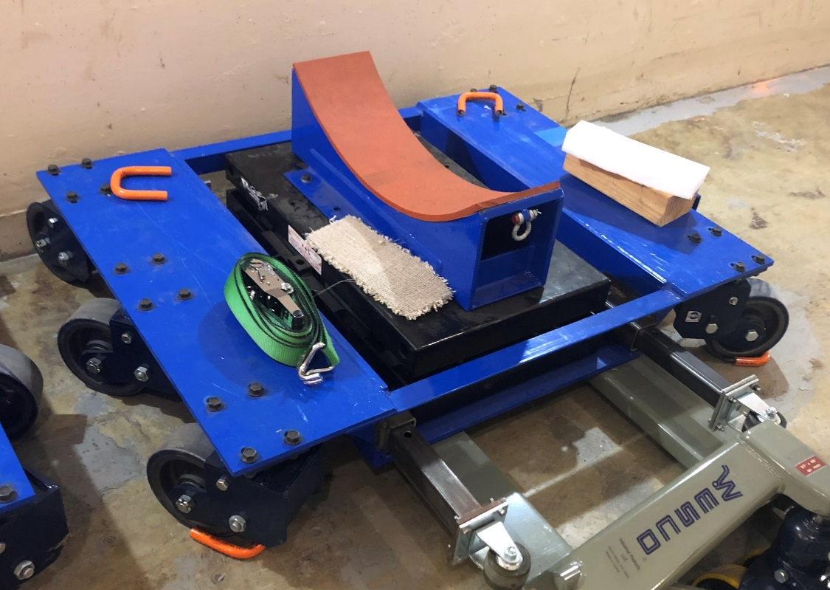
Delivery of CMs and Placement on Stands
Cryomodules were delivered from FNAL and Jlab directly to the “Sector 10 Adit”
CM was removed from the shipping fixture and placed on transport dollies
CM pulled down the tunnel by a tugger and then placed on the stands for alignment and remaining work

Slide 7
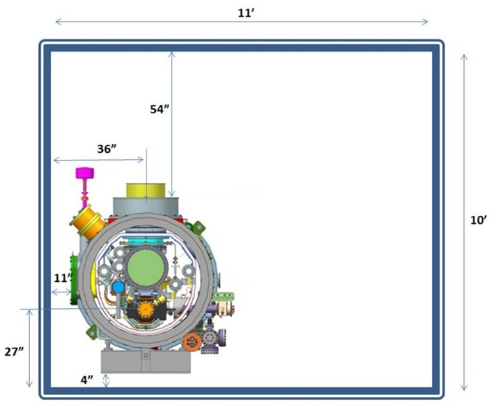
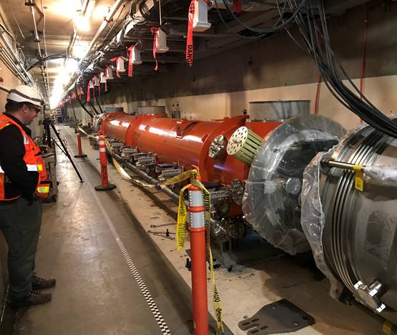
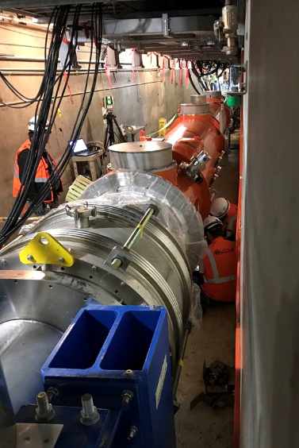
Cryomodule Interconnection Challenges
LCLS-II/SLAC configuration is different from other existing linacs
No cryogenic line separation between adjacent CMs
Continuous cavity strings (no warm sections between CMs)
Workspace constraints
Proximity to the Tunnel wall
Height of the beamline
Many but not all XFEL approach and techniques were applicable:
Welding: Adopted nearly all techniques
Vacuum beamline: Height and workspace is very different from XFEL
Cannot re-use tooling, but can re-use many of the best practices/techniques
Neither LCLS-II Partner Labs had performed the SLAC CM interconnections (procedures mostly developed on our own)
Wall workspace
Aisle passage

Slide 8
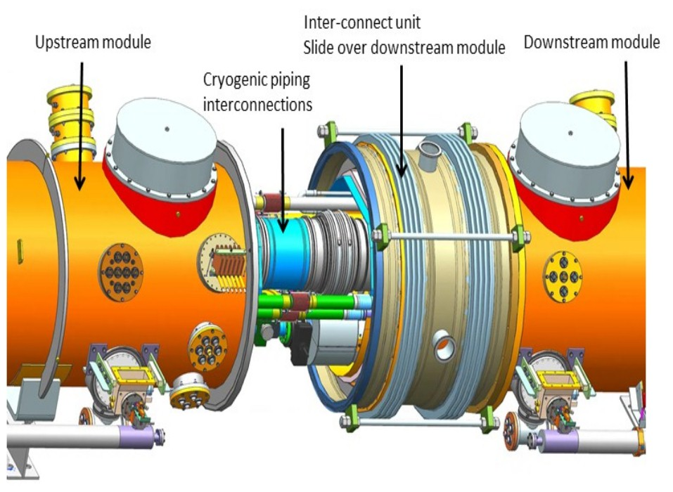
Cryomodule Interconnection Overview
Bellows interconnect unit between two modules or between an end CM and Cryo Distribution End Cap (EC) or Feed Cap (FC)
850 mm between CMs, but 700mm working space with Bellows installed
Interconnections include welding 6 cryogenic pipes in situ and UHV/particle free connection of HOM Absorber/BLA in beamline
Beam
HOM Absorber (Beamline Assy – BLA)

Slide 9
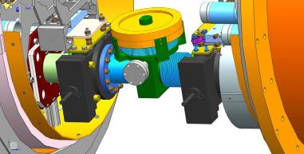
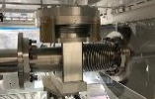
Particle Free Beamline Connection Challenges
The task is: Insert the drift or BLA assembly that connects the 2 beamlines and maintain ultrahigh vacuum (UHV) and low particulate (“particle free”) under particle free (PF) conditions throughout the installation
Many Different Types of Connections: CM-to-CM; CM-to-Cap; Cap-to-CM; L3 Break-to-CM (“Cap” = End or Feed)
Constraints that make the operation very difficult:
BLA weighs about 40 lbs
Height of beamline
UHV/PF condition
Dirty tunnel
Proximity to tunnel wall
Portable cleanroom: must fit and include a lifter, must support ISO-4 (Class 10) conditions
BLA assembly (HOM absorber)
Pump-out port
Gate valve of upstream CM
Gate valve of downstream CM
“Floppy” bellows
Fixed-to-fixed

Slide 10
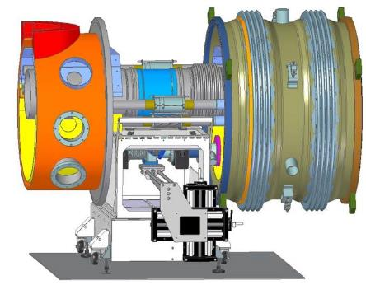
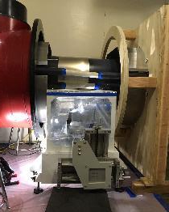
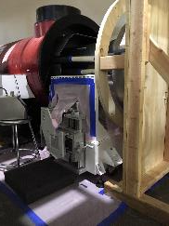
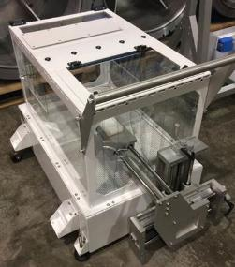
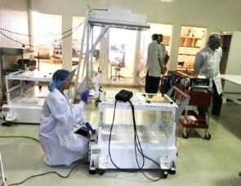
Making the Beamline Connection
Beam
Portable cleanroom with lifter
Fan filter unit blows from below
BLA is moved inward, then upward
Very low to ground!!
BLA enters from Aisle
Tech attaches from Wall side

Slide 11
WPC → Iterate on BLA Installation Process
Leak found
Prepare Work Area
Inventory/ Prepare BLA
BLA loaded in Clean Zone
Install: Expose CM/BLA beamline
Pump out, leak test BLA
Pump out “new” CM
Open to “old” CM
vacuum
Remove Equip-ment
Clean environ-ment
Deliver BLA
Place on stage
Remove BLA flanges
Check pump cart readiness
Open “new” CM Gate valve
Lesson: Sequence matters
PF Cart
Verify stage motions
Clean Zone(s)
Masking
Inspect BLA
Inspect BLA Interior?
Inventory equip-ment
Connect pump cart
Unbag first layer BLA
Remove Shipping Restraints
Remove CM flanges
Pump out, leak, RGA test BLA
Prior to FMEA
Complete Mechanical Install
Setup Clean-zone(s)
Final preps before uncovering
Move BLA to CM fixed
Unsuccessful pump-out
Install Thermal Strap
More QC at Gauge Tree Removal (Receiving)
Add bellows restraint
Connect BLA-CM fixed
Lesson: We need “Un-do” Procedures!
Close CM GV
Install Spring Bracket
Check masking
Remove bellows restraint
Close BLA right angle valve
Lesson: We need to and can drive to prepare well
Lesson: Add 3rd person for QA/QC
Check gaskets
Connect BLA-CM rotatable
Stop & notify
Clean
surfaces
Following FMEA
“Interrupt” Work
Lesson: highest time critical step!
Want as short as possible to minimize exposure of beamline AND to minimize ergonomic stress

Slide 12
Installation Issues: Non-conformances
NCR Topic | # CMs | # ICs | Details | Disposition
Mechanical Inspection | 52% | NA | Minor damage to Mag Shield / Issue with bellows | Rework at SLAC / Use-as-is
Beamline Vacuum | 17% | 9% | F1.3-12 Venting / Very small ceramic leak on F1.3-18 / Minor issues with pressure / Condition of BLA | Rework at PL / Rework at SLAC / Use-as-is / Replaced BLA
Coupler Vacuum | 14% | NA | Warm Coupler required pump-down | Rework at SLAC
Alignment | 89% | NA | Pipe misalignment and minor misalignment of BL Gate Valves | Adjusted Install Process
RF – M Parameter | 12% | NA | Small errors on 1 cavity | Use-as-is
Instrumentation | 14% | NA | Damaged connectors and shorted cables | Rework onsite / Use-as-is
Welding | 38% | 19% | Lack of penetration on CM pipe welds / Fit of IC pipes | Use-as-is / Adjusted Install Process
Major NCRs
F1.3-09 HGRP Leak detected during Pressure Test (CM10-CM11)
F1.3-12 Beamline bellows damaged during inspection
F1.3-20 Small Cavity HOM leak detected following installation (CM20)
All NCRs were proactively resolved. No issues expected to impact performance.

Slide 13
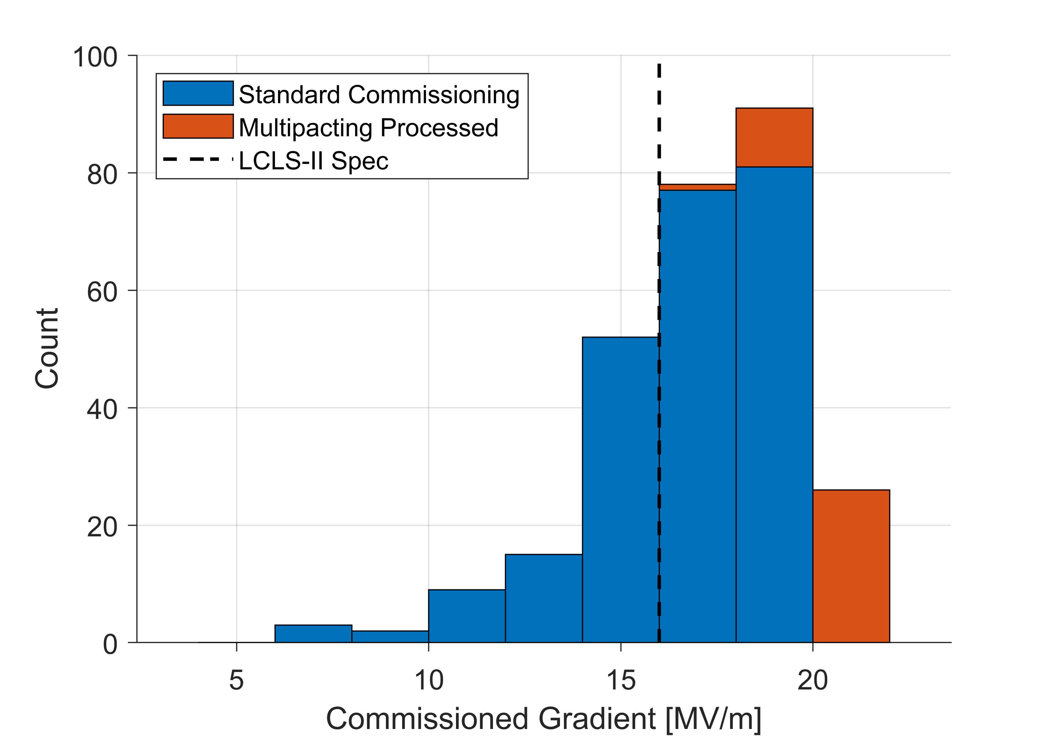
Overall SRF Cavity Performance
Gradient Performance
Cryomodule commissioning has been very successful
97% of installed cavities fully operational (planned 94%)
Majority of testing included an admin limit of 18 MV/m
Total commissioned voltage exceeds design by >20%
Total Commissioned Cavity Voltage: 4.9 GV

Slide 14
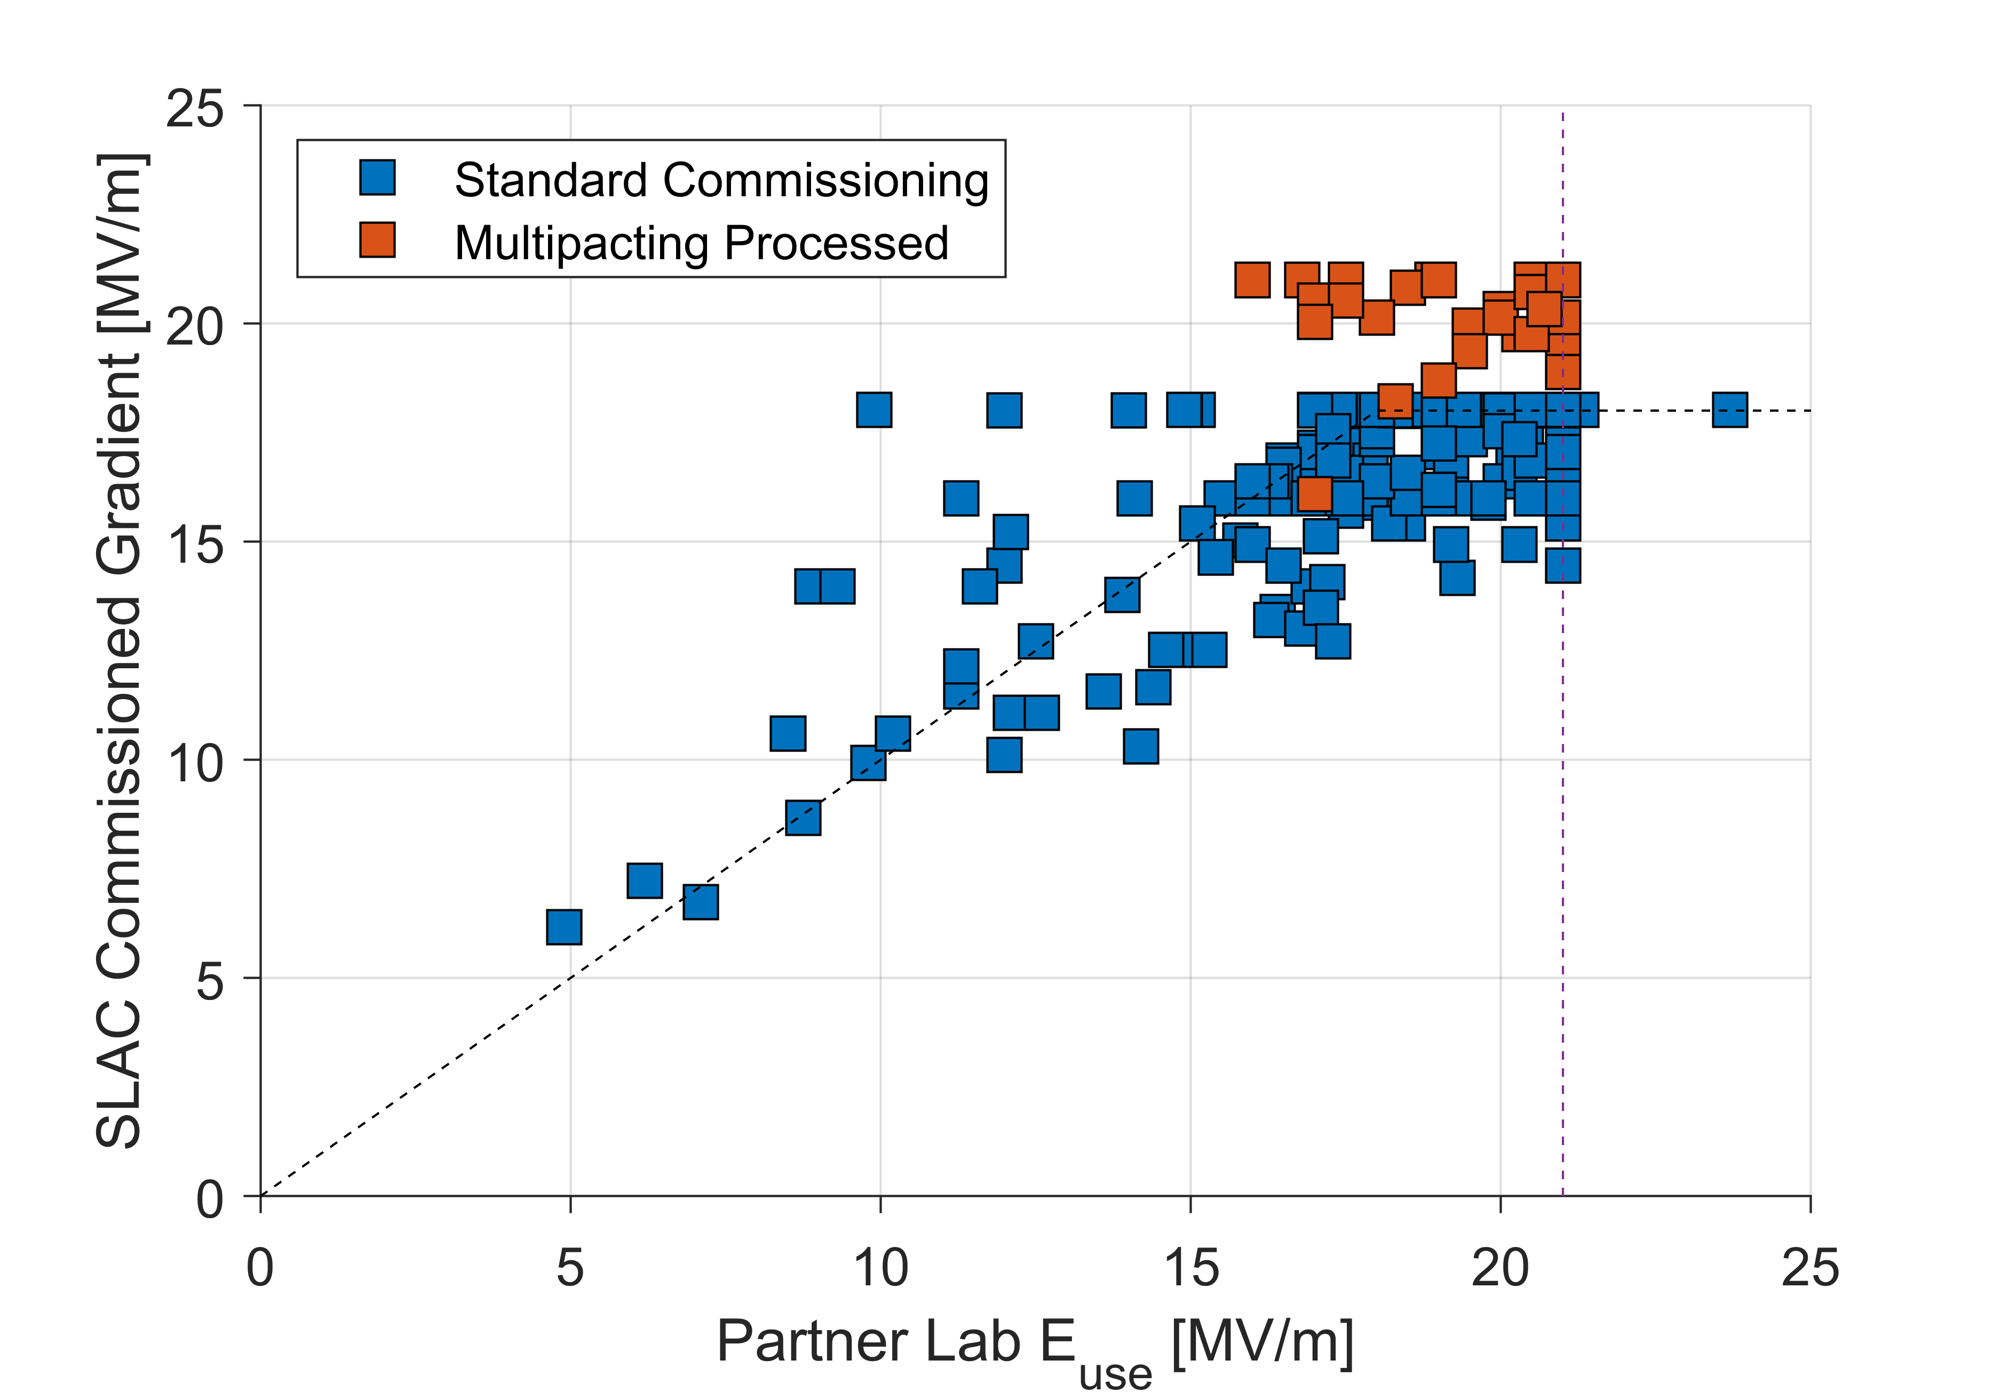
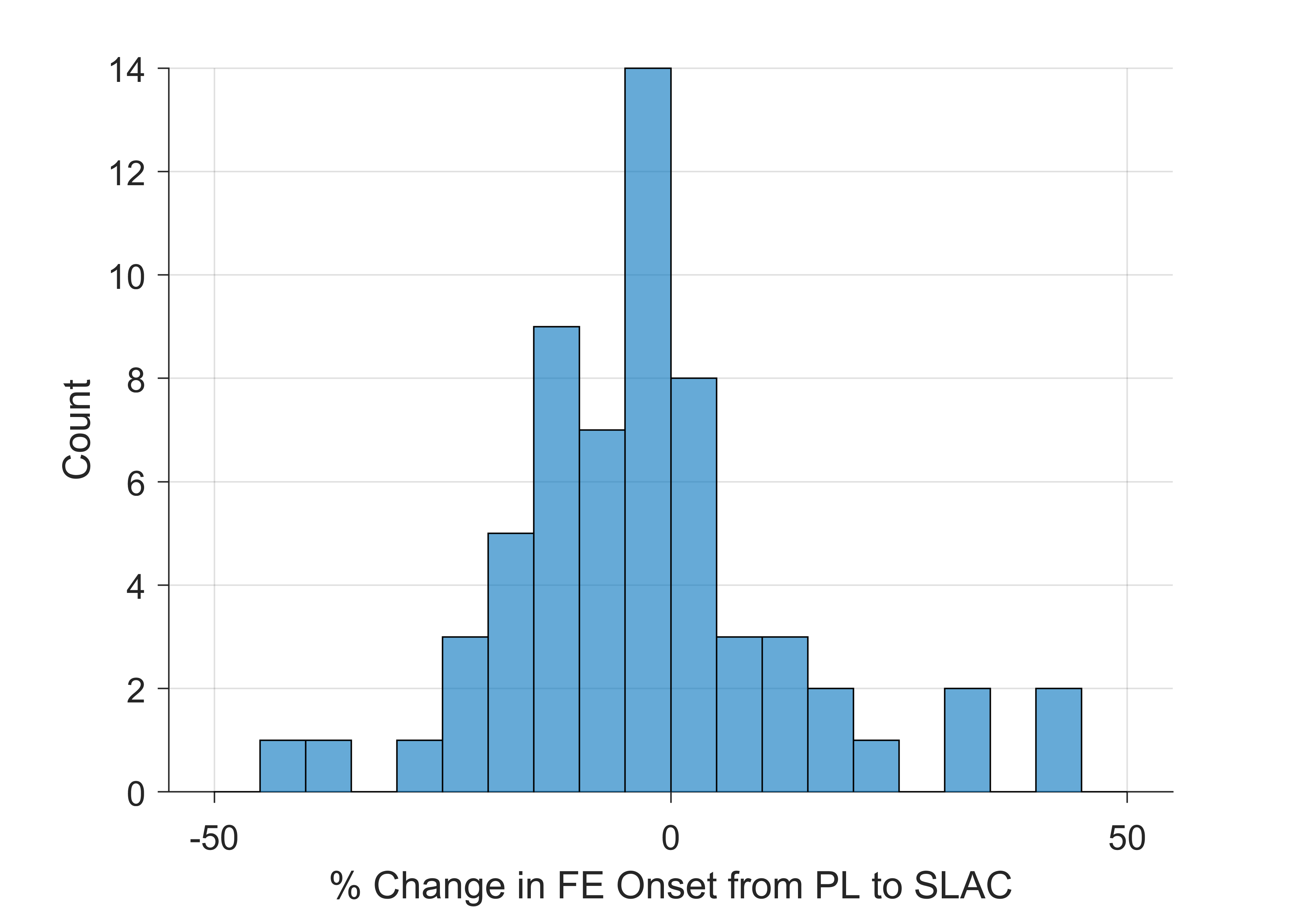
Change in Performance from Installation
Comparison with Acceptance Test
Gradient performance is in line with CM acceptance test measurements at FNAL and JLab
No observable change in field emission onsets or magnitude from installation
Remarkable achievement by the SLAC installation team
Change in FE Onset
$$\overline{Δ}=\left(−1±18\right)\%$$
Admin limits:
18 MV/m in commissioning
21 MV/m in acceptance test

Slide 15
Summary
Installation of the LCLS-II cryomodules went well overall
Enhanced rigor and work planning and control was implemented to ensure equipment and personnel were protected during the installation process
No non conformances were found during installation which impacted operation of the linac
No degradation in cavity performance from installation was observed

Slide 16
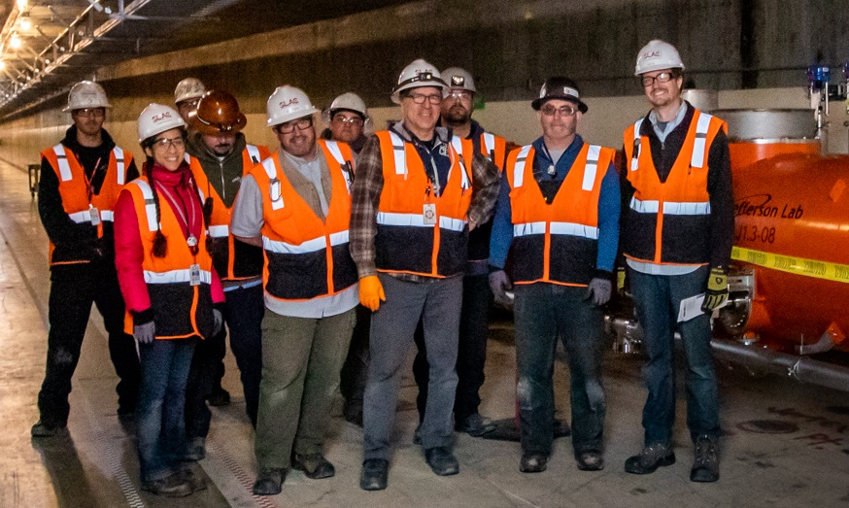
Special thanks to the entire LCLS-II collaboration for all their hard work to make this possible!
Thanks for your attention!

