Slide 1



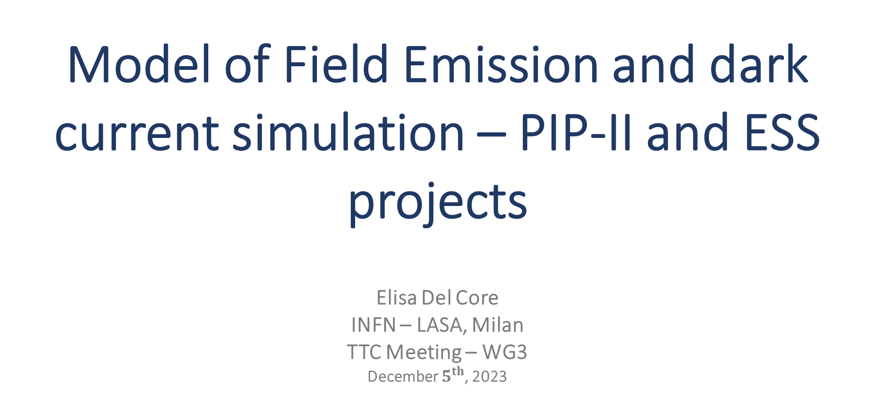
Model of Field Emission and dark current simulation – PIP-II and ESS projects
Elisa Del Core
INFN – LASA, Milan
TTC Meeting – WG3
December $5^{th}$, 2023
TESLA Technology Collaboration – December 5th, 2023

Slide 2
Outline
TESLA Technology Collaboration – December 5th, 2023
SRF cavities at LASA
Field emission
Case-study: PIP-II EZ-002 cavity
Conclusions

Slide 3
Outline
TESLA Technology Collaboration – December 5th, 2023
SRF cavities at LASA
Field emission
Case-study: PIP-II EZ-002 cavity
Conclusions

Slide 4
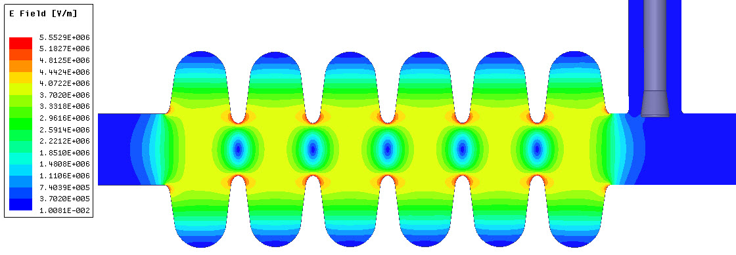
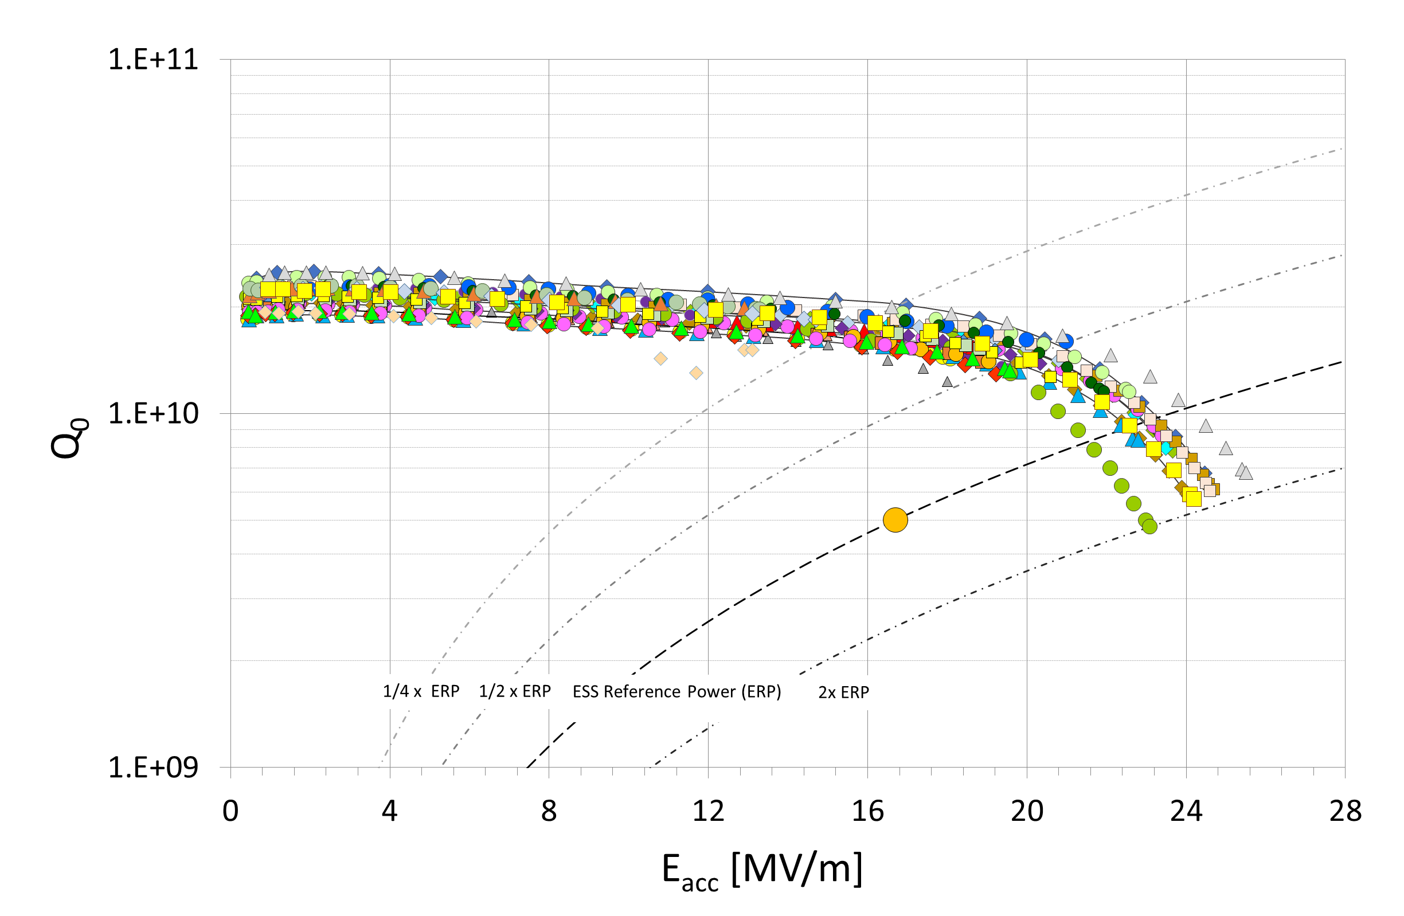
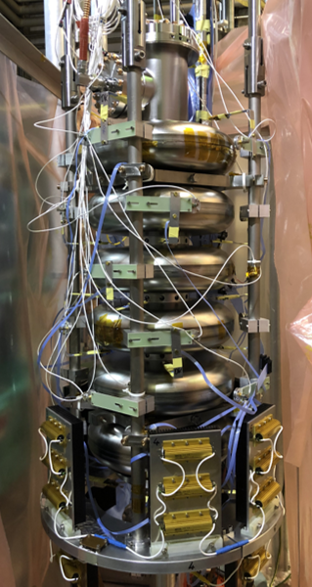
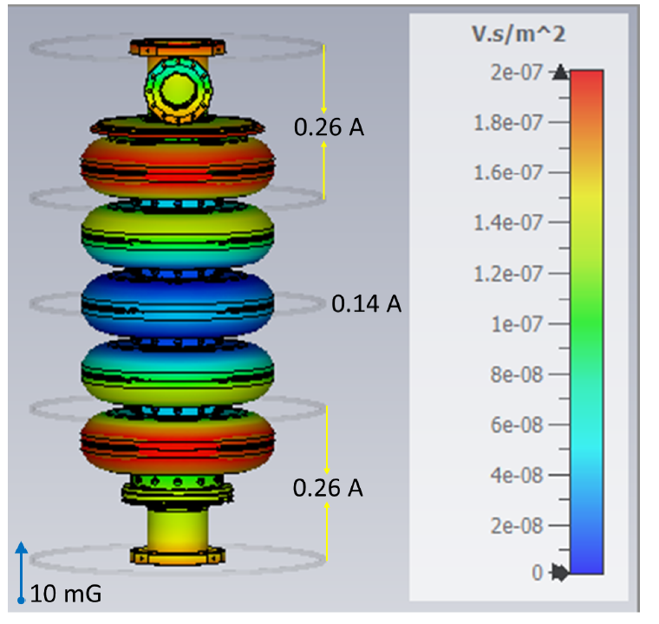
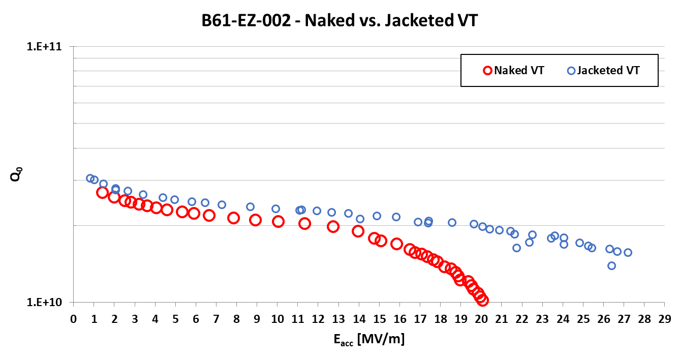
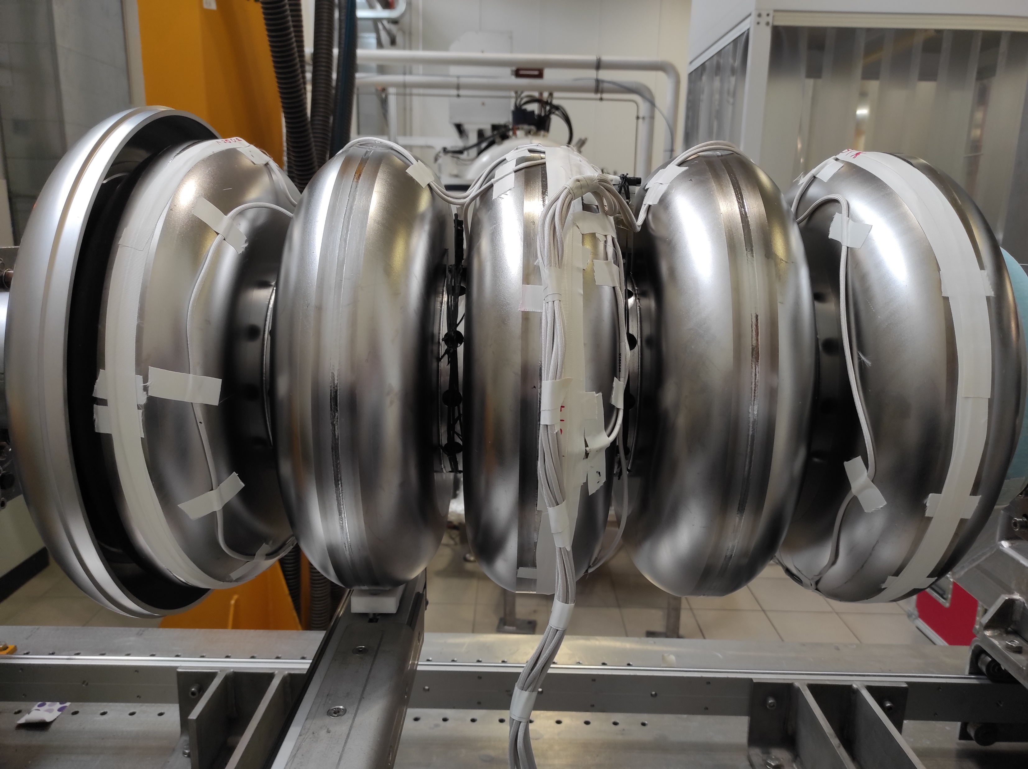
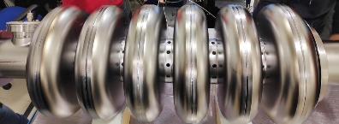

SRF Activities at LASA
TESLA Technology Collaboration – December 5th, 2023
Medium Beta Cavities for ESS:
  Design and Prototypes (even two Large Grain) Medium Beta Cavities
  Procure & test (@ DESY) all 36, 704.4 MHz cavities ready for integration
  Special cavities tested at LASA with advanced diagnostic
  All cavities delivered to CEA Saclay for CM integration
  Last two cavities for CM09 delivered in Nov, 2023
LB650 Cavities for PIP-II:
  Design and prototyping of LB650 cavity
  Developing mid-T bake and cold EP and their adaptation for industrial production
  Procure and deliver 38 cavities ready for installation in CM
  Delivery expected to be completed in 2026
  Updating LASA vertical test infrastructure for high $Q_{0}$
PIP-II Goals
E_{acc} = 16.9 MV/m
Q₀ = 2.4 10¹⁰
Test setup yet to be optimized!
ESS Goals
E_{acc} = 16.7 MV/m
Q₀ = 5 10⁹
SRF Bulk Nb R&D:
  INFN-Projects for ESPP Accelerator R&D:
    High-Q / High-G SRF
    SRF for FCC-ee
    Muon Collider SRF, novel fast frequency tuners
  Recipes development: mid-T bake, Two-step, doping
  Magnetic hygiene: B-field active compensation
  Diagnostics: quench, field-emission, trapped magnetic flux
  Analytical model for field-emission and dark current

Slide 5
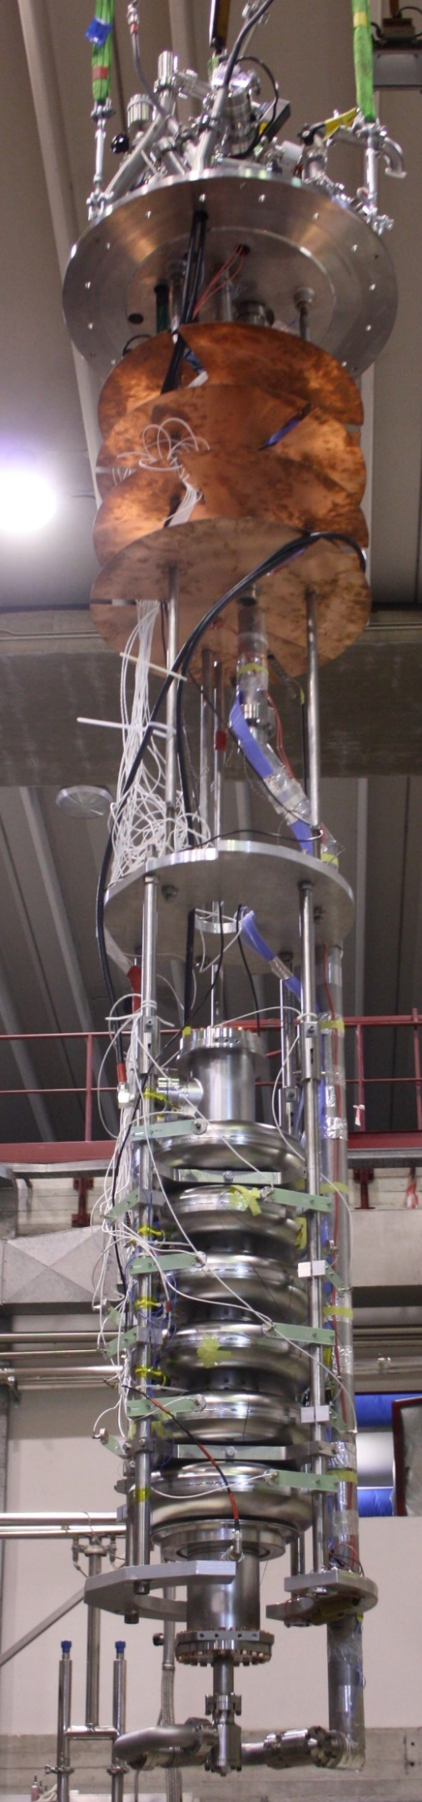
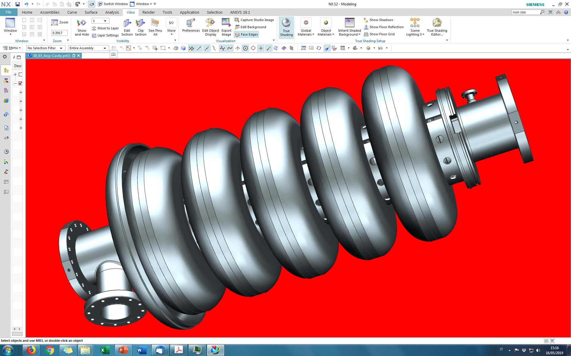

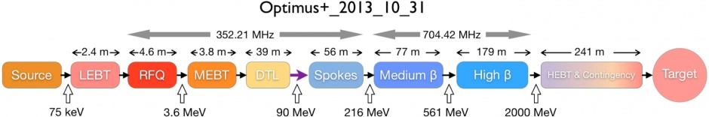
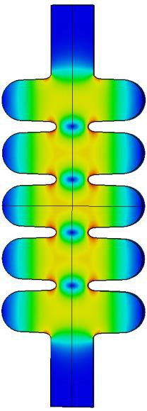
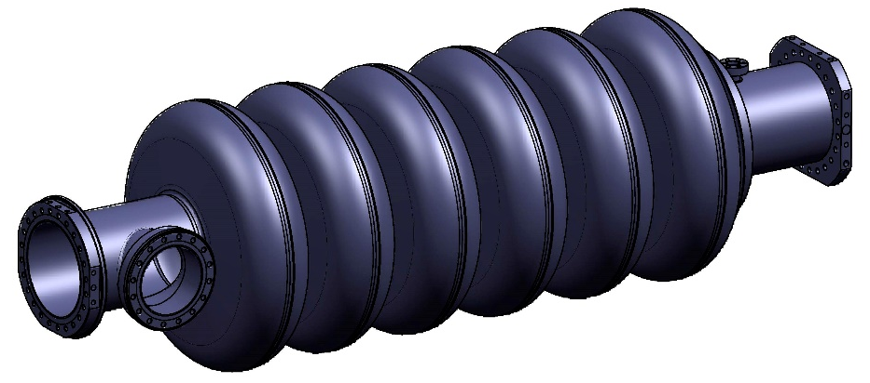
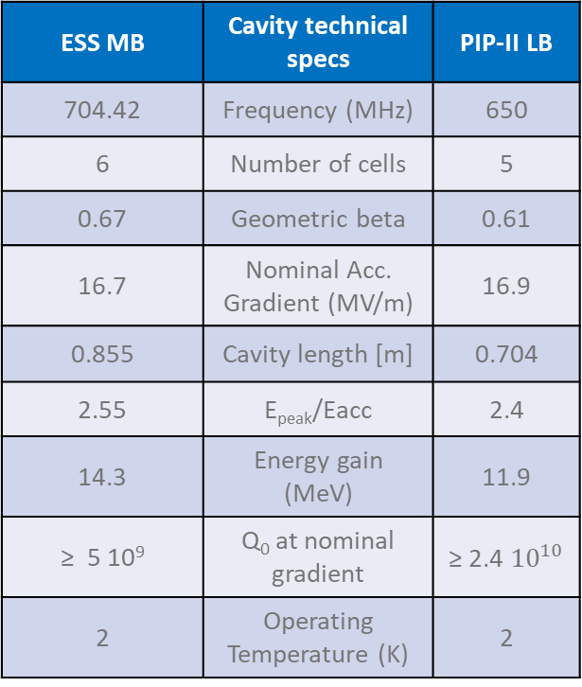
SRF CAVITIES at LASA
ESS – Medium Beta cavity
PIP-II – Low Beta cavity
TESLA Technology Collaboration – December 5th, 2023
ESS MB | Cavity technical specs | PIP-II LB
704.42 | Frequency (MHz) | 650
6 | Number of cells | 5
0.67 | Geometric beta | 0.61
16.7 | Nominal Acc. Gradient (MV/m) | 16.9
0.855 | Cavity length [m] | 0.704
2.55 | E_{peak}/Eacc | 2.4
14.3 | Energy gain (MeV) | 11.9
≥ 5 10⁹ | Q₀ at nominal gradient | ≥ 2.4 ${10}^{10}$
2 | Operating Temperature (K) | 2
Elliptical
LB650

Slide 6
Outline
TESLA Technology Collaboration – December 5th, 2023
SRF cavities at LASA
Field emission
Case-study: PIP-II EZ-002 cavity
Conclusions

Slide 7
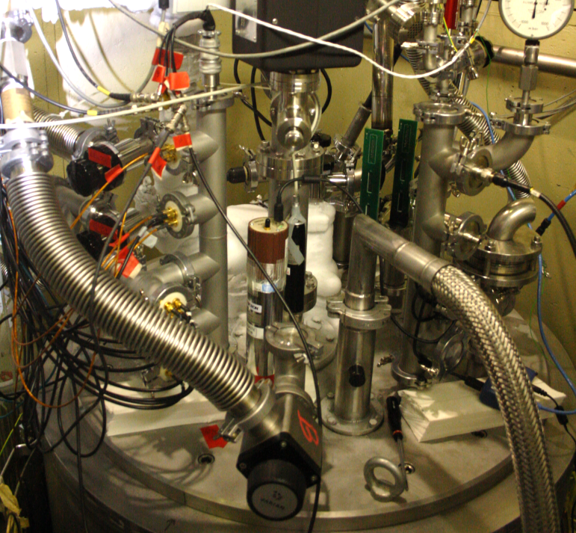
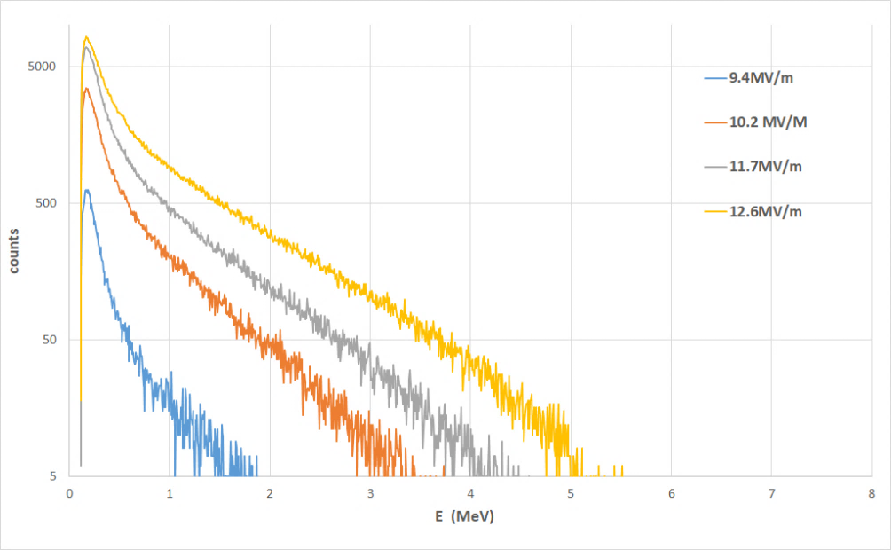

Introduction
Scintillator and proportional counter on cryostat cover
TESLA Technology Collaboration – December 5th, 2023
What we currently use to analyze field emission (FE):
External radiation detectors
  A part of impact electron energy
  is converted in X ray bremsstrahlung radiation.
  The maximum X ray energy (endpoint) corresponds to
  electron kinetic energy.
    Proportional counter: dose rate → it (partially) mimics the power drained by
    electron dark current
    Scintillator (NaI(Tl)) → it gives the X Ray spectrum therefore allowing
    endpoint evaluation (a part from severe pile-up events)
Inner diagnostic:
  electron pick-up
  Photodiodes array
Cavity Q drop → offers a way to evaluate the overall field emission
power if this phenomenon is the dominant one in
limiting the cavity performance
$$\frac{1}{Q(E_{acc})}=\frac{1}{Q_{0}}+\frac{R}{Q}\frac{P_{FE}}{{(E_{acc} l)}^{2}}$$

Slide 8
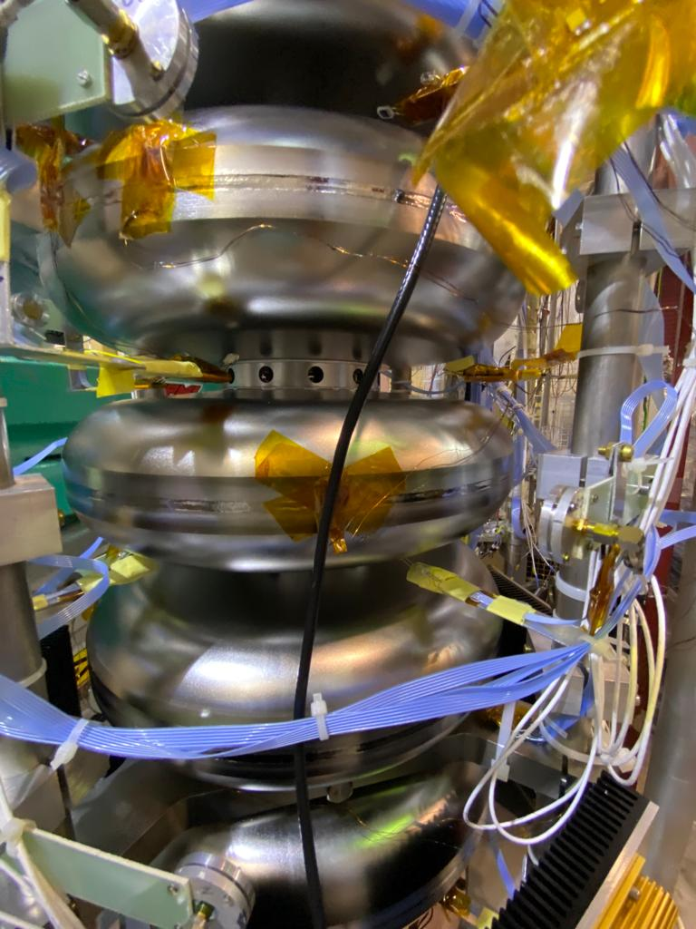
Problem: how to evaluate the REAL FE impact?
TESLA Technology Collaboration – December 5th, 2023
Field Emission can be invisible to detectors if impact energies are too low
External detectors can view only a limited part of emission pattern.
Photodiodes array
Difficult to localize “a priori” the emitter position. Inner detectors like photodiodes can help to reconstruct the pattern but a quantitative calibration of these sensors is still missing (but it’s under way)
FE can be coupled with other phenomena like secondary emission (multipacting), parasitic mode excitation, thermal quench → these may complicate a full modeling of cavity behavior

Slide 9
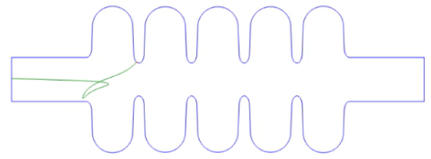
Field Emission model
TESLA Technology Collaboration – December 5th, 2023
Our goal is to exploit the experimental observables (dose rate, energy endpoint and Q-drop) to develop a self-consistent model of FE inside the cavity (emitter position and size, field enhancement factor)
Fishpact (2D model) → electron energy and tracking
  In this case Multipacting events are neglected (impact number = 1), so to simulate sheer field emission events: the electron “dies” after the first impact against cavity walls.
  Pro/cons:
  Limited post-processing features
  No emission models available (CST: field emission,
  thermionic, fixed, space charged limited)
  … BUT noticeably faster than other more advanced program!

Slide 10
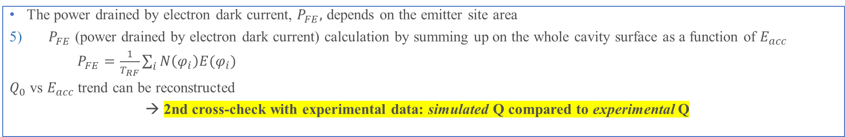
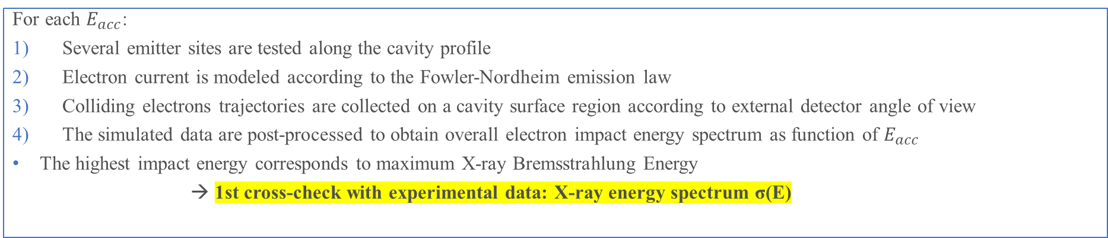
STEPS towards FE source identification
TESLA Technology Collaboration – December 5th, 2023
For each $E_{acc}$:
Several emitter sites are tested along the cavity profile
Electron current is modeled according to the Fowler-Nordheim emission law
Colliding electrons trajectories are collected on a cavity surface region according to external detector angle of view
The simulated data are post-processed to obtain overall electron impact energy spectrum as function of $E_{acc}$
The highest impact energy corresponds to maximum X-ray Bremsstrahlung Energy
→ 1st cross-check with experimental data: X-ray energy spectrum σ(E)
The power drained by electron dark current, $P_{FE},$ depends on the emitter site area
5) $P_{FE}$ (power drained by electron dark current) calculation by summing up on the whole cavity surface as a function of $E_{acc}$
$P_{FE}=\frac{1}{T_{RF}}\sum_{i}{N\left(φ_{i}\right)E(φ_{i})}$
$Q_{0}$ vs $E_{acc}$trend can be reconstructed
→ 2nd cross-check with experimental data: simulated Q compared to experimental Q

Slide 11
Outline
TESLA Technology Collaboration – December 5th, 2023
SRF cavities at LASA
Field emission
Case-study: PIP-II EZ-002 cavity
Conclusions

Slide 12
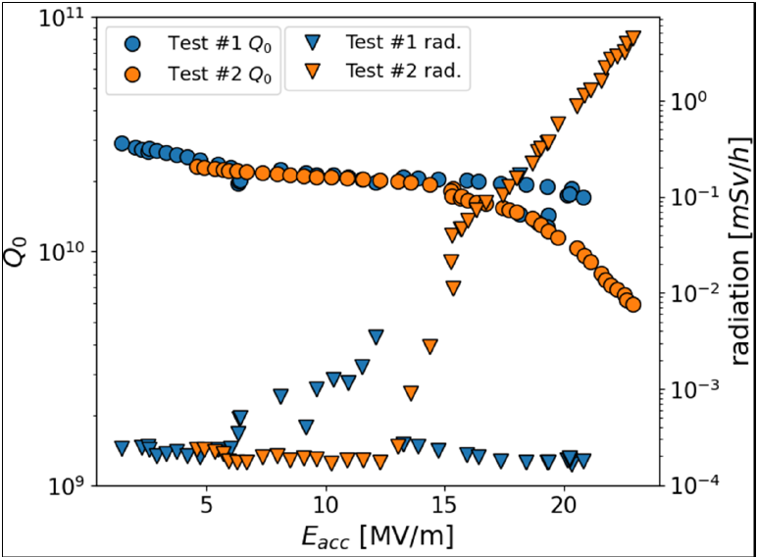
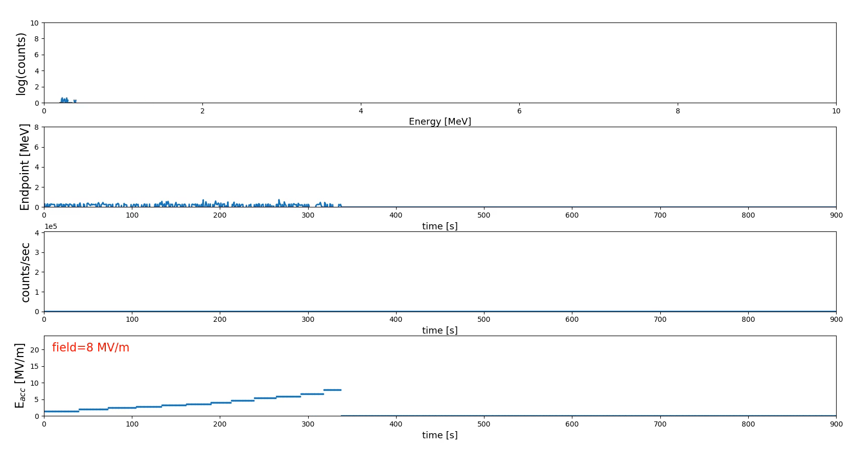
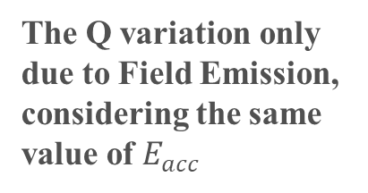
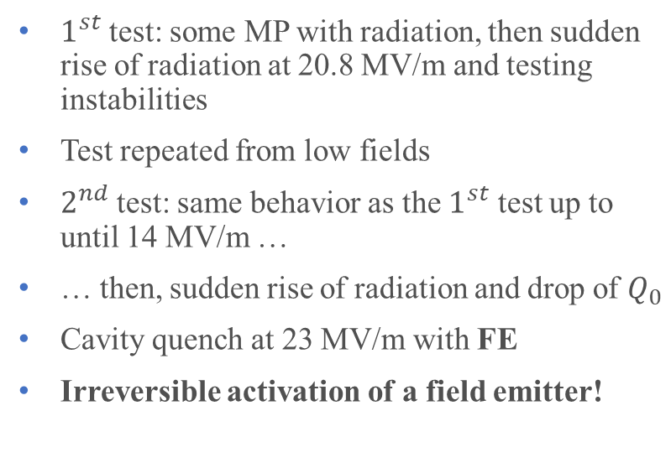
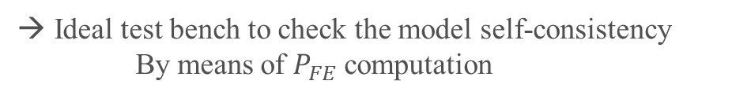

CASE STUDY – PIP II EZ-002 CAVITY
TESLA Technology Collaboration – December 5th, 2023
$1^{st}$ test: some MP with radiation, then sudden rise of radiation at 20.8 MV/m and testing instabilities
Test repeated from low fields
$2^{nd}$ test: same behavior as the $1^{st}$ test up to until 14 MV/m …
… then, sudden rise of radiation and drop of $Q_{0}$
Cavity quench at 23 MV/m with FE
Irreversible activation of a field emitter!
The Q variation only due to Field Emission, considering the same value of $E_{acc}$
Ideal test bench to check the model self-consistency
By means of $P_{FE}$ computation
$$\frac{1}{Q(E_{acc})}=\frac{1}{Q_{0}}+\frac{R}{Q}\frac{P_{FE}}{{(E_{acc} l)}^{2}}$$
Assuming Q-degradation only due to FE, $P_{FE}$ FE dissipated power, $Q_{0}$ low field Q, R/Q fixed parameter.

Slide 13
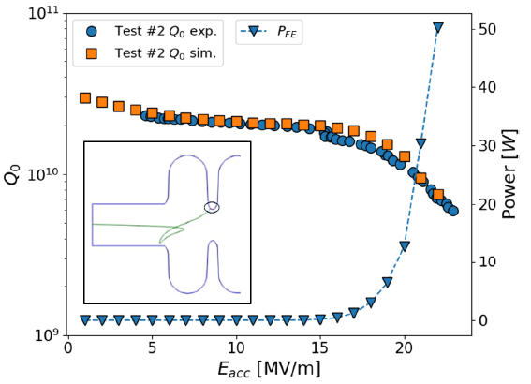
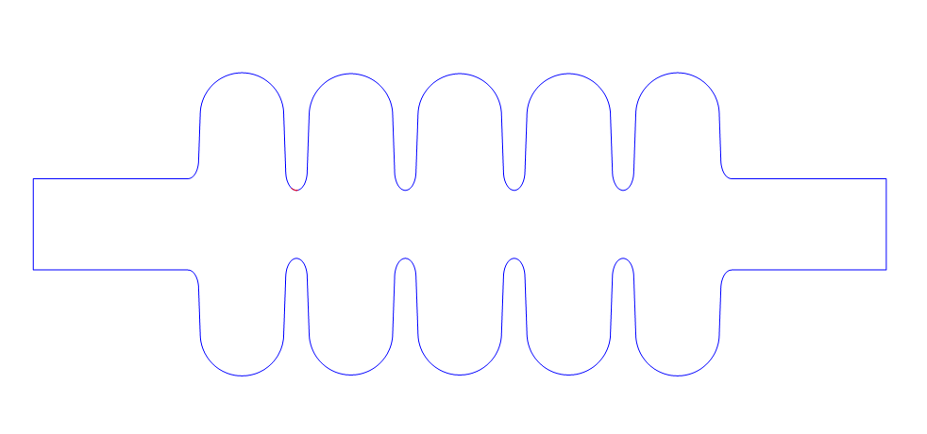
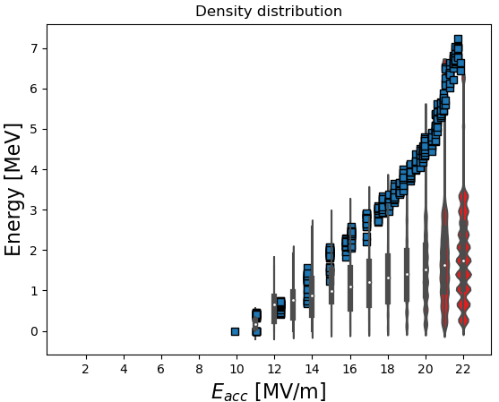
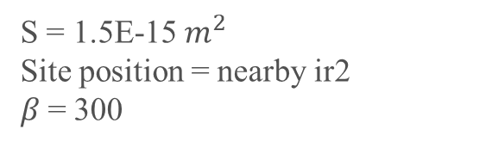
CASE STUDY – PIP II EZ-002 CAVITY Results
S = 1.5E-15 $m^{2}$
Site position = nearby ir2
$β$= 300
TESLA Technology Collaboration – December 5th, 2023
Blue squares: X-ray endpoints
Red violinplot: distribution density
Power FE @ 20 MV/m = 12 W

Slide 14
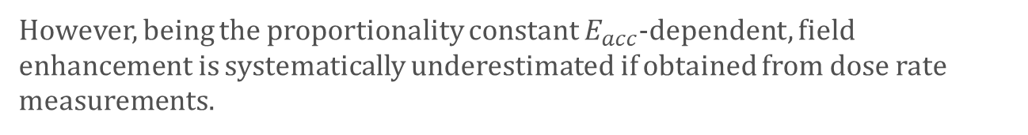




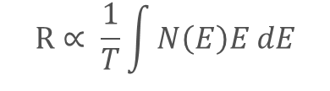

Transport model from electron to external X-rays
Only in the previous case, where the Q-drop is only, or mainly, due to the power drained by dark current, we can use that model.
We can use the dose rate to quantitatively reconstruct the FE scenario, but we need to consider the long chain of physical processes involved from electron emission to photon absorption, in the detector volume
Analytical approach (theoretically evaluating , bremsstrahlung cross section, x-ray attenuation, detector energy efficiency, …)
[DOI: 10.1103/PhysRevAccelBeams.26.072001]
TESLA Technology Collaboration – December 5th, 2023
Field enhancement $β$
→ Fit of Fowler-Nordheim equation
$$I∝{(β_{FN}E)}^{2.5}e^{−B_{FN}\frac{Φ^{3/2}}{β_{FN}E}}$$
$$β \sim 250/300$$
$$\log{\frac{R}{E^{2}}= \log{A} − \frac{B}{βE}}$$
$$dose ∝current$$
$$R∝ \frac{1}{T}\int{N\left(E\right)E dE}$$
However, being the proportionality constant $E_{acc}$-dependent, field enhancement is systematically underestimated if obtained from dose rate measurements.

Slide 15
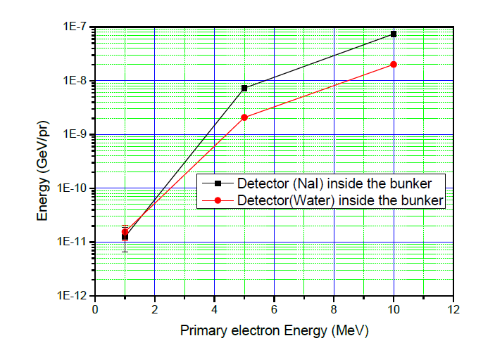
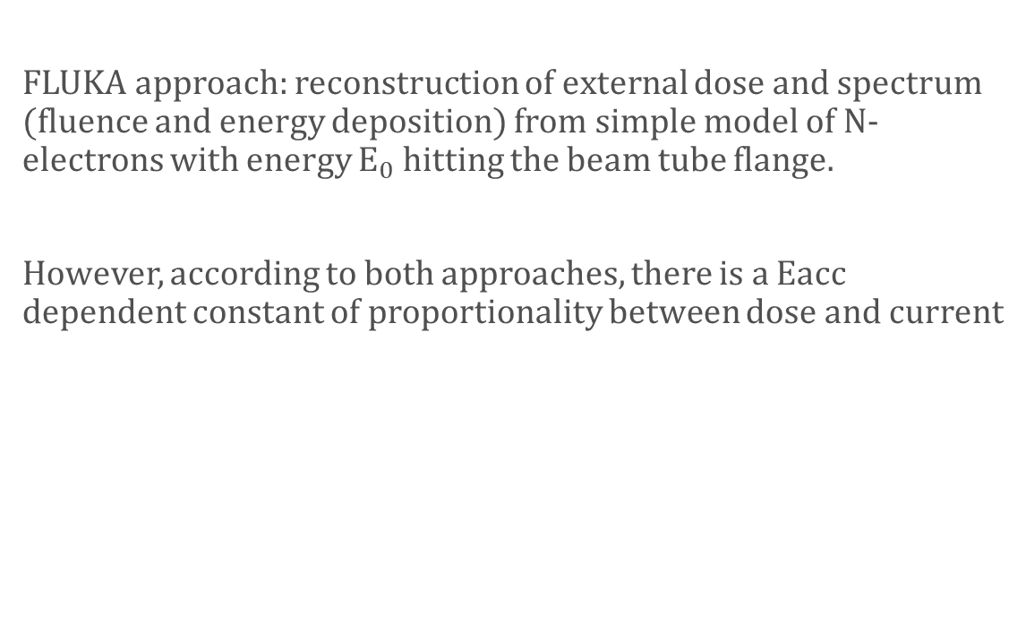

Transport model from electron to external X-rays: Fluka approach
LASA bunker FLUKA model for $\text{photon} \text{fluence}$
TESLA Technology Collaboration – December 5th, 2023
FLUKA approach: reconstruction of external dose and spectrum (fluence and energy deposition) from simple model of N-electrons with energy $E_{0}$ hitting the beam tube flange.
However, according to both approaches, there is a Eacc dependent constant of proportionality between dose and current
$$R \left(E_{acc}\right)=k\left(E_{acc}\right)∗ I(E_{acc})$$
Current
Dose rate
Coefficient

Slide 16
Outline
TESLA Technology Collaboration – December 5th, 2023
SRF cavities at LASA
Field emission
Case-study: PIP-II EZ-002 cavity
Conclusions

Slide 17
Conclusions
TESLA Technology Collaboration – December 5th, 2023
A program to reconstruct field emission behavior has been developed starting from already existing Fishpact code
The program allows also to evaluate some physical
parameters corresponding to experimental observables
like energy spectrum and total dissipated FE power
→ external dose evaluation on progress
The model self-consistency has been cross-checked thanks to the case of PIP-II cavity EZ-002 for which data are available with and without field emission: data for impact energy distributions and field emitting power are nearly coherent for every Eacc.
To do list:
  Model electron to photon count deconvolution so to exploit also dose rate measurements
  Evaluate Pile-up statistics for detector at high count rates
  Study model convergence when sampling with smaller phase steps so to find a trade-off between calculation speed and model accuracy
  Reconstruction of the model in FLUKA with a dedicated routine for Field Emission phenomena.
Analytical
Simulation with dedicated software

Slide 18
BACKUP SLIDES
TESLA Technology Collaboration – December 5th, 2023

Slide 19
External radiation detectors
TESLA Technology Collaboration – December 5th, 2023
Gas-filled (Xe) proportional counter (Thermo Electron FH 40-G) for dose measurement:
  Measurement range from 100 nSv/h to 1 Sv/h
  Continuous aquisition every 1 sec.
  Energy range from 45 keV to 1 MeV→ poor sensitivity for higher energies
NaI(Tl) scintillator (Ortec 905-3) for measuring X-ray spectrum
  Maximum count rate 106 counts/sec
  Energy range from few keV to 10 MeV
  Due to its high sensitivity to radiation, for high doses detector saturates producing count pile-up: screening with high Z material is needed!

Slide 20
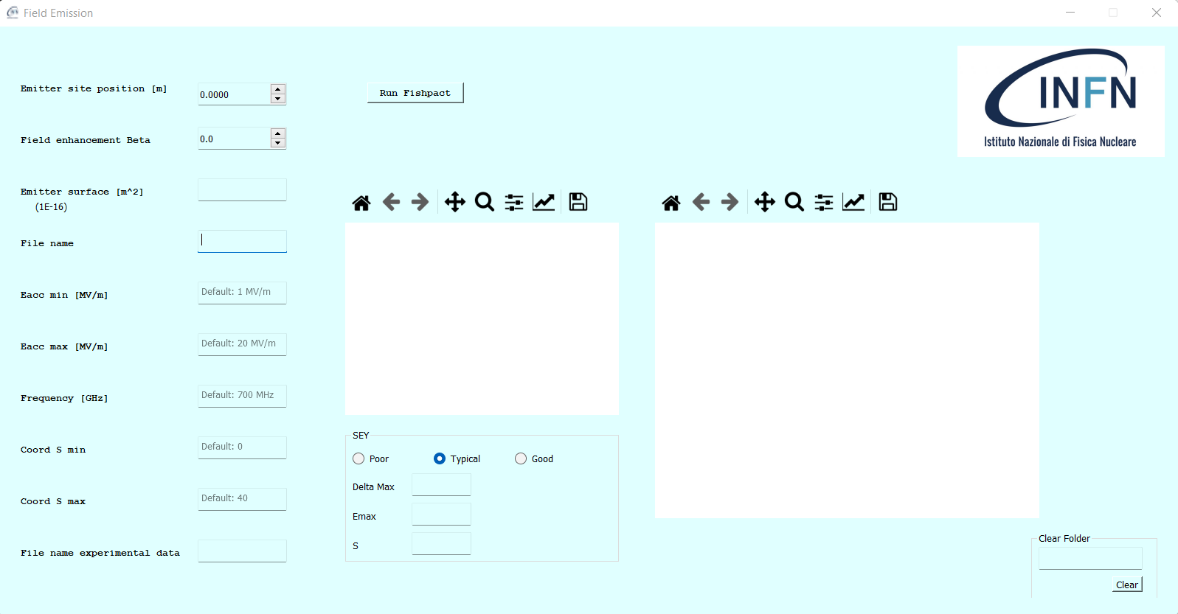
Graphic Interface
TESLA Technology Collaboration – December 5th, 2023
Mandatory to be compiled
Not Mandatory to be compiled
Mandatory to be compiled
For file removal

Slide 21
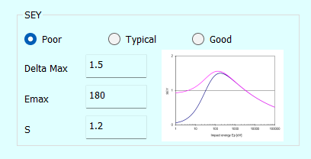
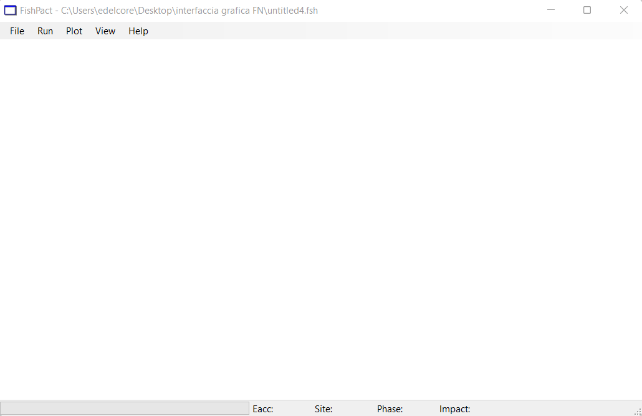
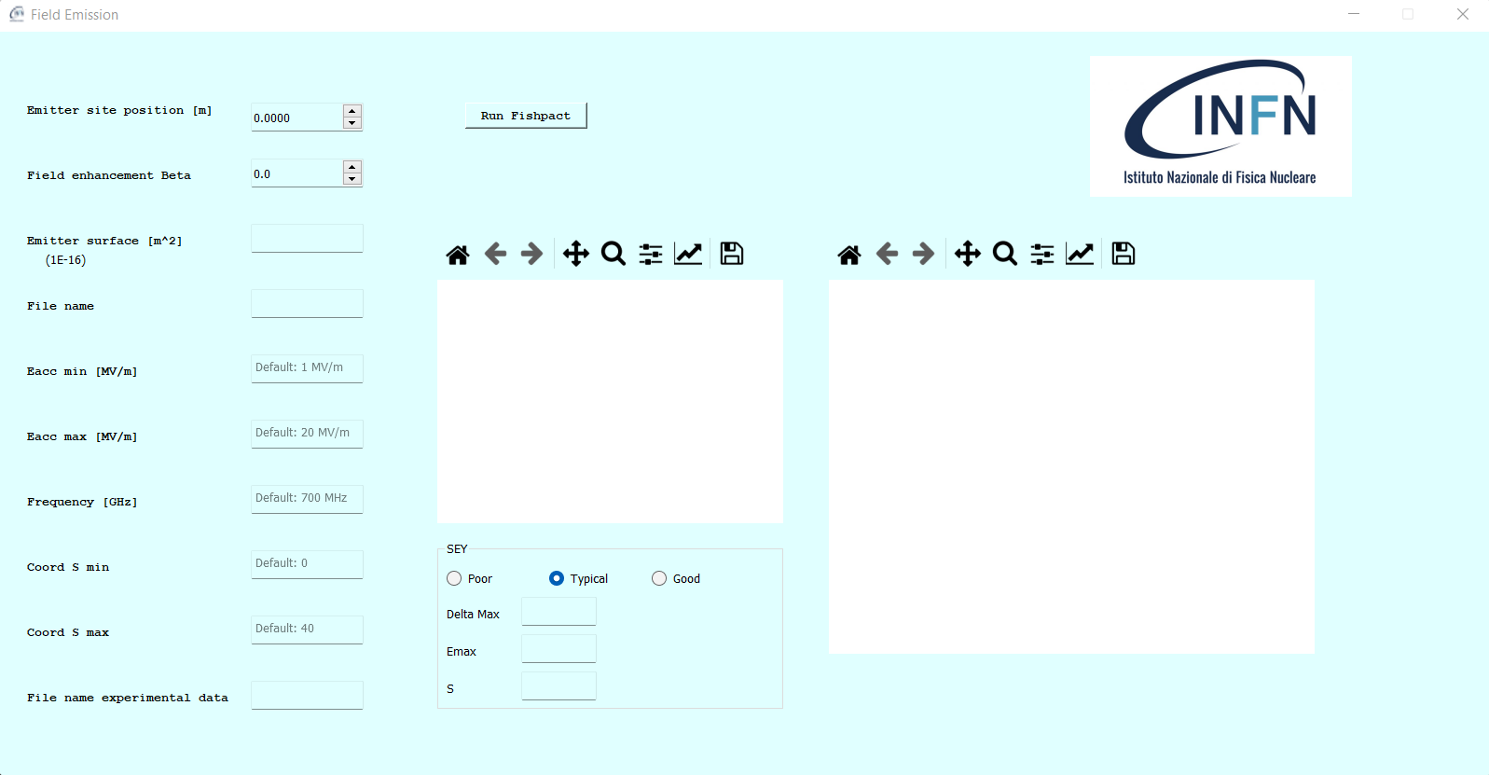
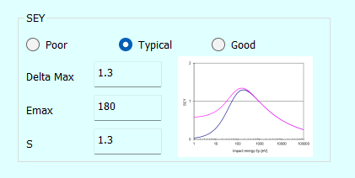
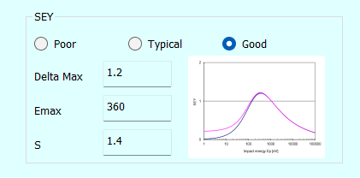
Graphic Interface Output
TESLA Technology Collaboration – December 5th, 2023
Start the Fishpact Simulation

Slide 22
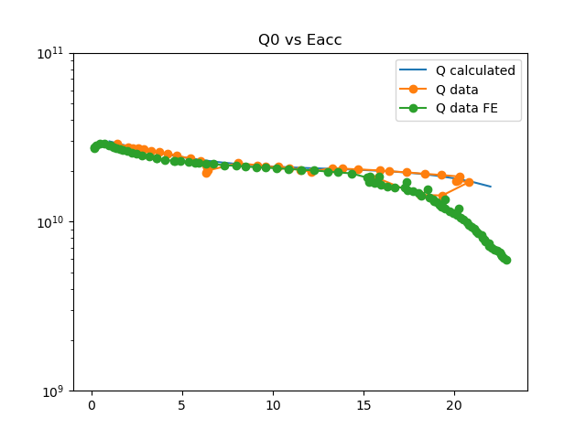
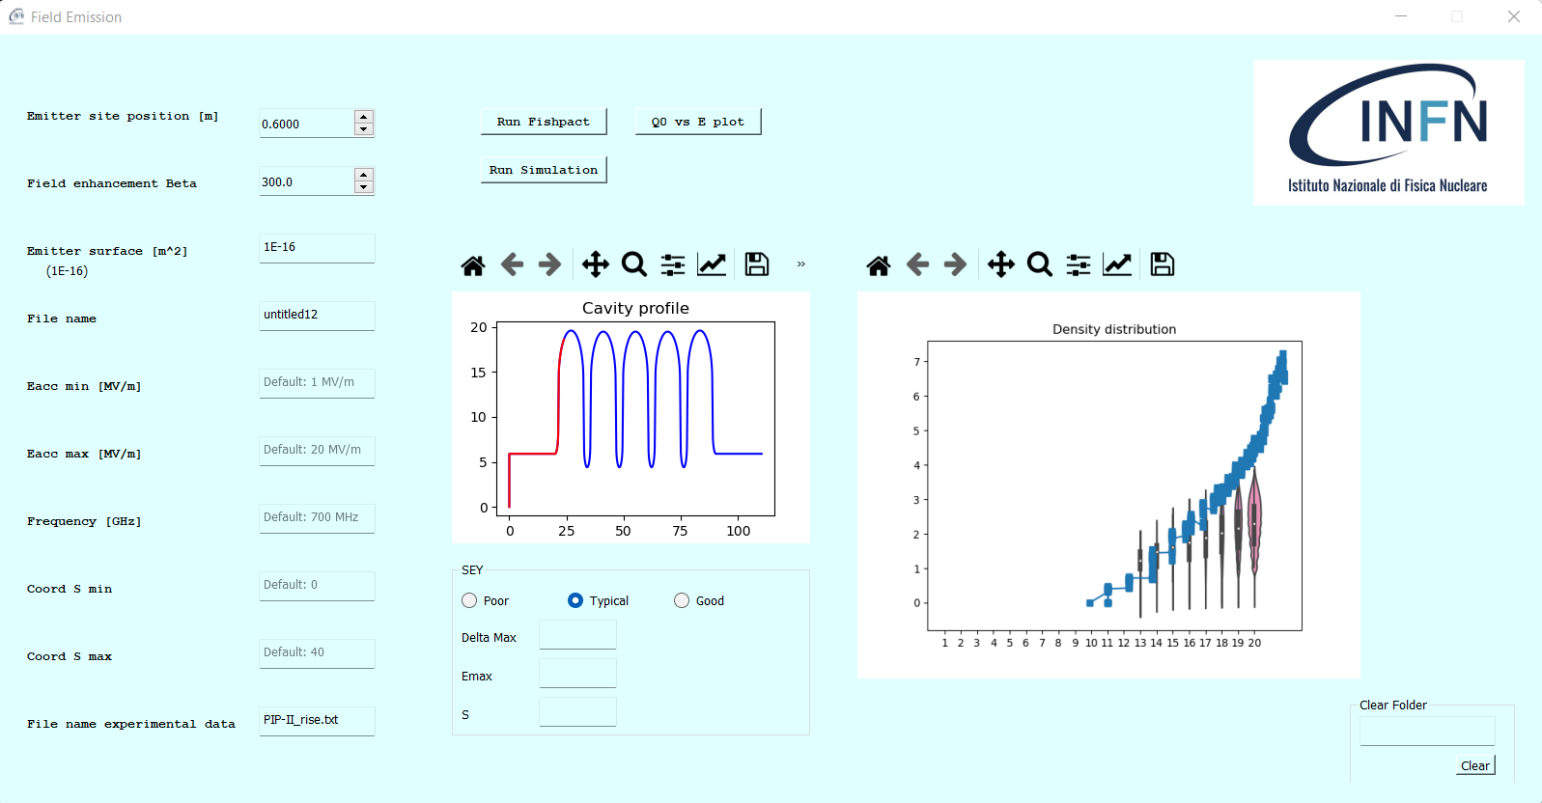
Graphic Interface Output (2)
TESLA Technology Collaboration – December 5th, 2023

Slide 23
Example of scintillator spectra

Slide 24
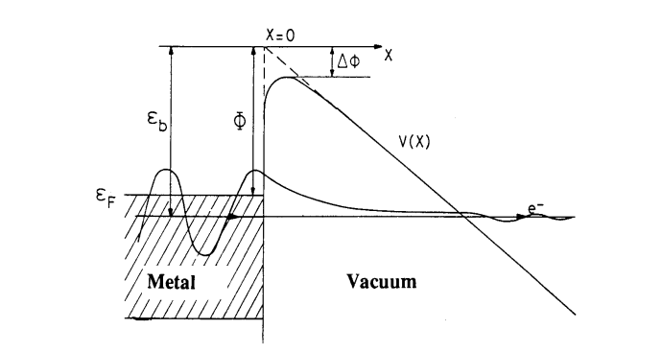
Field Emission
TESLA Technology Collaboration – December 5th, 2023
Emission of electrons induced by an electric field → electrons accelerated by RF fields until their impact on the surface
Fowler-Nordheim law to describe the phenomenon
Field emission problems:
Limits the accelerating gradient
Degradation of the Q value
Higher cryogenic consumption

Slide 25
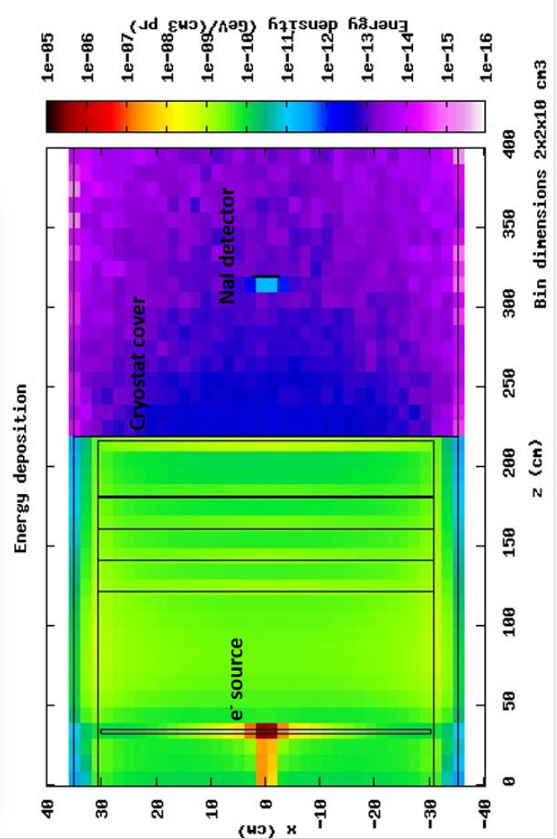
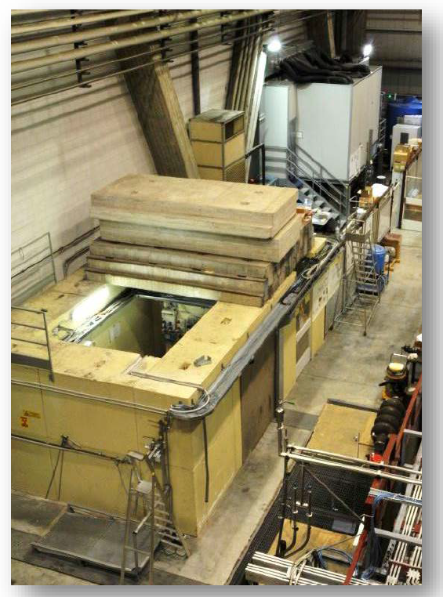
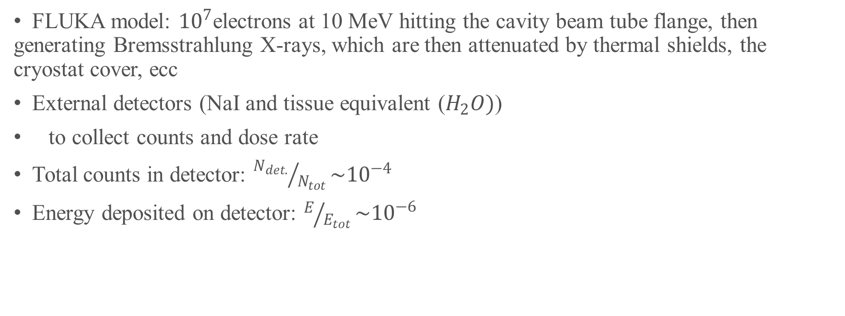
Lasa VTS radiation scenario
FLUKA model: ${10}^{7}$electrons at 10 MeV hitting the cavity beam tube flange, then generating Bremsstrahlung X-rays, which are then attenuated by thermal shields, the cryostat cover, ecc
External detectors (NaI and tissue equivalent ($H_{2}O)$)
to collect counts and dose rate
Total counts in detector: ${N_{det.}}/{N_{tot}}\sim {10}^{−4}$
Energy deposited on detector: $E/{E_{tot}}\sim {10}^{−6}$
TESLA Technology Collaboration – December 5th, 2023

