Slide 1
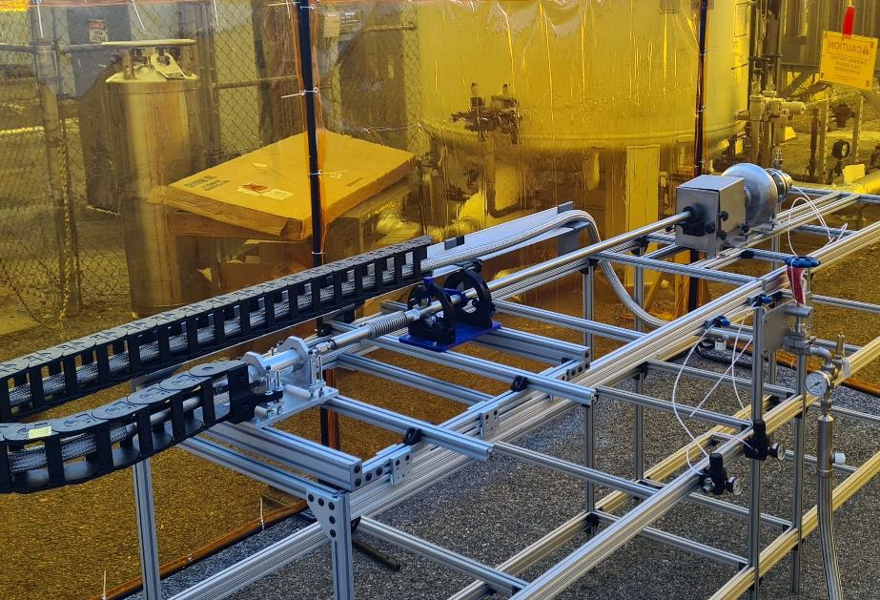
First Experience with Liquid Nitrogen Cleaning
Development status of a high pressure liquid nitrogen cleaning tool
TTC 2023, Fermilab
Roger Ruber

Slide 2
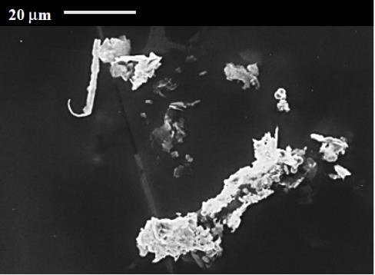
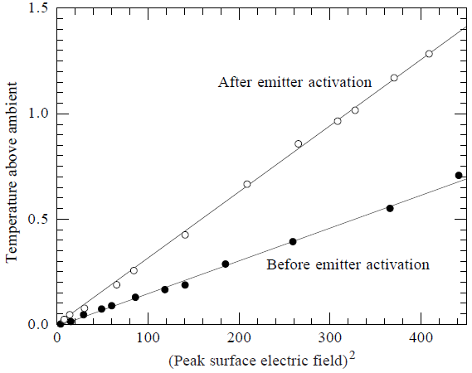
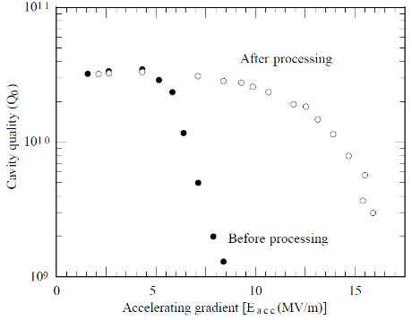
Why?
As a practical matter the principal limitation encountered at field levels above ~8 MV/m is field emission loading [1]
  Artificial emitters introduced into the cavities during surface treatments and assembly steps are the major causes for the emission of electrons
Three approaches to eliminate field emission loading [1]
  ultra-high vacuum annealing
  high peak power processing
  advanced surface cleaning techniques
Example effect of field emission
Stainless steel field emitter found in 1.5 GHz cavity
J. Knobloch, IEEE Trans. Appl. Superc. 9(2) (1999) 1016.
J. Knobloch, IEEE Trans. Appl. Superc. 9(2) (1999) 1016.
[1] P. Kneisel and B. Lewis, Advanced Surface Cleaning Methods, SRF (1995) 311.
https://accelconf.web.cern.ch/SRF95/papers/srf95l02.pdf

Slide 3
Particulate Contamination of Surfaces
Adhesion
  attraction between dissimilar particles or surfaces
Cohesion
  attraction between similar or identical particles or surfaces
van der Waal’s forces
  intermolecular forces
capillary forces
  thin liquid layer between particle and
  substrate surface
electrical double layer forces
  particles immersed in a liquid medium
  such as de-ionized water
electrostatic image force
  particles on a substrate surface
P. Kneisel and B. Lewis, Advanced Surface Cleaning Methods, SRF (1995) 311.
https://accelconf.web.cern.ch/SRF95/papers/srf95l02.pdf

Slide 4
Commonly Used “Advanced” Cleaning Methods
 | Overcome adhesion | Solvent for or react with hydro-carbons | Melt emitters
Ultrasonic/megasonic cleaning | X
High-pressure water | X
Helium processing |  |  | X
Plasma processing |  | X
Dry ice (CO₂) snow cleaning | X | X
Liquid nitrogen cleaning | X

Slide 5
Liquid Nitrogen Cleaning Concept
Combines actions from high-pressure ultra-pure water cleaning and dry-ice cleaning
  impact:
    by high-pressure jet
      high-momentum transfer on impact with surface particulate
  aerodynamic draft:
    from fluid velocity, which however becomes zero at cavity surface
    rapid evaporation of liquid nitrogen increases the fluid flow and velocity
    sound shock wave by combination of aerodynamic drag force and impact force
  thermal shock:
    cold shrinkage differential,
      by thermal gradient and thermal contraction of particulate, reduces contact surface and adhesiveness
    freezing out surface particulates,
      low temperature causes embrittlement, reduces elasticity and adhesiveness
    hence, less force required to remove particulates
Should not leave a residue
  nitrogen evaporates, no drying required, does not easily react at low temperature,
  however need warm-up time,

Slide 6
Commercial Use
Cleaning heat exchangers
  Conco Services, LLC
    “NitroLance” (decommissioned)
    https://www.youtube.com/watch?v=x_qS8srAuJo
Liquid jet cutting
  High Energy Cutting and Stripping Utilizing Liquid Nitrogen (2005)
    https://ntrs.nasa.gov/citations/20130010226
    https://www.foundrymag.com/issues-and-ideas/article/21927220/need-to-know-liquid-nitrogen-jet

Slide 7
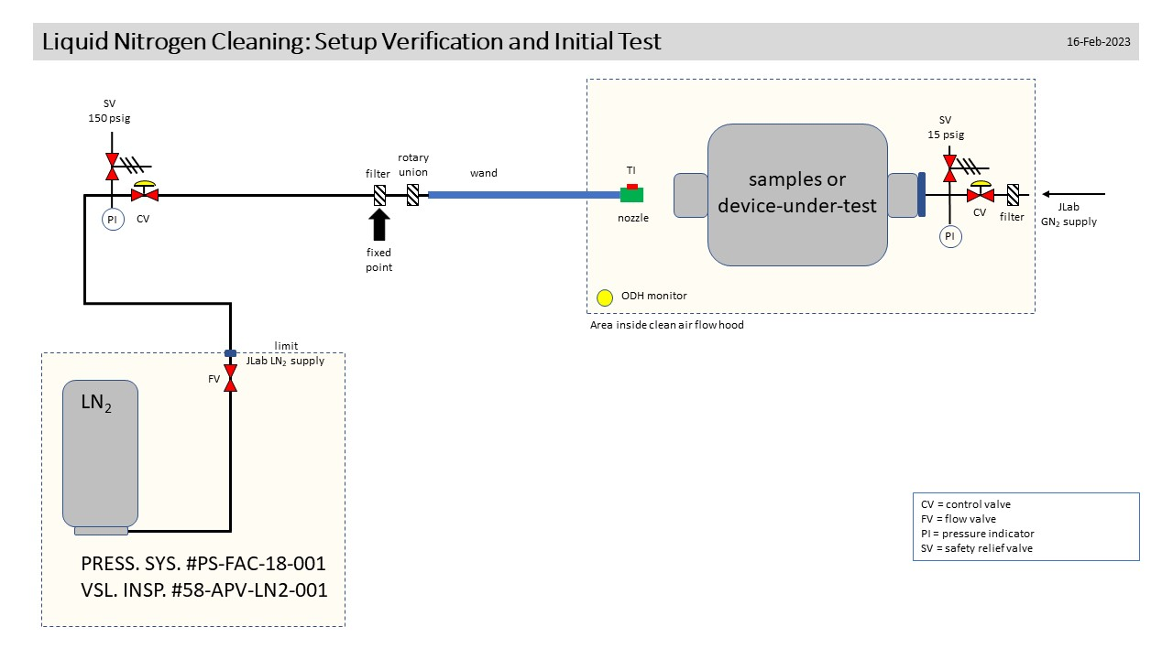
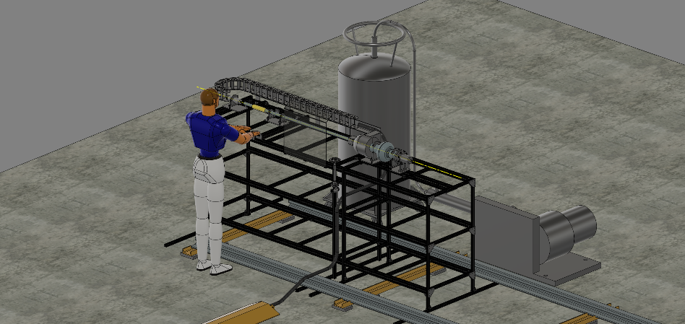
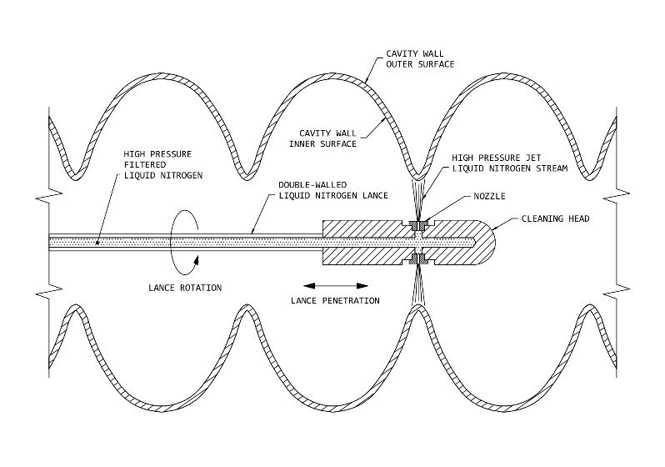
Proof-of-concept Test Setup

Slide 8
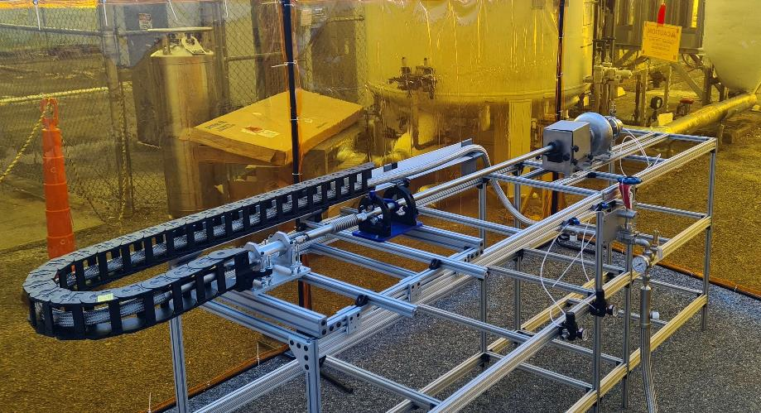
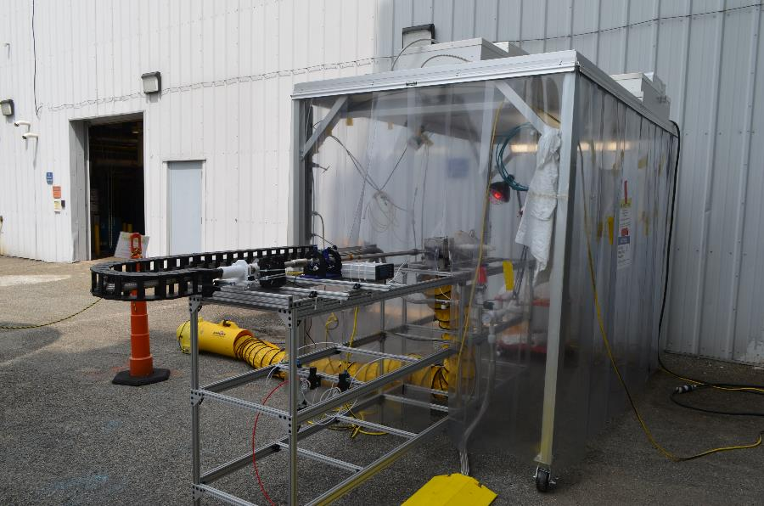
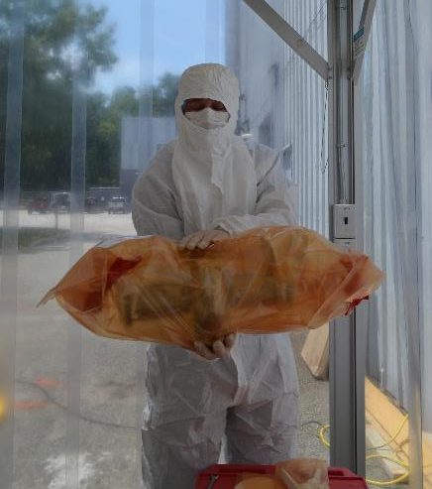
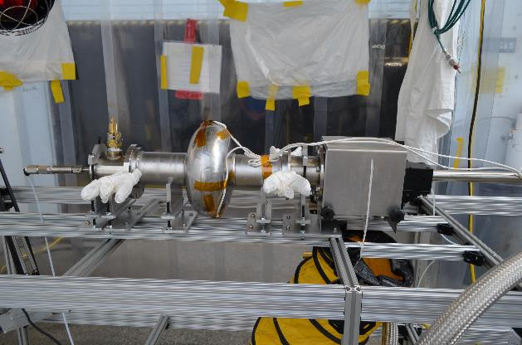
First Tests – Outdoor Safety and Workflow Demonstration

Slide 9
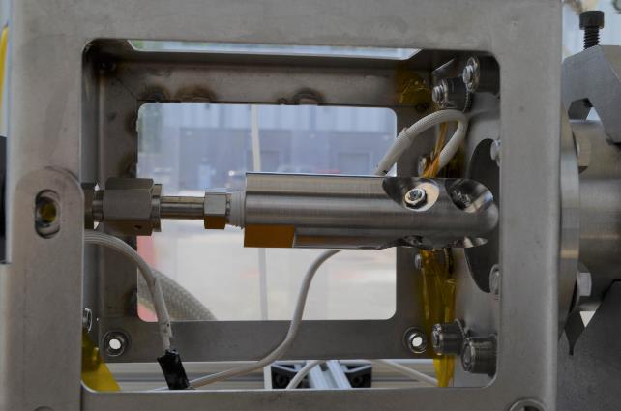
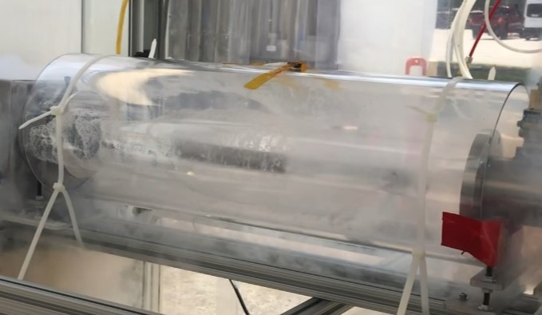
Observe Liquid Jet

Slide 10
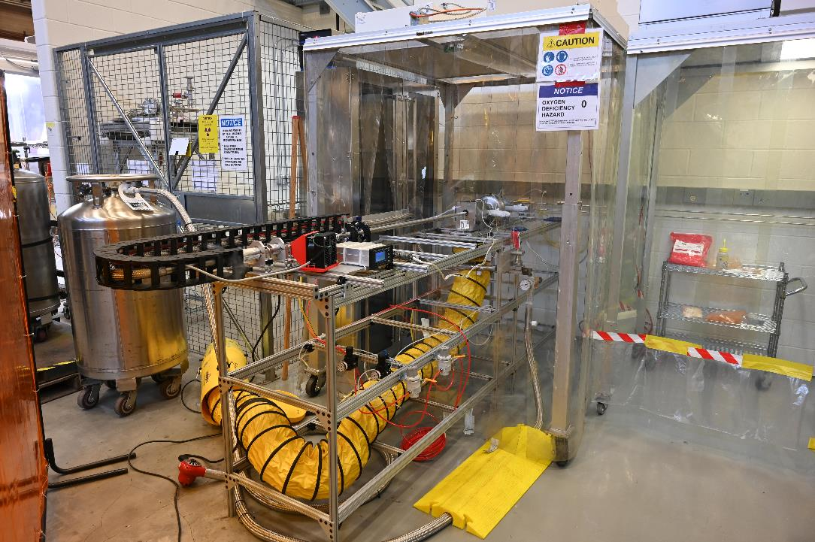
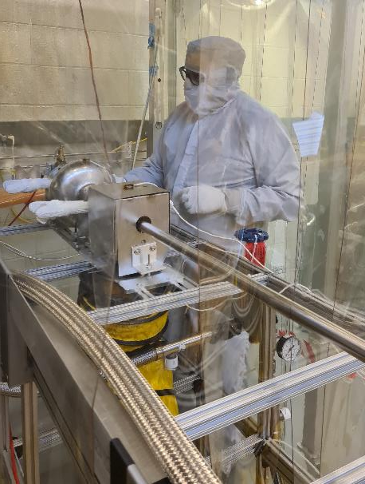
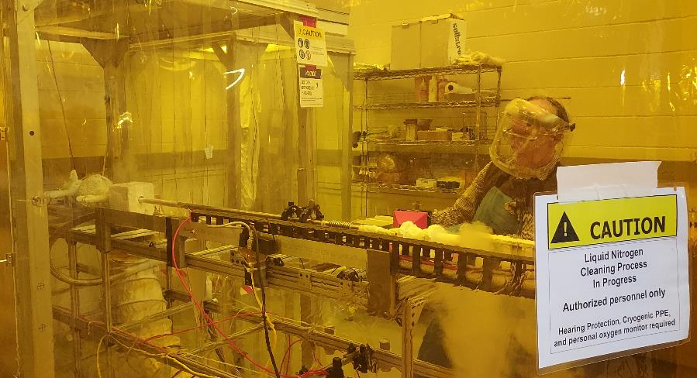
Cleaning at 10 bar

Slide 11
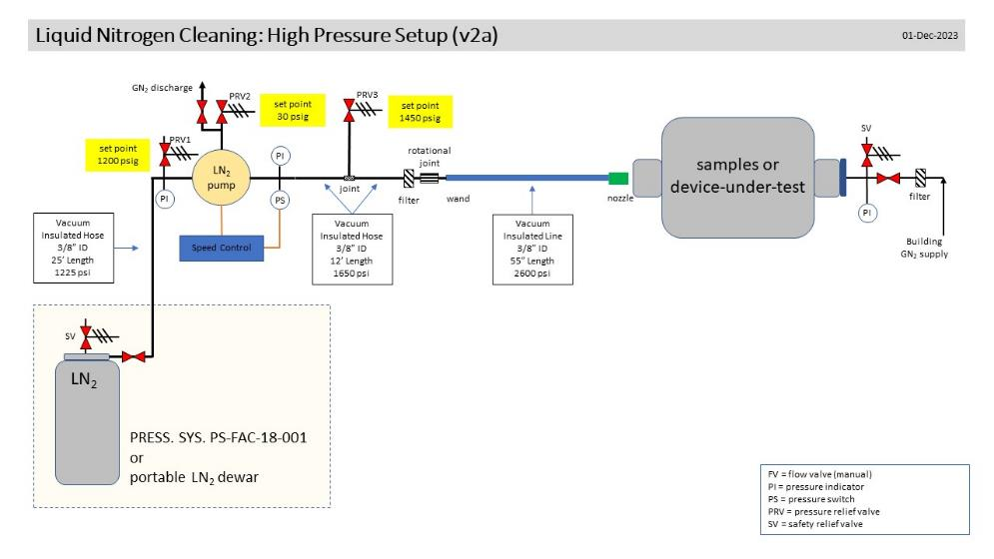
Path Forward and Conclusions
Cleaned cavity is waiting for vertical test to determine start of field emission onset
Re-clean at higher pressure of 20 bar
Add high-pressure liquid nitrogen pump
  rated output pressure up to 100 bar (adjustable)
  advancing through safety reviews...
Liquid nitrogen cleaning is a promising
alternative,
Continuing to improve setup and provide
a proof-of-concept
Thanks to many colleagues at Jefferson Lab for their help and support!
SRF Operations, SRF S&T, Environment & Safety, Cryogenics, Engineering
  Rongli Geng, Alex Eslinger, Tom DeSalvo, Phil Denny, Chris Dreyfuss, Dainnya Busbin, ...

