Slide 1
TTC WG3: Predicting Cavity & Coupler Ignition Thresholds in FRIB β = 0.085 QWRs for Plasma Processing
P. Tutt, W. Hartung, P. Berrutti, S. Kim, T. Xu
v

Slide 2
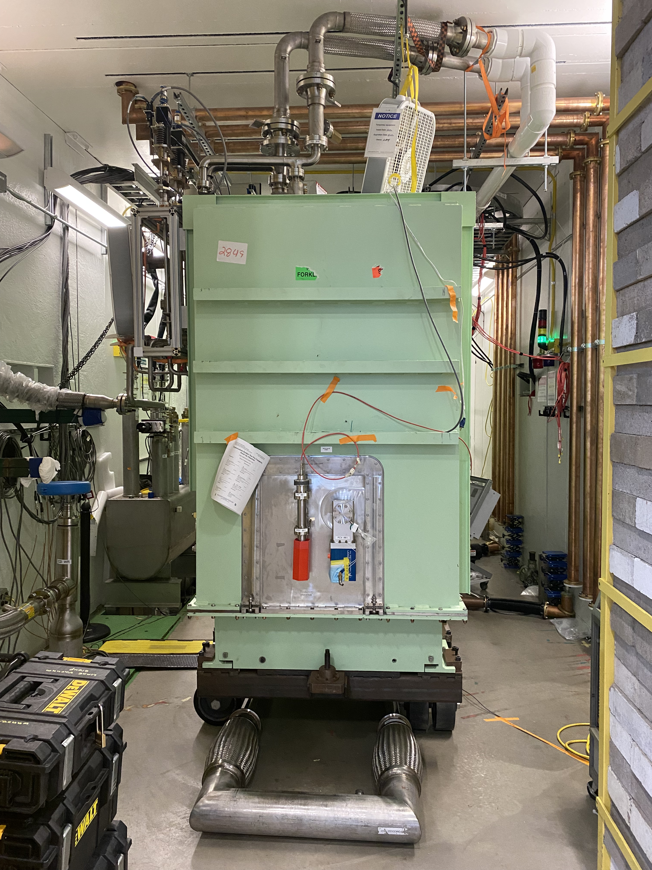
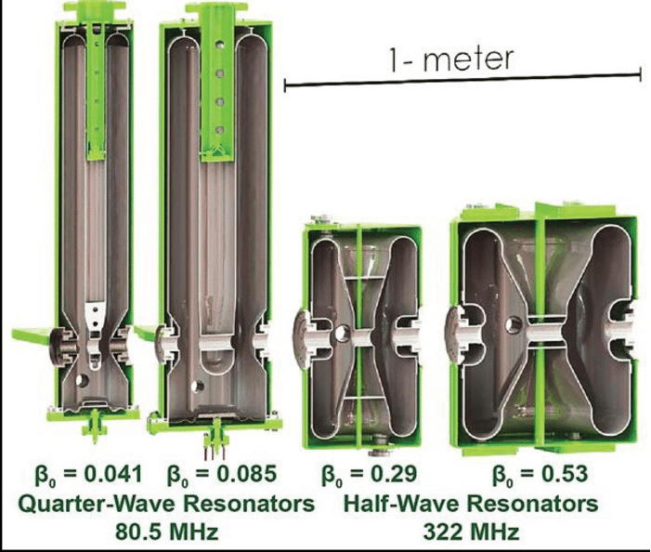
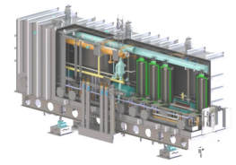
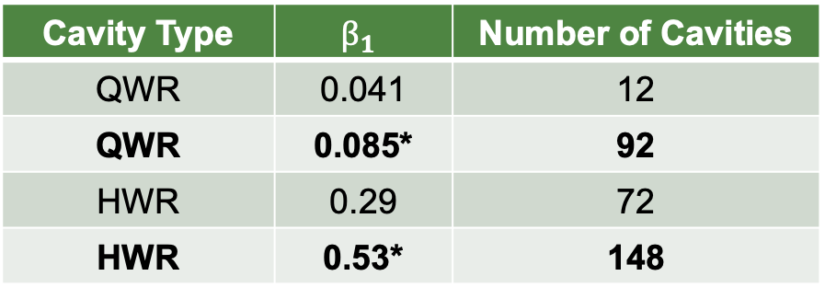
FRIB Cavities and Cryomodules
Cavity Type | $$β_{1}$$ | Number of Cavities
QWR | 0.041 | 12
QWR | 0.085* | 92
HWR | 0.29 | 72
HWR | 0.53* | 148
46 modules in total in the LINAC operating at 2K/4K
Plans to begin processing spare QWR module in December 2023/January 2024
  *Plasma processing development underway

Slide 3
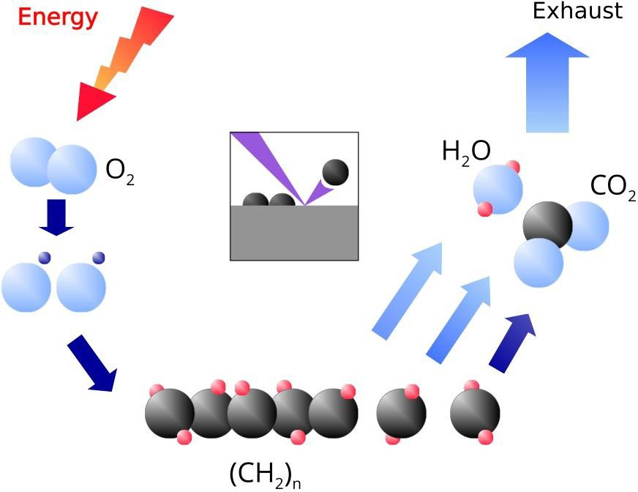
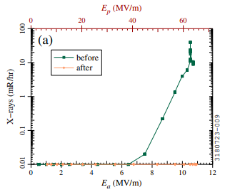
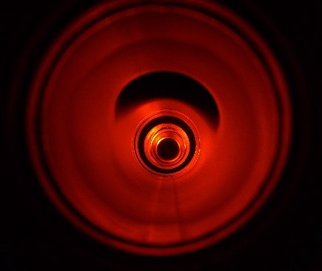
Plasma Processing
Plasma processing first demonstrated by ORNL for SNS; FNAL, JLab, and others have continued to pioneer this work
Plasma processing works by:
  Introduction of low pressure gas to room temperature cavity (Noble gas + O2)
  Ionization of gas creates a plasma
  Disassociated O2 can bond and remove hydrocarbons from surface
Processing attempted at FRIB with first 3 modes of β = 0.085 QWR with promising results:
[1] P. Berrutti, Proceedings of SRF23
Discharge with Ne + O2 in QWR

Slide 4
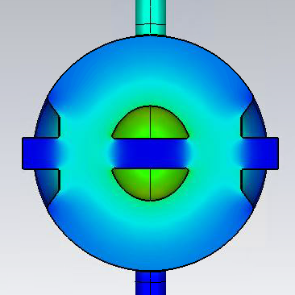
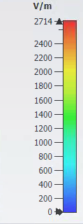
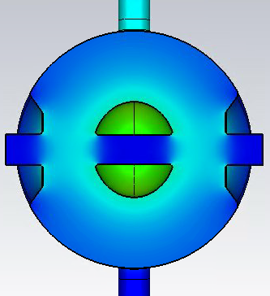
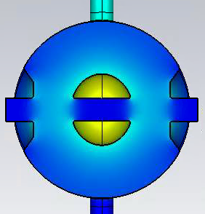
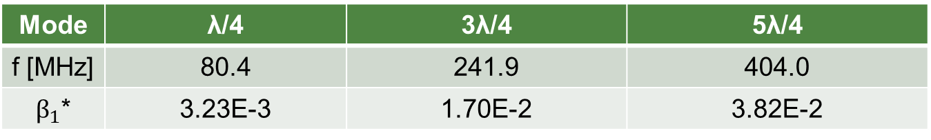
Modes used in FRIB Plasma Processing
View around accelerating gap:
Mode | λ/4 | 3λ/4 | 5λ/4
f [MHz] | 80.4 | 241.9 | 404.0
$β_{1}$* | 3.23E-3 | 1.70E-2 | 3.82E-2
*For FPC in extended position for improved coupling
Lower field in gap as frequency increases

Slide 5
Motivation for Predicting Ignition Thresholds
Multiple FRIB QWRs were processed with coupler plasma prior to development of a method for cavity plasma processing
Coupler plasma in FRIB QWRs may be difficult to detect and avoid if:
  RF frequency is low
  Large mismatch with FPC at room temperature
  Limited view of cavity interior
Potential harms of coupler plasma:
  Copper sputtering
  Damage FPC
Predicting ignition thresholds may help determine the working regime for cavity plasma
Methodology:
  Simulate e-field in CST MWS frequency domain solver
  Measure cavity, coupler ignition for first 3 QWR modes and normalize fields to measurement
  Compare to theoretical model

Slide 6
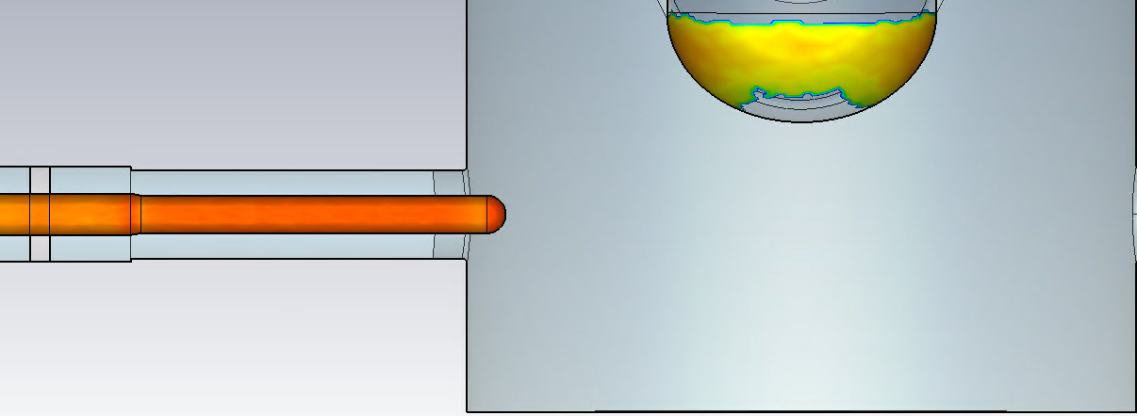
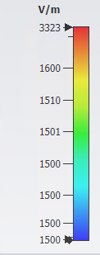
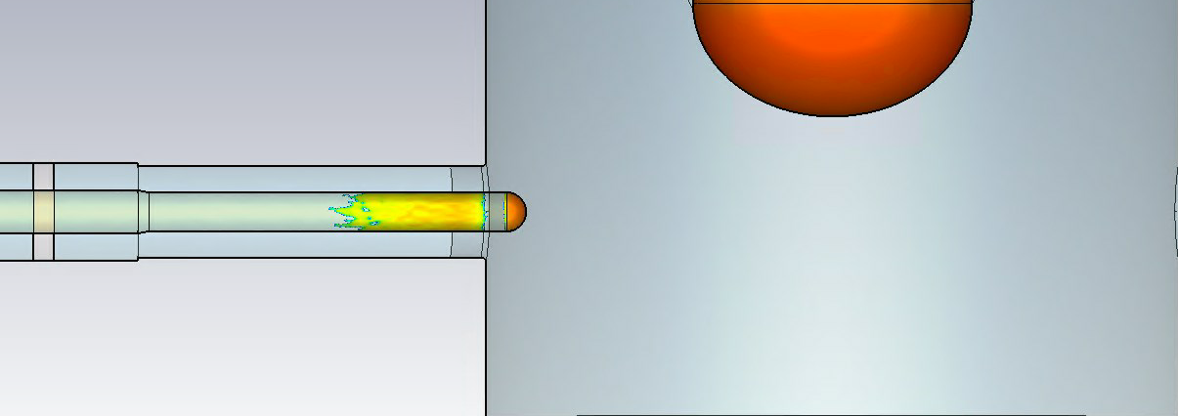
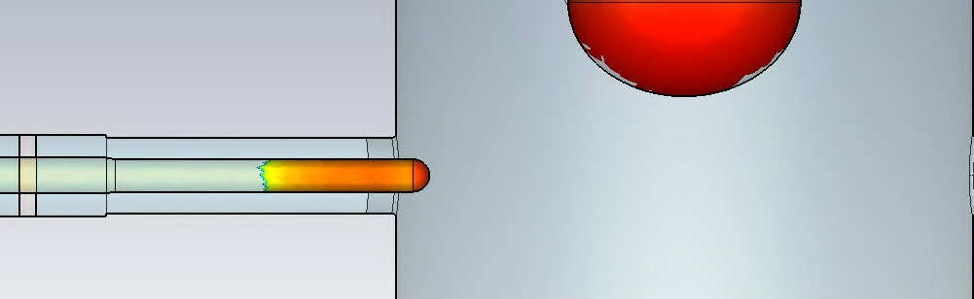
CST Simulations
Frequency domain solver in CST was used to simulate electric field distributions (Pf = .5 W)
Collect maximum values in cavity volume, on coupler tip, and on transmission line
**FPC in extended position for improved coupling**

Slide 7
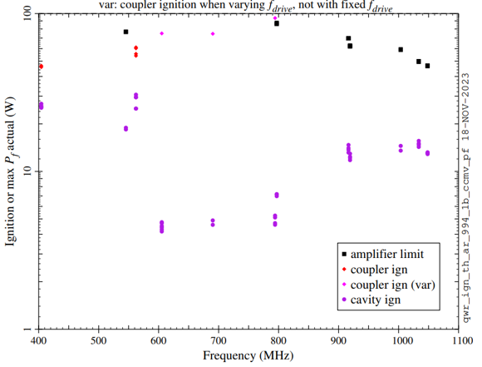
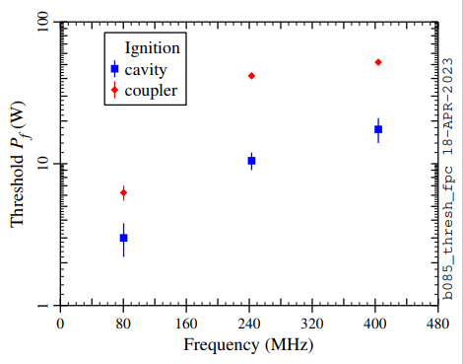
Ignition Measurements – Neon, Argon
Threshold forward power at ignition was measured for both cavity and coupler
Measurement conditions:
  Neon at 100 mTorr (right)
  Argon at 40 – 60 mTorr (left)

Slide 8
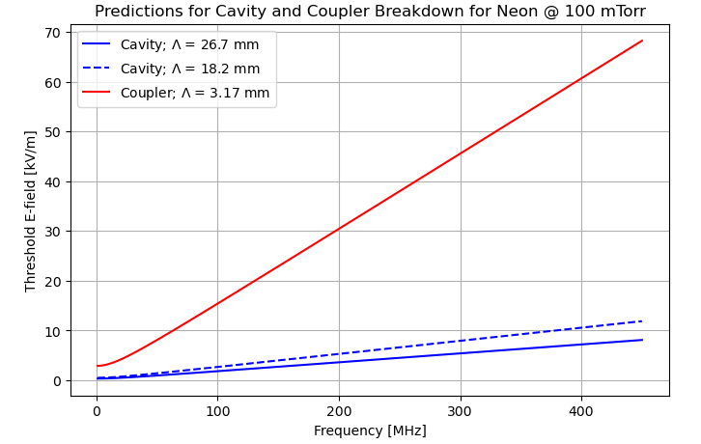
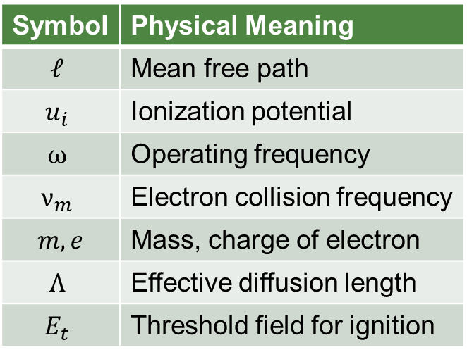

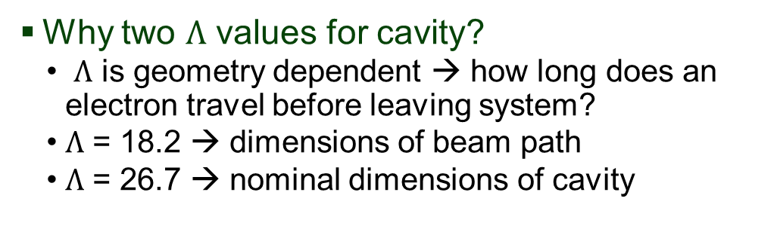
Developing a Theory for Breakdown
We use a diffusion based breakdown model following similar work performed for the CEBAF 5-cell cavity [2]
The criteria for breakdown is: ${E_{t}}^{2}= \frac{ℓ^{2}}{Λ^{2}}\frac{mu_{i}}{3e}\left(ω^{2}+{ν_{m}}^{2}\right)$
Model requires that $Λ$ > $ℓ$
Normalization:
  Cavity → stored energy; Coupler → forward power
Symbol | Physical Meaning
$$ℓ$$ | Mean free path
$$u_{i}$$ | Ionization potential
$$ω$$ | Operating frequency
$$ν_{m}$$ | Electron collision frequency
$m, e$ | Mass, charge of electron
$$Λ$$ | Effective diffusion length
$$E_{t}$$ | Threshold field for ignition
Why two $Λ$ values for cavity?
  $Λ$ is geometry dependent → how long does an electron travel before leaving system?
  $Λ$ = 18.2 → dimensions of beam path
  $Λ$ = 26.7 → nominal dimensions of cavity

Slide 9
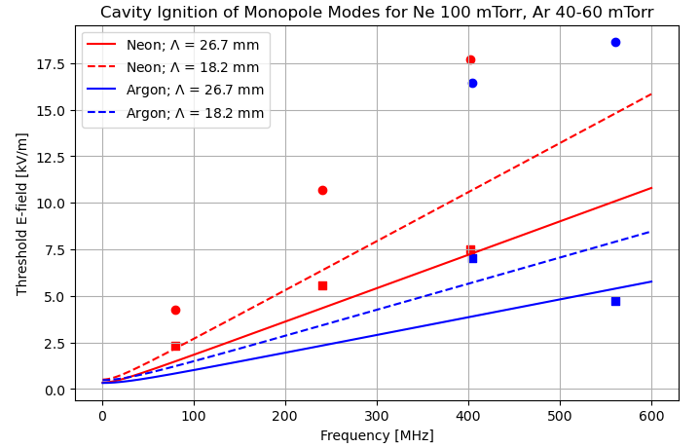

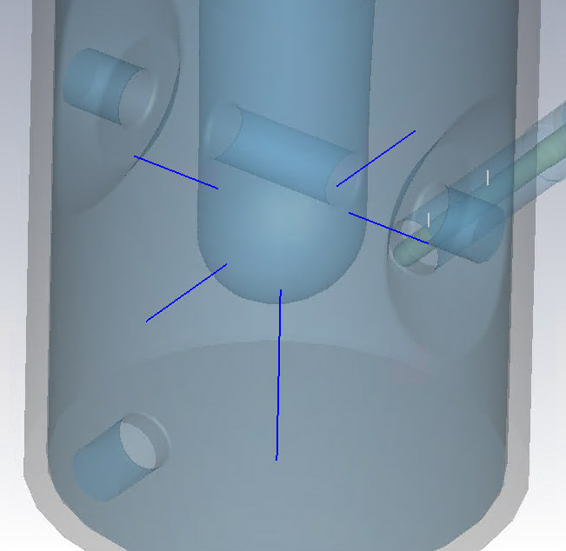
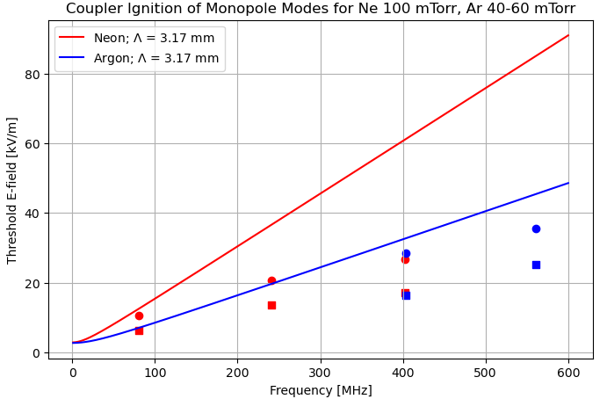
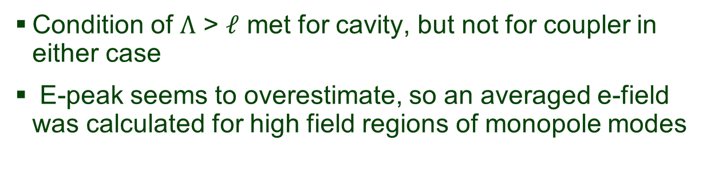
Comparing Theory, Measurement for Monopole Modes
Condition of $Λ$ > $ℓ$ met for cavity, but not for coupler in either case
E-peak seems to overestimate, so an averaged e-field was calculated for high field regions of monopole modes
Average field from region of high surface field to boundary where electron leaves system

Slide 10


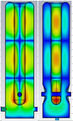
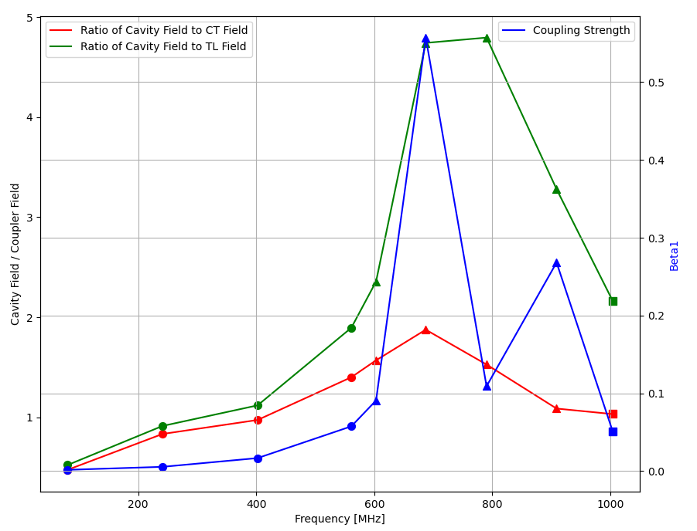



Examining additional HOMs
561 MHz
603 MHz
687 MHz
HOMs beyond 3λ/4 and 5λ/4 were investigated due to their improved coupling
In addition to first 3 modes, 6 additional modes were interesting:
790 MHz
909 MHz
1004 MHz
**FPC in nominal position to simulate cryomodule configuration**

Slide 11
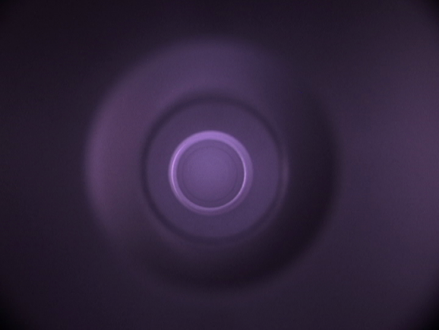
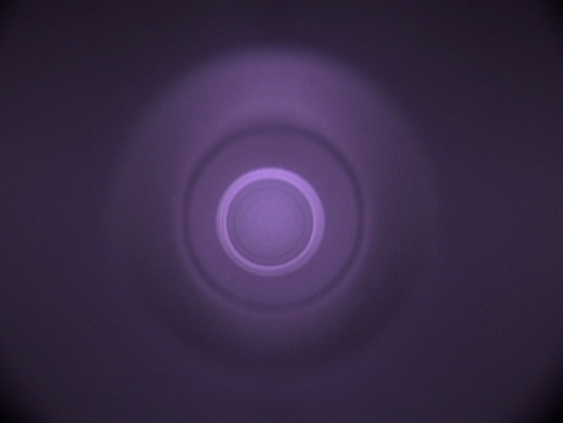
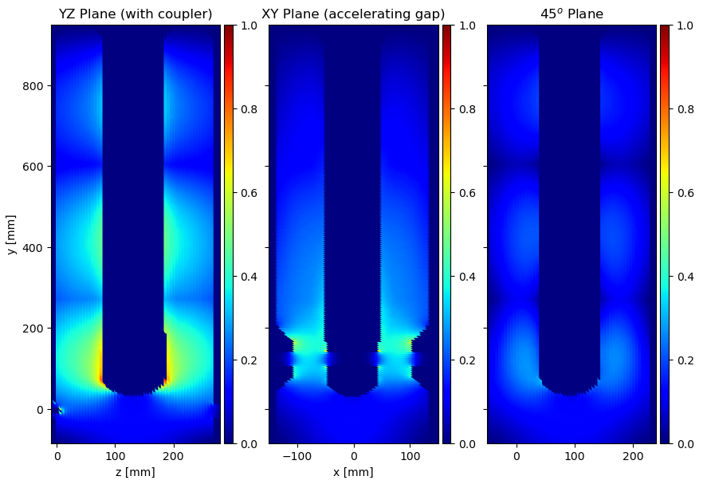
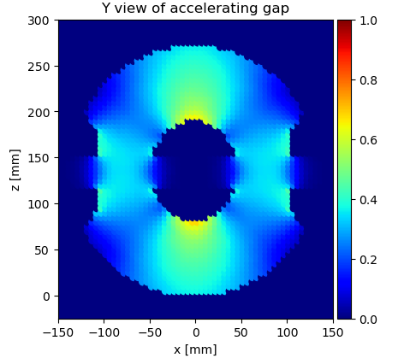
Dual-tone Excitation of FRIB QWR: 1004 MHz + 690 MHz
While HOMs offer improved coupling, plasma distribution is of concern for non-monopole modes
To investigate, CST fields were exported and normalized to their max field
The two are then superimposed to see if the modes can fill in each others gaps
This technique was explored experimentally with iterative adjustments to drive power and frequency
Light observed in both accelerating gaps
Have not attempted this recipe on a cavity with a before and after cold test

Slide 12
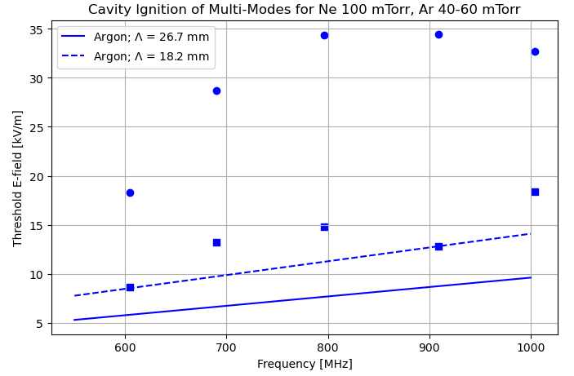
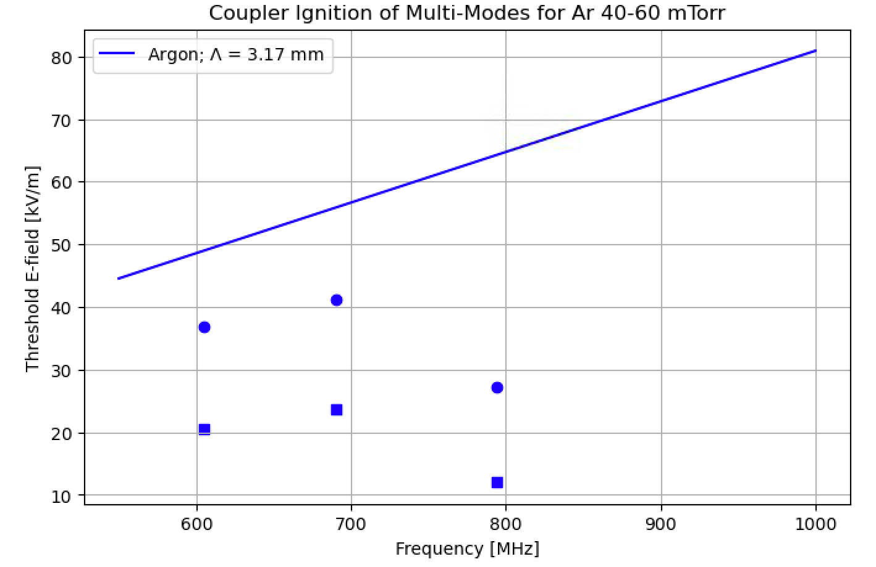
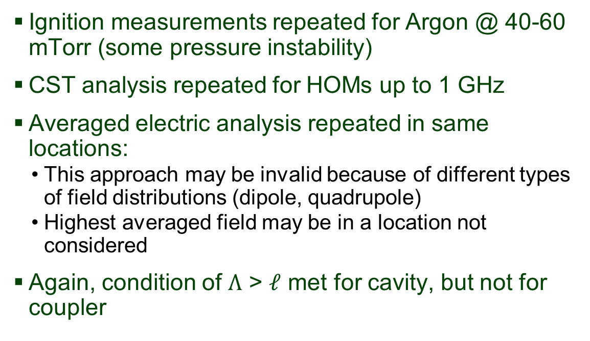
On-going Work: Comparing Measurement, Theory for Dipole & Quadrupole Modes
Ignition measurements repeated for Argon @ 40-60 mTorr (some pressure instability)
CST analysis repeated for HOMs up to 1 GHz
Averaged electric analysis repeated in same locations:
  This approach may be invalid because of different types of field distributions (dipole, quadrupole)
  Highest averaged field may be in a location not considered
Again, condition of $Λ$ > $ℓ$ met for cavity, but not for coupler
Dipole modes at 605 MHz, 690 Mhz, and 794 MHz required frequency “tuning” to ignite once amplifier limit was reached (~100 W)

Slide 13
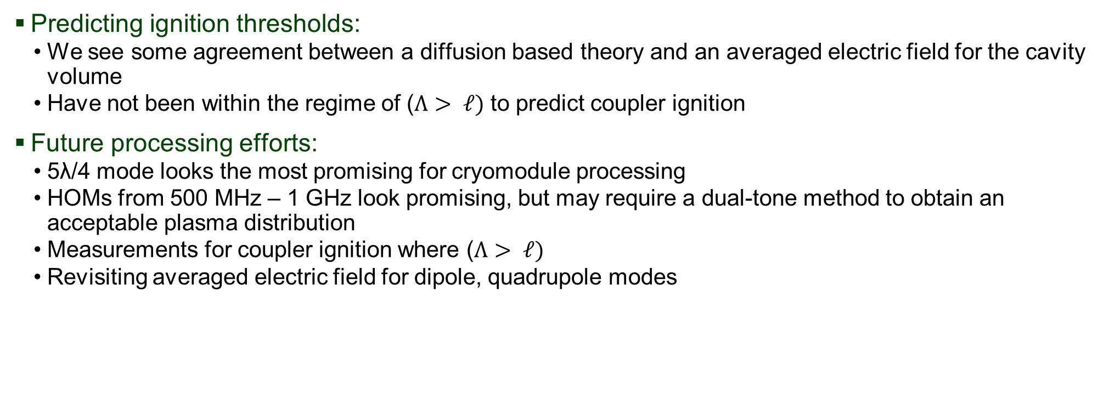
Takeaways
Predicting ignition thresholds:
  We see some agreement between a diffusion based theory and an averaged electric field for the cavity volume
  Have not been within the regime of ($Λ> ℓ)$ to predict coupler ignition
Future processing efforts:
  5λ/4 mode looks the most promising for cryomodule processing
  HOMs from 500 MHz – 1 GHz look promising, but may require a dual-tone method to obtain an acceptable plasma distribution
  Measurements for coupler ignition where ($Λ> ℓ)$
  Revisiting averaged electric field for dipole, quadrupole modes
We see potentially encouraging results for predicting cavity ignition, but have yet to predict the coupler ignition. If coupler ignition can be accurately predicted, then the working point of cavity plasma for various modes may be better understood.

Slide 14
Questions?
Thank you for listening!

Slide 15
Citations
[1] P. Berrutti, “Plasma Cleaning at FNAL: LCLS-II HE vCM Results and Ongoing Studies on Spoke Resonators”, presented at the 21th Int. Conf. RF Supercond. (SRF'23), Grand Rapids, MI, USA, Jun. 2023, THIXA02.
[2] Popović, S., Upadhyay, J., Mammosser, J., Nikolić, M., Vušković, L. Resonant-frequency discharge in a multi-cell radio frequency cavity (2014) Journal of Applied Physics, 116 (17), art. no. 173301. http://dx.doi.org/10.1063/1.4900994

Slide 16
Supplementary Material

Slide 17
Cavity Statistics for Spare QWR Cryomodule
Understanding variation in frequency, coupling will be important for processing an entire module
6 of 8 cavities measured on spare QWR cryomodule planned for future processing test
Comments:
  Coupling varies more for modes with nearby polarization (790, 909)
  Simulated coupling agrees well with measured coupling for most modes

Slide 18
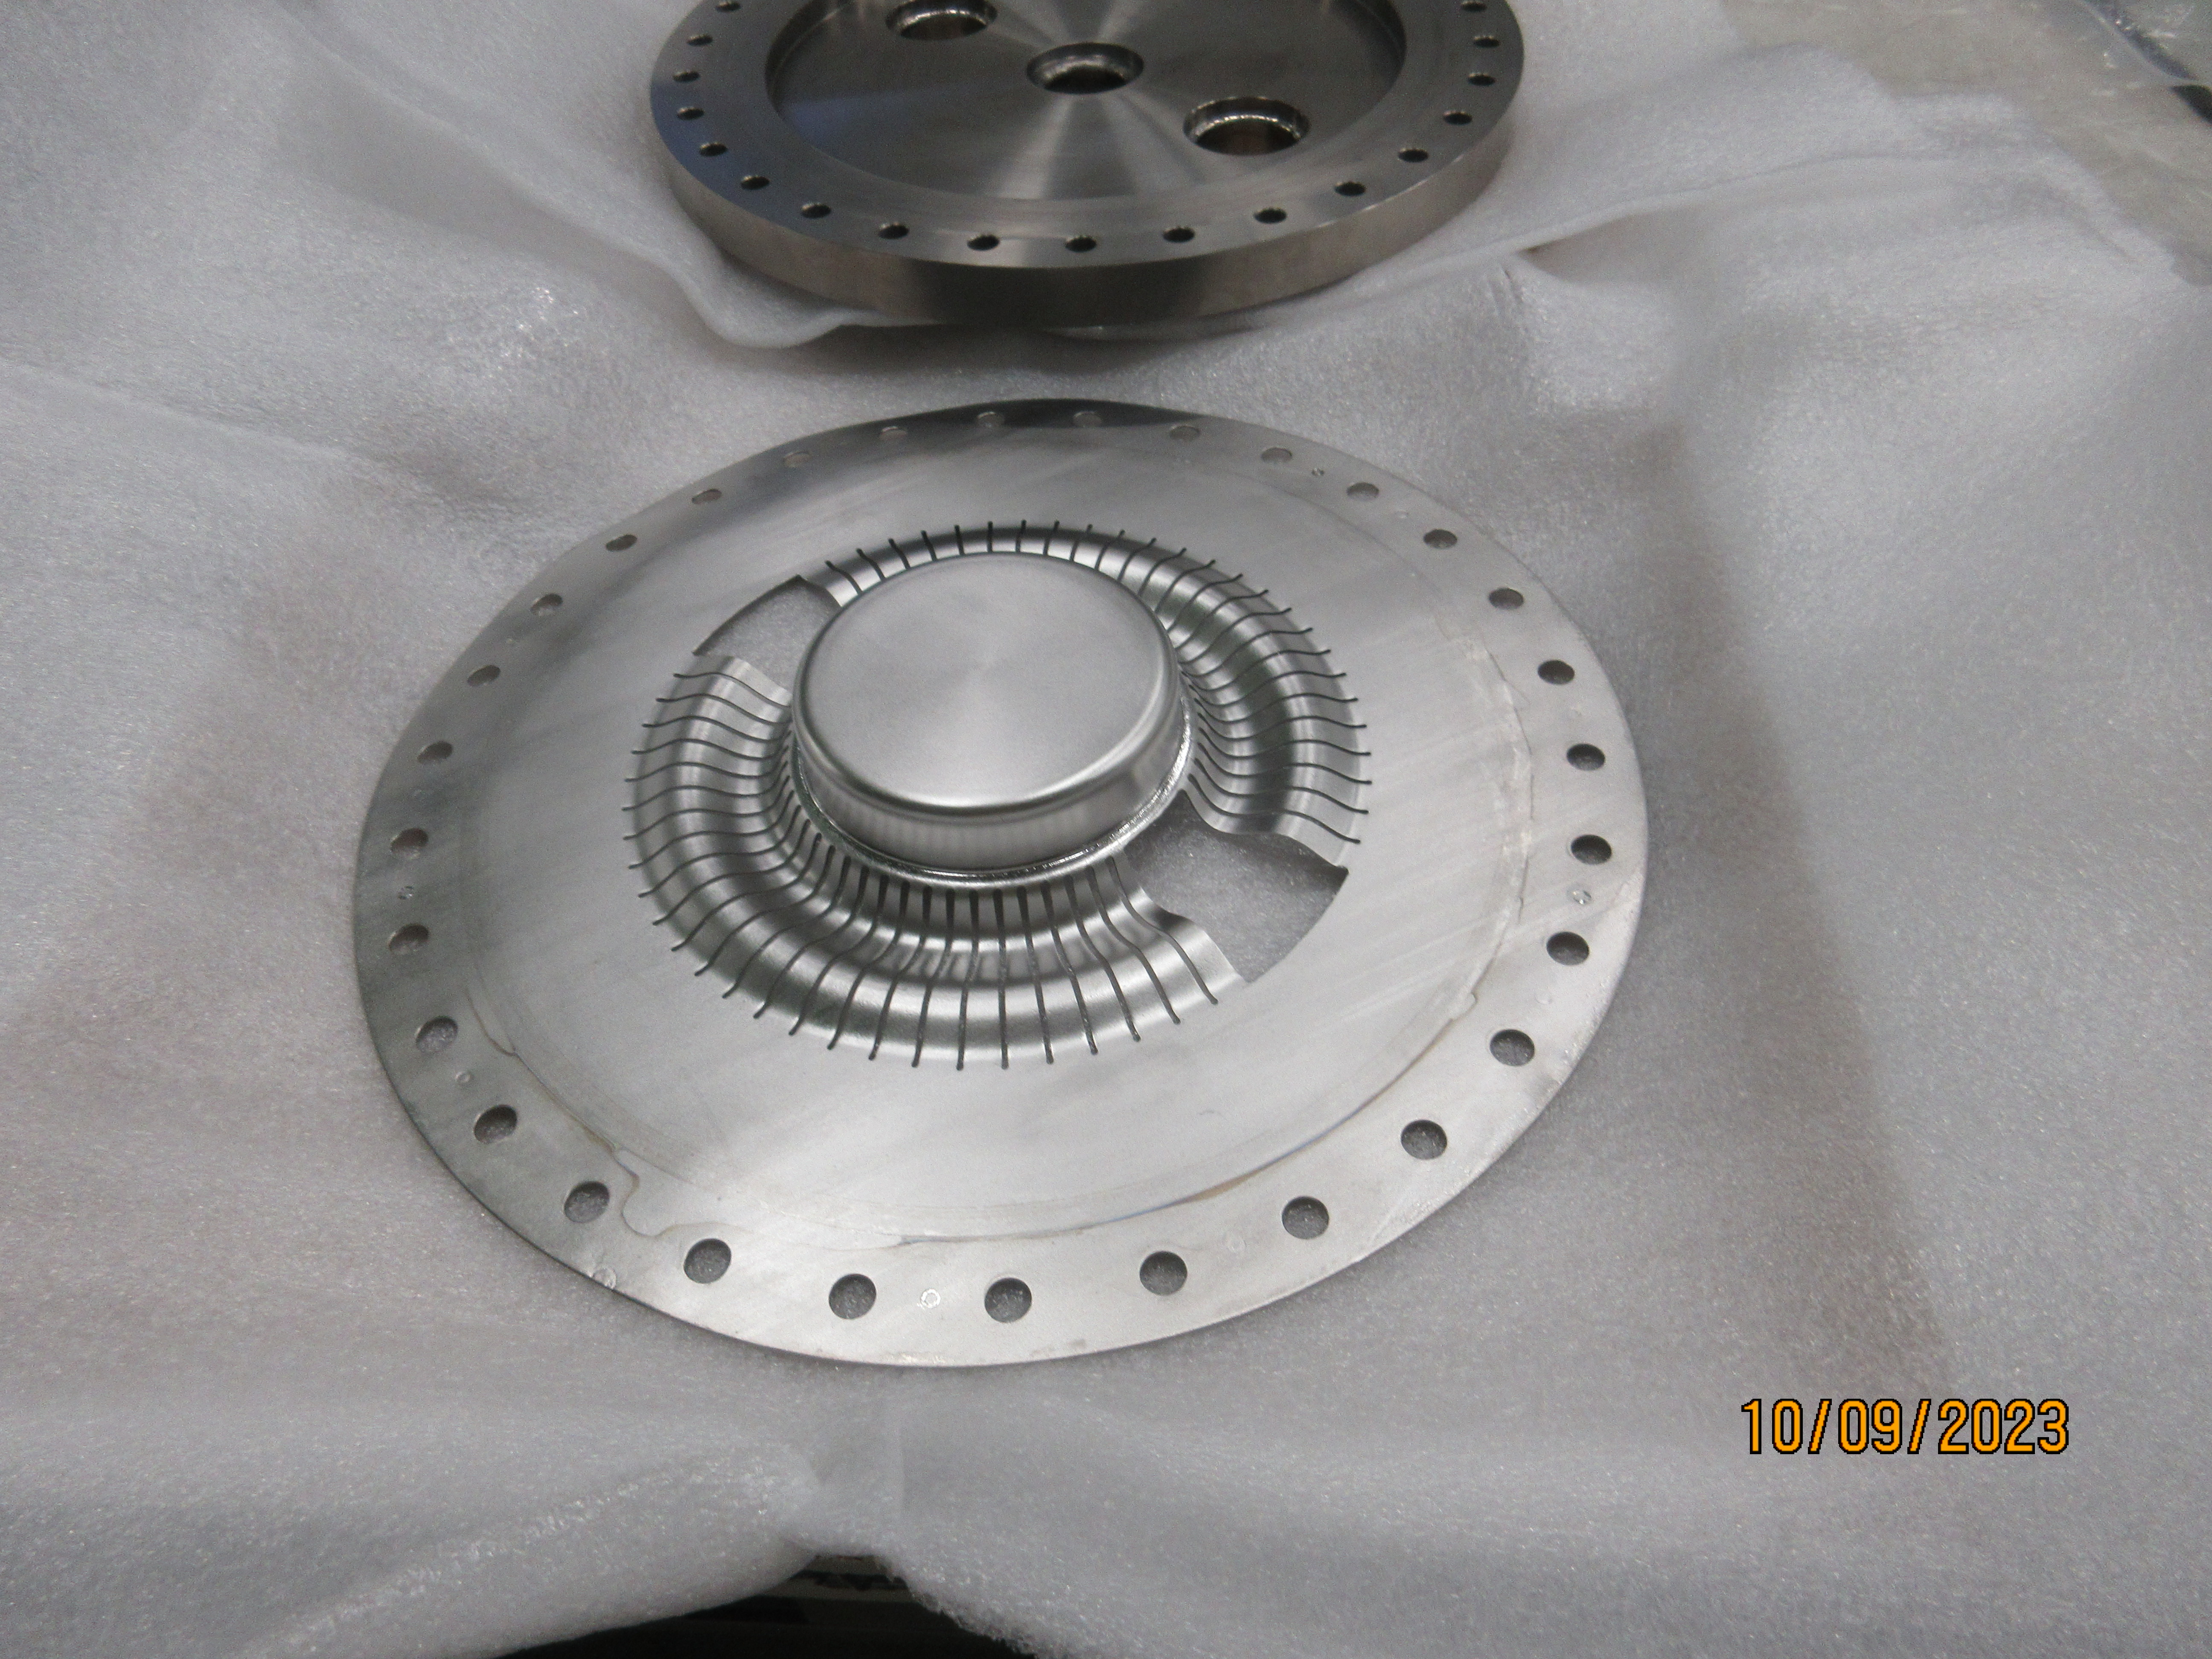
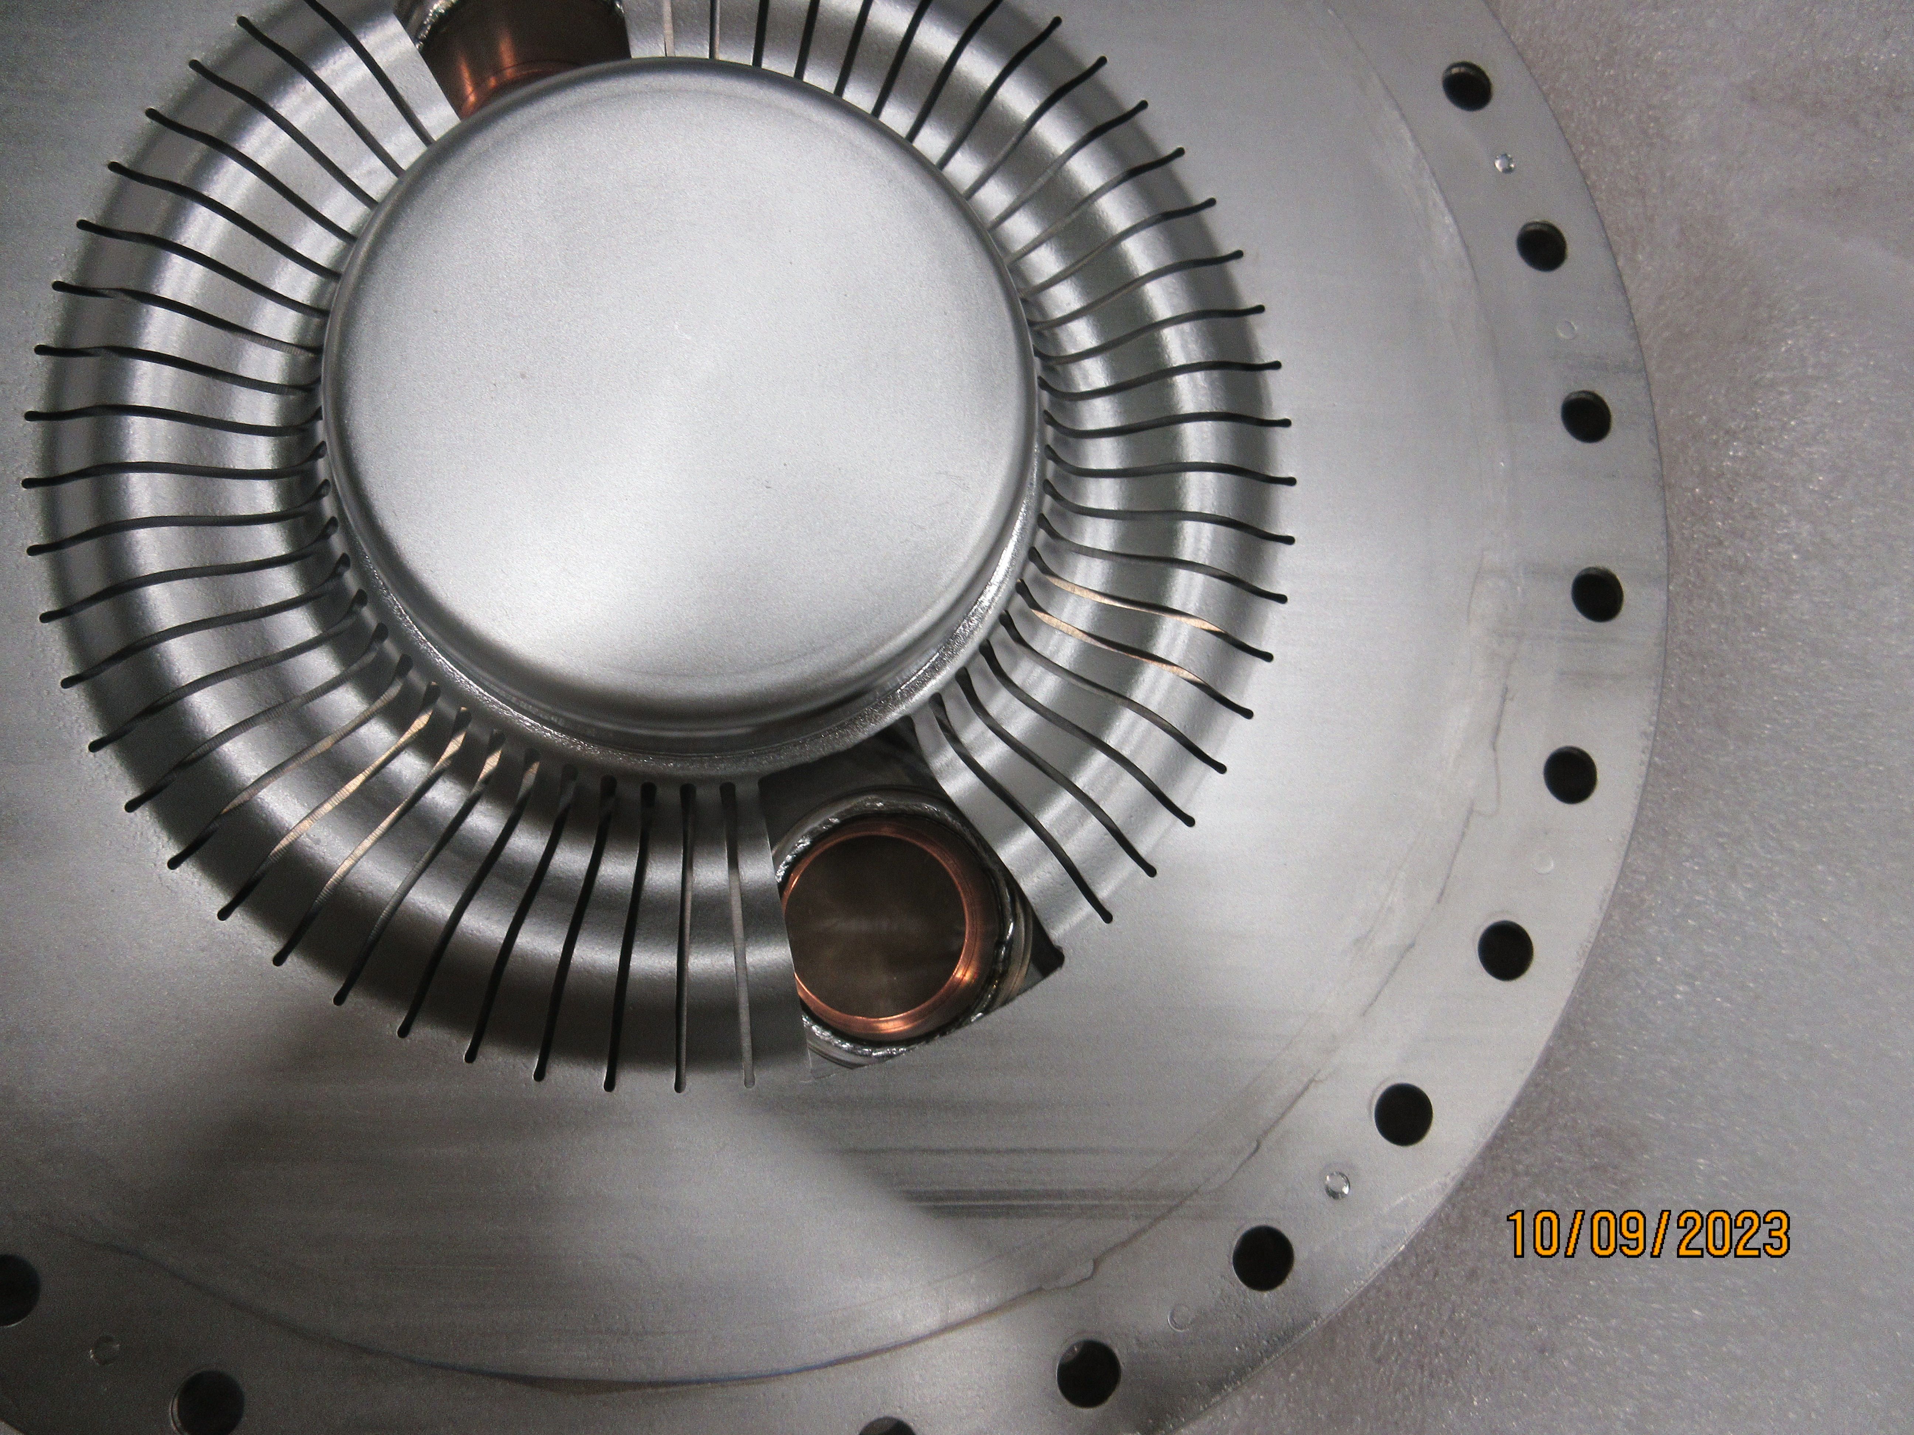
Modified bottom flange for HOM study

