Slide 1
DESIGN & OPTIMIZATION OF SINGLE SPOKE CAVITIES FOR MEDIUM ENERGY HIGH-INTENSITY PROTON ACCELERATOR
Abhishek Pathak
Tesla Technology Collaboration Meeting – 2023
06 December 2023

Slide 2
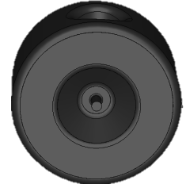
1. Introduction
4. HOM Analysis
2. Choosing right SSR
5. Multipacting
OUTLINE
3. RF Design
6. Final Design
7. Conclusion

Slide 3
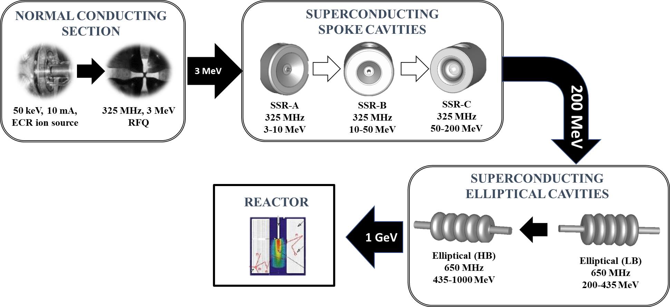
1 GeV LINAC FOR INDIAN ADS PROGRAM

Slide 4
MEHIPA ROADMAP

Slide 5
SINGLE SPOKE CAVITIES FOR MEHIPA

Slide 6
SSR DESIGN AND OPTIMIZATION STEPS
Determine the optimal beta (β) for the targeted energy range and acceleration gradient.
Conduct RF design iterations, focusing on minimizing peak surface fields and optimizing structural dimensions for the desired frequency.
Execute comprehensive Higher Order Mode (HOM) analysis to ensure beam stability and reduce power dissipation.
Carry out multipacting analysis to identify potential electron multiplication sites and implemented mitigation strategies to prevent operational disruptions.

Slide 7
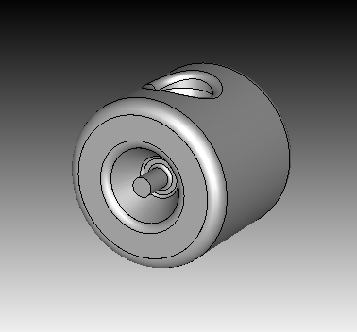
DESIGN CHALLENGES
Resonate at 325 MHz.
Peak surface electric < 40 MV/m.
Peak surface magnetic < 70 mT.
Maximize R/Q.
Compact design.
Transit time > 0.7for given energy
range.
Shape counters Multipacting.
OPTIMIZED CAVITY

Slide 8
CHOSING RIGHT $β_{optimal}$

Slide 9
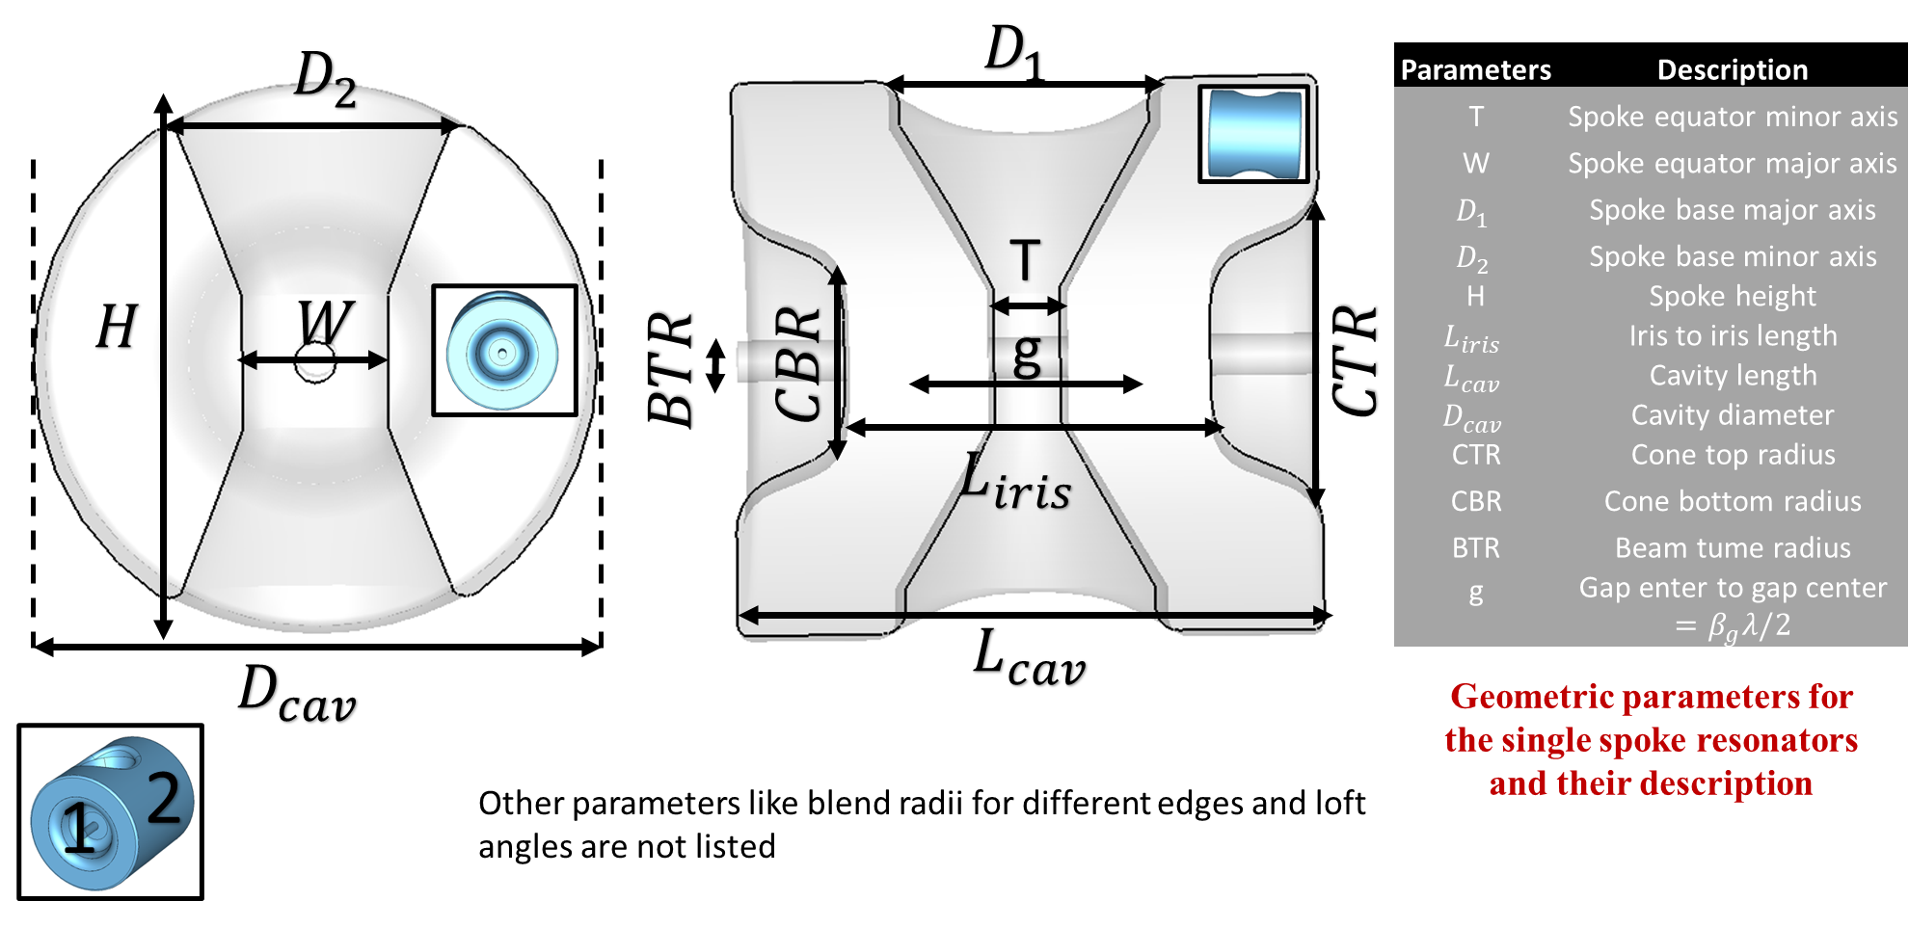
SPOKE CAVITY GEOMETRY

Slide 10
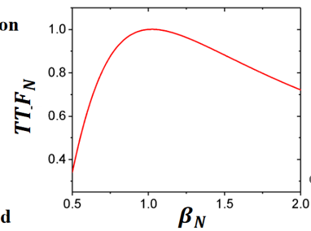
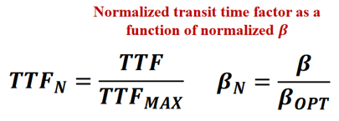
CAVITY $β$ OPTIMIZATION
Generalized TTF plot is obtained after normalization of TTF(β) with $TTF_{nax}$ and β with $β_{opt}$.
The normalized TTF was fitted to obtain the functional form.
Energy gain and number of cavities were calculated with different βopt for the given accelerating gradient and synchronous phase.

Slide 11
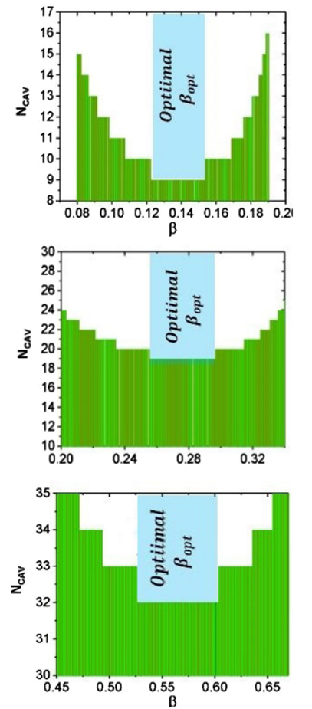
CAVITY $β$OPTIMIZATION
Number of cavities required to achieve the target energy gain for a given cavity accelerating gradient was plotted with variation in cavity $β_{opt}$
The region with minimum number of cavities defines the optimal $β$range.
We chose the lower $β_{opt}$ value to minimize the length of the cavity and therefore the length of the linac,

Slide 12
RF DESIGN & OPTIMIZATIONN

Slide 13
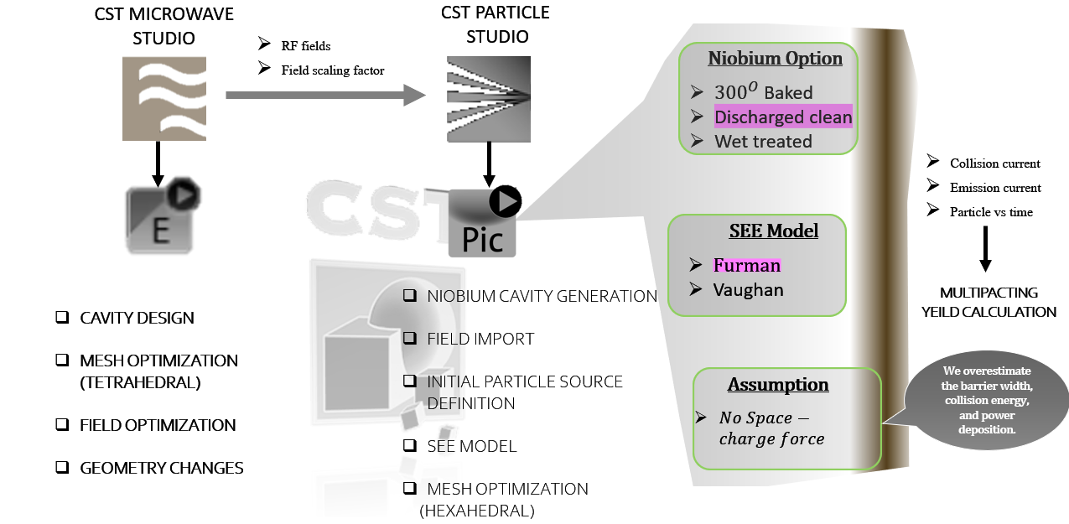
SIMULATION TOOLS

Slide 14
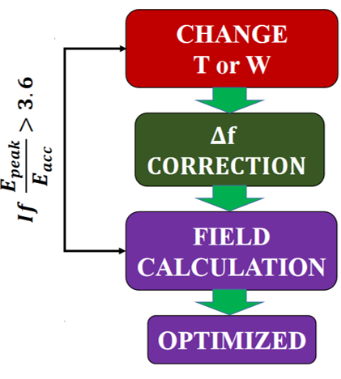
RF DESIGN AND OPTIMIZATION
Electric Field
Magnetic Field
The ratio of the peak electric field to the accelerating field is minimized using the spoke equator's major and minor axis (T and W) and cone top radius.
The ratio of the peak surface magnetic field to the accelerating gradient is optimized using the spoke base major and minor axis D1 and D2.
The resonant frequency of the cavity is tuned using the spoke height (H).
The TTF optimization was performed with the axial parameters, while keeping the field ratio within the limit.

Slide 15
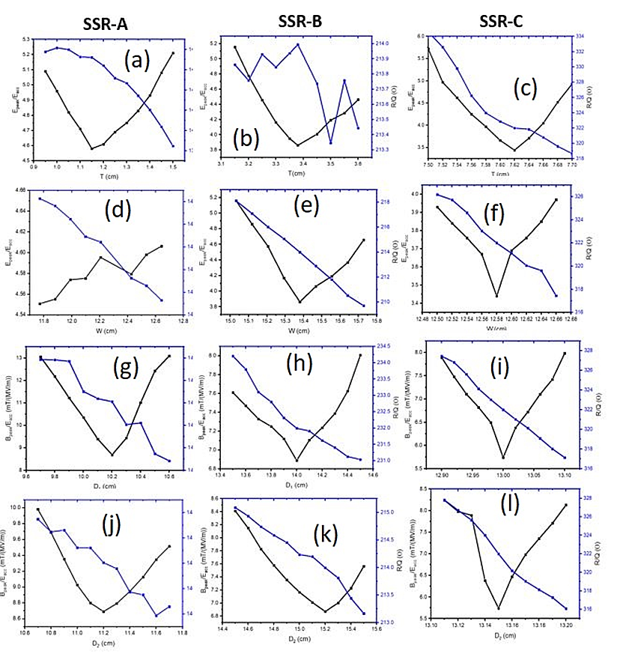
RF DESIGN AND OPTIMIZATION
The ratio of the peak electric field to the accelerating field is minimized using the spoke equator's major and minor axis (T and W) and cone top radius.
The ratio of the peak surface magnetic field to the accelerating gradient is optimized using the spoke base major and minor axis D1 and D2.
The resonant frequency of the cavity is tuned using the spoke height (H).
The TTF optimization was performed with the axial parameters, while keeping the field ratio within the limit.

Slide 16
FINAL RF DESIGN PARAMETERS
Parameter | SSR-A | SSR-B | SSR-C
Aperture radius (mm) | 15 | 15 | 30
Effective Length (cm) | 12.46 | 24.92 | 49.66
T (cm) | 1.55 | 4.41 | 3.81
W (cm) | 4.06 | 14.4 | 6.29
D1 (cm) | 6 | 7.6 | 13.1
D2 (cm) | 7 | 5 | 13.15
R/Q ($Ω)$ | 128.8 | 223.6 | 322
E_{peak}/E_{acc} | 4.75 | 3.49 | 3.44
B_{peak}/E_{acc} (mT/MV/m) | 8.16 | 6.58 | 5.74
Accelerating Gradient (MV/m) | 8 | 10 | 11

Slide 17
HIGHER-ORDER MODE ANALYSIS

Slide 18
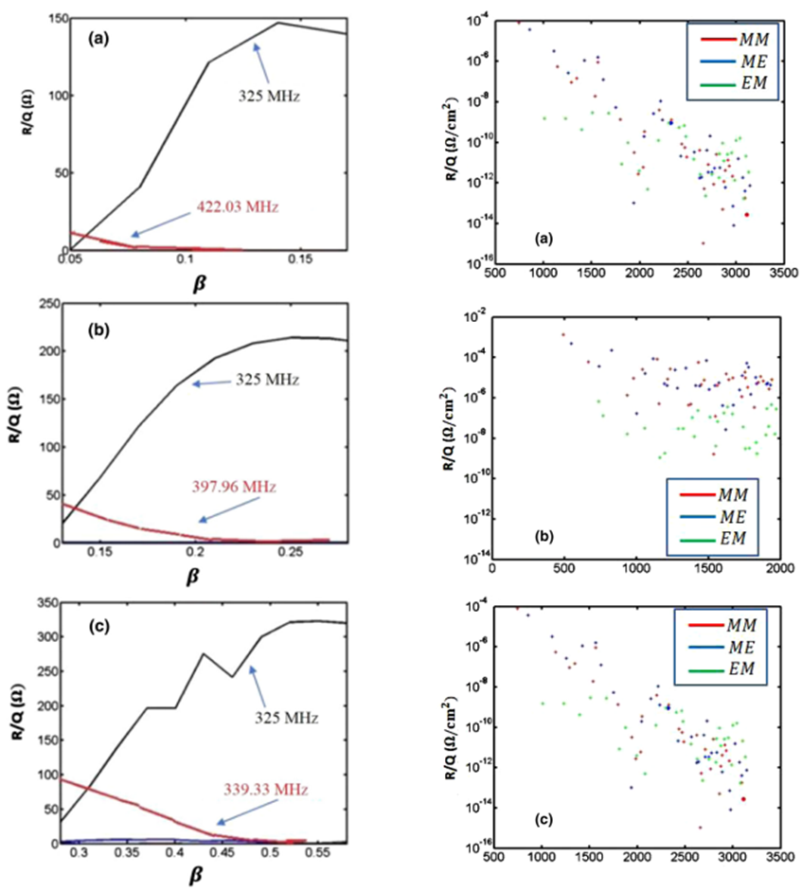
HIGHER-ORDER MODE ANALYSIS
SSR-A
SSR-A
The R/Q for the higher higher order monopole, dipole and quadrupole were calculated using different boundary conditions.
The R/Q for the operating mode was found to e dominant followed by the mode at 397 MHz which is far from the operating point.
The dipole and quadrupoles mode exibits insignificant R/Q.
SSR-B
SSR-B
SSR-C
SSR-C
$$\frac{R}{Q}=\frac{c^{2}}{ω^{3}×a^{2}×U }{\left|\int_{0}^{L_{cav}}{E_{z}e^{i\left(kz\right)}dz}\right|}^{2}$$

Slide 19
MULTIPACTING

Slide 20
MULTIPACTING : AN INTRODUCTION

Slide 21
SIMULATION TOOLS

Slide 22
MULTIPACTING : SIMULATION SETUP

Slide 23
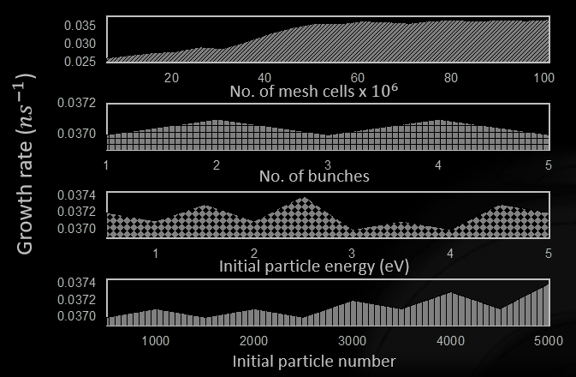
MULTIPACTING : SIMULATIONS
We performed controlled simulation with the following parameters to obtain the convergence,
Simulation time
Number of mesh cells
Number of electron bunches
Electron energy
Number of particles
Simulation time and mesh density were found to be the parameters that dictates the convergence of multipacting yield.

Slide 24
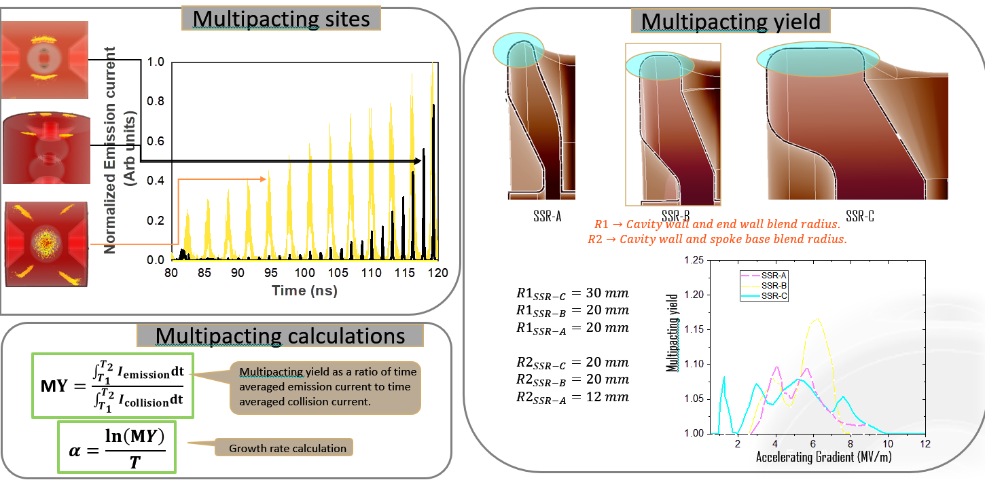
MULTIPACTING : SIMULATION RESULTS

Slide 25
FINAL THOUGHTS
Implemented three families of single spoke resonators in the Indian ADS program's MEHIPA stage, aiming to accelerate a 10 mA proton beam from 3 MeV to 200 MeV.
Adopted a systematic methodology to determine the $β_{opt}$ for cavities, targeting specific energy ranges and acceleration gradients.
Executed RF design optimizing for minimal peak surface fields and maximized R/Q ratio.
Calculated R/Q for monopole, dipole, and quadrupole modes; analysis indicates no significant higher order mode interference with cavity operations.
Conducted extensive multipacting analysis; applied curvature tuning in multipacting zones to mitigate observed two-point multipacting issues.
Achieved final cavity design that fulfills all specified functional .

Slide 26
REFERENCE
Please consider the above article for further details.

