Slide 1
Crab Cavities for Electron Ion Collider
Binping Xiao
Brookhaven National Lab
TTC2023 Meeting
Fermilab
December 5-8, 2023

Slide 2
Outline
EIC Crab Systems
Overview
197 MHz
RFD with 3 coax absorbers
Multipole components
394 MHz
RF-dipole (RFD) with 4 waveguide absorbers
Control
Feedback and noise
Summary
Notes:
Quickly evolving specs → designs.
Tuner, multipole components, noise control, high gain low delay control loop etc.

Slide 3
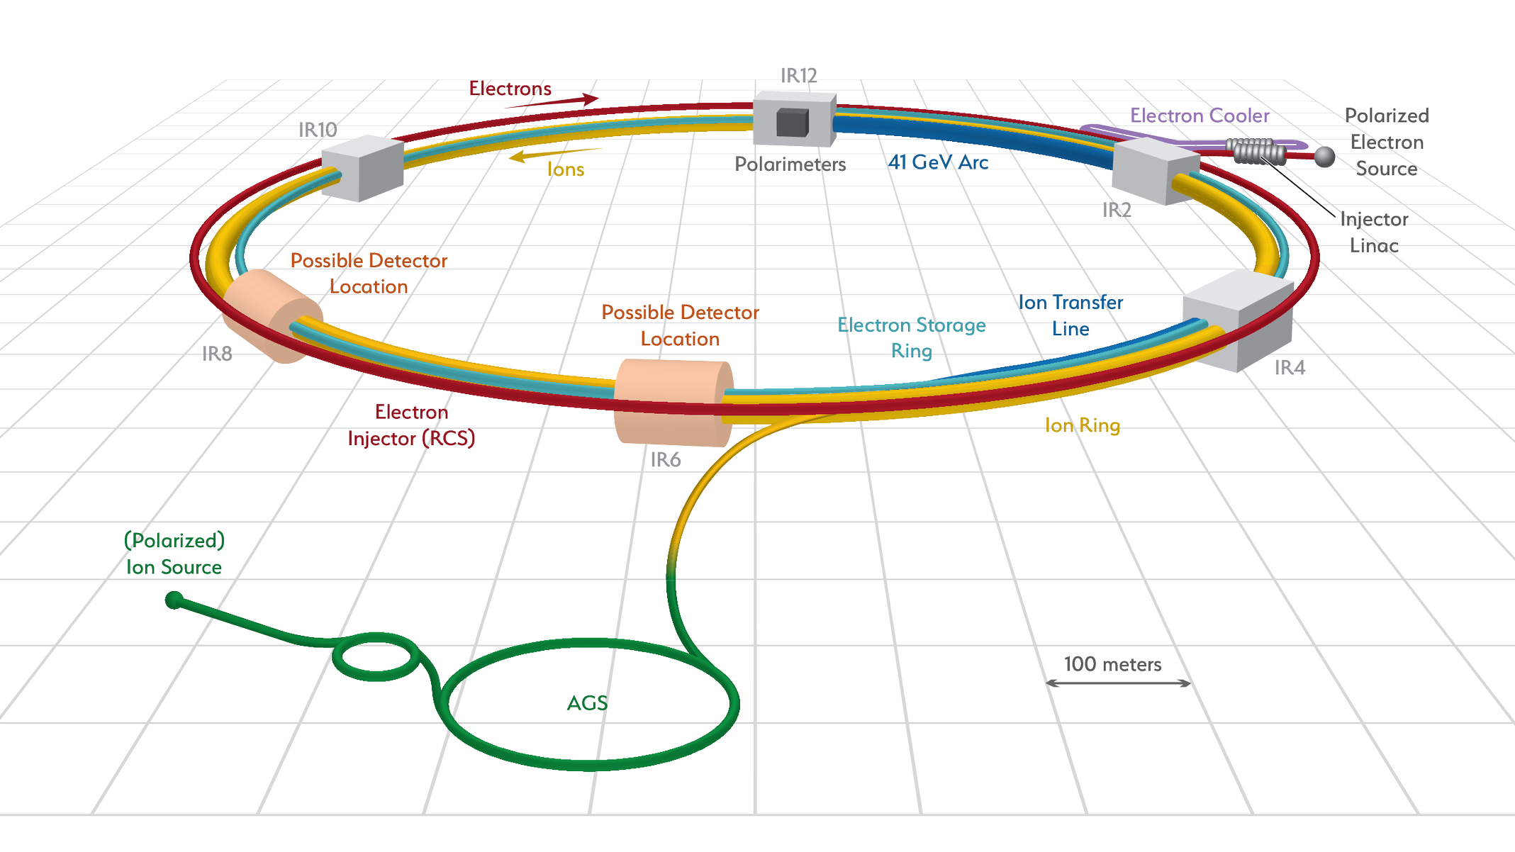
EIC Crab Systems Overview
Crab Cavities (IR6) | HSR (Cavities/CMs) | ESR (Cavities/CMs)
197 MHz | 8/4 | –
394 MHz | 4/4 | 2/2*
50% more
*or 4/4 for redundancy
HSR: Hadron Storage Ring
ESR: Electron Storage Ring
Operating voltage per cavity: 8.5 MV for 197 MHz & 2.9 MV for 394 MHz.
Designed specs: 11.5MV for 197MHz & 3.5MV for 394MHz, with E_{pk} 45MV/m & B_{pk} 80mT.
Impedance budget (per cavity): For 197MHz 10kΩ longitudinal 0.132MΩ/m horizontal 0.66MΩ/m vertical & for 394MHz 3.25kΩ-GHz longitudinal 0.12MΩ/m transverse (with two 394MHz for ESR per IP per side, considering two IPs).
And high HOM power per cavity, a few kW for hadron ring 197MHz and >40kW for electron ring 394MHz.
Notes:
Low in freq -> large in size, geometric constraint/mechanical design/fabrication/surface treatment/installation.
Tight impedance budget, high HOM power -> difficulties in damper designs.
for EIC, the longitudinal impedance budget is two orders of magnitude lower comparing with HL-LHC for 197MHz and three orders of magnitude lower for 394MHz, while the transverse impedance budget is one order of magnitude lower for both 197MHz and 394MHz.
Due to the high current and short bunch length, especially for electron bunch, the HOM power of both 197MHz and 394MHz systems are high while comparing with HL-LHC.

Slide 4
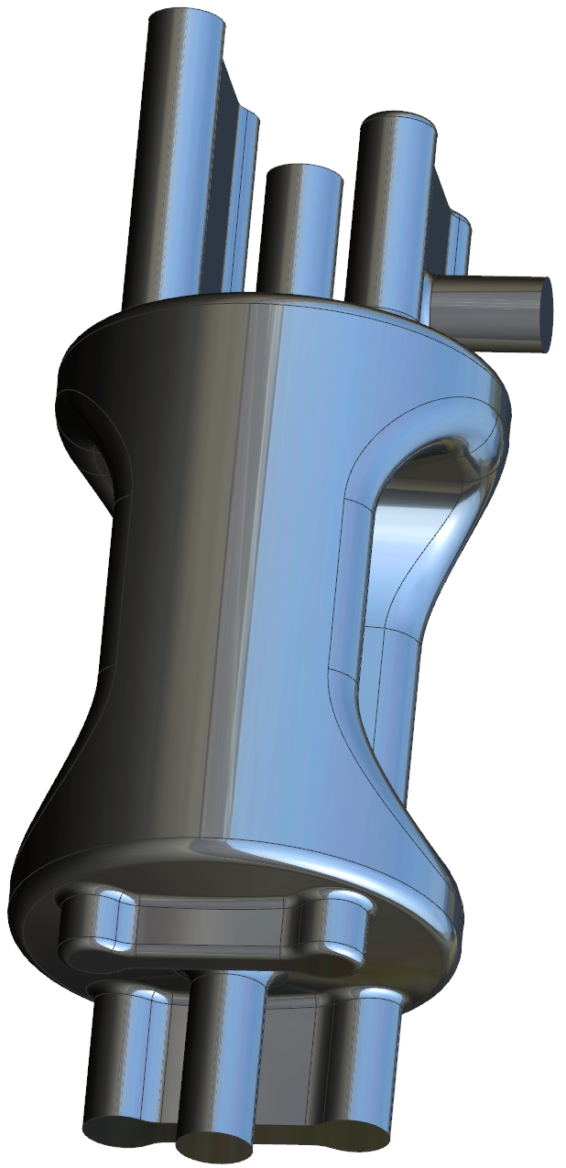
197 MHz Crab Cavity
Longer poles to provide higher crabbing voltage, elongated Double Quarter Wave (DQW) is not mechanically suitable, thus RFD is chosen.
Electromagnetic design requires to achieve:
Cavity peak surface fields of E_{p} < 45 MV/m and B_{p} < 80 mT at 11.5 MV
At nominal voltage of 8.5 MV they will be lower
Bare cavity dimensions:
Cavity length ≤ 1.5 m
Cavity diameter (without couplers) ≤ 0.6 m
S. De Silva
RF Property | Value
V_{t} [MV] | 8.5 | 11.5
E_{p} [MV/m] | 32.3 | 43.7
B_{p} [mT] | 58.1 | 78.6
Total V_{t} [MV] | 34
No. of cavities | 4 | 3
Operating Temp. [K] | 2.05
Stored Energy [J] | 50.3 | 92
R_{s} [Ω] (R_{BCS} = 0.4 nΩ) | 15
P_{diss} [W] | 9.6 | 17.6
Q₀ (G = 97.2 Ω) | 6.48×10⁹
Dimension | Value
Cavity Length [mm] (iris-to-iris) | 921.9
Cavity Length [mm] (flange-to-flange) | 1435
Cavity Diameter [mm] | 587.2
Pole Length [mm] | 524
Angle [deg] | 20

Slide 5
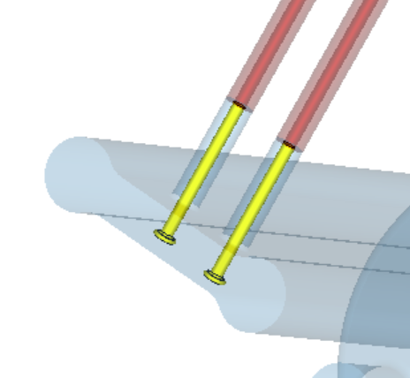
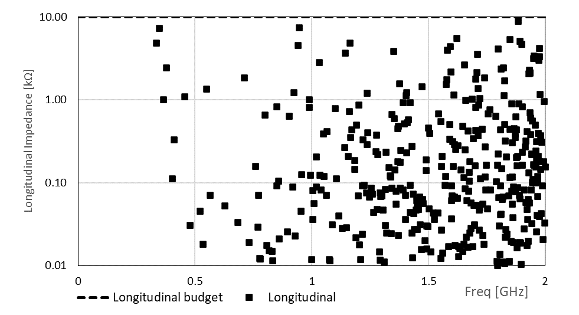
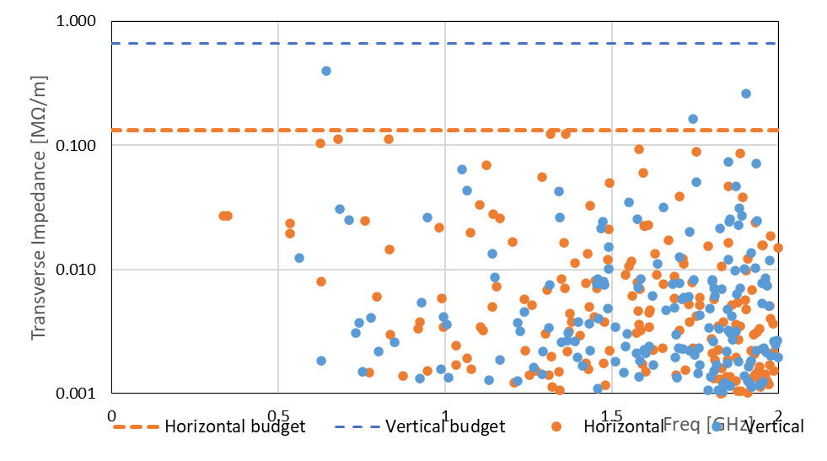
Coaxial HOM Couplers
Identical coaxial antennas in all the 3 couplers
No more than 2.3kW each port
In circuit definition
Z_{z} = 10 kΩ
Simulated with RF window designed for ILC crab cavities
Simulated with coax absorbers with VSWR similar to the off-the-shelf product
All longitudinal and vertical dipole modes are well damped
2 cavities in 1 cryomodule.
Z_{y} = 0.66 MΩ/m
Z_{x} = 0.132 MΩ/m
J. Henry

Slide 6
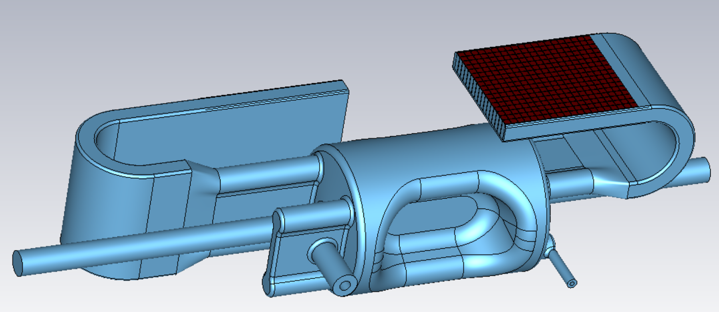
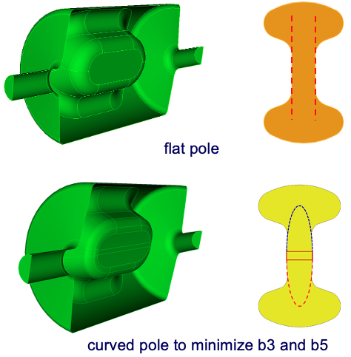
Multipole components
Specs at 10MV:
b₂ ≤ 2.05 mT
b₃ ≤ 69.8 mT/m
b₄ ≤ 1360 mT/m²
b₅ ≤ 85300 mT/m³
Specs are still preliminary as we need to add 394MHz crab into the study, include the 2nd IP, use realistic errors for magnets etc.
We know how to meet the specs
Capacitive plates (poles) need to be curved
Error analyses need to be done
Prototype with flat poles and first article will be curved poles
Poles machined from ingot Nb to ensure the accuracy so that multipole components will not be compromised
Currently focusing on prototype, and fabrication error of first article
Q. Wu, MOPL041, IPAC 2023
Z. Li, TUPTB068, SRF 2023
3D Model
$$b_{1} \left[mT∙m\right]$$ | 85.70
$$b_{2} \left[mT\right]$$ | 0.19
$$b_{3} \left[mT/m\right]$$ | 1342.72
$$b_{4} \left[mT/m^{2}\right]$$ | 3.35
$$b_{5} \left[mT/m^{3}\right]$$ | 71760.90
$$b_{6} \left[mT/m^{4}\right]$$ | 2186.21
Notes:
How to measure it is a big challenge!

Slide 7
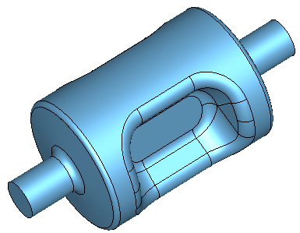
394 MHz Crab Cavity
394 MHz cavities will be installed on both HSR and ESR
197 MHz crabbing system is the primary crabbing system at HSR
Second harmonic crabbing system operating at 394 MHz will be installed at HSR to linearize the kick for the 6-7 cm long proton bunches
Beam aperture = 100 mm from HSR
Damping specs from ESR
HOM power handling from ESR
Single cavity cryomodule to be similar for both HSR and ESR is the current plan
Wide-Open-Waveguide (WOW) type produces >50% more HOM power comparing with on-cell damping design (next slide), thus is not preferred
Property
Operating frequency | 394.0
1st HOM [MHz] | 537
E_{p}/E_{t}* | 3.87
B_{p}/E_{t}* [mT/(MV/m)] | 8.08
B_{p}/E_{p} [mT/(MV/m)] | 2.09
G [Ω] | 125.4
R/Q [Ω] | 308.6
R_{t}R_{s} [Ω²] | 3.9×10⁴
Max V_{t} [MV] per cavity | 2.9
E_{p} [MV/m] | 29.5
B_{p} [mT] | 61.56
Total V_{t} [MV] | 2.9 | 4.75
No. of cavities | 1 | 2
36 cm
54 cm
S. De Silva
* E_{t} = V_{t}/(λ/2)

Slide 8
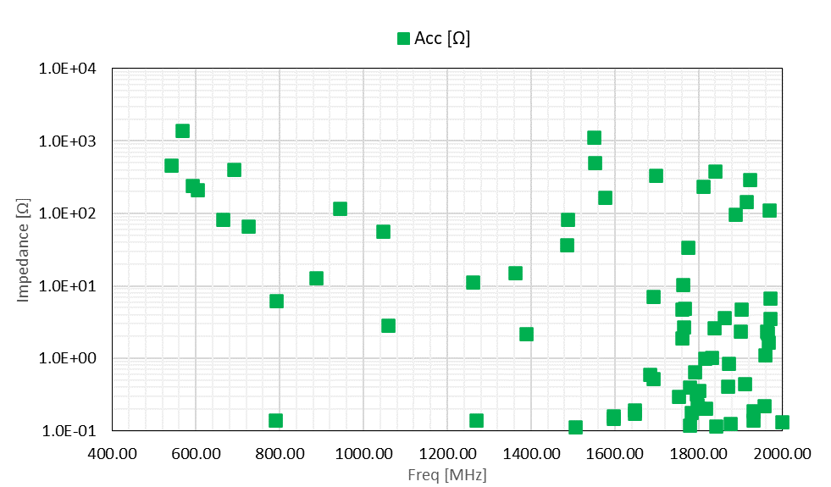
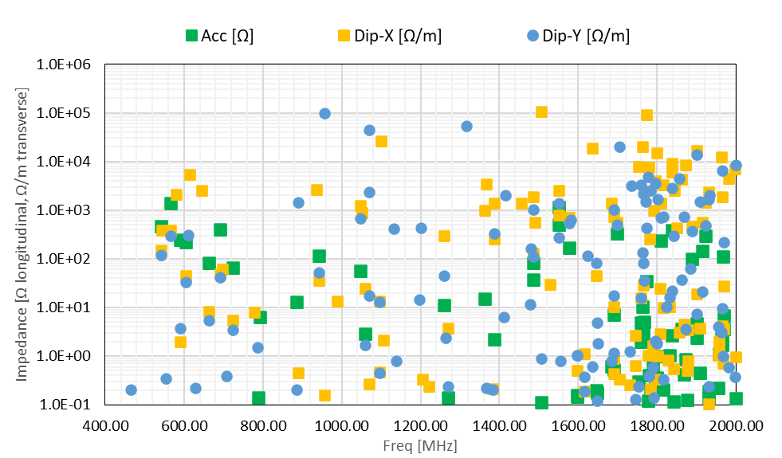
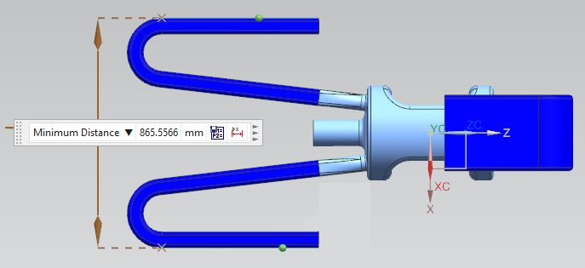
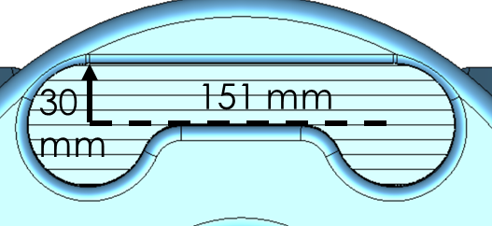
394 MHz HOM Damper Designs
HOMs are suppressed with 4 waveguide dampers
Tilted ridged waveguide allows more space between the beam pipe and waveguide for flanges
With increased crossing angle at the second IP, number of cavities may need to be increased to 8
HOM dampers are designed with sufficient margin; will not exceed impedance thresholds
In ESR HOM power for the 4 waveguide absorbers are 25.0 kW for modes below 2 GHz and 30.3 kW above 2 GHz
<12kW for each waveguide load
~5kW each beampipe port
Further optimization going on to reduce HOM power
Single ridged waveguide cross section

Slide 9
Crab Cavity Feedback System
The fundamental mode of the crab cavity has a large transverse impedance and the beta functions at the cavity are large.
Plan to keep fixed resonant frequency with wideband feedback on with zero voltage setpoint during injection and ramping.
High gain feedback: FPC Qext at1.75E6, effective Q ~300, a ~6000 gain.
Short feedback delay at ~380 nS, amplifiers need to be right on top of the tunnel.
Recent study by Themis showed it is possible to lower the requirement to 1400 gain with 1μS delay, still challenging but much better.
Requirement on high gain contradicts with the noise control requirement.
Plan to place the amplifiers right on top of (and outside) the tunnel to minimize the delay.
M. Blaskiewicz, Instabilities Driven by the Fundamental Crabbing Mode, BNL Tech Note BNL-222221-2021-TECH
M. Blaskiewicz, EIC MAC Review, July 15, 2022

Slide 10
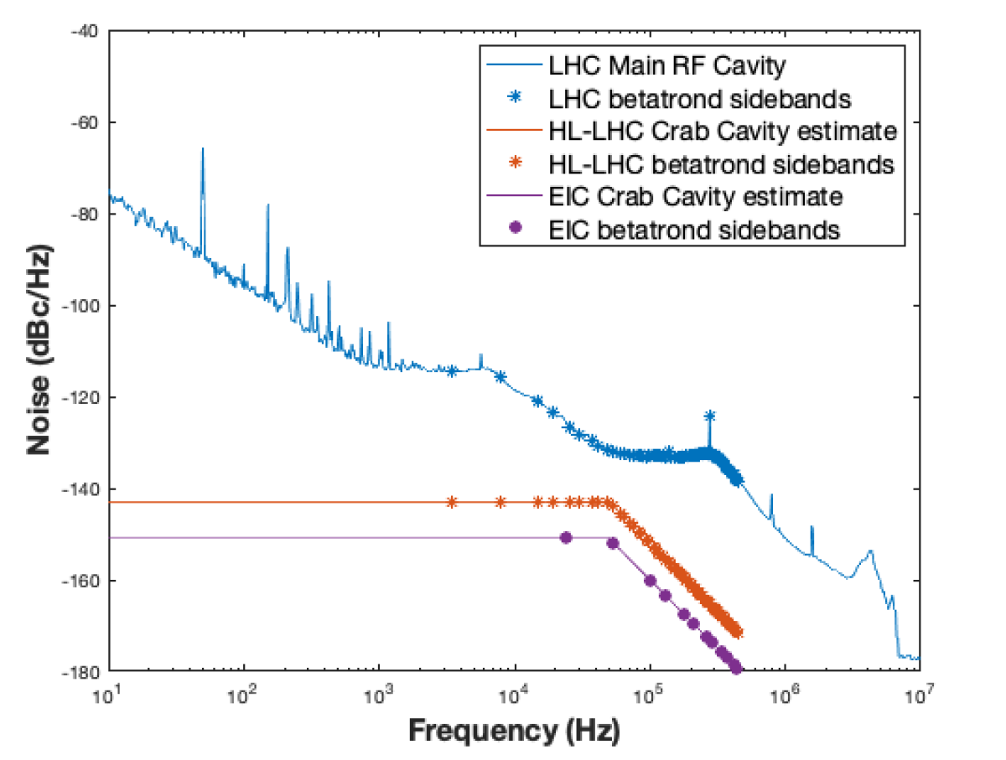
Crab Cavity Noise
T. Mastoridis, H. Huang, F. Severino
Bunch length
Crossing angle and beta*
Phase noise
Amplitude noise
Estimated tolerance for HL-LHC (<1%/hr emittance growth) and Hadron beam for EIC (Emittance growth comparable to IBS)
 | $σ_{Δφ}$(urad) | $σ_{ΔA}$(1e-6)
HL-LHC | 8.2 | 13.3
EIC 41 GeV Proton | 3.1 | 10.1
EIC 100 GeV Proton | 2.7 | 9.4
EIC 275 GeV Proton | 1.8 | 7.1
Tighter requirement on the crab cavity noise (a factor of 2~7 lower), both phase noise and amplitude noise, compared with HL-LHC.
Feedback system with small-error pickup (TBD).
Linear theory of crab cavity noise: P. Baudrenghien and T. Mastoridis, Phys. Rev. Accel. Beams 18, 101001 (2015)
T. Mastoridis, P. Fuller, P. Mahvi, Y. Matsumura, MOYD3, in the proceedings of NAPAC 2022, Albuquerque, NM

Slide 11
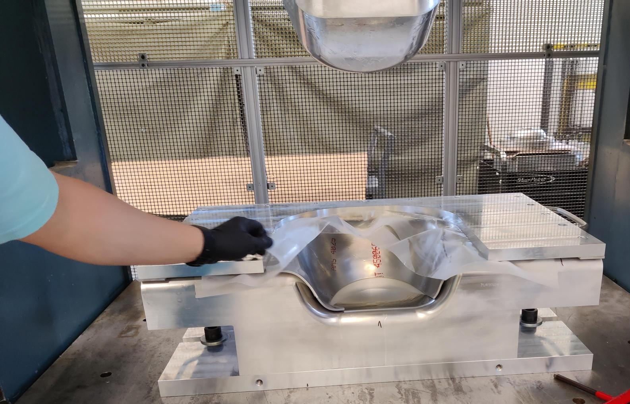
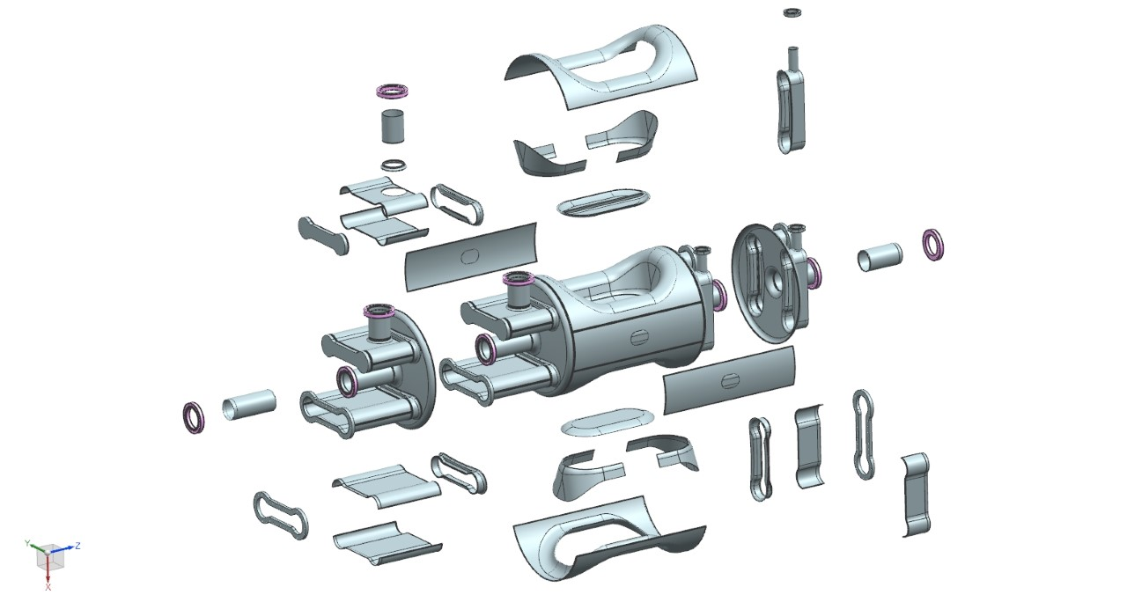
Fabrication started!
N. Huque
Notes:
Al 7075,

Slide 12
Summary
Specs and consequences
Large crabbing angle → high crabbing voltage
Tight impedance budget → on-cell damper
High current short bunch → high HOM power
Low frequency → large cavity size
Tight space
Tight multipoles → pole shape
Tight in noise and feedback system
Designs
Longer poles to provide higher crabbing voltage, elongated DQW is not mechanically suitable, thus RFD is chosen.
On-cell waveguide ports to provide better damping
197MHz: waveguide to coaxial design to avoid large waveguide damper; 2 cavities in 1 cryomodule to save longitudinal space.
394MHz: waveguide damper (preliminary); WOW type causes higher HOM power thus is not preferred.
Curved pole (machine from ingot Nb) for multipoles specs.
High gain low delay loop → Amplifier on top of tunnel for low delay
Noise control → Feedback with good pickup.

Slide 13
Acknowledgement
BNL – B. Xiao, Q. Wu, M. Blaskiewicz, W. Xu, J. Fite, D. Holmes, K. Smith, Z. Conway, J. C. Brutus, S. Verdu-Andres, A. Zaltsman, D. Xu, Y. Luo, Y. Hao, S. Berg, G. Narayan, F. Severino, K. Mernick, K. Hamdi, and many more
ODU – S. De Silva, J. Delayen
JLAB – A. Castilla-Loeza, N. Huque, M. Marchlik, J. Henry, R. Fernandes, N. Joshi, J. Matalevich, R. Rimmer, E. Daly, T. Satogata, J. Guo, H. Wang, S. Wang, H. Huang, G. Bamunuvita, and many more
SLAC – Z. Li
Cal Poly - Themis Mastoridis
TRIUMF – R. Laxdal, P. Kolb, Z. Yao

