Slide 1



Tuner Development for
HL LHC Crab cavities
K. Artoos, R. Calaga, P. Minginette
Thanks to HLLHC WP4 team
06/12/2023 TTC 2023 Meeting, Fermilab

Slide 2

Outline
Tuning principle: DQW +RFD
Tuning Frequency Sensitivity and Range
Tuner tests : SM18
Pre tuning of DQW cavity
Overview components
  Tuner actuator
  Tuner bellows + heat intercept + heater
  Tuner Frame with guidance
  Couplings
Conclusion

Slide 3
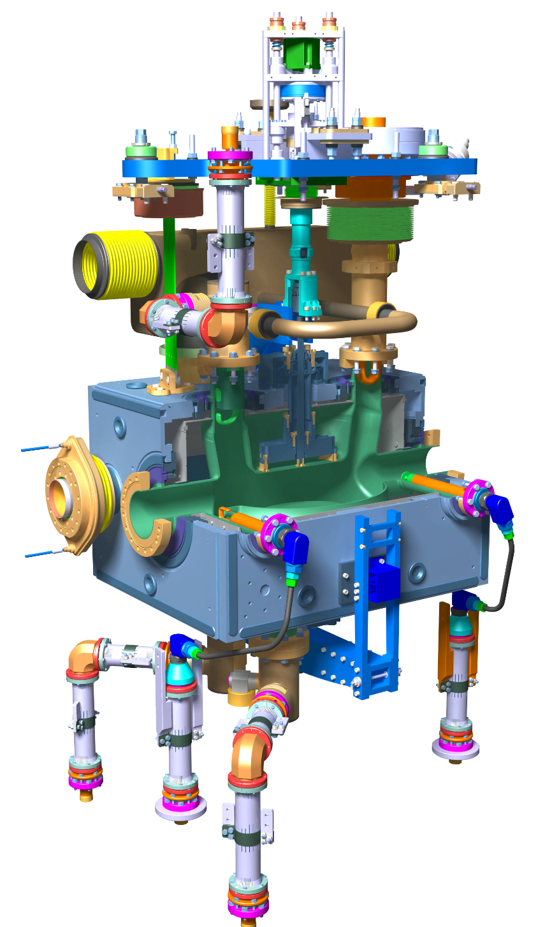
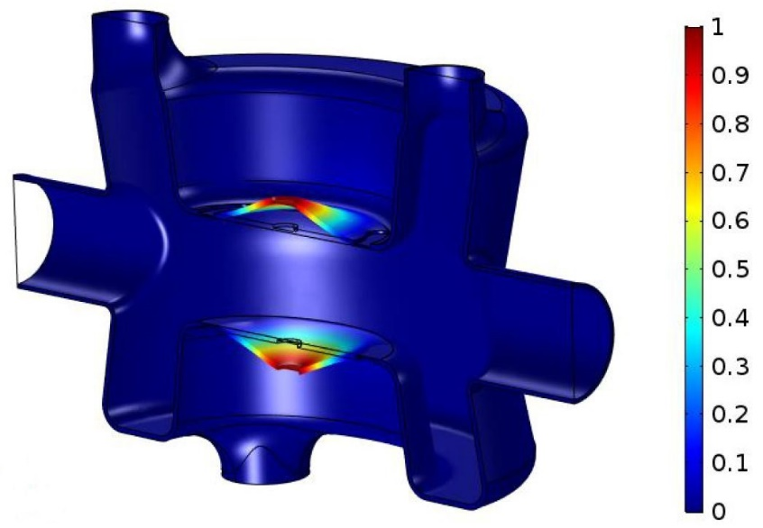
Tuning principle HL LHC DQW
DQW
Two vertical, concentric tubes moved in opposite direction by actuator
Inner deforms top cavity
Outer deforms bottom through tuning frame
Actuator is floating
Notes:
Tuning fundamental mode by a deformation of the cavity, symmetrical wrt the beam axis. On RFD it is an inductive part of the cavity that is deformed, on the DQW it is the poles (capacitive). Tuning rods are attached to a NbTi part welded to the cavity. Two concentric tubes are moved with respect to each other by an actuator installed outside of the vacuum vessel. The inner tube is connected to the top tuning rod, the outer tube is connected to the tuner frame surrounding the cavity , that is connected to the bottom tuning rod. The two tuner operate in the same way and have the same components, with some differences in shape or size for the frame.

Slide 4
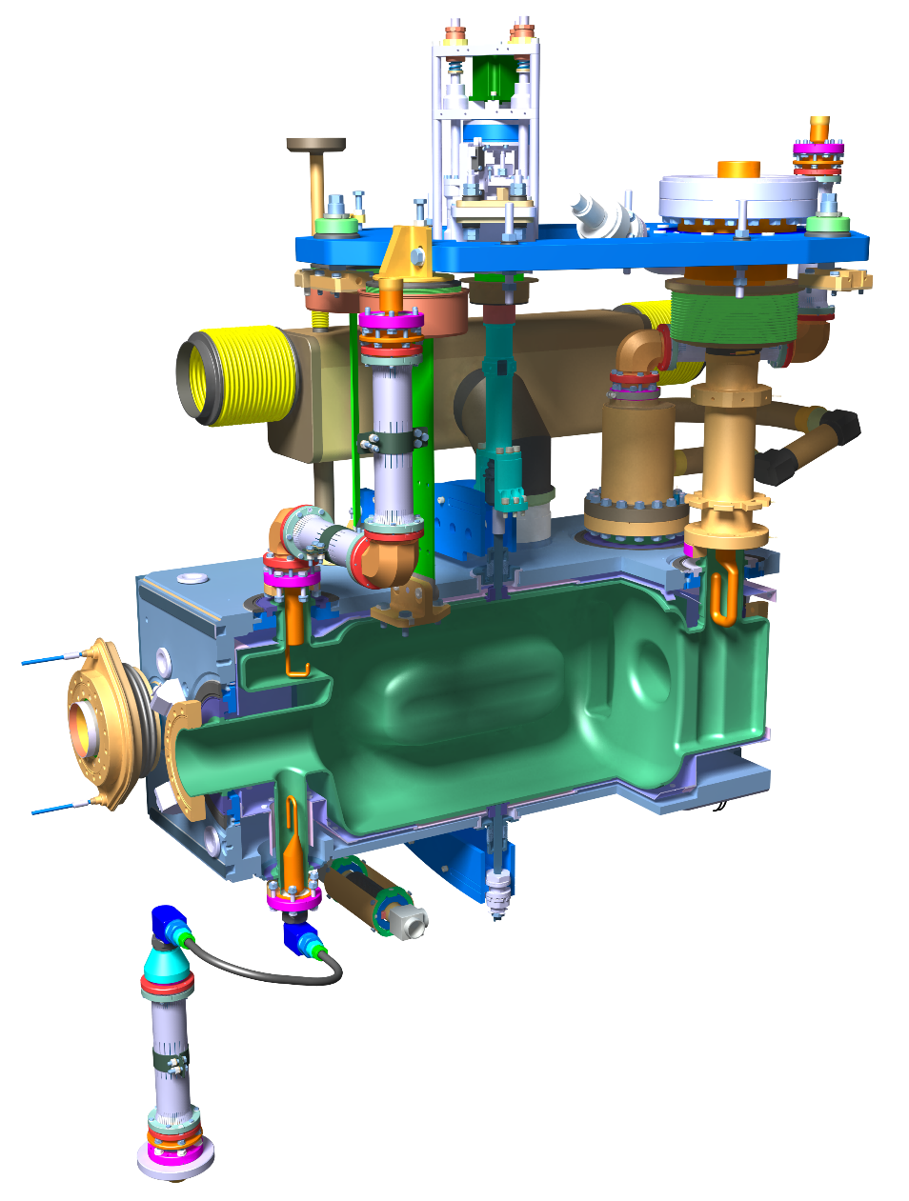
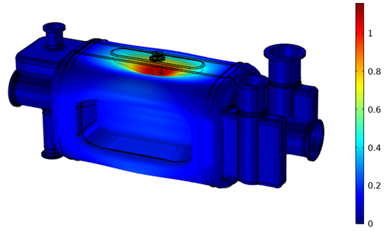
Tuning principle HL LHC RFD
RFD
Both tuners very similar
Differences only dimensional
Same actuator
Notes:
Tuning fundamental mode by a deformation of the cavity, symmetrical wrt the beam axis. On RFD it is an inductive part of the cavity that is deformed, on the DQW it is the poles (capacitive). Tuning rods are attached to a NbTi part welded to the cavity. Two concentric tubes are moved with respect to each other by an actuator installed outside of the vacuum vessel. The inner tube is connected to the top tuning rod, the outer tube is connected to the tuner frame surrounding the cavity , that is connected to the bottom tuning rod. The two tuner operate in the same way and have the same components, with some differences in shape or size for the frame.

Slide 5
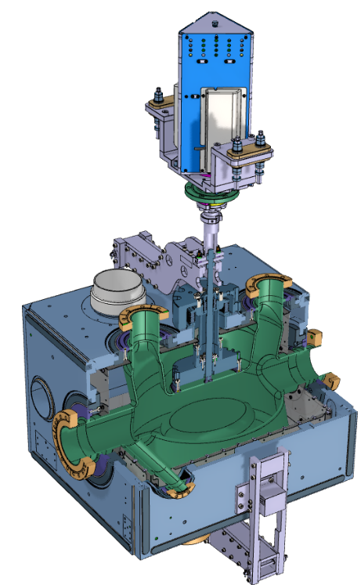
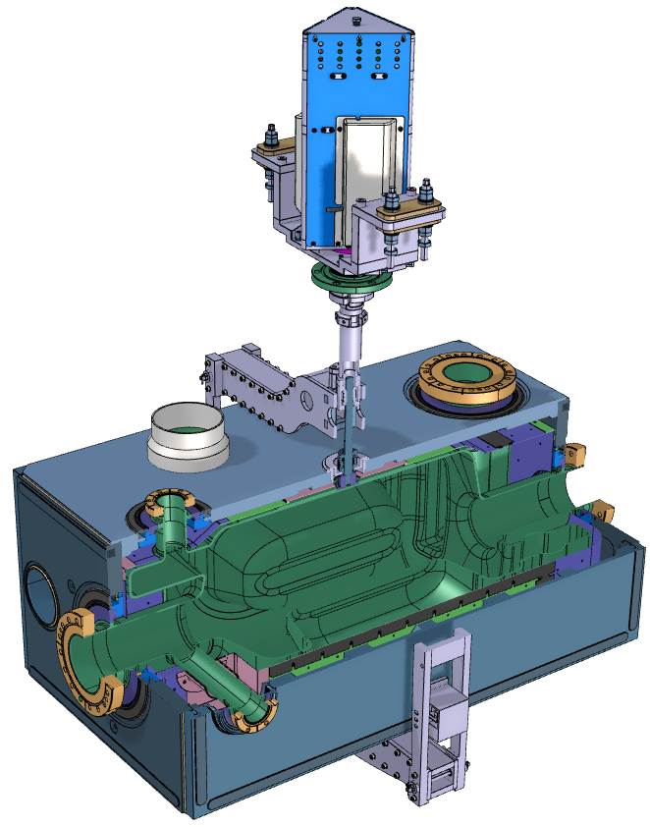
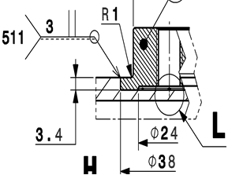
Tuning sensitivity and range (COMSOL+ ANSYS)
*Measured as change distance between 2 plates (≠ tuner actuator displacement)
DQW | RFD
Tuning Sensitivity:
318 kHz/mm* | 512 kHz/mm*
Cavity tuning stiffness:
2.6 kN/mm* | 2.8 kN/mm*
Specified tuning range at 2 K:
± 150 kHz | ± 150 kHz
Elastic limit range at 2 K:
± 454 kHz | ± 1.22 MHz
±1.44 mm* | ± 2.38 mm*
± 3.6 kN | ± 6.7 kN
The elastic limit range are for both cavities determined by the welds between the cavity and the NbTi connection part and in second place by stresses in cavity
Important: tuner is a structural part of the cavity and adds to it’s strength and stiffness, e.g. pressure test

Slide 6
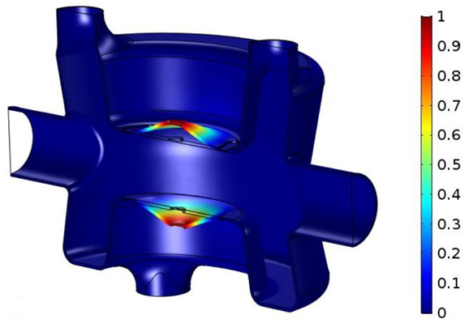

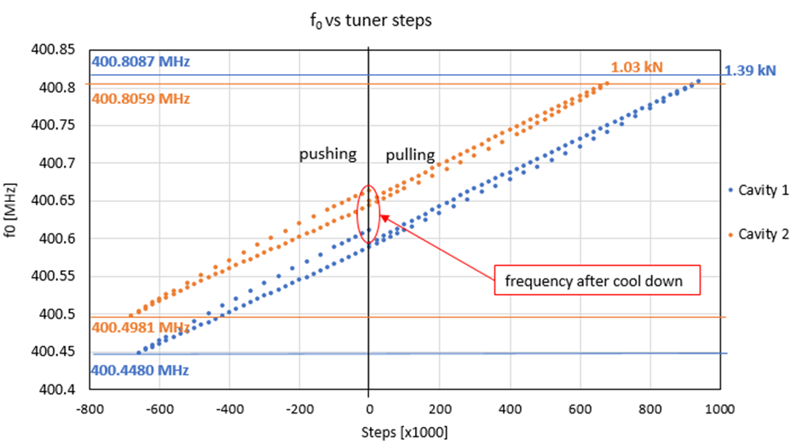
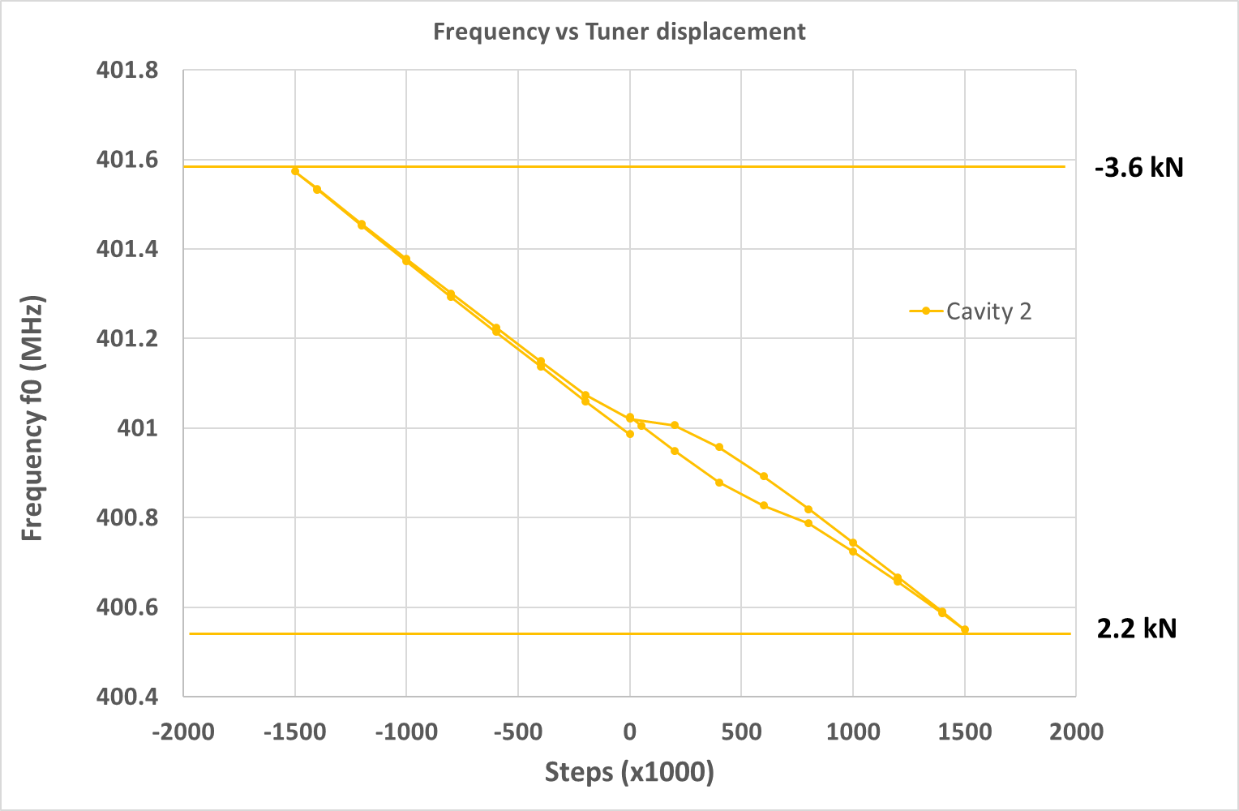
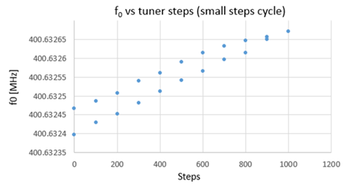
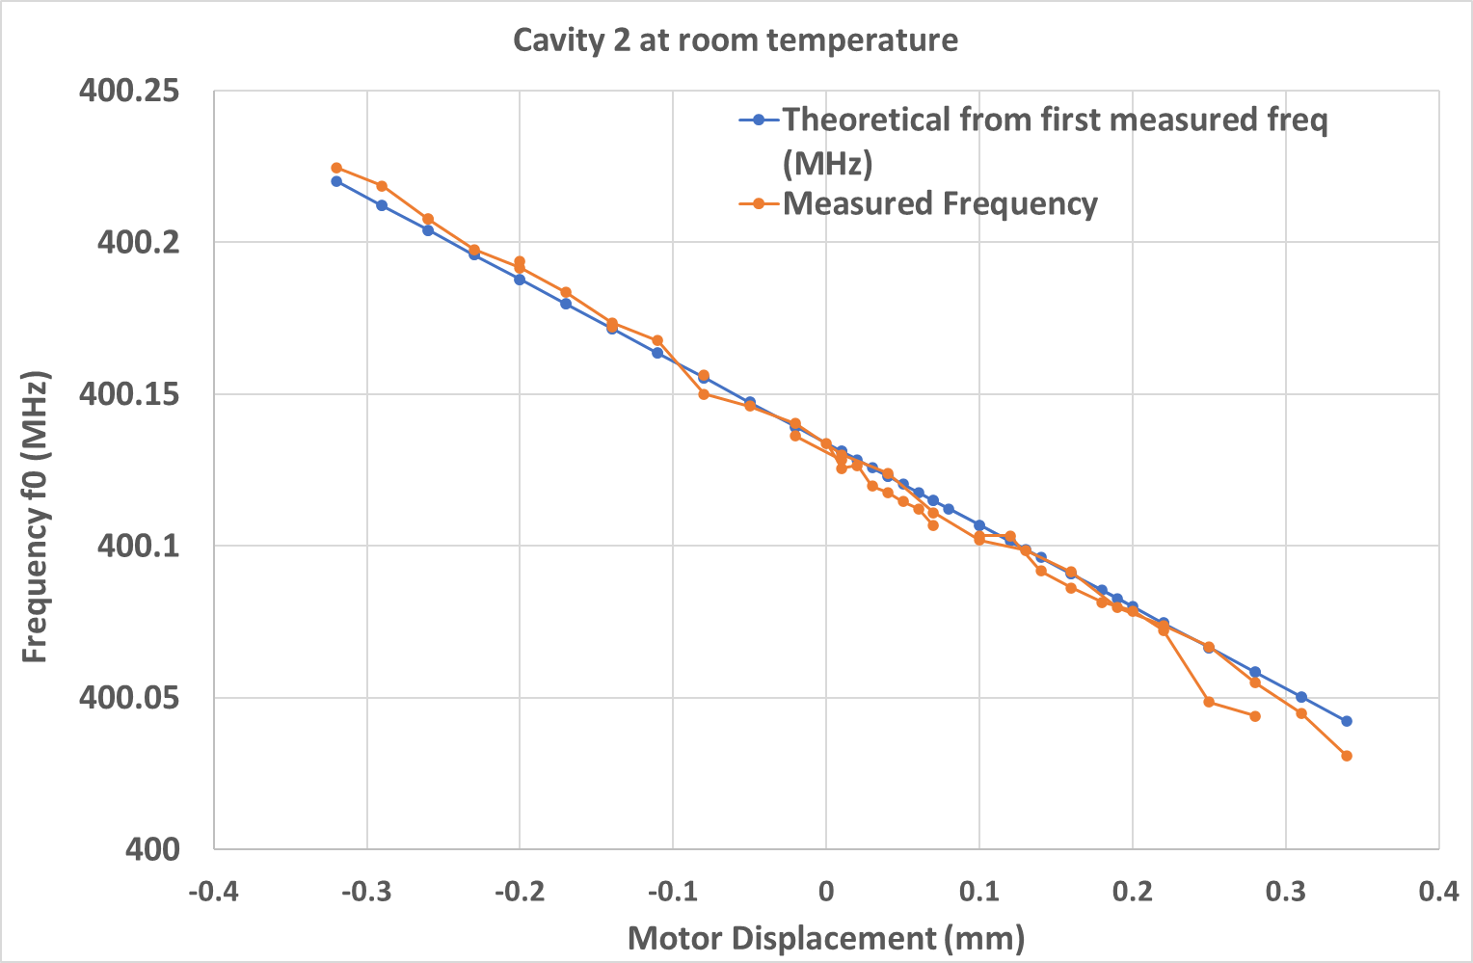
Tuning sensitivity and range
2 K Measurements on SPS prototypes
A. Edwards, K. Turaj, N. Valverde
Preliminary
25 – 50 Hz changes

Slide 7
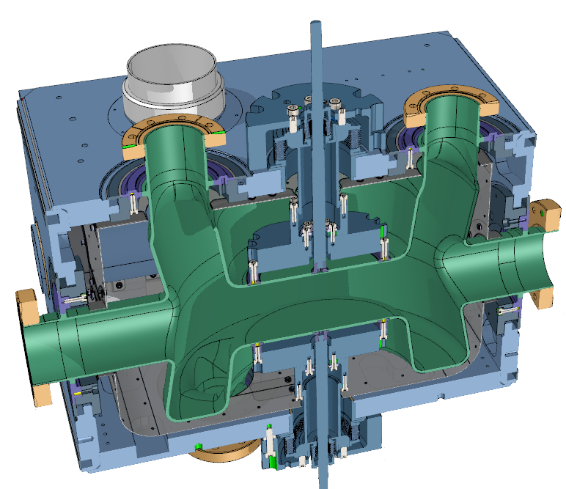
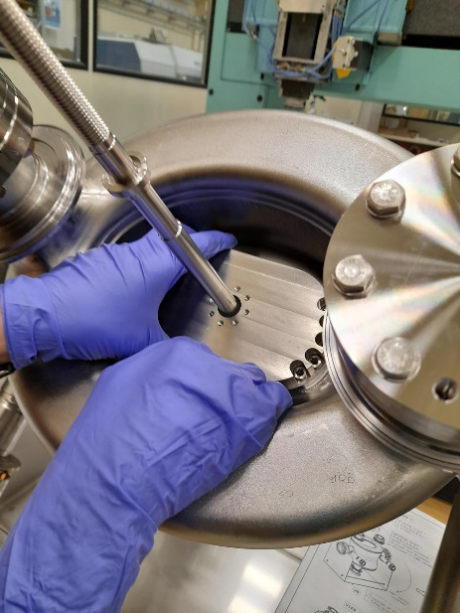
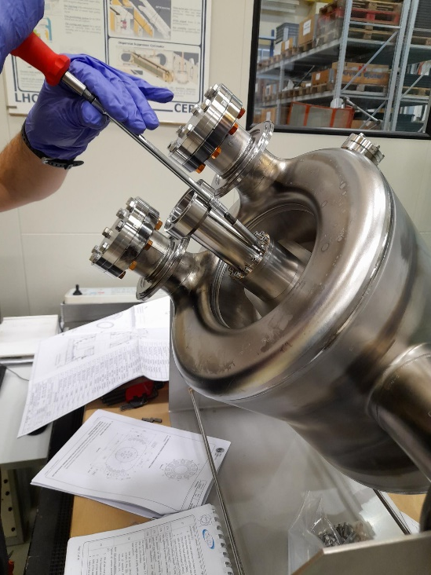
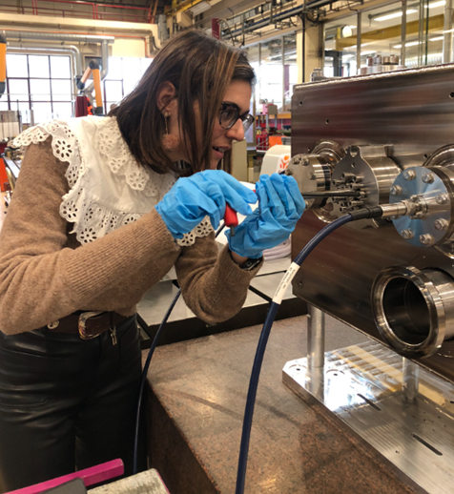
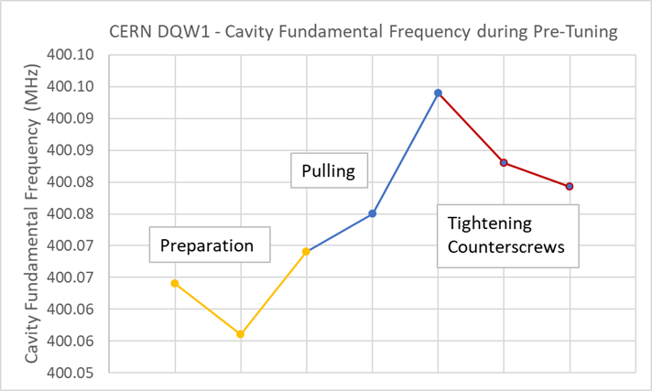
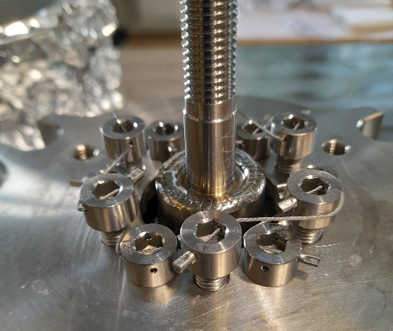
DQW Pretuner
Pre-tuning sensitivity: 1046 kHz/mm*
Pre-tuning range ± 300 kHz
Is limited by welds to NbTi connectors
Screws are cable locked after

Slide 8
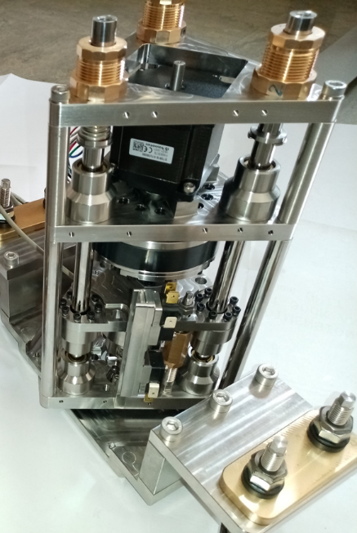
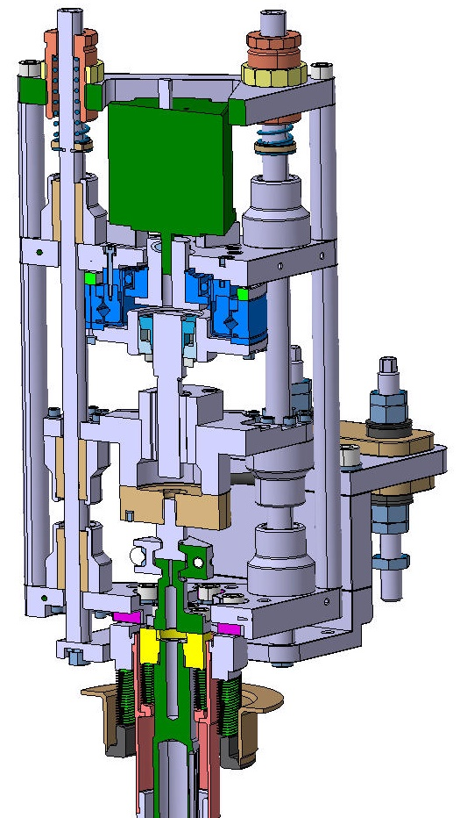
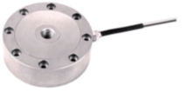
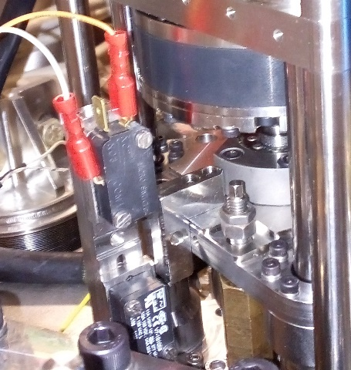
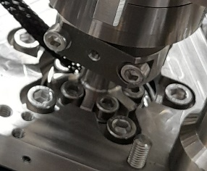
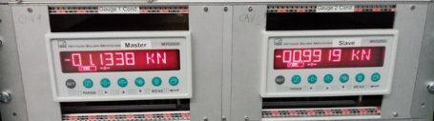
Overview components
ACTUATOR
Stepper motor
1.3 Nm bipolar, motor step 1.8 deg, micro stepping
Harmonic drive HFUS-20-100-2SO
Ratio 100, Accuracy < 1 arcmin, precision <0.1 arcmin (5 nm)
Fa Dyn 7.7 kN
Radhard grease SYNRAD 1252
Roller screw
Rollvis RV 12 x 1 static load capacity 17 kN
Sferax Compact GBL 1219 bearings XA +A (all metal)
Loadcell
So far: Kistler 10 kN 4576A55C1 class 0.1
For HL LHC custom built, CERN knowhow strain gauges
Limit switches
Difficult to set, not so reliable, probably will be replaced by magnetic encoder on motor with conditioner, also to have a position measurement
Mechanical end stops with max load interlock on load cell conditioner
Actuator coupling
Allows quick change of actuator + connection without frequency change
For HL LHC tuner height still to be reduced
Notes:
Remark: rather than certified expensive radhard components, we aim for fast swap over of entire actuator

Slide 9
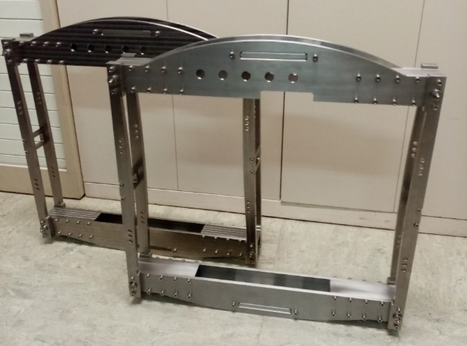
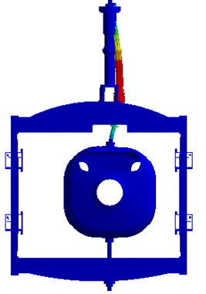
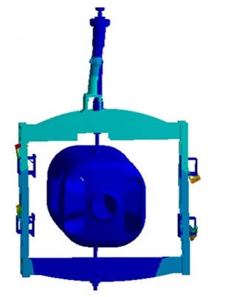
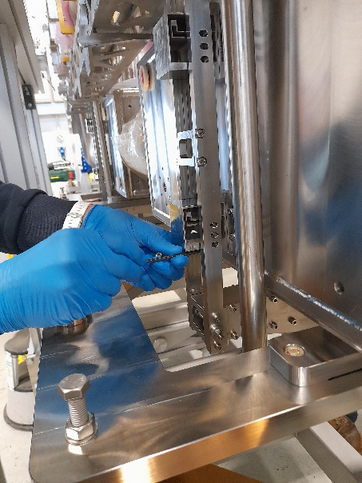
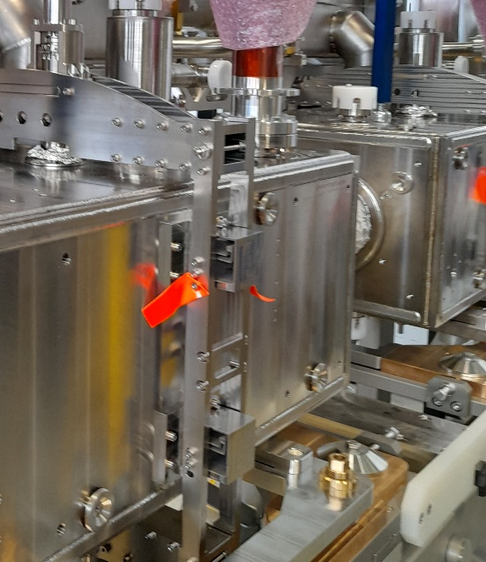
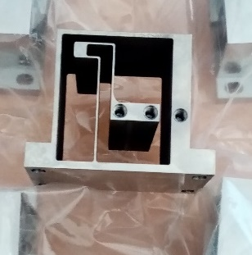
Overview components
Tuner Frame and guidance
Titanium Grade 2 (~ = thermal contraction cavity)
Bolted (Ti Gr. 23) (no welds)
Stiffness and mass drive the design
Non-linear buckling load multiplier
× 8 Compression
× 44 Traction
Flexural guide Titanium Grade 5 ELI
Stiffness longitudinal ~100x vertical, lateral~20x
Flexural guide increases the frequencies of vibrational modes and the buckling load multipliers
Aim to work in traction on the cavity

Slide 10
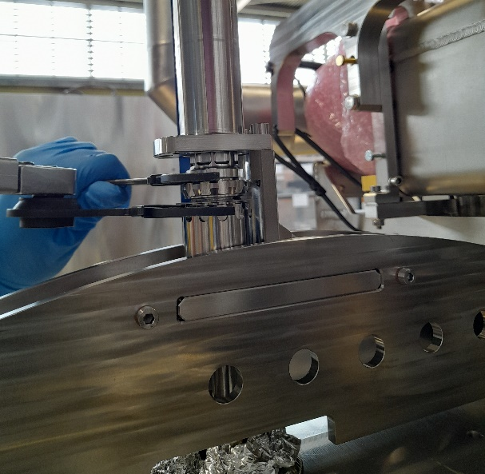
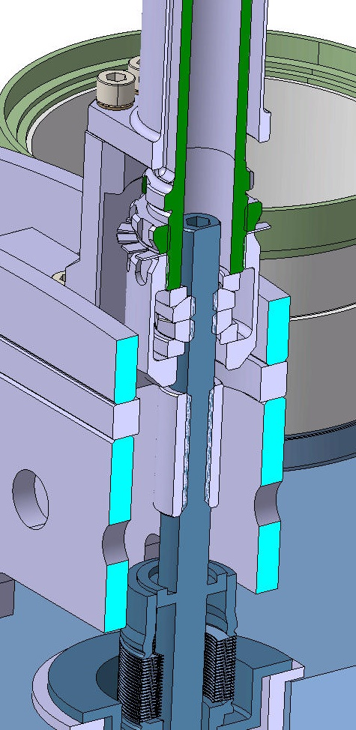
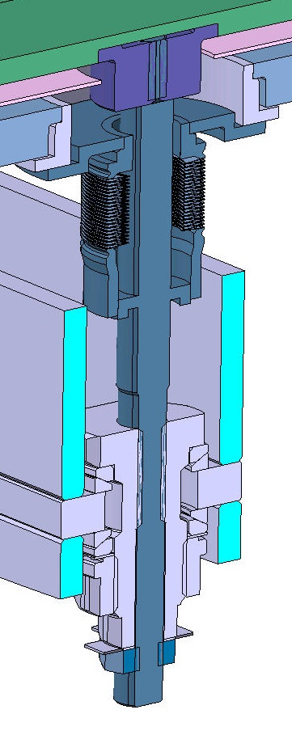
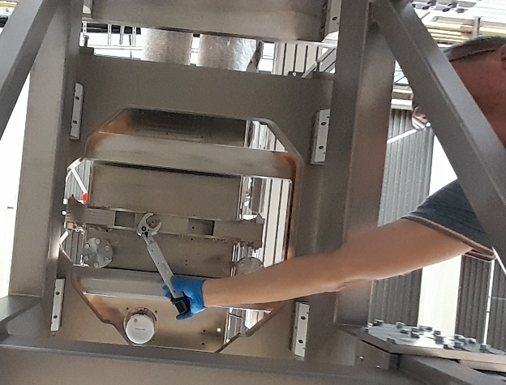
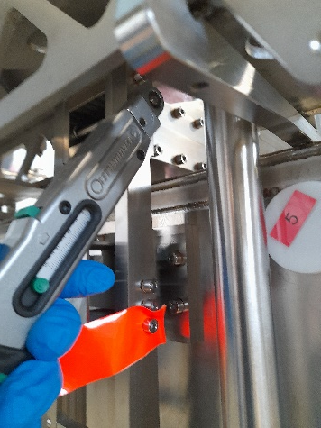
Overview components
Couplings Tuner to cavity
Deals with offsets nominal dimensions cavity
Connects tuner to cavity without deforming it
Torque tightening + custom lip washers(locking)
counter nuts against back lash
Design considers also access for torque tools

Slide 11
Conclusions
Design for HL LHC CRAB tuner well established
Launch of series during next months
Important lessons:
with prototype cryomodules being tested when already having to launch the series: foresee working 2 K mock-ups for testing tuner and LLRF (e.g. 1 cavity with tuner)
Foresee the torque tool access in the design
Use load cells in tuners
Some references:
Comsol RF calculations:
E. Cano Pleite et al.; Numerical evaluation of the tuning frequency, pressure sensitivity and Lorentz Force detuning of RF superconducting crab cavities, Proceedings 2018 COMSOL Conference, Lausanne
T. Guillen Hernandez et al., Numerical calculation of the Lorentz Force Detuning and the pressure sensitivity for the HL-LHC CRAB Cavity, IPAC 2023

Slide 12
Thank you for your attention!

Slide 13
Spare slides

Slide 14
ACTUATOR considerations (good questions)
Motor size: Use a smaller one?
The motor size (torque) is this high for two reasons:
We opted for a self-locking tuner, so need of a sufficient detend torque (unpowered motor remanent torque). This is also stiffer.
In the tuner LLRF control the motor stepping is not ramped, i.e., the steps send to the motor are sent at a fixed rate. At some rate, the motor will start cogging or vibrating because not enough time to reach next step. More torque means in this case a higher possible tuner speed.
Do you need the harmonic drive?
(yes, they are cool!)
The gear ratio (100) makes the self locking possible.
Cycloidal gears are also an option but : larger outer dimensions and less good precision/back lash
Do you need micro stepping ?
Micro stepping helps when driving long lead cables (smaller average charge changes)
Do you need the load cell?
It has proven very useful already to understand what happens inside the cryo module.
It also measures perturbations acting on the cavity such as pressure and thermal forces in the tuner

Slide 15
Comparison cycloidal/harmonic gears
Series | Size | Ratio | Average torque [Nm] | Transmission accuracy [arcmin] | Torsional stiffness [10³ Nm/rad] | Max radial load [N] | Max axial load [N] | Precision/backlash [arcmin] | Vertical dimension [mm] | Outer diameter [mm] | Weight [kg]
HFUS-2SO | 20 | 100 | 49 | <1 | 29 | 5150 | 7687 | <0.1 | 33.5 | 90 h6 | 0.81
RV | 15 | 141 | 137 | <1 | 131 |  |  |  | 65 | 130 | 3.6
N: RV-N | 25 | 107.66 | 245 | <1 | 210 | 6.975 | 2.610 | <1 | 62 | 133 | 3.8
N: RV-E | 6 | 103 | 58 | <1.5 | 69 |  |  |  | 53 | 122 | 2.5
TS: T series | 110 | 119 | 244 | <1 | 73 | 9300 | 13100 |  | 69.5 | 110 | 3.75
TS: M series | 50 | 63 | 18 | <1.5 | 8.6 | 1440 | 1900 | <1.5 | 41 | 50 | 0.47

Slide 16
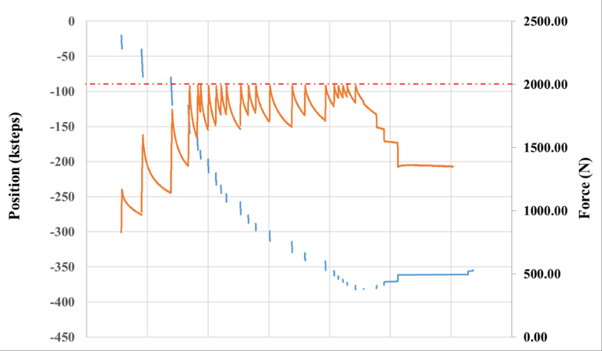
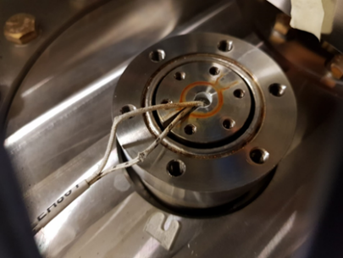
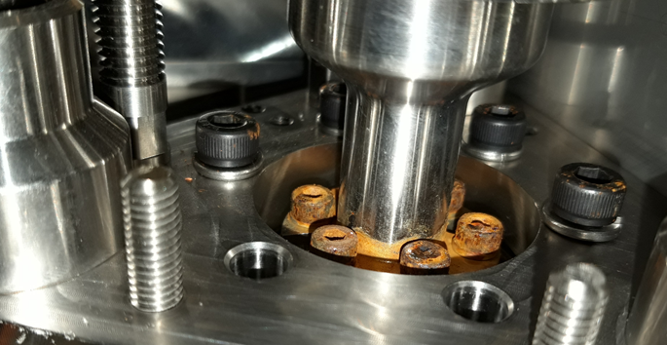
Reminder end of Run1 DQW SPS 2018
Sudden increase of stiffness 2-3 October after thermal cycle
no real blockage
One motor-gear coupling started slipping 19/10
Tuner heaters broken + wires damaged
Possible ice formation
Important observations:
Very hard to dismount motor in-situ or to replace the heater
Impossible to retighten the coupling without full actuator disassembly
No access to set limit switches and hard stop
Potentiometer not needed

Slide 17
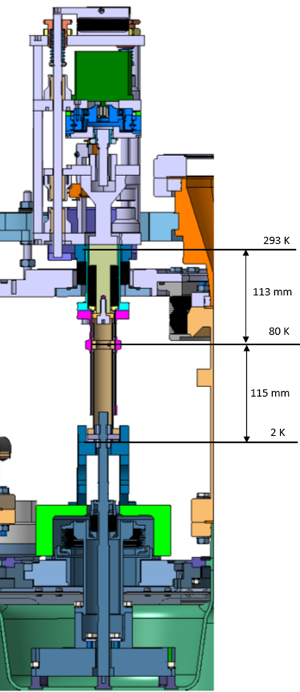
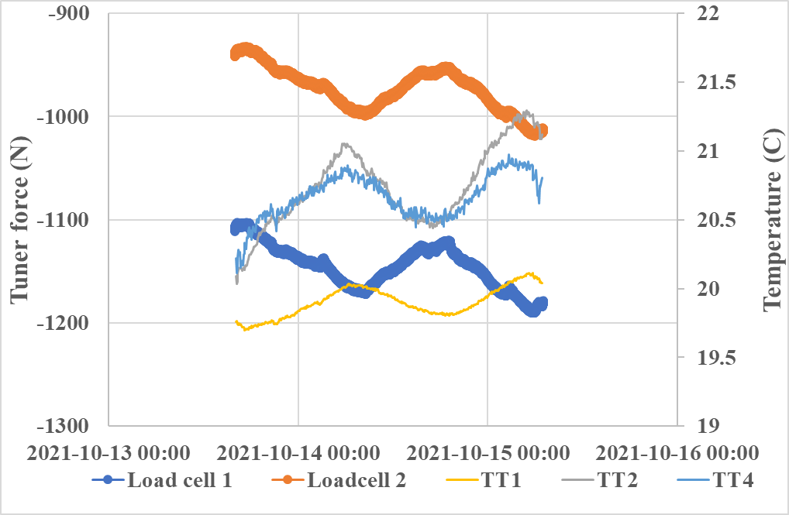
Frequency Drifts during “Quiet Periods”
In the SPS accelerator, we observed slow frequency drifts which were initially speculated to be due to He pressure changes, but later found to be due to tunnel temperature
Feedthrough bellow: sensitive to pressure (atm)
1% change atm >> ~ 3N *
Temperature gradient, change will change tuner load
Thermalisation temperature not measured, refer to FPC thermalisation
He Tank feedthrough + cavity surface. Sensitive to He tank pressure (and temperature when saturated liquid)
1 mbar >~3 N*
* Rough estimate

Slide 18
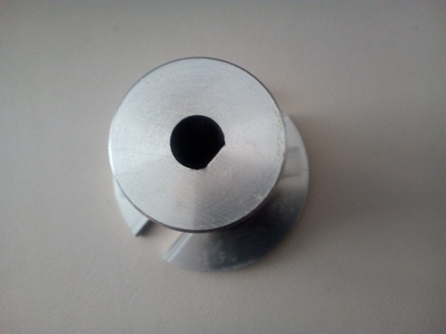
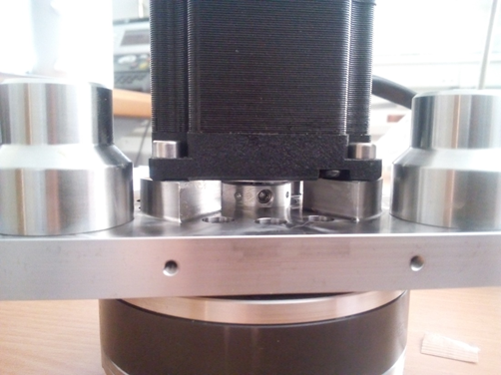
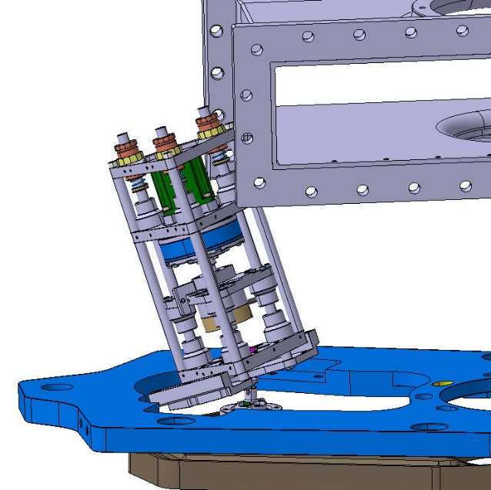
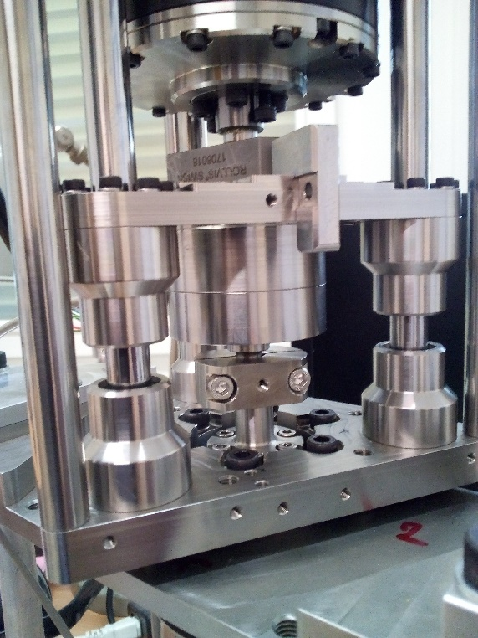
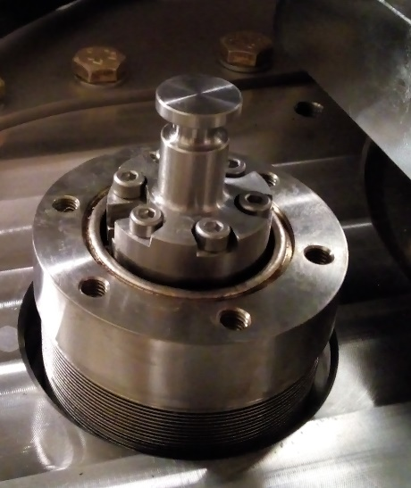
SPS DQW and RFD Upgrade
D-type slip-free Oldham coupling with set screw
Introduction connection clamp
Creation more space
Lowered actuator height
Removed potentiometers
Moved limit switches to front
Only 1 hard stop in front

