Slide 1


RFD Crab Cavity Production for LHC Hi-Lumi Upgrade
Manuele Narduzzi - FNAL
Tesla Technology Collaboration Meeting – Dec 5th – 8th, 2023

Slide 2
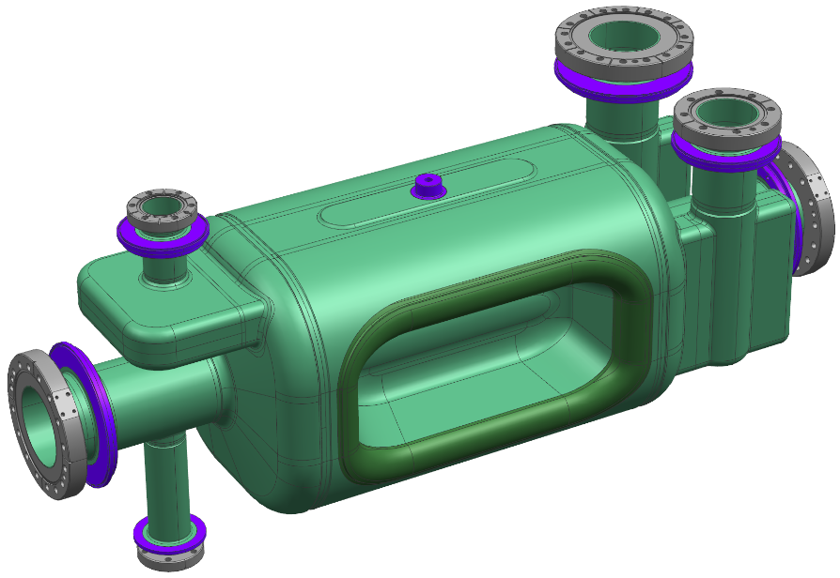
Outline
US-AUP Contribution to HL-LHC
Bare RFD fabrication strategy in industry
Bare RFD manufacturing challenges
  Poles forming case study
  End Groups to Main Body alignment for final EBW
  Pole-Corner-Half Main Body unconventional welding
  Optimization of CMM metrology
Summary

Slide 3
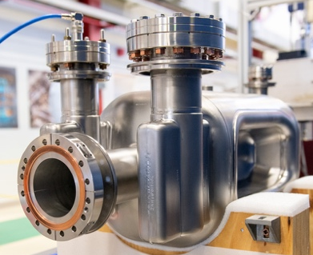
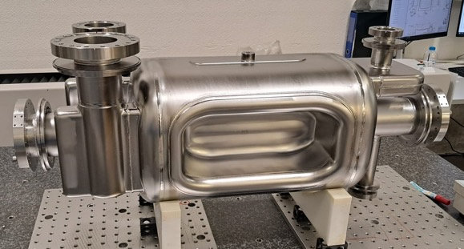
US-AUP contribution to HL-LHC
US contributes to HL-LHC with RFD dressed crab cavities in the framework of US-AUP*
Bare RFD Crab Cavities:
  The electromagnetic design was inherited from LARP**, updated after extensive R&D phase at CERN. 2 x LARP cavities were qualified via cold tests.
  2x AUP bare cavities prototypes have been qualified in VTS: exceeded functional requirements
  2x AUP Pre-series bare cavities have been completed, qualification ongoing
  10x AUP Series bare cavities, manufacturing in progress
*US-AUP: HL-LHC Accelerator Upgrade Project, managed by FNAL
**LARP: LHC Accelerator Research Program

Slide 4
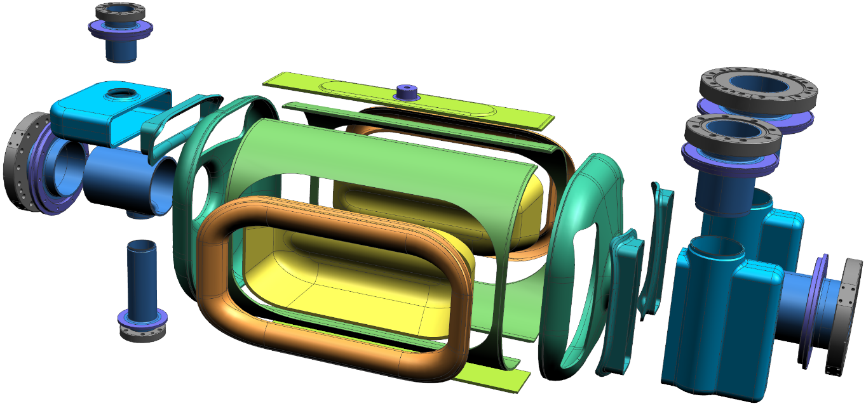
Bare RFD Crab Cavity fabrication strategy at ZRI*
Transition
V-HOM
Racetrack
V-HOM
Waveguide
Transition
H-HOM
H-HOM
Waveguide
Beam Axis Extr.
Antenna
Extr.
Beam Axis Extr.
Corner
Pole
FPC
Waveguide
Half Main Body
End Cap
Transition
FPC
Deep drawing of thick Nb sheets (up to 6.35mm), CNC of transitions from blocks & beam pipes from tubes
ZRI know-how for CNC machining & EBW interfaces
ZRI* as Zanon Research and Innovation Srl

Slide 5
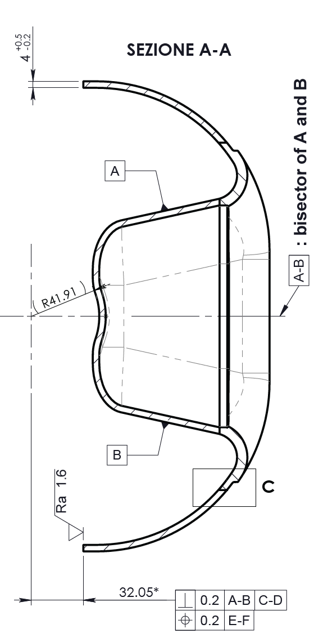
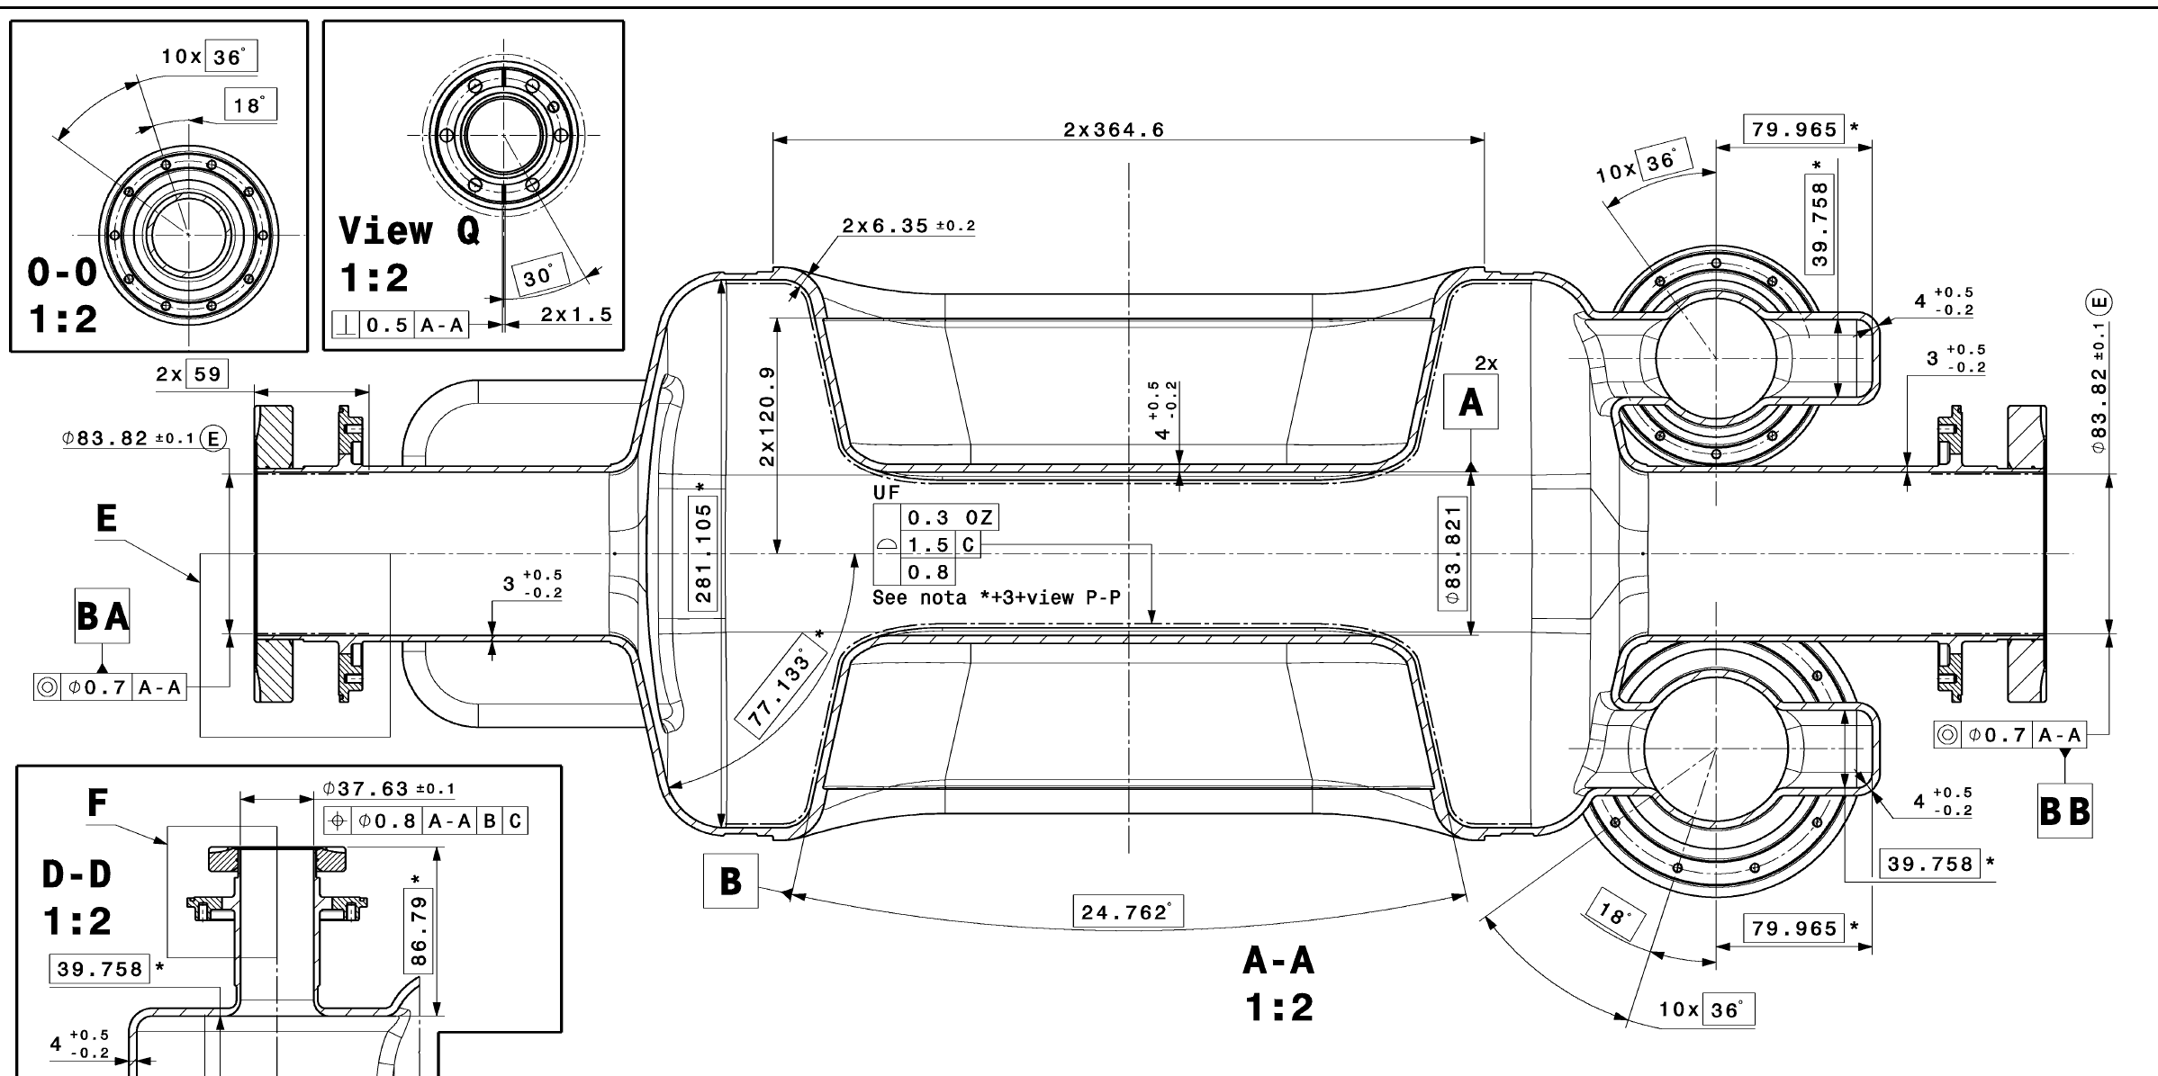
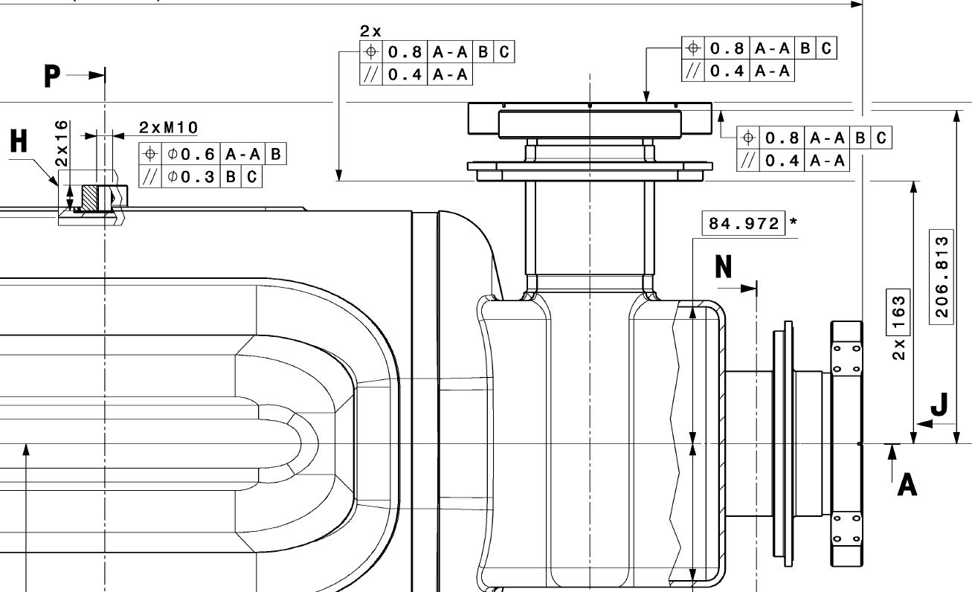
Bare RFD Crab Cavities manufacturing challenges
Sub-mm mechanical tolerances and complex shape:
  Poles symmetry & subcomponents shape and thickness
  End Groups to Main Body alignment for final EBW
  Pole-Corner-Half Main Body unconventional EBW
  Optimization of CMM metrology
3
4
4
1
1
2
2

Slide 6
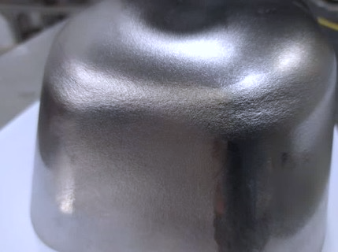
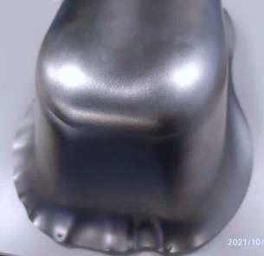
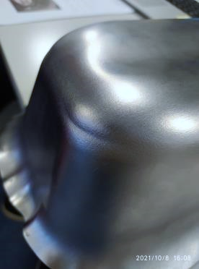
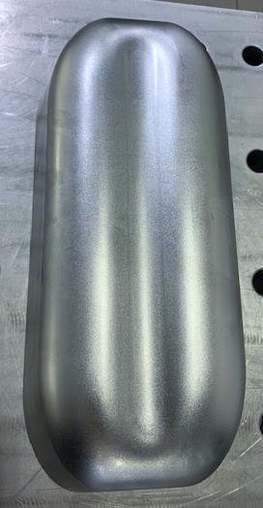
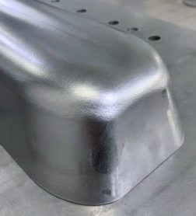
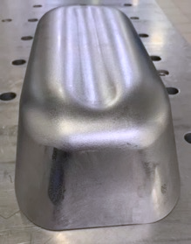
Poles deep drawing case study
Poles formed from specific batch showed “orange peel” appearance and excessive thickness reductions on corners (2.3mm of local shrinkage vs 3.5mm min. required from specification)
Held the production for several months!
Further tests with different material batches provided much better results:
shape, thickness, appearance, formability

Slide 7
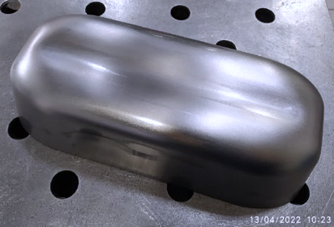
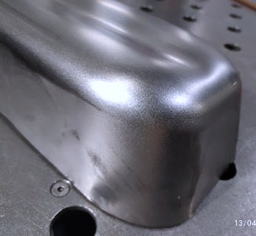
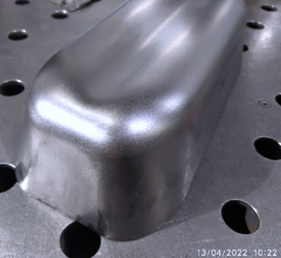
Poles forming: raw materials or procedure issue?
Raw Materials checks:
  Mechanical tests on three different materials: results within specs (up to 15% variation!)
  The Nb for series production showed characteristics more suitable for deep drawing
Forming tooling and procedure:
  CERN & ZRI formed a Pole from the same Nb sheet, using different procedure
  ZRI’s adopted a 2- step forming: better results due to friction reduction.
  ZRI procedure validated by CERN FE sims (Forming Limit Diagram failure criteria)
  Effective procedure even for non-ideal materials, such as the Nb for pre-series
Courtesy of
CERN
Initial forming
Trimming “crown” wrinkles
Greasing + Final Coining

Slide 8
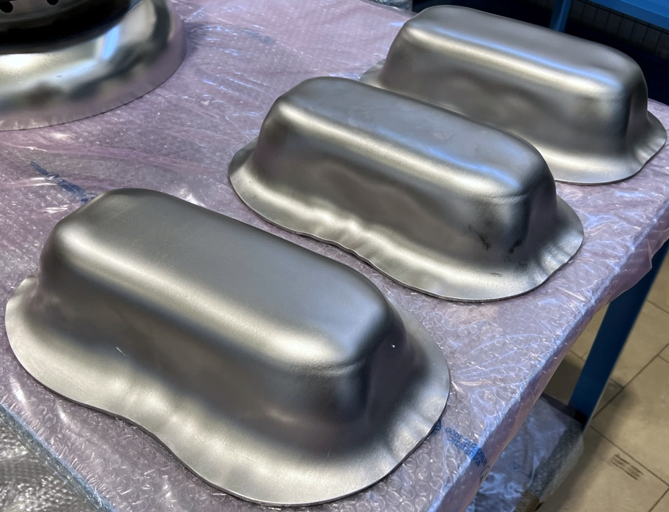
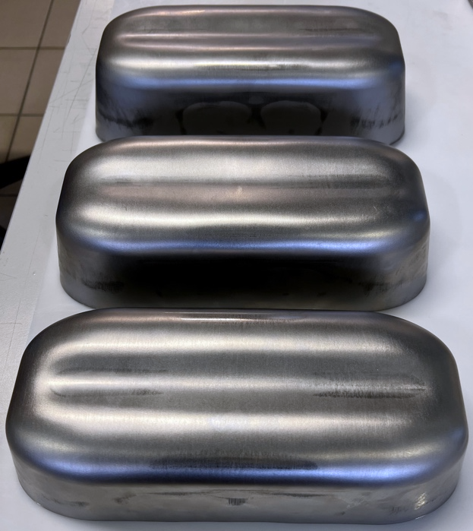
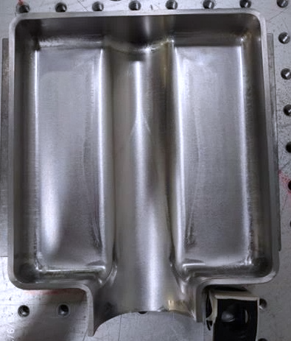
Poles & Waveguides forming: solved?
  Poles and Waveguides, formed from the series Nb batch, show non-repeatable results:
    Same Nb supplier, same Nb sheet, same tooling, operators and pressing machine…→ Different results!
    The results demonstrate that the deep drawing process is at its technological limits
    Other examples: the waveguides required multiple stamping and coining steps to get close to the shape accuracy and thickness requirements, unlike pre-series outcome.
Unacceptable Poles (left) and Acceptable Poles (middle) from the same Niobium sheet. Difficult coining of Waveguides (right)

Slide 9
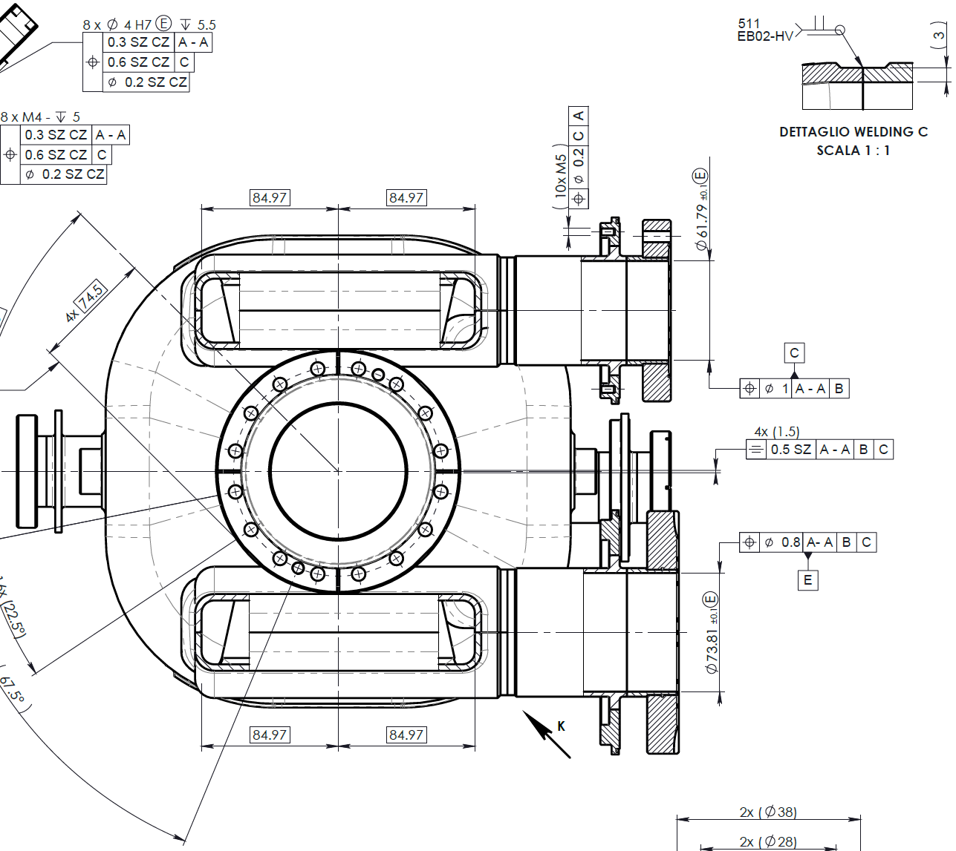
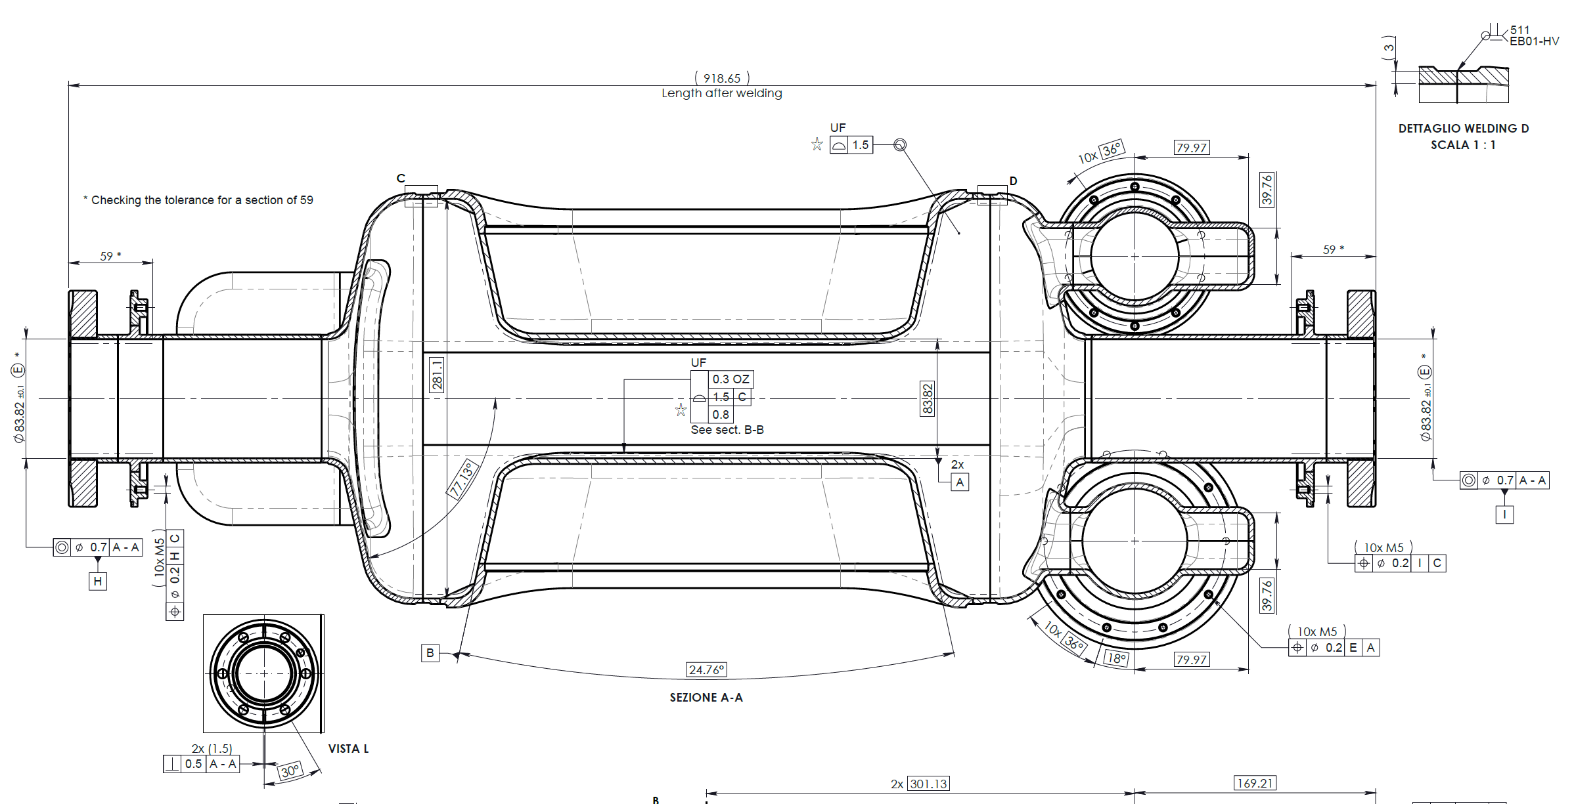
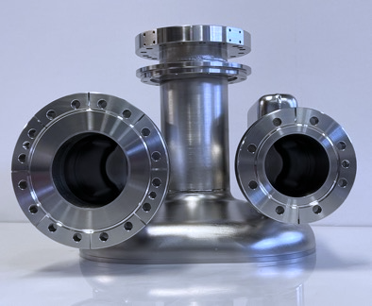
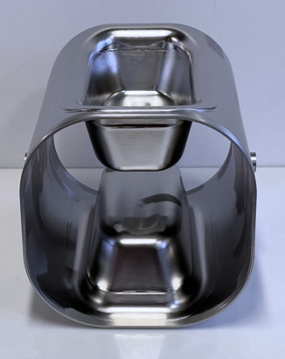
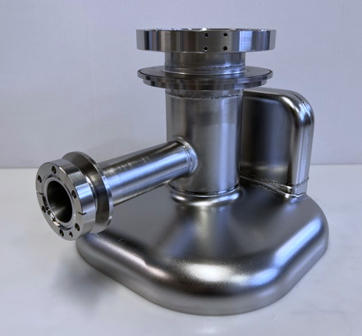
End Groups to Main Body alignment for final EBW
  RFD Crab Cavity required a sub-mm alignment after final EBW of the three main subcomponents (Main Body, FPC End Group and V-HOM End Groups)
C
H
A
I
  Custom welding interfaces machined from CMM data:
    Concentricity between datums H-A-I (obtained 0.5-0.8)
    Rotational constraints from datum C
  Both CNC and EBW required very complex fixtures and years of R&D, tests and DFMA*
DFMA*: Design For Manufacturing and Assembly

Slide 10
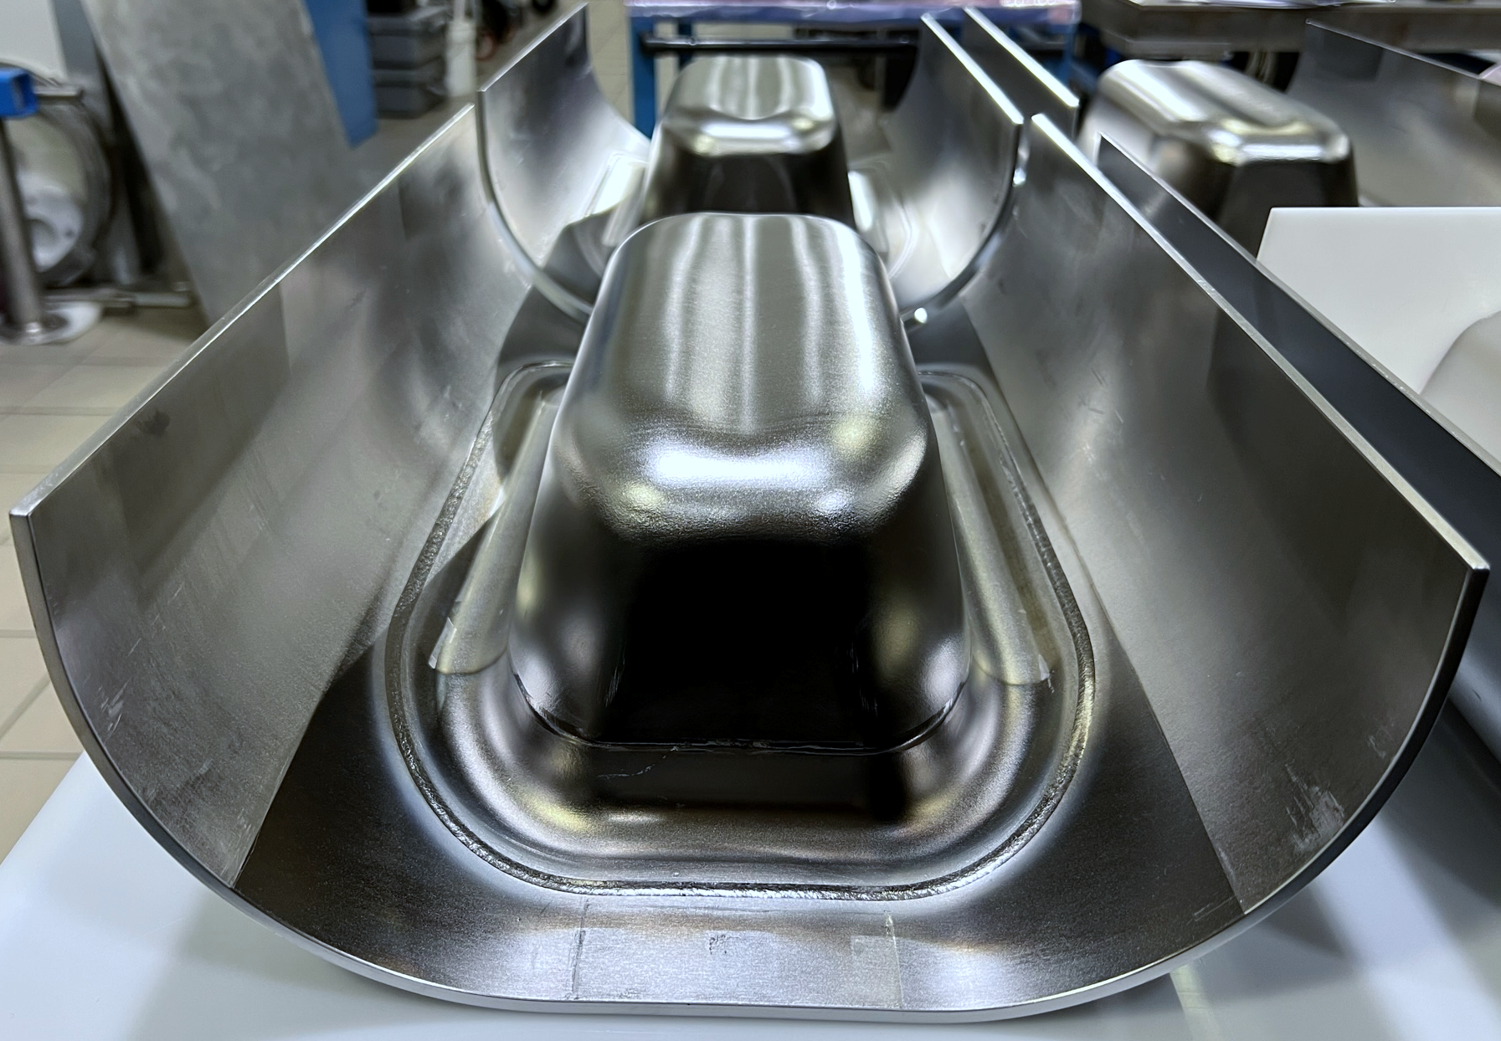
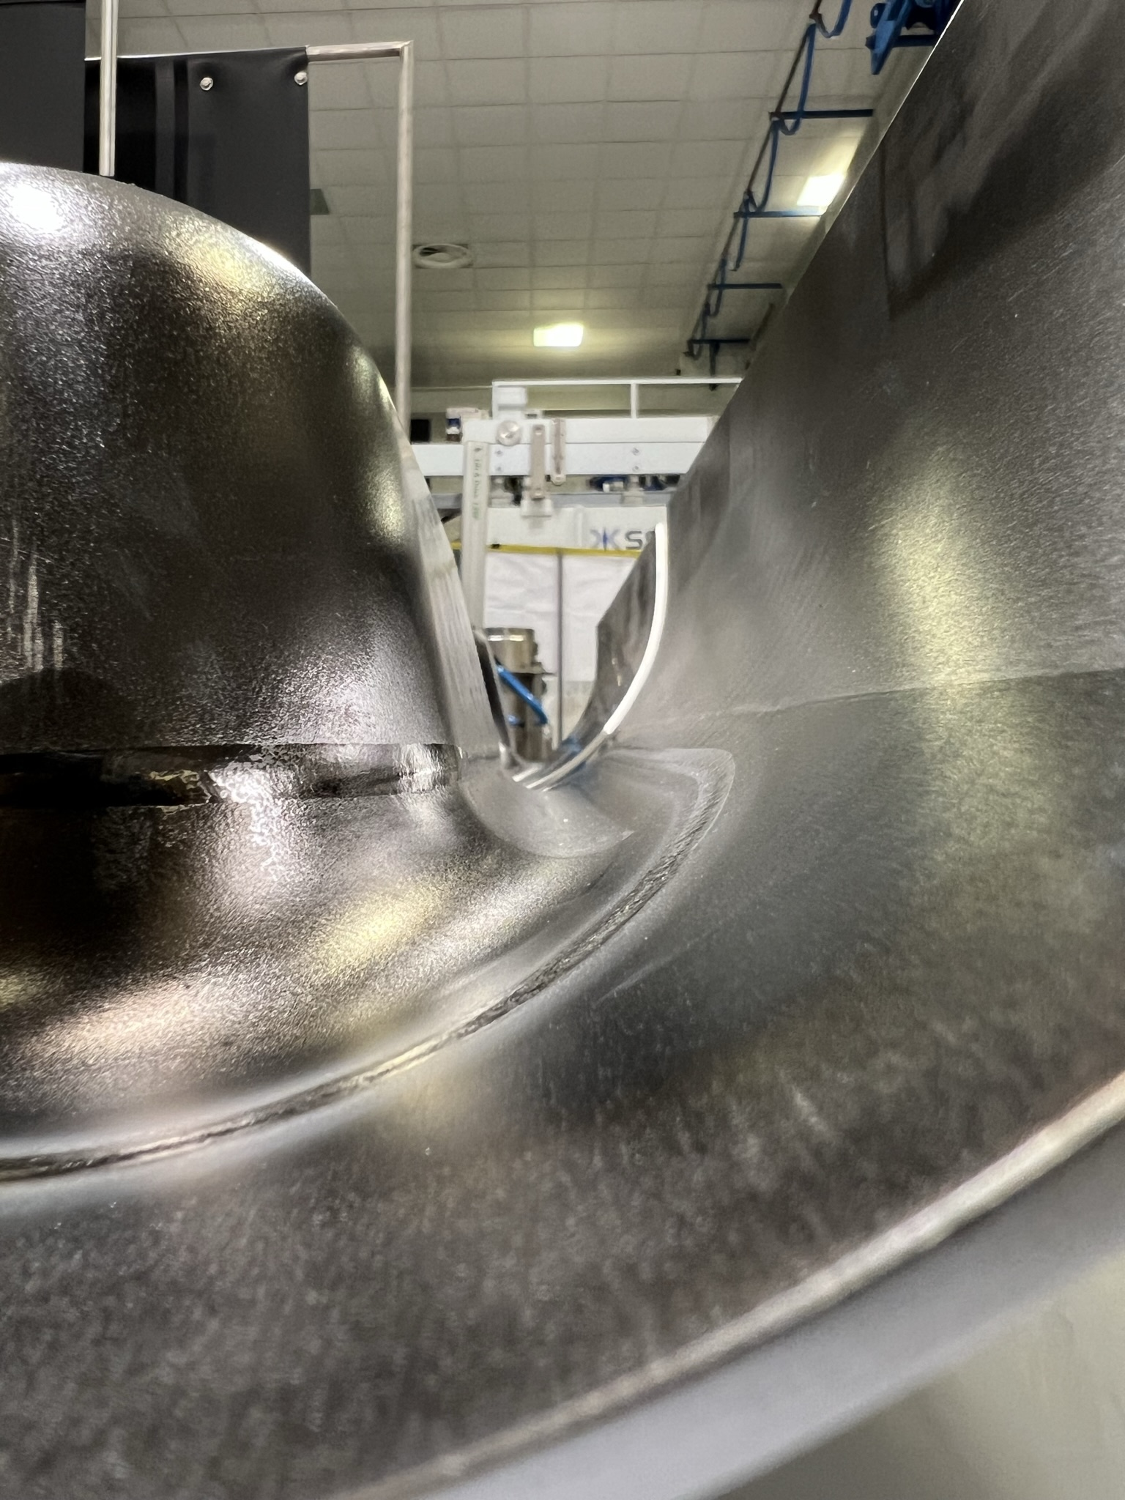
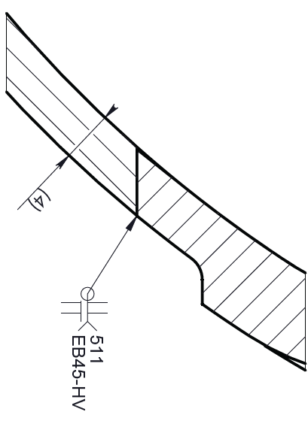
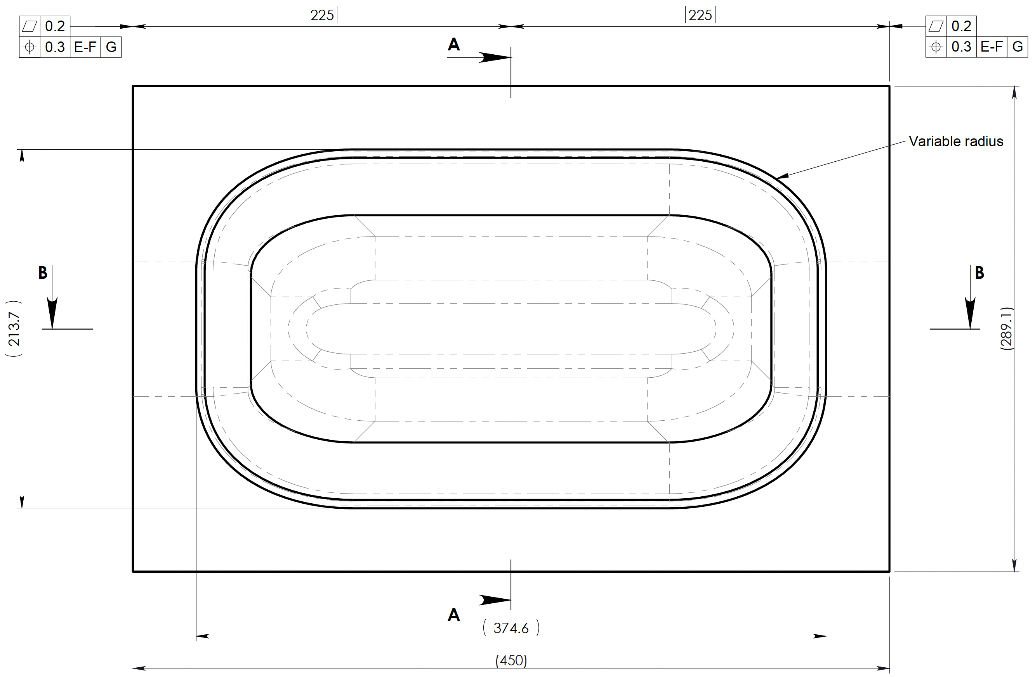
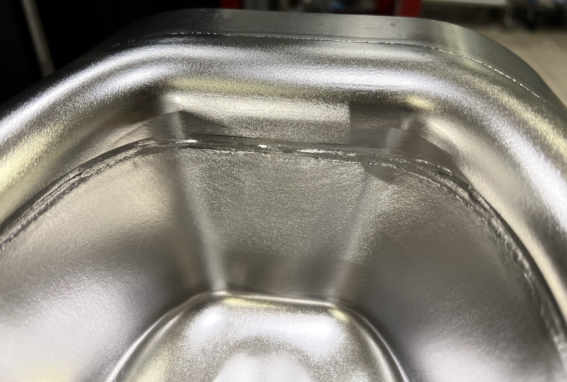
Pole-Corner-Half Main Body EB welding
  RFD cavities required unconventional EBW between such as Pole-Corner-Half Main Body:
    Shape accuracy of the whole Main Body internal surface < 0.4mm after EBW
    Variable radii and thicknesses EBW required careful fixtures design, machining and installation
    ZRI know-how, extensive R&D and months of tests yield to improved results
Notes:
Add pictures

Slide 11
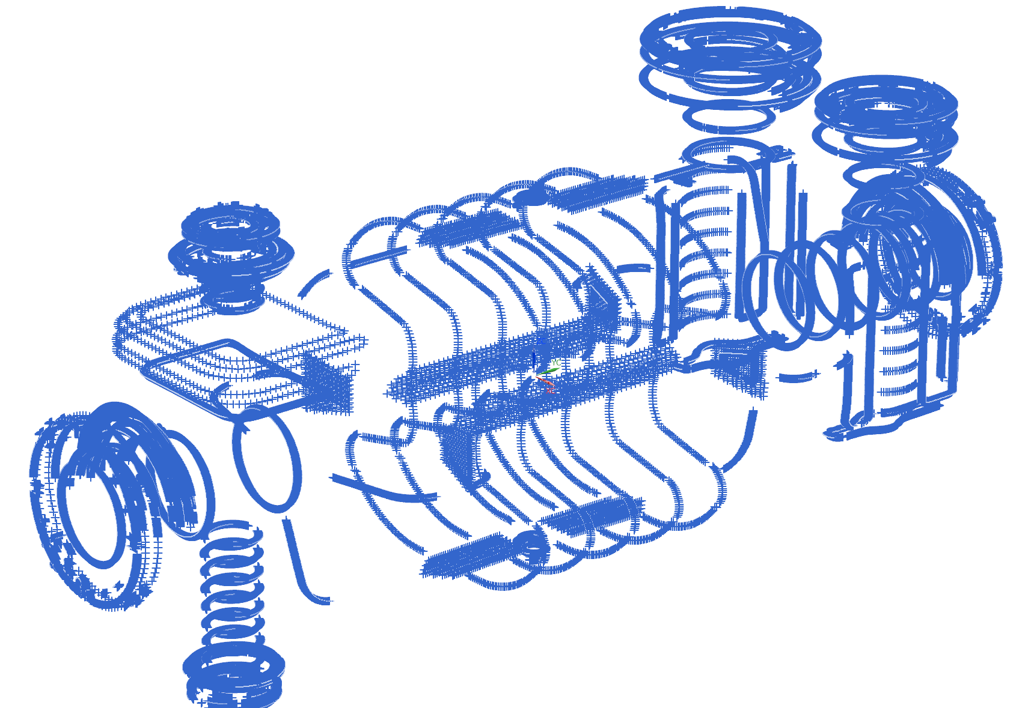
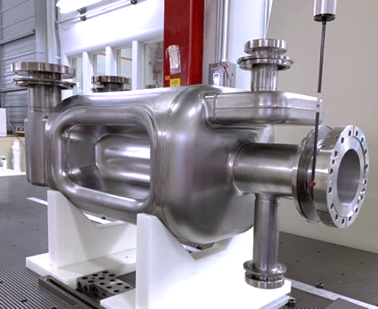
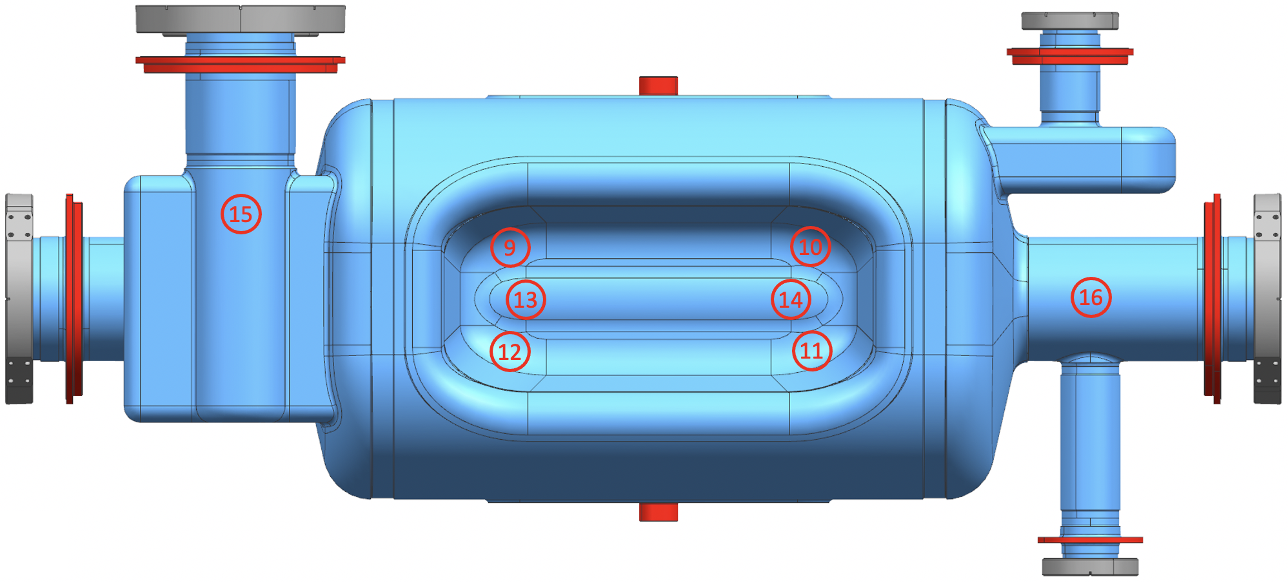
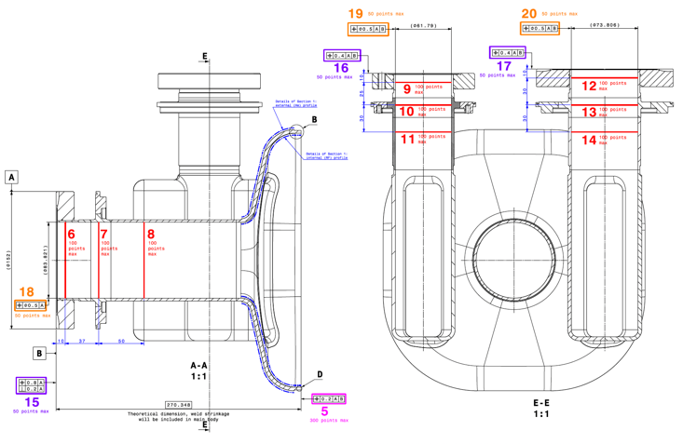
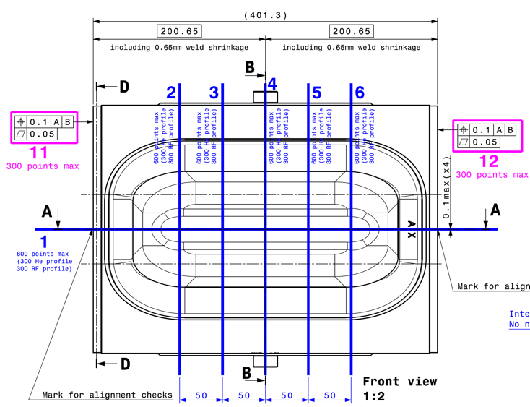
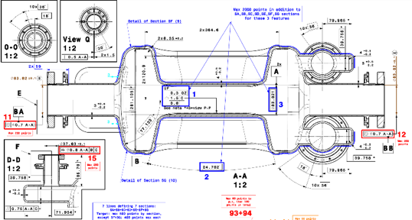
Optimization of CMM metrology
CMM on AUP RFD prototypes @ FNAL: huge effort to comply with Eng. Spec…
  hundreds of points, sections and thicknesses were measured and reported in a 44-page long report
  weeks of improvement to increase accuracy and speed up the measurements for Series
CERN and AUP optimized the data to be acquired to make effective and manageable
Work carried out for both the main subcomponents as well as the entire welded cavity
Notes:
Aggiungi disegno ispezione

Slide 12
Summary
Bare RFD Crab Cavities complex shape and sub-millimetric mechanical tolerances required years of effort in developing design for manufacturing, fixtures, tooling and procedures.
ZRI encountered problems in poles and waveguides deep drawing when working with the series niobium (100% compatible with the project specifications). Production was suspended for months to solve the issues.
Alignment of the three main subcomponents (Main Body and End Groups) for the final EBW required very careful CMM data analysis.
The Pole-Corner-Half Main Body unconventional EBW strategy required R&D for dedicated fixtures and procedures.
Joint effort between CERN-AUP to optimize the metrology to make it more manageable.
Notes:
reduce

Slide 13
Thanks for the attention!
Notes:
Add Slide transition to production.

Slide 14
Validation of DFMA:
ZRI Poles: Shape Accuracy history
After Re-shaping
Limits from Eng. Spec.
Notes:
Add thickness

Slide 15
QA/QC During Fabrication:
Quality Approval Process between AUP & CERN (1)
“Approval Process MTF-EDMS for AUP RFD Crab Cavities” (EDMS 2896383)
CERN approves:
  Fabrication drawings and Manufacturing Procedures: MIP, Welding & Brazing QA
  NDT, welders and brazing operators' certificates
  Raw material certificates and UT reports
AUP uploads and releases all manufacturing reports to EDMS / MTF
CERN reviews and releases:
  Bare Cavities final frequency and metrology, UT thickness (after BCP) + Cold RF test
  Dressed Cavities:
    Pressure test + LT of He Tanks and 2nd Beam Pipe for Jacketed Cavities
    Cold RF tests + Frequency at 2K+ for Dressed Cavities
CERN reviews and closes all the NCRs
Notes:
Prendi I bullet dale slide di Hector solo per bullet

Slide 16
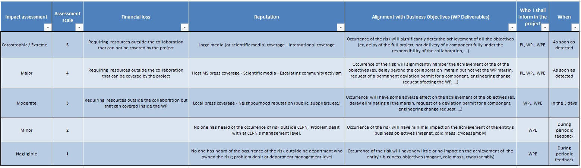
QA/QC During Fabrication:
Quality Approval Process between AUP & CERN (2)
“Handling, Sharing and approval of NCRs AUP-CERN” (EDMS 2384617)
The NC Impact is assessed by AUP based on:
  “AUP Quality Plan for vendors and FNAL Incoming Inspections NCs”
  Technical, Schedule, Financial and Reputational impact
Collaborations Impact Matrix used for assessment or escalate to CERN
Non-critical NCs are managed internally
  Shared with CERN via MTF
  NCRs use vendor’s templates
  Special attention to Welding
Critical NCs are managed as to HL-LHC NC Policy:
    Shared with CERN within days via MTF
    HL-LHC NC template is used
    5 Ws (What, Where, When, Who, Why)
Notes:
Prendi I bullet dale slide di Hector solo per bullet

Slide 17
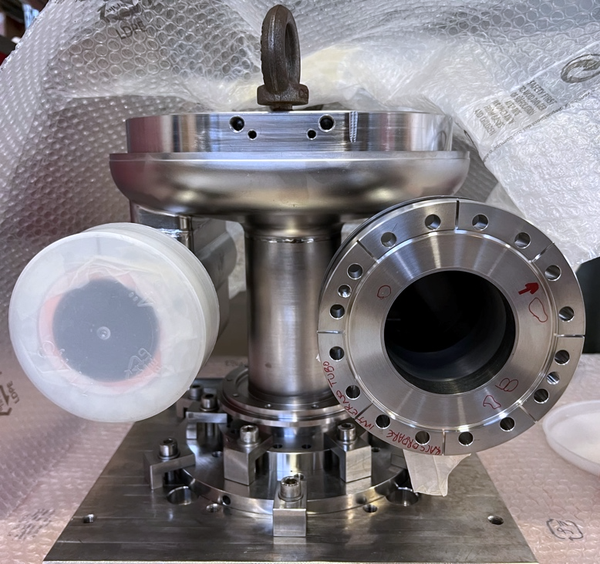
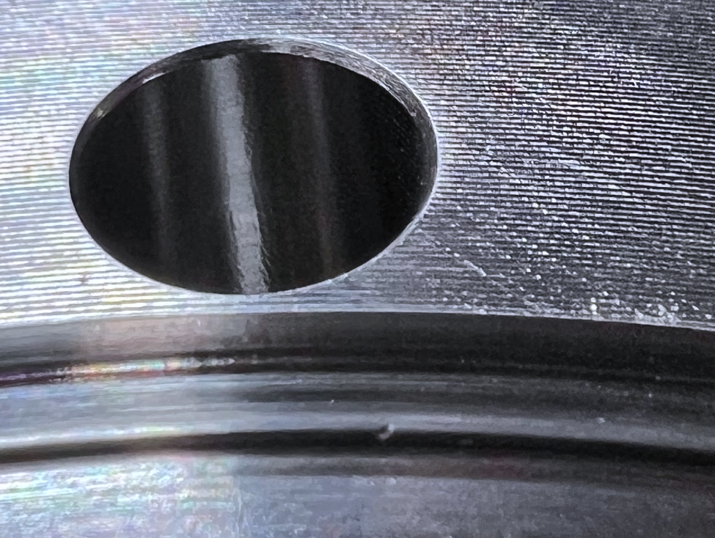
Pre-series NCRs: H-HOM knife edge case
Unacceptable defect on Knife Edge (depth > 0.2mm)
Attempts at adjustment provided unsatisfactory results
A custom-made cutting tool will be used for rework
  Entire flange plane will be reworked (keep the thickness acceptable)
  3+ weeks ETA for procurement of the cutting tool (for vertical lathe)
  1 week ETA for CNC machining

Slide 18
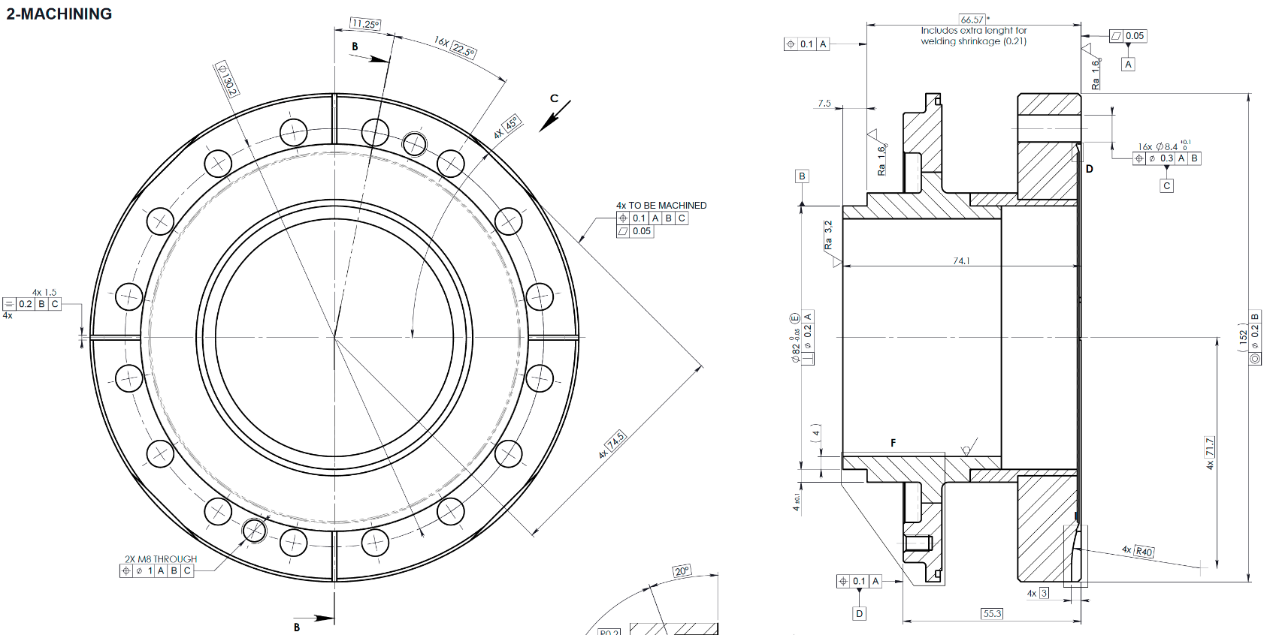
Pre-series NCRs: Beam Axis case
Machining issue on one of the Beam Axis brazed extremity.
Holes pattern and alignment planes shifted by 0.3mm.
AUP decided to reject the part. ZRI machined a new one.
+0.3 ∼
+0.3 ∼
+0.3 ∼
-0.3 ∼
-0.3 ∼
It slowed down production of pre-series cavities for several weeks

Slide 19
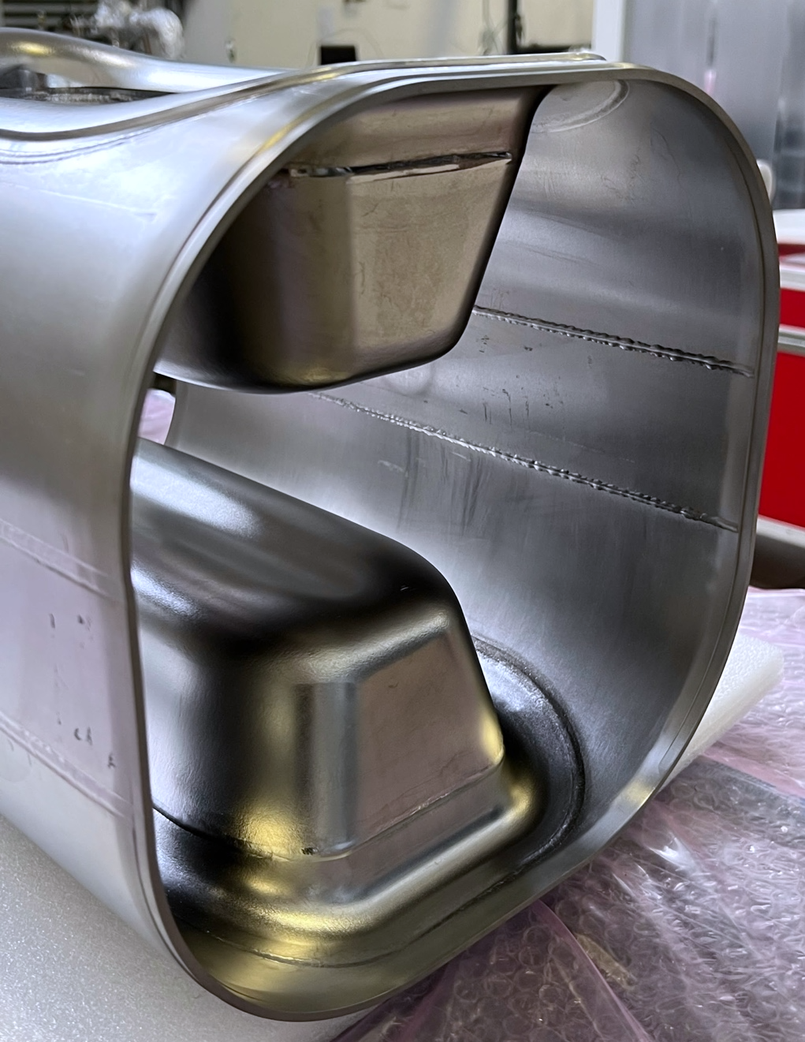
Pre-series NCRs: Main Body case
After Main Bodies EBW some scratches have been noticed during VT:
  The root cause was the EBW fixture removal
  Racetrack RF surfaces was the most affected
  Minor defects on Poles
Countermeasures
  Re-machining the fixture to avoid future problems
  Local grinding of the affected RF surfaces (according to the CERN’s approved ZRI procedure)

Slide 20
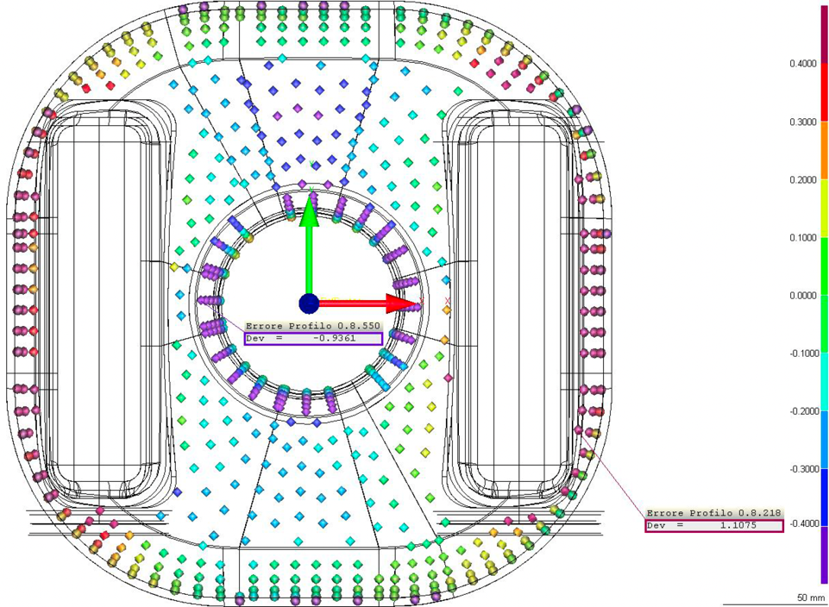
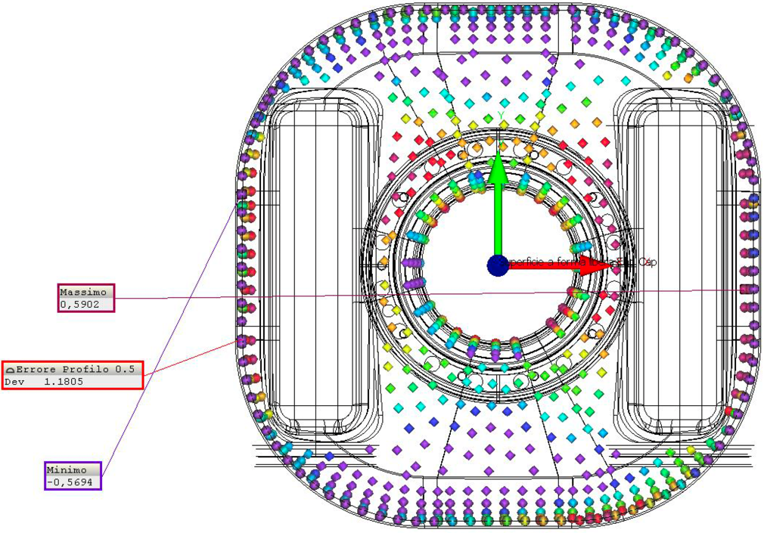
Pre-series vs Prototypes Metrology:
V-HOM End Group
Pre-series V-HOM End Group
{+/-0.25mm scale}
Prototype V-HOM End Group
{+/-0.4mm scale}
Several improvements in manufacturing have been implemented by ZRI:
  Forming tooling slightly reworked.
  EBW and CNC fixtures updated.
Significant improvement in shape accuracy from 2.22mm to +1.18mm.
Procedures deriving prototypes have been validated.

Slide 21
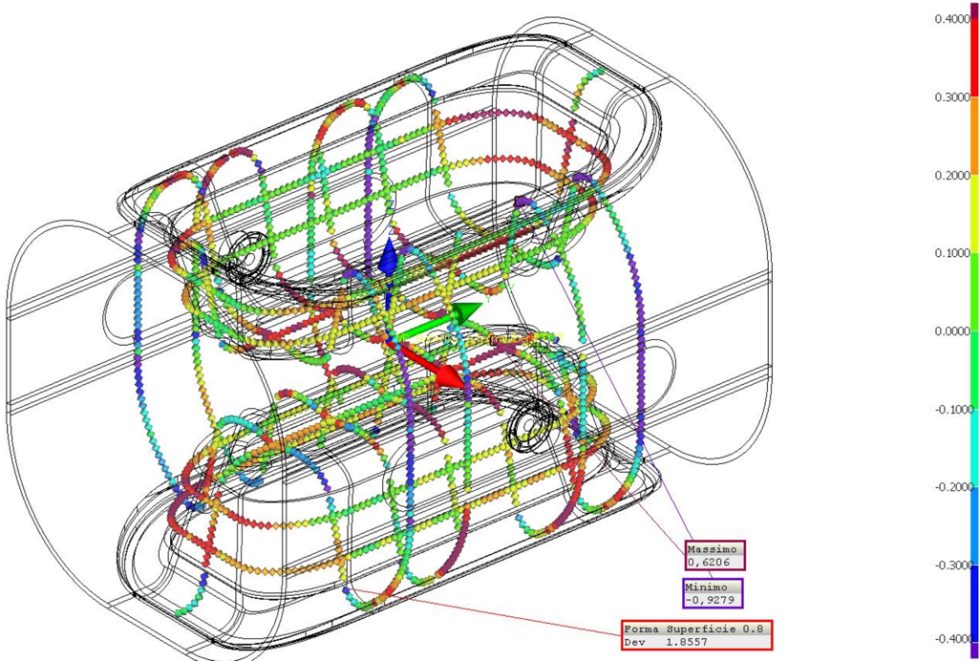
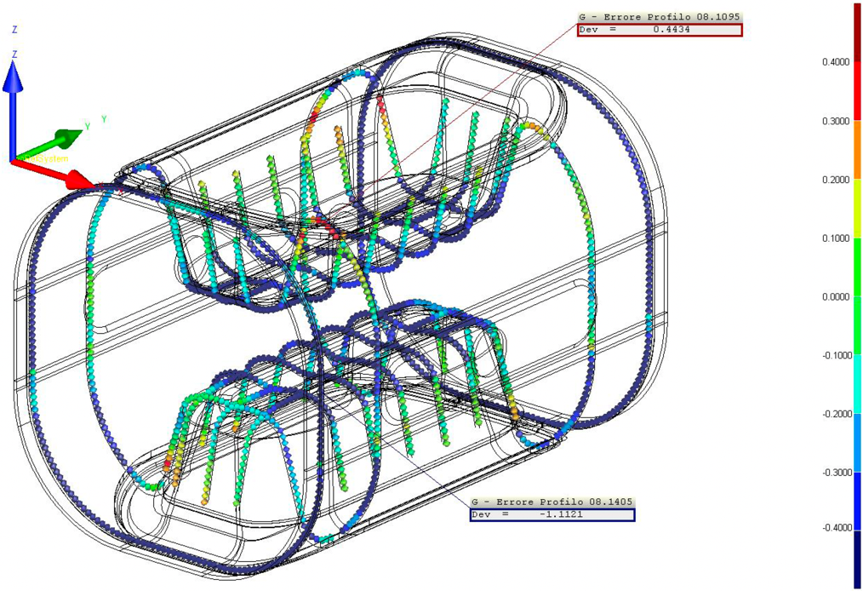
Pre-series vs Prototypes Metrology:
Main Body
Pre-series Main Body
Prototype Main Body
Effective reshaping of Main Body have been performed by ZRI:
  Poles and extremity of main body can be reshaped with sub-mm accuracy to enhance the cavity Frequency before final EBW
Noticeable improvement in shape accuracy from 2.22mm to +1.86mm.
Procedures deriving prototypes have been revised to improve results

Slide 22
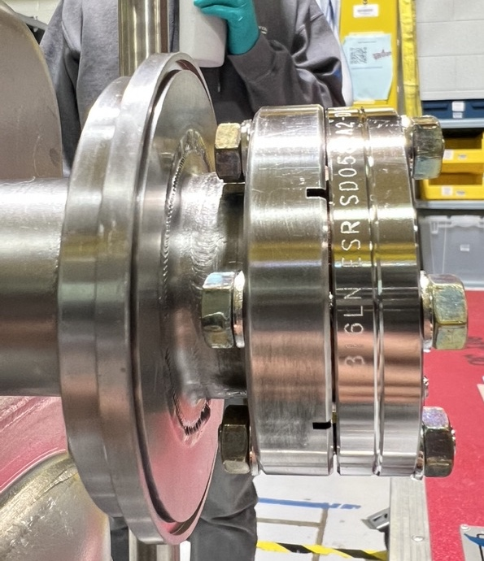
Prototype NRFDP001:
Clean Room assembly issues at ZRI
First Cold Test at FNAL: Cold leak at 2K
VT showed some assembly issues
  Concentricity cavity flanges/caps
  up to 230µm of gap (V-HOM side)
Shipped back to ZRI for a new HPR + updated assembly (witness by FNAL)
Second VTS at FNAL:
  Leak problems: solved
  Very good Q₀ at low field but FE limited cavity performances
Next steps: retesting at JLab + some extra NDTs on internal surfaces
Notes:
Overall goal

