Slide 1


Fabrication of 650 MHz Deflecting Cavity
Zhongyuan Yao
WG-2, TTC at FNAL
Dec. 5 – 8, 2023

Slide 2
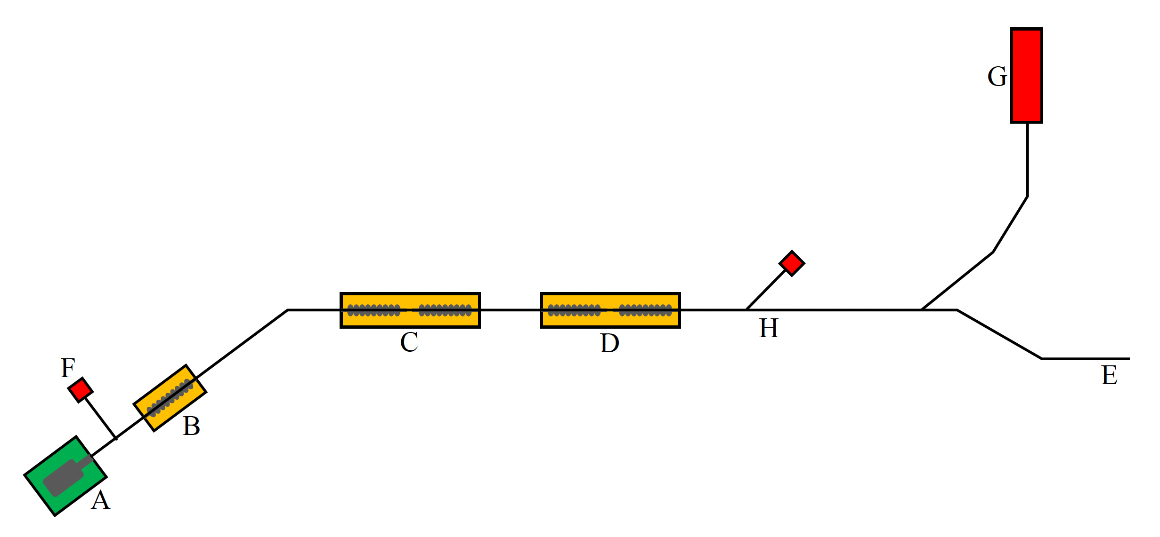
ARIEL e-Linac
100 kW CW electron beam for RIBs production in ARIEL
300 keV e-Gun
Injector and Accelerator CMs
  1.3 GHz, 9-cell, 10 MeV per cavity
to ARIEL

Slide 3
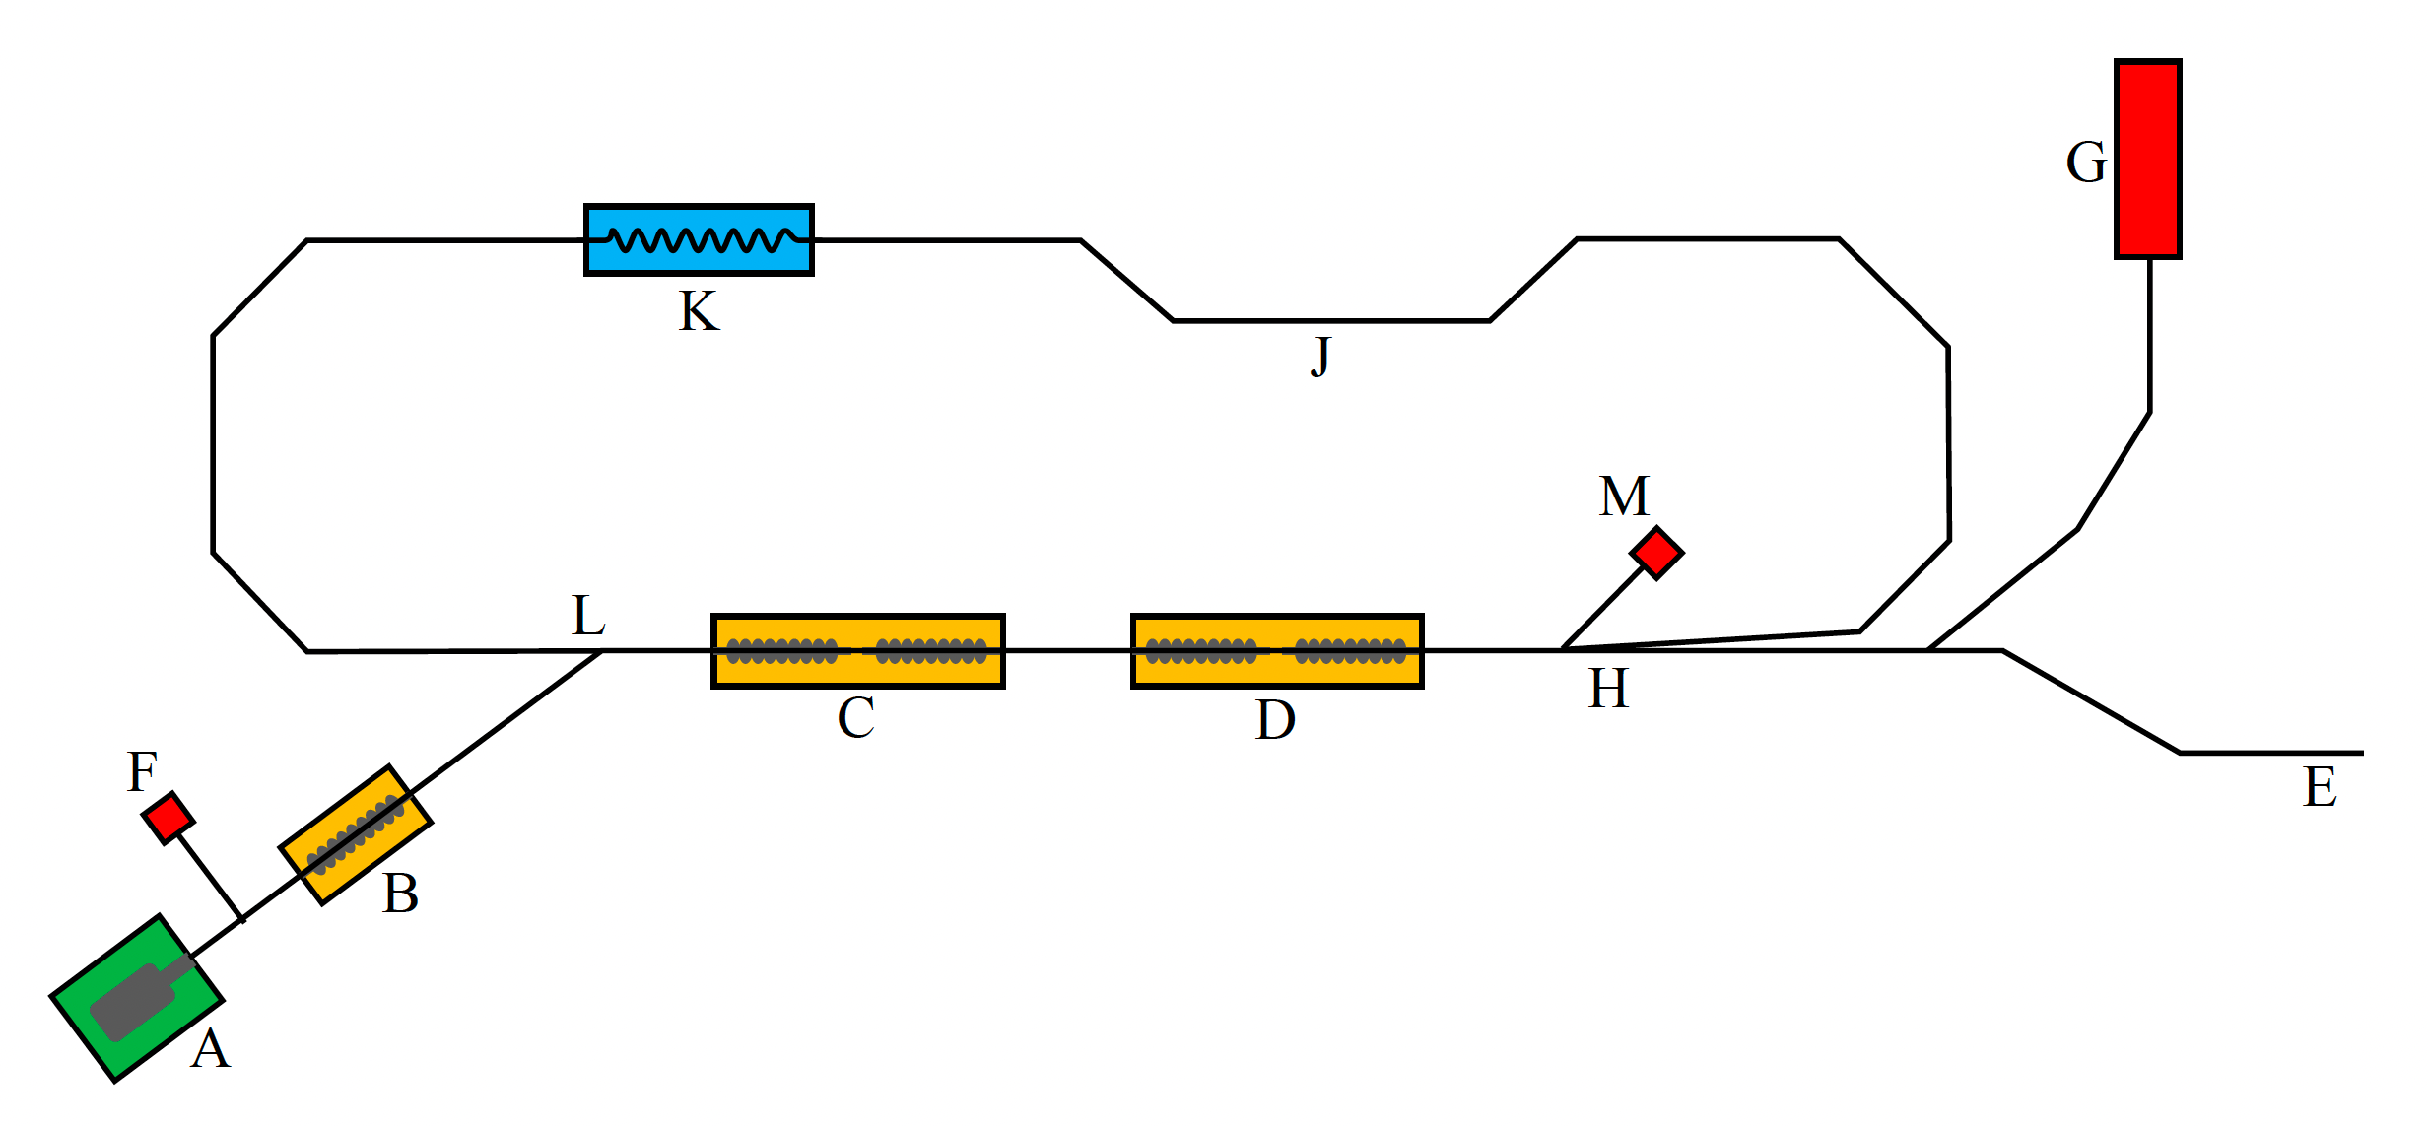
e-Linac Upgrade

Slide 4
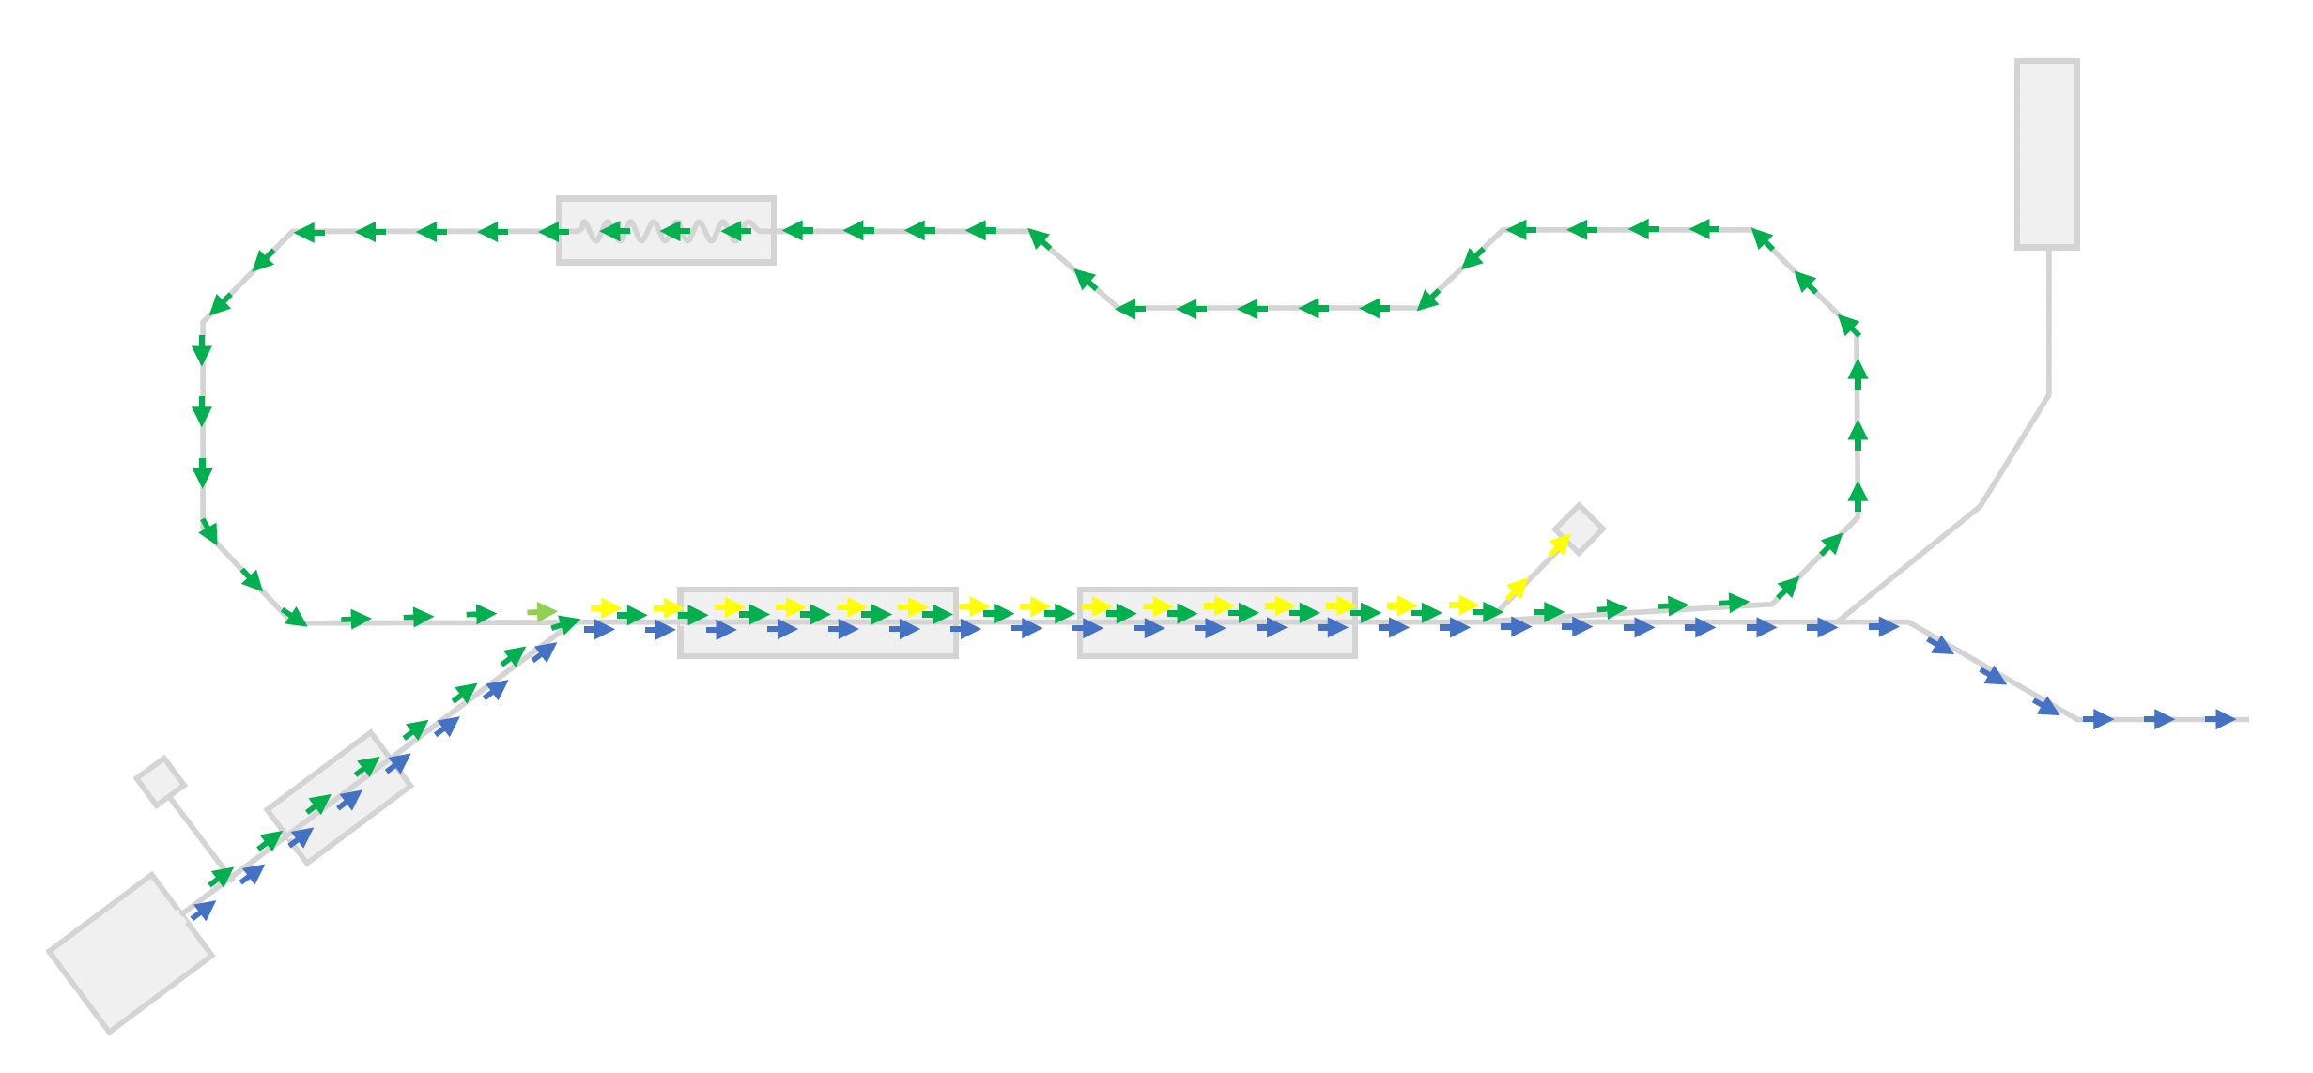
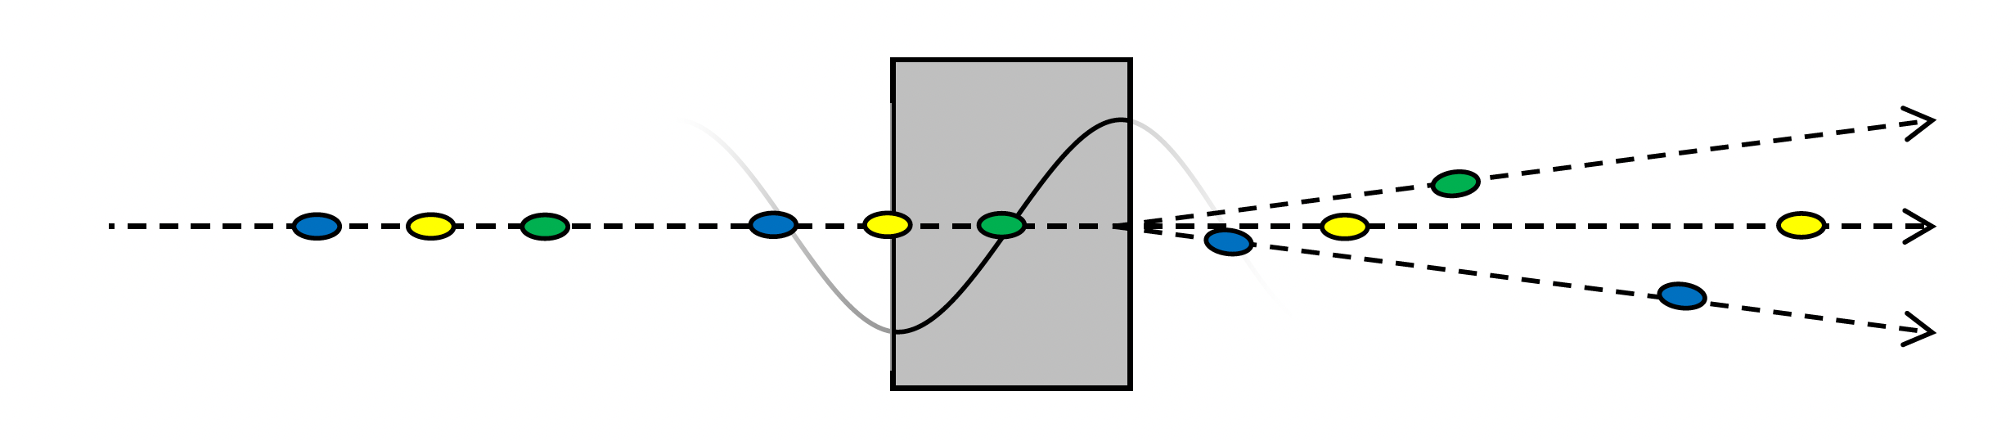
Beams in ERL Mode
ARIEL beam
Recirculating beam
Deacceleration beam
650MHz
RF separator

Slide 5
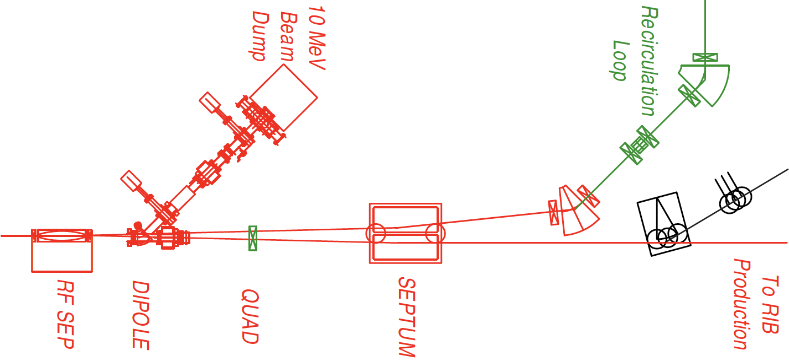
650MHz Deflecting Cavity
3mm beam separation of ARIEL and recirculating beams in 3m
RF separator requirements
  Initiate separation
    ±4.4 mrad angular deflection
    0.3 MV for 50 MeV beam
  Peak fields not demanding
  Limited longitudinal space
  High shunt impedance required
Beam Separator Scheme
3m

Slide 6
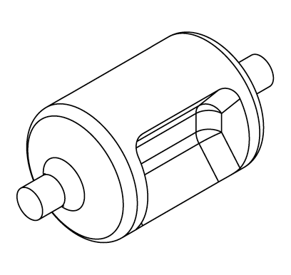
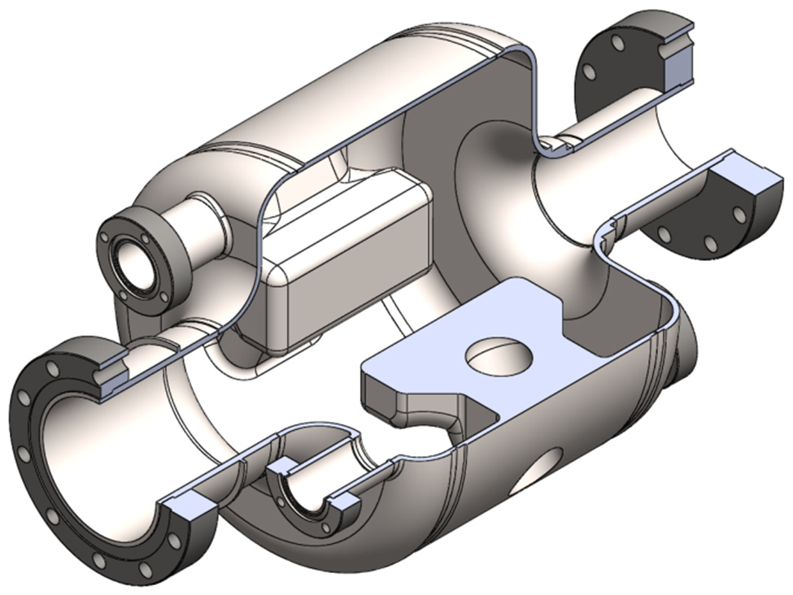
650MHz Deflecting Cavity
Baseline geometry from RF dipole design
Optimized for high R⊥/Q and short cavity length
 | Baseline | Post & Ridge
Frequency | 650 MHz | 650 MHz
Dimension | Φ 210 × 330 mm | Φ 204 × 175 mm
Nominal V⊥ | 0.3 MV | 0.3 MV
R⊥/Q | 411 Ω | 625 Ω
G | 117 Ω | 99 Ω
E_{peak} @ 0.3 MV | 4.5 MV/m | 9.5 MV/m
B_{peak} @ 0.3 MV | 7.8 mT | 12 mT
P₀ @ 4 K | < 1 W | < 1 W
50mm
73mm

Slide 7
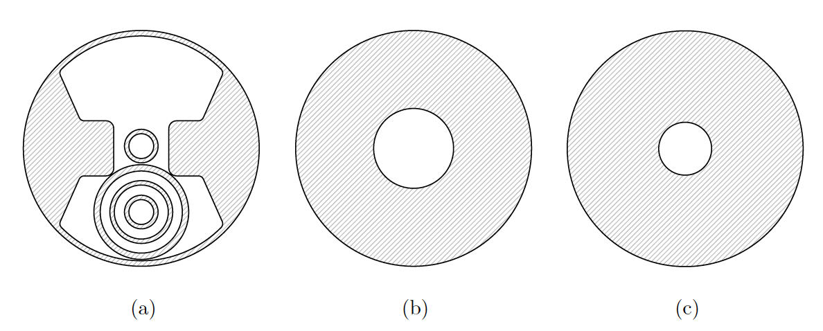
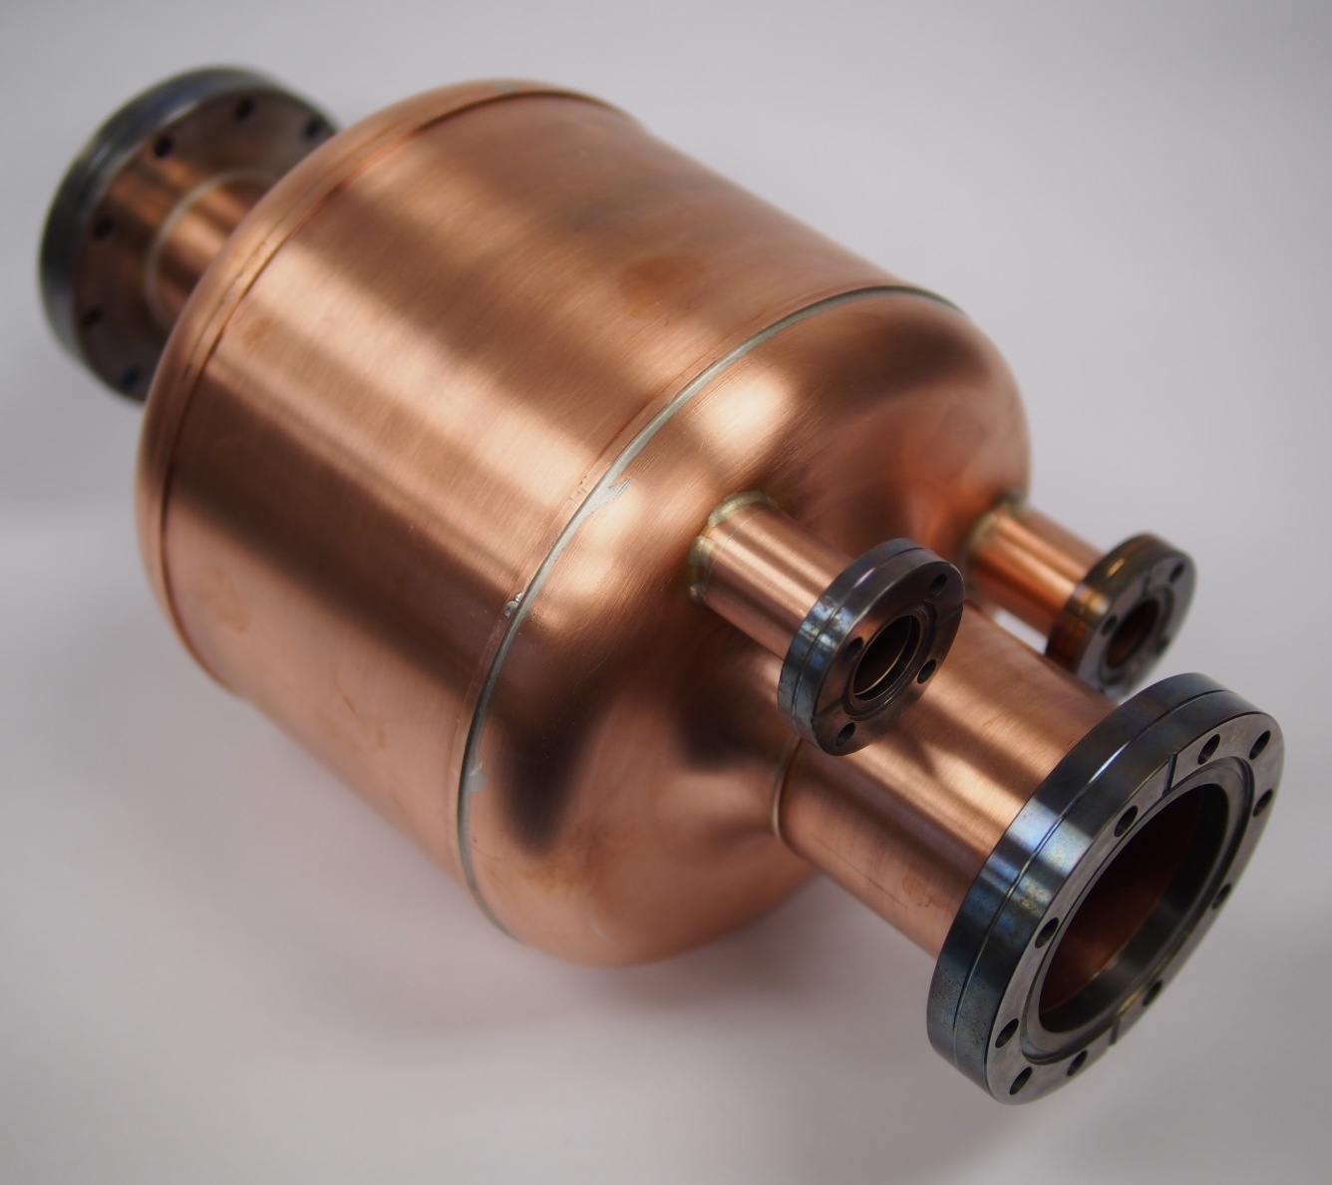
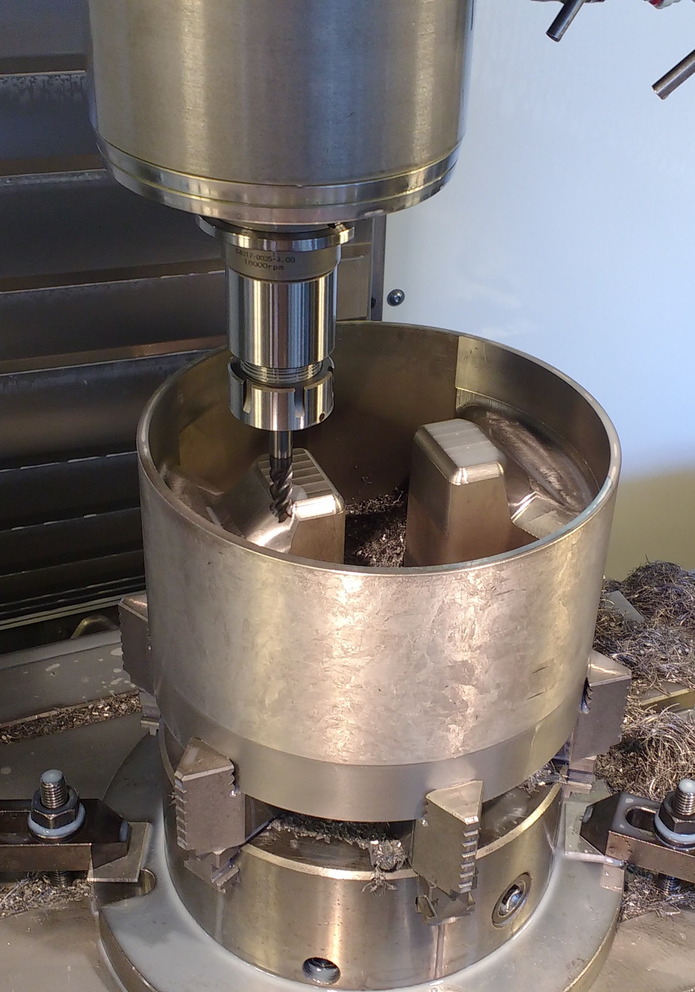
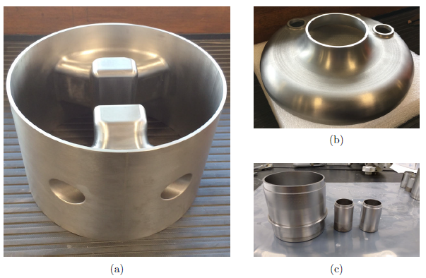
Low-Cost Fabrication
Reactor grade Nb (RRR-45)
Machined from solid block
  EDM to cutout beam pipes and RF ports
Copper cavity to prove machining

Slide 8
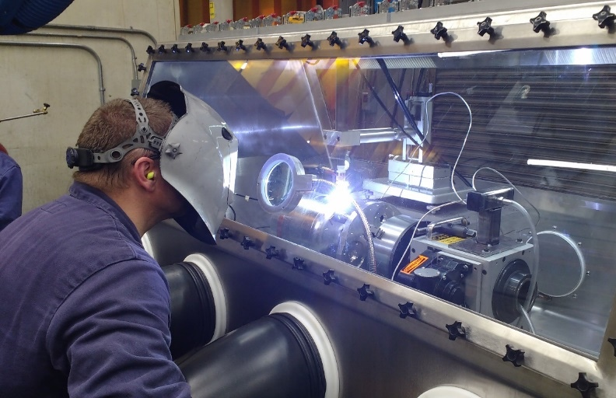
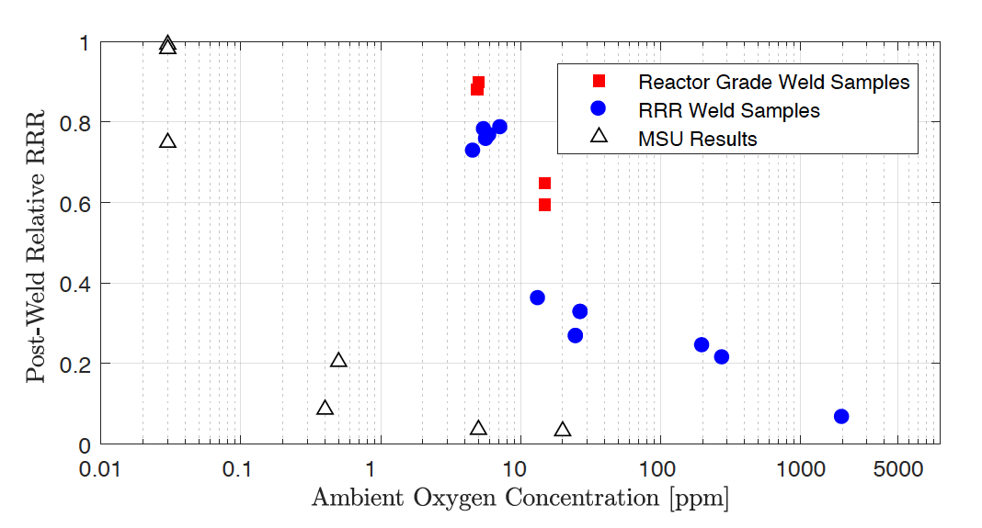
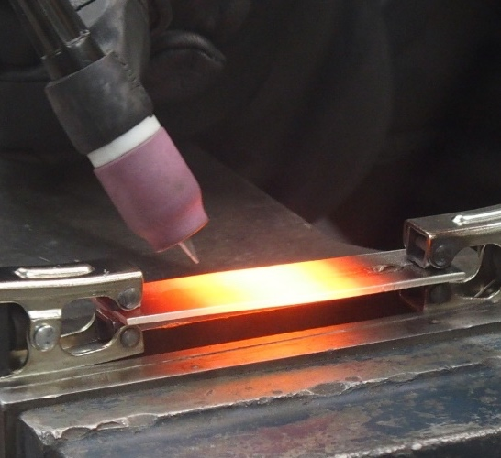
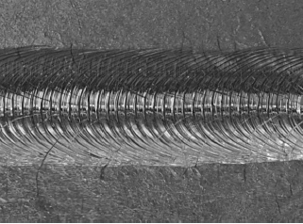
Tungsten Inert Gas (TIG) Welding
TIG welding developed
Sample welded and RRR measured
to qualify the process

Slide 9
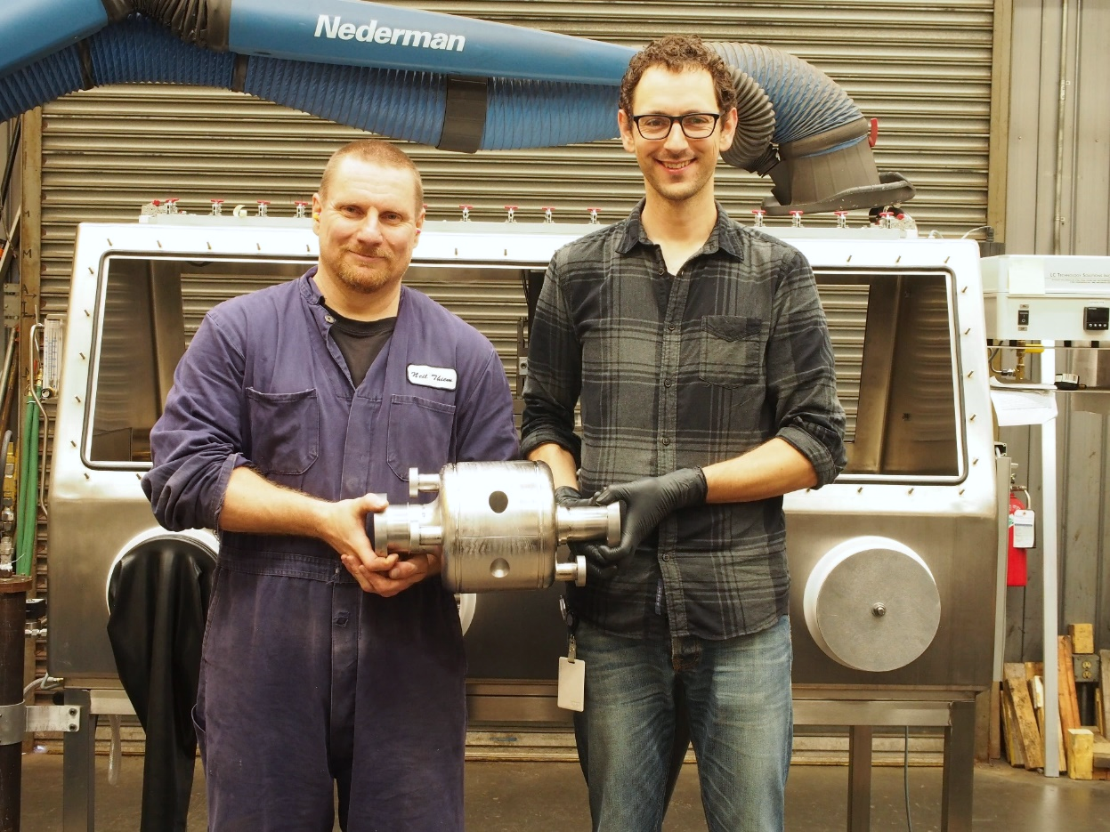
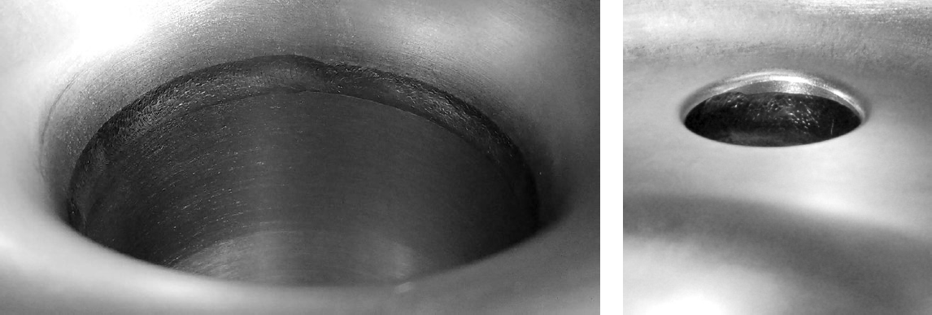
Completed Cavity
First SRF cavity fabricated in TRIUMF machine shop
1
2
3

Slide 10
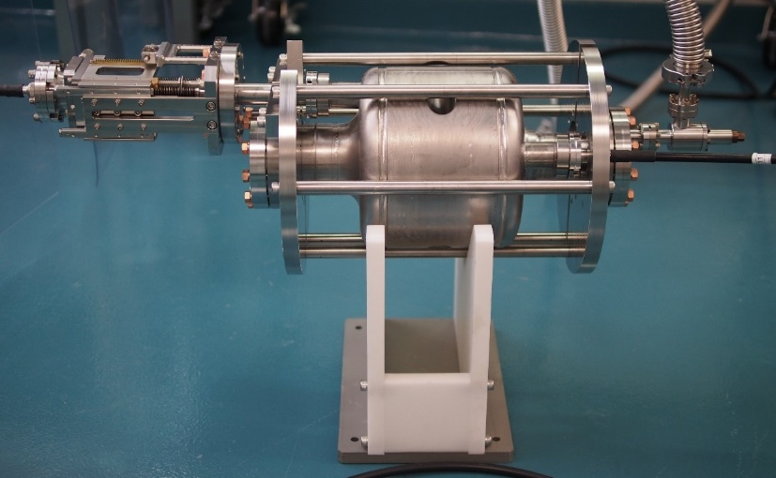
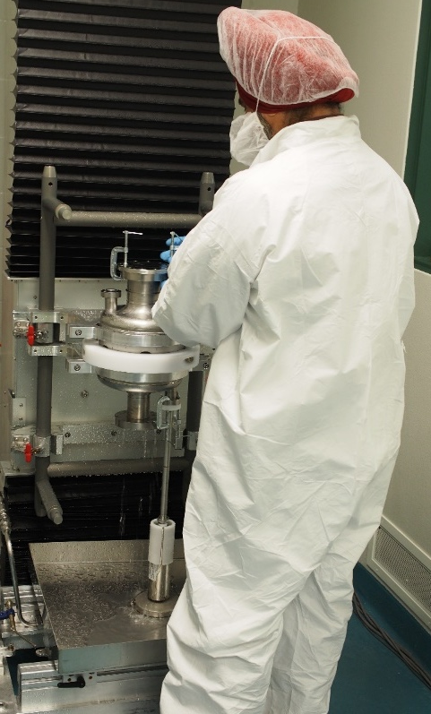
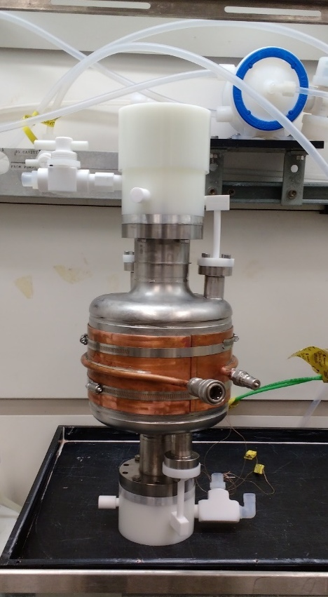
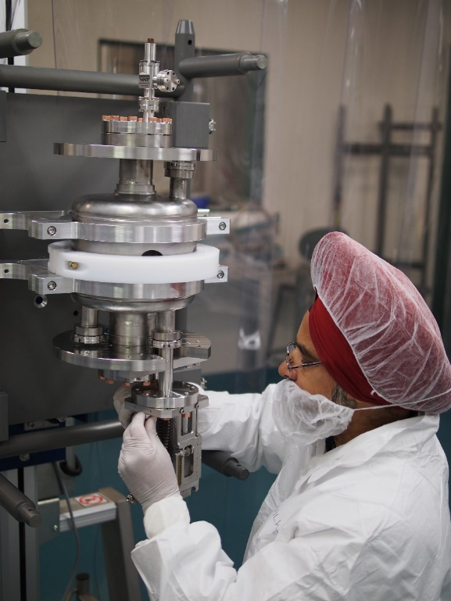
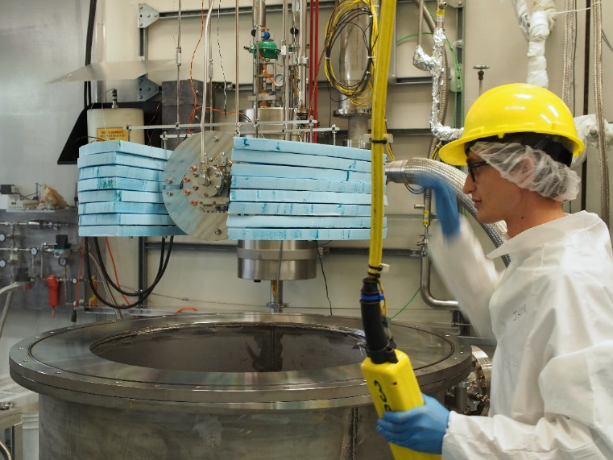
Preparations for Cold Test
aaa
bbb
  ccc
  ddd
HPR…
BCP…
Ready to go!
Assembling…
Into the cryostat...

Slide 11
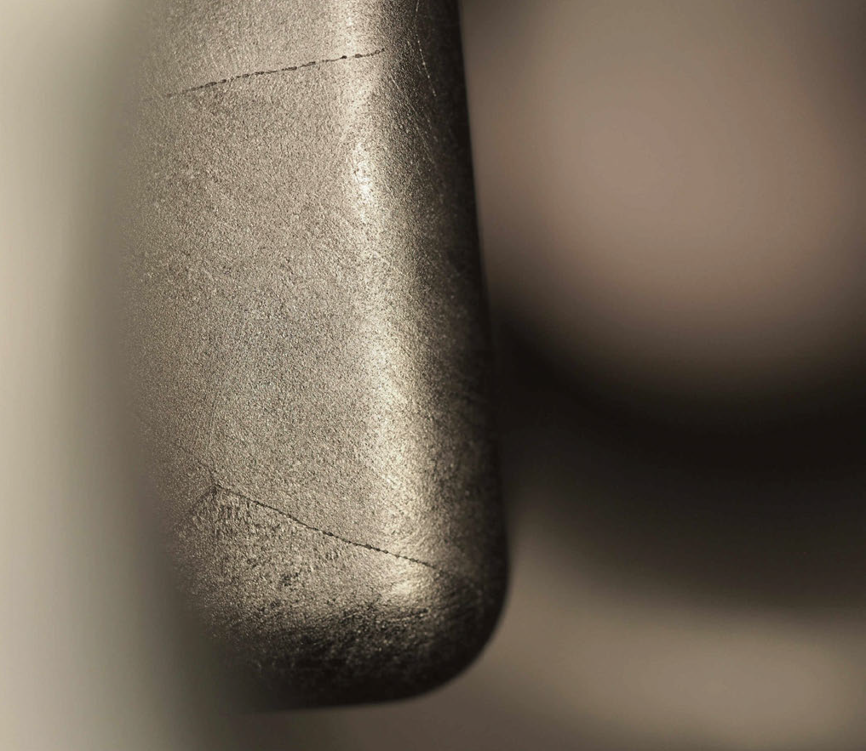
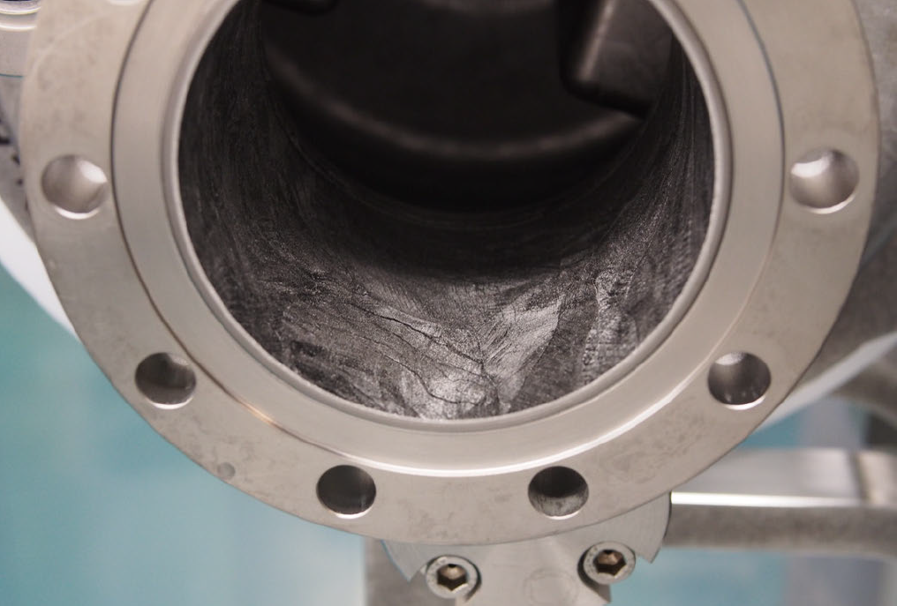
RF Surface Finish
BCP on reactor grade Niobium
led to uneven surface finish
Smoother areas appear darker
Cracks with a series of pits on ridges

Slide 12
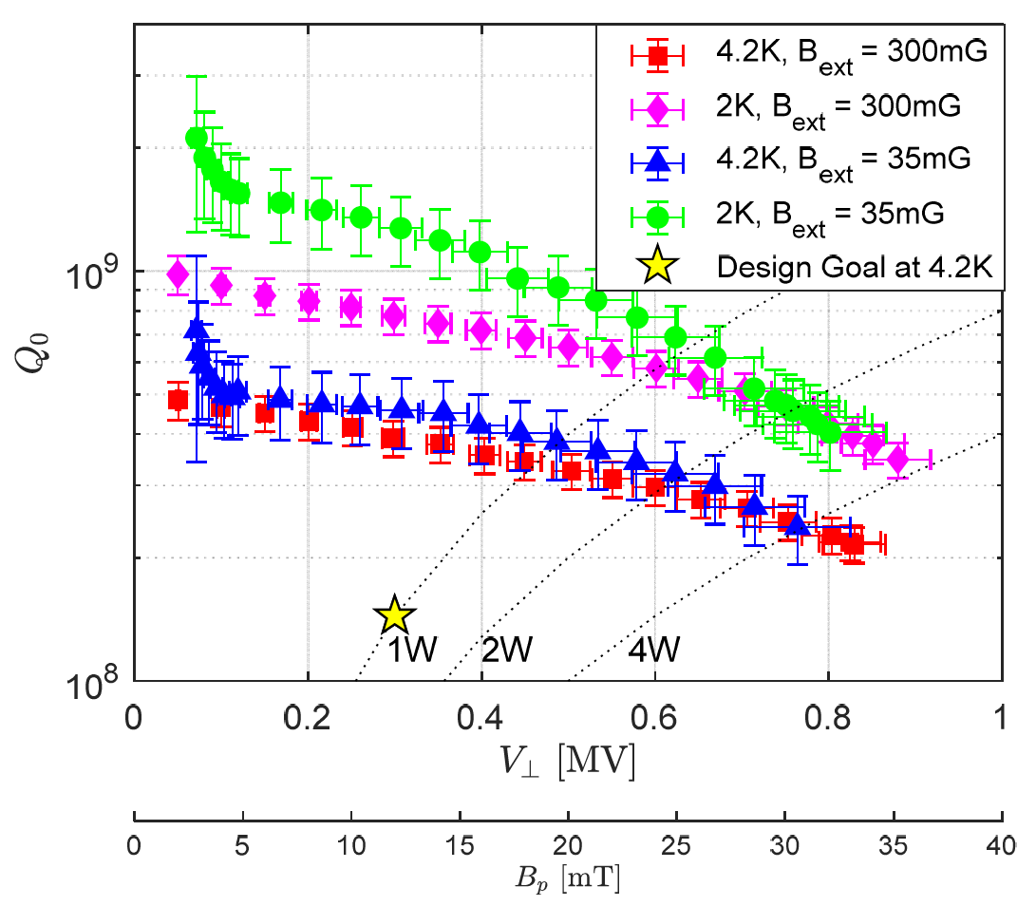
Cold Test Results
Surpassed design specifications
  Peak fields 25 MV/m and 32 mT
  Cavity quench at 0.8 MV
  No measurable X-ray
TIG weld didn’t cause issues
No Q-disease from 100 K soak
Mechanical properties
  df/dp = +9.7 Hz/mbar
  LFD = -101 Hz/MV²

Slide 13
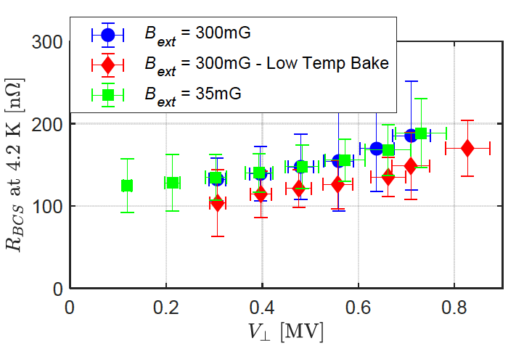
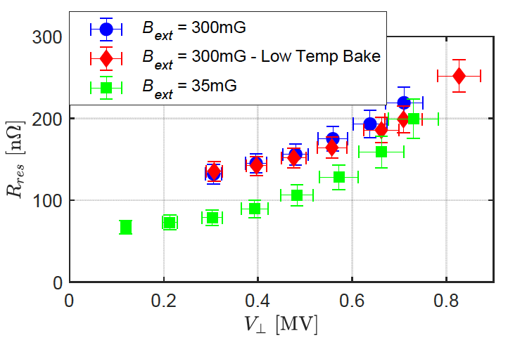
Surface Resistance
R_{BCS} and R_{res} extracted from cooldown data from 4 K to 2 K

Slide 14
Summary
650 MHz deflecting cavity was built in-house with novel (low-cost) fabrication technologies
  Reactor grade niobium
  Machined from solid block
  TIG welding
Cavity surpassed design specifications for voltage and quality factor
  Cavity reached 32mT before quench
  No obvious effect from low temperature bake
  No Q-disease without hydrogen degassing
  High residual resistance and strong Q-slope caused by poor surface finish after BCP

Slide 15
Acknowledgements
Many thanks to
  Entire SRF group
  Machine shop
  CMMS
  Cryogenics group
  Design office, Targets group, Detector group, and more
  Chris Compton (FRIB)

Slide 16




Thank you
Merci
Question?
www.triumf.ca
Follow us @TRIUMFLab

Slide 17
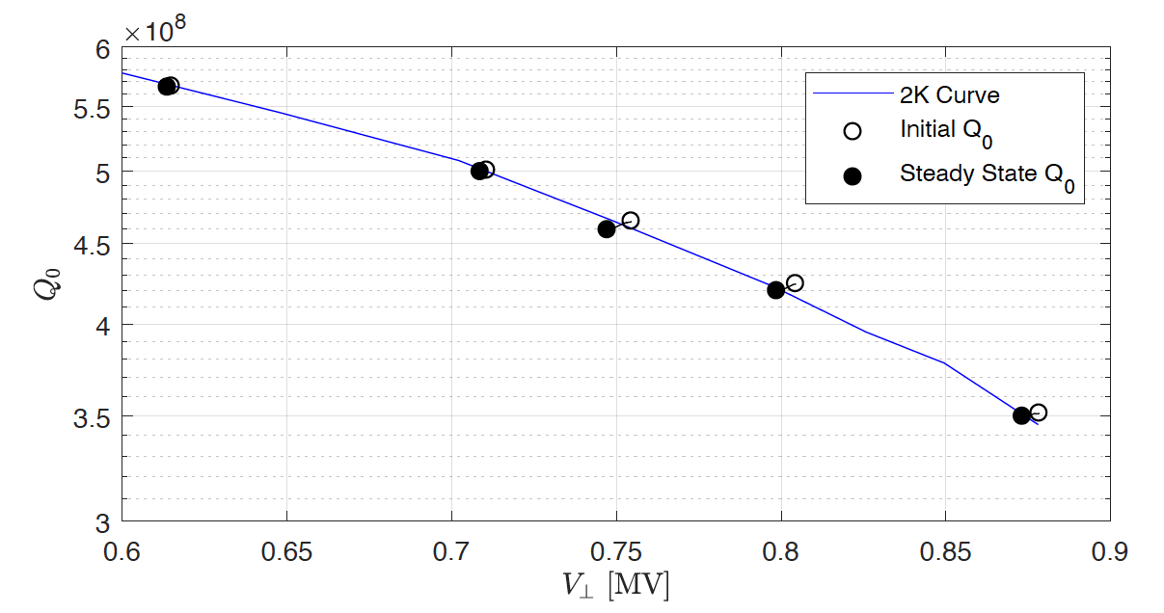
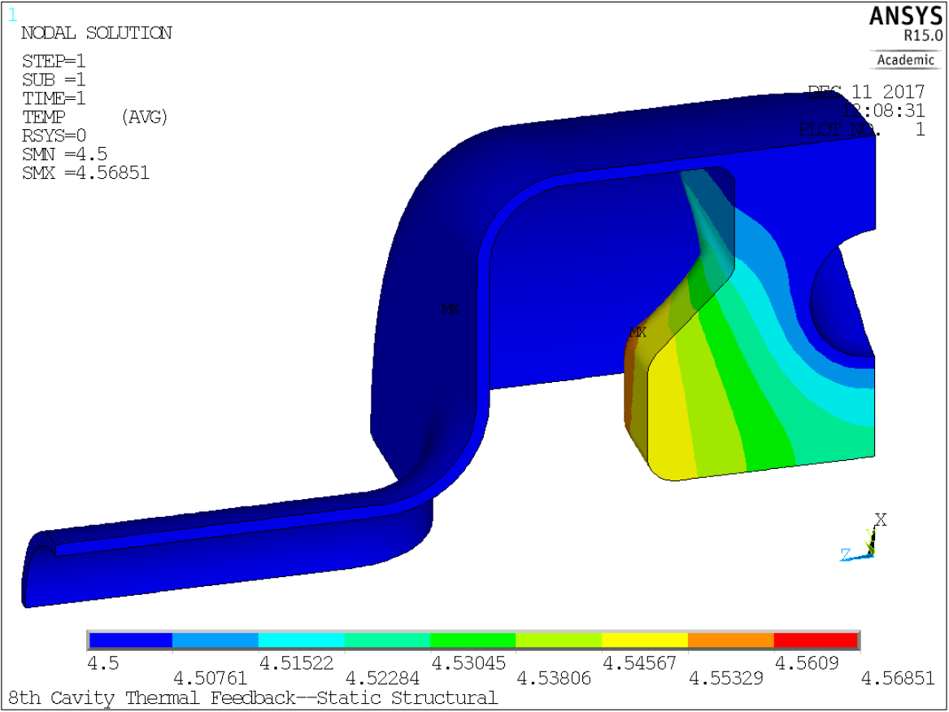
Thermal Effects
Solid ridge and RG Nb lead to ~100× thermal resistance from RF surface to helium interface comparing to typical SRF cavities
Measurement
  Suddenly increase V_{T}
  Observed > 0.7 MV
  < 1.5% Q decrease
Reverse meas.
  Reduce to 0.2 MV
  ~ 4% Q increase

Slide 18
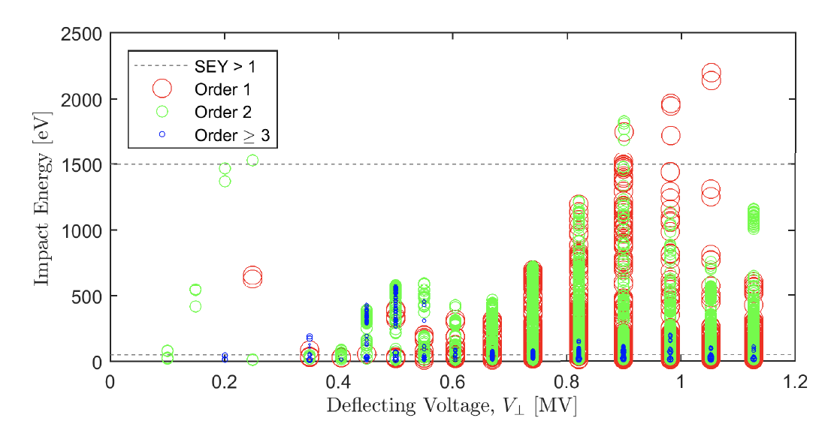
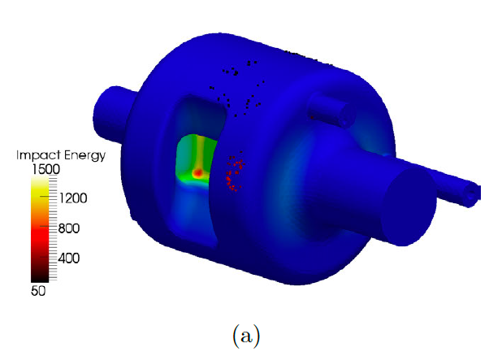
Multipacting
A few MP barriers observed at 4K
Processed in a few minutes w/ < 10 W power
  Not re-appear after
  processing
Trajectory at 0.5 MV

Slide 19
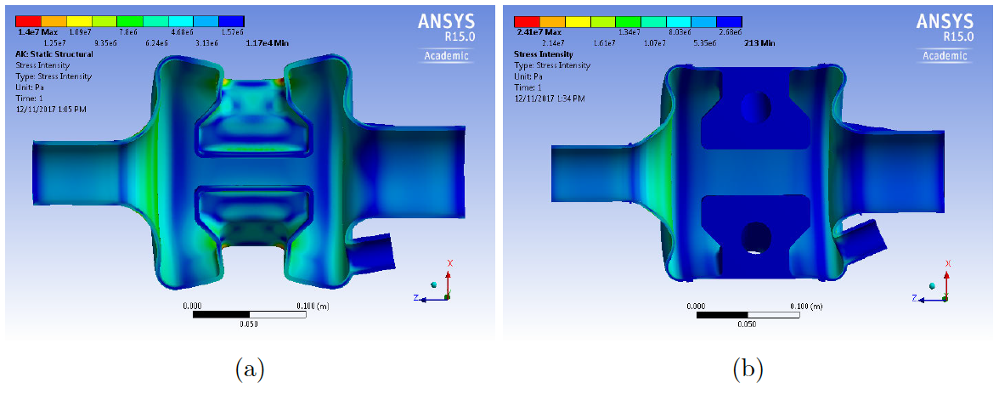
Solid Ridge
df/dp
  4mm shell – 80 Hz/mbar
  Solid ridge + 3mm shell – 1 Hz/mbar
    Test condition 13 Hz/mbar (9.7 Hz/mbar)

Slide 20
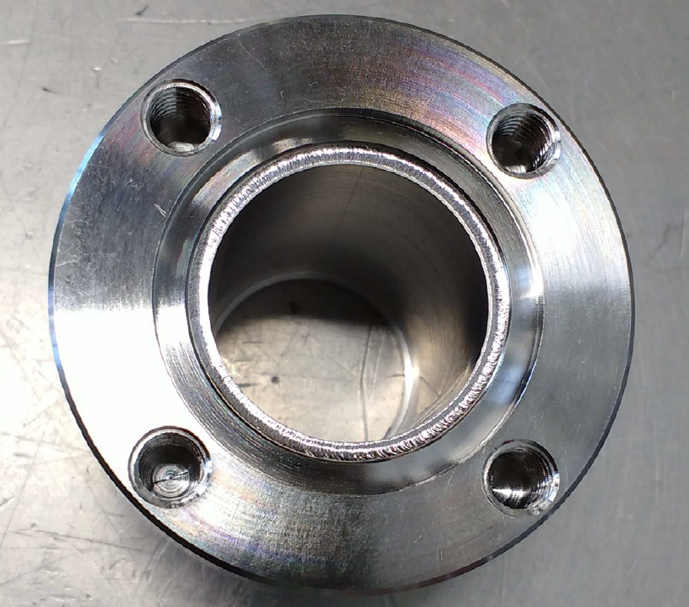
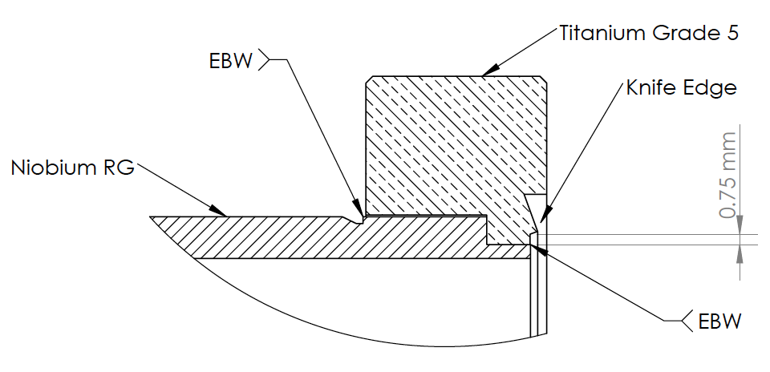
Ti Flange to Nb Tube
EBW

Slide 21
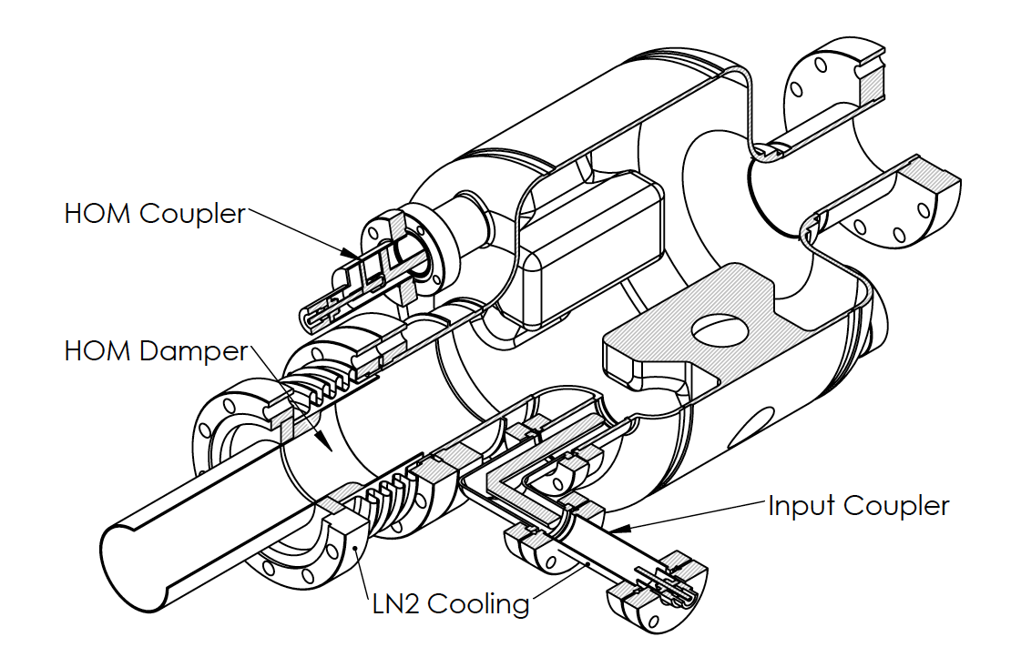
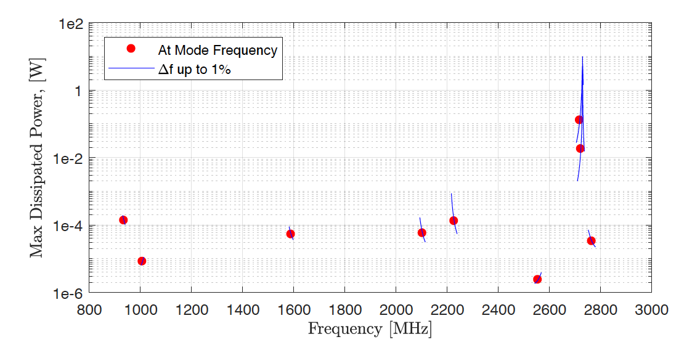
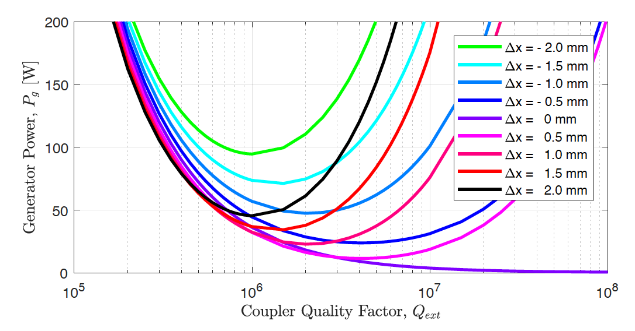
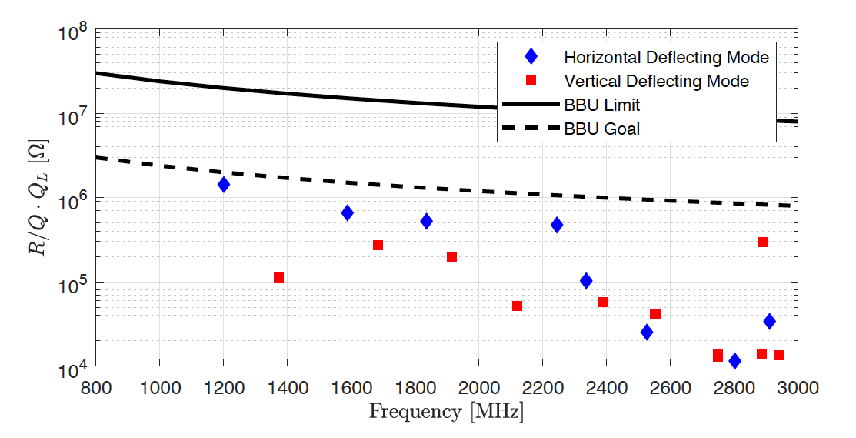
Cavity w/ RF Ancillaries

