Slide 1
Fabrication and testing of DQW crab cavities for HL-LHC upgrade
Katarzyna Turaj on behalf of WP4 and SY-RF-SRF
TTC meeting, Fermilab, December 5-8, 2023

Slide 2
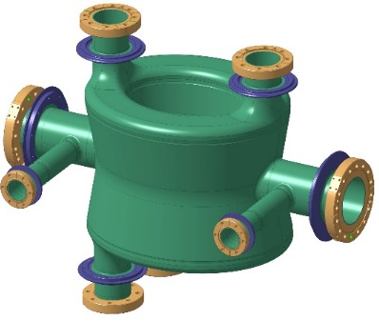
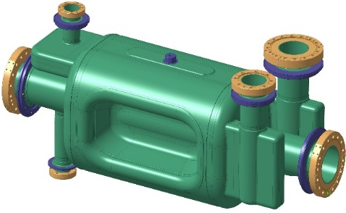
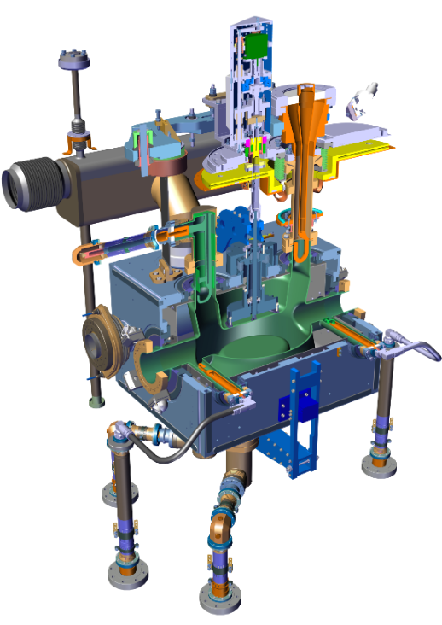
HL-LHC Cavity Geometries
Double Quarter Wave (DQW) cavity
– to be used in Point 5 (CMS), vertical
Radio Frequency Dipole (RFD) cavity
– to be used in Point 1 (ATLAS), horizontal
$f_{0}=400.79 MHz$
$VT = 3.4 MV$/cavity*
($E_{p}, B_{p} <40 MV/m, 70 mT$)
$$Beam aperture = 84 mm$$
RF power = 40 kW-CW
Operating Temp = 2 K
*Engineering spec: 4.1 MV dressed for 20% margin

Slide 3
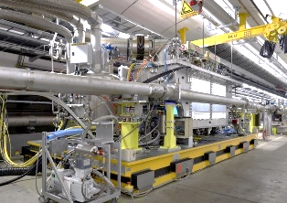
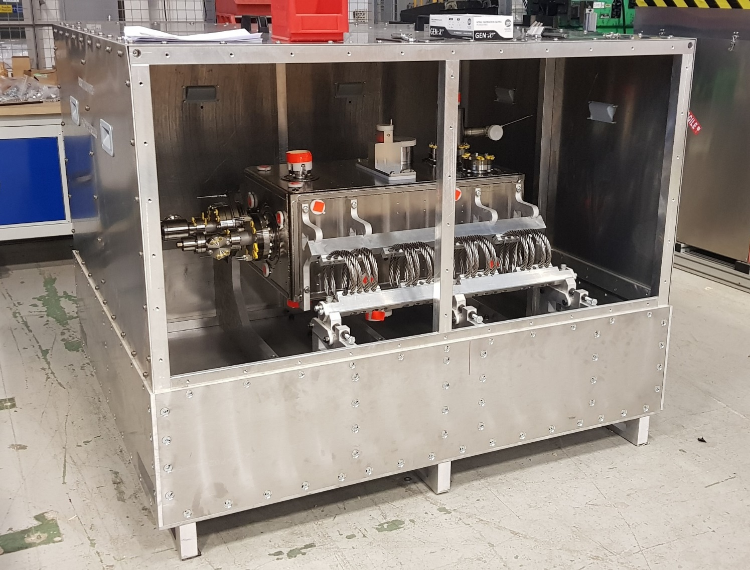
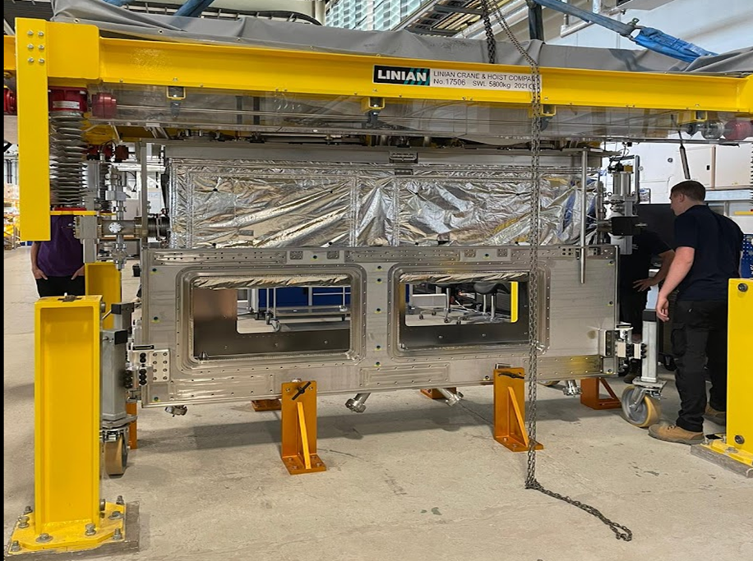
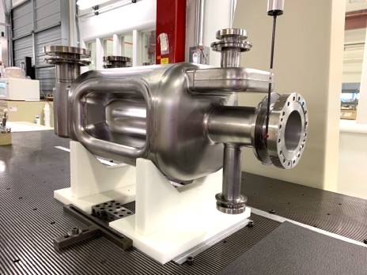
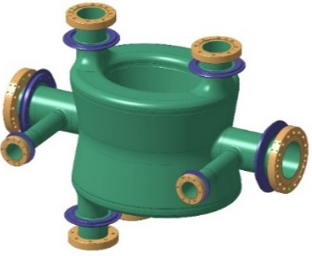
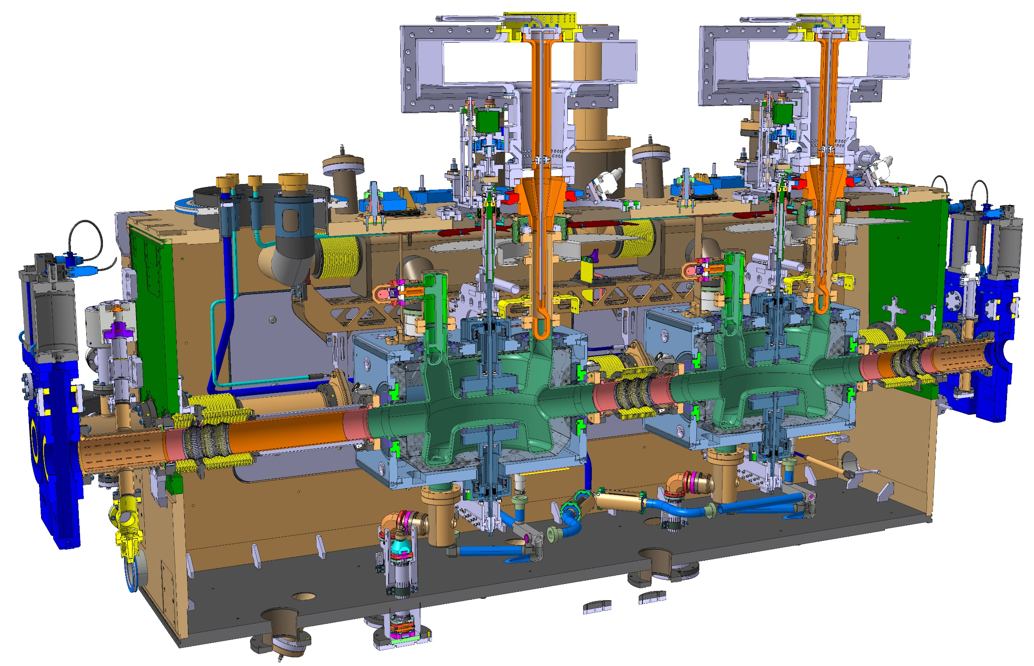
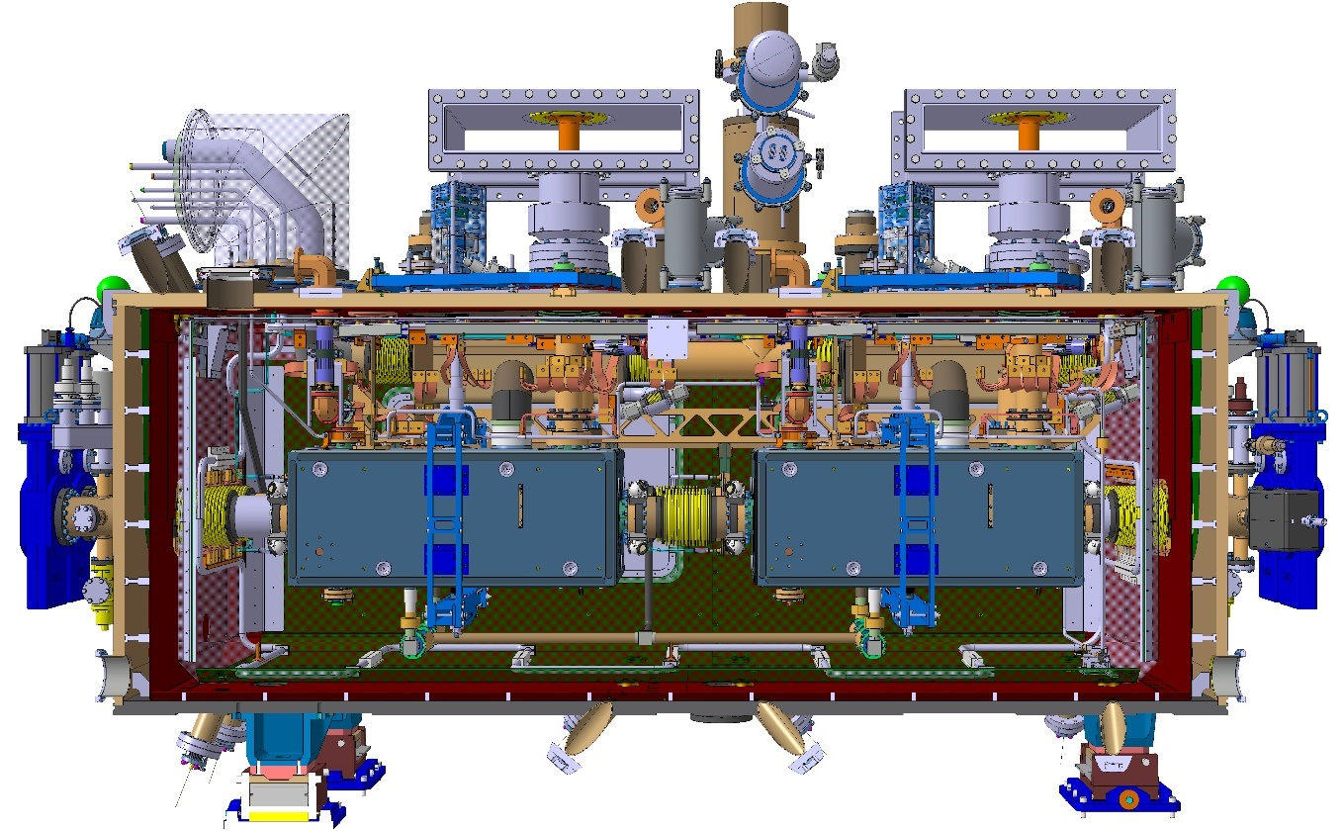
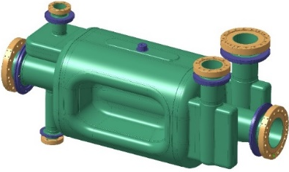
Planning
High Power RF system not shown below
2018-2022 | 2023 | 2024 | 2025 | 2026 | 2027 | 2028
DQW CM SPS-tests
RFD CM SPS-tests
USAUP-RFD proto (x2)
CERN-DQW
series (x2)
RI-DQW
pre-series (x2)
RI-DQW
series (x6)
UK-CERN DQW CMs
series (4 + 1)
Canada-CERN RFD CMs
series (5)
USAUP-RFD
pre-series (2)
USAUP-RFD series (10)

Slide 4
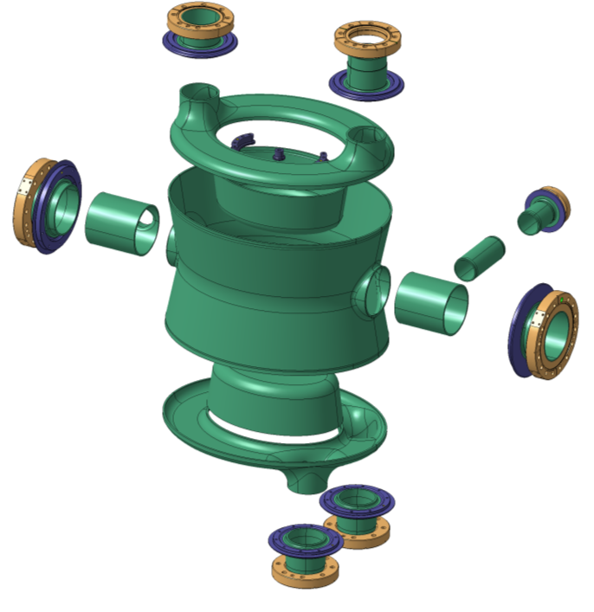
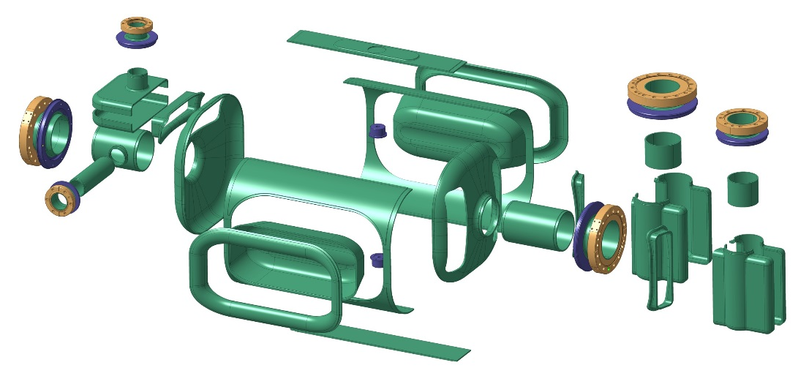
Cavity Manufacturing challenge
Cavities made of high purity bulk Niobium to sustain surface fields in excess of 50 MV/m & 100 mT
Very complex shaping, welding (30+) & assembly accuracy process to reach high final shape
M. Garlasche et al., link

Slide 5
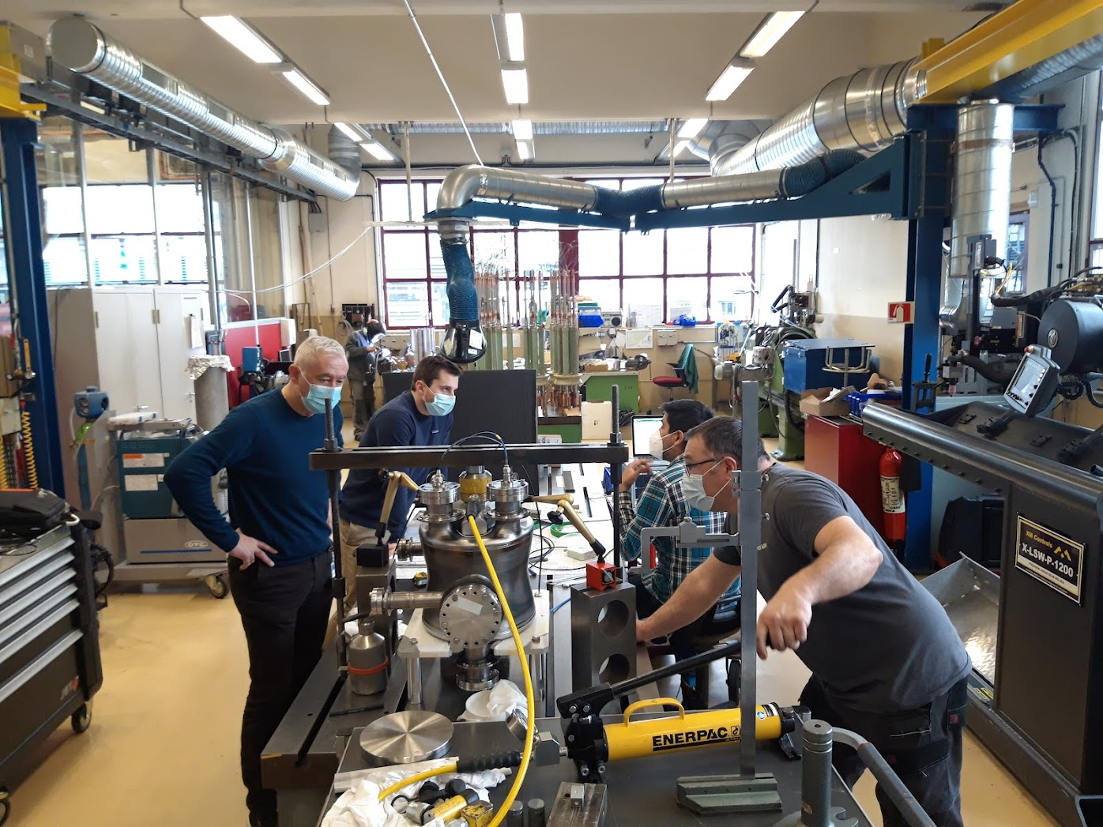
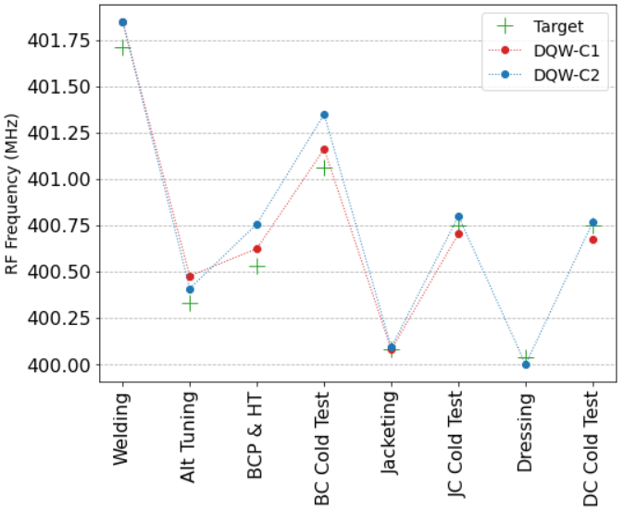
Reaching the right frequency
A series of precision trimming & RF measurements of sub-assemblies before final welding
Final re-shaping to reach target frequency & metrology
Successfully demonstrated on both DQW CERN & RI cavities
DQW, trimming
DQW re-shaping
Frequency evolution of DQW cavities produced by CERN
N. Valverde (link), A. Edwards et al., (link)

Slide 6
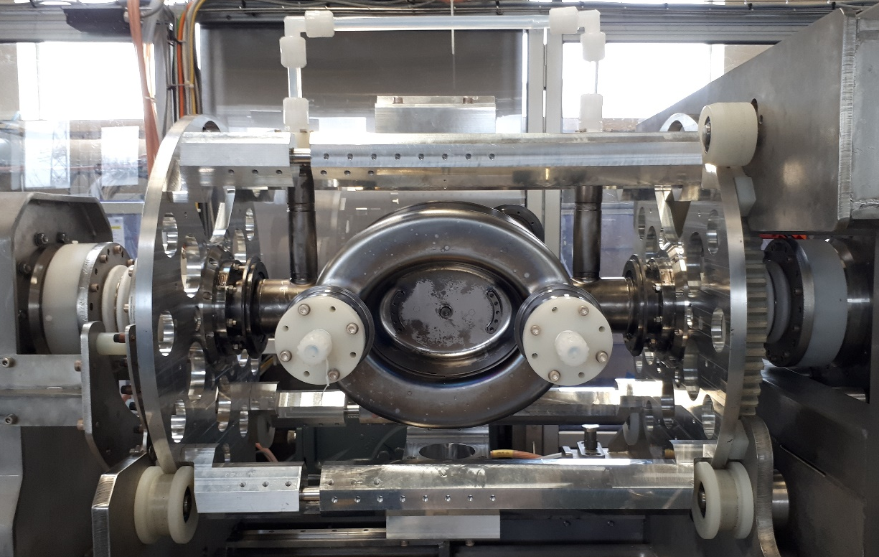
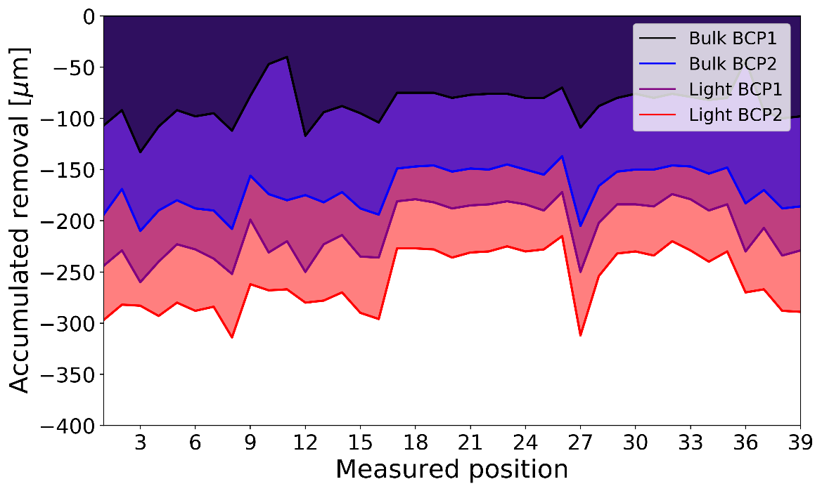
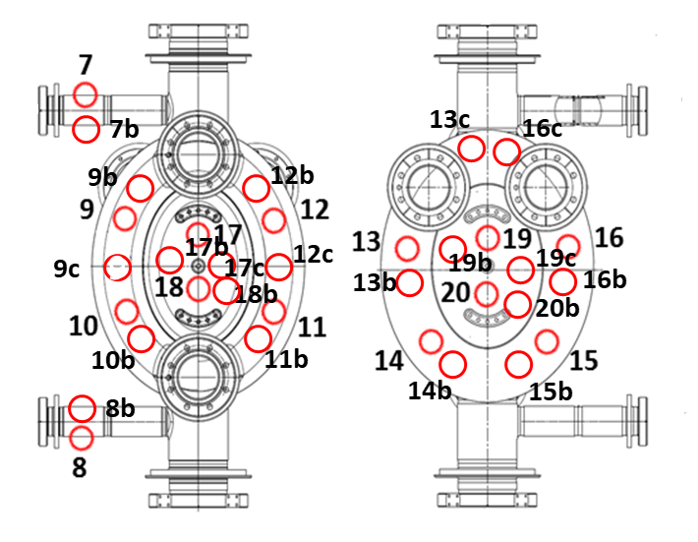
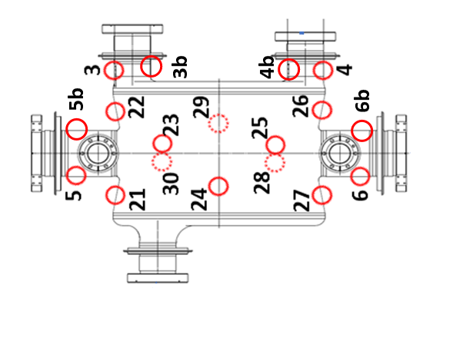
Surface preparation
A rotational BCP is used to remove $250 μm$during fabrication followed by a high-temperature UHV heat treatment (650°C, 24h)
Ultrasound measurement in several locations around cavity body
6
L. Ferreira et al., link

Slide 7
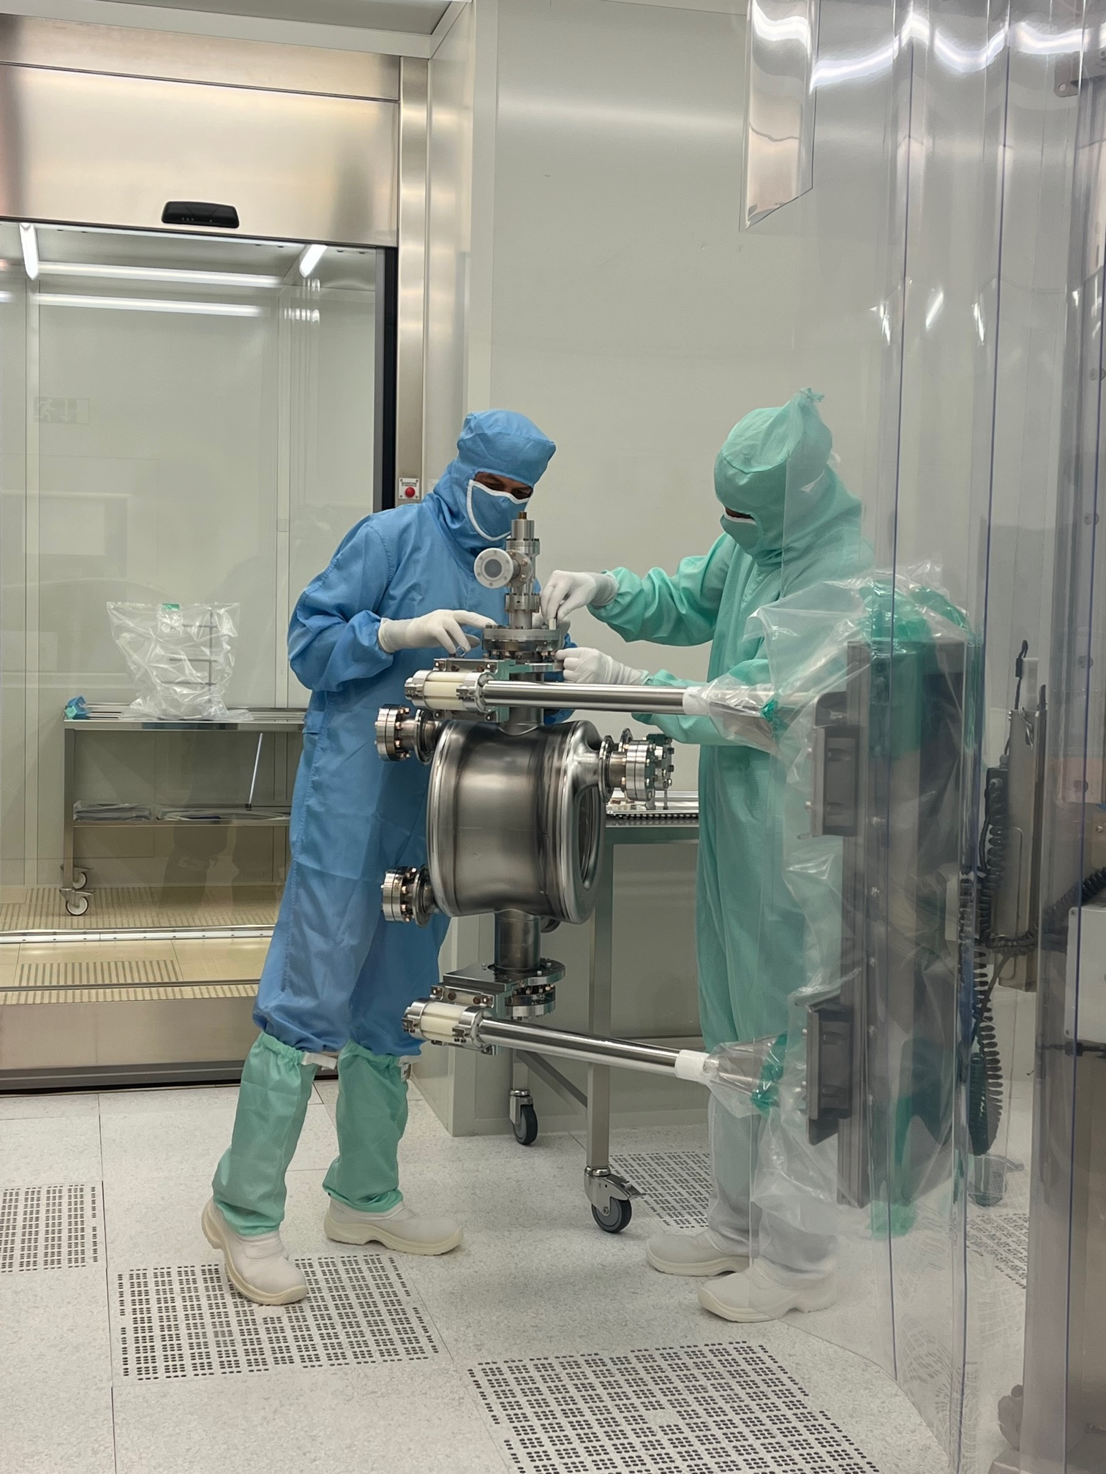
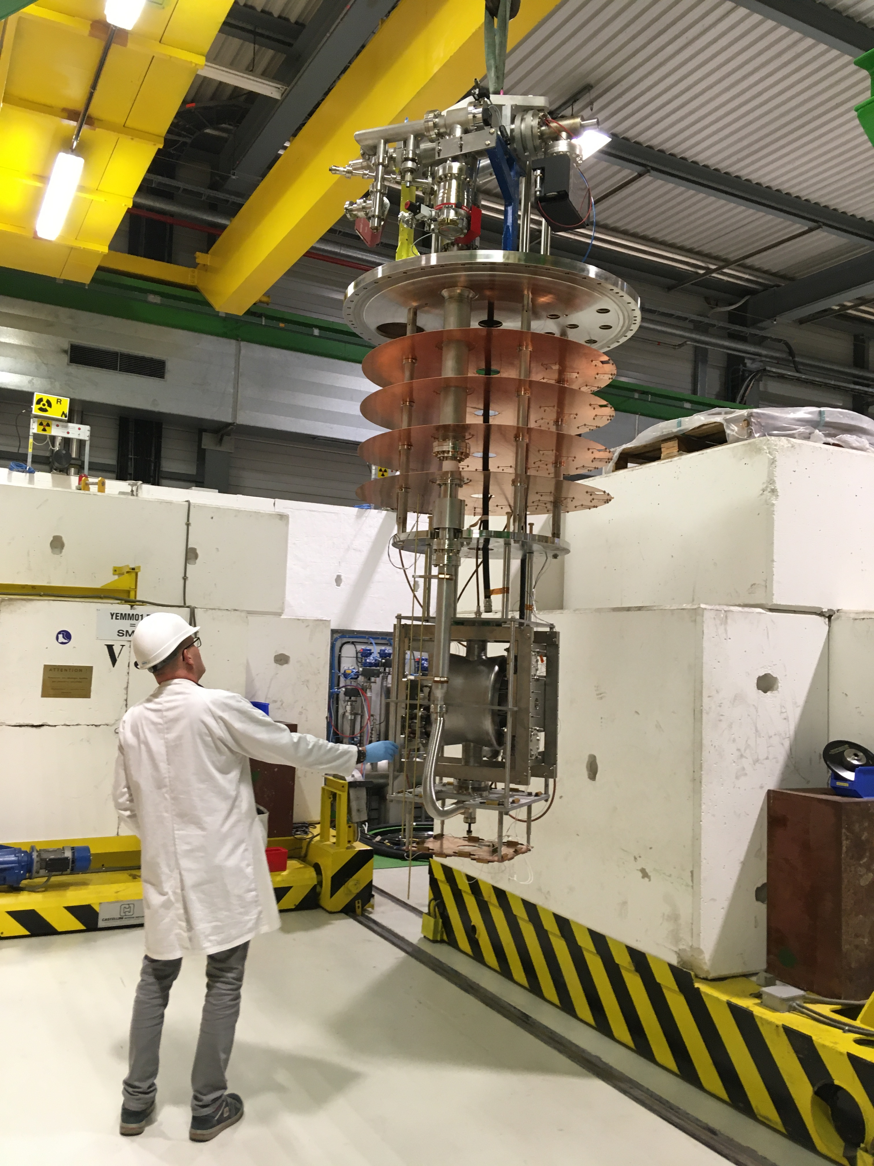
Cold Test Preparation, SM18
Standard procedure of high-pressure rinsing, clean room assembly and 120°C bake-out
Controlled cool-down to keep the gradient across the cavity to <50K
Nb-coated flanges to minimized RF losses

Slide 8
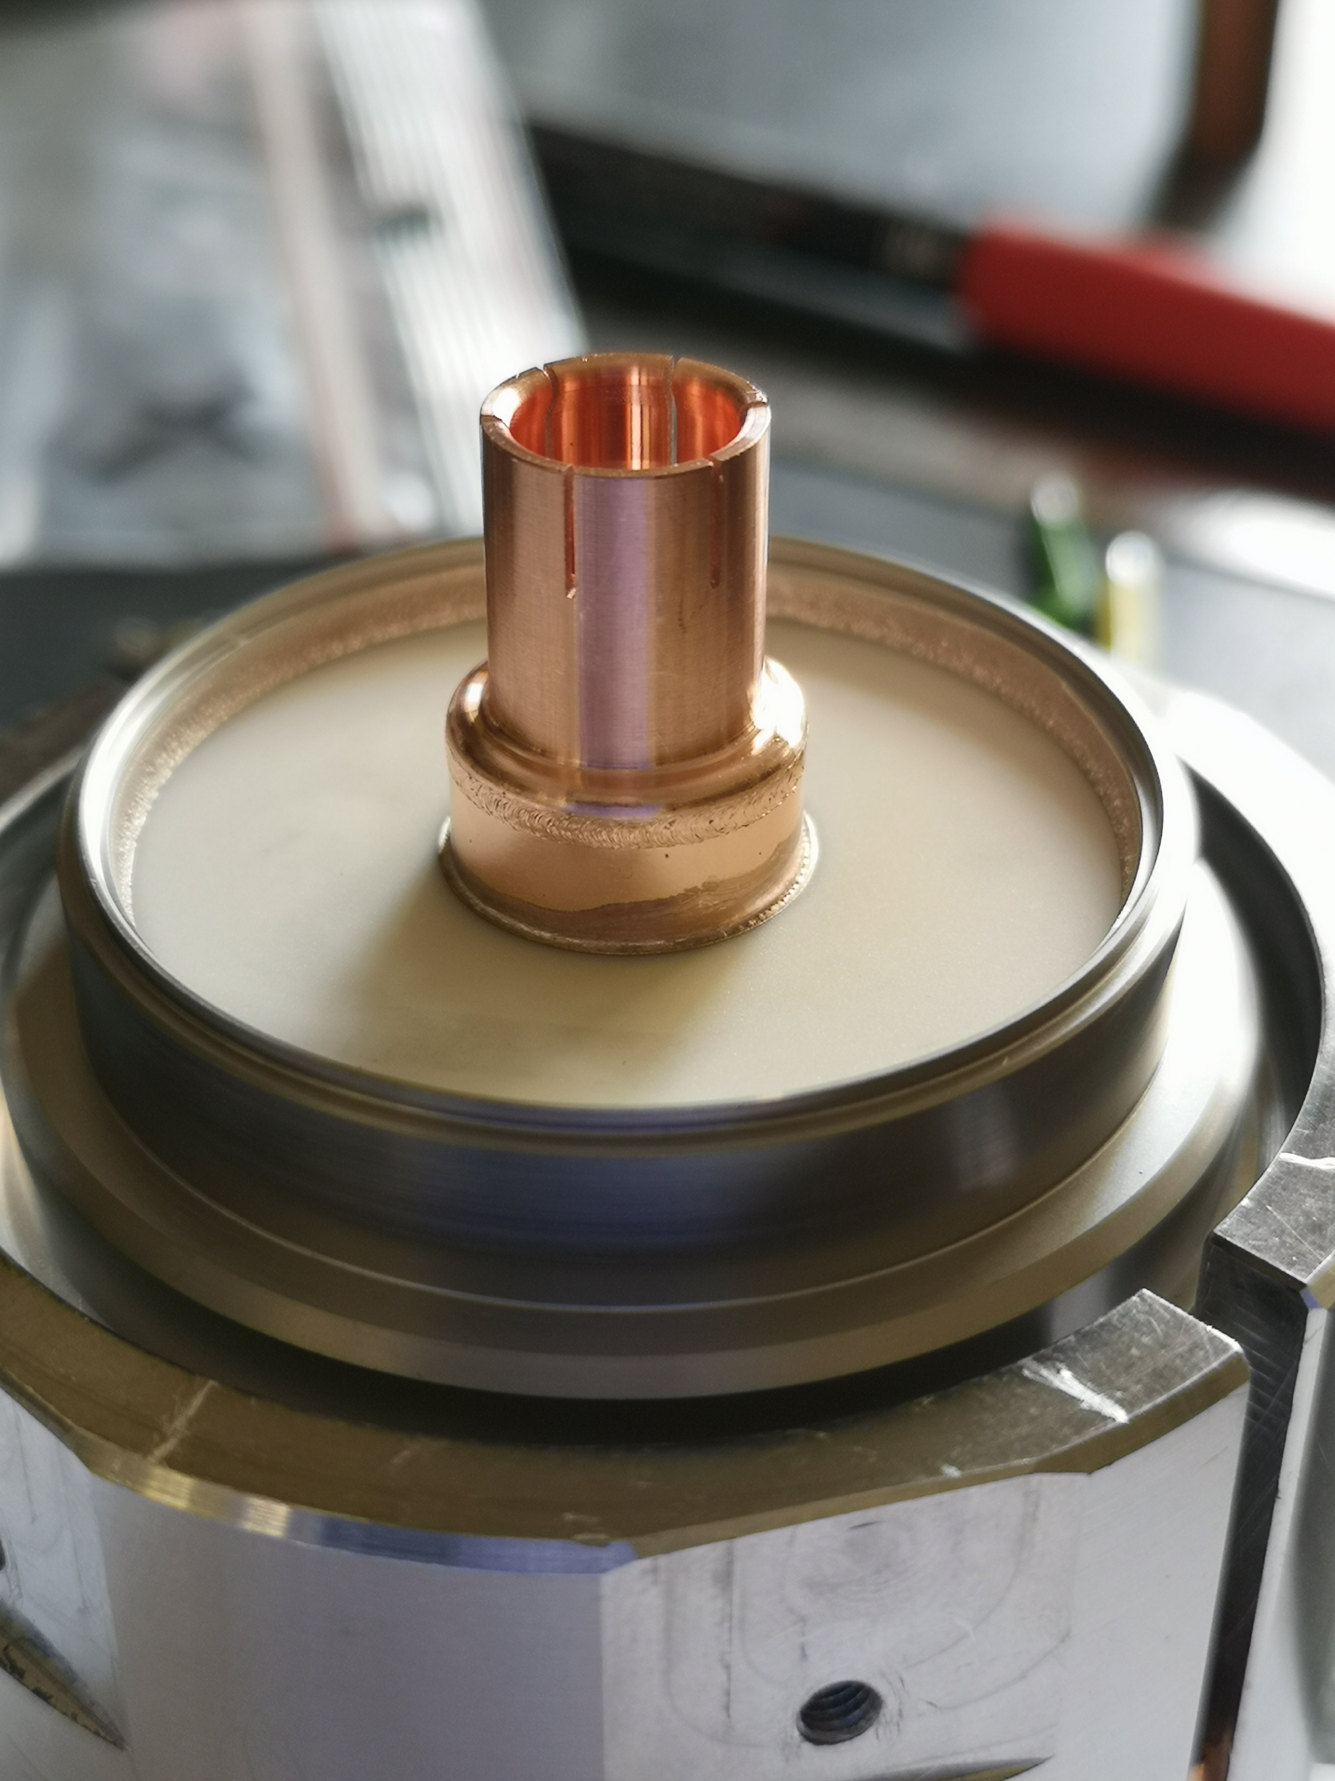
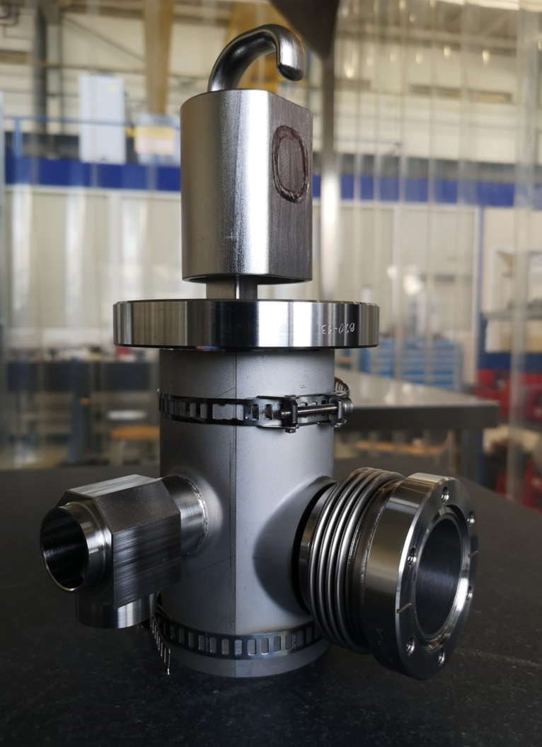
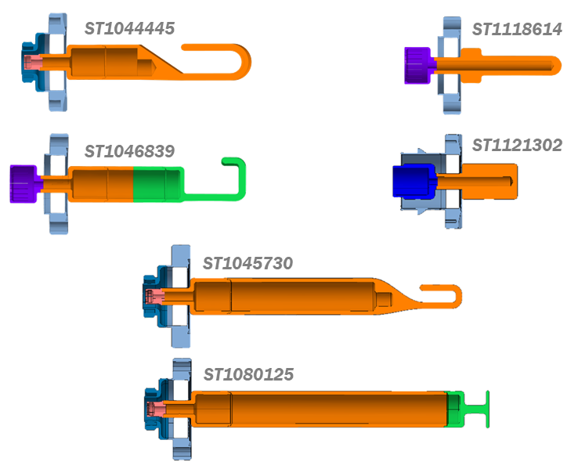
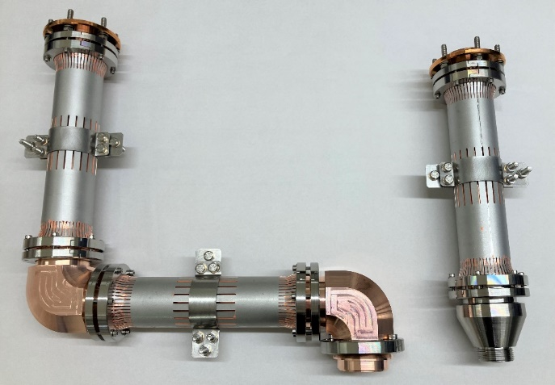
HOM Couplers, Antennas, Feedthroughs & RF Lines
4-HOM couplers in the DQW to achieve the strong damping ($I_{b}=1.1A$)
3 bulk-Nb HOM, 1 HF-HOM (Cu-Nb transitions, complex joining of two heterogenous materials)
HOM couplers withstanding up to 1kW-CW power with special $25Ω$ feedthrough for robustness
RF lines to extract HOM power from 2K environment to 300K in vacuum
Extensive program to design & build the RF lines was necessary
Standardized feedthrough for all HOM couplers
Brazed feedthrough with RF clamp
LHC-DQW HOM Coupler
RF lines
E. Montesinos (link), S. Barriere et al., link

Slide 9
Cold Tests
Baseline: tested 3 times as bare, jacketed and dressed configuration
Bare (BC)
Jacketed (JC): Cold Magnetic Shield + Helium tank assembly (bolted) and TIG welding
Dressed (DC): JC equipped with RF couplers (3 HOMs, 1 HF HOM, 1 FA + VT input antenna)
Experience shows that:
1 out of 2 cavities requires 2 additional cold RF tests and additional BCP and/or HPR in bare and dressed configuration
Bare
Jacketed
Dressed

Slide 10
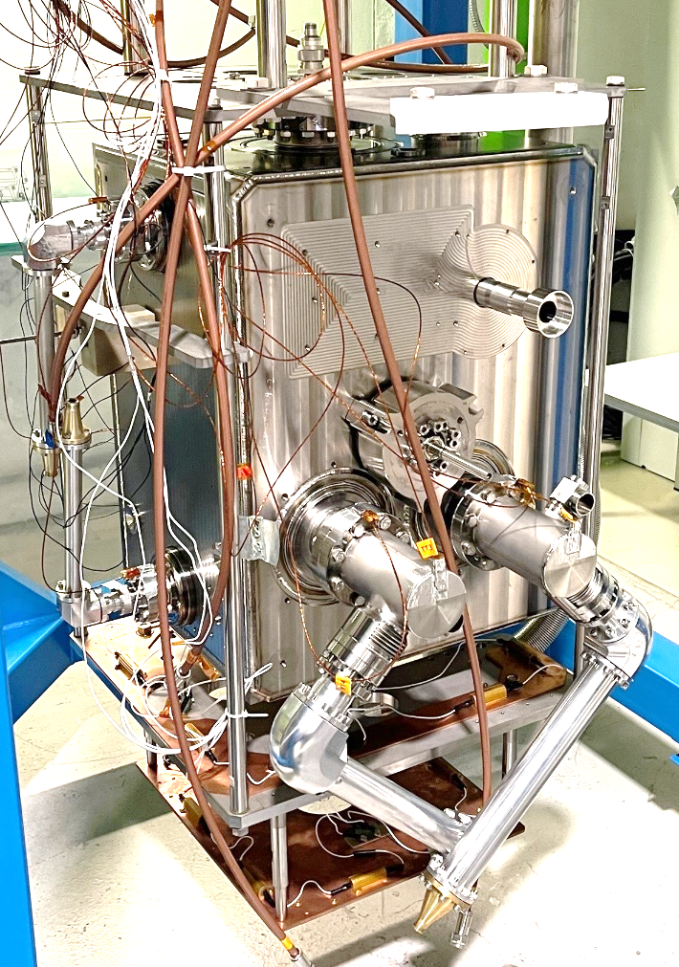
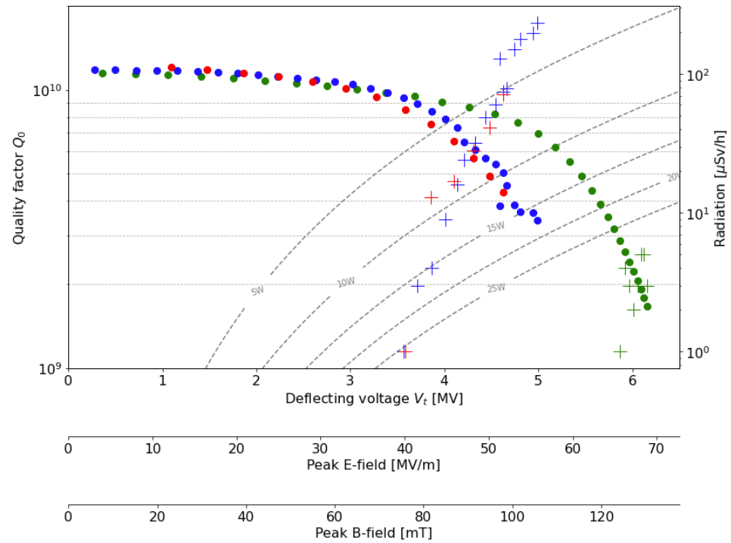
CERN-DQW, Series (1 & 2)
CERN built two series DQW cavities
DQW2-CERN dressed cavity exceeded the specification target: 4.6MV
1 CT stopped due to wrong antennas and 2 CT cavity reached 4MV (*)
DQW1-CERN dressed needs to be retested:
1 CT cavity reached 3.9MV: degradation observed after the high-power RF conditioning
2 CT cavity reached 3.5MV
DQW2: BC, JC, DC
1st series in final HL-LHC configuration qualified!
(*) Eng spec: Vt ≥4.1MV,Q0 ≥3.9×10⁹

Slide 11
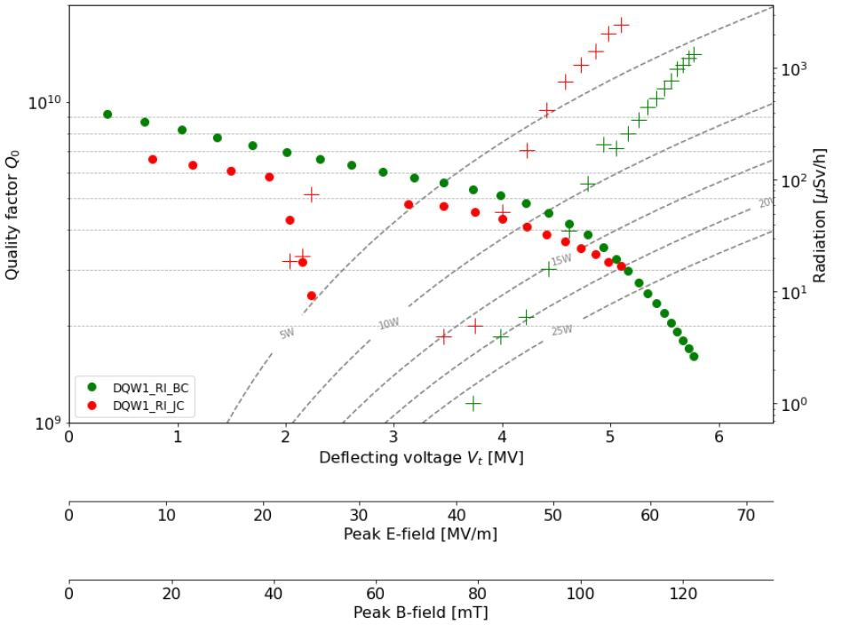
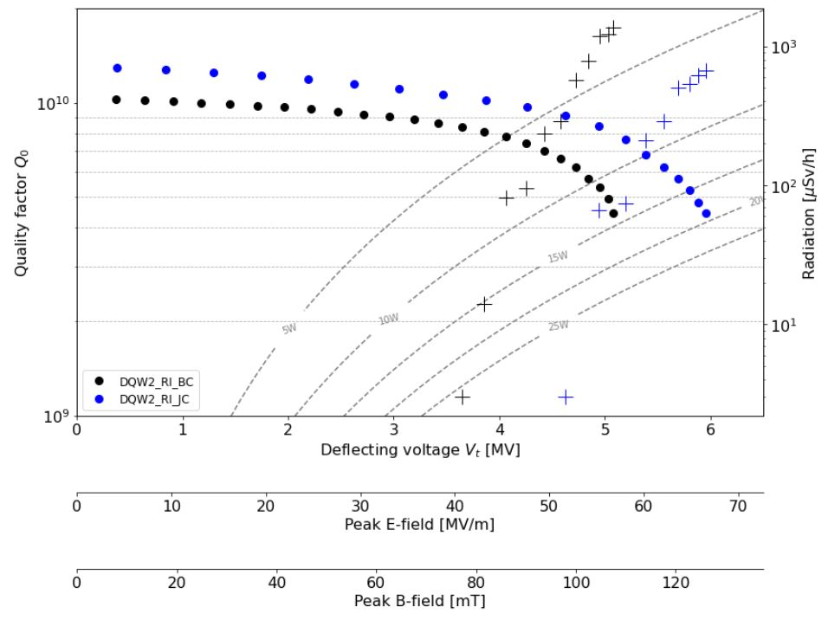
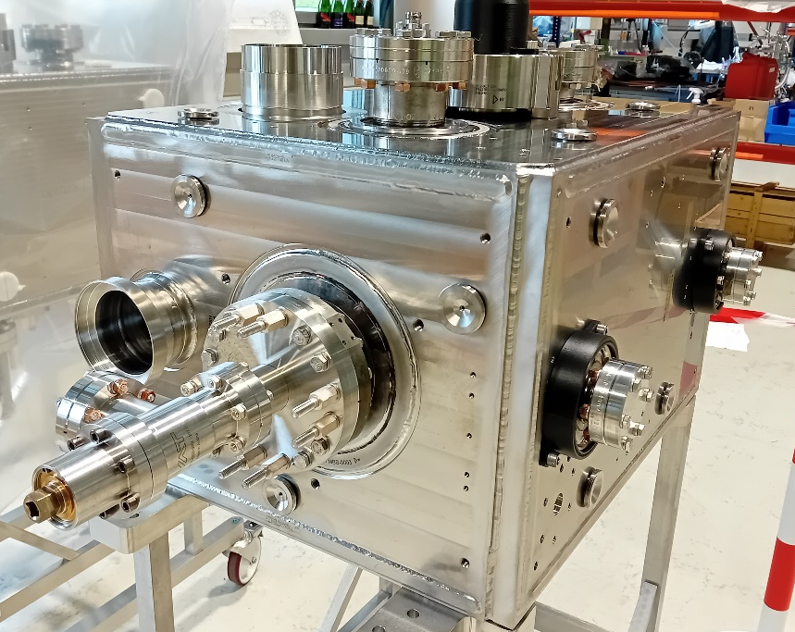
DQW Industrial Series (RI)
8 DQW (BC and JC) cavities produced in industry (Research Instruments, DE)
All cold tests and dressing of cavities at CERN
1st jacketed cavity achieved excellent cold test results
2nd jacketed cavity cold test was accepted, stopped by purpose at 5MV
Q slope visible since the beginning of the scan → seen in bare configuration as well
They will be tested in a dressed configuration soon.
2023 (JC)
BC (2022)
2022 (BC)
JC (2023)
Research Instruments (DQW1 & DQW2)

Slide 12
Challenges, lessons learned & conclusion
The max fields reached are mostly dominated by the presence of field emission.
Poor bare cavities performance (DQW1-RI & DQW1-CERN) can’t be recovered by HPR → light BCP needed
Both cavities tested 3 times in bare configuration
DQW1-RI: Q slope visible since the beginning of the scan
Thermal cycle, up to ≈20 K, consistently improved 𝑄₀ of both the jacketed and dressed cavities by ≈400%.
Dressed cavities performance limitation: ongoing investigations into field limitations above 4MV to try and surpass the specification.
Dressed DQW2-CERN achieved 4.6 MV (3rd CT), but dressed DQW1-CERN was tested twice without success despite changes in the process
As a precaution, dressed cavities are tested at 2.5K and only final measurements are made at 2K.
120̊C bakeout was implemented recently for the dressed cavity configuration.
HOMs coupler treatment required several iterations.
Continually learning and implementing actions to improve quality and meet project deadlines.

Slide 13
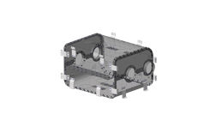
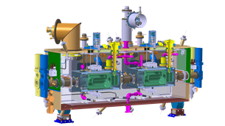
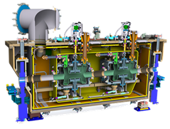
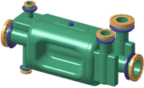
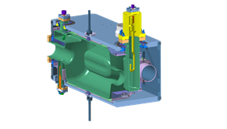
Spare: HL-LHC Crab Cavity Series
5 DQW cryomodules | 5 RFD cryomodules | 20 IOT RF Systems
Cavities + processing + helium vessels by Research Instruments (DE) & CERN Cold magnetic shields by UK HOM couplers + antennas by CERN 4 CM by UK (STFC) & 1 CM at CERN with some components from CERN All cavities & CM cold validation tests at CERN (and a backup at Uppsala-Sweden) | Bare cavities by Zanon (IT) under US-AUP Processing + cold magnetic shield + helium vessel + HOM couplers + antennas + cold tests by US-AUP 5 CM by TRIUMF-Canada with some components by CERN CM cold validation tests at CERN | High power amplifiers (IOT) CERN High power RF lines, circulators, loads by CERN (exploring new frontiers) $μ$TCA platform for LLRF by CERN

Slide 14
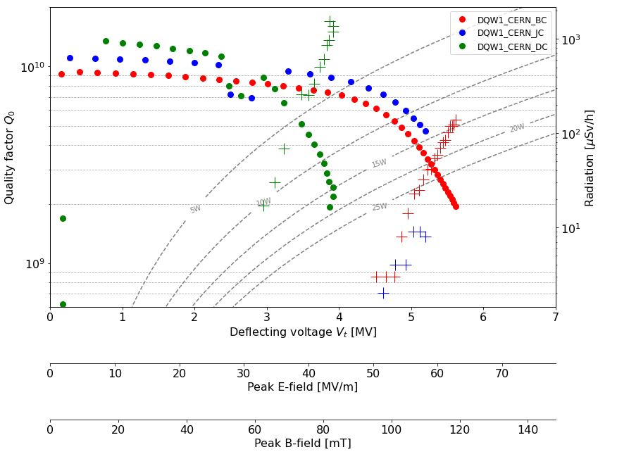
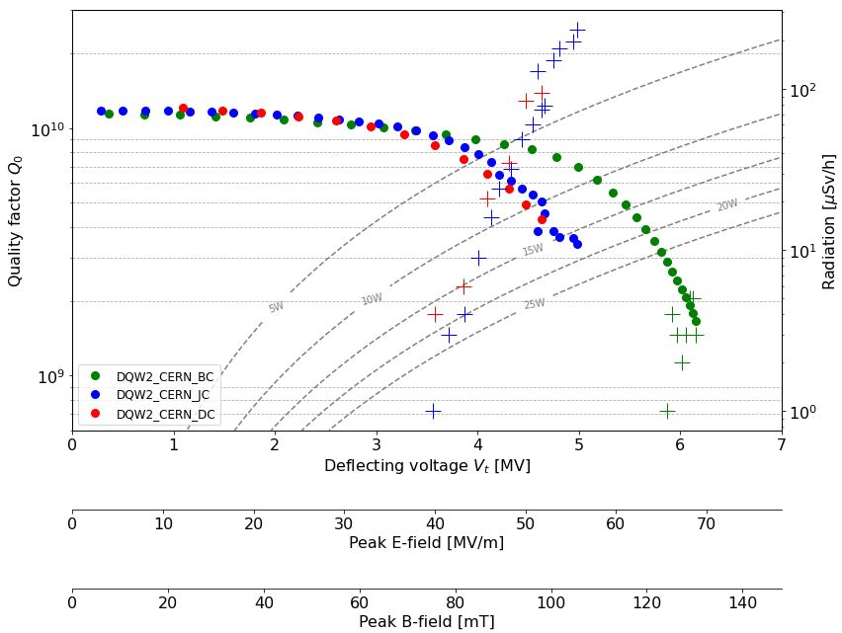
Spare: CERN Cavity Test Results – DQW1 & DQW2

Slide 15
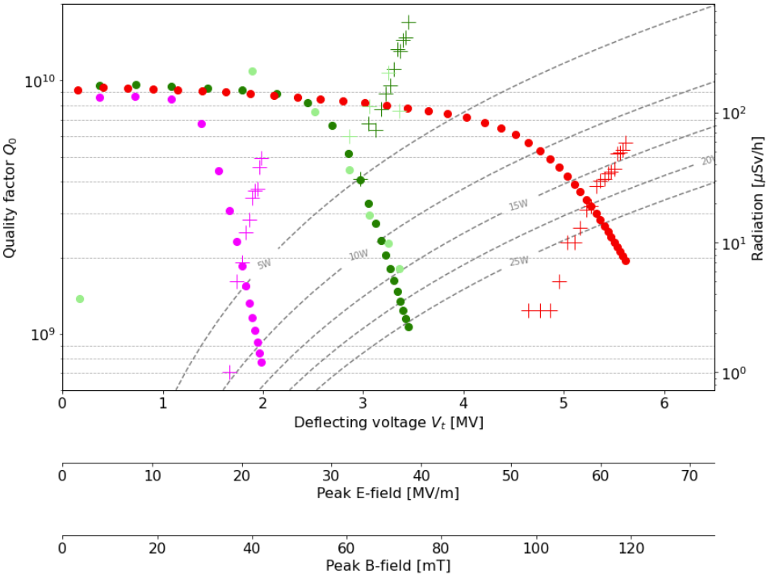
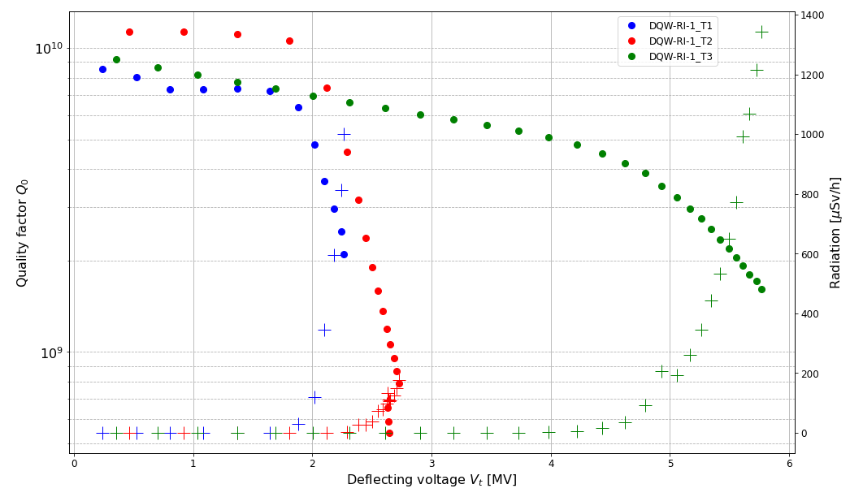
Spare: Bare Cavity Test Results – DQW1-CERN & DQW1-RI
DQW1_CERN

Slide 16
Spare: Cold tests
DQW cavities
CERN
DQW1
DQW2
RI
DQW1
JC
1 CT
BC
3 CT
JC
1 CT
BC
1 CT
JC
1 CT
BC
3 CT
JC
1 CT
DQW2
BC
1 CT
DC
2 CT
DC
3 CT
DC
DC
...
6 more coming

Slide 17
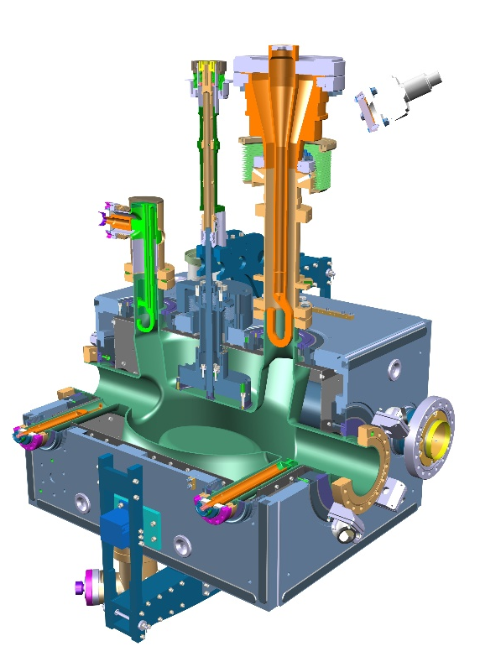
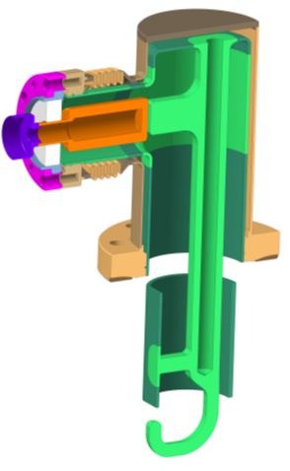
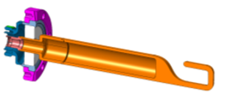
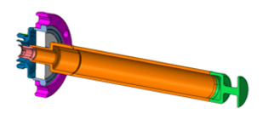
Spare: Crab Cavities & “Radio Frequency Auxiliaries”
HOM Couplers
x 36 units
HOM Couplers, Feedthroughs, Field Antennas HF-HOM and FPC for all LHC-series DQW crab cavities are being manufactured at CERN Main Workshop,
i.e. quantities for 8 cavities including spares
Fundamental
Power Couplers
x 14 units
HF-HOM Couplers
x 12 units
RF Field Antenna
x 12 units
Double Quarter Wave (DQW) cavity
– to be used in Point 5 (CMS)

