Slide 1



RFD Cavity Prototype and Testing for the HiLumi LHC Upgrade
A. Castilla, N. Huque, P. Owen – Jefferson Lab
S. De Silva, J Delayen - ODU
P. Berrutti, M. Narduzzi, C. Narug, L. Ristori - FNAL
Notes:
I’ll present the RFD test updates in name of the AUP-WP4 team.

Slide 2
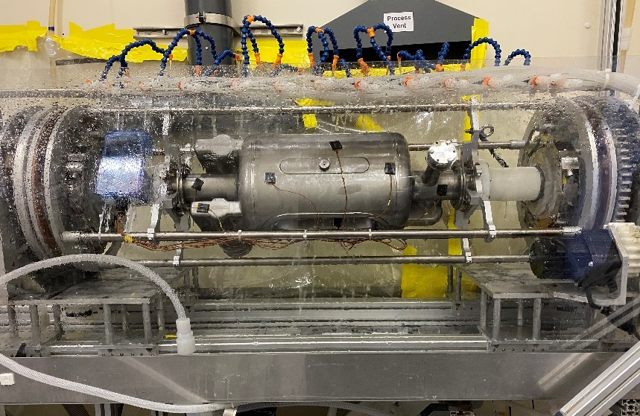
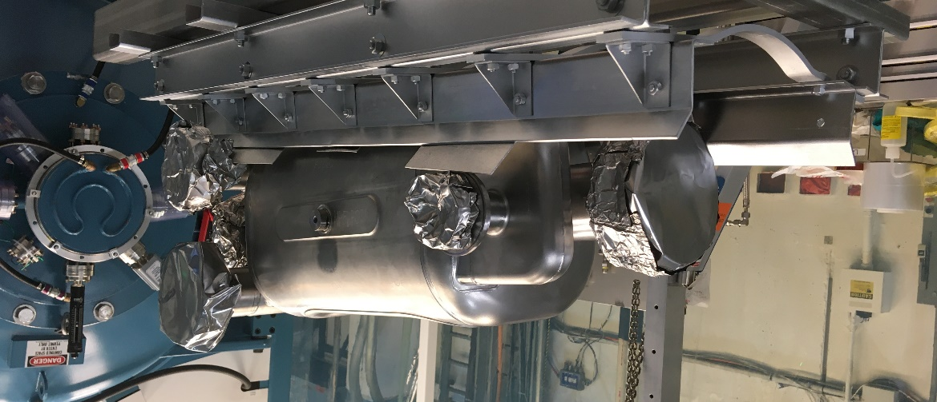
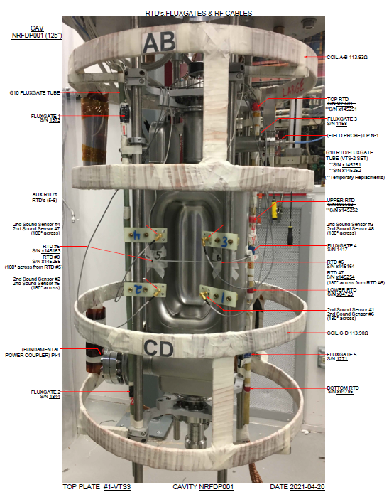
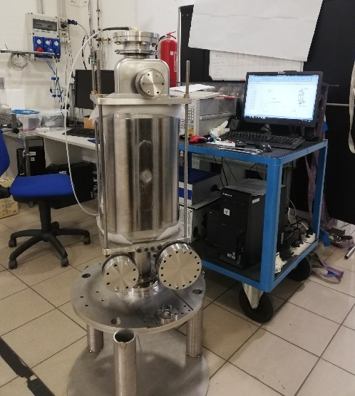
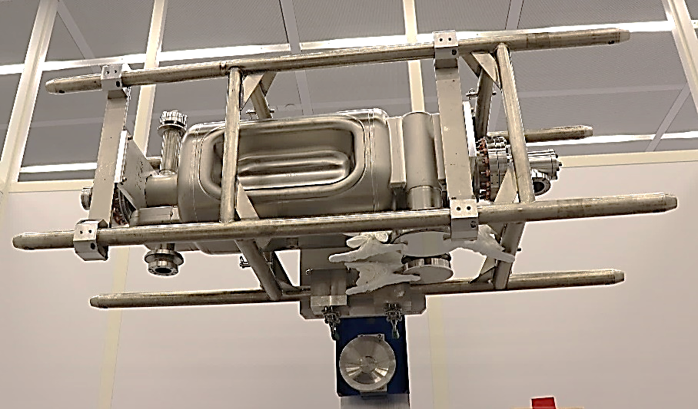
Prototypes (NRFDP001 & 2)
2 prototypes manufactured by ZRI in 2020.
Rotational BCP at ANL/FNAL facility (ave. removal 130+40 um).
600 C for 10 h heat treatment performed at FNAL.
1st HPR+Assy.+test at FNAL.
Notes:
2 prototypes were manufactured by Zanon.
Rotational BCP performed at Argonne/Fermilab facilities.
Heat treatment, HPR, assembly, and test of the bare cavities performed at Fermilab.
Test of the bare cavity w/HOMs done at Jefferson Lab.

Slide 3
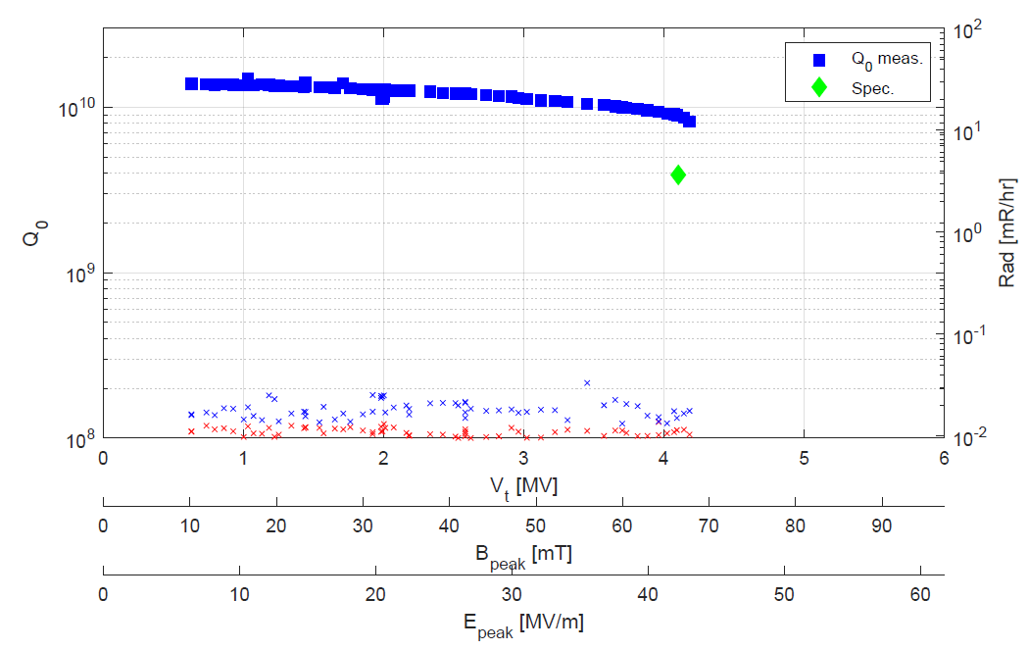

NRFDP001 Bare Cavity Test Results
P. Berrutti (FNAL)
Q₀= 8.2E9 V_{t}=4.18 MV at quench, Low field Q₀= 1.5E10, B_{ext}= 0.6 mG.
No FE detected: effective HPR and clean assembly
OST indicates quench spot between corner and end-cap weld and optical inspection showed defect in the quench area (final weld).
This cavity was sent to ZRI for complete re-processing in order to validate their procedures and improve the cavity performance.
Notes:
Prototype 1 performed relatively well.
It was virtually qualified.
However, a quench close to the nominal voltage and a subsequent optical inspection revealed a feature on the weld between the main body and one of the end-caps.
The cavity was sent back to the vendor, as an opportunity to validate their processing capabilities.

Slide 4
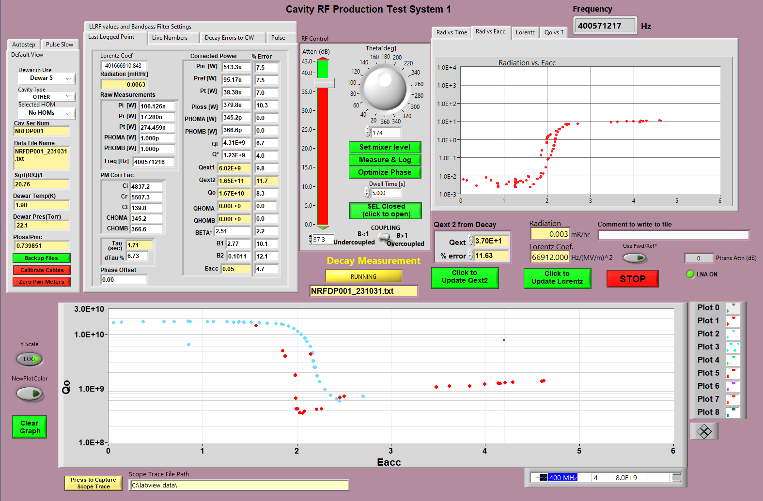
Latest NRFDP001 VT: Inconclusive
After re-processing at ZRI, proved inconclusive due to an early FE onset and suspected multipacting.
A first test performed at FNAL.
120C/48h bake and test at JLab showed similar results.
Notes:
Unfortunately, a recent test a Fermilab after reprocessing was inconclusive due to high field emission.

Slide 5
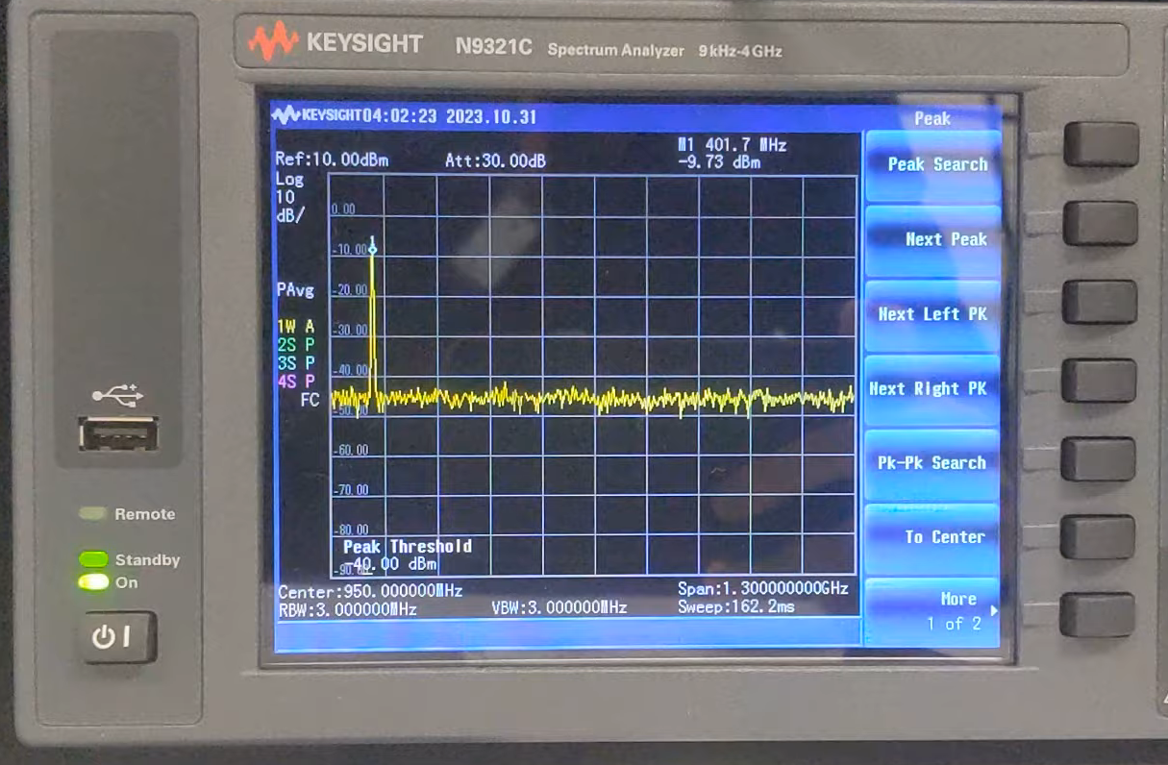
Latest NRFDP001 VT: Inconclusive (cont)
The cavity is currently being cleaned and prepared by a 2nd test at JLab the following week.
Notes:
Unfortunately, a recent test a Fermilab after reprocessing was inconclusive due to high field emission.

Slide 6
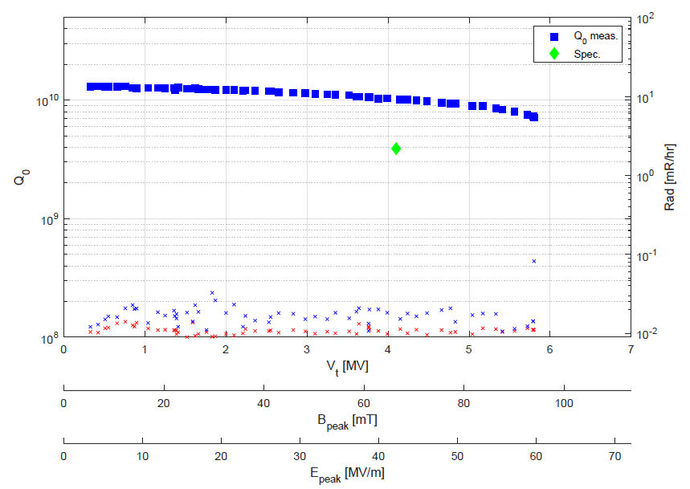
NRFDP002 Bare Cavity Test Results
Excellent results: hard quench at 5.8 MV, no detectable FE during the test.
Low field Q₀ exceeding 1.3E10, Q₀(@4.1MV)=1E10
E_{peak}= 59.7 MV/m B_{peak}= 94 mT @ 5.8 MV (quench)
P. Berrutti (FNAL)
Notes:
On the other side of the coin; Prototype 2 passed with flying colors it’s bare cavity test:
Low field Q above 1E+10, no measurable field emission and quench at 5.8 MV.
After that, the cavity was sent to Jefferson Lab.

Slide 7
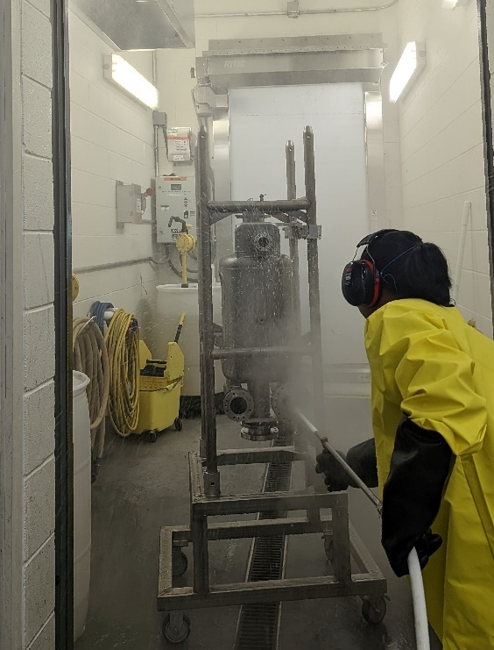
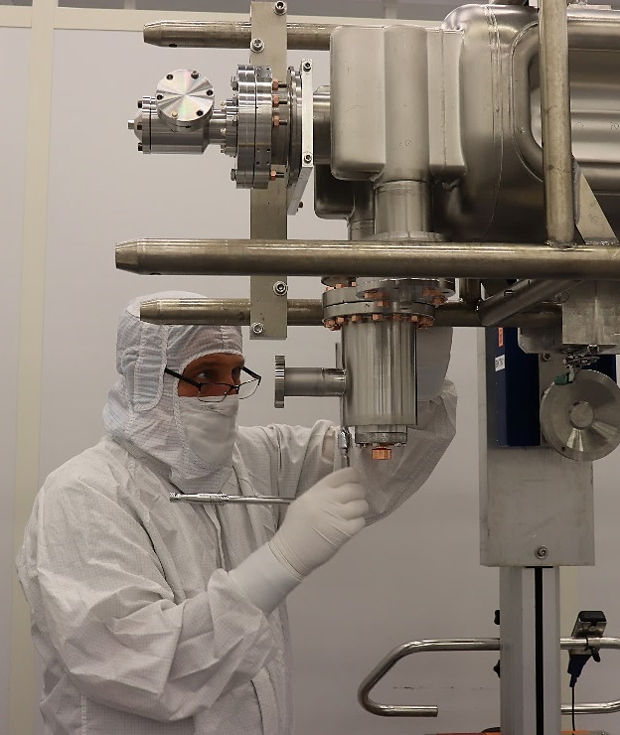
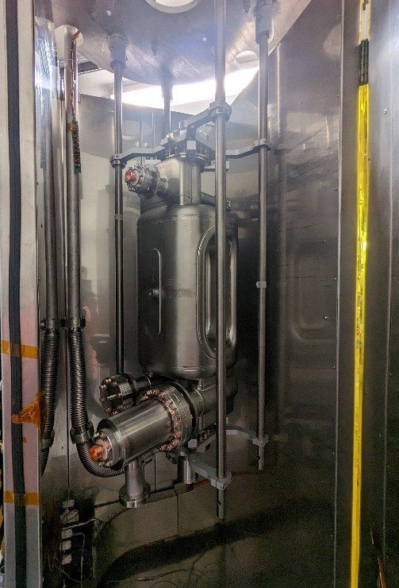
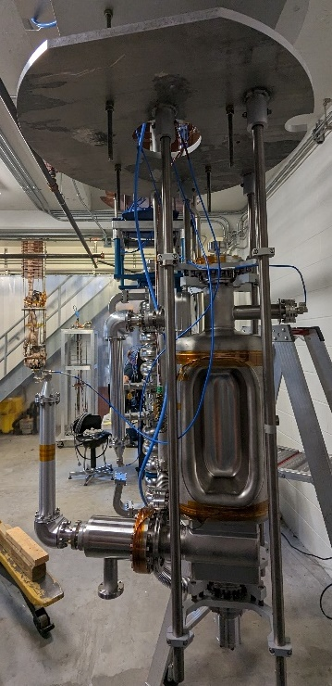
Bare cavity (prototype 2) + HOMs Testing
Several iterations to our hardware/procedure to seal the cavity.
Mixing hardware with US – EU [and CERN] standard has not made it easier (full “hardware kits” to be provided by CERN for the series).
Assembly prioritized seal over cleanliness.
Full cycle sequence is well understood.
Hand port rinse before HPR
Clean room assy.
48h @120C Bake
Instrumentation
Notes:
Achieving leak tightness proved challenging due to a mix of hardware standards and inappropriate procedures.
This forced us to prioritize leak tightness over cleanliness, to tackle our issues one by one.
Later on, this would pay off.

Slide 8
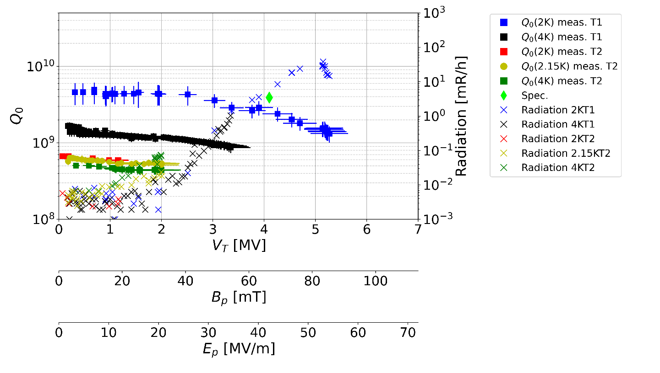

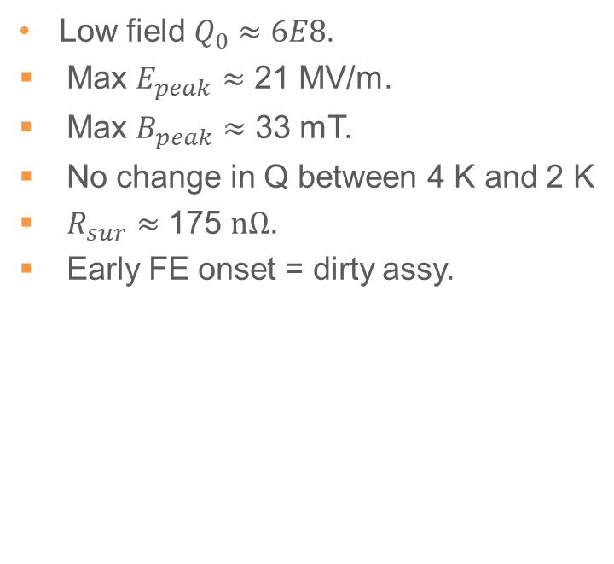
NRFDP002 w/HOMs
1st Test @2K
2nd Test @2.5K (superfluid leak)
Low field $Q_{0}≈4.6E9$.
  $Q_{0}(@4.1MV)≈3E9$.
  Max $E_{peak}$= 51 MV/m.
  Max $B_{peak}$= 80 mT.
  Power limited (150 W, no Quench).
  $R_{res}≈$ 20 $nΩ$.
Low field $Q_{0}≈6E8$.
  Max $E_{peak}$ $≈$ 21 MV/m.
  Max $B_{peak}$ $≈$ 33 mT.
  No change in Q between 4 K and 2 K
  $R_{sur}≈$ 175 $nΩ$.
  Early FE onset = dirty assy.
Notes:
A 1st test showed:
Early field emission onset.
Low Q’s in the mid-E+9.
We were power starved and did not reach quench.
The extra losses started to smell like what was seen at LARP, where a poor RF-contact on the HHOM gasket resulted in a similar situation.
A 2nd second test yielded even less favorable results:
A superfluid leak developed at 2K, limiting the forward power due to plasma discharges.
After a thermal cycle we achieved stable vacuum conditions at 2.15K.
However, we were still power limited due to a large reflection.
We virtually saw no change on the Q values between 4 and 2K.
After picking up some heating signatures on the HHOM flange, we were sure that we had an issue with our RF gasket.
We still had an early field emission onset.

Slide 9
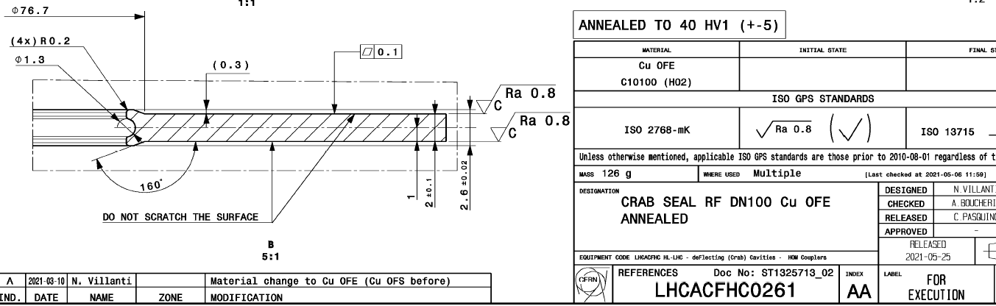
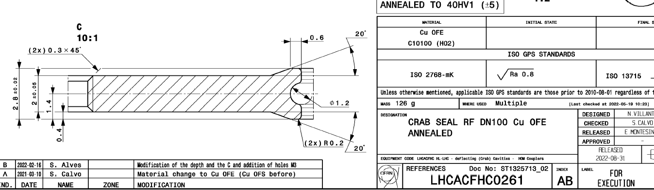
NRFDP002 test w/HOMs
  Amongst the different problems to solve we had:
  Improvement on the cleaning and assembly procedure needed to reduce FE onset.
  Understanding on the Qext for the VHOM is necessary.
  Poor RF contact on the HHOM RF gasket:
    Needed new hardware to sustain higher torques.
    Needed a new procedure to ensure full compression of the RF gasket.
Our RF gaskets (v.AA) 2.6 mm RF lip
Latest design (v.AB) 2.8 mm RF lip
Notes:
We identified at least 3 clear challenges to overcome:
First: we needed to solve the early field emission onsent, and the fact that we saw stronger coupling of the VHOM to the fundamental than expected.
Also: The RF losses in the HHOM flange.
There are two RF gasket designs that have a slight difference on the RF lip size, we, like CERN, use version AA with the smaller RF lip.
This is relevant because our technicians use the standard procedure for vacuum connections of conflat flanges, which does not require high torques or bringing the connections flange-to-flange. Evidently, even if this is ok to achieve leak tightness, it is not necessarily compatible with the RF seal.

Slide 10
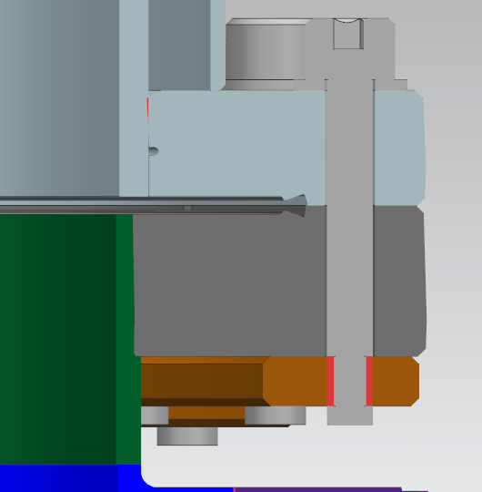
Flange Connection Measurements
Quantity | Nominal | Measured
Flange Thickness | 34.71 | 34.82
Flange Gap | 0 | 0.11
Nb Gap | 2.76 | 2.51
RF Seal gap (calculated) |  | -0.09
Dry assy. tested w/pressure sensitive paper on the RF lips.
At appropriate torque, the paper showed contact and a uniform crush.
The maximum thickness of the paper (4 plies in total: 2x top + 2x bottom) is 0.22 mm. The effective thickness will be less due to compression.
After disassembly, the gasket lips were measured and found to be 2.41mm (originally 2.6 mm), indicating that they were definitely crushed enough to plastically deform the lips.
Successfully repeated dry assy. using A286 SS socket bolts and Ag-coated nuts to reach higher torques and smaller gap.
This configuration was adopted as baseline for subsequent VT’s.
FLANGE THICKNESS
NOMINAL NB GAP
FLANGE GAP
Notes:
We did higher torque tests using pressure sensitive paper that showed both contact and uniform pressure around the RF lip.
For this we used different hardware that allows us to repeatably apply the necessary torques.
This was adopted for the following test.

Slide 11
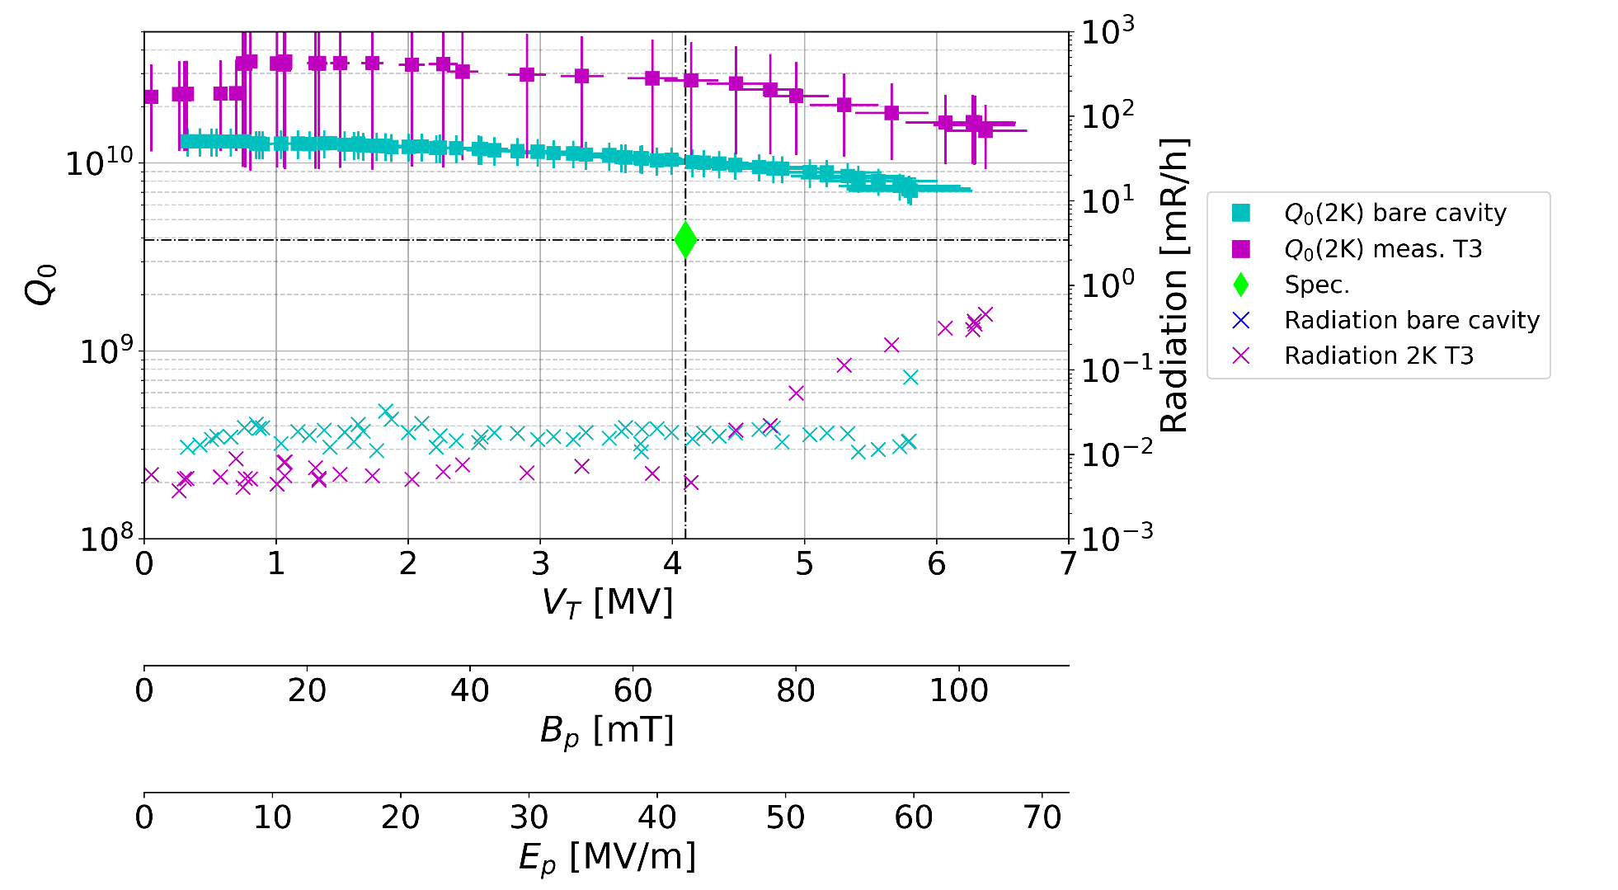
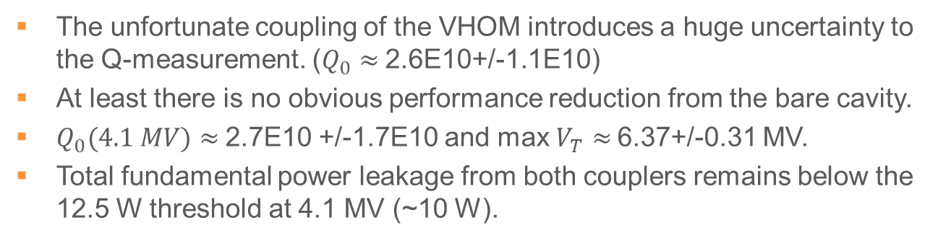
NRFDP002 3rd test w/HOMs
The unfortunate coupling of the VHOM introduces a huge uncertainty to the Q-measurement. ($Q_{0}≈$2.6E10+/-1.1E10)
At least there is no obvious performance reduction from the bare cavity.
$Q_{0}(4.1 MV)≈$2.7E10 +/-1.7E10 and max $V_{T}≈$6.37+/-0.31 MV.
Total fundamental power leakage from both couplers remains below the 12.5 W threshold at 4.1 MV (~10 W).
Notes:
With the updated hardware and procedures we finally solved the RF contact nightmare and re-qualified the cavity with the HOM couplers.
We do not see a degradation of the performance due to the installation of the couplers.
Furthermore we lowered the field emission onset and pushed it past the nominal voltage.
However, the strong coupling of the VHOM introduces a big uncertainty to the measurements, resulting in this oddly looking curve.
On the bright side, the combined power through the HOM couplers at nominal is well below the specification threshold.

Slide 12
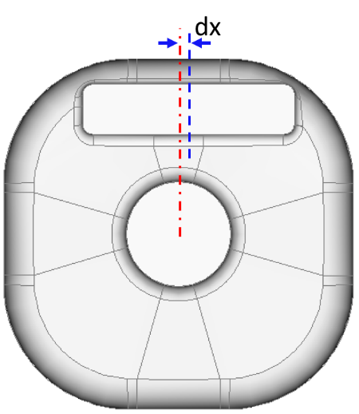
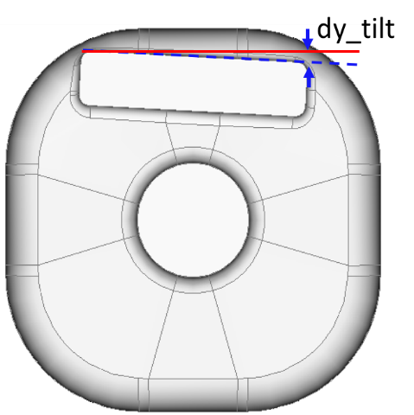
VHOM Coupler Waveguide Stub Geometry Tolerance On Power Leakage
10 W
Not sensitive to stub horizontal shift
Stub vertical tilt need be < 1 mm to limit power leakage to under 10 W
Z. Li (SLAC)
Notes:
From Zenghai’s simulations we think the principal culprit is the tight tolerance on the roll errors of the waveguide stub where the VHOM is located.
The sub-millimeter error is consistent with the tolerances achieved for the prototypes. However, as Leonardo mentioned on Monday, the series production has systematically achieved better manufacturing tolerances.

Slide 13
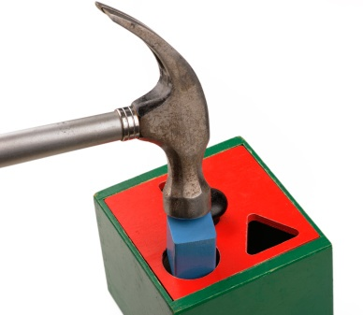
Summary
Transferable experience from LARP extremely valuable!
Handling procedures are finetuned.
Standardizing hardware for production is key.
A set of HHOM and VHOM prototypes validated by warm and cold measurements.
No evident reduction in performance or field reach observed on the cavity (prototype 2) from the HOM couplers.
Next:
  Jacketed cavity! (prototype 2).
  Prototype 1 under validation.

Slide 14
Backup

Slide 15
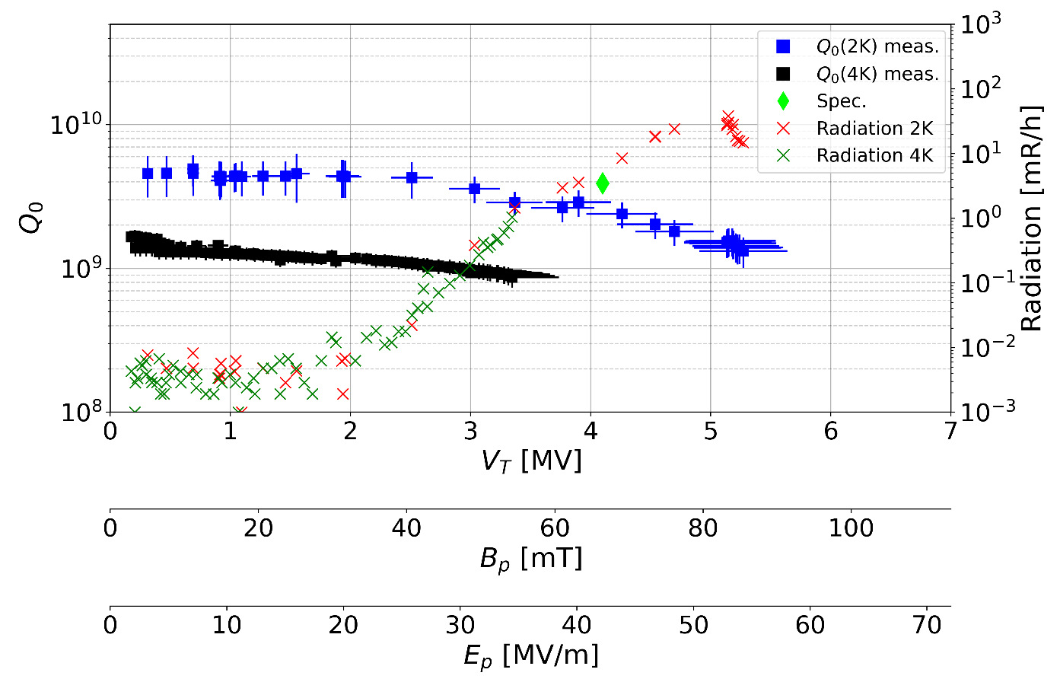
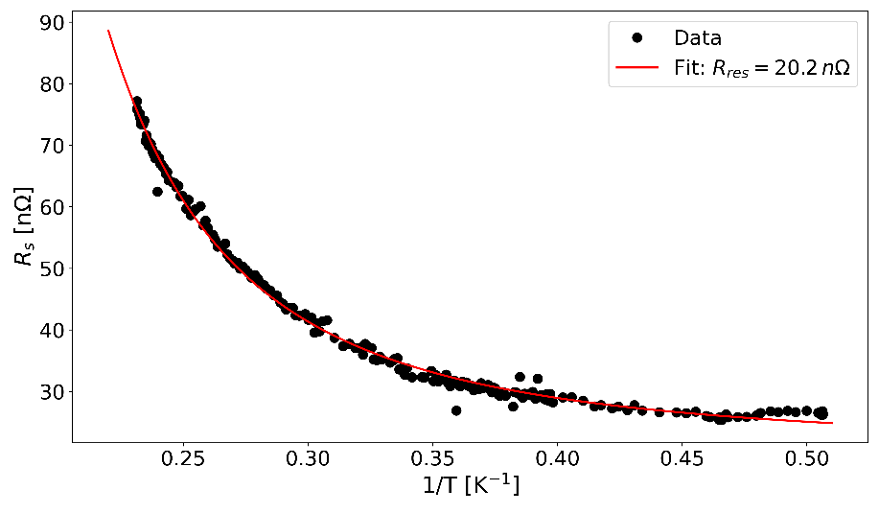
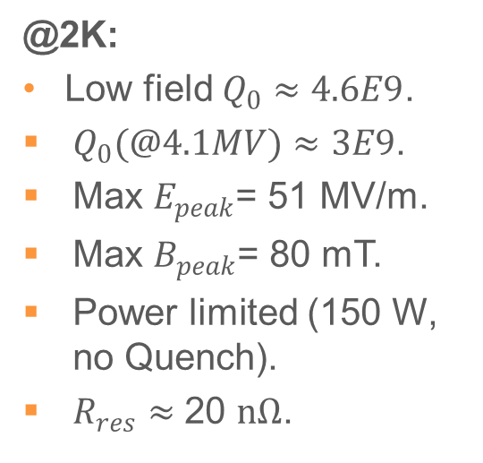
NRFDP002 1st test w/HOMs
@2K:
Low field $Q_{0}≈4.6E9$.
  $Q_{0}(@4.1MV)≈3E9$.
  Max $E_{peak}$= 51 MV/m.
  Max $B_{peak}$= 80 mT.
  Power limited (150 W, no Quench).
  $R_{res}≈$ 20 $nΩ$.
  Early FE onset (~2.5 MV/m) consistent with assembly trade-offs.
  Indications extra losses:
    Bad RF-gasket contact (dejavu?)
Notes:
A 1st test showed:
Early field emission onset.
Low Q’s in the mid-E+9.
We were power starved and did not reach quench.
The extra losses started to smell like what was seen at LARP, where a poor RF-contact on the HHOM gasket resulted in a similar situation.

Slide 16
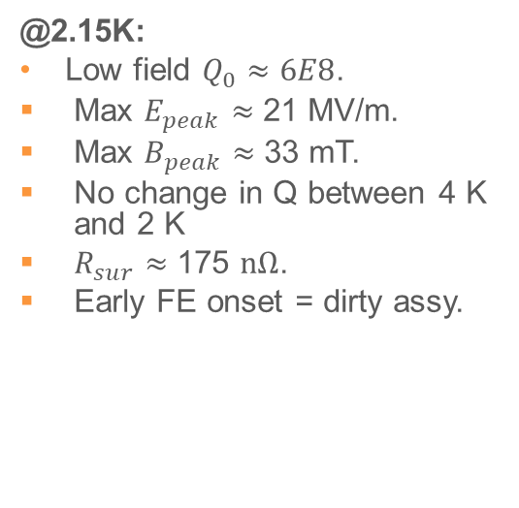
NRFDP002 2nd test w/HOMs
@2.15K:
Low field $Q_{0}≈6E8$.
  Max $E_{peak}$ $≈$ 21 MV/m.
  Max $B_{peak}$ $≈$ 33 mT.
  No change in Q between 4 K and 2 K
  $R_{sur}≈$ 175 $nΩ$.
  Early FE onset = dirty assy.
  A superfluid leak (~5E-5 torr) limited the FWD power (25 W) at 2 K.
  Vacuum conditions were stable at 2.15K but we were still power starved at 2 MV due to large reflections (~85 W FWD).
  At this point is more than sure that the poor RF shielding on the HHOM RF gasket is the culprit of our high losses (learned from LARP).
Notes:
A 2nd second test yielded even less favorable results:
A superfluid leak developed at 2K, limiting the forward power due to plasma discharges.
After a thermal cycle we achieved stable vacuum conditions at 2.15K.
However, we were still power limited due to a large reflection.
We virtually saw no change on the Q values between 4 and 2K.
After picking up some heating signatures on the HHOM flange, we were sure that we had an issue with our RF gasket.
We still had an early field emission onset.

Slide 17
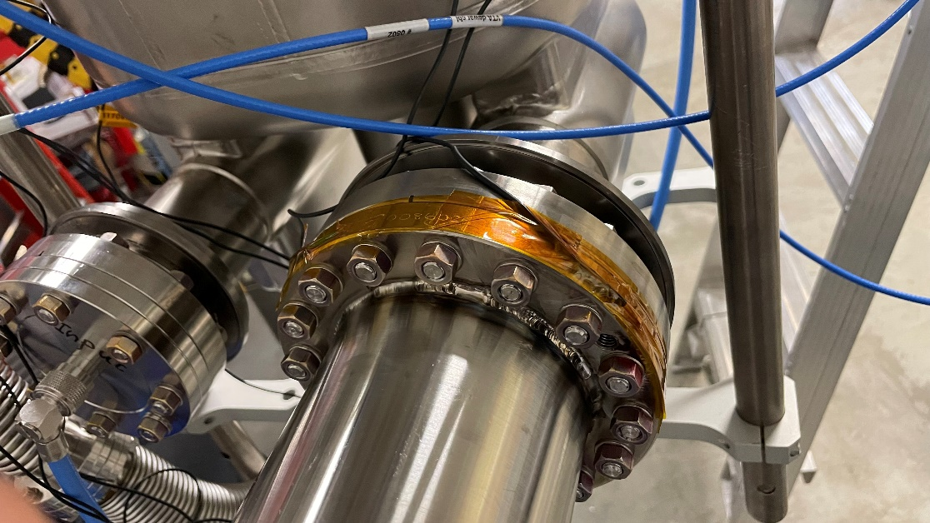
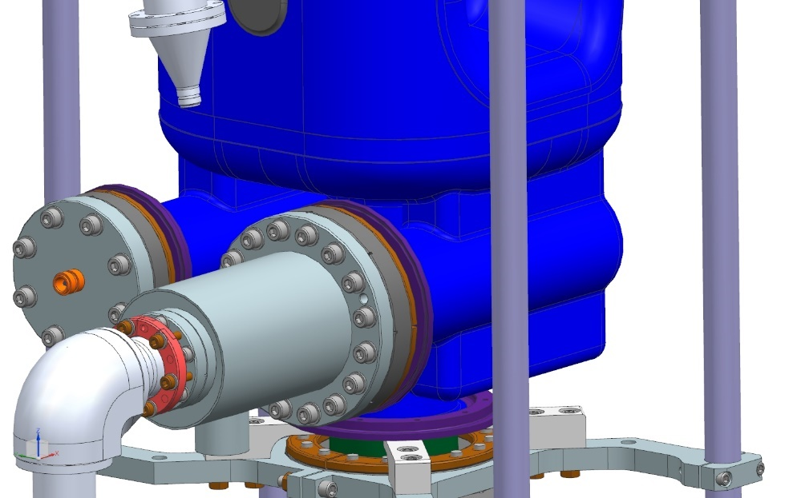
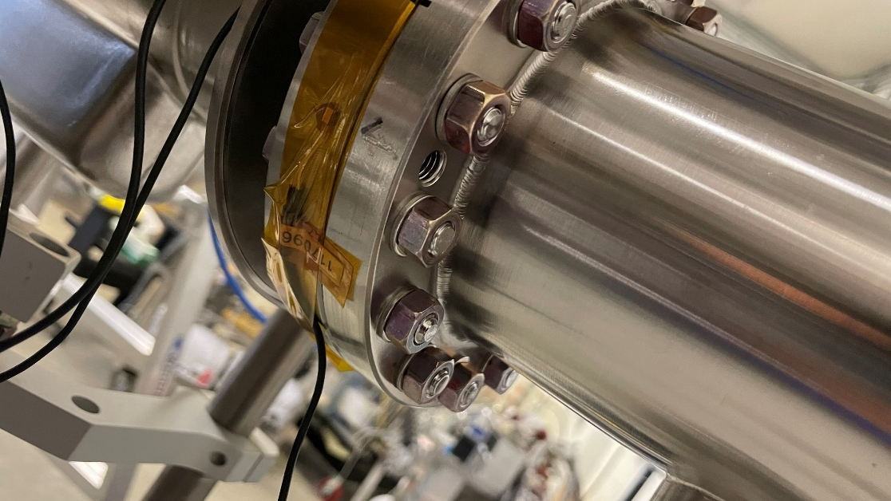
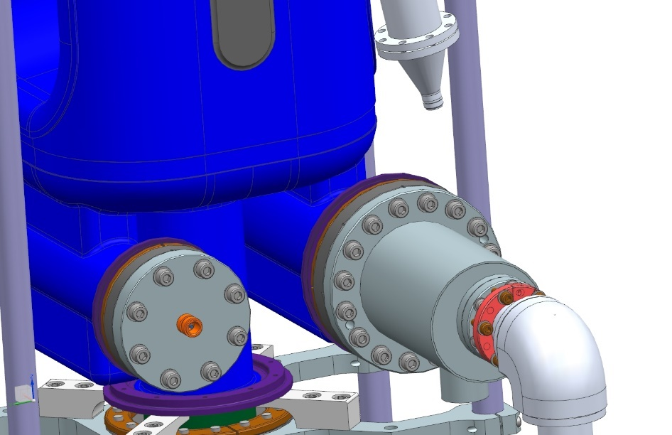
Temperature Sensors
HHOM-1
HHOM-2
HHOM-3

Slide 18
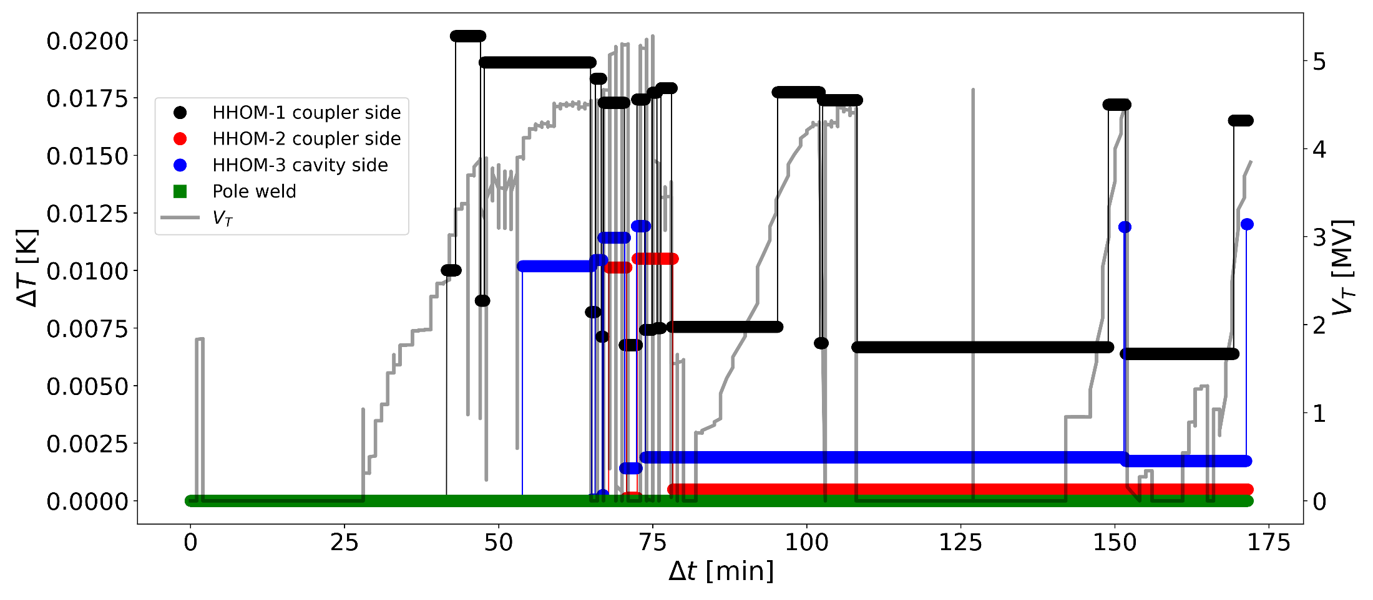
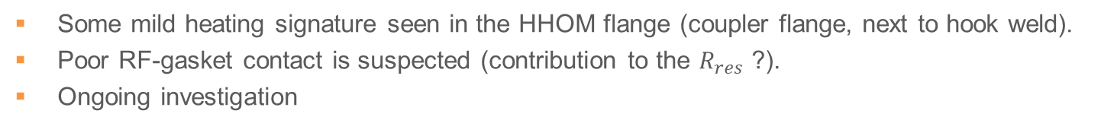
HHOM Heating Signature
Some mild heating signature seen in the HHOM flange (coupler flange, next to hook weld).
Poor RF-gasket contact is suspected (contribution to the $R_{res}$ ?).
Ongoing investigation

Slide 19
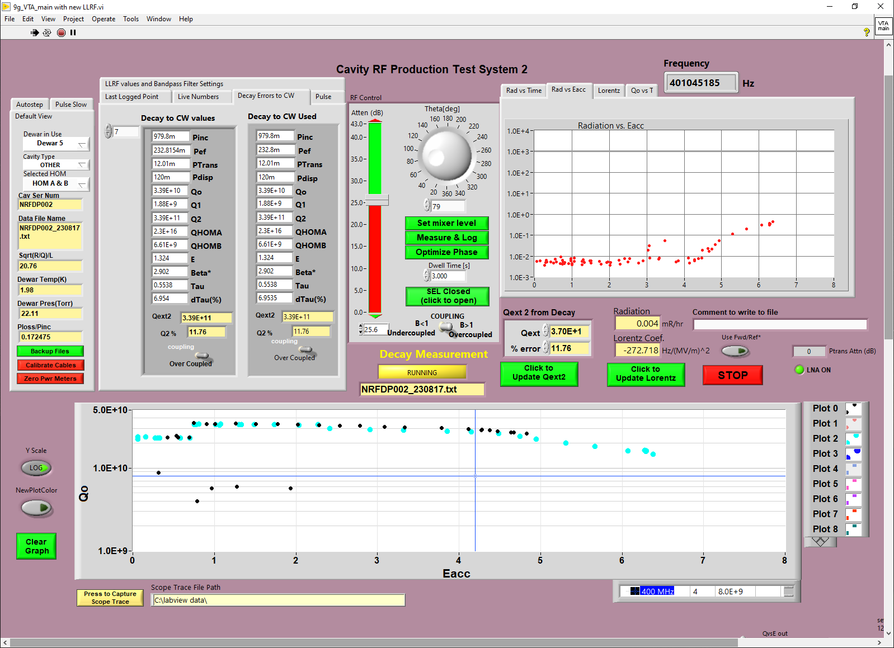
VHOM Coupling

Slide 20
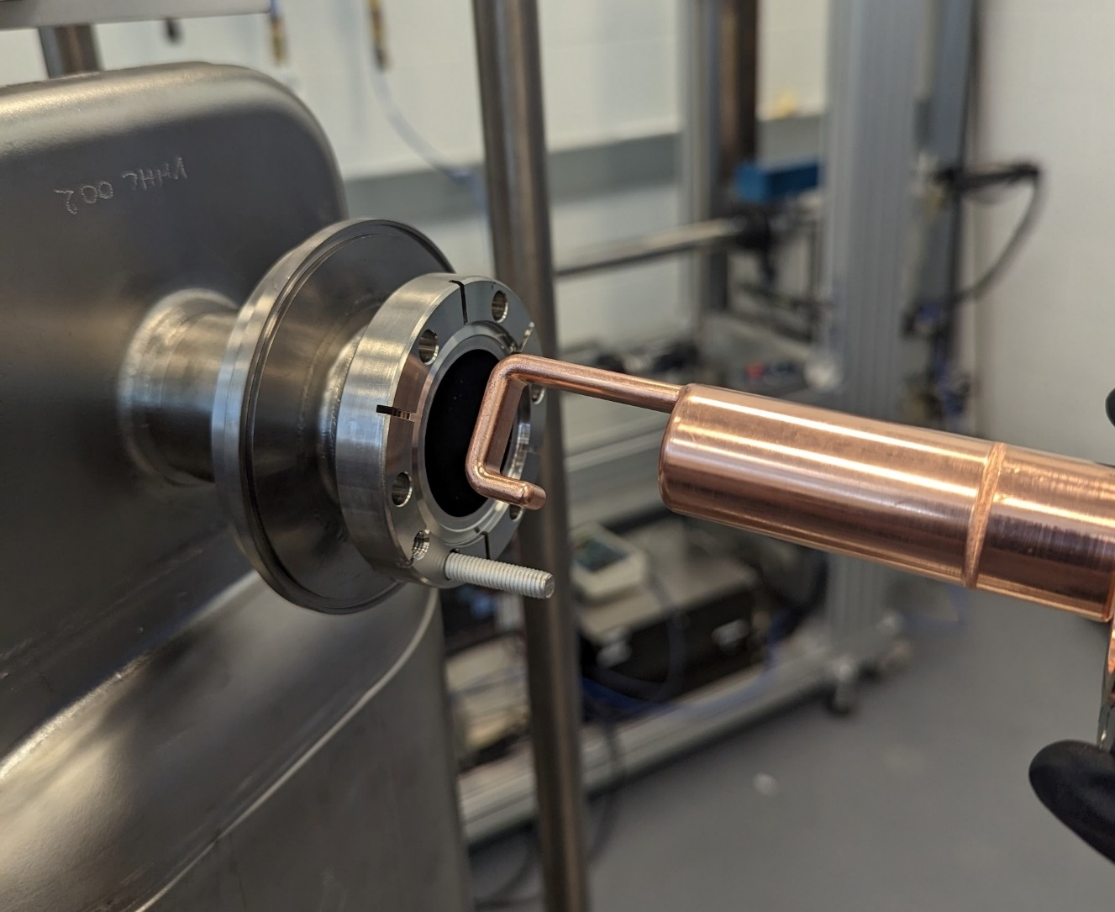
VHOM Warm Clocking Measurements (1)
Clocking
Starting point 0/360deg

Slide 21
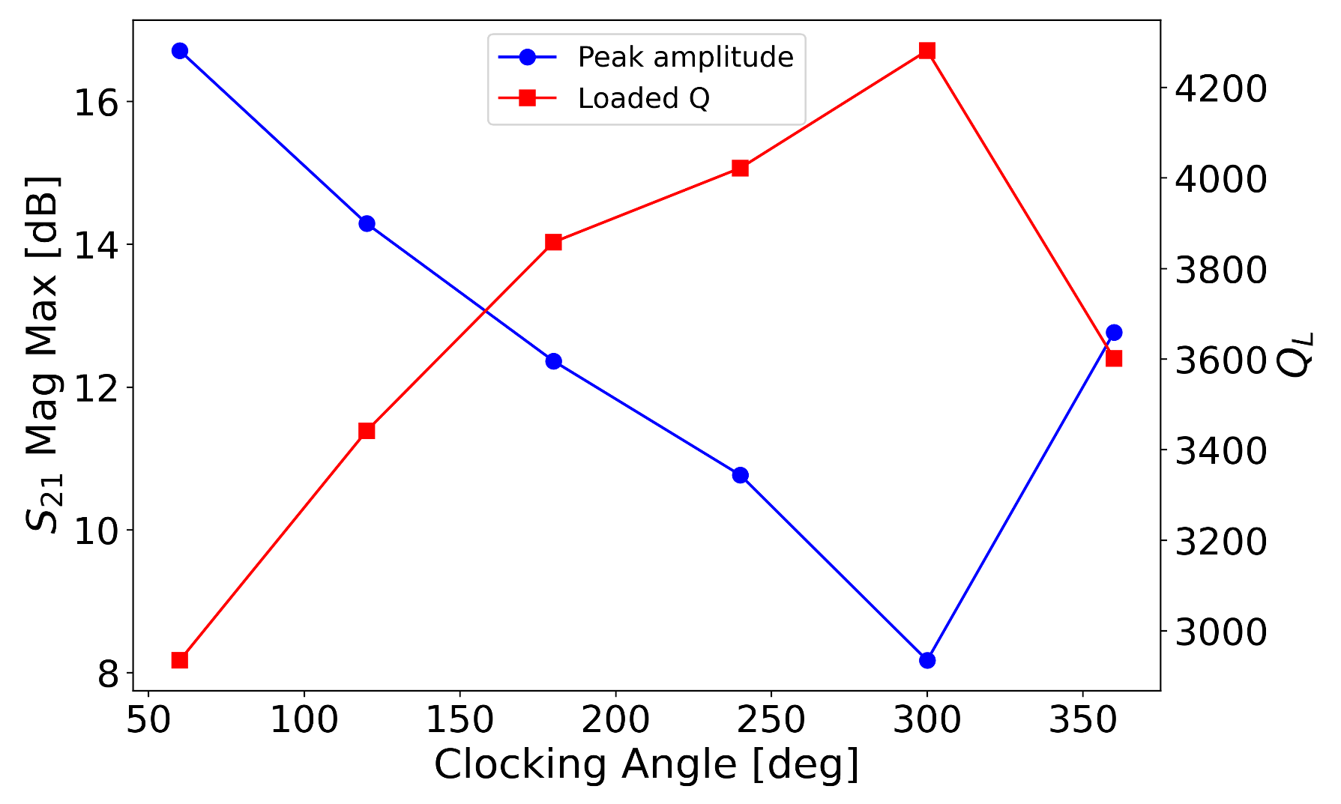
VHOM Warm Clocking Measurements (2)

Slide 22
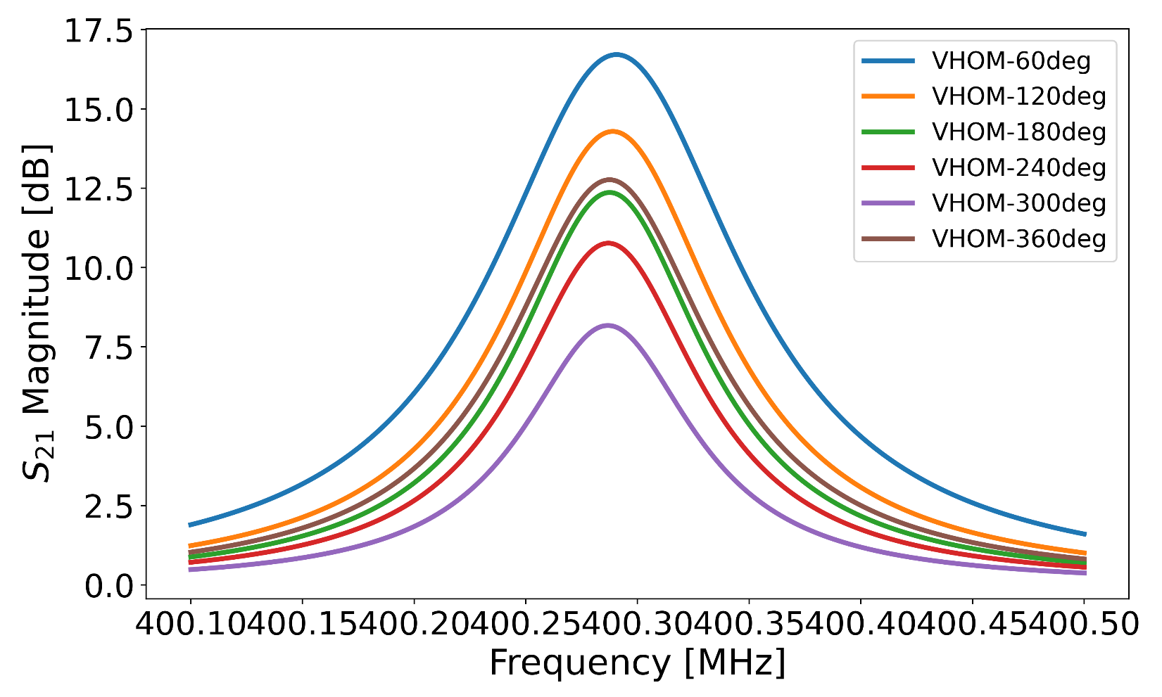
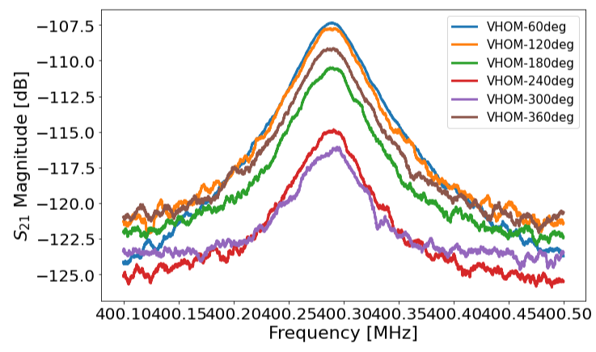
VHOM Warm Clocking Measurements (3)

Slide 23
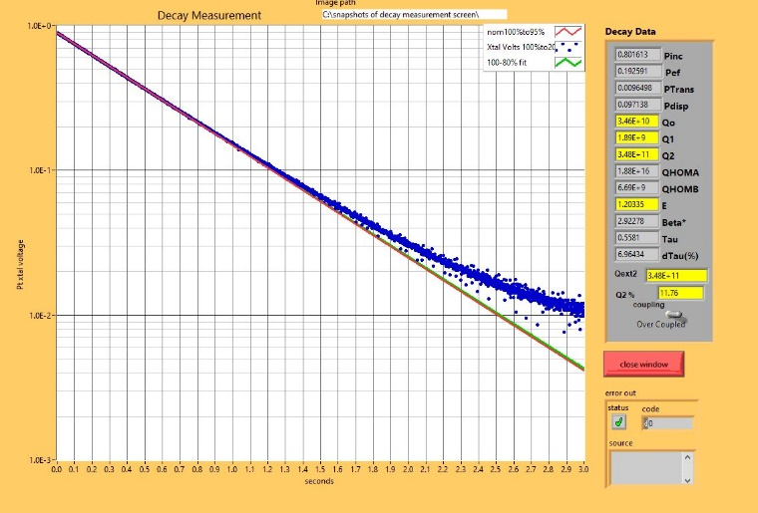
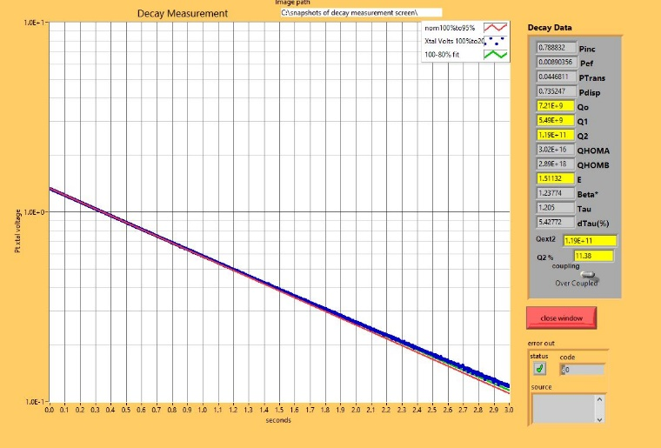
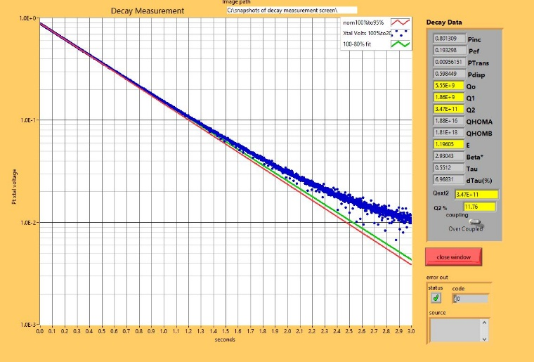
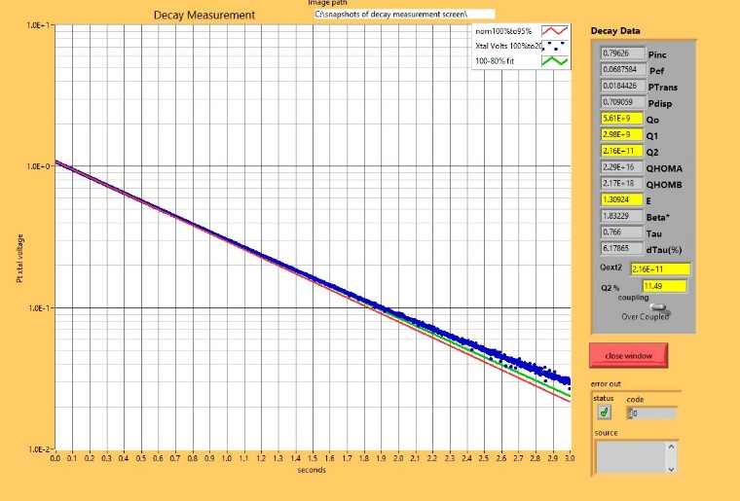
Decays with different VHOM terminations
Power meter
Open
Load
Short

Slide 24
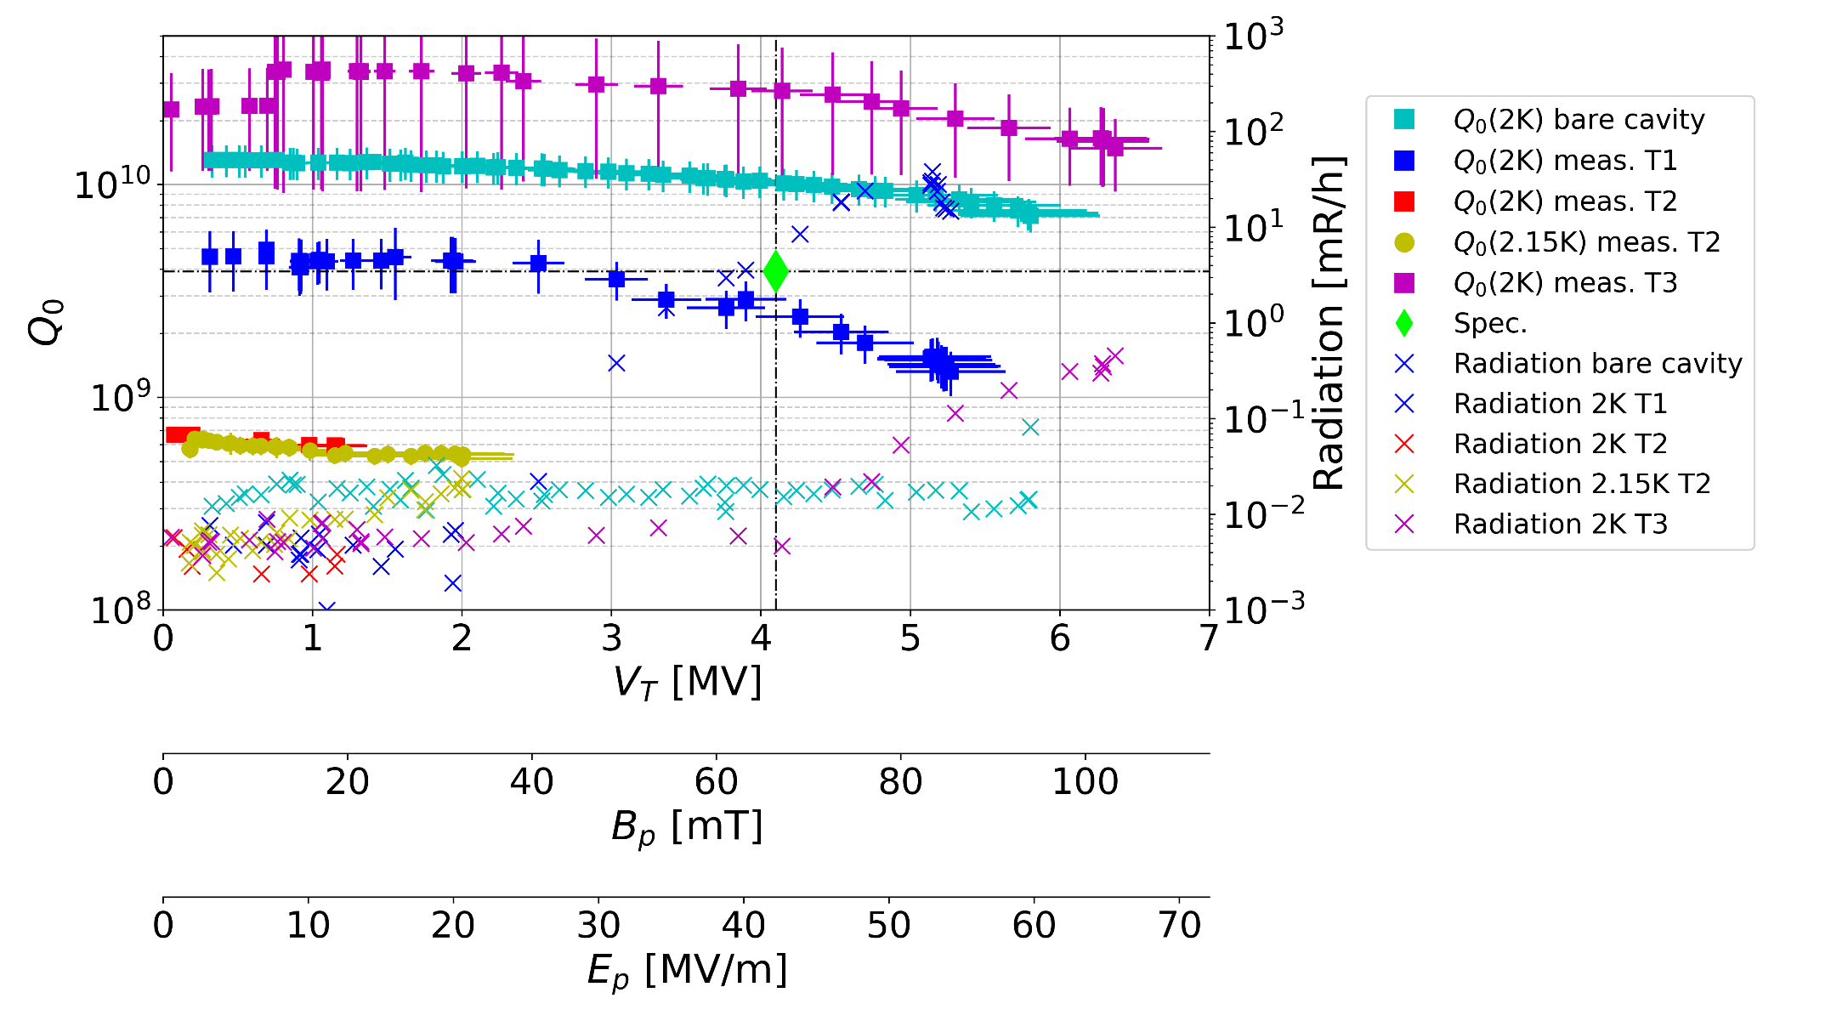
Prototype 2 Tests Summary
4
1
2
3
  Great performance (FNAL)
  RF losses (JLab)
  +RF losses (JLab)
  Almost back to bare (JLab)

Slide 25
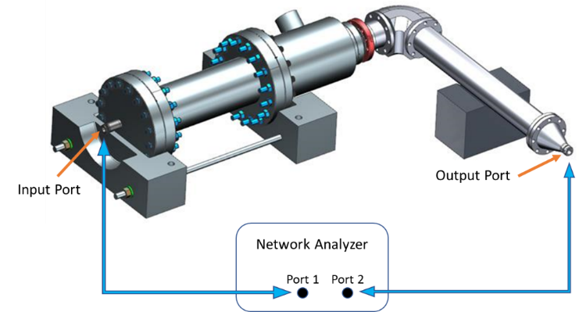
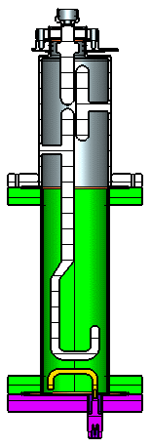
HOM Prototypes’ Warm Meas.
S. De Silva (ODU)
RF Box measurements:
Two RF test boxes designed and fabricated by ODU
Both test box cans and test probes were qualified with detailed CMM data and no effect on fabrication offsets
2 HHOM dampers sets were measured and qualified with the CERN mask
  Prototype set 1: HHOM3+FT2 was used in RFD2 VTA cold test
Prototype 1 (HHOM3+FT2): FT2 were trimmed to lower the notch → To reduce fundamental power
FTs will not be modified for pre-series and series sets

Slide 26
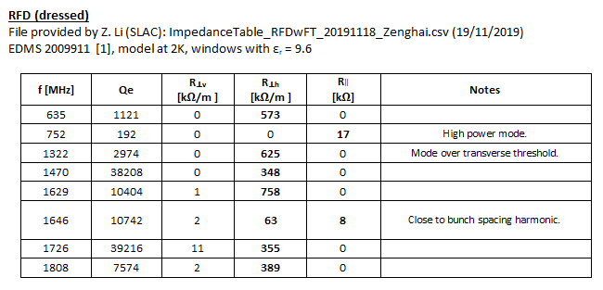
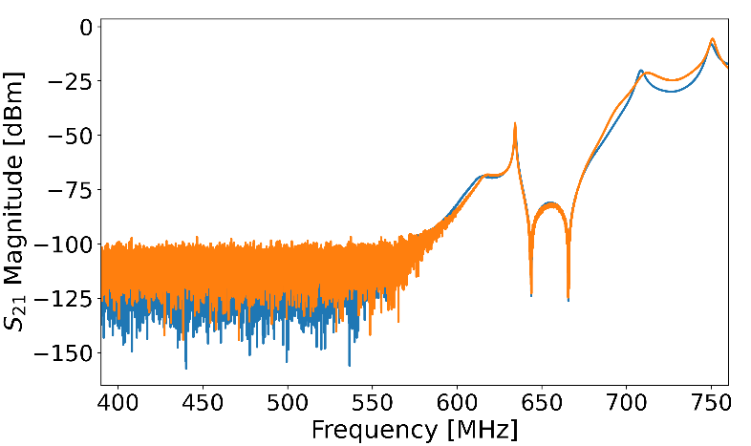
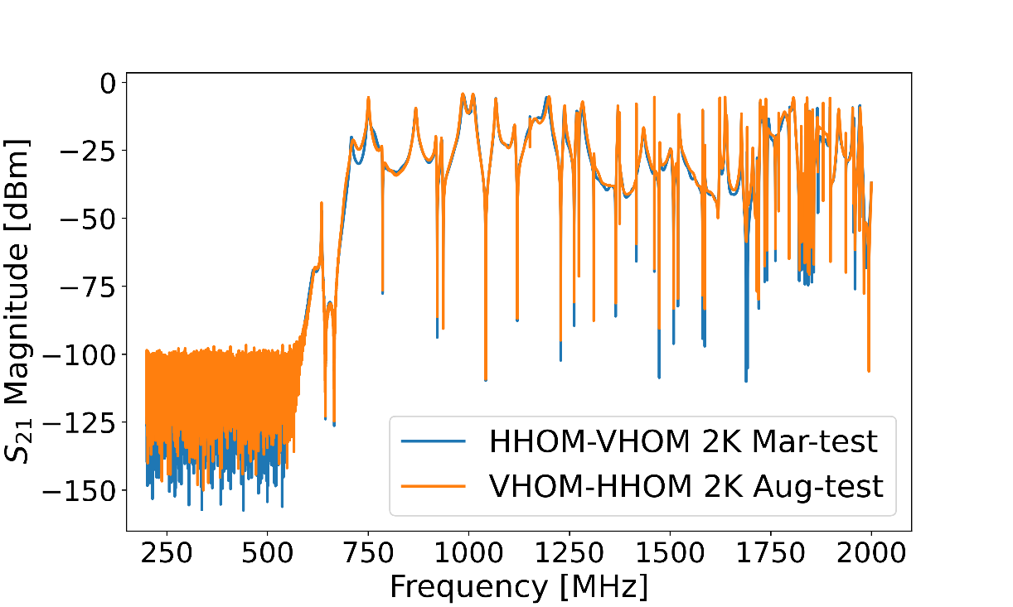
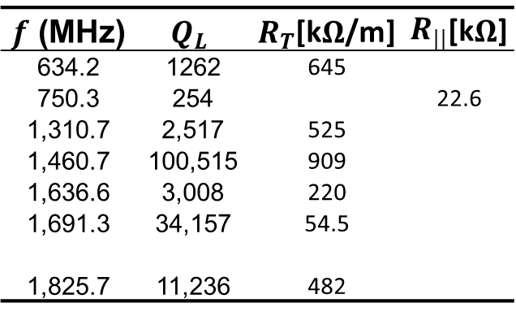
NRFDP002 2 K HOMs meas.
Good fundamental rejection and trans. of HOMs of interest (e.g. ‘750 MHz’).
$Q_{L}$ calculated from $S_{21}$ at 2 K using test input and HHOM coupler.
Comparing w/HOM Annex (EDMS 2488213).
$f$ (MHz) | $$Q_{L}$$ | $R_{T}$[k$Ω$/m] | $R_{||}$[k$Ω$]
634.2 | 1262 | 645
750.3 | 254 |  | 22.6
1,310.7 | 2,517 | 525
1,460.7 | 100,515 | 909
1,636.6 | 3,008 | 220
1,691.3 | 34,157 | 54.5
1,825.7 | 11,236 | 482

Slide 27

Flange Connection Measurements (1)
Nominal values in the table.
When the flange gap reaches zero, the lips would be compressed by 0.2mm and desirable RF contact can be achieved.
Quantity | Value (mm)
Cavity Flange Thickness | 19.7
HHOM Flange Thickness | 15.01
Total | 34.71
Nominal Nb Gap | 2.4
Seal Lip Height (+/-0.1) | 2.6
FLANGE THICKNESS
NOMINAL NB GAP
FLANGE GAP
Notes:
We did some simple tests and measurements to convince ourselves that increasing the torque and bringing the connection flange-to-flange could, in theory solve the poor RF contact in the HHOM connection.

