Slide 1
Path toward the validation of the first PIP2 SSR2 cavity :
experience vs simulations and challenges
WP2 - TTC meeting
D. Longuevergne
Work supported, in part, by CNRS/IN2P3 and by the U.S. Department of Energy, Office of Science, Office of High Energy Physics, under U.S. DOE Contract No. DE-AC02-07CH11359.

Slide 2
OUTLINE
SSR2 cavity
Processing and testing strategy
Test results and improvements
RELATED TALKS AT THIS TTC :
D. Passarelli, Recent Progress on PIP-II project, plenary session, Wednesday
M. Parise, Fabrication experience of PIP-II SSR1 and SSR2 cavities, WP2, Wednesday
Would like to thank all contributors :
@ IJCLab : Patricia Duchesne and all technicians of cryogenic group and SUPRATECH platform
@ FNAL : Mattia Parise, Donato Passarelli, Laura Grassellino, Alex Sukhanov and all people involved in PIP-II project.

Slide 3
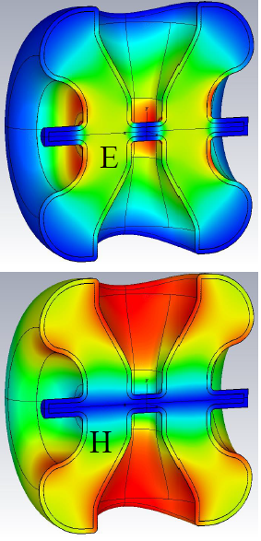
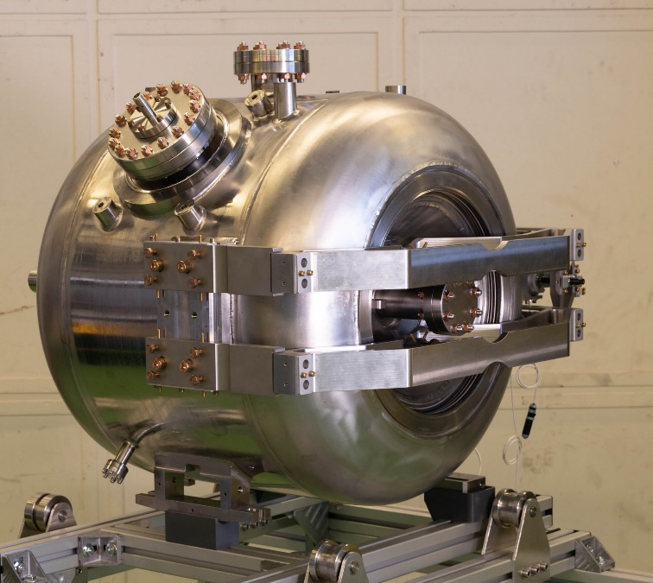
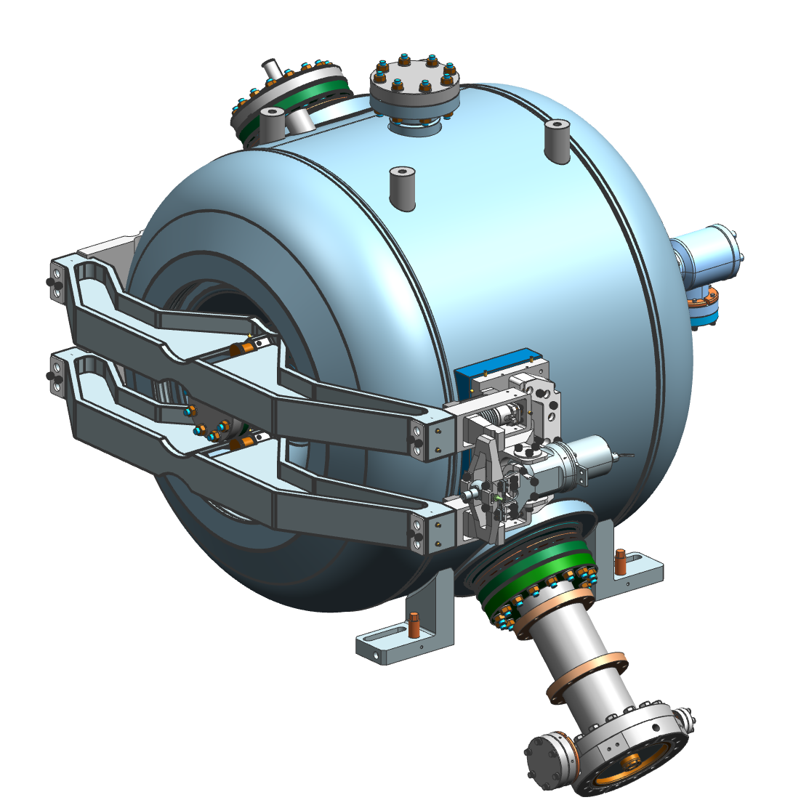
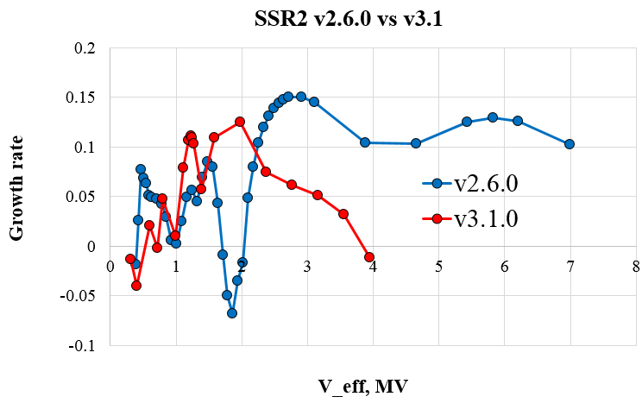
SSR2 CAVITY
Material : Bulk Niobium
β = 0.472
F₀ = 325 MHz
T : 2K
Vacc = 5 MV, Eacc : 11.5 MV/m
Qo > 8E9 @ 11.5 MV/m
Bpk/Eacc = 6.75 mT/MV/m
Epk/Eacc = 3.5
r/Q = 305 Ω
G = 115
K = 40.06
RF design by Fermilab : optimized for multipacting mitigation (inspired from Triumf Ballon Spoke, R. Laxdal)
Mechanical design by Fermilab and IJCLab : optimized for stability and tunability (lessons learned from SSR1 and ESS Spoke)
P. Berrutti et al., “New Design of SSR2 Spoke Cavity for PIP II SRF Linac”, SRF’19, TUP066, Dresden, Germany
M. Parise et al., “Mechanical Design and Fabrication Aspects of Prototype SSR2 Jacketed Cavities”, SRF’19, TUP014, Dresden, Germany

Slide 4
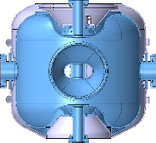
PROCESSING AND TESTING STRATEGY
3+3 prototypes
1st Set of 3 cavities
Final processing @ IJCLab
(flash BCP, HPR, baking)
OK
0 %
Vertical testing @ FNAL as received
Vertical testing @ IJCLab
Shipping @ FNAL
Full surface processing in industry
NOK
NOK
Re-processing @ IJCLab
Vertical testing @ IJCLab
OK
100 %
2nd set of 3 cavities
(not yet delivered)
Horizontal testing with coupler @ FNAL
…
Full surface processing in industry
Lessons learned

Slide 5
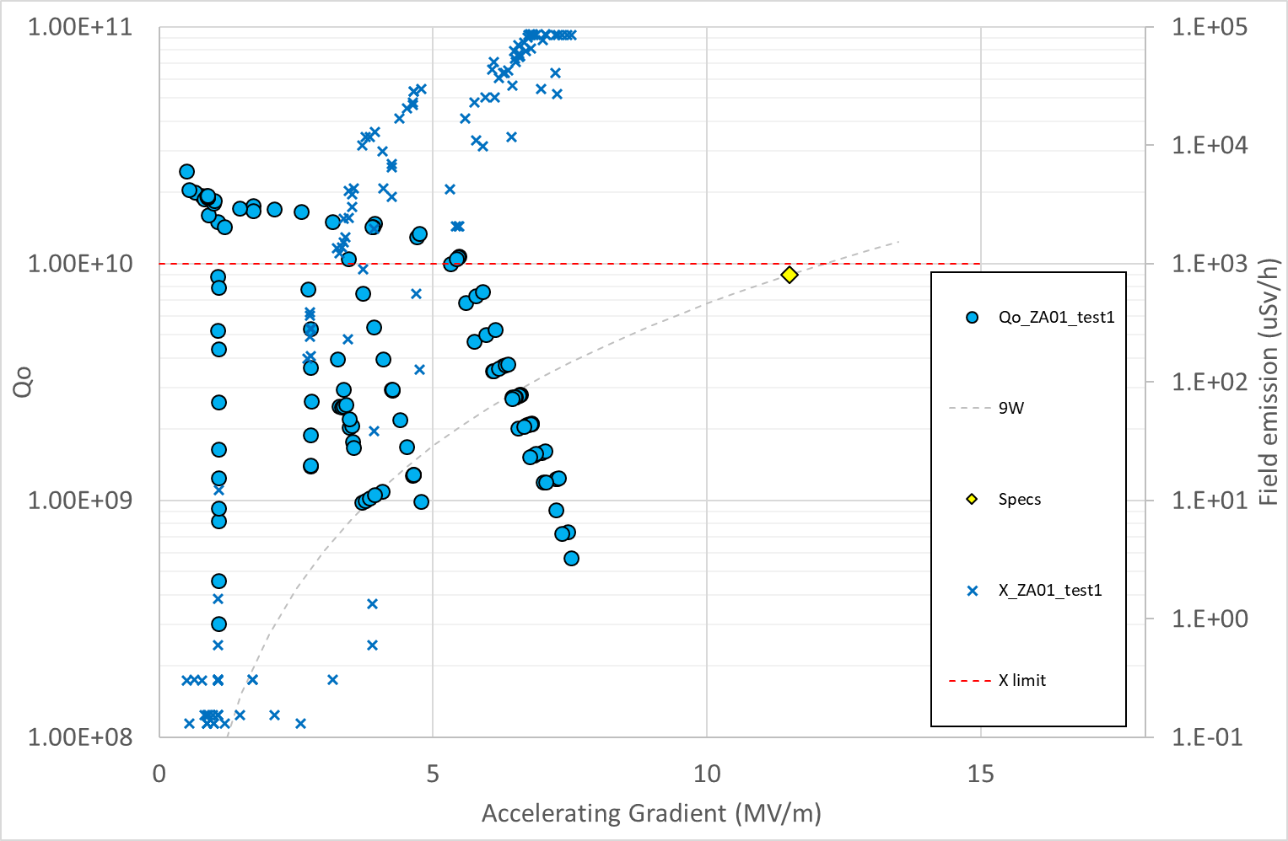
TEST RESULTS AND IMPROVEMENTS
Industry processed successfully multicells elliptical cavities (1.3 GHz, 704 MHz, …)
PIP-II is first project transferring to industry the processing technology for Spoke resonator (rotational BCP, …)
Significant oversight in preparation for processing and assembly

Slide 6
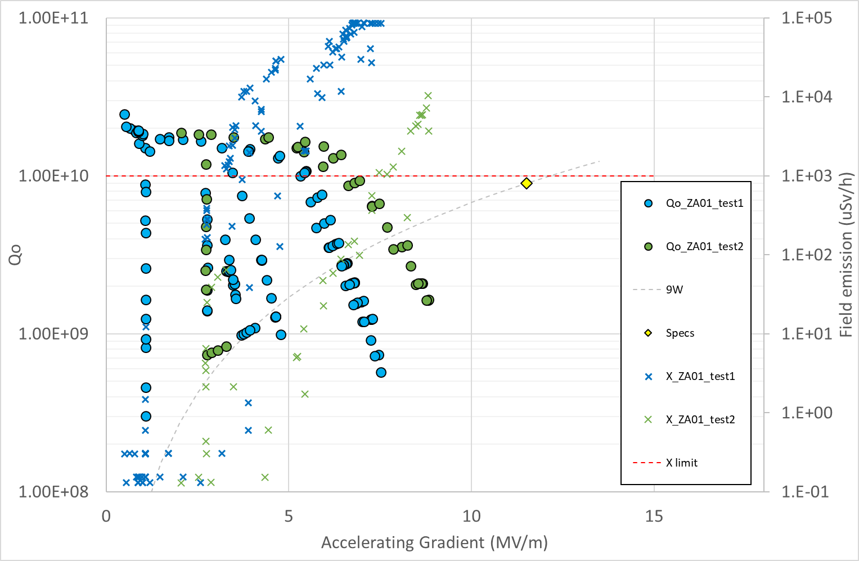
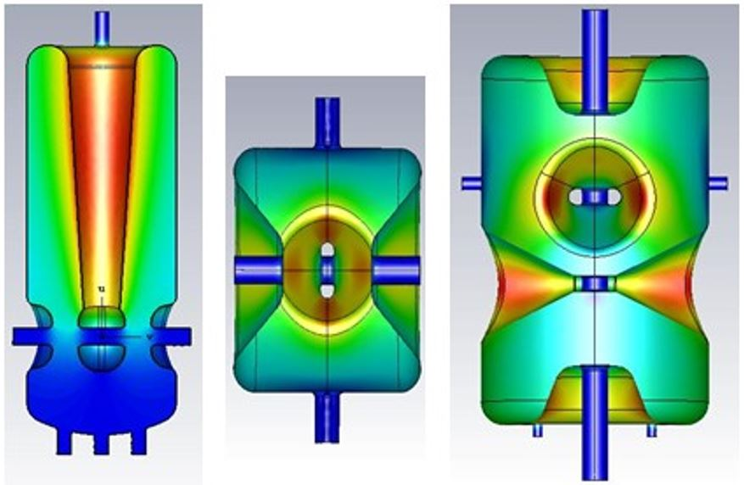
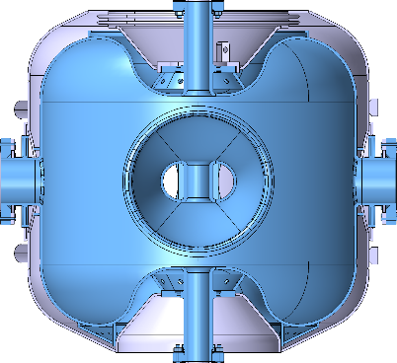
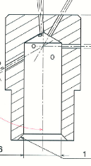
TEST RESULTS AND IMPROVEMENTS
Industry processed successfully multicells elliptical cavities (1.3 GHz, 704 MHz, …)
PIP-II is first project transferring to industry the processing technology for Spoke resonator (rotational BCP, …)
Significant oversight in preparation for processing and assembly
IJCLab processed successfully SPIRAL2 (QWR), ESS and MYRRHA cavities (Spoke)
Geometry of PIP-II SSR very close to MYRRHA SSR
HPR procedure and tooling is kept the same @ IJCLab.
Same HPR nozzle (8 water jets as shown below)
3 rinsing cycles per ports (same translation and rotation speed)
1 difference is not full crossing of HPR wand through beam pipes (high risk of collision).
5°
30°
90°
120°

Slide 7
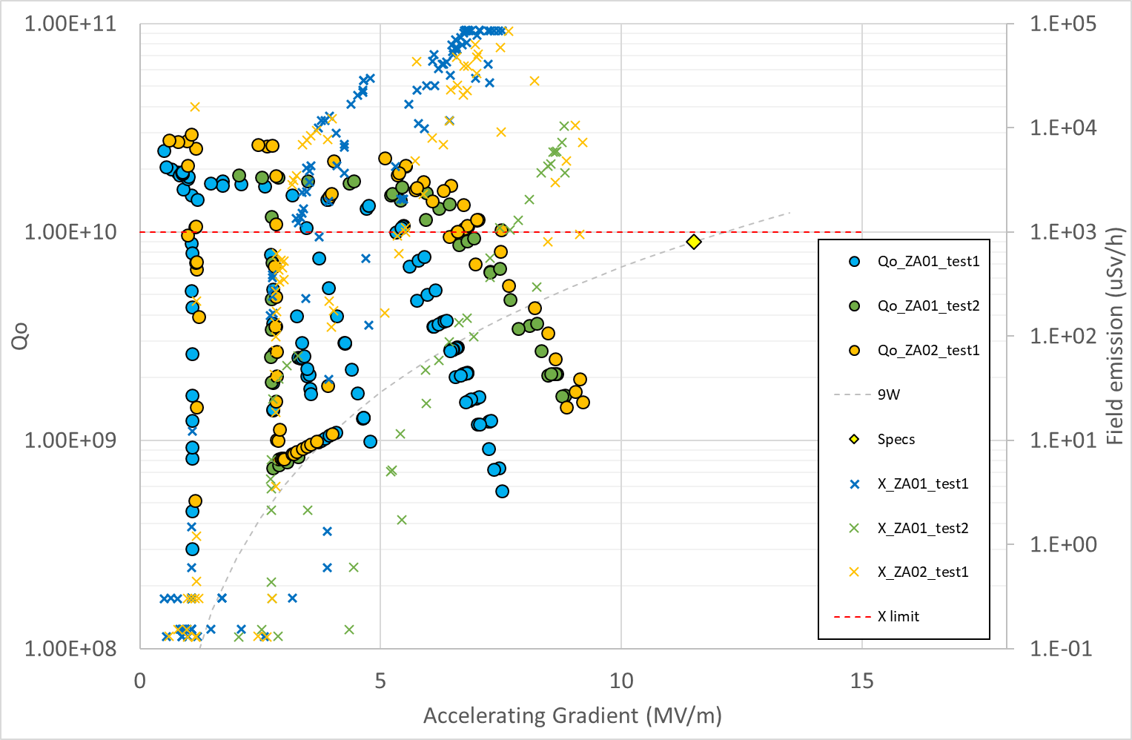
TEST RESULTS AND IMPROVEMENTS
Not really better !
What can be quickly improved ?
5°
30°
5°
30°
90°
90°
120°
120°
Let’s give a second chance

Slide 8
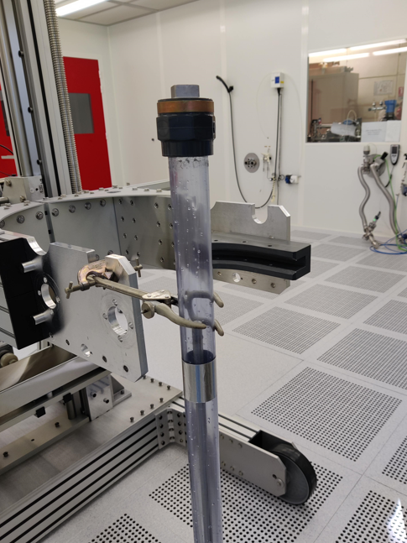
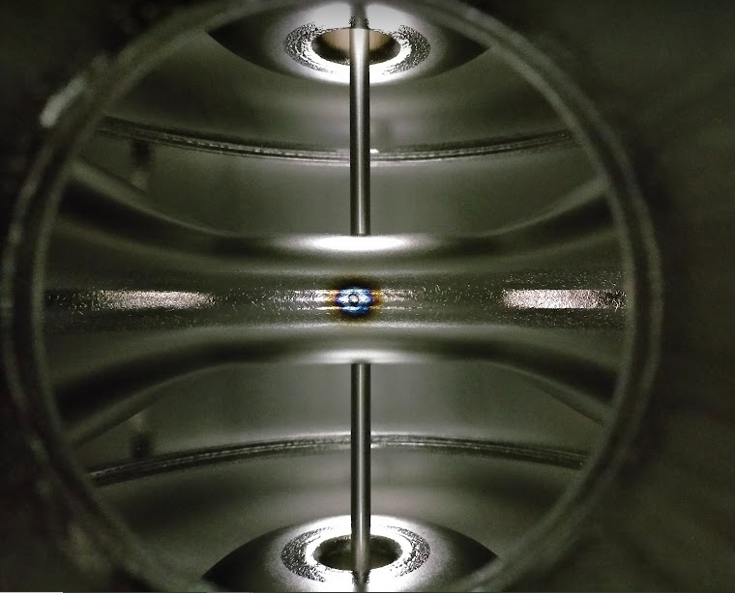
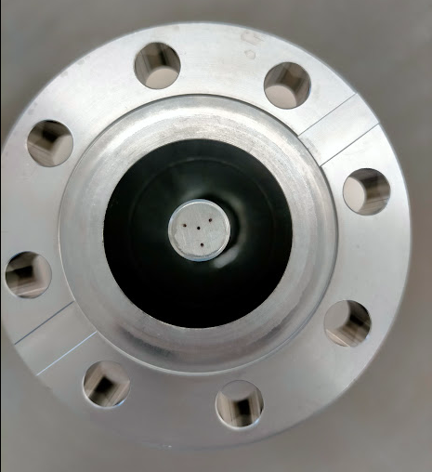
TEST RESULTS AND IMPROVEMENTS
Check compatibility of tooling to avoid collision
5°
30°
5°
30°
90°
90°
120°
120°
Full cavity crossing

Slide 9
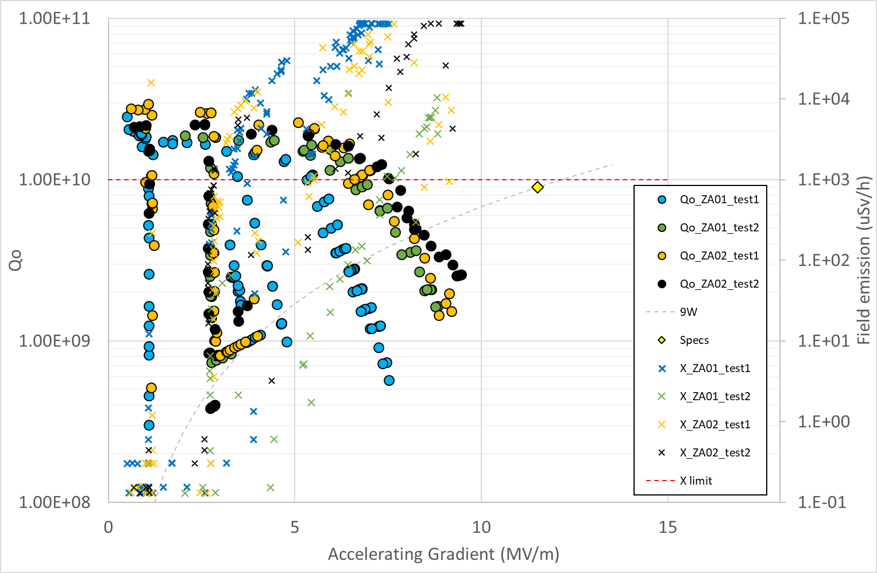
TEST RESULTS AND IMPROVEMENTS
Not really better !
CHECK FINELY SURFACE COVERAGE
5°
30°
5°
30°
90°
90°
120°
120°
Full cavity crossing

Slide 10
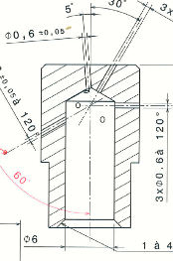
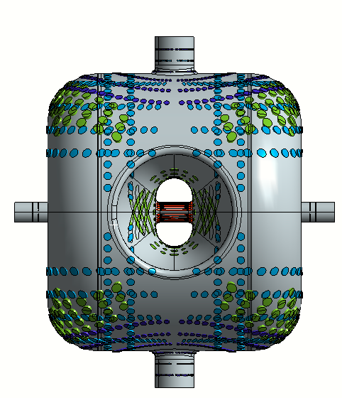
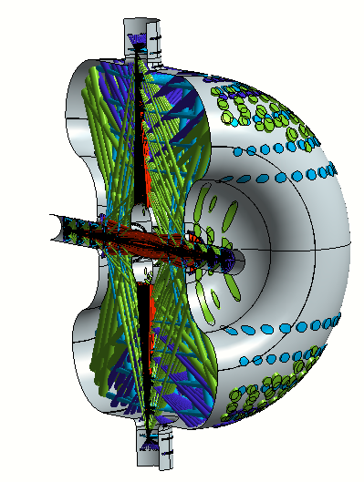
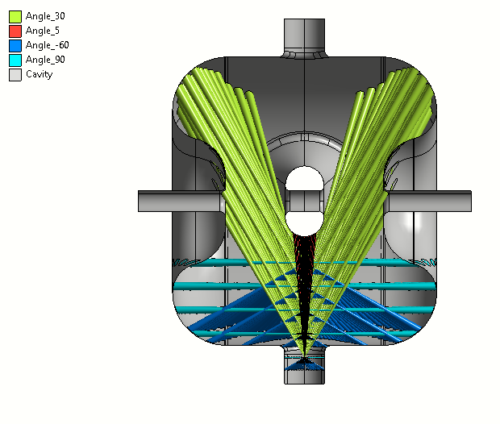
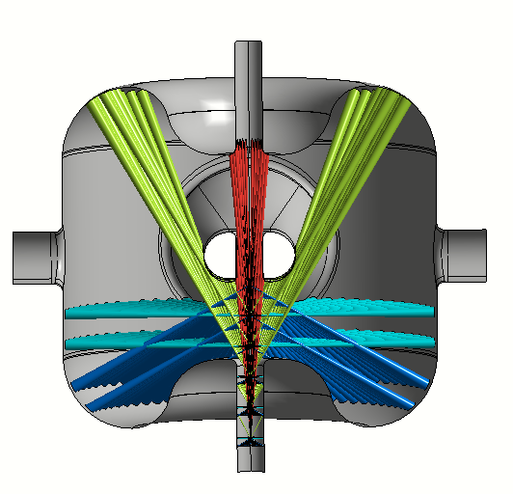
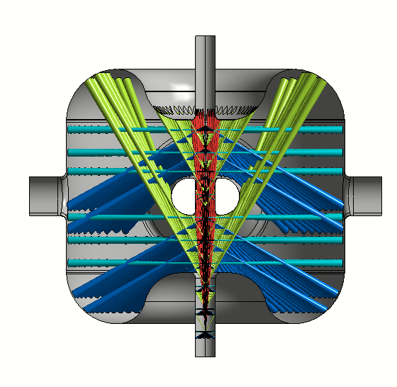
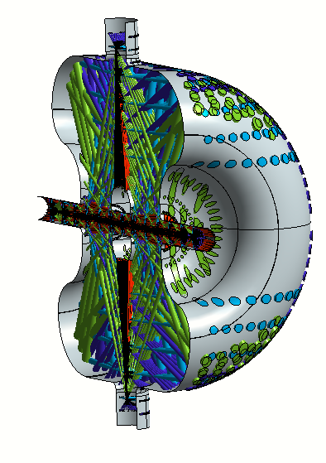
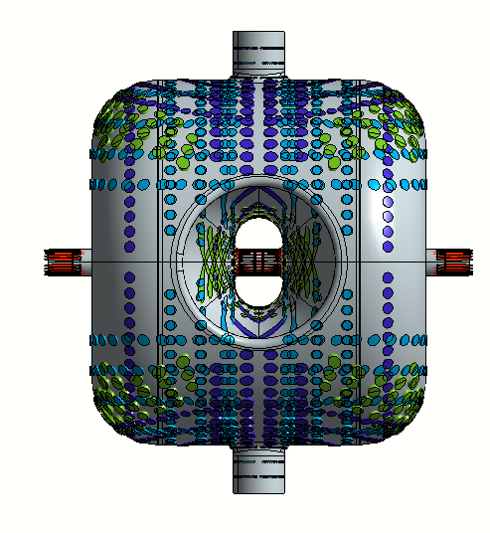
TEST RESULTS AND IMPROVEMENTS
8 holes:
1x5°
3x30°
2x90°
2x120°
through the coupler port:
through the beam port:
P. Duchesne, IJCLab
ZA02 – Test 1
ZA02 – Test 2
Thanks to these jets, better rinsing around the iris.
But, the jet are slightly tangent

Slide 11
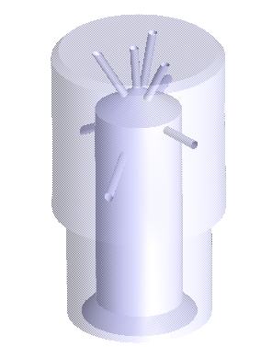
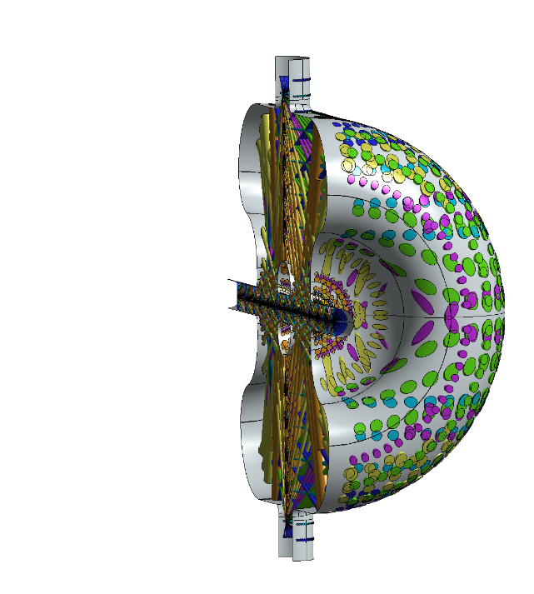
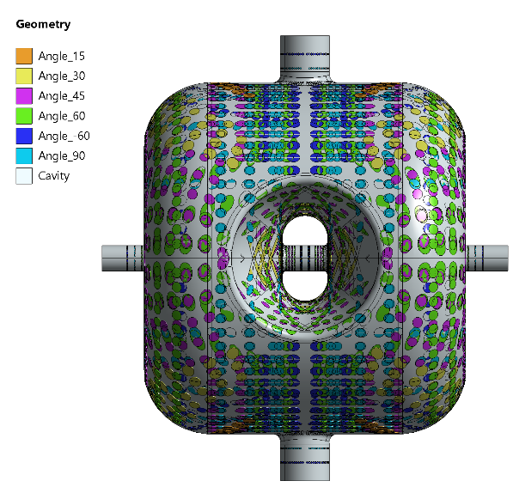
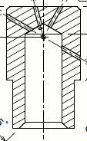
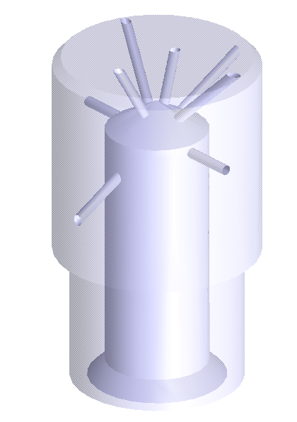
TEST RESULTS AND IMPROVEMENTS
5°
30°
5°
30°
90°
120°
90°
120°
Improve water jet angles
8 holes:
1x15°
1x30°
2x45°
1x60°
2x90°
1x120°
45°
15°
60°
30°
90°
120°
5°
30°
90°
Takes time to rebuild a HPR wand and nozzle
Meanwhile, let’s improve coverage by tilting the cavity
120°

Slide 12
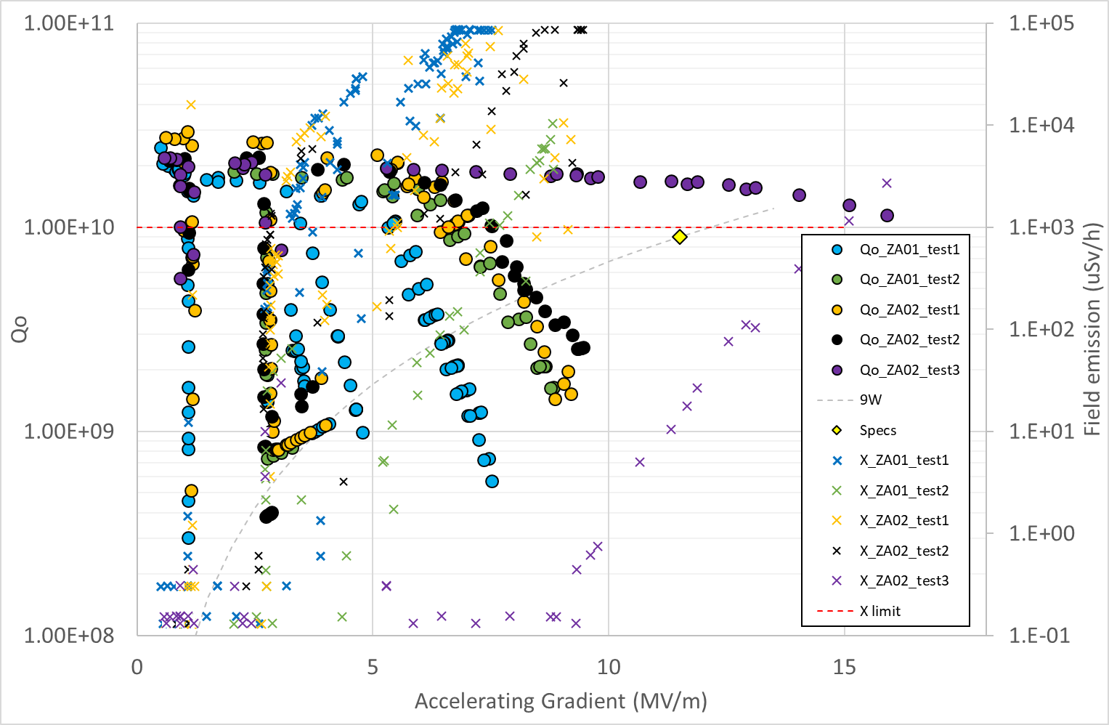
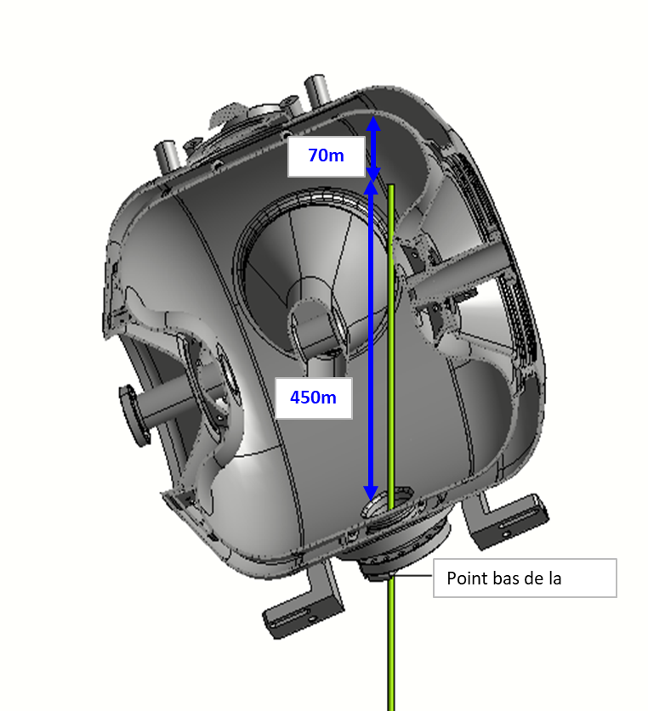
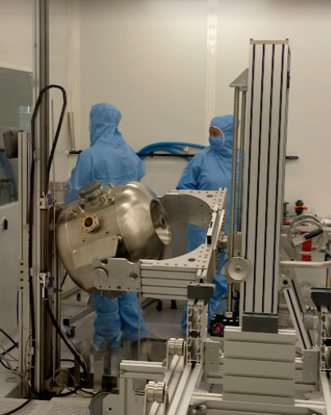
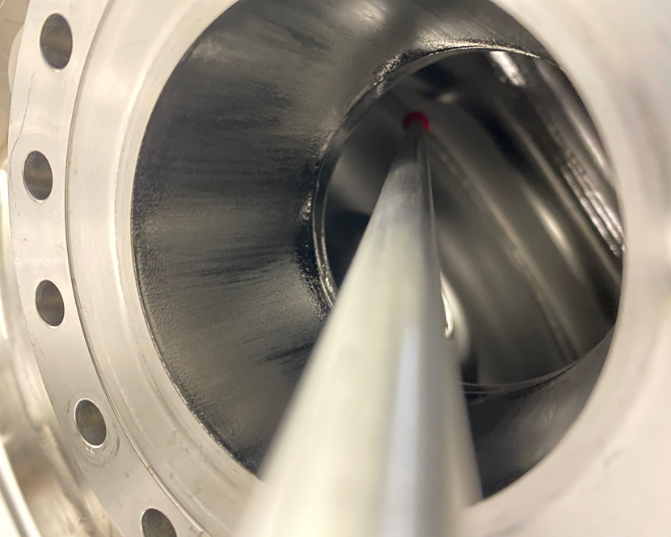
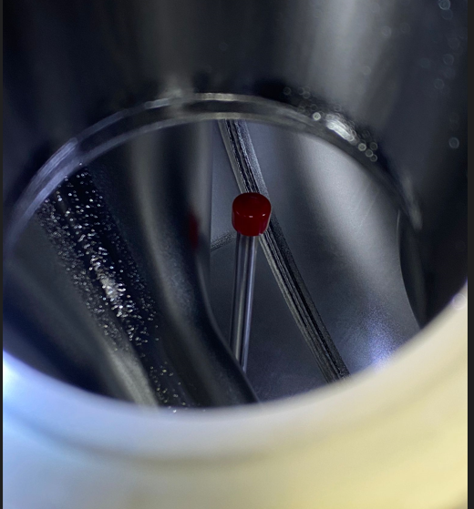
TEST RESULTS AND IMPROVEMENTS
Tilting of cavity during HPR
NICE IMPROVEMENT !
But HPR process 3 times longer and difficult to transfer to industry
Let’s step back to a more standard process with optimized nozzle
5°
30°
90°
120°

Slide 13
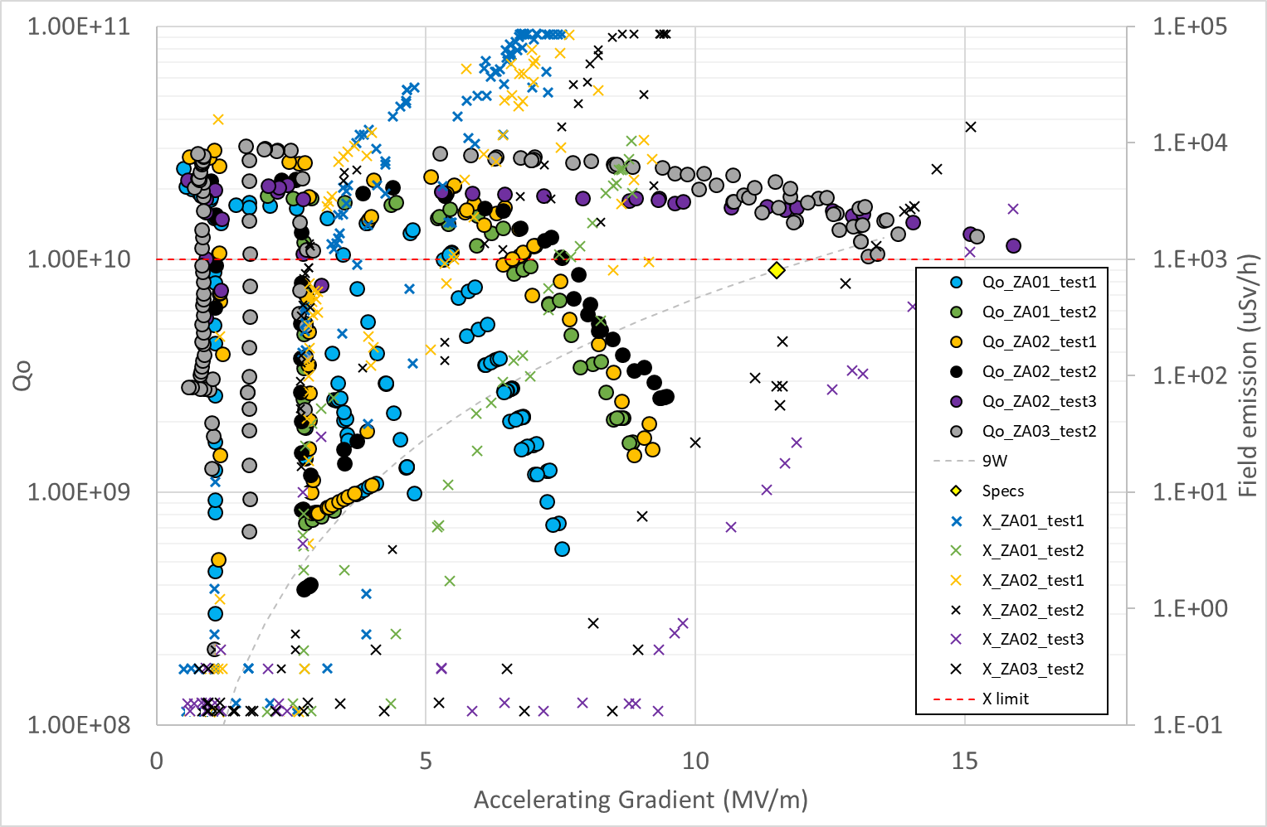
TEST RESULTS AND IMPROVEMENTS
Similar results but way less painful !
Solution can be transfered to industry
5°
30°
5°
45°
15°
60°
30°
8 holes:
1x15°
1x30°
2x45°
1x60°
2x90°
1x120°
30°
90°
90°
90°
120°
120°
120°

Slide 14
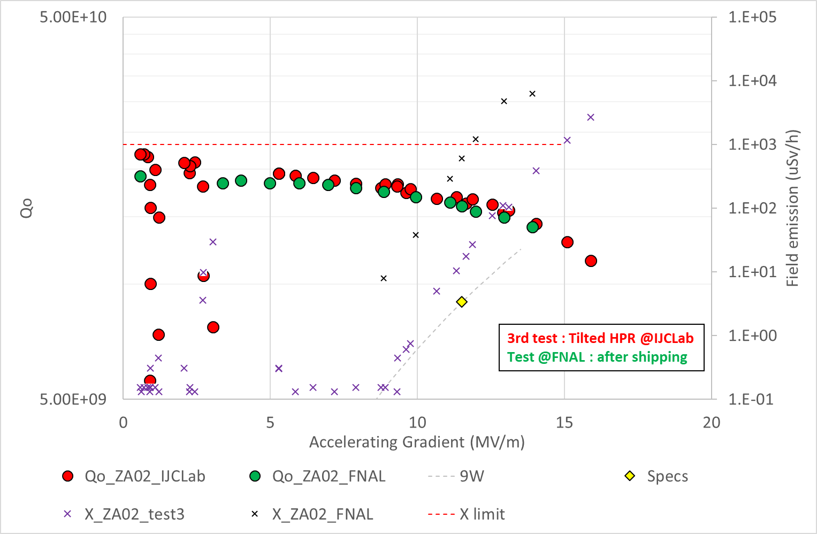
VERIFICATION TEST after SHIPPING
Cavity performances are conserved after shipping !
Need to harmonize X-rays measurements
Shipping to Fermilab
Tested as received

Slide 15
SUMMARY OF TESTS
 | Units | Criteria | ZA01 N°1 | ZA01 N°2 | ZA03 N°1 | ZA02 N°1 | ZA02 N°2 | ZA02 N°3 | ZA03 N°2
Vertical testing date | - | - | 25-oct-22 | 26-janv-23 | 26-janv-23 | 16-mars-22 | 24-mai-23 | 02-Aug-23 | 23-Aug-23
Frequency @300K before cool-down | MHz | 324.609 ±65 kHz | 324.548 | 324.560 | 324.545 | 324.620 | 324.614 | 324.614 | 324.544
Frequency @4.2K tuner disengaged | MHz | 325.075 ±65 kHz | 325.024 | 325.022 | 325.005 | 325.085 | 325.077 | 325.077 | 325.006
Frequency shift due to the cool down | kHz | 457 (simul) | 476 | 462 | 460 | 465 | 463 | 464 | 462
dF/dP Pressure sensitivity, tuner disengaged | Hz/mbar | <25 | - | -4.6 | -4.1 | -3.1 | -3.6 | -3.2 | -4.1
Lorentz Factor K_{L /} LFD, tuner disengaged | Hz/(MV/m)² | (-7.99 simul) | - | -8.1 | -7.1 | -7.2 | -7.7 | -8.1 | -8.8
Lorentz Factor K_{L /} LFD, tuner engaged | Hz/(MV/m)² | (-4.73 simul) | -4.8 | - | - | - | - | - | -
Field Emission onset (1 uSv/h) | MV/m |  | 3.9 | 4.5 | 3.5 | 4 | 4.4 | 9.8 | 8
Maximal achieved gradient | MV/m | 13.7 | 7.5 | 8.8 | 6.7 | 9.2 | 9.5 | 16 | 15
HPR nozzle And HPR procedure
Processed in industry
Processed in industry

Slide 16
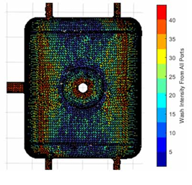
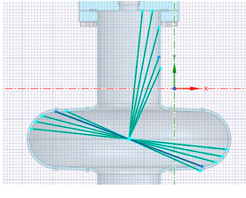
CONCLUSION and LESSONS LEARNED
Don’t only rely on your experience, check at least surface coverage of HPR during design phase ! This could lead to creation of dedicated ports to ease cleaning.
Pay attention to stagnating water in end walls. Water should escape immediately to ensure efficient particles removal
Real HPR is always less efficient than expected : take into consideration angle to wall, distance to nozzle, divergence of water jet and flowing water! Nice study done at Fermilab by Vijay Chouhan (TTC 2022 Aomori).
In complex geometries, optimization of HPR requires simulation tools. Some people already worked :
IJCLab : Patricia Duchesne : 3D, geometry : this presentation.
FNAL : Mattia Parise : 3D, geometry, efficiency (angle)
FNAL : Vijay Chouhan : 2D, geometry, efficiency (angle, rinsing time) : TTC High Q High G : link to pdf
FRIB : Blake Gower : 3D, geometry, efficiency (angle, distance, …) : this TTC-WG3 and SRF2023 : link to pdf
V. Chouhan, TTC High Q High G, May 2022
B. Gower, SRF2023, June 2023

Slide 17
THANK YOU FOR YOUR ATTENTION
Would like to thank all contributors :
@ IJCLab : Patricia Duchesne and all technicians of cryogenic group and SUPRATECH platform
@ FNAL : Mattia Parise, Donato Passarelli, Laura Grassellino, Alex Sukhanov and all people involved in PIP-II project.

Slide 18
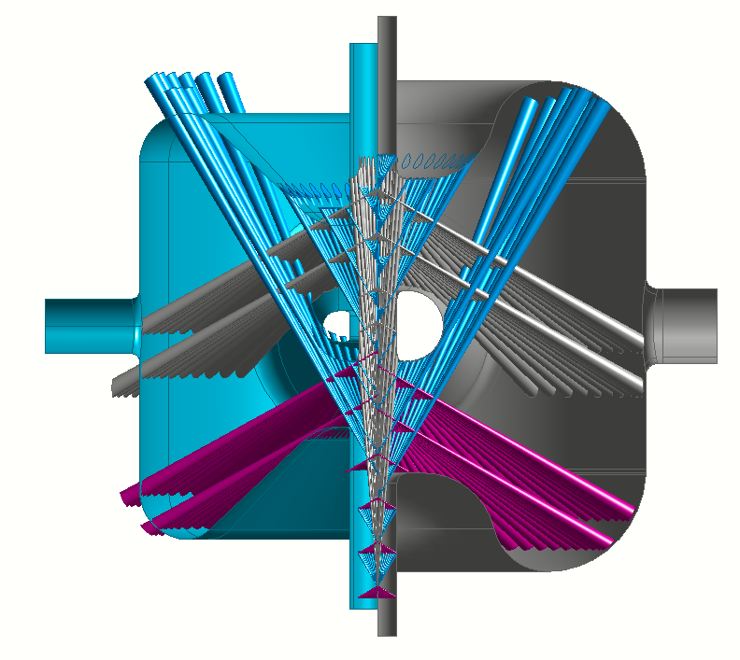
DIFFERENCE BETWEEN MYRRHA AND PIP-II
Myrrha
Local area never cleaned by 30° jets by the beam port due to the turning point
SSR2
Diverging jet
Local area probably cleaned by the 30° jets all around the circumference
Only the areas above and below the Spoke bar are rinsed for both cavities

Slide 19
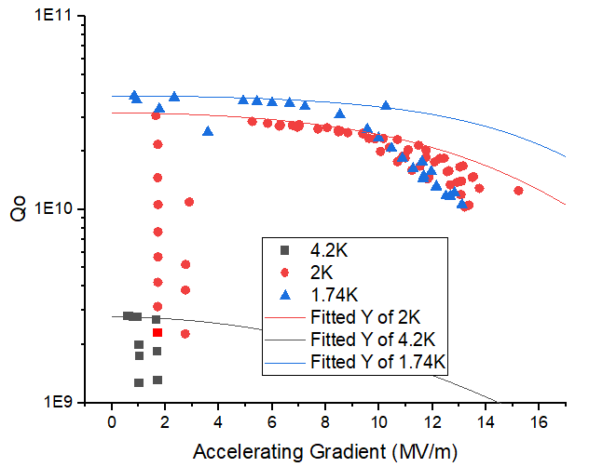
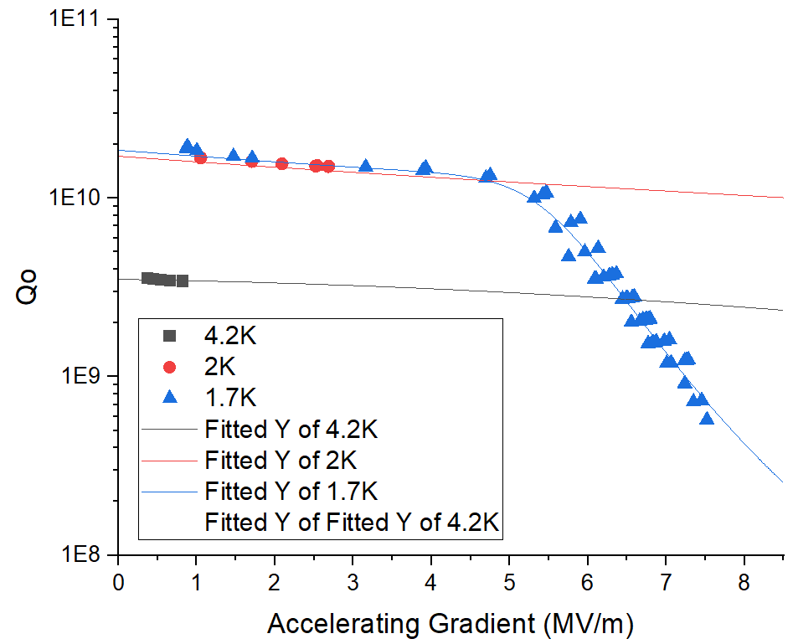
120°C BAKING
ZA03
ZA03 :
Rs (2K) = 3.75 nOhms
Rres = 2.65 nOhms
Rbcs (4K) = 39.2 nOhms
Rbcs (2K) ~ 1.1 nOhms
Baking is required for multipacting mitigation but should be limited to limit Qo degradation at 2K
ZA03 : baked 12h
Reducing the baking from 48h down to 12h didn’t change multipacting conditioning duration!
ZA01
ZA01 : baked 48h
ZA01 :
Rs (2K) = 7 nOhms
Rres = 6 nOhms
Rbcs (4K) = 26 nOhms
Rbcs (2K) ~ 1 nOhms

Slide 20
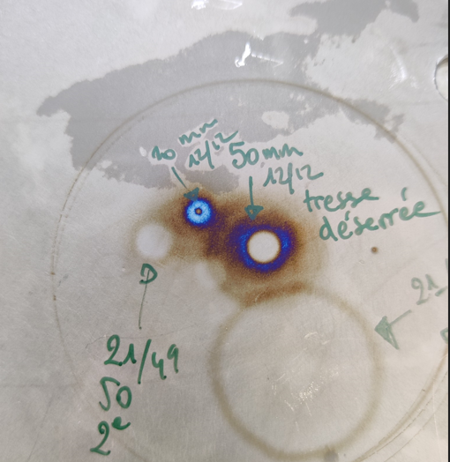
Niobium marking with HPR
Strong oxidation marks on Spoke bar due to accumulation of water impact
Does not promote field emission but should be avoided
=> Adapt HPR procedure to limit oxidation marks

