Slide 1
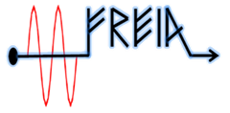



Experience of testing TEM cavities in FREIA laboratory: ESS series double-spoke cryomodules and CERN Crab cavity
Mykhailo Zhovner on behalf of FREIA team
7 Dec 2023

Slide 2
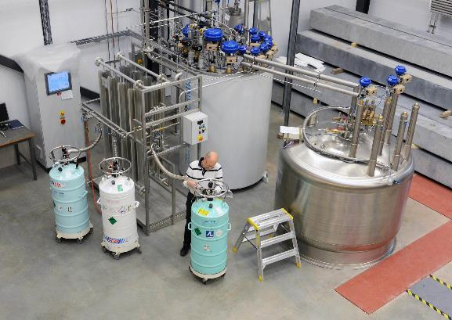
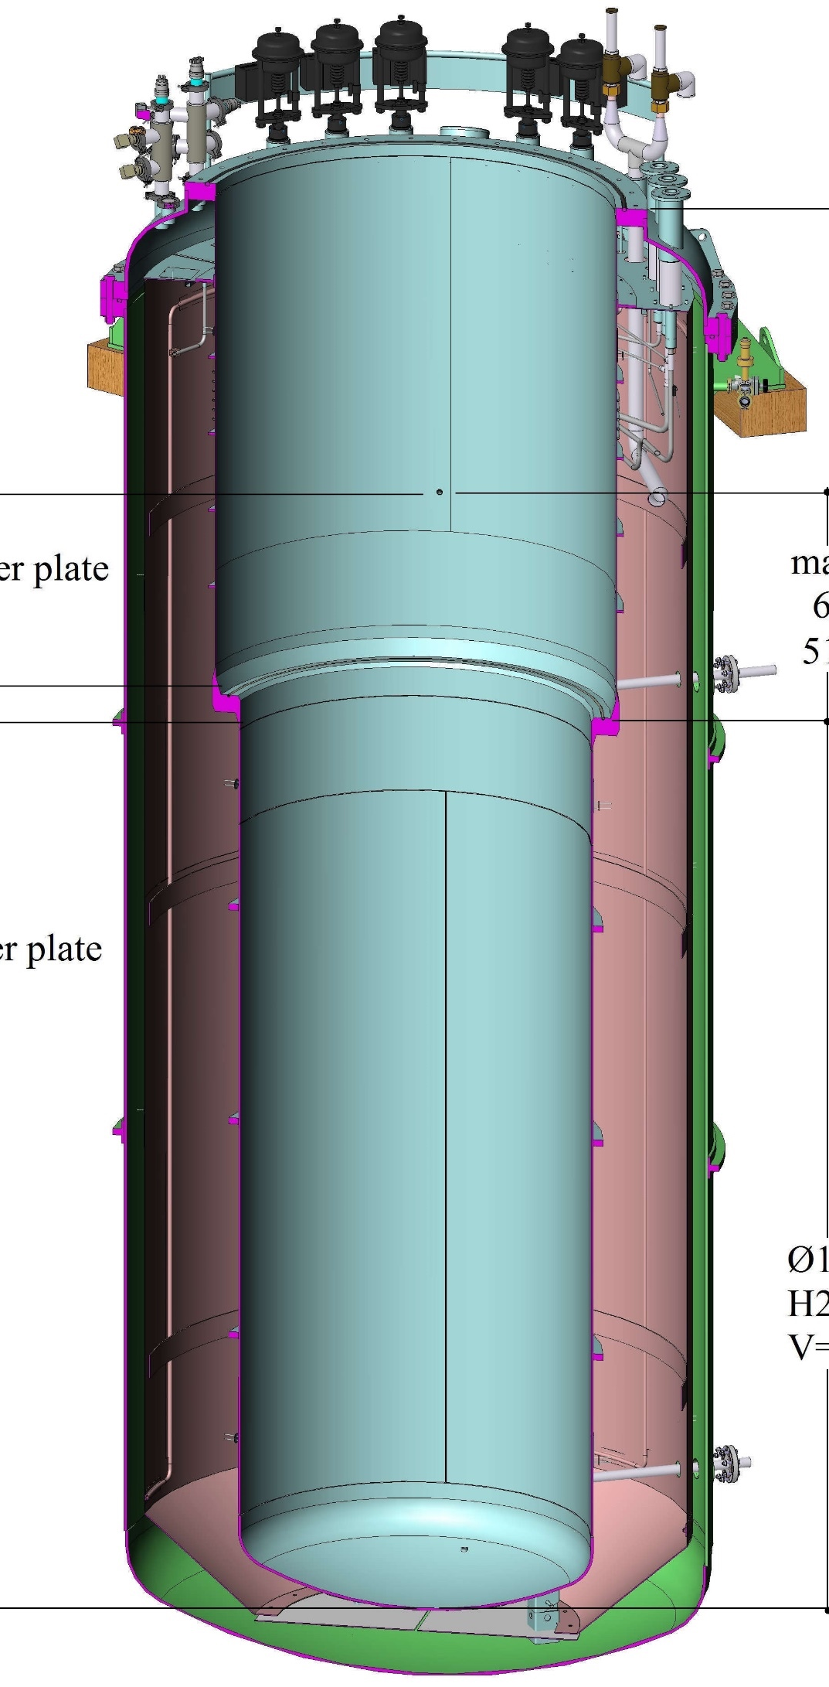
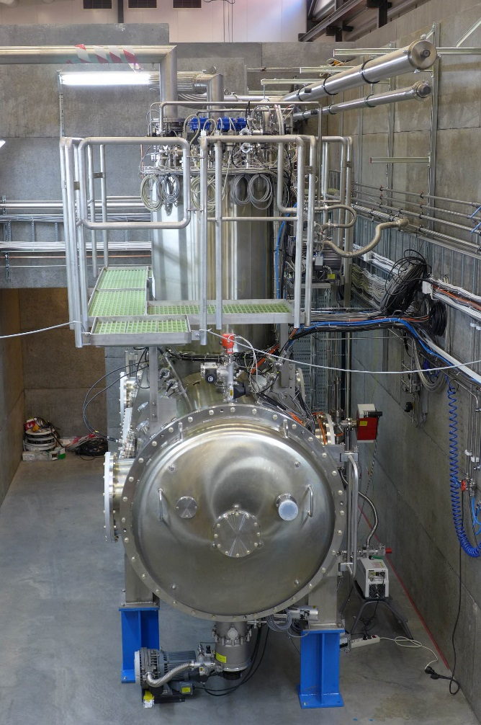
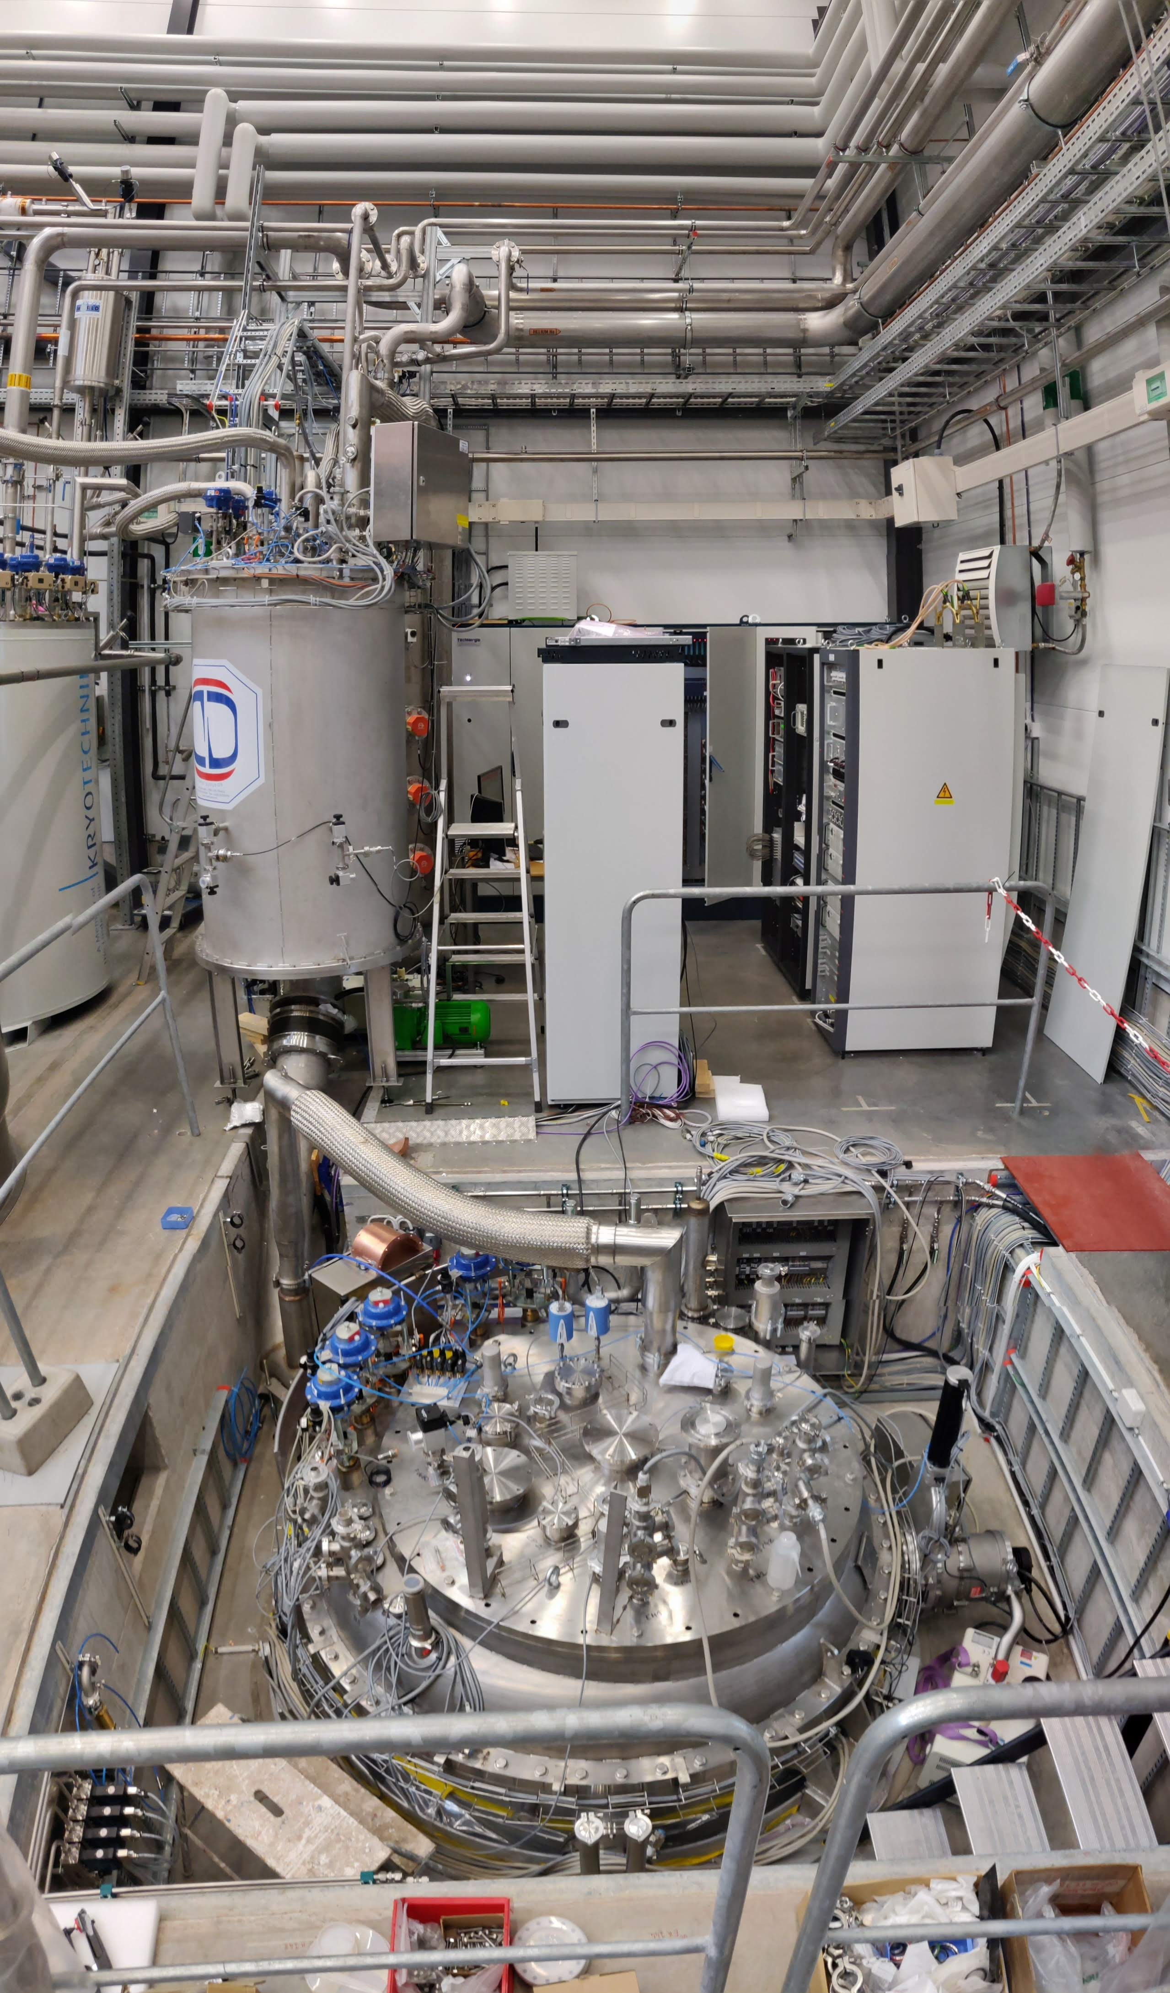
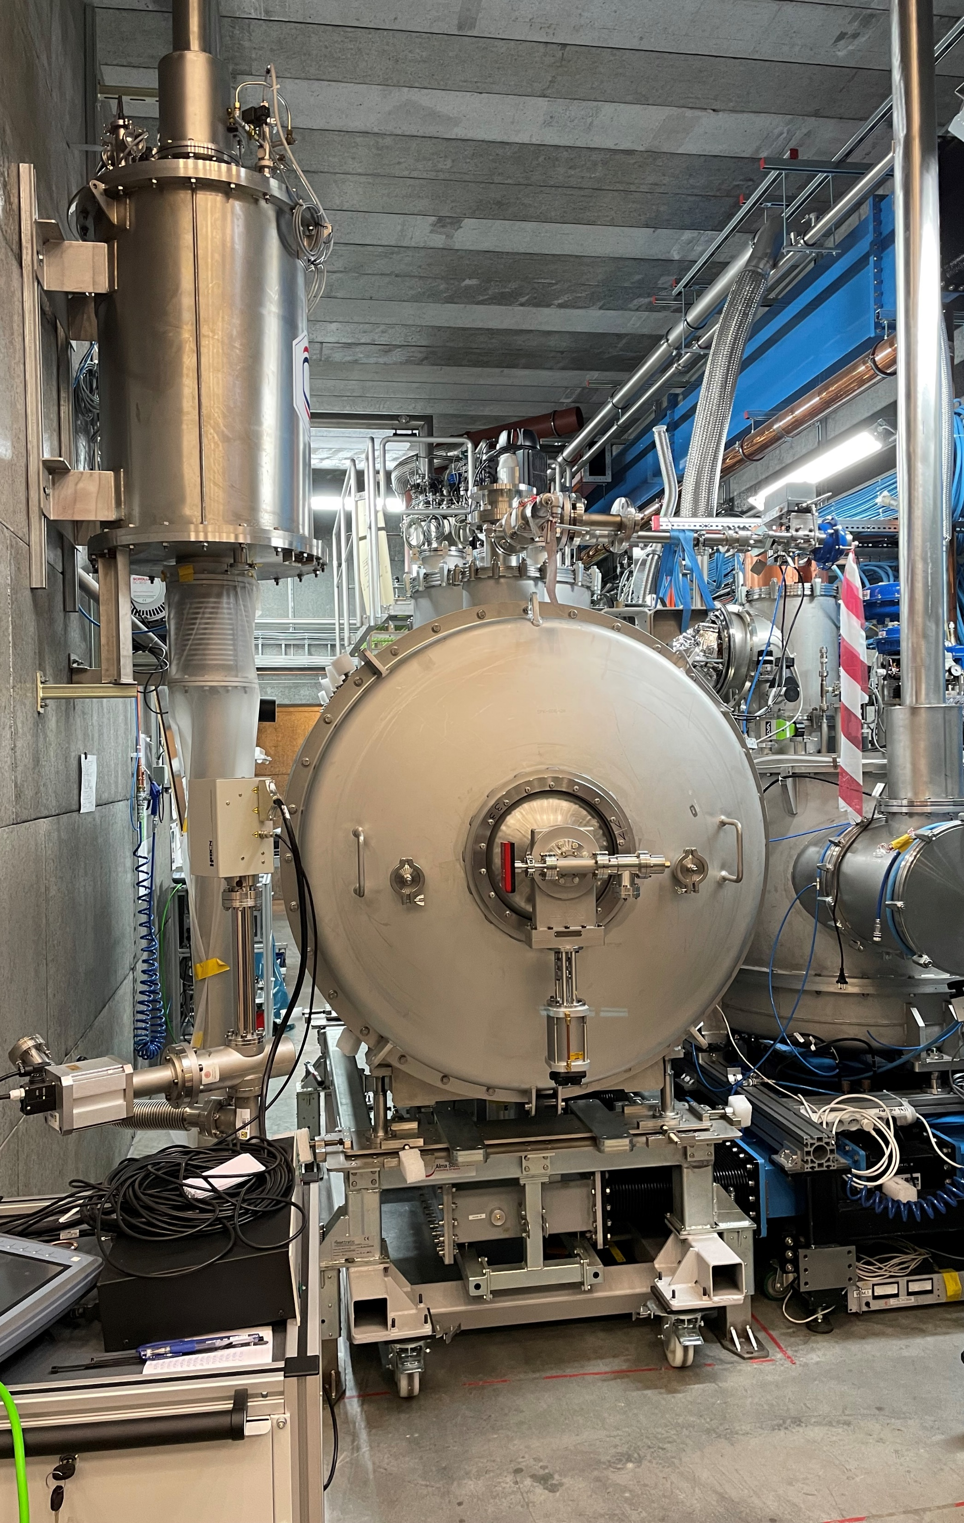
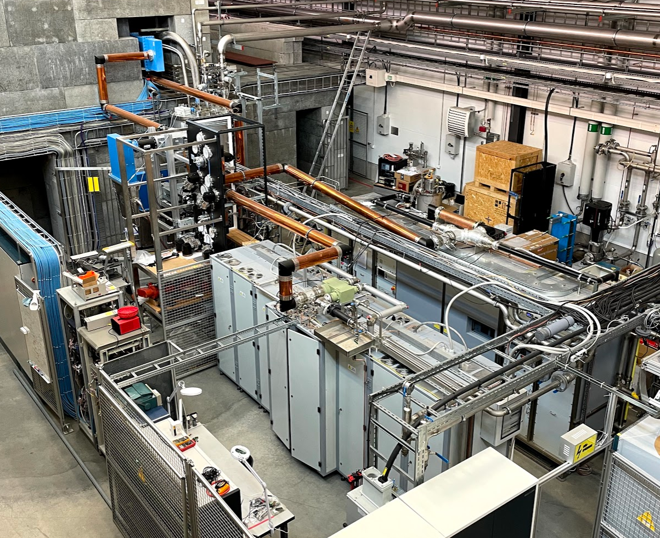
Briefly about FREIA laboratory
Çryomodule test stand
GERSEMI
HNOSS
Liquefier up to 140 l/h
High power RF plant
~ 120 l/h liquid He production
90W of continues power dissipation
Two tetrode based 352MHz 400kW pulse amplifier. Up to 16kW @ CW.
NI PXI based LLRF
Cryomodule test stand
Vertical cryostat
Horizontal cryostat
Everything needed for cryomodule (CM) + valve box (VB) installation.
Multiple bare cavity testing is available
Active magnetic field compensation.
3.2m x ø1.1m total volume
2.65m x ø1.1m below lambda plate
Inner size 3.3m x ø1.2m
For a cavity with a helium jacket
Ideal for coupler testing: FPC, HOM
Multiple cavities may be tested at the same time

Slide 3
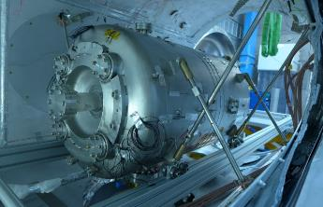
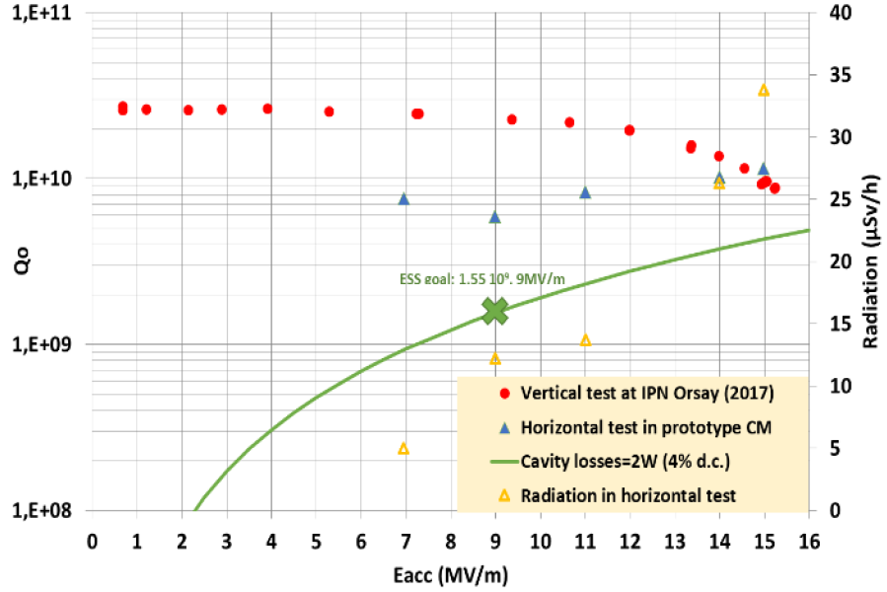
ESS prototype Medium-β Double spoke cavities
2 cavities equipped with FPC was tested.
Q factor is done by the calorimetrical method.
Both SEL and PID operation method are implemented.
The maximum gradient higher than 9 MV/m was achieved.
Cavity conditioning history

Slide 4
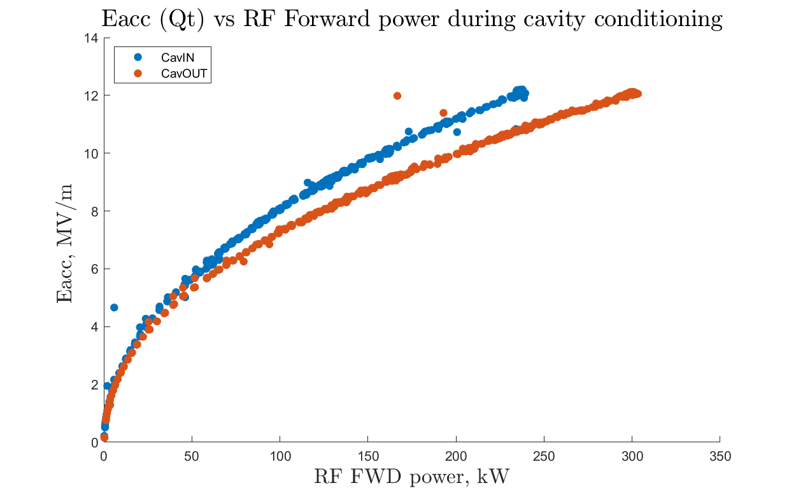
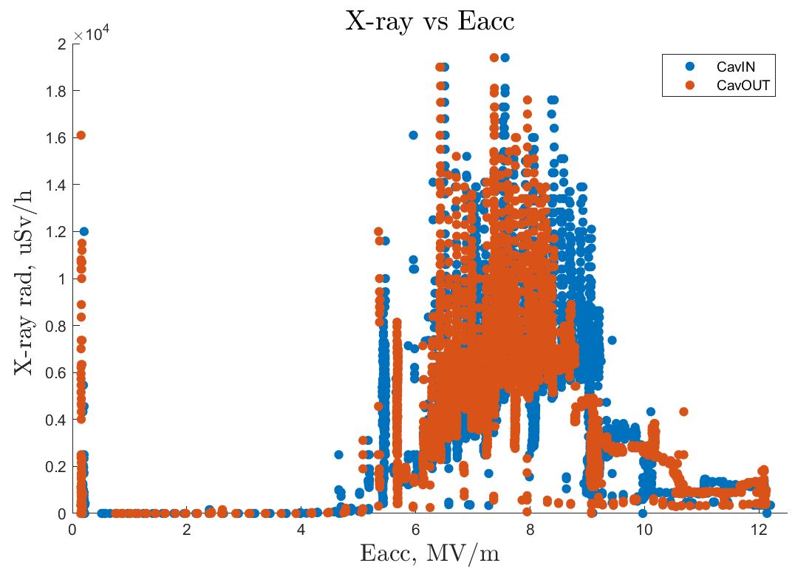
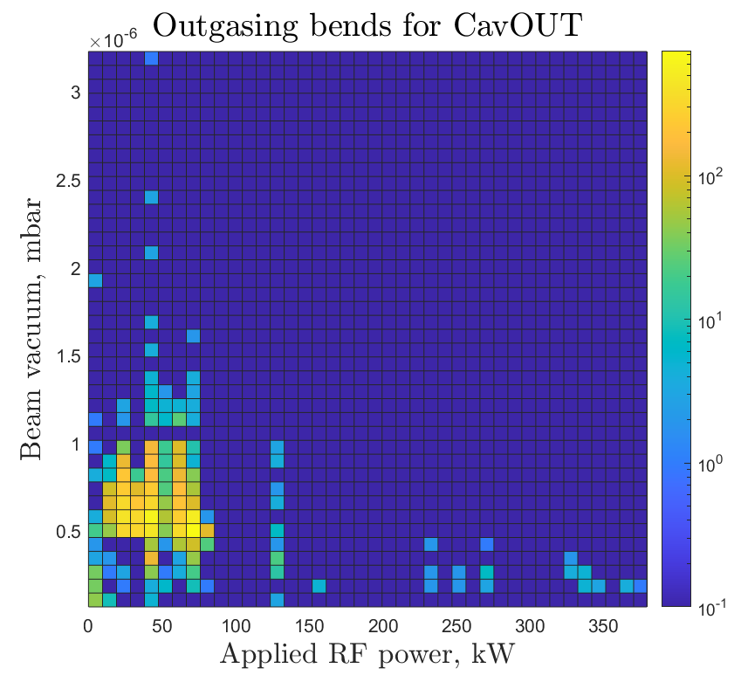
Multipacting conditioning of series CM
During cavity MP conditioning we deal with superposition MP bands from cavity and FPC.
Both MP sources have influence on the beam vacuum.
Usually, only MP from cavity generate X-ray.
5MV/m
9MV/m
Cavity
Low field
mulipacting
FPC
70 – 100 kW
Outgassing during warm FPC conditioning

Slide 5
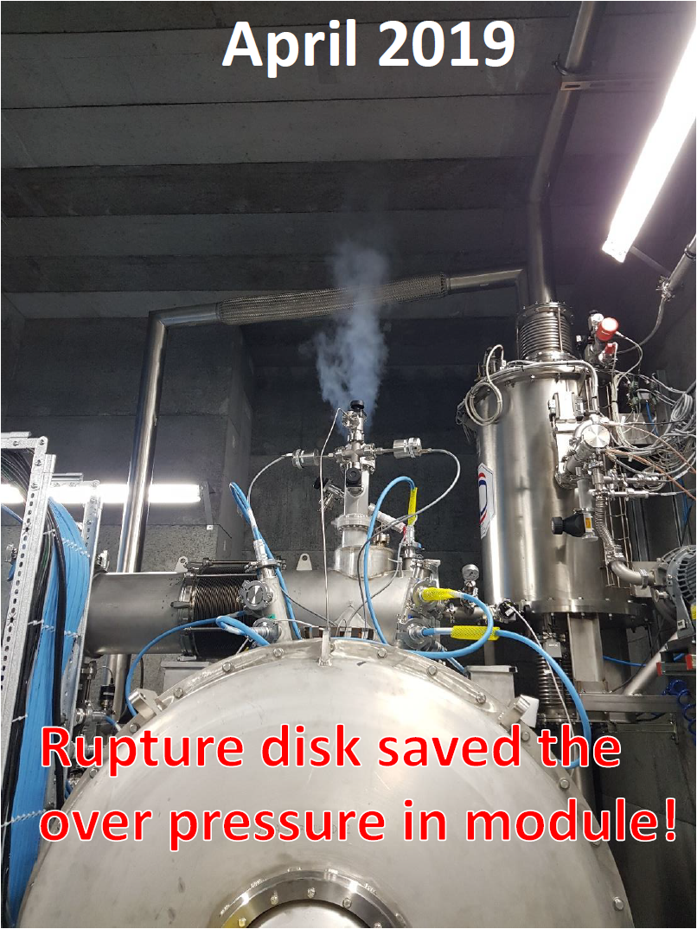
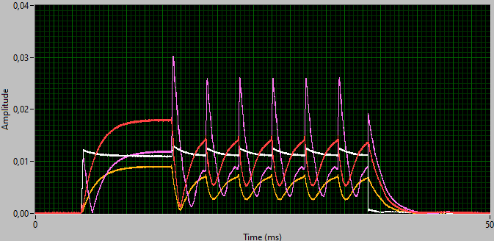
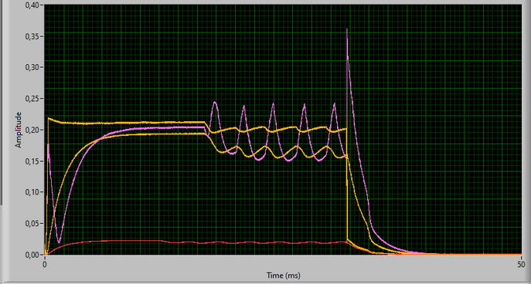
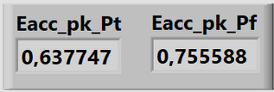

Local quench at low cavity field
Local quench & thermal feedback is ALWAYS observed at very low field in the spoke cryomodules so far
V_{f}*
V_{r}*
V_{t}*
V_{f}*
V_{r}*
V_{t}*
Low field multipacting can be easy conditioned.
Pulse operation during cavity conditioning prevent from global quench.
Small influence on cryogenic is observed.
He bathe pressure interlock should be activated from the beginning.
* - uncalibrated voltage from LLRF ADC

Slide 6
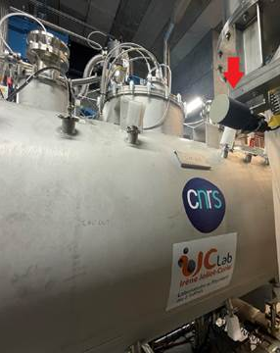
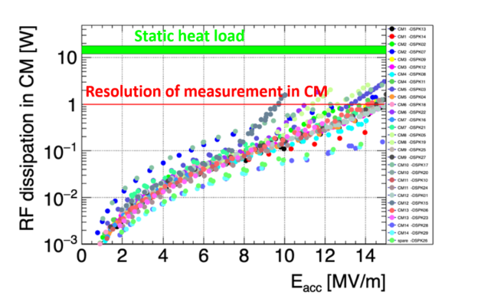
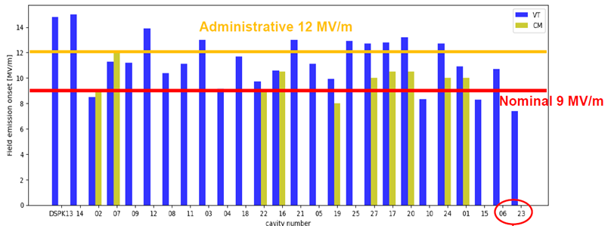
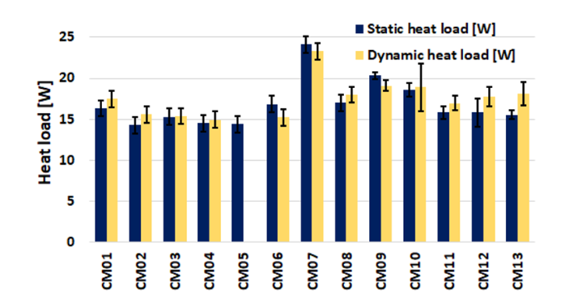
Field emission, VT vs Cryomodule. Power dissipation
Field emission onset measured from behavior of X-ray* during RF powering with reference to influents to cryogenics.
Field emission onset (DSPK#) comparison between vertical VT (IJCLab) and cryomodule CM (FREIA) tests.
30 cm
Cav2
Cav1
HPR after VT, not tested afterwards
Issue with pressure stability during the measurement.
By “historical reasons” both cavities share the same X-ray detector which placed transversal to beam axis between cavities.
Expected RF heat loss based on VT data is of the order of mW (after multipacting conditioning), which is much lower than the measurement resolution of the calorimetric method at FREIA. This indeed proves that cavity performance has not been significantly degraded after the vertical tests.
*
arXiv:2306.11333v1
Static vs Dynamic (9 MV/m both cavities) heat load

Slide 7
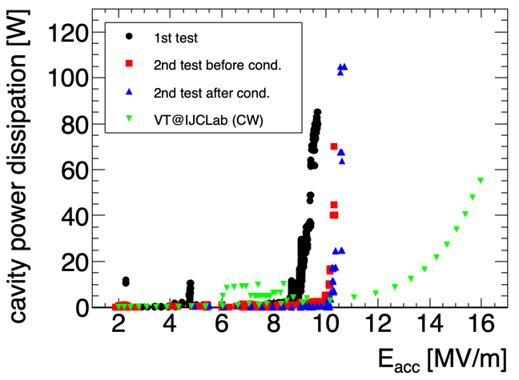
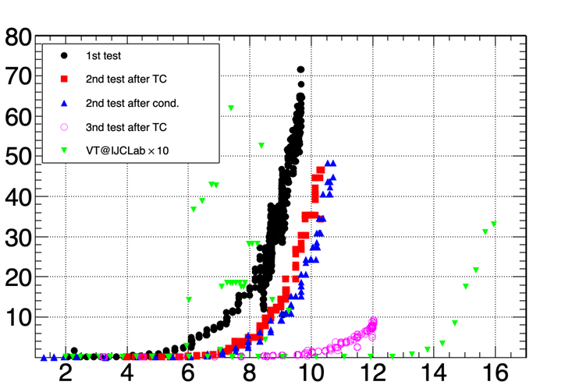
Field emission treatment
Field emission onset was degraded in CM11
The thermal cycle (Cryogenic failure) to 300K after the 1st test improved the performance.
The cavity power dissipation shows a sharp rise.
9 MV/m in the 1st test → 10MV/m in the 2nd test
RF conditioning was tried but small impact.
2nd thermal cycle helped a lot → why?
Future investigation to be continued.
FE treatment example. CM11
9MV/m
Initial test
FE onset evolution for CMs which was retested
After 1st TC*
Radiation [a.u.]
+RF condit.
VT
After 2nd TC
E_{acc} [MV/m]

Slide 8
Uncertainties, VT vs Cryomodule test stand
For E_{acc} estimation we using Q_{t} value measured at VT → official numbers
Additionally, Q_{t} estimation from integration of P_{r} after end of the pulse was implemented for last several CMs.
Visible consistent Q_{t} underestimation from VT.
Q_{t} Cav1 from VT
Q_{t} Cav2 from VT
Q_{t} Cav1 from FREIA
Q_{t} Cav2 from FREIA
E_{acc} estimation from provided Q_{t} well enough fit with some cavities features as field emission onset.

Slide 9
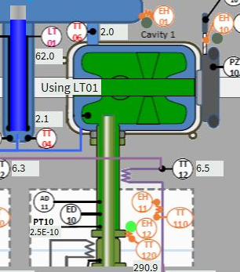
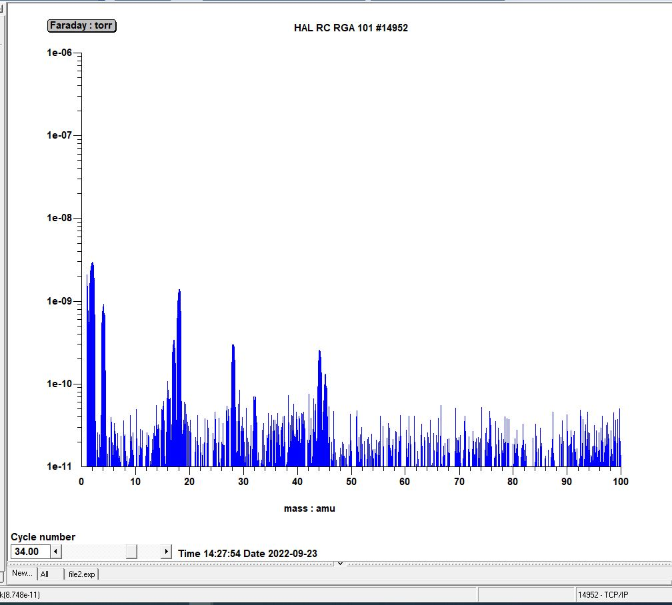
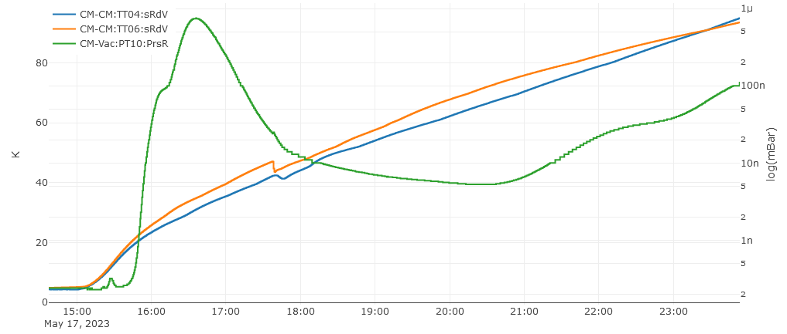
He accumulation on cavity walls
He signal often observed in beam vacuum during warmup when cavity wall temperature exceed ~10K.
RGA mass spectrum
He
Faraday: Torr
3rd
thermocycle
LR: 1.95E-7 mbar l/s
Mass: amu
4th
thermocycle
LR:2.7E-8 mbar l/s
2nd thermocycle
Cavity wall temperatures [K]
1st
thermocycle.
2K was achieved
5th
thermalcycle
LR:1.17E-7 mbar l/s
Beam vacuum [mbar]

Slide 10
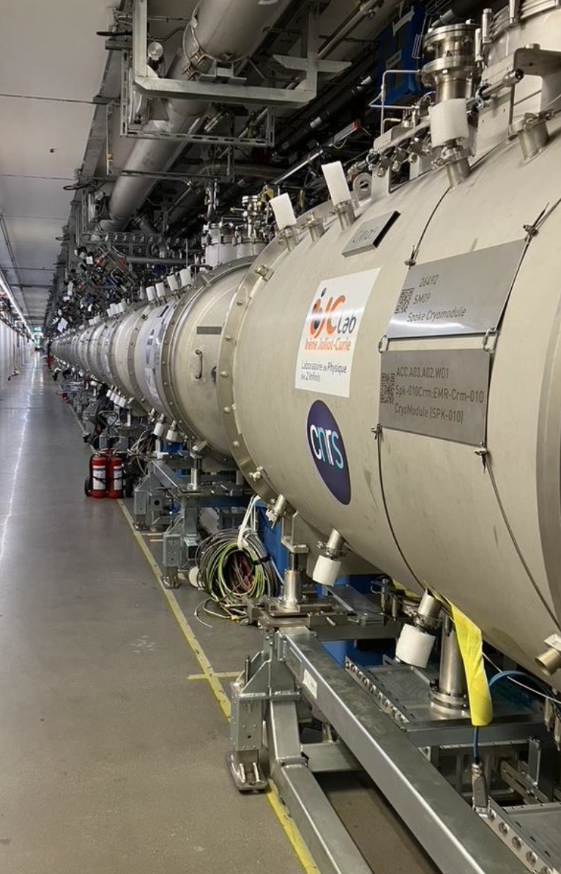
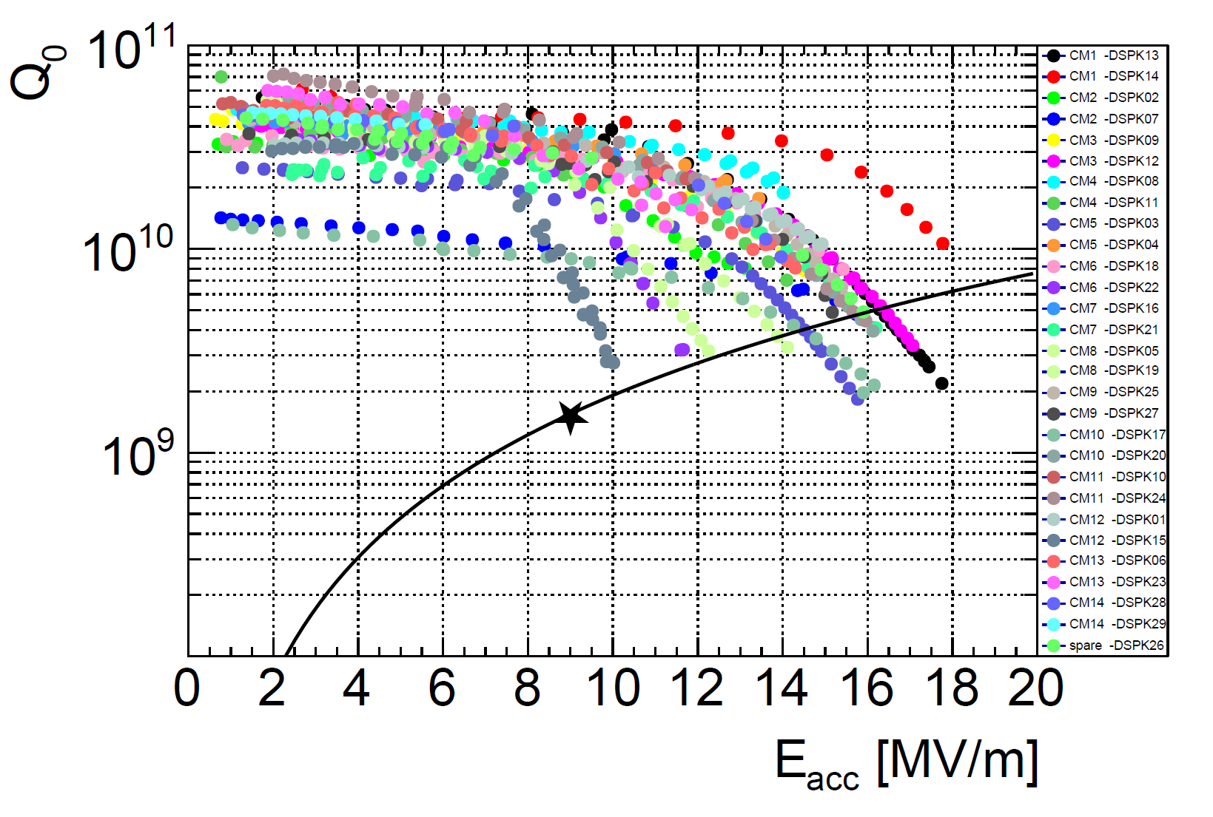
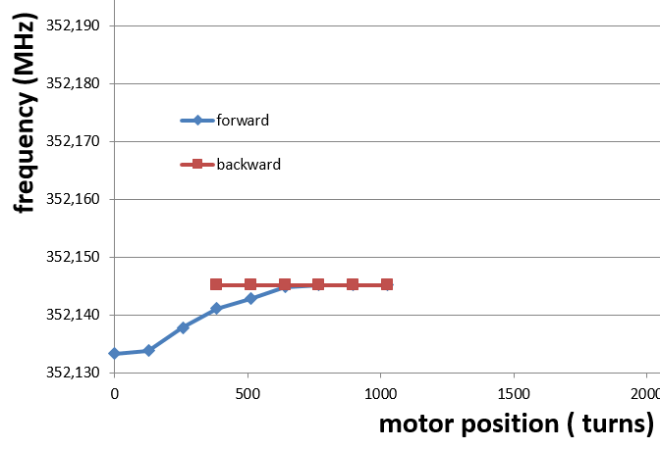
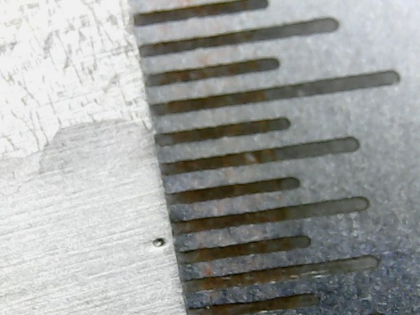
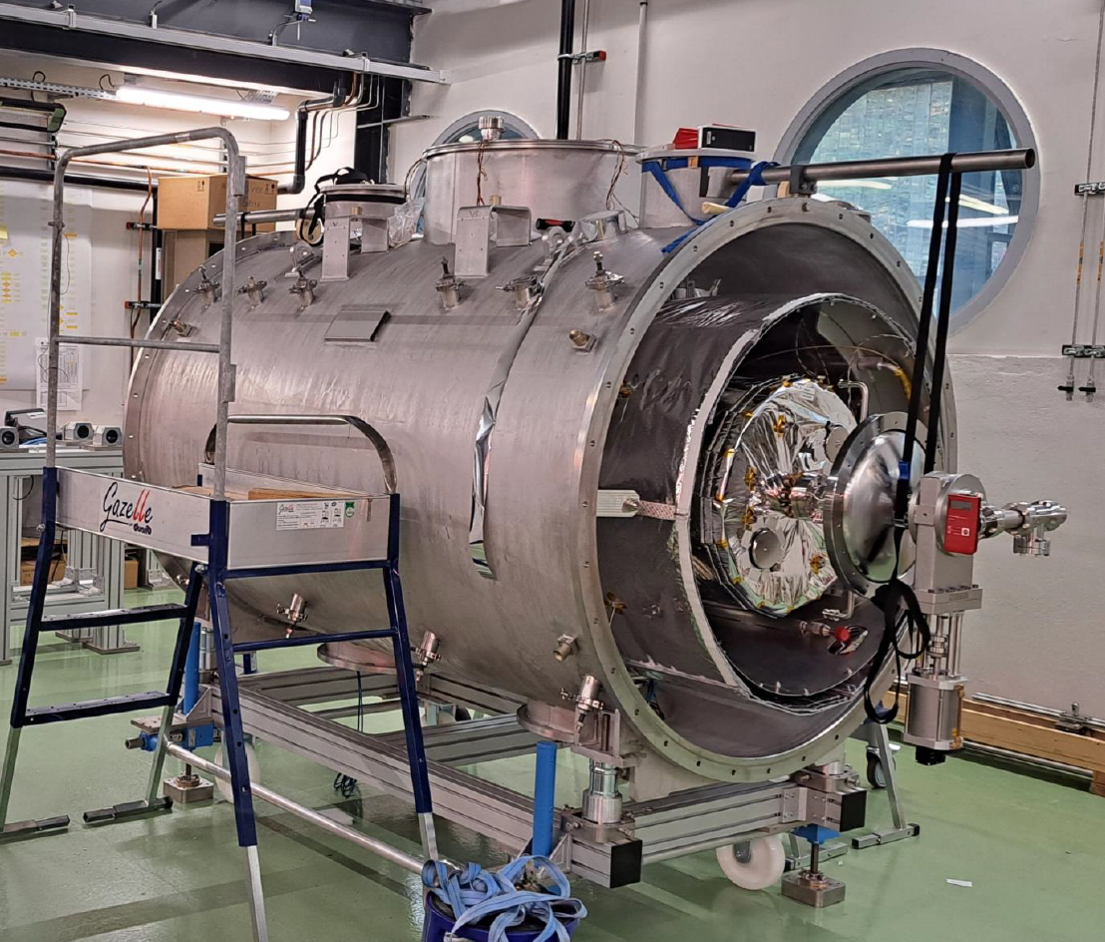
Results of CM testing
2 types of major issues cause a CM disqualification:
All 13 CM are installed in the tunnel
IJCLab
FREIA
CM02, CM03, CM04, CM10
Under ILCLab investigation
From A.Miyazaki. IJCLab
After repairing in IJCLab CMs were retested in FREIA, successfully approved and delivered to ESS.
Courtesy of IJCLab
CM04, CM09
Last, spare, CM under assembly

Slide 11
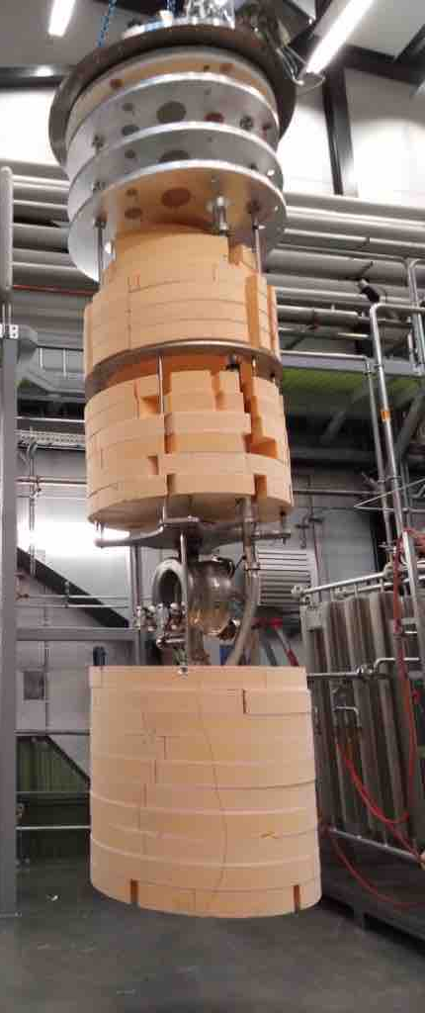
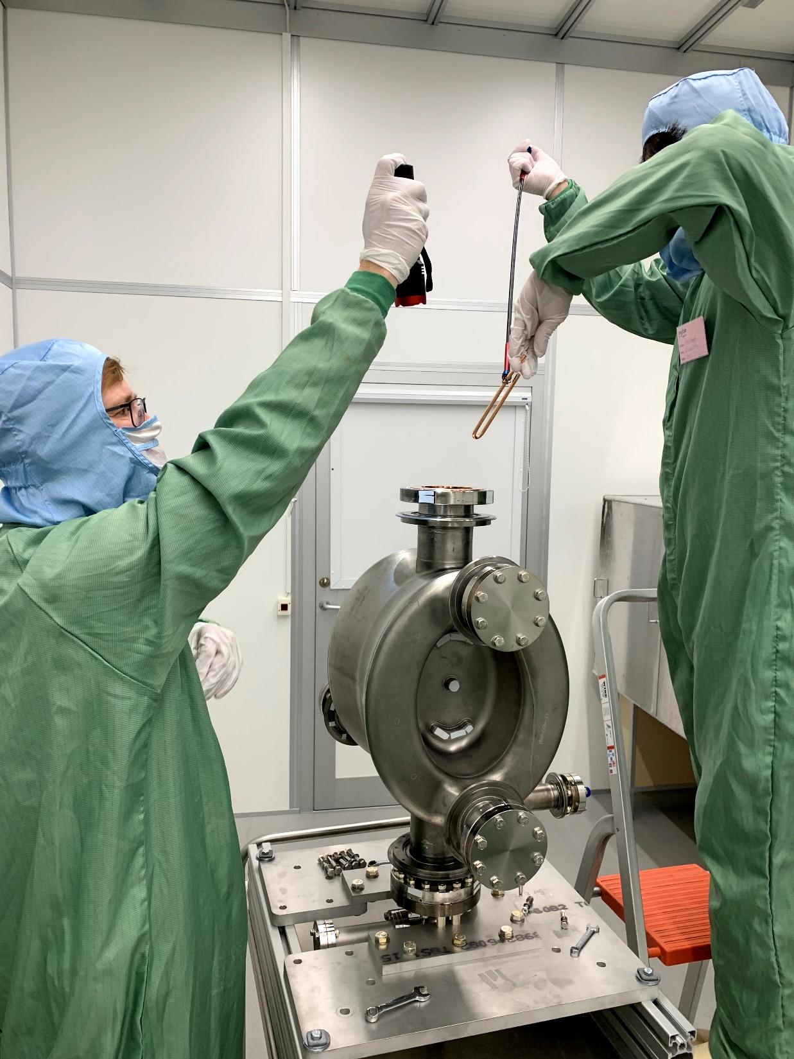
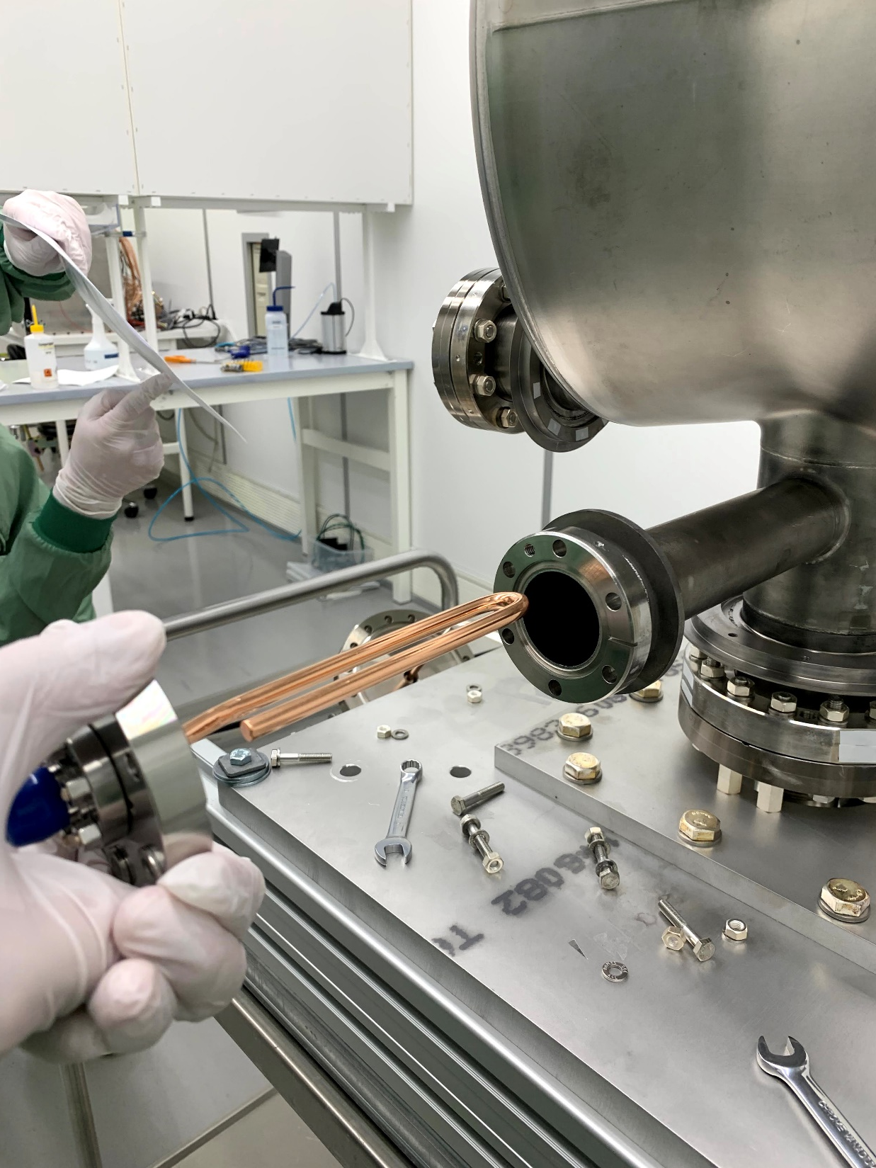
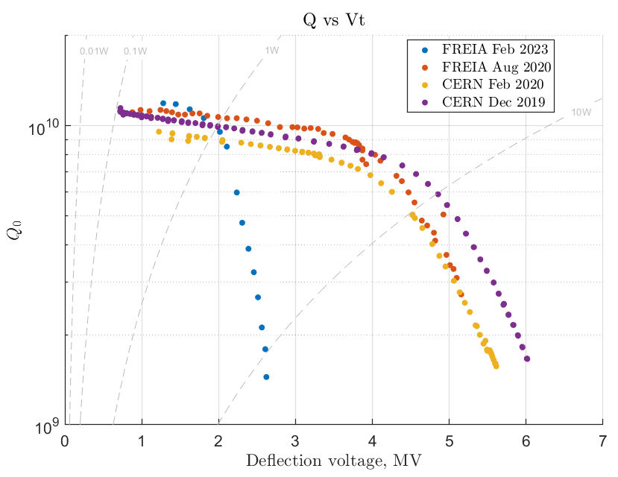
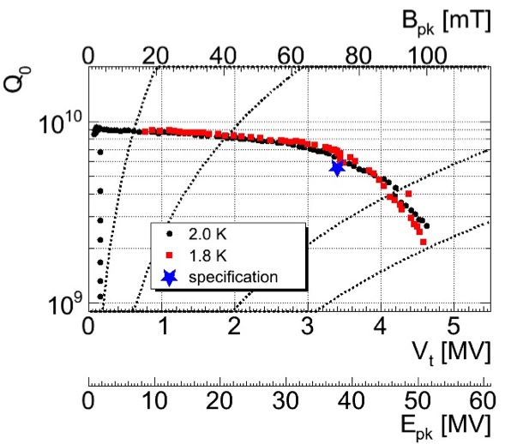
CERN DQW “Crab” prototype cavity
Was performed a series of VT at FREIA and CERN, Try to track a variation in cavity performance over the time, transportation, and multiple venting.
During reception test after cavity arrival, we didn't found HOM by VNA. Cavity was opened in clean room (Class 10), found broken antenna and attached back for VNA test.
Q vs E_{acc} 1st test
Before falling antenna
After antenna repairing + HPR
“Cryogenic” foams used to reduce liquid helium volume
arXiv:2011.05210

Slide 12
Learned lessons
From ESS double spoke cavities:
DSPC are robust, ridged and well predicted cavities.
Multipacting relatively tuff but its “field bands ” is well defined and repetitive.
It is easy to quench cavity at low field (<1MV/m), specially, during CW operation.
Low field multipacting can cause difficulties for field probe calibration in VT.
In our case, thermal cycles help a lot to treat FE.
Cold cavity walls able to accumulate He → making small cold leaks invisible during cold operation until warm up.
Having connected RGA to beam vacuum is a good practice.
Accurate Q₀ measurement in strongly over coupled case is a big challenge.
From CERN prototype Crab cavity:
Transportation of SRF cavities on long distance is not a greater idea.
Chemical treatment of cavity surface is mandatory to recover performance after mechanical interaction, like foaling down field probe.
SRF cavities do not become better with age. Clear visible performance degradation with every venting.

Slide 13
Thank you for attention!
Experience of testing TEM cavities in FREIA laboratory: ESS series double-spoke cryomodules and CERN Crab cavity

