Slide 1
Double-Spoke Cavity Cryomodule
for CSNS-Ⅱ Project
Cong Zhang, Wenzhong Zhou, Feisi He, Rui Ge, Miaofu Xu, Tongming Huang, Qiang Ma, Zhenghui Mi, Mengxu Fan, Yun Wang, Ke Zhou, Huachang Liu，Sheng Wang, Weimin Pan
(CSNS/IHEP)
2023-12-07

Slide 2
1. General Introduction To CSNS-Ⅱ
2. The Structure of DSR Cryomodule
3. The Integration of DSR Cryomodule
4. The Future Work
OUT-
LINE

Slide 3
1. General Introduction To CSNS-Ⅱ

Slide 4
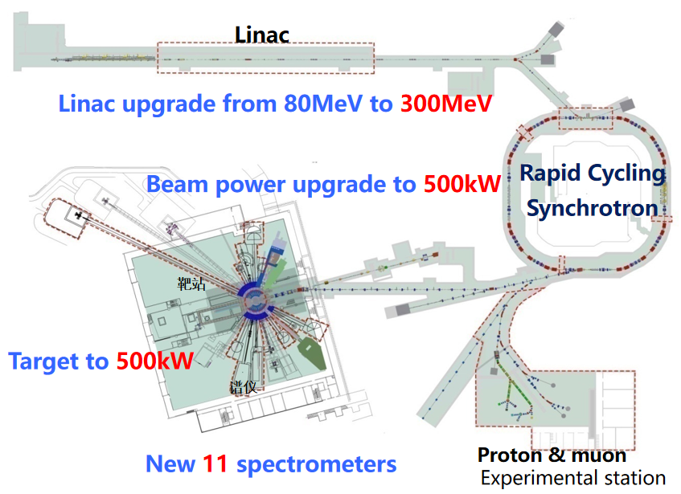
China Spallation Neutron Source II
Beam Parameters | CSNS-Ⅰ | CSNS-Ⅱ
Beam Power On Target （kW） | 100 | 500
Average Beam Current （μA） | 62.5 | 312.5
Linac Energy （MeV） | 80 | 300
Micropulse Ave Current （mA） | 15 | 40
Linac RF Frequency (MHz) | 324 | 324/648
Linac Beam Width （μS) | 400 | 600
Pulse Repetition Rate （Hz） | 25 | 25

Slide 5
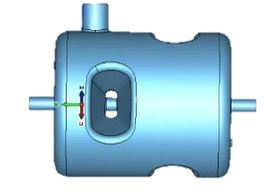
China Spallation Neutron Source II
Upgrade scheme of linear accelerator for CSNS-II
50keV
3MeV
80MeV
165MeV
300MeV
H⁻
RFQ
MEBT
DTL
Double-Spoke cavities
Elliptical cavities
LRBT
RCS
β₀=0.5
324MHz
10cryomodules
2 DSR/cryomodule
β_{g}=0.62
648MHz
8cryomodules
3cav/cryomodule
324MHz
648MHz
Х8
Х10
Double-Spoke Resonator(DSR)
6-Cell Elliptical Resonator

Slide 6
2. The Structure of DSR Cryomodule

Slide 7
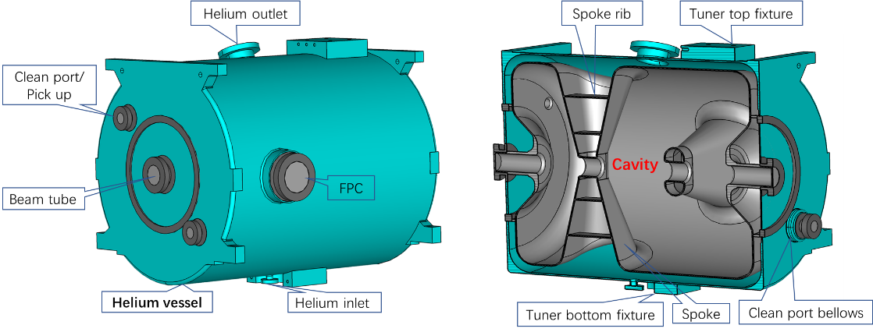
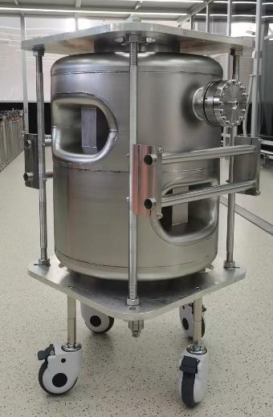
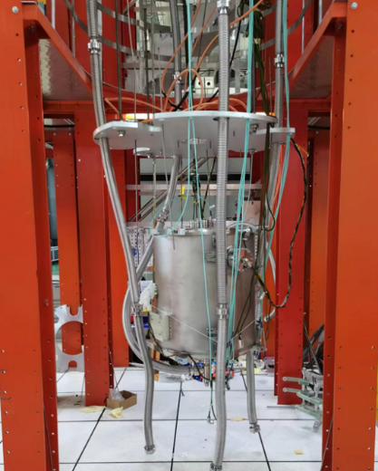
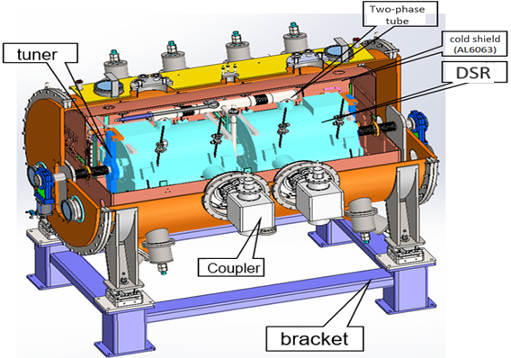
DSR Cavity and Cryomodule Look
Helium Vessel
Cavity：3.2mm/4.2mm RRR300 niobium sheets
Stiffening Ribs: low purity niobium
Helium Vessel: 4mm titanium sheet
Cryomodule: stainless steel
Magnetic Shielding: 1.3mm permalloy (1J79)
Naked DSR
DSR With Vessel
Cryomodule

Slide 8
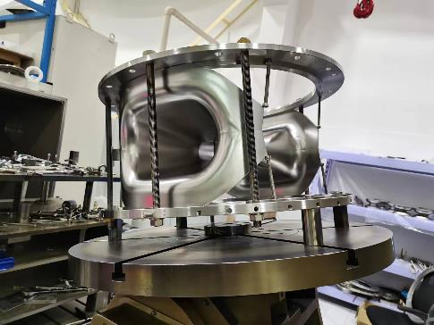
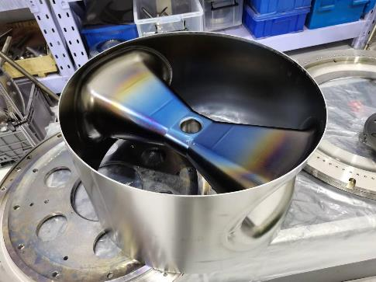
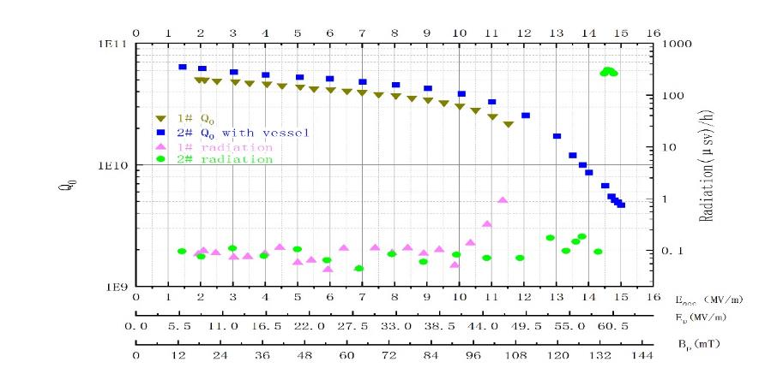
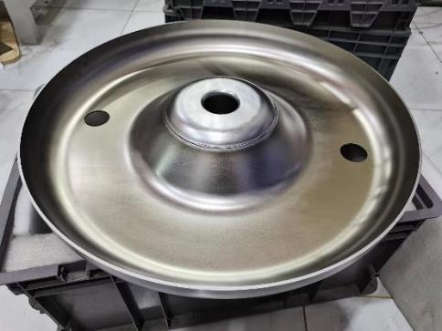
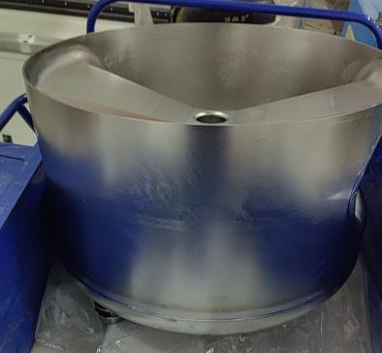
DSR Cavity Fabrication and Test
rinsing port added on the end covers
separate welding process
#1 cavity: E_{acc}~11.6 MV/m, Q₀~2.2E10
#2 cavity with vessel: E_{acc}~11.6 MV/m,
Q₀~4.6E10, B_{pk}~138mT, E_{pk}~61.5MV/m
Design Goal:
@ performance gradient E_{acc}=7.3 MV/m,
Q₀≥3E9 without obvious FE

Slide 9
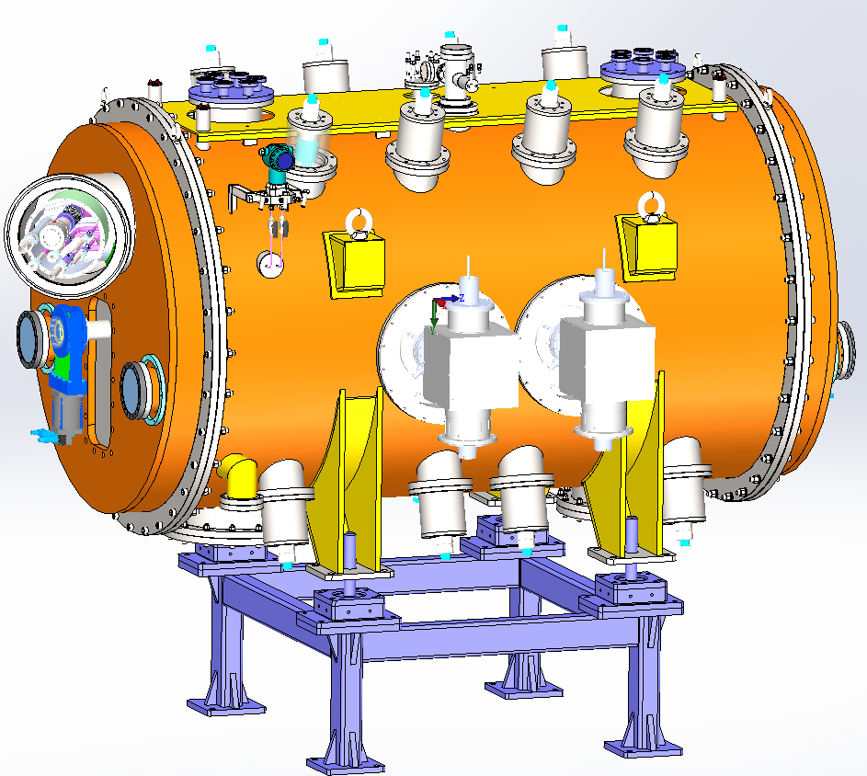
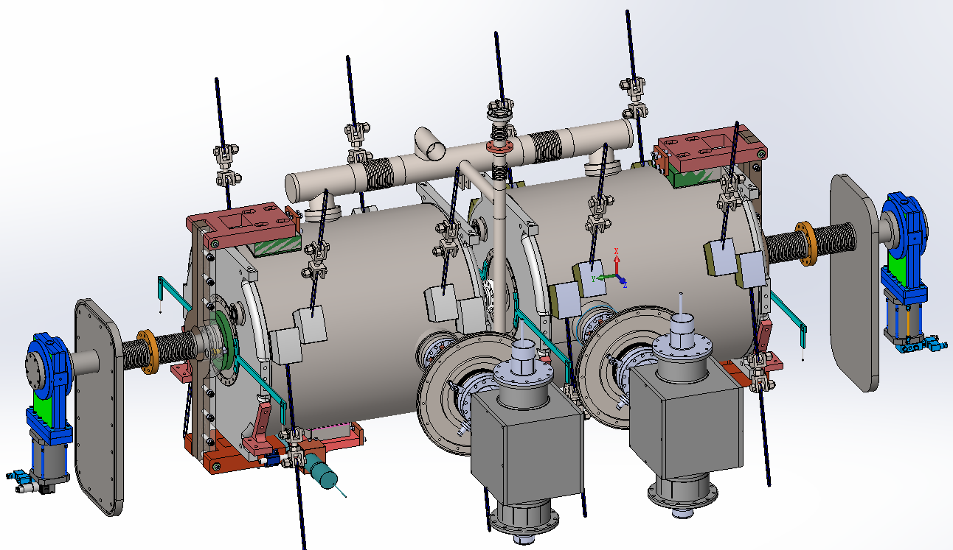
DSR Cavity Cryomodule (1)
differential pressure gauge
liquid pulsimeter installation
VAN gate valve
collimating target
beacon base
2K gas return
target base for cavity
two phase tube
tuner
7-channel cryogenic pipeline
thermal partition
deformation
monitoring target
strut for assembly
coupler
Cooling Down Process:
1.helium gas filled from bottom to precool
2. 4.2K liquid helium filled from bottom
3. specifed level achieved then to 2K
4. supplement from top by throttle valve
collimation window
tie rod bracing
pump for insulated vacuum
liquid level meter, heater, T-sensor, P-sensor

Slide 10
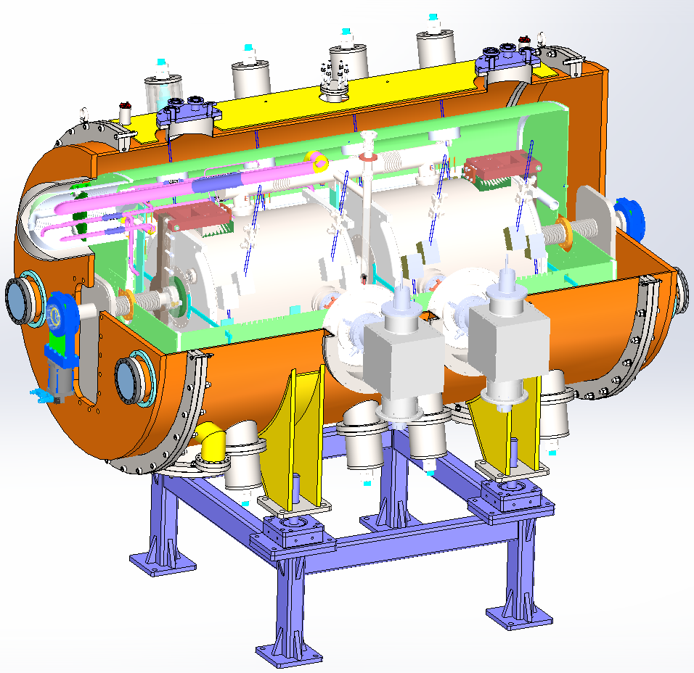
DSR Cavity Cryomodule (2)
two-phase tube
tie rod support structure applied for cavity string and cold shield to decrease heat load
single layer 60K cold shield
cavity string, coupler, tuner and beam pipe integration in clean room
non-embedded installation of liquid level meter, heater and P-sensor
base support ensure fine adjustment of 6-directions
two tuner service holes on the bottom in case of parts replacement
2K gas return
60K cold shield
tuner
coupler
tuner service hole
liquid level meter, heater, T-sensor, P-sensor

Slide 11
3. The Integration of DSR Cryomodule

Slide 12
DSR Cryomodule Assembly Procedure
cavity string in place
bottom cold shield assemby
cryogenic pipeline assemby
insulating material wrapping
tie rod assemby
transducer assemby
top cold shield assemby
aluminum fin tube welding
transducer assemby
installed into vacuum chamber
insulating material for cold shield wrapping
tie rod components assemby
cavity collimation
outside part of coupler installed
end flange installed
seven channel cryogenic pipeline installed
end cold shield installed

Slide 13
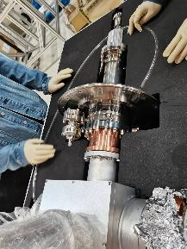
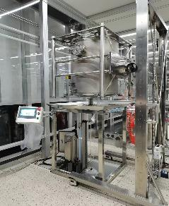
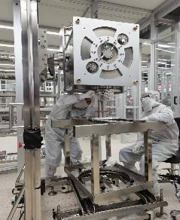
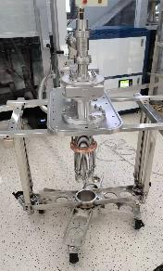
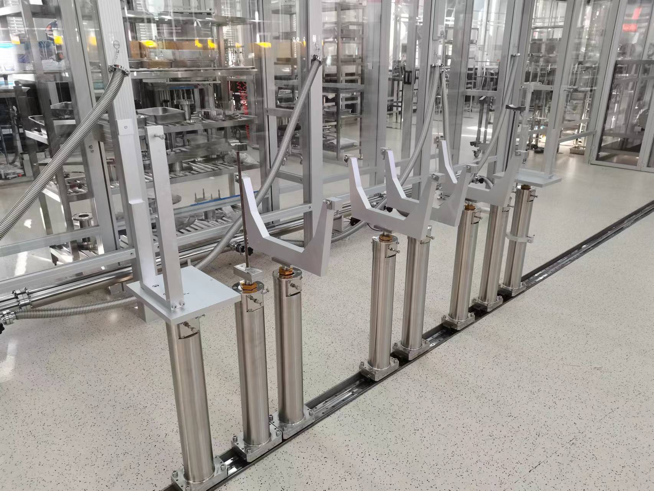
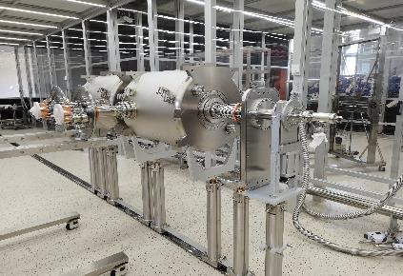
Cavity String Assembly In Clean Room
FPC Outside Clean
Vesseled Cavity HPR
FPC Mounted To Cavity
End Cover Bellow Assembly
Integration:
two DSR cavities
two FPCs
two gate valves
three bellows
in class-10 clean room
Cavity String Assembly Auxiliary
Cavity String Assembly

Slide 14
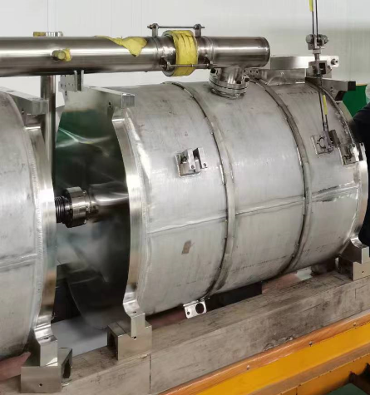
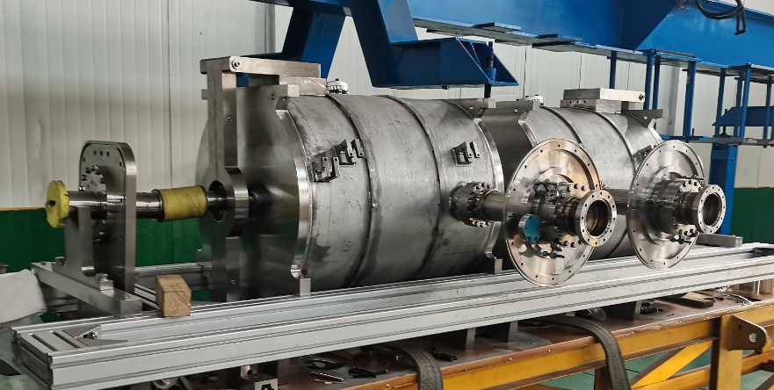
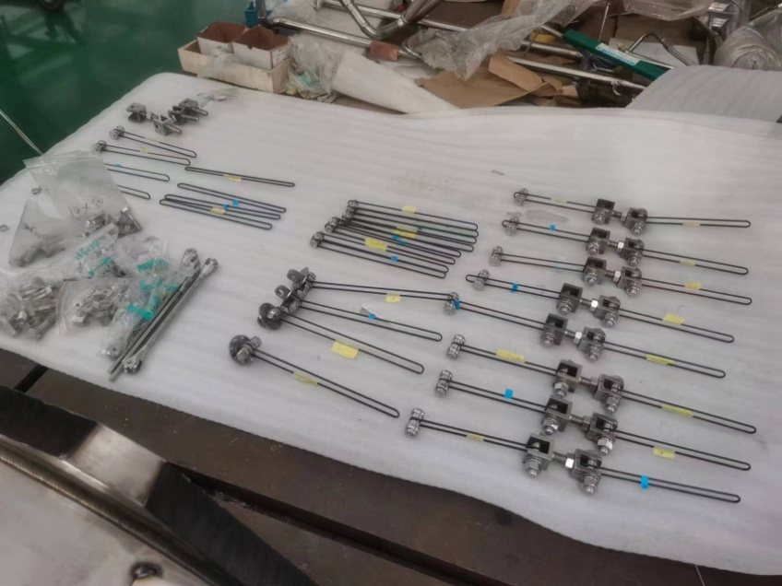
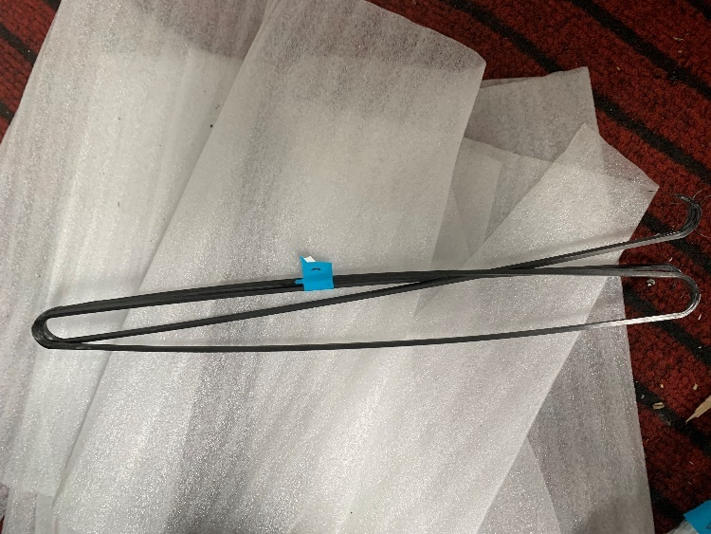
Mock Cavity Cryomodule R&D (1)
cavity string: mock cavity, two- phase tube, tie rod support
design pressure tolerance for mock cavity 2MPa, liquid nitrogen cold tested, positive pressure tested and vacuum tight tested, magnetic permeability <1.1
tie rod support: CFRP+316L(μ<1.05), strain test better than 0.8 TF at RT and better than 0.6 at LT
Cavity String
two-phase tube
Tie Rod Support
CFRP

Slide 15
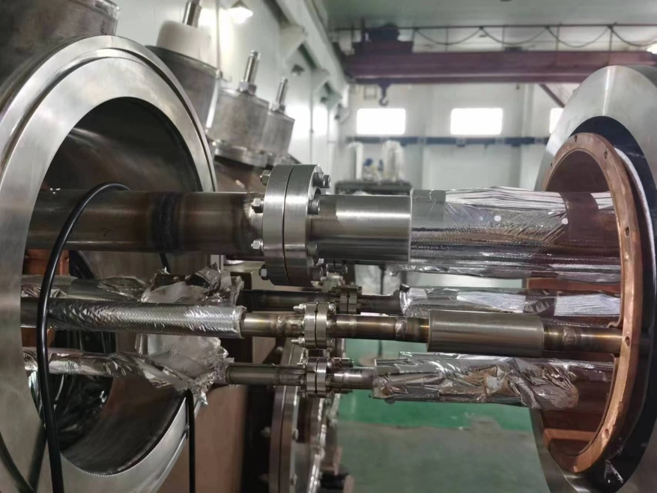
Mock Cavity Cryomodule R&D (2)
multi-channel cryogenic pipeline:
internal cryogenic transmission line, external vacuum line and cold shield included
316L, 304 seamless SS pipe, TU1OFC
G10 for support plate
liquid nitrogen cold shock test, positive pressure test and leakage test
ultrasonic clean before used

Slide 16
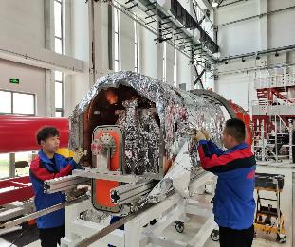
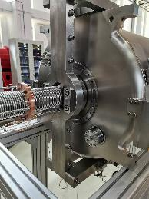
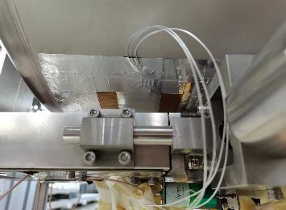
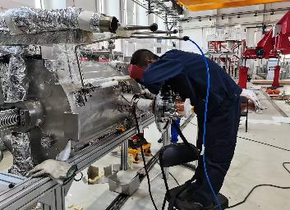
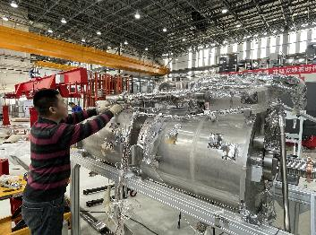
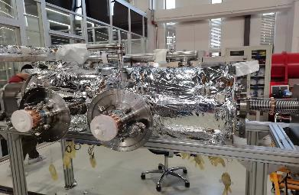
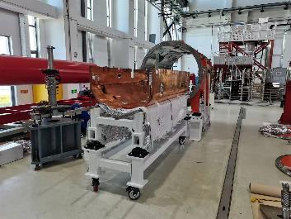
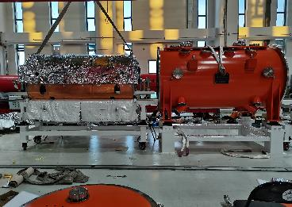
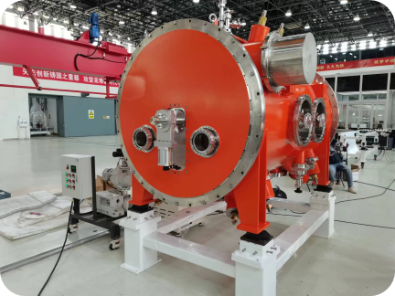
DSR Cryomodule Assembly
Mock String Removed
Tuner Installation
T-Sensor Installation
C-Pipeline Welding
M-Shielding Package
Insulation Material Package
Bottom Shielding Installation
String Into Chamber
Completion

Slide 17
4. The Future Work

Slide 18
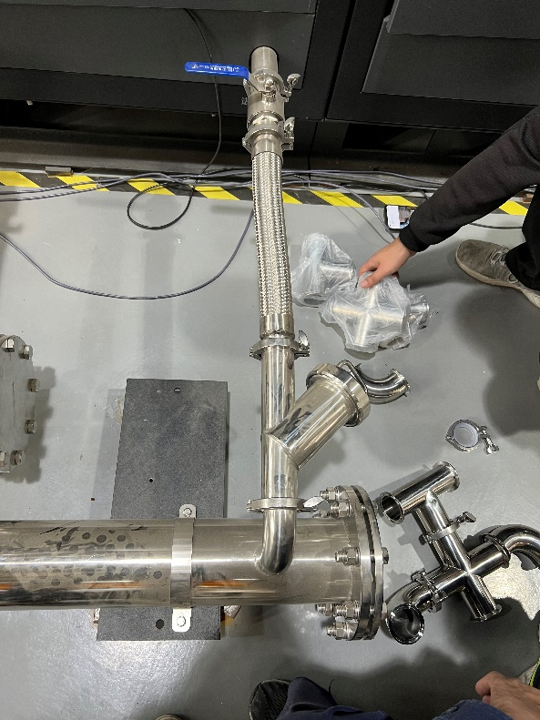
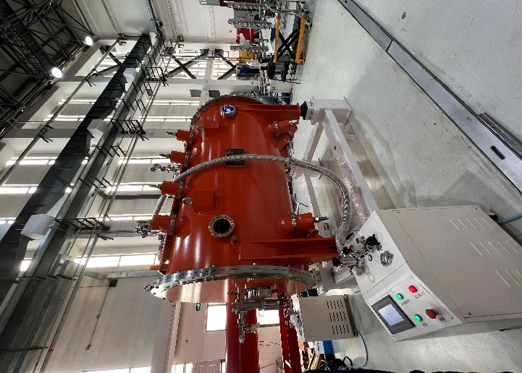
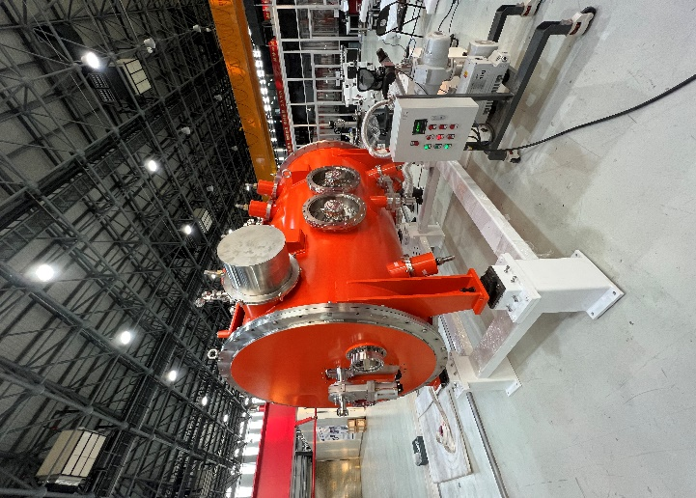
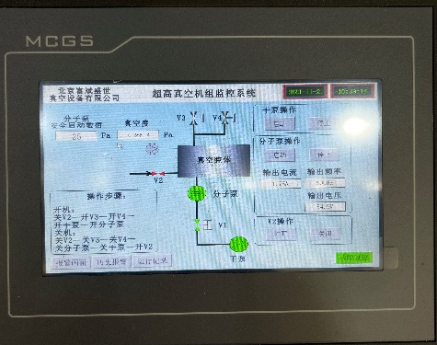
Horizontal Test Is Coming。。。
Valve box pipeline installing and valve commissioning
The solid-state amplifier under commissioning
LLRF is ready
Leak Check
Water Cooling Install

Slide 19
Thank You For Your Attentions！

