Slide 1


Hi Lumi LHC
Crab Cavity Cryomodules
Niklas Templeton
STFC Daresbury Laboratory
UK Crab Cavity Cryomodules WP Lead

Slide 2
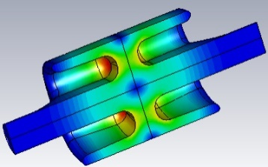
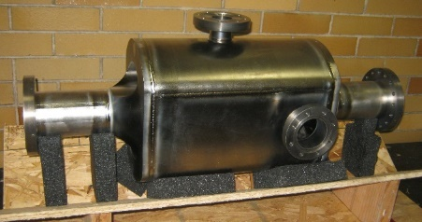
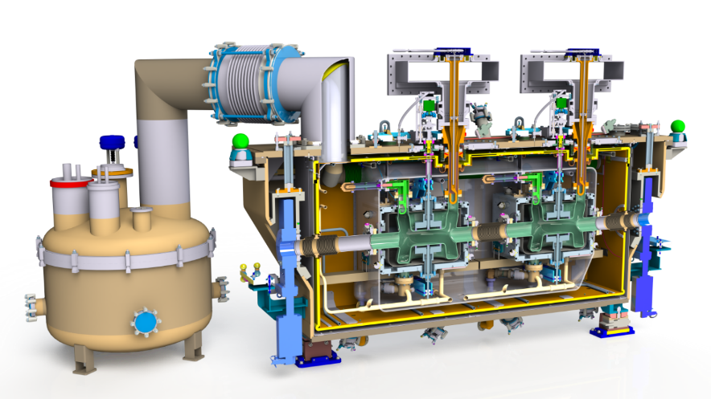
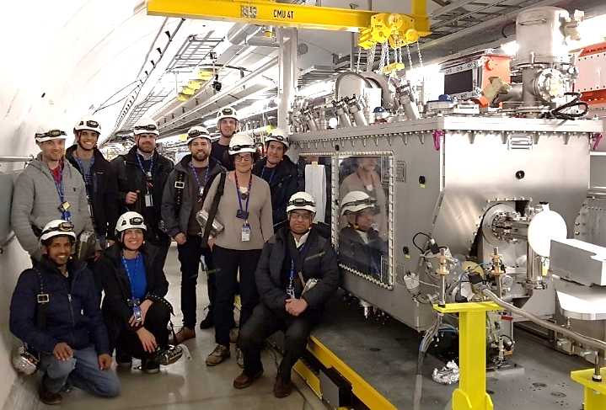
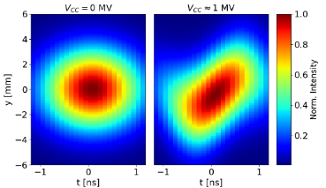
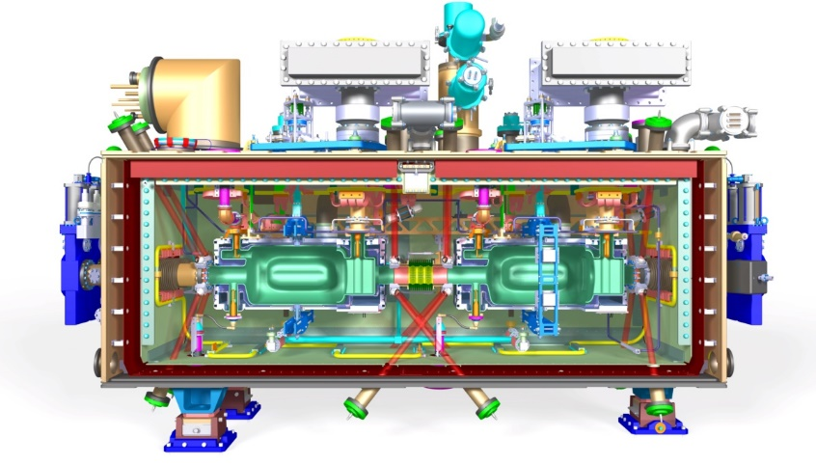
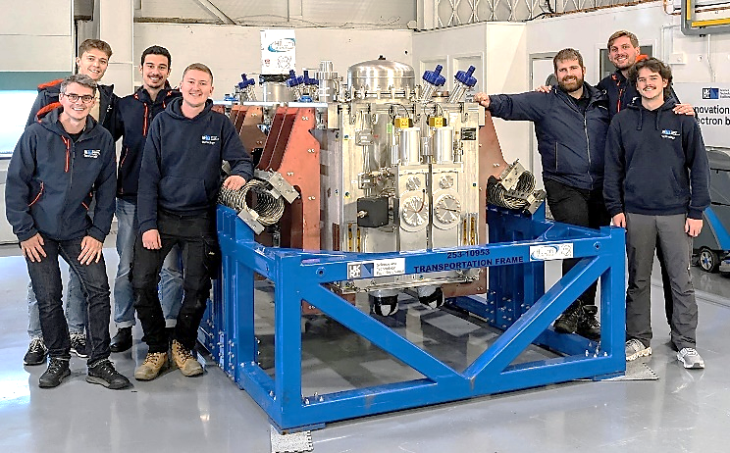
Crab Cavity Cryomodules for Hi Lumi LHC
Hi Lumi LHC Crab Cavities
Crabs Collaboration
Design Features & Innovations
RFD SPS Prototype Cryomodule Build
UK Lessons Learnt (so far)
UK 4-Rod Cavity Prototype 2012
DQW SPS Cryomodule 2018
RFD SPS Cryomodule 2023

Slide 3
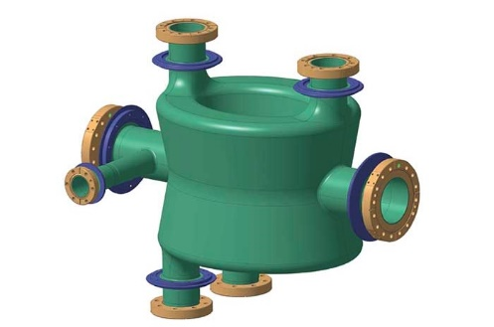
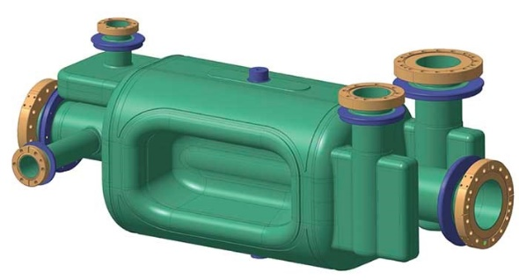
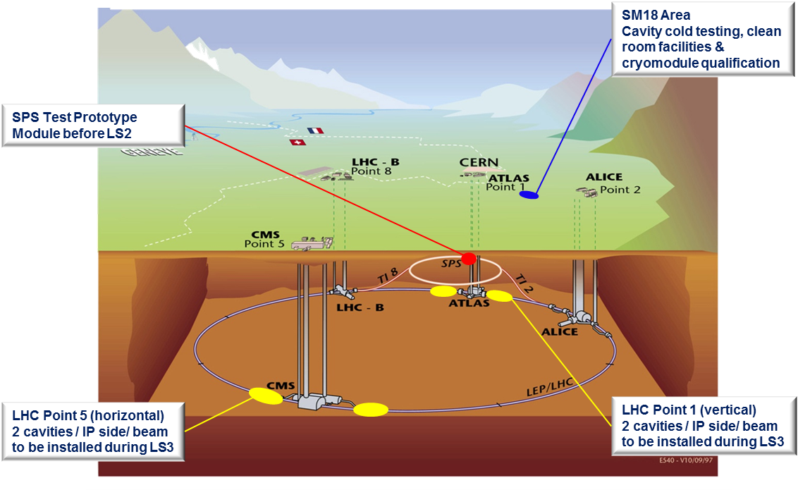
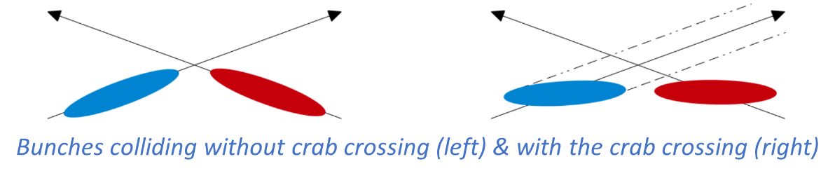
Hi Lumi LHC Crab Cavities
To maximise discovery potential of LHC by increasing rate of collisions
400 MHz crab cavities to mimic head on collision
4 cavities installed either side of Interaction Points
Double Quarter Wave (DQW) – vert. crabbing at CMS
RF design by BNL & CERN
Supplied by CERN & R.I.
Radio Frequency Dipole (RFD) – horiz. crabbing at ATLAS
RF design by ODU
Supplied by US-AUP & Zanon
DQW & RFD Crab Cavities

Slide 4
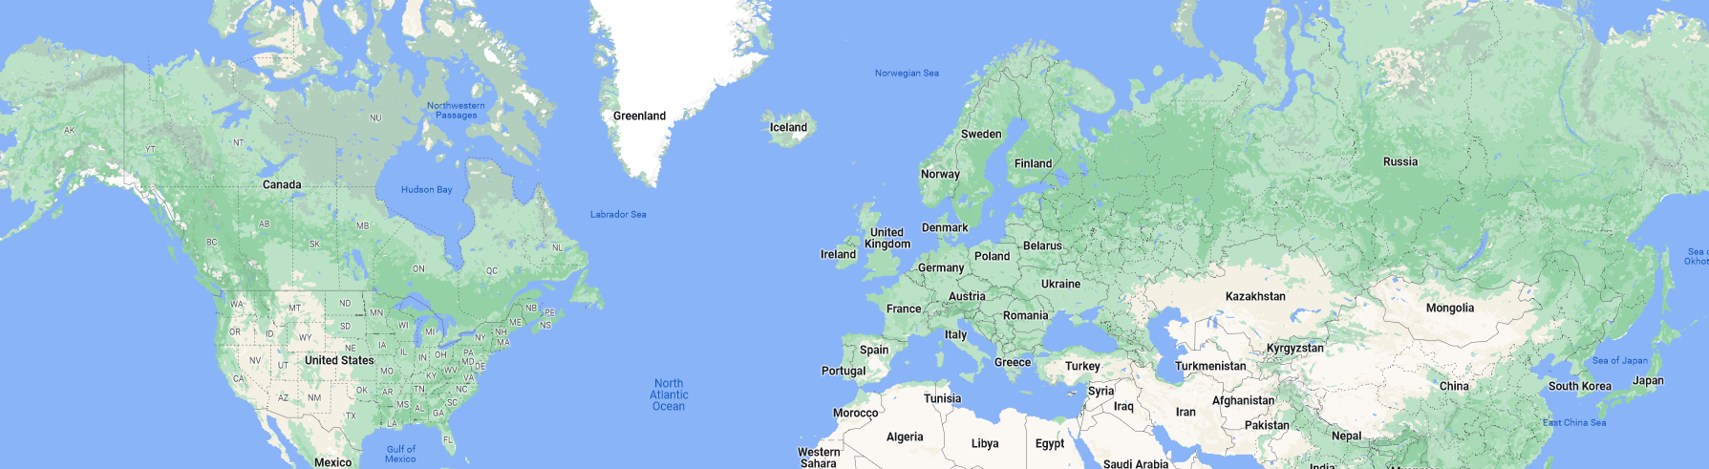
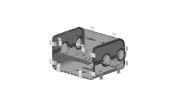
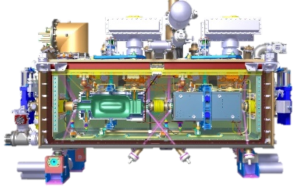
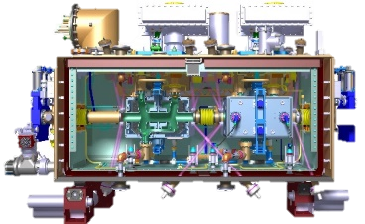
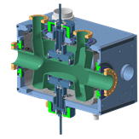
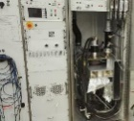
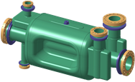
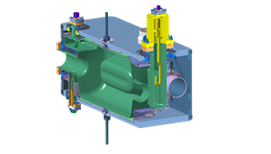
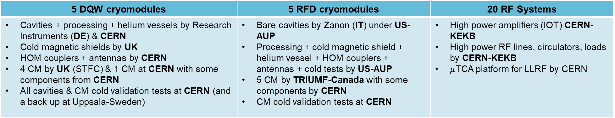
HL-LHC Crab Cavity Collaboration
Thanks to Rama Calaga
5 DQW cryomodules | 5 RFD cryomodules | 20 RF Systems
Cavities + processing + helium vessels by Research Instruments (DE) & CERN Cold magnetic shields by UK HOM couplers + antennas by CERN 4 CM by UK (STFC) & 1 CM at CERN with some components from CERN All cavities & CM cold validation tests at CERN (and a back up at Uppsala-Sweden) | Bare cavities by Zanon (IT) under US-AUP Processing + cold magnetic shield + helium vessel + HOM couplers + antennas + cold tests by US-AUP 5 CM by TRIUMF-Canada with some components by CERN CM cold validation tests at CERN | High power amplifiers (IOT) CERN-KEKB High power RF lines, circulators, loads by CERN-KEKB $μ$TCA platform for LLRF by CERN

Slide 5
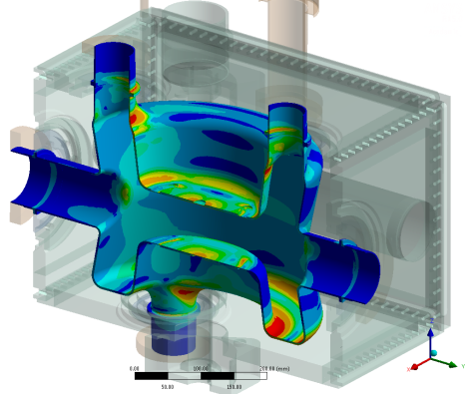
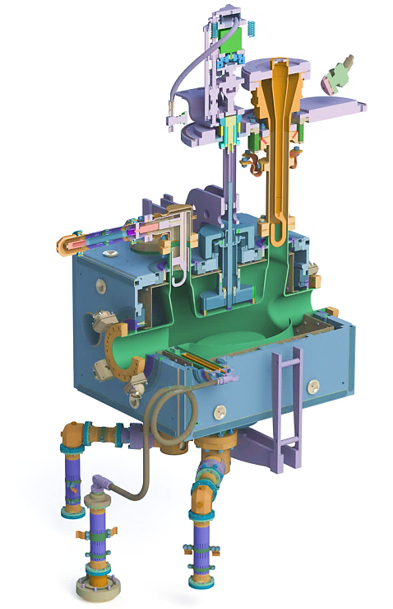
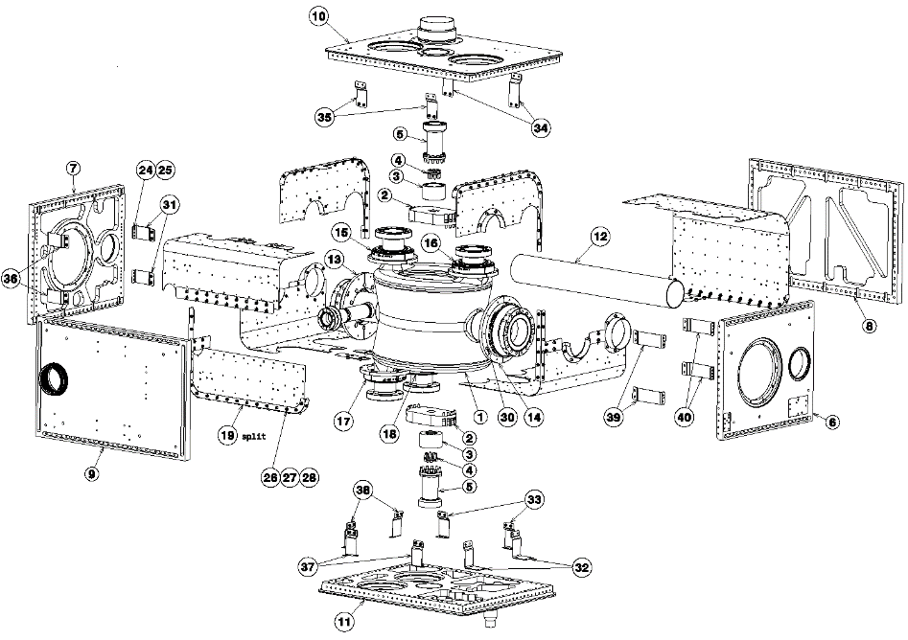
Dressed Cavity Equipped
Tuner
Fundamental Power Coupler
HOM Coupler
Bolted Ti He Tank
Inner Mag Shield
Secondary Line
Survey Targets
RF Pick-Up
Tuner Frame

Slide 6
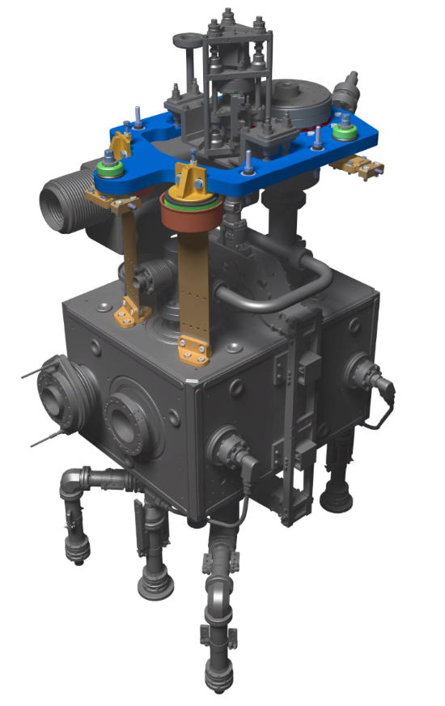
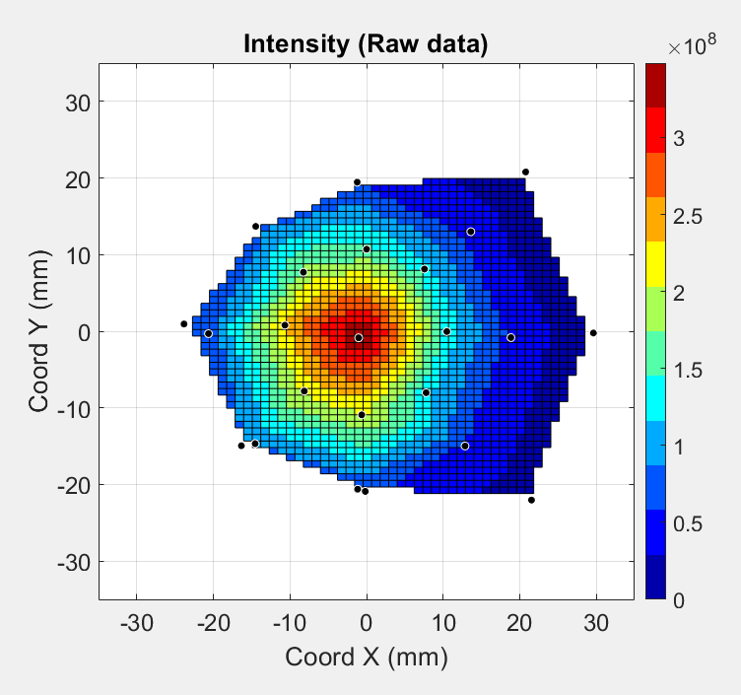
Cavity Support System
FSI Head
5-Point Kinematic Adjustment
TOP PLATE
Common Support Plate
Target
FPC Fixed Point
FSI Position Monitoring
Flexure Blades
~200kg Offset Mass

Slide 7
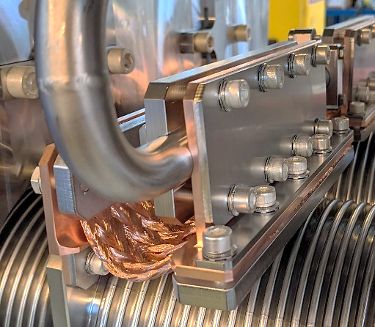
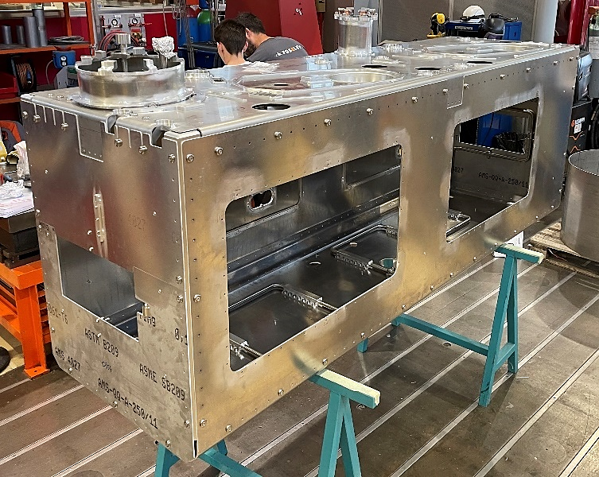
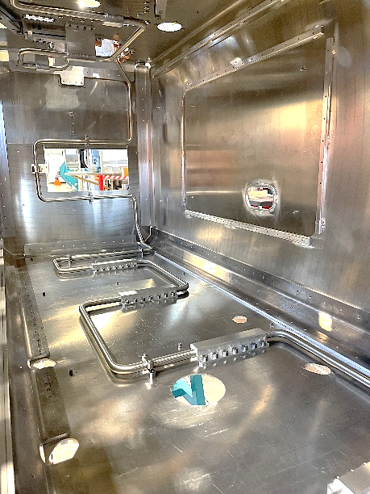
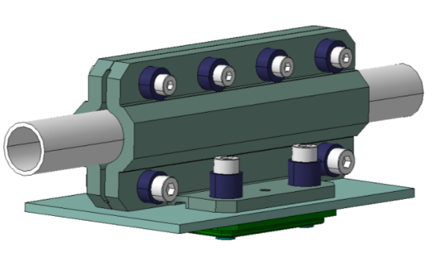
Thermal Screen
Cu Braids - Direct to Pipes
Al6061 Panels (t=2mm)
St. Steel Cryo Circuit
Al Stiffeners & Nut Plates
Al Pipe-Panel Clamps
Low Cost
Minimal Brazing/Welding
Ease of Assembly
Thermal Performance Validated
Ti Compensation Washers
Series Pipe-Panel Clamps

Slide 8
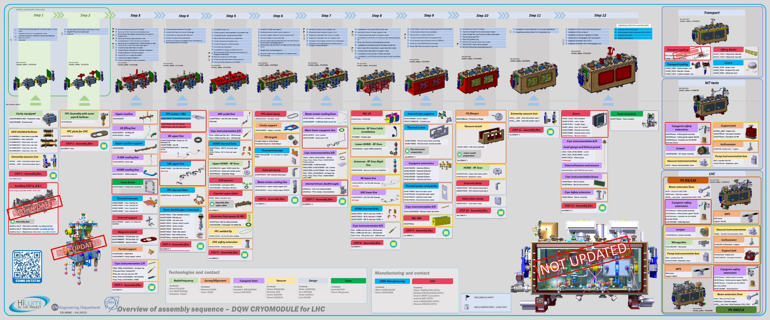
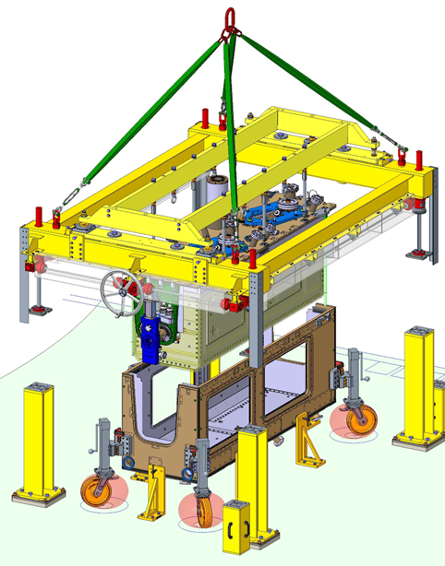
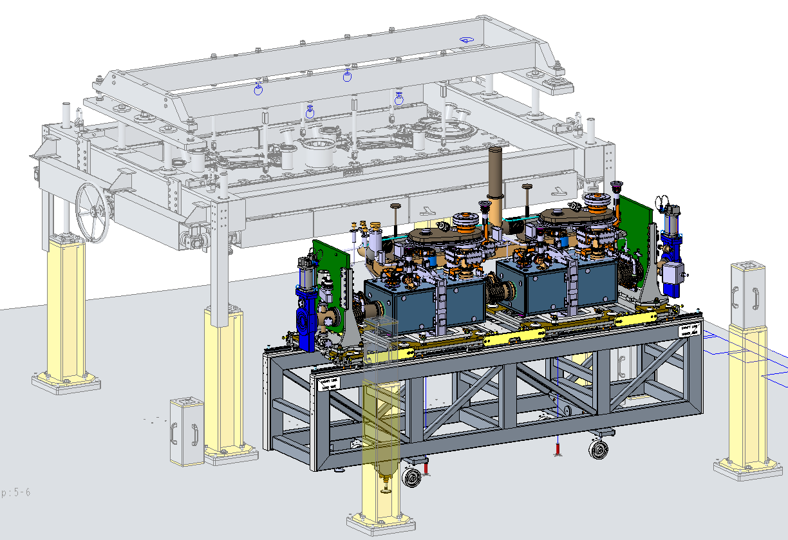
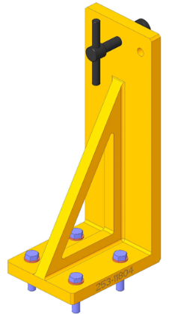
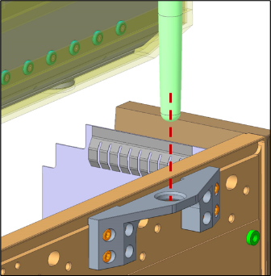
Build Overview
Thanks to Teddy Capelli
Crane Lift
Fine
Adjustment
2 Bays
Pushers
Guide Rods
Cryostating Infrastructure

Slide 9
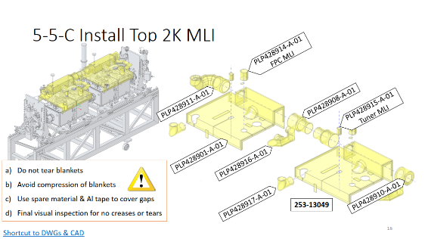
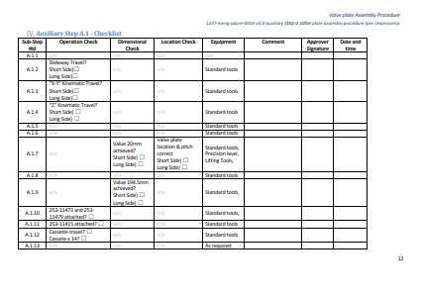
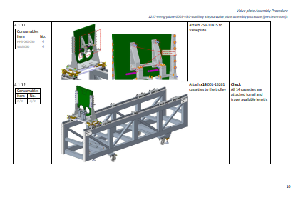
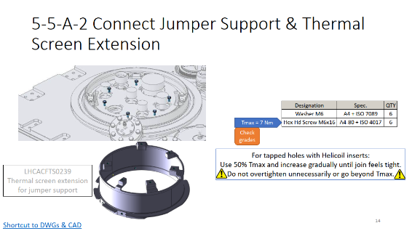
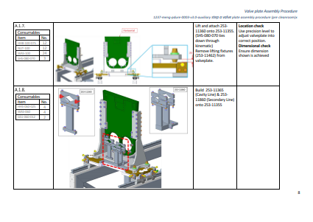
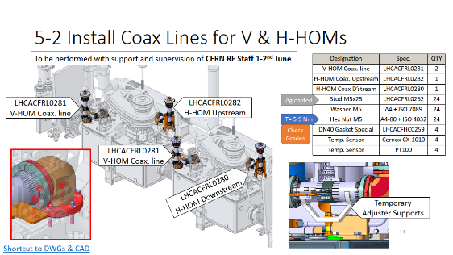
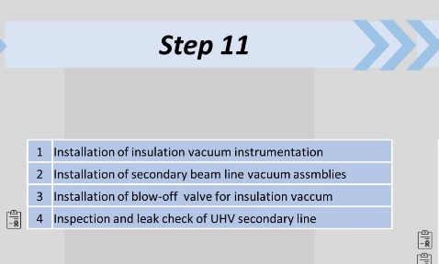
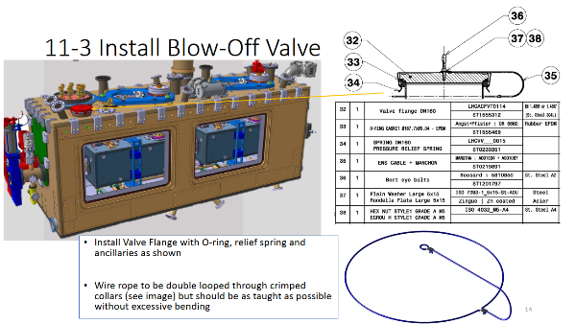
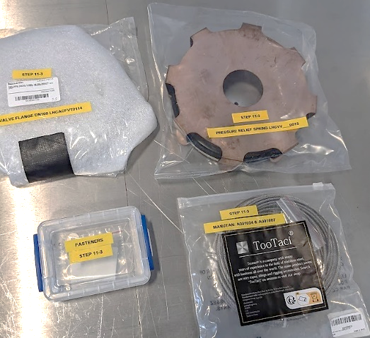
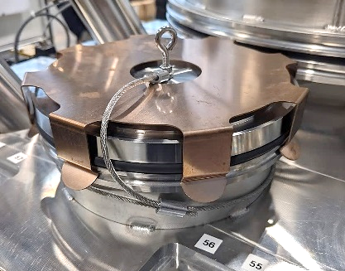
Detailed Build Procedures
Poster logic + tooling & infrastructure
Part of Traveller (QA)
Troubleshoots & de-risk build
Captures critical requirements, torques & sign-off
‘BOM kits’ pre-prepared by sub-step
Over 900p produced!

Slide 10
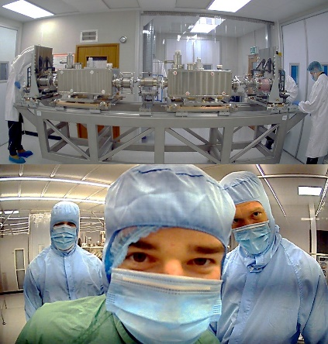
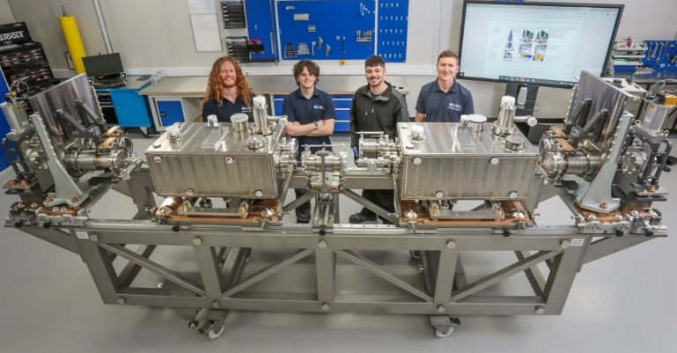
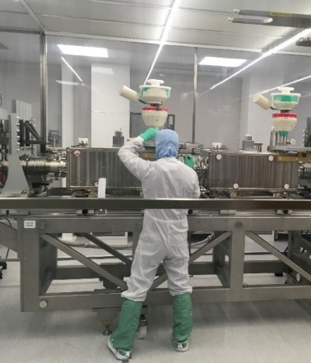
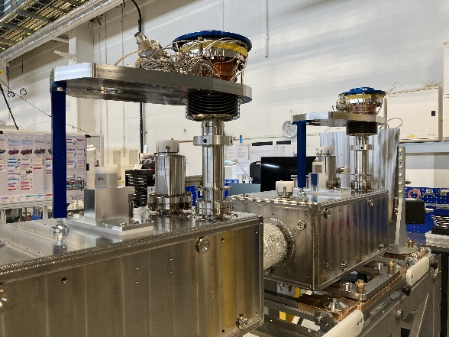
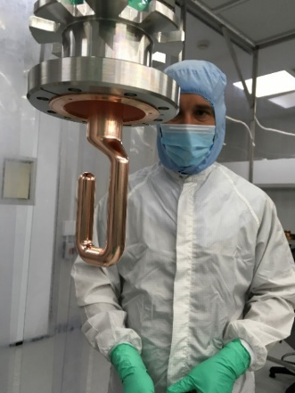
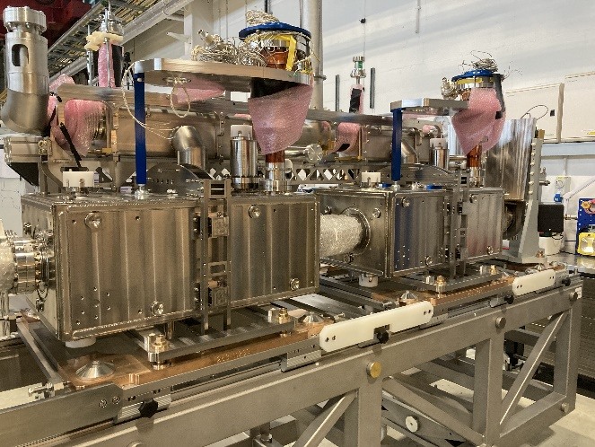



RFD Highlights (1/2)
Cavity string pre-cleanroom
Cleanroom assembly
First Welds
Upper cryo install
Top plate integration
Load Transfer Complete

Slide 11







RFD Highlights (2/2)
Thermal Screen
50K MLI
Instrumentation
Lower Cryomodule Integration
Shipping

Slide 12
4 Lessons Learnt
RFD Lowlights…
…with memorable titles
“Learn from the mistakes of others. You can't live long enough to make them all yourself.” – Eleanor Roosevelt

Slide 13





Protect Ya Bellows
Issue: hydroform bellows dent pre-cleanroom
Impact: minor (thankfully)
Root cause: assembly procedure execution error
Mitigations:
Better comms between engineers & technicians
  Procedure roll-out & sign-off
  More technical oversight
  Many phone calls
Additional bellows protection installed

Slide 14


Take On M.E.
(Multi-complex Engineering)
Issue: Re-design of test rig & re-qualification of Bi Phase line
Impact: Many months delay to manage QA & resolve NCs
Root Cause: Poor supplier QA
Mitigations: developed & brought in-house:
Welding & weld engineering
Steel procurement
Design of weld-test-transport jigs

Slide 15


Respect Yo QMS
(Quality Management System)
Issue: removal & replacement of NC bellows sub-assembly after delivery
Impact: Many weeks to fabricate, re-work & re-qualify
Root Cause: QA processes not followed
Mitigations:
Improved quality training & refreshers
More QA oversight
Local instructions to remove QMS barriers

Slide 16
Mo Checks – Less Problems
Issue: damage to power couplers discovered at CERN
Root cause analysis & resolution: on-going
Hypothesis: complex load transfer issue
Mitigations:
Tooling design improvements
More intermediate test & checks
  ISO4 glovebox for beamline tests
  Fundamental power coupler checks
BUILD CHECK & TEST (HOLD) POINTS
Step # | Activity | Alignment | RF | Leak Test | Other
0 | Cavity string pre-assembly | Y
1 | ISO4 string assembly |  | Y | Beamline
2 | FPC assembly |  | Y | Beamline
3 | Bi Phase welding |  |  | Welds
4 | Tuner & thermal links
5 | Top plate integration | Y | Y | Welds
6 | Top plate load transfer | Y | Y
7 | Lower cryolines & instr'n |  |  | Welds | Instr'n
8 | 2K MLI
9 | Thermal Screen & 50K MLI |  |  | Welds
10 | Cryomodule load transfer | Y | Y
11 | Vacuum equipment |  |  | 2ndline
12 | Cryomodule doors
13 | Outgoing acceptance | Y | Y | Insu-vac, Beamlines | Pressure, LN2, Instr'n
14 | Transport tooling & frame |  |  |  | Shockloggers

Slide 17






Hi Lumi Crab Cavity Cryomodules
RFD SPS Cryomodule delivered Oct ’23 with many challenges & obstacles overcome!
Next: series LHC Cryomodules:
DQW: 1x CERN + 4x STFC
RFD: 5x TRIUMF
>10k components (5k unique)
>900 procedure pages
56 CM welds (24 types)

Slide 18

Thanks! Questions?
Thanks to all Hi Lumi Crabs collaborators for their contributions

Slide 19

Poster by Teddy Capelli

Slide 20


RFD Thermal Budget
Static + Dynamic 4.1 MV (40 kW FPC)
Source | 2 K | 10 K | 80 K
Radiation | 3.4 | - | 30.0
CWT | 6.0 | 1.0 | 50.6
Supports Cav1 | 0.4 | 2.1 | 8.0
Supports Cav2 | 0.5 | 0.9 | 5.0
FPC | 4.8 | 4.6 | 46.4
VHOM lines | 1.4 | 2.6 | 13.0
VHOM antennas | 0.2 | - | -
HHOM lines | 1.4 | 2.6 | 13.0
HHOM antennas | 0.5 | - | -
Pickup lines | 2.0 | - | 10.6
Pickup antennas | 0.0 | - | -
Tuner | 0.8 | - | 10.2
Instrumentation | 2.3 | - | 10.0
He level sensor | 0.4 | - | 0.8
Cryo safety device | 0.7 | - | 4.8
Beam screen | 1.4 | - | -
Beam impedance | - | - | -
Cavity | 20.0 | - | -
 | 46.2 | 13.8 | 202.4
Thermal budget report for RFD
See EDMS 2310389 - Thermal budget RFD cryomodule
Courtesy J.Swieszek – L.Giordanino

Slide 21


Transport Frame Design & Test
38mm drop test performed with a dummy CM
~80% shock isolation

Slide 22







Welding Developments at Daresbury
Weld Procedure Specifications
Sample qualification: dye & macroscopic

Slide 23


Upper (Bi Phase) Cryoline
Support for bellows dP

