Slide 1
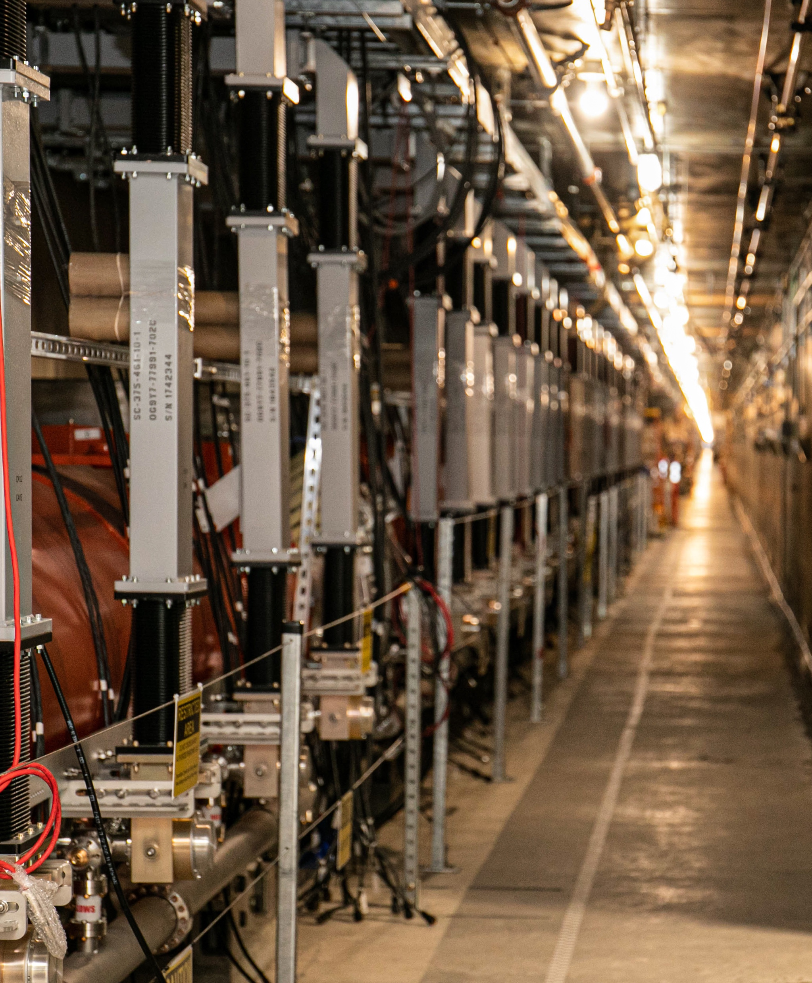
LCLS-II SRF operational experience
TTC2023 Fermilab, WG-4
Sebastian Aderhold
December 06, 2023

Slide 2
Outline
Facility Overview & Commissioning Recap
What’s going well
What could go better
What keeps me up at night
Summary

Slide 3
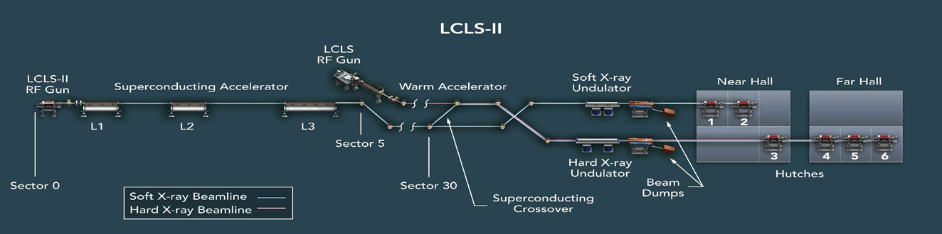
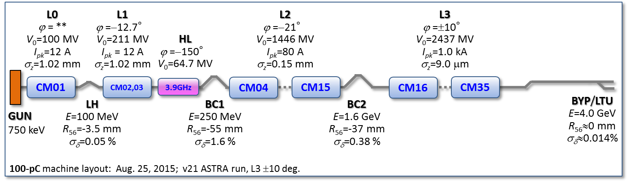
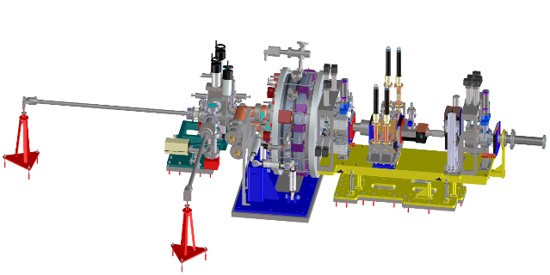
Linac & FEL Layout
RF Photocathode Gun
35 1.3 GHz Cryomodules
2 3.9 GHz Cryomodules
Photocathode Gun
750 keV electrons

Slide 4
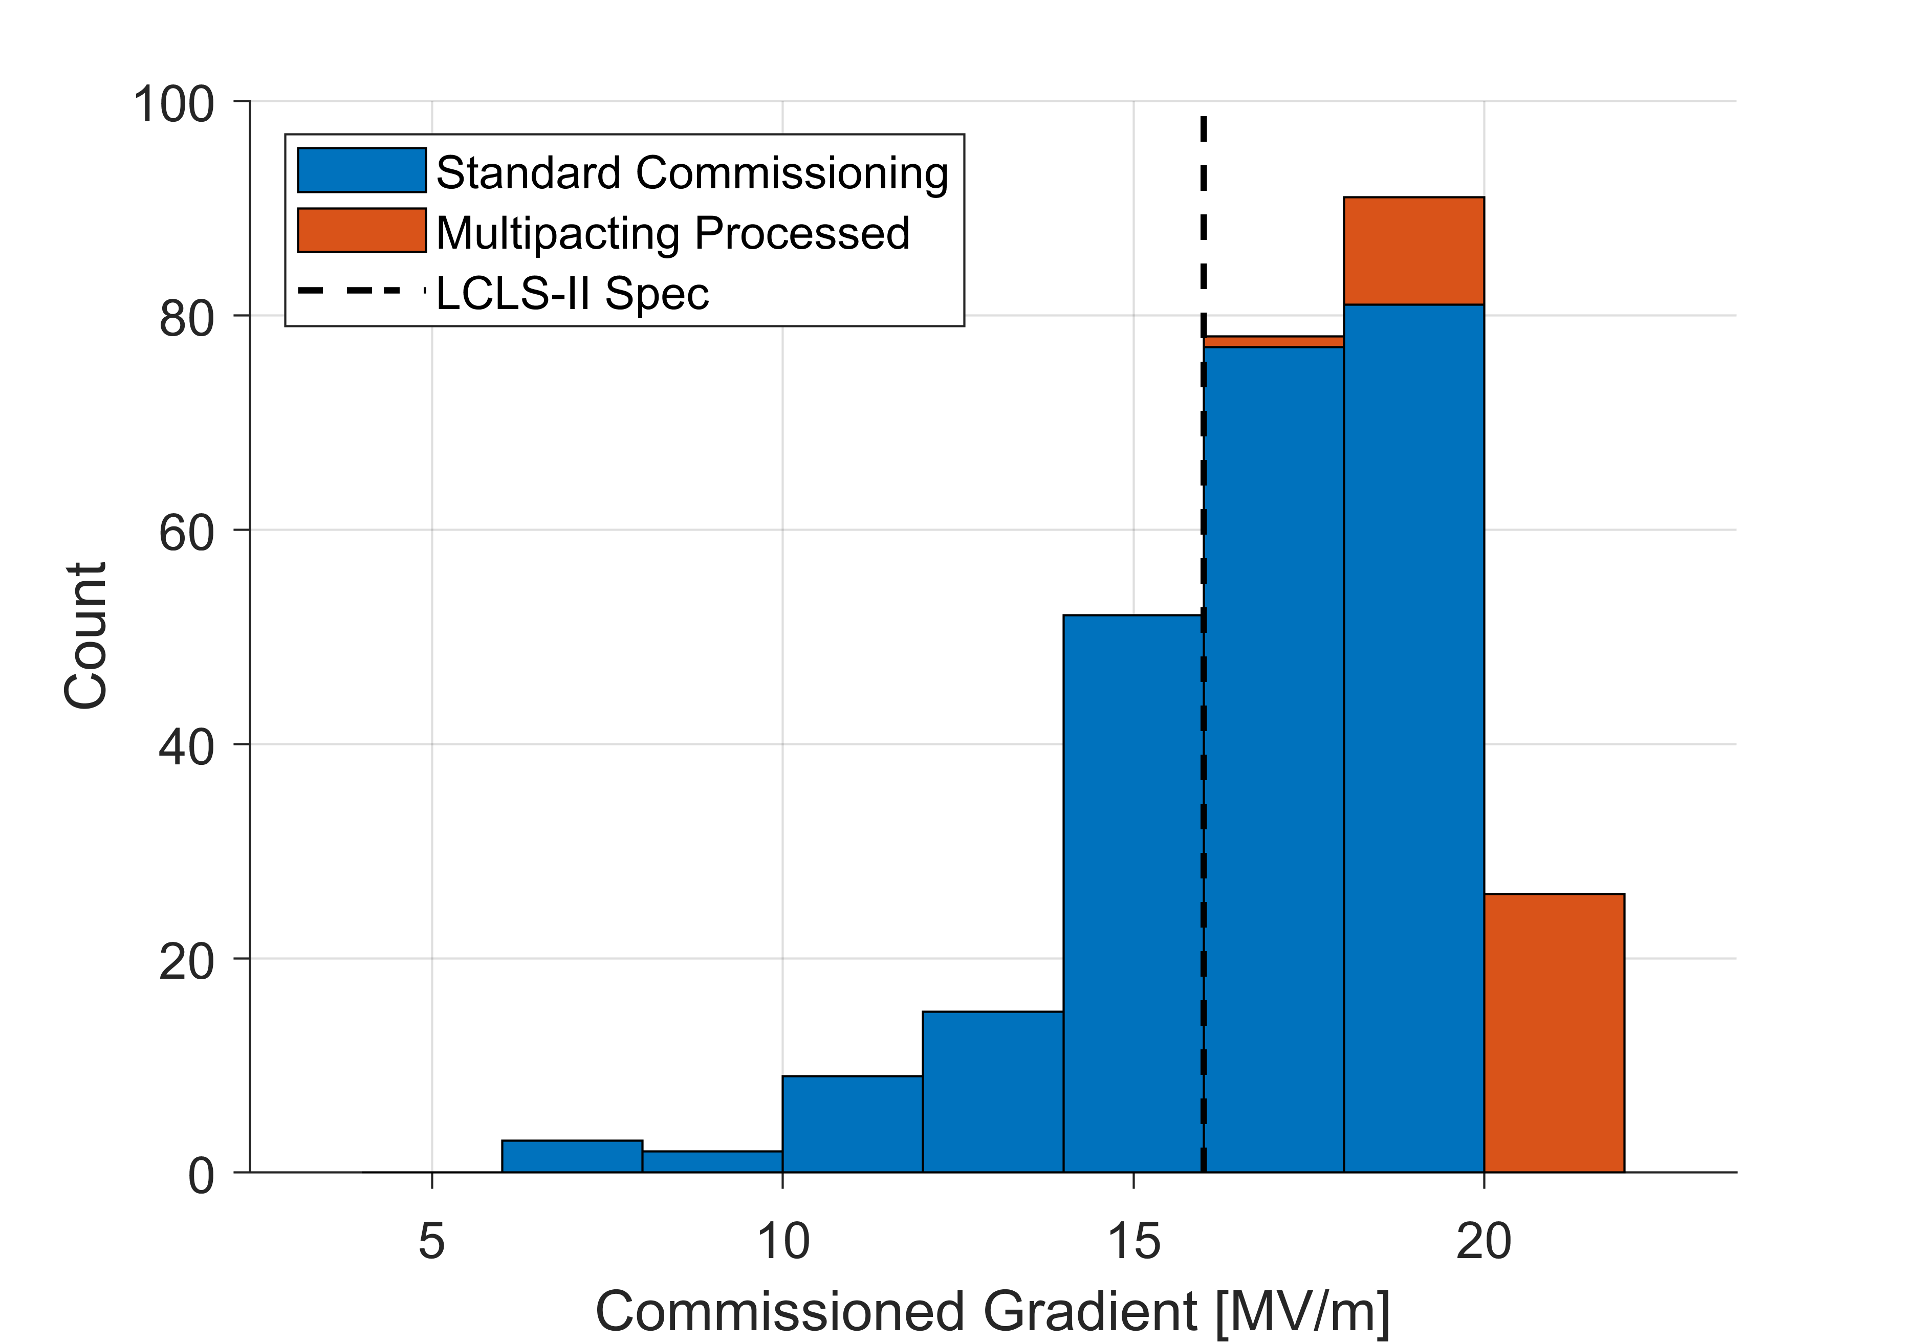
SRF Commissioning Recap
SRF commissioning was very successful
97% of all cavities fully operational (planned for 94%)
Total commissioned (summed individual cavity) voltage exceeded design by >20% and reached 4.8GV
No significant change in field emission observed with respect to cryomodule acceptance tests at partner labs
Gradient Performance

Slide 5
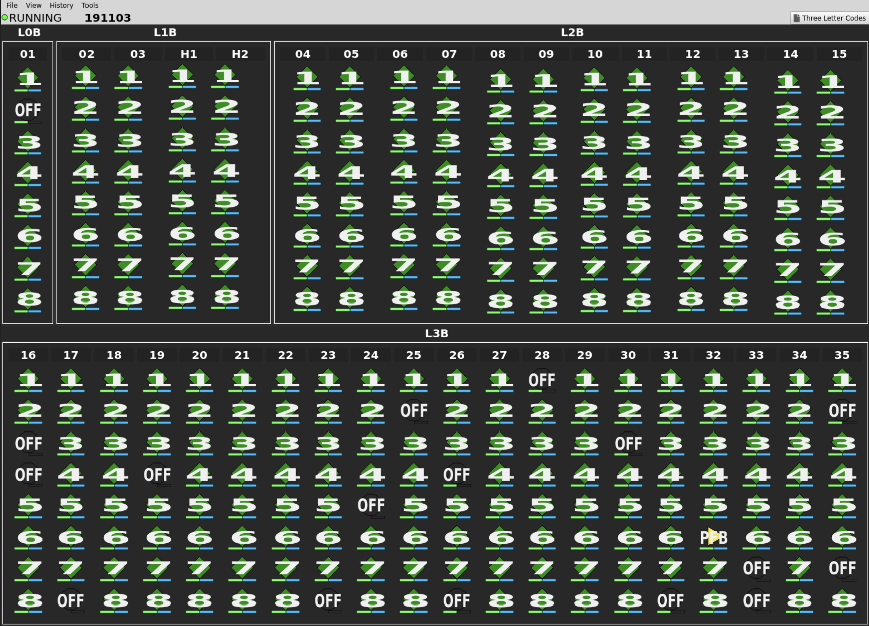
What’s going well
Cavity availability
After initial commissioning only 3% of cavities non-operational (problems inside the CM that need room temperature warm-up)
No additional cavities with problems inside cryomodule since then
All new problems related to LLRF system, cables/connections or SSAs
Individual Solid State Amplifiers allow to take single cavities with intermittent problems offline for maintenance
Generally enough amplitude overhead to compensate for cavities being repaired while the linac is running or during maintenance periods

Slide 6
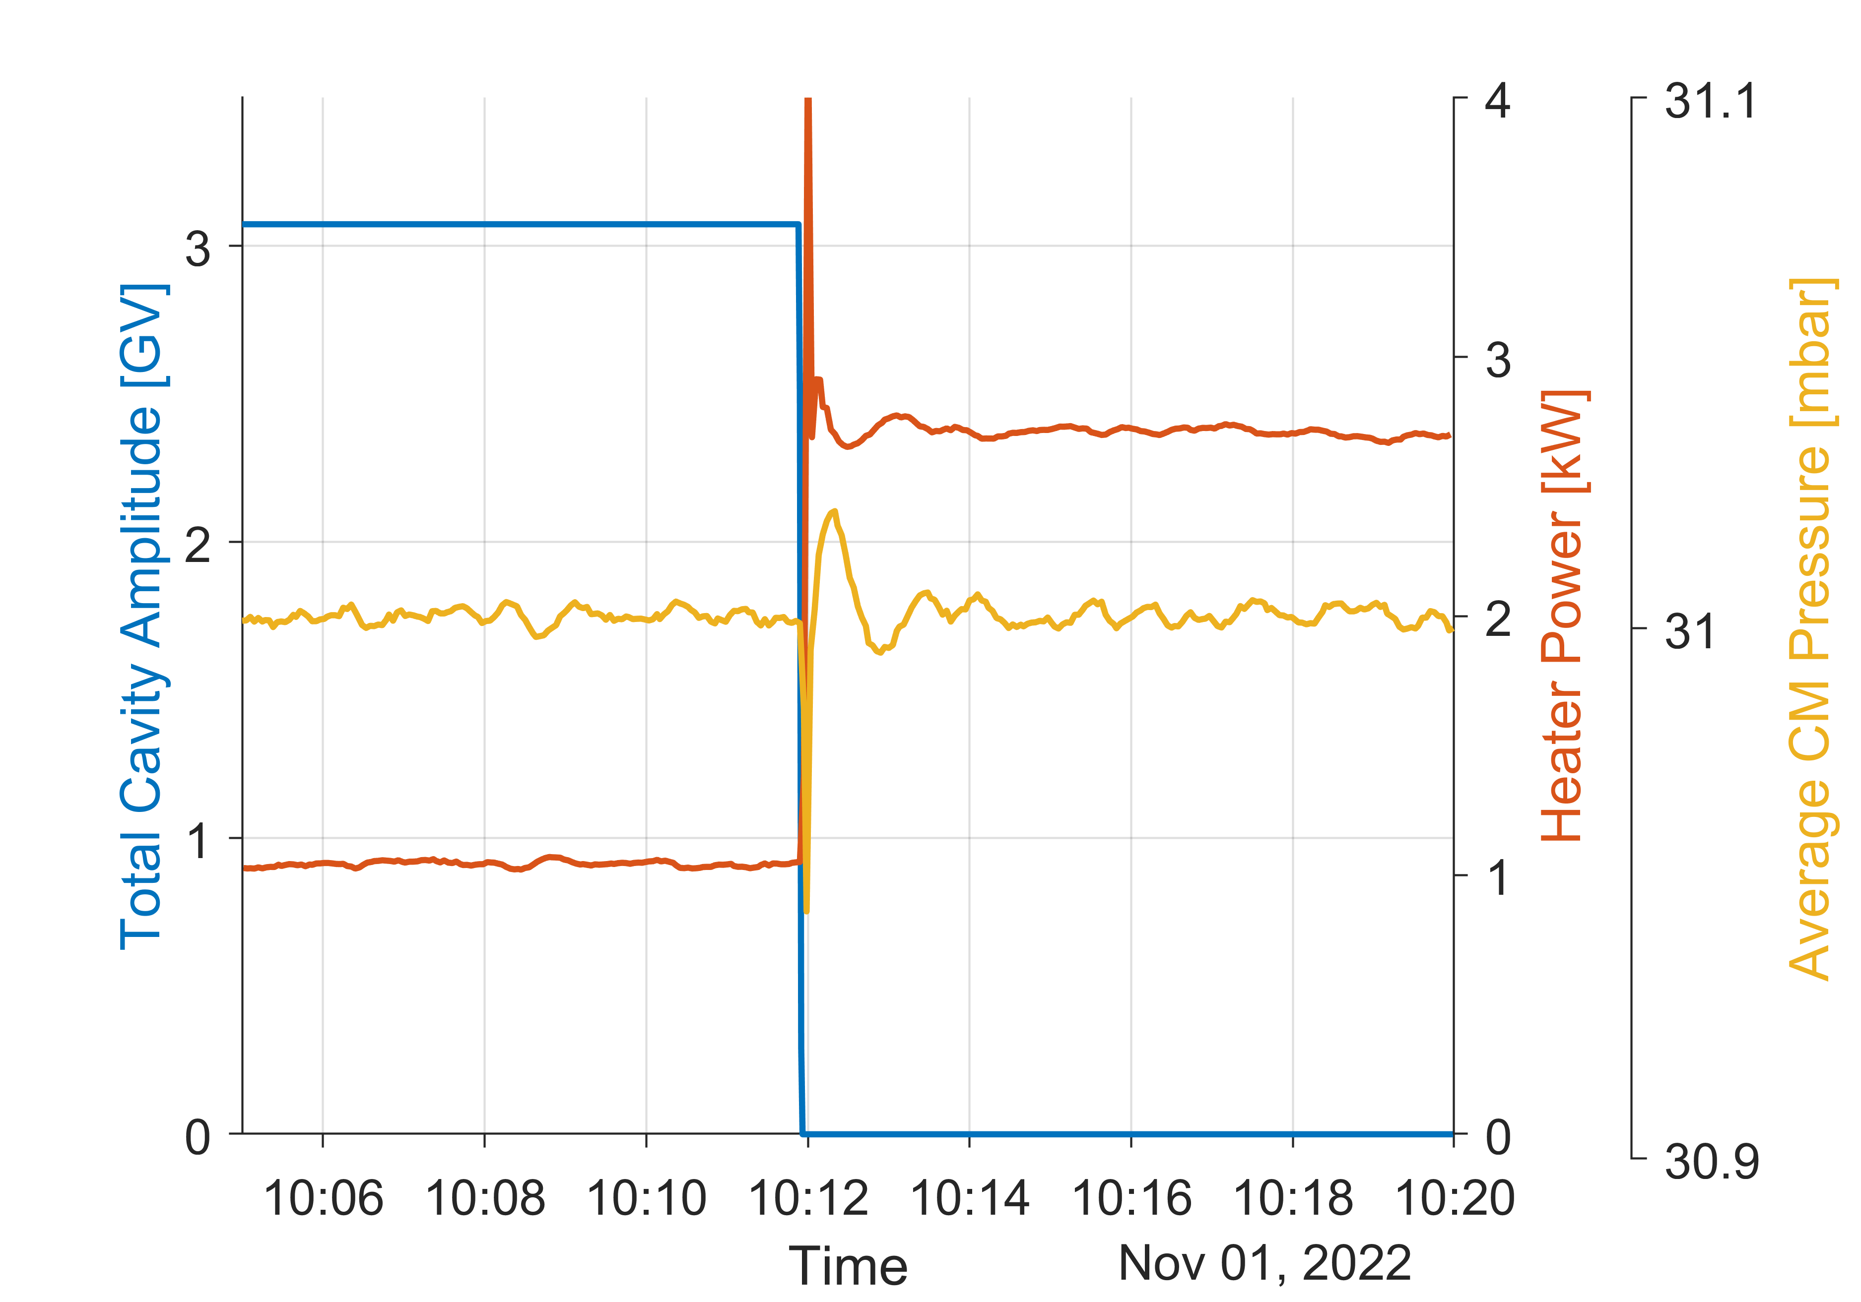
What’s going well
Cryo system is very robust
Electric heaters on underside of cavity helium vessels to compensate for change in RF heatload
Control loop regulates linac helium pressure by adjusting electric heaters to keep return pressure to cold compressors stable
Even in cases of sudden loss of all RF heat [e.g. shut-off by Personal Protection System (PPS)] feedback keeps cold compressors stable and recovers pressure within minutes

Slide 7
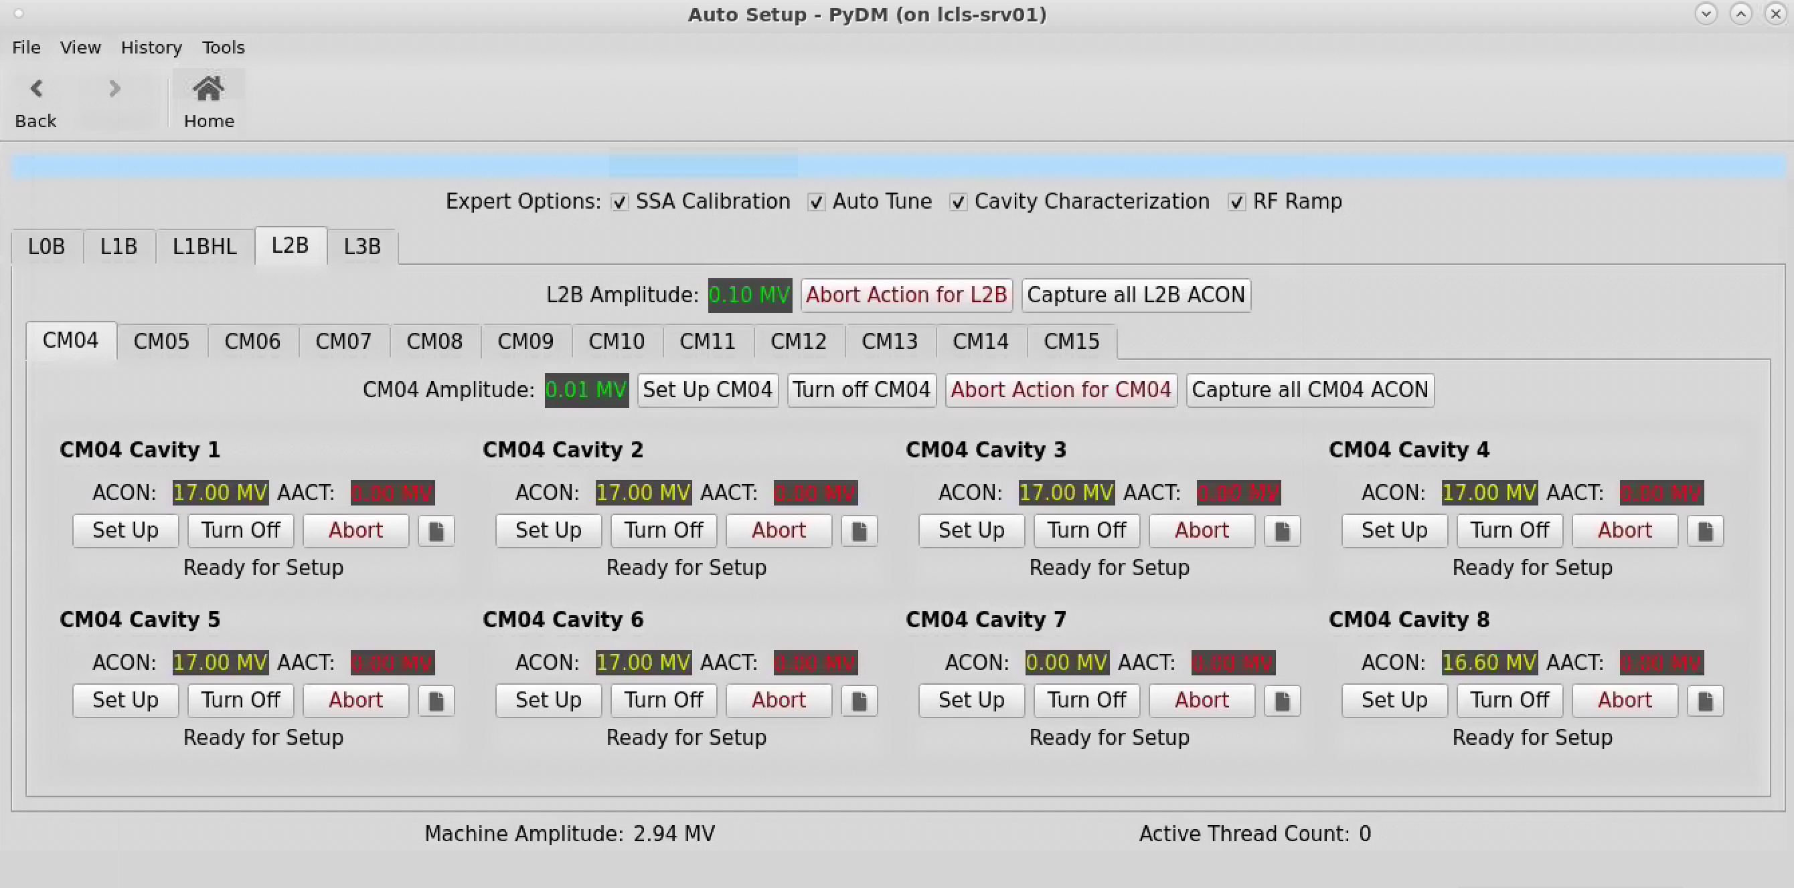
What’s going well
Auto Setup GUI
Push-button tool for initial set-up or to address cavities that have become unstable
Building heavily on software framework developed for and since initial linac commissioning
Simplified interface on top of expert screens for ease of operator use
  Automated sequence of steps, some level of
  error handling and checking if values are within
  set boundaries
Start of the whole linac (e.g. after maintenance days)
CM by CM within 30min - 1h, depending on number
of parallel instances
Recent infrastructure improvement cut down to
less than 5min, true single button

Slide 8
What’s going well
Microphonics
Overall microphonics levels are very good
  94% of cavities within specification of +/-10Hz
Only two cavities are currently amplitude limited due to microphonics
Biggest source of excessive microphonics are cooldown valve leaks
More details by R. Porter at SRF2023:
MOPMB081

Slide 9
What could go better
L3 insulating vacuum (upstream)
L3 string is separated into section upstream and downstream of insulating vacuum break
L3 upstream string exhibits higher than expected static heatload and increased insulating vacuum pressure
  Suspect leak from helium process pipe into insulating vacuum space
  Partially mitigated by doubled pump capacity
 | EXPECTED CM STATIC | OBSERVED CM STATIC (Initial) | OBSERVED CM STATIC (with Additional Pump)
LO-L2 | 9 W / CM → 150 W | 9 W / CM → 150 W | 9 W / CM → 150 W
L3-UPSTREAM | 9 W / CM → 90 W | 47 W / CM → 470 W | 17 W / CM → 170 W
L3-DOWNSTREAM | 9 W / CM → 90 W | 16 W / CM → 160 W | 16 W / CM → 160 W
TOTAL CM STATIC | 330 W | 800 W | 500 W
Added Pumps

Slide 10
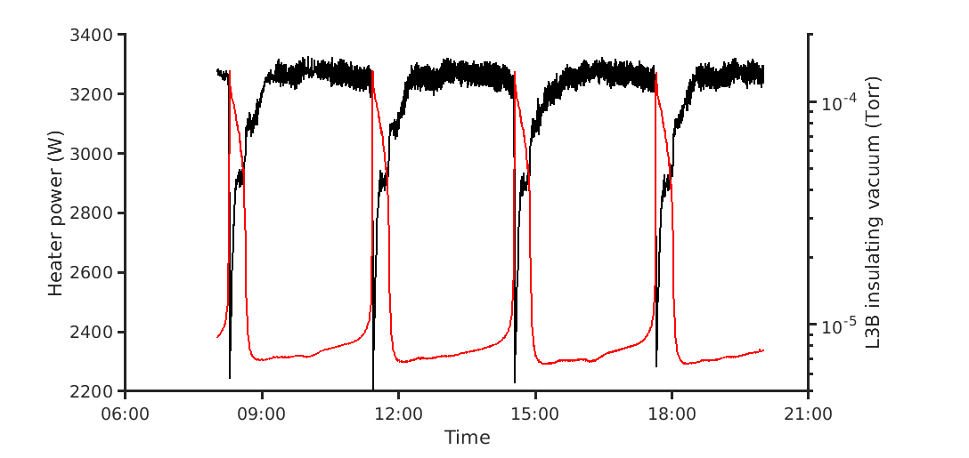
What could go better
L3 insulating vacuum (downstream)
L3 downstream string insulating vacuum pressure has oscillating behavior
  Oscillation period is dependent on whether RF is on (~1.5h) or off (~3h)
  Global heater feedback reacts in response to change in static heatload
  Suspect leak in cooldown line of one of the later CMs (~CM33-34)
  Most notable consequence is HOM couplers on some cavities to start (over-) heating
    Decreased cavity amplitudes slightly to accommodate

Slide 11
What keeps me up at night
New Field Emission in CM01
CM01 has specific cavity amplitude requirements for optimal injector performance and linac beam quality
  Cryomodule with high max amplitudes and without field emission was chosen for this location
  For best emittance preservation cavity 1 runs at low amplitude (6.5MV) and cavity 2 is chosen to be off
Prompted by unexplained high signals on beam loss monitors in injector moved radiation monitors next to CM01 and re-characterized field emission
  Found field emission in cavities 2, 3, 4, 5
No specific events in beamline vacuum that would explain particle migration or gas bursts

Slide 12
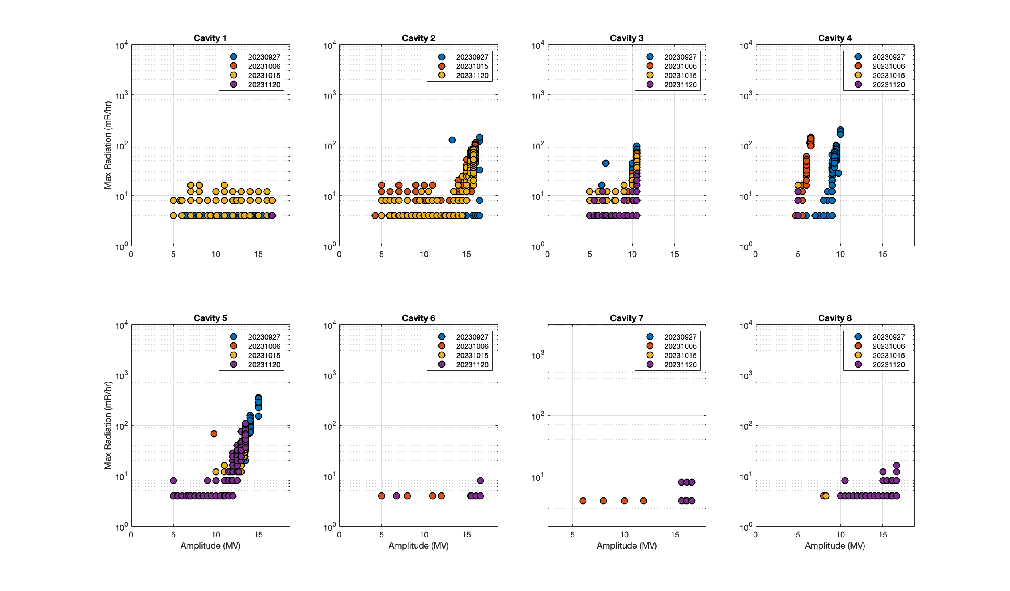
What keeps me up at night
CM01: measurements over time
Re-measure CM01 every few weeks
No change over time
On first RF ramp of cavity 2 (had been off before for programmatic reasons) no FE up until 16MV, then emitter activated. Now onset at 13MV
Cavity 4 showed 50mR/hr at ~10MV on 9/27. On 9/28 at the same amplitude: 10R
  Limited to 5MV since to prevent further degradation
Since 10/15 see very small amount of radiation in cavity 8 as well (just above background at 16.5 MV)

Slide 13
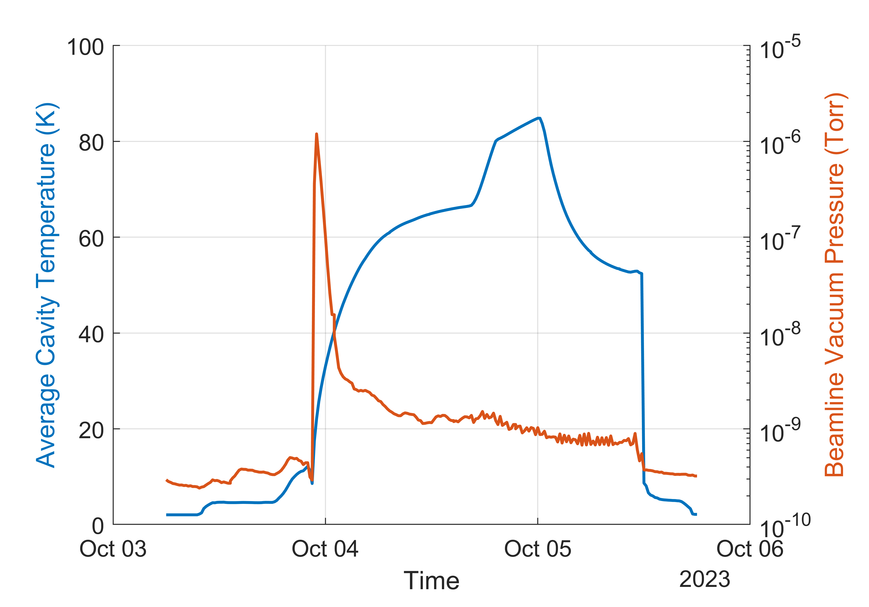
What keeps me up at night
CM01: temperature cycle to 80K
A thermal cycle was performed beginning of October to ~80 K to allow release of some adsorbed gases on the cavity surfaces
Following the thermal cycle, CM01 was re-characterized for field emission
No change was observed in the field emission onsets or magnitude in any of the cavities
Possible scenarios:
  The cause of the contamination is not adsorbed gas related
  80 K was not sufficiently warm to release the offending gas species

Slide 14
What keeps me up at night
CM01: Path forward
Will keep monitoring field emission levels in CM01 on a regular basis
Started re-characterization campaign for all other CMs (moving one set of sensors every maintenance period)
  No change in field emission found in the CMs checked so far
Assessing impact on injector performance
  Just at the lower edge of required energy for laser heater operation while keeping cavities below 50mR/hr when turning on cavity 2
  Seems feasible as long as FE does not get worse
Looking for mechanisms that would explain pattern with highest radiation in the middle of the CM
Long term solutions (both would need room temperature warm-up and significant work):
  Replace cryomodule with spare
  Perform in-situ plasma processing

Slide 15
Summary
Overall the LCLS-II SRF operation is going well
  Cryo feedback loops are robust, microphonics are within acceptable limits, automation tools are available and refined further
Helium leaks into the insulating vacuum of L3 string create higher static heat loads
  Partially mitigated by additional pumps
  Open for ideas on oscillating behavior of L3 downstream insulating vacuum
CM01 now shows FE that was not present during initial commissioning
  Most pronounced towards the center of the cryomodule
  No indication of potential source of contamination or other reason for degradation yet
  Open for similar experiences and ideas

Slide 16
CM01: evolution of FE onset and max amplitudes
Date | Amplitude | Cavity 1 | Cavity 2 | Cavity 3 | Cavity 4 | Cavity 5 | Cavity 6 | Cavity 7 | Cavity 8
Initial commissioning June ‘22 | onset | None | None | None | None | None | None | None | None
 | max | None | None | None | None | None | None | None | None
9/27/23 | onset | None | 13MV | 10MV | 8MV | 12MV | None | None | None
 | max | None | 15.8MV | 10.5MV | 10MV | 13.5MV | 16.6 | 16.6 | 16.6
9/28/23 | onset | None | 13MV | 10MV | 5MV | 12MV | None | None | None
 | max | None | 15.8MV | 10.5MV | 5MV | 13.5MV | 16.6 | 16.6 | 16.6
10/15/23 | onset | None | 13MV | 10MV | 5MV | 12MV | None | None | 16.5 MV
 | max | None | 15.8MV | 10.5MV | 5MV | 13.5MV | 16.6 | 16.6 | 16.6 MV

Slide 17
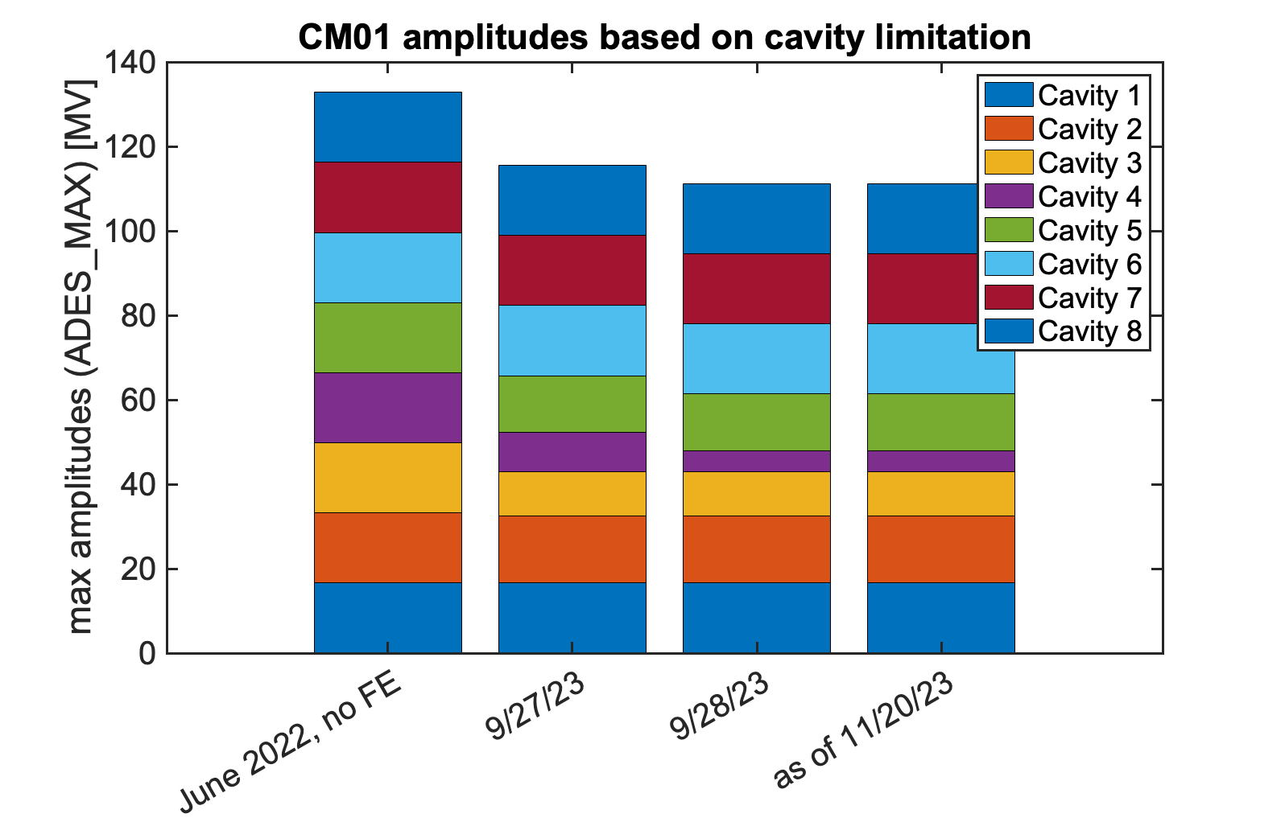
CM01: evolution of FE onset and max amplitudes

