Slide 2
Elliptical ESS module tests: performances overview experienced at ESS Test Stand
On behalf of the ESS SRF and IFJ PAN Team
PRESENTED BY Cecilia maiano on behalf of SRF team

Slide 3
Agenda
Statistics of elliptical cryomodules test
Cryomodules test workflow, tools and challenges/achievements

Slide 4
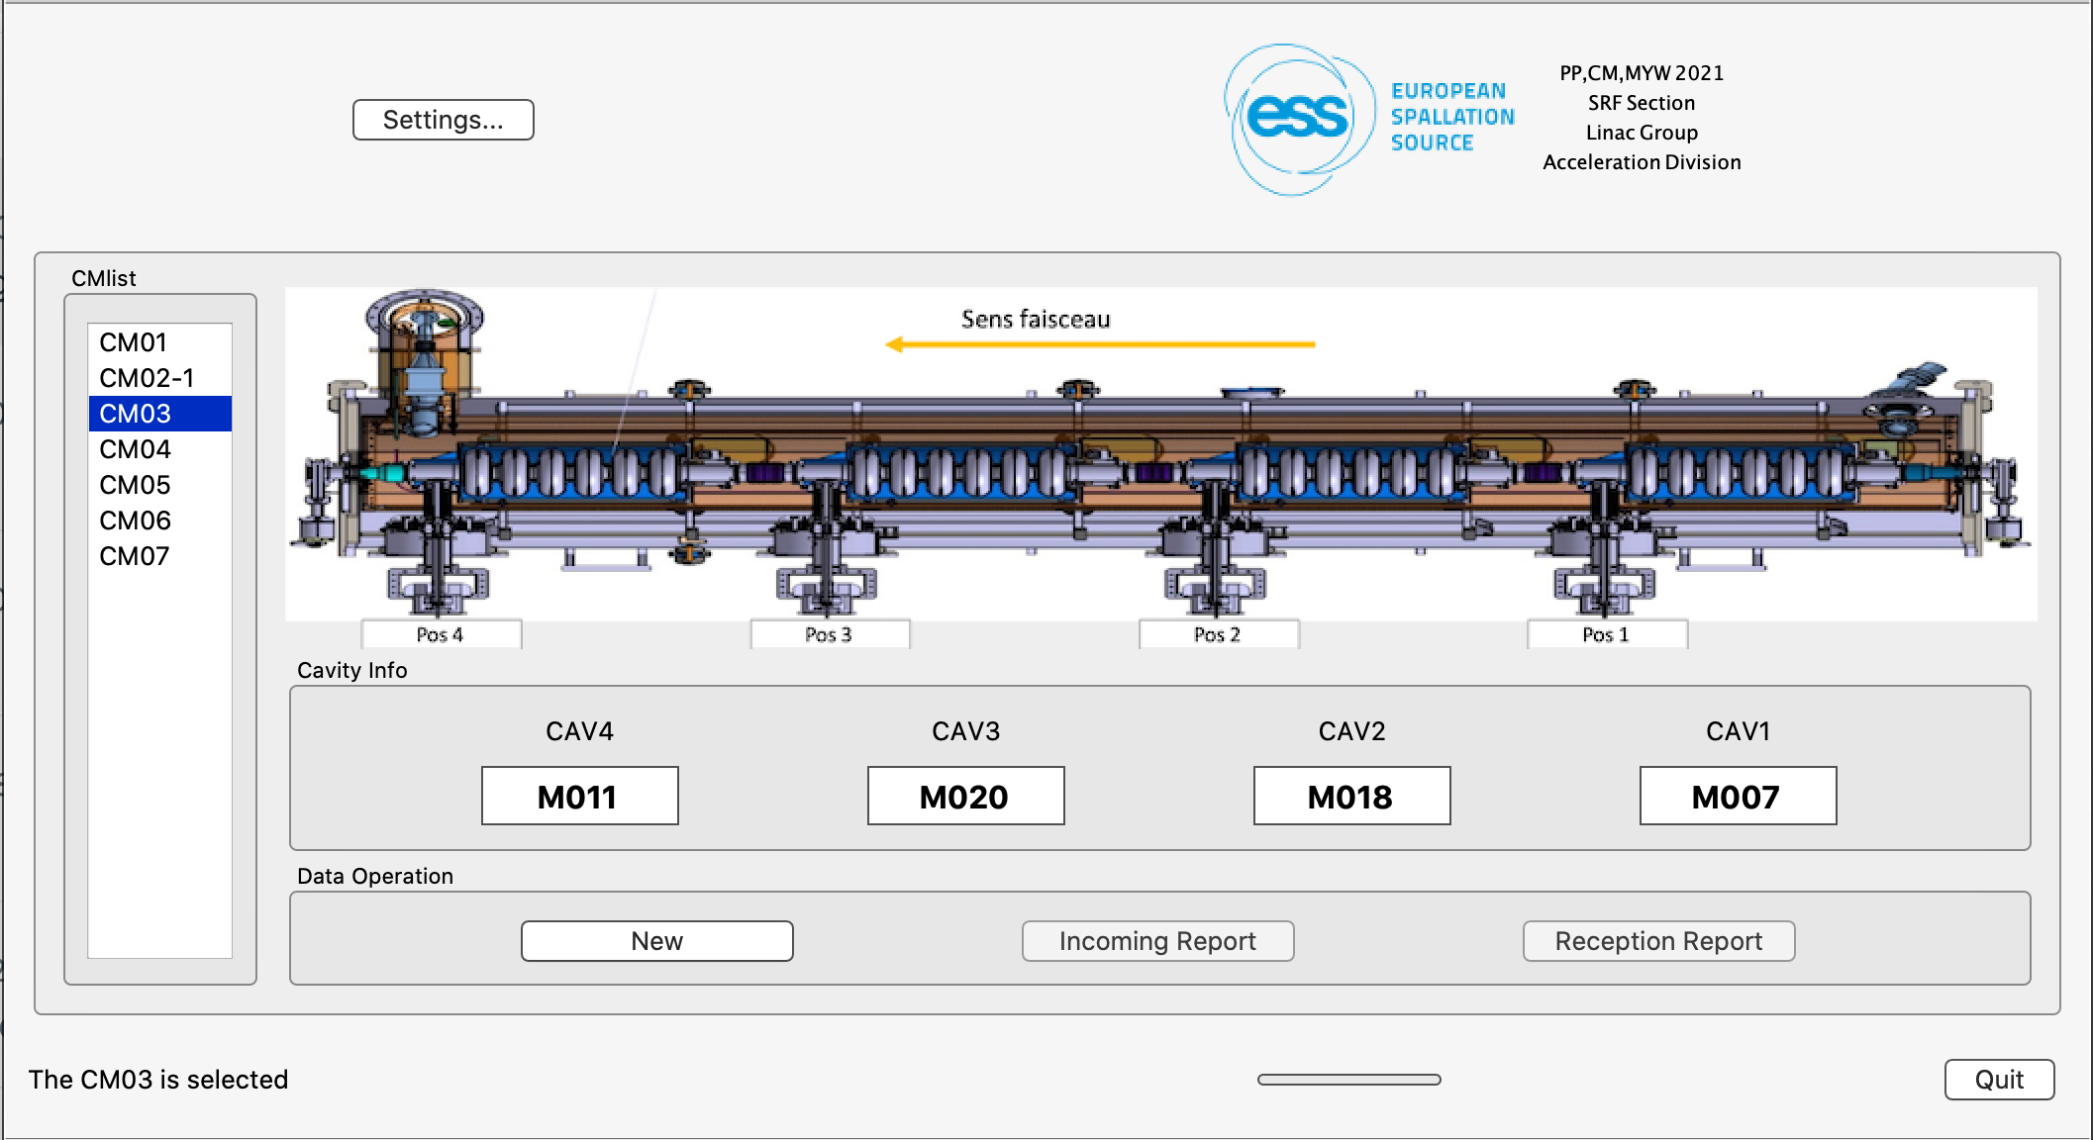
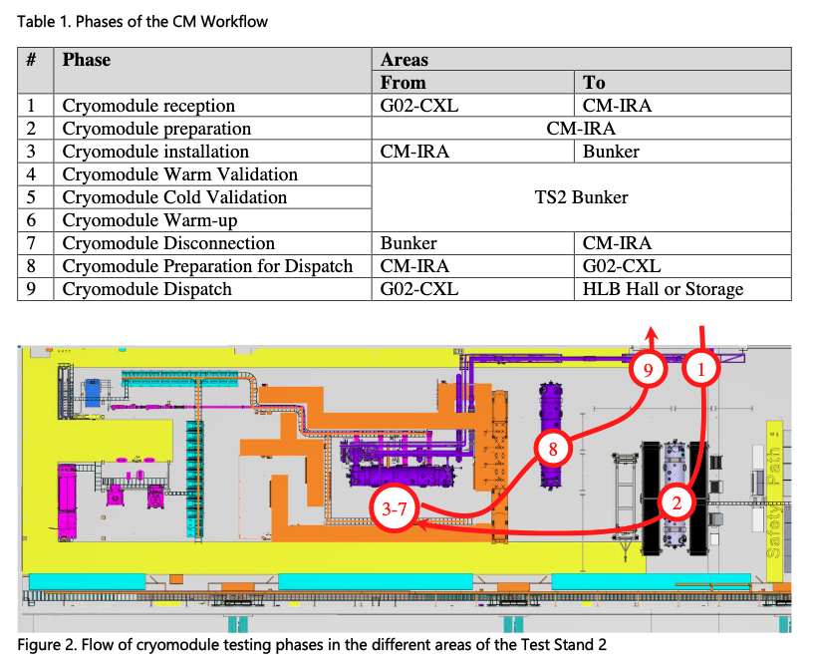
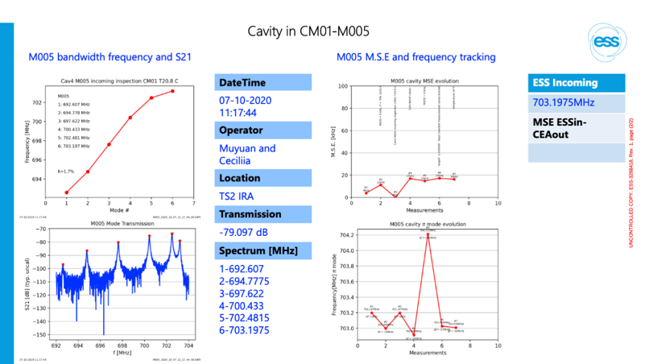
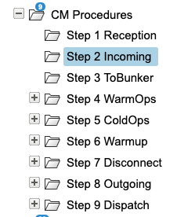
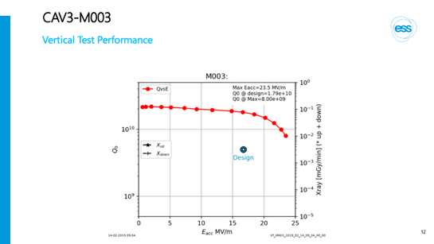
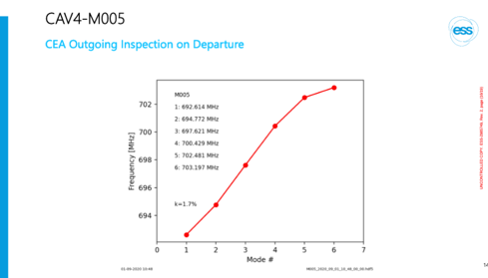
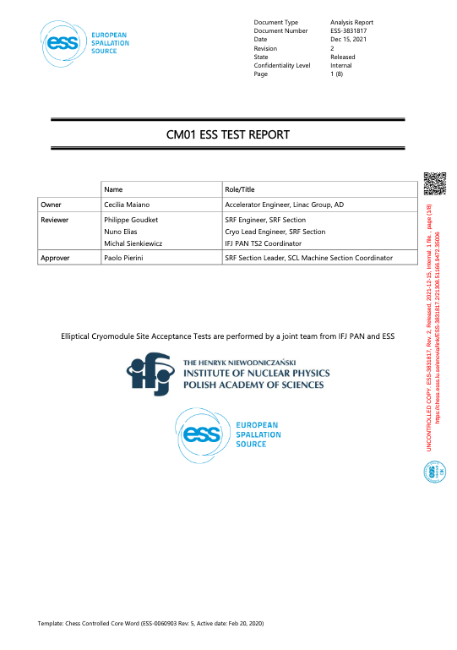
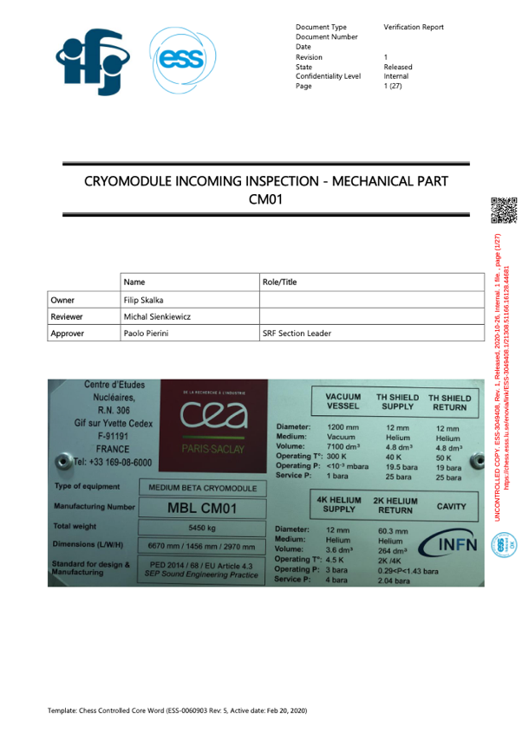
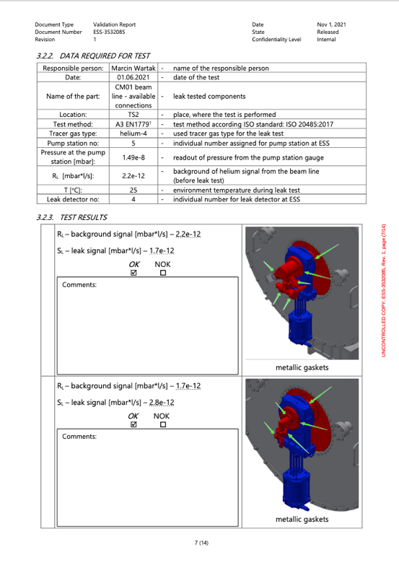
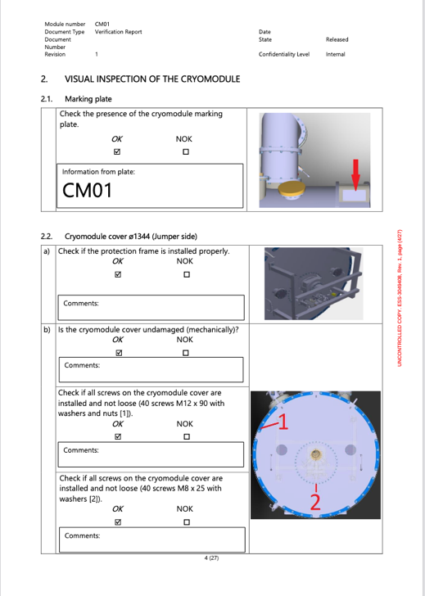
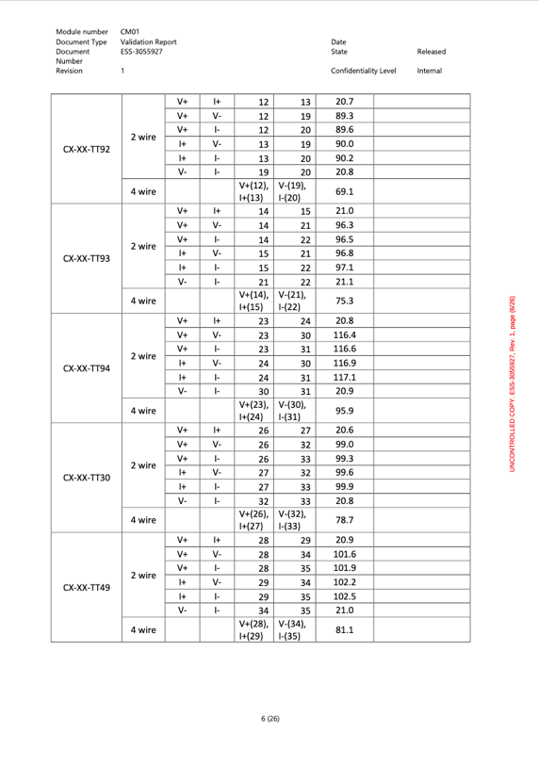
ELL CM: ESS Test Stand
The workflow is split in phases
CM lifecycle is intensively documented
Cryomodule Assembly from (INFN/STFC) CEA
Cryomodule testing phase (Mec/Vac/Cryo/SRF)
SRF
Master test report
(min 21 docs)
Vacuum
Mechanical
Electrical
Site Acceptance Test of CM

Slide 5
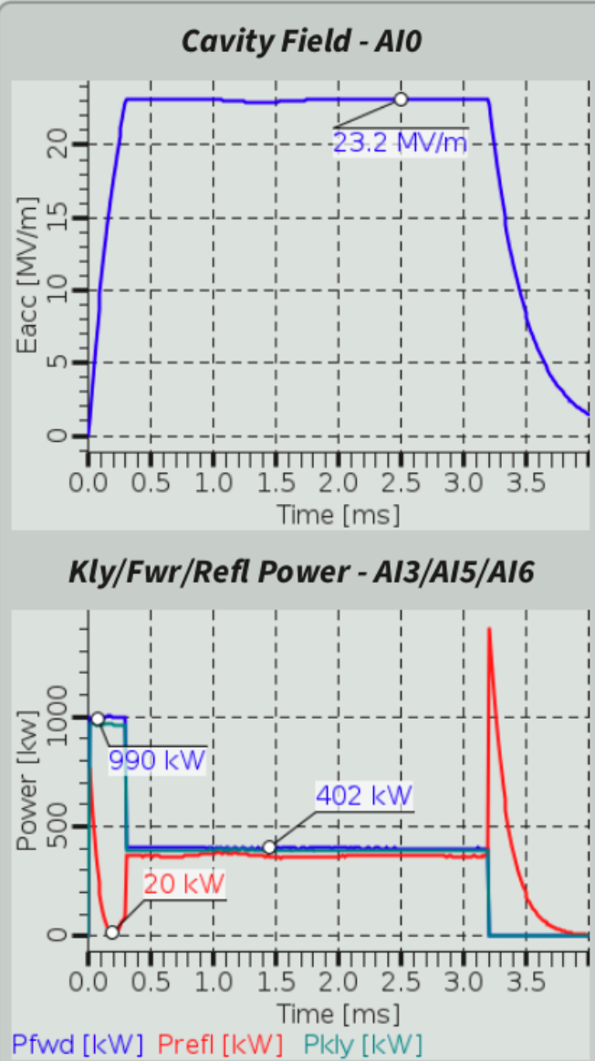
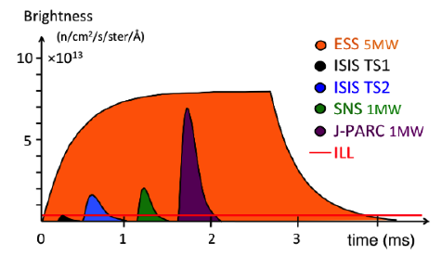
Elliptical modules test phases
Long RF pulses at 14 Hz 4% duty cycle
Off resonance
Incoming inspections + connections in bunker
Warm Coupler conditioning
Cool down (4K)
Cold coupler conditioning
Cold cable calibrations
Tuning to resonance
On resonance (in parallel dynamic heat loads)
Gradient calibration (kt CM)
Cavity conditioning in open loop (PL 3.2 ms, nominal gradient)
Cavity operation in closed loop (piezo for HB)
Dynamic Heat loads
Off resonance (again)
Detuning + warm up + disconnections + radioprotection surveys (before moving modules from supervised area)
ESS Neutron pulse
2.9 ms flat top!

Slide 6
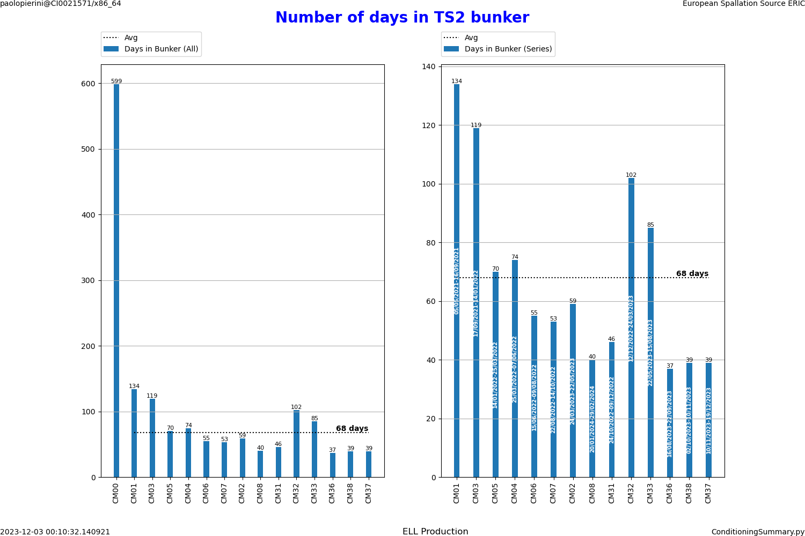
TS2 Statistics – 14 CM tested
Trend improving over time, but
CM03: Repair of gauge (2x test)
CM32: Cryoplant trip
CM33: Needed to add pumping during conditioning due to severe vacuum activity
Aiming at a constant throughput of not more than 6 weeks in bunker (42 calendar days max)
1 proto
7 MB
6 HB
Prototype, used for TS2 commissioning:
2y, several CD/WU

Slide 7
Nominal CM Test Schedule – 6 Weeks in Bunker
12 days
2 days
2 days
3 days
3 days
5 days
5 days
1 day
4 days
5 days
5 days
1 day
Open Bunker Door
Open Bunker door after test
Nov 6
Dec 18
CM In
Close Bunker Door
CM Out
Nov 10
Nov 17
Dec 22
2023
2023
45
46
47
48
49
50
51
2023
Today
Nov 13 - Nov 17
VB/RFDS
Connection
Nov 16
IL Checks & WCC Preparation,
Nov 17 - Nov 19
WCC (2/day) (with support from operations in MCR)
Nov 20
Integral leak test
Warm Conditioning and Cooldown
Nov 21 - Nov 22
Cooldown
Nov 23 - Nov 26
CCC (2/day) ( in collaboration with operation in MCR)
Nov 27
2K Pumpdown
Nov 28
Cavity Tuning & Calibration
Nov 29 - Dec 4
Cavity Conditioning (1/day, soak test during WE in MCR)
Dec 5 - Dec 7
DHL+ cavity operation in closed loop with piezo (cavities soak test
in closed loo in collaboration with operation in MCR if feasible)
Cold Operation
Dec 8 - Dec 14
LLRF+piezo test
Nov 29 - Dec 14
Static Heat Load
Dec 15 - Dec 19
Warmup
Disconnection
Dec 18 - Dec 22
Vacuum tests and CM Disconnections
Conferences
Dec 4 - Dec 8
TTC workshop

Slide 8
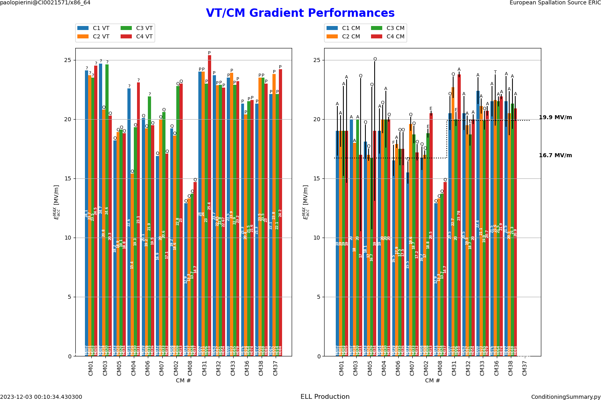
RF Performances: Gradient
Nominal gradient is generally met
Few marginal cav
Most of HB reach the coupler administrative power limit for SW operation slightly above the nominal gradient
Test uncertainties large at the start of TS2 commissioning, improving with time
Test in January
Under test

Slide 9
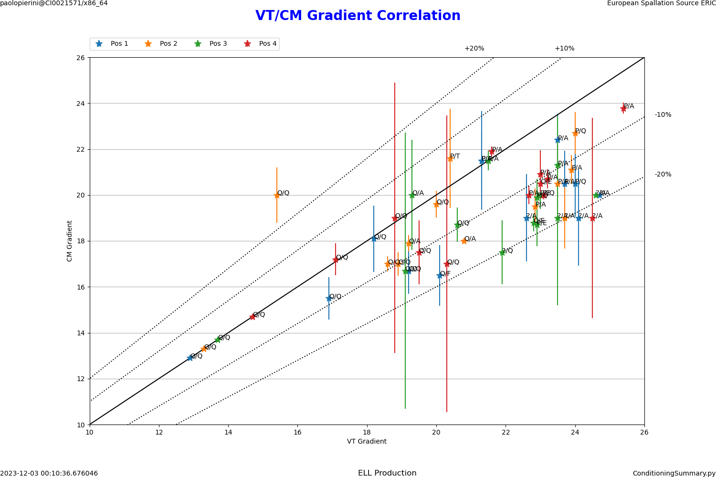
Sanity Check: VT vs CM checks
As expected VT/CM results typically agree within 10-15%
The part at higher gradients suffers from the onset of the Admin limit (max coupler power in SW) in CM testing
CM Gradient
Vertical Gradient

Slide 10
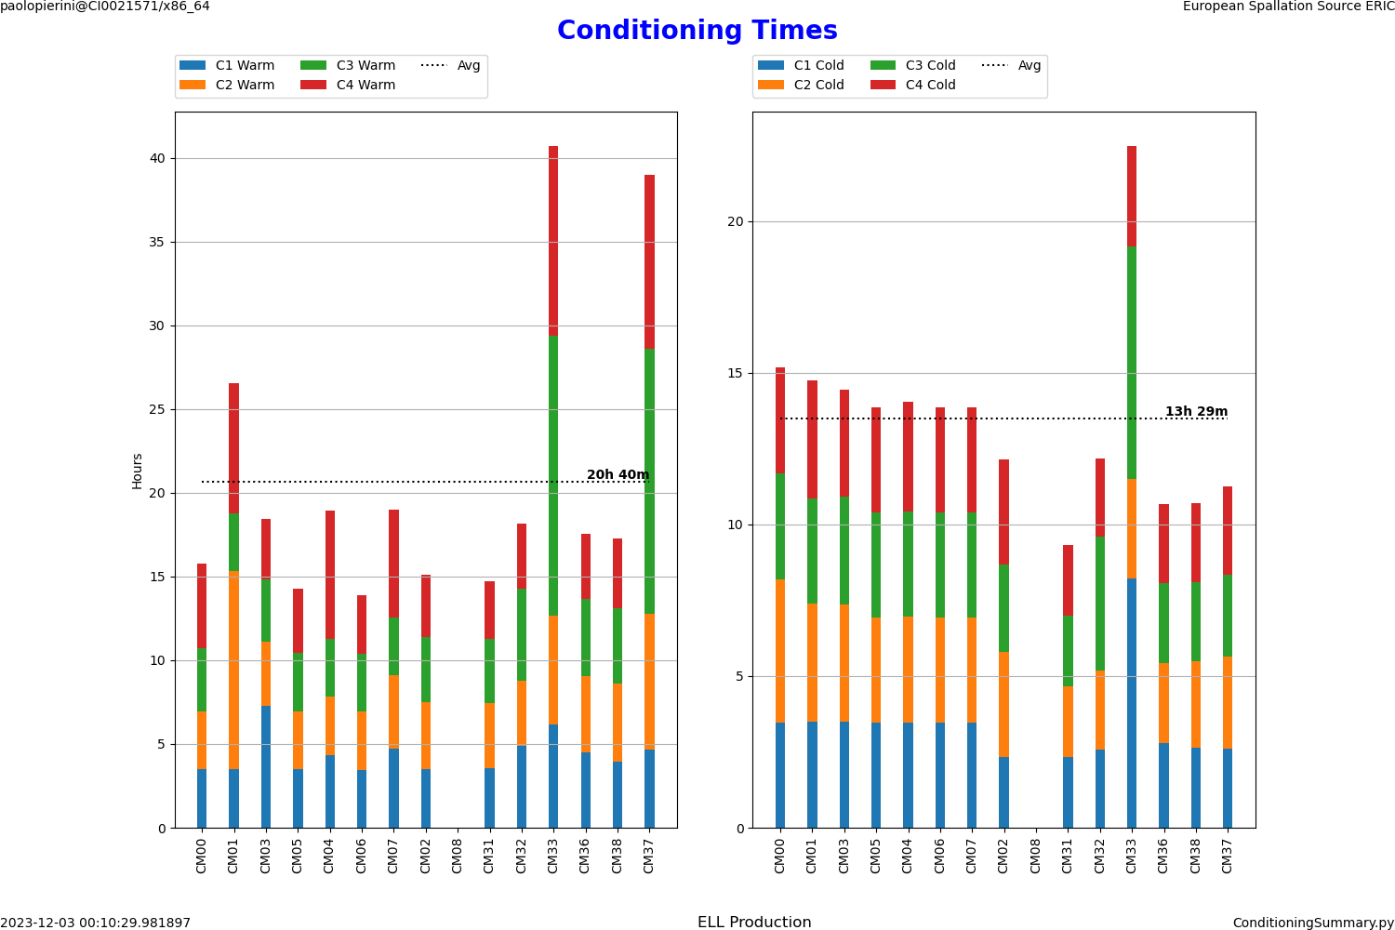
Conditioning
Keeping track of experience, as it will be repeated in tunnel
Conditioning times correlate with number of NCR registered during assembly
CM33 was extremely long, but we profited from the involvement of ESS OPS to run 24/7 conditioning through our automated scripts
SRF experts may speed up the process, but the procedure is able proceed with no supervision
No bias applied during conditioning (only test)
warm
cold

Slide 11
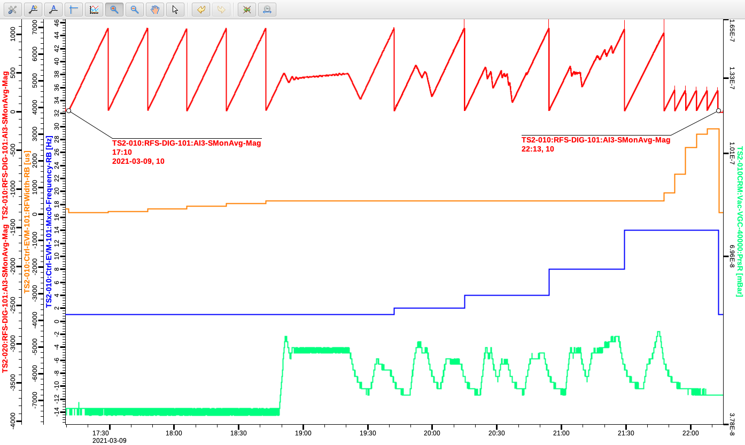
Conditioning sequence
For ESS power couplers
For ESS a sequence of conditioning steps has been defined by CEA for the elliptical power couplers, sweeping gradually the average RF power
Short pulses (< 500 us)
Full nominal klystron power
Long pulses (>500 us)
Limited to nominal power to set cavities at nominal field
A similar sequence exists for spoke couplers
MB sequence
Vacuum is the process variable

Slide 12
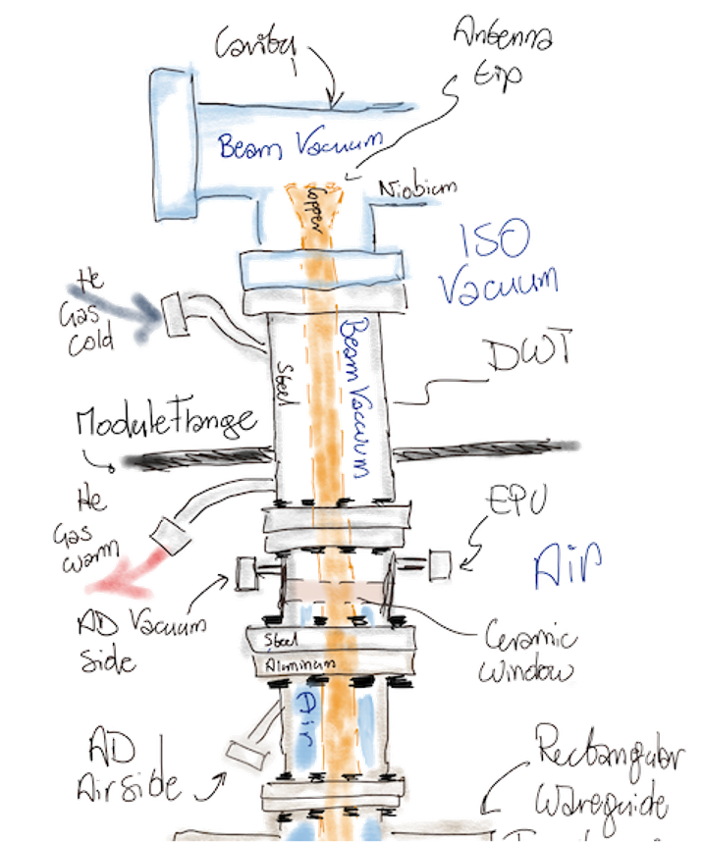
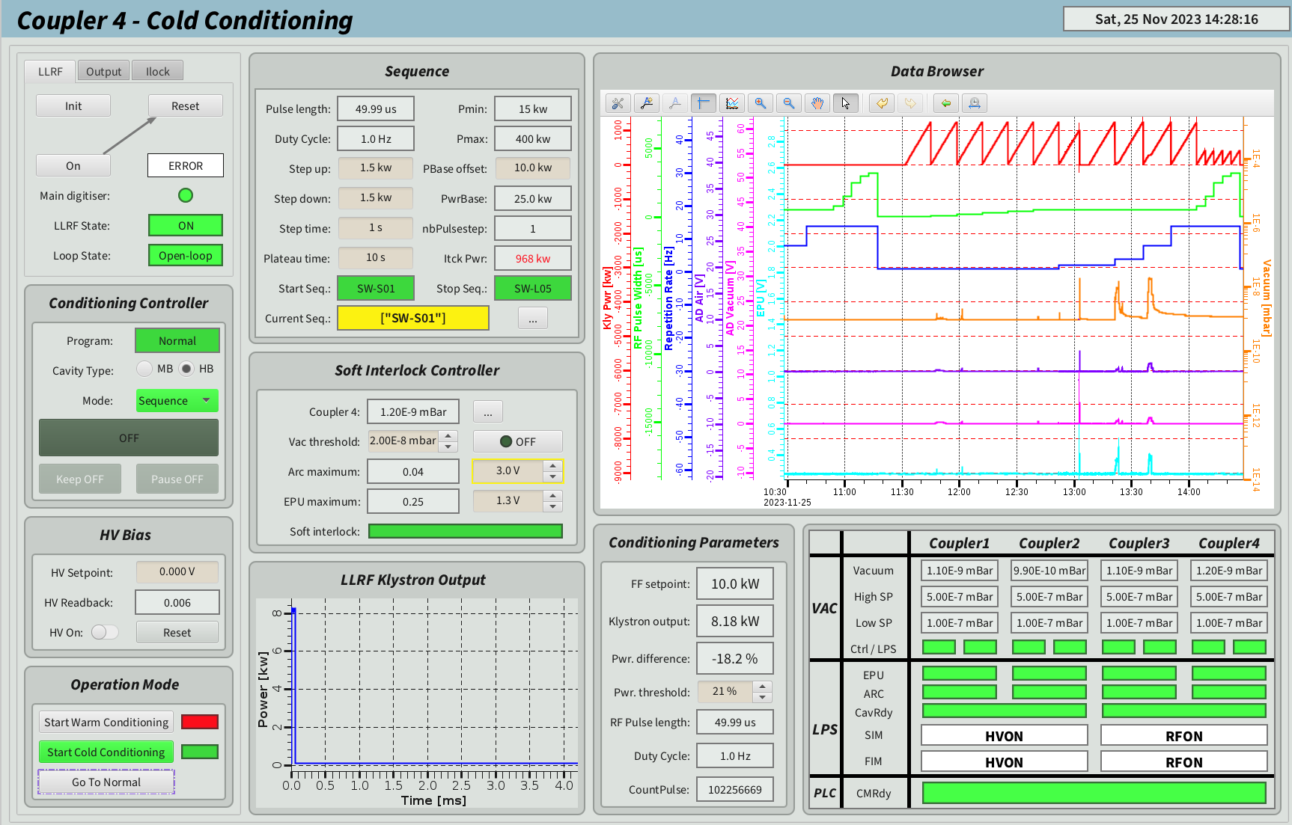
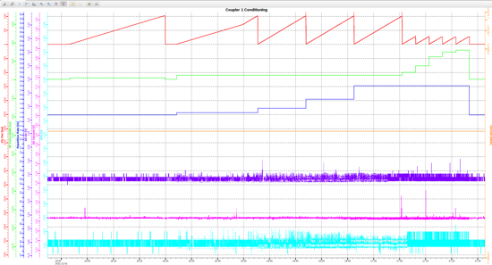
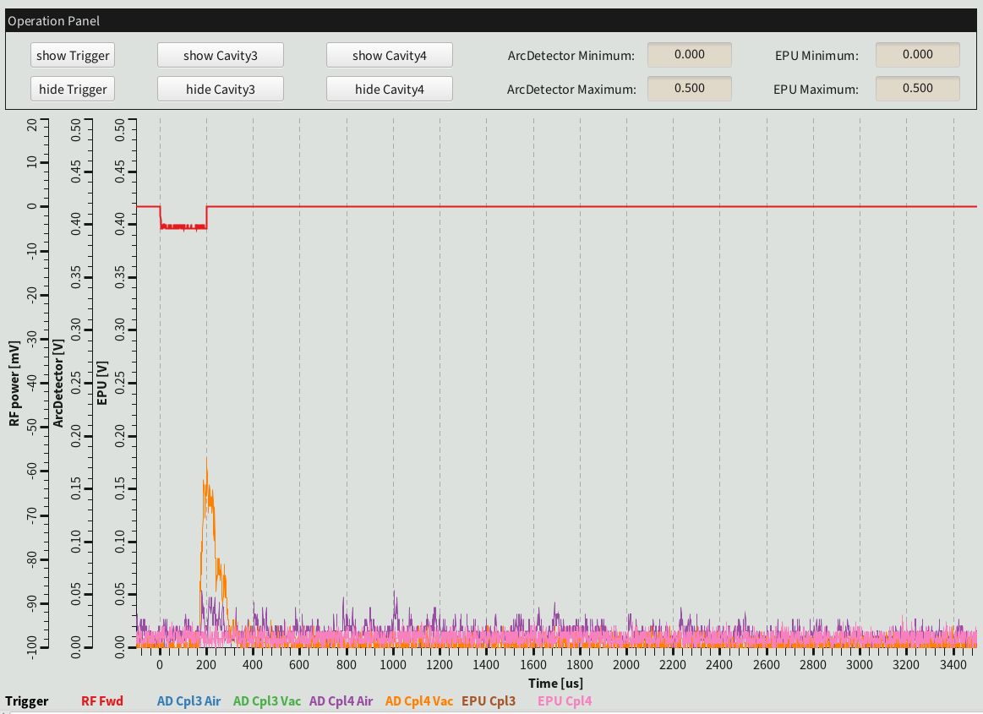
Coupler conditioning sequence
Warm and cold coupler conditioning
Automated sequencer script runs through the steps, and monitors vacuum, EPU and AD signals.
Admin limits in full reflection mode:
Power cannot exceed 300/400 kW for RF pulses (for medium and high beta couplers respectively) longer than 500 μs.
Peak power cannot exceed 1.1/1.2 MW for any pulse length
AD and EPU
Signal monitoring

Slide 13
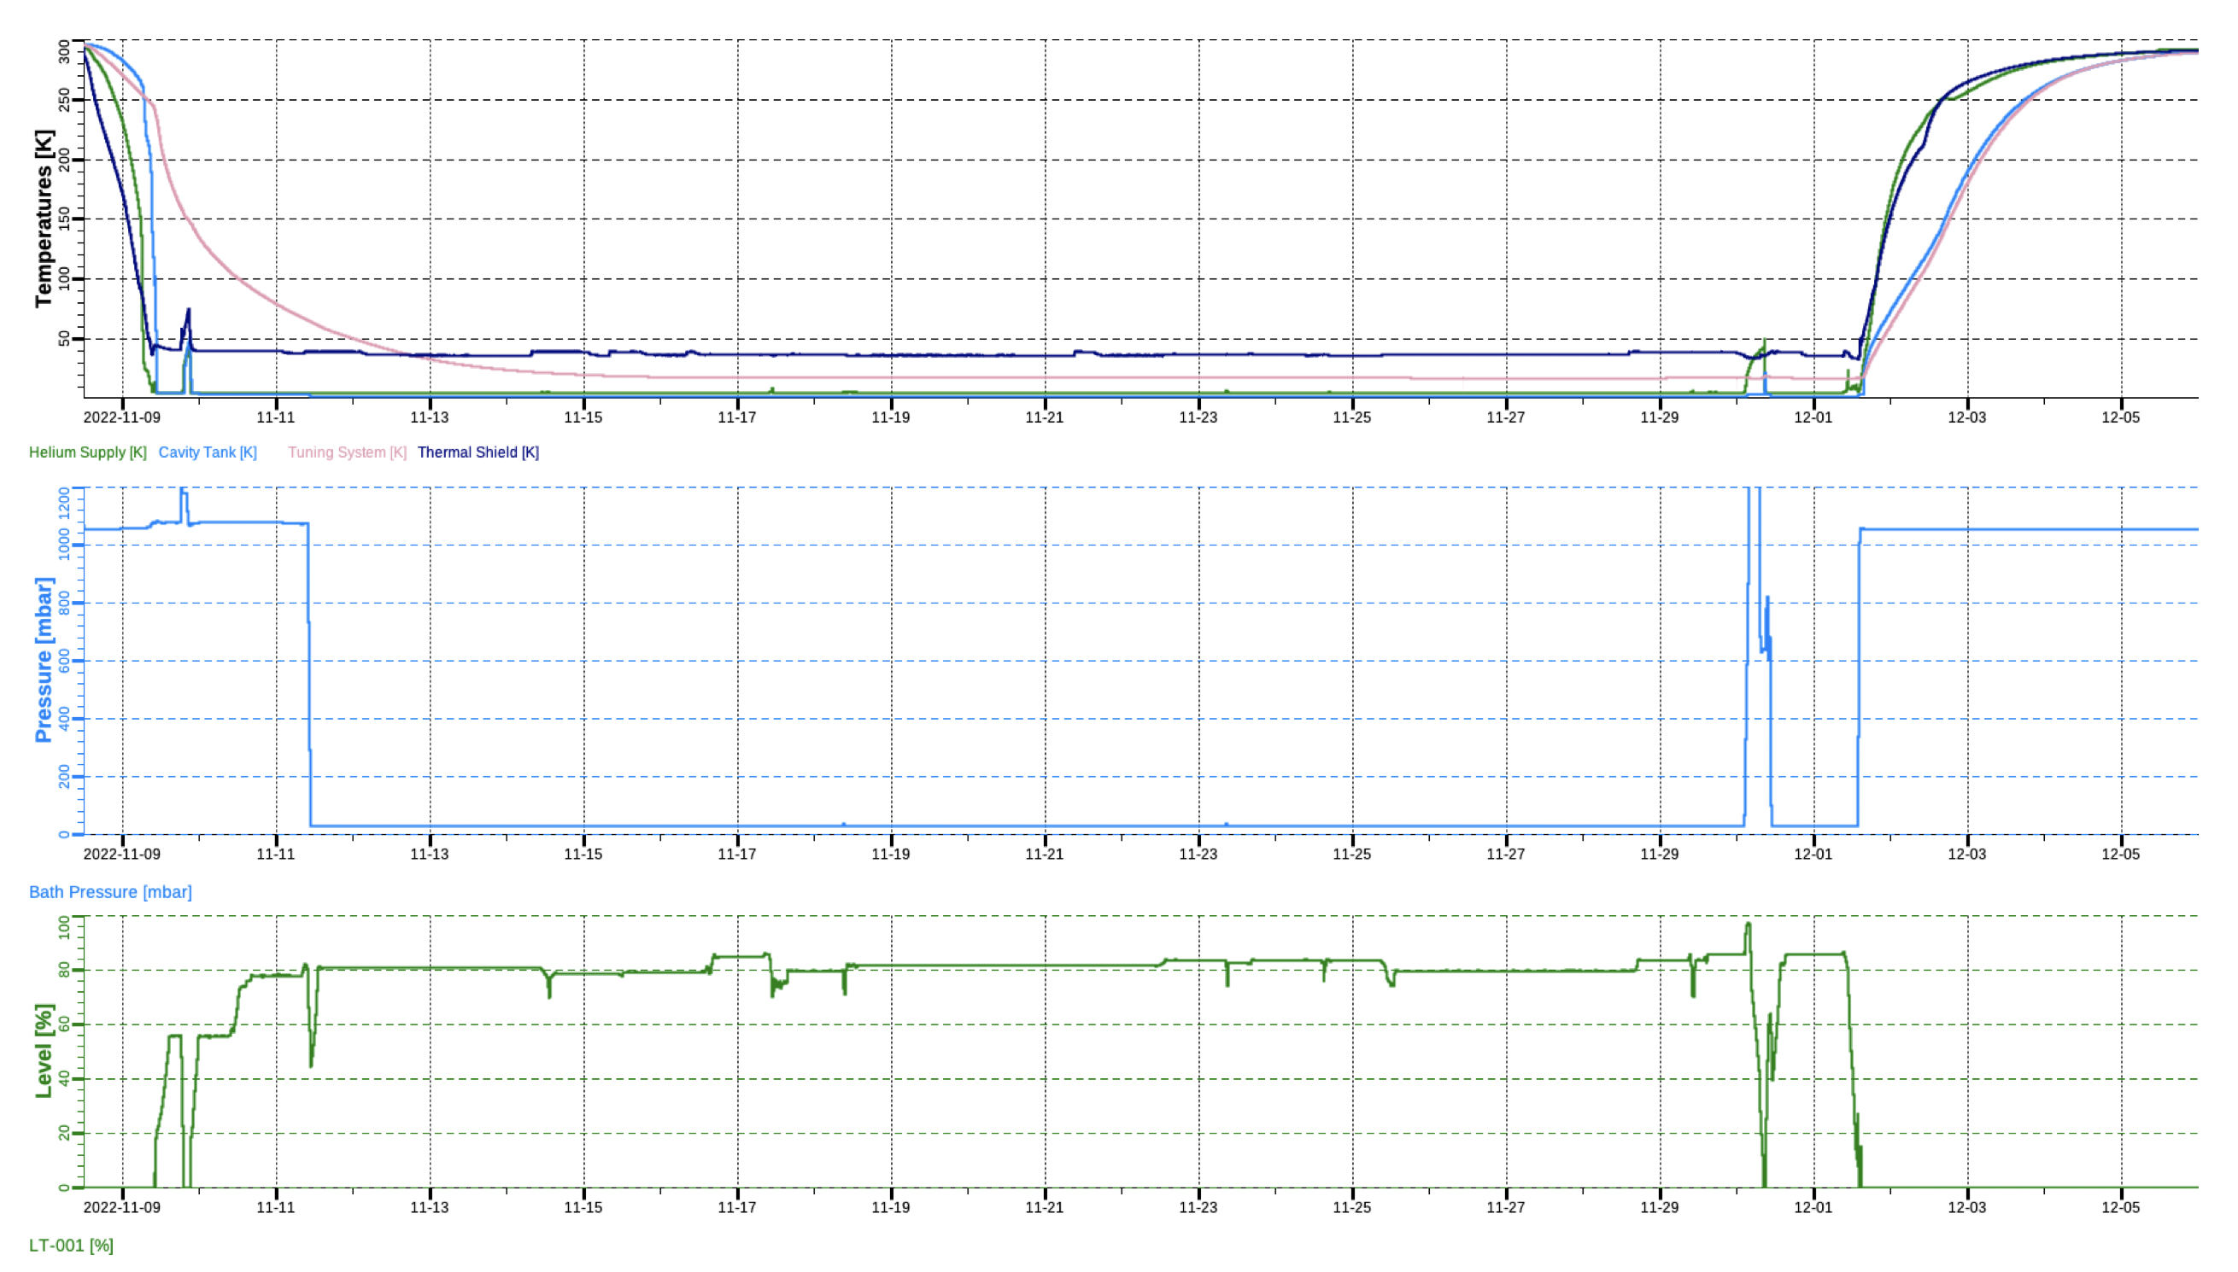
Full Cooldown Cycle
Slow thermalization of tuning system
Thermal shields ~ 50 K
Cold mass temperatures
1 bar = 4.2 K
2d
Cryo-trip!
Bath pressure
30 mbar = 2 K
Liquid level in CM
~20 d cold
2K Pumpdown
Heat load measurements
Credits, N. Elias, ESS

Slide 14
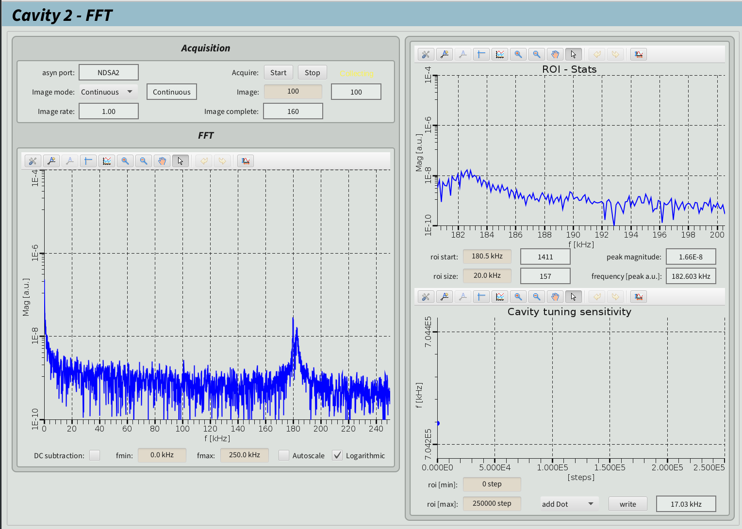
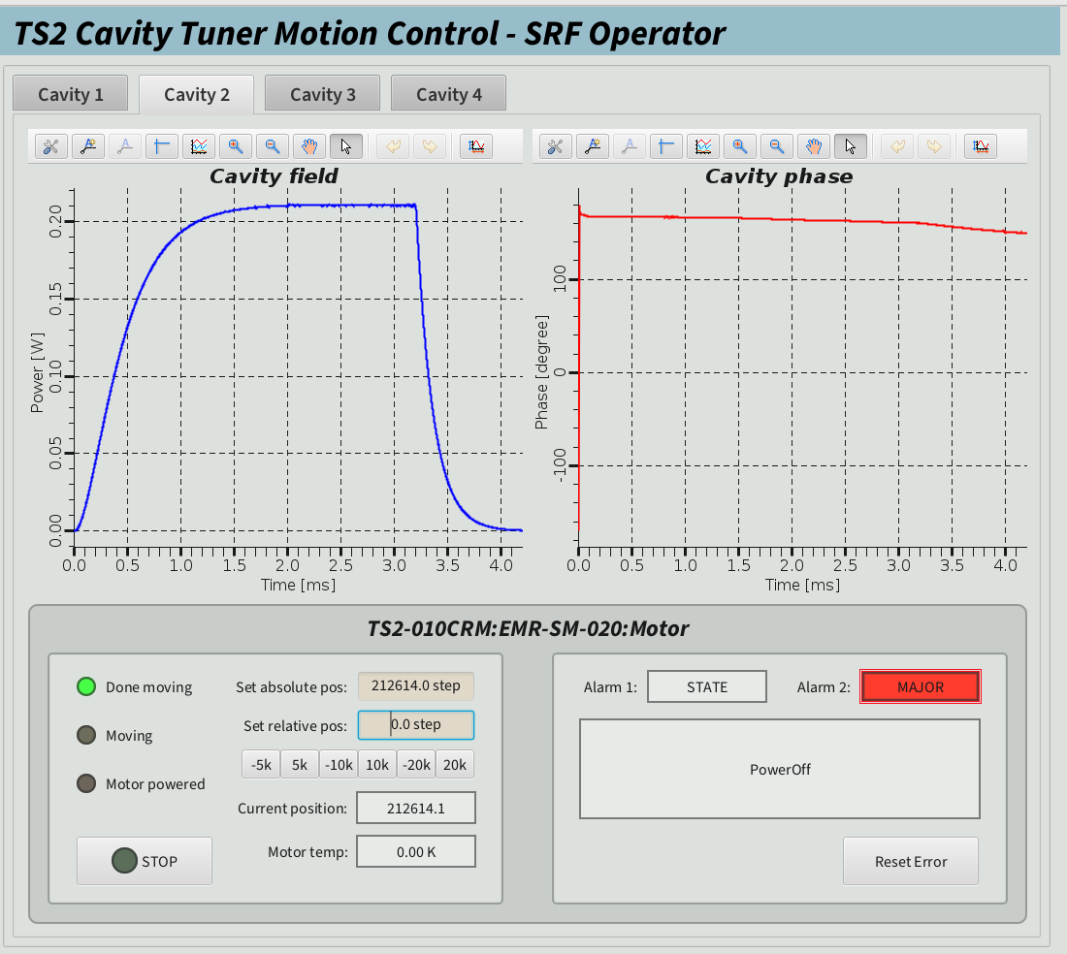
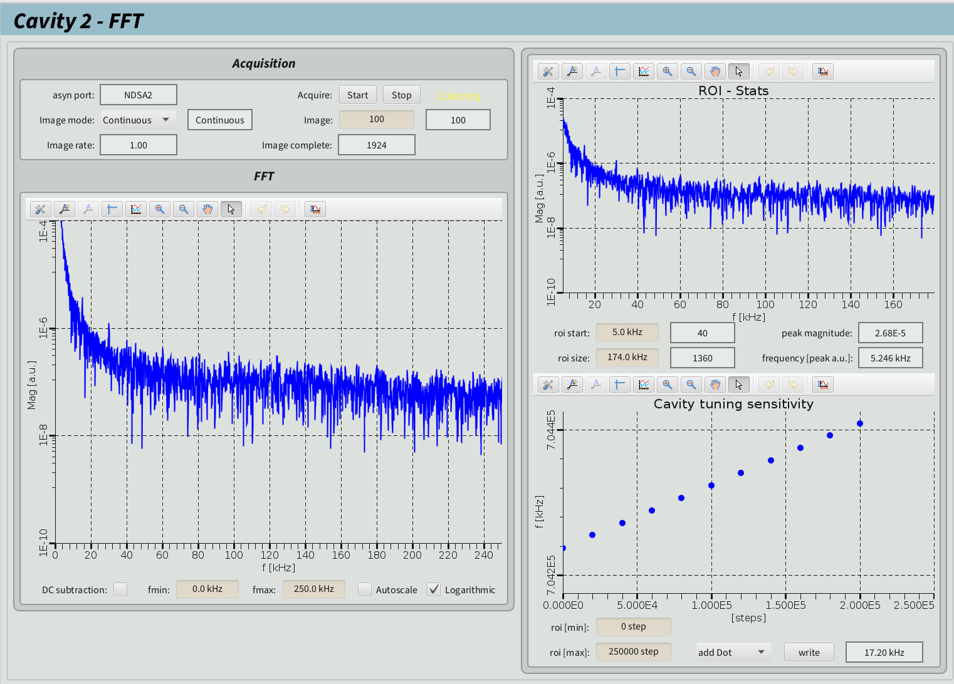
Tuning tool
Far and Fine tuning tools
Fine tuning with power increase and phase flattening
LLRF
Far tuning with calculations from LLRF Waveforms
Tuning sensitivity
(health check)
Motor control

Slide 15
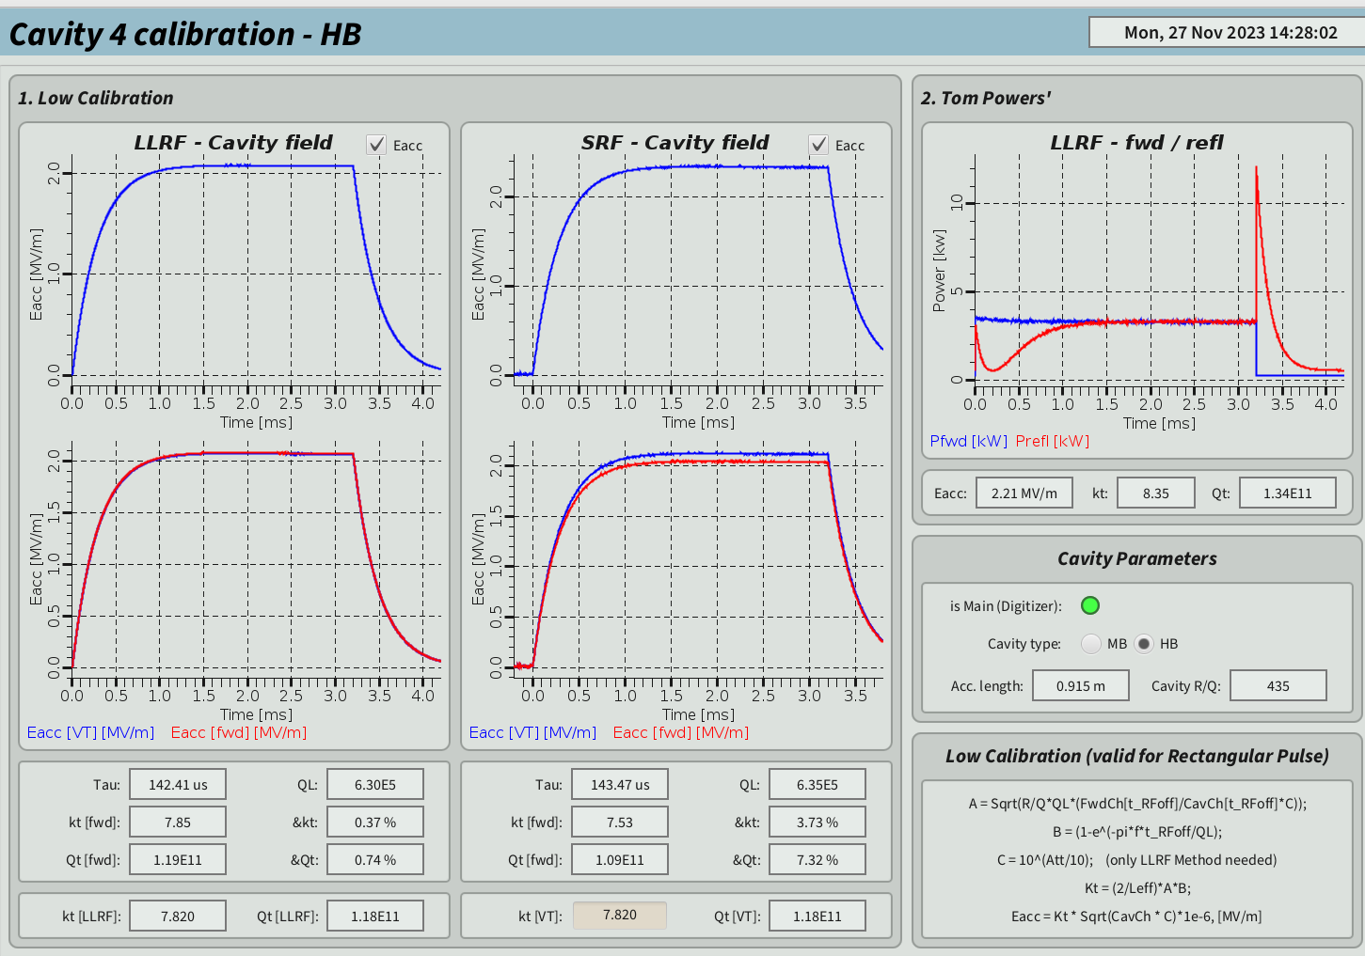
Calibration tool
Convert from power sent from Klystron to E_{acc} (or V…)
Using cavity parameters and calibration factors
PU antenna recalibrated using forward power, as VT calibration factors lead frequenctly to overestimation of cavity field
By using different methods and readings we estimate uncertainty of gradient calibration
Extra Diag at TS2 for benchmarking
Redundant power monitoring

Slide 16
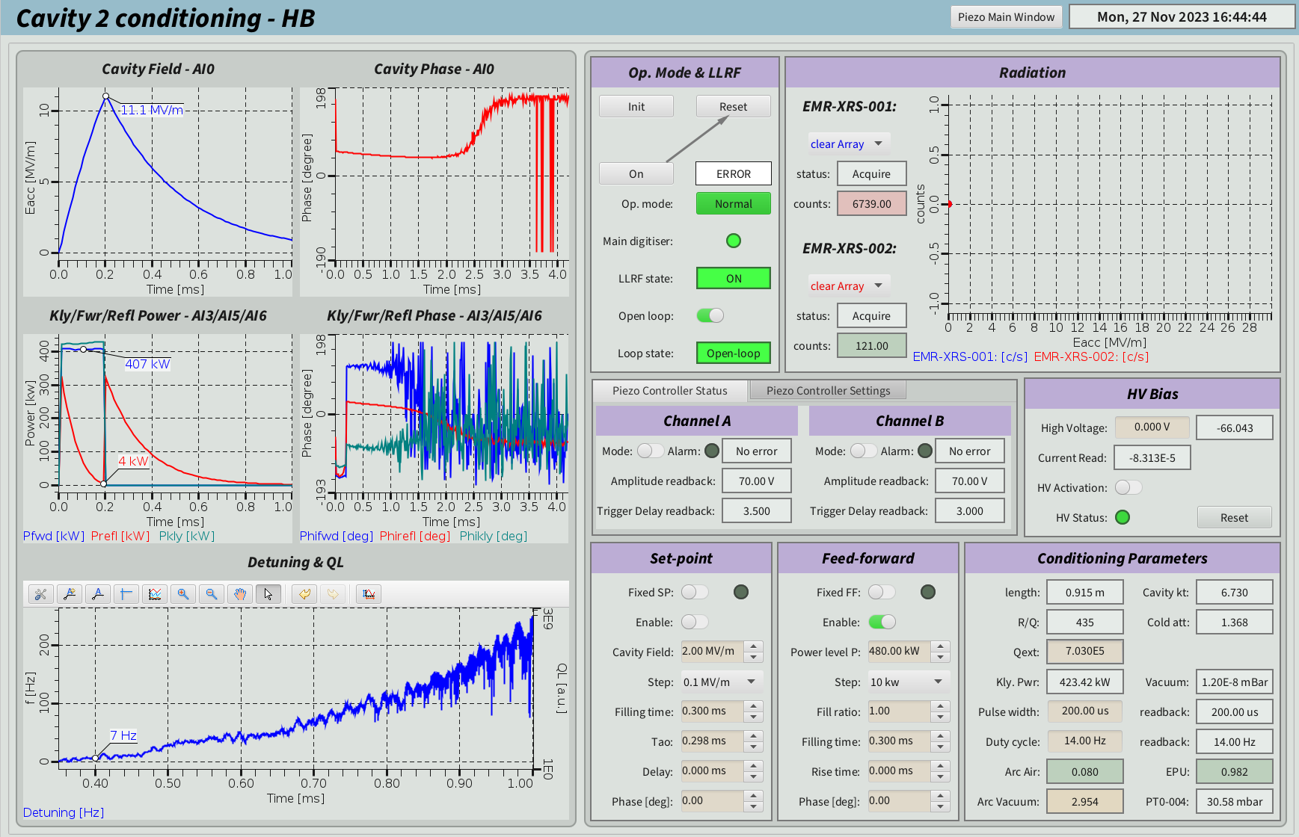
Cavity Conditioning/Operation tool (TS2)
Getting PV from several subsystems, still manual process
LLRF
Open loop at low field, then Closed loop to cope with LFD
Piezo
Bias
RF pulse control, calibrations, cavity parameters and diagnostic signals
Cavity IOC, providing in-pulse detuning calculation

Slide 17
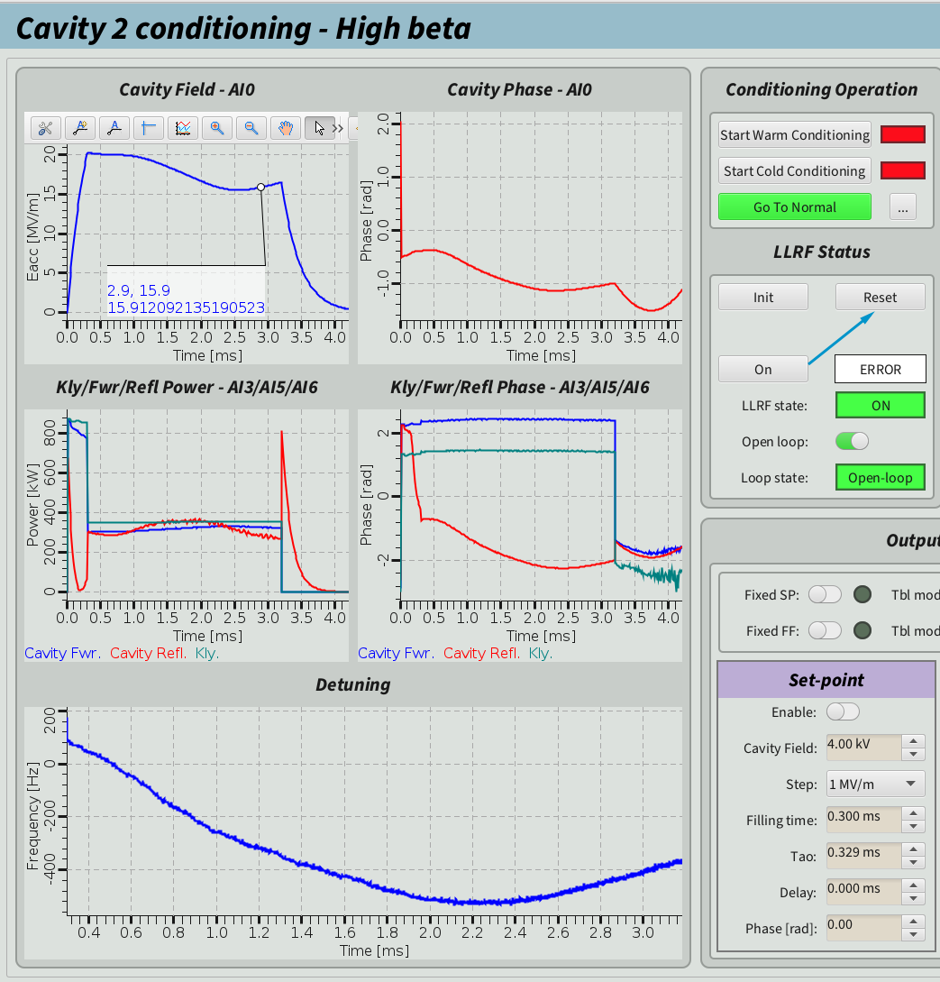
Push to high field
Lorentz Force Detuning
The RF pulse carries a mechanical pressure
The thin-walled cavity can deform due to this pressure and the cavity self-detunes
Lorentz Force Detuning
In pure open loop the LFD kills the cavity field as the cavity detunes substantially and the field drops
ESS will operates at 3.2 ms RF pulses, leading to high LFD values!
Higher effect than other pulsed machines
Detuning kills the cavity field! LFD > 600 Hz, full BW ~ 1 kHz

Slide 18
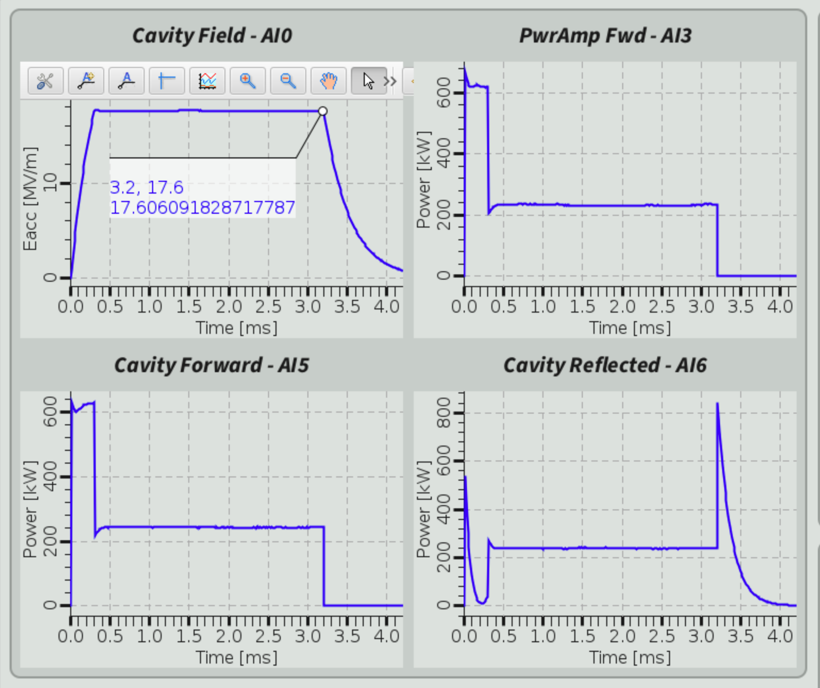
Further developments for LLRF
Piezo OFF
Cavity detuning at high field (LFD) requires > 50% extra power at pulse end!
Piezo ON
We can now operate LLRF in closed loop reliably
This has improved cavity characterization uncertainties
All cavities are checked now individually in closed loop
Only 4-cavity operation in open loop
This is particularly important for HB, to highlight the challenges of high gradient long pulse operation under severe Lorenz Force Detuning
FB loop overpower 1 BW = 2x power
Flat pulse with FB
Proof of principle of piezo operation. Next, integrate in LLRF

Slide 19
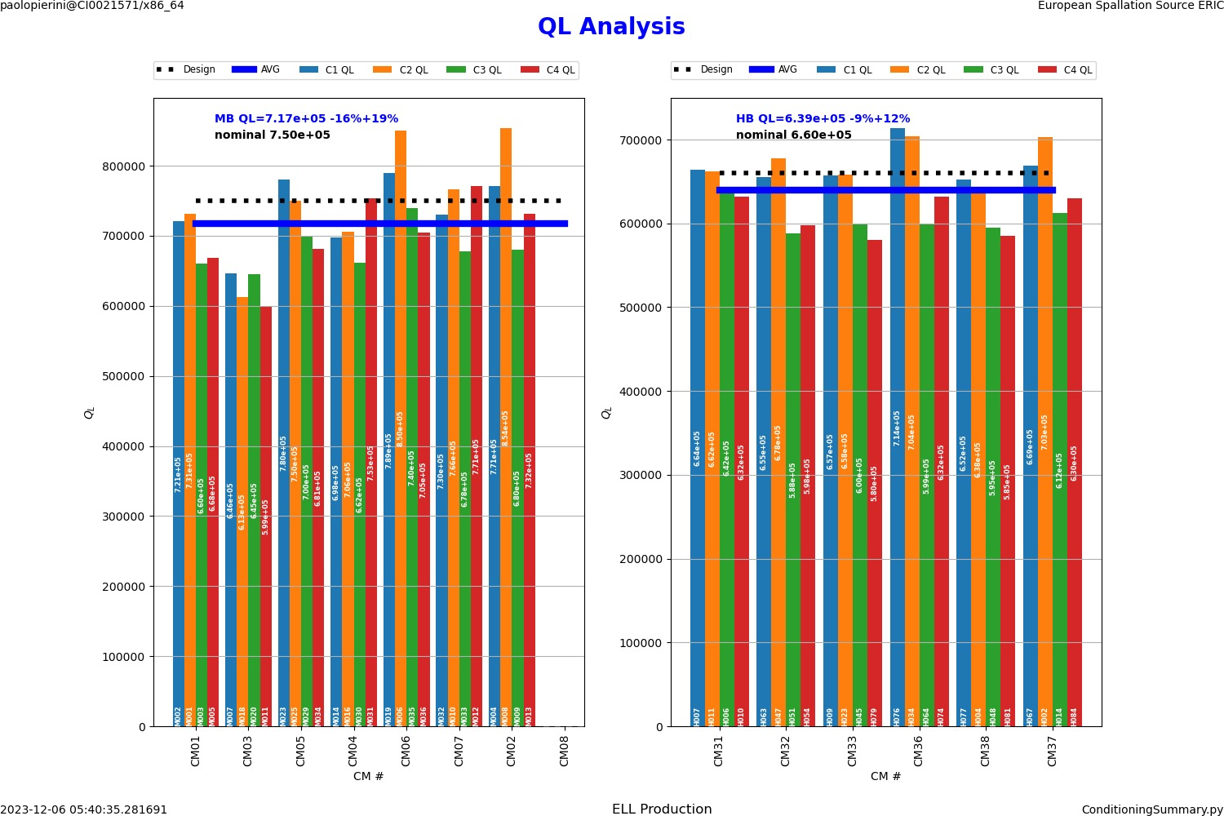
QL (fixed coupler)
ESS Cavity DB keeping track of all measurements and capable of compiling statistics

Slide 20
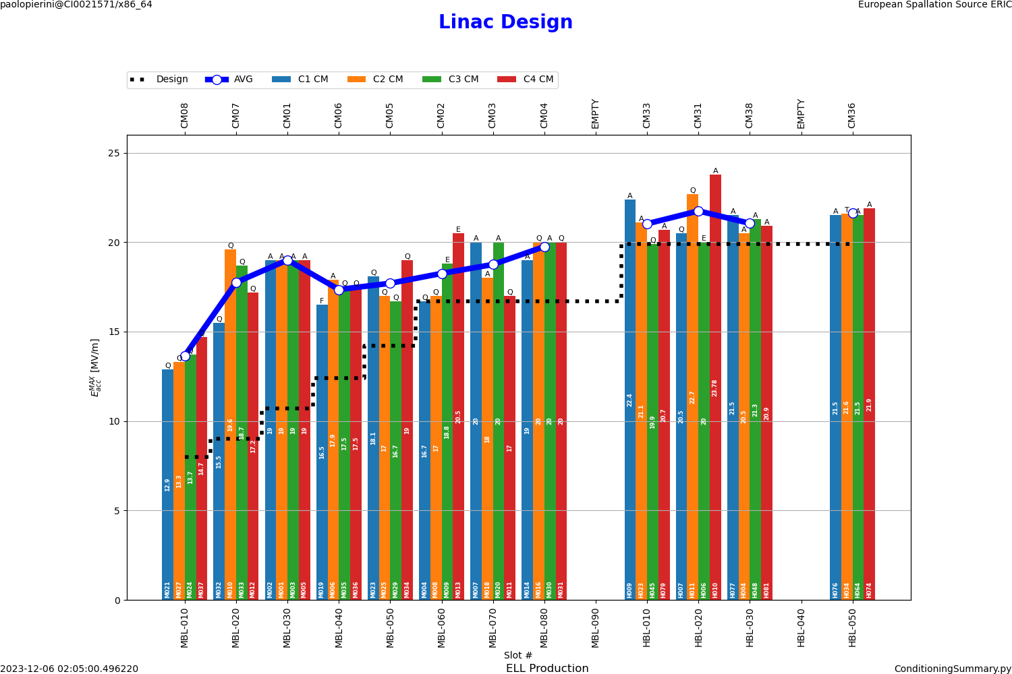
Linac Configuration
ESS Cavity DB used to generate linac configuration, to match performance with gradient requirements of the nominal design

Slide 21
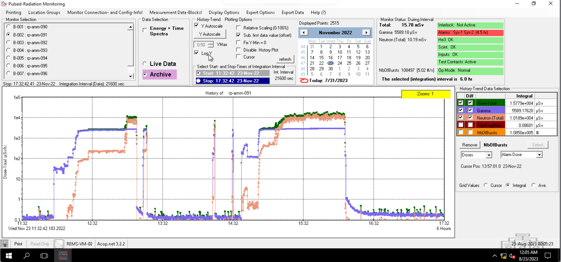
Concern: HB produce neutrons
Credits: C. Maiano
CM31 at TS2, Nb activation by Field emission from cavities
Will it harm operation?
Severe radiation background already affects cavity protection diagnostics (fibers for arc detectors), how do we differentiate from beam losses? Activity with BI to mitigate by filtering background
HB testing shows much more radiation than MB
n dose rate tens of mSv/h
FE experience with ESS cryomodules in TS2 – TTC 2023-
Pandora - RP -dose rate (uSV/h)
Joint work with RP to document TS2 rad measurements during RF excitation
Moderate 92mNb activation (y,n) observed
Scintillators - Energy Spectrum (dN/dE) count rate

Slide 22
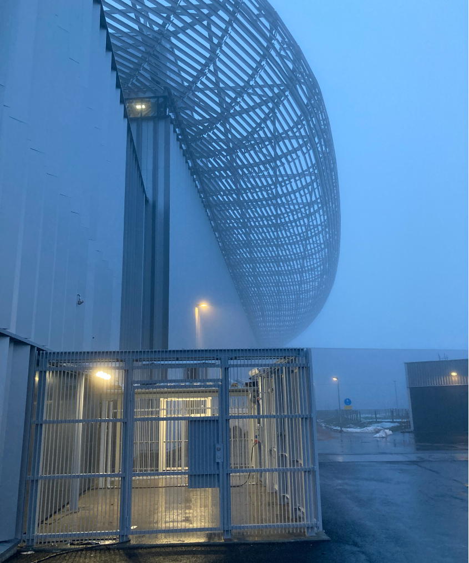
Thanks Acknowledgments * ESS: TS2 SRF, IFJ, CRYO, VAC, RP teams * CEA in-kinds

