Slide 1

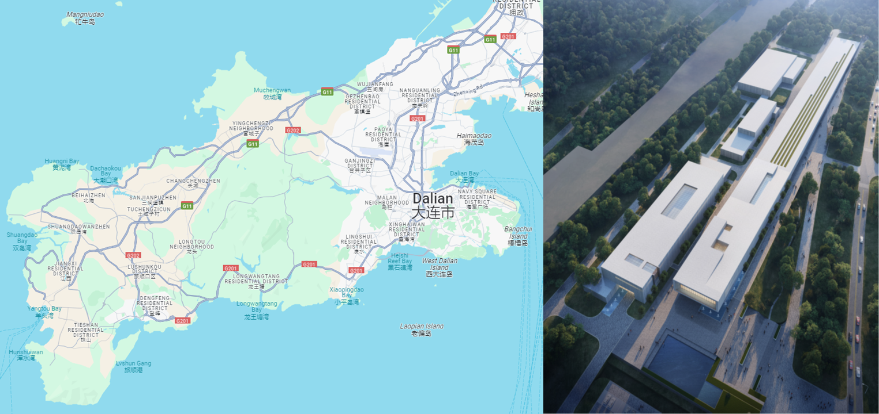
DALIAN INSTITUTE OF CHEMICAL PHYSICS,
CHINESE ACADEMY OF SCIENCES
Development of 1.3GHz 2-cell Superconducting Accelerator Module for DALS Injector
Quan Zhou Ph.D.
Dalian Light Source Science Laboratory,
SRF & cryogenic Tech. Research Group
Dalian YingGeShi
Dalian Advanced Light Source
December 6,2023

Slide 2
Report Content
01
Research Background
Dalian Advanced Light Source injector layout.
02
Module Design
Cavity; Coupler; Tuner; Beam line component; Cryogenic thermostat etc.
03
Research Progress
Fabrication; Process; Test; Assemble.

Slide 3
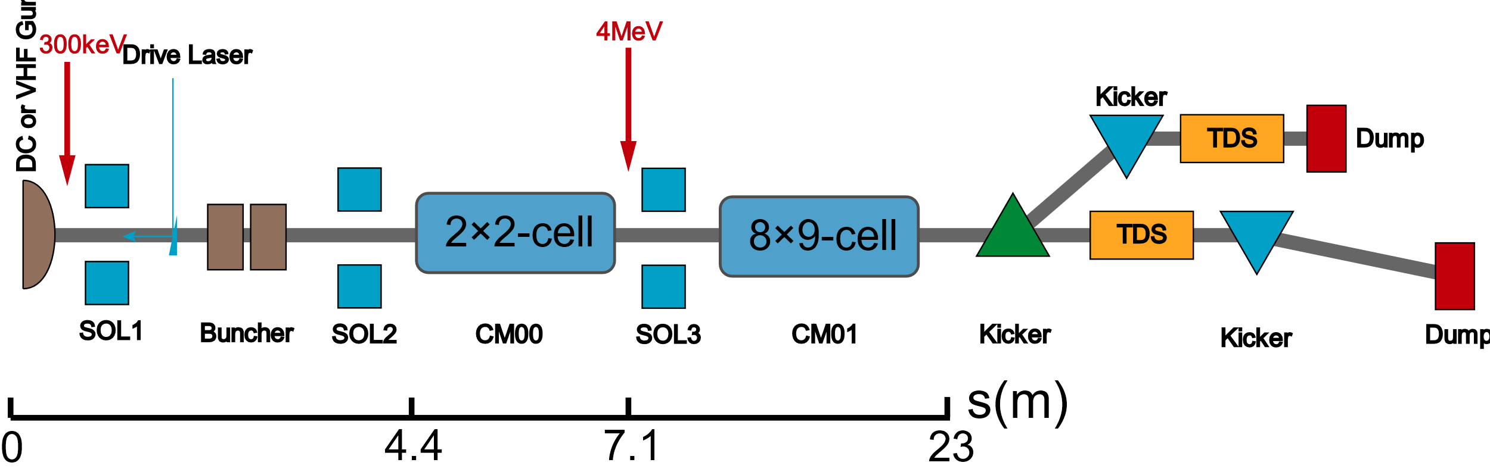
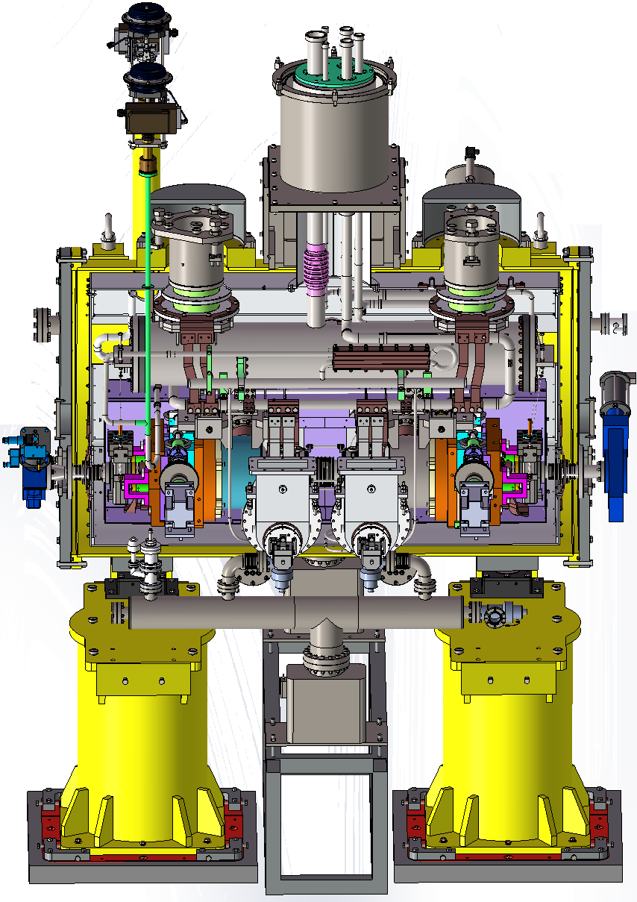
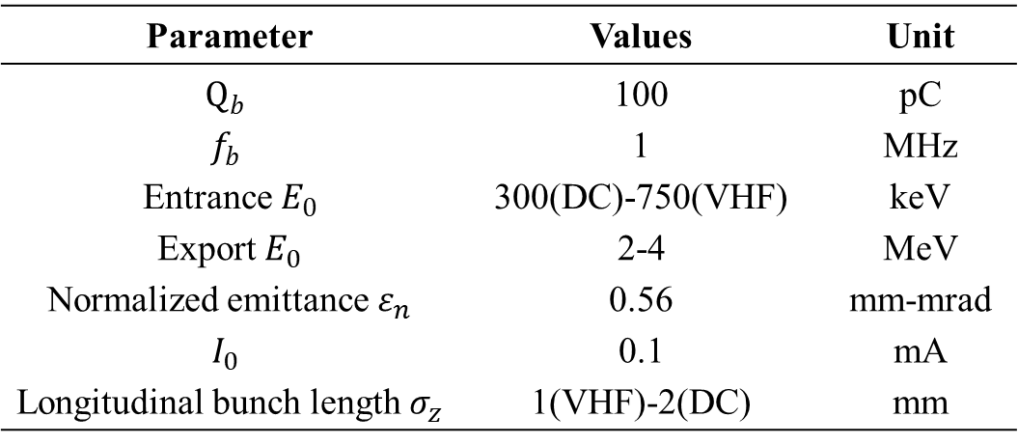
Research Background
JT & Cool Down Valve
Vacuum Barrier
Post
Carbon Steel Shield
Cold Plate
Dalian Advanced Light Source Injector
HTC
Manual valve
CM00 Beam Design Parameters
VAT
Gate valve
Parameter | Values | Unit
$$Q_{b}$$ | 100 | pC
$$f_{b}$$ | 1 | MHz
Entrance $E_{0}$ | 300(DC)-750(VHF) | keV
Export $E_{0}$ | 2-4 | MeV
Normalized emittance $ε_{n}$ | 0.56 | mm-mrad
$$I_{0}$$ | 0.1 | mA
Longitudinal bunch length $σ_{z}$ | 1(VHF)-2(DC) | mm
Tuner
Cavity
Magnetic Shield
Twin
Coupler
DC: Direct Current gun; VHF: Very High Frequency gun;
CM00 Module

Slide 4
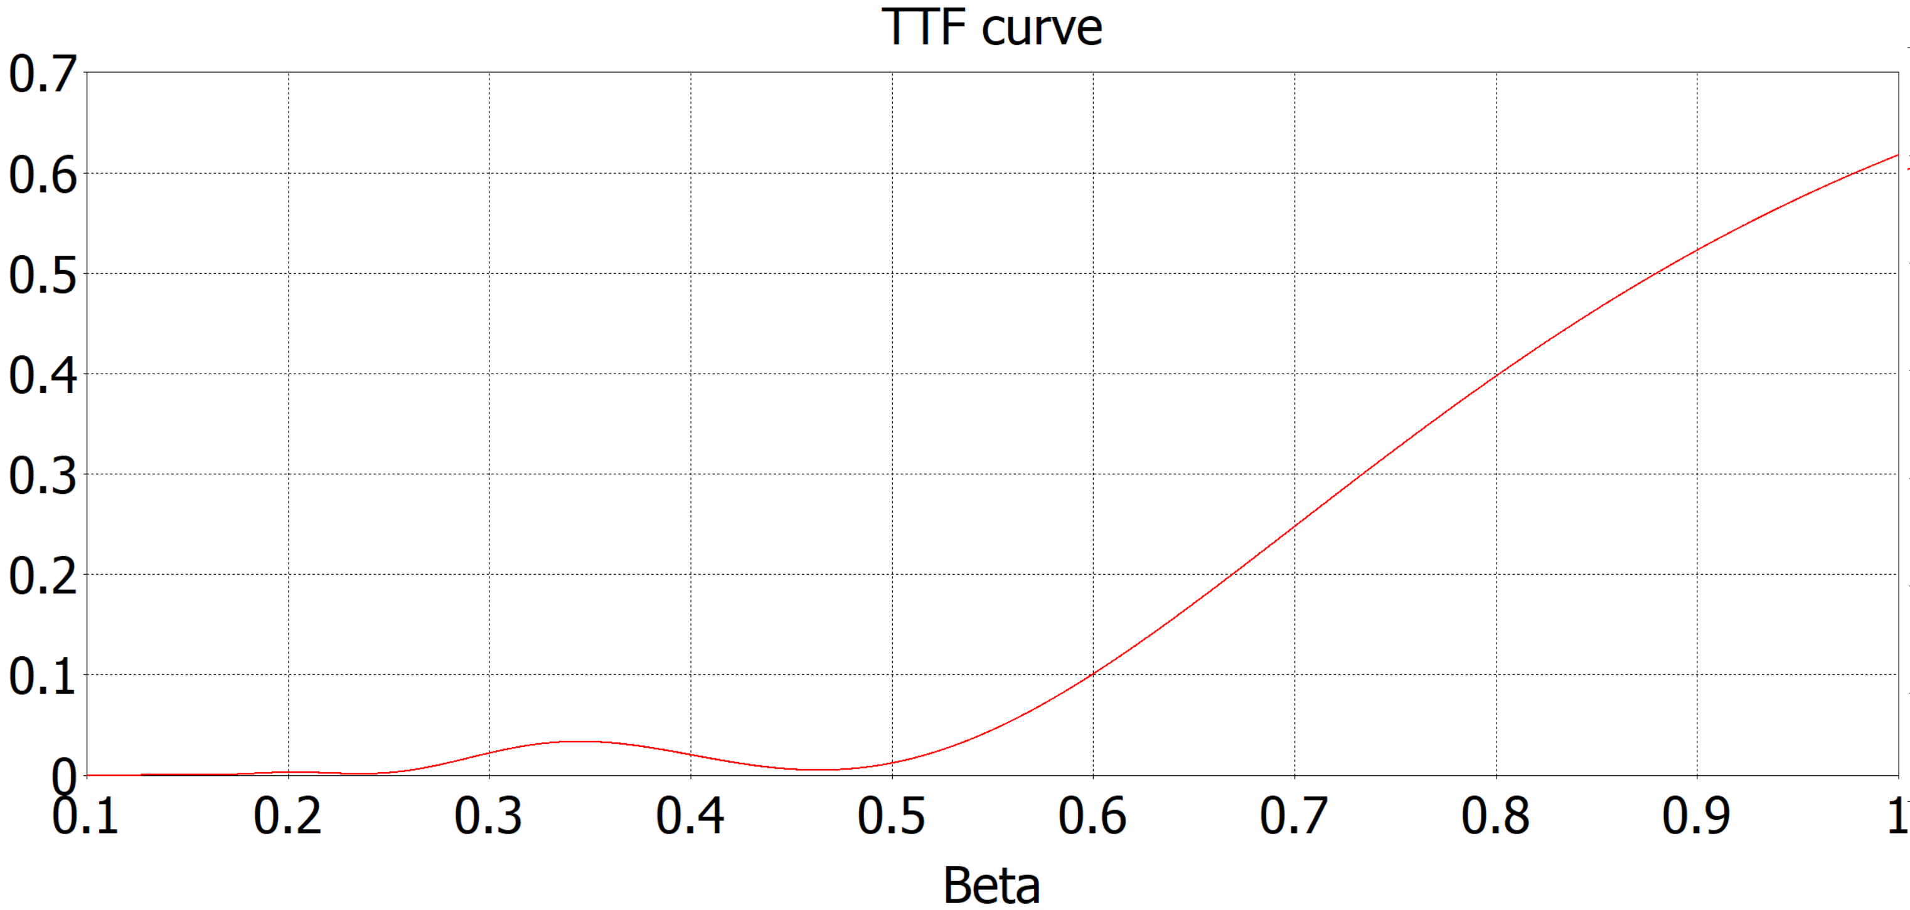
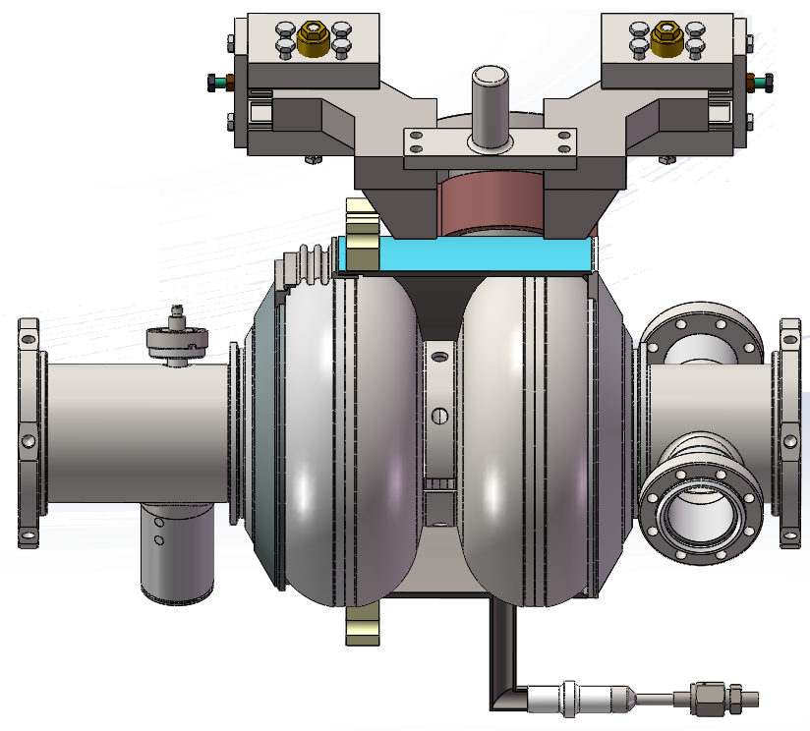
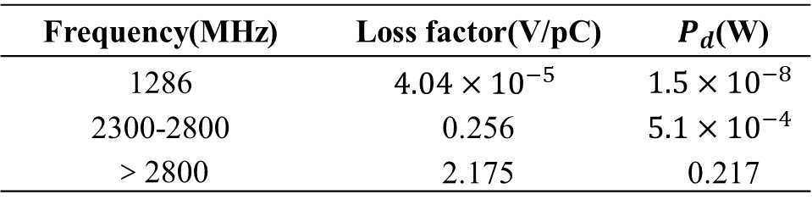
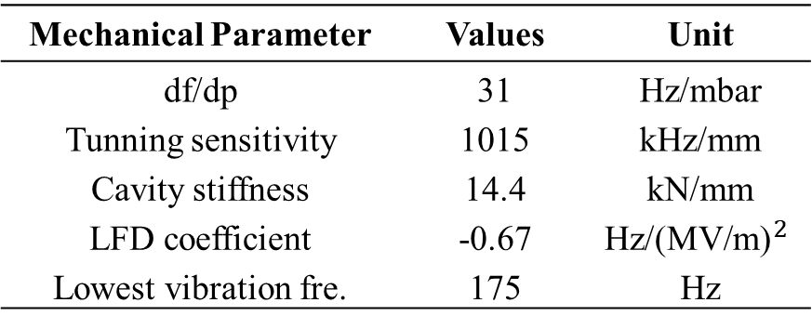
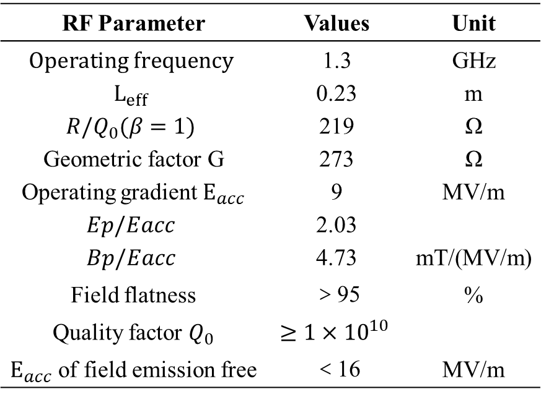
Module Design: Cavity
RF Parameter | Values | Unit
$$Operating frequency$$ | 1.3 | GHz
$$L_{eff}$$ | 0.23 | m
$$R/Q_{0}(β=1)$$ | 219 | Ω
Geometric factor G | 273 | Ω
Operating gradient $E_{acc}$ | 9 | MV/m
$$Ep/Eacc$$ | 2.03
$$Bp/Eacc$$ | 4.73 | mT/(MV/m)
Field flatness | ＞95 | %
Quality factor $Q_{0}$ | $$≥1×{10}^{10}$$
$E_{acc}$ of field emission free | ＜16 | MV/m
C Type Clamp
60%
85%
Fix Limit
CF35
700keV
300keV
Pt
DN 78
DN 40
PHOM
VCR
1.3GHz 2-cell Twin coupler TESLA Cavity
Mechanical Parameter | Values | Unit
df/dp | 31 | Hz/mbar
Tunning sensitivity | 1015 | kHz/mm
Cavity stiffness | 14.4 | kN/mm
LFD coefficient | -0.67 | $${\text{Hz}\text{/(}\text{MV}\text{/}\text{m}\text{)}}^{2}$$
Lowest vibration fre. | 175 | Hz
HOM Parameters
Frequency(MHz) | Loss factor(V/pC) | $P_{d}$(W)
1286 | $$4.04×{10}^{−5}$$ | $$1.5×{10}^{−8}$$
2300-2800 | 0.256 | $$5.1×{10}^{−4}$$
＞2800 | 2.175 | 0.217

Slide 5
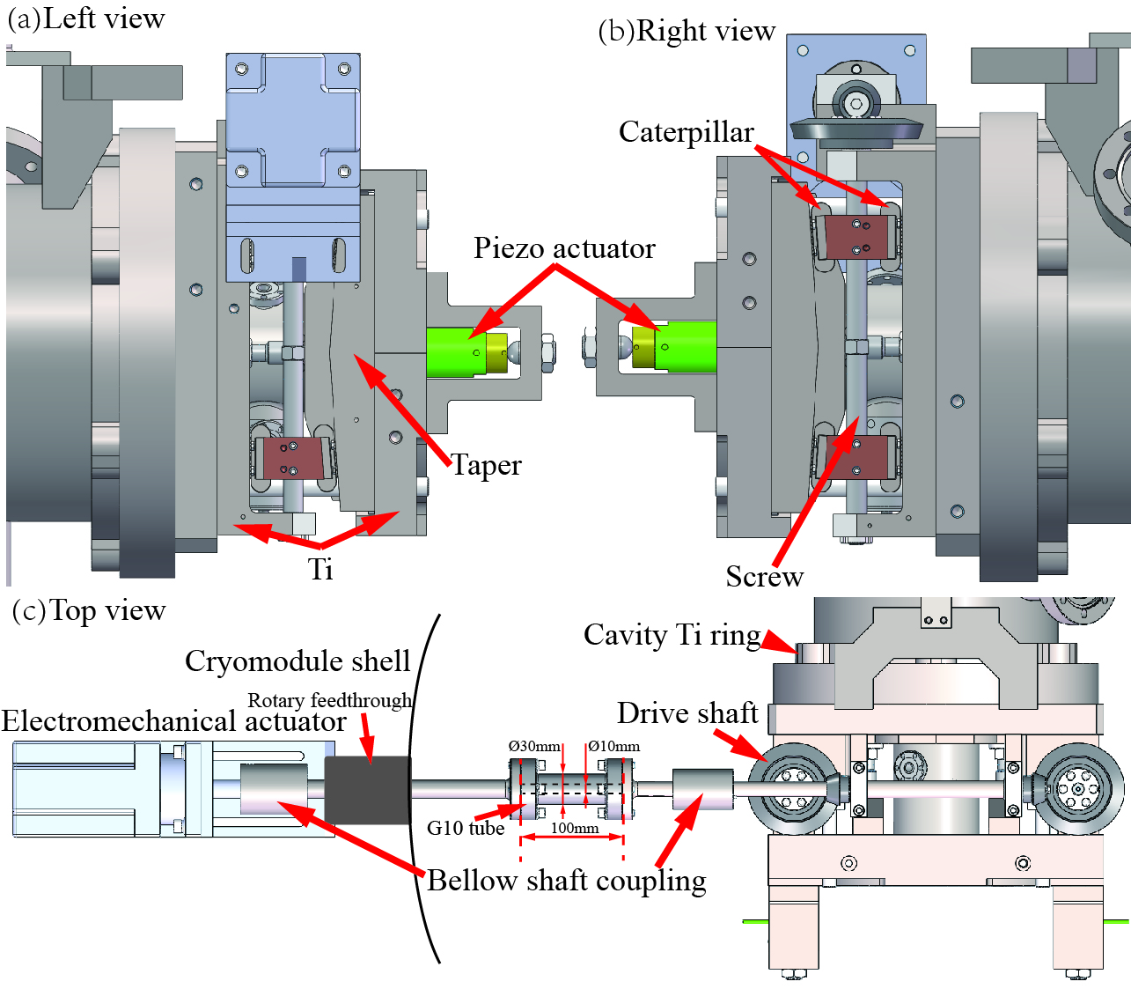
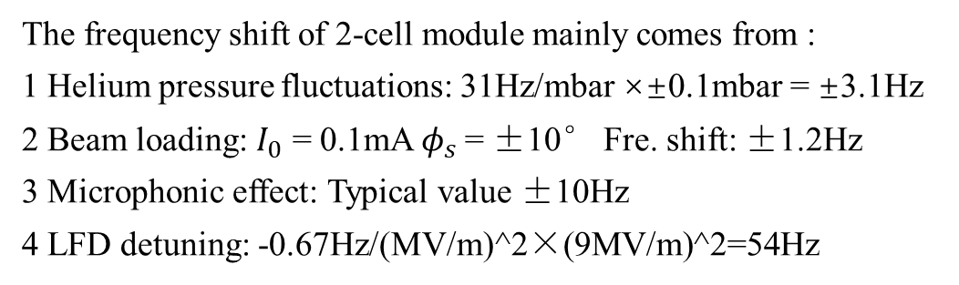
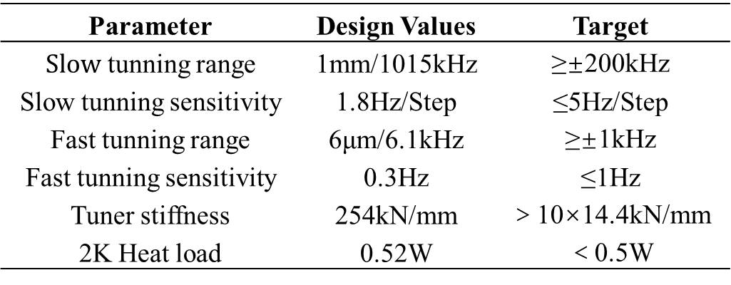
Module Design: Tuner
Tuner Mechanical & Heat Load Parameters
Parameter | Design Values | Target
$Slow$ tunning range | 1mm/1015kHz | ≥±200kHz
Slow tunning sensitivity | 1.8Hz/Step | ≤5Hz/Step
Fast tunning range | 6μm/6.1kHz | ≥±1kHz
Fast tunning sensitivity | 0.3Hz | ≤1Hz
Tuner stiffness | 254kN/mm | ＞10×14.4kN/mm
2K Heat load | 0.52W | ＜0.5W
The frequency shift of 2-cell module mainly comes from :
1 Helium pressure fluctuations: 31Hz/mbar ×±0.1mbar = ±3.1Hz
2 Beam loading: $I_{0}$ = 0.1mA $φ_{s}$ = ±10° Fre. shift: ±1.2Hz
3 Microphonic effect: Typical value ±10Hz
4 LFD detuning: -0.67Hz/(MV/m)^2×(9MV/m)^2=54Hz
KEK Slide Type Tuner

Slide 6
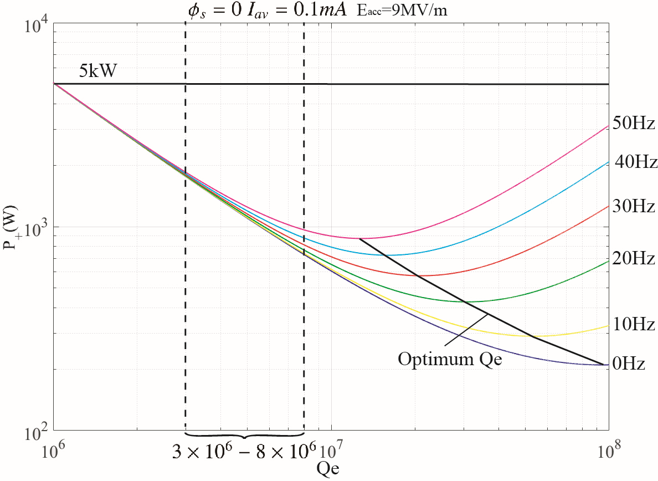
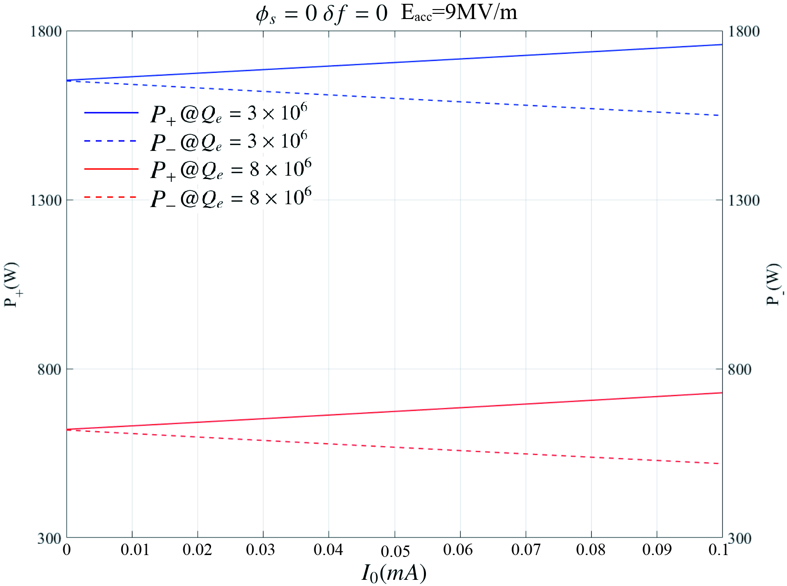
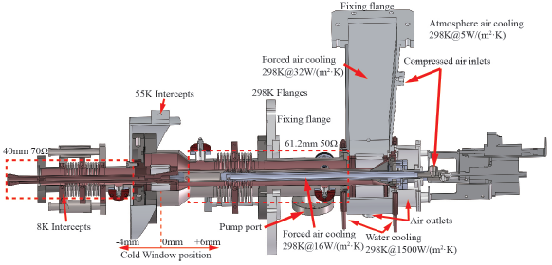
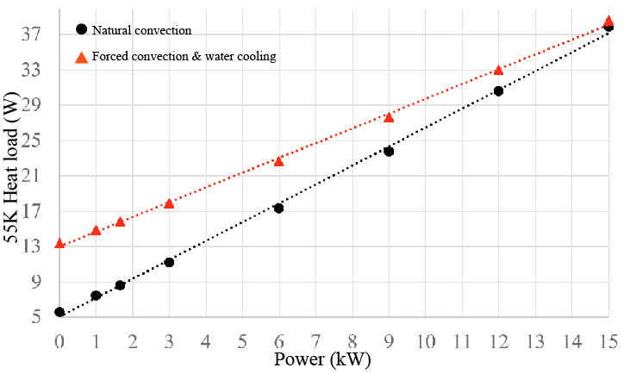
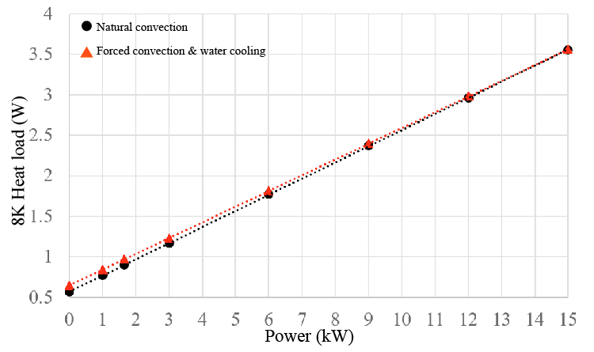
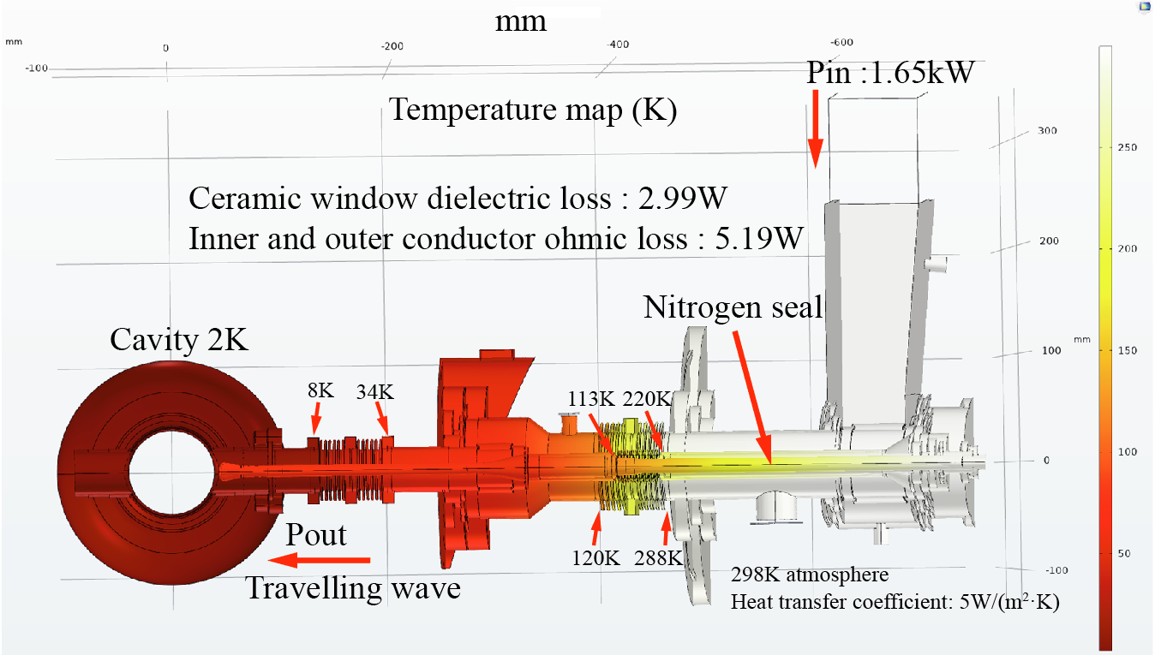
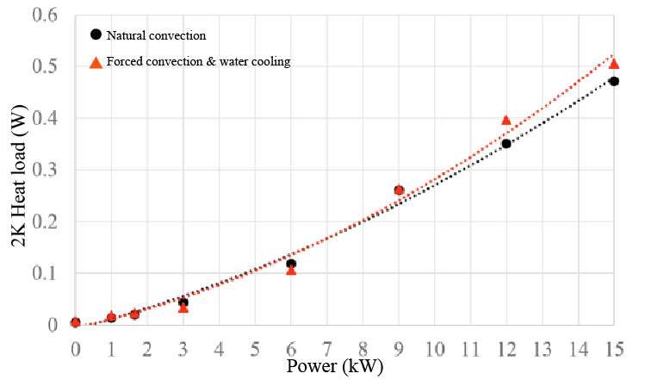
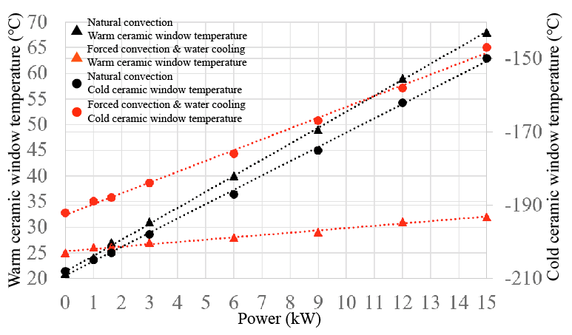
Module Design: Coupler
Power required for cavity operation
5mm
Modified TTF-III Coupler
Heat load analysis
Operating temperature map

Slide 7
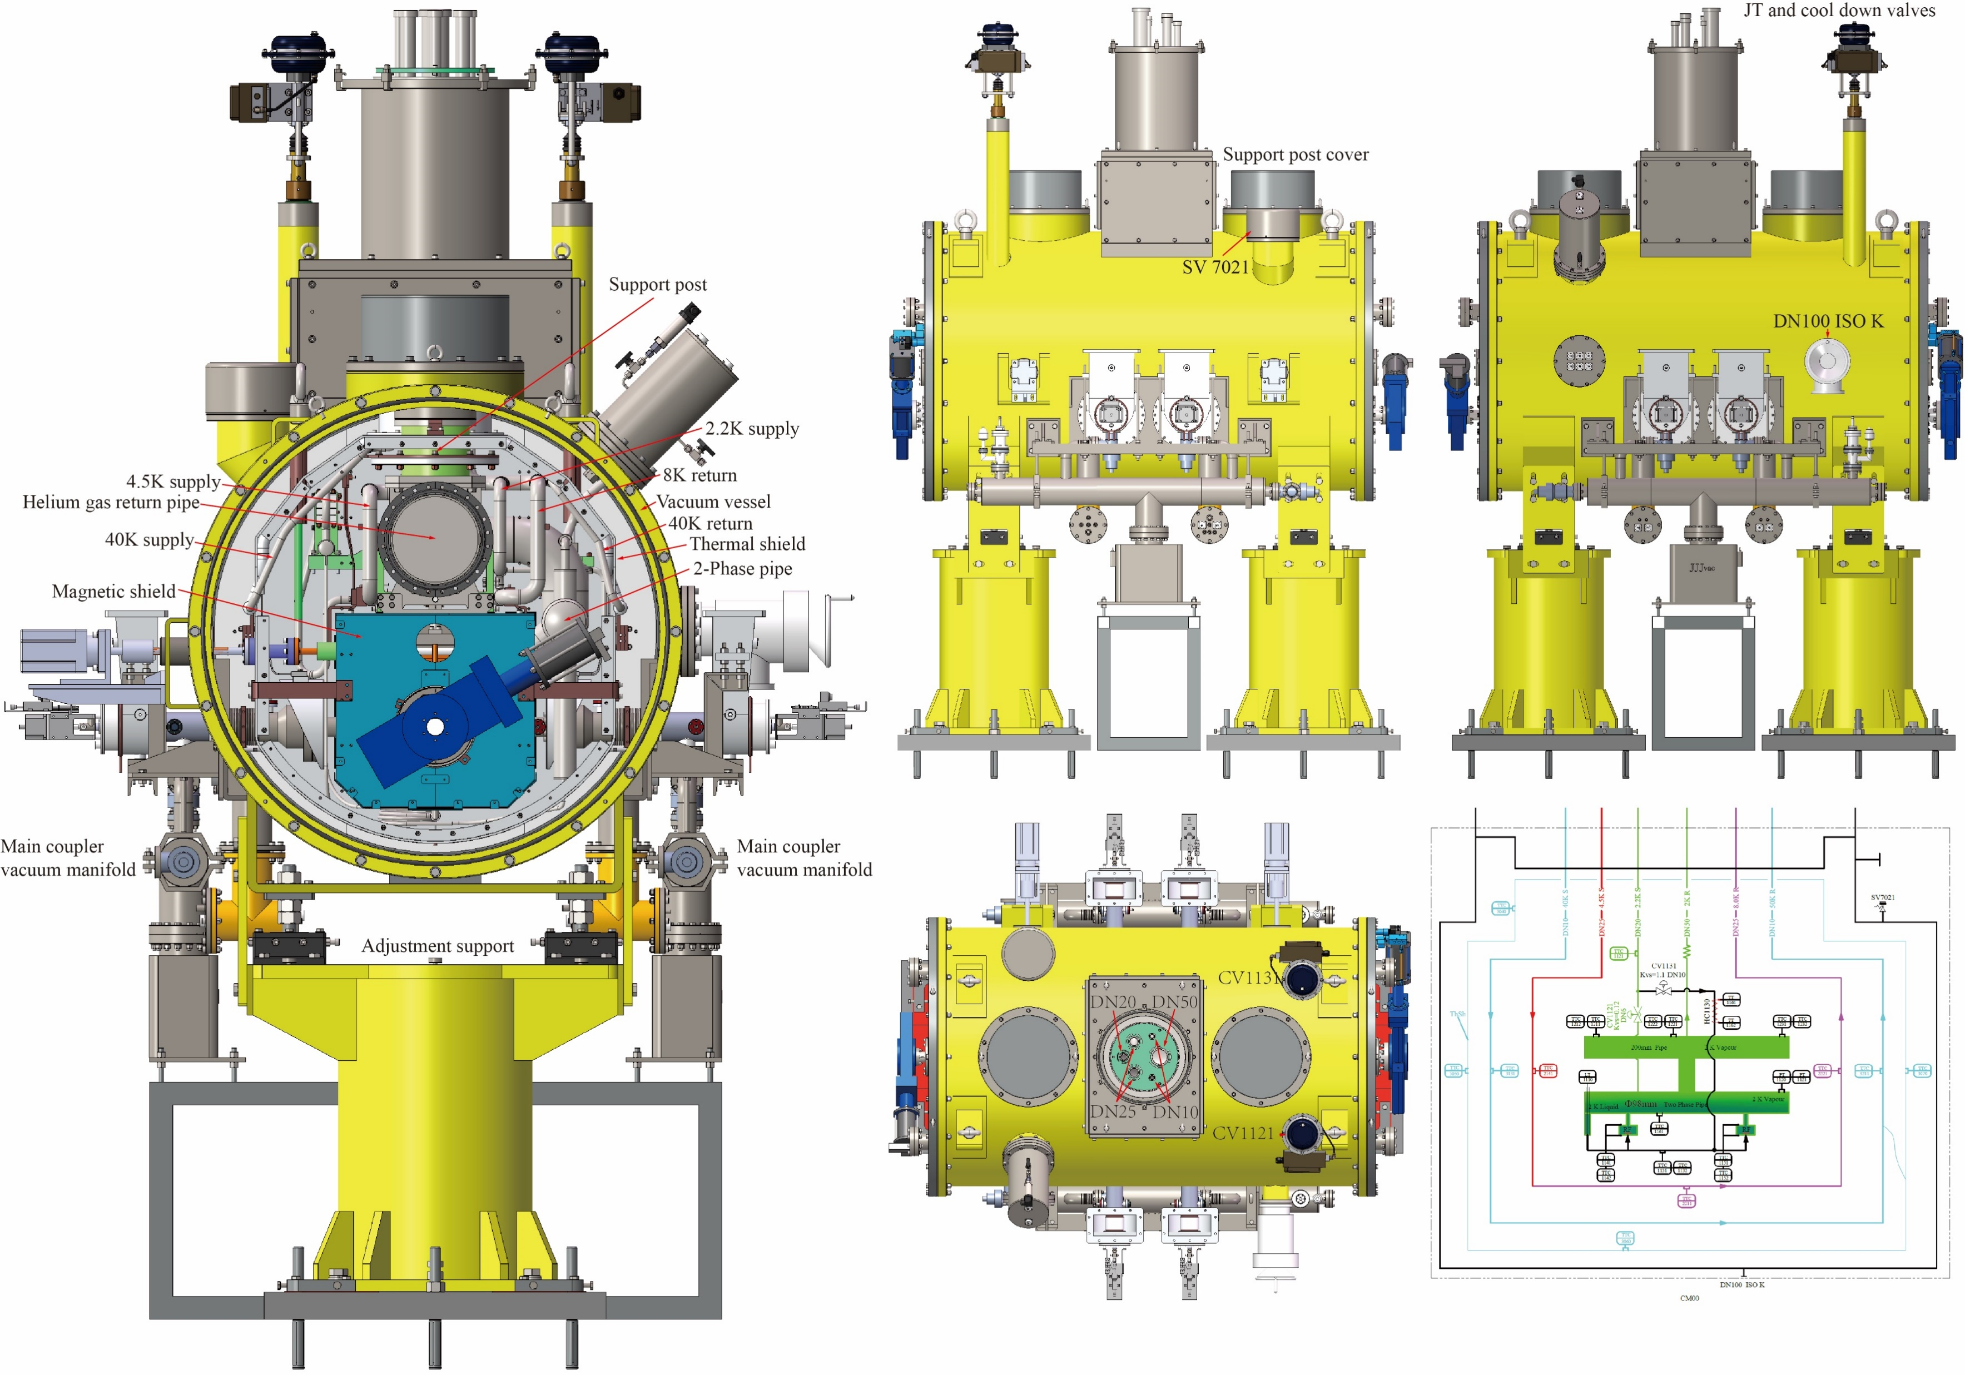
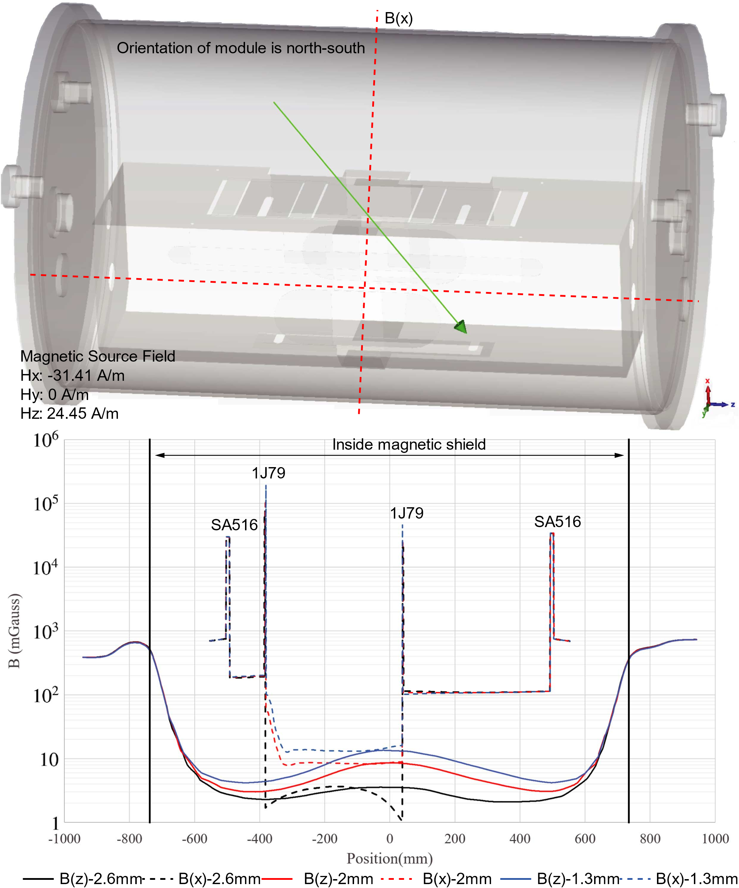
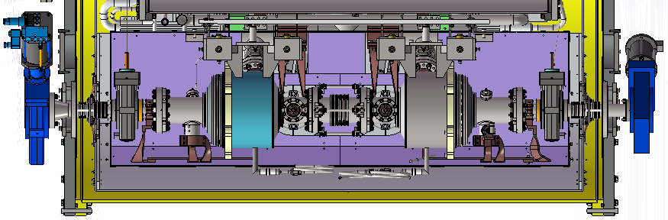
Module Design
Pipes; Thermostat; Cold plates and others
Magnetic Shield Design
98mm
Invar rod
DN63
DN38
50K
2K
2K
50K

Slide 8
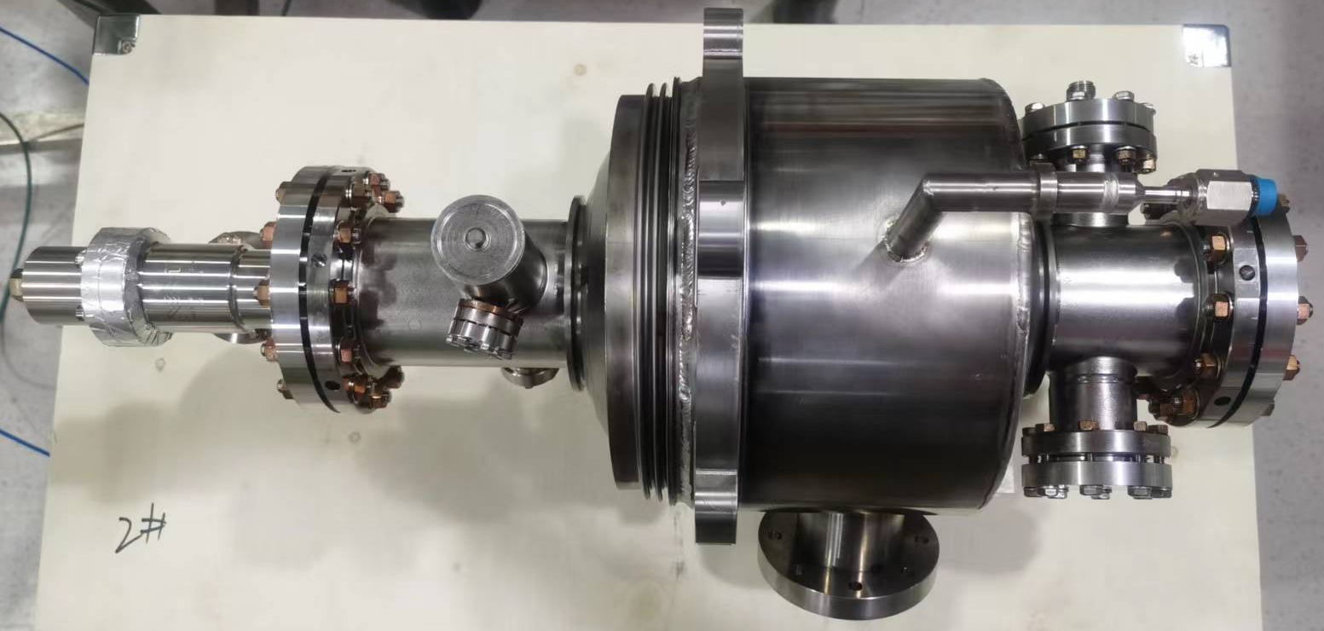
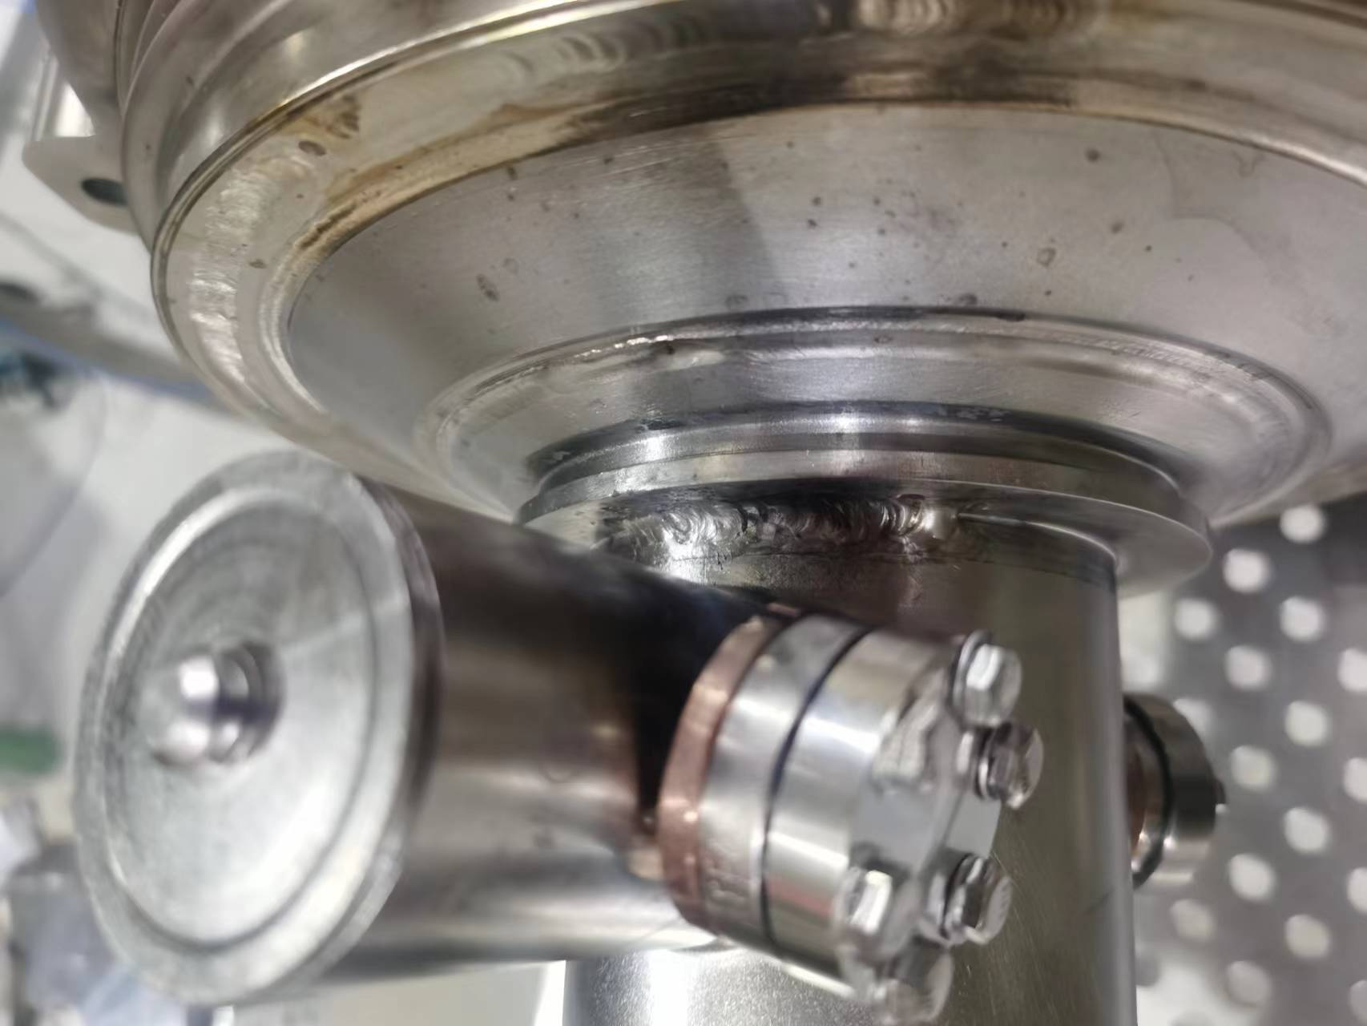
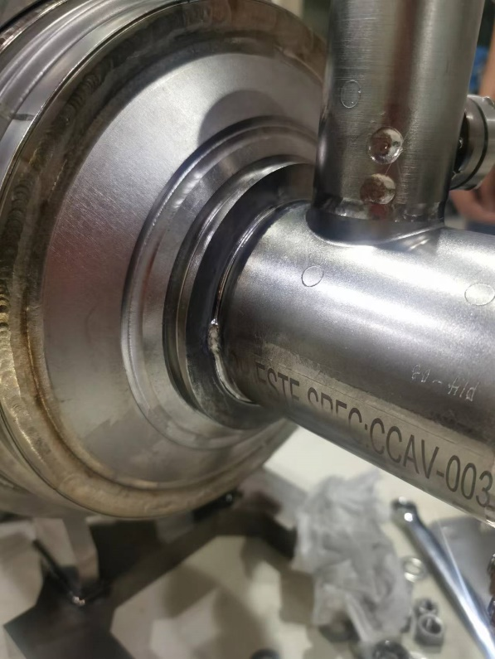
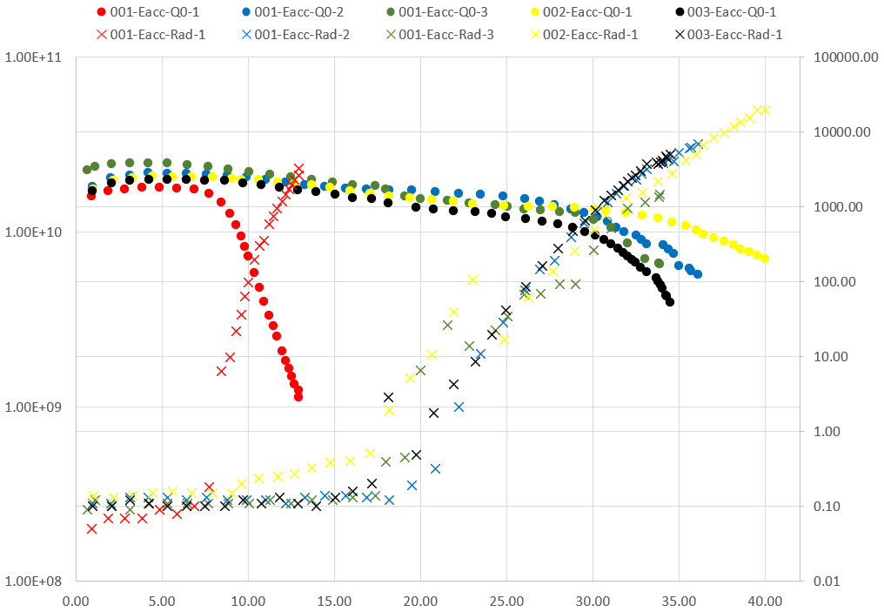
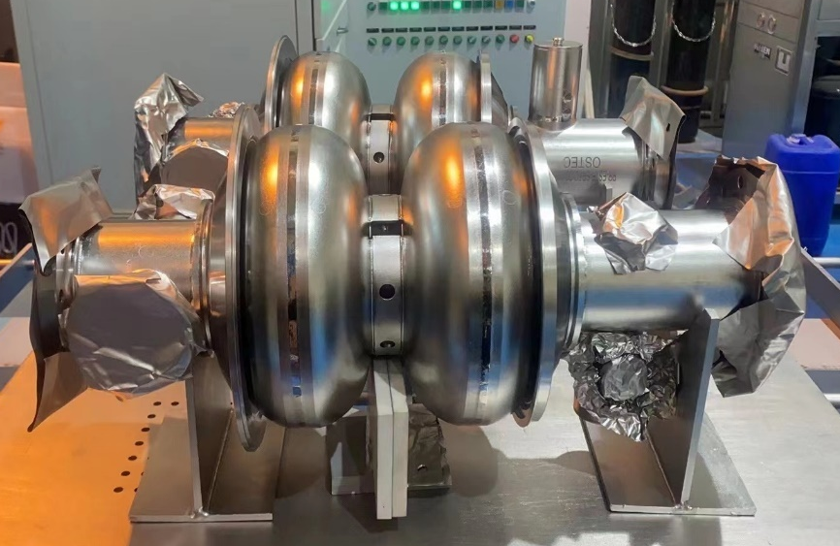
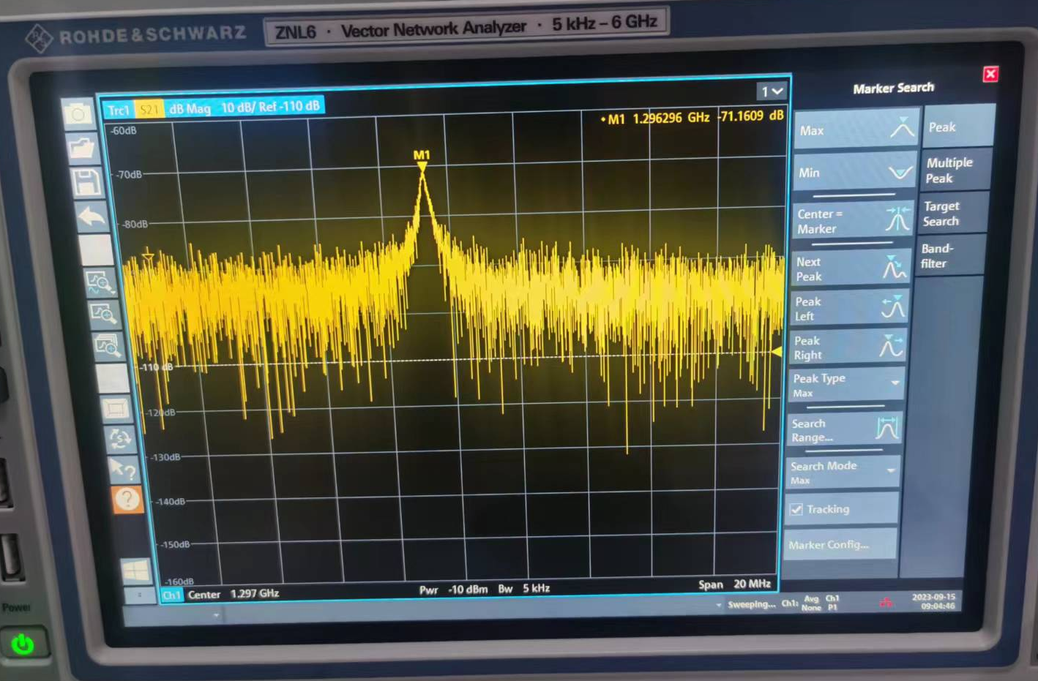
Research Progress: Cavity
Cav01
Cav02
Cav03
Cav01-03 with helium vessel
Cav02-03 helium vessel leaking
Cav03 severely compressed after transport
Cav04-05 naked cavity
With Helium Vessel
EP: 30μm
BCP: 15μm
BCP: 30μm
EP: 30μm
Annealing after heavy EP
2K Vertical test
1296.3MHz

Slide 9
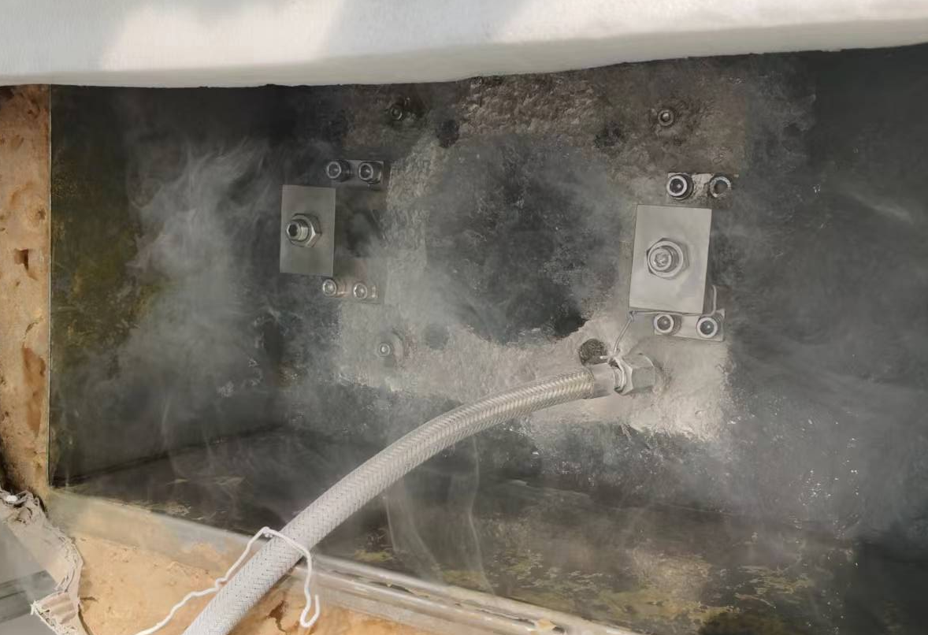
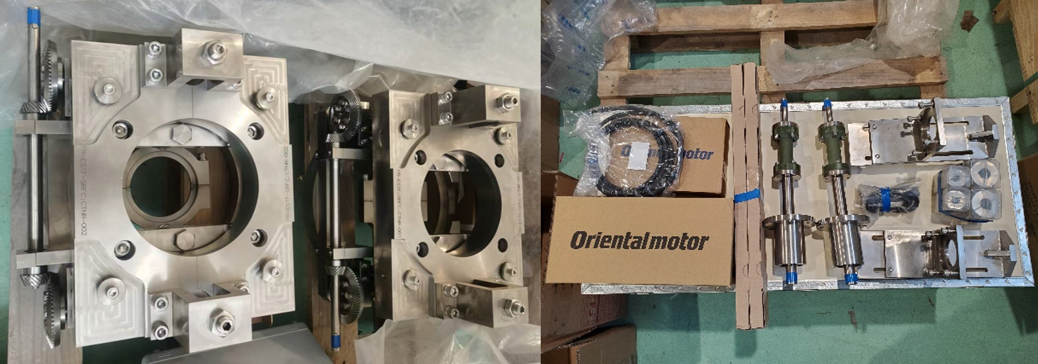
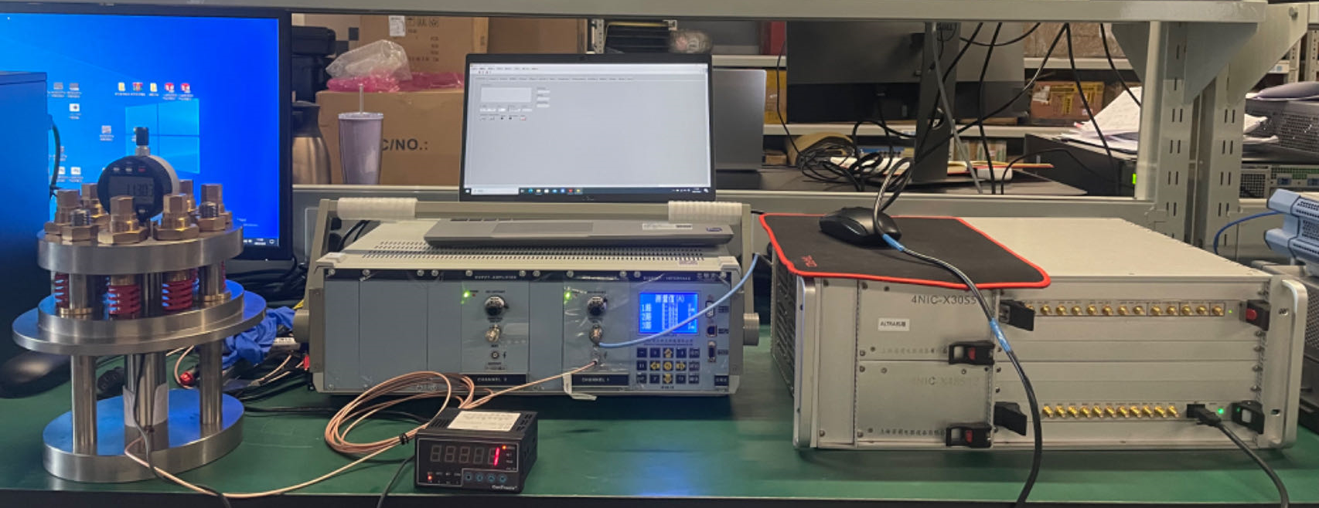
Research Progress: Tuner
Tuner01-02
Full stroke moving test in liquid nitrogen
Piezo01-06
Displacement curve
Creep motion
7.5×10⁻²μm/V
8×10⁻²μm/V

Slide 10
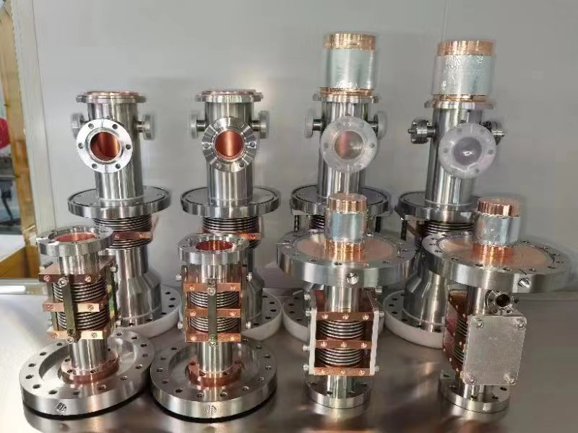
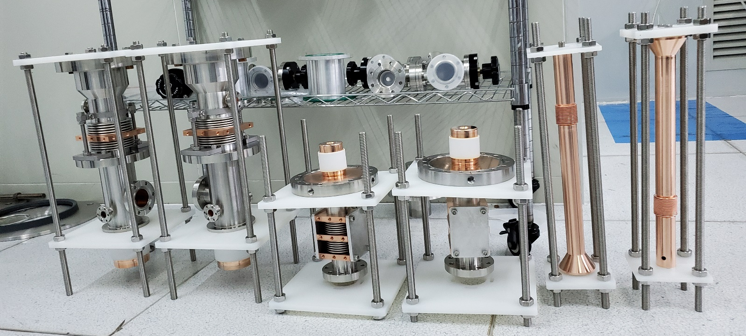
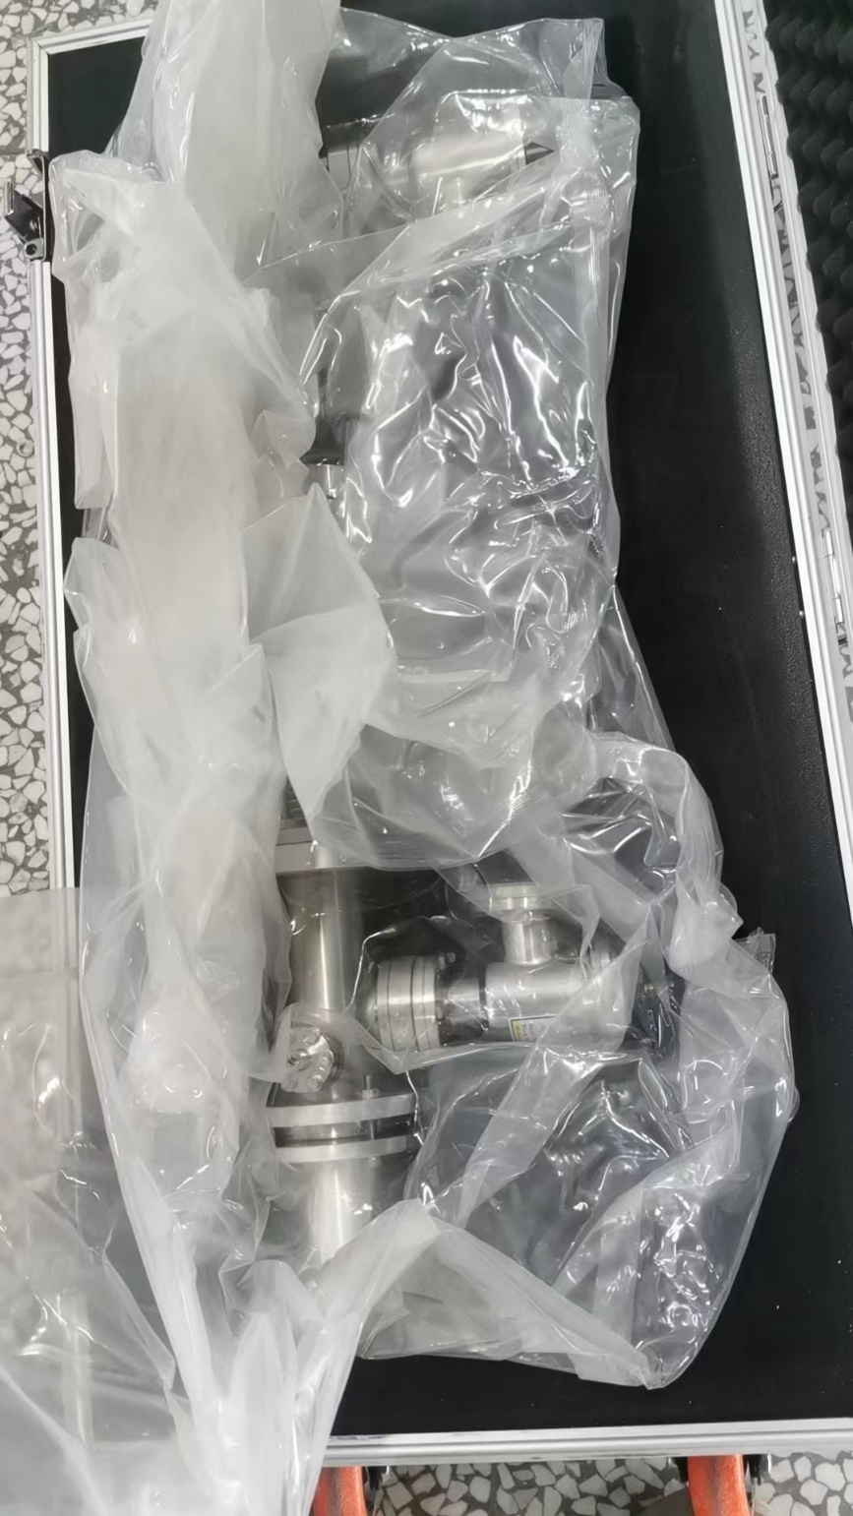
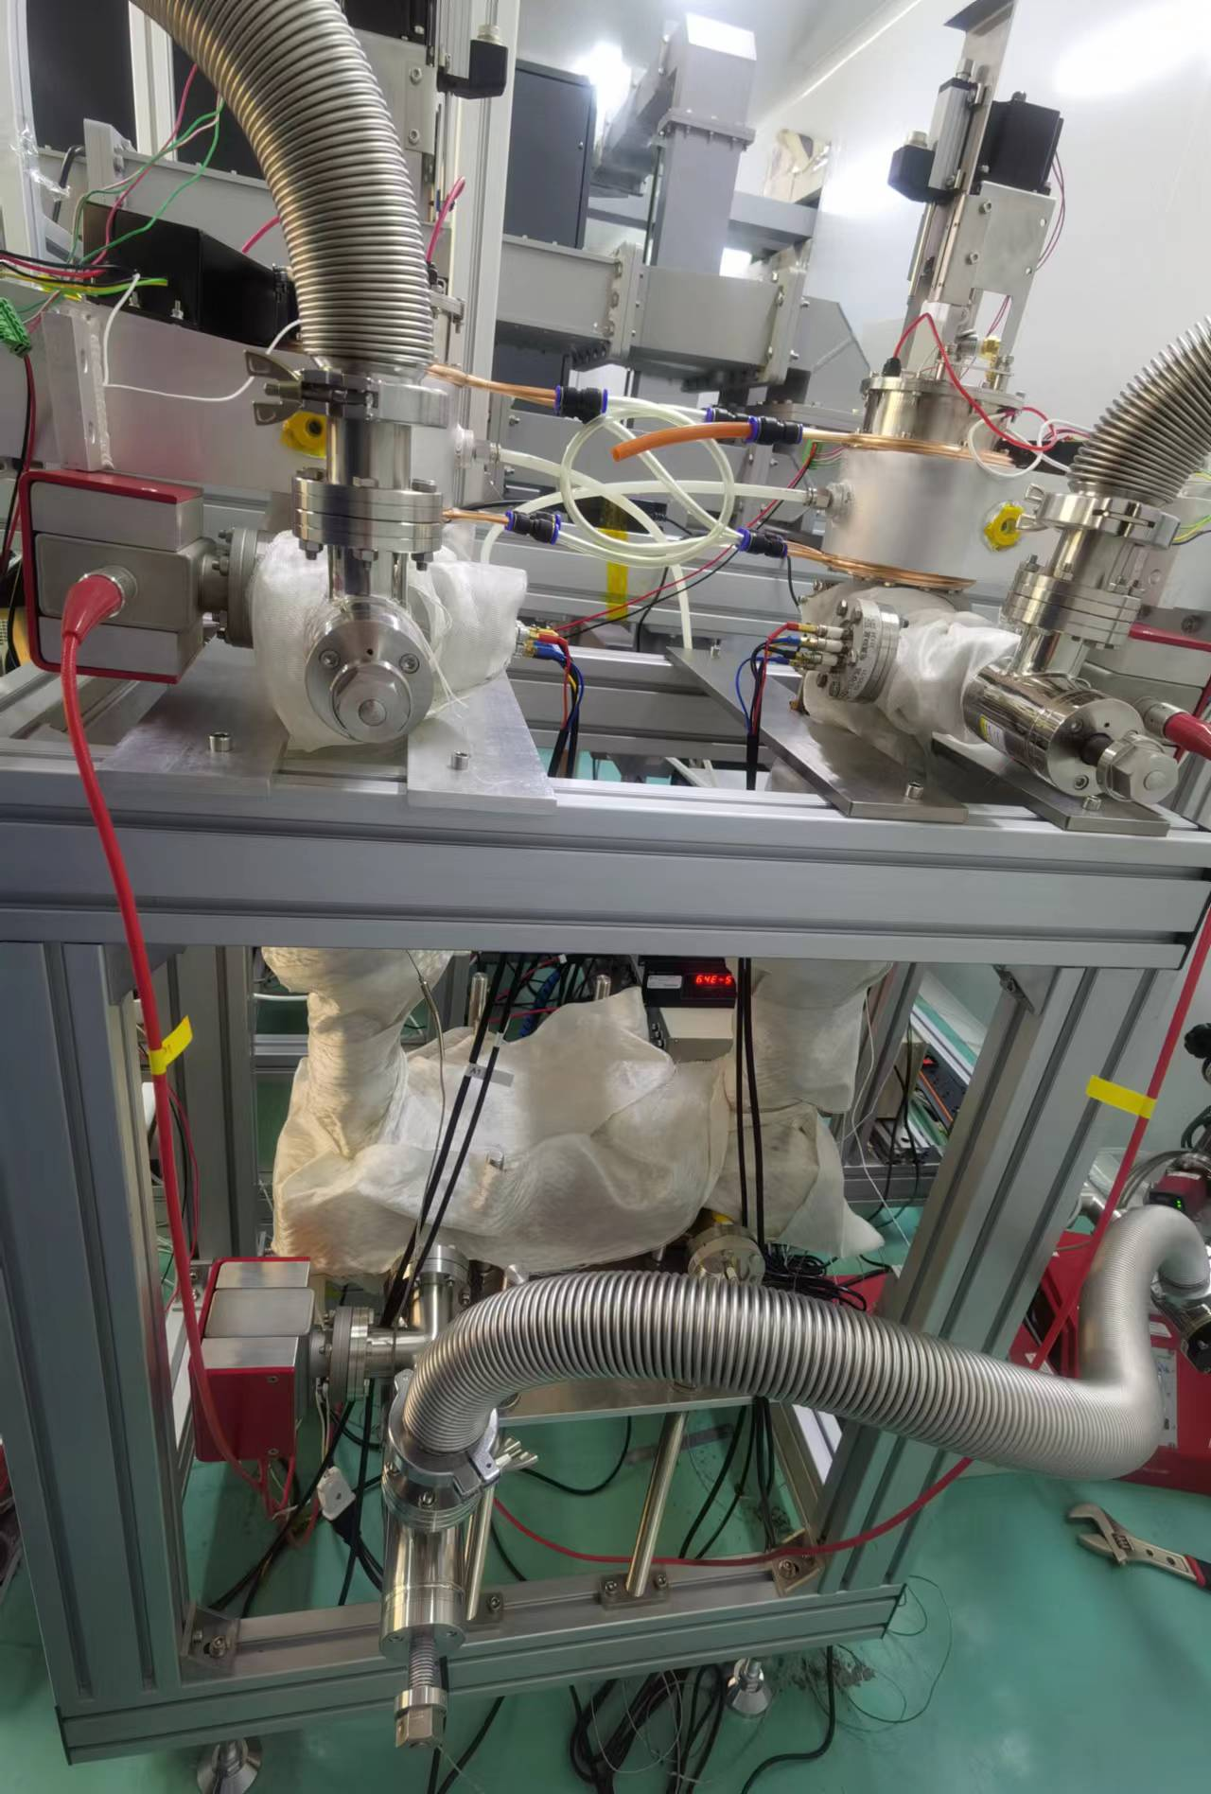
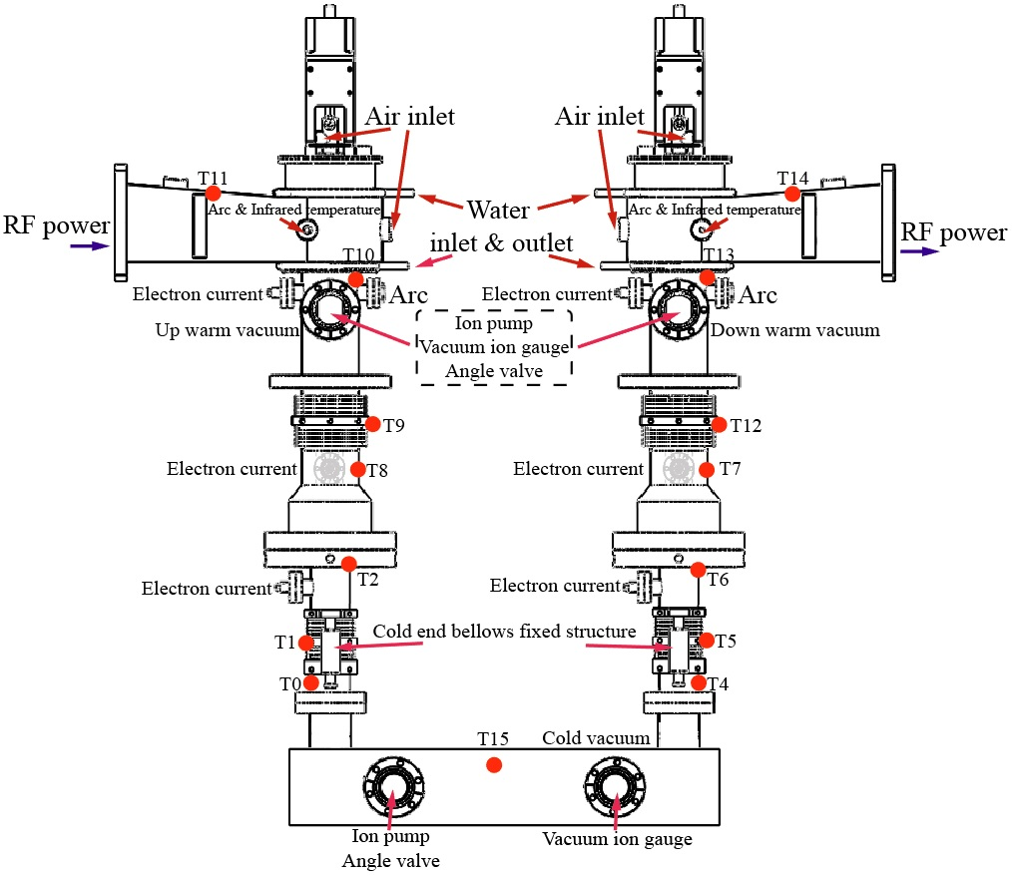
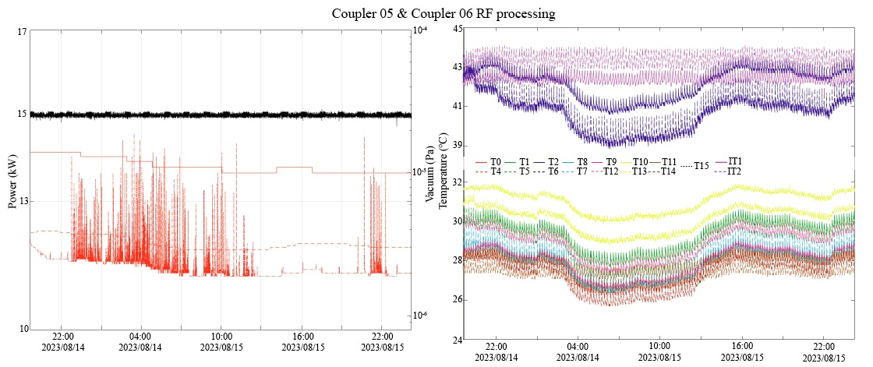
Research Progress: Coupler
Coupler 01-06
Coupler RF processing clean assemble
Coupler 01-06
Coupler RF processing setup
Coupler 03 warm inner conductor bellow leaking
Coupler packing
RF processing results

Slide 11
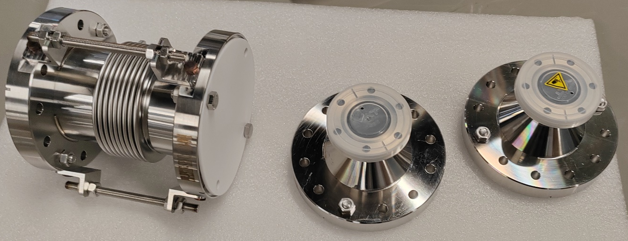
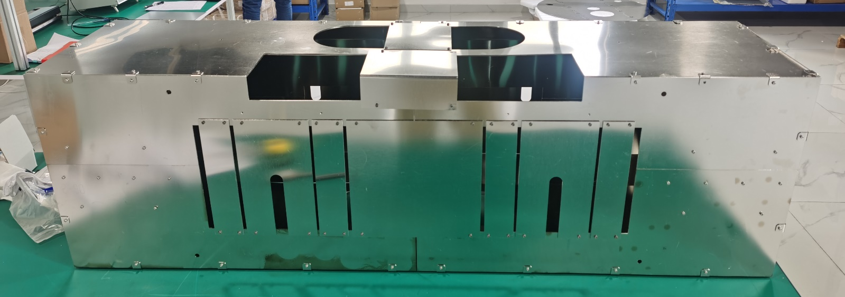
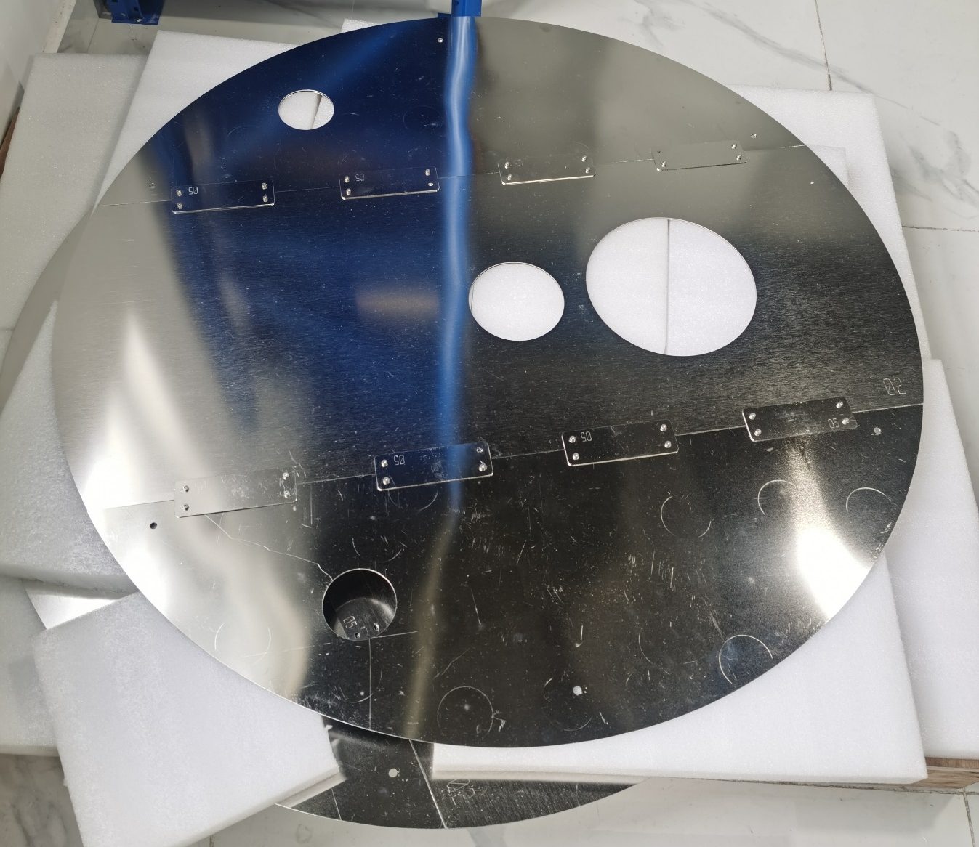
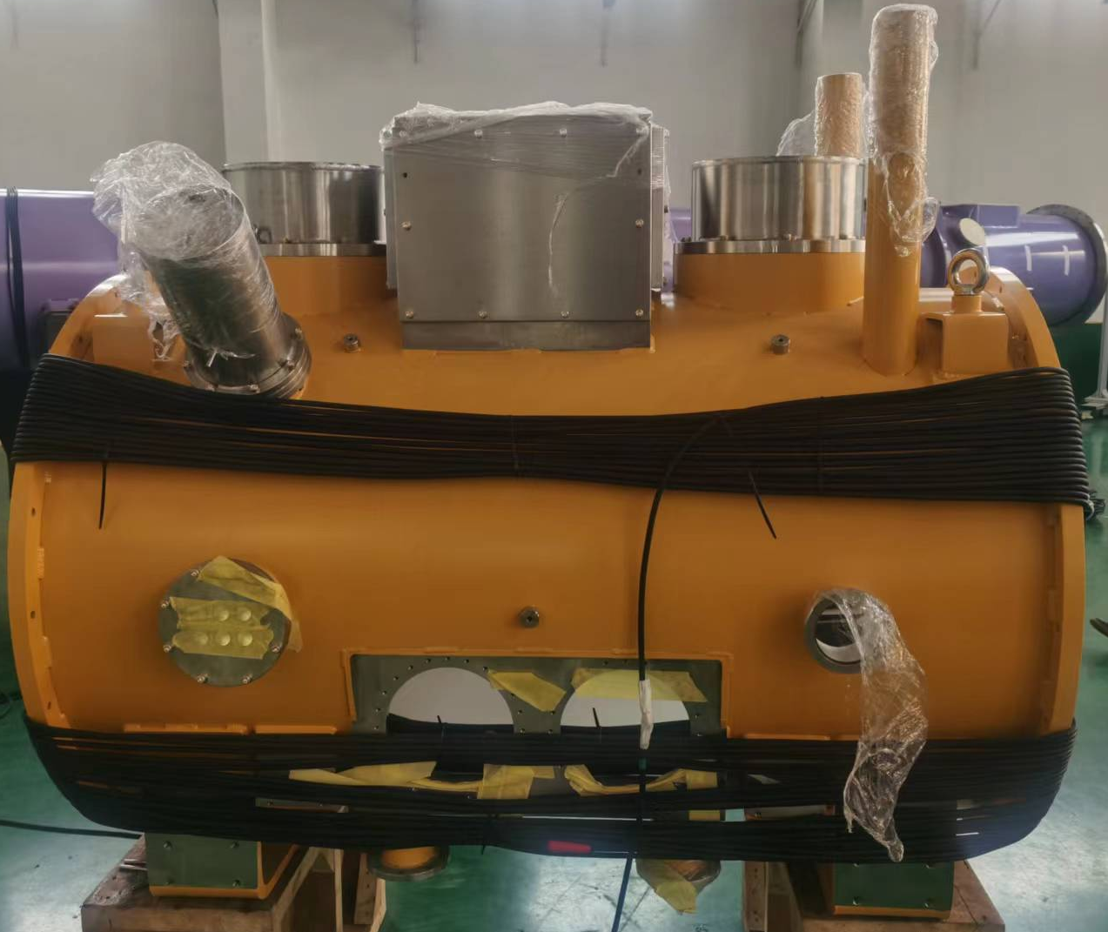
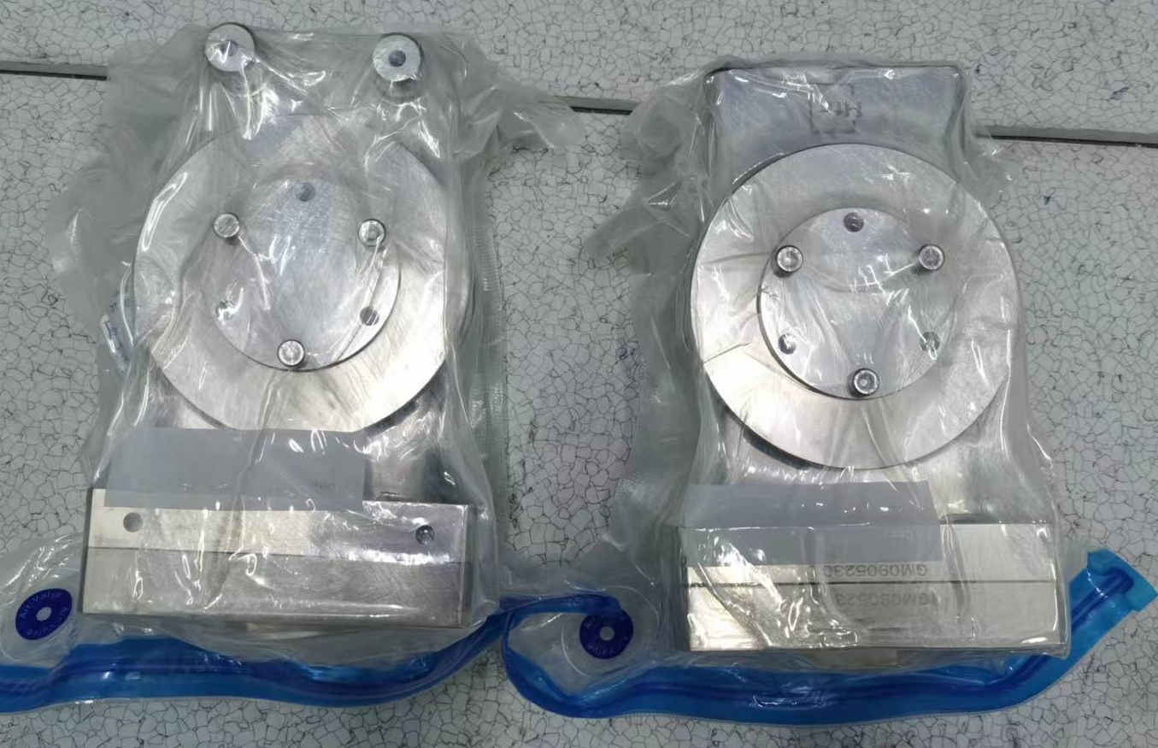
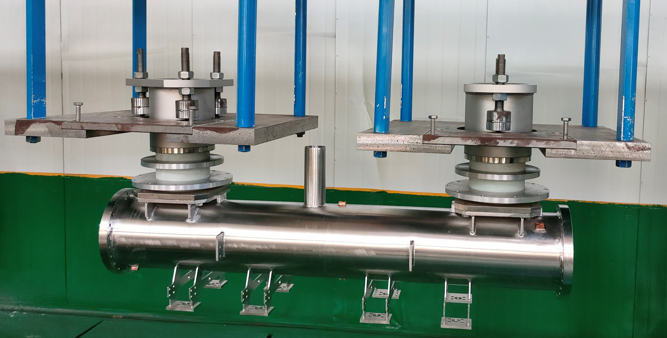
Research Progress
Beam tube
Permalloy magnetic shield
Thermostat demagnetization
Manual gate valve
Post alignment
RT to 2K beam tube is under fabrication
Cryogenic thermostat overall leakage check to be completed

Slide 12
DALIAN INSTITUTE OF CHEMICAL PHYSICS,
CHINESE ACADEMY OF SCIENCES
Special Thanks to
SRF Laboratory, Institute of Heavy Ion Physics, Peking University
RF Surface Technology Laboratory, Linear Accelerator Center, IMP
Superconducting module & cryogenic system team,
Institute of Advanced Science Facilities, Shenzhen
Q&A
December 6,2023

