Slide 1
H-BCAM alignment system for PIP-II cavities and cryomodules: design and measurements
Jacopo Bernardini
TESLA Technology Collaboration Meeting
5-8 December 2023

Slide 2
Outline
H-BCAMs for PIP-II
Alignment strategy
Alignment monitoring on HB650 cryomodules
Coldmass insertion
Cryomodule Cooldown
Summary

Slide 3
H-BCAMs for PIP-II

Slide 4
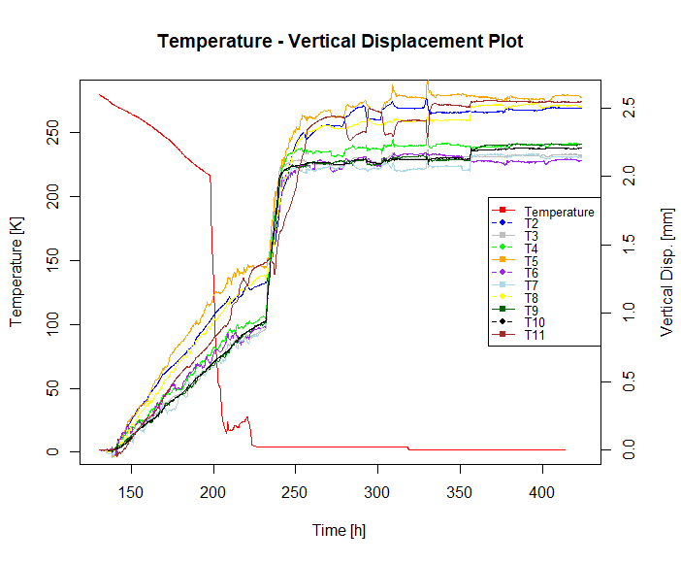
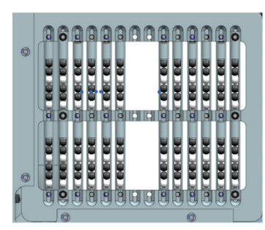
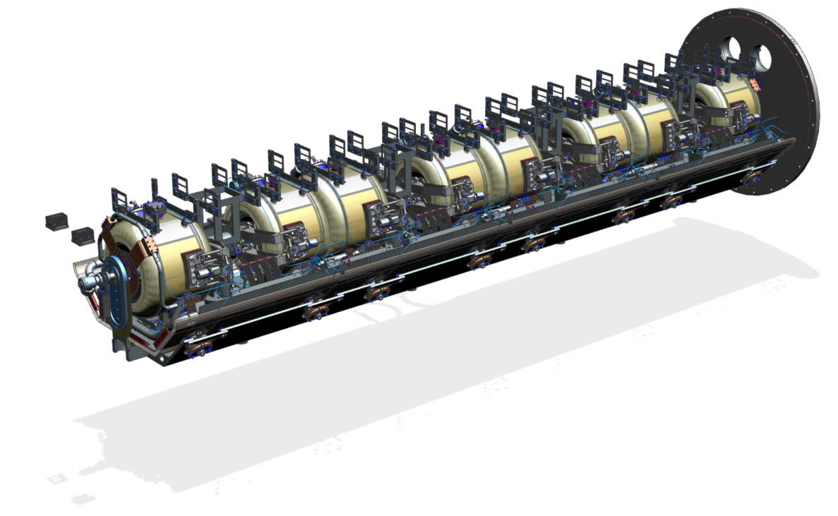
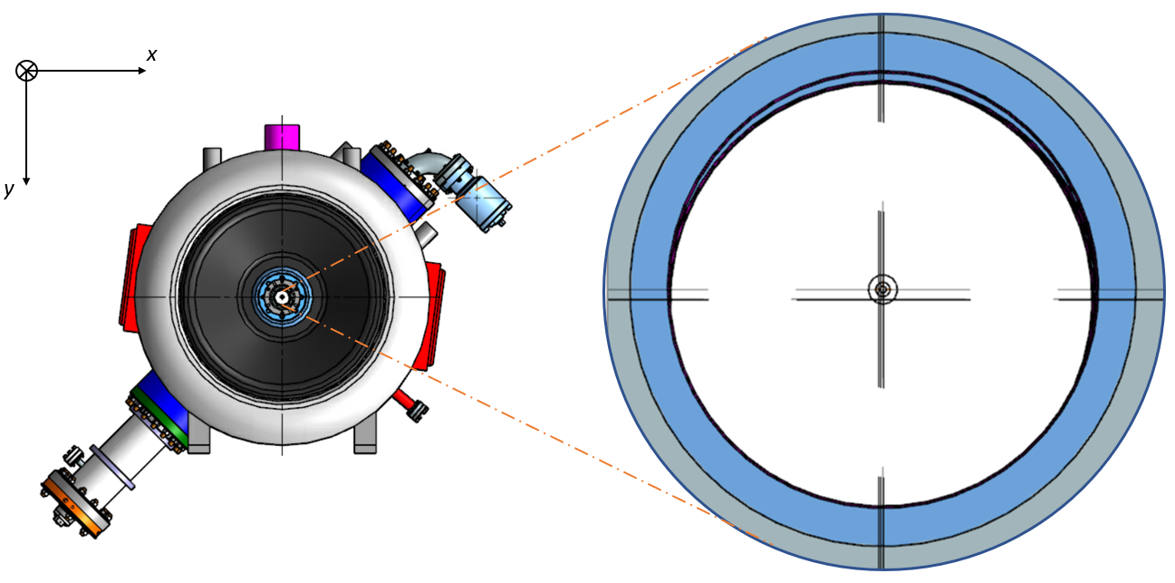
H-BCAMs for PIP-II
BCAMs (Boston CCD Angle Monitor) are optical instruments developed by Brandeis University;
Technology already adopted in the field of High Energy Particle Accelerators (HIE-ISOLDE at CERN);
Technology employed at Fermilab to monitor PIP-II cryomodules internal alignment.

Slide 5
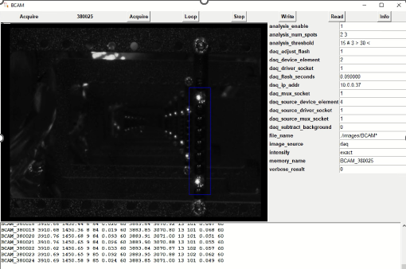
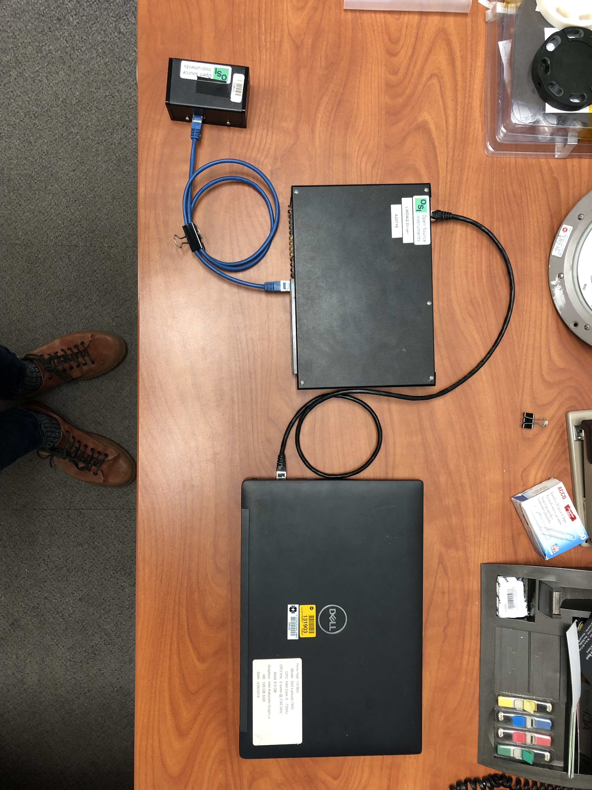
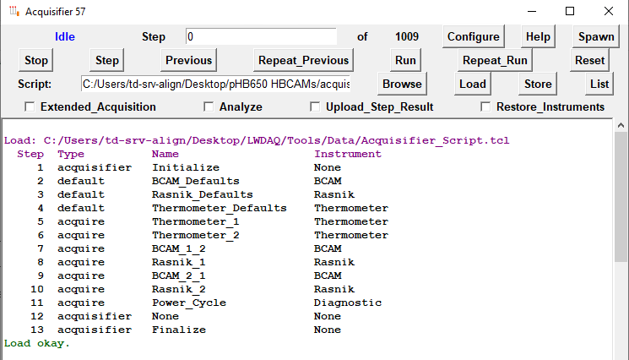
H-BCAMs for PIP-II
5
3
4
1
2
BCAM (several models available, H-BCAM model is used for PIP-II).
RJ-45 cable to connect the BCAM to the driver.
LWDAQ (long wire data acquisition) driver.
RJ-45 cable to connect the driver to the laptop.
Laptop to run the LWDAQ acquisition software.

Slide 6
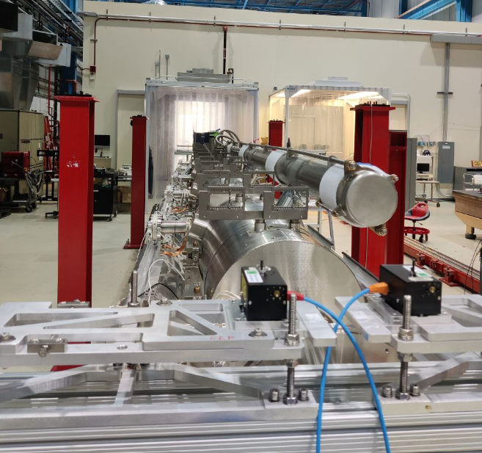
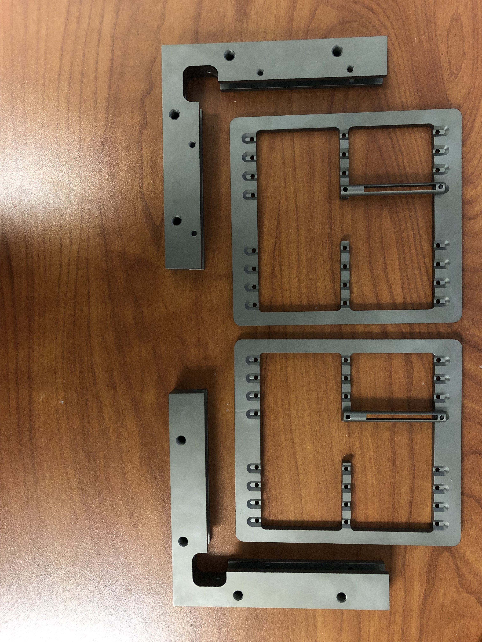
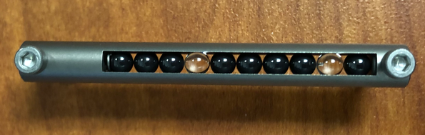
H-BCAMs for PIP-II
7
6
Mechanical system to support the BCAMs during string assembly and on the cryomodule.
Frames mounted on the top of string components.
Targets: highly reflective glass balls attached to cavities and magnets.
8
d

Slide 7
Alignment Strategy

Slide 8
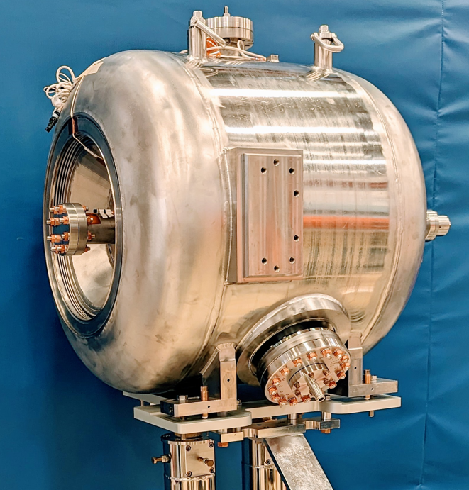
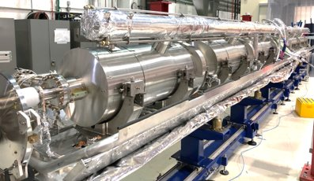
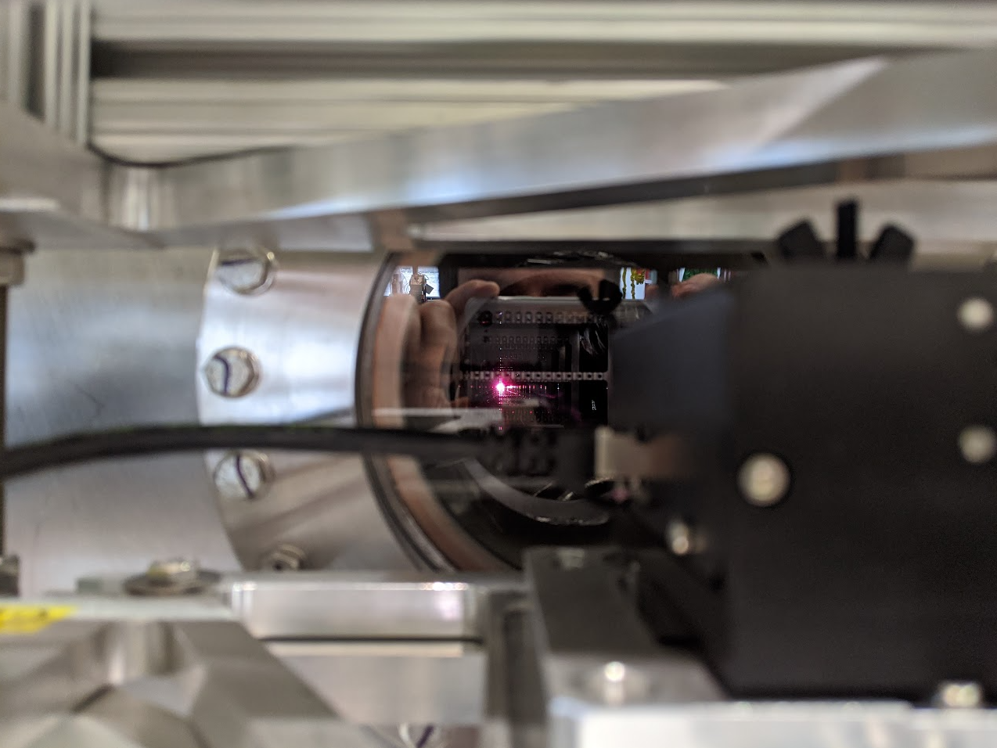
Alignment strategy
1
Fiducials
2
Electric axis
Geometric axis
Geometric axis of cavities and magnets identified and referenced to external fiducials.
Cavities and magnets mechanically aligned with the laser tracker: cooldwon induced misalignment must be compensated at this phase.
BCAMs used to monitor the alignment in the subsequent phases.
3

Slide 9
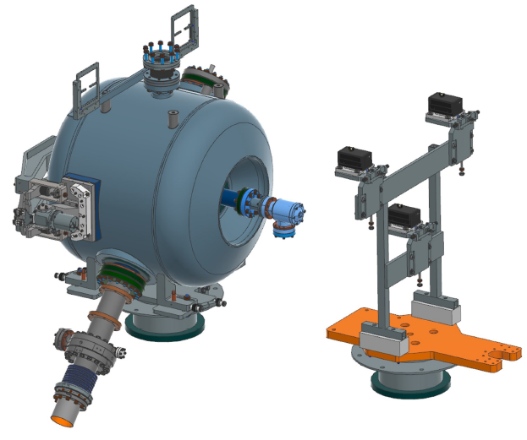
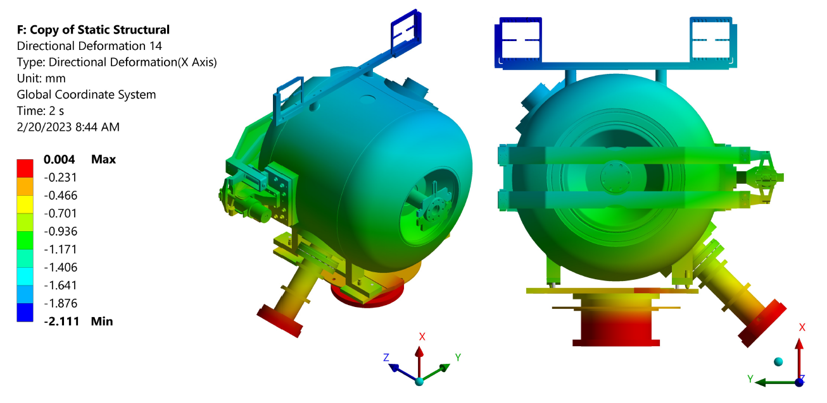
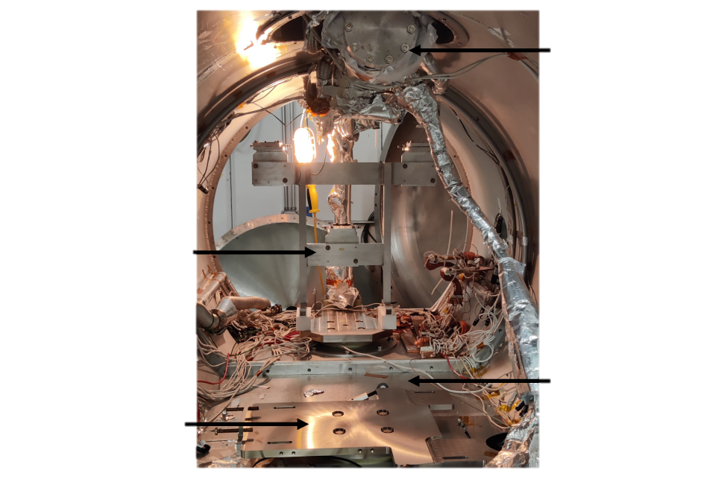
Misalignment induced by cooldown
B
C
A
2-phase return
The misalignment induced by cooldown is estimated with FEA.
Analyses can be validated through testing in the spoke test cryostat (STC).
Testing in the spoke test cryostat can also be used to correlate the displacement of targets to the displacement of the beamline axis.
BCAMs stand
Thermal shield
Cavity support

Slide 10
Alignment Monitoring on HB650 CMs

Slide 11
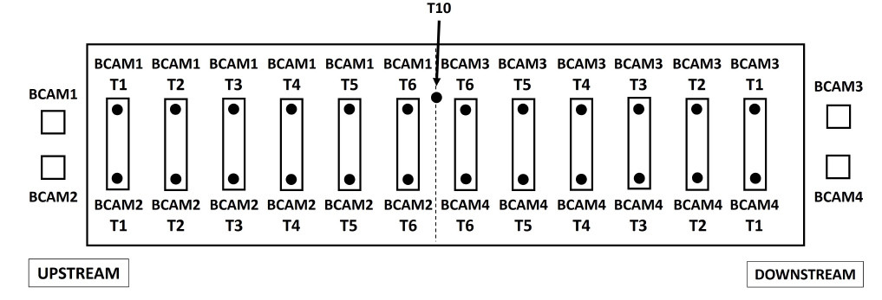
Alignment monitoring on HB650 CM
2 BCAMs are mounted upstream, and 2 downstream. Each BCAM looks at the targets and at the opposite BCAM.
BCAMs’ targets are assembled on string components before assembling the upper thermal shield.
Each target needs to be moved in place into the field of view of the BCAMs.
The presence of highly reflective objects (such as MLI) or light sources into the field of view of the H-BCAMs have a negative impact on the data acquisition.

Slide 12
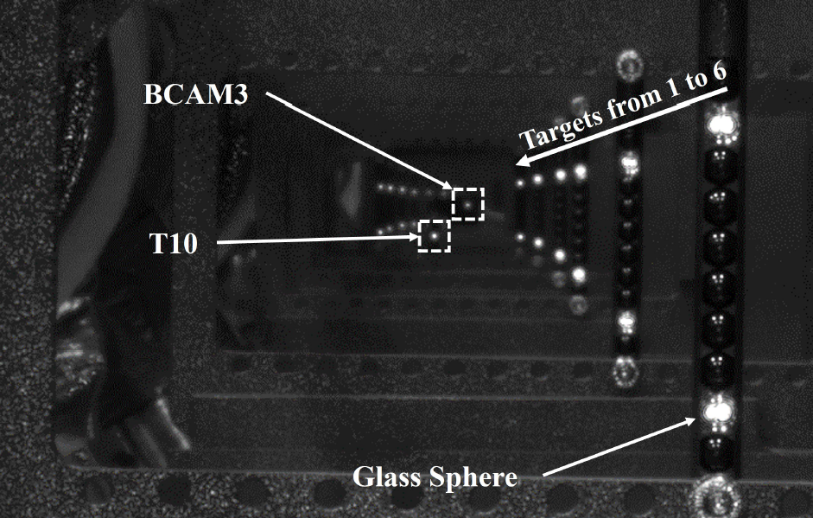
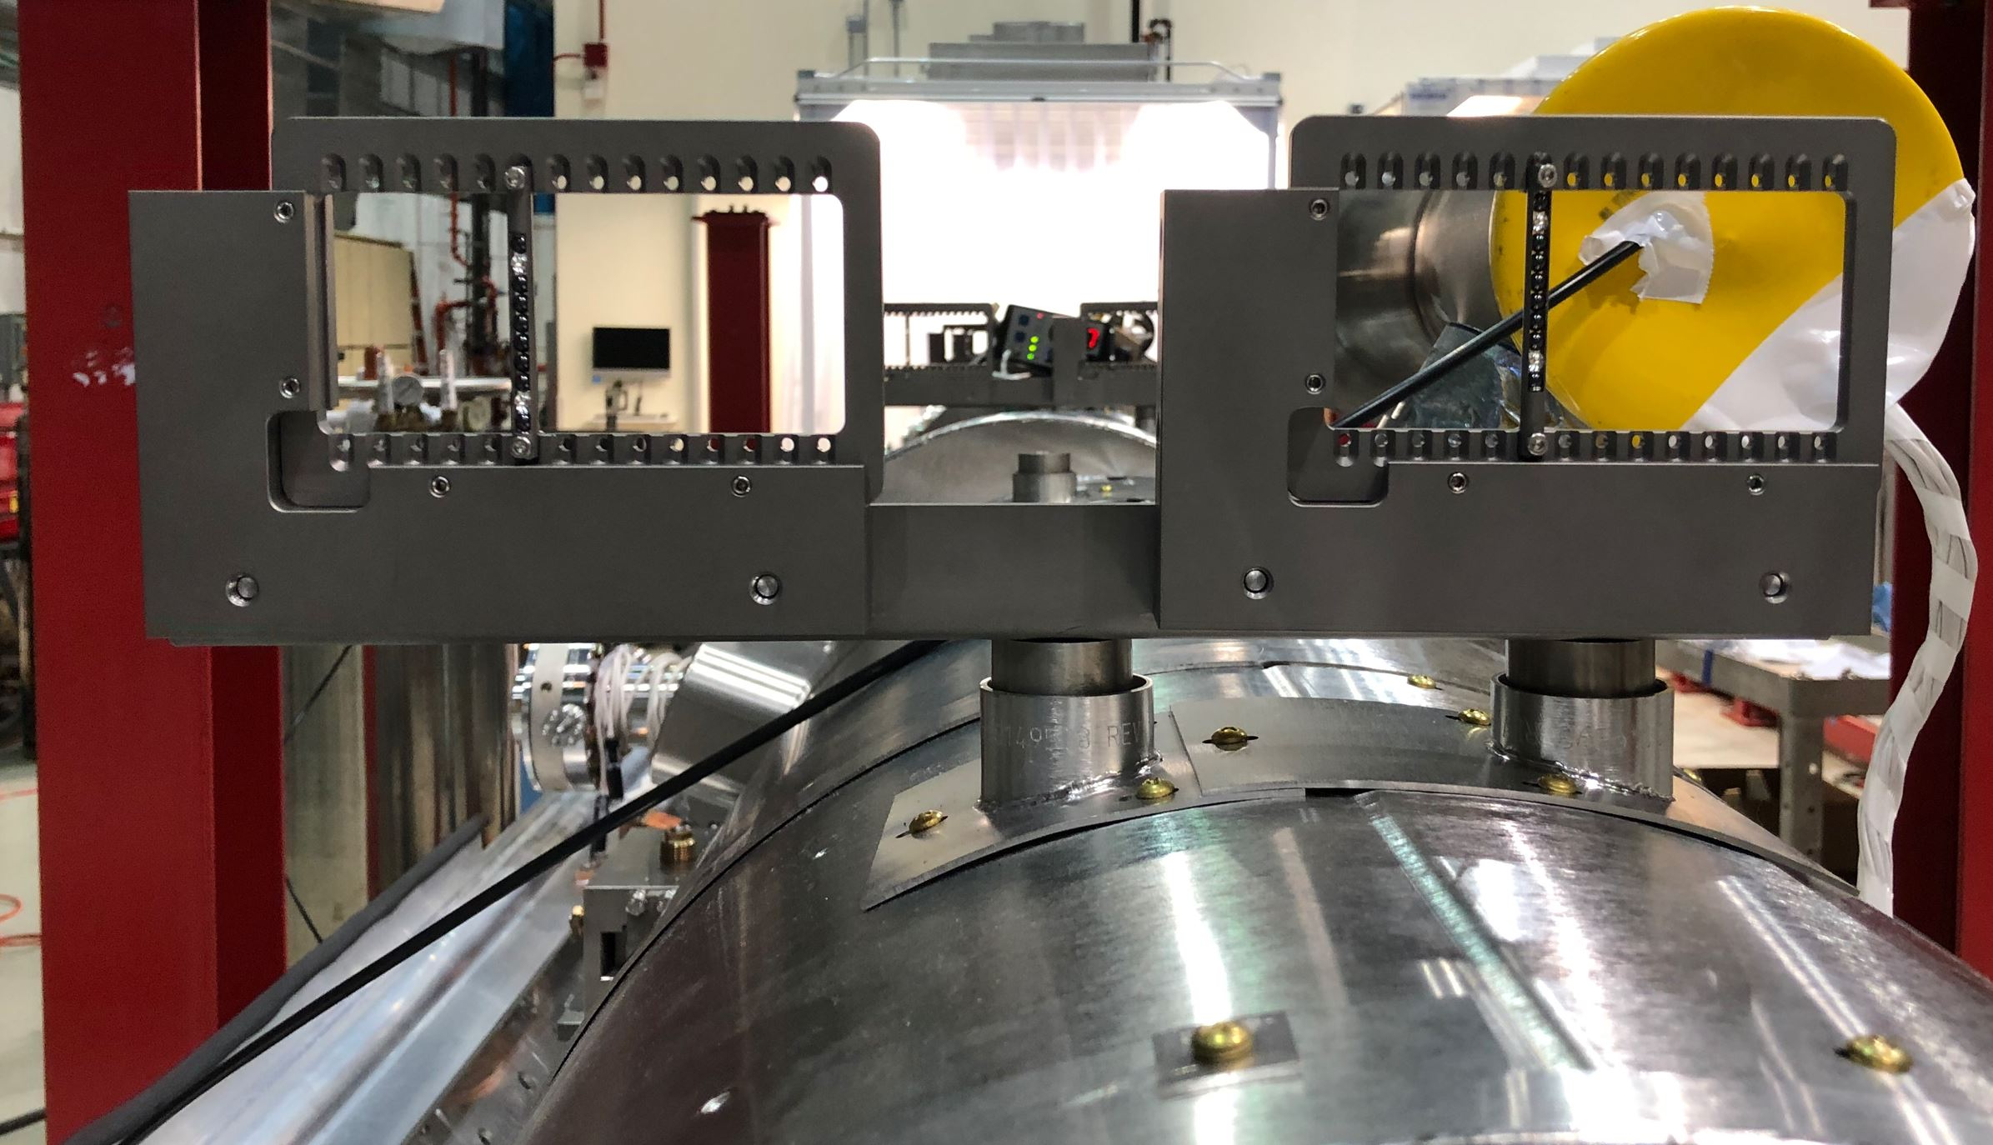
Alignment monitoring on HB650 CM
2 BCAMs are mounted upstream, and 2 downstream. Each BCAM looks at the targets and at the opposite BCAM.
BCAMs’ targets are assembled on string components before assembling the upper thermal shield.
Each target needs to be moved in place into the field of view of the BCAMs.
The presence of highly reflective objects (such as MLI) or light sources into the field of view of the H-BCAMs have a negative impact on the data acquisition.

Slide 13
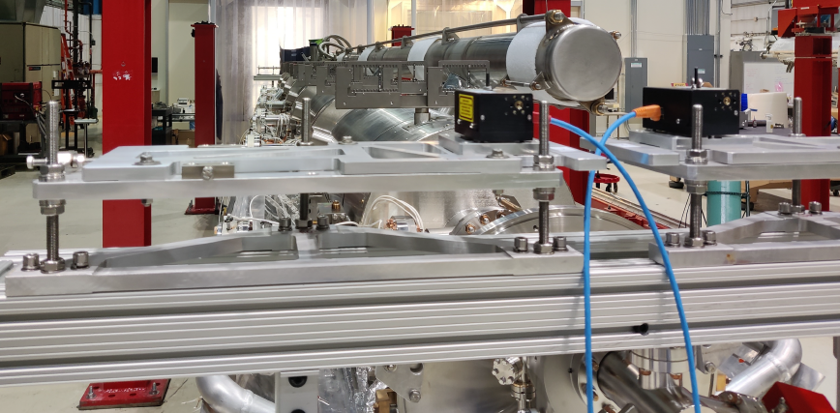
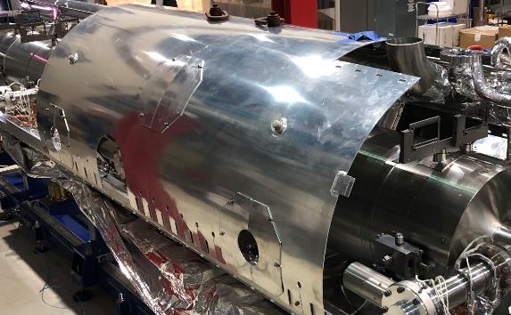
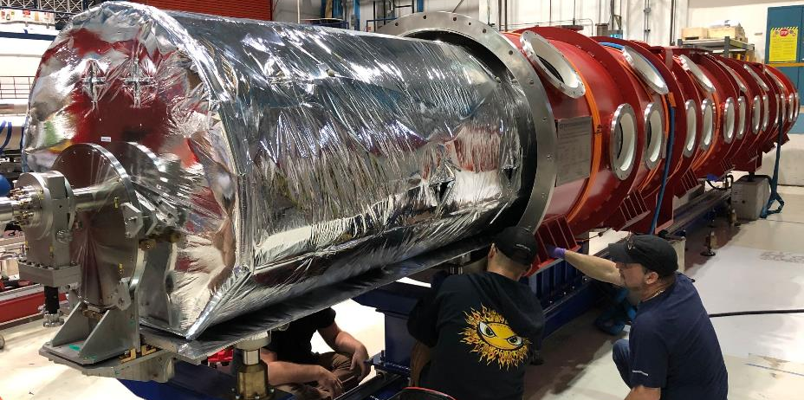
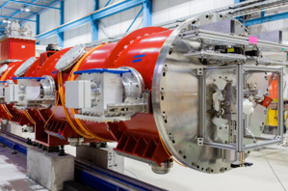
Alignment monitoring on HB650 CM
Insertion of the coldmass into the vacuum vessel.
BCAMs’ position referenced to the string
BCAMs positioned back to the coldmass
Position of targets acquired with BCAMs
Position of targets acquired with BCAMs
Complete coldmass assembly
Comparison of pre- and post- insertion targets’ position
BCAMs removed and coldmass inserted

Slide 14
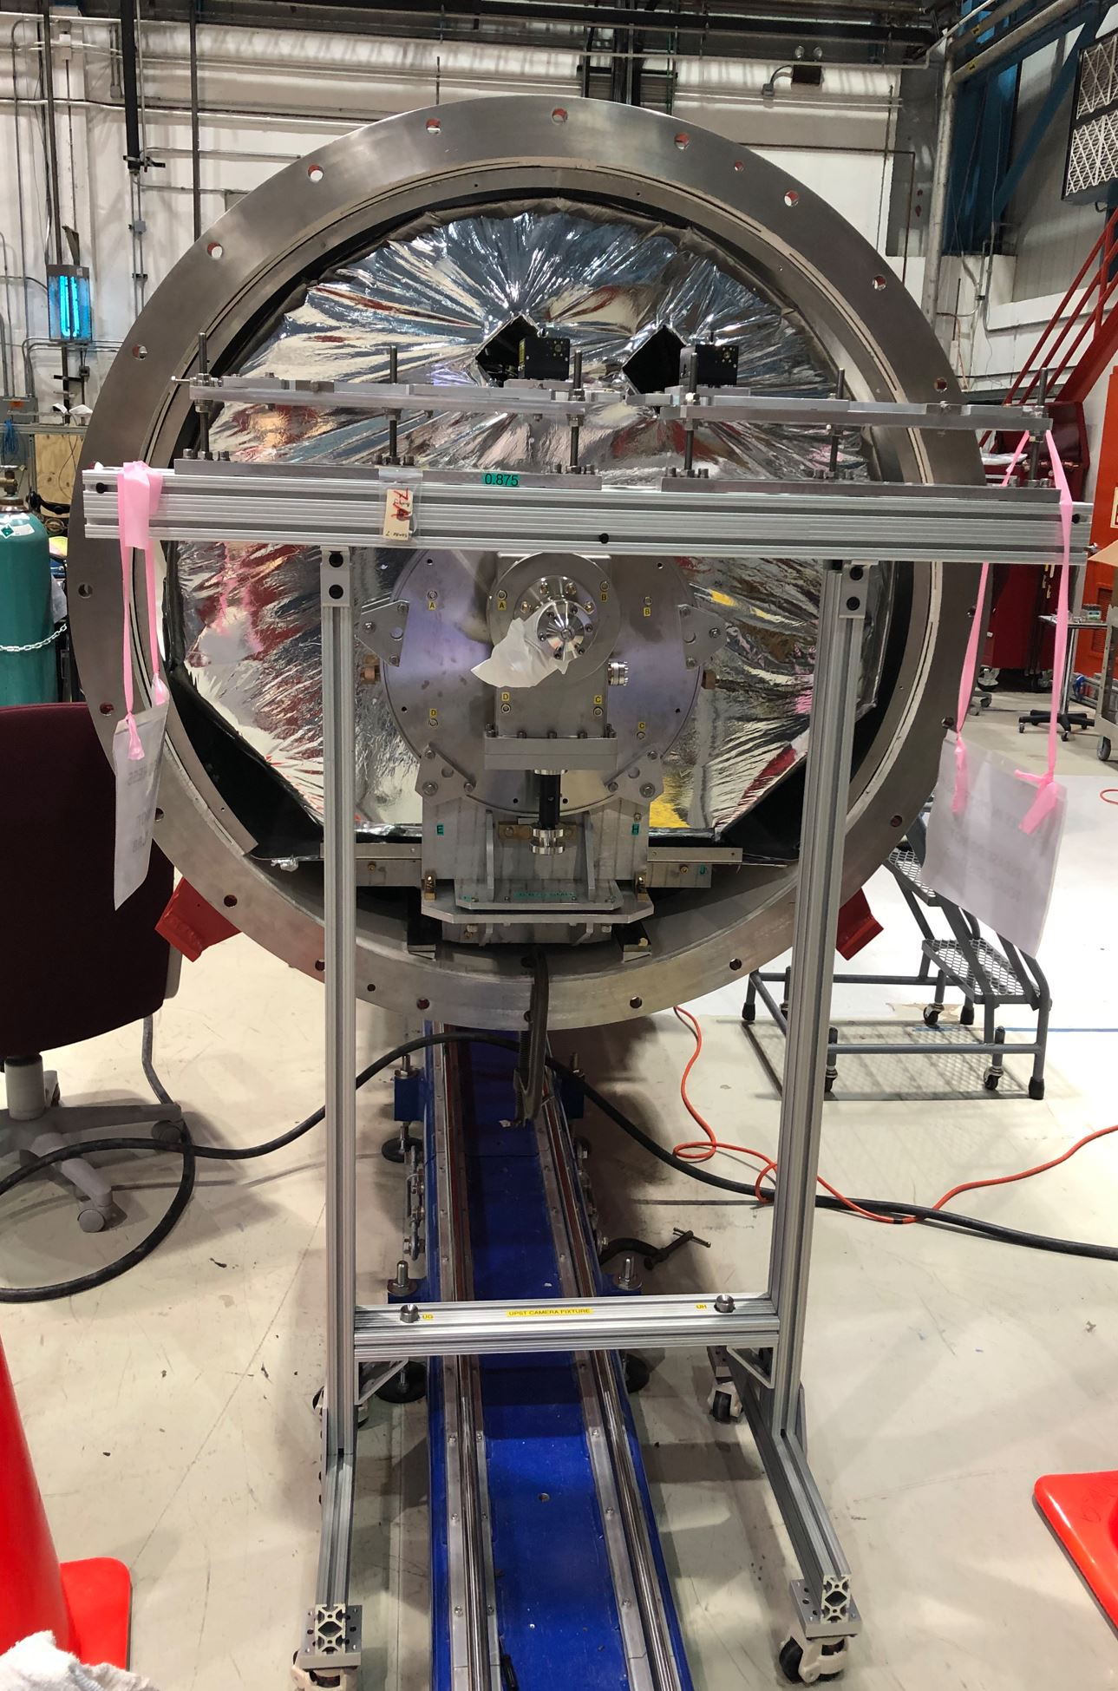
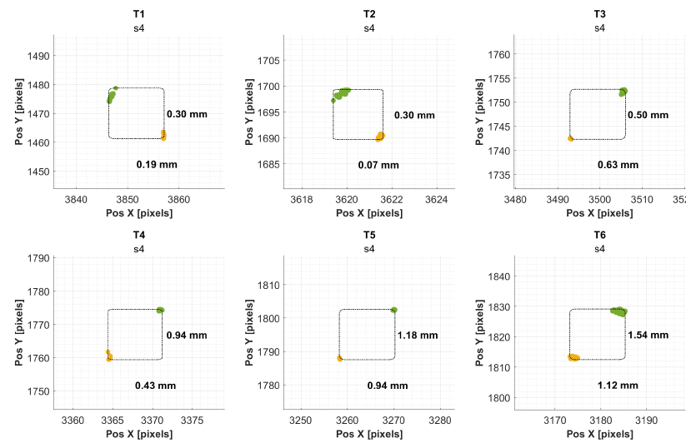
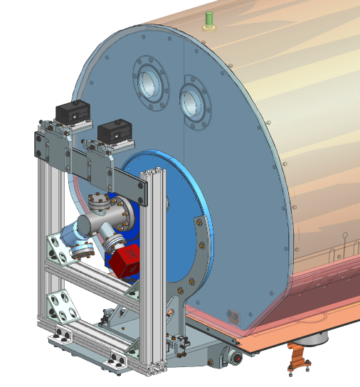
Alignment monitoring on HB650 CM
Insertion of the coldmass into the vacuum vessel.
Errors in repositioning the BCAMs after the insertion of the coldmass prevent a clear comparison between pre- and post- insertion data.
BCAMs shall follow the coldmass during its insertion into the vacuum vessel.

Slide 15
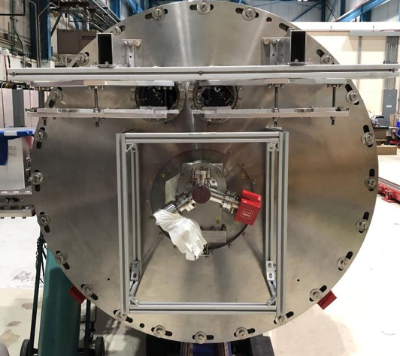
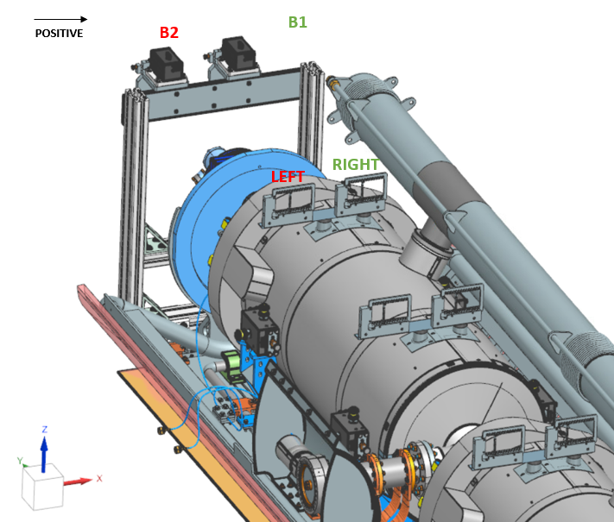
Alignment monitoring on HB650 CM
Cryomodule cooldown.
Maximum horizontal misalignment = 0.22 mm
BCAMs are mounted on metrology tables attached to the US and DS side of the vacuum vessel

Slide 16
Alignment monitoring on HB650 CM
Cryomodule cooldown.
Maximum vertical misalignment = 0.61 mm
BCAMs are mounted on metrology tables attached to the US and DS side of the vacuum vessel

Slide 17
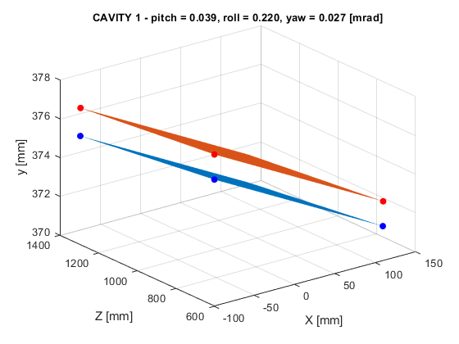
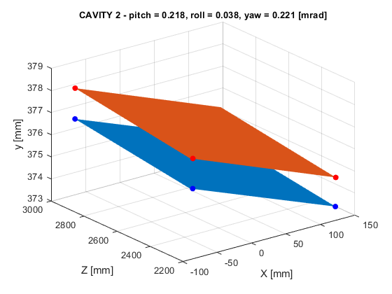
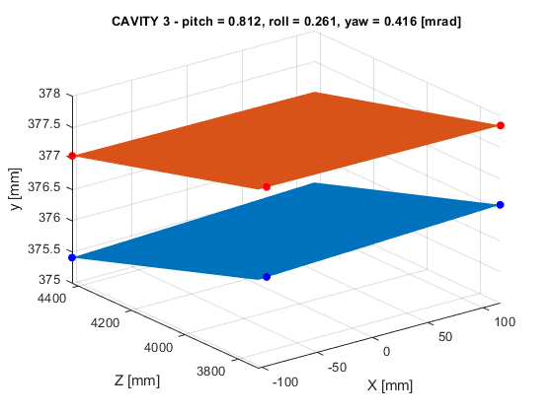
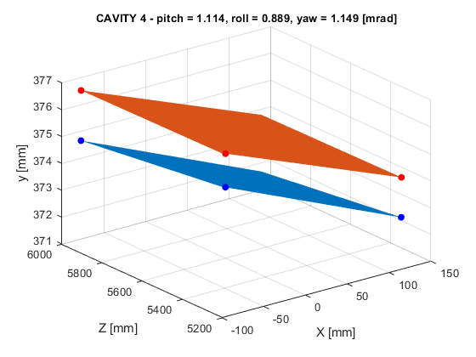
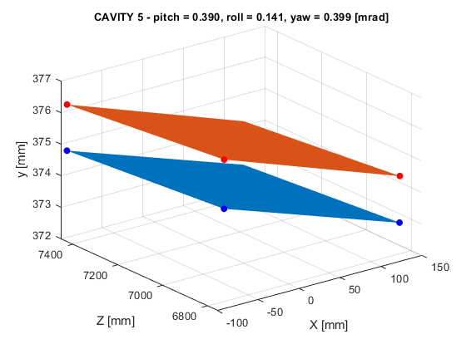
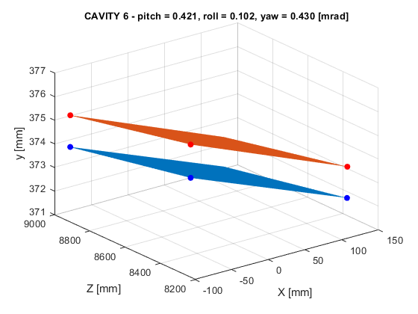
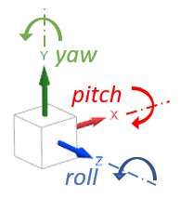
Alignment monitoring on HB650 CM
Cryomodule cooldown.
At warm
At cold

Slide 18
Summary
H-BCAMs are employed in PIP-II as post coldmass assembly alignment monitoring system.
The alignment needs to be monitored:
During coldmass insertion
During transportation
During cooldown. The misalignment induced by cooldown needs to be estimated and compensated during string assembly.
The H-BCAMs were used for prototype SSR1 and HB650 cryomodules.
The design of the H-BCAMs metrology tables was improved to allow a continuous monitoring during coldmass insertion and transportation for SSR cryomodules.

Slide 19
THE FUTURE OF FERMILAB
Follow us:
http://pip2.fnal.gov/
/showcase/pip-ii/

Slide 20
Questions?

Slide 21
Back-up slides

Slide 22
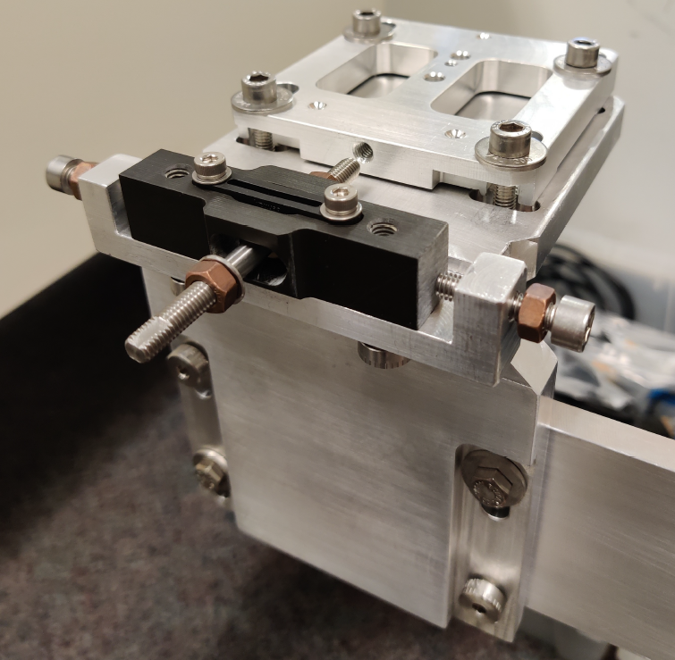
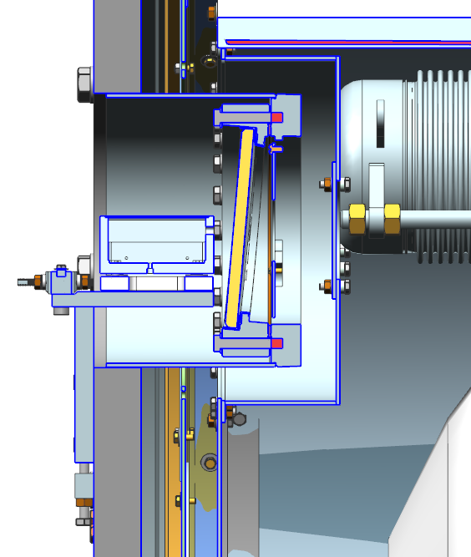
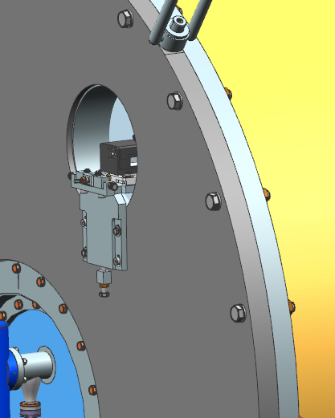
Alignment monitoring on HB650 CM
Alignment during transportation: targets’ positions acquired with BCAMs before and after transportation to UKRI.
650 CMs
SSR CMs
The metrology table is not compatible with the transportation tool. BCAMs need to be removed during transportation.
Pins are used to attach the metrology table to the vacuum vessel for 650 CMs.
A more compact support system will be used for SSR CMs.

Slide 23
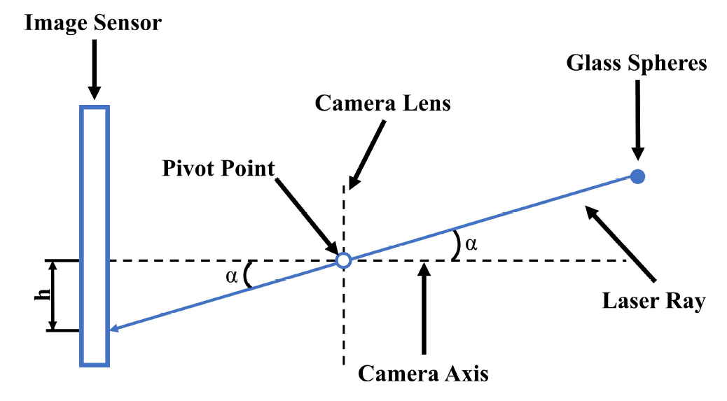
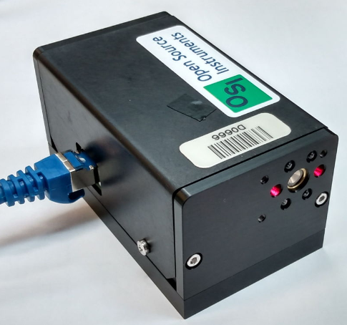
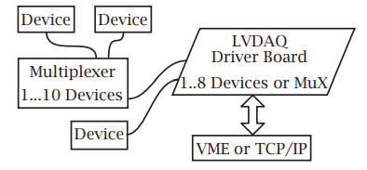
H-BCAMs features and working principle
Working principle
LWDAQ connection scheme
Black H-BCAM

Slide 24
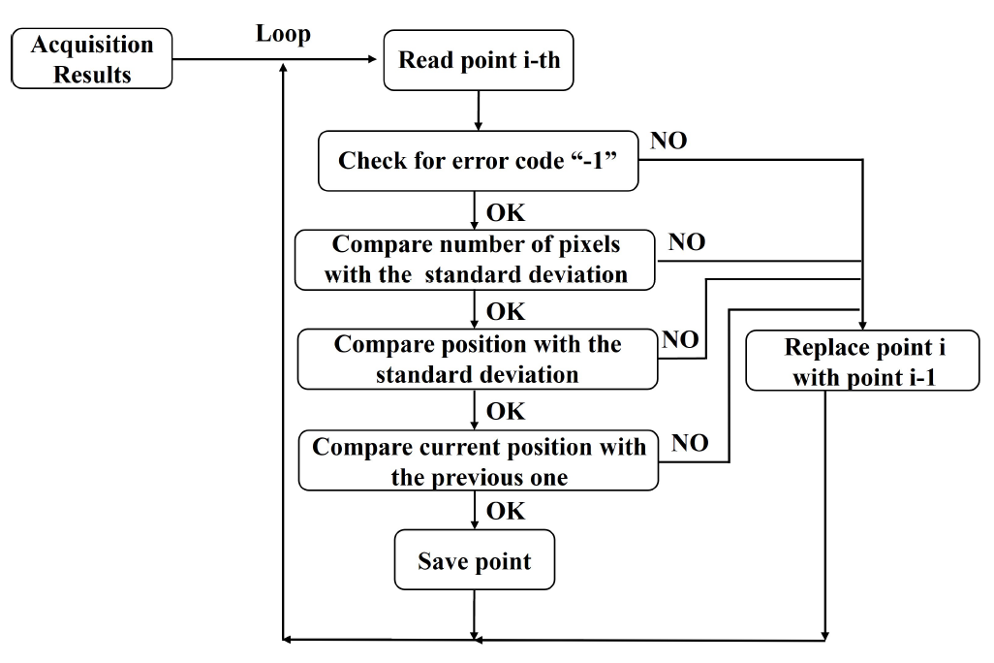
Acquisition data post-processing
Raw Data
Filtered Data

Slide 25
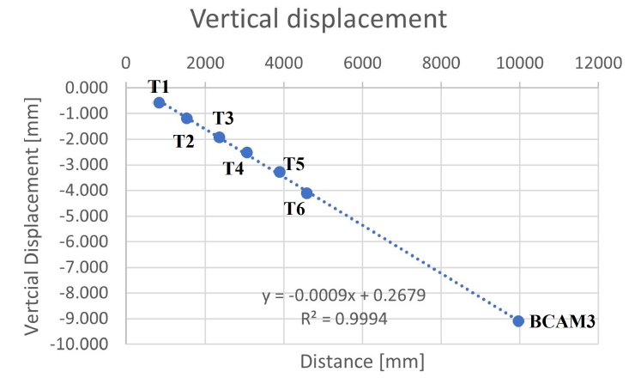
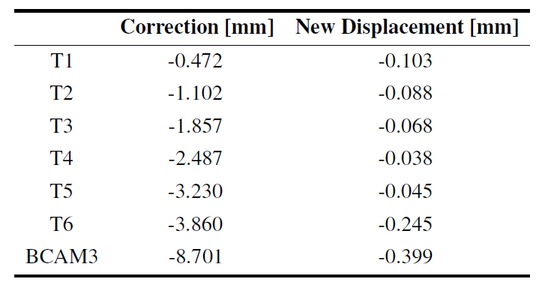
Correction of errors induced by BCAMs’ rotation

