Slide 1
Heat Load Measurement for 1.3 GHz CM at IHEP
Feisi He, Mei Li (IHEP, Beijing, China)
Presented by Han Li (IASF, Shenzhen, China)
TTC Meeting, FNAL, Dec. 6, 2023

Slide 2
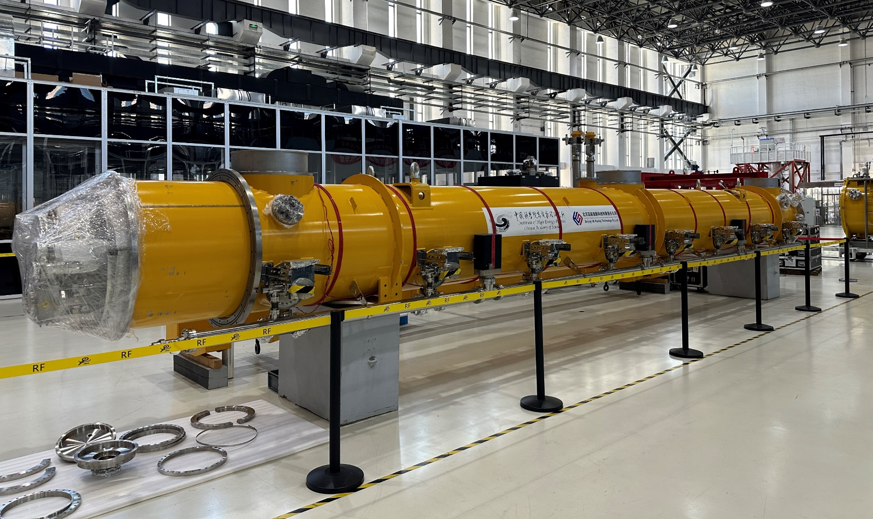
World’s First Mid-T 1.3 GHz Cryomodule by IHEP
For Dalian Advanced Light Source (DALS) R&D.
Refer to Jiyuan Zhai’s talk on Tuesday WG1: Performance of First Mid-T 1.3 GHz Module

Slide 3
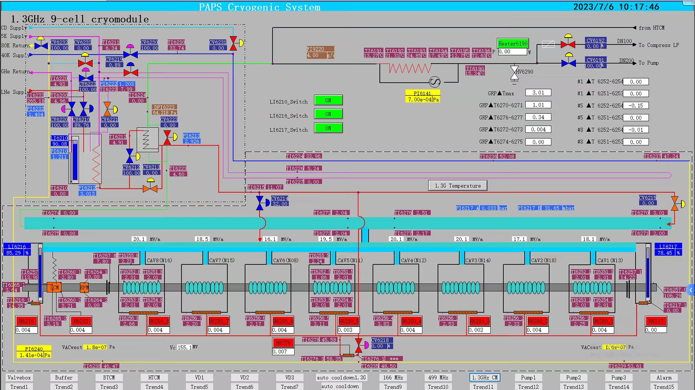
Module Cryogenic Control Interface
Mass flow meter
Endcap pre-cooling valve
J-T valve
Heater in liquid level tank
Cooldown valve
Heater in liquid level tank

Slide 4
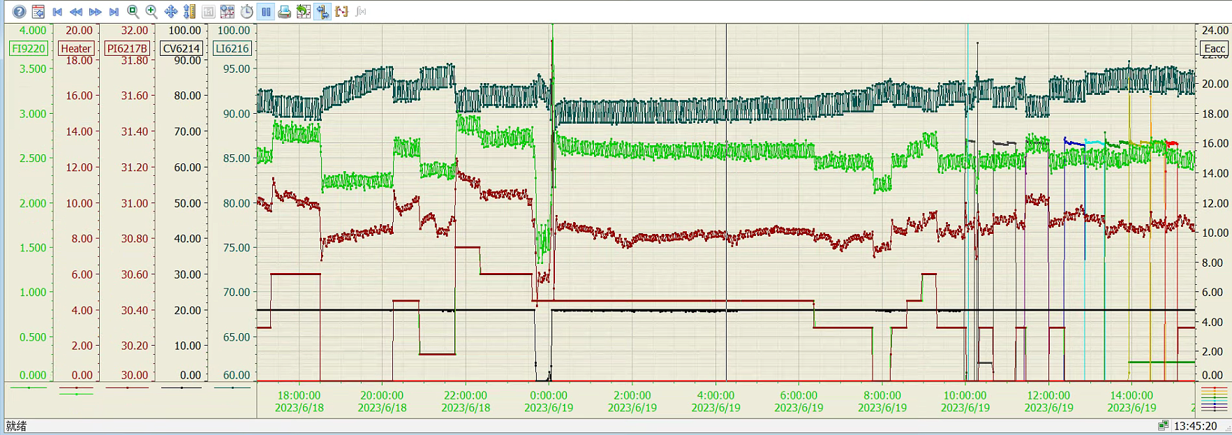
Heat Load Measurement: Uncertainty of Flow Rate
The flow rate reading from mass flow meter at room temperature have an uncertainty of $1.96×σ_{f_read}=0.5 \%×range\left(only if reading<\frac{range}{2}\right)+0.5 \%×reading$, typically $σ_{f_read} \sim 0.01−0.015 g/s.$
The flow rate data is obtained during a period of time. The standard deviation of the data is the random error $σ_{f_r}$ (typically $σ_{f_r}\sim 0.001 g/s$ with > 600 data in 5 mins)
The flow rate at static state may vary after several hours, which introduce a systematic error, and the uncertainty $σ_{f_s}\sim 0.05 g/s$ can be estimated by standard deviation of measured values. By measuring the flow rate at known heater power before and after Q-measurement, the $σ_{f_s}$ could be calibrated.
Total uncertainty of flow rate is $δf=\sqrt{{σ_{f_read}}^{2}+{σ_{f_r}}^{2}+{σ_{f_s}}^{2}}$
Date of measurement | Static flow rate [g/s]
2023.6.26 10:19 | 1.211
2023.6.29 6:45 | 1.119
2023.7.3 1:44 | 1.093
2023.7.7 1:06 | 1.100
2023.7.7 8:16 | 1.070
Standard deviation | 0.055

Slide 5
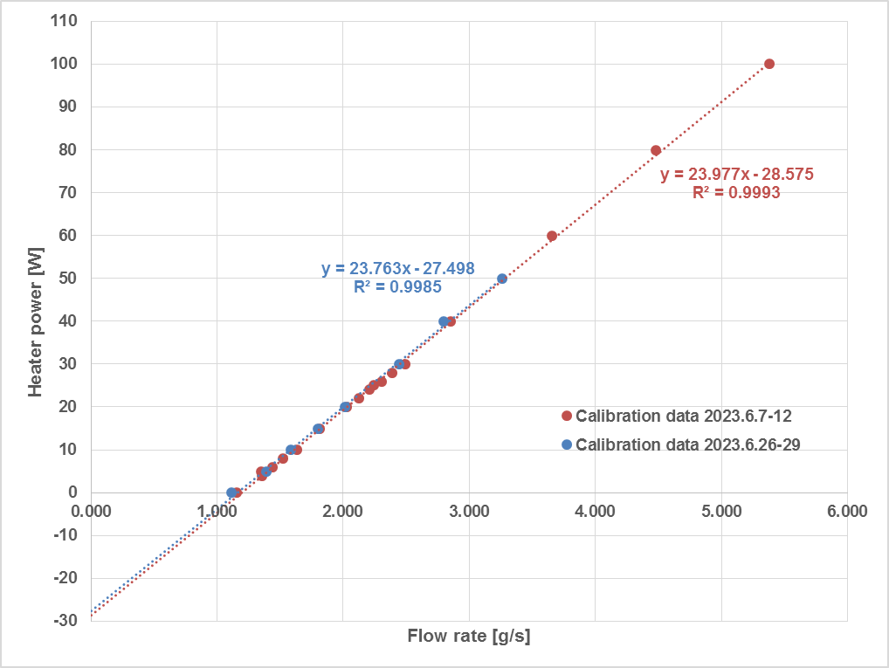
2 K Static Heat Load Measurement (Mass Flow Method)
Close bottom cooldown valve (CV6218), endcap pre-cooling valve (CV6215) and J-T valve (CV6214).
Calibration of mass flow rate is done with a heater immersed in the helium liquid level tank.
In most cases, flow rate is measured from liquid level 80 % to 75 %.
*Note: standard deviation is used in this table
 | Using latent heat | By calibration (2023.6.7-12) | By calibration (2023.6.26-29)
Module 2 K static heat load [W] | (23.04 J/g) * flow [g/s] | (24.0±0.2 J/g) * flow [g/s] | (23.8±0.4J/g) * flow [g/s]
Static heat load [W] | 25.8±1.3 | 28.6±0.4 | 27.5±0.8
$$\left\{\begin{aligned}Q_{static}=a_{fit}×f_{static} \\ 0=Q_{dyn}=a_{fit}×f_{static}+b_{fit}\end{aligned}\right.⇒Q_{static}=−b_{fit}$$
$$Q_{dyn}=a_{fit}×f_{measure}+b_{fit}$$
when dynamic heat load is 0, then
$$σ_{Q_fit}=σ_{Q_r}×\sqrt{\frac{1}{n}\left(1+\frac{{\left(f_{measure}−\overline{f_{i}}\right)}^{2}}{σ_{fi}^{2}}\right)}$$
where $σ_{Q_r}=\sqrt{\frac{\sum_{i=1}^{n}{{\left[Q_{i}−\left(a_{fit}×f_{i}+b_{fit}\right)\right]}^{2}}}{n−2}},$
$$\overline{f_{i}}=\frac{1}{n}\sum_{i=1}^{n}{f_{i}},σ_{fi}^{2}=\frac{1}{n}\sum_{i=1}^{n}{{(f_{i}−\overline{f_{i}})}^{2}}$$
Better fitting accuracy (important during single-cavity Q measurement) if closer to averaged flow rate $\overline{f_{i}}$ during calibration.
Better fitting accuracy with more data (n).

Slide 6
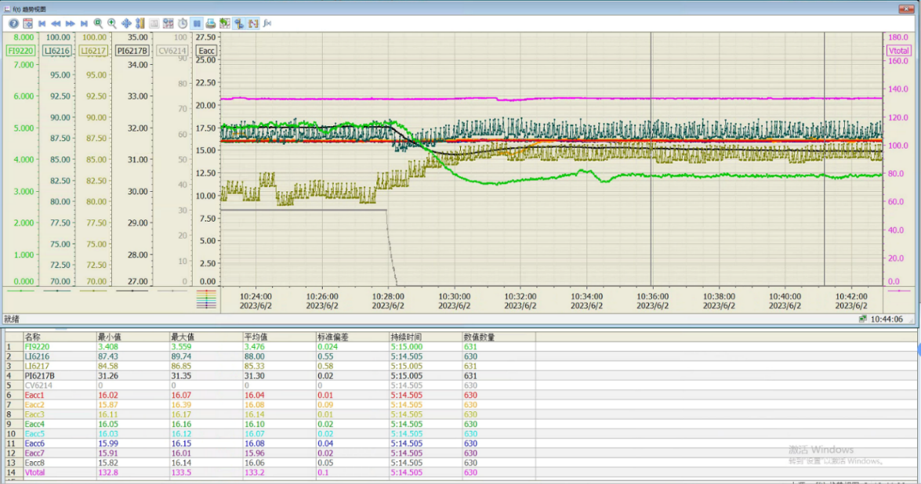
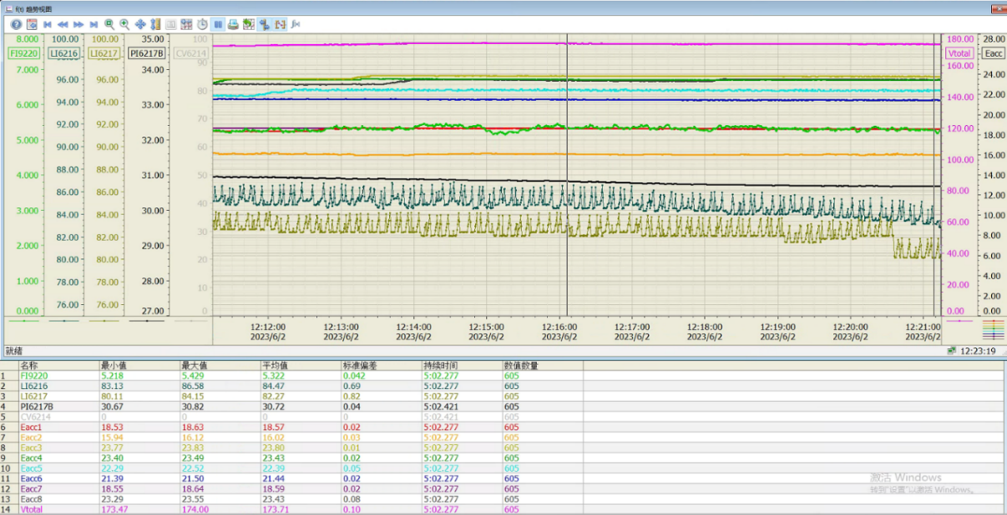
Dynamic Heat Load of 8 Cavities at 16 MV/m and 21 MV/m
Close bottom cooldown valve (CV6218), endcap pre-cooling valve (CV6215) and J-T valve (CV6214).
Total uncertainty of dynamic heat load is $δQ_{dyn}=\sqrt{{σ_{Q_fit}}^{2}+{(a_{fit}×δf)}^{2}}$
*Note: standard deviation is used in this table
RF Voltage, cool down (date, rate) | Measurement Date | Mass flow [g/s] | Q_{dyn} [W] (Cal. 6.7-12) | Q_{dyn} [W] (Cal. 6.26-29) | Q_{dyn} [W] (use latent heat)
133 MV, fast cool down (6.1, > 40 g/s) | 2023.6.2 | 3.75±0.05 | 61.3±1.3 | 61.6±1.4 | 60.5±1.9
133 MV, fast cool down (6.1, > 40 g/s) | 2023.6.2 | 3.82±0.05 | 63.0±1.3 | 63.2±1.4 | 62.3±1.9
133 MV, slow cool down (6.19, ~ 7 g/s) | 2023.7.3 | 3.60±0.05 | 57.7±1.2 | 58.0±1.4 | 57.2±1.9
133 MV, slow cool down (6.19, ~ 7 g/s) | 2023.7.4 | 3.64±0.05 | 58.7±1.2 | 59.0±1.4 | 58.4±1.9
174 MV, fast cool down (6.1, > 40 g/s) | 2023.6.2 | 5.62±0.05 | 106.2±1.4 | 106.0±1.9 | 103.8±1.9

Slide 7
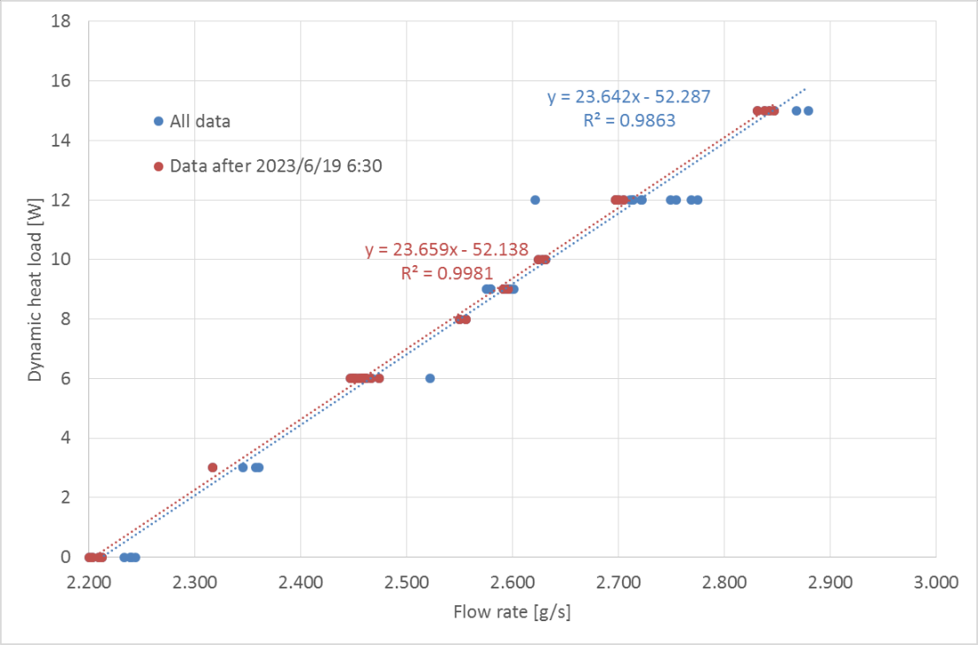
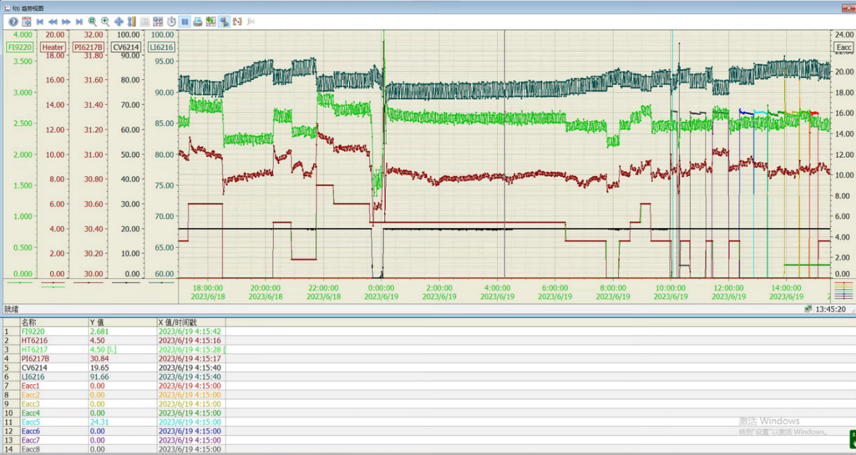
Dynamic Heat Load of Single Cavity at 16 MV/m
The J-T valve CV6214 is fixed at 20 %.
Heater power 6-7 W keeps the liquid level constant at ~ 90 %.
The dynamic heat load is calibrated with a heater immersed in the liquid level tank; heater power 0-15 W is adopted to get best fitting accuracy around 7-8 W.
*Note: standard deviation is used in this table
 | Cav1 | Cav2 | Cav3 | Cav4 | Cav5 | Cav6 | Cav7 | Cav8
Dynamic heat load at 16 MV/m [W] | 7.4±0.3 | 10.0±0.3 | 8.0±0.3 | 6.8±0.3 | 6.8±0.3 | 7.1±0.3 | 10.5±0.3 | 6.2±0.3

Slide 8
Back up

Slide 9
2 K Pumps and Mass Flow Meters

