Slide 2
Methods and results of heat load measurements (static/dynamic), valid for test stands cryomodules installed in the linac at ESS
CM Heat Load Measurements at ESS
PRESENTED BY <NUNO ELIAS>

Slide 3
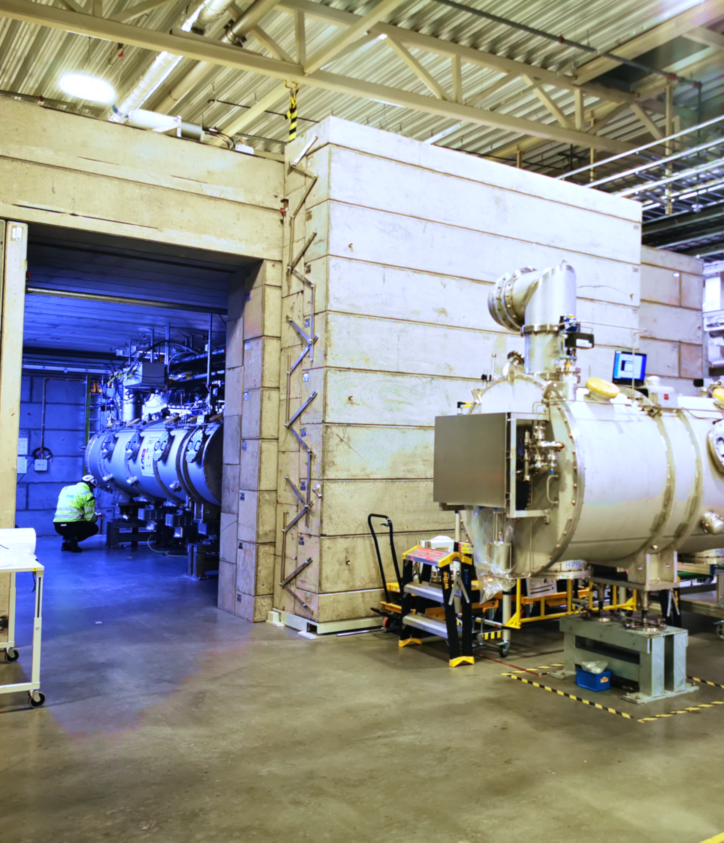
Agenda
Static Heat Loads
- Flowmeter (evaporated mass flow)
- Flowmeter (nominal mass flow)
- Flowmeter + 2_point enthalpic difference
- Level Decrease (equivalent evaporated mass)
- Pressure Increase (accrued energy)
Dynamic Heat Loads
- Heater Compensation

Slide 4
ESS Elliptical Cryomodule at TS2(simple)
Sub-headline to strengthen the headline above
The level of the helium bath is measured by two redundant level gauges, LT-01 and LT-02, and it is controlled by regulating the JT valve (CV-01) opening. The typical operating level is 90 %±5 % with liquid on the diphasic line.
The pressure of the saturated helium bath is measured by PT-04 sensor and maintained stable by controlling the VLP return valve (CV-04) placed downstream of the HX.
The flow returned to the TICP is measured after the 2 K pumps by the flowmeters FT-20 and FT-21.
A fraction of the HP helium supply flow is used to cool the power couplers double wall (23 mg/s per coupler), limiting heat loads by conduction from the external vessel parts through the power coupler structure into the cavities.

Slide 5
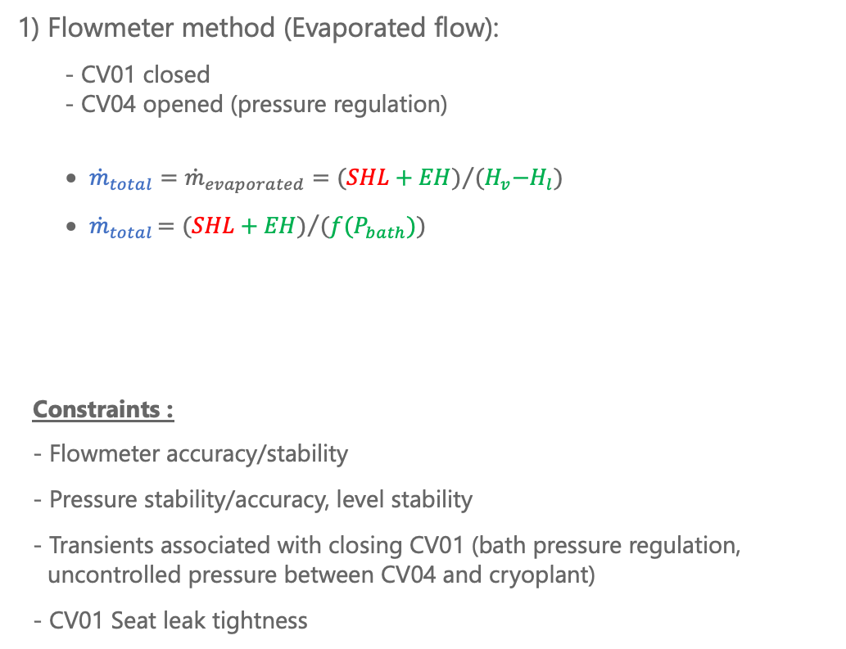
Static Heat Loads (1)
Evaporated mass flow
1) Flowmeter method (Evaporated flow):
  - CV01 closed
  - CV04 opened (pressure regulation)
      ${\dot{m}}_{total}={{\dot{m}}_{evaporated}=(SHL+EH)}/{(H_{v}{−H}_{l})}$
      ${\dot{m}}_{total}{=(SHL+EH)}/{(f(P_{bath}))}$
Constraints :
- Flowmeter accuracy/stability
- Pressure stability/accuracy, level stability
- Transients associated with closing CV01 (bath pressure regulation, uncontrolled pressure between CV04 and cryoplant)
- CV01 Seat leak tightness

Slide 6
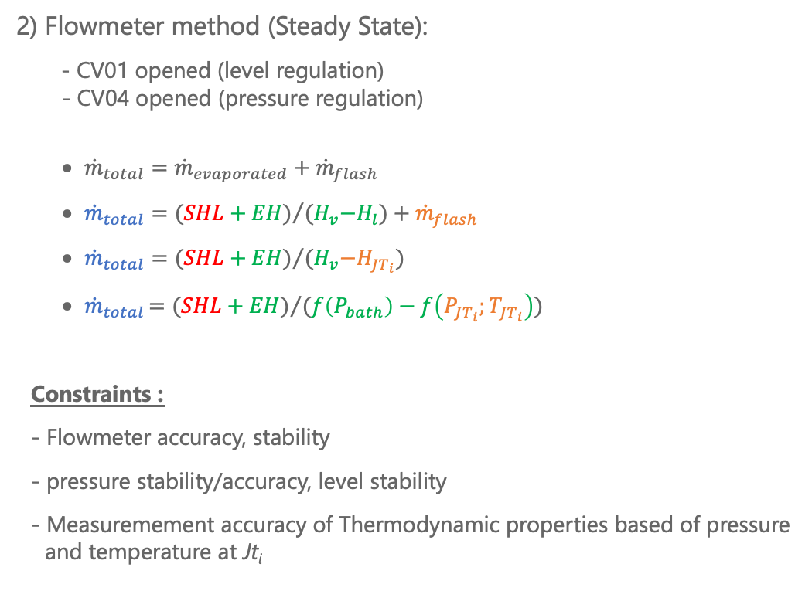
Static Heat Loads (2)
Nominal Flow (steady state)
2) Flowmeter method (Steady State):
- CV01 opened (level regulation)
- CV04 opened (pressure regulation)
      ${\dot{m}}_{total}={\dot{m}}_{evaporated}+{\dot{m}}_{flash}$
      ${\dot{m}}_{total}={(SHL+EH)}/{(H_{v}{−H}_{l})}+{\dot{m}}_{flash}$
      ${\dot{m}}_{total}={(SHL+EH)}/{(H_{v}{−H}_{JT_{i}})}$
      ${\dot{m}}_{total}{=(SHL+EH)}/{(f\left(P_{bath}\right)−f\left(P_{JT_{i}};T_{JT_{i}}\right))}$
Constraints :
- Flowmeter accuracy, stability
- pressure stability/accuracy, level stability
- Measuremement accuracy of Thermodynamic properties based of pressure and temperature at Jt_{i}

Slide 7
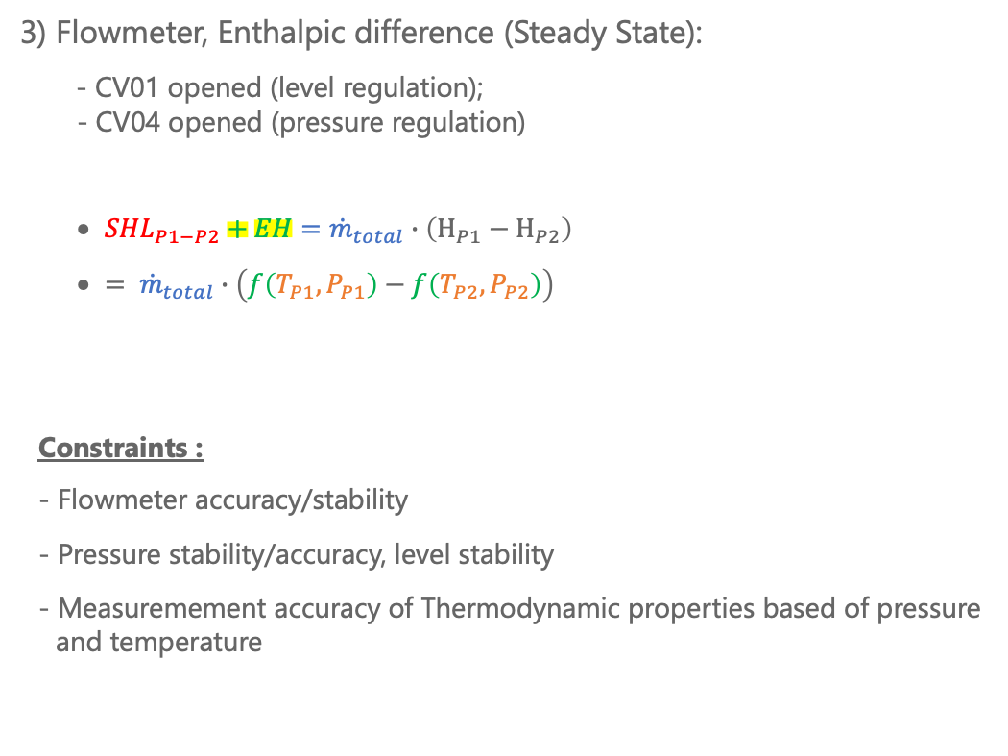
Static Heat Loads (3)
Flowmeter + Enthalpic difference (circuit)
3) Flowmeter, Enthalpic difference (Steady State):
- CV01 opened (level regulation);
- CV04 opened (pressure regulation)
      ${SHL}_{P1−P2}+EH={\dot{m}}_{total}∙\left(H_{P1}−H_{P2}\right)$
      $= {\dot{m}}_{total}∙\left(f\left(T_{P1}, P_{P1}\right)−f\left(T_{P2}, P_{P2}\right)\right)$
Constraints :
- Flowmeter accuracy/stability
- Pressure stability/accuracy, level stability
- Measuremement accuracy of Thermodynamic properties based of pressure and temperature

Slide 8
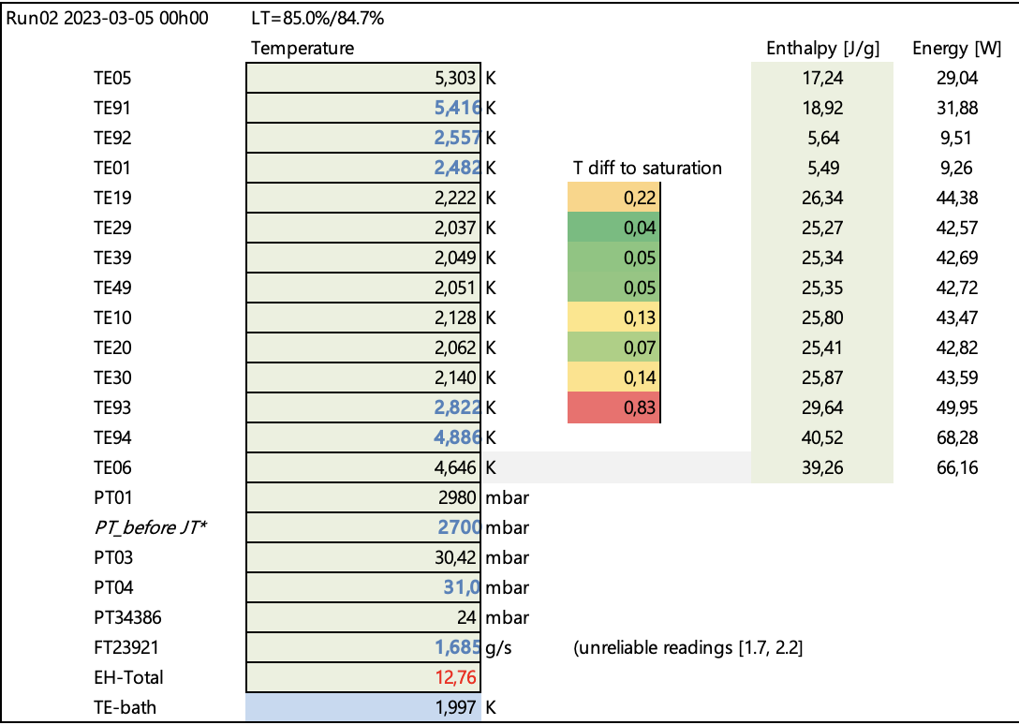
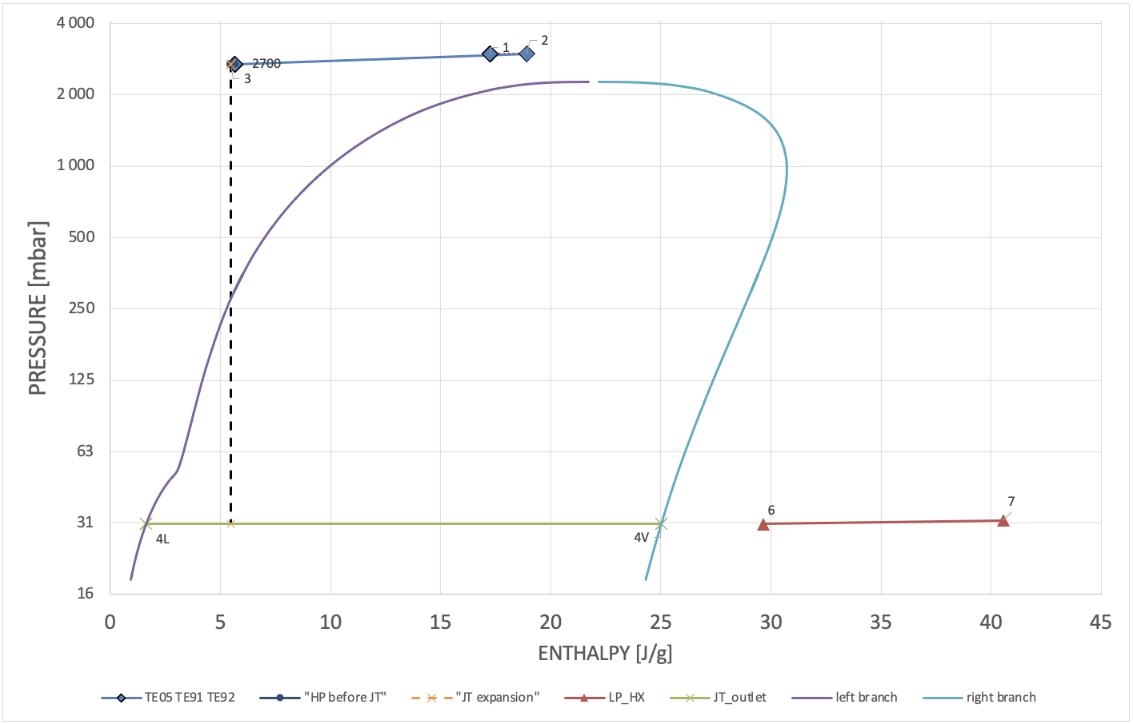
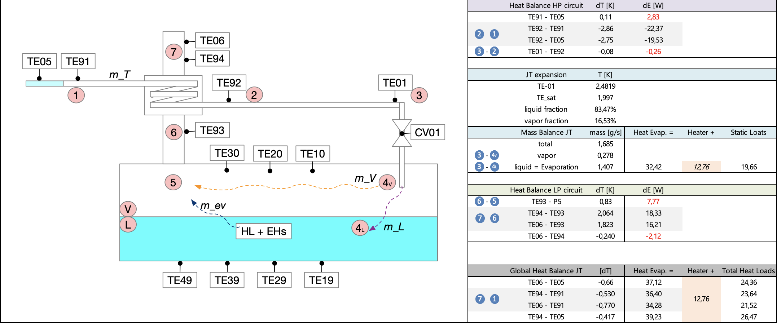
Static Heat Loads (3)
- Bath T discrepancy
- Redundant sensors discrepancy
- JT efficiency (liquid/vapor fraction)
- HX heat balance
- Heat Loads (syst T errors)
Flowmeter + Enthalpic difference (circuit)
EH= 12.8 W

Slide 9
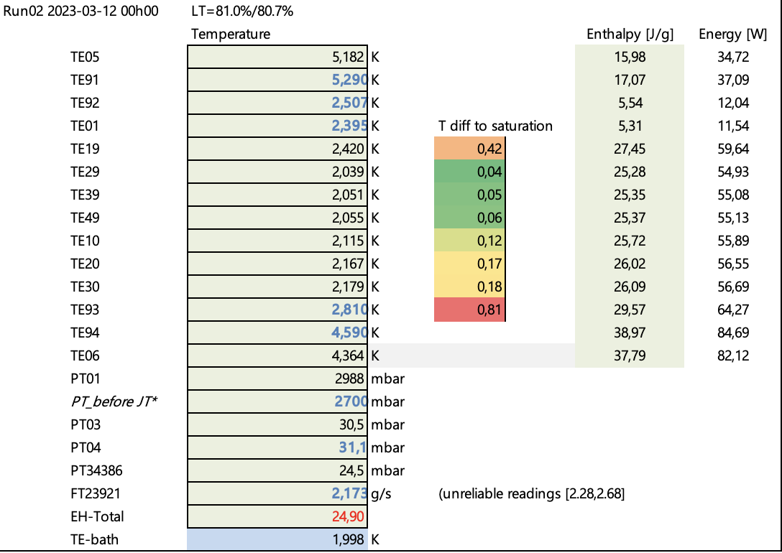
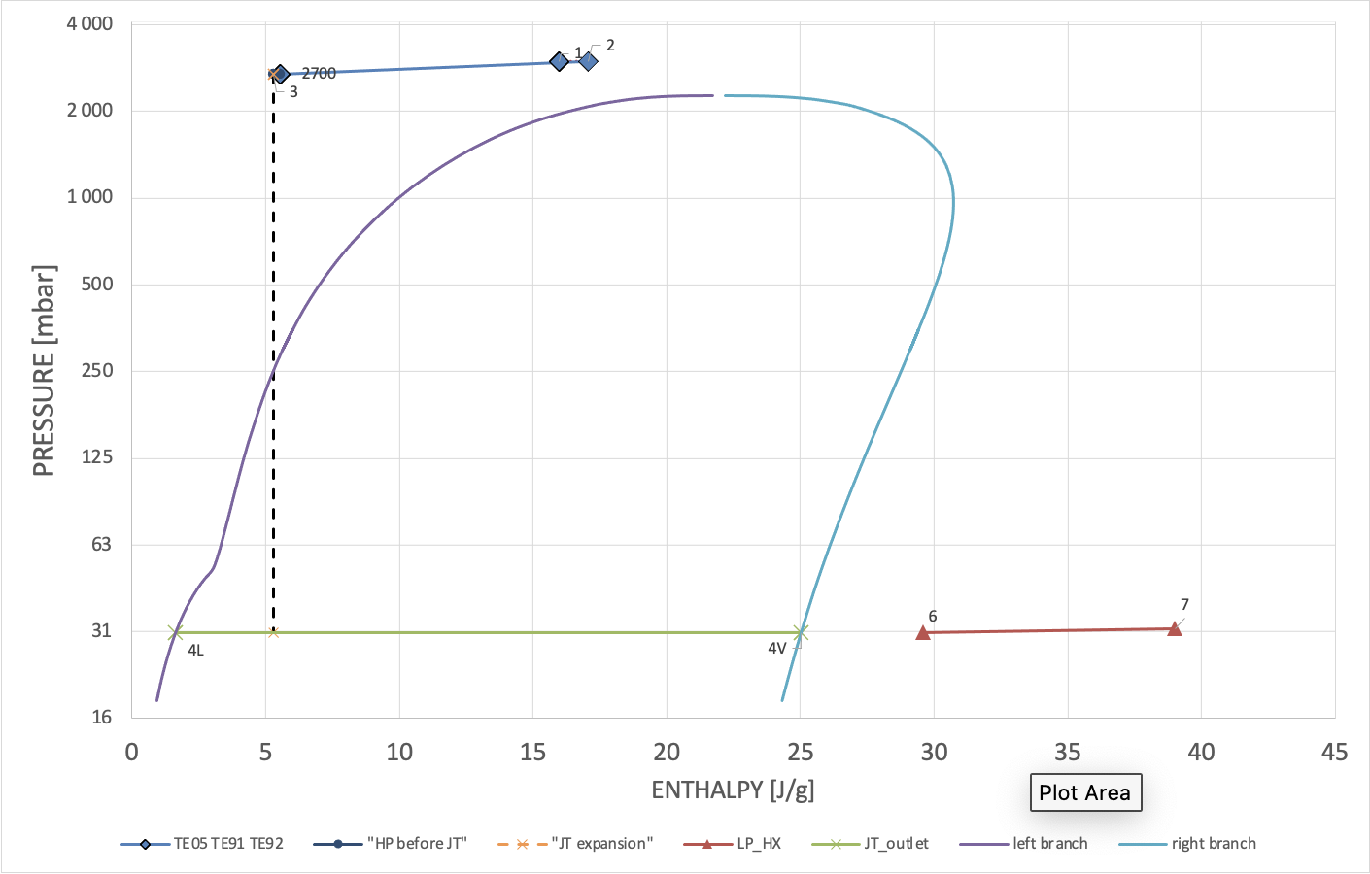
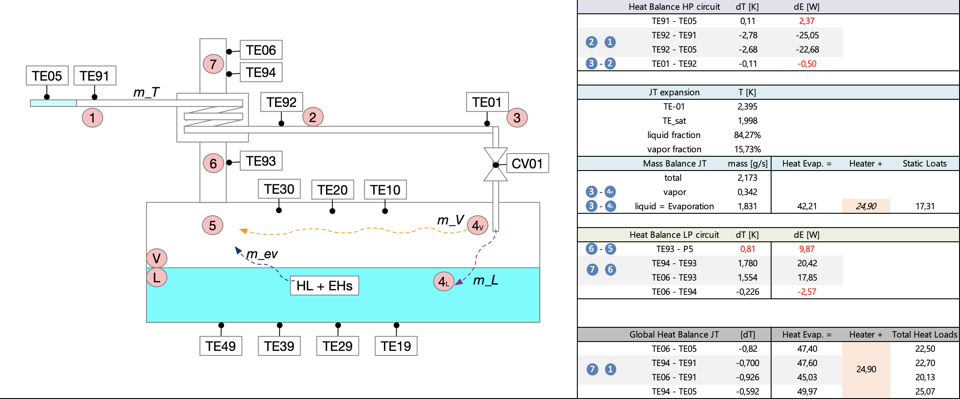
Static Heat Loads (3)
- Bath T discrepancy
- Redundant sensors discrepancy
- JT efficiency (liquid/vapor fraction)
- HX heat balance
- Heat Loads (syst T errors)
Flowmeter + Enthalpic difference (circuit)
EH= 24.9 W

Slide 10
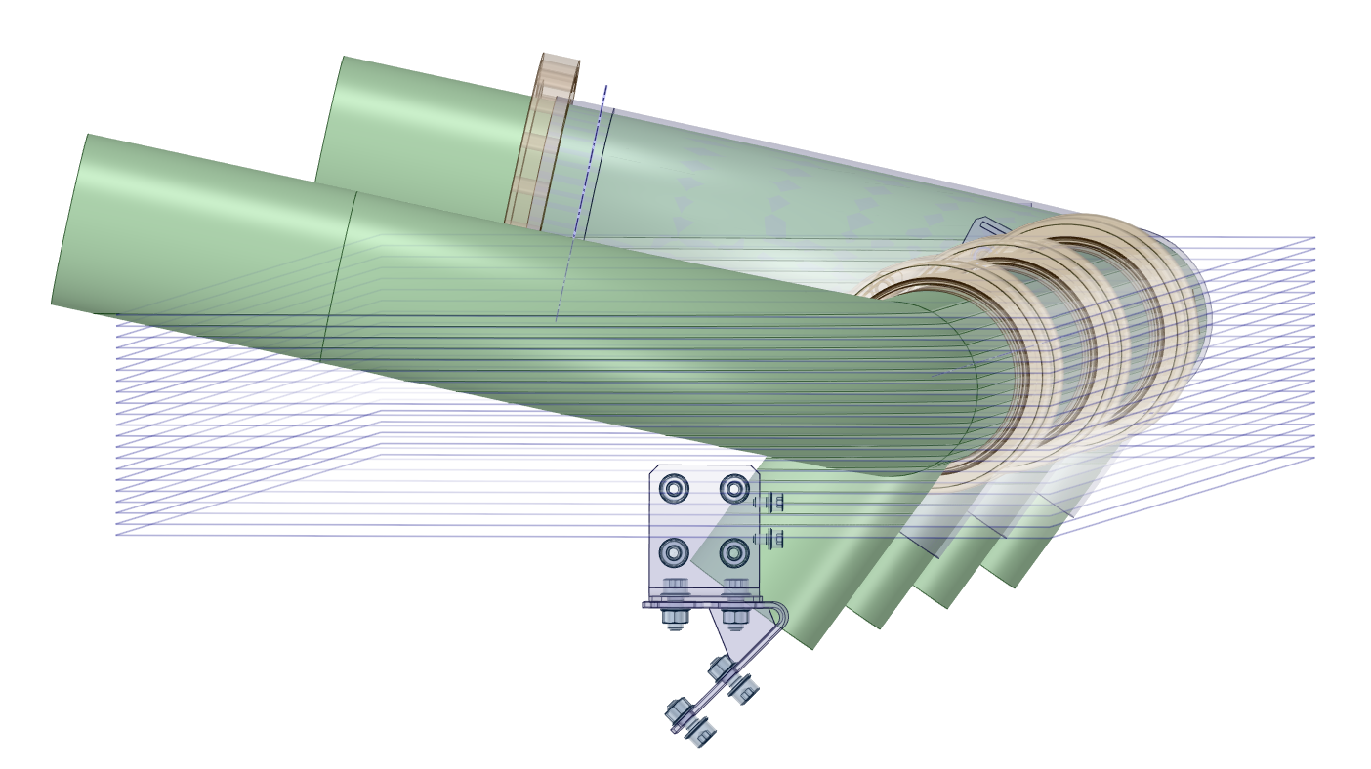
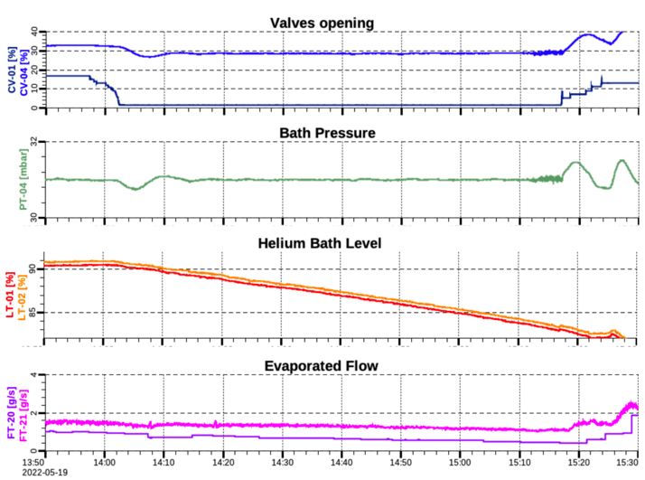
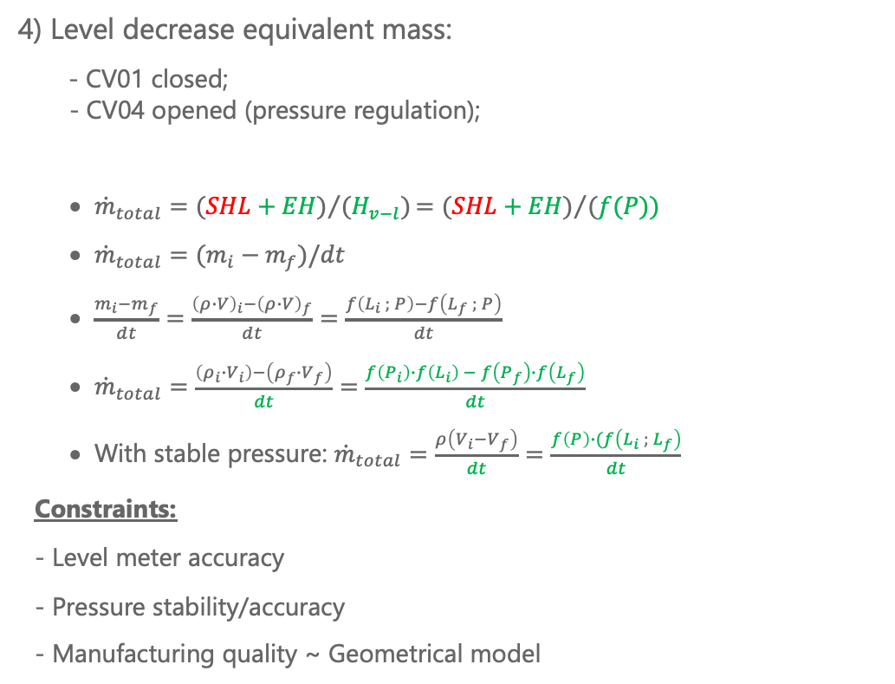
Static Heat Loads (4)
Evaporated mass (level) over time
4) Level decrease equivalent mass:
- CV01 closed;
- CV04 opened (pressure regulation);
      ${\dot{m}}_{total}={(SHL+EH)}/{(H_{v−l})}{=(SHL+EH)}/{(f(P))}$
      ${\dot{m}}_{total}=(m_{i}−m_{f})/dt$
      $\frac{m_{i}−m_{f}}{dt}=\frac{{\left(ρ∙V\right)}_{i}−{\left(ρ∙V\right)}_{f}}{dt}=\frac{f\left(L_{i} ; P\right)−f\left(L_{f} ; P\right)}{dt}$
      ${\dot{m}}_{total}=\frac{\left(ρ_{i}∙V_{i}\right)−\left(ρ_{f}∙V_{f}\right)}{dt}=\frac{f\left(P_{i}\right)∙f\left(L_{i}\right) − f\left(P_{f}\right)∙f\left(L_{f}\right)}{dt}$
      With stable pressure: ${\dot{m}}_{total}=\frac{ρ\left(V_{i}−V_{f}\right)}{dt}=\frac{f\left(P\right)∙(f\left(L_{i} ; L_{f}\right)}{dt}$
Constraints:
- Level meter accuracy
- Pressure stability/accuracy
- Manufacturing quality ~ Geometrical model

Slide 11
Static Heat Loads (4)
Evaporated mass (level) over time
4) Level decrease equivalent mass:
- CV01 closed;
- CV04 opened (pressure regulation);
      ${\dot{m}}_{total}={(SHL+EH)}/{(H_{v−l})}{=(SHL+EH)}/{(f(P))}$
      ${\dot{m}}_{total}=(m_{i}−m_{f})/dt$
      $\frac{m_{i}−m_{f}}{dt}=\frac{{\left(ρ∙V\right)}_{i}−{\left(ρ∙V\right)}_{f}}{dt}=\frac{f\left(L_{i} ; P\right)−f\left(L_{f} ; P\right)}{dt}$
      ${\dot{m}}_{total}=\frac{\left(ρ_{i}∙V_{i}\right)−\left(ρ_{f}∙V_{f}\right)}{dt}=\frac{f\left(P_{i}\right)∙f\left(L_{i}\right) − f\left(P_{f}\right)∙f\left(L_{f}\right)}{dt}$
      With stable pressure: ${\dot{m}}_{total}=\frac{ρ\left(V_{i}−V_{f}\right)}{dt}=\frac{f\left(P\right)∙(f\left(L_{i} ; L_{f}\right)}{dt}$
Constraints:
- Level meter accuracy
- Pressure stability/accuracy
- Manufacturing quality ~ Geometrical model

Slide 12
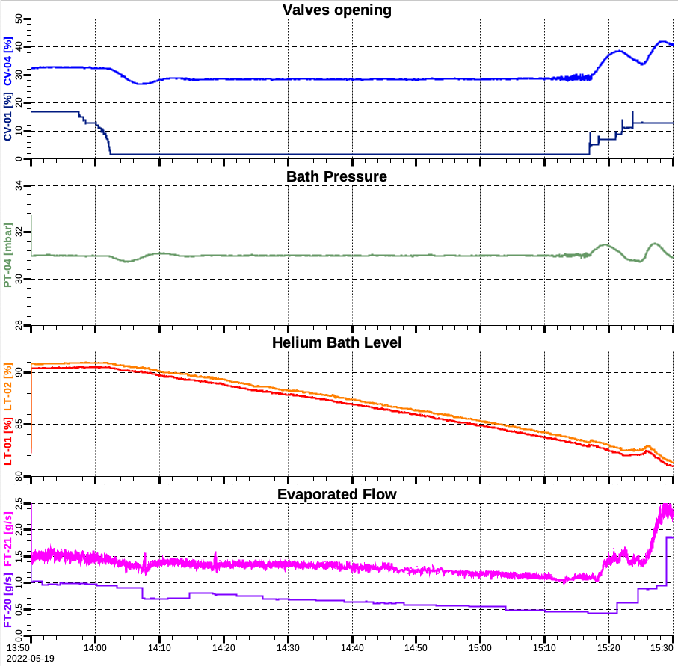
Static Heat Loads (4)
Evaporated mass (level) over time
4) Level decrease equivalent mass:
- CV01 closed;
- CV04 opened (pressure regulation);
      ${\dot{m}}_{total}={(SHL+EH)}/{(H_{v−l})}{=(SHL+EH)}/{(f(P))}$
      ${\dot{m}}_{total}=(m_{i}−m_{f})/dt$
      $\frac{m_{i}−m_{f}}{dt}=\frac{{\left(ρ∙V\right)}_{i}−{\left(ρ∙V\right)}_{f}}{dt}=\frac{f\left(L_{i} ; P\right)−f\left(L_{f} ; P\right)}{dt}$
      ${\dot{m}}_{total}=\frac{\left(ρ_{i}∙V_{i}\right)−\left(ρ_{f}∙V_{f}\right)}{dt}=\frac{f\left(P_{i}\right)∙f\left(L_{i}\right) − f\left(P_{f}\right)∙f\left(L_{f}\right)}{dt}$
      With stable pressure: ${\dot{m}}_{total}=\frac{ρ\left(V_{i}−V_{f}\right)}{dt}=\frac{f\left(P\right)∙(f\left(L_{i} ; L_{f}\right)}{dt}$
Constraints:
- Level meter accuracy
- Pressure stability/accuracy
- Manufacturing quality ~ Geometrical model

Slide 13
Static Heat Loads (4)
Evaporated mass (level) over time
Flowmeter
4) Level decrease equivalent mass:
- CV01 closed;
- CV04 opened (pressure regulation);
      ${\dot{m}}_{total}={(SHL+EH)}/{(H_{v−l})}{=(SHL+EH)}/{(f(P))}$
      ${\dot{m}}_{total}=(m_{i}−m_{f})/dt$
      $\frac{m_{i}−m_{f}}{dt}=\frac{{\left(ρ∙V\right)}_{i}−{\left(ρ∙V\right)}_{f}}{dt}=\frac{f\left(L_{i} ; P\right)−f\left(L_{f} ; P\right)}{dt}$
      ${\dot{m}}_{total}=\frac{\left(ρ_{i}∙V_{i}\right)−\left(ρ_{f}∙V_{f}\right)}{dt}=\frac{f\left(P_{i}\right)∙f\left(L_{i}\right) − f\left(P_{f}\right)∙f\left(L_{f}\right)}{dt}$
      With stable pressure: ${\dot{m}}_{total}=\frac{ρ\left(V_{i}−V_{f}\right)}{dt}=\frac{f\left(P\right)∙(f\left(L_{i} ; L_{f}\right)}{dt}$
Constraints:
- Level meter accuracy
- Pressure stability/accuracy
- Manufacturing quality ~ Geometrical model
LD equiv. mass

Slide 14
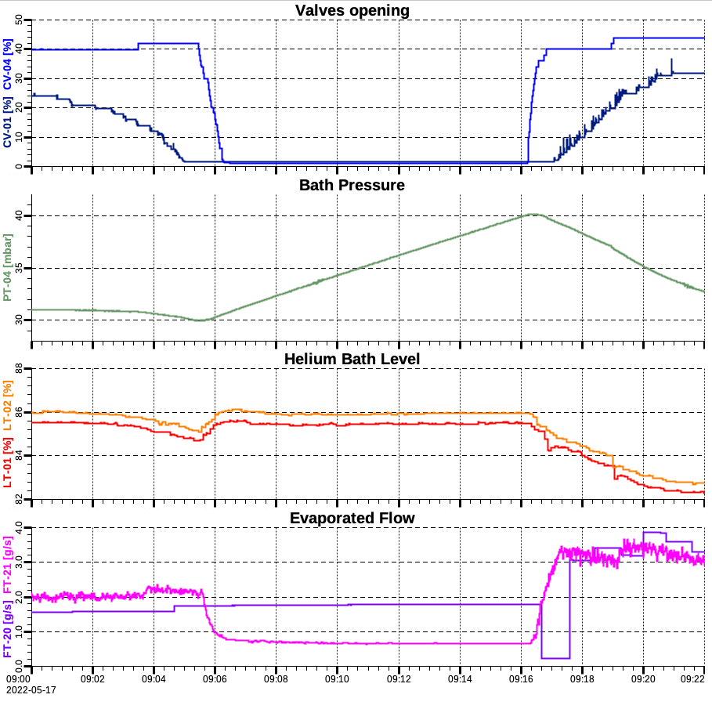
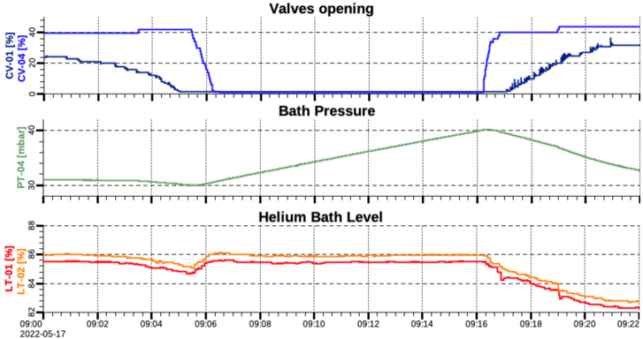
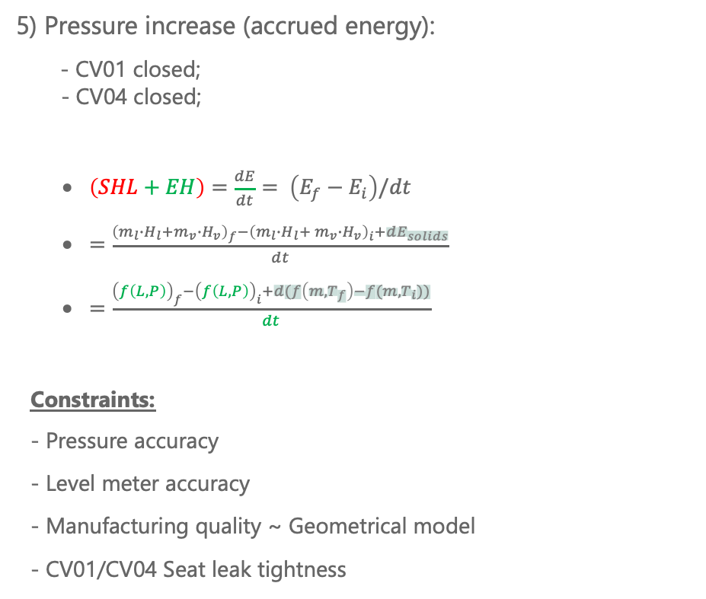
Static Heat Loads (4)
Accrued energy of system over time
5) Pressure increase (accrued energy):
- CV01 closed;
- CV04 closed;
      $\left(SHL+EH\right)=\frac{dE}{dt}= \left(E_{f}−E_{i}\right)/dt$
      $=\frac{{\left({m_{l}∙H_{l}+m}_{v}∙H_{v}\right)}_{f}−{\left({m_{l}∙H_{l}+ m}_{v}∙H_{v}\right)}_{i}+dE_{solids}}{dt}$
      $=\frac{{\left(f\left(L, P\right)\right)}_{f}−{\left(f\left(L, P\right)\right)}_{i}+d(f\left({m,T}_{f}\right)−f(m,T_{i}))}{dt}$
Constraints:
- Pressure accuracy
- Level meter accuracy
- Manufacturing quality ~ Geometrical model
- CV01/CV04 Seat leak tightness

Slide 15
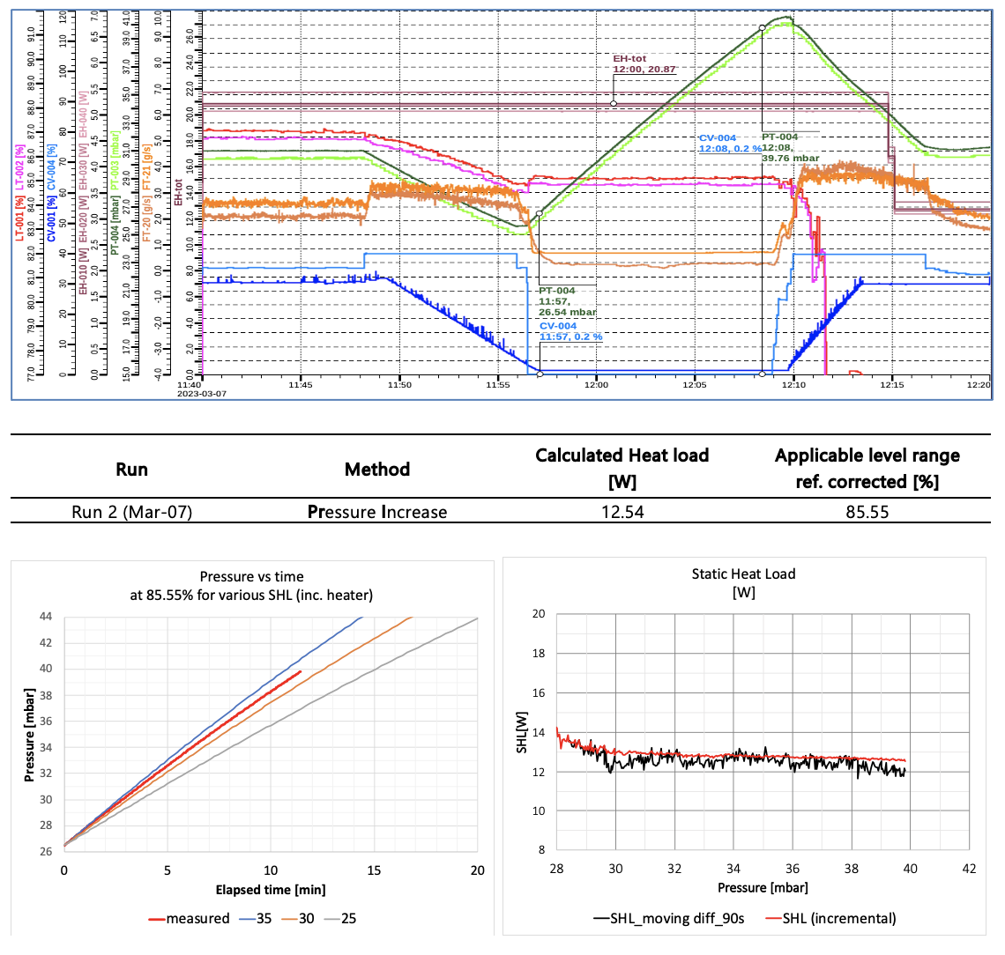
Static Heat Loads (4)
Accrued energy of system over time
#CM32
5) Pressure increase (accrued energy):
- CV01 closed;
- CV04 closed;
      $\left(SHL+EH\right)=\frac{dE}{dt}= \left(E_{f}−E_{i}\right)/dt$
      $=\frac{{\left({m_{l}∙H_{l}+m}_{v}∙H_{v}\right)}_{f}−{\left({m_{l}∙H_{l}+ m}_{v}∙H_{v}\right)}_{i}+dE_{solids}}{dt}$
      $=\frac{{\left(f\left(L, P\right)\right)}_{f}−{\left(f\left(L, P\right)\right)}_{i}+d(f\left({m,T}_{f}\right)−f(m,T_{i}))}{dt}$
Constraints:
- Pressure accuracy
- Level meter accuracy
- Manufacturing quality ~ Geometrical model
- CV01/CV04 Seat leak tightness

Slide 16
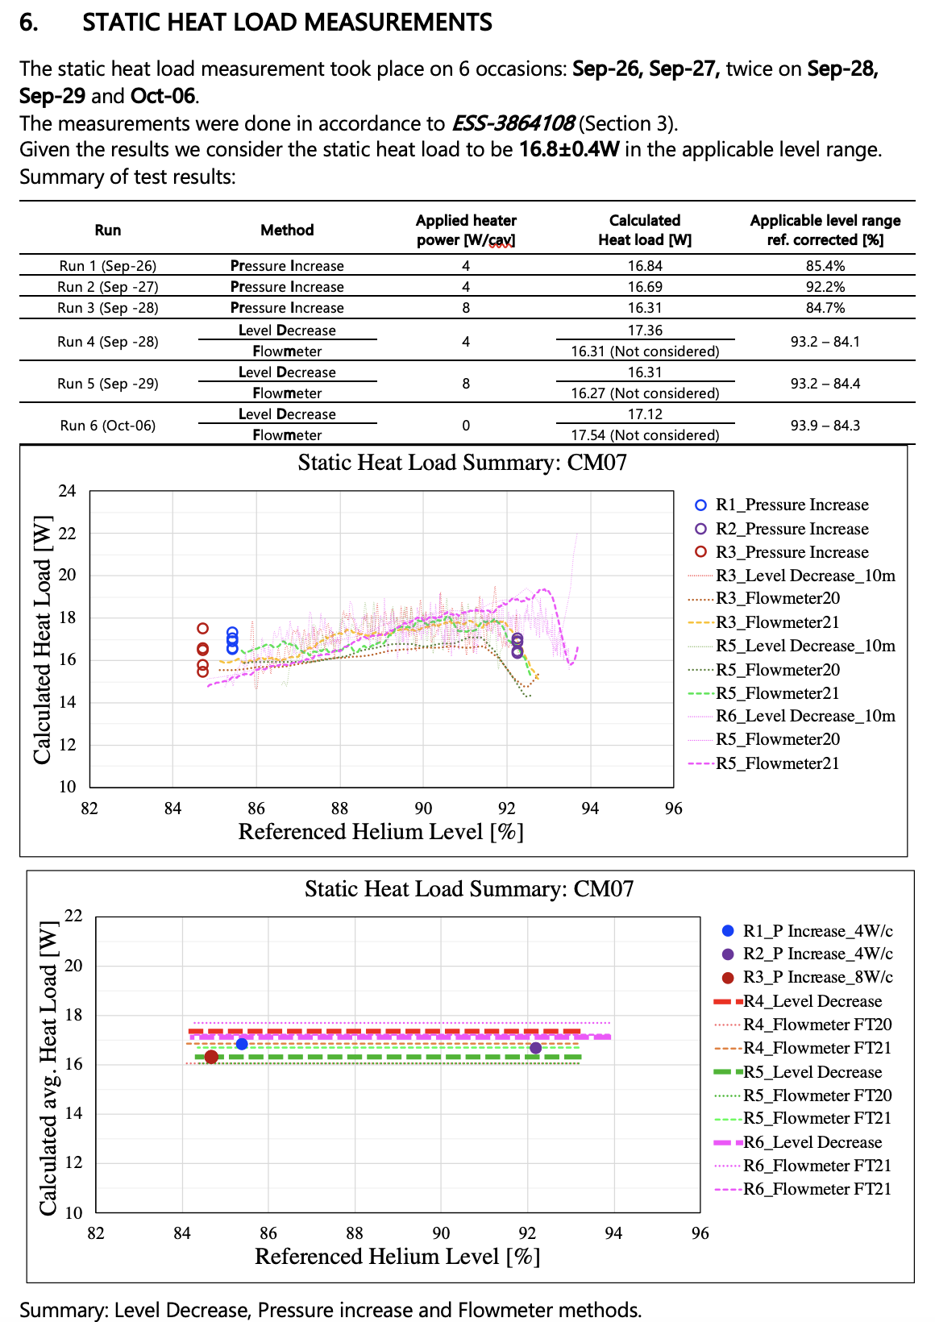
Static Heat Loads (summary)
#CM07
At ESS we use a diversity of methods to calculate the SHL.
This allows us to:
-> cross-check the results against each other.
-> characterize systematic errors of instrumentation
-> characterize (up to some extent) the sources of the heat loads.
-> better understand the behaviour of the system.

Slide 17
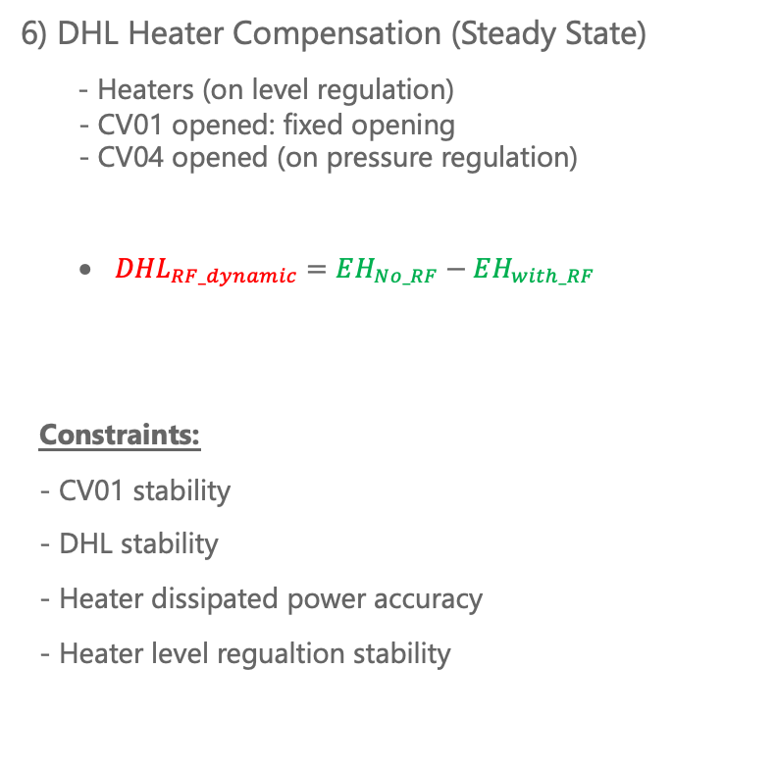
Dynamic Heat Loads (1)
Compensation of DHL with cavity heaters
6) DHL Heater Compensation (Steady State)
- Heaters (on level regulation)
- CV01 opened: fixed opening
- CV04 opened (on pressure regulation)
      ${DHL}_{RF_dynamic}=EH_{No_RF}−EH_{with_RF}$
Constraints:
- CV01 stability
- DHL stability
- Heater dissipated power accuracy
- Heater level regualtion stability

Slide 18
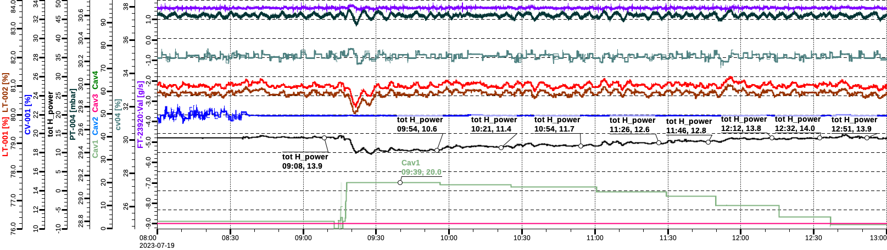
Dynamic Heat Loads (1)
Compensation of DHL with cavity heaters
6) DHL Heater Compensation (Steady State)
- Heaters (on level regulation)
- CV01 opened: fixed opening
- CV04 opened (on pressure regulation)
      ${DHL}_{RF_dynamic}=EH_{No_RF}−EH_{with_RF}$
Constraints:
- CV01 stability
- DHL stability
- Heater dissipated power accuracy
- Heater level regualtion stability

Slide 19
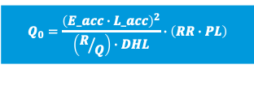
Dynamic Heat Loads (1)
$$Q_{0}=\frac{{\left(E_acc∙L_acc\right)}^{2}}{\left(R/Q\right)∙DHL}∙\left(RR∙PL\right)$$
Compensation of DHL with cavity heaters
#CM33
6) DHL Heater Compensation (Steady State)
- Heaters (on level regulation)
- CV01 opened: fixed opening
- CV04 opened (on pressure regulation)
      ${DHL}_{RF_dynamic}=EH_{No_RF}−EH_{with_RF}$
Constraints:
- CV01 stability
- DHL stability
- Heater dissipated power accuracy
- Heater level regualtion stability

Slide 20
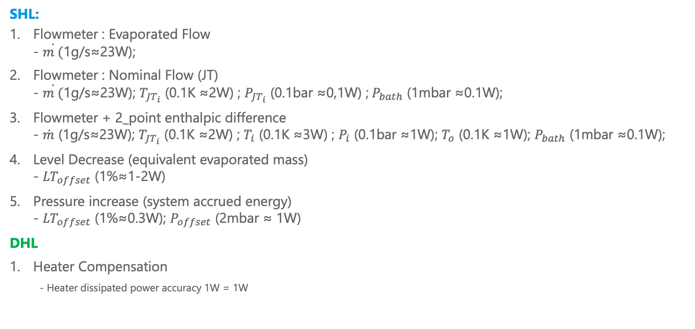
Error quantification ≈ @SHL=20W
Sources of errors
SHL:
Flowmeter : Evaporated Flow
- $\dot{m (}$1g/s≈23W);
Flowmeter : Nominal Flow (JT)
- $\dot{m (}$1g/s≈23W); $T_{JT_{i}}$ (0.1K ≈2W) ; ${P_{JT_{i}}\text{ (0.1}\text{bar}\text{ ≈}\text{0,1}\text{W}\text{) ;} P}_{bath}$ (1mbar ≈0.1W);
Flowmeter + 2_point enthalpic difference
- $\dot{m}$ (1g/s≈23W); $T_{JT_{i}}$ (0.1K ≈2W) ; $T_{i}$ (0.1K ≈3W) ; $P_{i}$ (0.1bar ≈1W); $T_{o}$ (0.1K ≈1W); $P_{bath}$ (1mbar ≈0.1W);
Level Decrease (equivalent evaporated mass)
- ${LT}_{offset}$ (1%≈1-2W)
Pressure increase (system accrued energy)
- ${LT}_{offset}$ (1%≈0.3W); $P_{offset}$ (2mbar ≈ 1W)
DHL
Heater Compensation
      - Heater dissipated power accuracy 1W = 1W

Slide 21
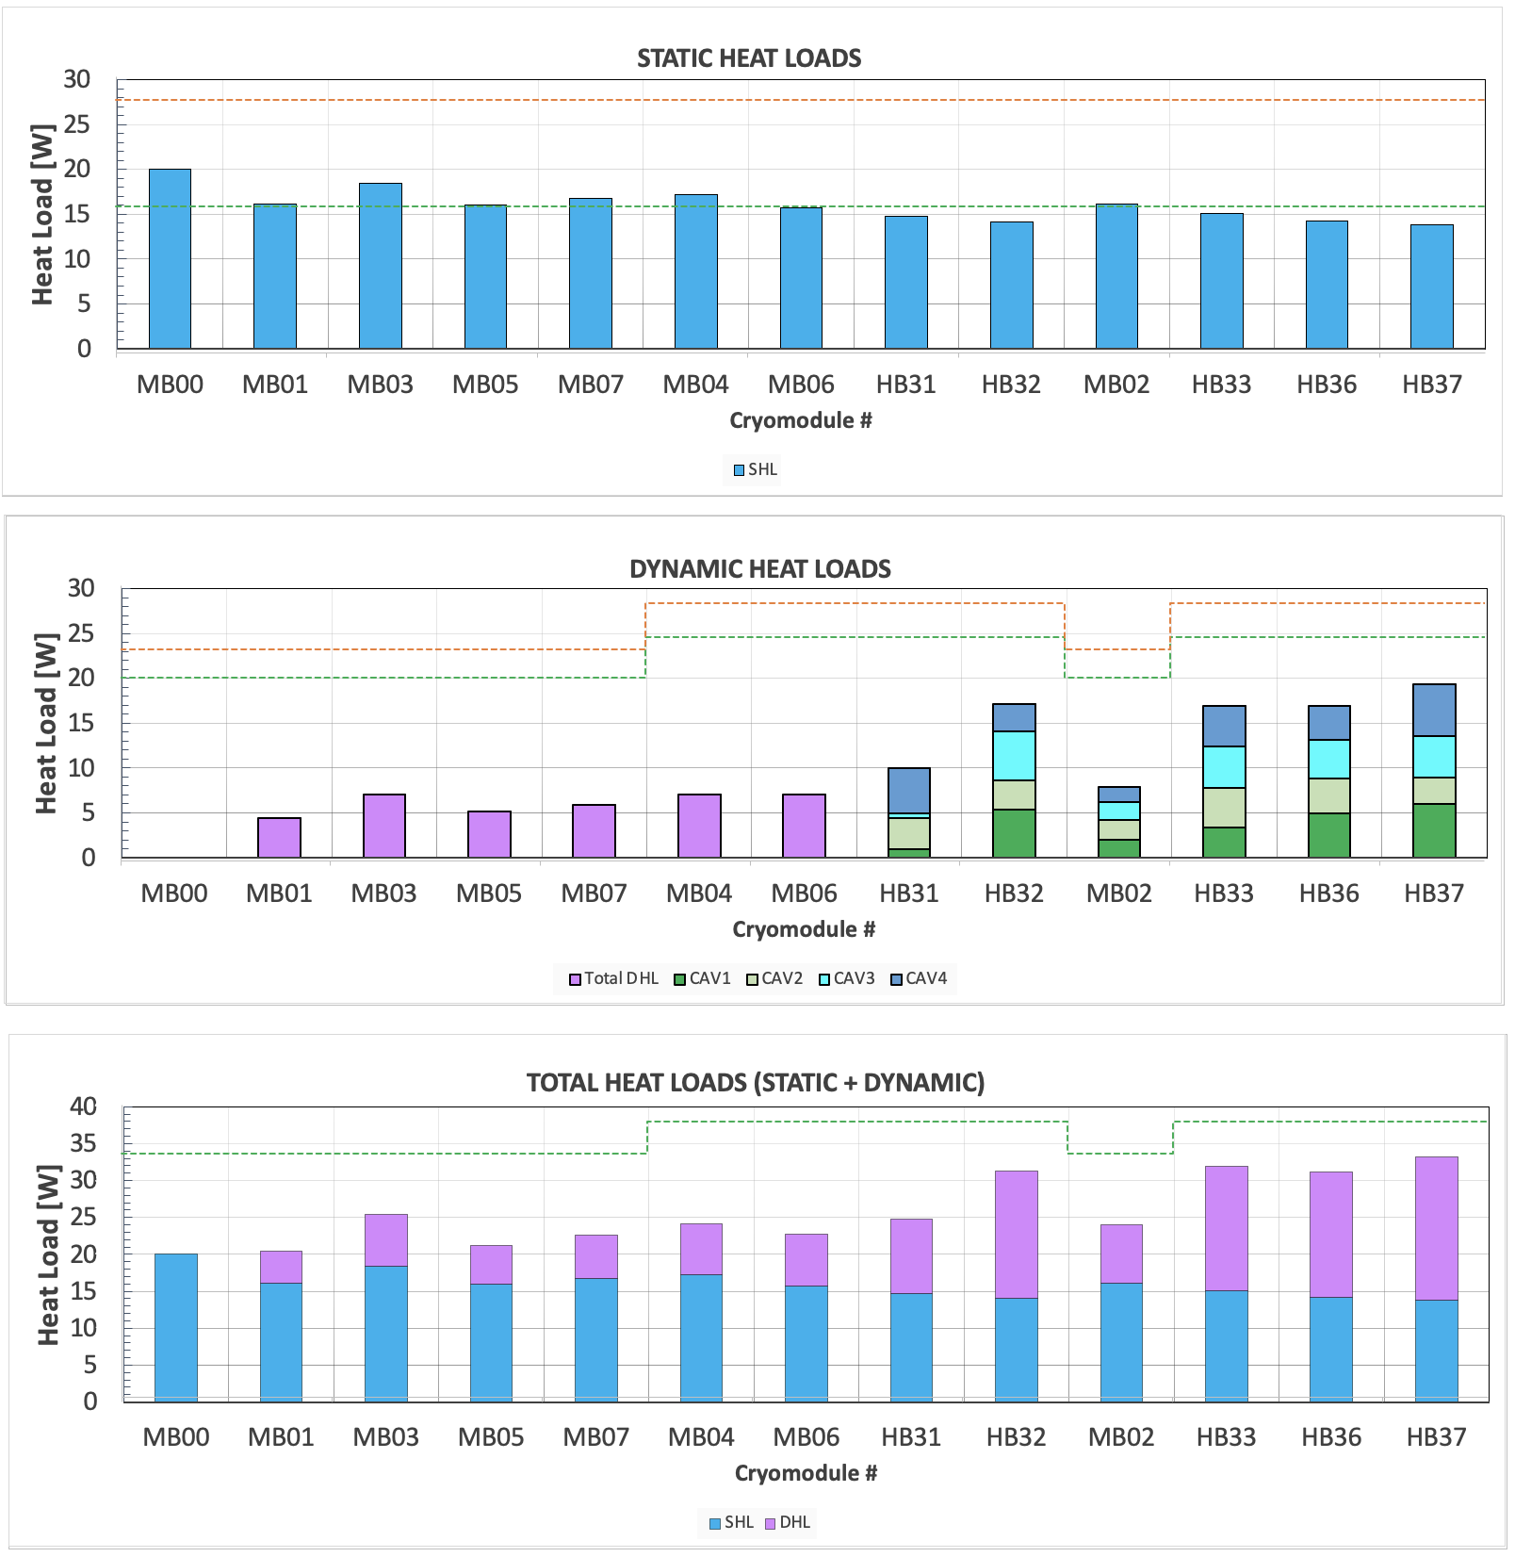
Summary of measured heat loads
Static
Dynamic
Total

Slide 22
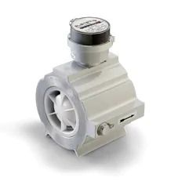
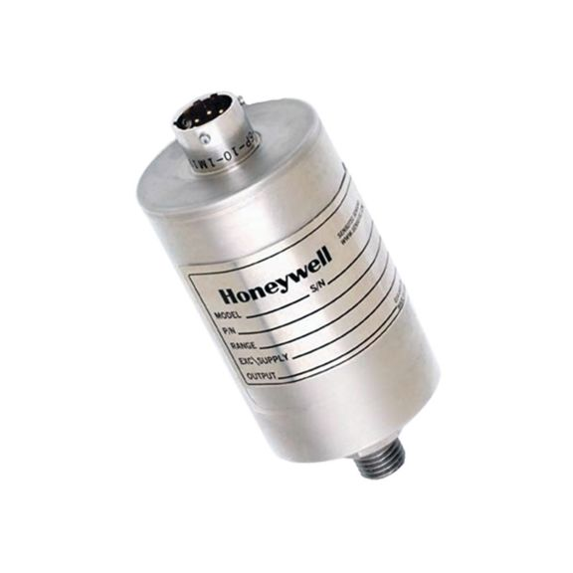
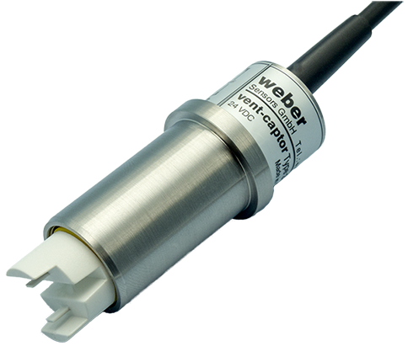
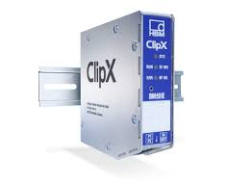
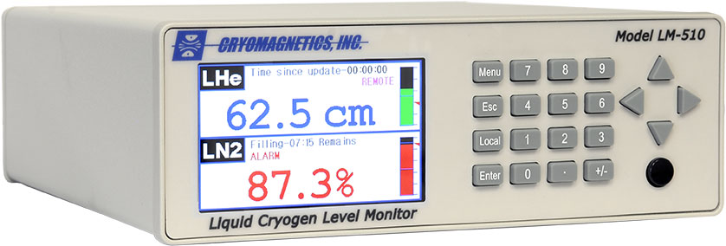
Instrumentation and Acquisition
Sub-headline to strengthen the headline above
Flowmeters:
- Honeywell QA/QAE Quantometer.
- Weber Vent-captor 3205.30
Pressure sensors:
- Honeywell STJE.
Pressure conditioning:
- HBM ClipX signal conditioner.
Temperature sensors:
- CernoX
Temperature conditioning:
- Lakeshore
- CABTR
Turbine gas meter
Level sensors:
- Cryomagnetics
Level conditioning:
- Cryomagnetics
Calorimetric principle

Slide 23
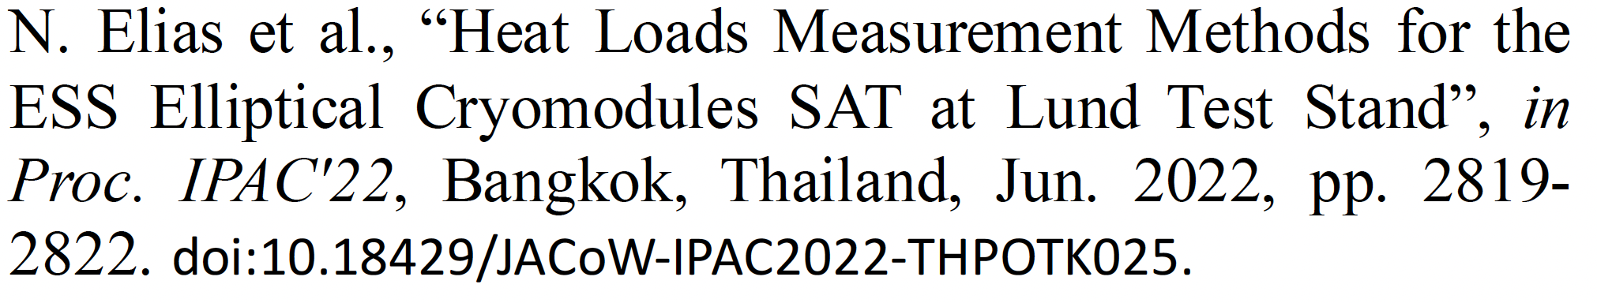
Presentation End
Reference:

