Slide 1
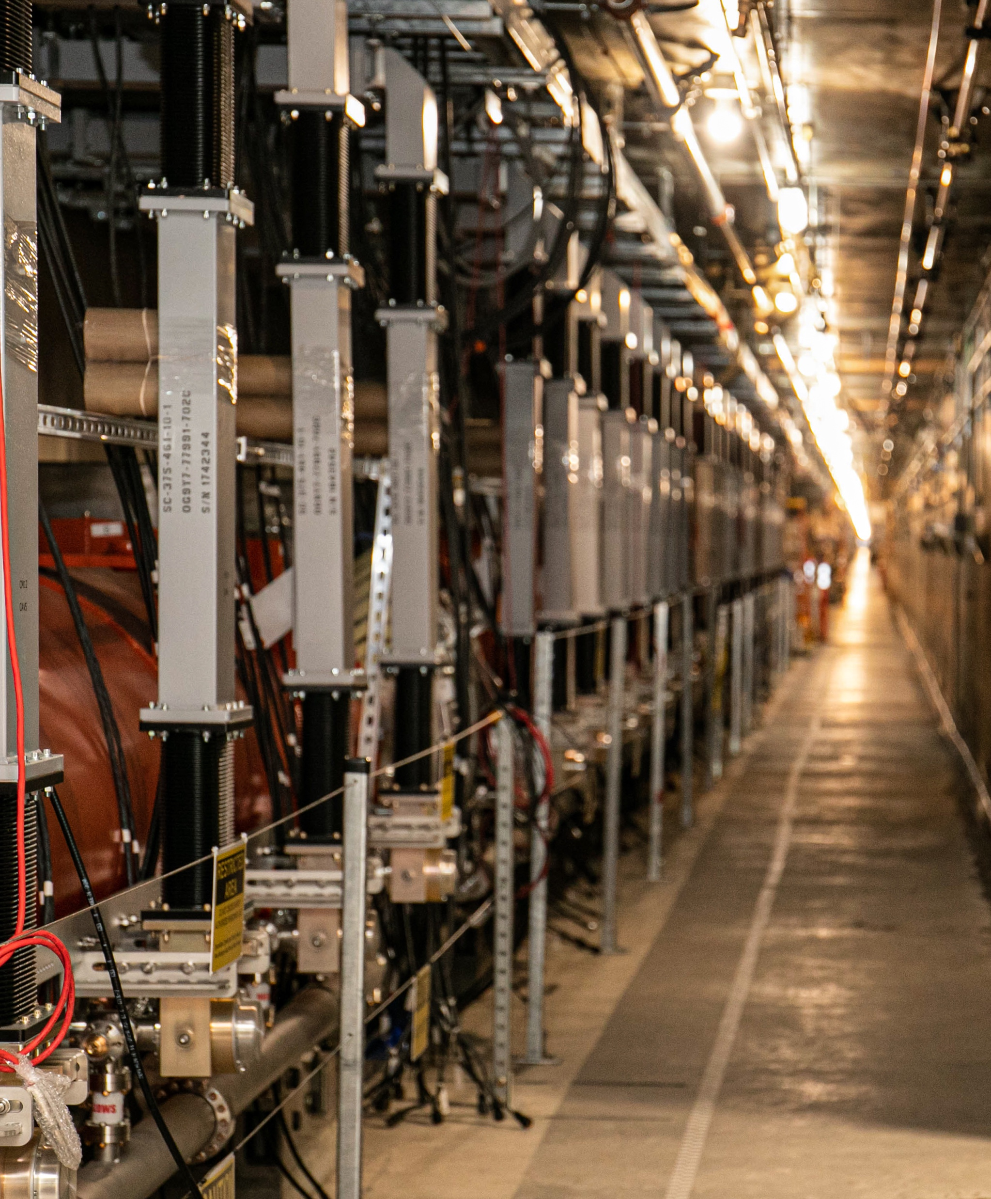
Heat Load Measurements at LCLS-II
Lisa Zacarias, SRF Engineer, SC Linac Physics
Presented to the TESLA Technology Collaboration (TTC) on Dec 6, 2023

Slide 2
Outline
Static Heat Load Measurements
Verifying Linearity
Dissipated Power from Rate of Helium Evaporation
Results
Dynamic Heat Load Measurements
Background
Calibrations
RF Measurements
Single Cavity Extraction
Results

Slide 3
Static Heat Load Measurements
1

Slide 4
Verifying Linearity
Heater Power | dL/dt (%/hr)
80 W | 31.0
60 W | 23.7
40 W | 16.4
20 W | 9.2
0 W | 1.5
Method
Set electric heater power to fixed value
Close JT valve to prevent filling
Record averaged rate of liquid level drop
Decrease heater power from 80 W to 0 W in steps of 20 W
Notes:
Average DS and US dLL/dt

Slide 5
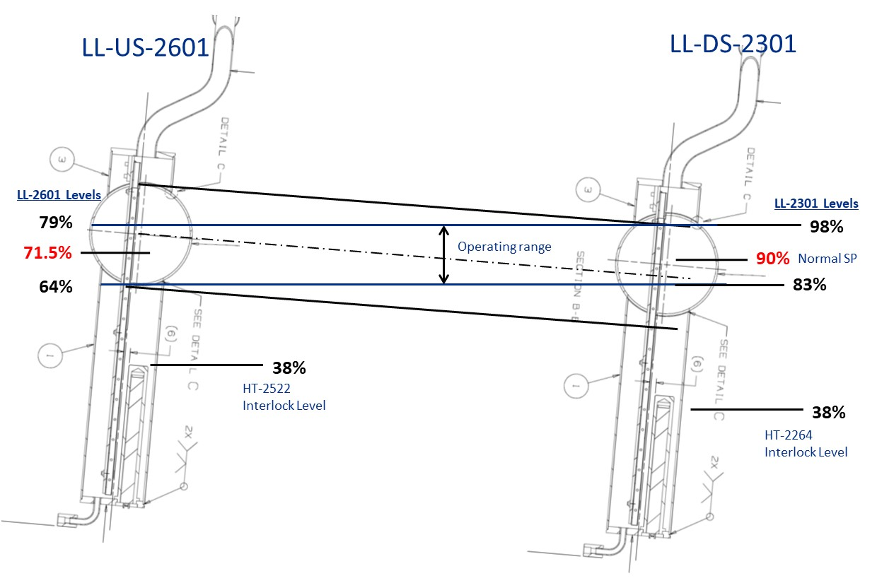
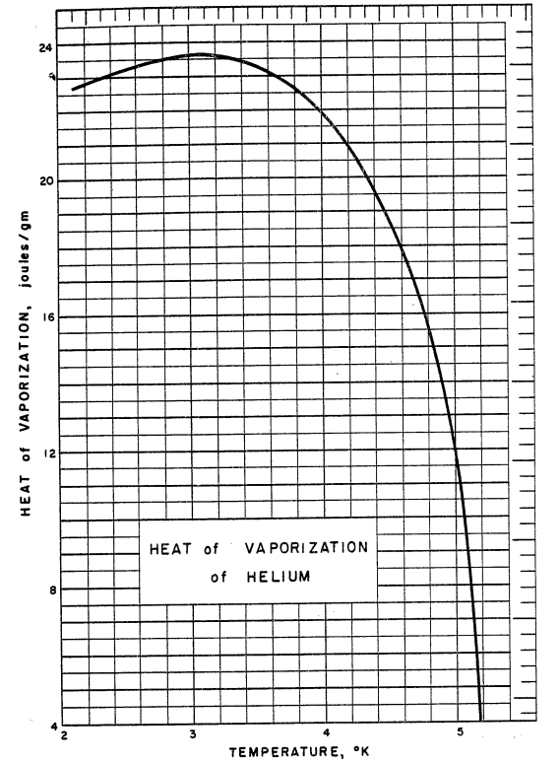
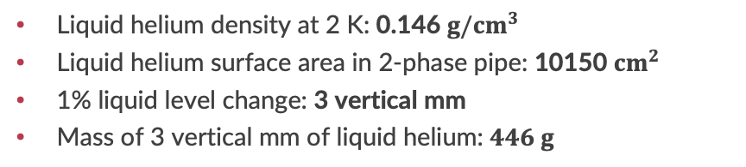
Dissipated Power from Rate of Helium Evaporation
Mass
Power
Liquid helium density at 2 K: 0.146 $g/{cm}^{3}$
Liquid helium surface area in 2-phase pipe: 10150 ${cm}^{2}$
1% liquid level change: 3 vertical mm
Mass of 3 vertical mm of liquid helium: $446 g$
Latent heat: 23 J/g
Rate of change of mass given r [%/s]: 446r g/s
Power from helium evaporation given r [%/s]: 10225r W
Notes:
For CM static heat load the JT valve was closed. So the latent heat of 23 J/g works fine for converting g/s to W.
If the JT valve is open, the conversion factor from g/s to Watts should consider the effect of flash (vapor production downstream of the valve)

Slide 6
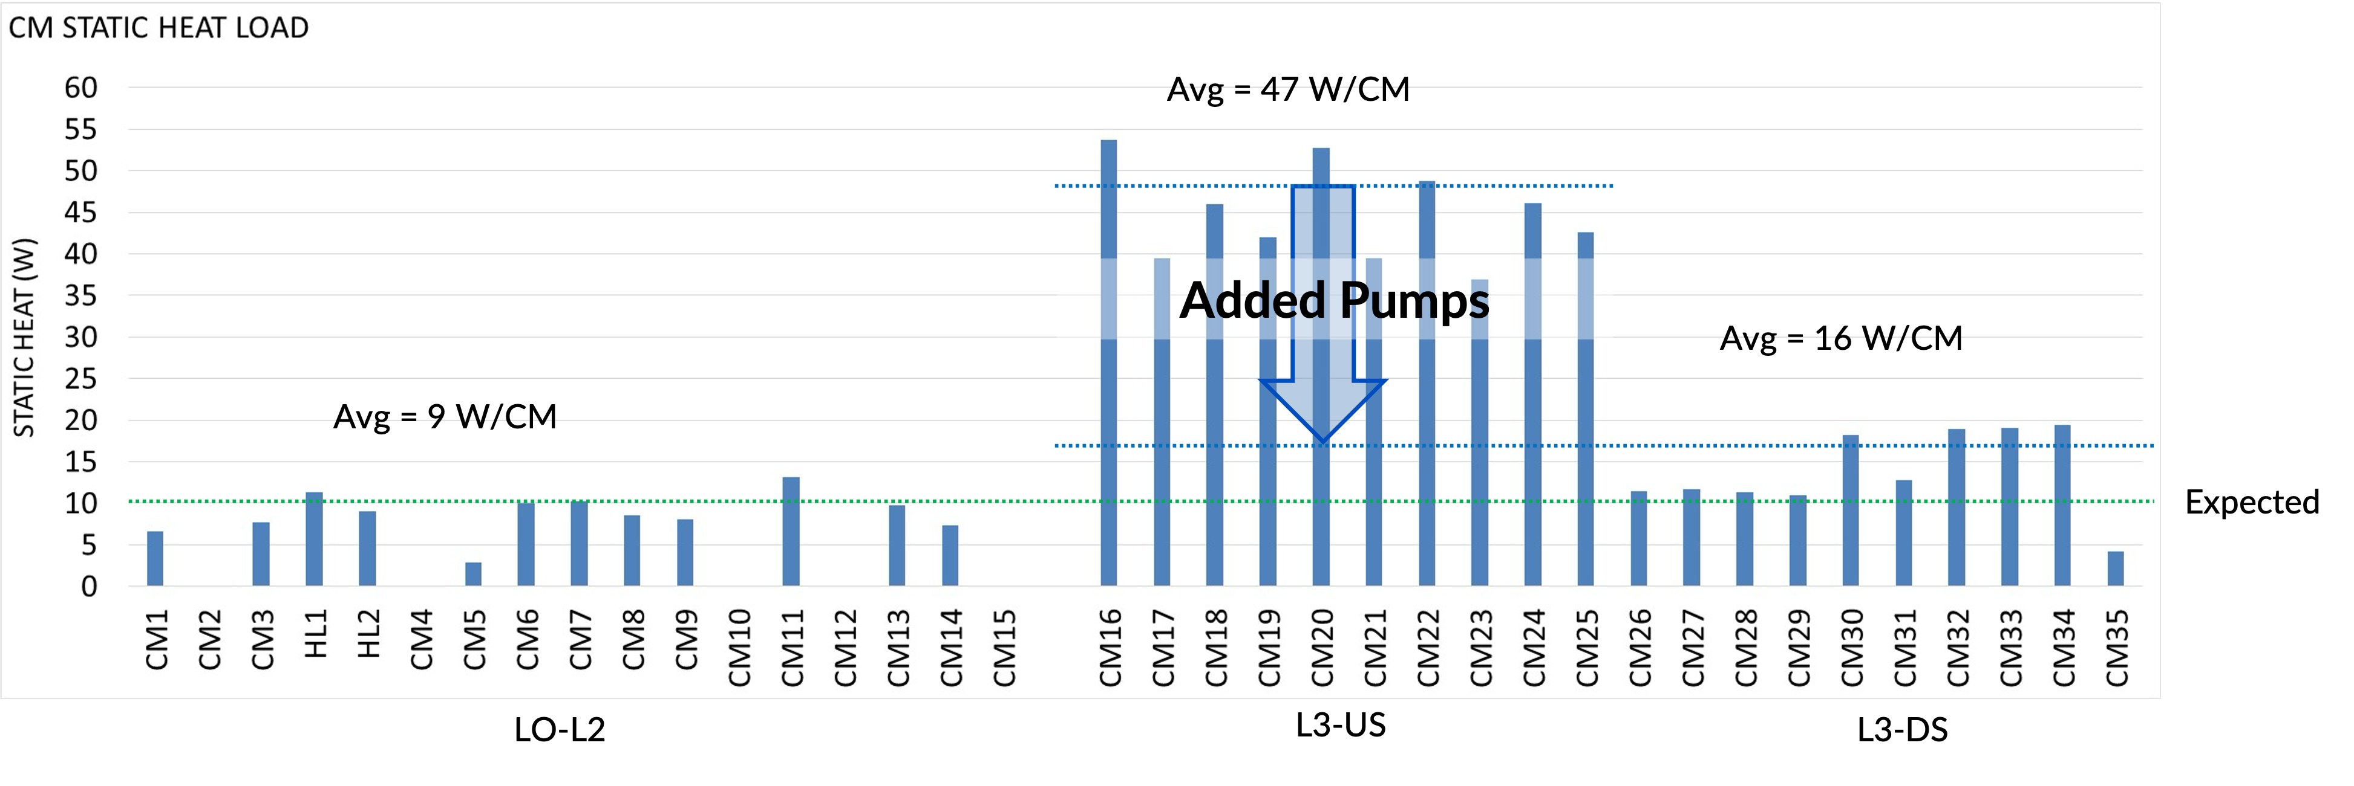
Results
 | EXPECTED CM STATIC | OBSERVED CM STATIC (Initial) | OBSERVED CM STATIC (with Additional Pump)
LO-L2 | 9 W / CM → 150 W | 9 W / CM → 150 W | 9 W / CM → 150 W
L3-UPSTREAM | 9 W / CM → 90 W | 47 W / CM → 470 W | 17 W / CM → 170 W
L3-DOWNSTREAM | 9 W / CM → 90 W | 16 W / CM → 160 W | 16 W / CM → 160 W
TOTAL CM STATIC | 330 W | 800 W | 500 W
Notes:
Some CMs had leaky CD valves, which prevented measurement. Expected error ~10%

Slide 7
Dynamic Heat Load Measurements
2

Slide 8
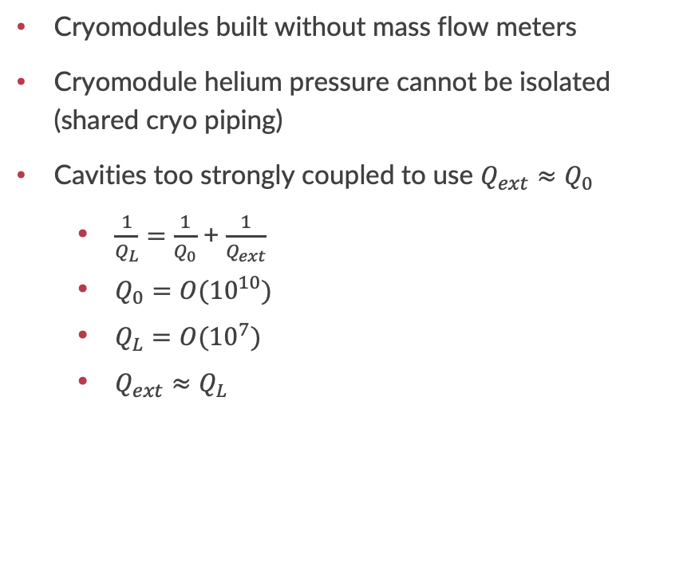
Background
Why not use existing methods?
Premise
Cryomodules built without mass flow meters
Cryomodule helium pressure cannot be isolated (shared cryo piping)
Cavities too strongly coupled to use $Q_{ext}≈Q_{0}$
  $\frac{1}{Q_{L}}=\frac{1}{Q_{0}}$ + $\frac{1}{Q_{ext}}$
  $Q_{0}=O({10}^{10})$
  $Q_{L}=O({10}^{7})$
  $Q_{ext}≈Q_{L}$
Joule-Thomson (JT) valve regulates downstream liquid level
Constant heat load
  Rate of refill = rate of evaporation
  JT valve reaches steady position
Locking JT valve at steady position and changing heat load allows liquid level to change

Slide 9
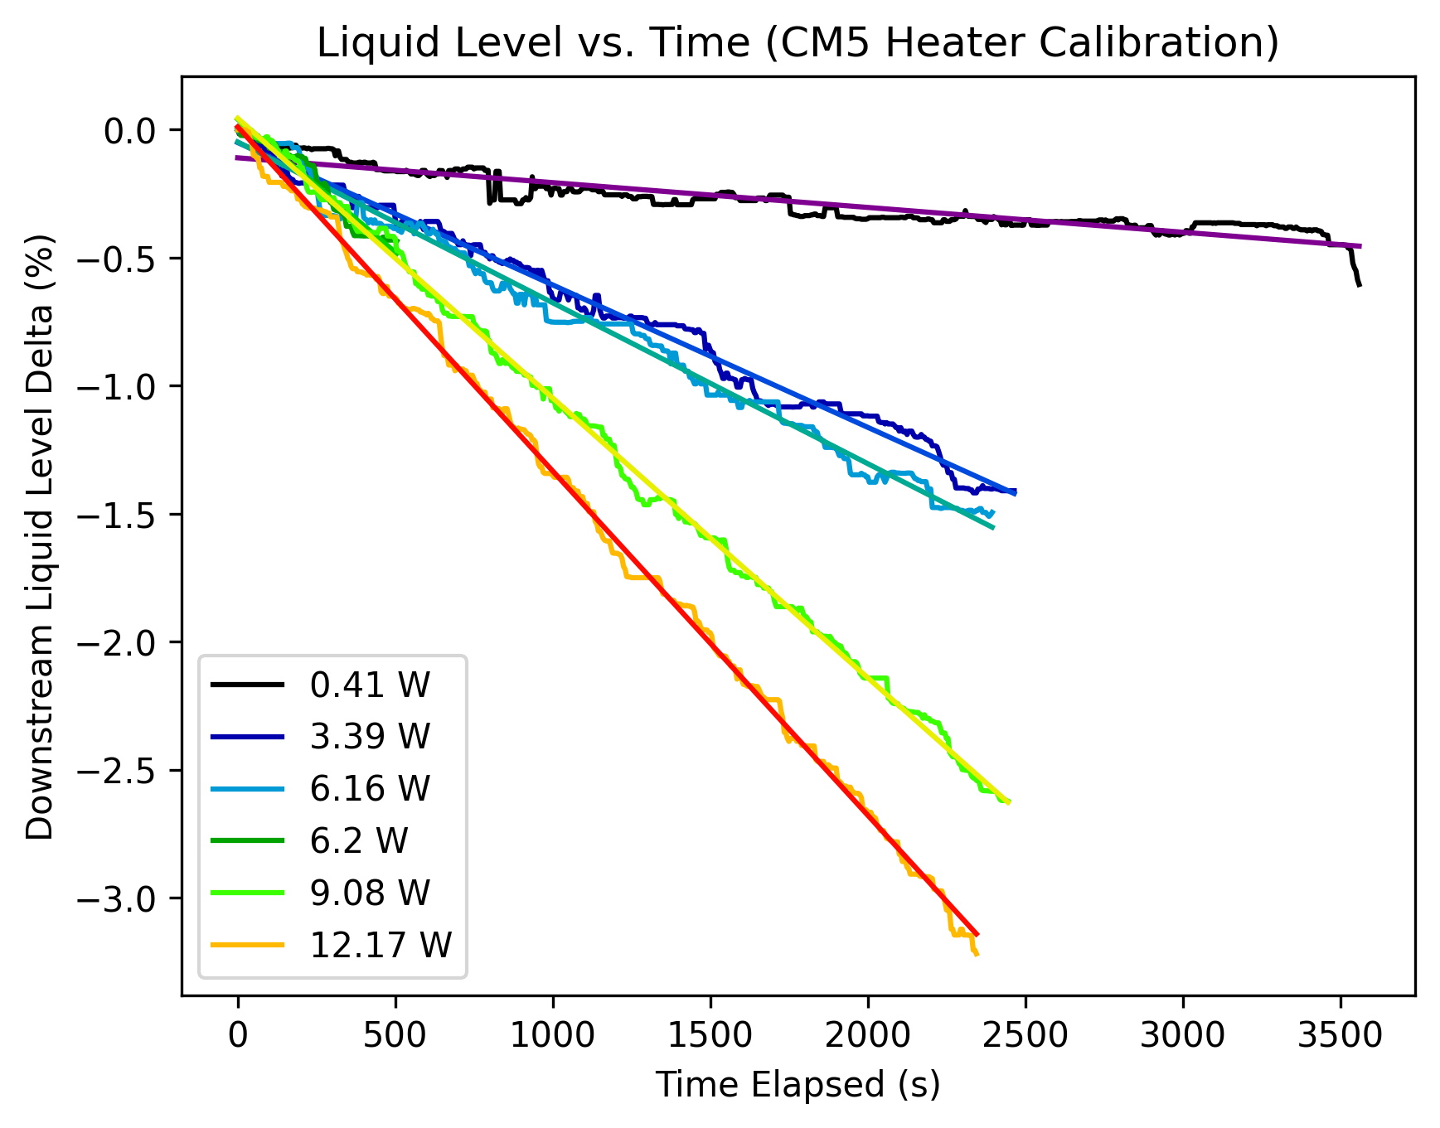
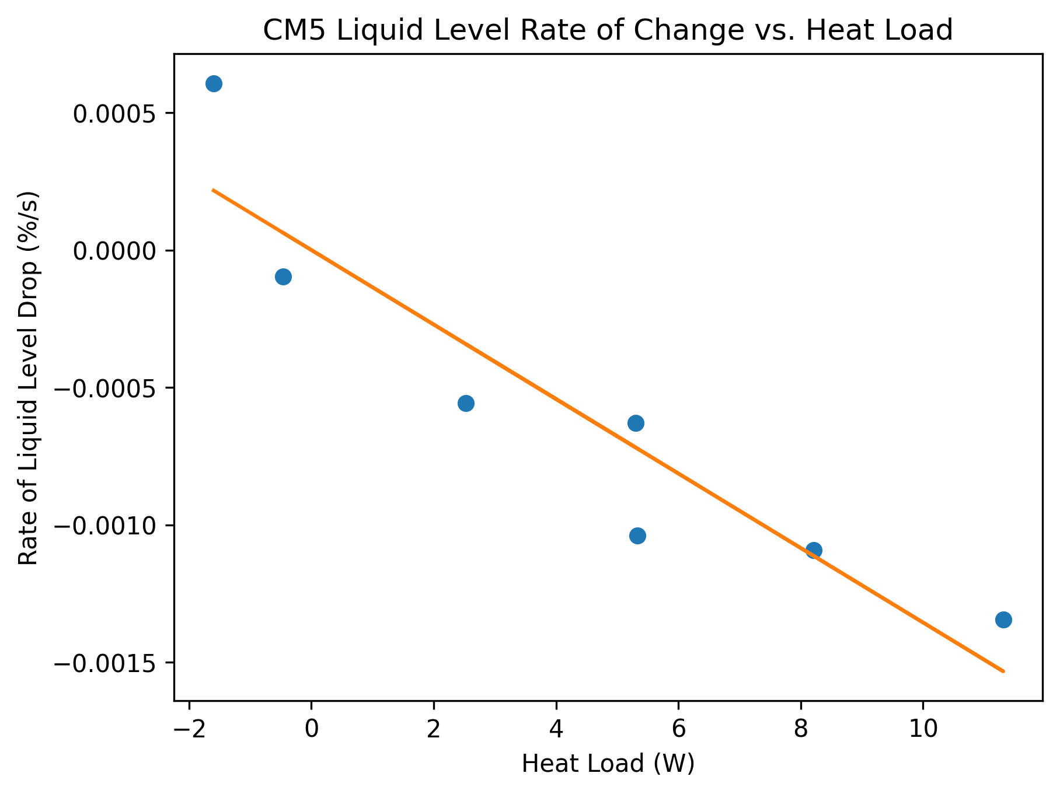
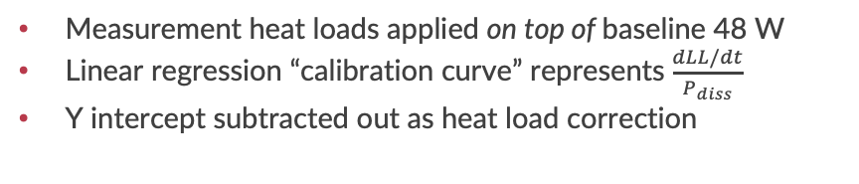
Calibrations
Method
Results
Measurement heat loads applied on top of baseline 48 W
Linear regression “calibration curve” represents $\frac{dLL/dt}{P_{diss}}$
Y intercept subtracted out as heat load correction
Single cavity heat loads cost time and accuracy
Now measure full cryomodule instead of single cavities
Notes:
Low heat load calibrations took a minimum of 5 hours and had corrections as high as 50 W

Slide 10
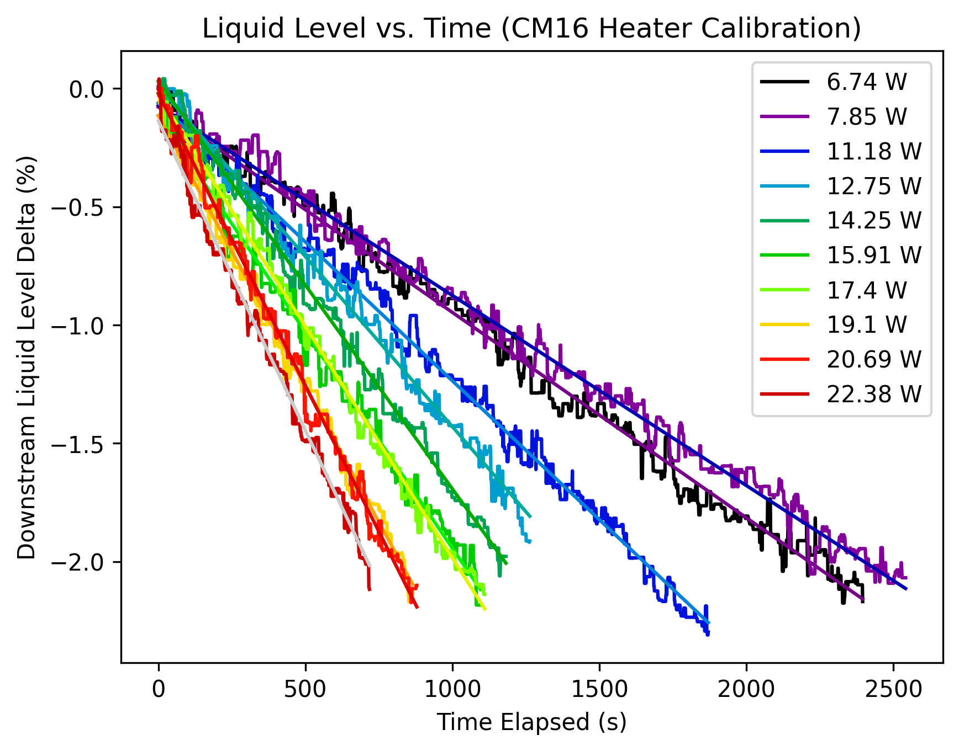
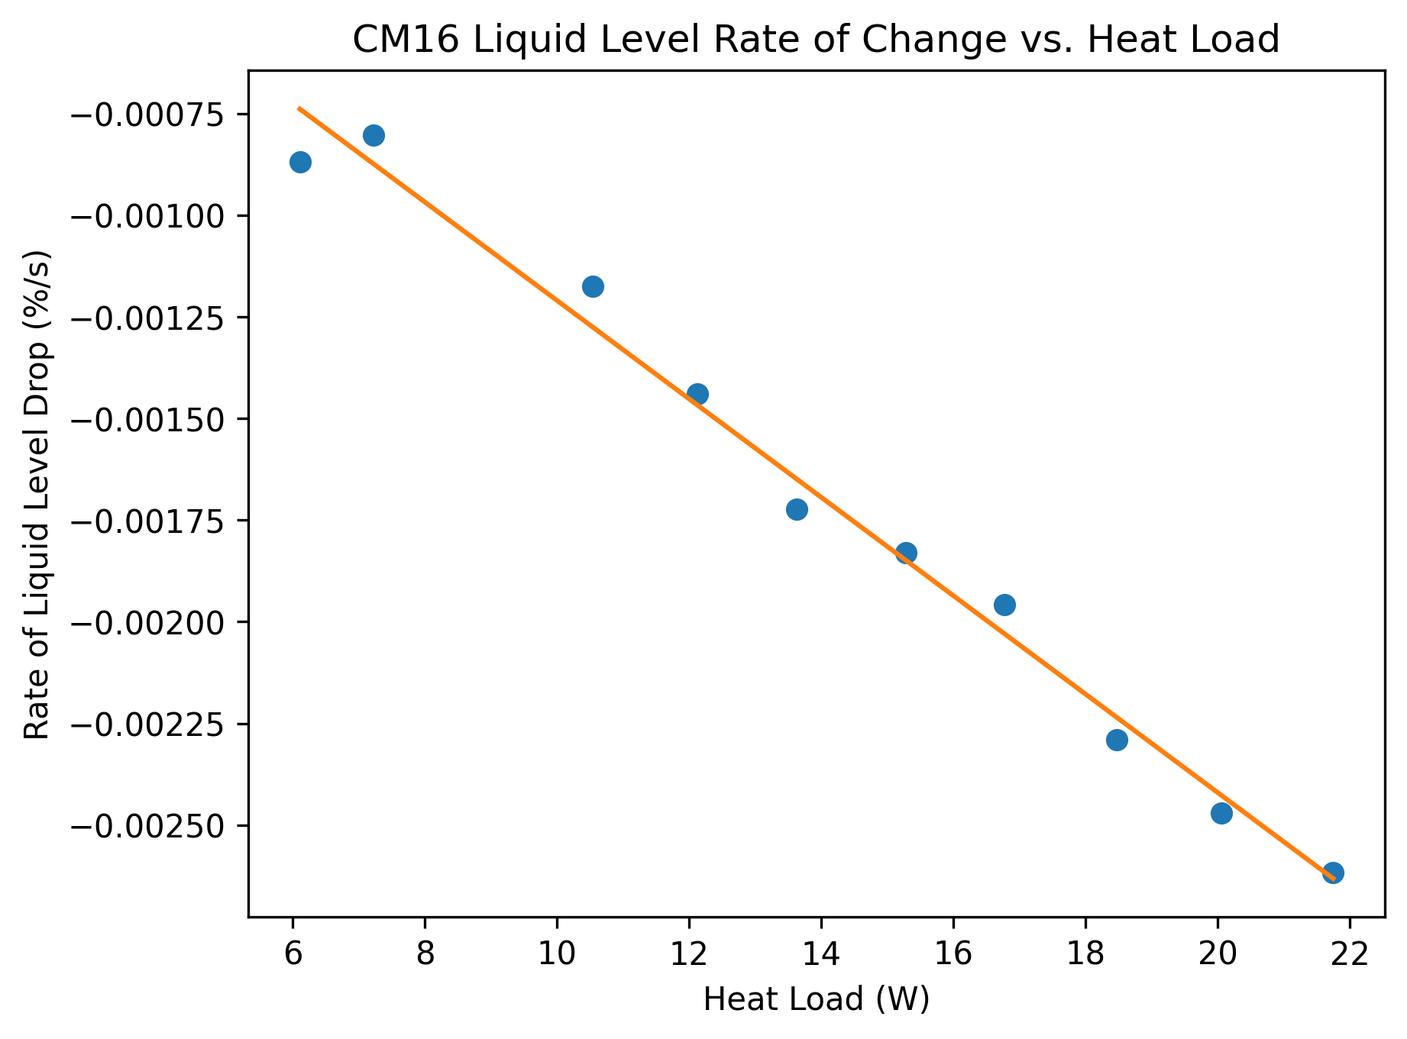
Calibrations
Method
Results
Measurement heat loads applied on top of baseline 48 W
Linear regression “calibration curve” represents $\frac{dLL/dt}{P_{diss}}$
Y intercept subtracted out as heat load correction
Single cavity heat loads cost time and accuracy
Now measure full cryomodule instead of single cavities

Slide 11
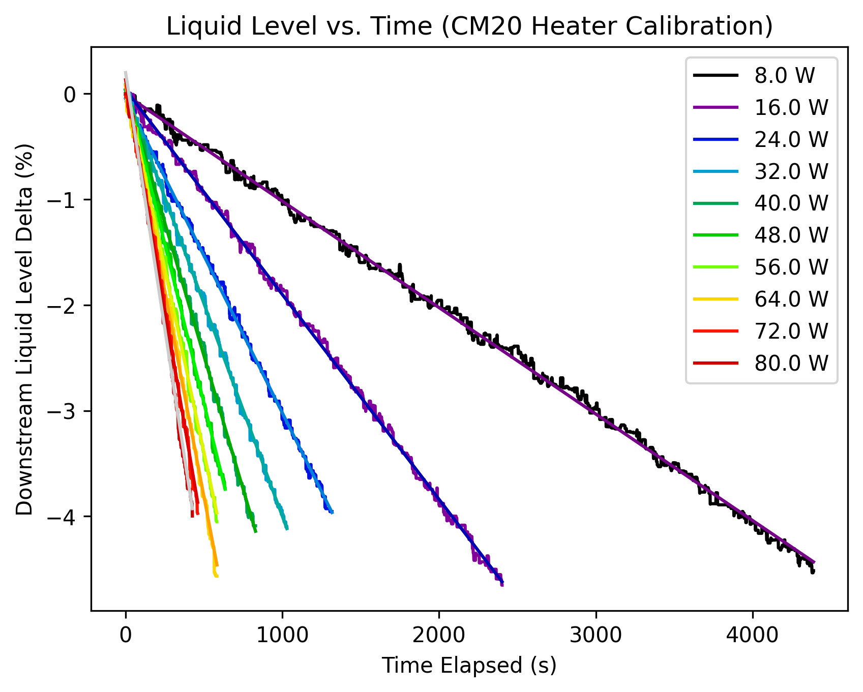
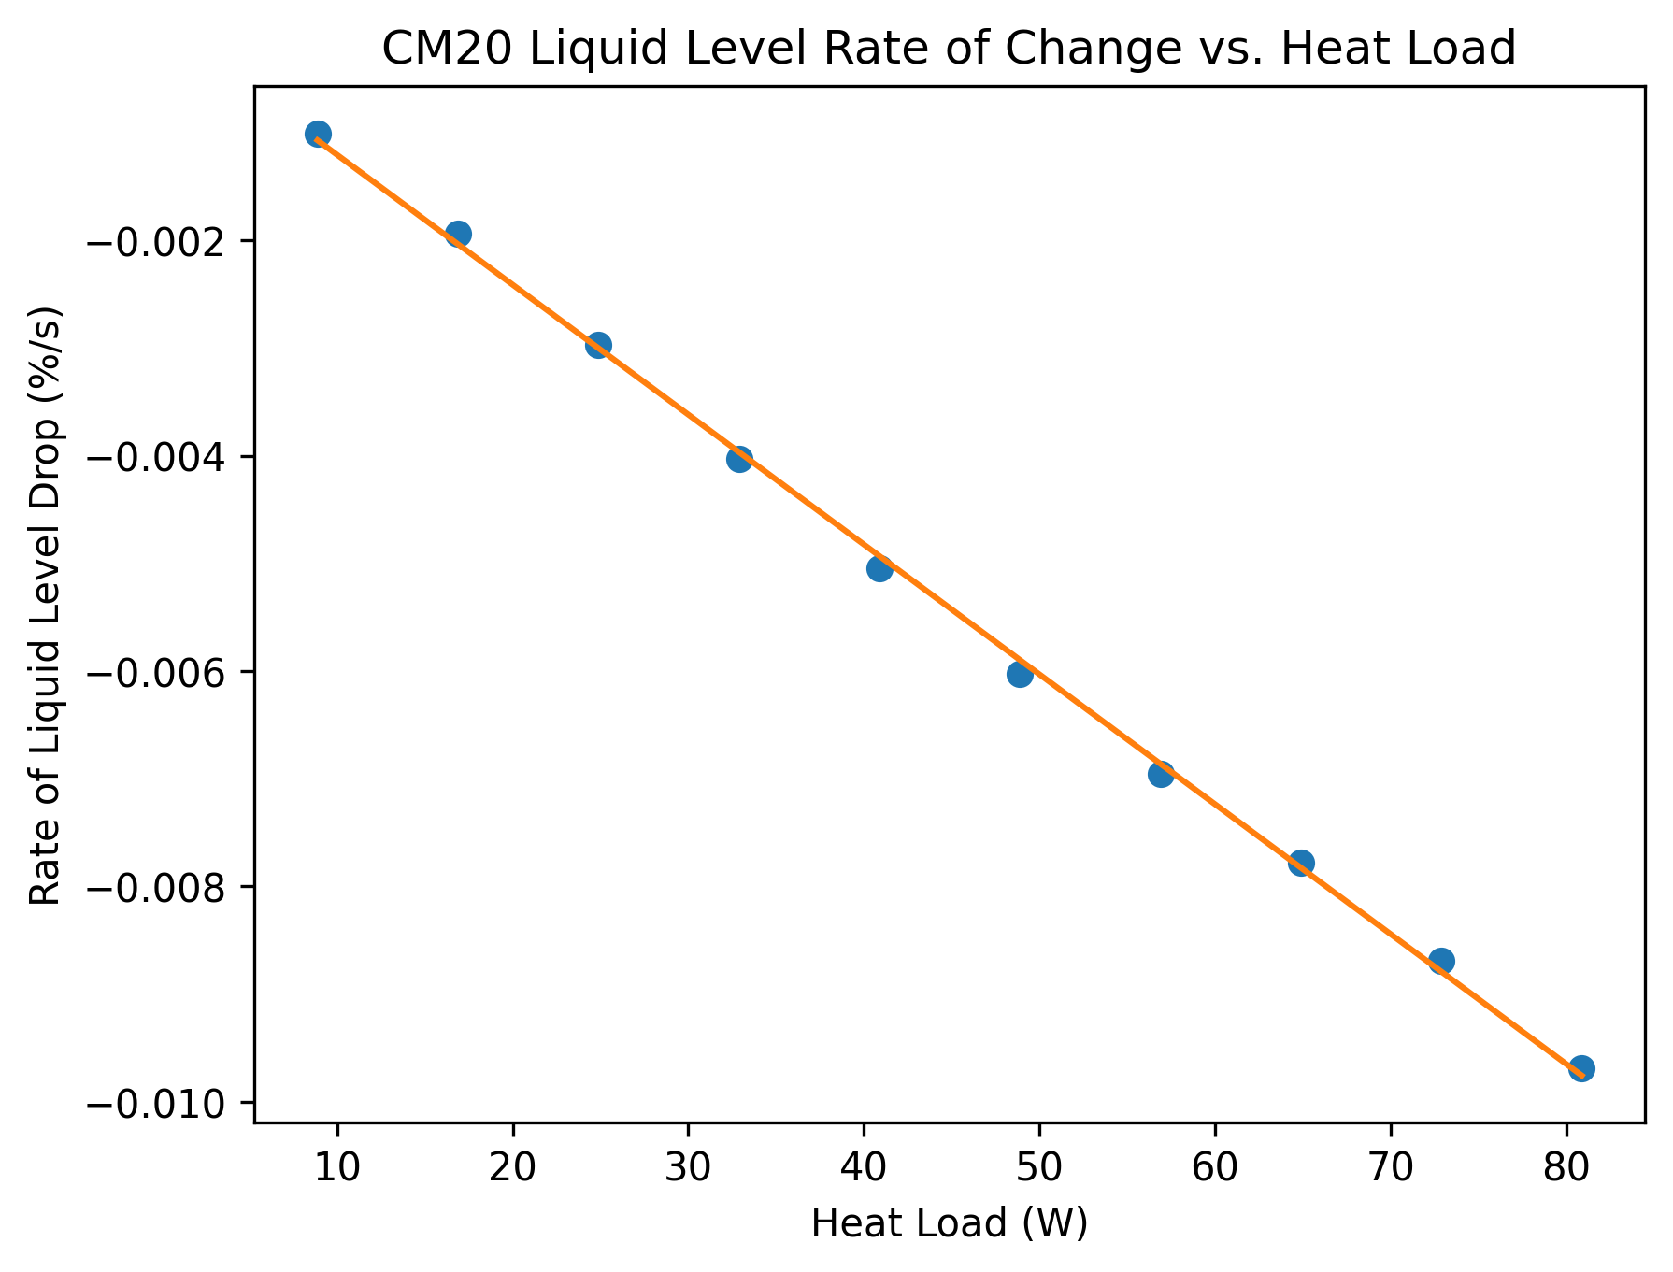
Calibrations
Method
Results
Measurement heat loads applied on top of baseline 48 W
Linear regression “calibration curve” represents $\frac{dLL/dt}{P_{diss}}$
Y intercept subtracted out as heat load correction
Single cavity heat loads cost time and accuracy
Now measure full cryomodule instead of single cavities
Notes:
Higher heat loads allow for full calibration in as little as an hour with corrections as small as 10^-2 W

Slide 12
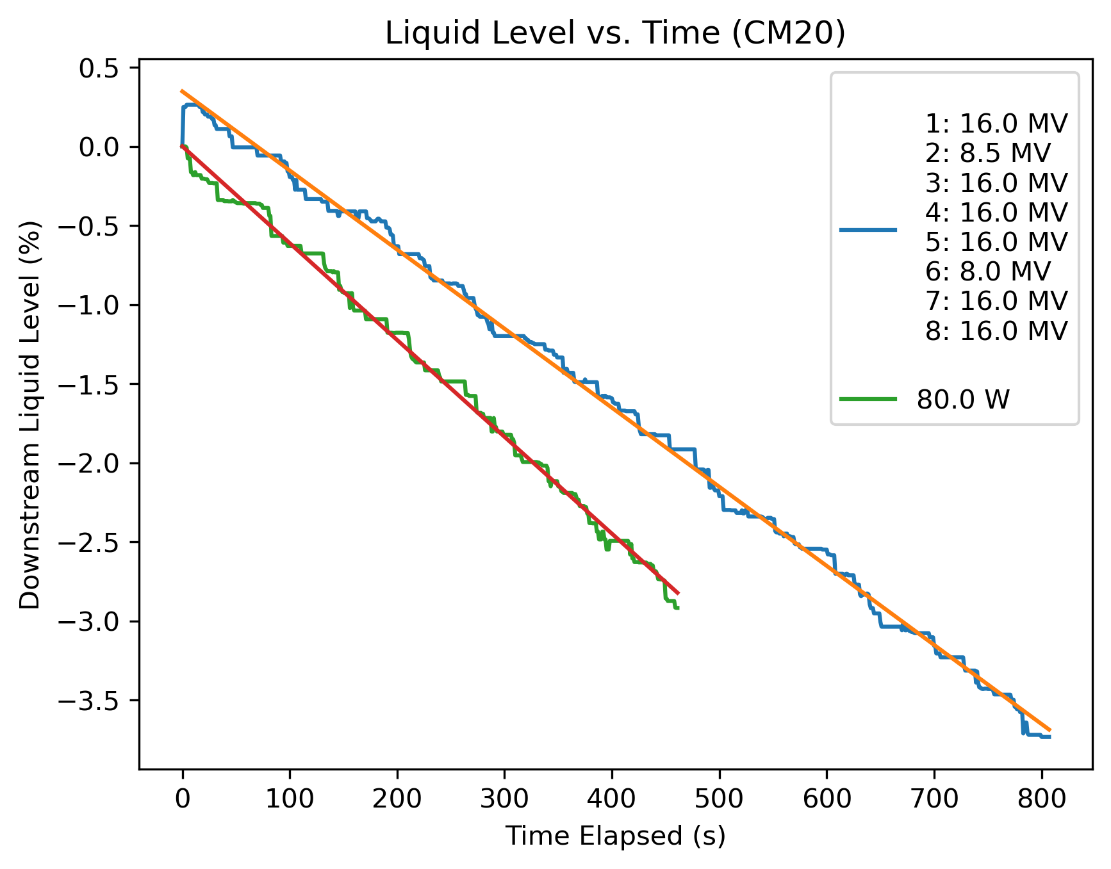
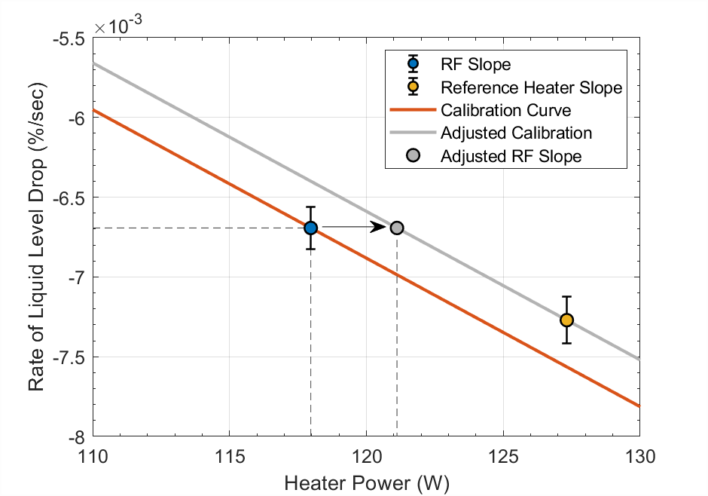
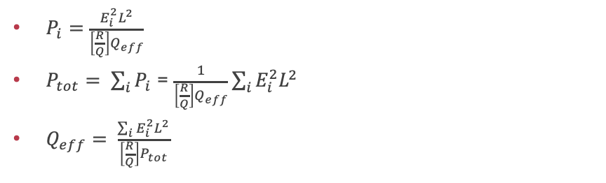
RF Measurements
Effective Q
Drift
$P_{i}=\frac{E_{i}^{2}L^{2}}{\left[\frac{R}{Q}\right]Q_{eff}}$
$P_{tot}= \sum_{i}{P_{i}}$ = $\frac{1}{\left[\frac{R}{Q}\right]Q_{eff}}\sum_{i}{E_{i}^{2}L^{2}}$
$Q_{eff}= \frac{\sum_{i}{E_{i}^{2}L^{2}}}{\left[\frac{R}{Q}\right]P_{tot}}$
Calibration used significantly impacted measured heat load
Introduced secondary 80 W heater measurement to account for drift
Notes:
Multi cavity measurement required new definition

Slide 13
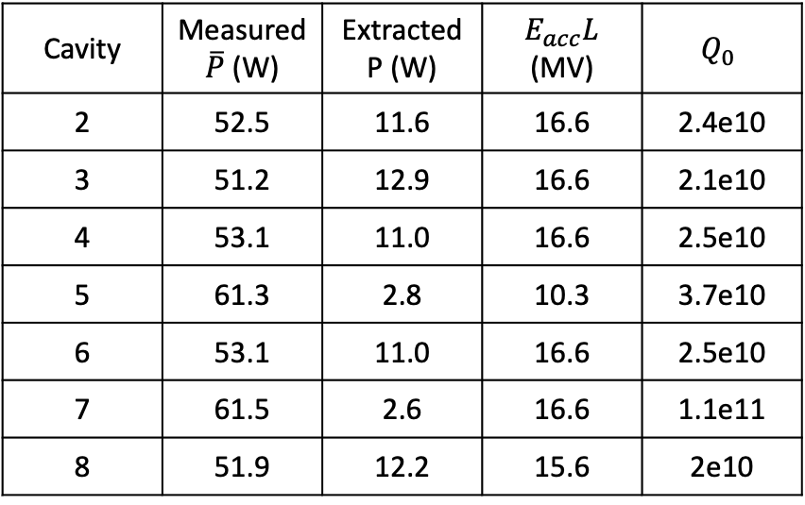
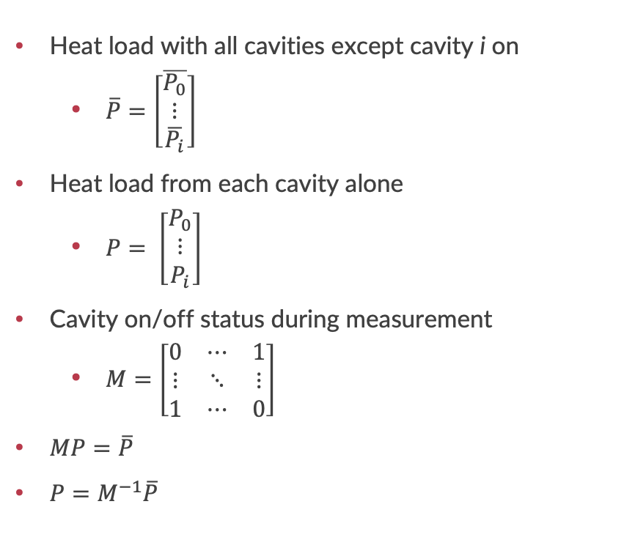
Single Cavity Extraction
Heat load with all cavities except cavity i on
  $\overline{P}=\left[\begin{matrix}\overline{P_{0}} \\ ⋮ \\ \overline{P_{i}}\end{matrix}\right]$
Heat load from each cavity alone
  $P= \left[\begin{matrix}P_{0} \\ ⋮ \\ P_{i}\end{matrix}\right]$
Cavity on/off status during measurement
  $M=\left[\begin{matrix}0 & ⋯ & 1 \\ ⋮ & ⋱ & ⋮ \\ 1 & ⋯ & 0\end{matrix}\right]$
$MP=\overline{P}$
$P=M^{−1}\overline{P}$
Very time intensive, used as needed
Cavities dissipating < 4 W fall within noise
  Very large error bars
Cavity | Measured $\overline{P}$ (W) | Extracted P (W) | $E_{acc}L$ (MV) | $$Q_{0}$$
2 | 52.5 | 11.6 | 16.6 | 2.4e10
3 | 51.2 | 12.9 | 16.6 | 2.1e10
4 | 53.1 | 11.0 | 16.6 | 2.5e10
5 | 61.3 | 2.8 | 10.3 | 3.7e10
6 | 53.1 | 11.0 | 16.6 | 2.5e10
7 | 61.5 | 2.6 | 16.6 | 1.1e11
8 | 51.9 | 12.2 | 15.6 | 2e10

Slide 14
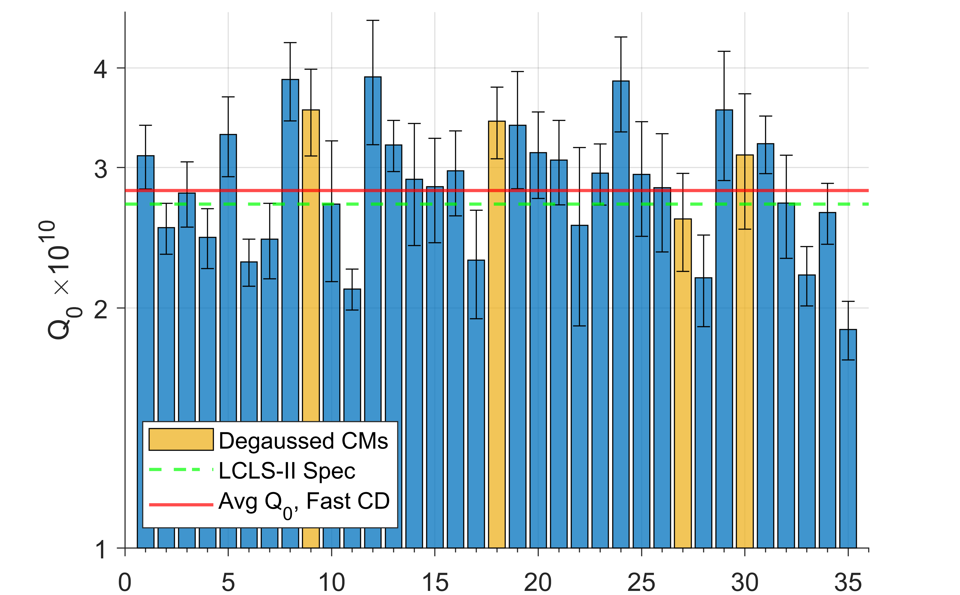
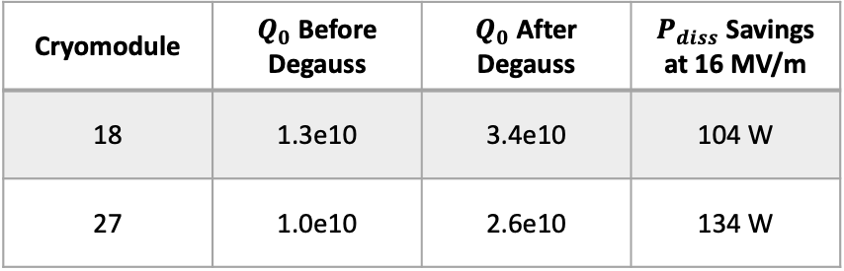
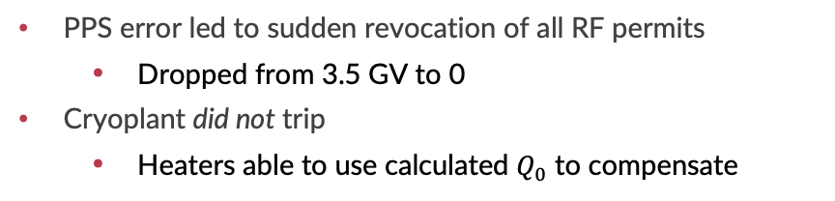
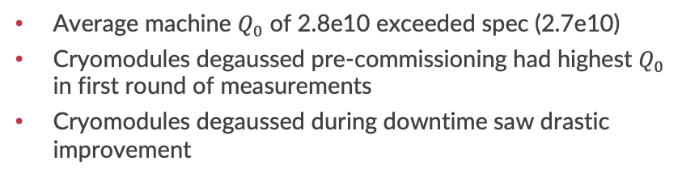
Results
Cryomodule | $Q_{0}$ Before Degauss | $Q_{0}$ After Degauss | $P_{diss}$ Savings at 16 MV/m
18 | 1.3e10 | 3.4e10 | 104 W
27 | 1.0e10 | 2.6e10 | 134 W
Degaussing
Stress Test
Average machine $Q_{0}$ of 2.8e10 exceeded spec (2.7e10)
Cryomodules degaussed pre-commissioning had highest $Q_{0}$ in first round of measurements
Cryomodules degaussed during downtime saw drastic improvement
PPS error led to sudden revocation of all RF permits
  Dropped from 3.5 GV to 0
Cryoplant did not trip
  Heaters able to use calculated $Q_{0}$ to compensate
Notes:
Validation of benefits of degaussing strengthened case for it being standard part of CM installation
Almost fully automated
15-20% error

Slide 15
Final Thoughts
Main takeaways
Liquid level-based measurements have proven to be robust enough for standard accelerator operation
  Reliable static measurements led to an improvement of 300 W
  Reliable dynamic measurements validated the use of degaussing in cryomodule installation
Extra Resources
Dynamic heat load measurement details in SRF 23 proceedings
  https://accelconf.web.cern.ch/srf2023/papers/mopmb090.pdf
(Incomplete) Acknowledgements
Jlab team including but not limited to E. Daly, M. Drury, D. Savransky, J. Kent for initial idea and testing
SLAC cryo group for measurement support; V. Ravindranath, E. Fauve, and A. Apte specifically for static heat load measurement details
SLAC SRF team and operations for assistance in development and data gathering

