Slide 1
Heat load measurements on STF and cERL at KEK
Hiroshi Sakai
on behalf of STF and cERL Grp.

Slide 2
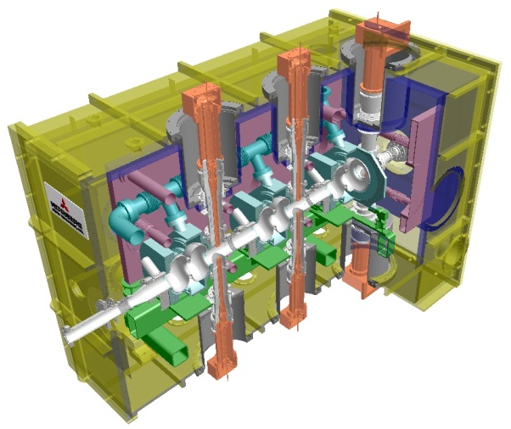
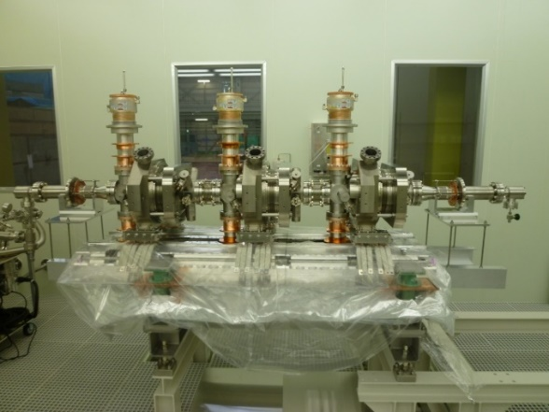
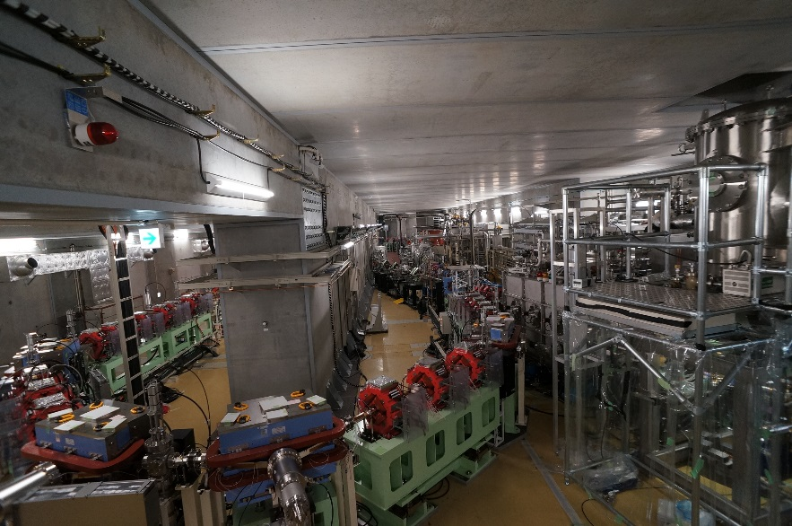
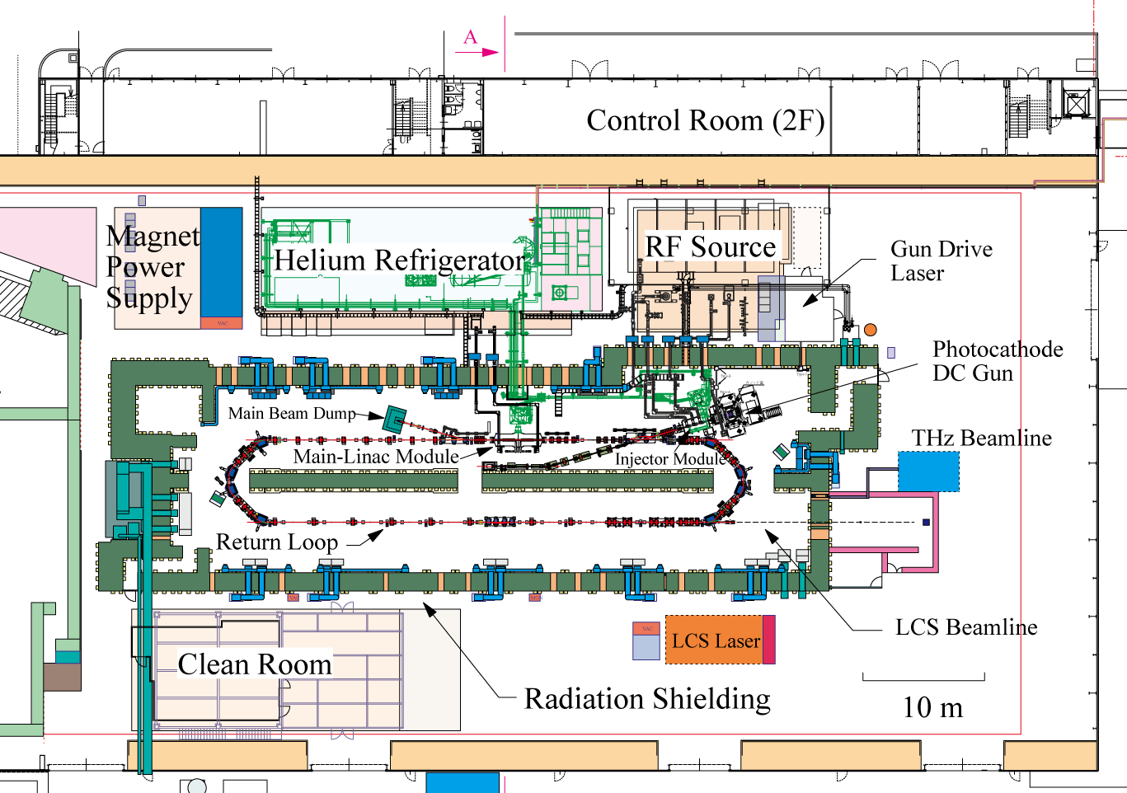
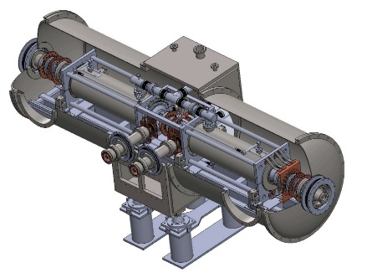
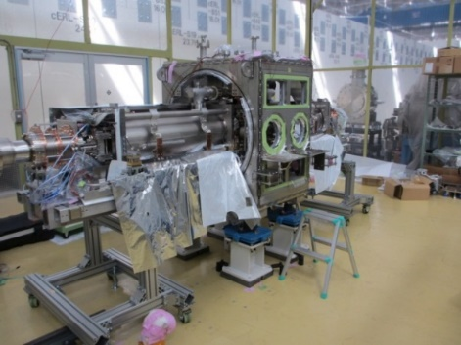
A) Apparatus of cERL injector & main linac cryomodule
2-cell Cavity
Tuner
Injector module
Cryostat
2-cell cavity × 3
Double coupler
Assembling in Jun/2012
Beam Operation started from 2013
RF frequency: 1.3 GHz
Input power :
10kW/coupler (10mA, 5MeV)
180kW/coupler (100mA, 10MeV)
E_{acc}: 7.6MV/m（5MeV）
15MV/m (10MeV)
Unloaded-Q: Q₀ > 1×10¹⁰
e-
Input Coupler
HOM Coupler &
RF Feedthrough
Main linac module
HOM damped (for 100mA BBU suppression)
9-cell cavity (named as ERL-model2)× 2
Cryostat
Two 9-cell SC cavities
HOM absorber
Operation at 2K
Tuner
Assembling in Oct/2012
Present status
Beam Energy | 17.6 MeV
Injector Energy | 3.0 – 5.0 MeV
E-Gun Energy | 500 keV
Beam repetition | 1.3 GHz
Average current | 1 mA CW (max)
Input couplers
e-
RF frequency: 1.3 GHz
Input power : 20kW CW (SW)
E_{acc}: 15 MV/m（design）
Unloaded-Q: Q₀ > 1×10¹⁰

Slide 3
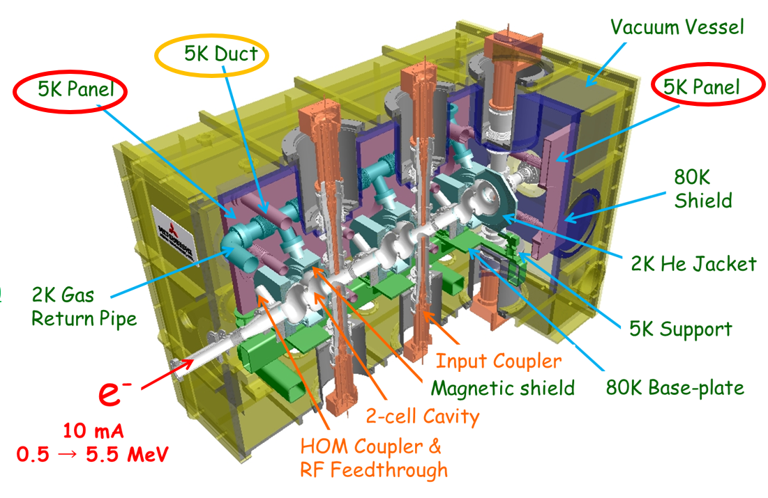
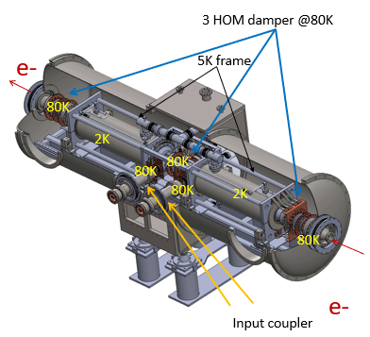
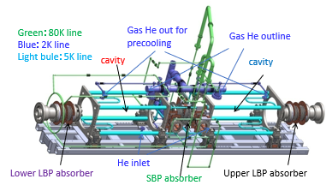
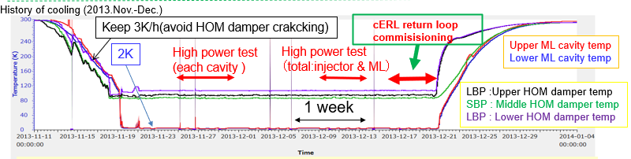
cERL detailed Cryomodule temperature distribution
cERL main linac
cERL injector

Slide 4
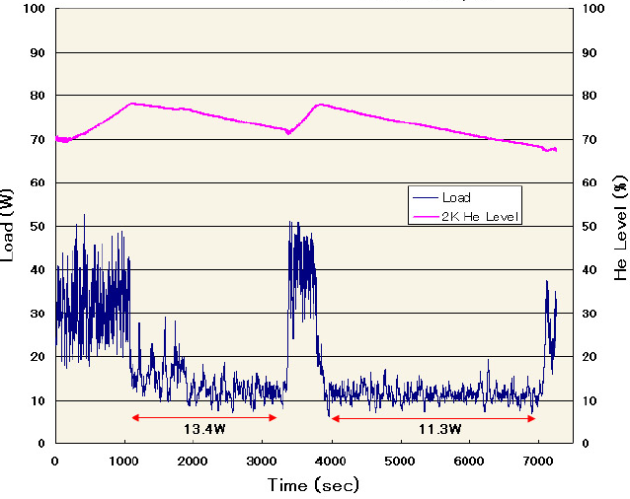
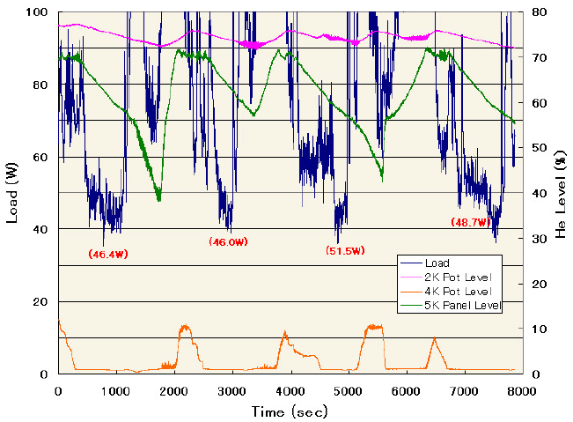
cERL injector static heat load measurement
Measurement of static heat loads
Static heat load ; 2K
Static heat load ; 4.2K
ave. 2K heat load = 12 W
(including 2K heat load in cold-box = 1 W)
Cryomodule = 11 W at 2 K
Estimation = 14 W,
including 1 W/coupler (x6),
0.2 W/HOM-cable (x15) and others (5W).
ave. 4.2K heat load = 48 W
(including 4.2K heat load in cold-box= 1 W)
Cryomodule = 47 W at 4.2 K
Estimation = 49 W,
including 4 W/coupler (x6),
1 W/HOM-cable (x15) and others (10W).

Slide 5
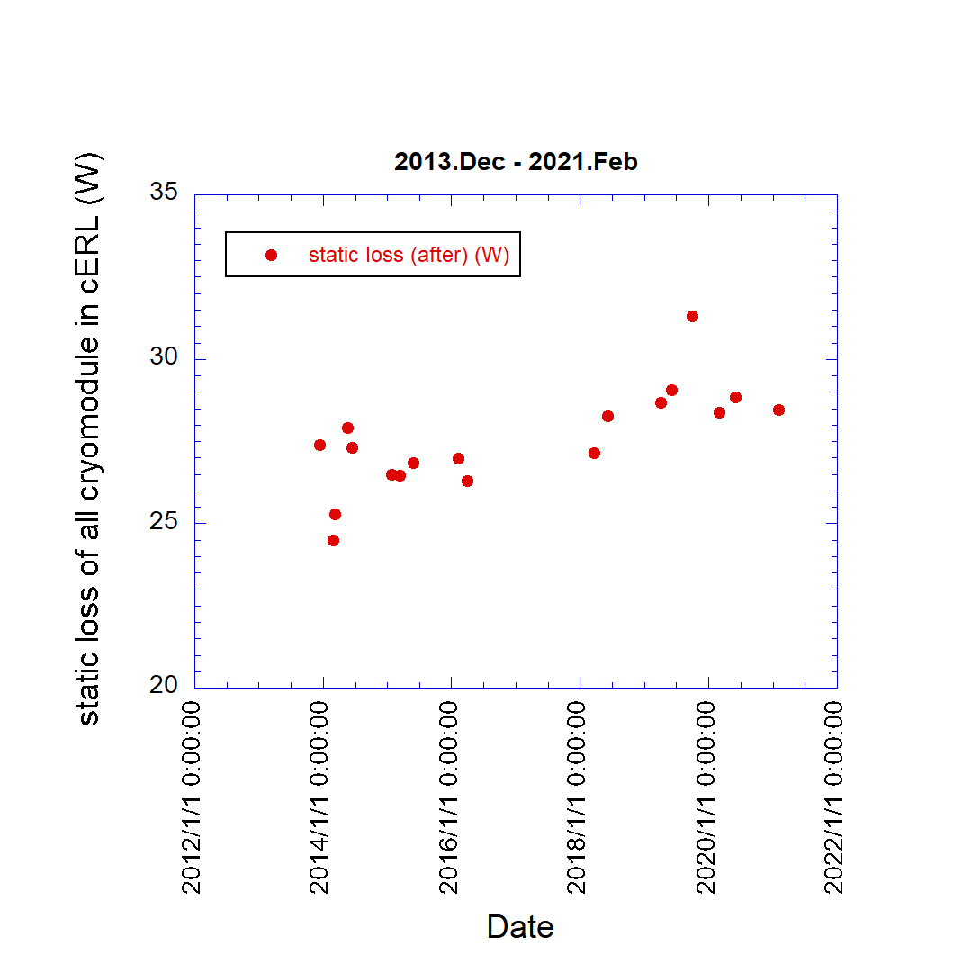
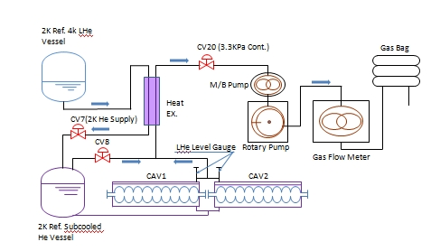
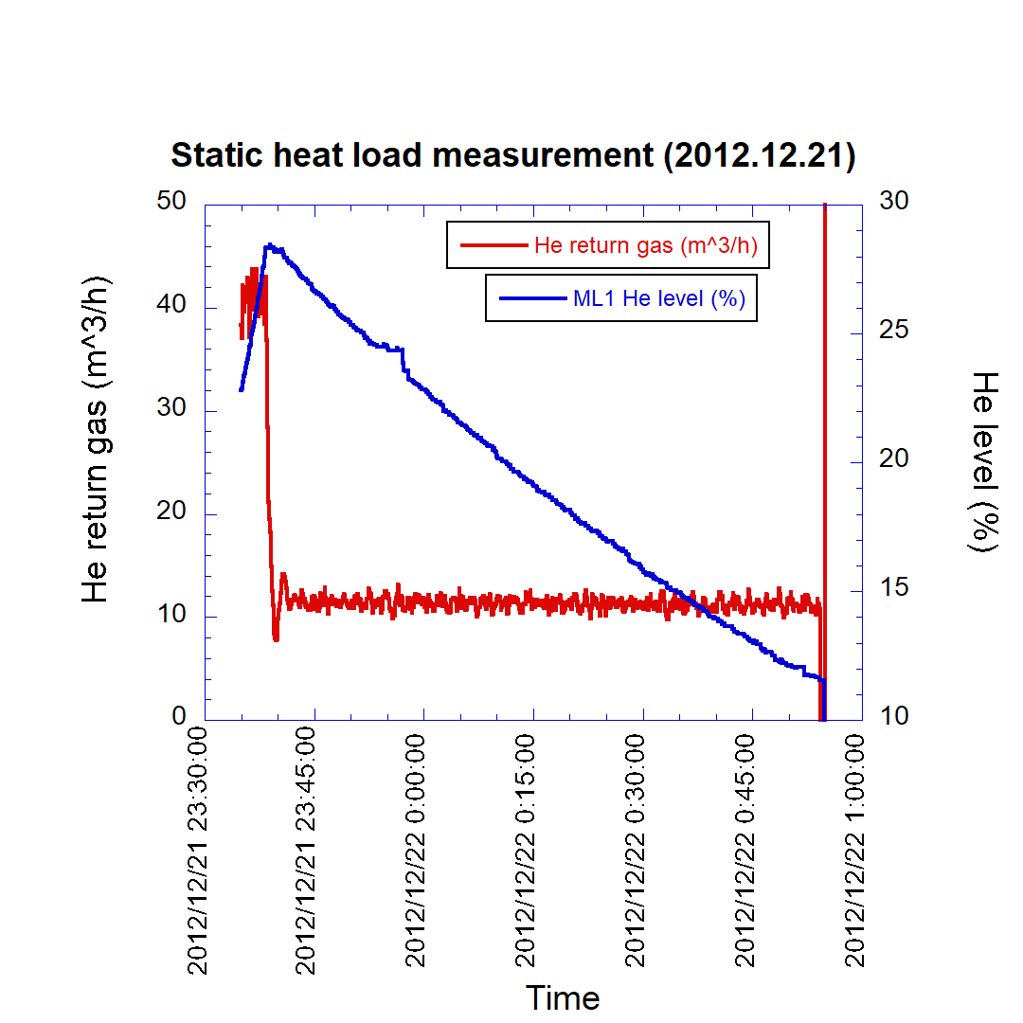
Measurement cERL ML static heat load & total (long term)
CV7 Valve close for static loss measurement
Long term of total heat load of total cryogenic loss at 2K
At this time
5 K line is slightly higher than normal
Static heat load
cERL main linac
Only Module : 11 W
Valve close
Total static heat load 27-28 W
  Injector : 11 W (static)
  Main linac : 11 W (static)
  Other (transfer tube etc) : 5-6W
Heat Load Measurements

Slide 6
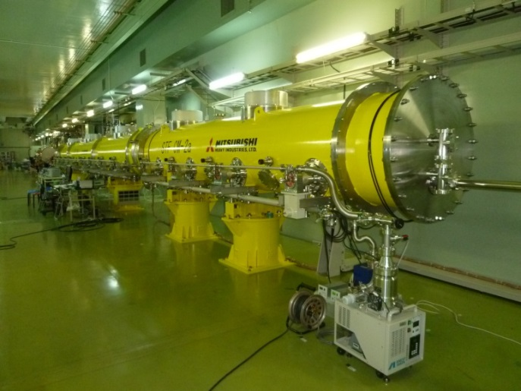
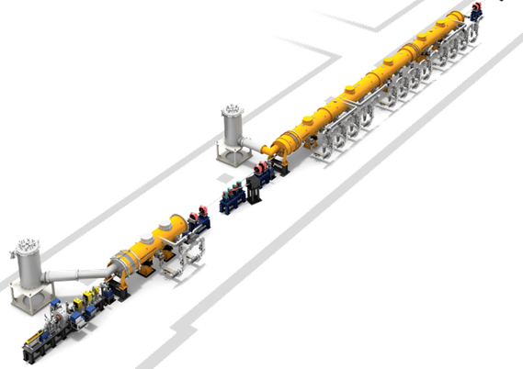



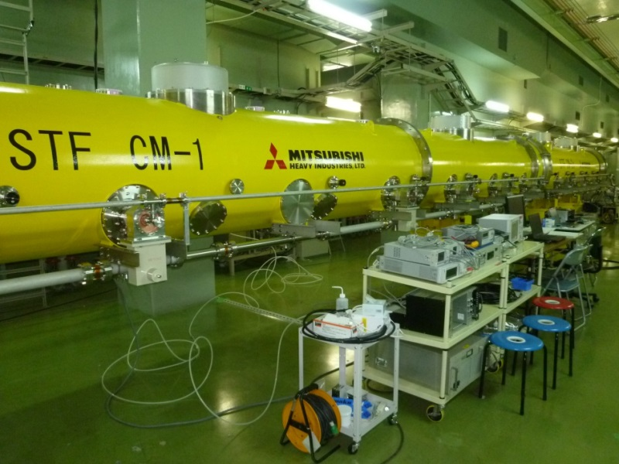
STF-2 cryomodules – 14 cavities
CM2a Cryomodule
(four 9-cell cavities)
2014’ Oct.-Nov.
First cool-down tests
(Low RF power tests)
CM1 Cryomodule
(eight 9-cell cavities)
Cold Box -2
Total 14 9-cell cavities
Capture Cryomodule
(two 9-cell cavities)
Cold Box -1
Photocathode RF-Gun:
(1.3 GHz, 6 mA, 1 ms, 5 Hz)

Slide 7
Dynamic heat load in STF-2 Cryomodule
32.6 W
41.0 W
33.8 W
32.5 W
Static Loss = 32.6 W
Coupler RF Loss = 1.2 W
Cavity RF Loss = 7.2 W ( ~1.0 W/cavity)
average Eacc = 31.5 MV/m
duty factor = 0.8 %
Level [%]
Pressure [kPa]
Heat load [W]
Temp [K]
Flow [m3/h]
Low Q-value due to
strong field emission
32.6 W / 1.5 module = 21.7 W/module

Slide 8
backup

Slide 9
冷凍負荷測定(Return He Gas 測定方法)
Flow meter
CAV1
LHe Level 18%
バルブ、液面操作
He Gas量の求め方
RF入力してCAV1 LHe液面計で28%以上を一定時間維持する。
CV7のバルブを閉じ2K LHeの供給を停止する。
Gas flow meterでReturn He Gasを計測。
CAV1 LHe Levelが14%以下になったらRF入力を停止し次の測定に備えてCV7バルブで2K LHeを供給する。
決まった液面高さ間(25%-15%)での傾きを求める。
定めた(18%)液面高さのReturn He Gas流量を求める。
その18%時のStatic loss(detuneのdynamic lossとほぼ同じ)を除したものをHe Gas量とする。
Heat loss (W) = 1.076*He流量(m^3/h)
By K.Hara

