Slide 1
Heat load measurement at DESY
XFEL, FLASH, single cryomodules, …
Serena Barbanotti for the MKS group
TTC Meeting at Fermilab, 6/12/2023

Slide 2
Heat load calculation: methodology
For the single cryomodules and the FLASH and XFEL linac
Heat load estimated for three different temperature levels:
External shield: 40-80 K Internal shield: 5-8 K Cavity environment: 2 K
Static heat load calculation at 5-8 K and 40-80K
Stable flow
Calculate heat loads from flow and delta enthalpy
Static heat load calculation at 2K
Stable flow, turn off magnets and RF, subtract heaters
close JT valve and measure amount of evaporated LHe at constant pressure (isothermal).
In the AMTF hall: warm flowmeters after compressor used,
Dynamic heat load calculation at 2K, 5-8 K and 40-80K
Same method as static measurement, with RF
Subtract average static component from total value
${\dot{Q}}_{s,5/80K}=\dot{m}∆h=\dot{m(}h_{out}\left(p_{out},T_{out}\right)−h_{in}\left(p_{in},T_{in}\right)$)
${\dot{Q}}_{s,2K(XFEL)}=\dot{m}∆h=\dot{m(}h_{out}\left(p_{out},T_{out}\right)−h_{in}\left(p_{in},T_{in}\right)$)
$${\dot{Q}}_{s,2K(AMTF)}=L\dot{m} L=23. 40 J/g@ 2 K , 31 mbar$$
$${\dot{Q}}_{d}={\dot{Q}}_{total}−{\dot{Q}}_{s}$$

Slide 3
FLASH

Slide 4
Static heat loads
Presented at SRF23
2K and 40/80K static heat loads
Calculated during operation as flow × delta enthalpy
Enthalpy for the 2K evaporated helium: constant temp 2K, and pressure 31 mbar (23 Torr)
Average 2K static heat load 30 W, 40/80 K static heat load ~1 kW
No reliable data for the 5/8 K circuit (liquid in the pipes, unknown quality)
40/80 K static heat loads
Time | RF energy (GeV) | P (bar) | Flow (g/s) | Heat load (W)
12/2018 | 0 | 11.8 | 15.4 | 796
12/2019 | 0 | 12.3 | 24.8 | 799
12/2020 | 0 | 12.8 | 16.8 | 888
12/2022 | 0 | 1.4 | 4.9 | 889
04/2023 | 0 | 1.4 | 8.9 | 1111
2 K static heat loads
Time | RF energy (GeV) | P (bar) | Heat load (W)
12/2018 | 0 | 1.6 | 23
12/2019 | 0 | 1.6 | 35
12/2020 | 0 | 1.6 | 26
12/2022 | 0 | 1.4 | 28
04/2023 | 0 | 1.4 | 33

Slide 5
XFEL

Slide 6
Heat loads (HL) of single modules in AMTF
Slide R. Ramalingam
40-80 K, 5-8 K and 2 K circuits
All measurements refer to 2K operation
Three test stands available for cold test of single XFEL cryomodules
Average value of all 103 tested XFEL cryomodules (CM) at the three test stands (2014 – 2015)
2K dynamic loads value at average cavity gradient of 23 MV/m
Circuit | Average static HL / CM (W) | Average dynamic HL / CM (W)
40-80 K | 93 | n.a.
5-8 K | 11 | n.a.
2 K | 5.6 | 4.2

Slide 7
Heat loads (HL) of the linac
Slide R. Ramalingam
Values to be used for future design
Static and dynamic heat loads measured at XLVB for entire XFEL Linac ( Including TL, FC&EC, SCB)
Circuit | Static HL (W) | Dynamic HL (W)
 |  | 11.5 GeV | 14 GeV | 16.5 GeV
40-80 K | 9800 | 1700 | 2300 | 3200
5-8 K | 800 | n.a. | 140 | 210
2 K | 530* | 200 | 470 | 700
TL = Transfer Lines (XLTL1-3, 2K F)
FC & EC = Feed and End caps
SCB = String connection boxes
* Includes 15 W isothermal heat load for Injector.
Average XFEL linac heat load per cryomodule (CM)
Circuit | Static HL / CM (W) | Dynamic HL / CM (W)
 |  | 11.5 GeV | 14 GeV | 16.5 GeV
40-80 K | 102 | 18 | 24 | 33
5-8 K | 8 | n.a | 2 | 2
2 K | 5.5 | 2 | 5 | 7
Uncertainty around +10 %

Slide 8
HL measurements at low RF energies for CW upgrade Extrapolate CW expected heat loads at low gradient (total linac energy < 6 GeV) from pulsed measurements (1.6 % duty cycle) at higher gradient (14 GeV)

Slide 9
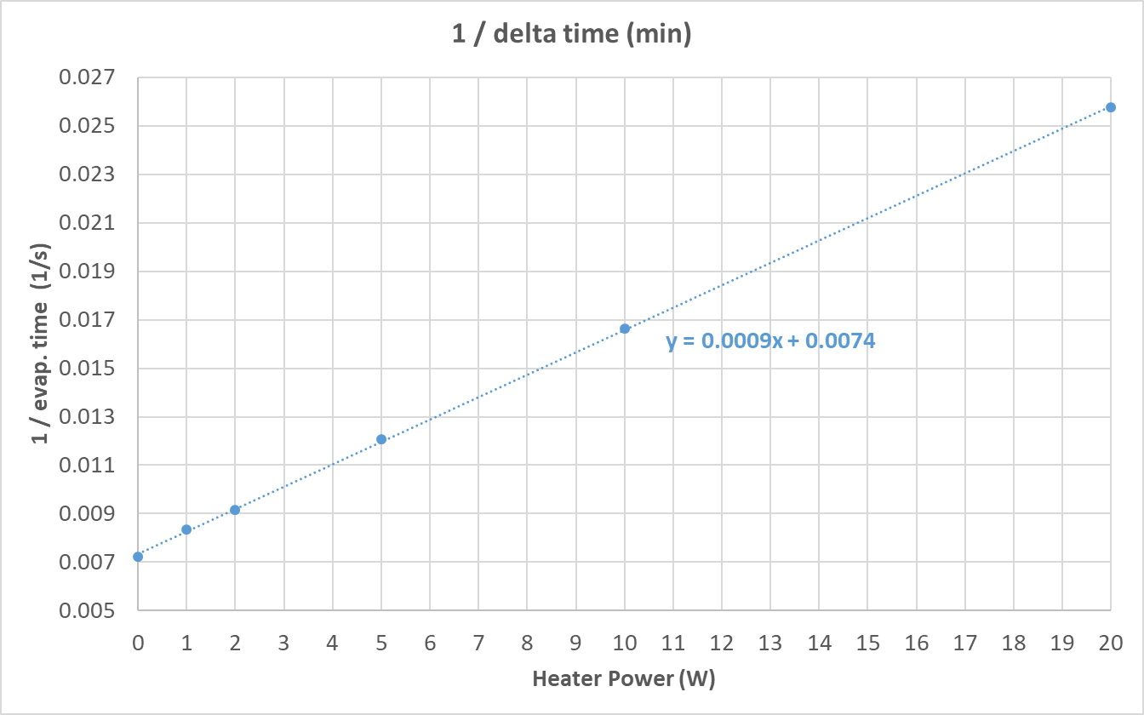
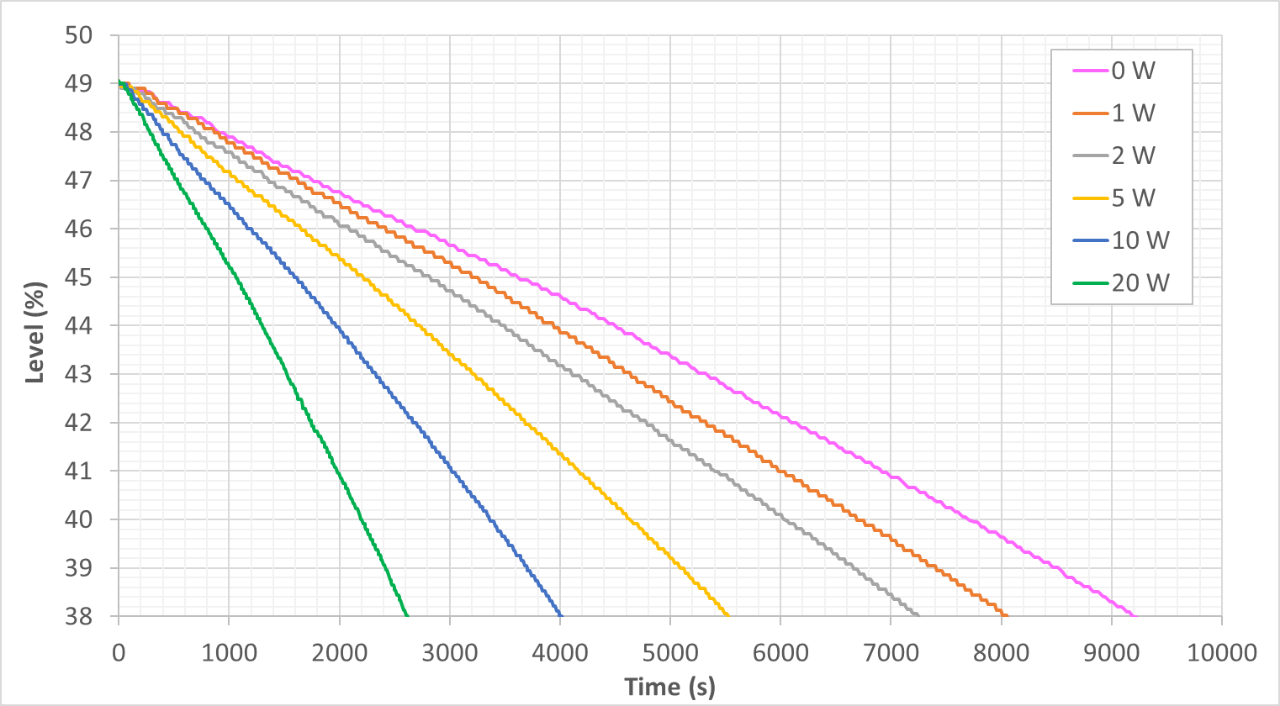
Heat load measurement at XATB2 (XM50.1)
Pictures E. Abassi
Test using change in level over time
Left: test with different heaters
Right: linear curve to extrapolate heat load with RF

Slide 10
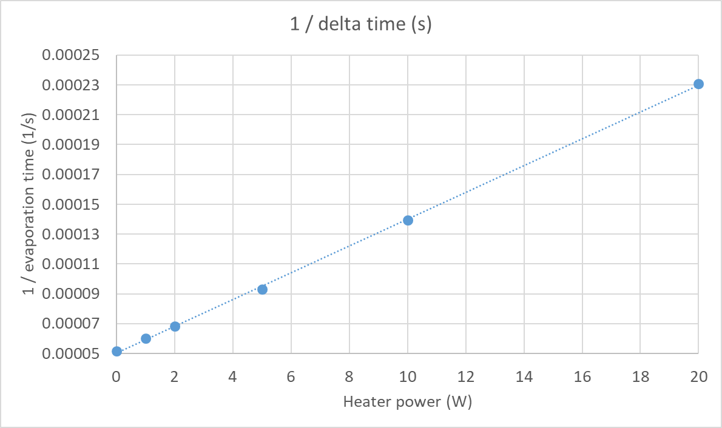
Heat load measurement at CMTB (XM46.1)
Pictures E. Abassi
Test using change in level over time
Challenges:
Repeatability
Evaluation of error bars
Dynamic heat load does not fit with evaporated gas

Slide 11
Questions
For the community
What are typical error bars in such measurements?
Does anybody have experience in measuring low heat loads on top of high static values?
Calibration of heaters: is the warm flow a good calibration? Or is the opposite better (use the heaters to calibrate the warm gas flowmeters)?
Heaters in small boxes: dissipation in cables or outside the helium volume?

Slide 12
Thank you for your attention

