Slide 1
SNS Heat load measurements methods
Paolo Pizzol
TTC Meeting
2023 Fermilab

Slide 2
Overview of SNS
Pulsed… Effective RF Duty factor… 7%
SNS Heat load measurements methods – P. Pizzol, 12/05/2023

Slide 3
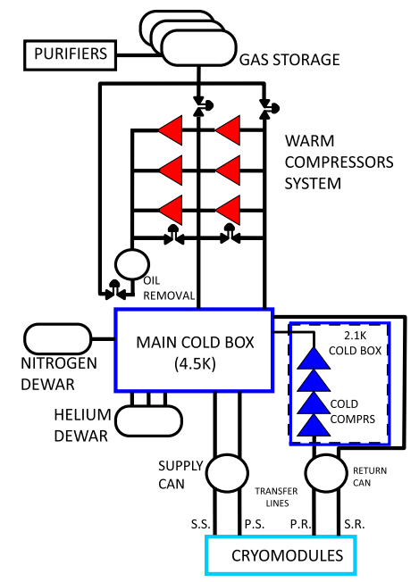
Overview of SNS cryo system and requirements
 | Primary | Secondary | Shield
Supply temperature [K] | 4.5 | 4.5 | 38
Return Temperature [K] | 2.1 | 300 | 55
Supply pressure [bar] | 3 | 3 | 4
Return pressure [bar] | 0.041 | 1.05 | 3
Static load | ~850 W | 5 g/s | 7050 W
Dynamic load | ~600 W | 2.5 g/s | -
Capacity | 125 g/s | 15 g/s | 8300 W
System not designed to calculate individually cryomodule heat loads
Cavity heaters are controlled by cryomodule – not per cavity
SNS Heat load measurements methods – P. Pizzol, 12/05/2023

Slide 4
3 Types of Cryomodules – Average Heat Losses
Medium Beta (11 CM)
Static Heat Loss: ~25 W
Dynamic Heat Loss: ~26.5 W
High Beta (14 CM)
Static Heat Loss: ~28 W
Dynamic Heat Loss: ~29.5 W
PPU (7 CM)
Static Heat Loss: 25 W
Dynamic Heat Loss: ~6 W
SNS Heat load measurements methods – P. Pizzol, 12/05/2023

Slide 5
Heat Load Mapping Recording JT Valve Position
Changes is JT valve position indicate changing load within the cryomodule
JT position versus heat load is experimentally derived an compared to operation
Similar performance of JT valves at 4K and 2K
Linac is mapped periodically
Insert HP vs JT graph here
SNS Heat load measurements methods – P. Pizzol, 12/05/2023

Slide 6
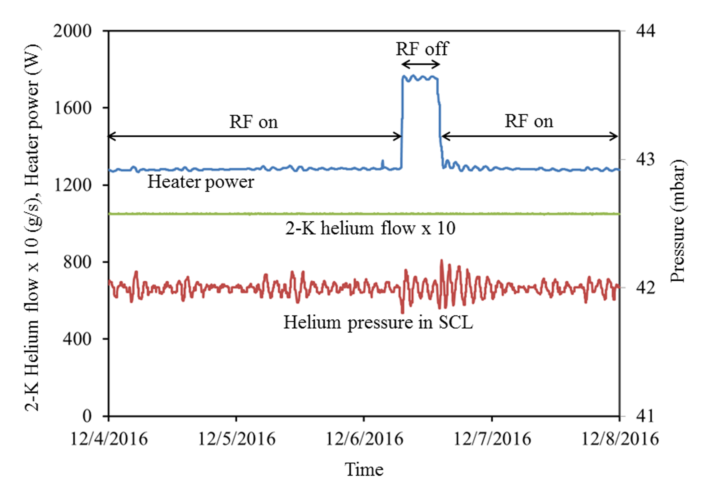
Dynamic Heat Losses @ 2K
When RF power is applied, the He fill level changes accordingly. The JT valve then moves to compensate and keep the fill level constant. The heater power is then reduced to keep the flow and pressure stable. When RF power is off, the opposite happens.
SNS Heat load measurements methods – P. Pizzol, 12/05/2023

Slide 7
Thank you for your attention
Questions?
SNS Heat load measurements methods – P. Pizzol, 12/05/2023

