Slide 1
Fast cooldown procedure used for the PIP-II prototype HB650 cryomodule at PIP2IT
Mike White
TESLA Technology Collaboration Meeting
5-8 December 2023

Slide 2
Outline
Objective & Background
Prototype HB650 Cryomodule Geometry & PIP2IT cave layout
Helium flow path through the cryomodule
Fast Cooldown Procedure
Measured temperatures and estimated flow rate
Conclusion

Slide 3
Objective & Background

Slide 4
Objective
Large and directional thermal gradients across the superconductor during transition has the effect of sweeping the magnetic fields out of the bulk material.
Leads to improved performance of nitrogen doped SRF cavities
Required cooldown rate
Cooldown rate of measured cavity temperatures of >= 20 K/min
Expected that >= 80 g/s of 4.5K helium supply flow rate needed to achieve cooldown rate based on previous results of individual dressed HB650 cavities

Slide 5
Thermal Gradients during Superconducting Transition
Nitrogen doped niobium RF cavities can very efficiently store energy, producing large beam acceleration for low heat loads.
This efficiency can be significantly degraded by magnetic fields trapped in the bulk superconductor.
These trapped fields are caused by slow/quasi-isothermal cooling through superconducting transition in the presence of ambient magnetic fields.
In addition to significant design effort spent to minimize ambient fields, large and directional thermal gradients across the superconductor during transition has the effect of sweeping the magnetic fields out of the bulk material, more closely approximating the true Meissner state.
This thermal gradient is achieved by using very high cryogen flow rates directed, by design, at one side of the cavities, exhausting at the opposite end.

Slide 6
Geometry & Test Cave

Slide 7
Prototype HB650 Cryomodule Cross Sectional View
Cooldown pipe header running under all cavities with 2 taps per cavity
6 cavities
~530L of LHe during normal operation

Slide 8
Prototype HB650 Cryomodule Cross Sectional View

Slide 9
PIP2IT Cave

Slide 10
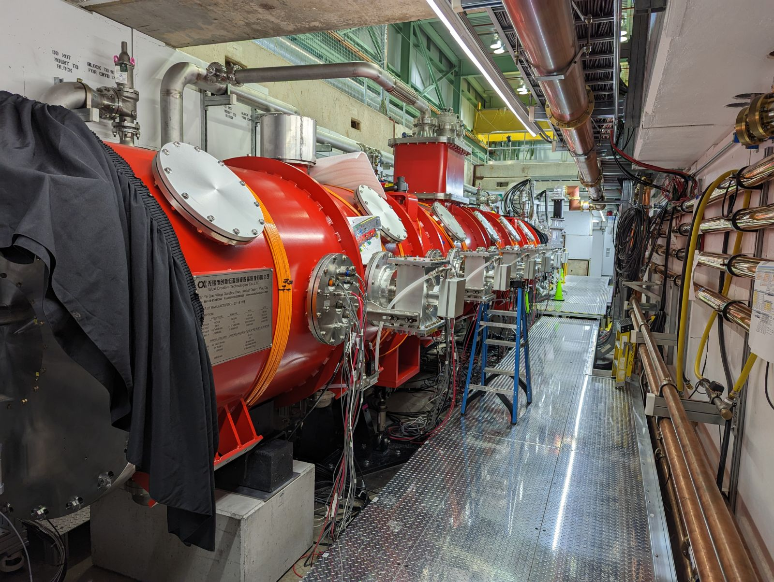
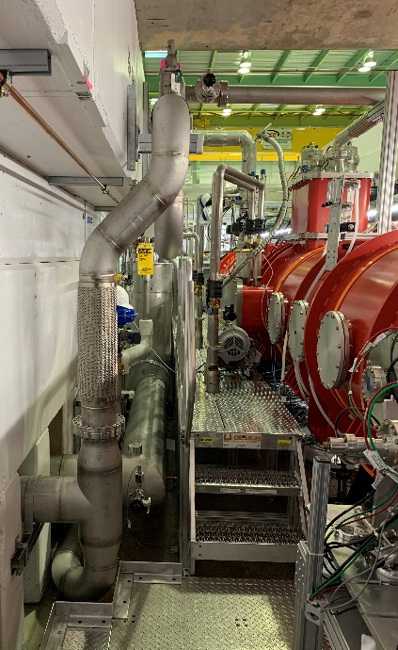
PIP2IT Cave

Slide 11
Helium Flowpath

Slide 12
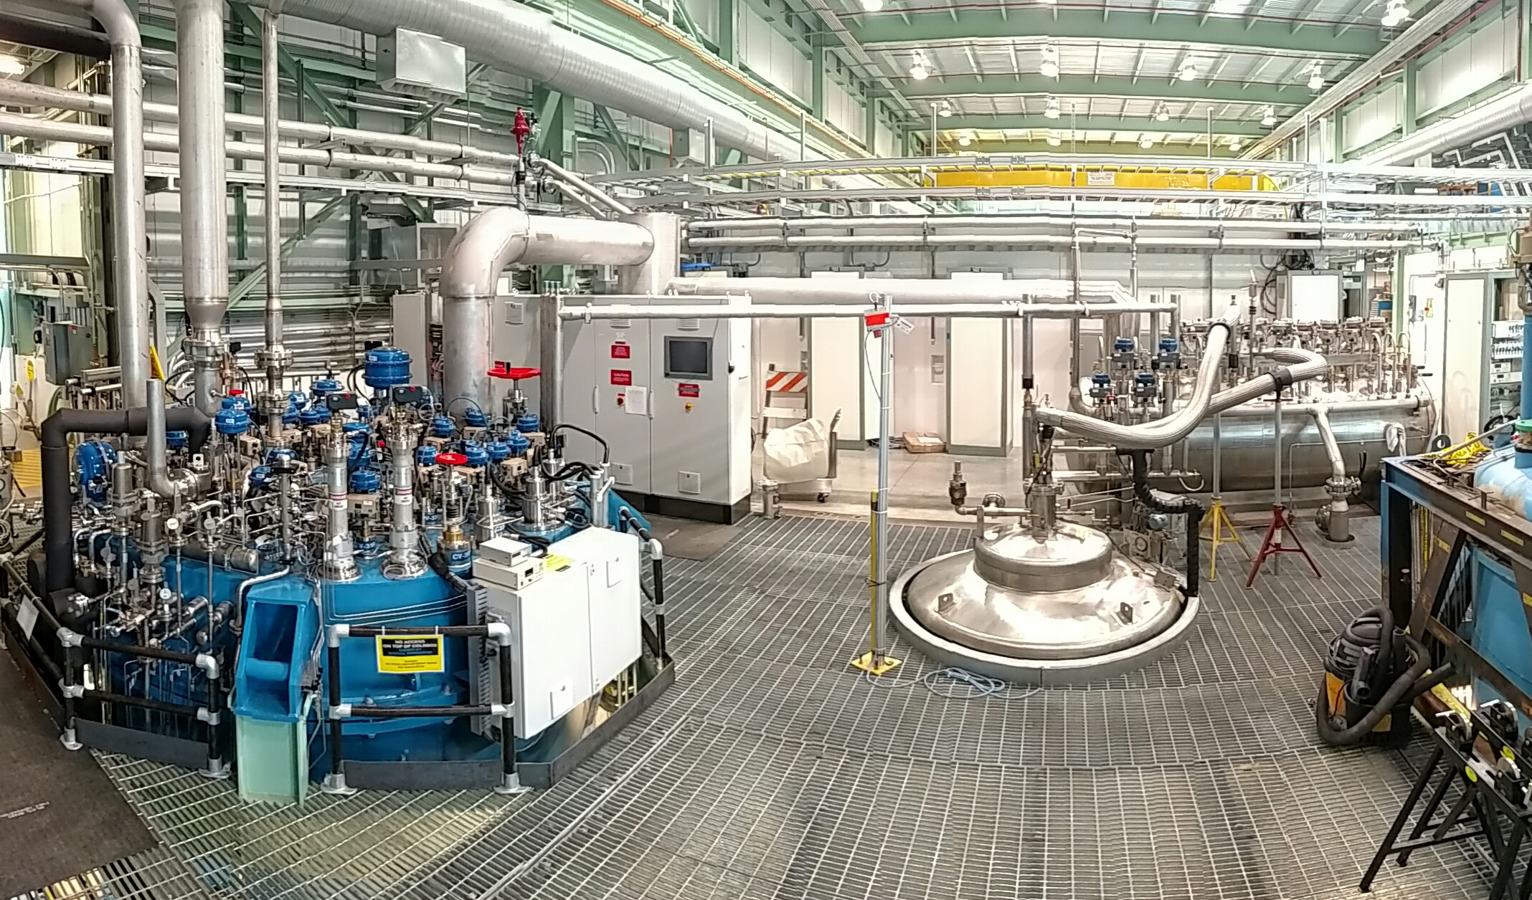
CMTF LHe Plant & Storage Dewar
Superfluid Cryogenic Plant (SCP)
Design for liquefier load of 16 g/s
Acceptance test liquefier load of 26 g/s
With replacement LN₂ heat exchanger the liquefier capacity is now in the range of 20-25 g/s
3,000 L Dewar
Boiloff used to temporarily “supercharge” plant capacity
Liquefier loads imbalance the plant heat exchangers, which then tends to warm up the plant and the associated supply temperature
Added boiloff vapor from storage dewar temporarily helps rebalance the heat exchangers and keep the plant cold
SCP
3,000L LHe Dewar

Slide 13
Helium Flowpath through the Cryomodule
5K Supply Valve
Warm mixing valve at compressor discharge pressure of 190 psig (13 bar.g)
Return flow to compressor suction at ~1 psig (7 kPa.g)
Cooldown Control Valve (bypasses JT heat exchanger)
Measured cooldown return flow rate
Cooldown flow through the bottom of each of the cavities
Surface mounted temperature sensors to monitor during fast cooldown
Synoptic HMI for the PIP2IT HB650 Cryomodule
Shortly after filling with liquid helium at 4.3 K

Slide 14
Procedure

Slide 15
Procedure
SRF cavities soak to 50K for at least 2 hours prior to start of fast cooldown
Ahead of time cryomodules typically “soak” at <= 4.5K for at least a week to “thermalize” the cryomodule
Warm mixing valve regulates supply temperature
Interlock shuts down mixing if warm flow sent backwards into transfer line
During fast cooldowns the SCP supply capacity is supplemented by rapidly boiling off liquid in the 3,000 L LHe dewar using a heater.
Based on LCLSII cryomodule testing, which uses a cryogenic temperature Coriolis flowmeter in the 5K supply line, it is known the SCP can supply in excess of 99 g/s for short durations of less than 10 minutes.
The storage dewar liquid level is built up ahead of the fast cooldown. Storage dewar heater power is ramped up as the fast cooldown process starts
The warm mixing valve is closed. Flow is “trickled” through the cryomodule until the cold wave approaches the cooldown valve
One of the cryo operators quickly opens the cryomodule cooldown valve, but not so fast that plant LHe supply pressure is severely disrupted.
Once the cooldown valve approaches LHe temperatures the operator will reverse and close down on the cooldown valve to keep the flow rate from getting too high
The other cryo operator closes down the 3,000L dewar supply valve as necessary to try to maintain a constant LHe supply pressure
Fast cooldown is over ~10 min. Filling the cryomodule with liquid and restabilizing the plant & storage dewar takes the rest of the workday.

Slide 16
Calculation of Estimated Mass Flow Rate
The PIP2IT cryogenic distribution system does not include any cryogenic temperature flowmeters, so in real-time the supply flow rate to the SRF cavities is unknown during fast cooldown.
Without a supply flowmeter some trial and error is required to fine tune the fast cooldown procedure to be able hit the flow rate target while minimizing the perturbation to the plant and LHe storage dewar
First time is just an educated guess on what to do and when exactly to do it
However, knowing the inlet temperature, inlet pressure, valve position, and outlet pressure the flow rate through the PVCD control valve can be estimated using the valve sizing equations in IEC 60534.
PVCD uses a C_{v} = 3.2 equal percentage bullet with a 100:1 ratio.
Note that a flowmeter on the cooldown return piping will report values significantly lower than the flow rate being supplied to the cavities
The prototype HB650 cryomodule has a liquid volume of ~530 L
Total helium mass in the “liquid volume” increases significantly during fast cooldown process even though no liquid level is measured
The return side flowmeter peaked at roughly 20 g/s, so during a fast cooldown most of the supply flow is being converted into helium storage within the cryomodule

Slide 17
Fast Cooldown Observations
The estimated flow rate through PVCD based on archived data was calculated to be in excess of 150 g/s while the top of the cavities were crossing the niobium transition temperature.
Measured cooldown rates
Cooldown rate at the bottom of the SRF cavities greatly exceeded 20 K/min
Cooldown rate at the top of the cavities remained close to 20K/min approaching the niobium transition temperature of 9.2K.
Temperature sensors are surface mounted, so there is a little bit of lag between cavity niobium temperature and measured temperature
The cooldown rates at either the top and bottom of each cavity were similar across the string of cavities, indicating that the flow rate through each cavity is approximately equal
The 3,000L dewar heater was at 800 W for the brief period during fast cooldown
The 3,000L dewar level dropped from 33% to 19% over 40 minutes, indicating that about 420 L of LHe were consumed by fast cooldown and stabilizing the cavities at ~4.5 K

Slide 18
Fast Cooldown of Prototype HB650 Cryomodule
TX-030 is upstream of PVCD
TX-031 is downstream of PVCD
The first digit in temperature sensor number corresponds to the cavity number in TX-101 through TX-602
Plot showing the fast cooldown of the HB650 Cryomodule

Slide 19
Conclusion
Fast cooldown successfully completed on a new cryomodule type
Had to extrapolate existing fast cooldown experience, since the pHB650 cryomodule has approximately twice the helium volume of LCLS-II and LCLS-II HE cryomodules
Estimated delivery flow rate (~150 g/s) was significantly in excess of the estimated required flowrate (~80 g/s)
Desired cooldown rates achieved
Process for managing the SCP refrigerator and 3,000L Dewar for this cryomodule is similar to the process that has been used extensively on the LCLS-II and LCLS-II HE cryomodules
Same process could be adapted for other plants and other cryomodule types at other laboratories
Existing installations may be adapted for fast cooldowns

Slide 20
Questions?

Slide 21
THE FUTURE OF FERMILAB
Follow us:
http://pip2.fnal.gov/
/showcase/pip-ii/

