Slide 1
First cooldown study for
single-cavity CM for DASL
Dong Xinbo, Sun Zheng, Su Huikun ,Li Han and Wang Xilong
1.Institute of Advanced Science Facilities, Shenzhen(IASF)
2.Dalian Institute of Chemical Physics (DICP), Chinese Academy of Sciences
7th,December, 2023
Notes:
S3FEL is the abbreviation of our project

Slide 2
Introduction
01

Slide 3
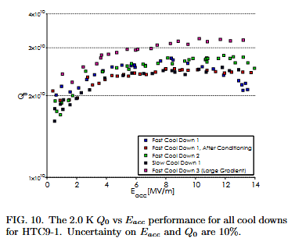
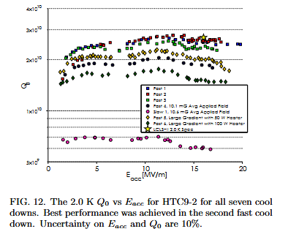
Foundation of the work
It was proved for a N-Doped cavity, Cooldown rate and thermal gradients around Tc have a drastic impact on the Meissner effect
Will degrade residual resistance due to trapped magnetic flux
Could be used to achieve low residual resistances even in high ambient fields
Finally affect the performance of Q₀
It has been proved that keeping a larger temperature gradient within the Cavity when across the Tc will get a better Q₀ performance.
However some questions Remained:
An optimized FCD mass flow to achieve a large thermal gradients ?
A efficient initial temperature to achieve a large thermal gradients?
How does thermal gradients expel the magnetic field efficiently ?
The magnetic field direction affect Q0 under same FCD process?
[1] Romanenko A , Grassellino A , Melnychuk O ,et al.Dependence of the residual surface resistance of superconducting RF cavities on the cooling dynamics around Tc[J].Journal of Applied Physics, 2014, 115(18):184903-184903-7.DOI:10.1063/1.4875655.
[2] Gonnella D , Eichhorn R , Furuta F ,et al.Nitrogen-doped 9-cell cavity performance in a test cryomodule for LCLS-IIa)[J].Journal of Applied Physics, 2015, 117(2):935-937.DOI:10.1063/1.4905681.
Notes:
为什么要做这个测试, 引出大连

Slide 4
Test process
02

Slide 5
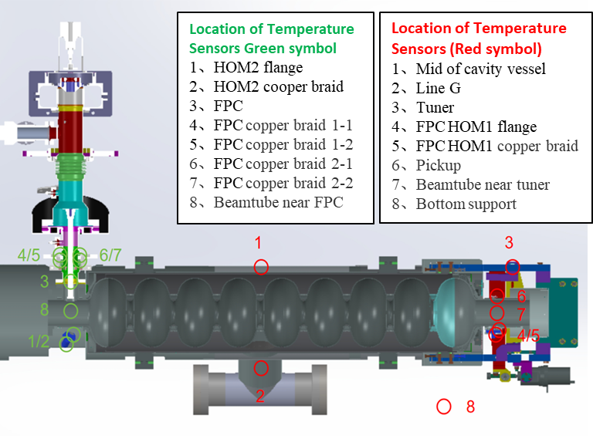
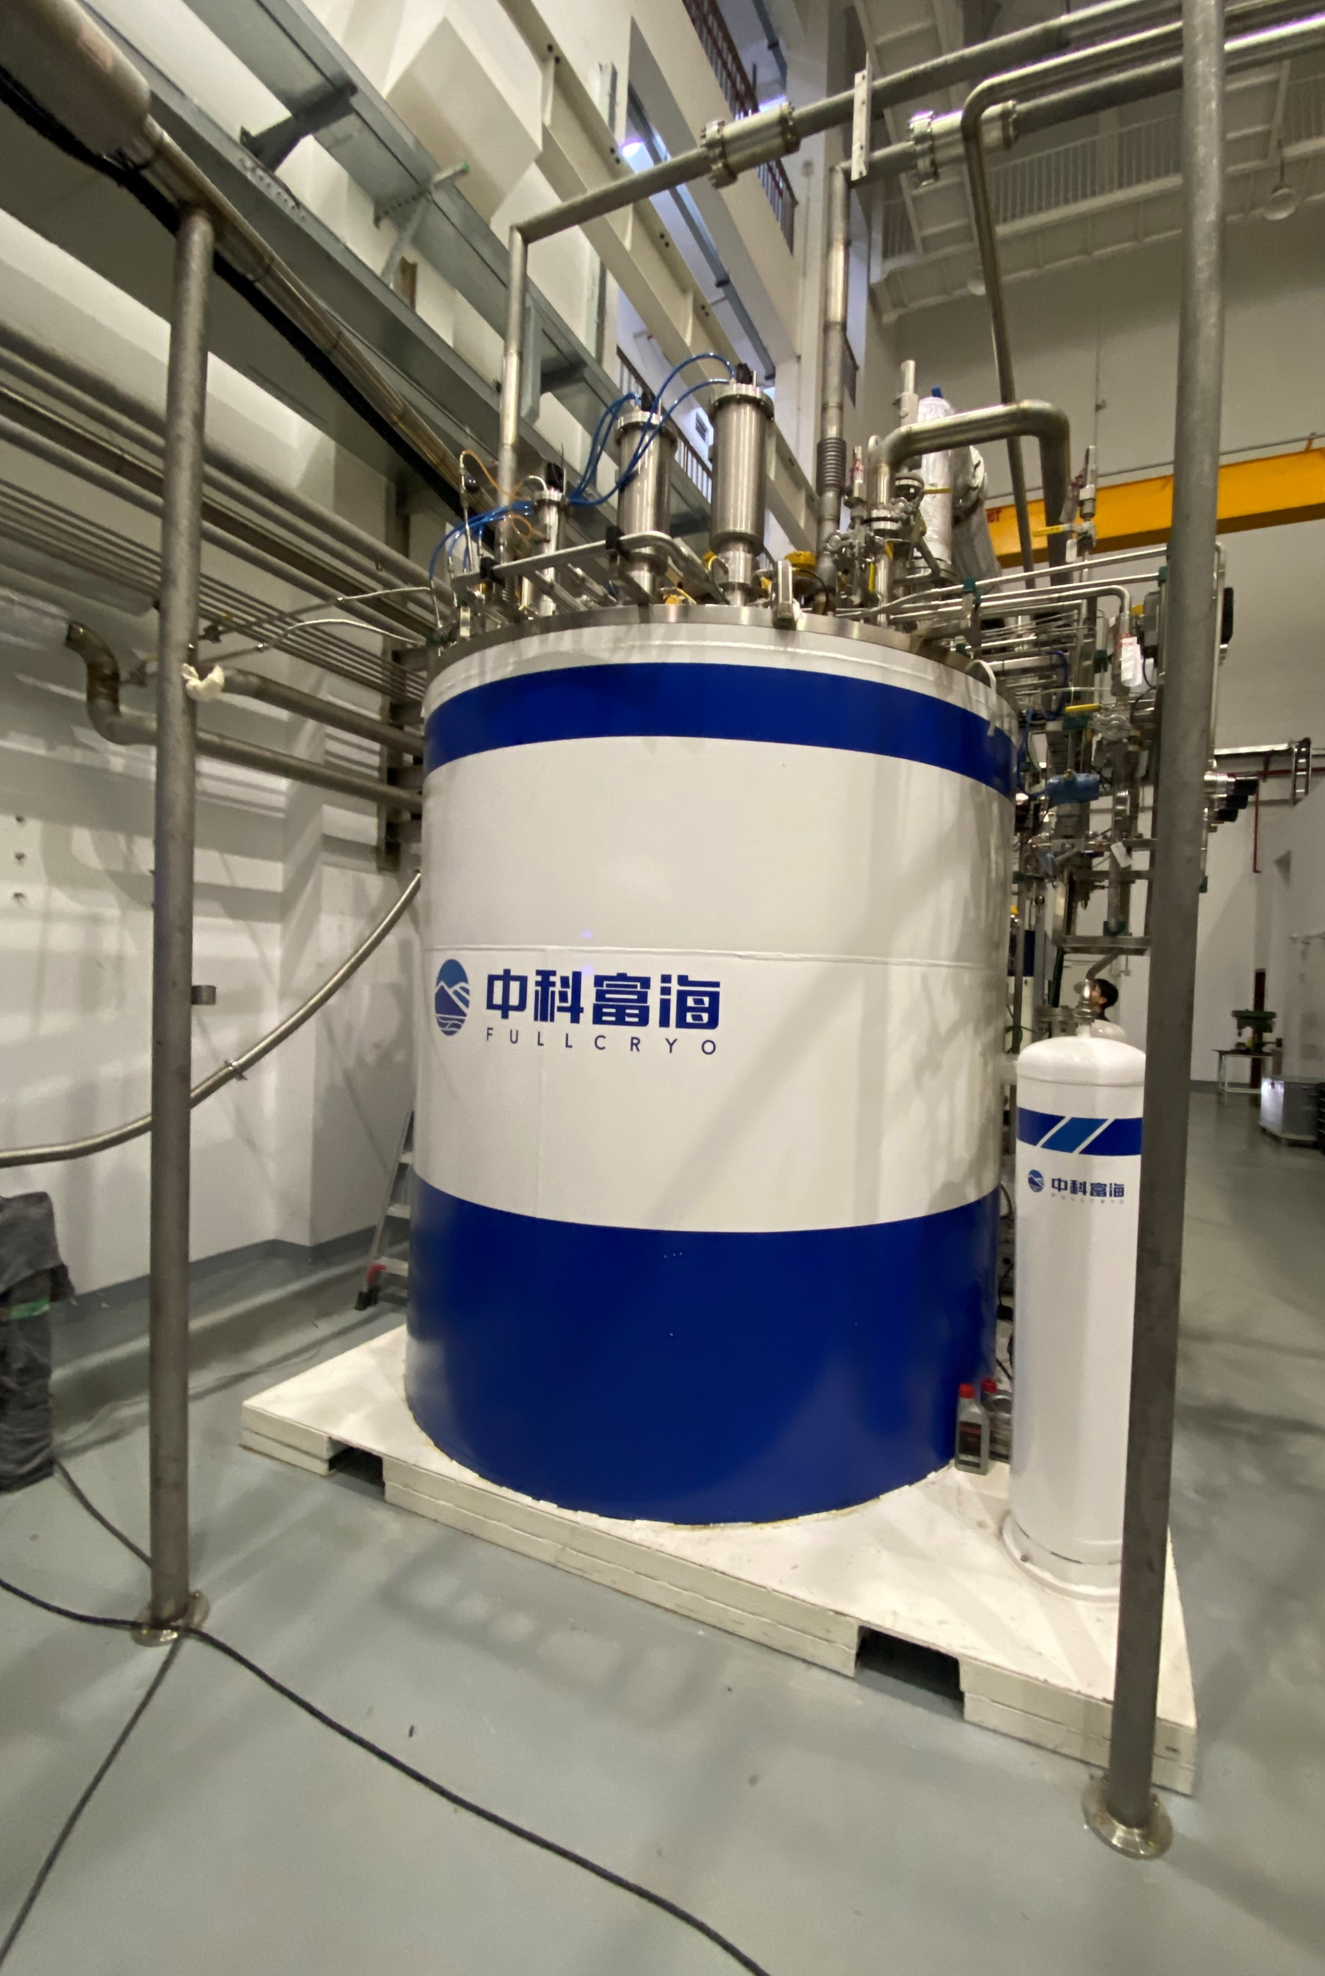
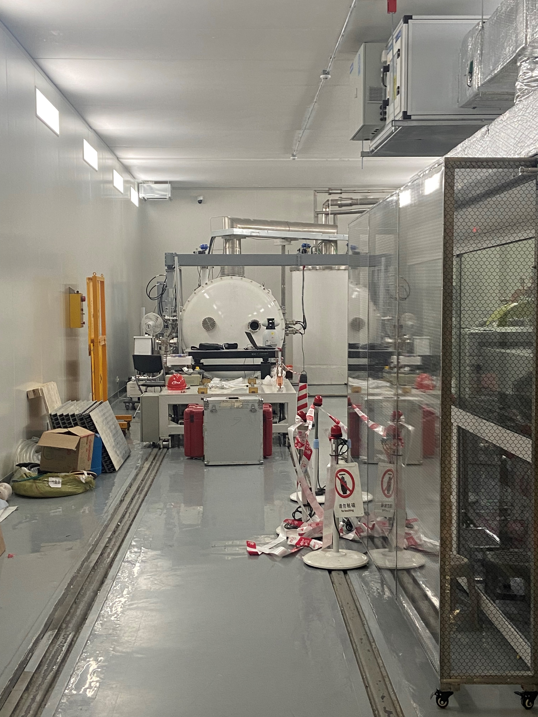
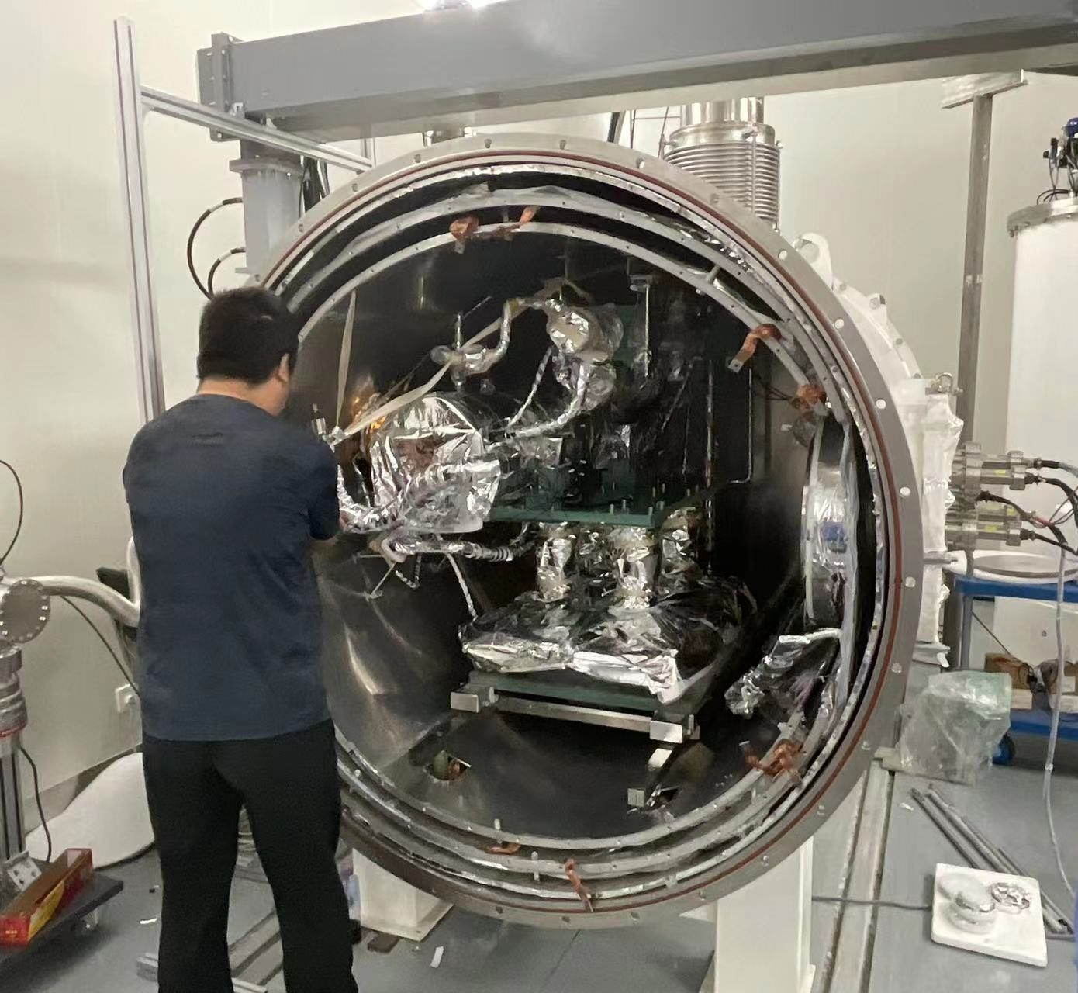
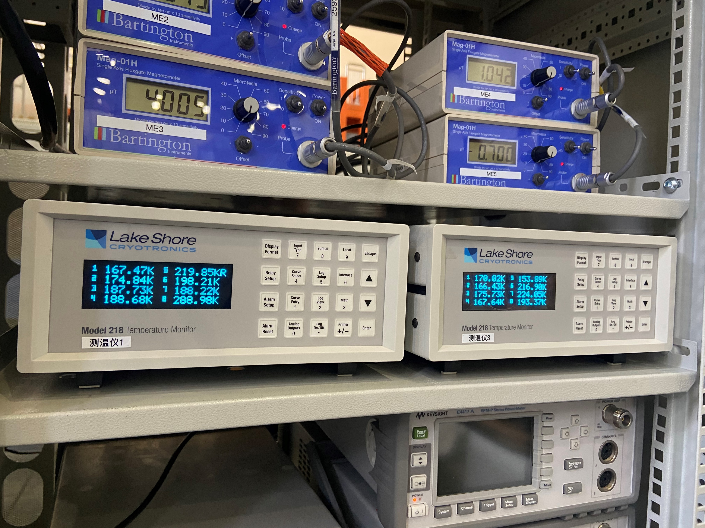
Test Platforms
We cooperated with CSNS (Chinese Spallation Neutron Source) which located in DongGuan city ,Guangdong province.
We use the superfluid helium test platform established by CSNS. And our single 9-cell cavity is assembled in the customized horizontal test box.
100 W@2K helium refrigerator
Single horizontal test platform
Assembled cavity
Instruments and monitor
Notes:
测试内容，场地，器材，

Slide 6
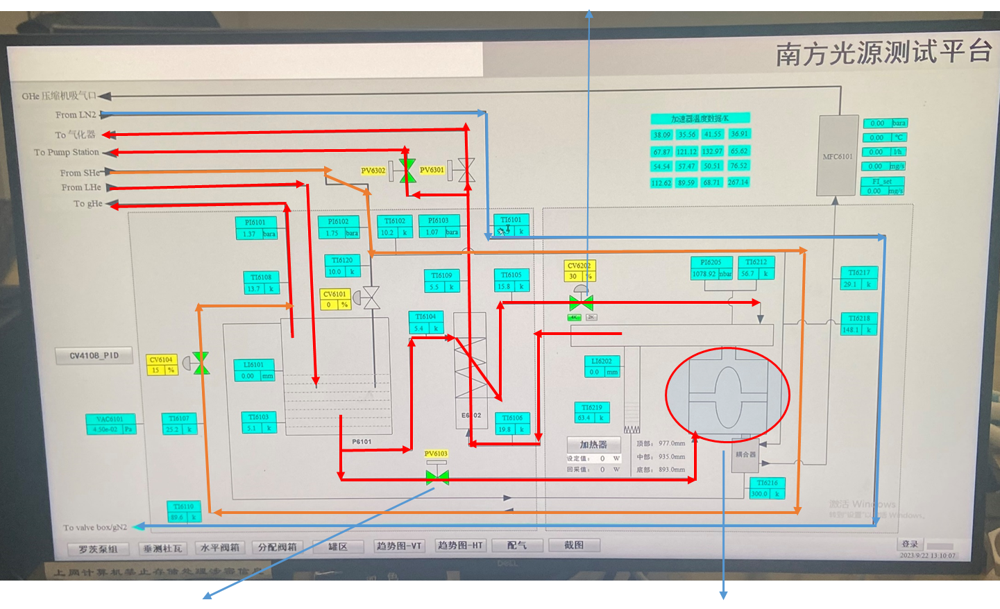
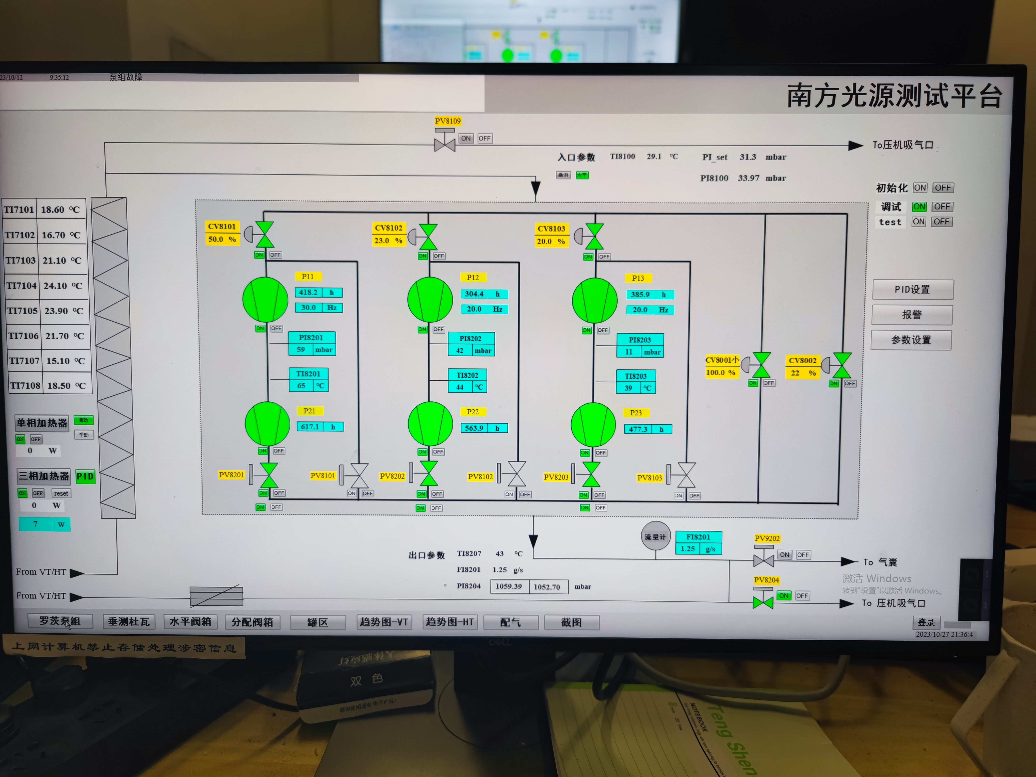
Cryo process
From 2023.09 to 2023.11, First CD Study.
1.Cool down the cavity from 300K-50K.the process takes almost 24 hours.
2. FCD preparation: Close the PV6103.Then begin to introduce nominally 4.5 K, 1.3 bar Liquid helium from dewar and fill in the subcooled tank. During the process, control CV6202 with a very small opening to roughly maintain the cavity to 50 K .
3. After the subcooled tank is filled with a high level LHe, the FCD procedure is ready to begin.
4. FCD process: Open the PV6103 to let LHe directly filling in the cavity through the CD pipeline which in the bottom of the dressed cavity. The mass flow of FCD can be monitored by a thermal mass flow meter which assembled at downstream of the 2K return pipeline. Maxium mass flow is over 10g/s (over the range of the flow meter) .
5. After the cavity is filled with a level of LHe, the FCD procedure is finished and the PV6103 will be closed. Then We use the CV6202 to supply the LHe to the two phase pipeline and control the liquid level (LI6202)
6. 4 K-2 K process: the PVPS is started to pump down the pressure to 31 mbar and maintain 2K temperature
Subcooled tank
CV6202:JT valve
Vacuum Pump system
LN2 supply
LP return
Two bypass valve will open during FCD process to test the mass flow.
2K return
SHE supply
LHE supply
GHE return
LHe fill in.
FI8201:
Flow meter
GN2 to ATM
PV6103:
CD vavle
Cavity to test
Notes:
测试系统流程和关键仪器仪表

Slide 7
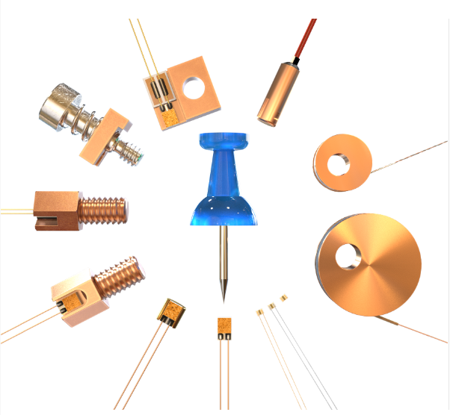
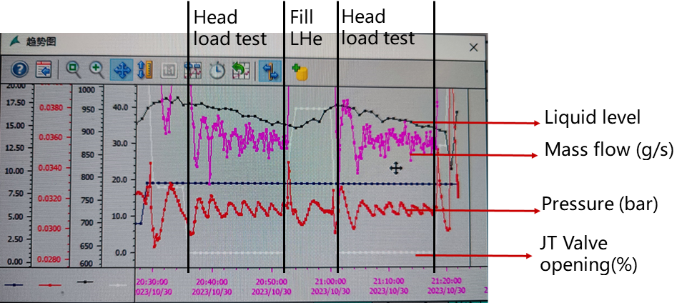
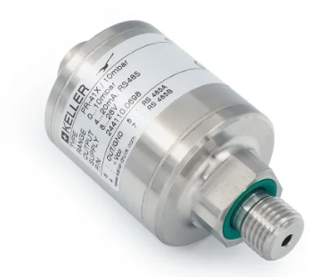
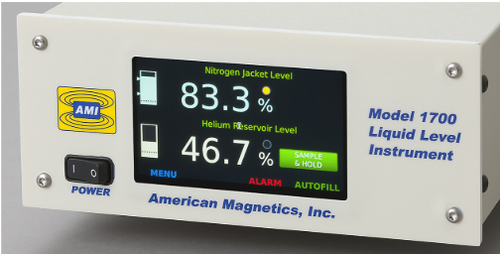
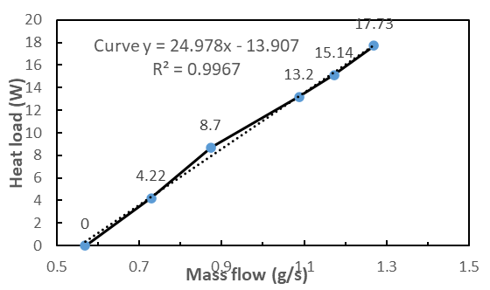
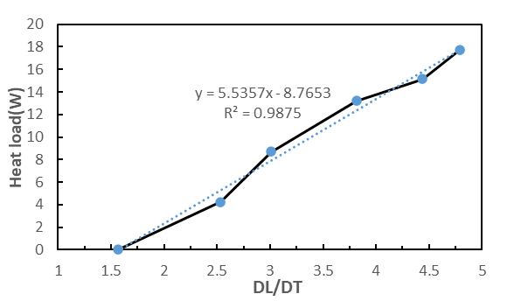
Heat load measurement
1.Two methods was applied to test the static and dynamic heat load of the cavity.
2.The first method is by using mass flow meter and the second one is using liquid level meter. A heater is used to calibrate the massflow rate and the liquid level change. The mass flow method has a better accuracy.
Mass flow meter : QuadraTherm780i by SIERRA
Temperature sensor :
CERNOX by Lakeshore
Data monitor during heat load measurement
Pressure sensor :
PAA-41X by KELLER
Liquid level meter :
Model 1700 by AMI
Calibrated curve of two methods by using an electrical heater

Slide 8
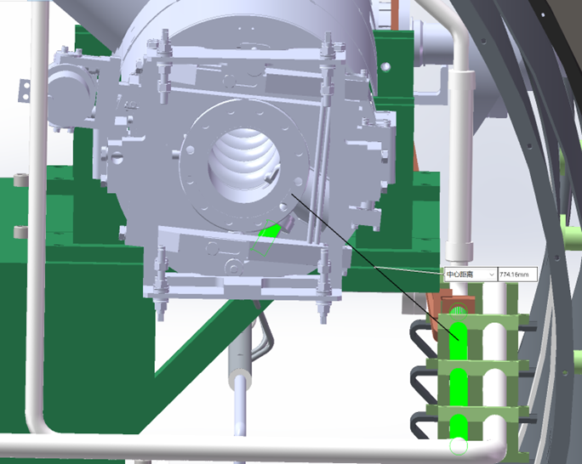
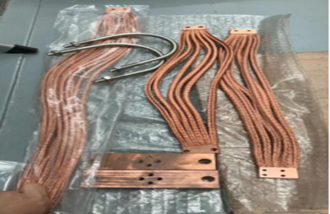
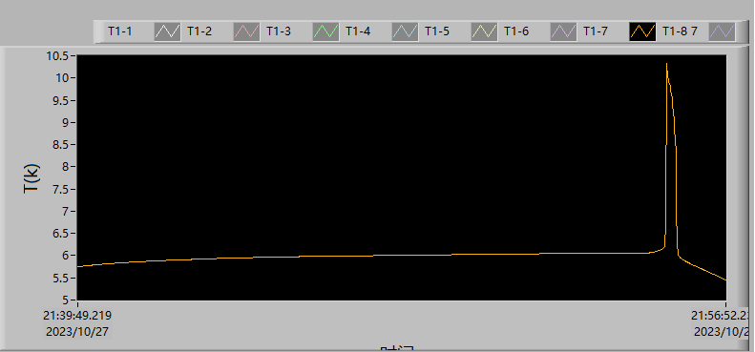
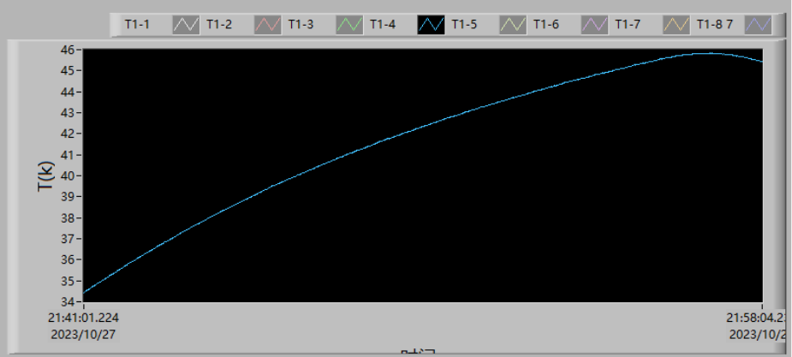
Preliminary result and challenges
Preliminary result and challenges :
We tried to measure the Eacc Vs Q₀ by using mass flow method . However the Q0 result is significantly lower than the vertical test result.
We found the several temperature near FPC 1 HOM and tuner was abnormal raised during the test. Especially, when the Eacc is above 12MV/m, the temperature will raise up to safety margin within several minutes and then trigger the safety protection.
Based on the data observation, we conclude that the structure of the copper braid is too long to cool down the HOM1 coupler efficiently. The heat will accumulate and then cause a temperature abnormal raise.
Eacc (MV/m) | Mass flow （g/s） | Total heat load (W) | Electrical heater (W) | Dynamic heat load (W) | Q0
6 | 0.810 | 18.954 | 4.216 | 1.895634 | 1.98E+10
6 | 0.806 | 18.8604 | 4.216 | 1.802034 | 2.08E+10
8 | 0.899 | 21.0366 | 4.216 | 3.978234 | 1.67E+10
8 | 0.898 | 21.0132 | 4.216 | 3.954834 | 1.68E+10
10 | 1.140 | 26.676 | 4.22 | 9.617634 | 1.08E+10
10 | 1.132 | 26.4888 | 4.22 | 9.430434 | 1.10E+10
10 | 1.144 | 26.7696 | 4.22 | 9.711234 | 1.07E+10
12 | 1.428 | 33.4152 | 4.216 | 16.356834 | 9.16E+09
12 | 1.328 | 31.0752 | 4.216 | 14.016834 | 1.07E+10
12 | 1.373 | 32.1282 | 4.216 | 15.069834 | 9.94E+09
Beamtube near tuner
FPC 1 HOM flange
Abnormal temperature elevation when Eacc is above 12MV/m
The 3D structure of the test platform and the copper braid uesd

Slide 9
Summary
&
Next Plan
03

Slide 10
Summary & Next Plan
SUMMARY
The first single cavity test has been completed by DALS using CSNS test platform.
The procedures of cryo process was finished during the first test.
The preliminary heat load is measured by two methods , which one use mass flow sensor and another use liquid level instruments.
The temperature near tuner is abnormal rasied when the Eacc is up to 12MV/m , so the Q₀ vs Eacc measurement is not completed during the first cool down test.
NEXT PLAN
We plan to warm up the test cavity recently and then change the structure of the copper braid near tuner and FPC HOM to fix the temperature abnormal problem .
Test procedures and parameters will continue to be updated based on feedback from the first testing observations.
Continue to complete the single N-doped cavity horizontal test in CSNS. Especially ,research the effect of initial cooldown temperature and mass flow rate during the FCD process.

