Slide 1
LCLS-II Cooldown Experience
Including fast cooldown!
Ryan Porter, SLAC National Accelerator Laboratory
On behalf of the LCLS-II Collaboration
TTC Meeting, Dec 7, 2023

Slide 2
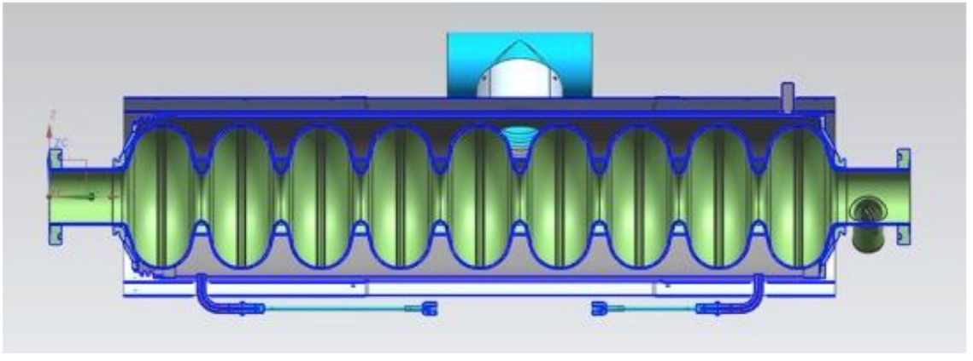
Cryomodule Cryogenics Layout
Nitrogen doped cavities require fast cooldown
Two helium supply lines to cavities
One line directly to ‘two-phase’ pipe for helium supply during operation
Second ‘cooldown’ line to provides helium to the bottom of cavity helium jackets for fast cool downs.
Helium Supply line
∆T
Cooldown Valve
Helium Gas Return
Two Phase Pipe
Cool Down Line

Slide 3
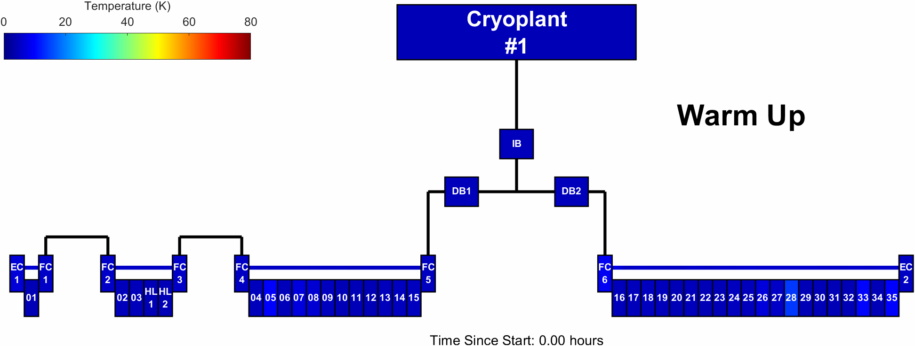
Linac-Cryoplant Schematic
The linac is fed by two distribution boxes
We can warm up/cooldown each half of the linac independently
We do not have gas storage capacity to warm up the entire linac
We cannot warm up individual cryomodules

Slide 4
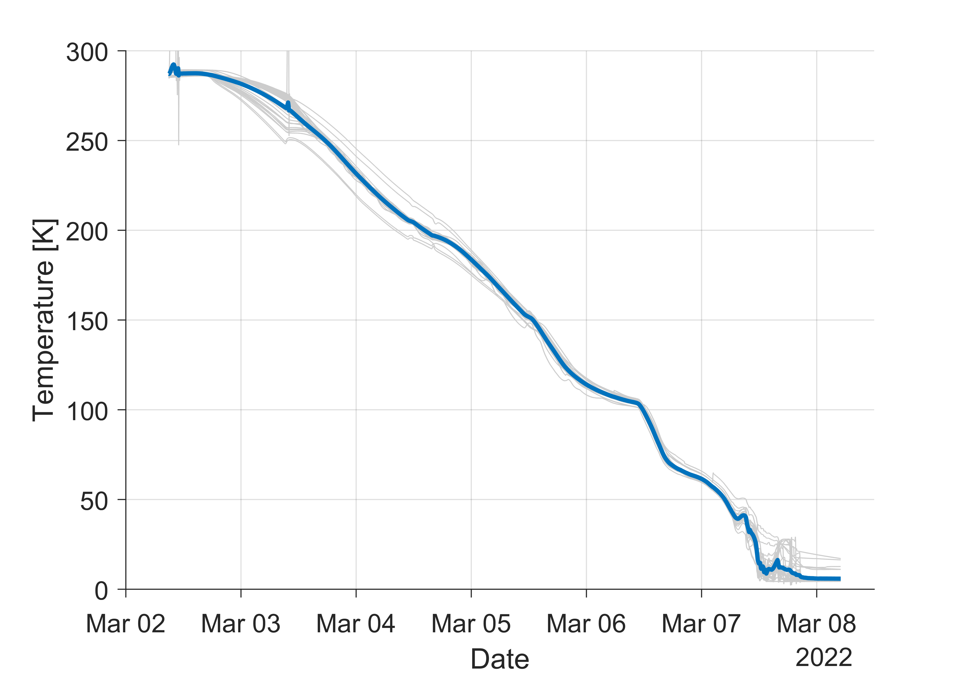
Cool Down & Pump Down to 2 K
Cavity Temperatures During Cool Down
Cool down of the entire linac was completed in ~5 days!
A rate of 2-3 K/hour was maintained over that duration
Cool down was near-fully automated by the cryogenic controls system
CD valves were used to maintain rate and safe temperature gradients across the linac
After multiple attempts, stable operation at 2 K was achieved only 11 days later
2-3 K/hr
Slide Courtesy of D. Gonnella

Slide 5
Fast Cool Down
Fast cool down of the cavities is critical to achieve High-Q₀
Half of the linac must be fast cooled at a time
~24 hours to warm up and fast cool half the linac
Special tools were developed to automate this process to make it robust and repeatable
Slide Courtesy of D. Gonnella
Coloring based on actual temperature data during FCD

Slide 6
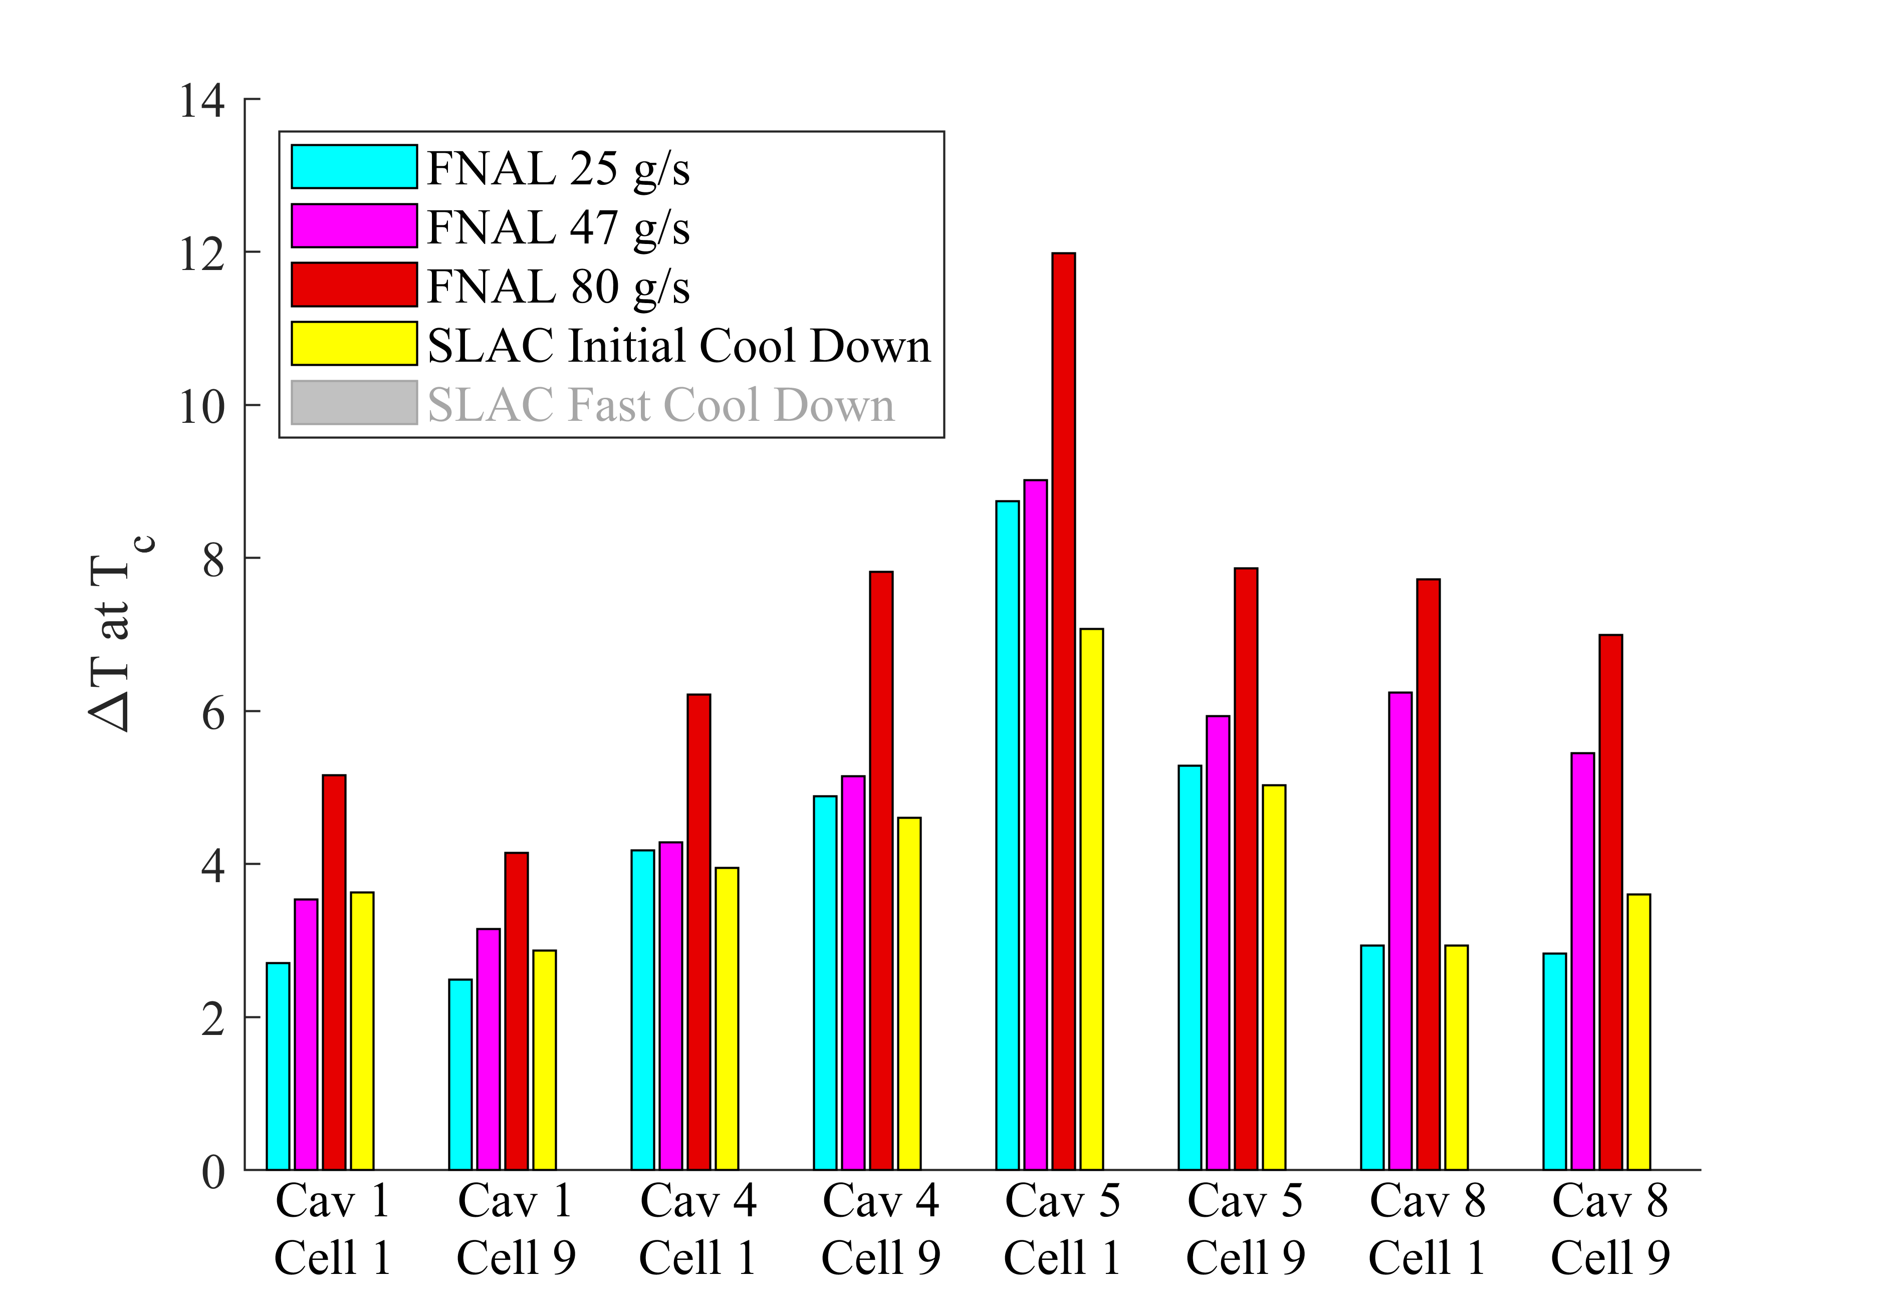
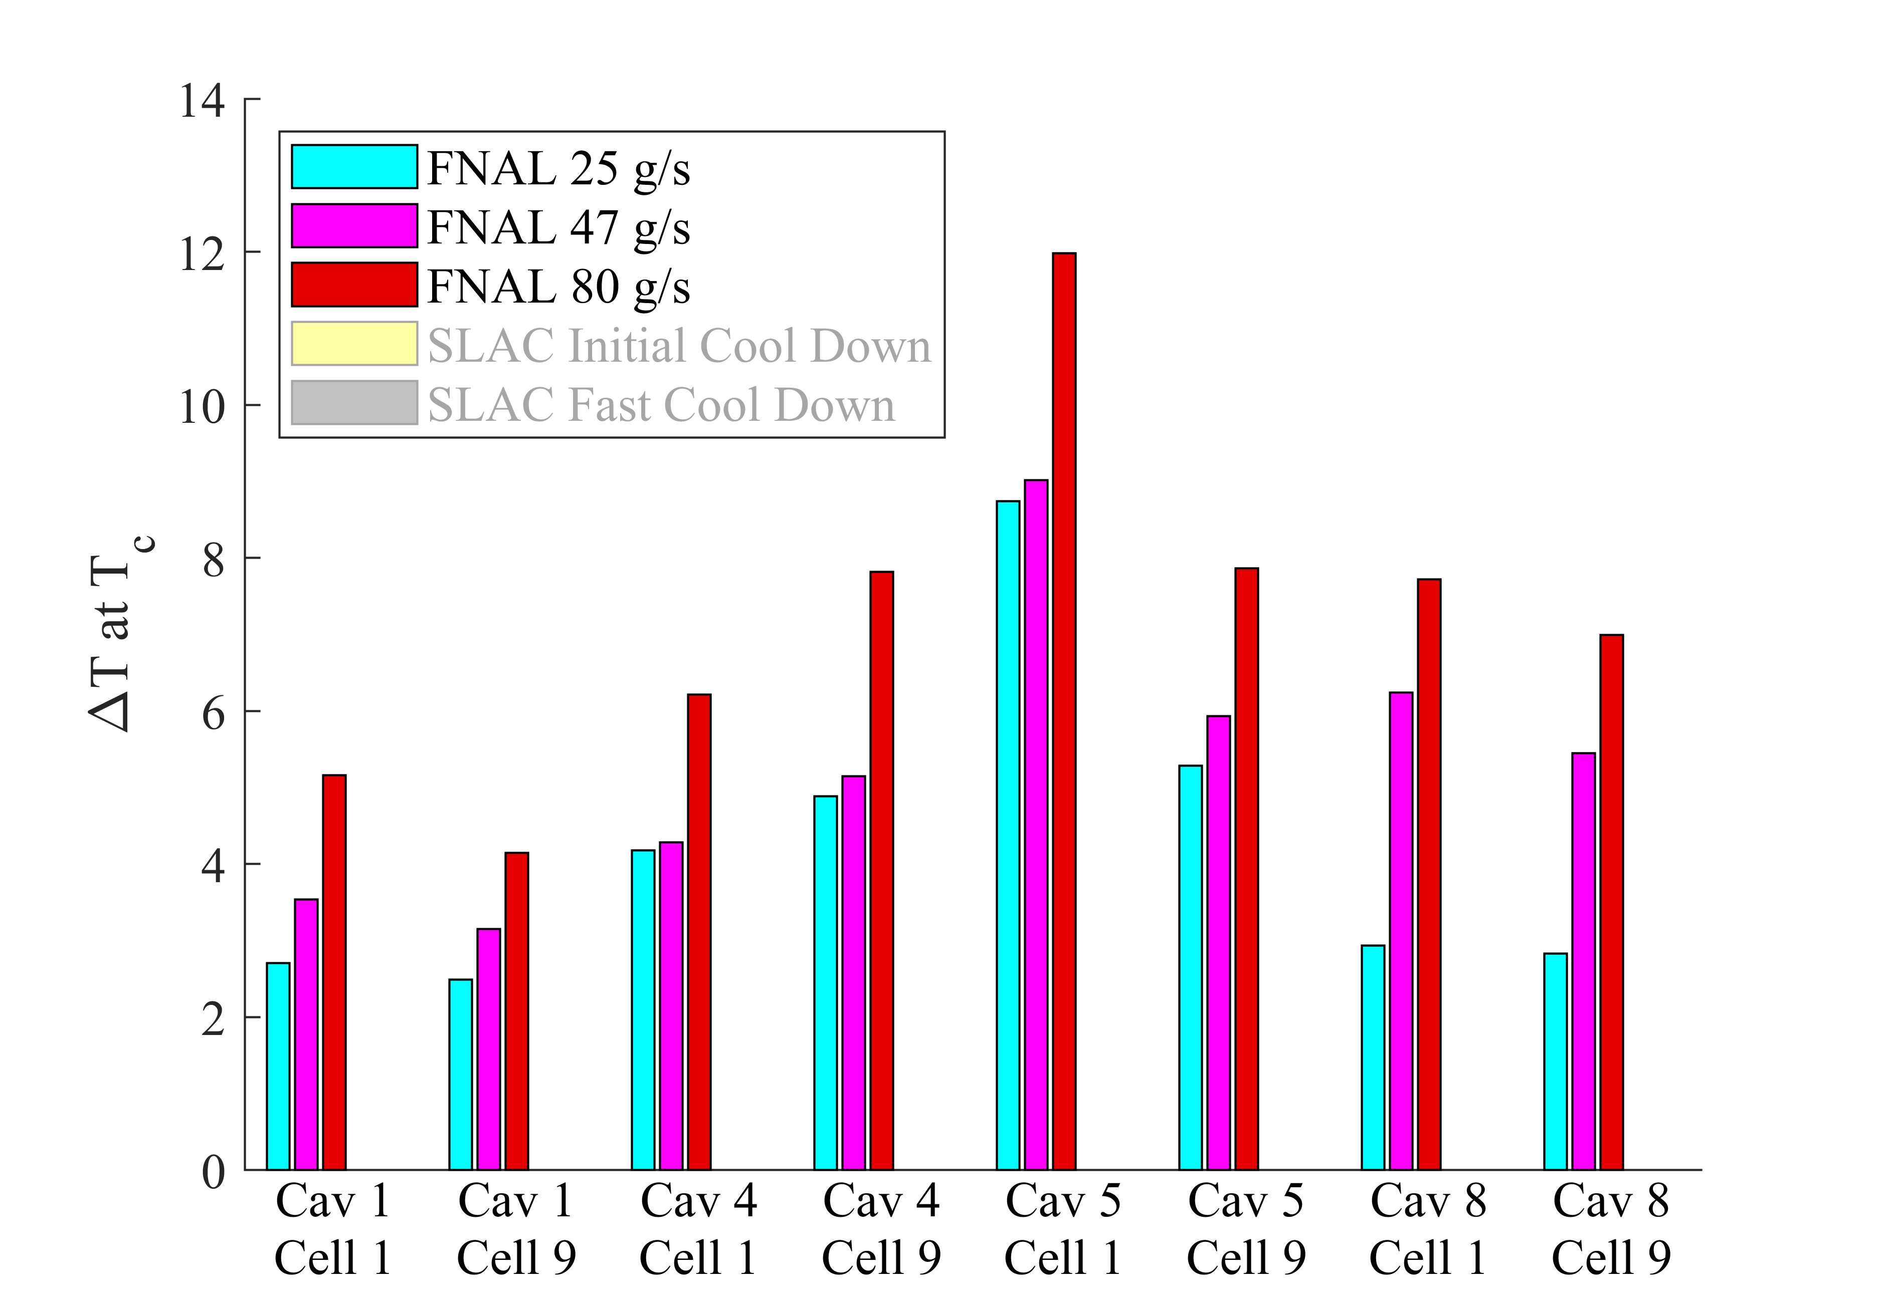
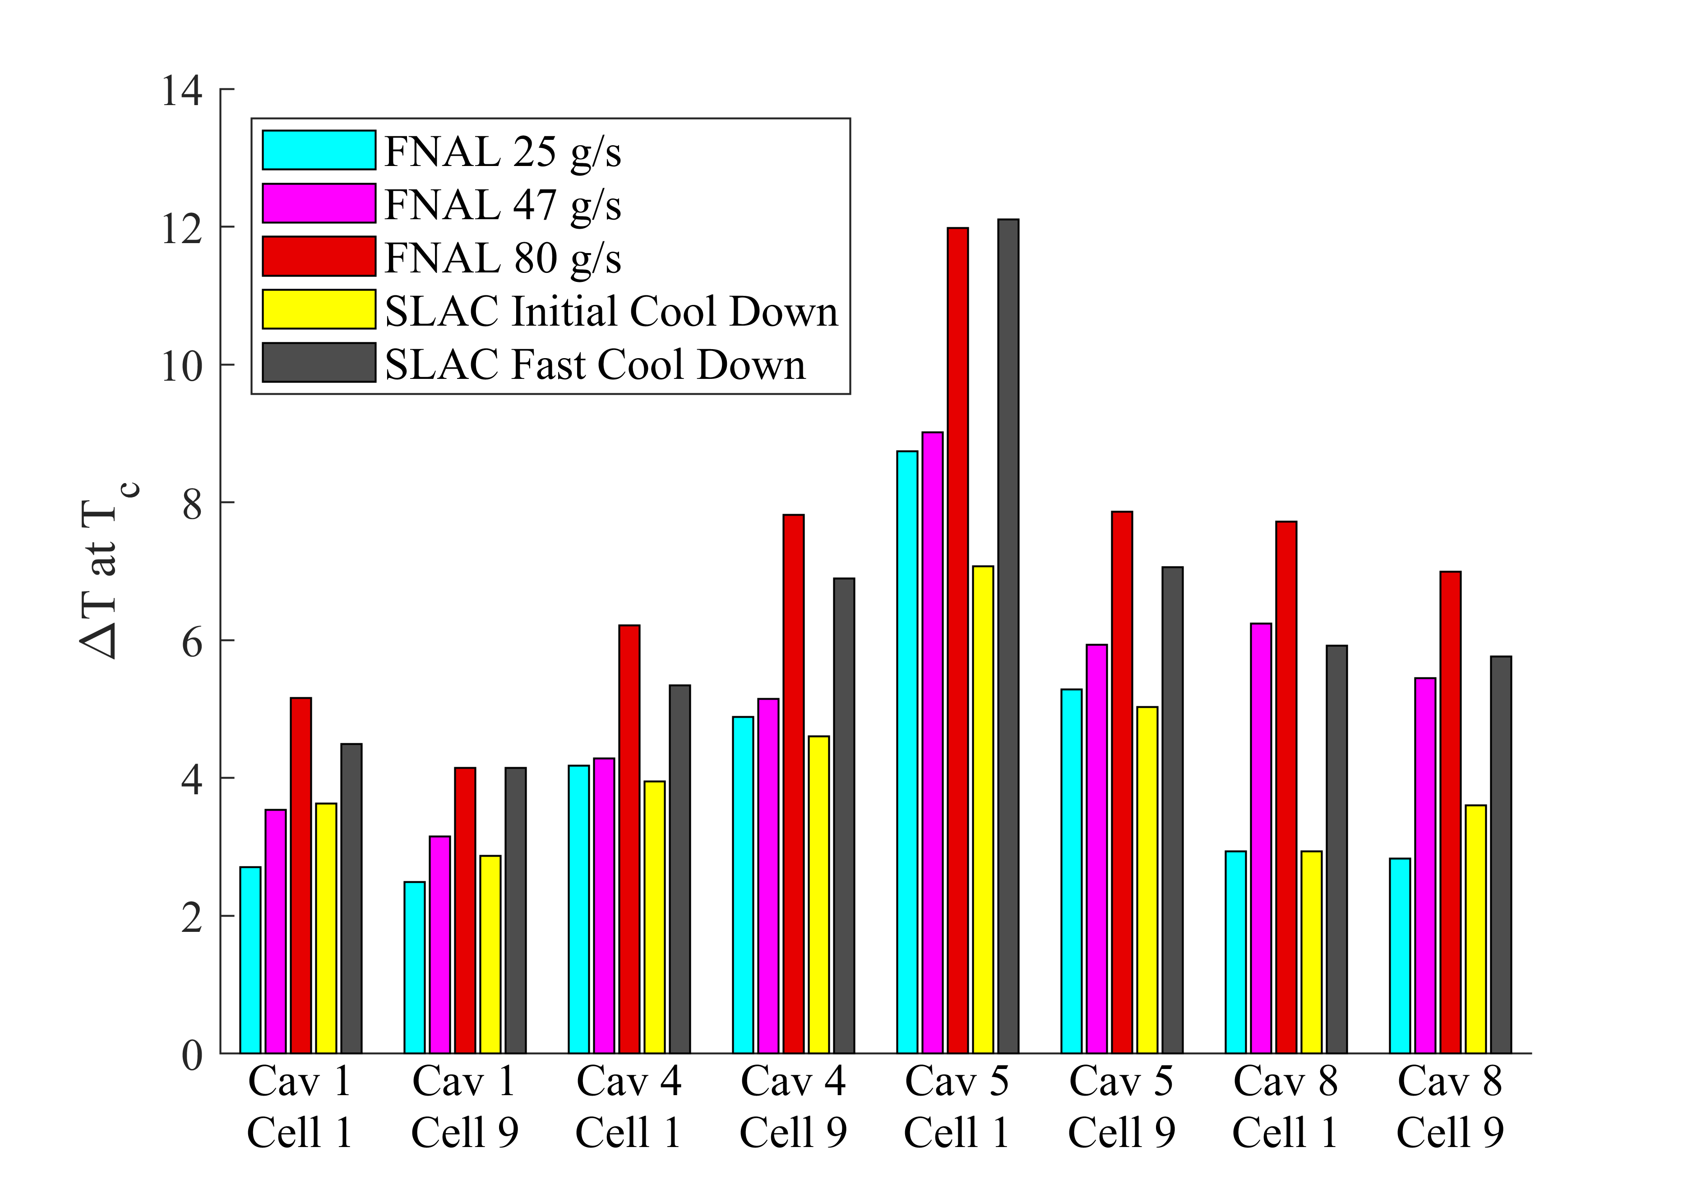
Fast Cool Down Results Part 1
What we really care about is the cool down gradient not the rate – faster usually means larger gradients
Two installed CMs have temperature sensors located on the cavity cells
Gradients from the SLAC fast cool down and testing at FNAL could be compared to gauge how “successful” we were
Non-optimized cool down results in lower ∆T than achieved at the test stands
Fast cool down process produces similar gradients to FNAL CMTF
We are now able to routinely achieve similar temperature gradients across the cavities to what was achieved during CM testing
∆T at NC/SC Transition
∆T
Slide Courtesy of D. Gonnella
Sufficient cool downs for High Q₀ achieved at SLAC

Slide 7
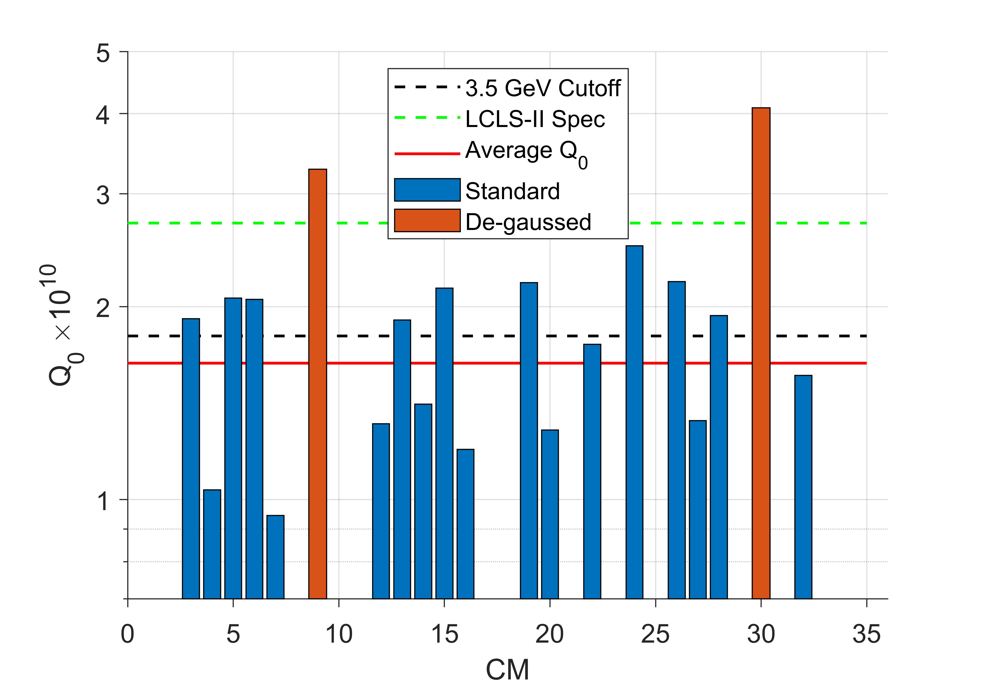
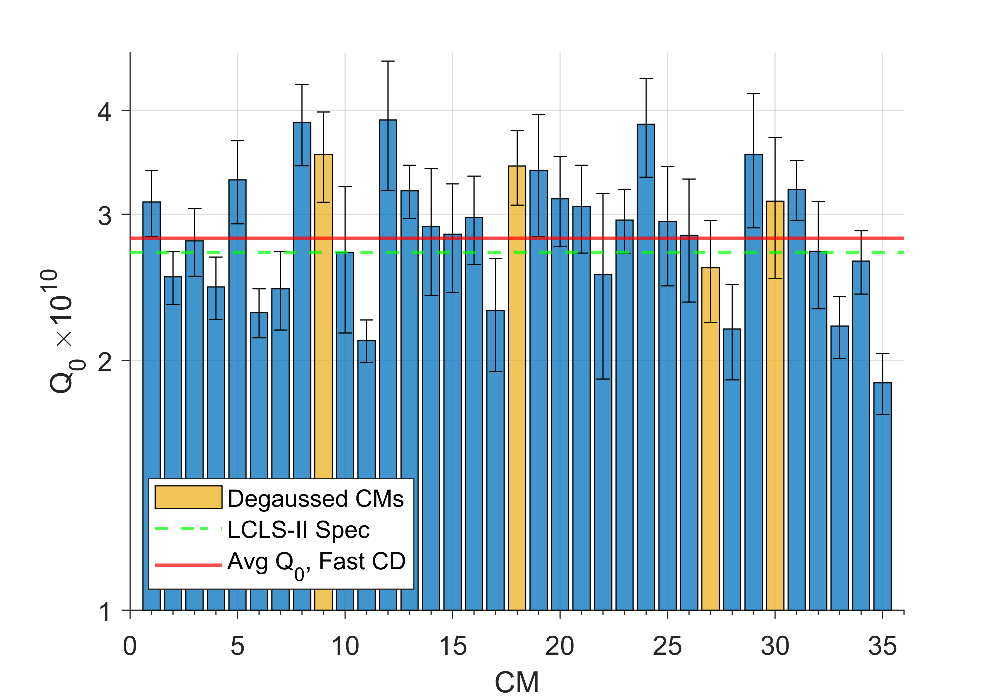
Fast Cool Down Results Part 2
Average CM Q₀ Before Fast Cool
Average CM Q₀ After Fast Cool
Fast cooldown improved average Q₀ from 1.6x10¹⁰ to 2.8x10¹⁰
The average Q₀ exceeds the spec of 2.7x10¹⁰

Slide 8
Conclusions
Cooled down the LCLS-II linac in ~5 days
Have demonstrated fast cooldown in the installed LCLS-II linac
We achieved high cooldown gradients during fast cooldowns
Similar temperature gradients to those achieved in test stands
Sufficient to achieve a high Q₀ of 2.8x10¹⁰, exceeding the spec of 2.7x10¹⁰
Can warmup and fast cool half of the linac in ~24 hours

