Slide 1
PIP-II Couplers: Lessons Learned
J. Helsper
TESLA Technology Collaboration Meeting
5-8 December 2023

Slide 2
Outline
Coupler Design Overview
High Voltage Bias
Ti-N Coating
CT Scanning
Cold Cathode Gauges

Slide 3
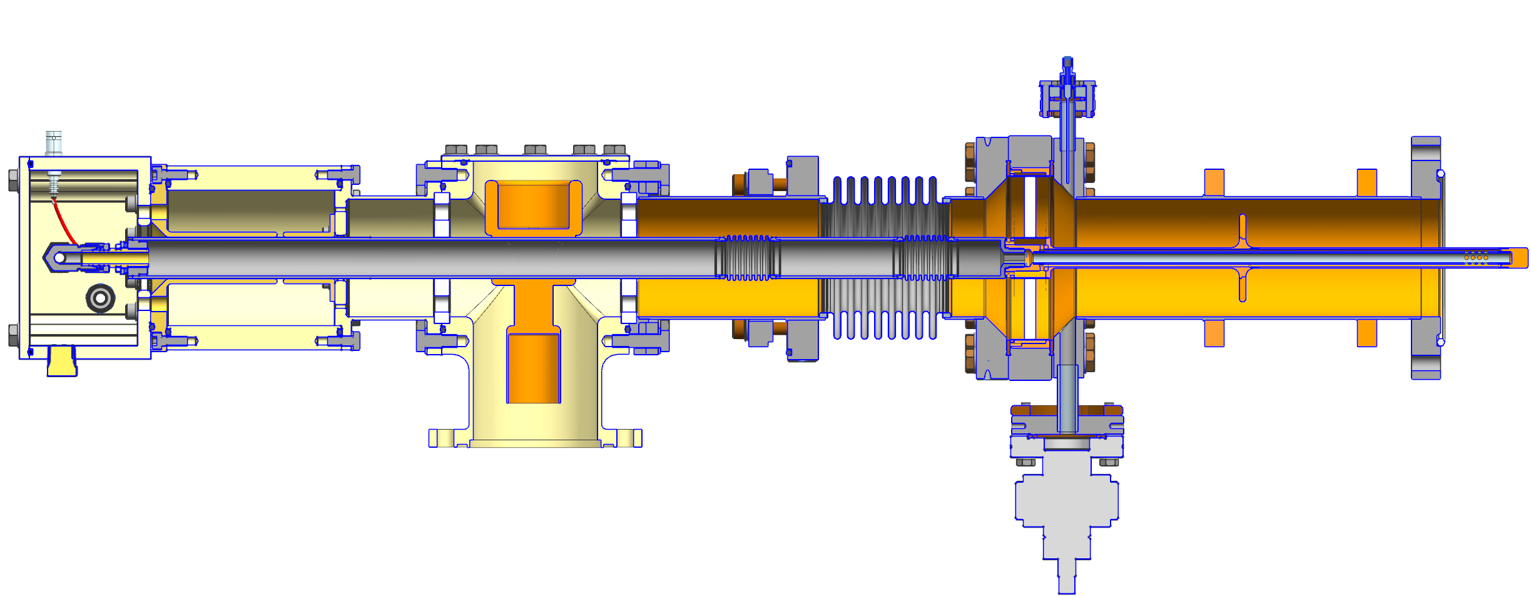
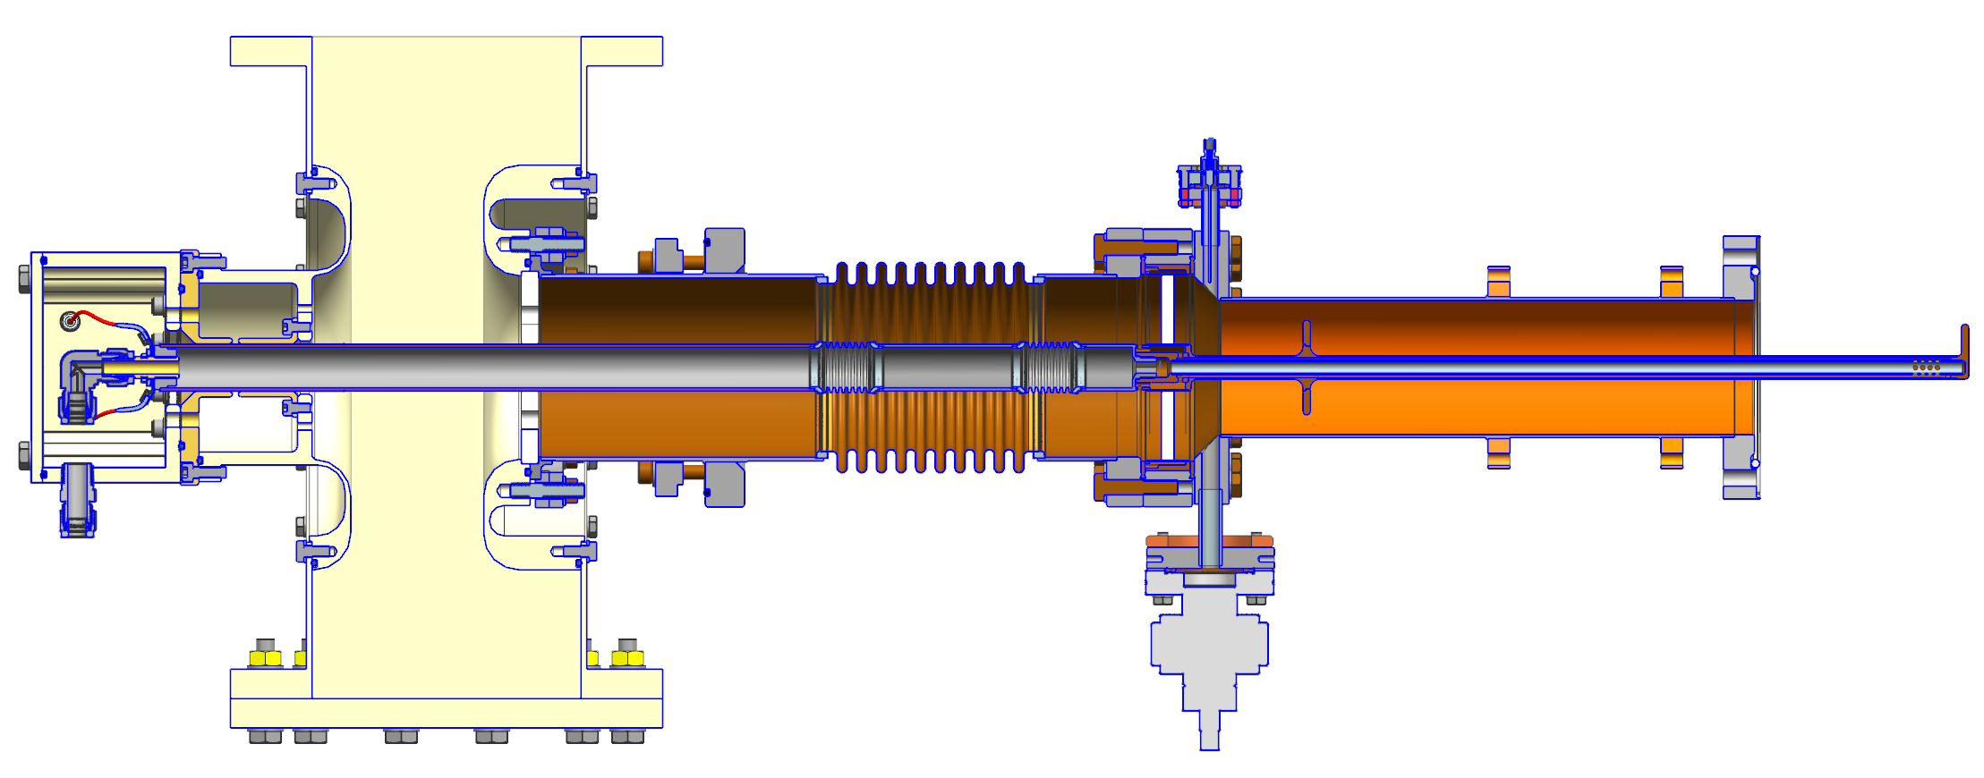
Design Overview (verbal description)
325 MHz
650 MHz

Slide 4
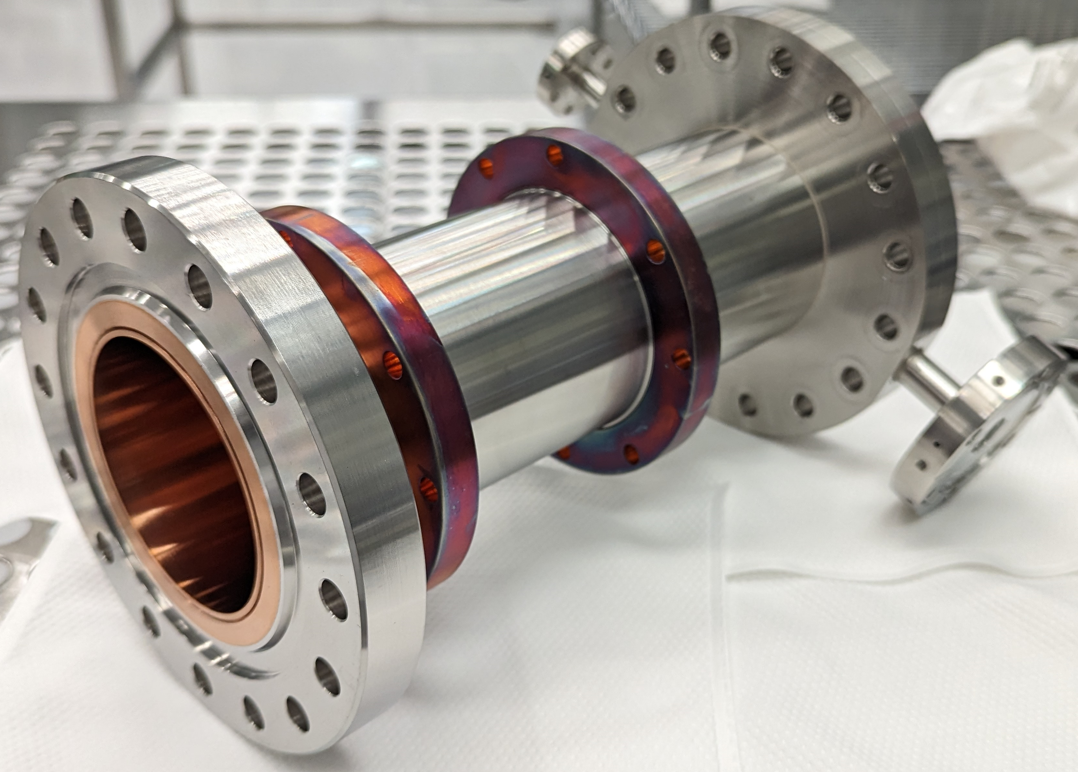
Couplers As-Built
650 MHz
325 MHz

Slide 5
High Voltage Bias

Slide 6
High Voltage Bias
High Voltage Bias (4.5 kV 650 MHz, 3.7 kV 325 MHz) is ALWAYS used
Warm RF testing + Cryomodule operation
Warm RF Testing
Simulations show the HV should be enough to suppress fully, but RF Conditioning is still needed for high power levels
650MHz conditioned to 50 kW CW, 325 MHz conditioned to 12 kW CW
No MP after conditioning
Cryomodule Operations
1 ms response time for interruption of HV Bias to RF power OFF
No MP detected during pHB650 CM Testing (38 kW CW)
Minimal if any RF conditioning was needed for couplers

Slide 7
Ti-N Coating

Slide 8
Ti-N Coating
325 MHz Results:
Ti-N Coating made no significant improvement for coupler conditioning or Multipacting
650 MHz Results:
Pending warm RF test of 2x Ti-N Couplers
Performed cold test on LB650 cavity up to 30 kW with HV Bias
Performed tests on losing HV Bias when operating at full power
No problems with stored energy in cavity creating Multipacting
Production Coupler Plan
Ti-N coating is not planned for use on PIP-II production couplers; only HV Bias
Subject to change if new results from 650 MHz tests; option open for coating

Slide 9
CT Scanning

Slide 10
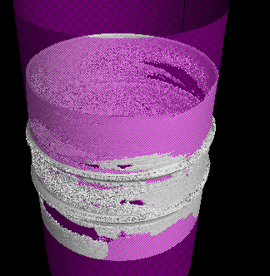
Computed Tomography Scanning
ppSSR2 Ceramic Window CT Scans
Only ceramic with brazed copper sleeves (can NOT scan w/ flange)
Inner Braze: 20 microns resolution. Outer Braze: 71 microns
Dark spots are thought to be braze voids – attempts to confirm this were inconclusive
Production Plan
Build a database with a record for each coupler
Not planning to use as disqualification measure as of now
Others: CT Scanning experience / comments on Ceramic Braze QC?
20 um
71 um

Slide 11
Cold Cathode Gauges

Slide 12
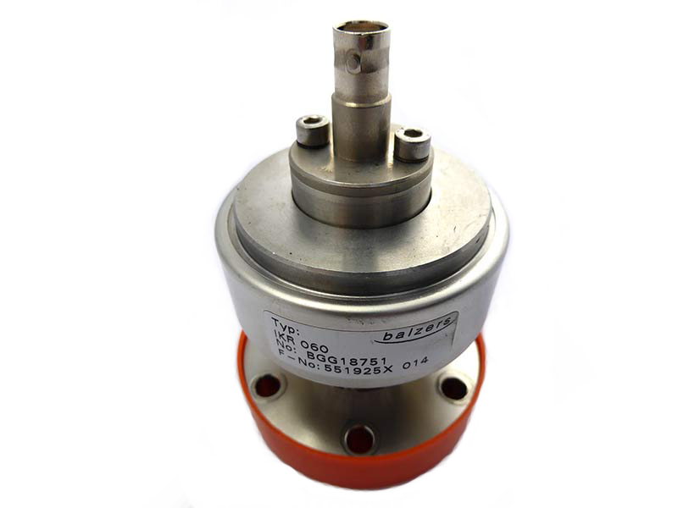
Cold Cathode Gauges
Every coupler has a Pfeiffer cold cathode gauge
Useful for Warm RF testing (vacuum spike – multipactor)
Thought to be useful for leak detection during Cryomodule operation
With CM string at in 1e-10 – 1e-9 range, after a few months, gauges went ‘offline’ and can not be woken up
Operating in CM insulating vacuum
Thoughts as to why? Current hypothesis is the Penning electron field ‘sputtered out’
Anyone with similar experience? (failure / operating long term in e-10 / in insulating vac)
No activity noted during pHB650 testing
Production Plans
Use of CCG in production string is under discussion

Slide 13
Final Slide
These topics were presented:
Coupler Design Overview
High Voltage Bias
Ti-N Coating
CT Scanning
Cold Cathode Gauges

Slide 14
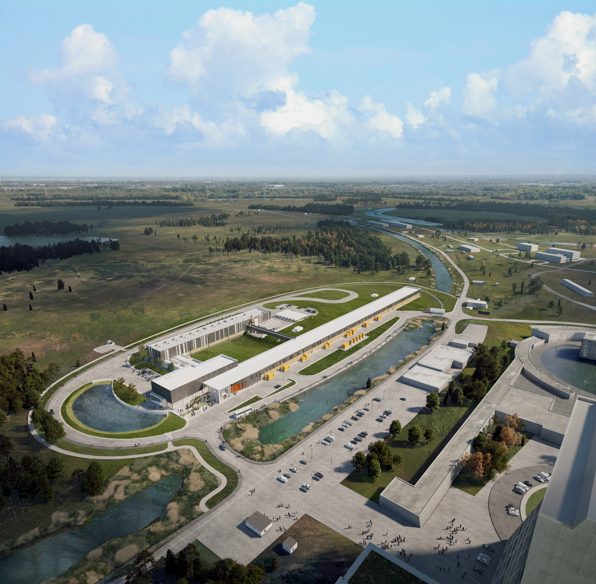
THE FUTURE OF FERMILAB
Follow us:
http://pip2.fnal.gov/
/showcase/pip-ii/

Slide 15
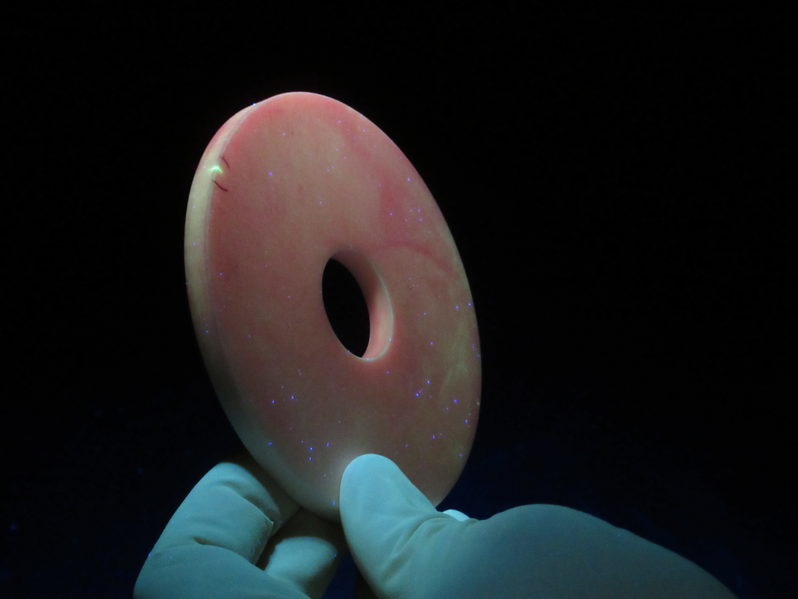
UV Dye Penetrant Checked Ceramic Window (thanks Sandry Wallon!)

Slide 16
Discussion (speaker will take notes)
Ti-N Coating
Notes
High Voltage Bias
Notes
CT Scanning
Notes
Cold Cathode Gauges
Notes

