Slide 1
Development of 3.9 GHz/ 1.3 GHz tuner
for S³FEL project & DALS project
Mukun Wu-3.9GHz Tuner
Min Lv-1.3GHz Tuner
Presented by Linhong Zha
Dec 7, 2023, TTC Meeting

Slide 2
Outline
Background
Development of 3.9GHz Tuner for S³FEL project & DALS project
Development of 1.3GHz Tuner for S³FEL project & DALS project
Summary

Slide 3
Background

Slide 4
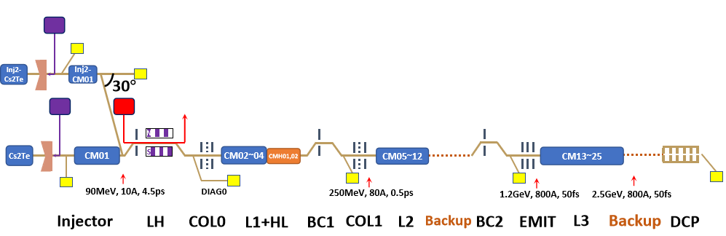
Background: Project Needs for Tuners
Shenzhen Superconducting Soft x-ray Free Electron Laser(S³FEL) project
&DaLian Advanced Light Source(DALS) project
need 320 1.3GHz Tuners and 40 3.9GHz Tuners in total.
 | SMTF(S³FEL)[1] | PATF(S³FEL)[2] | S³FEL | DALS | Total
1.3 GHz CM | 1 | 3 | 26 | 10 | 40
1.3 GHz Tuner | 8 | 24 | 208 | 80 | 320
3.9 GHz CM | 1 | 2*[3] | 2 | 2*[3] | 5
3.9 GHz Tuner | 8 | 16*[3] | 16 | 16*[3] | 40
[1] SMTF: Superconducting Cryogenic Test Facility.
[2] PATF: Prototype Accelerator Test Facility.
[3] PATF of S³FEL Project shares 2 3.9GHz CMs with DALS project.
S³FEL Layout
DALS Layout

Slide 5
Background: Technical specifications
1.3GHz Tuner
VS
3.9GHz Tuner
Narrow cavity bandwidth requires higher tuning resolution
Smaller volume and higher stiffness requires stricter mechanical design
Key Parameters for 1.3&3.9GHz Tuner
Item | 1.3GHz Tuner | 3.9GHz Tuner
Cavity bandwidth(Hz) | 30 | 170
Cavity Tuning Sensitivity(kHz/mm) | 340 | 2300
Cavity Stiffness(kN/mm) | 3 | 5.4
Diameter of helium tank(mm) | 240 | 140
Slow Tuner frequency range(kHz) | 450 | 750
Slow Tuner dimensional range(μm) | 1300 | 300
Slow Tuner sensitivity(Hz/step) | 1 | 10
Slow Tuner stiffness(kN/mm) | 30 | 40
Fast Tuner frequency range(kHz) | 1 | 1
Fast Tuner tuning resolution(Hz) | 1 | 1

Slide 6
3.9GHz Blade Tuner

Slide 7
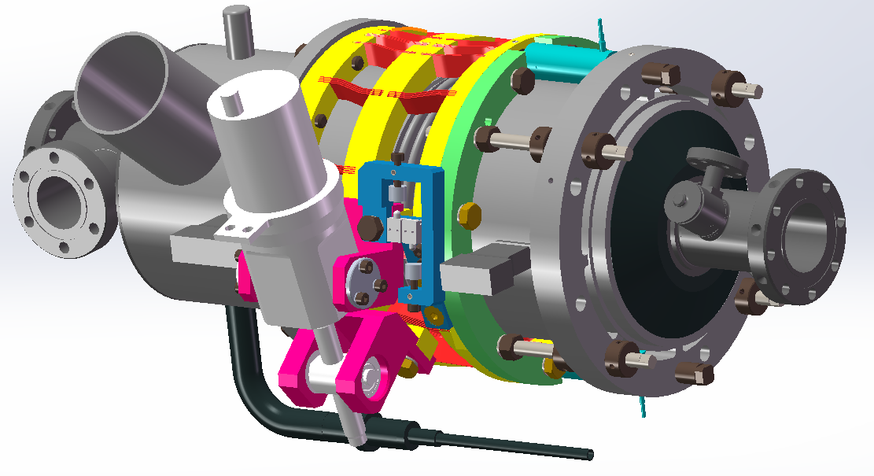
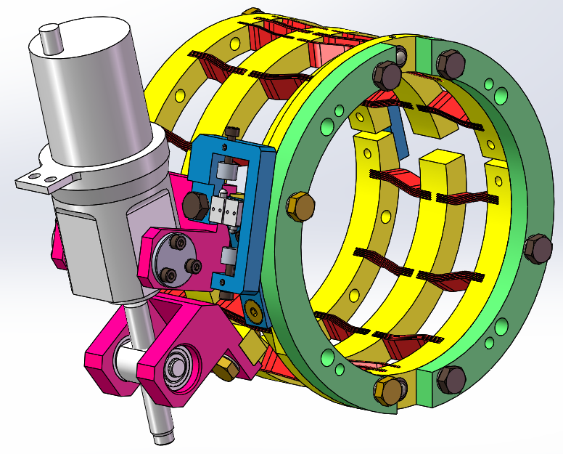
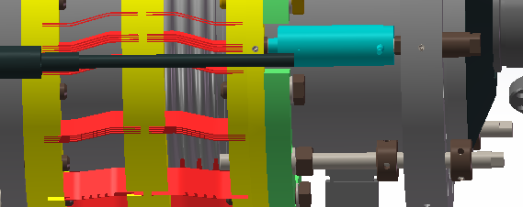
3.9GHz Blade Tuner: Basic Design
Based on Eu-XFEL/LCLS-II Blade Tuner design
Coaxial slow tuner
Fast tuner: Two PI Piezo
Stepper motor and Piezo type are same as that of LCLS-II 1.3GHz Tuner
Helium tank
Slow Tuner
Piezo
Stepper motor
Limit switch
Welding Ring
S3FEL 3.9GHz blade tuner design
∆X<0.3mm
Reference: Y. Pischalnikov, E. Borissov, J. C. Yun, DESIGN AND TEST OF THE PROTOTYPE TUNER FOR 3.9 GHz SRF CAVITY FOR LCLS II PROJECT, 2016

Slide 8
3.9GHz Blade Tuner: Basic Design
Modifications have been completed according to projects needs:
Blades: Increase Blades number, thickness, and change blades distribution
limit switches: Adjustments on limit switches mechanical structure.
Production: R&D Experiments on blades processing methods
LCLS-II
S³FEL& DALS
Reference: Y. Pischalnikov, 3.9GHz SRF Cavity Tuner,LCLS II 3.9 GHz Cryomodule Final Design Review, 2017 January 30.

Slide 9
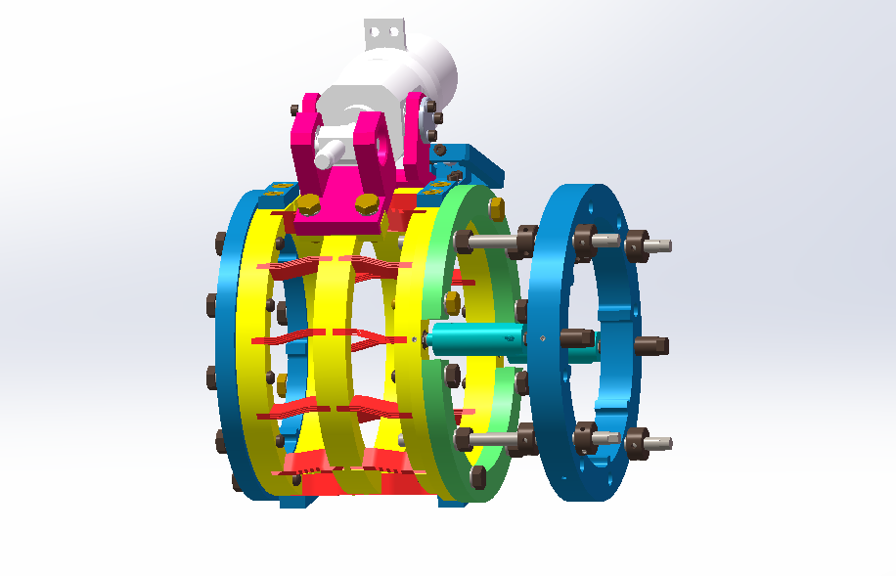
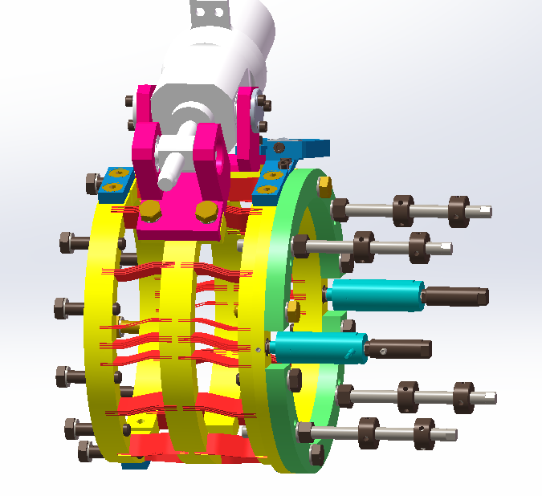
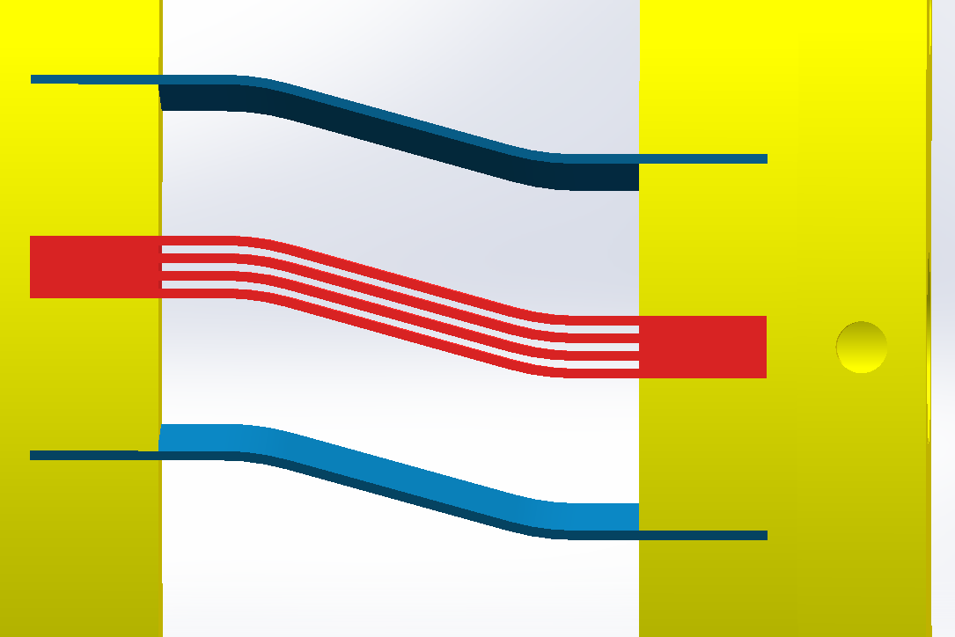
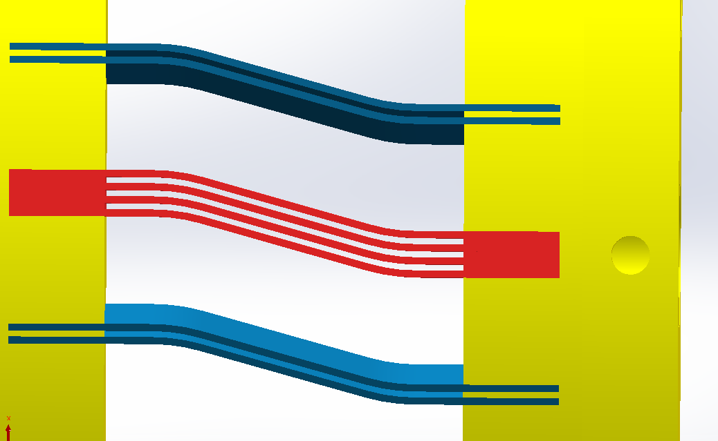
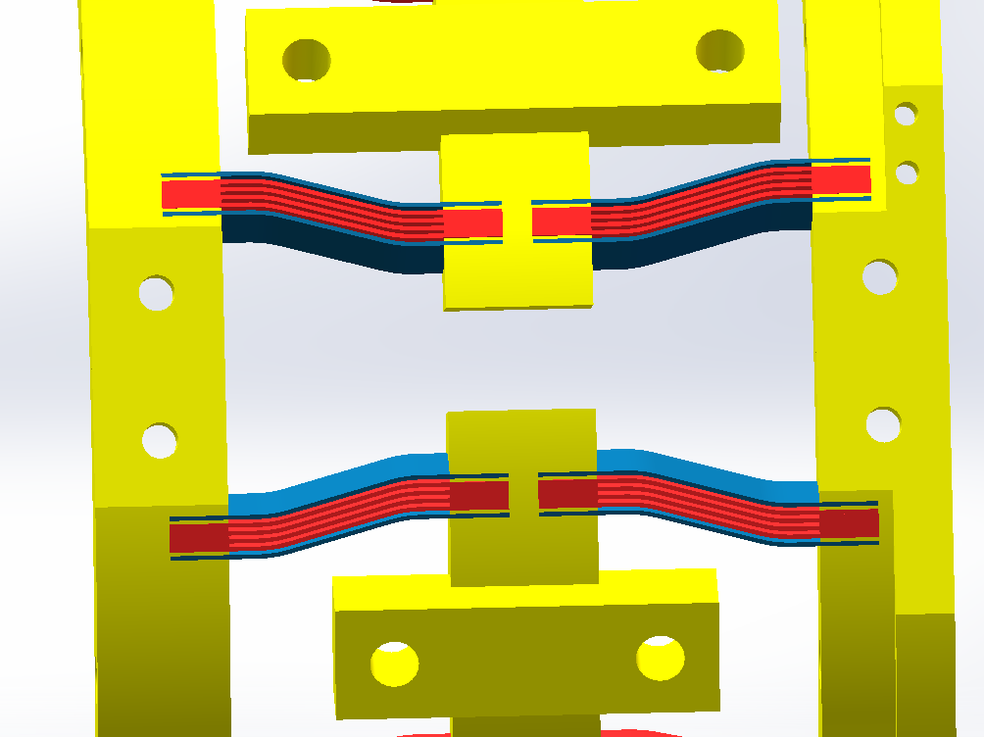
3.9GHz Blade Tuner: Blades Optimization
Blades: Increase Blades number, thickness, and change blades distribution
2sides×12sets×4blades per set=96 blades,
Uniform distribution
Blade thickness：0.5mm
120 blades,
Not uniform distribution
Blade thickness：0.6mm
Based on LCLS-II
S3FEL
Preliminary
Optimization
Extra 2 sets with a blade near Piezo
Extra 2 sets with 2 blades near Piezo
Increase 2 blades each set near Stepmotor
(a)
(b)
(c)
Notes:
然后是叶片优化过程。 初步设计有24组叶片组，每组包括4片叶片。 叶片组在圆周上均匀分布。首先，在Pizeo的上方和下方分别添加一组叶片组，以增加该点的刚度。 方案a和方案b之间的区别是每组1或2个叶片。 其次，靠近步进电机的每组叶片数量从 4 个增加到 6 个。图中蓝色的是新添加的叶片。 结果，叶片总数从96个增加到120个，并且叶片分布也不均匀。 此外，叶片的厚度也增加，以增加调谐器的刚度。

Slide 10
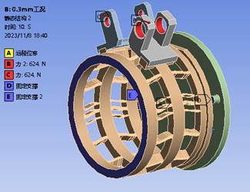
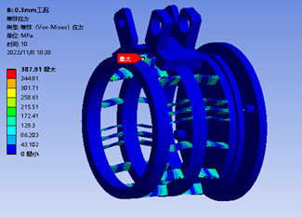
3.9GHz Blade Tuner: Blades Optimization
Optimization principle:
Ensure tuning range meets technical specifications.
higher slow tuner stiffness: to protect cavity from microphonic effect.
smaller dicrepency of fast tuner stroke: to make fast tuner stroke more uniform coaxially.
smaller maximum tuner stress: to enlarge tuning range.
 |  | S³FEL& DALS |  |  |  |  | LCLS-II
 | Comment | 4 blades(0.6mm of thickness ) per set |  |  |  |  | 4,0.5mm
 |  | Base | Base+(a) | Base +(b) | Base +(a)+(c) | Base+(b)+(c) | Base | Base +(a)
Slow tuner Stiffness (kN/mm) | Generrally 40KN/mm | 39.745 | 45.175 | 51.929 | 46.942 | 52.971 | 28.757 | 33.158
Dicrepency of fast tuner stroke(mm） （stroke near the piezo VS average） | smaller，better | 0.00134 | 0.00109 | 0.001 | 0.0011 | 0.00098 | 0.00149 | 0.00127
Axial force of Stepper motor(N) | Max 1300N | 542 | 586 | 596 | 600 | 624 | 417 | 429
MAX stress(MPa) | Max 834 | 422 | 407 | 412 | 395 | 388 | 375 | 367
Tuner frequency range（kHz） | 750KHz | 1362 | 1412 | 1384 | 1416 | 1435 | 1555 | 1594
Boundary Condition
Max Stress
Notes:
在确保调谐范围符合规格的前提下，第一提高慢调音器刚度以保护腔体免受颤噪效应的影响；第二减小快调谐圆周行程差，使快调器的行程在同轴更加均匀；最后减小调谐器的最大应力
慢调谐刚度：越大越好，根据仿真结果，刚度大可以减小超导腔受到麦克风效应的影响，更加稳定
快调谐调谐行程差：Piezo附近的环受到的力更大，所以形变量会比平均要大。单独增加piezo旁边的叶片数量，可以减小行程差，让整个环上的快调谐行程更加均匀
电机受的轴向力：小一些更好，但是只要不超过最大值就可以
最大应力：减小调谐器最大应力可以增大调谐范围
所有的仿真都是常温下，因为低温的材料随温度变化的物性参数缺失，我门有的数据大概是有三四个温度数据，然后在仿真软件里它自动拟合的，所以计算不准确

Slide 11
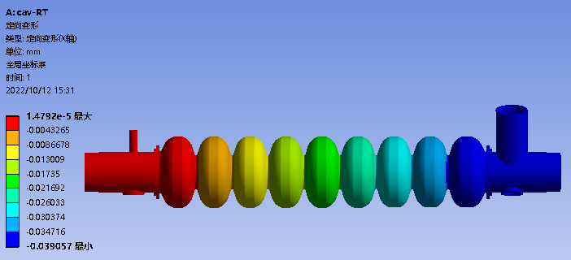
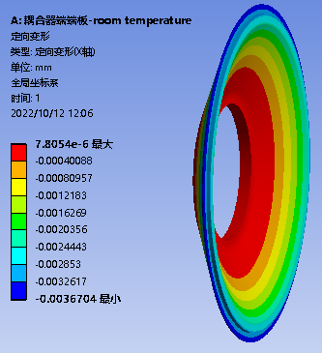
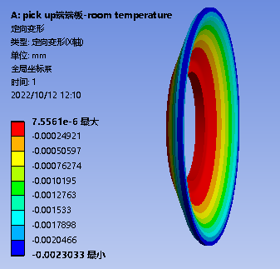
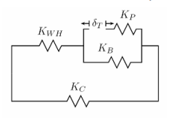
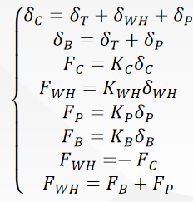
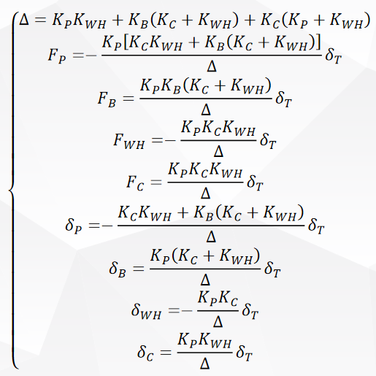
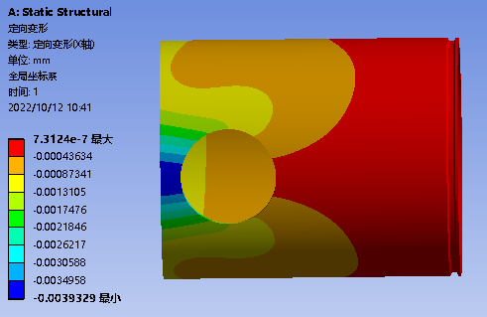
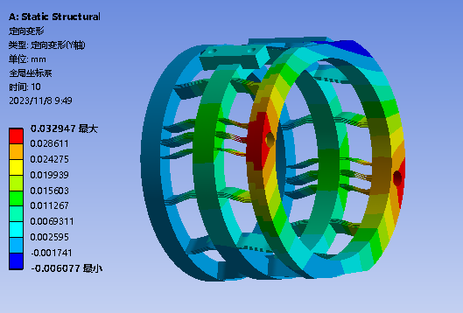
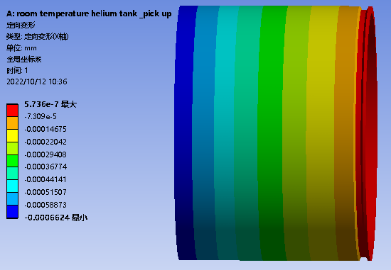
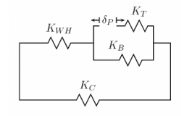
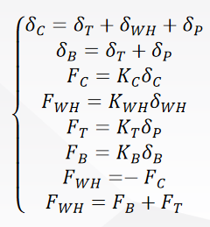
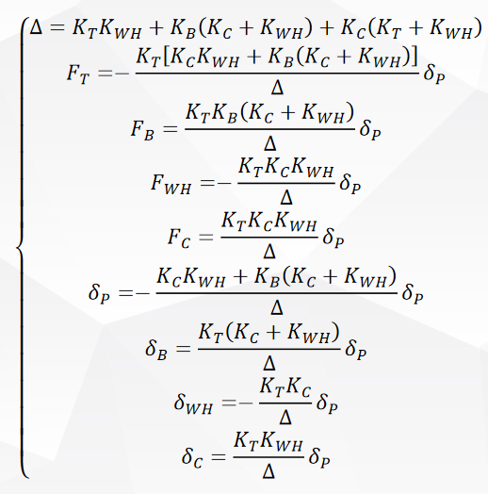
3.9GHz Blade Tuner: Blades Optimization
Fast Tuner Tuning efficiency: 75.22%→77.30%
Slow Tuner Tuning efficiency: 82.3% →82.3%
Slow tuner Tuning efficiency caculation
Fast tuner Tuning efficiencycaculation
Part | Preliminary |  | Optimization
 | Force （N） | Dimentional changes（ μm） | Force （N） | Dimentional changes（ μm）
helium tank | -4.4460 | -0.1532 | -4.4460 | -0.1532
tuner | 4.6882 | 1 | 4.6882 | 1
cavity | 4.4460 | 0.8233 | 4.4460 | 0.8233
piezo | -4.6882 | -0.0234 | -4.6882 | -0.0234
bellows | 0.2422 | 0.9766 | 0.2422 | 0.9766
Part | Preliminary |  | Optimization
 | Force （N） | Dimentional changes（ μm） | Force （N） | Dimentional changes（ μm）
helium tank | -4.0621 | -0.1400 | -4.1744 | -0.1439
tuner | -4.2834 | -0.1078 | -4.4018 | -0.0831
cavity | 4.0621 | 0.7522 | 4.1744 | 0.7730
piezo | 4.2834 | 1 | 4.4018 | 1
bellows | 0.2213 | 0.8922 | 0.2274 | 0.9169
Slow tuner caculation
Stiffness simulation
Fast tuner caculation
Notes:
慢调谐效率不变是因为取决于氦槽或其他结构，不取决于调谐器本身

Slide 12
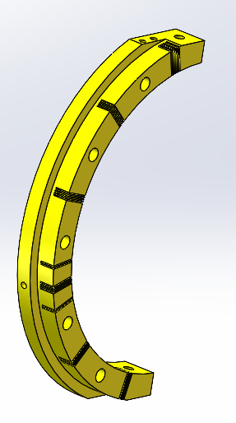
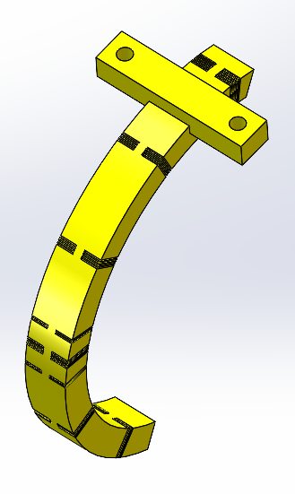
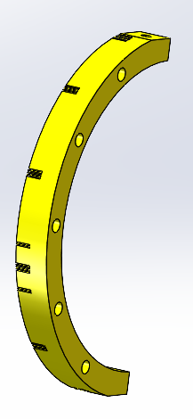
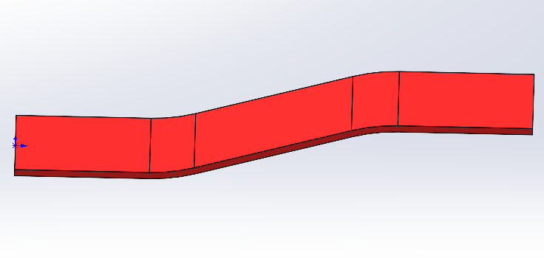
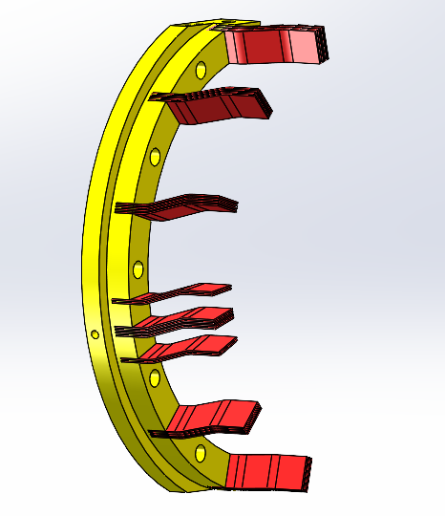
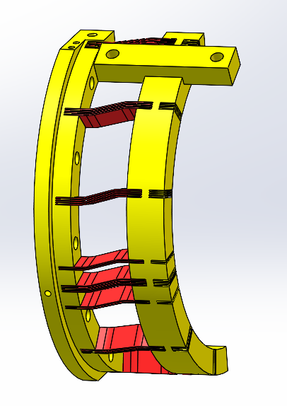
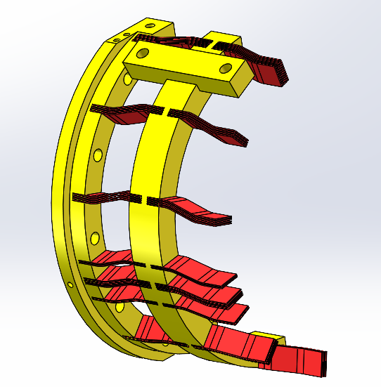
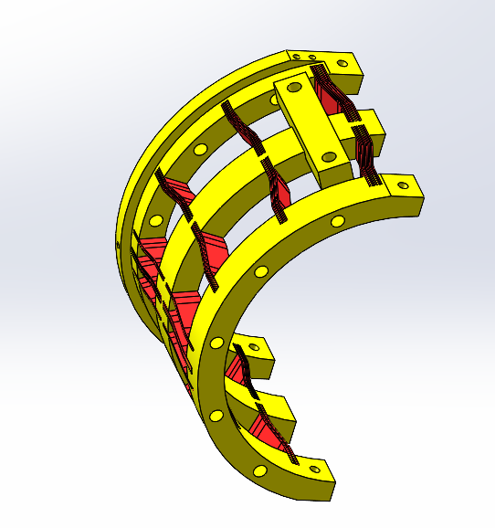
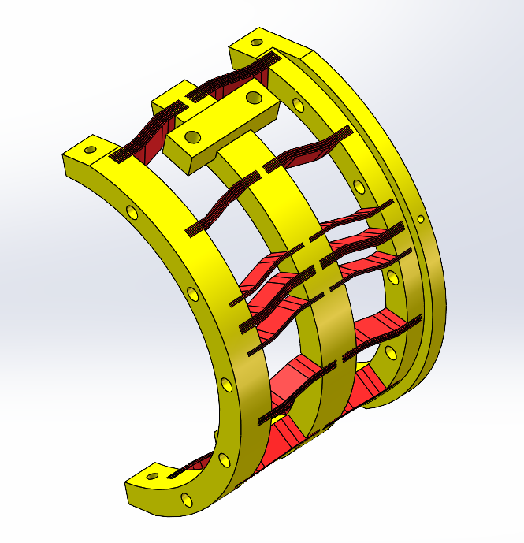
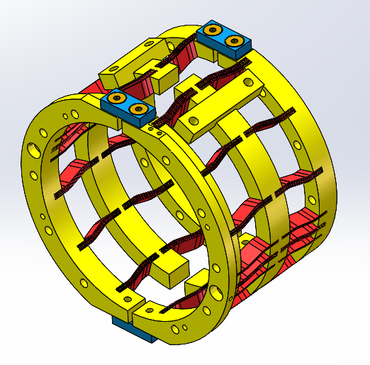
3.9GHz Blade Tuner: Production
Blades joining process——EBW
Machining
Insert blades
Fix blades on semiring using tooling
EBW
Assembly,
maching again

Slide 13
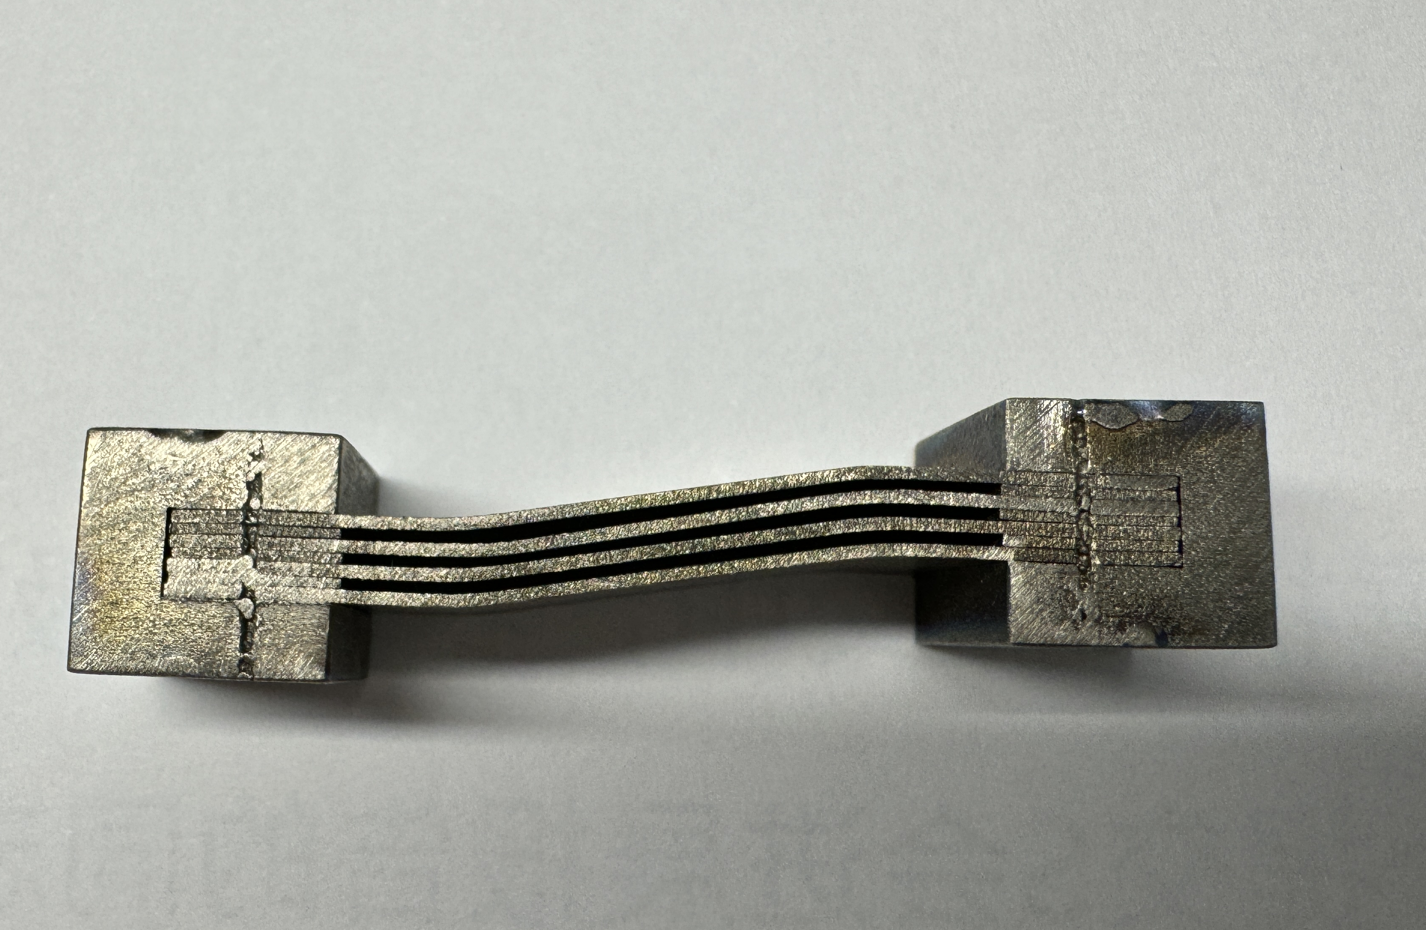
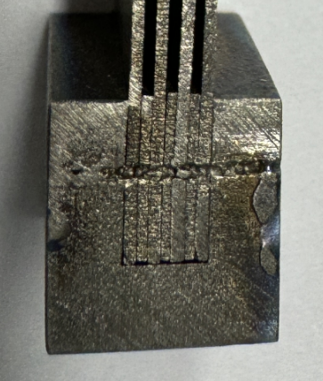
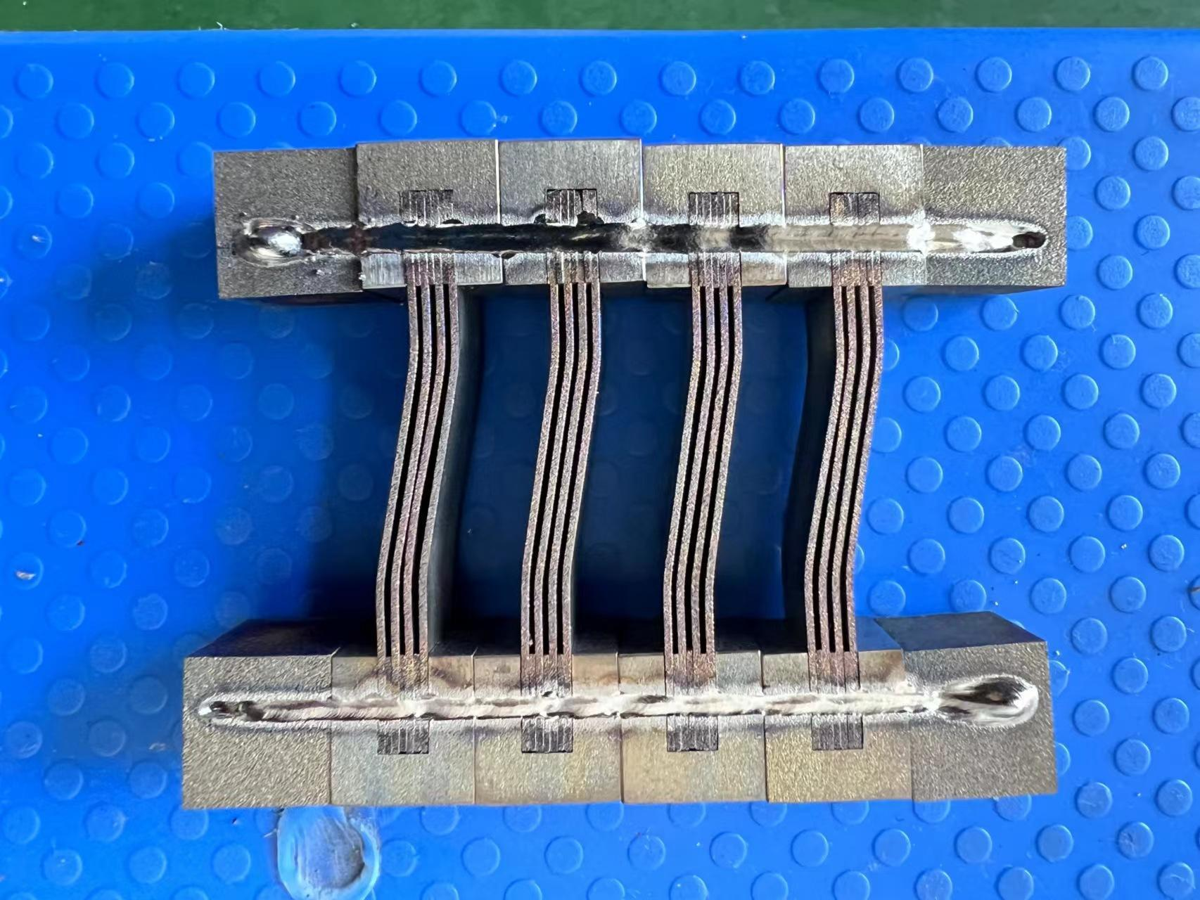
3.9GHz Blade Tuner: Production
Blades joining experimental process:
Blades joining first, insert groove, brazing→Blades insertion first, EBW
① Blades joining first, insert groove, then brazing
② Blades joining first, insert groove, then EBW
It is difficult to control the gasket from slipping
③ Maching grooves for each blade, Insert blades, then EBW

Slide 14
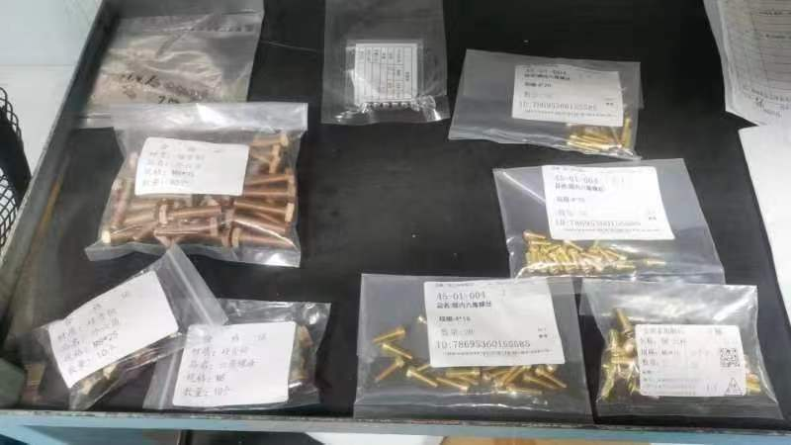
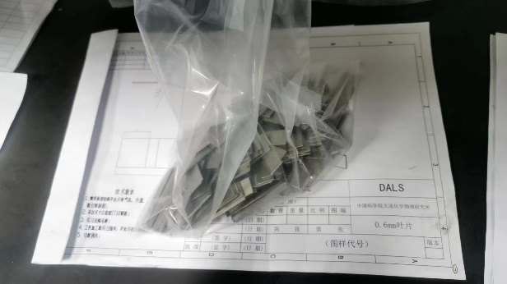
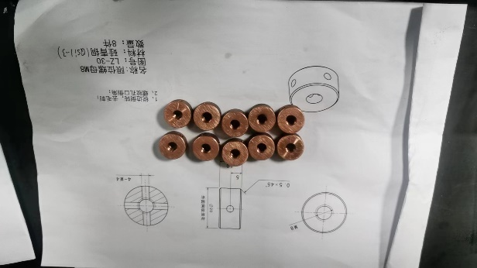
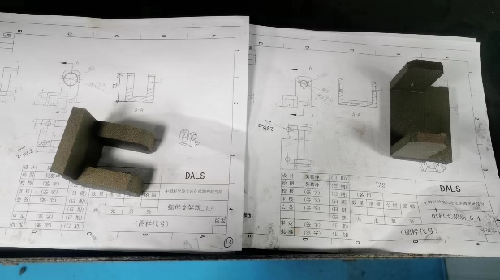
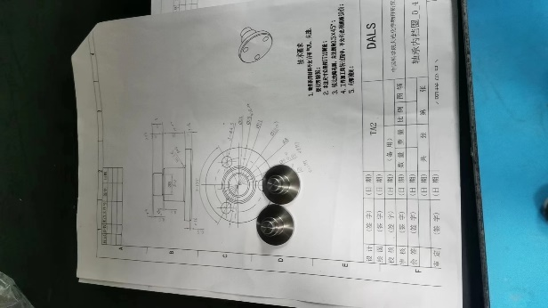
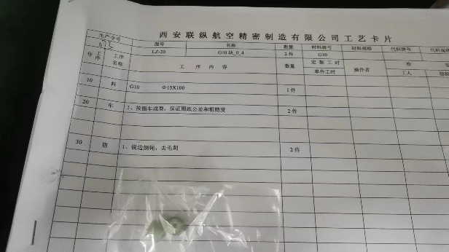
3.9GHz Blade Tuner: Production
1 prototype is under machining process.
Notes:
目前仅在零件加工阶段

Slide 15
1.3GHz Lever-type Tuner

Slide 16
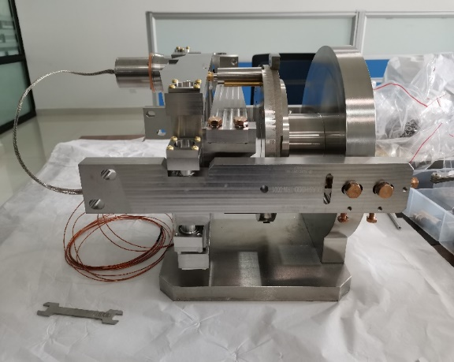
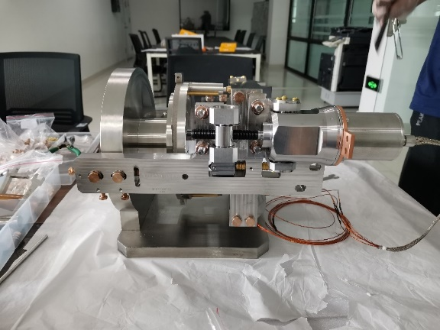
1.3GHz lever-type Tuner: Design
Based on LCLS-II/SHINE design
Link plate 1
2 Piezos
Step motor
Link plate 3
Limit Switch
Right horizontal arm
Left horizontal arm
S3FEL&DALS 1.3GHz Tuner Design
1.3GHz Prototype of DALS project
Tuner ration 1/20
10 sets of 1.3GHz tuners have completed trial assembly at factory;
Reference: LCLS-II Final Design Report, September 21, 2015
SRF Cavity Tuner (for pCM), Yuriy Pischalnikov, Final Design Review for pCM Tuner, April 15, 2015
Notes:
传动比 腔走1mm，电机需要走20mm

Slide 17
1.3GHz Tuner: Current State
Tested at Single cavity CM HTS at CSNS(Cavity at 2K)
477.7kHz
0.28Hz/Step
50000steps/round(1mm), 0.28Hz/Step=14kHz/mm(Stepper Motor stroke)
Notes:
过零点是因为两个方向，原点1.3GHz附件找一个状态定义为原点，腔处于压缩状态。电机松开，腔腔频变大；电机压缩，腔频变小，但是只测试到压缩50kHz

Slide 18
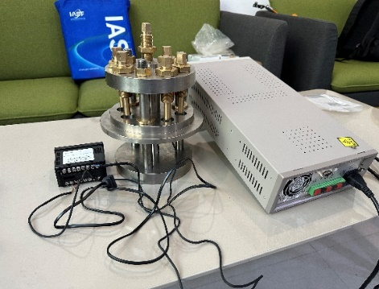
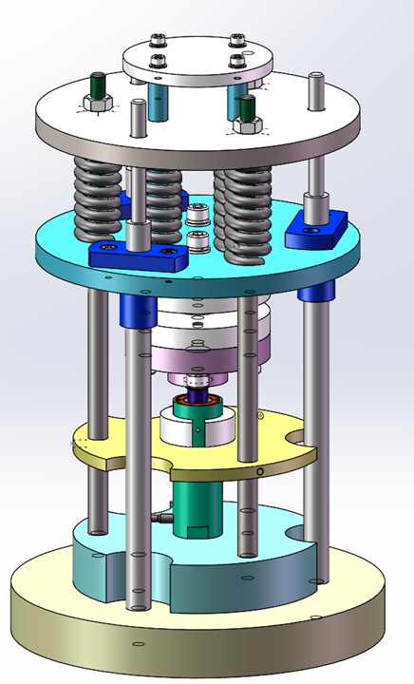
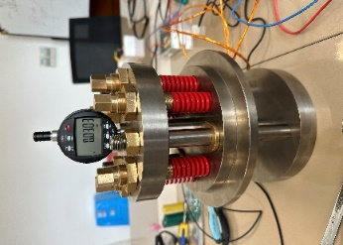
1.3GHz Tuner: Current State
PI Piezo performance was tested at room temperature and 2k at Single cavity CM HTS.
Position gauge
Mechanical system
signal source
Pressure gauge
Verification of Max.length 39.2mm of Pizeo at RT with load of 3334N
Tuning range achieved 2.3kHz
Good repeatability
Notes:
低温大约是常温行程范围的1/10，所以低温下4mm，满足设计指标
降温后Piezo调谐范围也达标

Slide 19
Summary

Slide 20
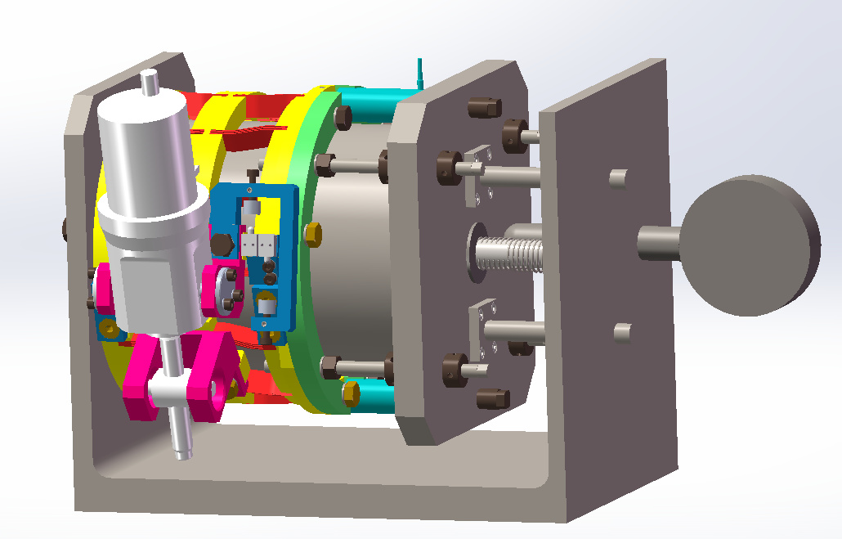
Summary
3.9GHz Tuner
Mechanical design and experimental processing of 3.9GHz Tuner completed. It has higher stiffness and smaller stress besides meeting the tuner specifications, which can better protect cavity.
1 set of 3.9GHz Blade Tuner is being processed, and Slow tuner testing platfom for 3.9GHz is under development.Next step is offline testing（Slow Tuner）.
1.3GHz Tuner
1.3GHz Tuner use mature LCLS-II/SHINE design, and testing results show that tuner parameters well exceed technical requirements specifications.
Room temprature and cryogenic offline testing platform for 1.3GHz Tuner will be established soon.

