Slide 1
1. Design and fabrication of a twin-FPCs 1.3GHz 9-cell cavity
2. Third Harmonic SRF Cryomodule for the SSRF Storage Ring
TESLA Technology Collaboration Meeting, 2023, Fermilab
Hongtao Hou, SARI-CAS
Zhenyu Ma, SARI-CAS
On behalf of SRF group
7 December, 2023
houht@sari.ac.cn

Slide 2
Design and fabrication of a twin-FPCs 1.3GHz 9-cell cavity
SHINE

Slide 3
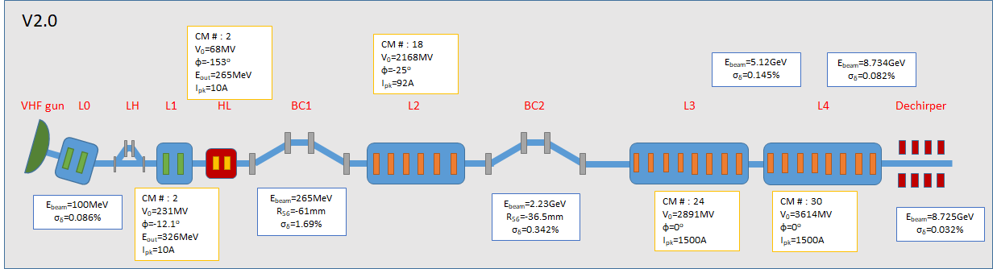
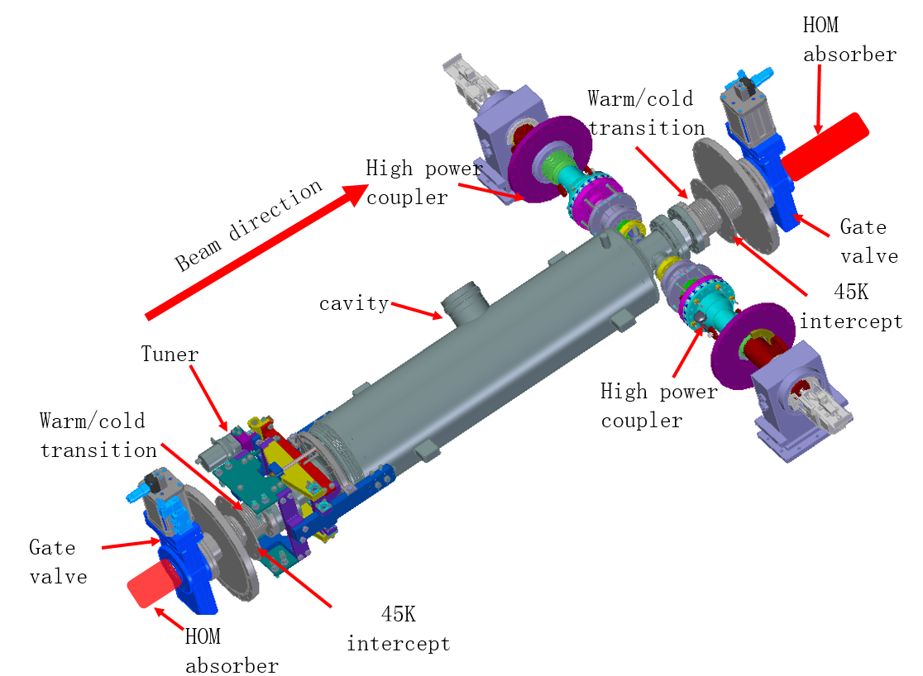
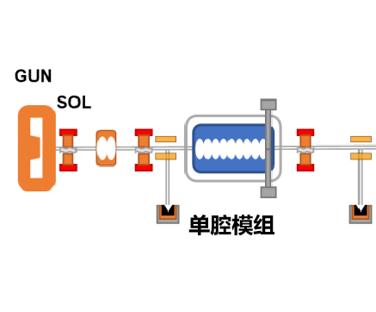
Layout of SHINE SRF Accelerator
3
1 GUN 2 Solenoid 3 Buncher 4 Bend 5 cavity with twin FPC 6 Dump
4
4
Reduce RF kick
Suppression the influence on Emittance
1
2
3
2
5
2
6
6

Slide 4
Influence of TESLA type cavity
Beam
Asymmetric increase beam emittance
Perturbation from upstream HOM coupler
RF kick from FPC
Simulation shows emittance will increase from 0.25 mm mrad to 0.30 mm mrad (+24%), if using standard TESLA cavity
Cavity with twin FPCs
Axial symmetry cavity；
Enlarged beam pipe at downstream for HOM propagation
Eliminate HOM couplers
Twin FPC located downstream

Slide 5
Worldwide cavities with Twin-FPC
Cornell ERL injector
KEK cERL injector
Triumph e-linac

Slide 6
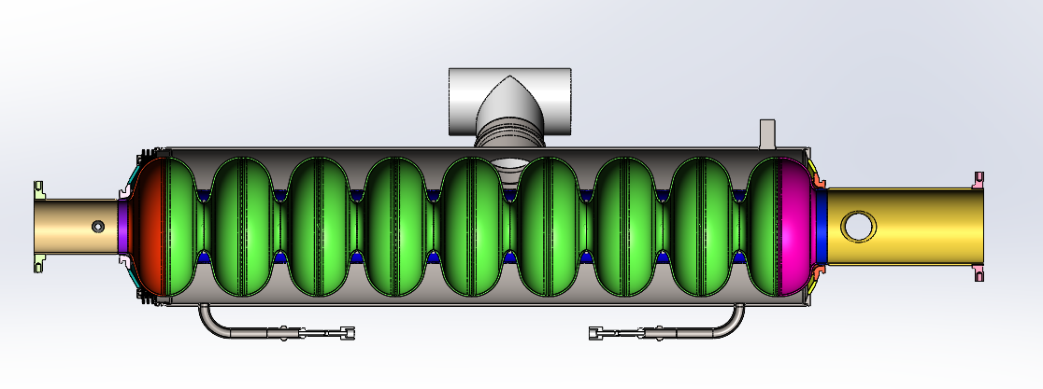
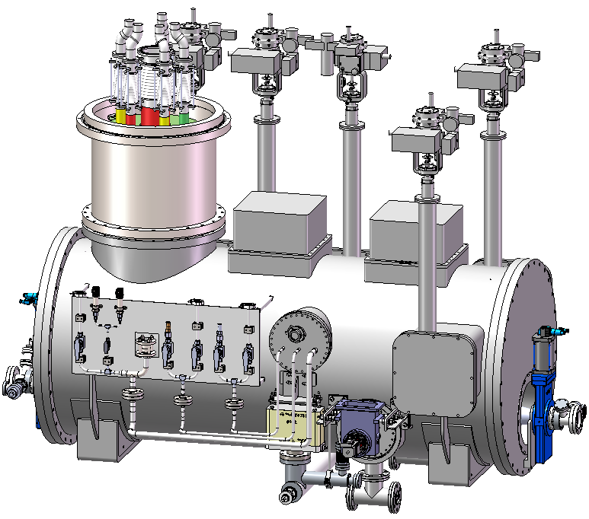
Design of the cavity
Axial symmetry cavity；
Enlarged beam pipe at downstream for HOM propagation
Eliminate HOM couplers
Twin FPC located downstream
Using CST、Mutipac、Ansys
Beam pipe HOM absorber

Slide 7
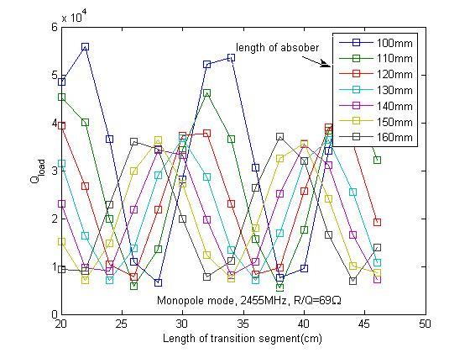
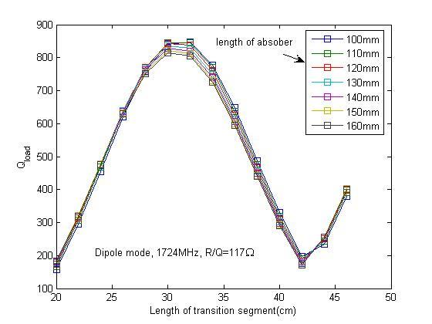
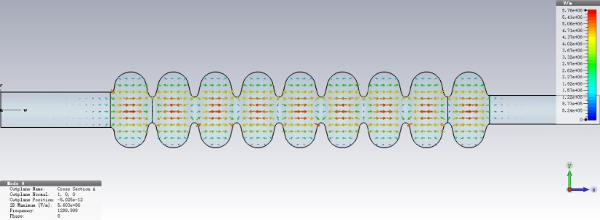
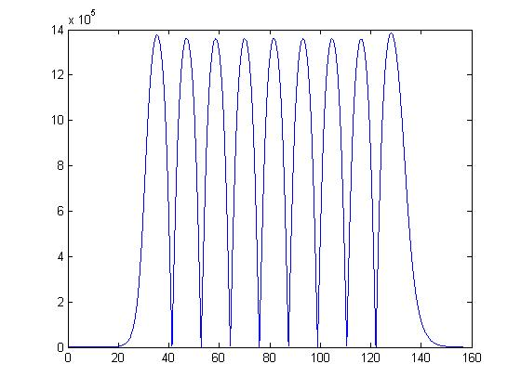
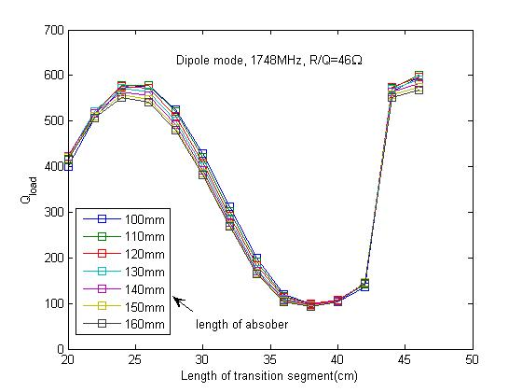
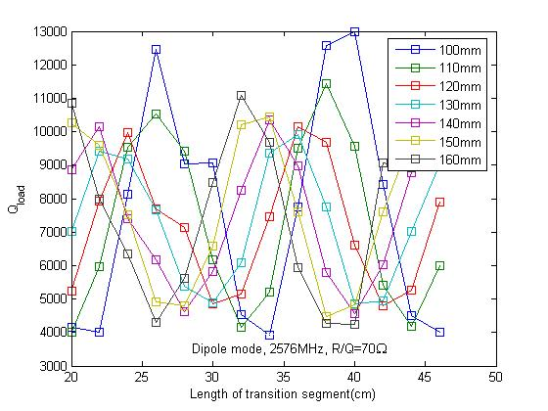
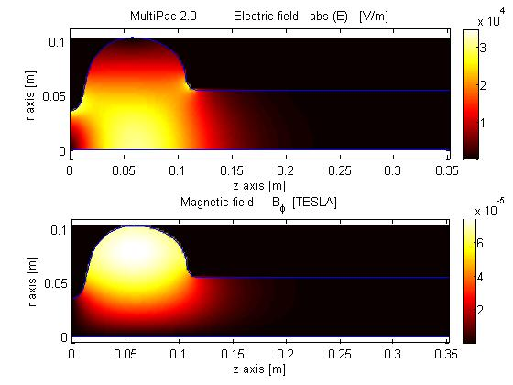
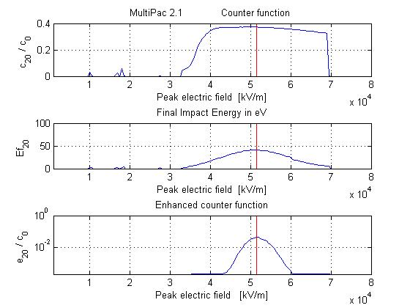
Simulation Results
Epeak/Eacc | Bpeak/Eacc （mT/(MV/m)） | R/Q （Ω） | G （Ω） | f（MHz） | flatness
2.0 | 4.2 | 983.4 | 273.6 | 1300.0001 | 98.3%
Report from Yan Wang, et.al, SARI-CAS
Ql of monopole and dipole modes with different HOM absorber locations

Slide 8
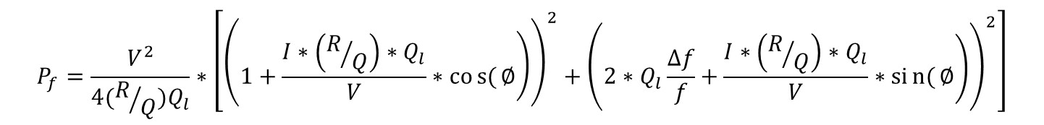
Power requirement
E_{acc}=12MV/m、Q₀=1.5×10¹⁰，Q_{e}=3.53×10⁷，assuming frequency detuning by microphonics δf=10 Hz，with 15% power loss
Ib/mA | Pf/kW | Pb/kW | Pr/kW | Pf/KW（single FPC）
0 | 1.66 | 0 | 1.66 | 0.83
0.05 | 2.05 | 0.62 | 1.43 | 1.025
0.1 | 2.48 | 1.25 | 1.23 | 1.24
0.15 | 2.96 | 1.87 | 1.09 | 1.48
0.2 | 3.5 | 2.49 | 1.01 | 1.75
0.25 | 4.08 | 3.11 | 0.97 | 2.04
0.3 | 4.71 | 3.74 | 0.97 | 2.355

Slide 9
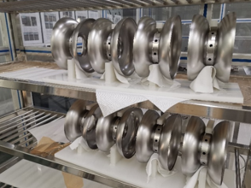
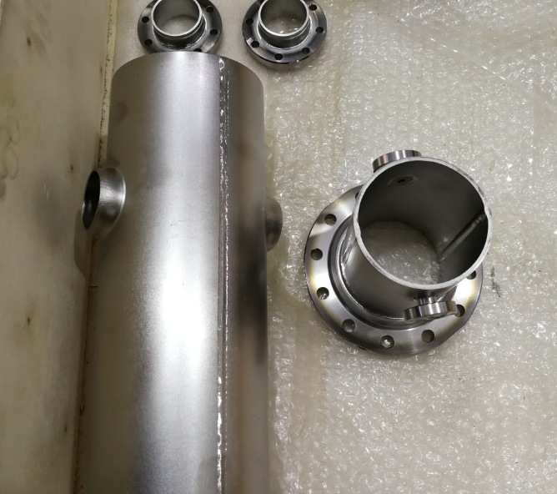
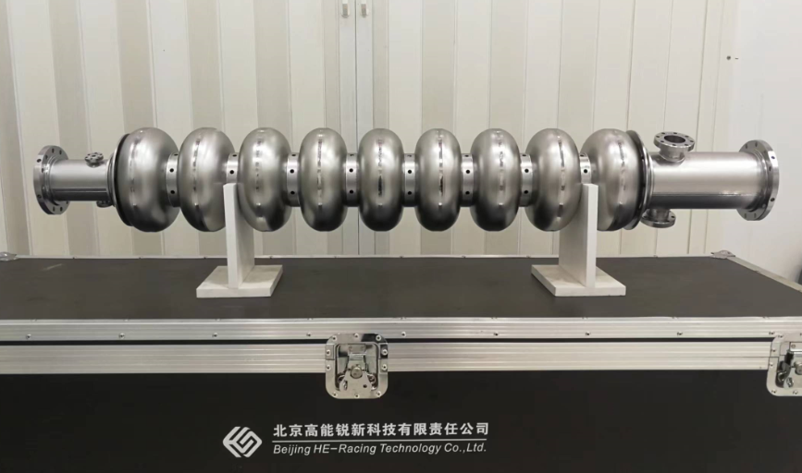
Fabrication
Specification
Frequency：1300.2+/- 0.1 MHz @ 2.0 K， field flatness ≥ 90%（dressed cavity）
Q0> 1.5 e10 @ Eacc=12 MV/m，Eacc_max ≥ 19MV/m
Low QL of HOM modes with high r/Q： QL < 1e6
straightness ≤0.4 mm，length ≤+/- 3.0 mm，shape accuracy ≤+/- 0.5 mm
Leakrate ≤ 1e-10 mbar l/s
Pressure test of dressed cavity: 0.23 MPa
High purity Nb material
Deep drawing
Electron beam welding
BCP treatment
Helium vessel welding
Vertical test

Slide 10
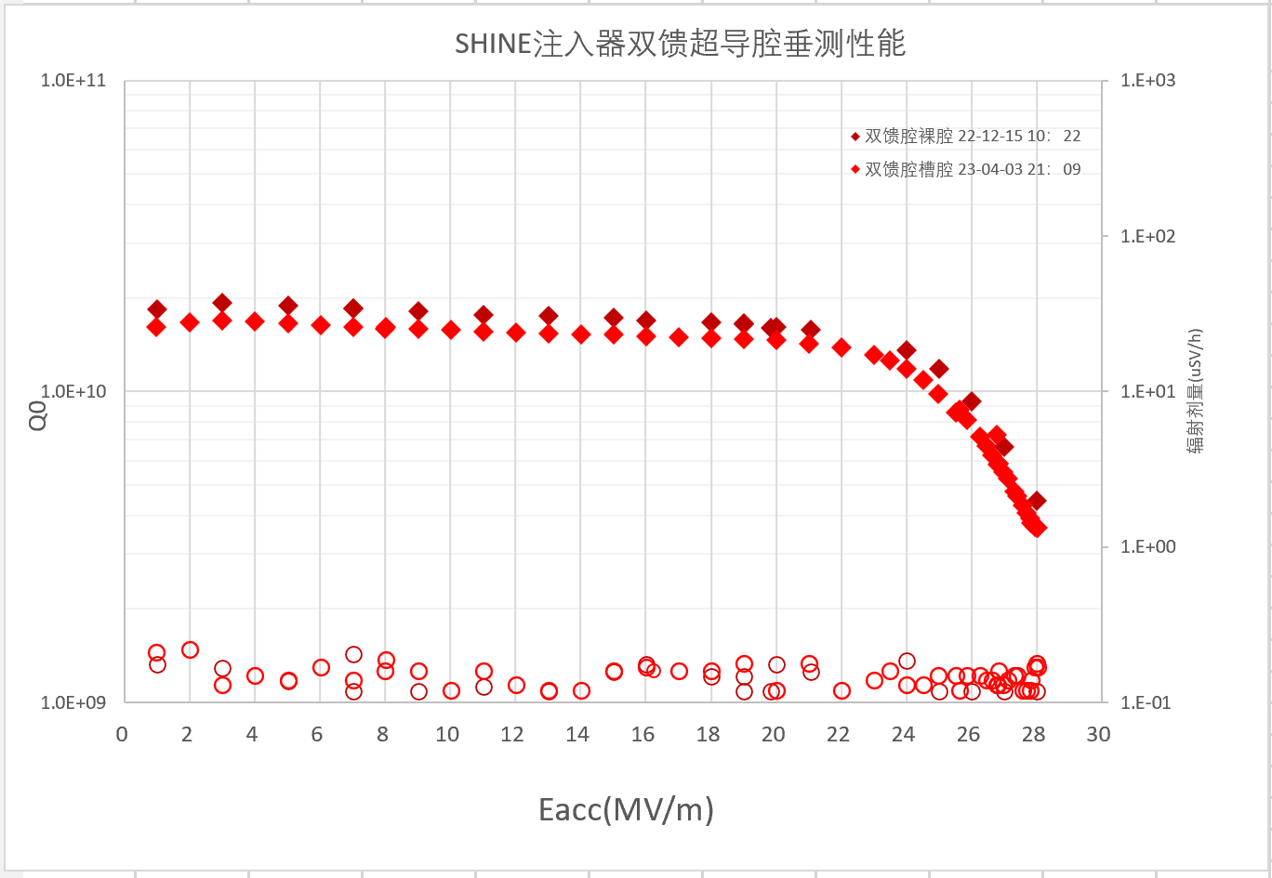
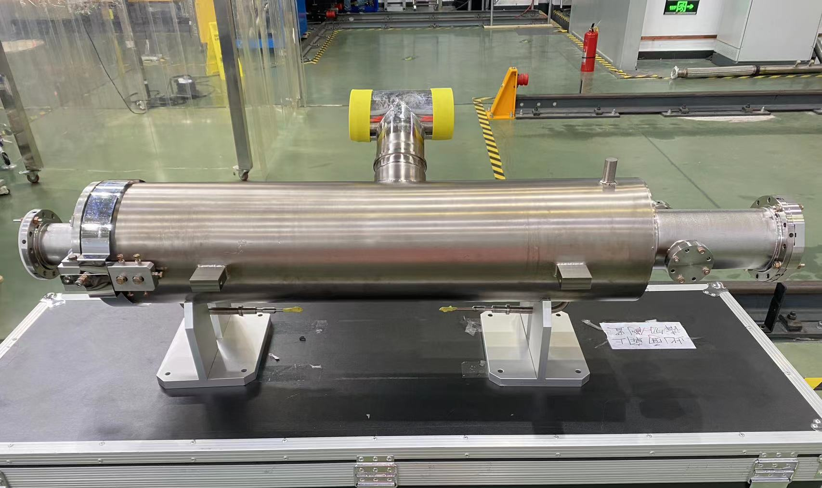
Vertical test results: f=1300.146 MHz @ 2K, Q₀> 1.5 e10 @ E_{acc}=12 MV/m，E_{acc_max} ~28MV/m

Slide 11
Third Harmonic SRF Cryomodule for the SSRF Storage Ring
SSRF

Slide 12
Motivation
  Improve beam quality and increase lifetime
    More insertion devices installed into the tunnel which reduce lifetime
  Increase single bunch beam current threshold
    Single bunch beam current >20 mA is required by Fast X-ray Imaging Beamline
Design of the system
  Passive or Active, SC or NC was compared before choosing a passive SC cryomodule
  One coupled 2-cell cavity can provide high enough harmonic voltage

Slide 13

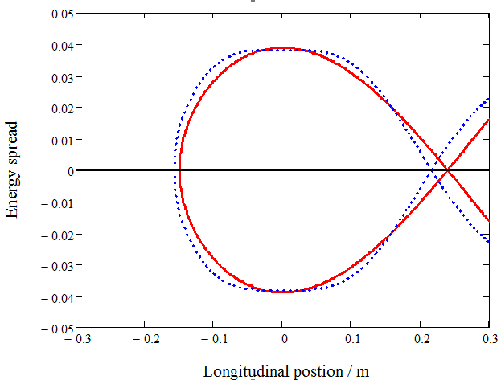
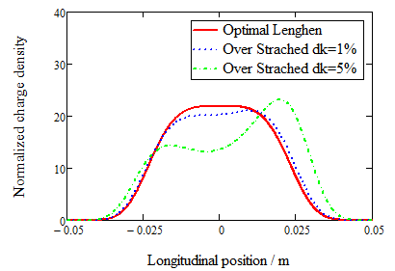
Requirement of harmonic cavity for SSRF
Table-1: Parameters of SSRF Storage Ring
Main rf voltage: 4.5 ~ 5.4 MV by three 500MHz SC cryomodules
Theoretical harmonic voltage is 1.4 ~ 1.8 MV for h=3
Calculated stretching factor is larger than 2 with different filling patterns
Parameter | Description | Value
E | Beam energy | 3.5 GeV
C | Circumference | 432 m
I_{dc} | DC beam current | 0.2 ~ 0.3 A
f_{rf} | RF frequency | 499.654 MHz
h | Harmonic number | 720
α | Momentum compaction | 4.2e-4
σε | Energy spread | 0.001
U₀ | Radiation loss per turn | 1.4 MeV
V_{rf} | Main rf voltage | 4.5 ~ 5.4 MV
Q_{s} | Nominal synchrotron tune | 0.0075
σl | Nominal rms bunch length | 3.8 mm
V_{h} | Harmonic rf voltage | 1.4 ~1.8 MV

Slide 14
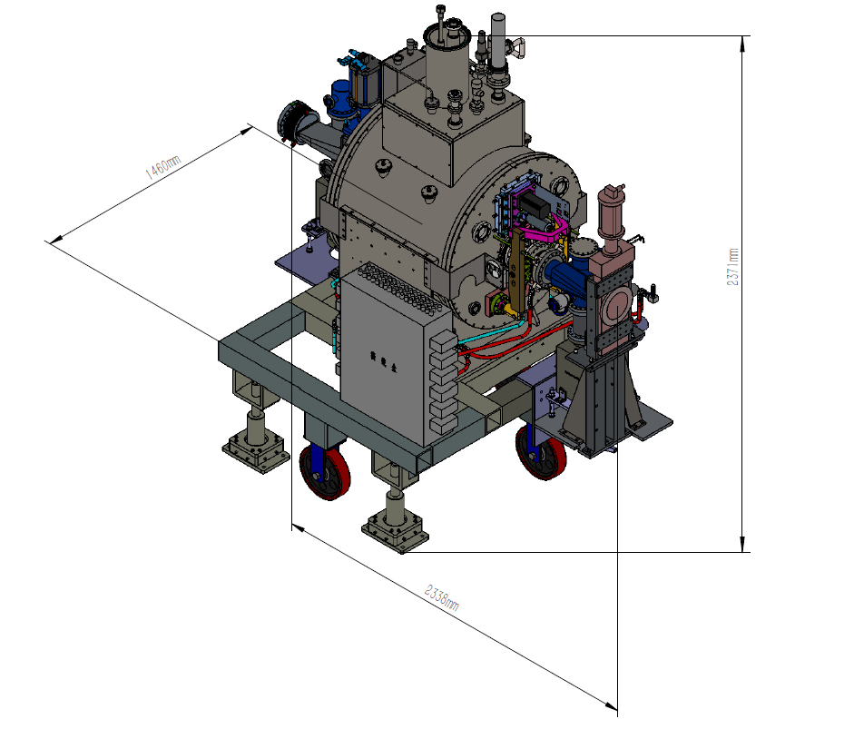
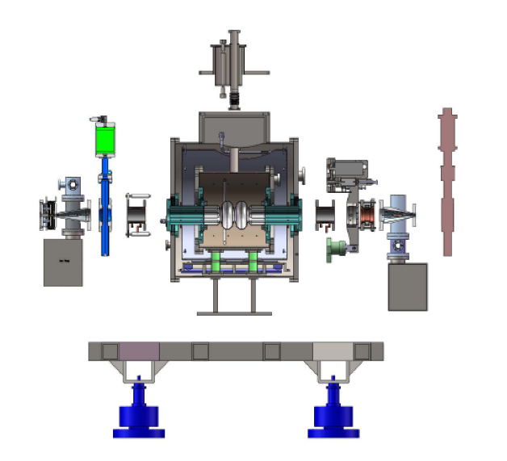
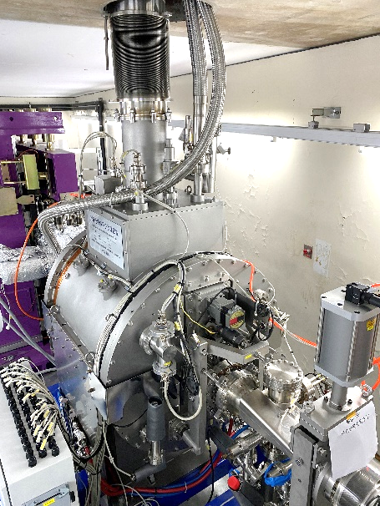
Bunch Control System at SSRF based on Passive Superconducting RF Cavity
Key component: SSRF has completed intellectual property rights.
Cryomodule=L*W*H=2338 mm*1460mm*2371mm, beam center=1300mm
  Nb cavity: HOM-free, passive, 1500MHz, two-cell cavity made of RRR>300 niobium material
  Cryostat: helium vessel, thermal shielding, magnetic shielding, sensors, safety valves and burst disc
  HOM absorber: beamline type, SiC material
  Tuner: mechanical together with piezo
  Vacuum parts: pipes, sliding joints, gate valves, tapers with synchrotron light shielding, ion pumps
  Monitor/Interlock and LLRF control: based on PLC and digital IQ techniques, interlocks
Multi-transfer lines
Gate-valve
HOM free 2-cell Nb Cavity
HOM
absorber
Sliding
Joints
Gate-valve
Tuner
Assembly
Taper with ion pump
(downstream)
Adjustable Module base
Cryostat
HOM
Absorber
Taper with ion pump
(upstream)

Slide 15
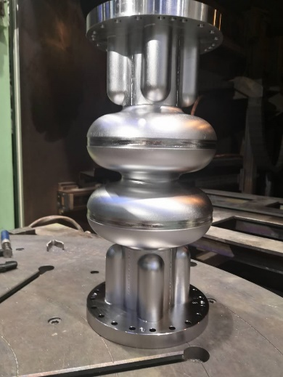
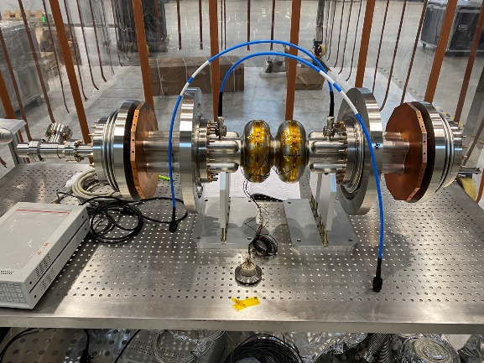
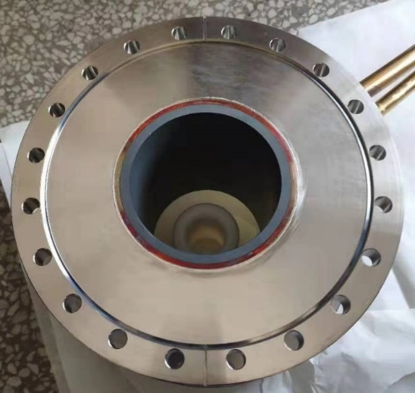
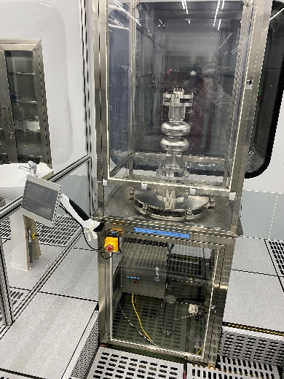
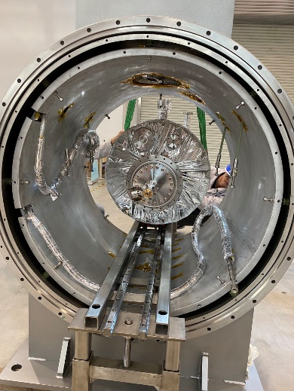
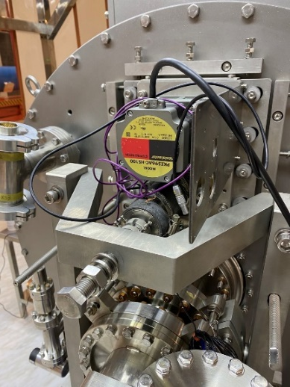
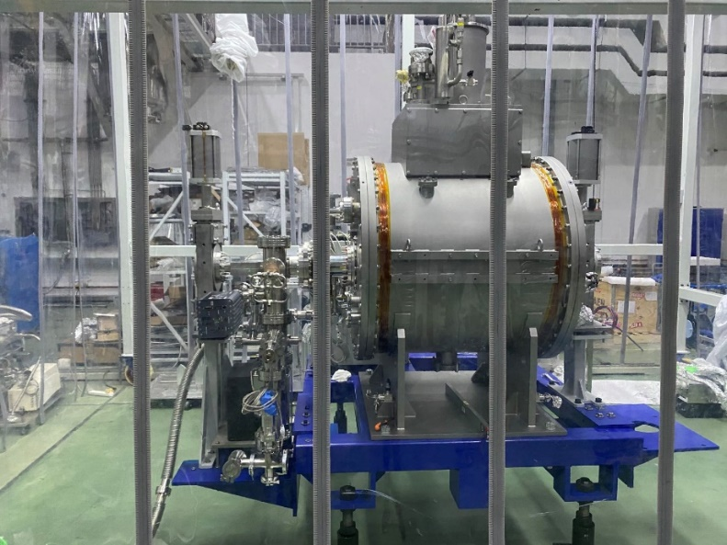
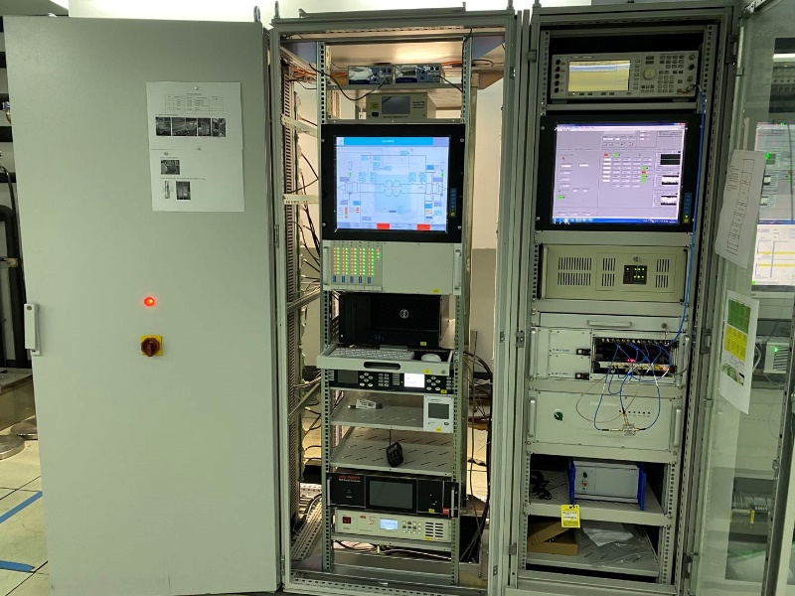
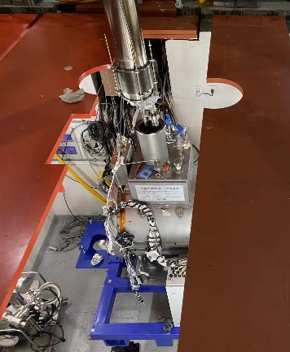
Superconducting 3HC cryomodule development
1500MHz 2-cell Nb cavity
Cavity with thermal transition
Cryostate
HOM absorber
Tuner
Cryomodule Assembly
Interlock and LLRF controller
Horizontal test
In tunnel

Slide 16
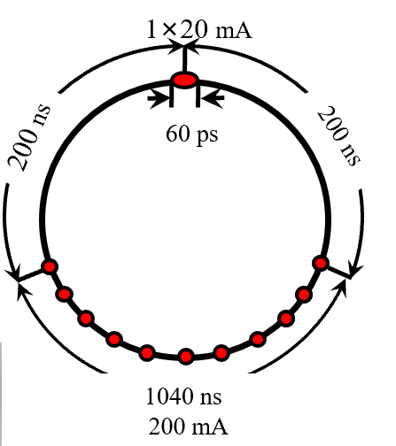
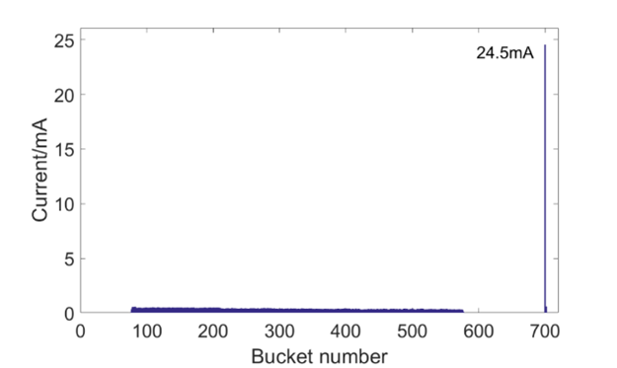
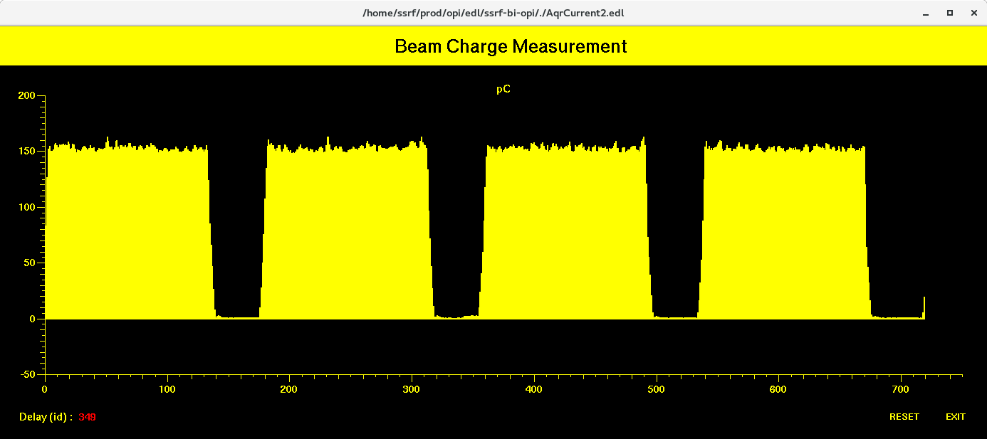
Commissioning with Beam
Bunch size (Half Band Width) lengthening factor is larger than twice
  Stretching factor is 2.2 with uniform filling pattern
  Stretching factor ~ 3 with hybrid filling pattern
  Single bunch beam current reached 24.5 mA in hybrid filling pattern
  Steam camera is used to measure bunch length
3HC operation state
  Stable cavity voltage, adjusted smoothly by tuner
  Cryogenic, vacuum are stable
  No influence observed on main rf system
多束团模式
Single bunch current in Hybrid filling pattern
Uniform filling pattern
One of Hybrid filling pattern

Slide 17

Thanks for your attention!

