Slide 1

Cryogenic operation of the FLASH linac at DESY below 0.5 bar
K. Jensch
Batavia, 07.12.2023

Slide 2

Agenda
Overview
01 Introduction
FLASH Linac
Why should the operating pressure of the FLASH accelerator be changed?
02 Option to fulfill the legal requirements
03 Solution how the changes were realized
04 Operating below 0.5bar
05 Summary

Slide 3
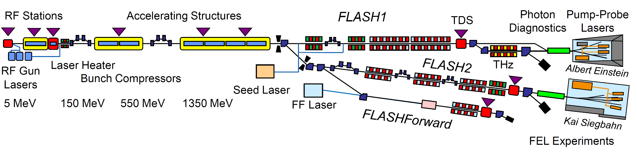
FLASH2020 to FLASH2020+
Status 2022 after the “Phase 0” shutdown
FLASH details: see SRF2023 TUIAA02, M. Vogt: “FLASH 2020+ Upgrade Project”
Phase 0
Energy upgrade
3rd BC (FLASH2)
TDS (FLASH2)
Injector Laser
Afterburner FLASH2
Phase 1
Variable gap undulators (FLASH1)
Pump-probe laser (FLASH1)
Phase 1+
High rep.rate seeding (FLASH1)
Photon diagnostics (FLASH1)
Phase 2
New variable gap undulators + chicanes
for new lasing concepts (FLASH2)
Laser heater in 1st BC
New 2nd bunch compressor (BC)

Slide 4
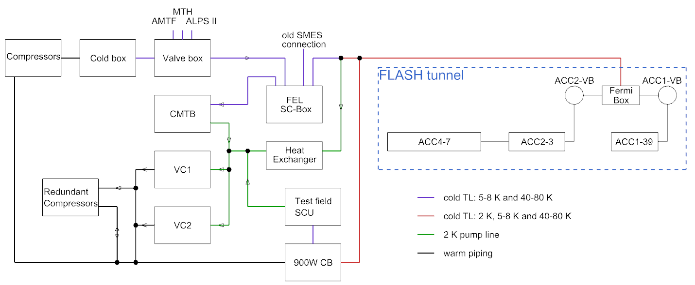
FLASH cryogenic supply
In 2023
One 3.9 GHz and seven 1.3 GHz SC cryomodules
Cooled by one former HERA cryoplant, shared with CMTB (2006), AMTF (2010), ALPS II (2021)

Slide 5
Why should the operating pressure of the FLASH accelerator be changed?
FLASH is in operation since mid-1990s, first as TTF, then as TTF/VUV-FEL machine and since 2005 as FLASH.
For the operation it was agreed mid ‘90s with the regulating authority for pressure vessel to operate the linac with 4 modules and as a test field.
Since 2009 FLASH contains 8 modules (7x 1.3 GHz and one 3.9 GHz) and since 2005 is a user-machine
The updated operational safety regulations (Betriebssicherheitsverordnung “BetrSichV”)
  NO exceptions allowed! → All components above 0.5 bar at test stands and research facilities needs to be fully certified after major plant modifications!
Major FLASH upgrade in 2020: two new modules has to be installed on the ACC2/3 section → it counts a major modification and the whole accelerator has to be proofed by a inspection body!
Only two of the eight installed module fulfil the requirements → we need a plan and working solution…

Slide 6
Option to fulfill the legal requirements
Option 1 “New cold accelerator”
Six new 1.3 GHz cryomodules
New cryo infrastructure in the linac, boxes, caps and so on
→ absolute unrealistic in terms of budget and time…
Option 2 “Decommissioning of FLASH” → No option
Option 3 “Reduction of the operating pressure in all cryo circuits below 0.5 bar”
But cryo circuits are designed for:
  2K circuit – 16 mbar to 2 bar
  4/5K circuit – 1 to 16 bar
  40/80K circuit – 1 to 16 bar
Safety lines to the installed relief valves were also designed for these pressure values

Slide 7
Can FLASH be operated at 0.5 bar?
Calculation and real test
Calculations were performed to verify that the existing piping system of the modules, boxes and transfer lines is sufficient for the low pressure
For steady state operation -> It will work
For warm up / cool down -> “Should” work, but needs to be tested (operation may take a week longer)
Safety lines to the relief (safety) valves are definitely too small!
Standard spring loaded relief (safety) valves will not “work”!
Operation test with FLASH
Test steady state operation beginning of 2020 -> worked, 4/5K and 40/80K circuits could be operated stably
Test warm up / cool down April 2020 -> it was a challenge for the operators to find the correct parameters, valve settings and so on “on the fly”. Some of the valves were not dimensioned for these pressure!

Slide 8
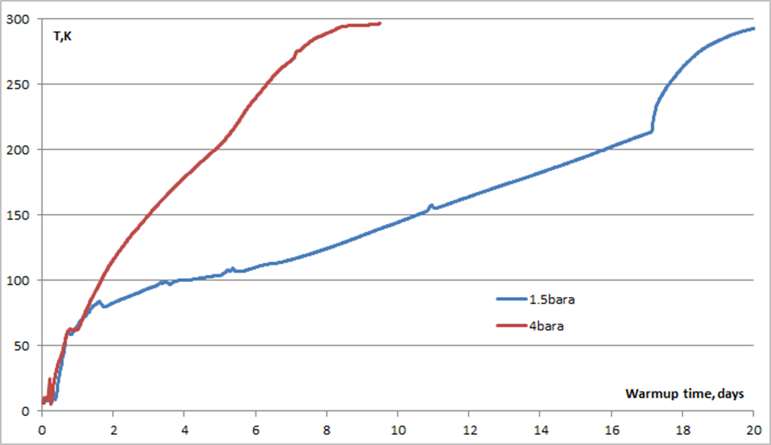
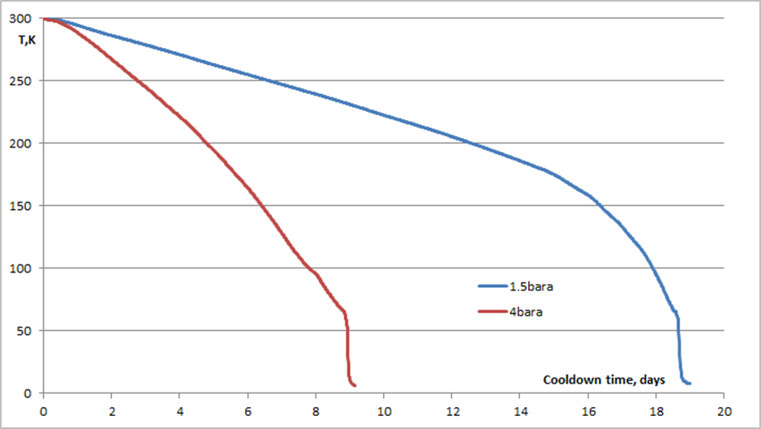
Test run warm up / cool down with max. 0.5bar
With the original pipe and valve configuration
Warm up
Cool down

Slide 9
Option to fulfill the legal requirements
Burst discs -> No desired option
Specified working pressure up to 0.49 barg is too close to the 0,5 barg set pressure
Pump and purge actions and operation up to 0.49barg lead to shift of the breaking point of the burst discs -> the opening pressure will be reduced
Back-pressure of 0.3 barg shifts the opening pressure -> not acceptable
After a burst, the disc has to be replaced
Standard spring loaded relief (safety) valves -> Not a option
Specified working pressure up to 0.49 barg is too close to the 0.5 barg set-pressure
Back-pressure of 0.3 barg -> the SV will open at 0,5 barg but not completely
After the valves have opened -> the pressure must be reduced by 0.3 bar to fully reclose the safety valves

Slide 10
Back-Pressure
Pressure that exists at the outlet of a SV as a result of the pressure in the discharge system
Superimposed Back pressure
System used @ FLASH
Back pressure @ exhaust manifold
is maximum of 0,3 barg if the screw
compressors fail.
Without Back pressure
Built-up Back pressure

Slide 11
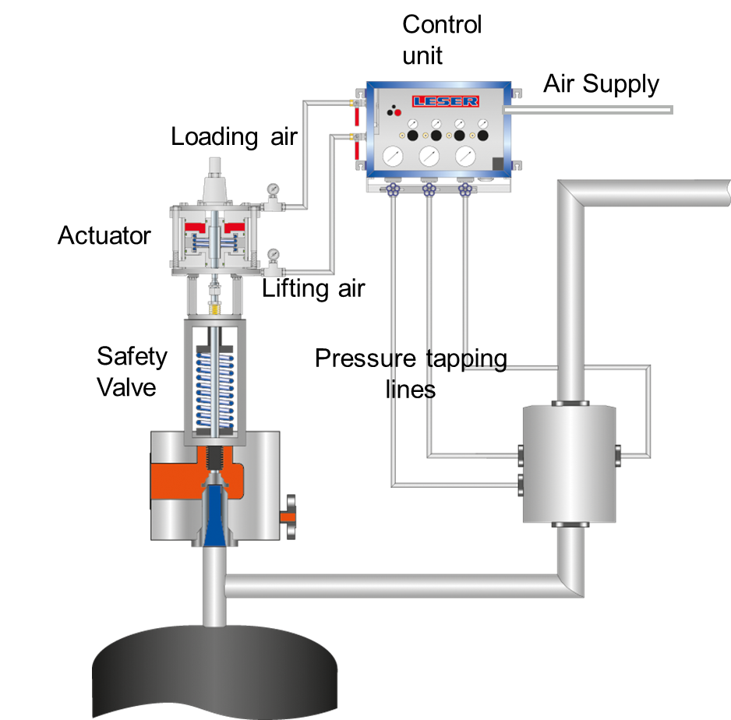
Option to fulfill the legal requirements
Solution -> standard spring loaded relief valves with added Pneumatic Supplementary Loading System
Using “pneumatic supplementary loading system” the back pressure can be compensated and hence the system remain below 0,5 barg which is the requirement of “BetrSichV”

Slide 12
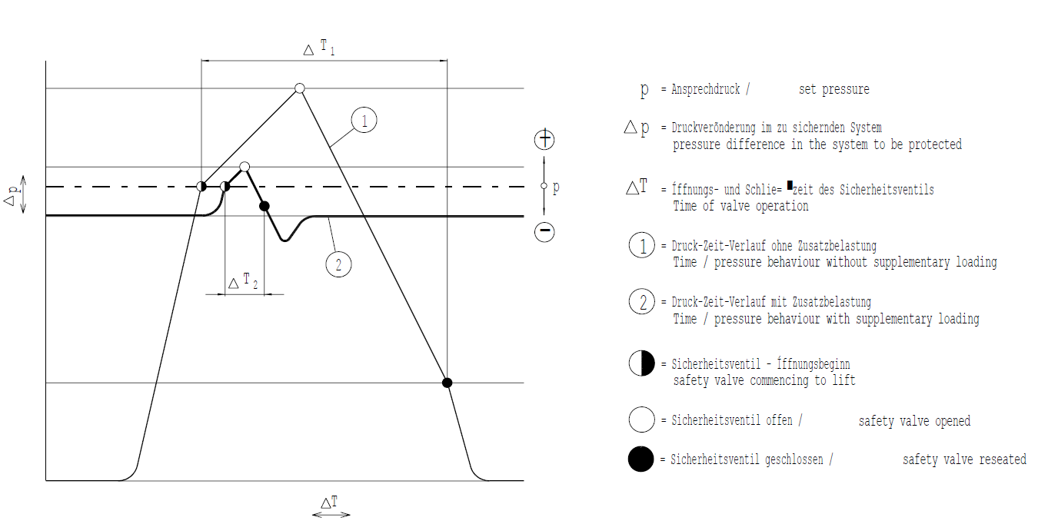


Pneumatic Supplementary Loading System
This system also allows to operate closer to 0,5 barg
Pressure
Time

Slide 13
Where there is sun there is also shade
The lower working pressure requires more and larger relief valves
Helium inventory nearly the same before and after changing but the differential pressure between the process circuits and the safety collector is dramatically reduced.
FLASH until 2021 FLASH after
  2K circuit – 2 bar to 0.(3)bar max 0.5 to 0.(3)bar
  4/5K circuit – 16 bar to 0.(3)bar max 0.5 to 0.(3)bar
  40/80 circuit – 16 bar to 0,(3)bar max 0.5 to 0.(3)bar
The total numbers of required relief valves more than doubled
The dimension of the new relief valves increased, e.g. DN20 to DN50

Slide 14
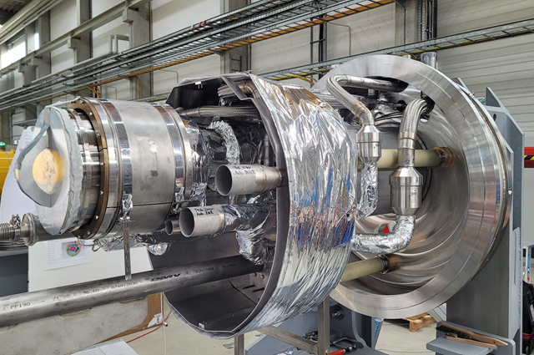
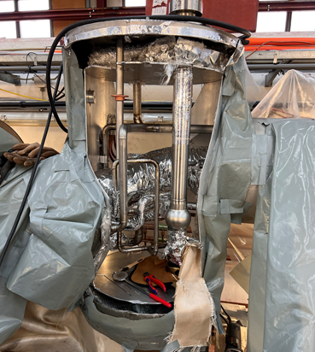
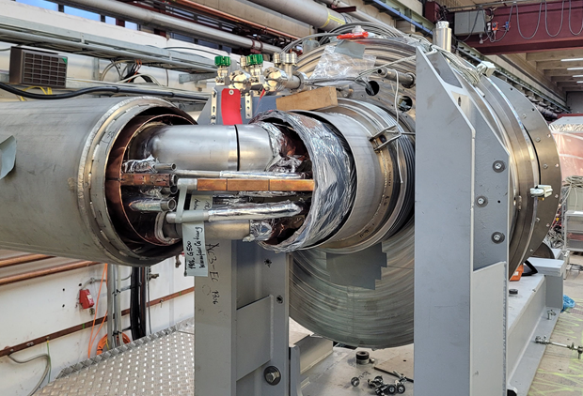
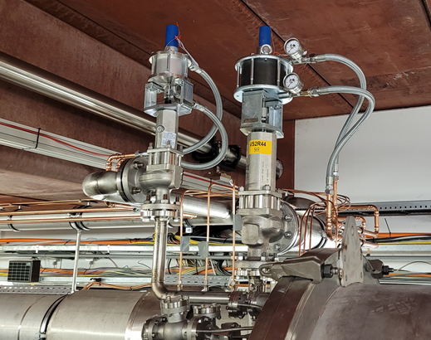
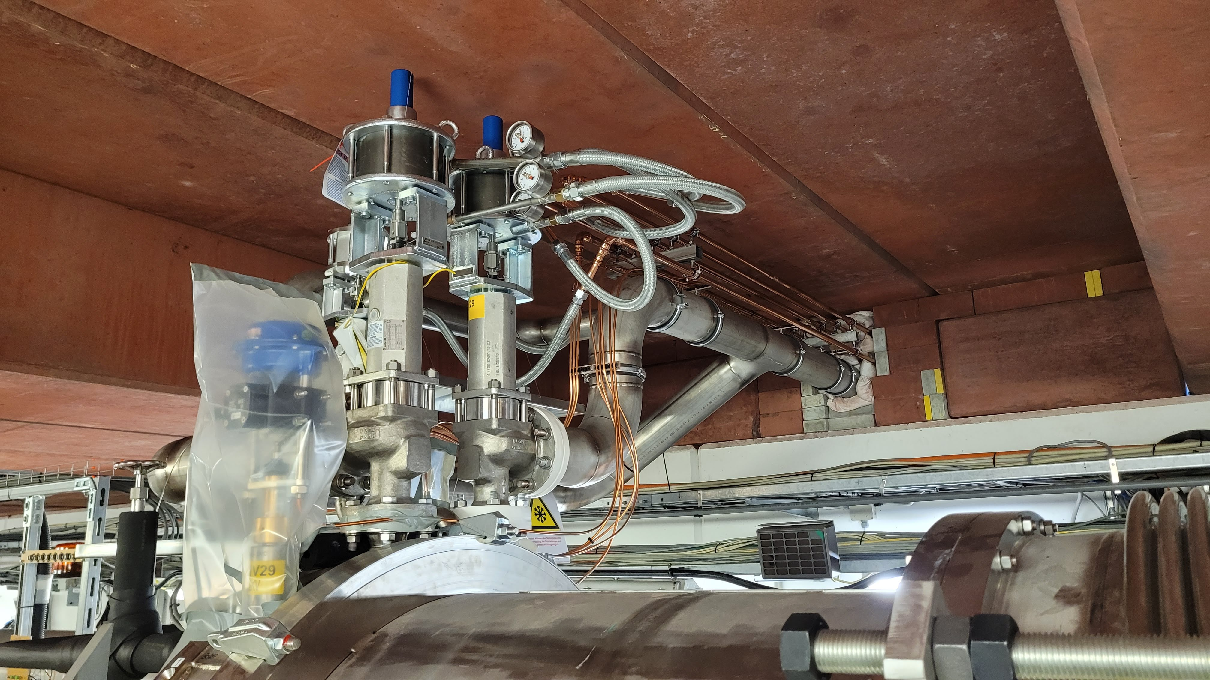
Integration of the new relief valves
Some impressions

Slide 15
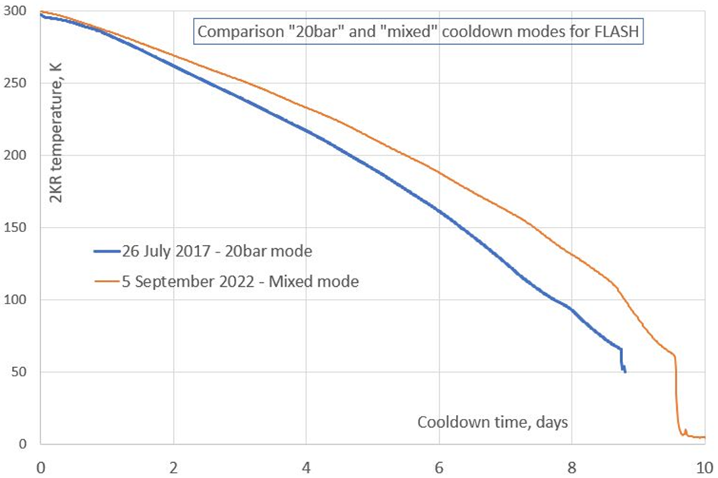
Cooling cycles and cool down with new configuration
Since 2002, FLASH has seen 9 cool-downs and
8 warm-ups
Average cool-down/warm-up time (to 4 K):
~10 days each
Expected a slightly longer cool down with 0.5 bar operation, but no substantial difference in cool down duration observed
  Some issues with mixing warm gas and cold gas
  in the 4 K forward line → more practice needed!
  FEL sub-cooler box in 2017 already cold, in 2022 cooldown together with FLASH

Slide 16
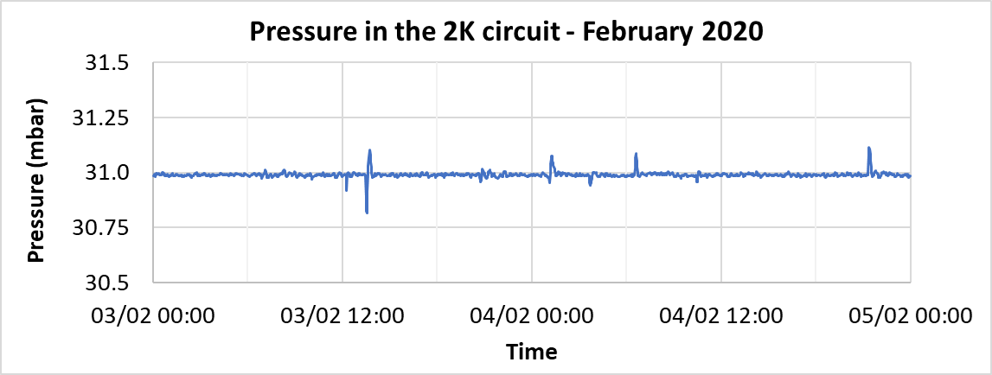
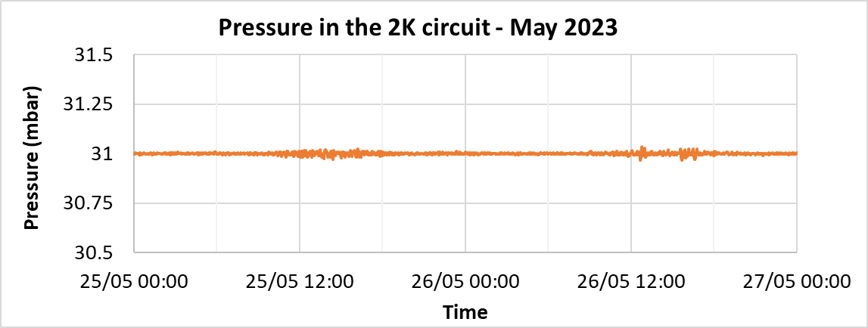
2K Pressure stability for the Cavity
Average pressure stability
better than 0.1 mbar (75 mTorr)
Values not affected
by 0.5 bar operation

Slide 17
Summary
One year of 0.5 bar operation
Low pressure but nearly same Helium inventory required more and larger relief valves
Slight higher static heat loads due of more and larger safety lines
The system is more sensitive to disturbances
  A faster reaction time is needed
  Modification under discussion for next shutdown
The system is more sensitive to to changes in parallel systems (AMTF, CMTB, ALPSII)
  More caution needed during parallel and transient operation
Recovery after a outage takes longer, more caution needed to avoid opening of relief valves

Slide 18
Thank you for your attention!
and
Thanks to my colleagues where I could pick up information and slides

Slide 19
Kay Jensch
MKS Group
Kay.jensch@desy.de
+49 (0) 40 8998-3010

