Slide 1
Overpressure protection for the PIP-II CM beamline
Mattia Parise
TESLA Technology Collaboration Meeting
5-8 December 2023

Slide 2
Outline
Introduction
Inputs and Assumptions
Calculating the Pressure
Results and Conclusion

Slide 3
Introduction

Slide 4
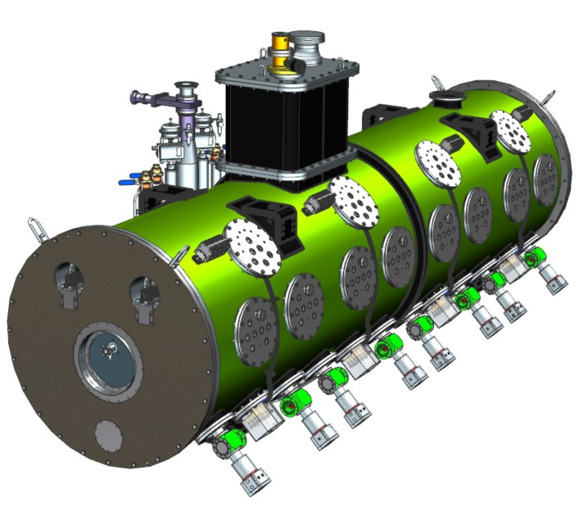
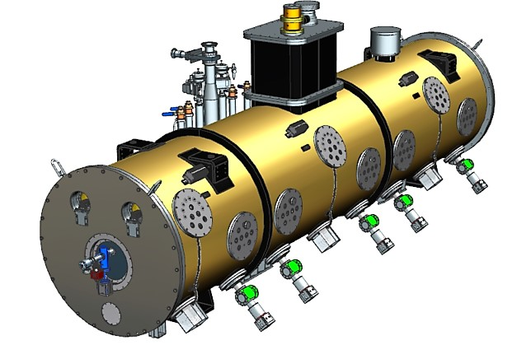
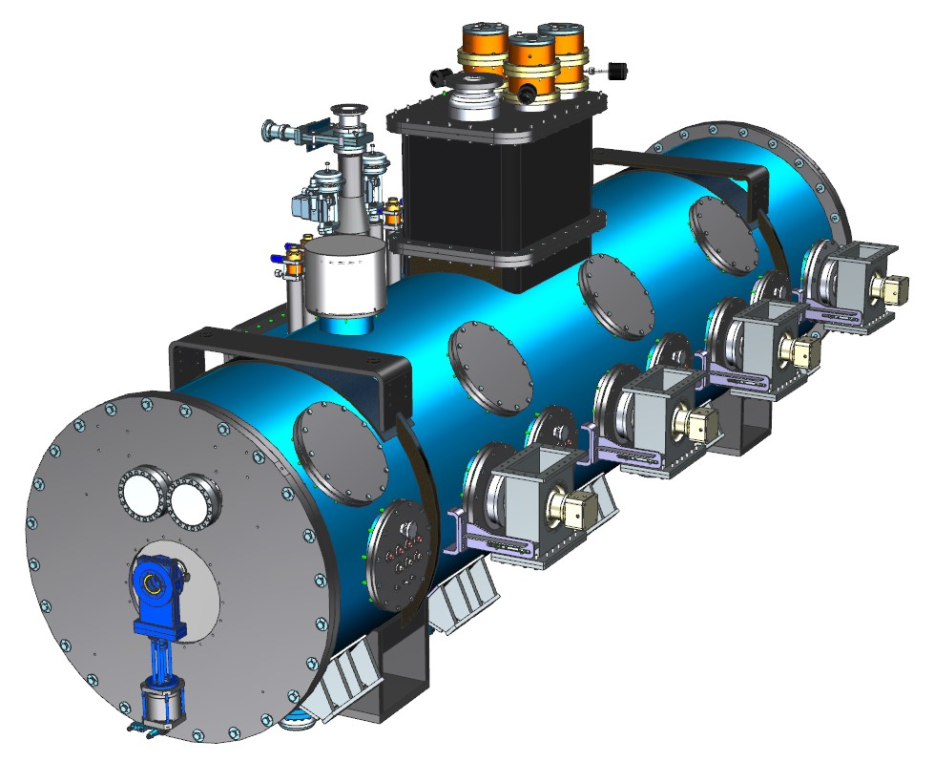
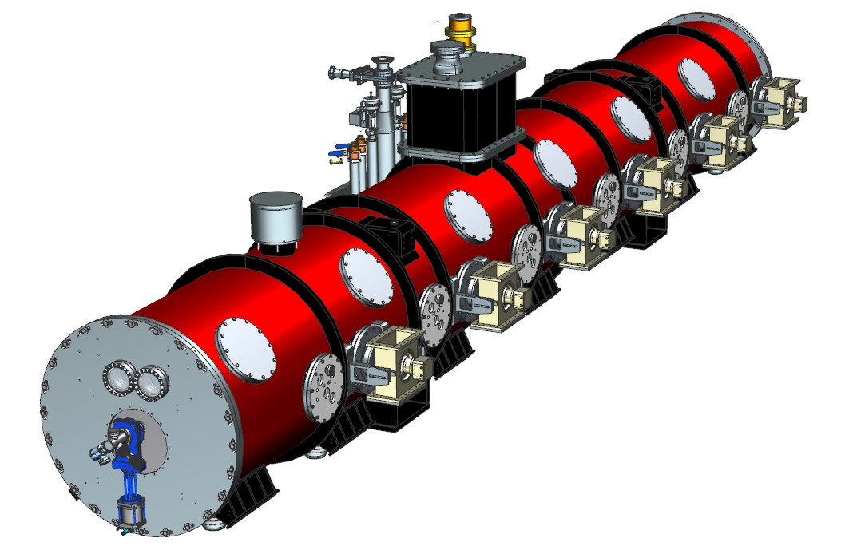
Introduction
SSR1
SSR2
LB650
HB650

Slide 5
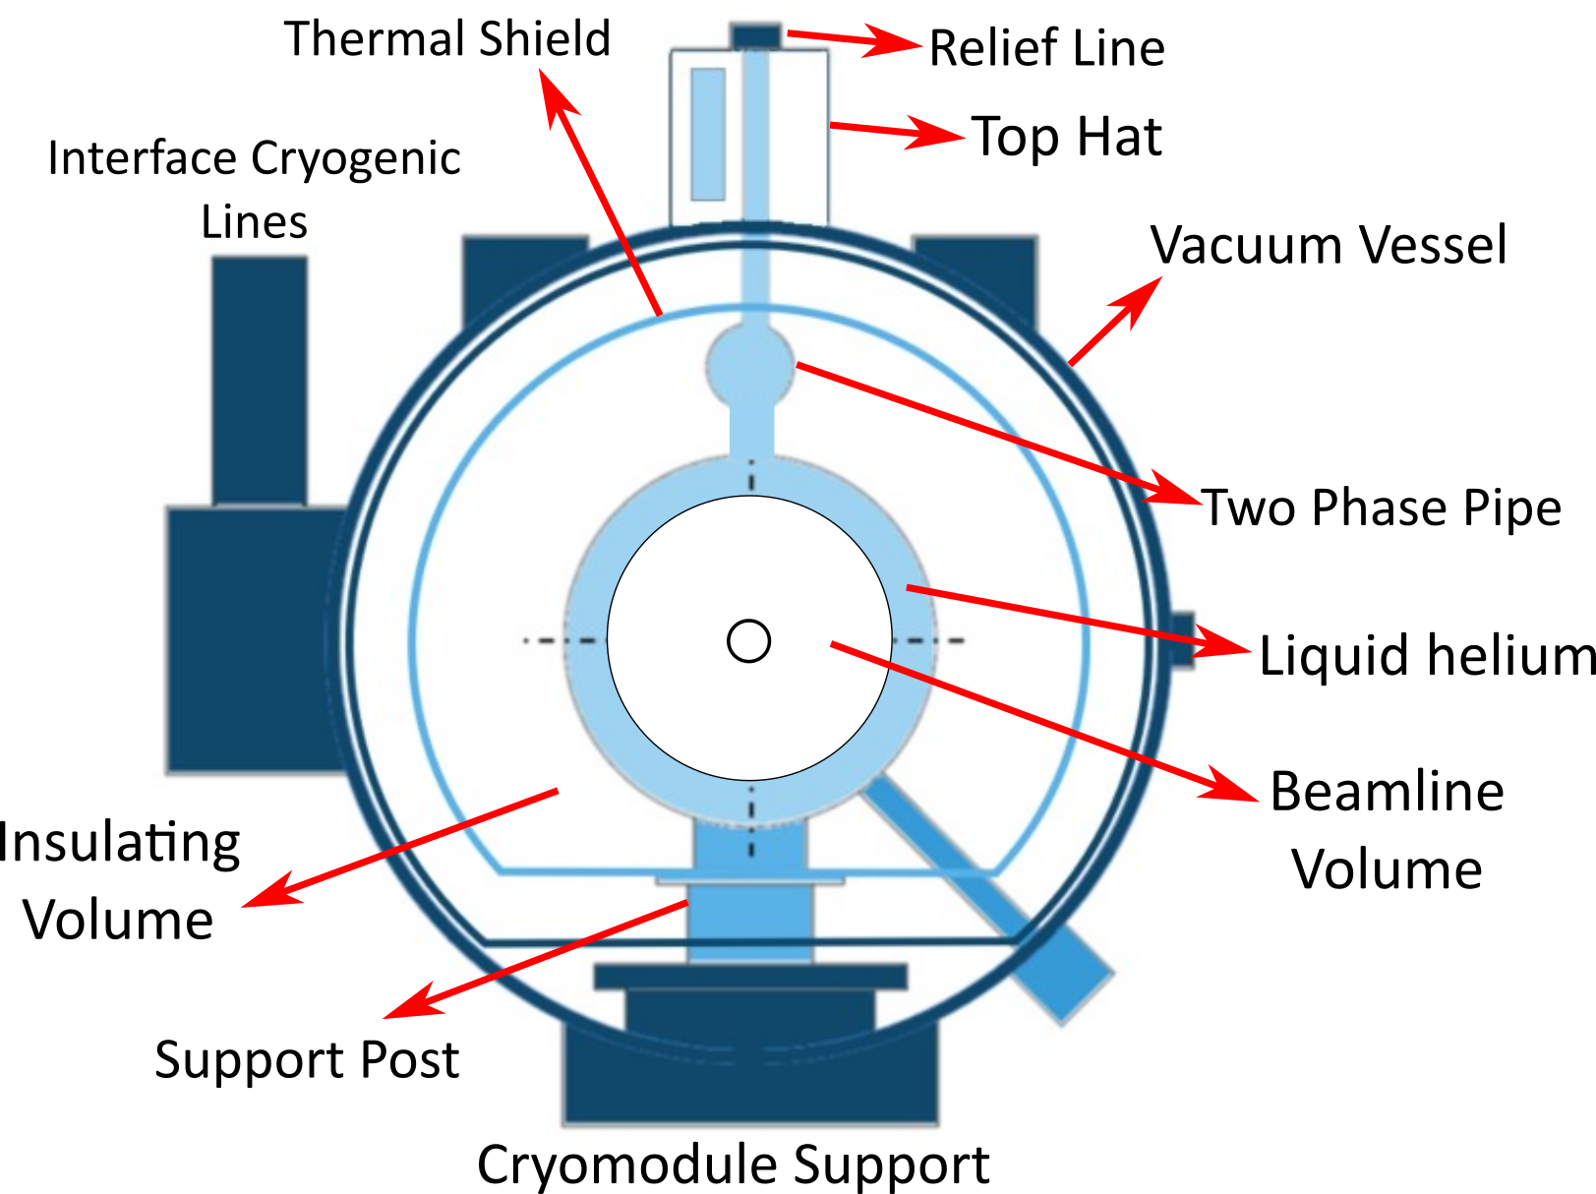
Introduction
SSR1
SSR2
LB650
HB650
Helium circuit relief line

Slide 6
Introduction
SSR1
SSR2
LB650
HB650
Beamline Volume

Slide 7
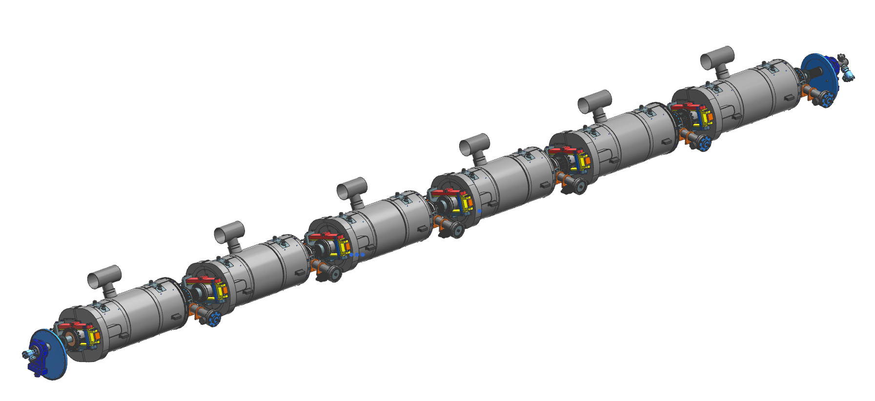
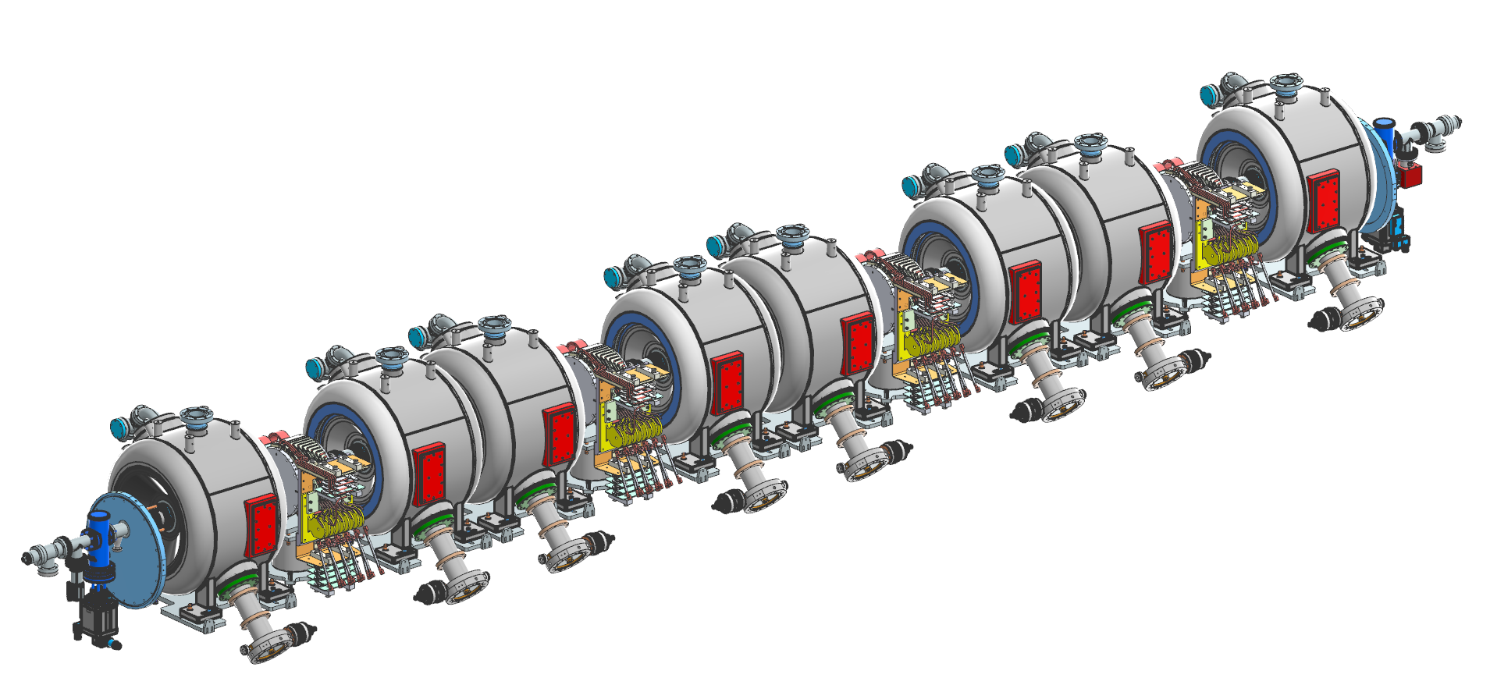
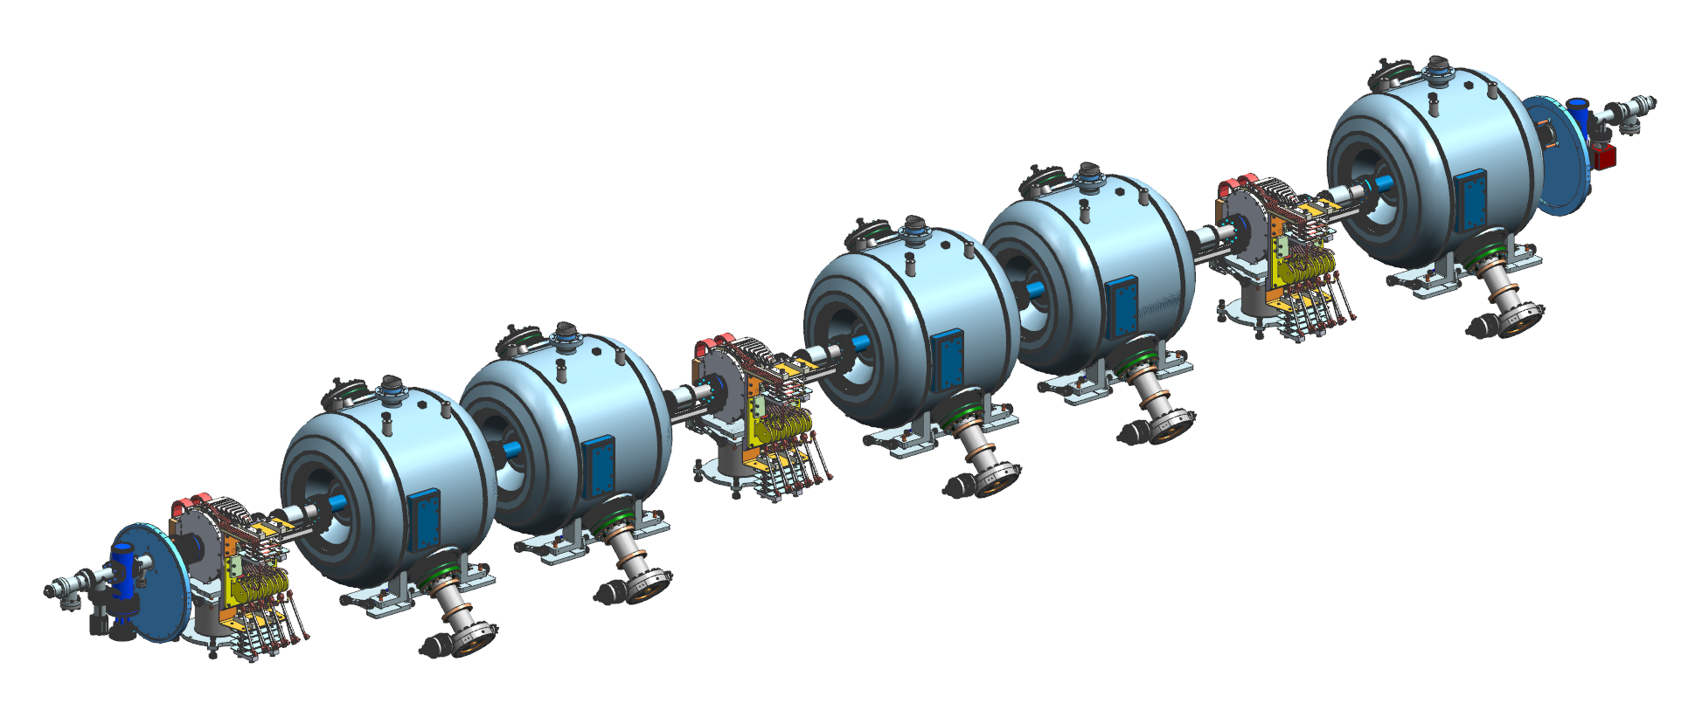
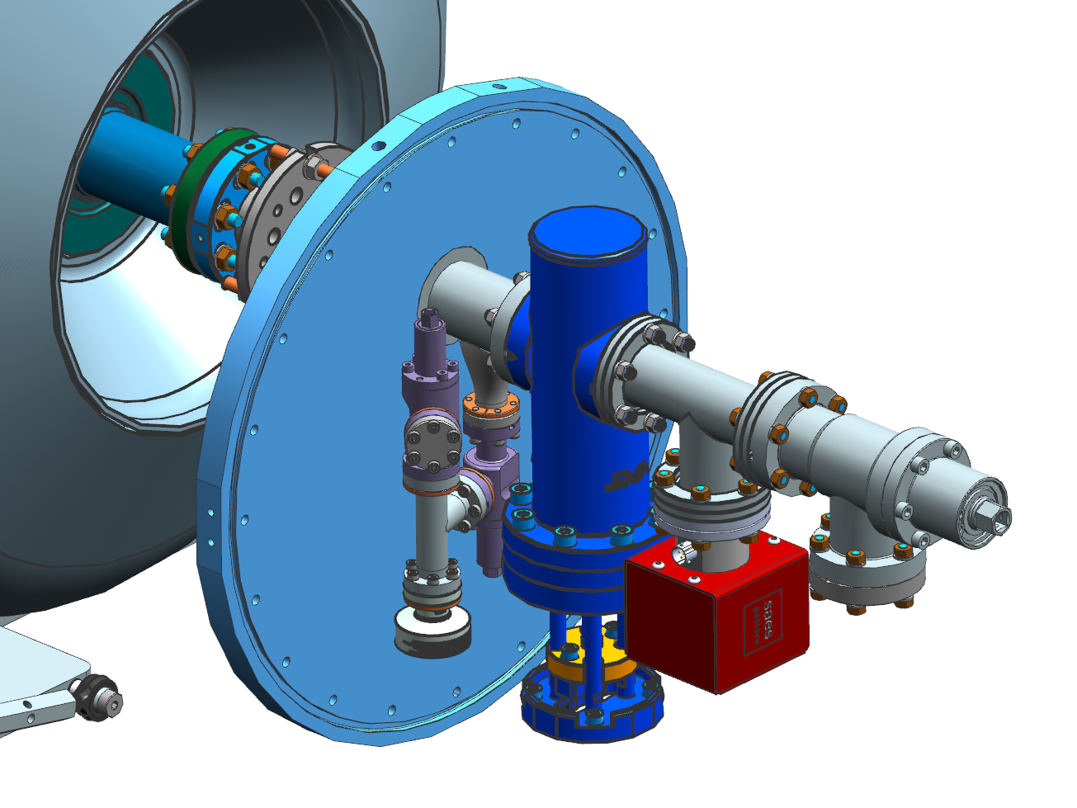
Introduction
HB 650 String Assembly
SSR1 String Assembly
Relief
sub-assembly
Gate Valve
Although cavities and string layouts may be different, all strings end groups share a common design
SSR2 String Assembly
End Flange

Slide 8
Inputs and Assumptions

Slide 9
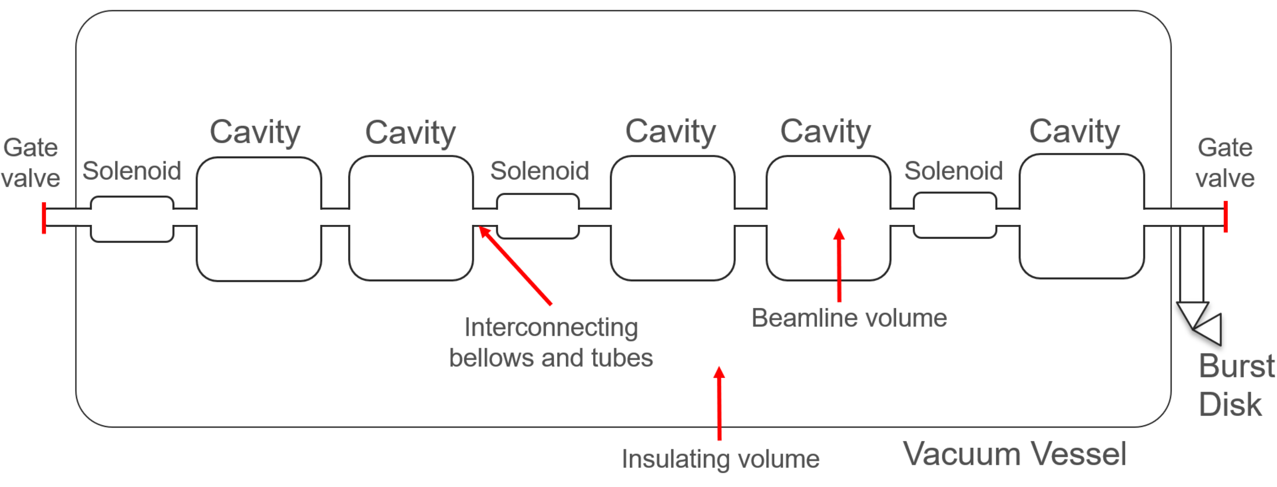
Inputs and Assumptions
SSR2 CM Schematic
Section transverse to the beam of the ppSSR2 CM. Many elements are in common with the others PIP-II CM
Scheme defining the boundary of the problem.
The CM includes 5 cavities and 3 solenoids connected by tubes and bellows.

Slide 10
Inputs and Assumptions
SSR2 CM Schematic
Section transverse to the beam of the ppSSR2 CM. Many elements are in common with the others PIP-II CM
Scheme defining the boundary of the problem.
The CM includes 5 cavities and 3 solenoids connected by tubes and bellows.
A burst disk is installed outside the vacuum vessel and connected to the beamline volume
A defect (leak) in the shell between the helium circuit and the beamline volume
Liquid helium fills the beamline volume for a certain time
Losing/spoiling insulating vacuum: convection from air at room temperature
Beamline volume surfaces see 293K (radiation) and conduction from support posts

Slide 11
Inputs and Assumptions
SSR2 CM Schematic
Section transverse to the beam of the ppSSR2 CM. Many elements are in common with the others PIP-II CM
Scheme defining the boundary of the problem.
The CM includes 5 cavities and 3 solenoids connected by tubes and bellows.
A burst disk is installed outside the vacuum vessel and connected to the beamline volume
A defect (leak) in the shell between the helium circuit and the beamline volume
Liquid helium fills the beamline volume for a certain time
Losing/spoiling insulating vacuum: convection from air at room temperature
Beamline volume surfaces see 293K (radiation) and conduction from support posts

Slide 12
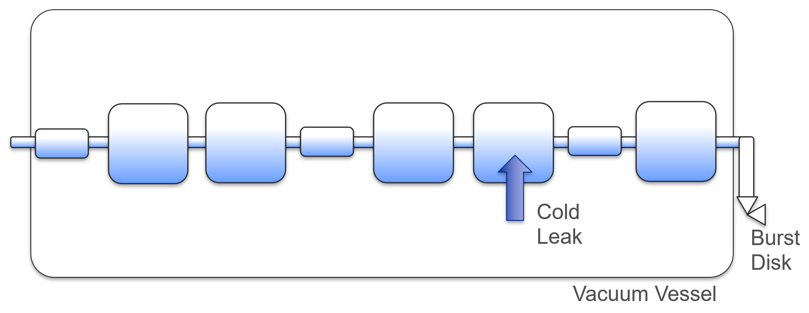
Inputs and Assumptions
SSR2 CM Schematic
Beamline volume is filled with helium due to a leak
Section transverse to the beam of the ppSSR2 CM. Many elements are in common with the others PIP-II CM
Scheme defining the boundary of the problem.
The CM includes 5 cavities and 3 solenoids connected by tubes and bellows.
A burst disk is installed outside the vacuum vessel and connected to the beamline volume
A defect (leak) in the shell between the helium circuit and the beamline volume
Liquid helium fills the beamline volume for a certain time
Losing/spoiling insulating vacuum: convection from air at room temperature
Beamline volume surfaces see 293K (radiation) and conduction from support posts

Slide 13
Inputs and Assumptions
SSR2 CM Schematic
Beamline volume is filled with helium due to a leak
Section transverse to the beam of the ppSSR2 CM. Many elements are in common with the others PIP-II CM
Scheme defining the boundary of the problem.
The CM includes 5 cavities and 3 solenoids connected by tubes and bellows.
A burst disk is installed outside the vacuum vessel and connected to the beamline volume
A defect (leak) in the shell between the helium circuit and the beamline volume
Liquid helium fills the beamline volume for a certain time
Losing/spoiling insulating vacuum: convection from air at room temperature
Beamline volume surfaces see 293K (radiation) and conduction from support posts

Slide 14
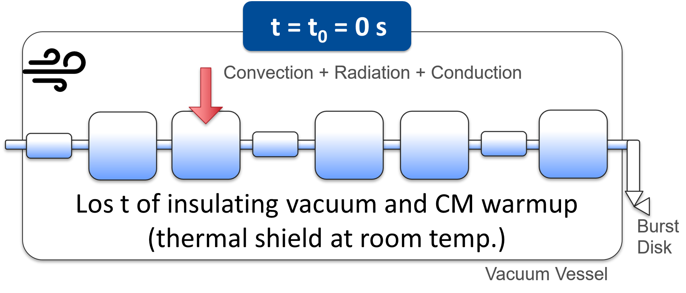
Inputs and Assumptions
SSR2 CM Schematic
Section transverse to the beam of the ppSSR2 CM. Many elements are in common with the others PIP-II CM
Scheme defining the boundary of the problem.
The CM includes 5 cavities and 3 solenoids connected by tubes and bellows.
A burst disk is installed outside the vacuum vessel and connected to the beamline volume
A defect (leak) in the shell between the helium circuit and the beamline volume
Liquid helium fills the beamline volume for a certain time
Losing/spoiling insulating vacuum: convection from air at room temperature
Beamline volume surfaces see 293K (radiation) and conduction from support posts

Slide 15
Inputs and Assumptions
SSR2 CM Schematic
Section transverse to the beam of the ppSSR2 CM. Many elements are in common with the others PIP-II CM
Scheme defining the boundary of the problem.
The CM includes 5 cavities and 3 solenoids connected by tubes and bellows.
A burst disk is installed outside the vacuum vessel and connected to the beamline volume
A defect (leak) in the shell between the helium circuit and the beamline volume
Liquid helium fills the beamline volume for a certain time
Losing/spoiling insulating vacuum: convection from air at room temperature
Beamline volume surfaces see 293K (radiation) and conduction from support posts

Slide 16
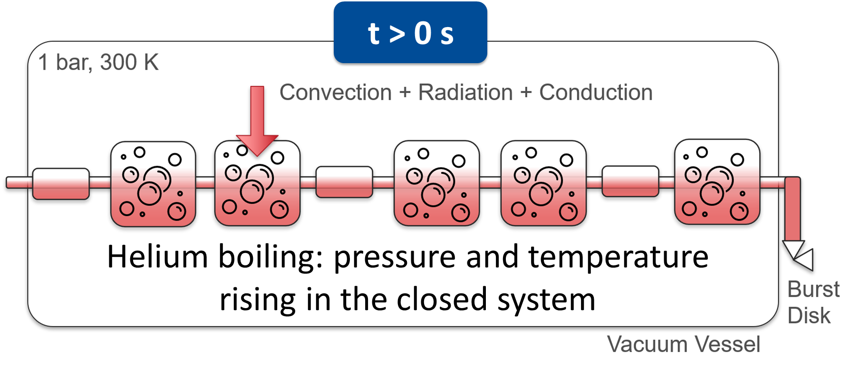
Inputs and Assumptions
SSR2 CM Schematic
Section transverse to the beam of the ppSSR2 CM. Many elements are in common with the others PIP-II CM
Scheme defining the boundary of the problem.
The CM includes 5 cavities and 3 solenoids connected by tubes and bellows.
A burst disk is installed outside the vacuum vessel and connected to the beamline volume
A defect (leak) in the shell between the helium circuit and the beamline volume
Liquid helium fills the beamline volume for a certain time
Losing/spoiling insulating vacuum: convection from air at room temperature
Beamline volume surfaces see 293K (radiation) and conduction from support posts

Slide 17
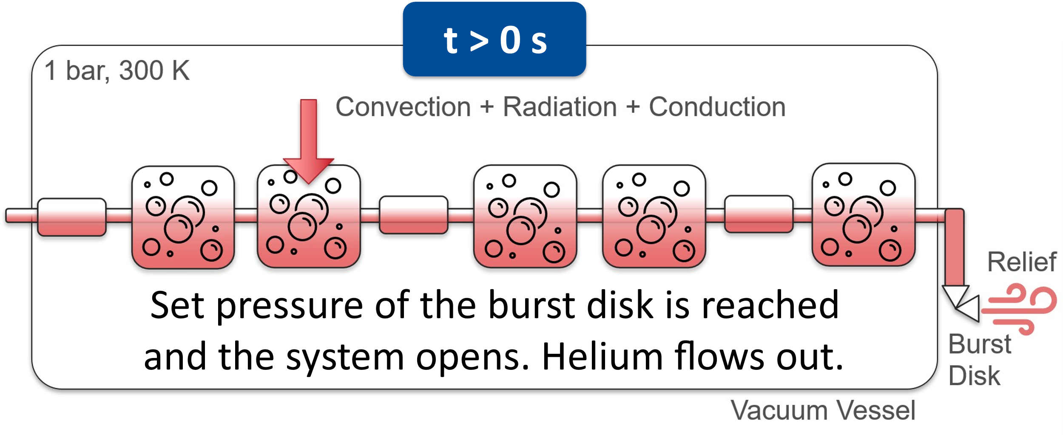
Inputs and Assumptions
SSR2 CM Schematic
Section transverse to the beam of the ppSSR2 CM. Many elements are in common with the others PIP-II CM
Scheme defining the boundary of the problem.
The CM includes 5 cavities and 3 solenoids connected by tubes and bellows.
A burst disk is installed outside the vacuum vessel and connected to the beamline volume
A defect (leak) in the shell between the helium circuit and the beamline volume
Liquid helium fills the beamline volume for a certain time
Losing/spoiling insulating vacuum: convection from air at room temperature
Beamline volume surfaces see 293K (radiation) and conduction from support posts

Slide 18
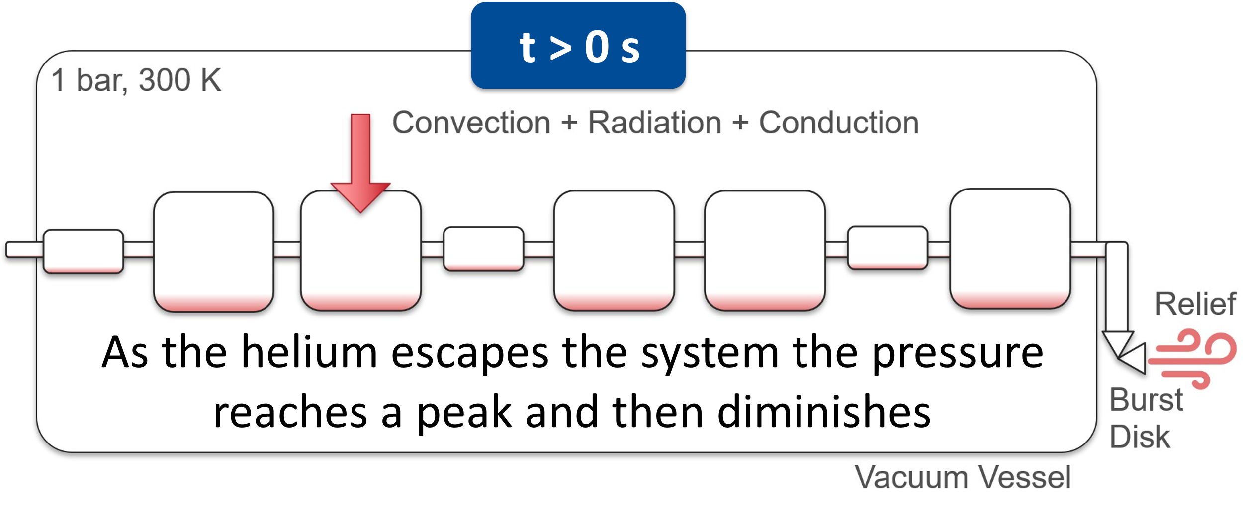
Inputs and Assumptions
SSR2 CM Schematic
Section transverse to the beam of the ppSSR2 CM. Many elements are in common with the others PIP-II CM
Scheme defining the boundary of the problem.
The CM includes 5 cavities and 3 solenoids connected by tubes and bellows.
A burst disk is installed outside the vacuum vessel and connected to the beamline volume
A defect (leak) in the shell between the helium circuit and the beamline volume
Liquid helium fills the beamline volume for a certain time
Losing/spoiling insulating vacuum: convection from air at room temperature
Beamline volume surfaces see 293K (radiation) and conduction from support posts

Slide 19
Calculating the Pressure

Slide 20
Calculating the Pressure
Pressure and temperature of helium is calculated iteratively at each time increment using a system of equations.

Slide 21
Calculating the Pressure
Pressure and temperature of helium is calculated iteratively at each time increment using a system of equations.
The mass flow of the helium leaving the system is proportional to the sum of resistance coefficient along the line

Slide 22
Calculating the Pressure
Pressure and temperature of helium is calculated iteratively at each time increment using a system of equations.
The mass flow of the helium leaving the system is proportional to the sum of resistance coefficient along the line
Convection
Radiation
Conduction
Heat transfer to helium includes 3 contributions. Cavities, solenoids and tubes are modeled as cylinders and analytical formulas are used.

Slide 23
Results and Conclusion

Slide 24
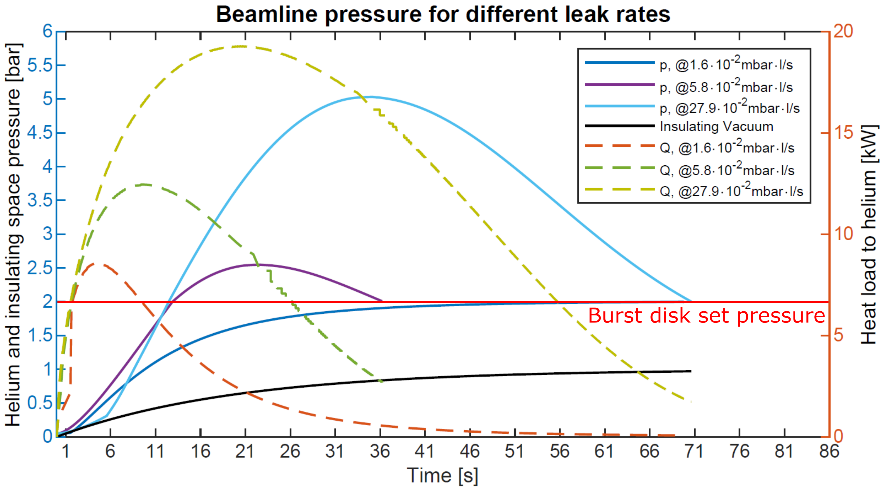
Results and Conclusion
For a defect with a leak rate < 1.6 · 10⁻² mbar·l/s the burst disk will not open.
The maximum allowed leak rate is 27.9 · 10⁻² mbar·l/s. The beamline volume reaches the MAWP.

Slide 25
Results and Conclusion
All the beamline components go through rigorous inspections including leak checks performed using a leak detector with a sensitivity better than 2 · 10⁻¹⁰ mbar·l/s. Given no dynamic loads during operation and the applied thermal cycle goes from room temperature to cryogenic operation, it is safe to assume that such defect, even if present will not compromise the structure and that the burst disk is correctly sized.
For a defect with a leak rate < 1.6 · 10⁻² mbar·l/s the burst disk will not open.
The maximum allowed leak rate is 27.9 · 10⁻² mbar·l/s. The beamline volume reaches the MAWP.

Slide 26
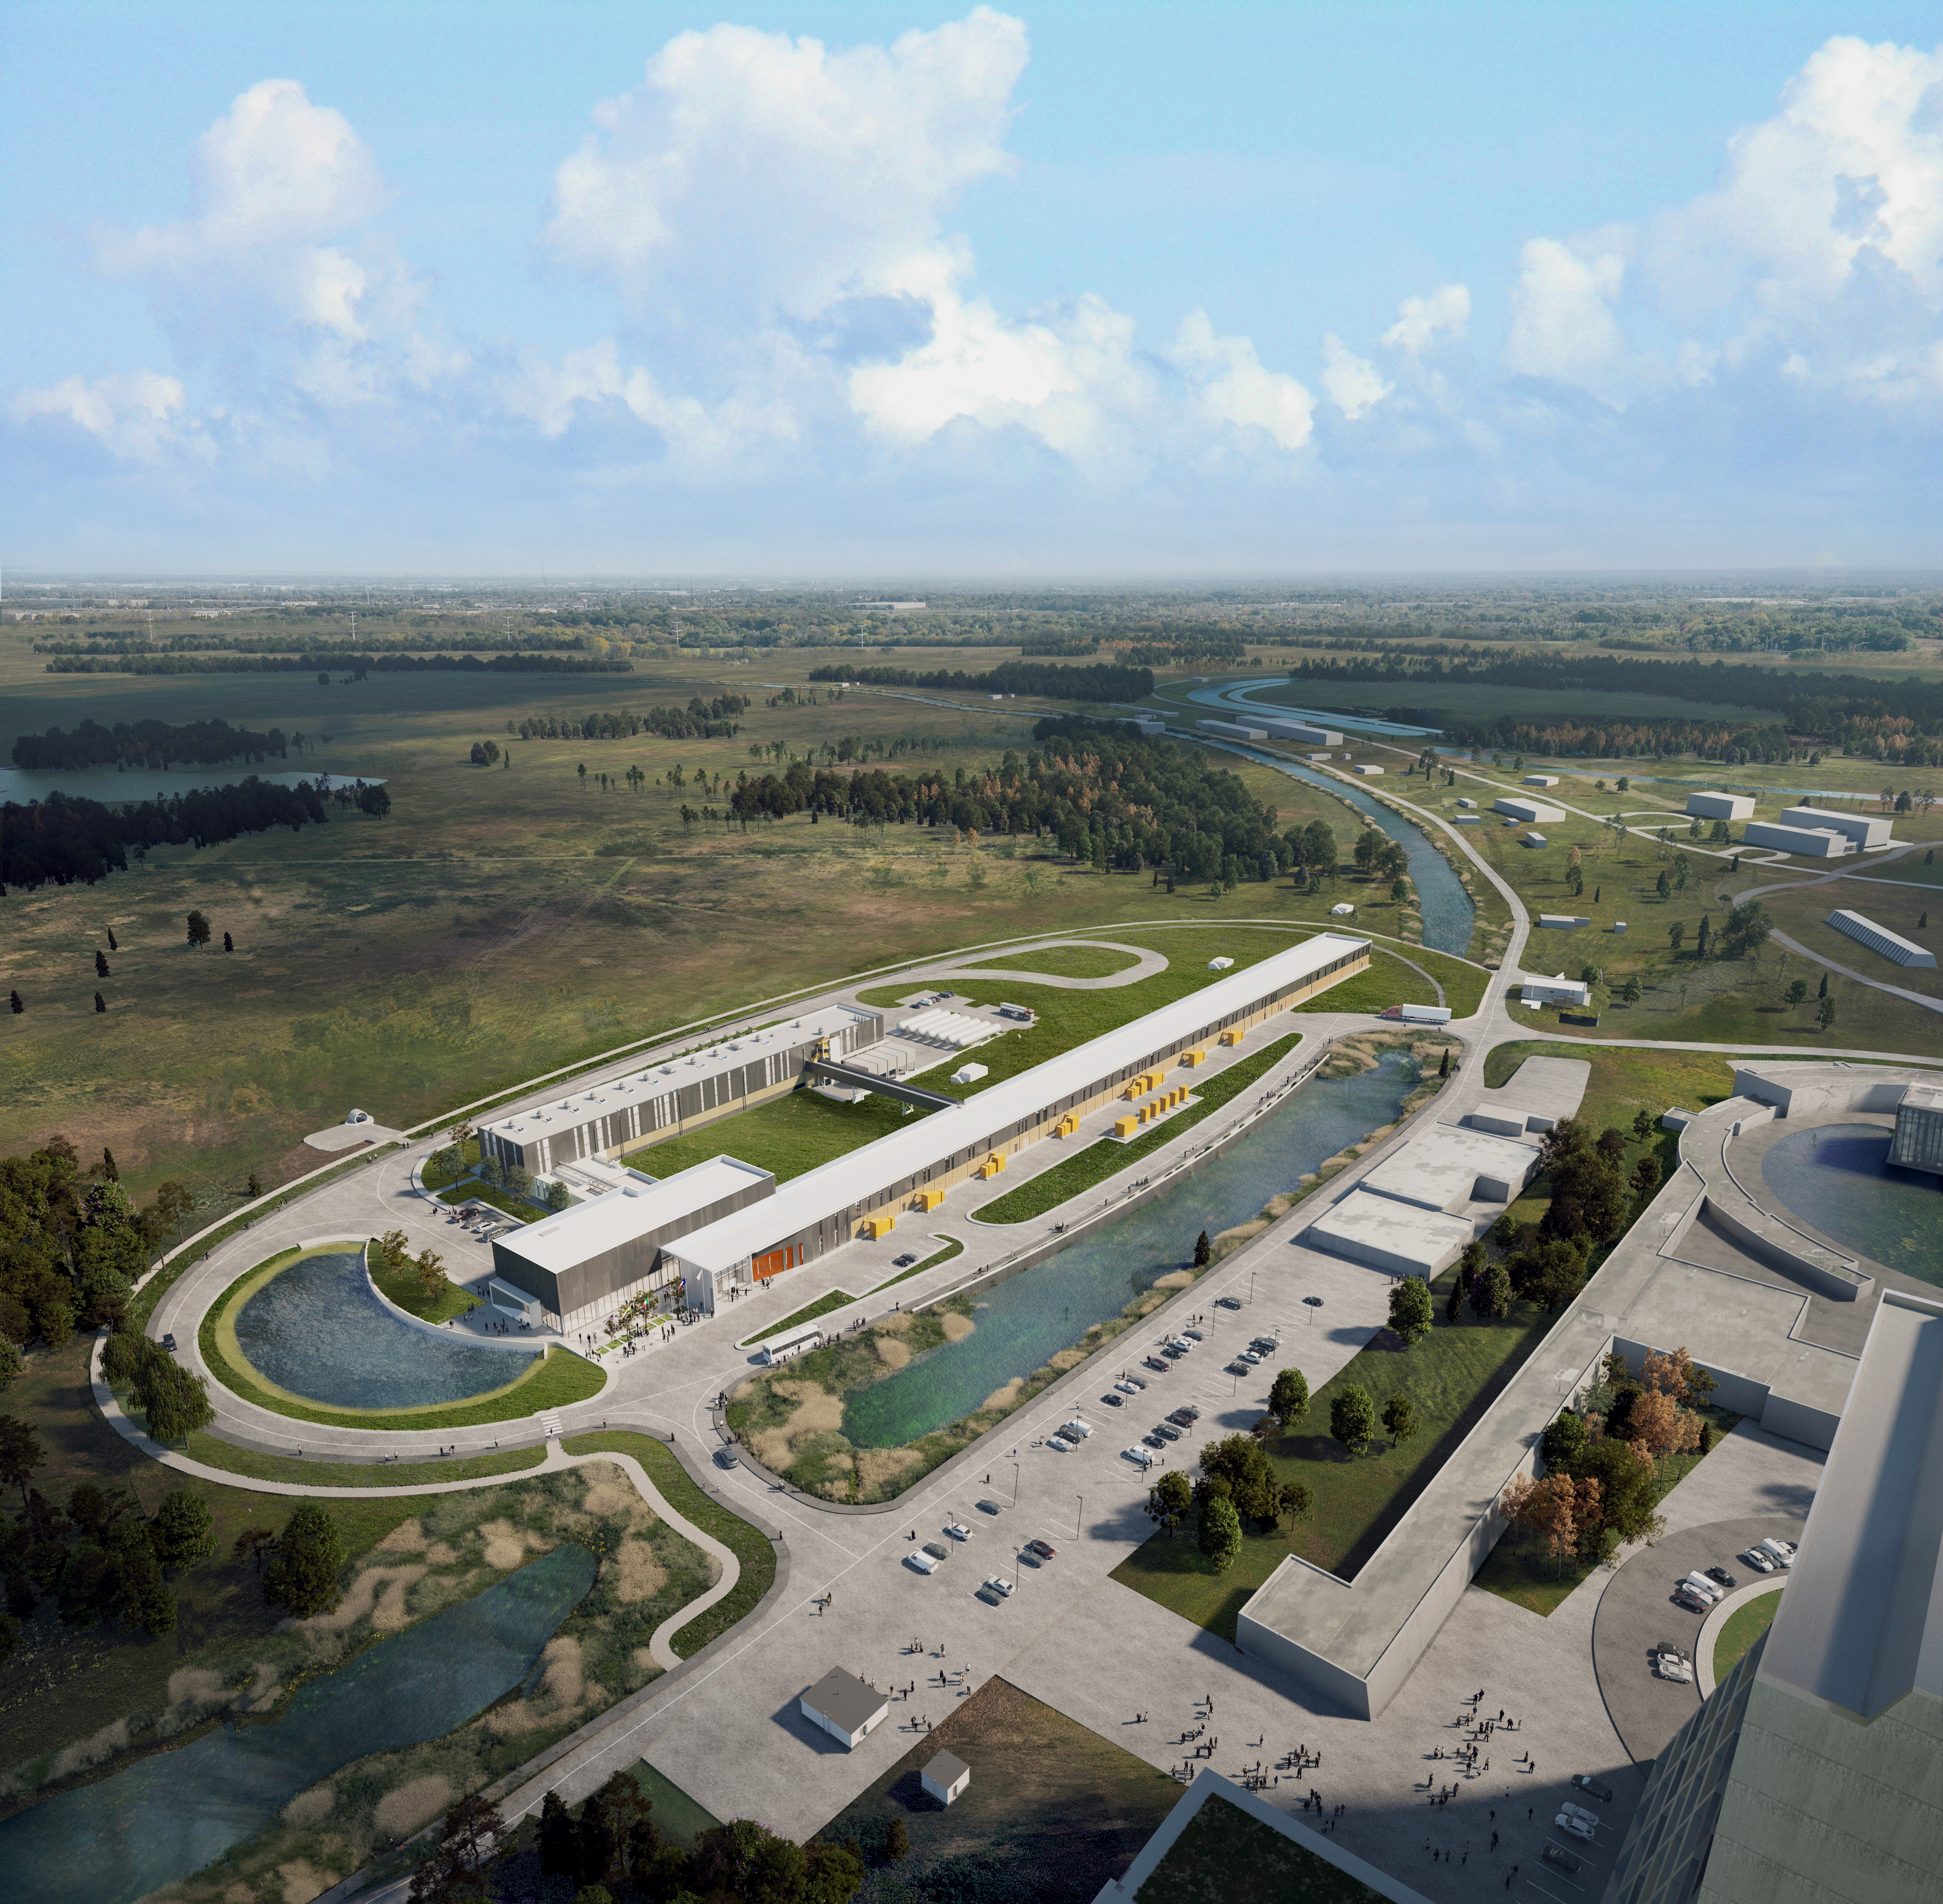
THE FUTURE OF FERMILAB
Follow us:
http://pip2.fnal.gov/
/showcase/pip-ii/

Slide 27
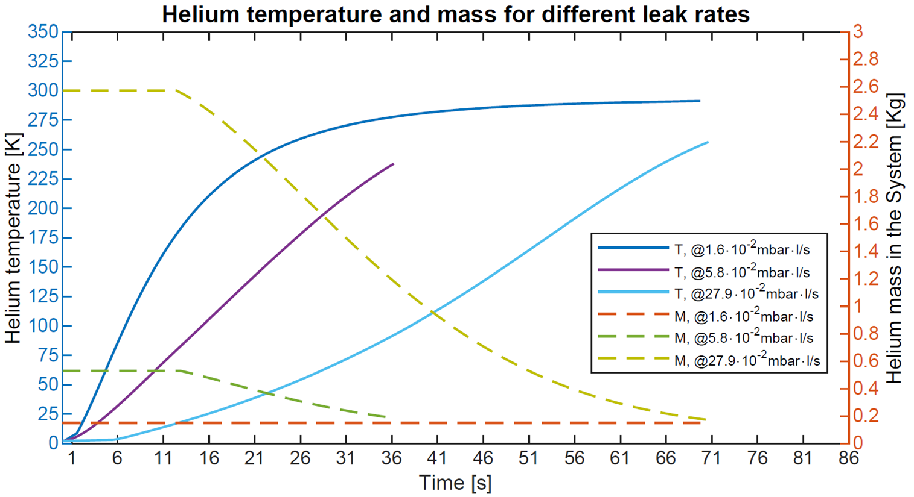
Results and Conclusion
For a defect with a leak rate < 1.6 · 10⁻² mbar·l/s the burst disk will not open.
The maximum allowed leak rate is 27.9 · 10⁻² mbar·l/s. The beamline volume reaches the MAWP.

