Slide 2
ESS Cryomodule design, PED strategy and operating experience
PRESENTED BY Nuno ELIAS (on behalf of SRF team)

Slide 3
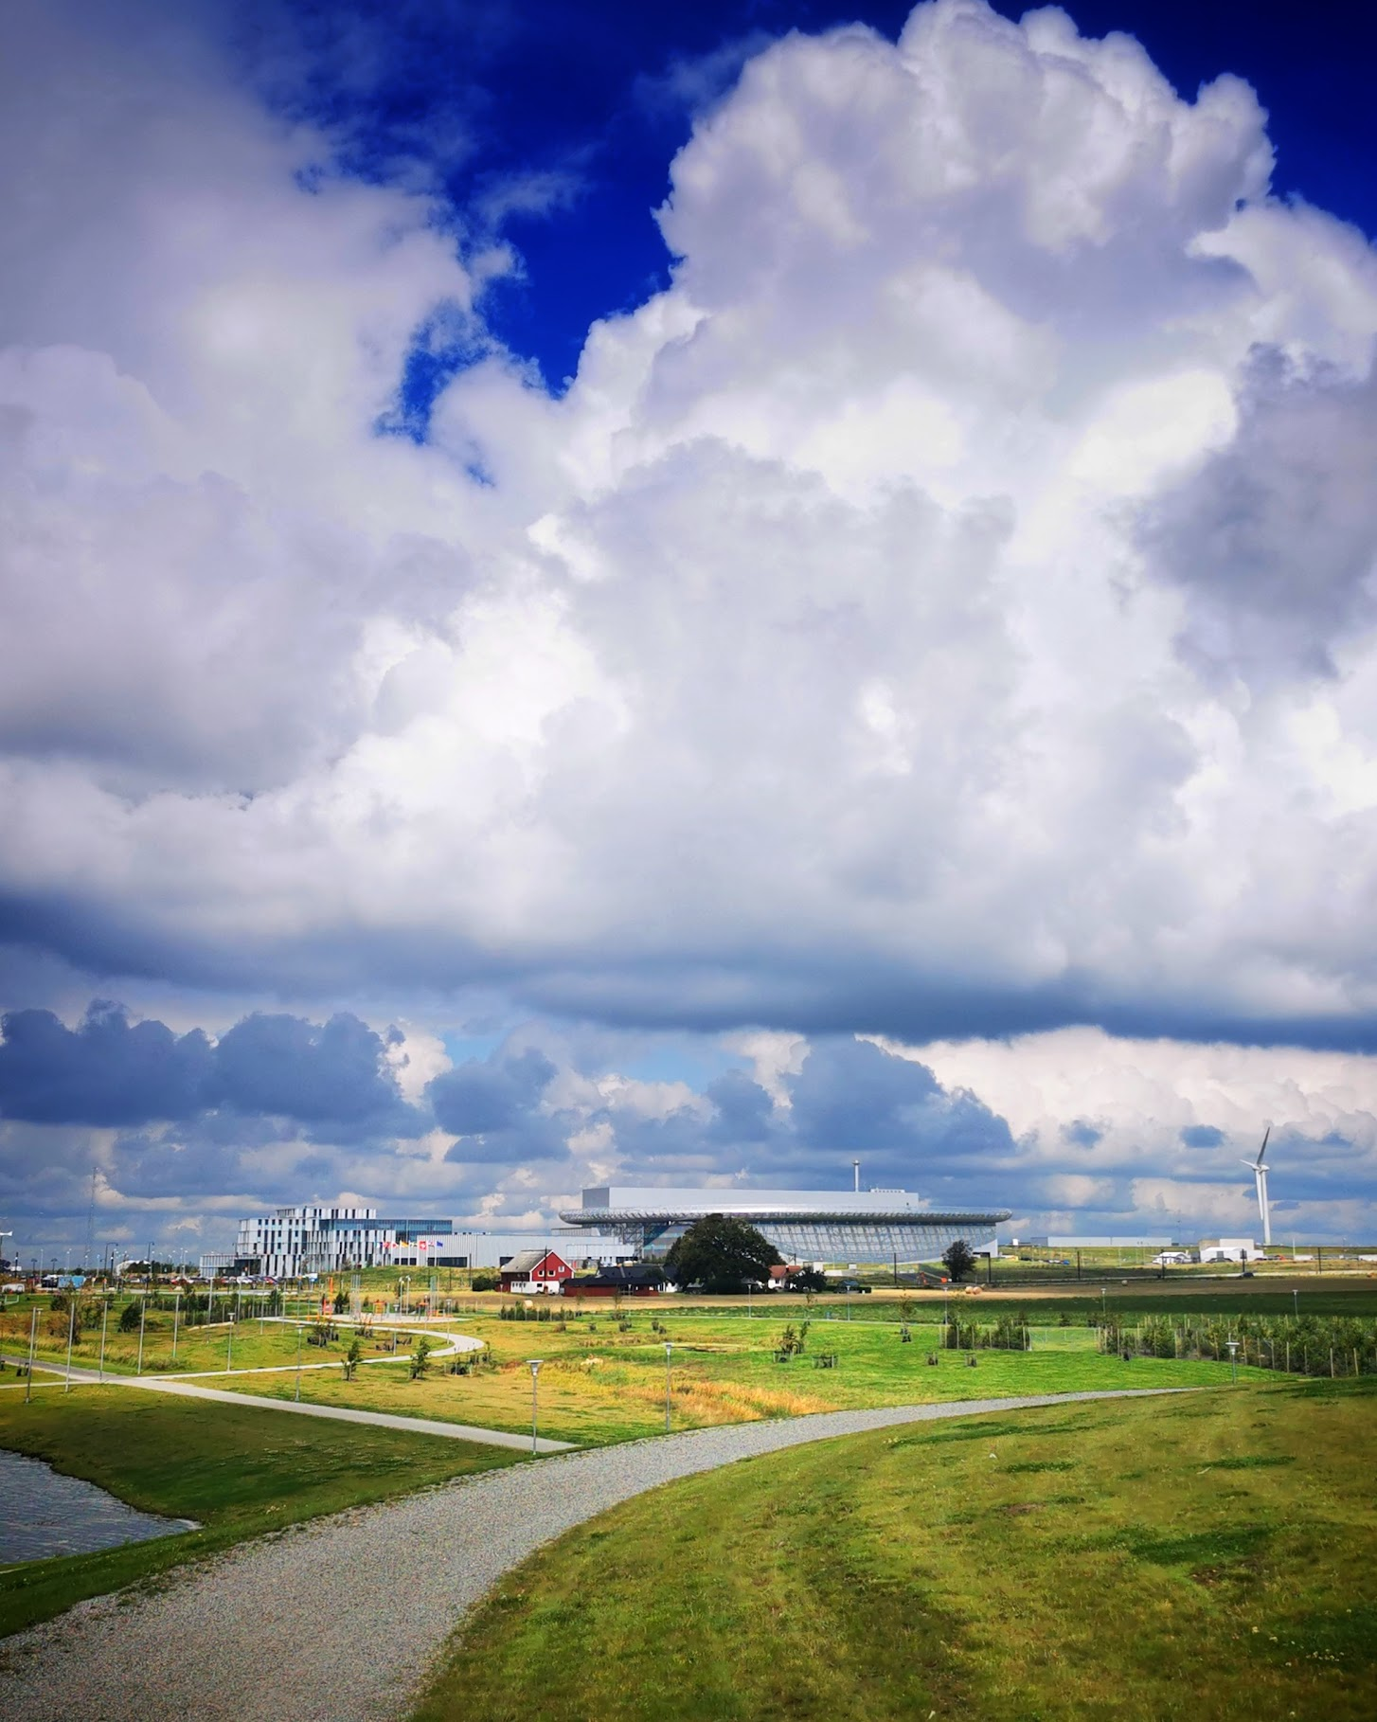
2
ESS CM Design

Slide 4
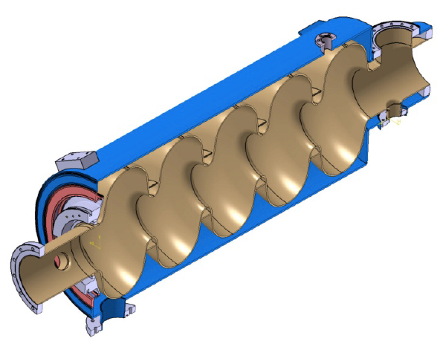
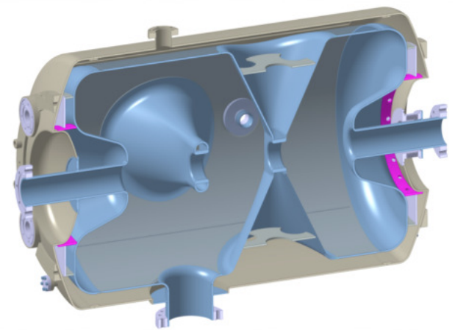
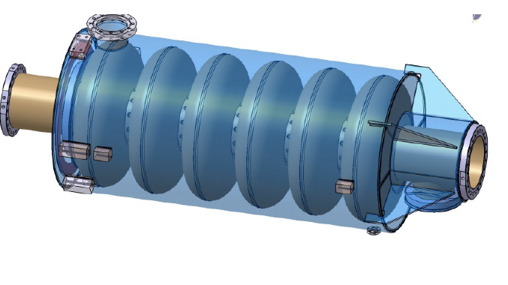
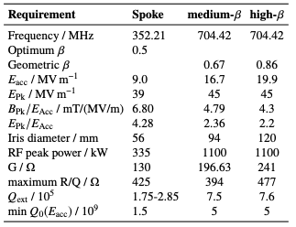
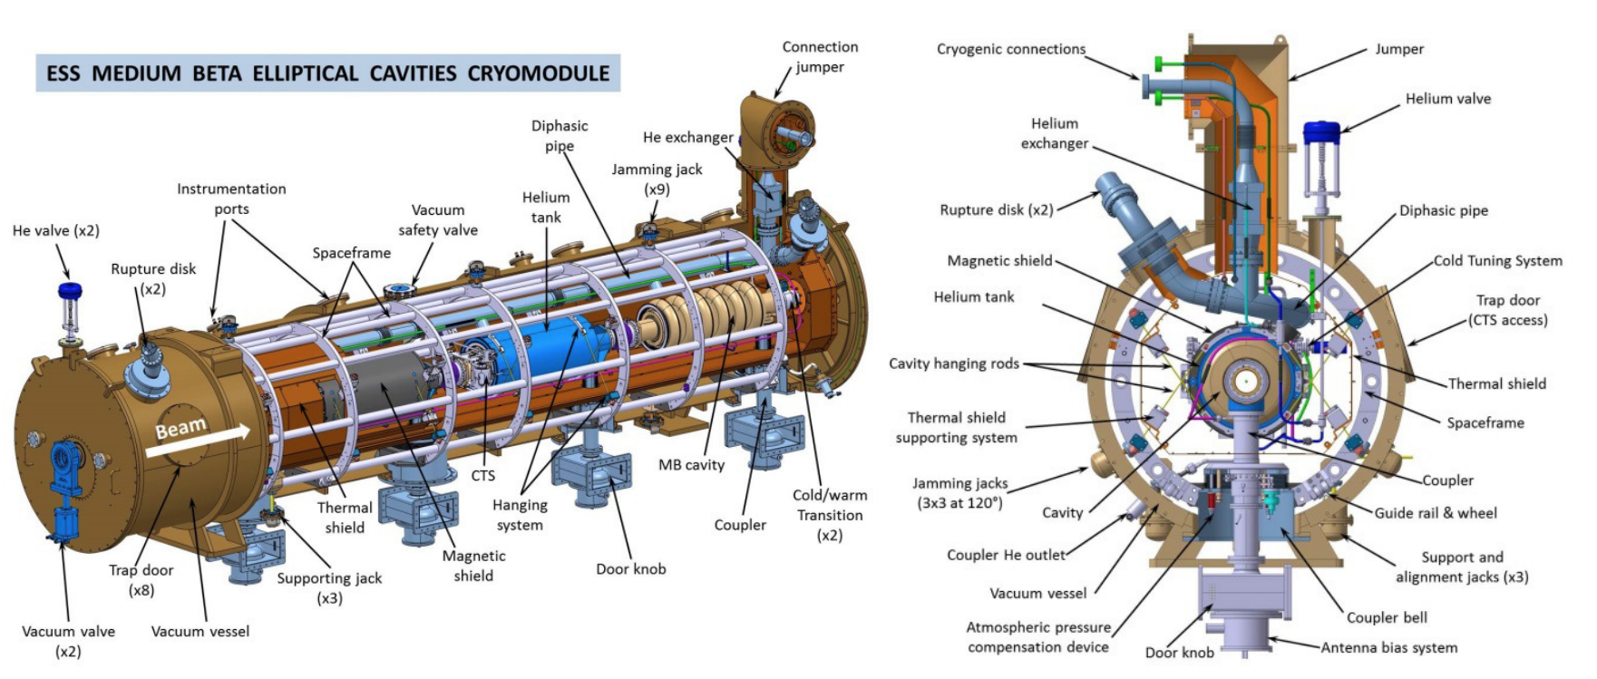
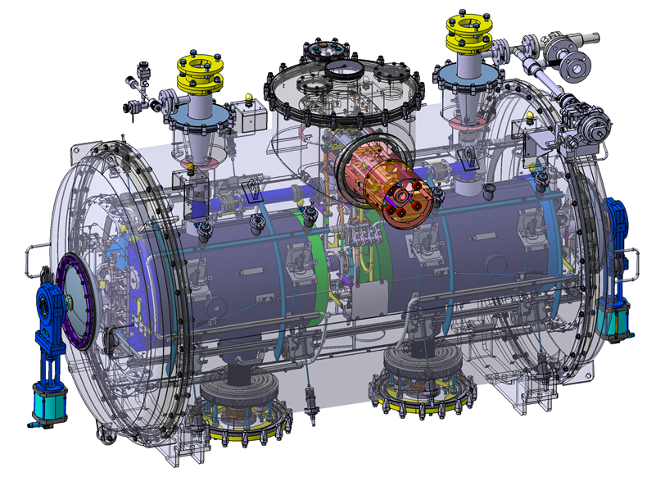
ESS Cavities and Cryomodules
Summary
Spokes
Medium Beta
High Beta
IJC-LAB (ZANON)
INFN-LASA (ZANON)
STCF (RI)
IJC-LAB
CEA

Slide 5
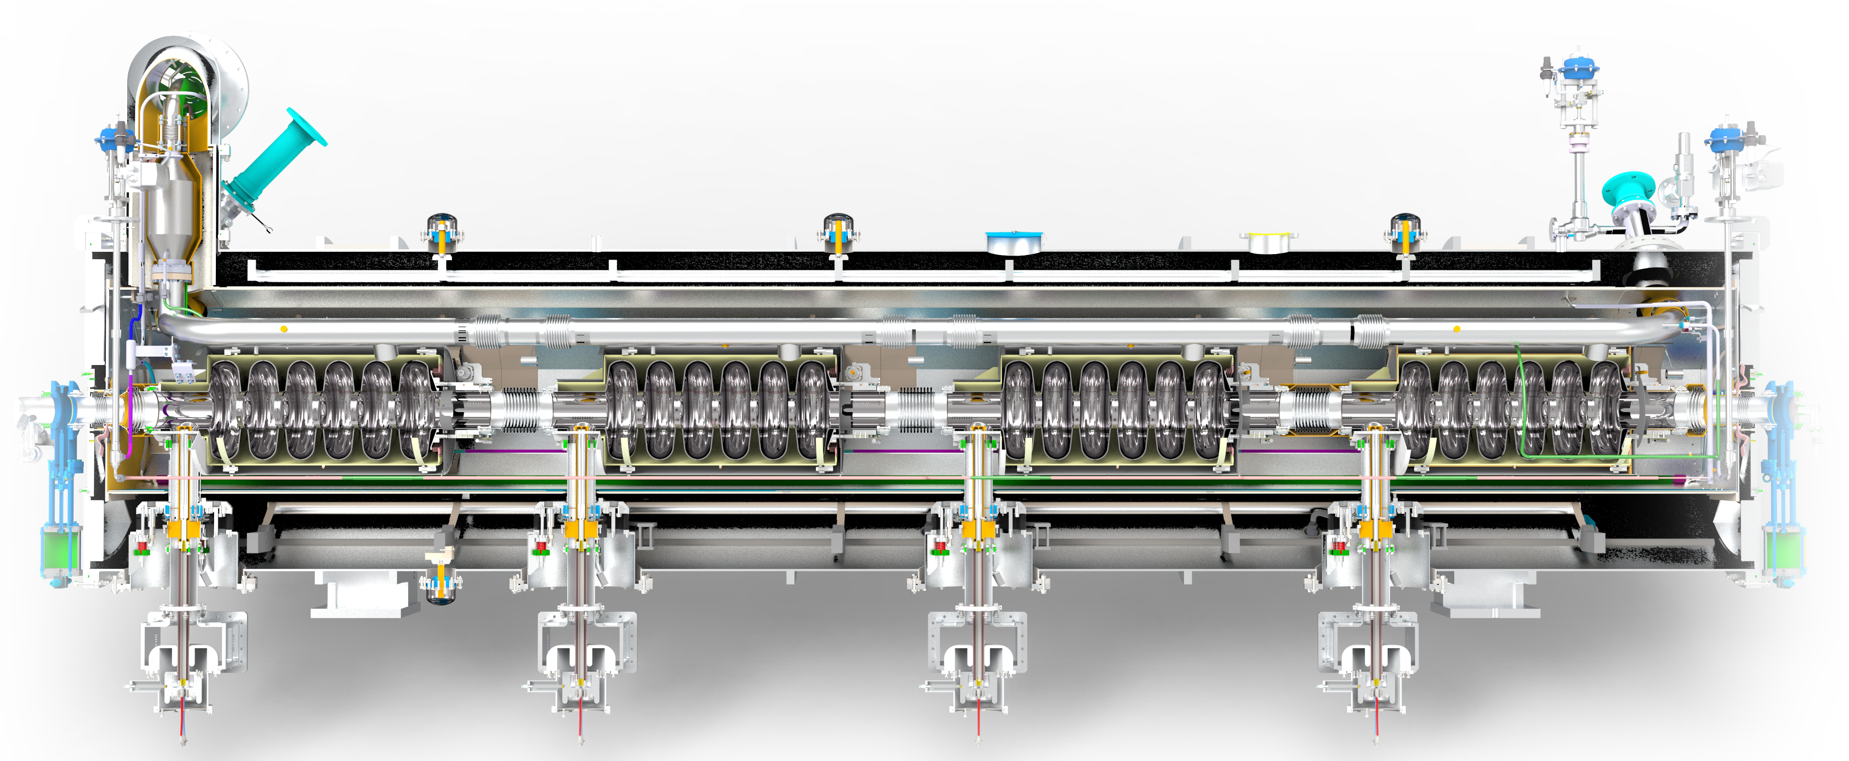
ESS Elliptical cavities Cryomodule
Sub-headline to strengthen the headline above
Jumper connection to Vbox
Burst Disk
Fillling valve
Safety Valve
Diphasic line
FAV
JT valve
HX
Burst disk
Tuner
He guard
PC
DKnob
Space -frame
Credits: T. Grandsert, N. Elias
Source: CEA

Slide 6
Some views of the internal circuits

Slide 7
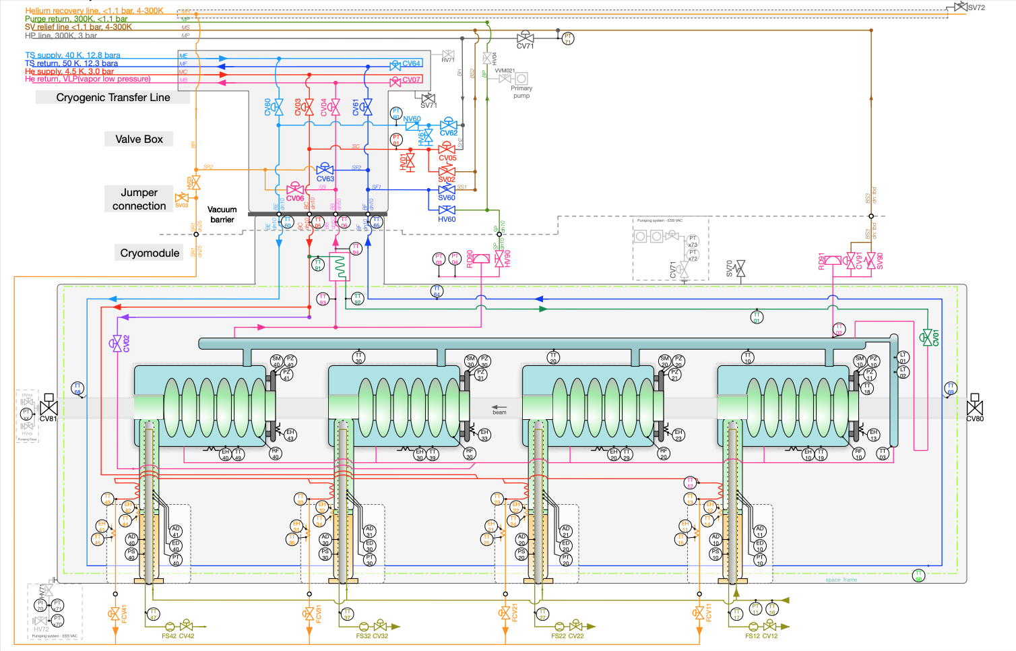
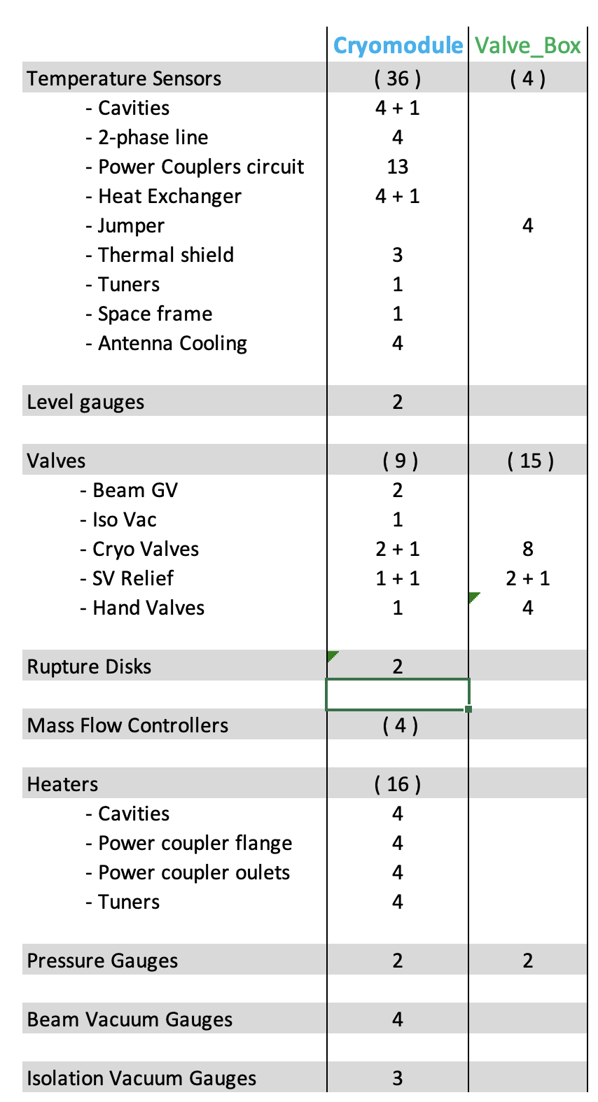
Process Diagram
Instrumentation and Devices

Slide 8
Process Diagram
Circuits breakdown
Circuits (jumper interface)
- Thermal Shield supply
- Thermal Shield return
- Helium supply line (4.5K)
- Helium return line (vapour return)
Additional Internal circuits:
- Helium supply (CV02)
- Helium supply (CV01)
- Power coupler DWC supply
Auxiliary circuits:
- HP line
- Purge return
- Helium recovery line
- Safety relief line

Slide 9
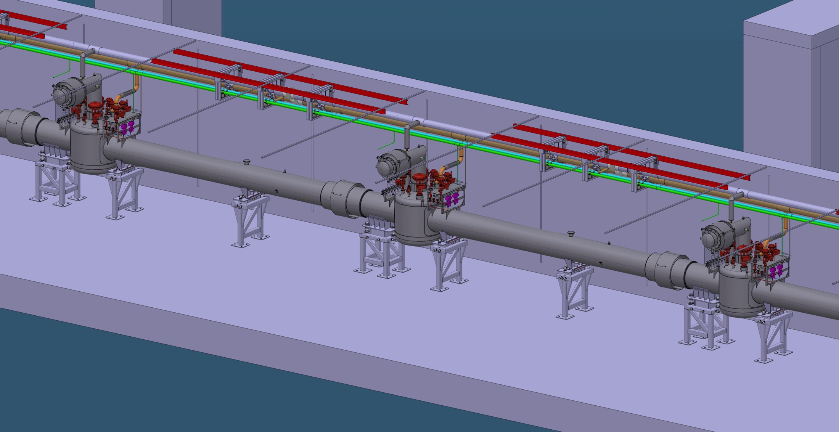
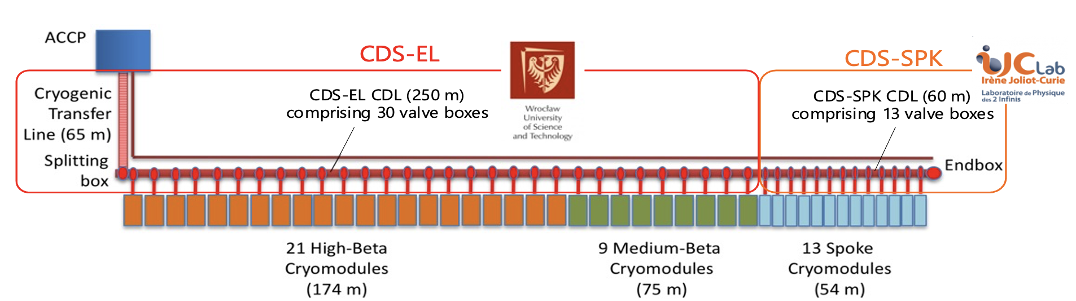
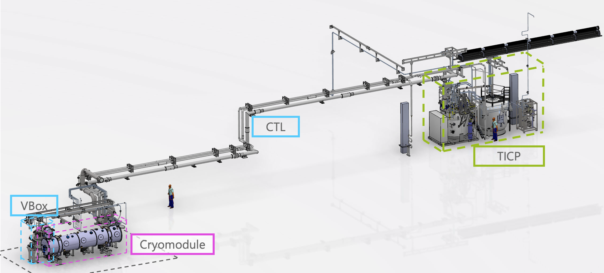
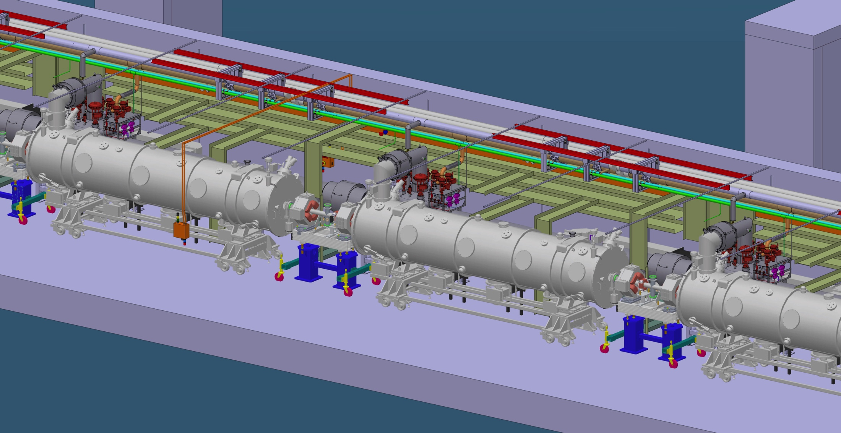
CMs and Cryogenics distribution
Accelerator & Test Facility (TS2)
Accelerator
TS2

Slide 10

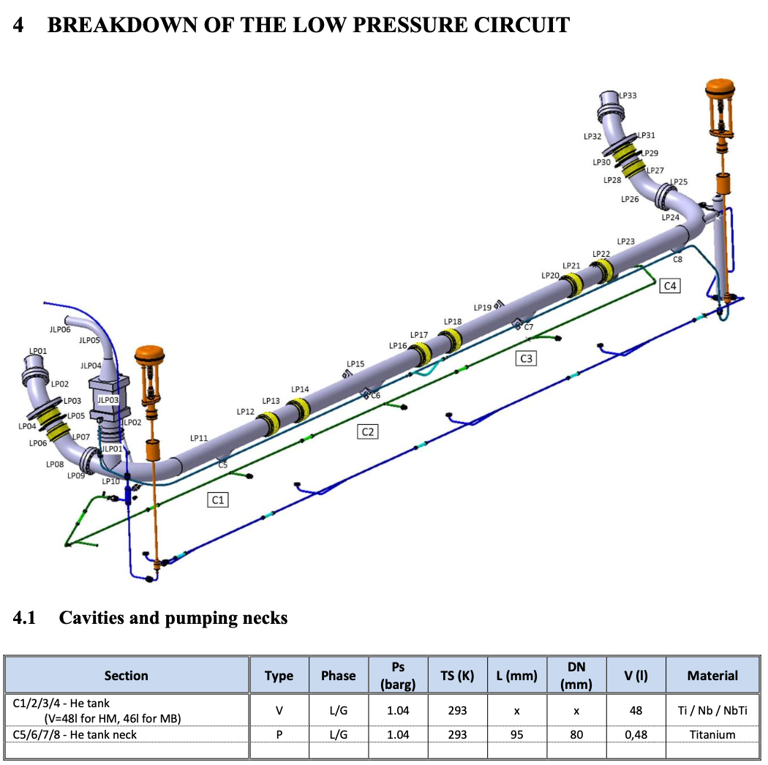
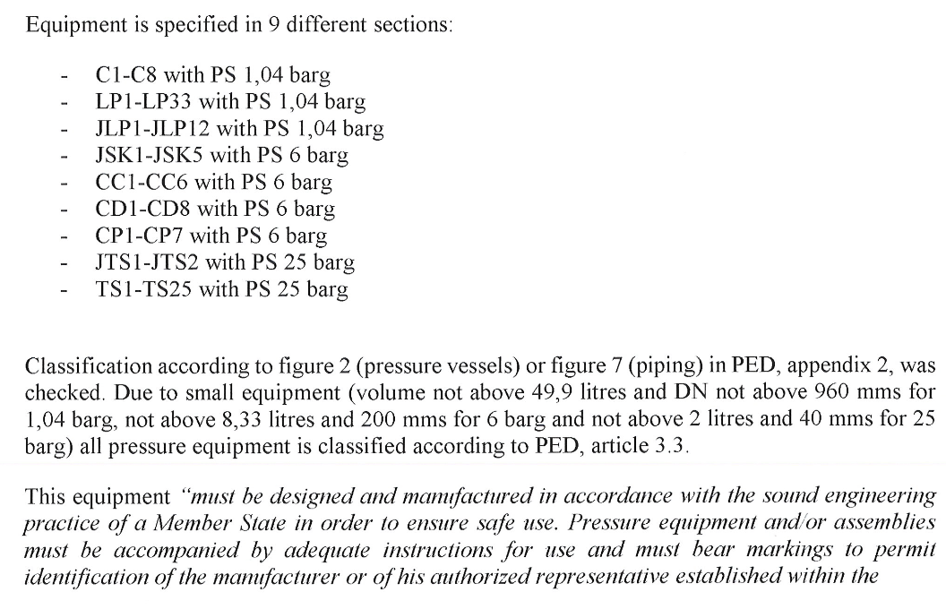
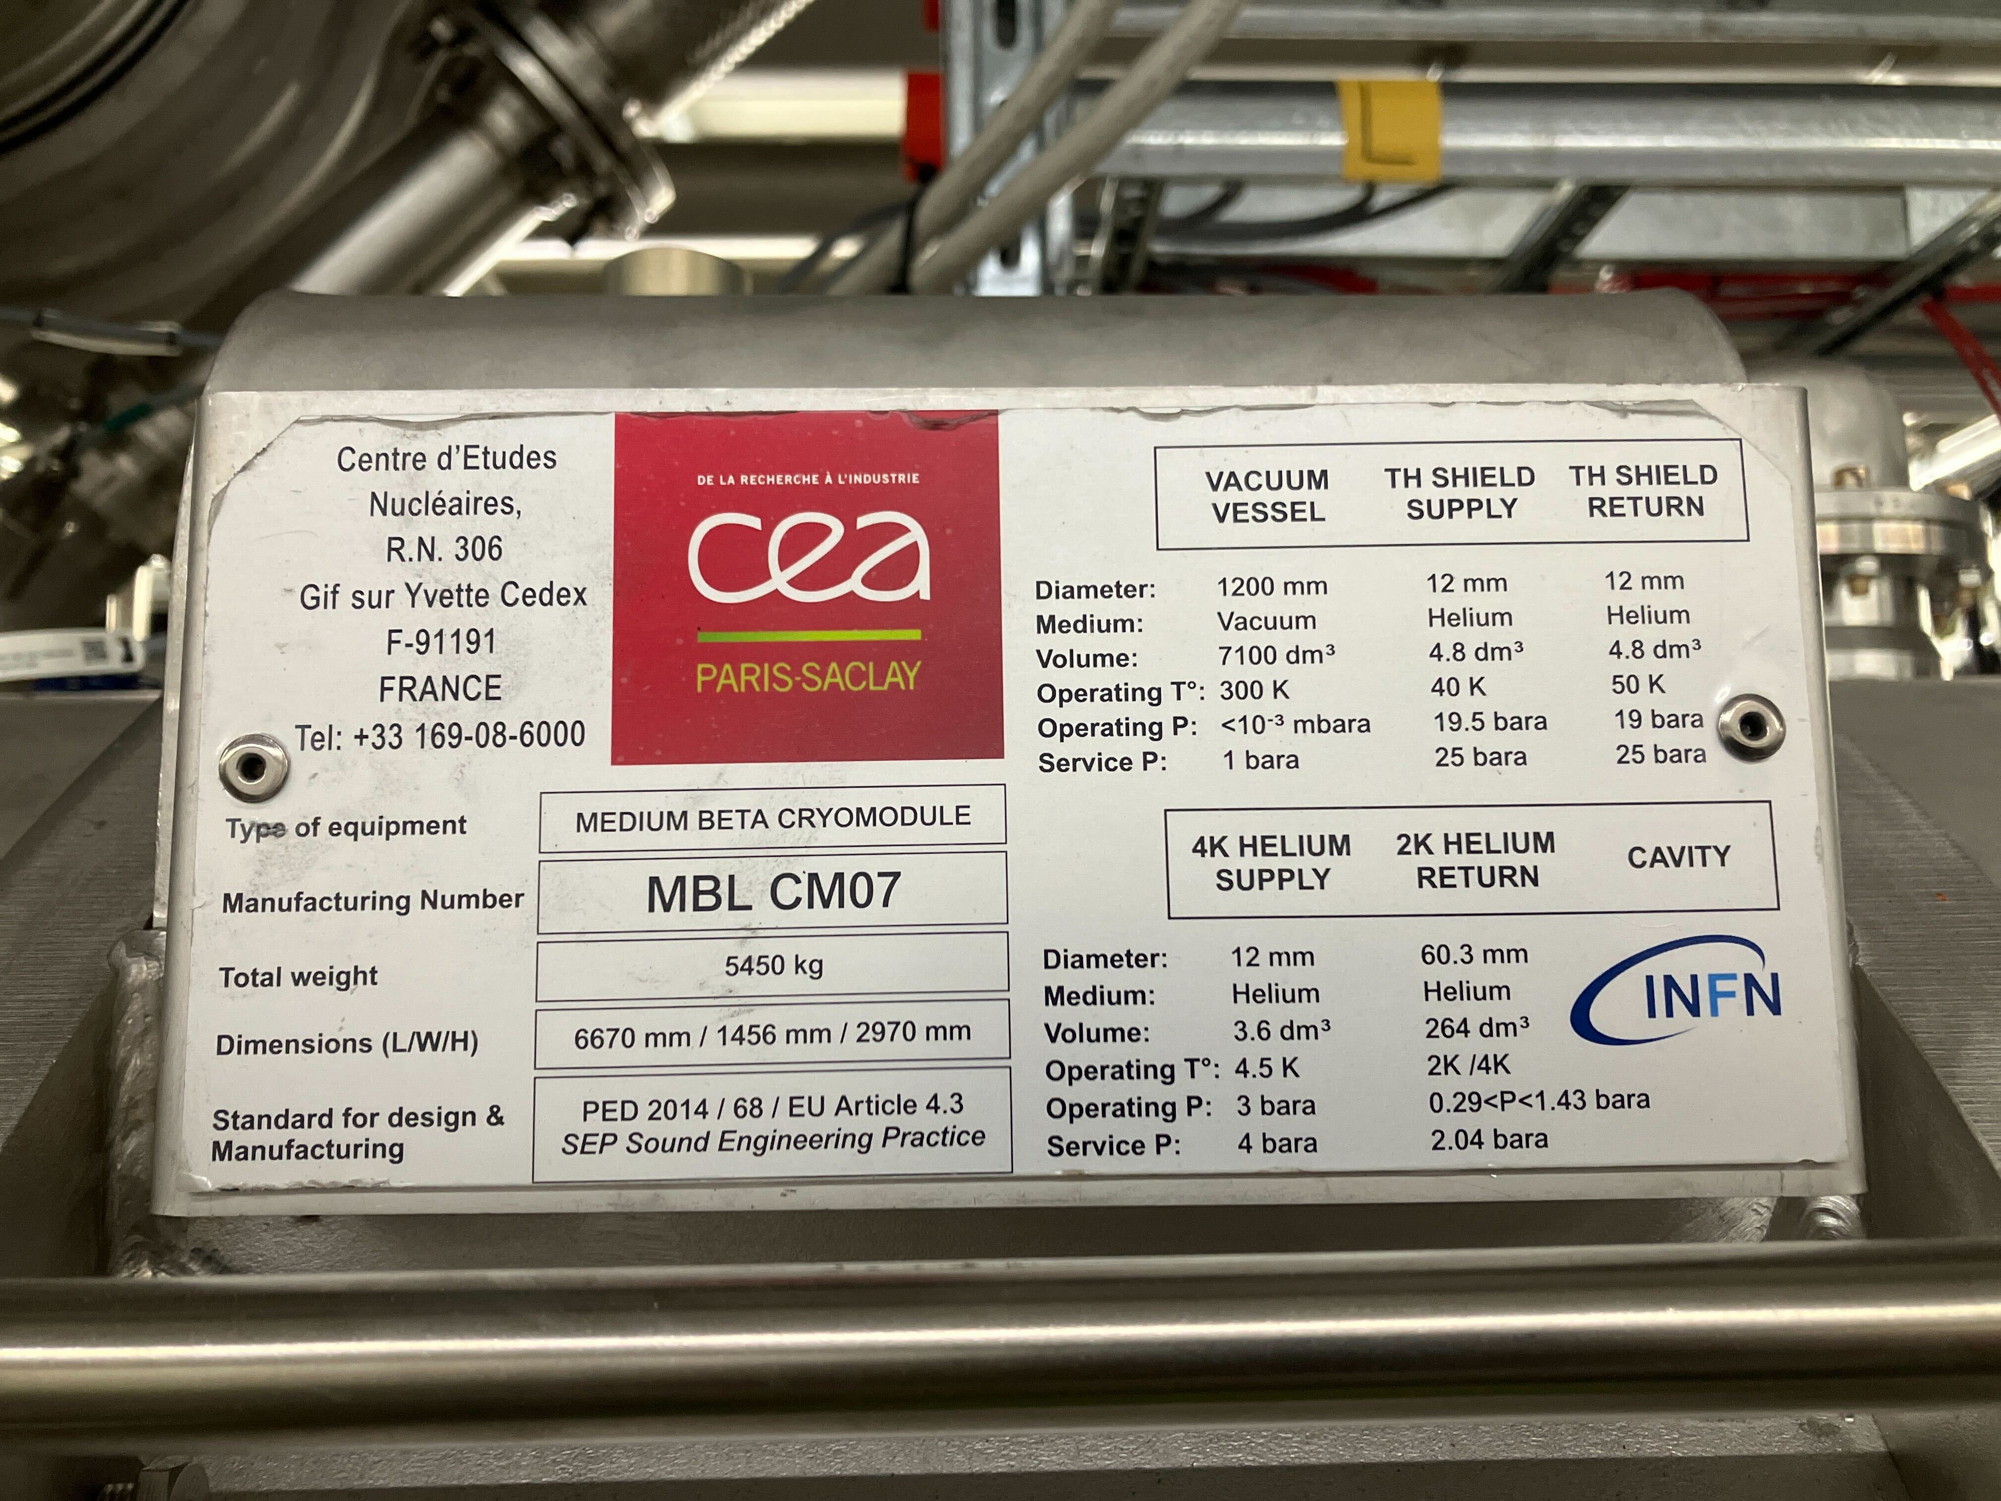
PED strategy
Sub-headline to strengthen the headline above
Cryomodule and its circuits is designed and manufactured according to Standard PED 2014/68/EU Article 4.3
+Swedish standard AFS 2005:2
Service pressure =1.04barg (LP)

Slide 11
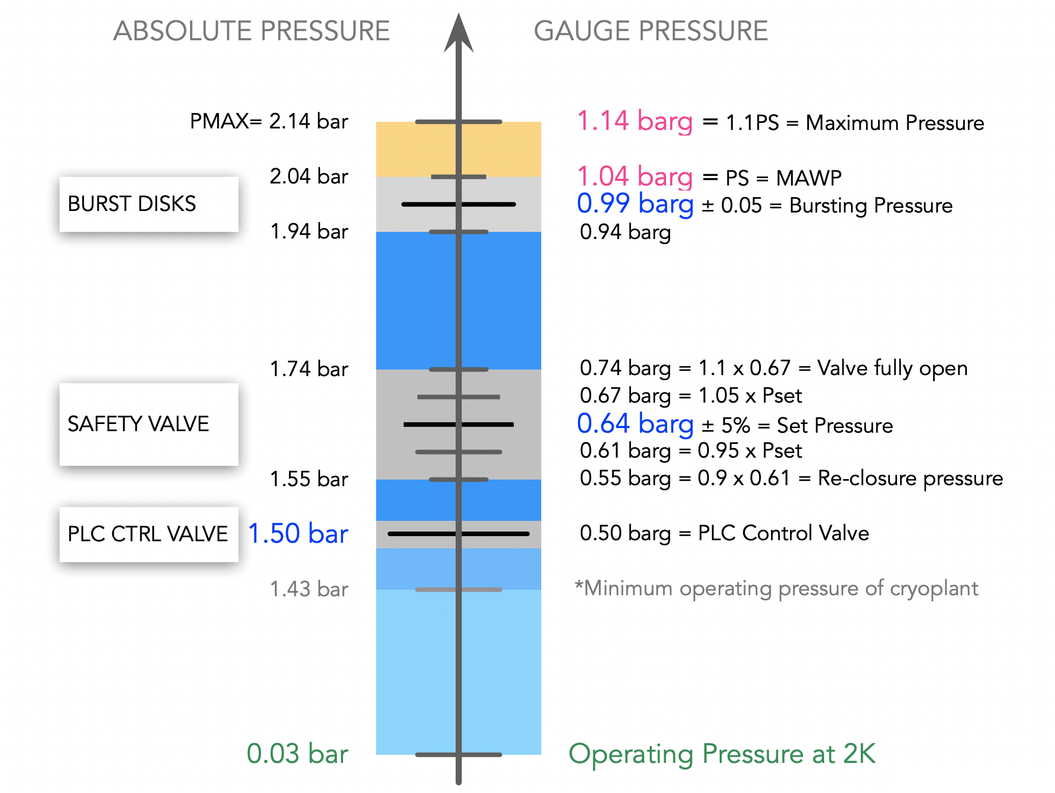
Pressure scale
Levels of protection
2 Rupture disks : Helium Collector
1 Pressure Relief valve : Safety relief line
1 Fast acting valve : Helium relief line

Slide 12
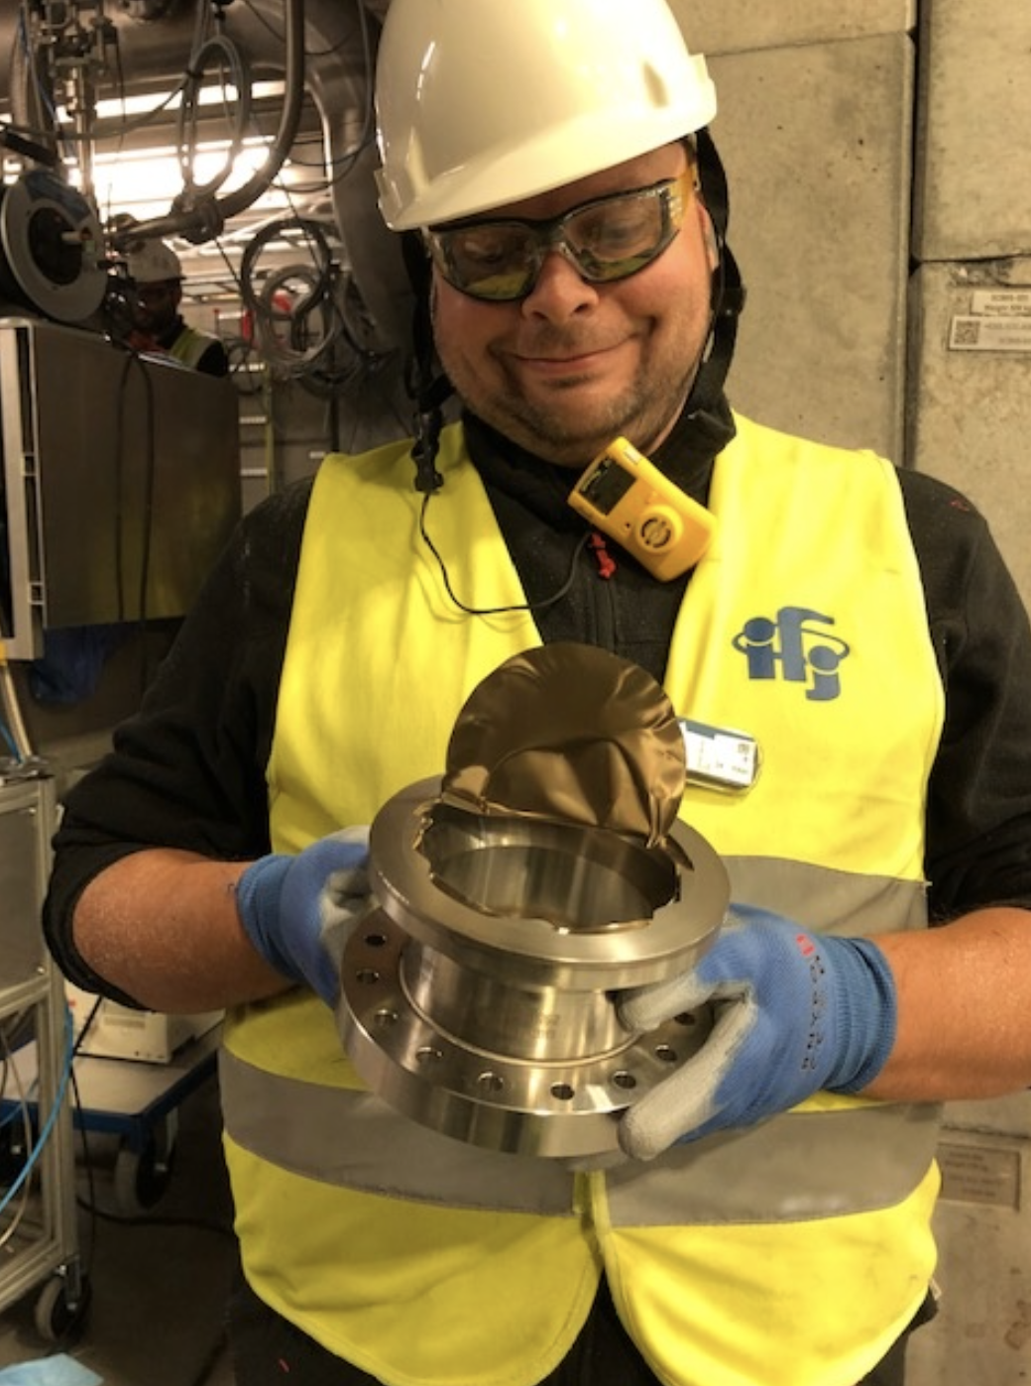
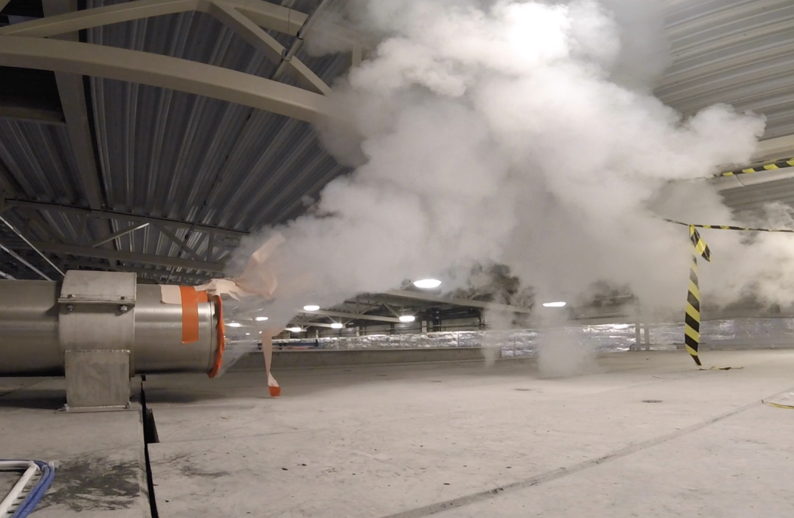
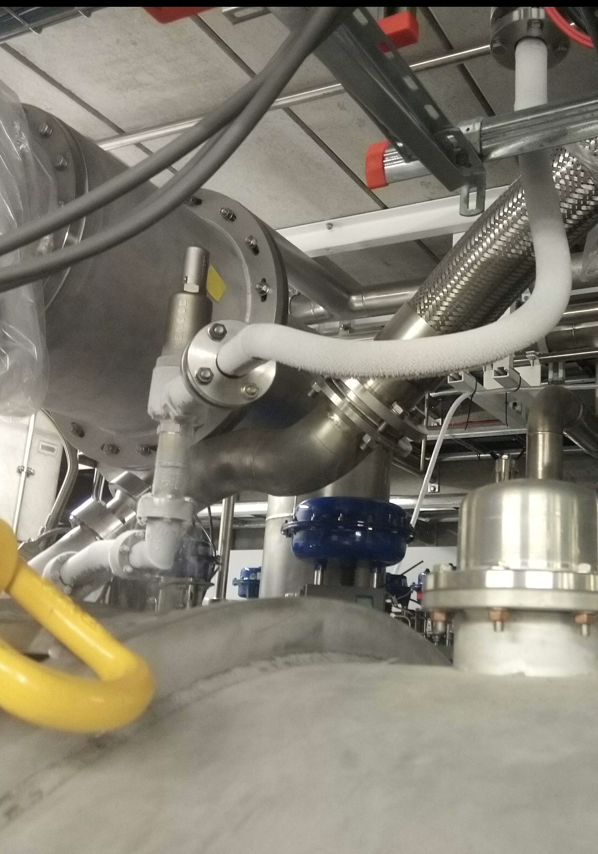
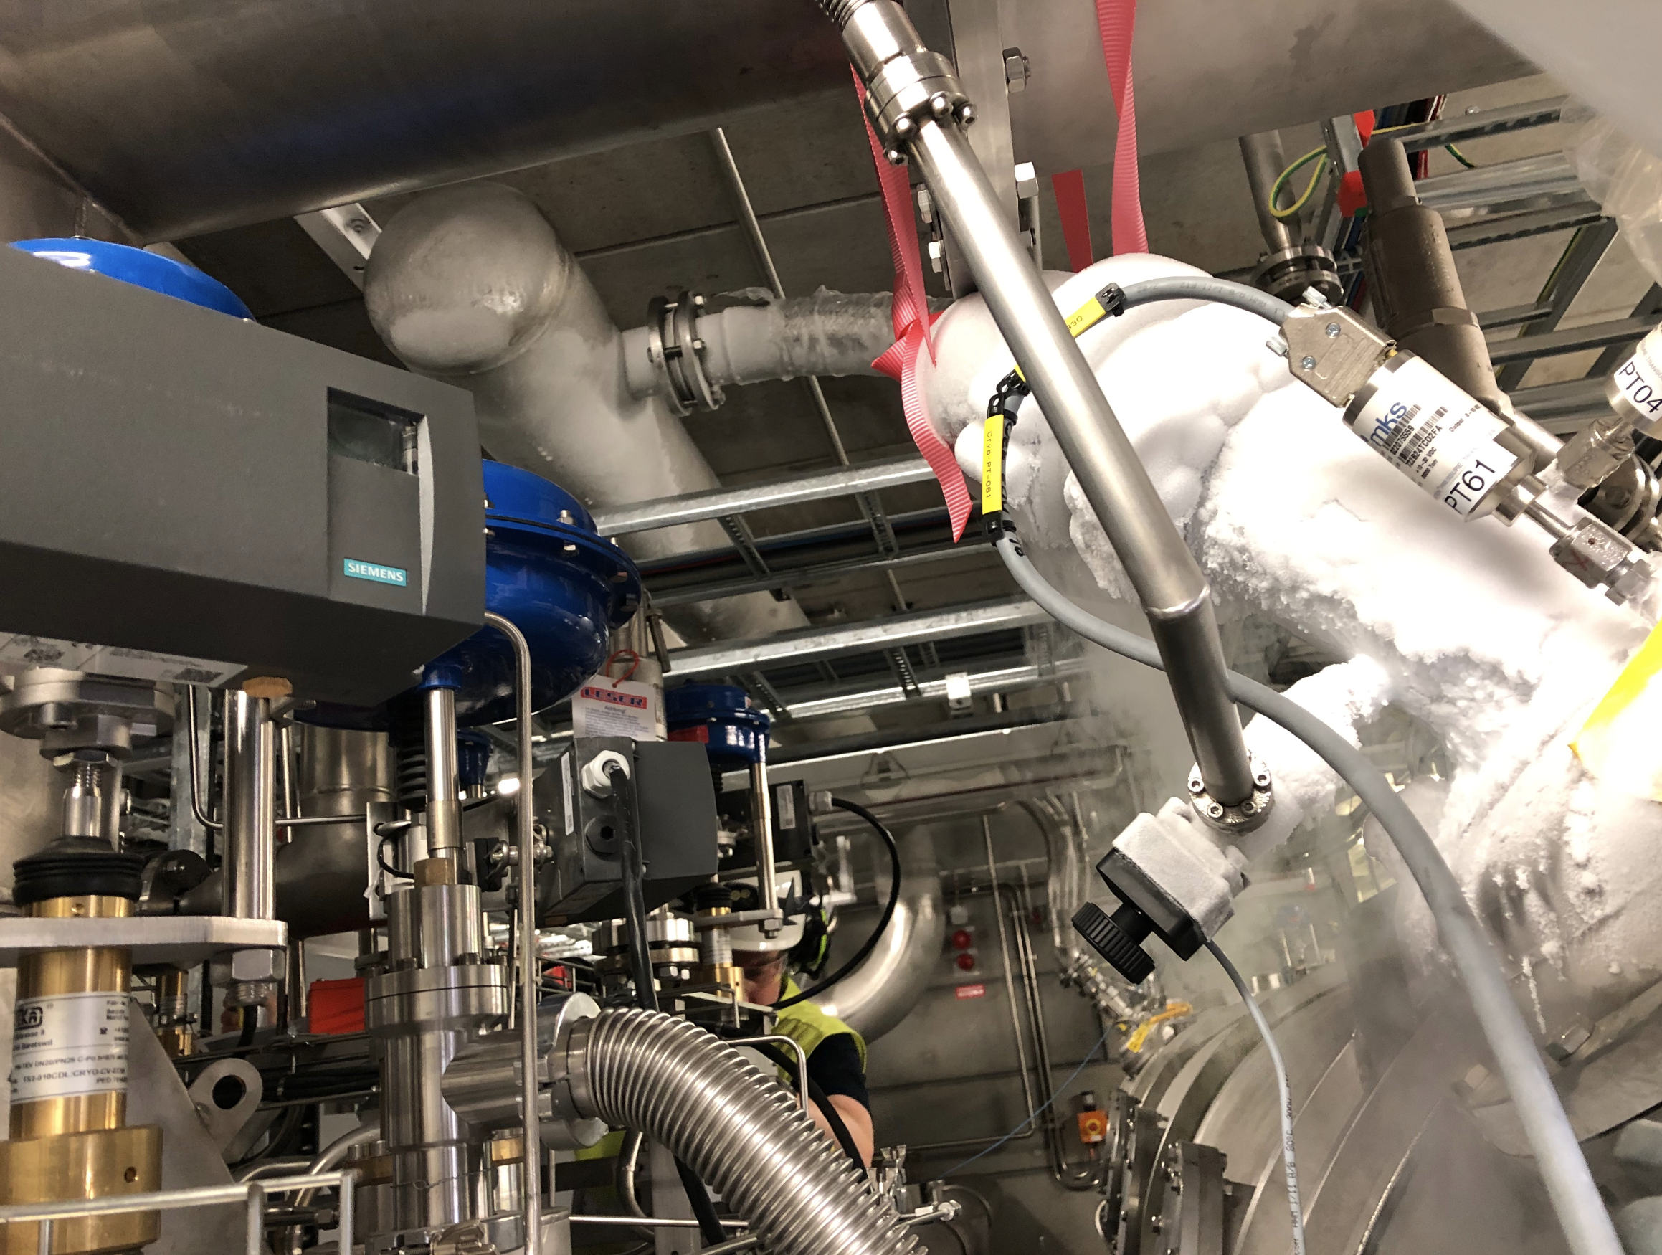
Testing our safety devices
Back in 2020
Goal:
Controlled Rupture Disc failure test
Involve H&S in out operations
Educate team on how to deal in such event,
Create procedures for exchange of rupture disk,
Have fun waiting for a bang and watching an helium discharge.
1) closure of return valve (SV)
2) simulation of compressor failure
3) reproduce CEA event: level overfilling

Slide 13
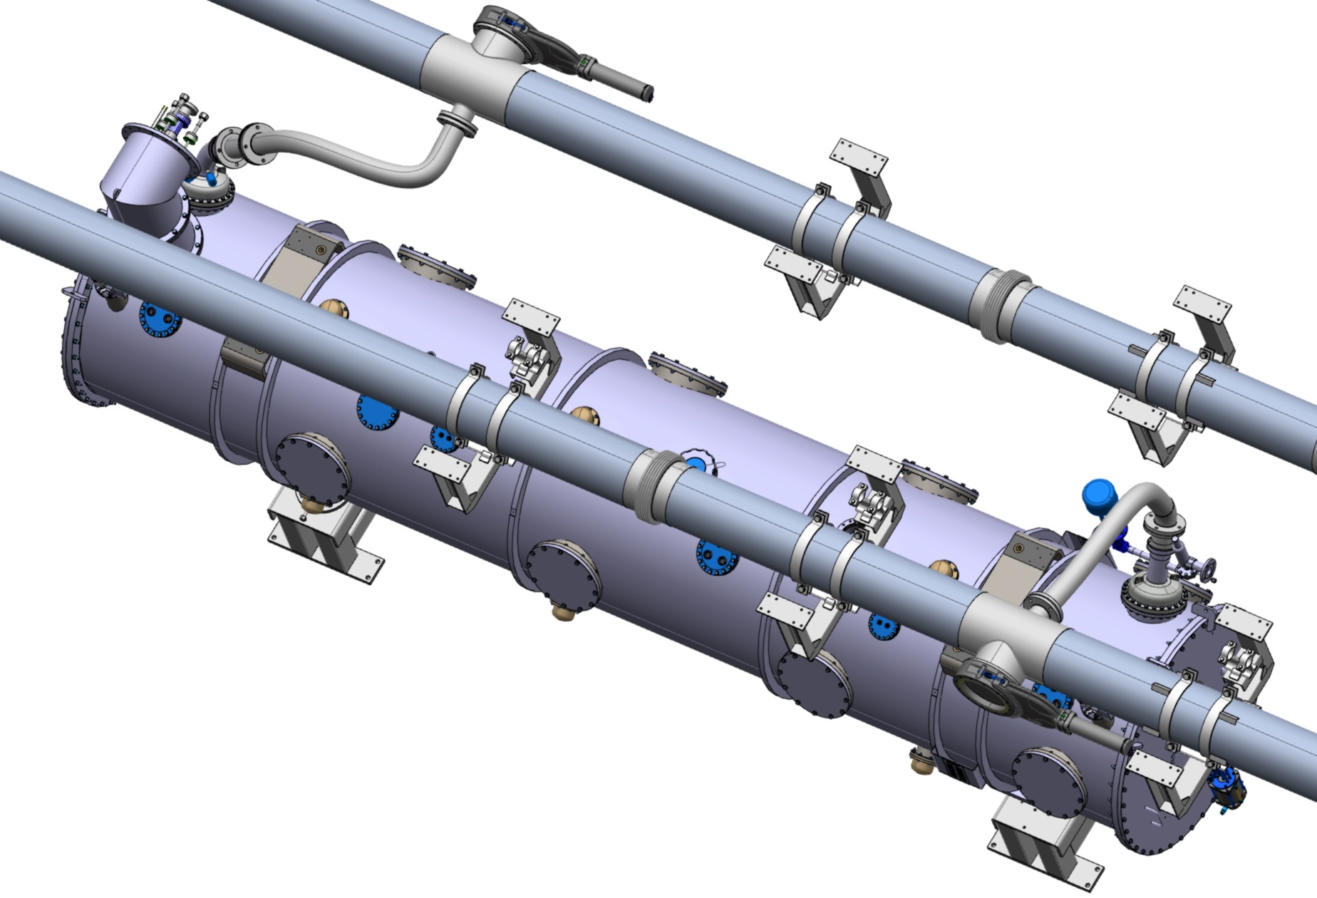
Safety Helium Collector
Helium Collector – Exhaust of Rupture Disks
Protecting people in the case of RD event
- 2 (warm) helium collectors, each connected to a RD
- Gate Valves on each collector can closed or open.
No tunnel access - Collector is inactive
- Gate valves are OPEN
- Helium Release takes place to tunnel.
Tunnel access granted- Collector is Active
- Gate valves are CLOSED
- Helium Release takes place into collector.

Slide 14
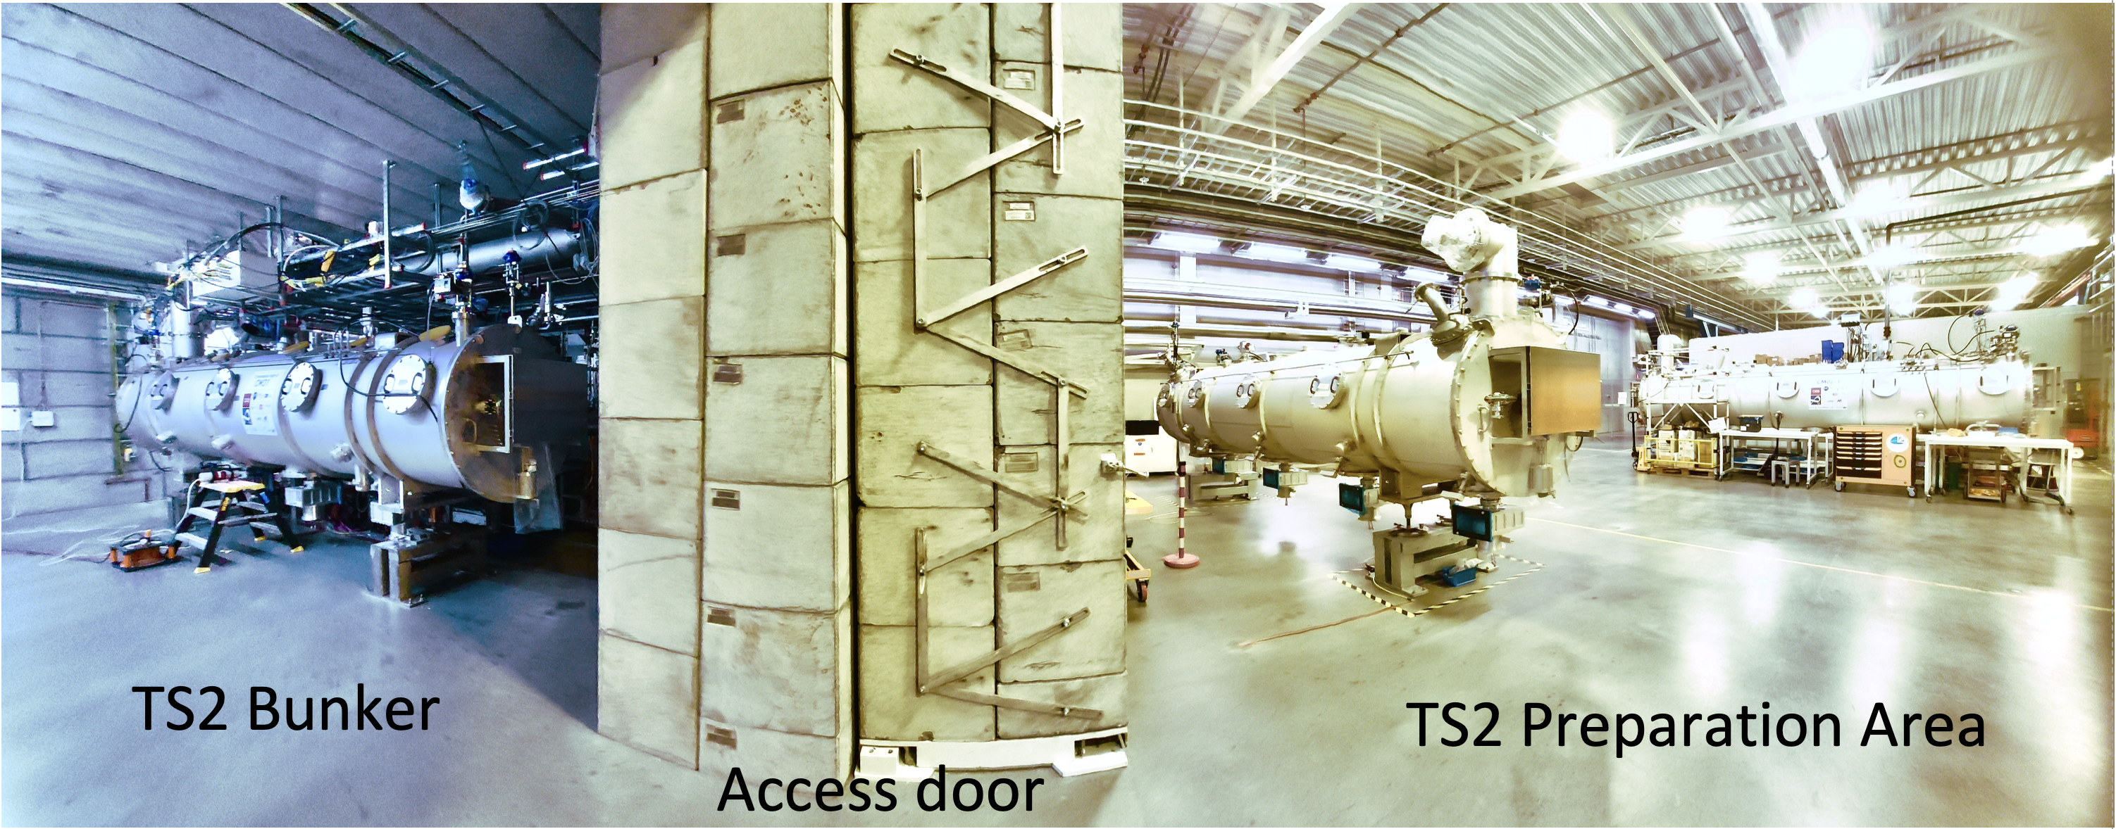
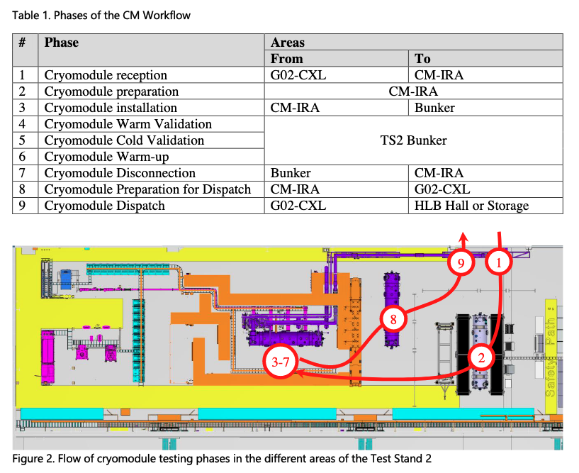
2
Operation Experience

Slide 15


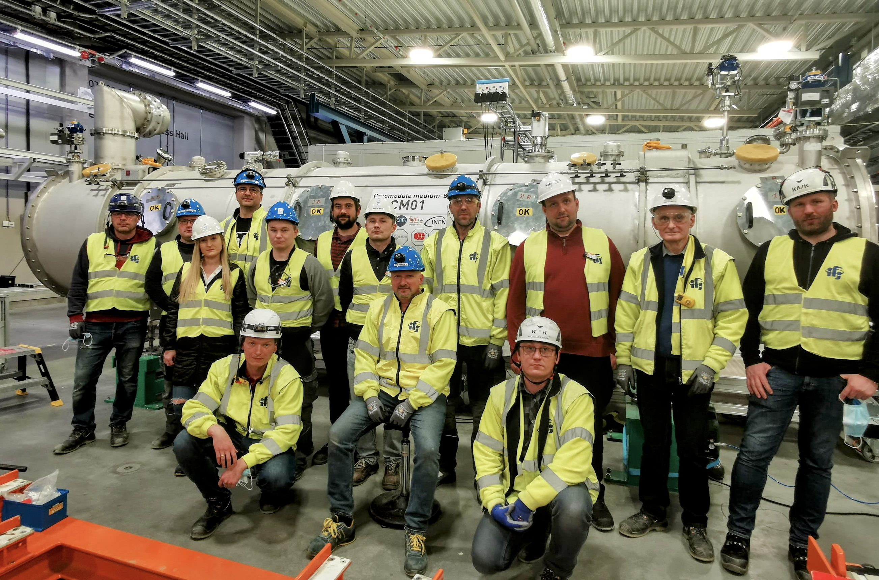



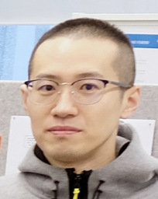



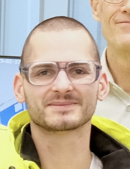
Operating Experience
Teams and support
SRF section @
Nuno
Henry
Cédric
MuYuan
Cecilia
Wolfgang
Philippe
+ICS, CRYO, VAC, RF, RP, INFRA, S&Align, Rigging, OPs teams

Slide 16
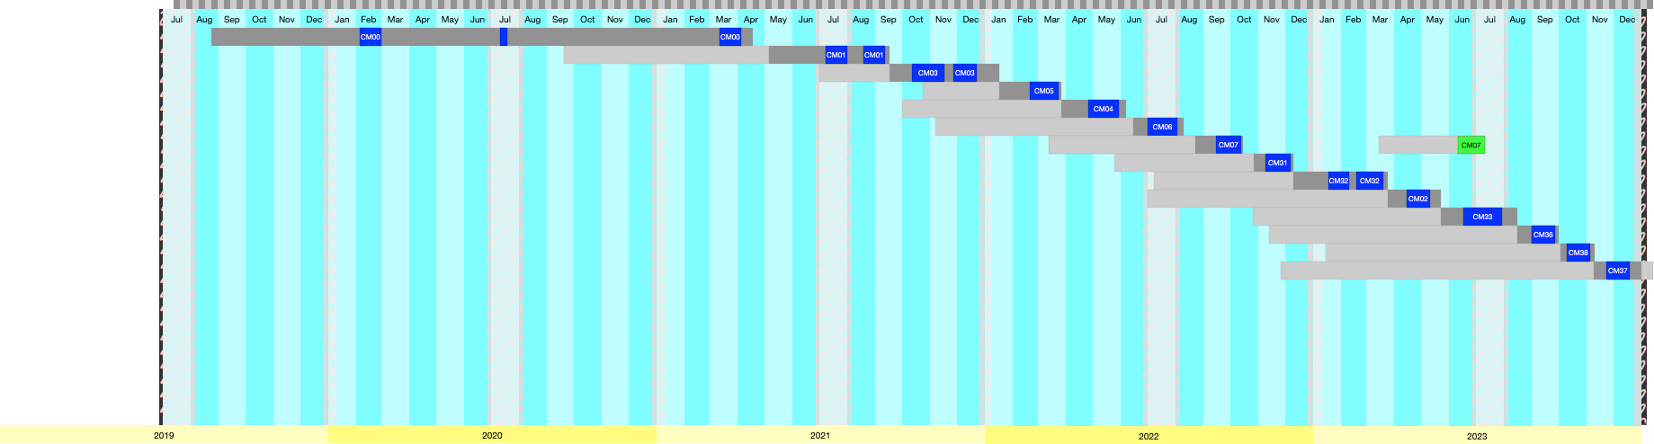
Operating Experience
TS2 and FREIA
Test Stand 2: A total of 14 Elliptical Cryomodules tested (19 CD – WU cycles)
LINAC: 1 Elliptical (pilot installation)
FREIA: A total of 13 Spoke Cryomodules tested / 1
LINAC: 1 Spoke (pilot installation)

Slide 17
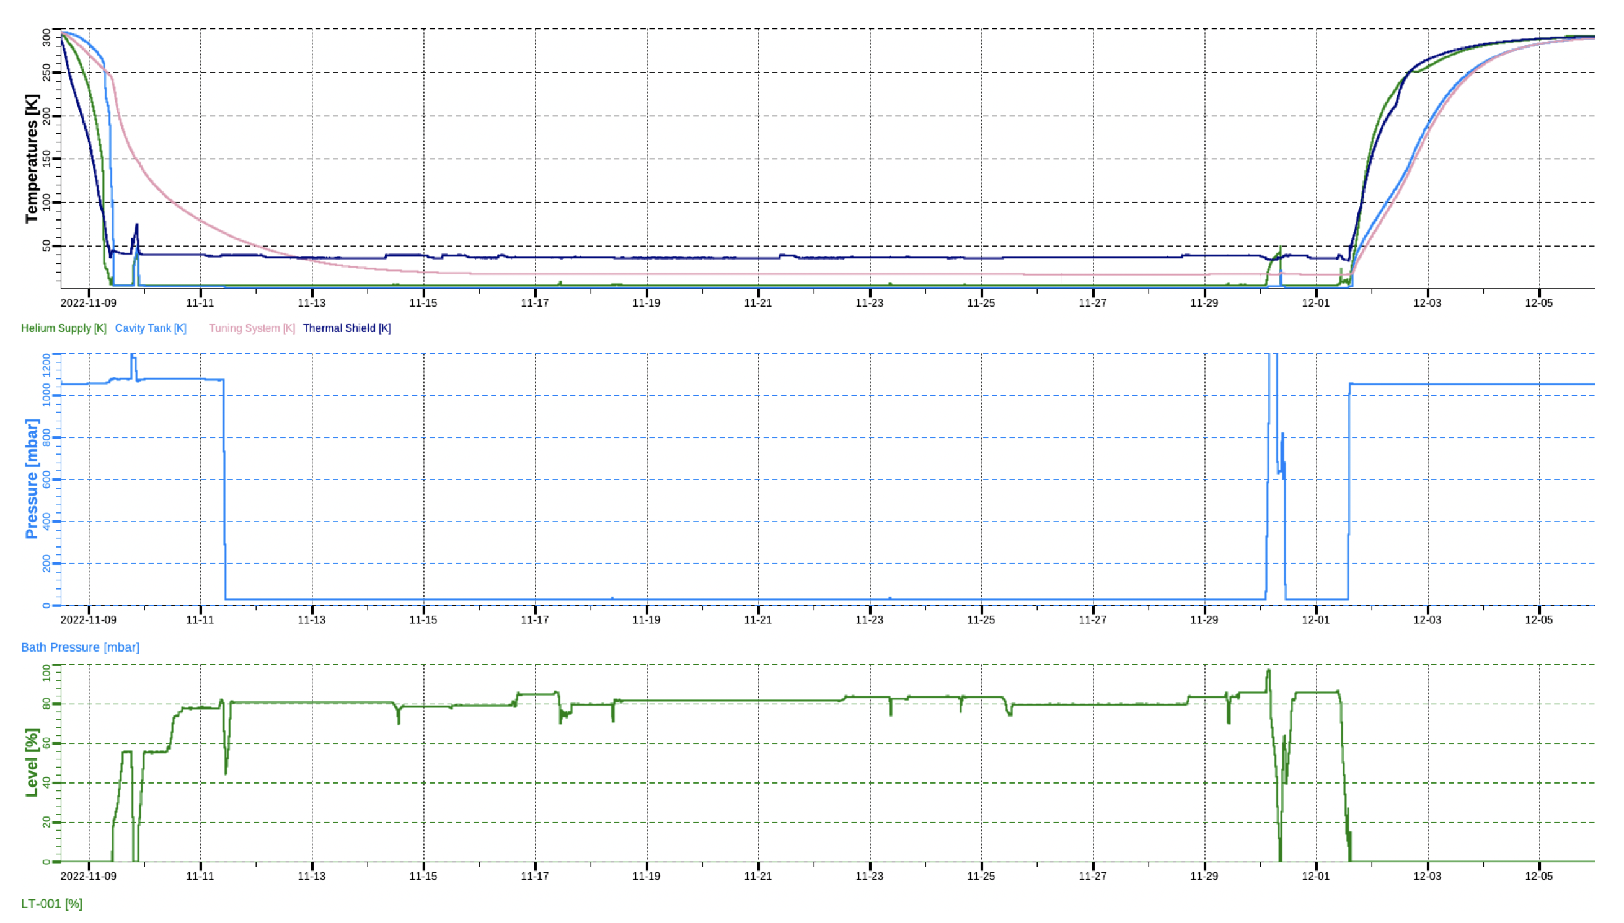
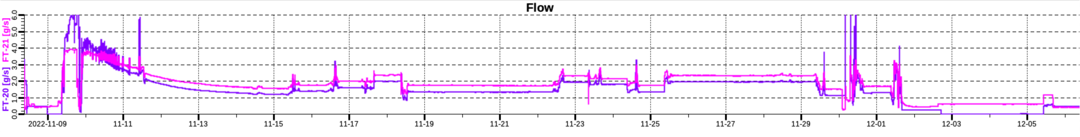
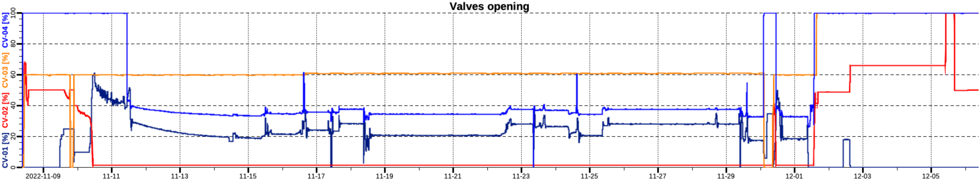
Full Cooldown Cycle
Slow thermalization of tuning system
Thermal shields ~ 35 K
Cold mass temperatures
1 bar = 4.2 K
2d
Cryo-trip!
Bath pressure
~20 d cold
2K Pumpdown
31 mbar = 2 K
Liquid level in CM
Heat load measurements

Slide 18
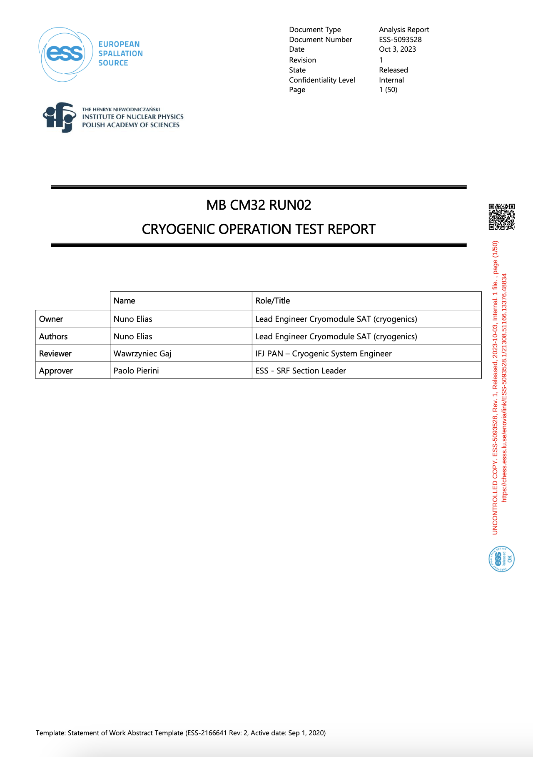
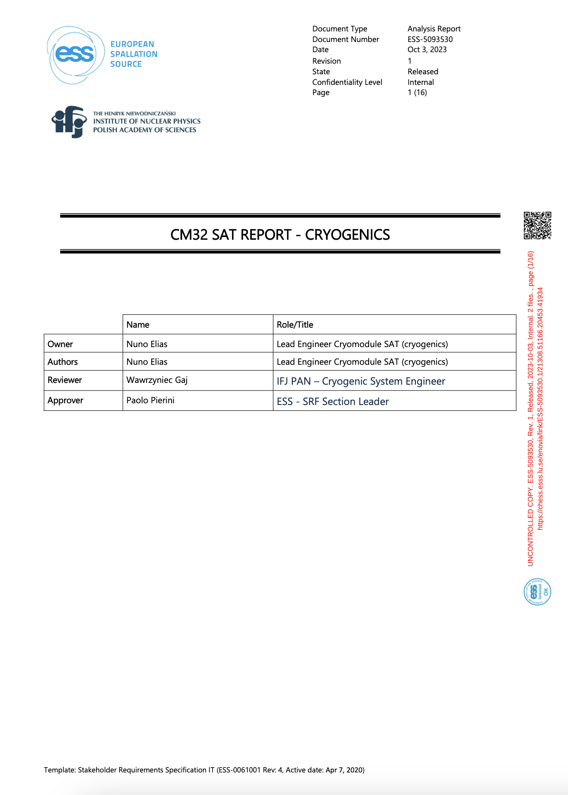
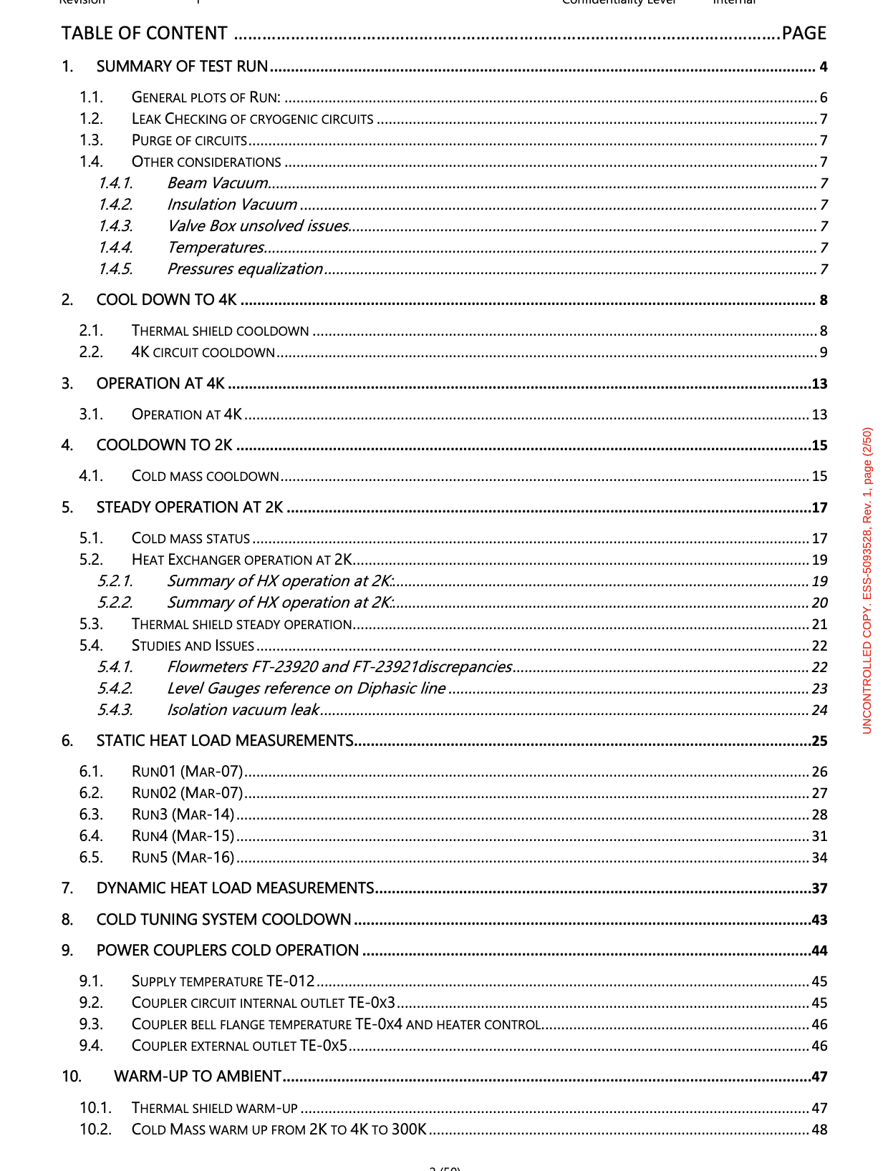
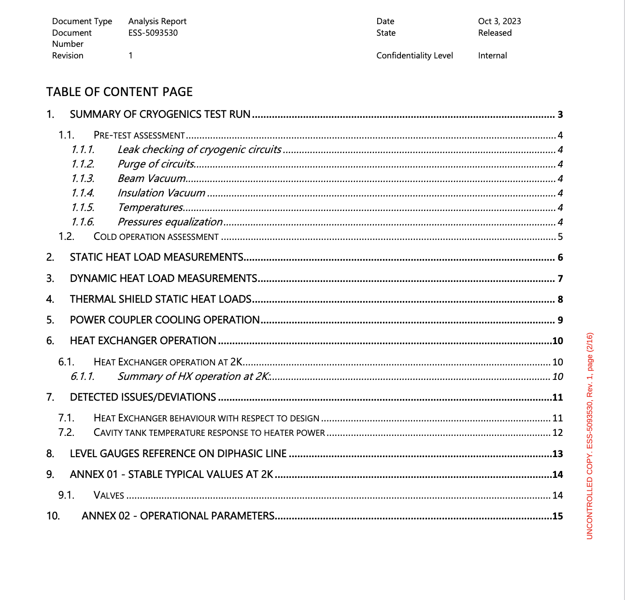
Reports
Getting to know the Cryomodule

Slide 19
Measurement of Heat loads
SHL
Static Heat Loads
- Flowmeter (evaporated mass flow)
- Flowmeter (nominal mass flow)
- Flowmeter + 2_point enthalpic difference
- Level Decrease (equivalent evaporated mass)
- Pressure Increase (accrued energy)
We use a diversity of methods to calculate the SHL.
-> cross-check the results against each other.
-> characterise JT valve and HX performance
-> characterize systematic T_errors of instrumentation
-> characterize (up to some extent) the sources of the heat loads.
-> better understand the behaviour of the system.
See: Wednesday talk

Slide 20
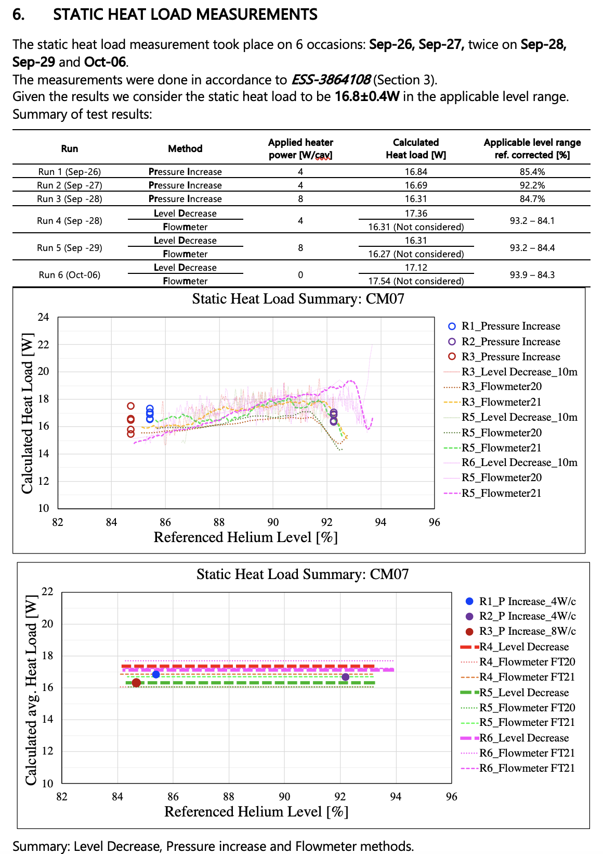
Measurement of Heat loads
Sub-headline to strengthen the headline above
Static Heat Loads
- Flowmeter (evaporated mass flow)
- Flowmeter (nominal mass flow)
- Flowmeter + 2_point enthalpic difference
- Level Decrease (equivalent evaporated mass)
- Pressure Increase (accrued energy)
- JT performance
- Heat exchanger performance
- evaluation of temperature measurements syst_errors
Dynamic Heat Loads
- Heater Compensation
See: Wednesday talk

Slide 21
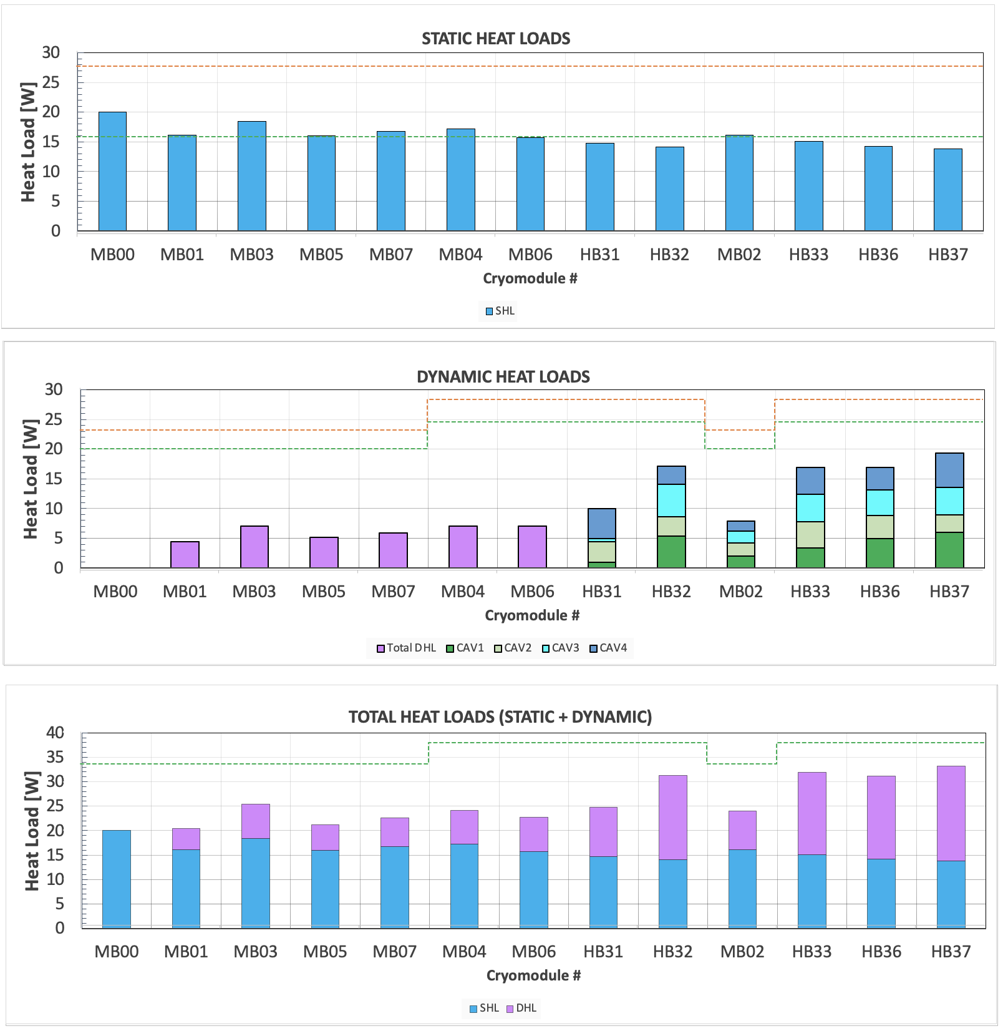
Summary of measured heat loads
Static
Dynamic
Total

Slide 22
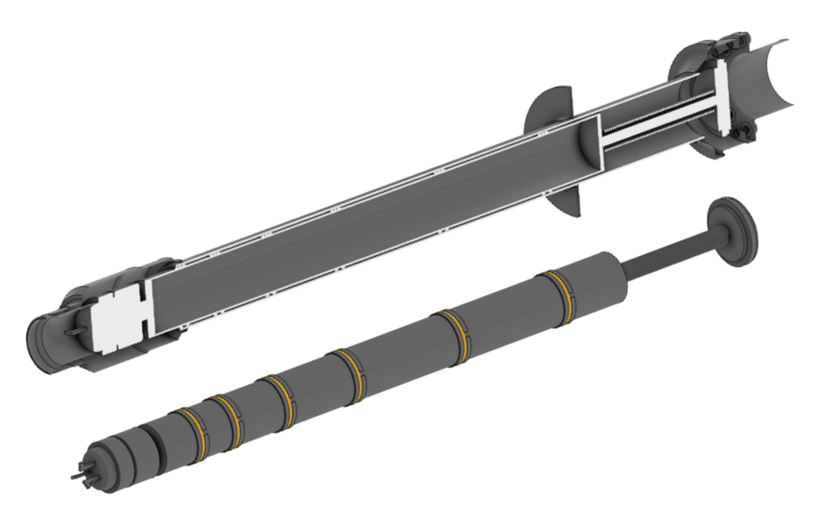
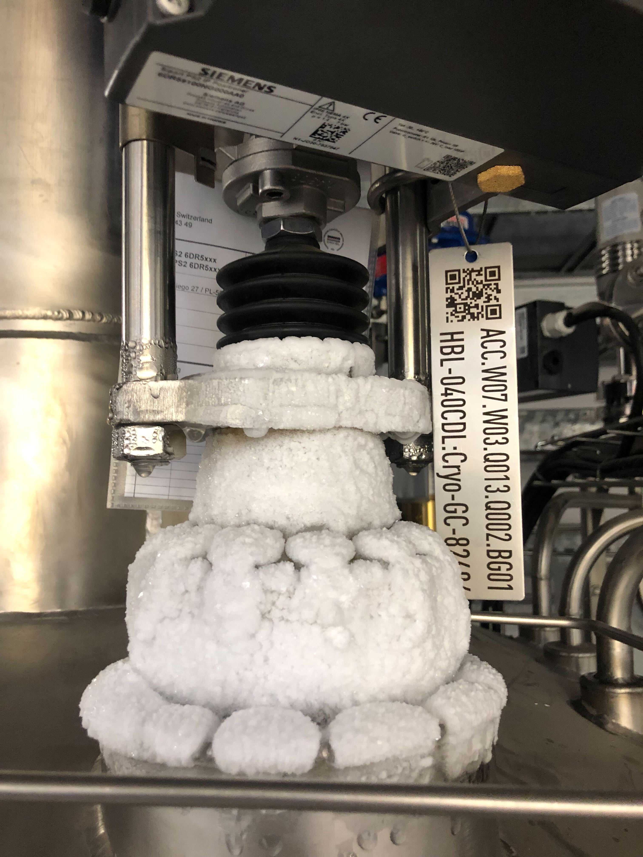
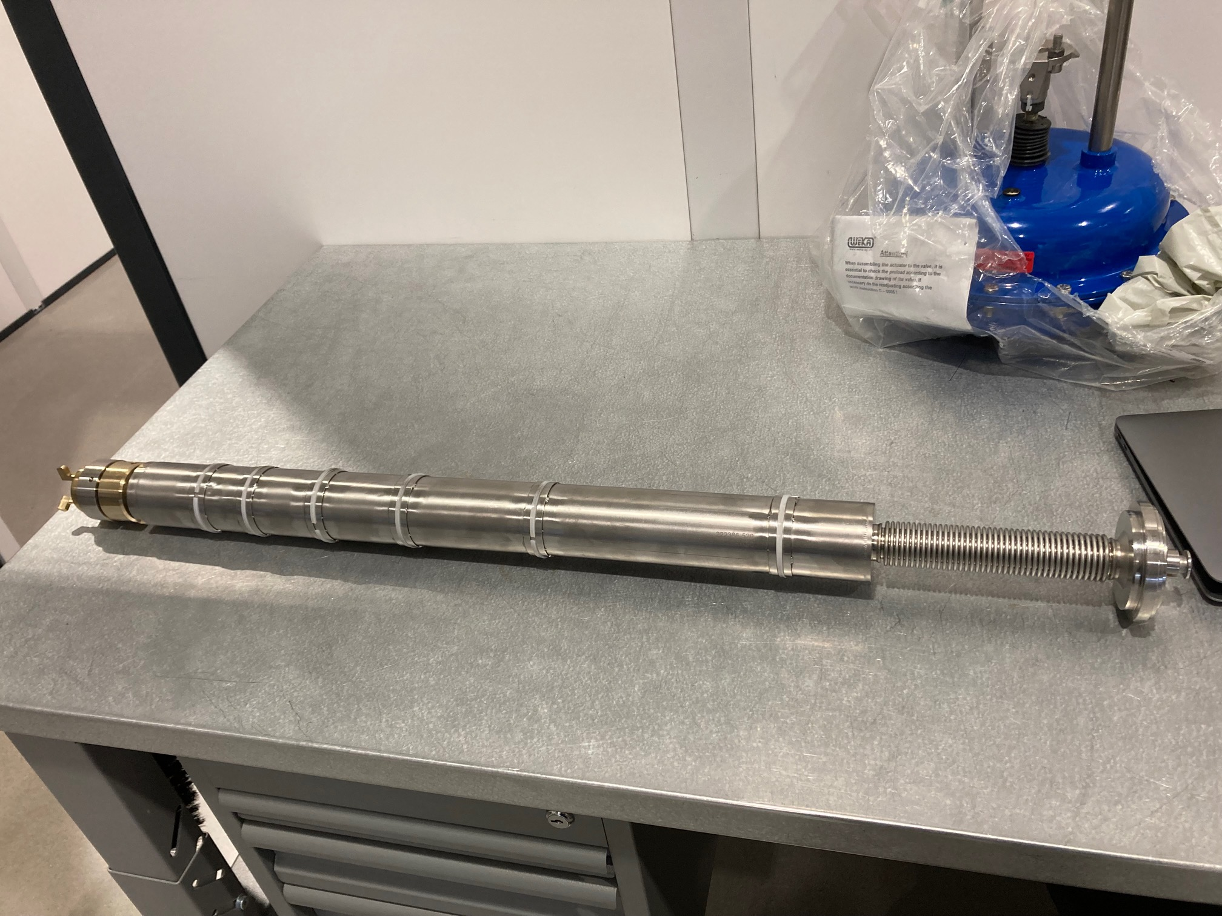
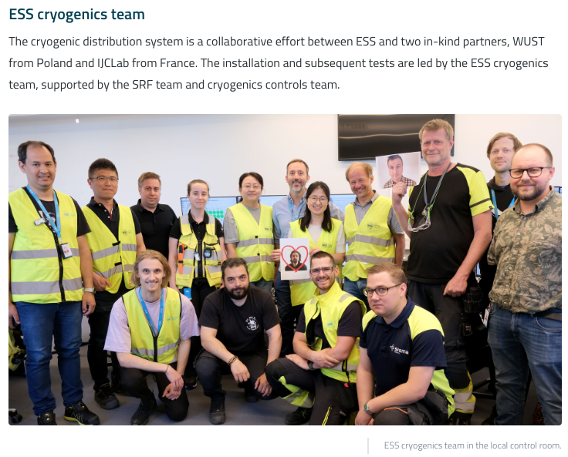
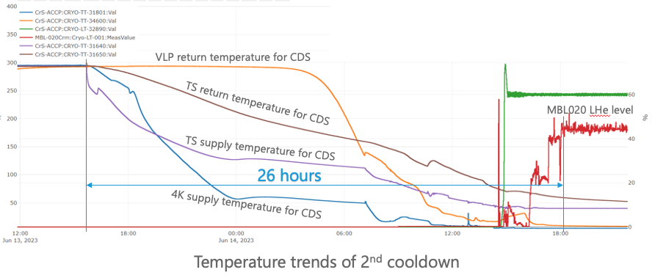
2nd CD (ACCP+CDS ) with 2 CMs
Credits: J.Frydrich/P. Arnold
1st Cooldown of the ACCP and CDS: Dec-2022 (8K)
- identification of some issues (high HL, TAO, valves tightness)
2nd Cooldown of the ACCP and CDS: Jun-2023 (2K)
+ 2 cryomodules (Spokes SPK-110 and Elliptical MBL-020), pilot installation.

Slide 23
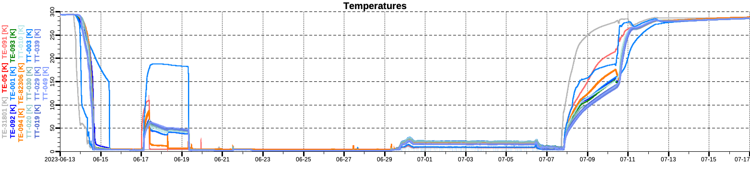
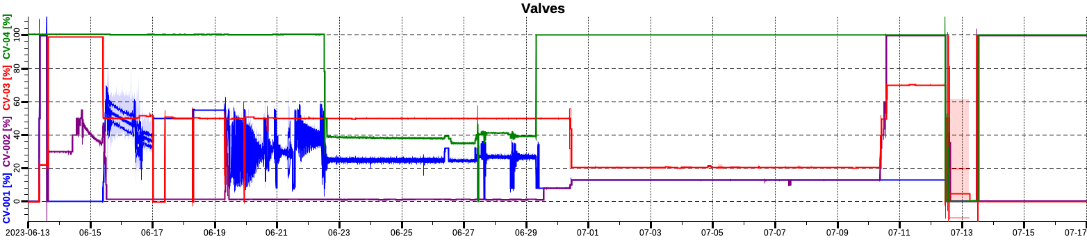
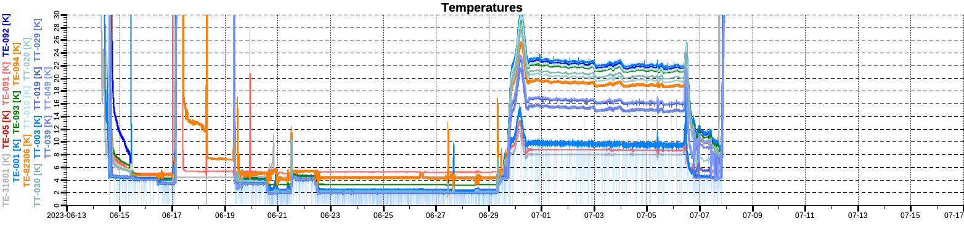
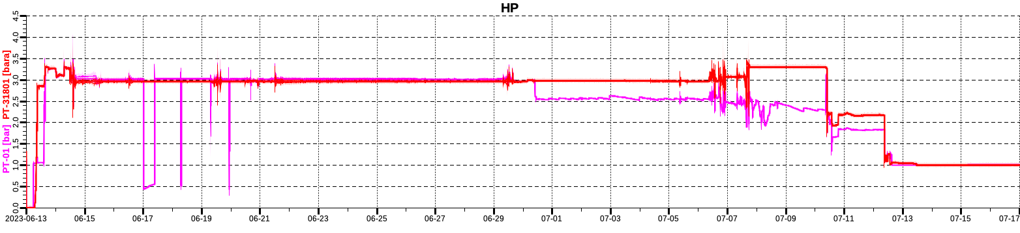
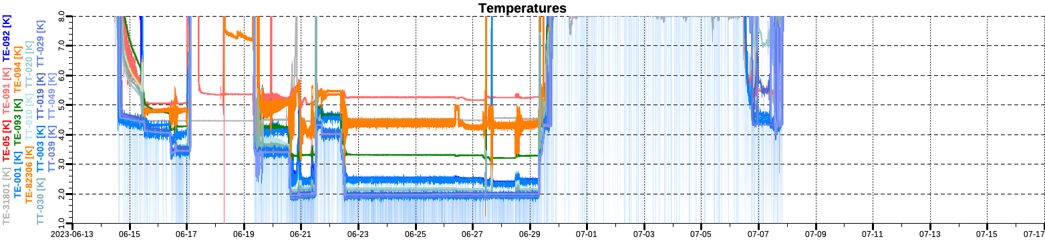
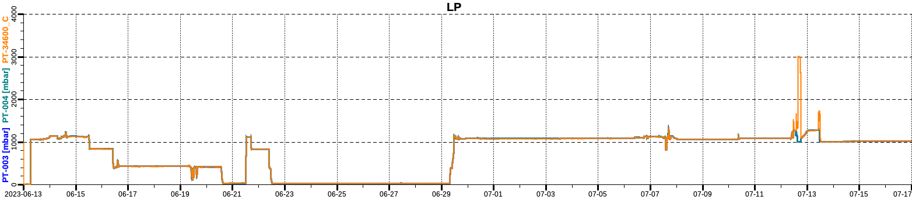
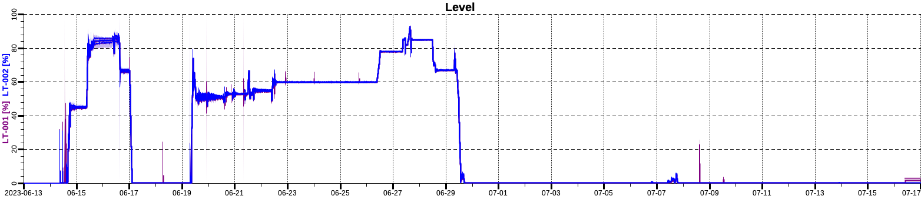
2nd CD (ACCP+CDS ) with 2 CMs
Temperature:
Some plots
Valves
High Pressure:
Low Pressure:
Level:

Slide 24
Concluding Remarks
Incremental experience operating CMs at ESS
+4y experience at TS2, Commisioning and Operating and SAT of ellitical CMs
14 ELL-CMs (8MB+6HB): 19CD/WU cycles
Growing a team while building a facility from scratch
The past year showed that we are on the right track
    The installation of the SRF linac is ongoing at a fast pace
    Cooldown of ACCP+CDS+Pilot CMs was a success
    While Maintaining the Test schedule of acceptance of CMs
Thank you and hope to see you soon at ESS

Slide 25
Finish presentation
Special thanks to:
- IFJ-PAN / CEA / INFN / STFC and ESS colleagues

