Slide 1
Design of PIP-II Cryomodules:
Approach adopted for code equivalency
V. Roger
7 December 2023

Slide 2

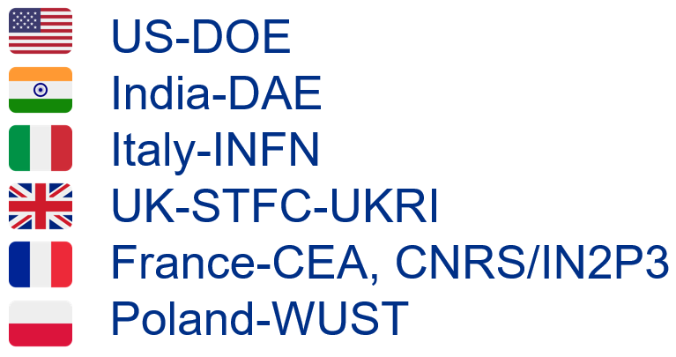
Introduction
2

Slide 3
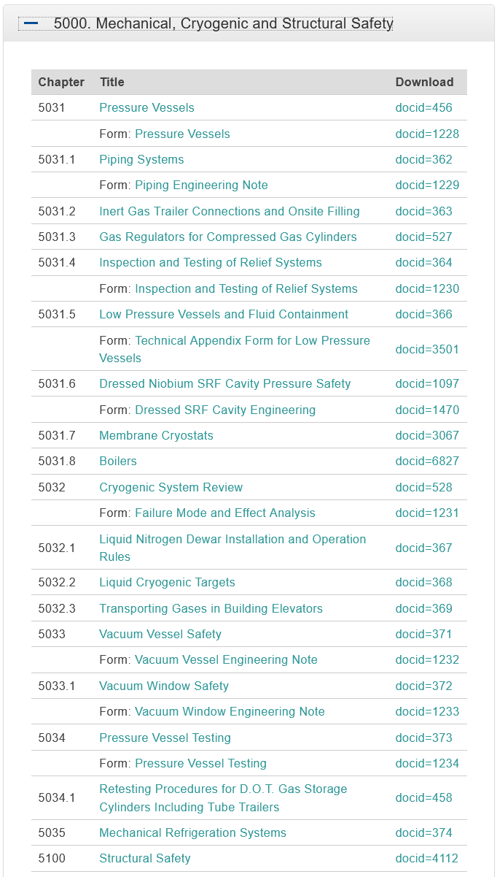
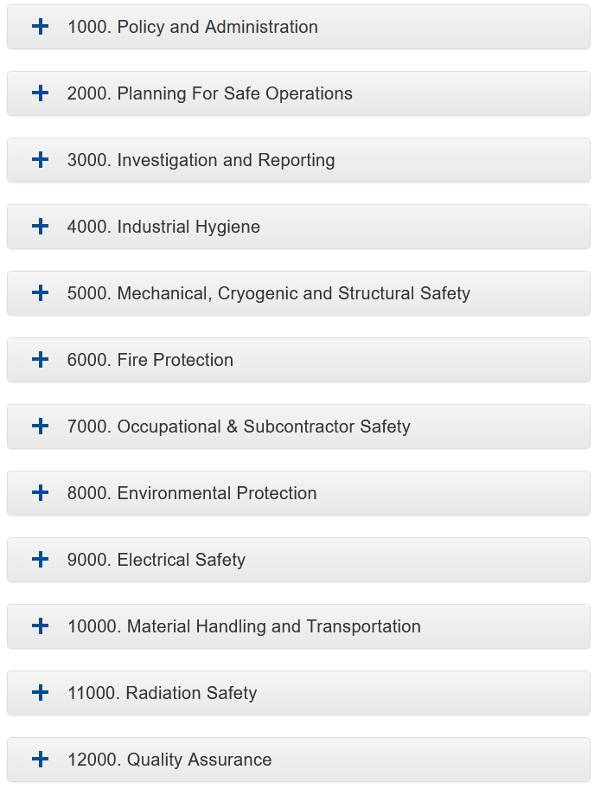
Code of Federal Regulations
In accordance with 10 CFR 851, Worker Safety and Health Program, Fermilab’s ES&H Management System requires equipment built for use at the laboratory be designed, constructed and tested to applicable codes and standards.
3

Slide 4
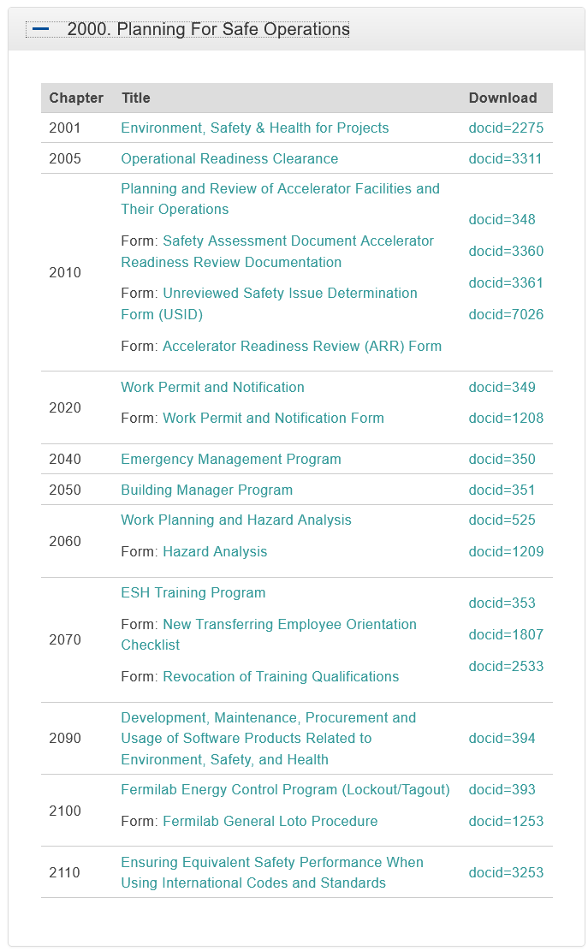
FESHM Chapter 2110
FESHM Chapter 2110, Ensuring Equivalent Safety Performance when Using International Codes and Standards, was developed to define the process used to establish equivalent safety performance between U.S. and International engineering design codes and standards.
Creation and review of a White paper done by a group of qualified persons. This white paper includes the formal engineering analysis that captures the comparisons of the U.S. Codes and Standards vs. an international standard and the conclusion of safety performance equivalency or not.
Submission of the White paper to the Chief Safety Officer (CSO) for approval and subsequent submittal to DOE Fermi Site Office (FSO) for concurrence.
4

Slide 5
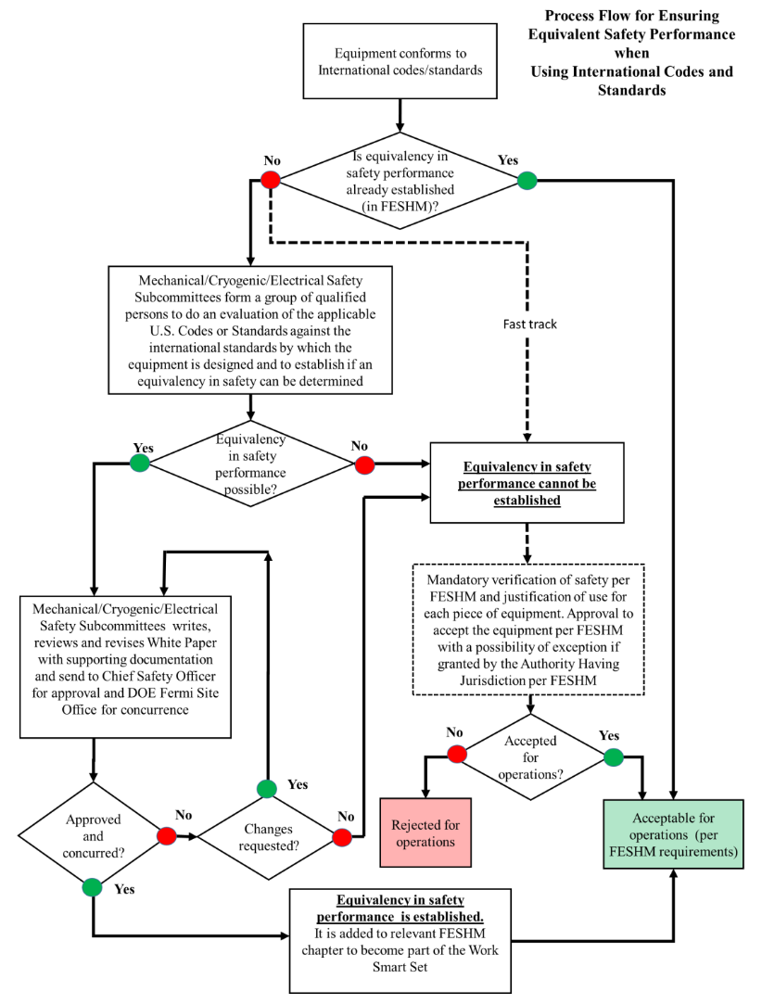
FESHM Chapter 2110
If safety performance equivalency between the codes is established and recommendations of the White Paper are approved by the CSO and the FSO concurs that the Laboratory followed their due process, an existing FESHM chapter can be amended/modified per established procedure to list international standards as appropriate standards for certain equipment.
5

Slide 6
FESHM Chapter 2110
The following equivalency studies have been approved by Fermilab. Study 1 is approved by DOE but DOE directive was to follow ASME compliance for studies 2, 3 & 4. A variance request has been asked by Fermilab and is still pending.
Study | Component Type | National Consensus Code | International Code
1 | Vacuum Vessels | ASME BPVC | EN13445
2 | Pressure Vessels | ASME BPVC VIII | EN13445
3 | Process Piping | ASME B31.3 | EN13480
4 | Pressure Relief Devices | ASME BPVC VIII | EN4126
Fermilab is allowed to have a local AHJ to assess structural and electrical equipment.
6

Slide 7
PIP-II Integrated Environment, Safety & Health Management Plan
This plan establishes the framework and expectations for the ES&H program for the PIP-II Project. This plan and its requirements apply to all work carried out by Project staff. It states that “Structures and equipment built for the PIP-II project are required to meet applicable national consensus codes, standards or code equivalencies as defined in the Functional Requirements Specifications (FRS) for the deliverable. The FRS flow down includes Technical Requirements Specifications which identify the key codes, standards and best practices to be followed during the design process.”
7

Slide 8
PIP-II Cryomodule Design Handbook
Part of this work has been directly included in the Technical Requirements Specifications (TRS), in order to define:
  Leak test requirements
  A list of Allowed and Forbidden materials for the beam line and coldmass due to cleanliness, magnetic field requirements and radiation damage
The others have been shared with all Partners in order to get similar quality at Fermilab and to the PIP-II Partners.
  Design of bellows with two plies
  Good practice to connect thermal straps
  Good practice to design and set up MLI
  Specifications for Bi-metallic parts
  QC to be done during manufacturing, before and after CM assembly.
8

Slide 9
PIP-II Cryomodule Design Handbook
This work was also used in order to design cryomodules in a way that it will ease the procurement and assembly in USA, Europe and India.
  Use of metric units on drawings
  Use of metric hardware
  Use of metric sheets
  Use of pipe size that can be procured in ISO or Imperial
  Ban of socket fittings on all piping
9

Slide 10
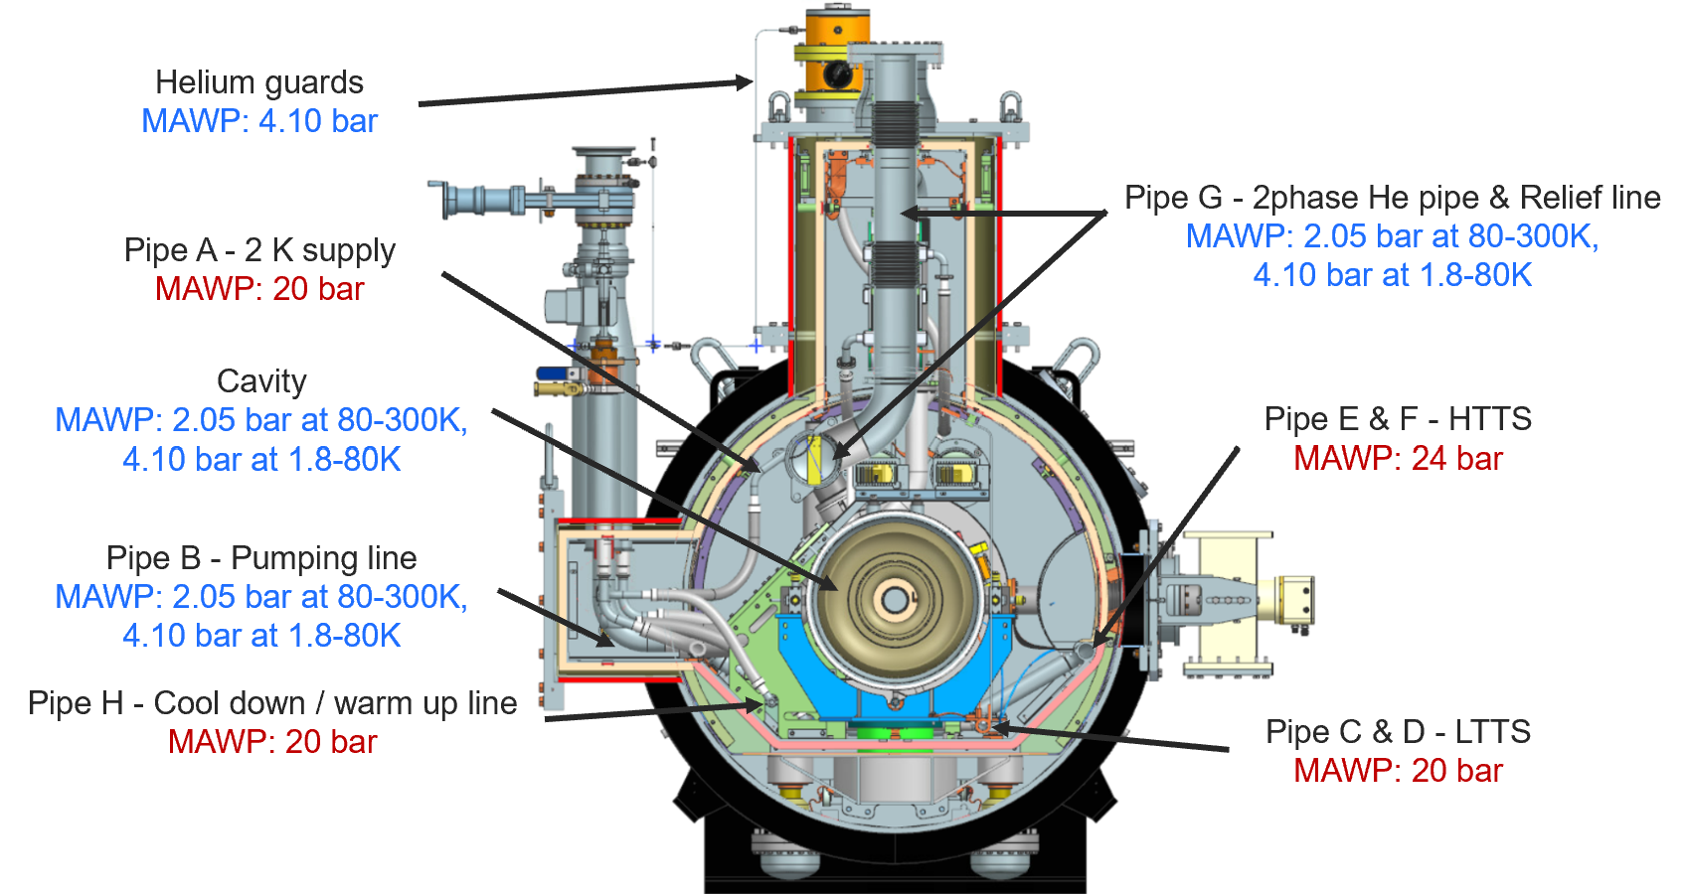
PIP-II Cryomodule Design Handbook
However, it has been decided to keep a dual design pressure for the cavities, two phase He pipe and relief line even if this is not allowed by the EN code. Such dual design pressure simplify significantly the design of these components and make easier the operation.
10

Slide 11
PIP-II Cryomodule engineering notes
For the LB650 and HB650 CMs procured and assembled by CEA and UKRI, all piping will be done per ASME B31.3 code.
Earlier designs and analysis performed to EN codes were modified to meet ASME. This work was ease by the standardization effort set among SSR and 650 cryomodules.
11

Slide 12
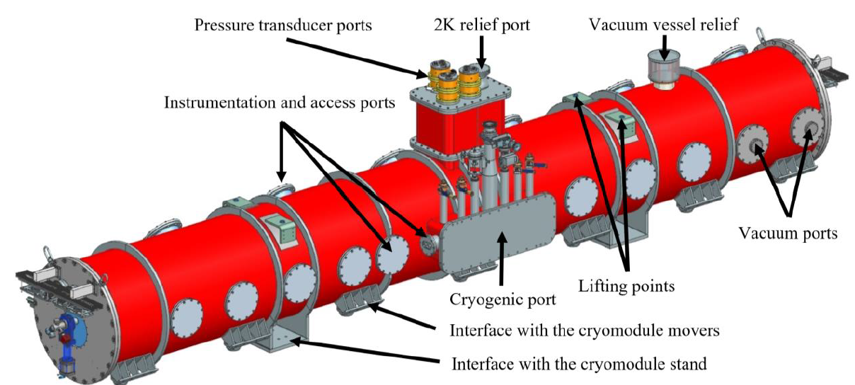
PIP-II Cryomodule - Standardization
All SSR and 650 cryomodules share the same cryogenic layout and the size of the cryogenic lines are identical for all cryomodules.
External interfaces have been standardized to simplify the design of the Cryogenic Distribution System (CDS) and to share tooling among SSR and 650 cryomodules.
12

Slide 13
Summary
A clear path for the PIP-II cryomodules code compliance has been established. It won’t be affected by the DOE decision about the variance request submitted by Fermilab since all piping will be done anyway per ASME B31.3.
13

Slide 14
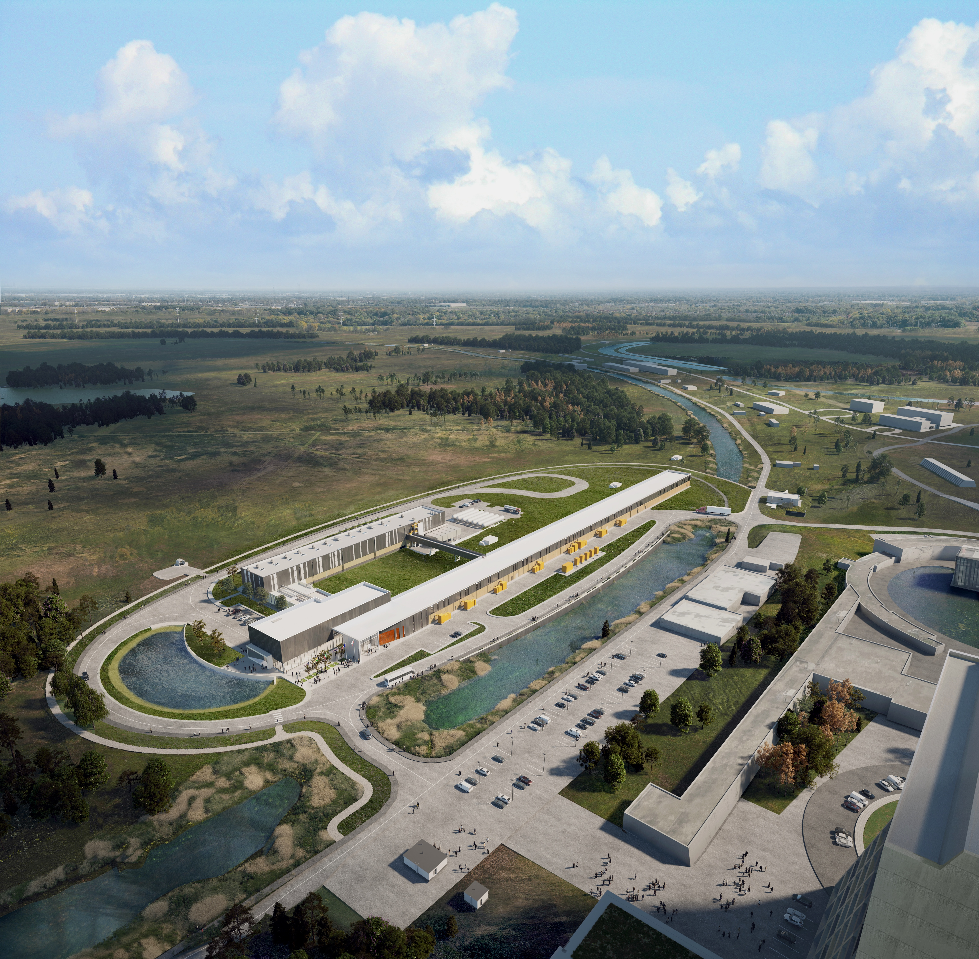



THE FUTURE OF FERMILAB
Follow us:
www.pip2.fnal.gov
@PIP2accelerator
/showcase/pip-ii/

