Slide 1
Muon Collider Higgs Factory Mini-Workshop:
Workshop Goals and Critical Issues
Mark Palmer
November 13, 2012

Slide 2
Welcome
I would like to add my welcome to everyone who has been able to join us today
This meeting represents to first MAP workshop after the start of our 6-year Feasibility Assessment
  This is an important time to explore the role of a Higgs Factory in our planning
  This is an opportunity to use that information in the preparation of a realistic staging plan for a Muon Accelerator Facility

Slide 3
Some Administrative Issues
We are asking for a $10 registration fee to help cover expenses for today which could not be charged to the program
  Please see Elaine to pay and get a receipt if you haven’t already done so
Group Photo
  During the afternoon coffee break

Slide 4
Workshop Goals (I)
With the announcement of the discovery of a
“Higgs-like” particle on July 4th, it is clearly time to:
  Pull out the previous work from a decade ago on the Muon Collider Higgs Factory option and see what we can do
  Update our options based on work that has been done to better define muon collider design options over the last decade
  Develop a clear statement about the physics reach and capabilities that a muon-based facility can provide, with reach extending to the energy frontier

Slide 5
Workshop Goals (II)
With the start of the U.S. Community Summer Study 2013, we need to:
  Prepare a statement for the US (and world) HEP community that clearly lays out a program leading to a facility based on muon accelerators
  Clearly state the potential for a muon-based Higgs Factory as part of that program
  Ensure that the breadth of physics research that can be supported by a muon-based facility is clearly laid out to the community

Slide 6
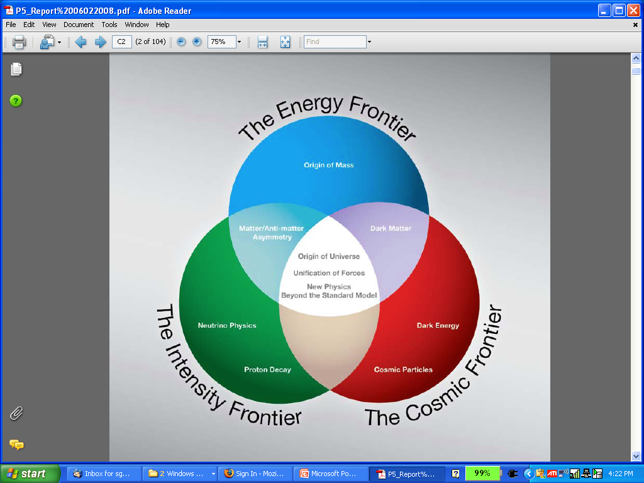
Why a Muon Accelerator Program?
  Muon accelerator R&D is focused on developing a facility that can address critical questions on two frontiers…
  The Intensity Frontier:
  with a Neutrino Factory producing well-characterized ν beams for precise, high sensitivity studies
  The Energy Frontier:
  with a Muon Collider capable of reaching the multi-TeV center-of-mass energies
The unique potential of a facility based on muon accelerators is physics reach that spans 2 frontiers

Slide 7
Critical Issues (I)
The Timeline
  Completion of the MAP Feasibility Assessment
    FY13-FY18
    Where do we go afterwards?
  How could a Muon-based Collider be staged?
    Complete critical R&D and Performance Evaluations
    Provide physics
    Stay within the necessary fiscal constraints
    Coupling to the Intensity Frontier Program
    Coupling to Project X Development in the US Prgram
    Detector Development

Slide 8
Approximate dates
Uncertainties increase with time
Timelines of HE projects (C.Biscari@European Strategy: Sept 2012)
 | 2012 |  |  | 2015 |  |  |  |  | 2020 |  |  |  |  | 2025 |  |  |  |  | 2030 |  |  |  |  | 2035
LHC
HL-LHC
HE-LHC
RHIC
LHeC
eRHIC
Higgs factory ILC
ILC 0.5 TeV
CLIC Higgs fact klys
CLIC 0.5 TeV
CLIC E Upgrades
LEP3
SuperTristan - TLEP
SAPPHiRE
MUON COLLIDER
LWFA LC
RDR (CDR) R&D TDR/Preparation
Construction Operation
PROPOSED
APPROVED

Slide 9
A “Technically Limited” Staging Scenario with Physics Output at Each Stage
Now
≥ 2030s?
MAP 6-yr Feasibility
Assessment Program
νSTORM
Swap?

Slide 10
Critical Issues (II)
Accelerator Questions
  Interface with the Proton Driver/Project X
  Target Options
  Cooling R&D and Design
  Collider Design and Performance Evaluation
  The Machine Detector Interface and Backgrounds
  And more…

Slide 11
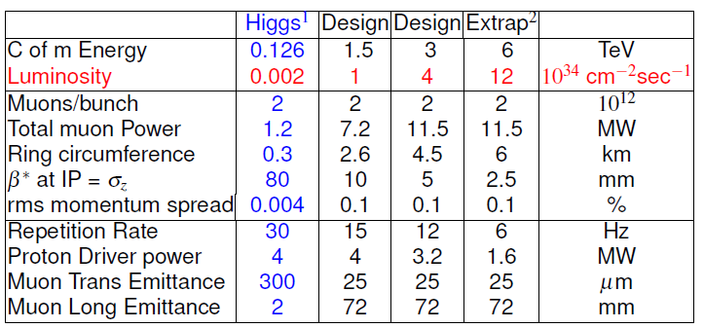
Muon Collider parameters
R.B,Palmer
Depends on cooling scenario:
10³¹a~10³² cm⁻²sec⁻¹

Slide 12
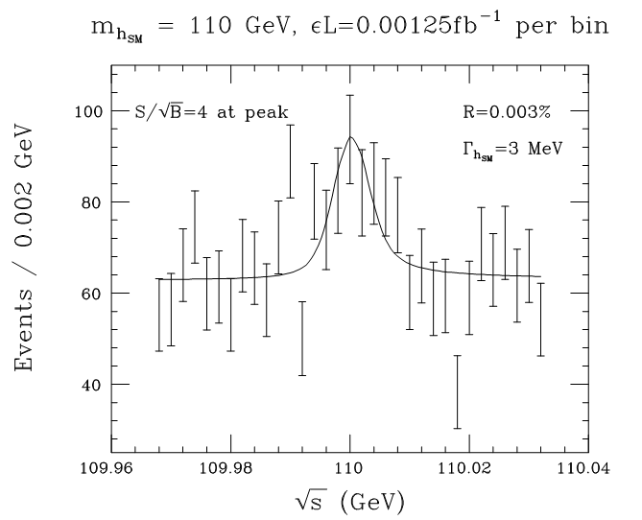
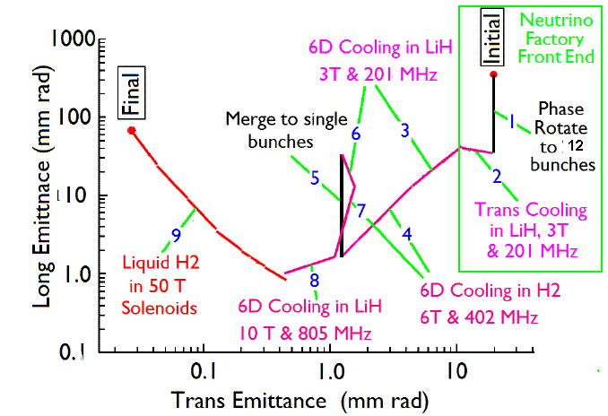
126 GeV Higgs Factory (D.Neuffer)
s-channel coupling of Muons to HIGGS with high cross sections:
Muon Collider of with L = 10³² cm⁻²s⁻¹ @ 63 GeV/beam (50000 Higgs/year)
Competitive with e+/e- Linear Collider with L = 2. 10³⁴ cm⁻²s⁻¹ @ 126 GeV/beam
Sharp resonance: momentum spread ~ 4 × 10⁻⁵
Major advantage for Physics of a μ⁺μ⁻ Higgs Factory: possibility of direct measurement of the Higgs boson width (Γ~3MeV FWHM expected)
Reduced cooling:
ε_{⊥N} =0.3π⋅mm⋅rad,
ε_{||N} =1π⋅mm⋅rad

Slide 13
Higgs MC Parameters
D.Neuffer
AAC12
NuFACT12
Proton Linac 8 GeV
Accumulator,
Buncher
Parameter | Symbol | Value
Proton Beam Power | P_{p} | 4 MW
Bunch frequency | F_{p} | 15 Hz
Protons per bunch | N_{p} | 4×5×10¹³
Proton beam energy | E_{p} | 8 GeV
Number of muon bunches | n_{B} | 1
μ^{+/-}/ bunch | N_{μ} | 5×10¹²
Transverse emittance | ε_{t,N} | 0.0002m
Collision β* | β* | 0.05m
Collision β_{max} | β* | 1000m
Beam size at collision | σ_{x,y} | 0.02cm
Beam size (arcs) | σ_{x,y} | 0.3cm
Beam size IR quad | σ_{max} | 4cm
Collision Beam Energy | E_{μ+},E_{μ_} | 62.5(125geV total)
Storage turns | N_{t} | 1000
Luminosity | L₀ | 10³²
+4→1 bunch combiner
Hg target
Drift, Bunch, Cool
Linac
RLAs
Collider Ring
δν_{BB} =0.027

Slide 14
Critical Issues (III)
Detector and Physics
(some questions from the SLAC Energy Frontier Retreat, Breidenbach/Jaros)
  Machine timescale?
  Backgrounds
    Radiation damage – detector activation?
    Extreme timing capability needed to separate backgrounds
    Significant detector R&D needed
  Forward direction taken by shielding – deadcone 15⁰ ?
  (MDI simulation effort for Higgs MC underway)
  Polarization? (Revisit for Snowmass – lumi trade-offs)
  Energy variability? (Utilize polarization-based energy measurement – decay electrons)
  Vertex detector distance from beam?
  Well defined energy and small energy spread (+)
  S channel Higgs production (+)

Slide 15
Conclusion (I)
Is a Muon-Based Higgs Factory muon collider ready to build?
  No
    Must move forward with accelerator feasibility R&D
    Must move forward with more detailed assessments of physics capabilities
  Nevertheless, we must ask the question of how much mis-match is there (realistically) between the R&D timetable and real funding decisions in the US? These may well be reasonably matched…
  a supports a continued and expanded R&D effort
A Program based on Muon Accelerators is well-matched to the stated US HEP direction
  Ability to support high capability research across 2 frontiers
  a offers excellent return on investment
  Can be hosted at our remaining US HEP laboratory
  The MASS Working Group has been charged with preparing MAP’s overall response for CSS2013

Slide 16
Conclusion (II)
Plan for the next year…
  This meeting is the kick-off meeting for a series of MAP-related meetings leading to CSS2013
    Muon Collider Higgs Factory Workshop
      Location: UCLA
      Dates: Likely March 21-22 (or 23), 2013
    MAP Collaboration Meeting
      Location: Fermilab
      Dates: Sometime in May 2013
    Other CSS meetings (Energy Frontier, Intensity Frontier and Facilities)
      Schedule being developed at:
      http://www.snowmass2013.org/tiki-index.php?page=Community+Summer+Study+2013
  CSS 2013 Meeting
    Location: U of Minnesota
    Dates: July 29 – August 6, 2013

Slide 17
Backup Slides

Slide 18
Muon Accelerator Physics Scope
Energy
Frontier
Intensity
Frontier

Slide 19
Muon Accelerators
Program Baselines

Slide 20
Muon Collider Concept
Muon Collider Block Diagram
Proton source:
For example PROJECT X at 4 MW, with 2±1 ns long bunches
Goal:
Produce a high intensity μ beam whose 6D phase space is reduced by a factor of >10⁶ from its value at the production target
Collider: √s = 3 TeV
Circumference 4.5km
L = 3×10³⁴ cm⁻²s⁻¹
μ/bunch = 2x10¹²
σ(p)/p = 0.1%
ε_{⊥N} = 25 μm, ε_{//N}=72 mm
β* = 5mm
Rep. Rate = 12 Hz

Slide 21
Muon Collider - Neutrino Factory Comparison
NEUTRINO FACTORY
ν Factory Goal:
O(10²¹) μ/year
within the
accelerator
acceptance
Share same complex
MUON COLLIDER

Slide 22
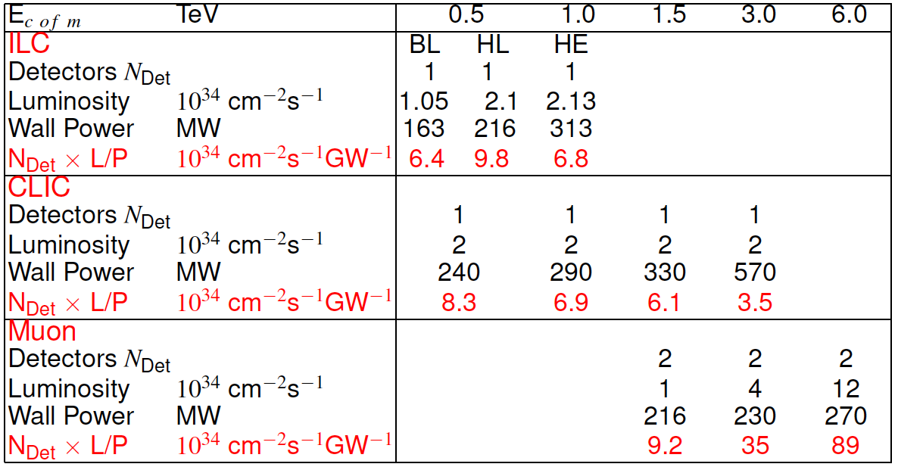
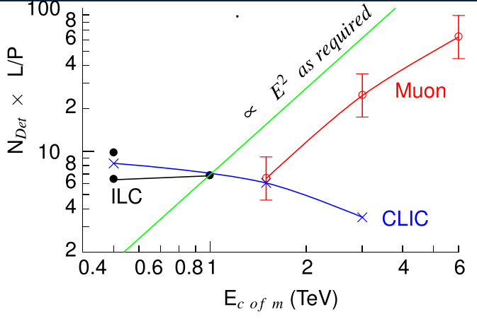
Luminosity Production Metric vs E_{CM}
R. Palmer
MAP DOE Review 2012

Slide 23
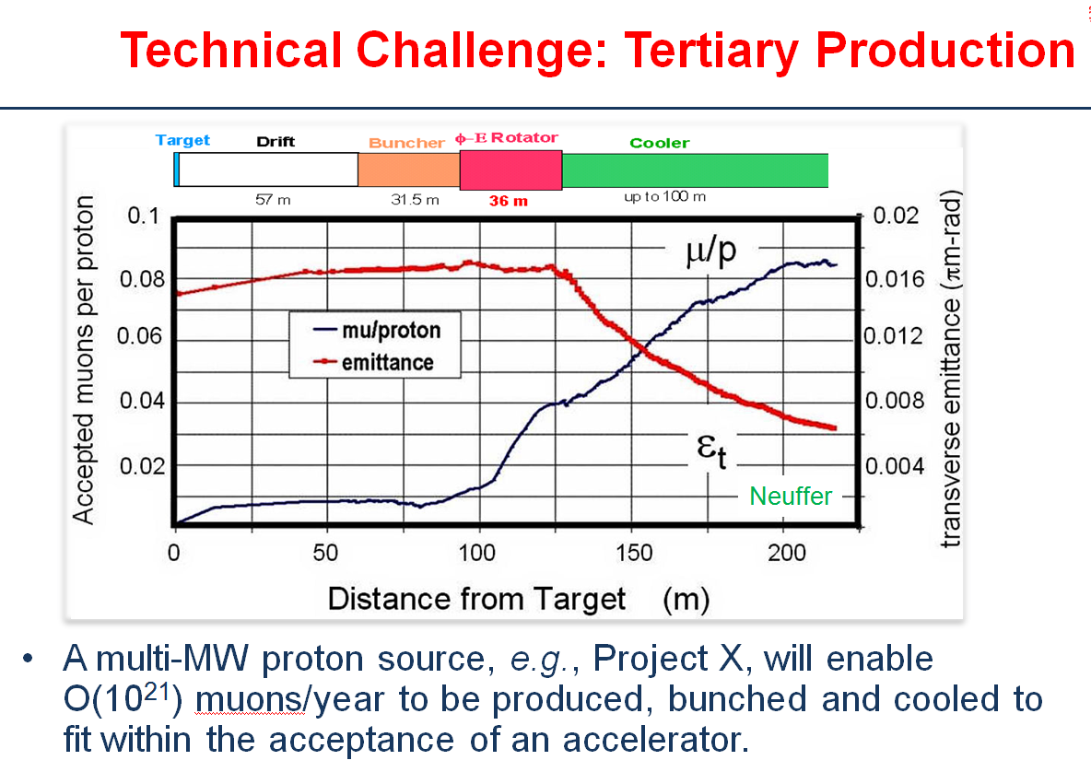
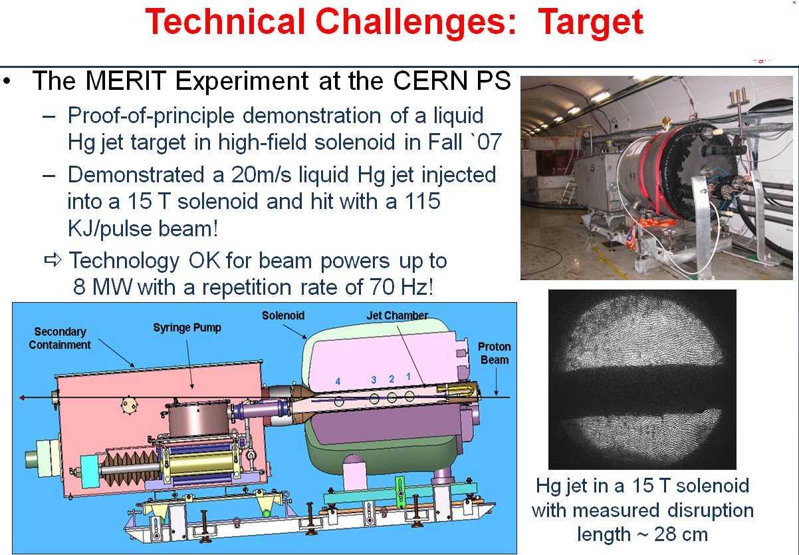
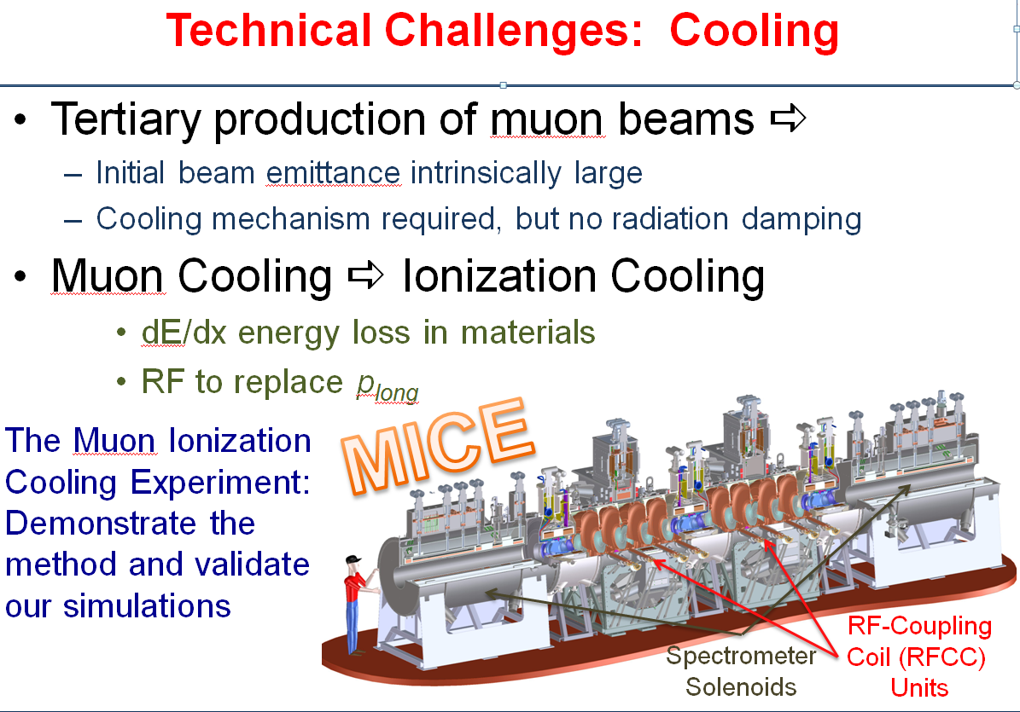
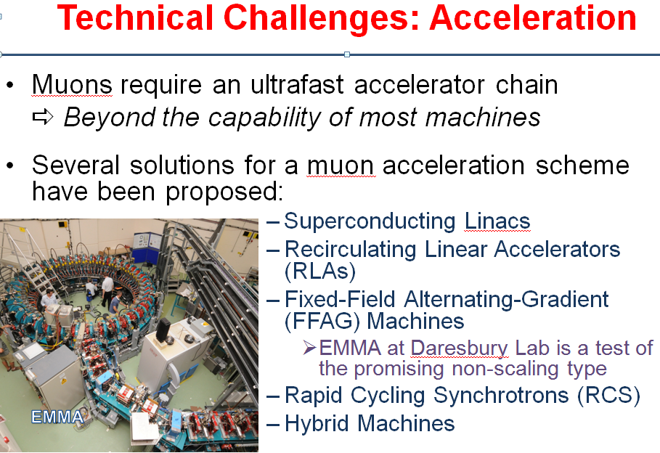
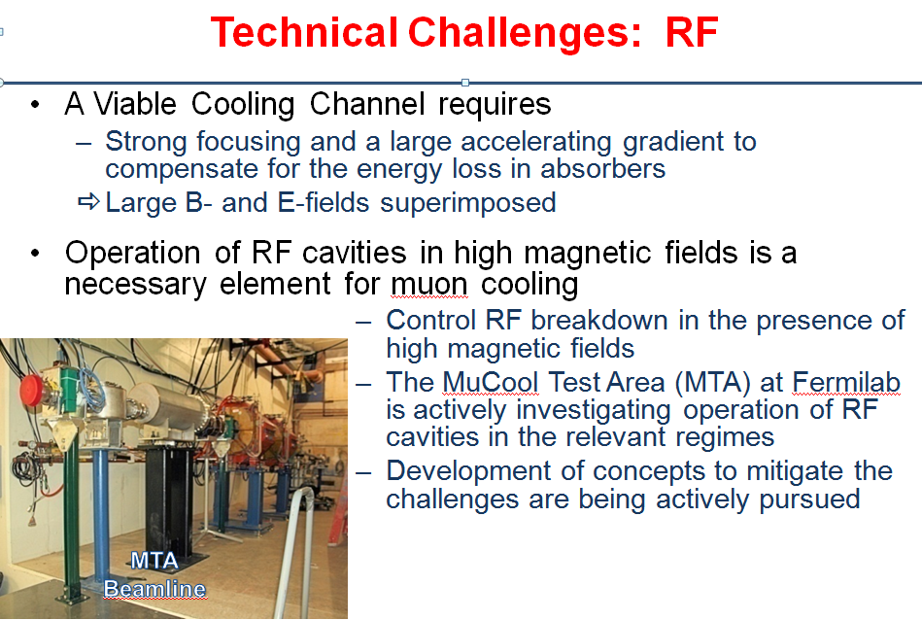
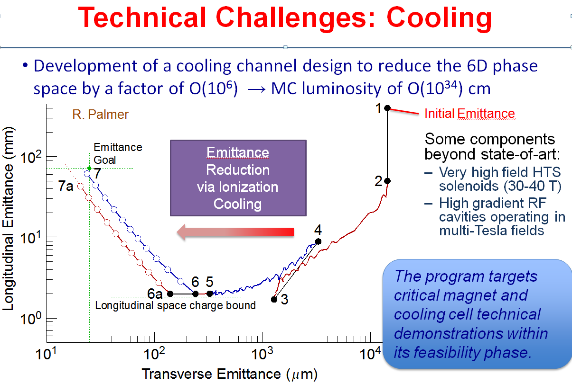
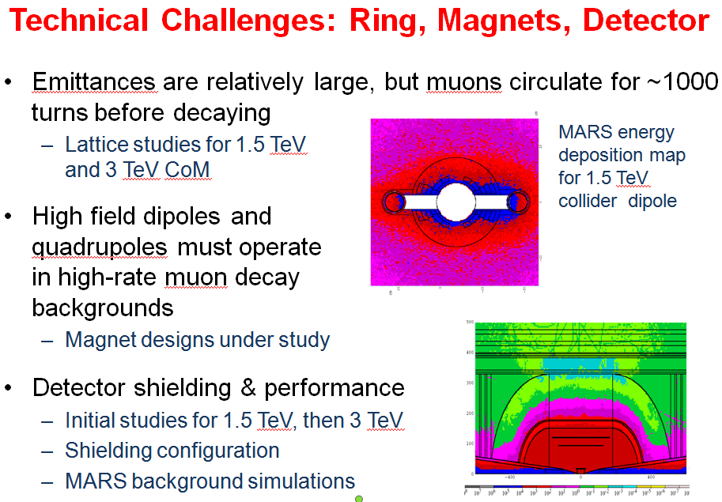
Technical Challenges
MAP 6-yr Feasibility
Assessment Program

Slide 24
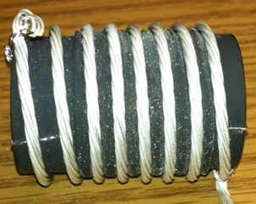
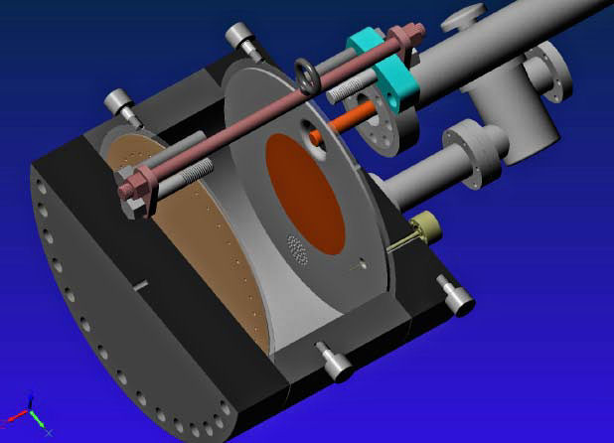
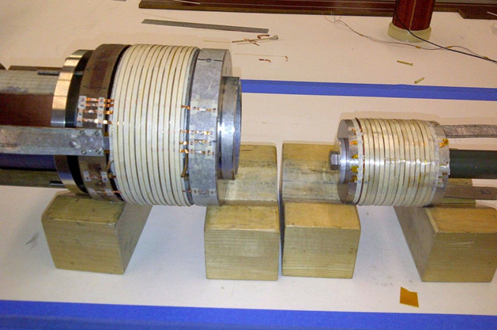
MAP FY12 Technology Highlights
Successful Operation of 805 MHz “All Seasons” Cavity in 3T Magnetic Field under Vacuum
MuCool Test Area/Muons Inc
World Record
HTS-only Coil
15T on-axis field
16T on coil
PBL/BNL
Demonstration of High Pressure RF Cavity in 3T Magnetic Field with Beam
Extrapolates to
μ-Collider Parameters
MuCool Test Area
Breakthrough in HTS Cable Performance with Cables Matching Strand Performance
FNAL-Tech Div
T. Shen-Early Career Award
The Path to a Viable
Muon Ionization
Cooling Channel
1% Dry Air (0.2% O2) in GH2
Pure GH2
1% Dry Air
(0.2 % O2)
in GH2 at
B = 3T
~50X reduction in
RF power dissipation
E₀ = 25 MV/m

Slide 25
Approximate dates
Uncertainties increase with time
Timelines of HE projects (C.Biscari@European Strategy: Sept 2012)
 | 2012 |  |  | 2015 |  |  |  |  | 2020 |  |  |  |  | 2025 |  |  |  |  | 2030 |  |  |  |  | 2035
LHC
HL-LHC
HE-LHC
RHIC
LHeC
eRHIC
Higgs factory ILC
ILC 0.5 TeV
CLIC Higgs fact klys
CLIC 0.5 TeV
CLIC E Upgrades
LEP3
SuperTristan - TLEP
SAPPHiRE
MUON COLLIDER
LWFA LC
RDR (CDR) R&D TDR/Preparation
Construction Operation
PROPOSED
APPROVED

Slide 26
A “Technically Limited” Staging Scenario with Physics Output at Each Stage
Now
≥ 2030s?
MAP 6-yr Feasibility
Assessment Program
νSTORM
Swap?

Slide 27
Muon Collider
Detector Group Questions:
M. Breidenbach
J. Jaros
Machine timescale?
Backgrounds
  Radiation damage – detector activation?
  Extreme timing capability needed to separate backgrounds
  Significant detector R&D needed
Forward direction taken by shielding – deadcone 15⁰ ? (MDI simulation effort for Higgs MC underway)
Polarization? (Revisit for Snowmass – lumi trade-offs)
Energy variability? (Utilize polarization-based energy measurement – decay electrons)
Vertex detector distance from beam?
Well defined energy and small energy spread (+)
S channel Higgs production (+)

Slide 28
Conclusion
Is a Higgs Factory muon collider ready to build?
  No
    Must move forward with accelerator feasibility R&D
    Must move forward with more detailed assessments of physics capabilities
  Nevertheless, we must ask the question of how much mis-match is there (realistically) between the R&D timetable and real funding decisions in the US? These may well be reasonably matched…
  a supports a continued and expanded R&D effort
A Program based on Muon Accelerators is well-matched to the stated US HEP direction
  Ability to support high capability research across 2 frontiers
  a offers excellent return on investment
  Can be hosted at our remaining US HEP laboratory

