Slide 1
The First Muon Collider:
125.5712 GeV Higgs Factory
David Neuffer
November 2012

Slide 2
Outline
Introduction
  Motivation
Scenario Outline and Features
  Based on 2001 Snowmass ~
  Parameters - cooling
  Proton Driver, Front End, Accelerator, Collider
    Features-spin precession energy measurement
Variations ?
Upgrade Path(s)
  to High-Energy High Luminosity Muon Collider

Slide 3
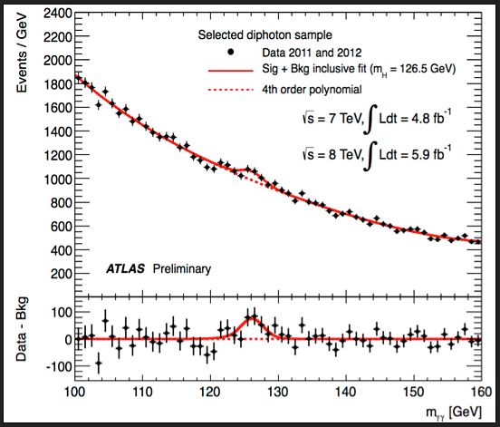
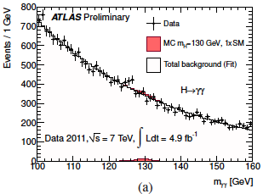
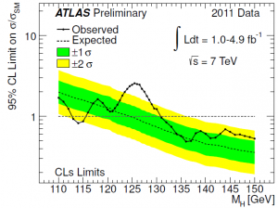
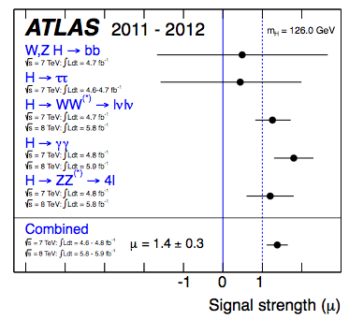
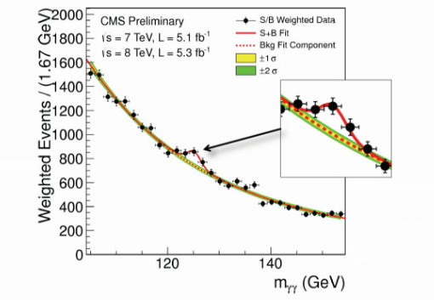
125 GeV Higgs!
Low Mass Higgs ?
  Observed at ATLAS-CMS
    ~125GeV
    ~”5+σ”
  cross-section H→γγ larger than MSM
    ~<2× in LHC measurement
      a bit “beyond standard model” ?

Slide 4
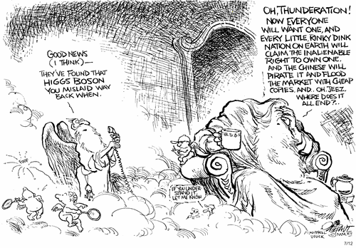
Higgs Boson found !

Slide 5
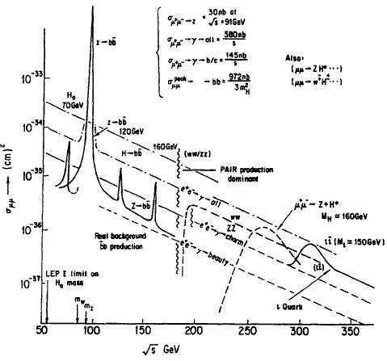
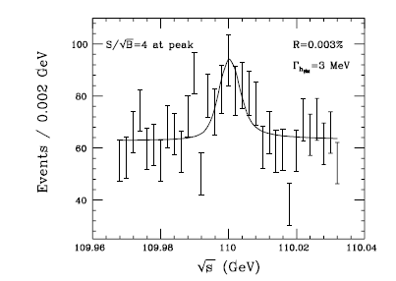
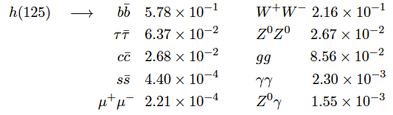
  μμ → H cross-section, width?
  Barger, Berger, Gunion, Han, Physics Reports 286, 1-51 (1997)
Cross section expected to be ~50pb
  μ⁺μ⁻ → H
  σ ∝ m_{μ}² = 43000 m_{e}²
  width ~4MeV
at L=10³¹, t=10⁷s
→5000 H
  Beyond SM may be larger, wider
Could scan over peak to get M_{H}, δE
  H → b ̅b or W⁺W^{- *} mostly
δE = 0.003% =4 MeV
e⁺e⁻ 5.15 × 10⁻⁹
~10³⁶/pt

Slide 6
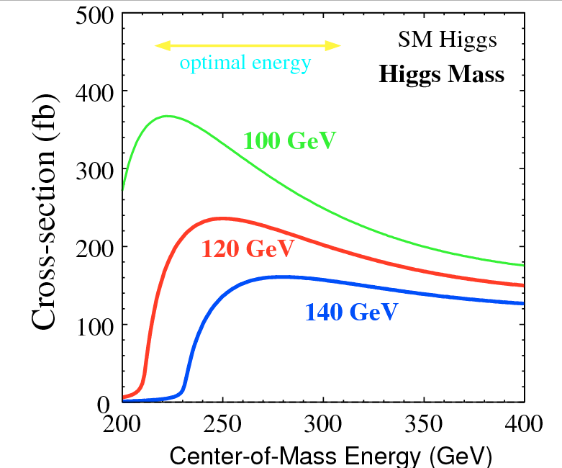
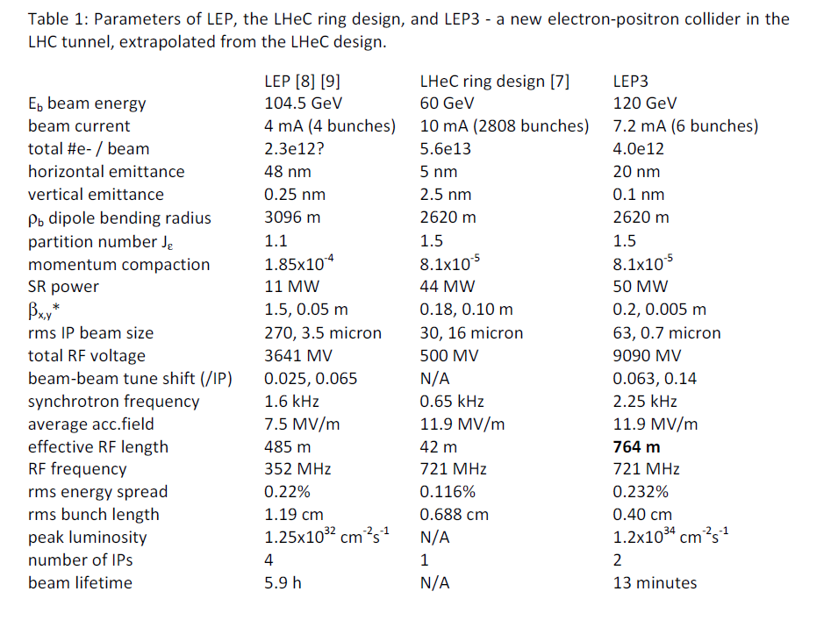
Compare to e⁺-e⁻ Collider
No direct H production in e⁺-e⁻
  No narrow resonance
    associated production Z +H
e⁺-e⁻ → ZH
  ~0.2pb at 250GeV
    background is ~10pb
  200/year at L =10³² (~LEP)
  20000/year at L =10³⁴
    0.015pb e⁺-e⁻ → ZH→l⁺l⁻H
    1500 “high-quality” events
Z + H not as cleanly separated from background
  H width cannot be resolved
But do not have to sit on resonance to see H

Slide 7
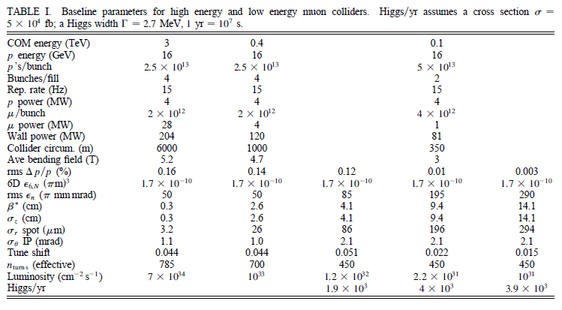
Collider Parameters
0.1~ →0.4 →3 + TeV Collisions
Parameters from 2003 STAB (+ Snowmass 2001)
    C. Ankenbrandt et al., Physical Review STAB 2, 081001 (1999), M. Alsharo’a et al., Physical Review STAB 6, 081001 (2003).
→0.125

Slide 8
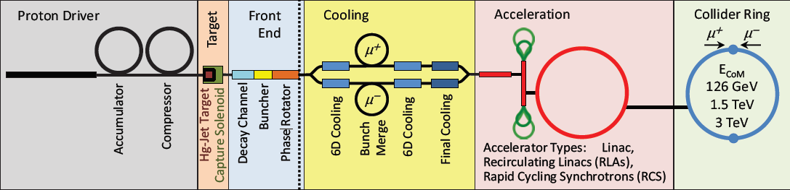
μ⁺-μ⁻ Higgs Collider Design
Based on “3 TeV” μ⁺-μ⁻ Collider design
  scaling back cooling system; acceleration, collider ring
  126 GeV precision Higgs measurements could be done as initial part of HE μ⁺-μ⁻ Collider program …
    follow-up to LHC/LC programs ?
  4 MW proton driver, solenoid target and capture, ionization cooling system, acceleration and collider ring
plus polarization precession for energy measurement at 10⁻⁶
  ~10—20% polarization precession
Is there a “fast-track” path to the μ⁺-μ⁻ Higgs ?

Slide 9
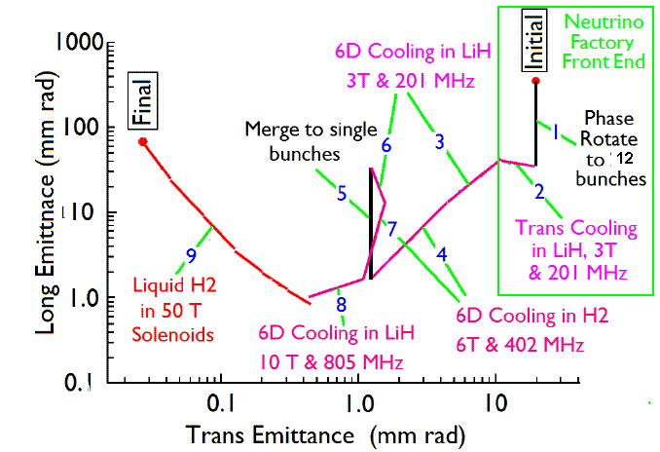
Natural 6-D muon cooling limits
Ionization cooling couples x, y, z
At moderate B, E_{RF}, λ_{RF,} optimal 6-D cooling is:
є_{T} = ~0.0003m,є_{L} = ~0.0015m
  σ_{E}= 3MeV→ σ_{z}=0.05m
Cooling to smaller є_{T} requires “extensions”
  reverse є exchange
  high B-fields, extreme rf, small E_{μ}
Initial derated values
  є_{T} = 0.0004m, є_{L} = 0.002m

Slide 10
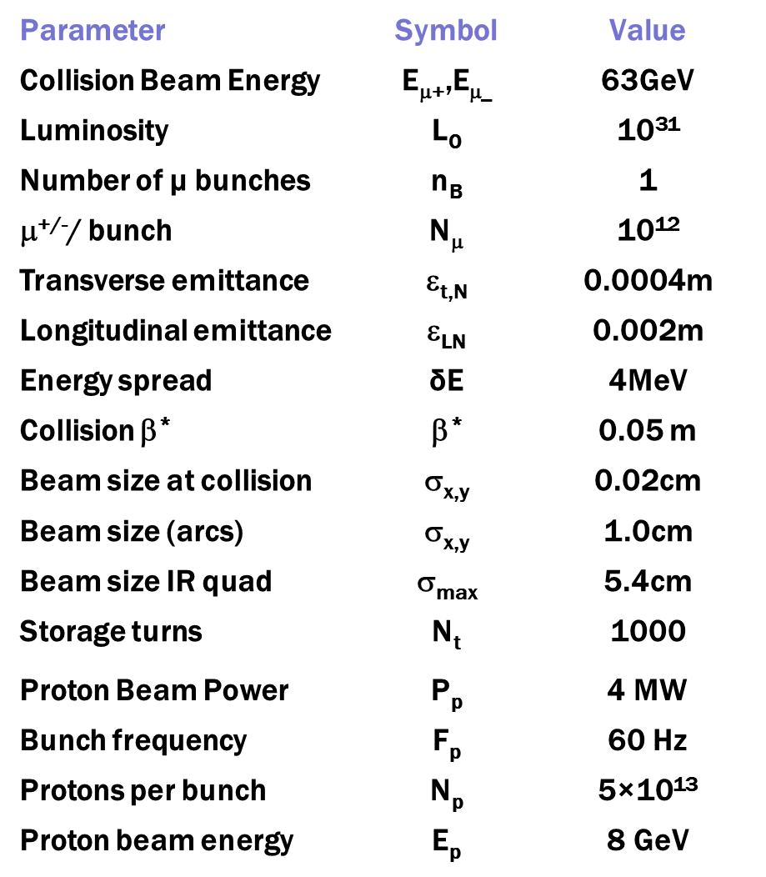
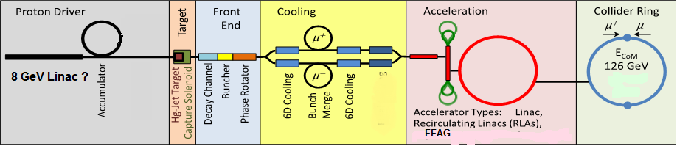
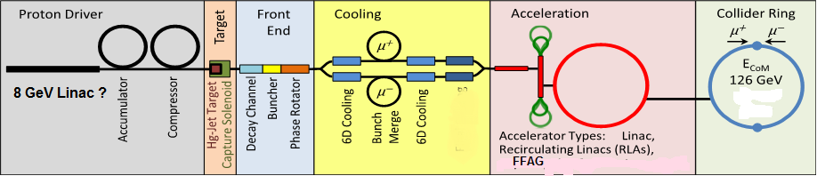
126 GeV μ⁺-μ⁻ Collider
8 GeV, 4MW Proton Source
  15 Hz, 4 bunches 5×10¹³/bunch
π→μ collection, bunching, cooling
    ε_{⊥,N} =400 π mm-mrad, ε_{‖,N}= 2 π mm
    10¹² μ/ bunch
Accelerate, Collider ring
  δE = 4 MeV, C=300m
  Detector
  monitor polarization precession
  for energy measurement
    δE_{error} → 0.1 MeV

Slide 11
Project X Upgrade to 4MW
Upgrade cw Linac to 5ma
  15 MW peak power
  run at 10% duty cycle
Increase pulsed linac duty cycle to ~10%
  8GeV × 5ma × 10% = 4MW
Run at 15 Hz (6.7ms injection/cycle)
  matches NF/MC scenarios
Chop at 50% for bunching
  source/RFQ →10ma
Need Accumulator,
Compressor to bunch beam
  + bunch combiner “trombone”

Slide 12
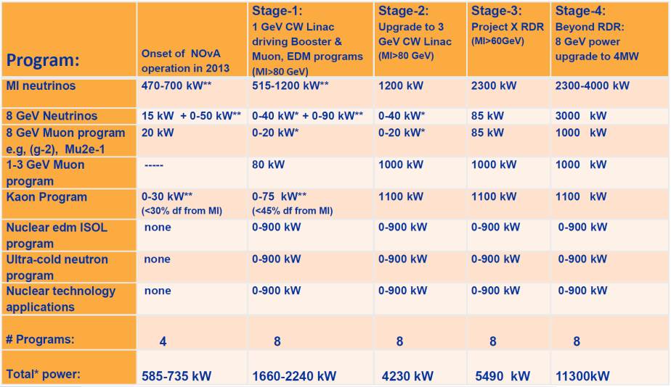
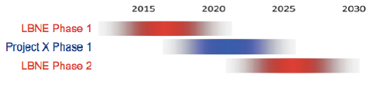
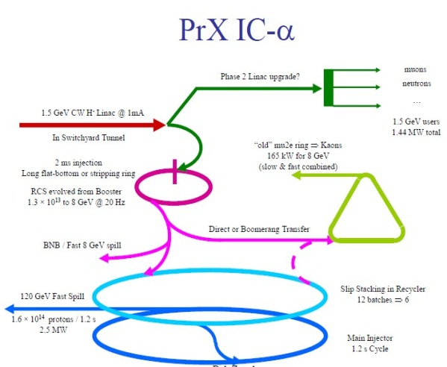
Alternative “Low-Budget” Proton driver?
Proton driver delayed …
  many stage f scenario
    20+ year ….
Is there a shorter path from X1 to μμ Higgs?
  2MW Main Injector?
    60GeV – 1.5Hz,
    ~10¹⁴/pulse
    divide into 10 bunches
    ~15 Hz, 10¹³p, 1m
  3MW 3GeV
  Higgs Accelerator + Protons

Slide 13
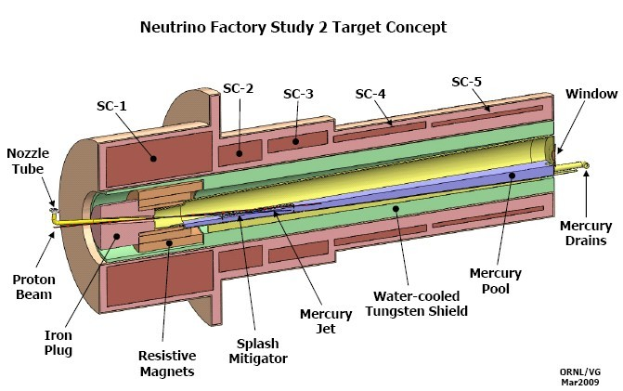
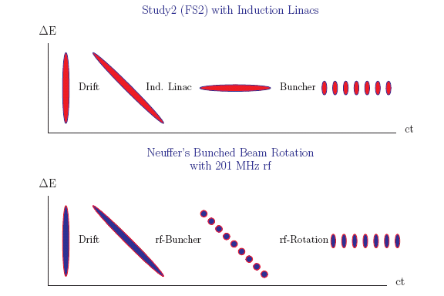
Solenoid lens capture
Target is immersed in high field solenoid
Particles are trapped in Larmor orbits
  B= 20T -> ~2T (15T → 1.8T)
  Particles with p⊥ < 0.3 B_{sol}R_{sol}/2=0.225GeV/c are trapped
  π→μ
  Focuses both + and – particles
  Drift, Bunch and “high-frequency” phase-energy rotation
π→μ

Slide 14
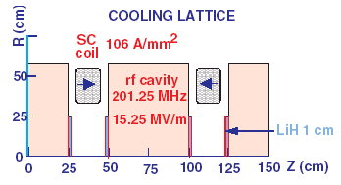
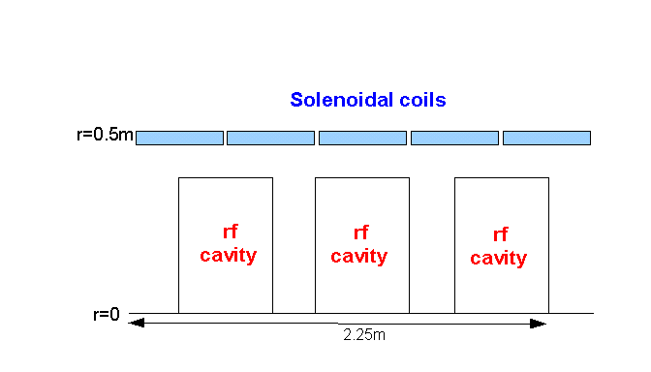
High-frequency Buncher and φ-E Rotator
Drift (π→μ)
“Adiabatically” bunch beam first (weak 320 to 240 MHz rf)
Φ-E rotate bunches – align bunches to ~equal energies
  240to 202 MHz, 15MV/m
Cool beam 201.25MHz
Captures both μ⁺ and μ⁻
  born from same proton bunch
p
π→μ
FE Target
Solenoid
Drift
Buncher
Rotator
Cooler
10 m
~50 m
~30m
36m
~80 m

Slide 15
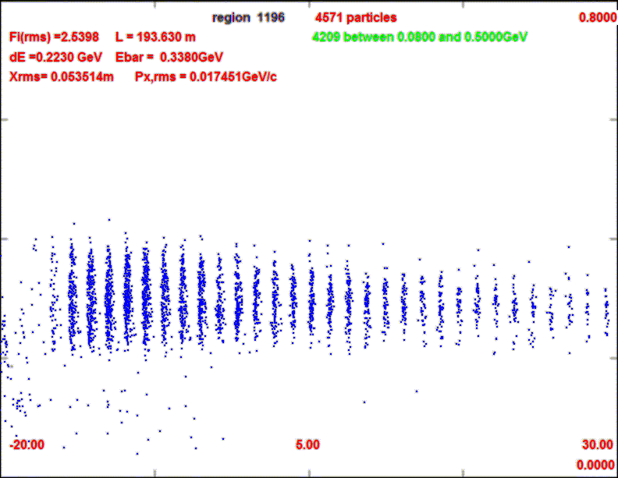
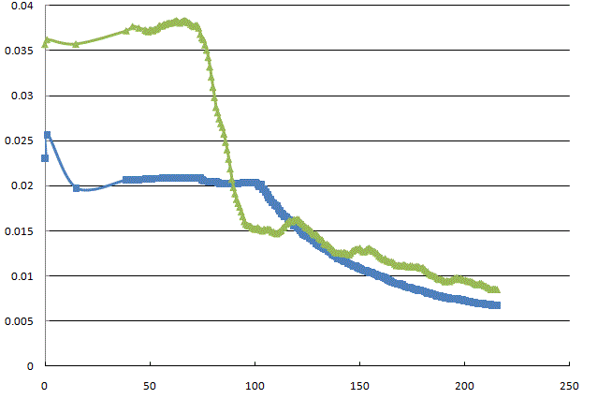
Beam at end of μ Source
Shorter bunch train
    15 → 12 bunches
  Bunch phase space larger
Obtains ~0.1 μ/p₈
  A_{t} < 0.03, A_{L} <0.2
  Choose best 12 bunches
    ~0.008 μ/p₈ per bunch
    ~0.005 μ/p₈ in acceptance
800 MeV/c
0
0.3
µ⁻/p
ε_{L}/10
0.2
ε_{T}

Slide 16
μ Capture / Buncher /Φ-E Rotation
Advantages
  high rf frequency (200 MHz)
  captures both signs
  high-efficiency capture
  well matched into cooling
  cost (?)
Disadvantages
  requires initial protons in a few short, intense bunches
  train of μ bunches (not single)
    requires later recombiner
  low polarization
    10---20%
  large number of rf frequencies
  weak initial cooling
Alternatives/variations should be (re)explored
  nondistortion induction linacs
  200 MHz → ?
    need > 10MV/m …
  larger polarization?
    rf manipulate π before decay
  Φ-E Rotation is “adiabatic”
    ¼ phase oscillation?
    40m→10m but higher gradient

Slide 17
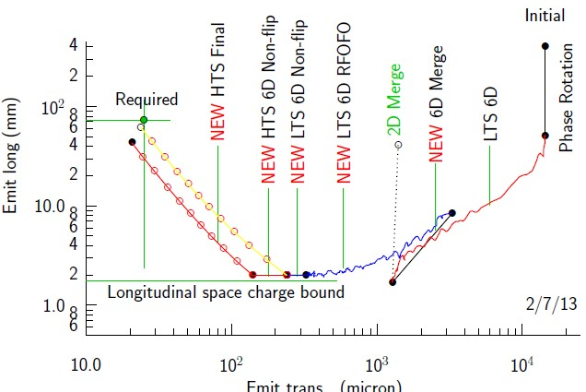
Cooling Scenario for 125 GeV
Use much of baseline cooling scenarios
  need initial 200/400 Mhz cooling sections
  need bunch merge
  and initial recooler
Do not need final cooling (high field section)
  final transverse cooling sections for luminosity upgrade
  high-field cooling not needed (B < ~12T)

Slide 18
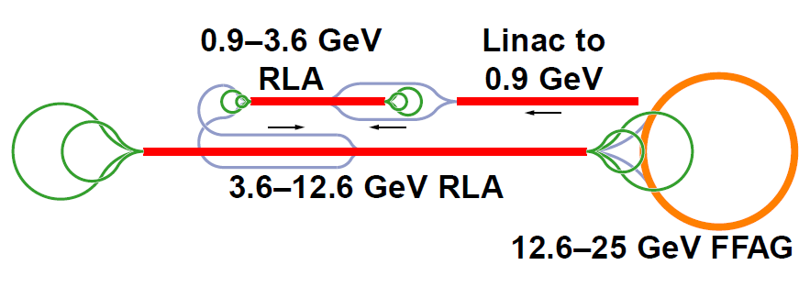
Acceleration - scenario
Use 25 GeV IDS neutrino factory acceleration scenario; extend to 63 GeV
  but small longitudinal emittance can make acceleration much easier (S. Berg)
    higher-frequency rf 400/600 MHz
    much smaller beams
25-63 GeV FFAG

Slide 19
Acceleration Scenario (Lebedev)
Linac + ~10 Pass Recirculating Linac to 63 GeV
5-6 GeV pulsed SRF Linac (650 MHz)
  “Dog-bone” recirculation
same Linac can also be used for 3→8 GeV Project X stage 3
  4MW for protons ?
3 GeV Linac
650 MHz SRF
~5 GeV Recirculating Linac
650 MHz
~12 turns to 63 GeV

Slide 20
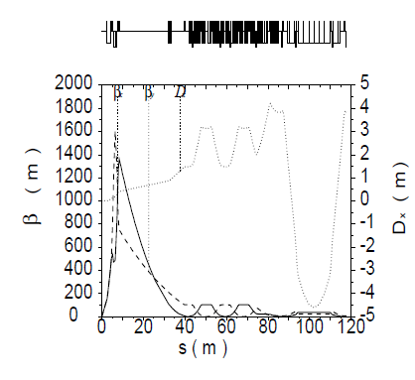
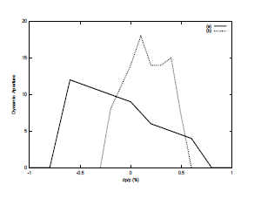
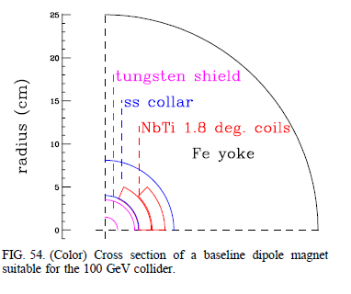
Collider Ring (1999)
  Johnstone, Wan, Garren
    PAC 1999, p. 3066
1 bunches of μ⁺ and μ⁻ (50x50)
  2×10¹² μ/bunch
β* = 10 cm→ 4cm
  σ= 0.04cm
β_{max} = 600m→2000m
  σ=3cm
  IR quads are large aperture (25cm radius)
ε_{L} =0.012 eV-s
  δE ~0.03 GeV if σ_{z} = 12cm
  δE/E < 10⁻⁴
Collider is not beam-beam limited
  r_{μ}=1.36*10⁻¹⁷m
  Δν=0.002
R=33m
at B_{ave}= 6T

Slide 21
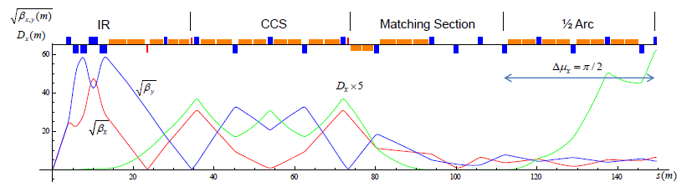
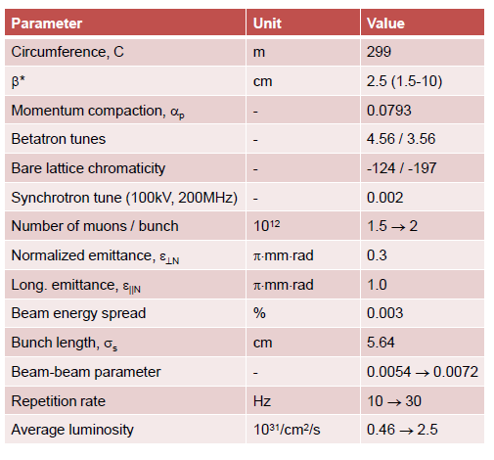
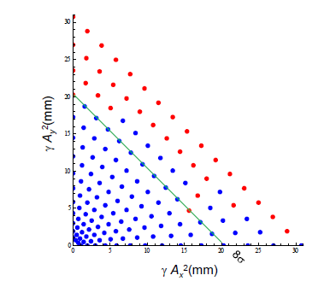
Updated 63 x 63 GeV Lattice
Y. Alexahin

Slide 22
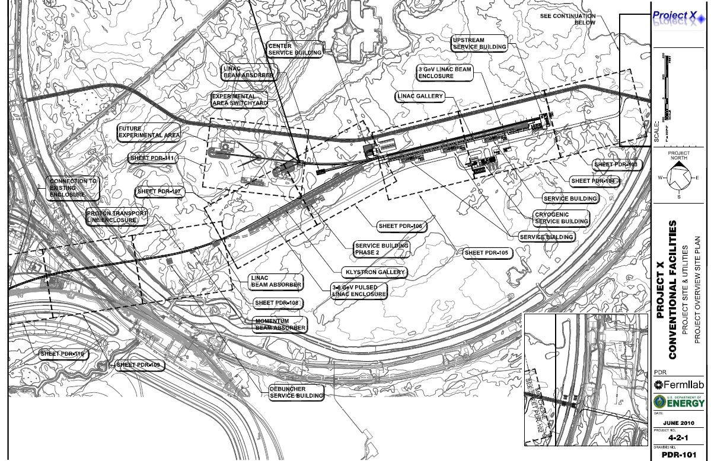
Scale of facility
Collider Ring
Proton Ring
Target +π→μ
Capture
RLA
Cooling line
Linac

Slide 23
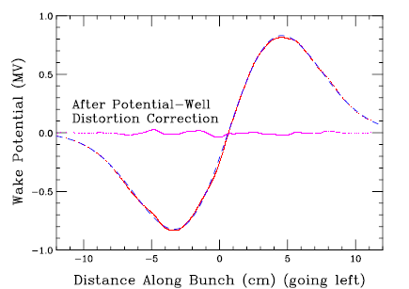
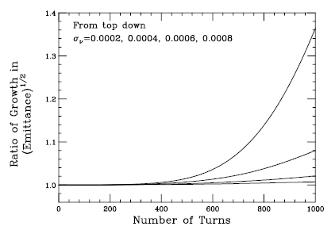
Beam Instability Issues
Studied in some detail by K.Y Ng (1999)
  PhysRevSTAB 2, 091001
    “Beam Instability Issues of the 50x50 GeV Muon Collider Ring”
  Potential well distortion
    compensated by rf cavities
  Longitudinal microwave instability
    ~isochronous lattice, small lifetime
  Transverse microwave Instability
    damped by chromaticity (+ octupoles)
  Beam Breakup
    BNS + δν damping

Slide 24
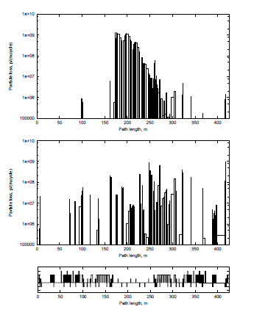
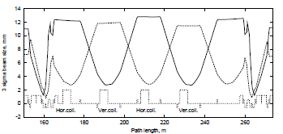
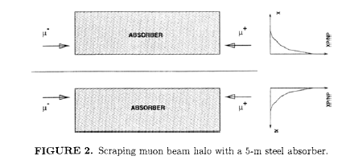
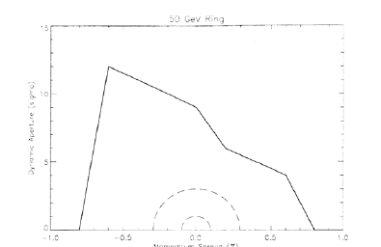
Losses/Background
Major Problem is μ-decay
  electrons from decay in detectors
  also beam halo control
Collimation
  remove beam halo by absorbers in straight section (opposite IR)
    Drozhdin, Mokhov et al.

Slide 25
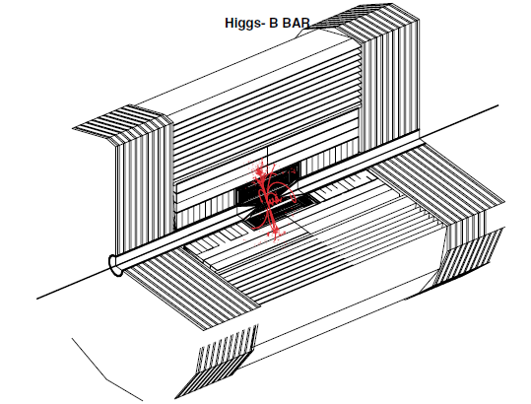
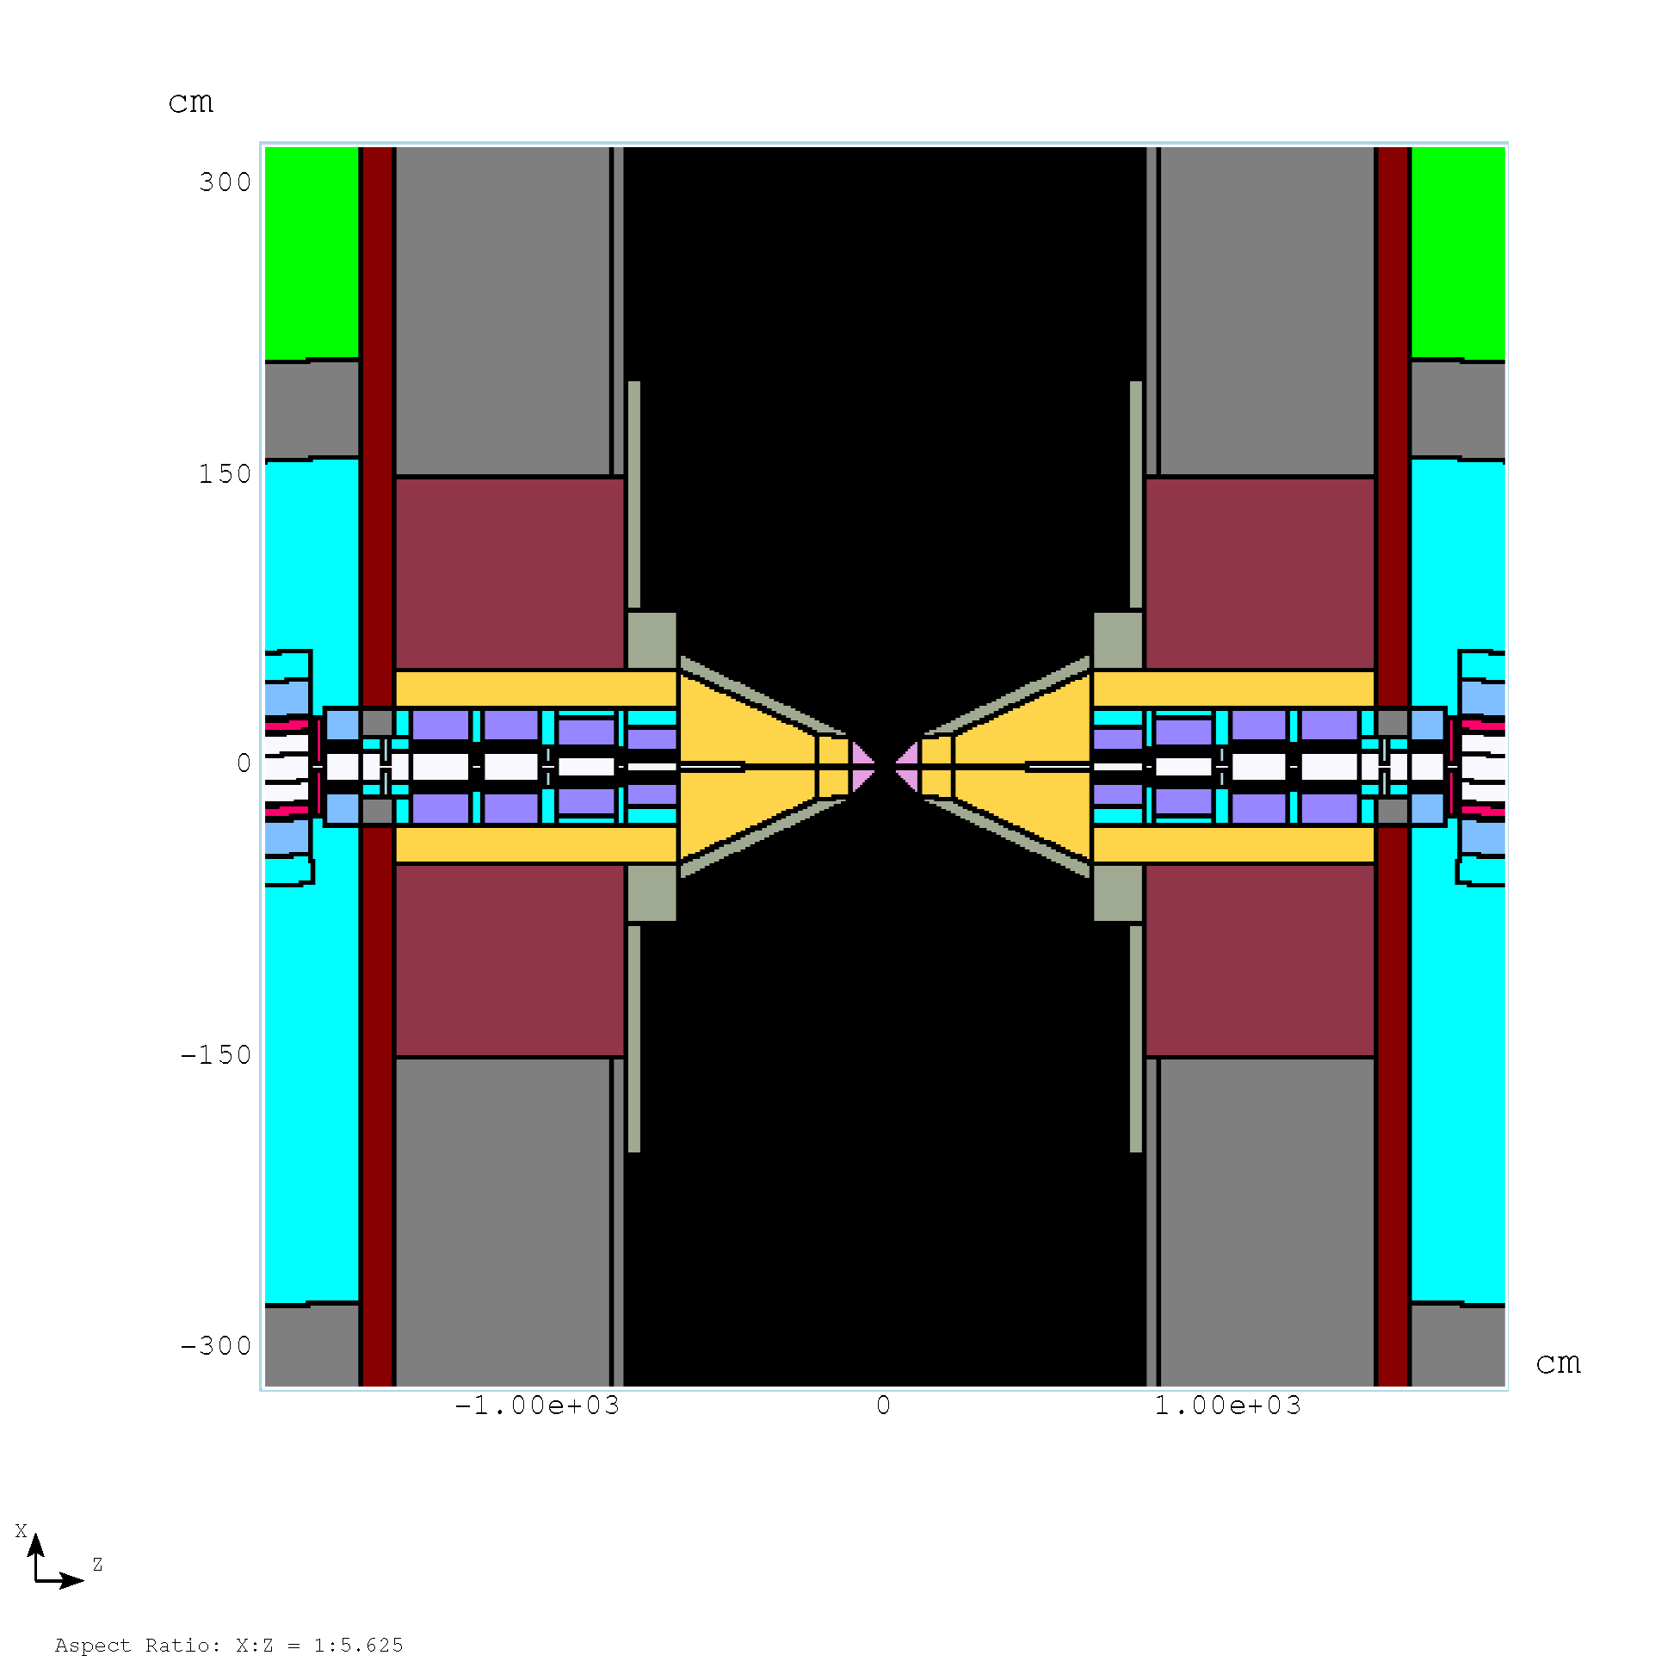
125 GeV Detector
μ-Decay Background reduced by “traveling gate trigger”
    Raja -Telluride
  Detector active for 2 ns gate from bunch collision time
  H→b b*

Slide 26
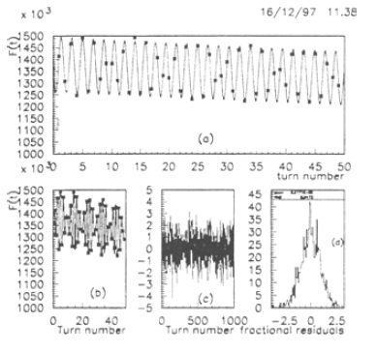


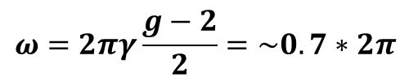
Polarization & Energy measurement
Raja and Tollestrup (1998) Phys. Rev. D 58 013005
Electron energy (from decay) depends on polarization
  polarization is ~25% → 10%
  Measure ω from fluctuations in ΣE_{e} from decay in a calorimeter
    10⁶ decays/m
  E_{μ} depends on Frequency
  Frequencies can be measured very precisely
  E, δE to 0.1 MeV or better (?)
  need only > ~5% polarization ?
$$ω=2πγ\frac{g−2}{2}=\sim 0.7∗2π$$

Slide 27
μ⁺μ⁻→Z (90 GeV) = “Training Wheels”
Run on Z until luminosity established
  easier starting point
  σ = ~30000 pb
    3000 Z/day at L=10³⁰
  Debug L, detectors, background suppression, spin precession, at manageable parameters
  Useful Physics at Z ?
    E, ΔE to ~0.1 MeV or less
    μ⁺μ⁻ → Z₀
  Then move up to 125 GeV
    energy sweep to identify H
    δE ~ 10MeV → 3MeV

Slide 28
Higgs MC Parameters -Upgrade
Proton Linac 8 GeV
Reduce transverse emittance to 0.0002m
More Protons/pulse (15 Hz)
Accumulator,
Buncher
Parameter | Symbol | Value
Proton Beam Power | P_{p} | 4 MW
Bunch frequency | F_{p} | 15 Hz
Protons per bunch | N_{p} | 4×5×10¹³
Proton beam energy | E_{p} | 8 GeV
Number of muon bunches | n_{B} | 1
μ^{+/-}/ bunch | N_{μ} | 5×10¹²
Transverse emittance | ε_{t,N} | 0.0002m
Collision β* | β* | 0.05m
Collision β_{max} | β* | 1000m
Beam size at collision | σ_{x,y} | 0.02cm
Beam size (arcs) | σ_{x,y} | 0.3cm
Beam size IR quad | σ_{max} | 4cm
Collision Beam Energy | E_{μ+},E_{μ_} | 62.5(125geV total)
Storage turns | N_{t} | 1000
Luminosity | L₀ | 10³²
+4→1 bunch combiner
Hg target
Drift, Bunch, Cool
Linac
RLAs
Collider Ring
δν_{BB} =0.027

Slide 29
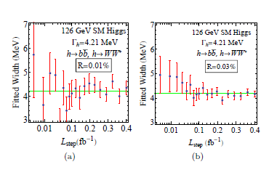
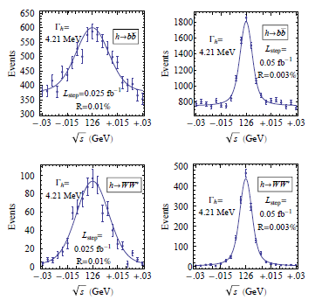
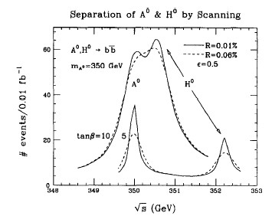
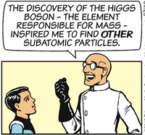
Upgrade to higher L, Energy
higher precision
extended Higgs
  A, H at 500 GeV ?
  larger cross sections
  larger energy widths
TeV new physics ?
T. Han & S. Liu

Slide 30
Upgrade path (E and L)
More cooling
  ε_{t,N}→ 0.0002, β*→1cm
Bunch recombination
  60Hz → 15 ?
  L →10³²
More cooling
  low emittance
  ε_{t,N}→ 0.00003, β*→0.3cm
  L→10³³
More Protons
  4MW → 8 → ?
  15Hz
  L→10³⁴
more Acceleration
  →4 TeV or more …
  L→10³⁵

Slide 31
Comments
125.5 GeV Higgs is not easy
  small cross section, small width
Need high-luminosity (> ~10³⁰ cm⁻²s⁻¹)
  Need high-intensity proton Driver
    N MW, 5—50 GeV, pulsed mode (10—60 Hz)
  Need MW target, π→μ collection
  Need ionization cooling by large factors
    ε_{t}: 0.02 → 0.0003 m; ε_{L}: 0.4 → 0.002 m.
  acceleration, collider ring, detector
    spin precession energy measurement
  can get precision energy and width
Not extremely cheap
  Most of what we need for high-L high-E μμ Collider

Slide 32
Conclusions
An Initial Muon Collider (125 GeV) could be constructed, L>~10³¹cm⁻²s⁻¹
  L -> 10³² cm⁻²s⁻¹
  needs less transverse cooling
  does need front end (captures both μ⁺ and μ⁻)
  can be initiated on the Z₀
  Need more design development for Snowmass 2013
Could be upgraded to high-energy
  more cooling, reverse emittance exchange
  more acceleration

Slide 33
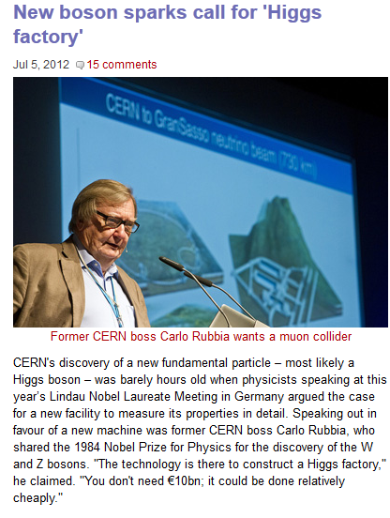


Professional endorsement

