Slide 1



Apply Helical Cooling Channel for Higgs Factory
Katsuya Yonehara
Accelerator Physics Center, Fermilab

Slide 2
Outline of my talk
Review past helical cooling channel simulation effort
Discuss what we are working now to realize the helical beam element
Discuss new beam element for Higgs Factory

Slide 3
Concept of an Ionization Cooling Channel
More detail, please see
A. Chao edt., Physics and Engineering
Emittance evolution
Cooling
Heating

Slide 4
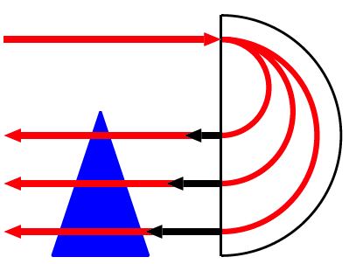
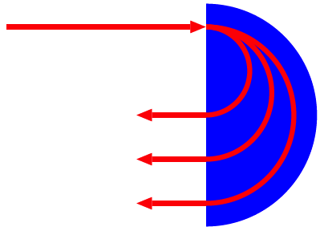
Concept of Emittance Exchange
Dipole magnet
Homogeneous
absorber filled
dipole magnet
p
p-δp
p
p+δp
Wedge absorber
Red: Reference orbit
Blue: Beam envelop
Homogeneous absorber filled
continuous helical dipole magnet

Slide 5
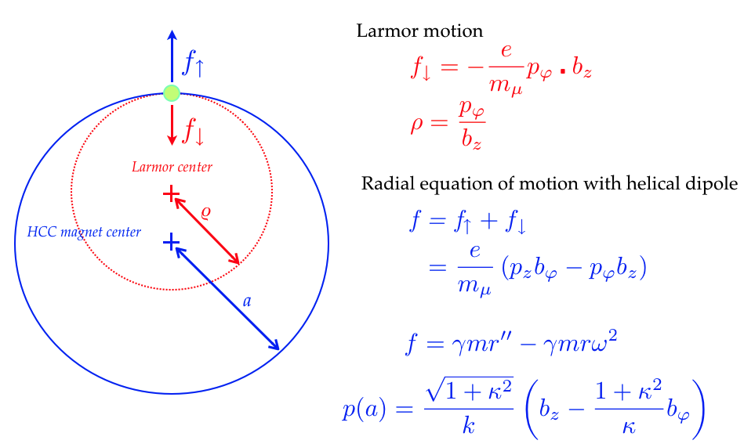
Basic particle dynamics in HCC
(Helical Cooling Channel)
Ya Derbenev & R.P. Johnson, PRSTAB 8 041002 (2005)

Slide 6
Homogeneous Cooling Material Filled Helical Cooling Channel
Advantage: A continuous magnet structure
  Fast cooling
  Single pass
    No critical injection & extraction issue
    No heating absorber issue
  No beam resonance
  Etc…
Challenge: Require technological development
  Need state of the art technology
  Some critical device will be discussed in this talk

Slide 7
Helical Cooling Channel Simulation
Goal phase space
ν = 0.325 GHz
λ = 1.0 – 0.8 m
100 % @ z = 0 m
92 % @ z = 40 m
Study2a
ν = 0.65 GHz
λ = 0.5 – 0.3 m
86 % @ z = 49 m
ν = 1.3 GHz
λ = 0.3 m
73 % @ z = 129 m
66 % @ z = 219 m
GH2 pressure = 160 atm
Analytical helical field
Idea pillbox cavity
60 μm Be RF window
E ~ 27 MV/m
60 % @ z = 303 m
For detail field parameters, please see
K. Yonehara et al., IPAC 2010, MOPD076

Slide 8
Radial Distribution in Final HCC
σ_{r} = 4.6 mm
@ z = 303 m
• Beam size is small enough to fit in 1.3 GHz SRF (DA 10 cm)

Slide 9
Final Momentum/Energy distribution from HCC Simulation
σ_{p} = 6.8 MeV/c
σ_{E}= 6.0 MeV
@ z = 303 m
• Population in δE = [-1/3 σ, 1/3 σ] = 4 MeV is 26 %
• Possible improvement:
Phase rotation, more longitudinal cooling, etc

Slide 10
Considerable HCC Simulation Efforts
Improve final longitudinal emittance
  Tapering momentum along with HCC length makes better cooling because of larger energy loss rate (dE/dx)
  Increase helical field strength to realize low beta function
  Design E-t phase rotation
Design a matching section
  Connect straight section to HCC
  Transport beam with RF frequency shift
Use fast & powerful computer to optimize HCC
→ NERSC is almost ready to go! (Goal D&S effort in FY13)

Slide 11

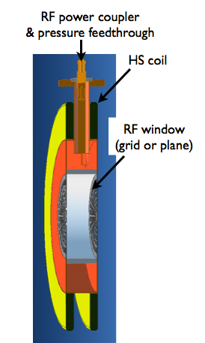
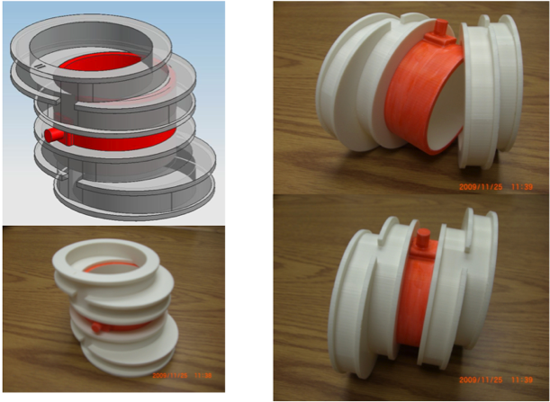
Develope HCC beam element
Integrated HCC cell
Assemble HCC cell
HCC cell

Slide 12
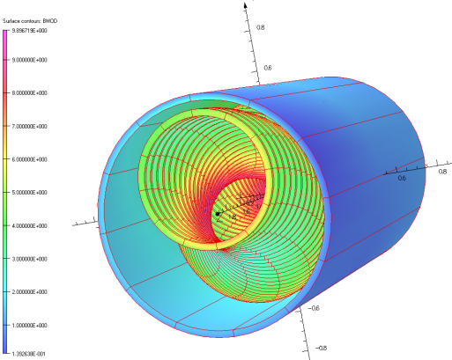
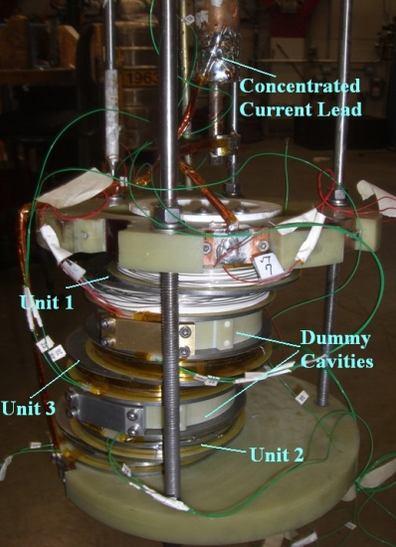
HCC magnet R&D
HCC magnet consists of helical solenoid (HS)
coil and a straight solenoid
Helical solenoid (HS) cell
• Made NbTi, NbSn₃ & YBCO HS coils
• Experimentally verified simulation
• Development of winding HS coil
• Design mechanical support
• Development of quench protection
G. Flanagan et al., IPAC 2012, THPPD041

Slide 13
HCC RF cavity R&D
Most crucial device for HCC
HCC needs a continuous cooling material
Continuous HCC RF system is considered
Proposed hydrogen gas filled RF cavity
  Gas acts as a beam cooling material
  Gas also suppresses an RF electric breakdown
Proposed dielectric loaded RF cavity
  Compact

Slide 14
Plasma loading effect in gas filled RF cavity (Feasibility test)
Beam generates an ion pair in a gas filled RF cavity during ionization (cooling) process
Electron is so light that it consumes much RF power (plasma loading effect)
Electron is removed by a small amount of electronegative gas
1% Dry Air (0.2 % O2) in GH2
RF envelope w/o beam
Pure GH2
RF envelope w beam
1% Dry Air
(0.2 % O2)
in GH2 at B = 3 T
Beam on
Plasma loading is not an issue!
E₀ = 25 MV/m

Slide 15
Produce Polarized Muon Beam
Studying polarized muon beam becomes important especially for Higgs Factory
In fact, muon spin is oriented in pion decay because of parity violation
However, the angular distribution is isotropic, overall muon polarization is zero
Fortunately, bunched muon beam preserves polarization since ToF of muons has a memory of orientation of pion decay
Polarization is useful to calibrate kinetic energy and increase Higgs production (figure of merit ∝ p²)

Slide 16
Spin Exchange Process
Pair particle
Muon spin
Polarization
Hyperfine coupling (A=44.2 GHz)
• Full spin transfer possible by using RF field in zero-crossing B field
• Polarization becomes 100 %

Slide 17
Relative-Speed Zero Proton Beam
Intense polarized proton beam is under
study (electron-heavy ion collider)
No relativistic energy required
  β will be 0.7~0.9
No long straight section needs
  Depend on the cross section of muonium production rate
  1 meter is enough for hyperfine interaction
Cold proton beam even cool down muon phase space (analogy of electron cooling)
Proton cooling may improve 36 times faster cooling than electron in energy transfer process
Polarized proton ring
μ storage ring

Slide 18
Summary
Evaluated HCC for Higgs Factory
  Final transverse emittance looks fine
  Need more optimization to obtain low longitudinal emittance (factor three cooling)
Developed HCC beam element
  R&D of helical solenoid coil goes very well
  R&D of high pressure gas filled cavity seems to be feasible
  Next step: Dielectric loaded RF test
Discussed spin-exchange process to make a polarized muon beam
  Need serious theoretical investigation

