Slide 1
Project X Proton Source
Keith Gollwitzer
Accelerator Division
Fermilab
Muon Collider Higgs Factory Mini-Workshop
November 13, 2012

Slide 2
Outline
Summary of Project X
Upgrade of Project X to 4 MW
Possible Operational Scenarios

Slide 3
Project X Mission Goals
Provide a neutrino beam for long baseline neutrino oscillation experiments based on a capability of targeting at least 2 MW on proton beam power at any energy between 60-120 GeV.
Provide MW-class, multi-GeV, proton beams supporting multiple kaon, muon and neutrino based precision experiments. Simultaneous operations of the rare processes and neutrino programs are required.
Provide a path toward a muon source for possible future Neutrino Factory and/or Muon Collider.
Provide Options for implementing a program of Standard Model tests with nuclei and/or nuclear energy applications.

Slide 4
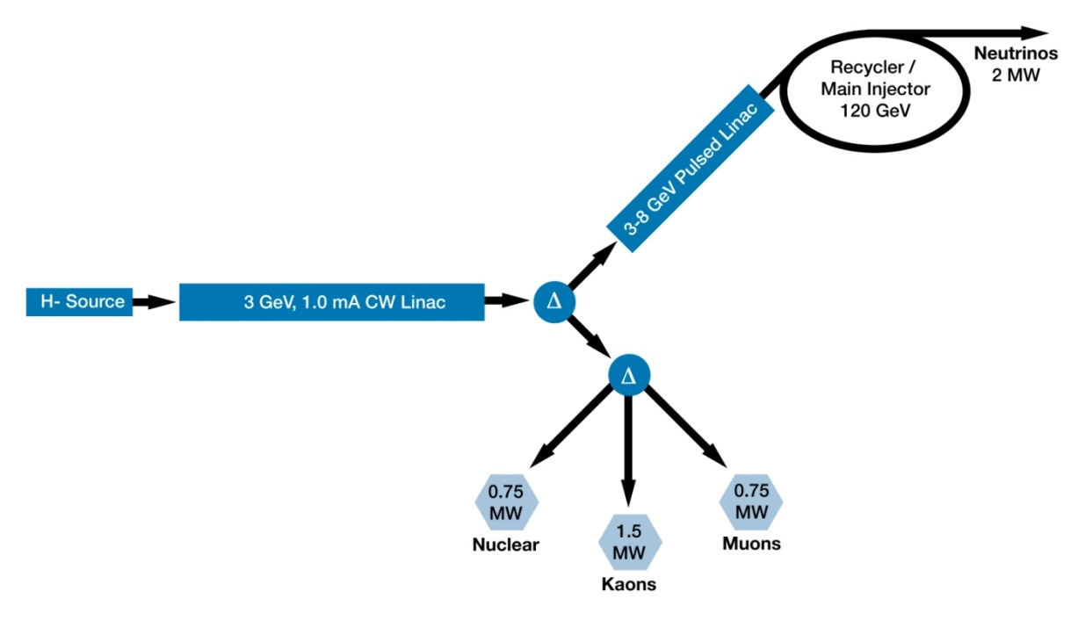
Project X Reference Design
CW Linac will support average beam current of 1 mA to 3 GeV
Pulsed Linac (3-8 GeV) will have a ~5% duty factor
Possible 8 GeV beam power of 320 kW
Programmable Chopper System (part of H- source) will provide appropriate bunch structure for the linac experiments as well as fill the appropriate part of the RF buckets in the accumulating Recycler Ring

Slide 5
Project X Staging
Recently, DOE requested Fermilab to propose staging of Project X
Ion Source and CW Linac to 1 GeV; inject into current Booster; possible 1 MW at 1 GeV
CW Linac 1 to 3 GeV with 3 GeV experiment campus
Pulsed Linac 3 to 8 GeV; inject into Recycler
Upgrade Project X to 4 MW at 8 GeV

Slide 6
Upgrade
Upgrade Project X to achieve 4MW at 8GeV
Increase particles
Doubling particles per linac bunch
Average beam current increase to 5 mA
Increase pulsed linac duty factor
Increase to 10%
Additional RF power and infrastructure
Beam Reformatting
Accumulation Ring
Bunch Compression

Slide 7
Proton Driver Layout
4MW Target
Accumulator Ring
Compressor Ring

Slide 8
Possible Operational Schemes - 1
Upgraded Project X
Pulse at 15Hz
Pulse for 6.67ms
Programmable chopper allows half of beam through
Accumulation Ring
Converts ion beam to proton beam
RF buckets synchronized to chopper
Results in 4 bunches

Slide 9
Possible Operational Schemes - 2
Desired frequency to Compressor Ring
60 Hz: Transfer single bunch at a time
30 Hz: Transfer 2 bunches at a time
15 Hz: Transfer all 4 bunches
Compressor Ring bunch rotates beam and extracts into 1, 2 or 4 beam lines to target
Multiple beam lines are such that all bunches arrive simultaneously

Slide 10
Multiple Beam Lines to Target
Extracted bunches from Compressor Ring are sent into different length beam lines

Slide 11
Multiple Beams onto Target
Each beam line enters the target area with an angle to the solenoid axis and will have a path such that the center of the interaction region is on the solenoid’s axis

Slide 12
Why 4 Bunches
Instability due to intense particle bunches
Believe that 1 MW per bunch is possible at 15 Hz running of Project X
If 4MW is desirable, then multiple beam lines are needed to deliver beam to target
V. Lebedev: maximum power per bunch
Final Bunch Parameters
(Compressor Ring)
Initial Ring Bunch Parameters
(Accumulator Ring)

Slide 13
Summary
There is an upgrade path from Project X to provide 4 MW of 8 GeV proton beam to a target with the desired characteristics
Questions?

