Slide 1
Superconducting Rapid-Cycling Synchrotron as High-Power Proton Source for Muon Collider
Henryk Piekarz
Accelerator Physics Center, FERMILAB

Slide 2
Motivation
Proposal [1] for Higgs Factory based on the Low-Energy Muon Collider asks for a proton source of:
2.09 MW power with 1.63 10¹⁵ protons/second
We will outline a synchrotron-based proton source that will
match, and possibly exceed, this requirement while maintaining
reasonable levels of technical feasibility and cost.
[1] R.P Johnson et al., “Conceptual Design of a Higgs Factory
Muon Collider”, This Workshop

Slide 3
Outline of the Synchrotron-based Proton Source
Proton source consists of:
H⁻ Source 50 keV
Pulse Linear Accelerator 1 GeV
Rapid Cycling Synchrotron 8 GeV, 60 Hz
Pion/Muon production target 2-3 MW

Slide 4
Basic Parameters of Proton Source
Parameters of proton source for Muon Collider (M) are scaled from the earlier design [2] of a proton source for the Project X (X).
Parameter | PLA-M | PLA-X | SRCS-M | SRCS-X
E _{inj} [GeV] | 0.005 | 0.005 | 1 | 1
E _{extr} [GeV] | 1 | 1 | 8 | 8
Path/Ring length [m] | 335 | 335 | 829.9 | 829.9
Pulse rate [Hz] | 60 | 10 | 60 | 10
Beam current [mA] | 5 | 10 | - | -
Pulse width [ms] | 1 | 1 | - | -
Protons per pulse | - | - | 2.7 10¹³ | 5.4 10¹³
Beam power [kW] | 375 | 125 | 3000 | 1000
[2] H. Piekarz, “ Project X with Superconducting Rapid Cycling Synchrotron and Dual Storage Ring”,
IPAC12 , New Orleans, 2012

Slide 5
1 GeV Proton Linac
The SNS 1 Gev Linac can be used as injector to the Rapid Cycling Synchrotron.
As this Linac is currently operating the construction procedure and cost are established.

Slide 6
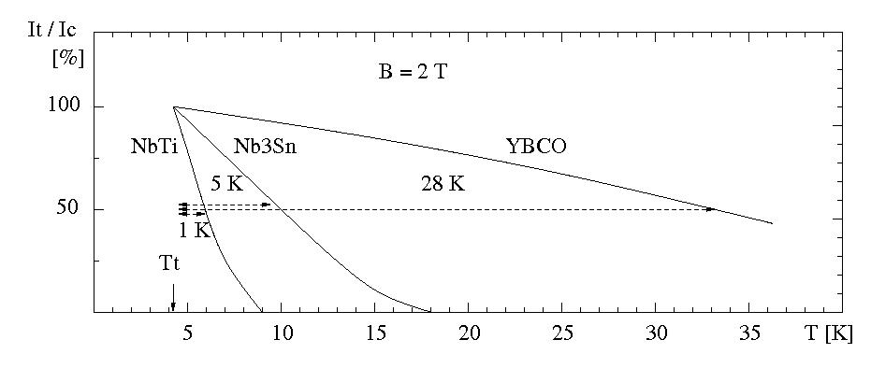
Rapid-Cycling Synchrotron- Superconductor Choice (I) Temperature Margin & Radiation Hardness
Temperature margin for safe and possibly quench-free operations is make or break
parameter of superconducting power cable for rapid-cycling magnet applications.
For operation at 4.2 K, It /Ic = 50% and 2 T field, YBCO offers temperature margin
30 times wider than with NbTi, and 6 times wider than with Nb₃Sn conductors.
YBCO strand (344C-2G) has also shown strong resilience to radiation ! *)
*) R. Gupta, “Radiation Studies for HTS Magnets”, www.bnl.gov/magnets/staff/gupta/Talks/FAM08/fam-radiation.pdf

Slide 7
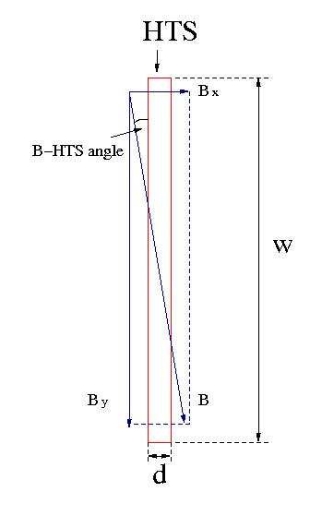
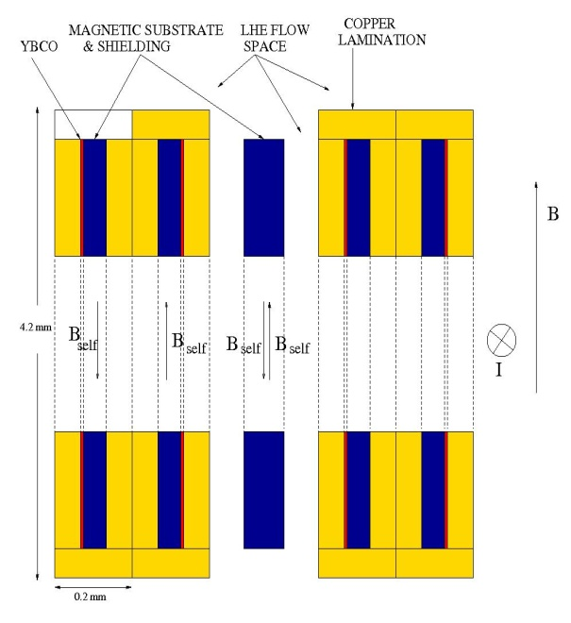
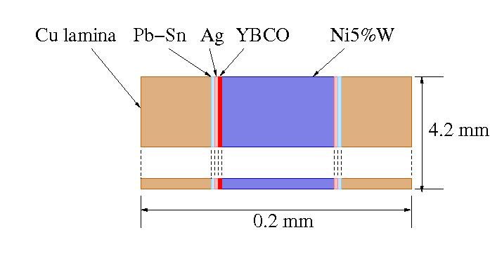
(II) Minimization of AC Losses
(I) – If HTS tape and magnetic field in the cable cavity are parallel to each other the AC power losses are strongly supressed as only the narrow edge (2 µm) of HTS strand is exposed to the magnetic field. It is critical that B to HTS angular orientation is as parallel as possible.
(2) – As magnetic substrate (Ni5%W ) is part of the HTS tape, pairing strands with substrate sides facing each other helps to suppress the self-field coupling induced power loss.

Slide 8
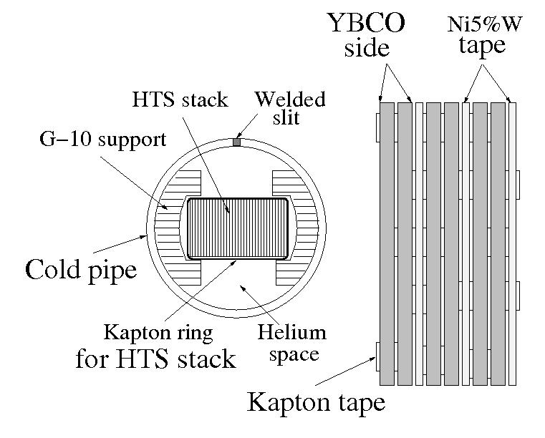
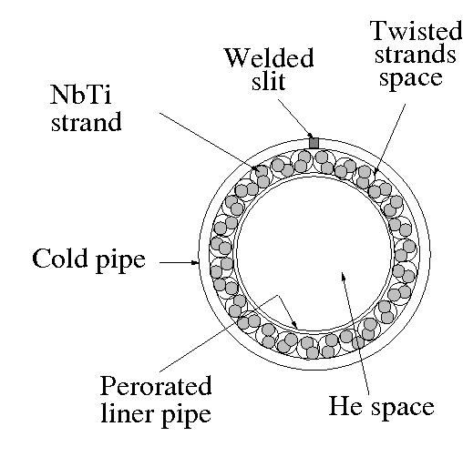
Test of HTS & LTS Cable Power Loss in Ramping Magnetic Field
Test cables:
1.4 m long HTS and LTS cables to carry 16 kA current at 2 T
with nominal 10 K and 2 K temperature margins, respectively.
HTS cable stack consists of 10 pairs of 344C-2G strands
(4.5 mm x 0.2 mm) with 9 Ni5%W tapes (4 mm x 0.07mm)
between the strand pairs
LTS cable consists of 23 twisted pairs of 0.8 mm NbTi strands. The LHe cooling channel is 6 times that of SIS magnet cable to be about equal with the HTS cable
Top view
Cross-section
Cables were exposed to 0.5 T ramping field of up to 20 Hz rep. rate.
HTS cable was rotated in +/- 10⁰ angle range relative to B-field.
LHe coolant of 8 K, 0.23 MPa and flow rate (0.4 - 0.8) g/s was used.

Slide 9
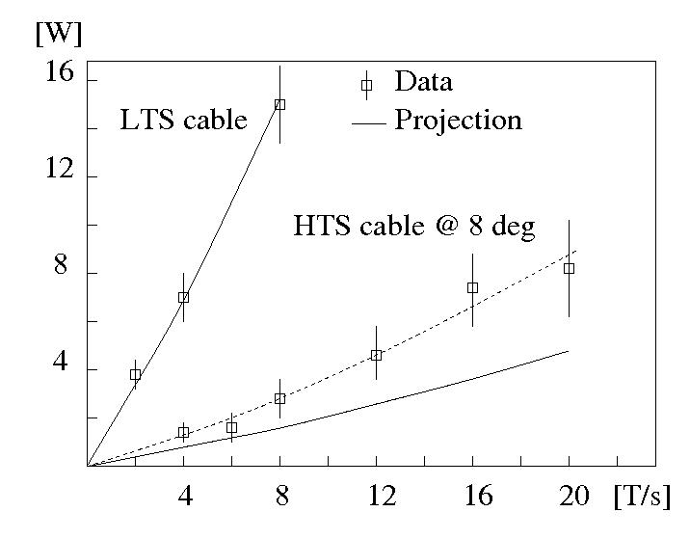
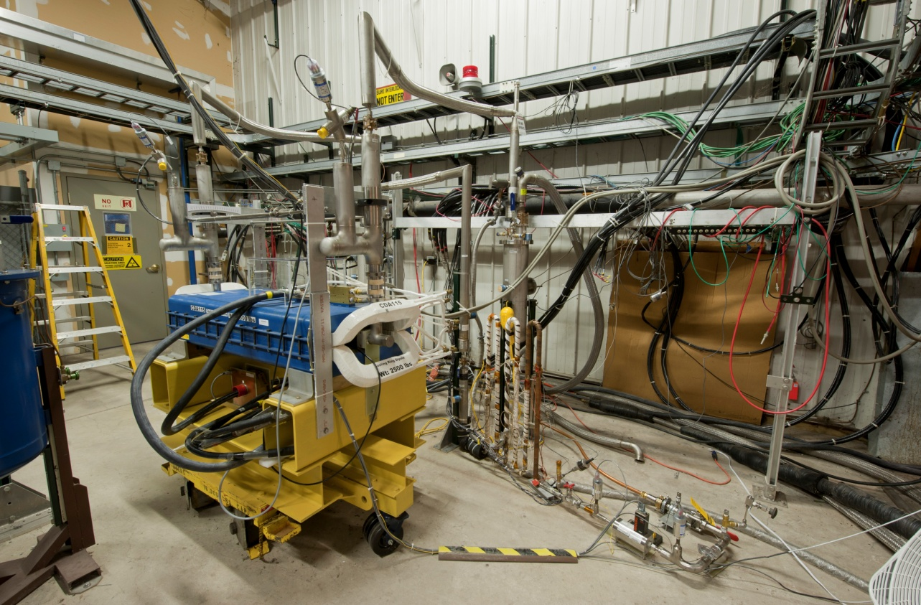
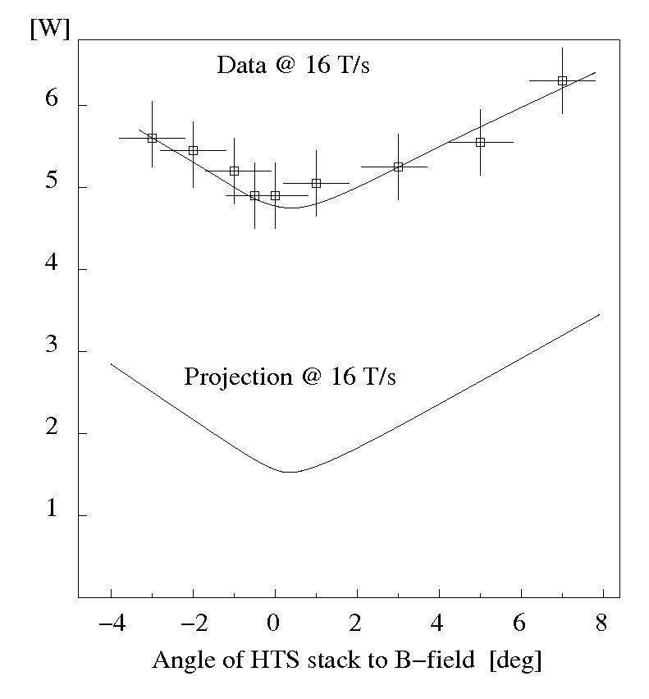
Test of HTS & LTS Cables in Ramping Magnetic Field
Test results *): (1) P _{meas} (LTS) = P _{proj} (LTS)
(2) P _{meas} (LTS) = ~ 5 x P _{meas} (HTS)
(3) P _{meas} (HTS) = ~ 2 x P _{proj} (HTS) **)
**) Probable reason: cable movement in plane parallel to B-field, or HTS stack – B misalignment, or cable twist
*) H. Piekarz et al., IEEE, Proc. MT-22, Marseille, 2011

Slide 10
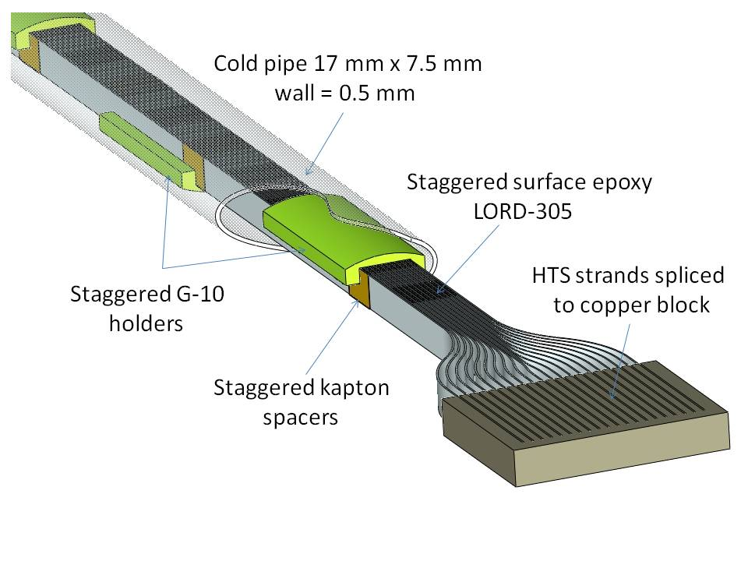
HTS Sub-Cable Design for Rapid Cycling Dipole
Sub-cable assembly shown above immobilizes HTS stack while
forcing liquid helium to flow up and down between the strands
11/12/2012

Slide 11
SRCS Main Arc Magnet Parameters
Parameters | SRCS-M |  | SRCS-X
B _{inj} | B _{oper} [T | T] | 0.04 | 0.30 |  | 0.04 | 0.30
Beam gap [mm] | 50 |  | 50
I _{top} [kA | N _{turns}] | 10 | 1 |  | 10 | 1
Rep. rate [Hz] | 60 |  | 10
dB/dt [T/s] | 30 |  | 5
Superconductor HTS | 344C-2G | SuperPower |  | 344C-2G
N strands | 2 x 12 | 2 x 12 |  | 2 x 12
T _{oper} [K] | 5 |  | 5
T _{margin} [K] | 25 |  | 25
Power loss @ 5 K [W/m] | 20 | 10 | 2
Power loss / accelerator [kW] | 17 | 8.5 | 1.7
Cryogenic power for SRCS-M is substantial but less
than 24 kW available from the Fermilab cryogenic plant

Slide 12
Power Requirements for SRCS-M
Main arc magnet parameter | SRCS-M
Magnet inductance - core space [µH/m] | 5
Inductance between cores [µH/m] | 1
Total synchrotron inductance [mH] | 3.1
Current at injection [kA] | 2.5
Current at extraction [kA] | 9.8
Repetition rate [Hz] | 60
Number of power supply sectors | 8
Magnet string inductance per sector [µH] | 390
Voltage drop per sector [V] | 400
Ramping power per sector [MVA] | 3.6
Ramping power loss per sector [MVA] | 0.4
Total Ramping power loss [MW] | 4
As a result of high repetition rate the ramping power is substantial. Experience with Booster and Main Injector calls for splitting this power system to sectors of no more than 4 MVA each.
Power required to keep the cycling accelerator system working is no higher than 10% of the ramping power, so the overall required power is at about 4 MW.

Slide 13
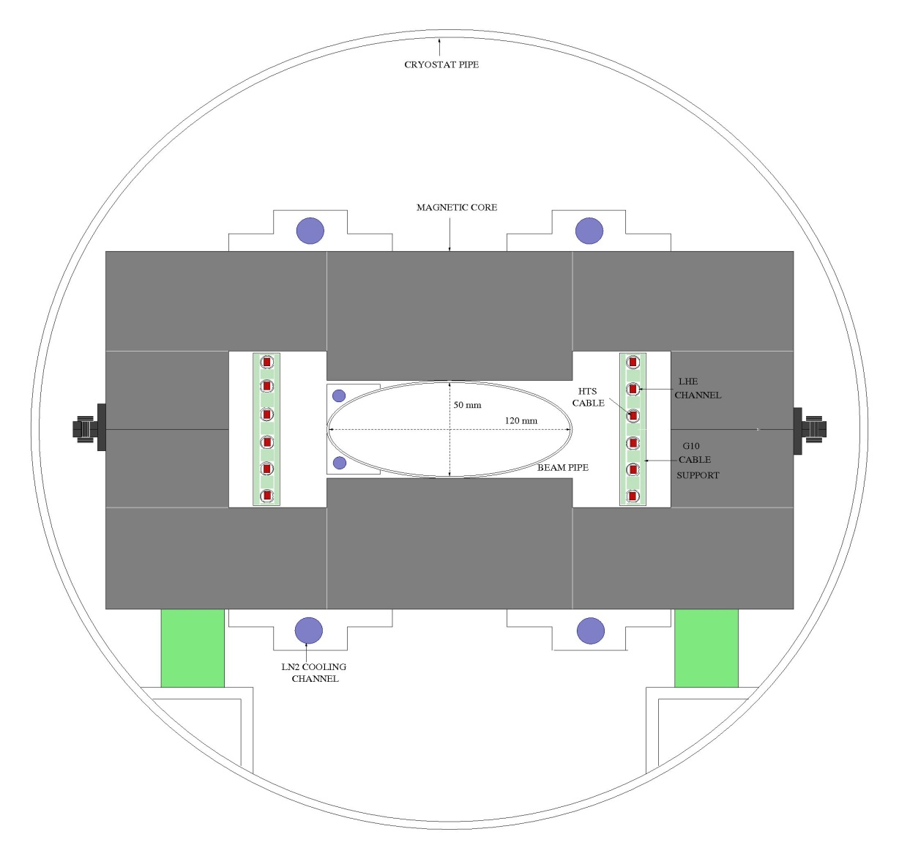
Arrangement of Rapid Cycling HTS Dipole
Magnetic core is installed inside the cryostat pipe allowing use of LN₂ flow to cool the core and the beam pipe. As a result the most top/bottom sub-cables can be placed close to the core (no need for their own cryostats) and a good vacuum level is achieved in the beam pipe
11/12/2012

Slide 14
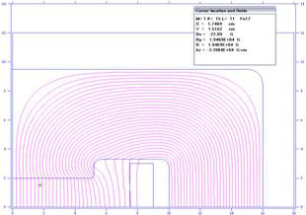
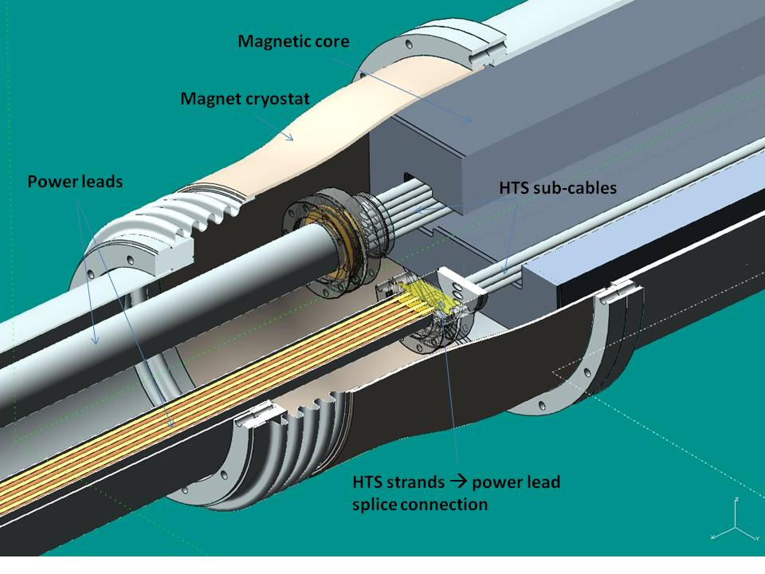
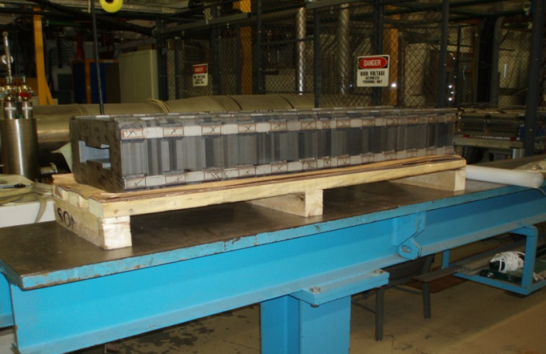
HTS Test Dipole Design & Fabrication Status
TEST MAGNET PROPERTIES:
Cable: Single turn of 6 parallel sub-cables connected at leads end Core: Fe3%Si, 105 µm laminations
96 344C-2G strands (~ 600 m length) L = 1200 mm, Gap = 40 mm x 100 mm
Projected <Angle _{HTS – B-FIELD} > ≈ 2⁰ Operating temp.: 80 K to RT
Instrumented : B _{max} = 1.8 T, I_{max} = 90 kA, dB/dt _{max} = 16 T/s , T _{max} = 15 K
Test: B _{max} = 0.5 T, I_{max} = 27 kA, dB/dt _{max} = 10 T/s , T _{max} ~ 25 K
Core design
Fabricated core
All HTS cable components have been fabricated
11/12/2012

Slide 15
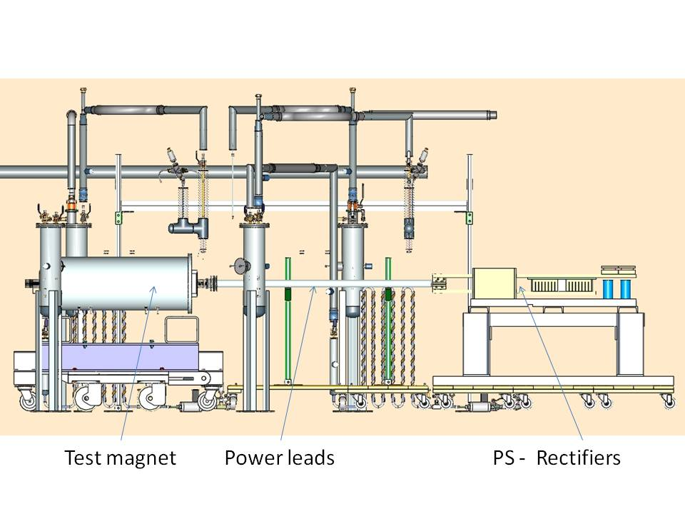
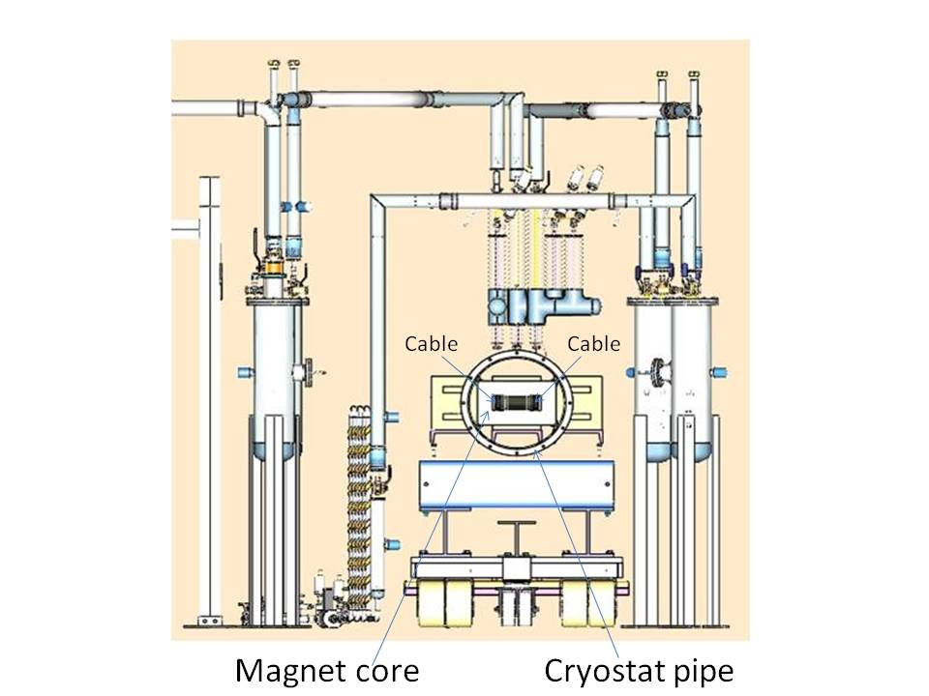
HTS Dipole Test Setup Status
Figures show test components with design complete & fabrication in progress
Side view
Front view
Component design will end in mid-August, fabrication complete by December. System assembly, safety proceedings through March, 2013.
Expected magnet tests in E4R Enclosure: Spring – Early Summer 2013.
11/12/2012

Slide 16
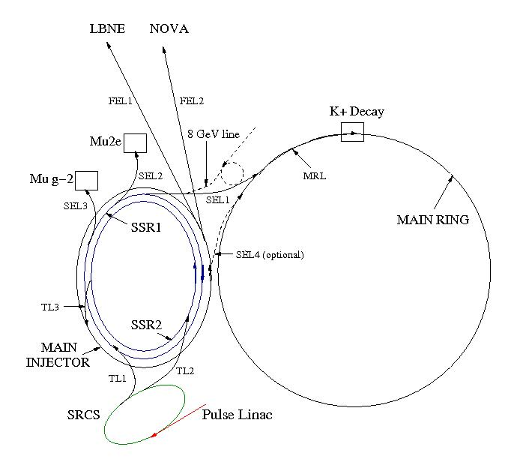
High-Power Proton Source for Project X
Project X accelerator complex with SRCS *)
*) H. Piekarz, “Project X with Rapid Cycling & Dual Storage Rings Synchrotrons”, arxiv.org/pdf/1205.1527 (2012), and IPAC-12, New Orleans, May 21-25, 2012

Slide 17
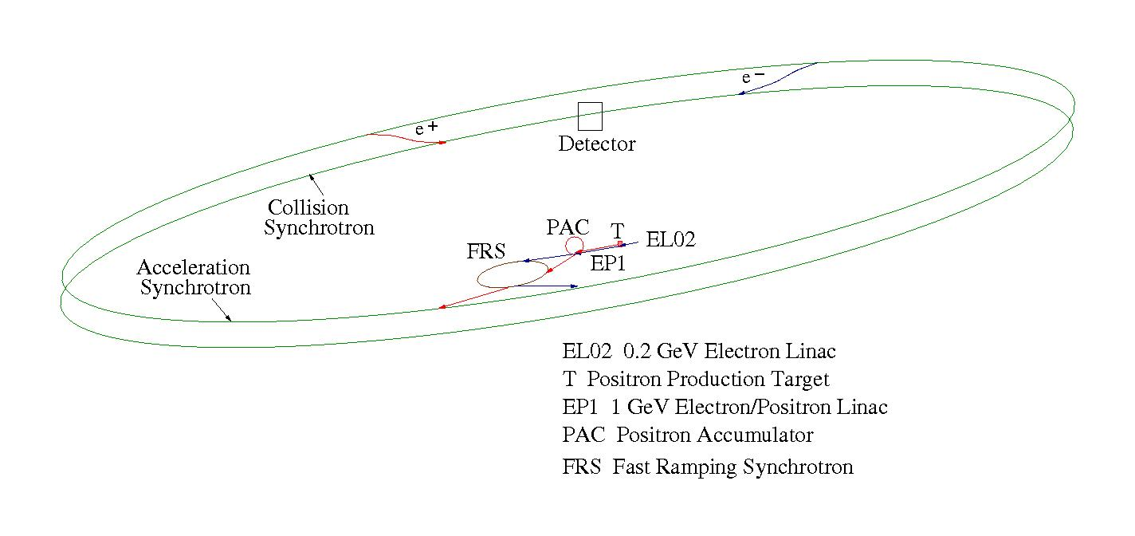
SFRS Synchrotron for E⁺ E⁻ Collider (Fermilab Site Filler)
The FRS synchrotron for E⁺- E⁻ Collider is of the same size as the SRCS for the Muon Collider and Project X. All these synchrotrons be placed in the same tunnel and location at the Fermilab site sharing the power and cryogenic infrastructures.

Slide 18
Summary & Conclusions
A proton source of up to 3 MW with HTS-Based Rapid Cycling Synchrotron is doable
HTS Rapid Cycling Dipole fabrication is well advanced and tests will proceed in early 2013
Estimated cost of 8 GeV SRCS-M synchrotron (including tunnel & ramping supplies) is $M 250
Cost of 1 GeV proton pulse linac is $M 350
Estimated cost of proton source is at $M 600
If the muon cooling and acceleration systems are achievable than the Low-Energy Muon Collider with a synchrotron based proton source is probably the most effective and least expensive option to pursue the study of the Higgs at Fermilab !
Thank you for your attention !
11/12/2012

