Slide 1
Challenges for Pixel sensors for the Frontiers
Instrumentation Frontier Community Meeting
Argonne National Lab
January 11th 2013
Gino Bolla
Purdue University
bolla@cern.ch

Slide 2
Introduction/disclaimer
Most of what I will show is an overview of what was presented at Pixel 2012 in Japan.
I will focus more on topics I know better (LHC) and on detectors I am more familiar with (CMS and ATLAS).

Slide 3
Figures of merit
A pixel detector usually has to deliver:
High Detection Efficiency (~100 %)
Good Resolution (precision)
Moreover in most applications it is also judge on the stability of these “deliverable” versus time.
Radiation hardness
Stability
Robustness

Slide 4
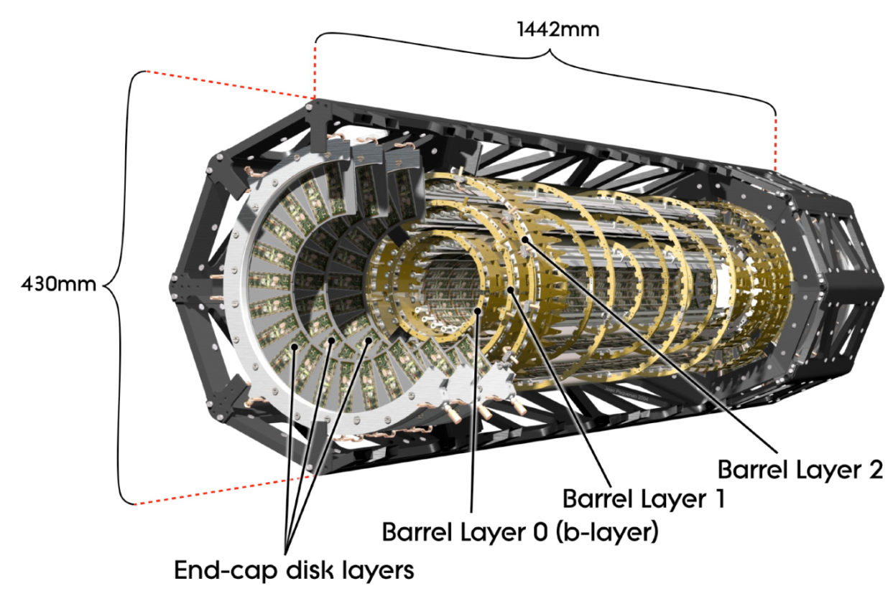
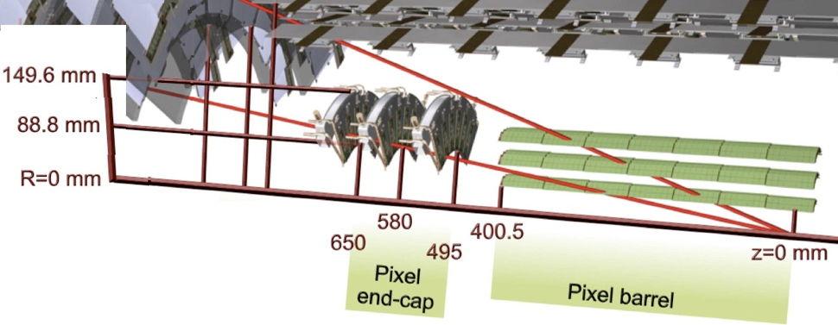
The ATLAS Pixel Detector
Three barrel layers:
  R= 5 cm (B-Layer),
  9 cm (Layer-1), 12 cm (Layer-2)
  modules tilted by 20º in the Rφ plane to overcompensate the Lorentz angle.
Two endcaps:
  three disks each
  48 modules/disk
Three precise measurement points up to ⏐η⏐<2.5:
  RΦ resolution:10 μm
  η (R or z) resolution: 115 μm
1456 barrel modules and 288 forward modules, for a total of 80 million channels and a sensitive area of 1.7 m².
  Environmental temperature
  about -13 ºC

Slide 5
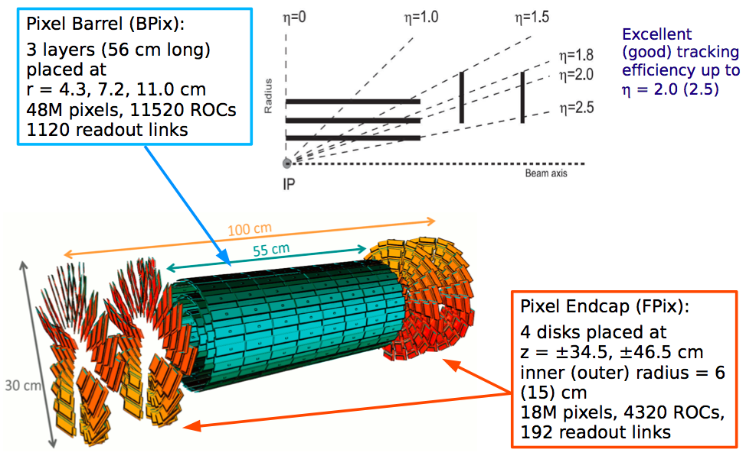
The CMS Pixel Detector

Slide 6
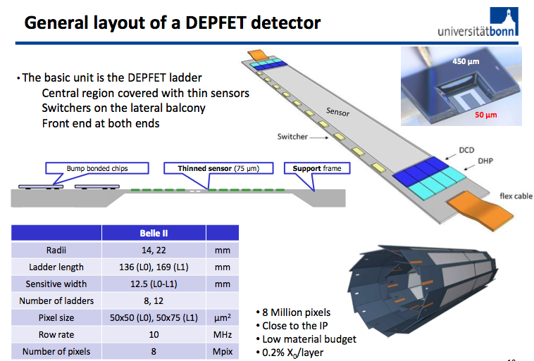
The Belle Pixel Detector

Slide 7

A Toroidal LHC Apparatus
25 m
45 m

Slide 8
A Toroidal LHC Apparatus
More often than not these detectors are buried inside everything else with minimal and sporadic (if at all) potential maintenance.
25 m
45 m

Slide 9
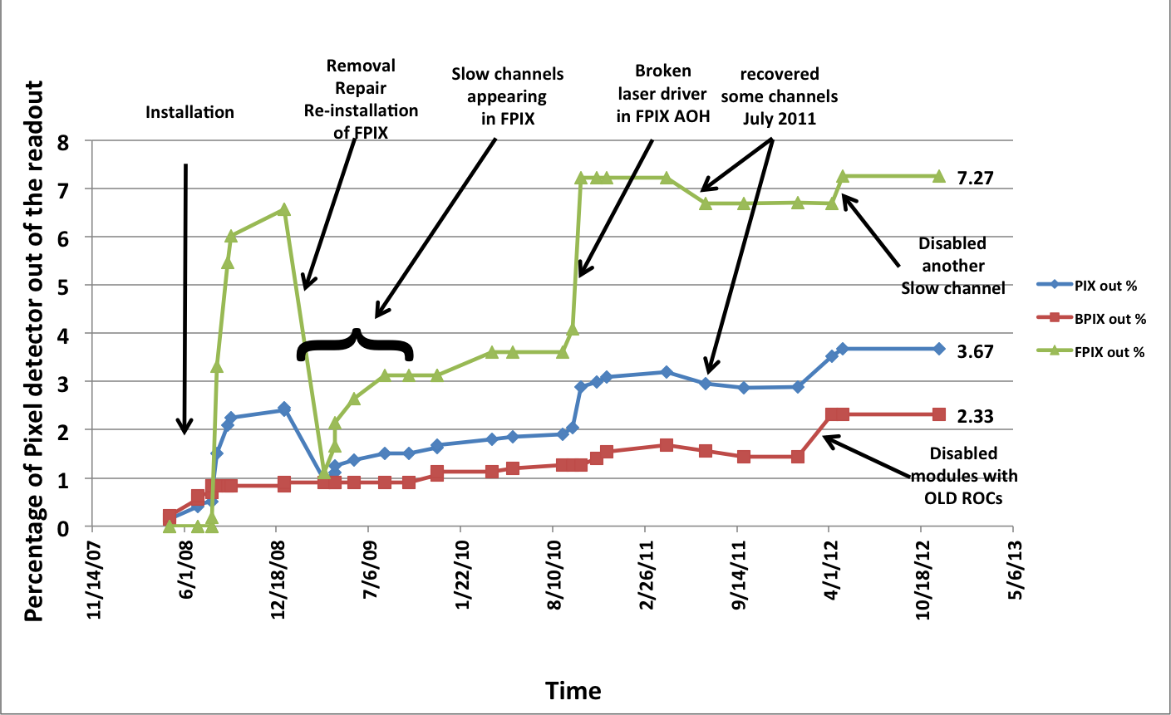
Consequent impact on efficiency
CMS Pixel dead channels

Slide 10
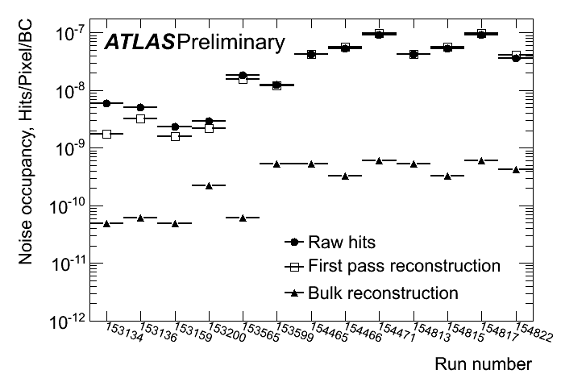
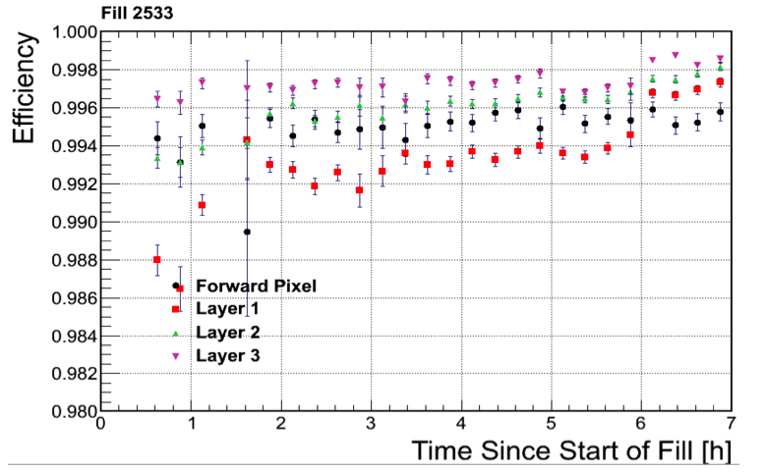
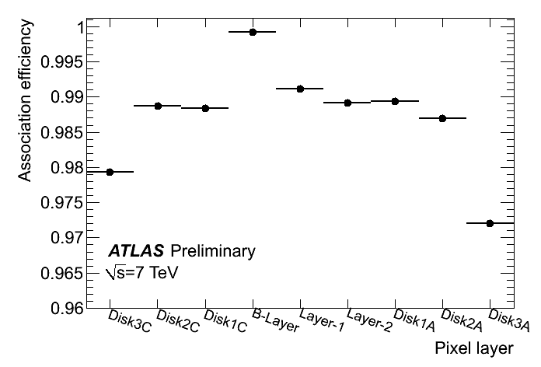
Noise occupancy and efficiency
Noise occupancy if usually very low (below ~10⁻⁹), masking less than 0.02% of the pixels.
The hit efficiency of each silicon layer can be measured performing a track fit without that layer and looking for hits aligned with the resultant tracks. Typical hit inefficiencies are of the order of 0.2%.
Inefficiency has some other (can be large) contributions (buffer size in FE electronics)
√s=7 TeV
CMS

Slide 11
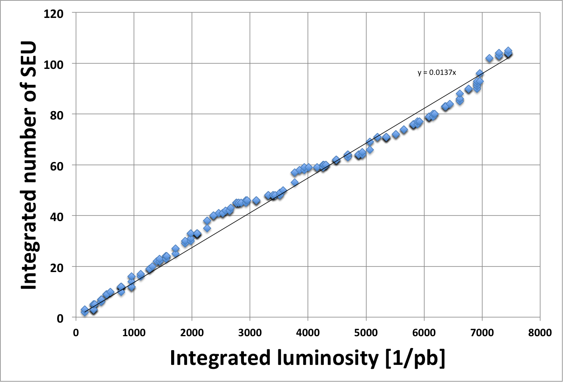
Efficiency: on SEU
Efficiency of the sensor is just a component.
There are several others that affect efficiency|
Catastrophic SEUs need a stop-reset-start loop.
System are usually not designed for efficient recovery. |
CMS pixel. Every 73 pb⁻¹ (5 hours) you need to stop data-taking for ~30 secs.
This is for 5E33.
@ 5E34 with no improvements in the SEU tolerance this would correspond to 2% deadtime.

Slide 12
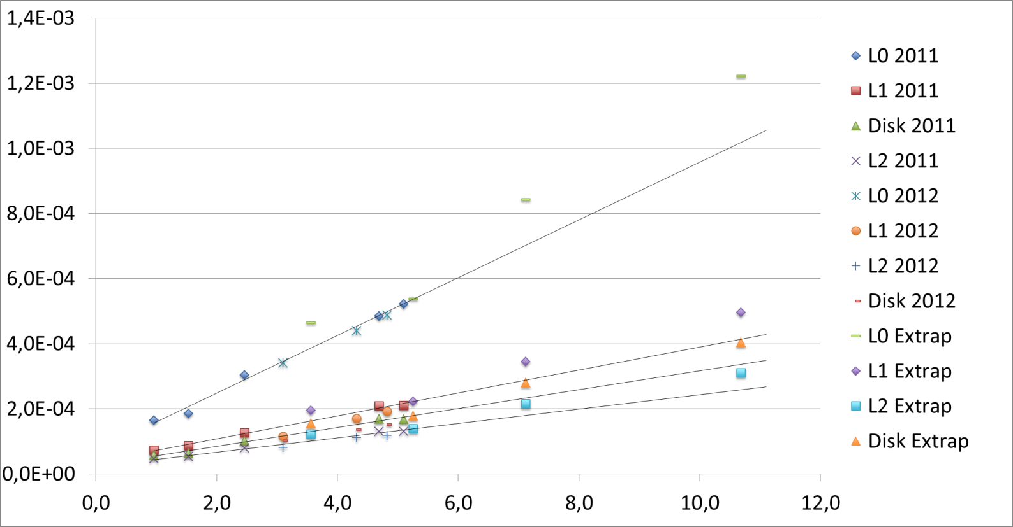
Occupancy extrapolation: ATLAS
The Pixel Detector is now operating in a very reliable way at 7 10³³cm⁻²s⁻¹ @ 50 ns. But after the shutdown LHC luminosity will increase. Extrapolations of the expected occupancies due to minimum bias are done for 3 LHC luminosities: 1, 2 and 3 10³⁴ cm⁻²s⁻¹@ 25 ns (2015-2017).
ATLAS Preliminary
Pixel Detector
Minimum bias occupancy
Pixel occupancy
2 10³⁴
14 TeV
3 10³⁴
14 TeV
10³⁴
14 TeV
Now
Bunch lumi (1E30)
Extrapolate these plots to and 5 10³⁴ cm⁻²s⁻¹@ 25 ns 5 E34 and you find yourself with occupancy almost at the % level.
These data needs to be transferred out (this is a topic covered somewhere else).
But granularity (resolution) has an impact on the data-rates.

Slide 13
Radiation damage
The sensors of the ATLAS/CMS Pixel Detector were designed to be still operational after a fluence of ~10¹⁵ n_{eq}/cm².
That would correspond to ~300 fb⁻¹ of integrated luminosity for the innermost layer.
Today, at ~15 fb⁻¹, the detector is still in its infancy...
But effects are starting to be measurable:
  Increase of leakage current
  Depletion voltage

Slide 14
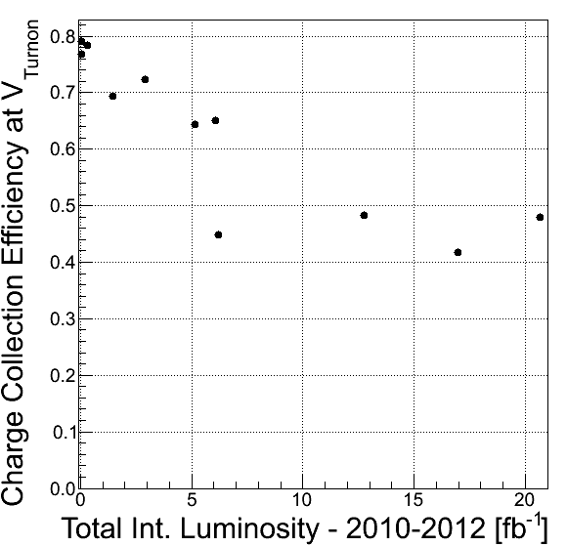
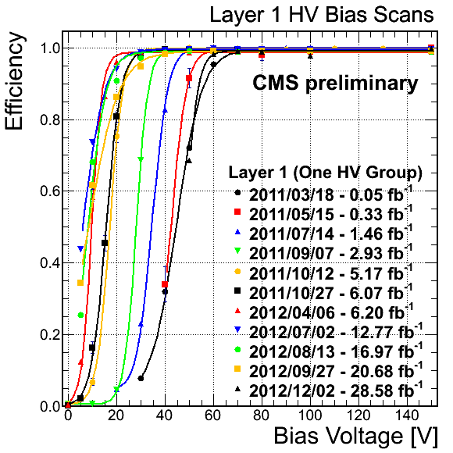
Efficiency and radiation damage: CMS
After inversion you reach full efficiency with ½ of the full charge
This is with a threshold of ~3000 e-
CCE at the 99% eff point – Layer 1

Slide 15
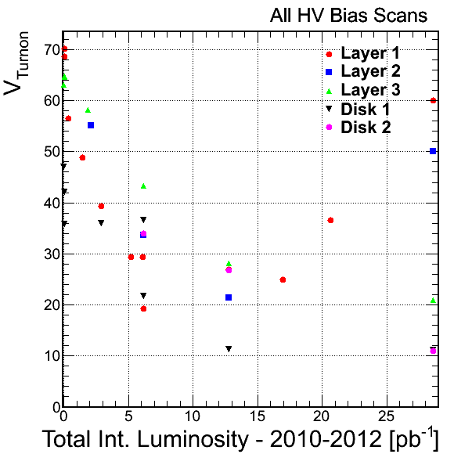
Depletion Voltage: CMS
Lines added to guide the eye for the innermost layer.
Innermost layers are clearly “inverted”

Slide 16
Depletion Voltage: CMS
What do you do when you reach this point?

Slide 17
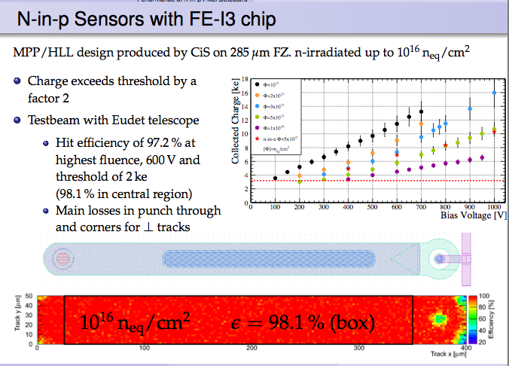
ATLAS: find the limits of planar tech.

Slide 18
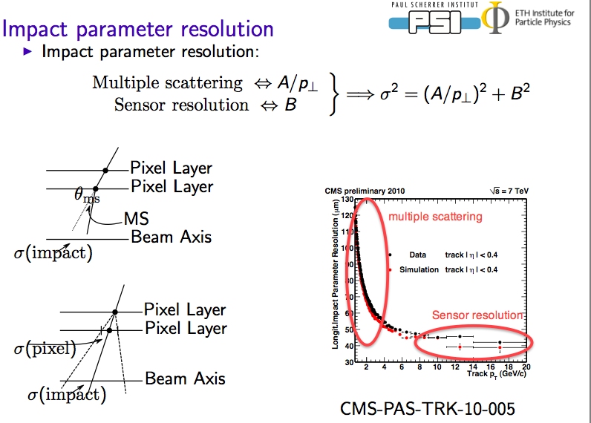
On the resolution

Slide 19
General guidelines
Improve the detector hit resolution for high pt
  Moving to smaller and smaller pixels.
  Smaller thresholds to enhance charge sharing.
Minimize the mass to improve resolution at low pt
  Thinner detector
  Lower power consumption
    To minimize the mass of services

Slide 20
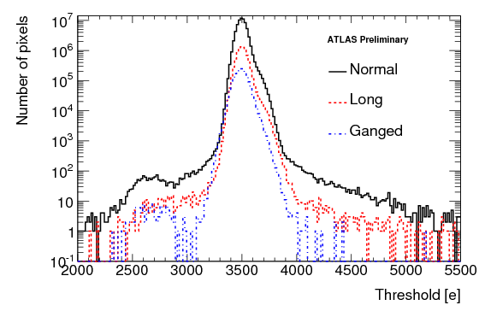
Calibration procedures
Given the enormous number of channels and free parameters to tune, the read-out electronics and the DAQ software were designed with particular attention to the calibration procedures.
Using the internal front-end electronics self-test and charge injection capabilities:
  Tune the custom rad-hard opto-link parameters to guarantee error free data transmission.
  Adjust the discriminator threshold of each channel to minimize threshold dispersion.
  Measure the noise of each channel.
  Tune the time-over-threshold.
Threshold and noise are determined by measuring the discriminator response as a function of the injected charge.
The Pixel Detector is operated at 3500 e threshold, with a dispersion of few tens of electrons.

Slide 21
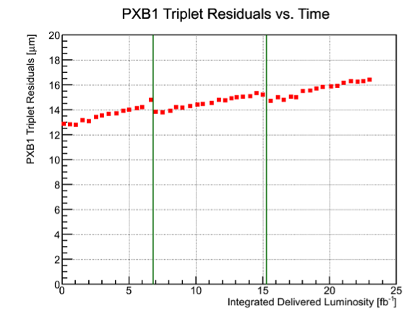
Calibration → resolution
In CMS we already notice the degradation of resolution as radiation damage is integrated.
It is partially recovered with recalibrations:
Lenghty process that can be applied only during extended periods without beam.
The overall effect is likely due to drifts of the internal voltages of the FE electronic.
A faster calibration process would help on maintaining stable performance versus time

Slide 22
Some general remarks
The “classic” silicon planar technology is being pushed to its limits.
By requiring smaller and smaller pixel
  No longer compatible with “standard” interconnection
By exposure to higher and higher radiation levels
The challenge associated with the smaller pixel has been addressed in other section of this workshop.
Example is yesterday presentation by Julia Thom
Diamonds and 3D sensor could increase the radiation hardness of “conventional” pixel systems
The sensor is just a component where the ongoing development
Sensor development can benefit from improvements in other components:
FE electronic with lower and lower thresholds
Reduction of the mass of services.

