Slide 1
Digital Hadron Calorimeter using Gas Electron Multipliers
Jae Yu
For GEM DHCAL Group
Jan. 11, 2013
CPAD Workshop, ANL
Introduction
30cmx30cm Prototype with 13bit kPiX Readout
30cmx30cm Prototype with 1bit DCAL Readout
Large Scale GEM Development
Summary

Slide 2
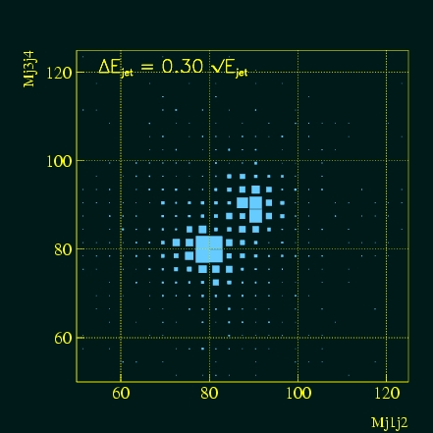
Introduction
LC physics topics demand
  Distinguish W from Z in two jet final states ➔ Good di-jet mass resolution
  Higher Jet energy resolution;
  Excellent jet angular resolution
Particle Flow Algorithm is a solution to this
  Replace charged track energy with momentum measured in the tracking system
    Requires efficient and precise removal of associated energy cluster
    Fine calorimeter granularity necessary
  Use calorimeters measure neutral particle energies (~30% of jet energies)
  Best known method for jet energy resolution improvement, used in CMS
Large number of readout channels will drive up the cost for analogue style energy measurement ➔ Digital HCAL
Tracking calorimeter with high gain sensitive gap

Slide 3
DHCAL General Requirements
Thin and sensitive readout layer for compact design
1 or 2 level digital hit recording for PFA use
On-board amplification, digitization and discrimination for readout, minimizing noise and cross-talk
Flexible design for easy implementation of arbitrary cell size for upgrade
Minimal intrusion for minimal dead-space design
Ease of construction and maintenance
Cost effective
➔ Gas detectors are good candidates

Slide 4
DHCAL Gas Amplification Requirements
Sufficiently large gain for good S/N ratio
Minimize cross-talks between cells in readout
Isolated readout path from active volume to avoid coherent noise
Modularity, retaining continuity for gas and HV supplies and readout
Digitized readout from each cell
Allow pixel readout design to avoid strip ambiguity
Keep low HV for safety and reliability
Simple readout electronics for cost savings and reliability

Slide 5
Why GEM?
GEM developed by F. Sauli (CERN) 1997 for use as pre-amplification stage for MSGD’s
Allow flexible design, using printed circuit readout ➔ Can be as fine a readout as GEM hole pitch
High gains, above 10⁴,with spark probabilities per incident less than 10⁻¹⁰
Fast response and high rate capability
  40ns drift time for 3mm gap with ArCO₂
Relative low HV
  A few 100V per each GEM gap compared to 10-16kV for RPC
Rather reasonable cost
  Foils are made of copper-clad kapton with chemical perforation
  Scaling to large size foils does not increase cost proportional to the area

Slide 6
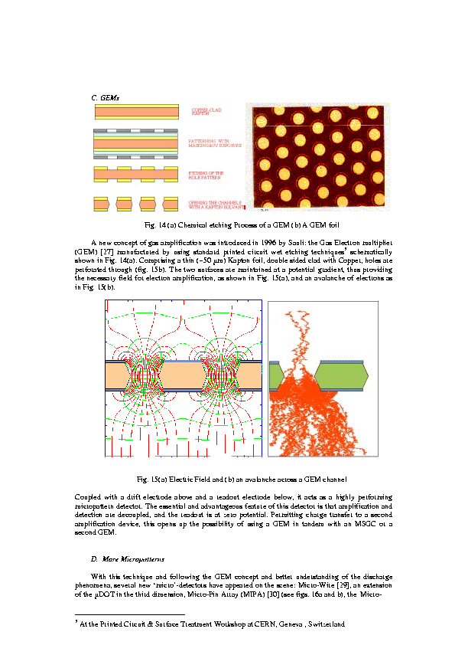

Large amplification
140μm
70μm
CERN-open-2000-344, A. Sharma

Slide 7
The Goals?
Develop and construct precision calorimeter for future accelerators
Demonstrate suitability of DGEM layer as active element of DHCAL
Construction/testing of DGEM chamber/layers of various sizes – to 1m².
Study of the response of double-GEM chambers to charged particles
Use of analog (13 bit kPiX) and digital (1 bit DCAL) readouts with GEM.
Measurement of double-GEM chamber/layer characteristics
Understanding of issues with chambers/layers (sparks, cross-talk, ..)
Establish operating conditions for large GEM/DHCAL chambers in a calorimeter

Slide 8
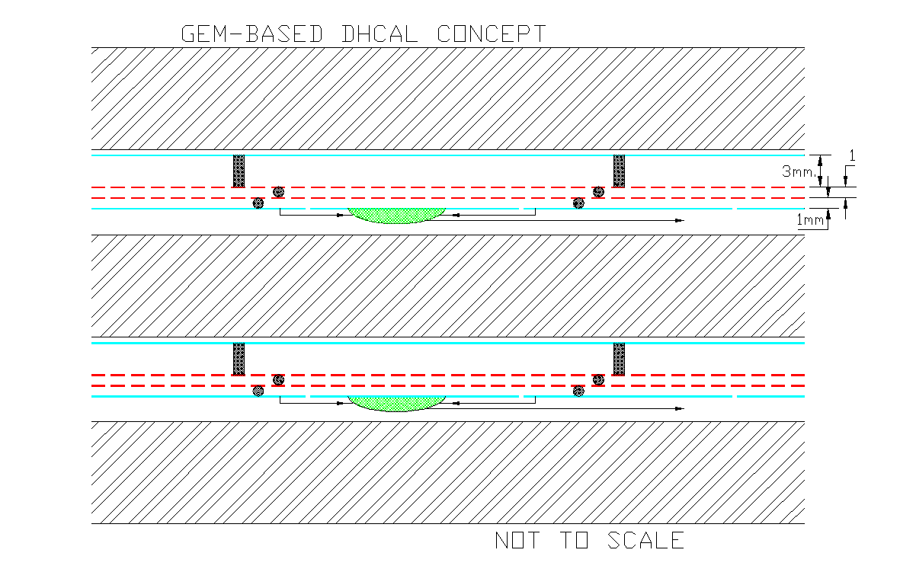
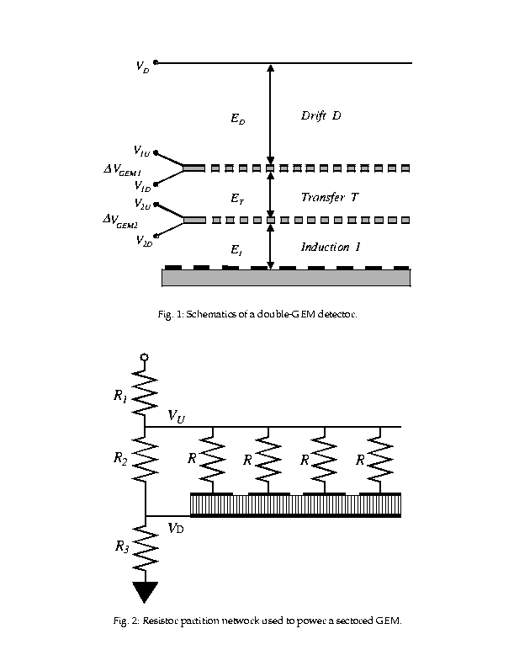
GEM-based Digital Calorimeter Concept
Use Double GEM layers
{
-2100V
~6.5mm
∆V ~400V
∆V ~400V
0V

Slide 9
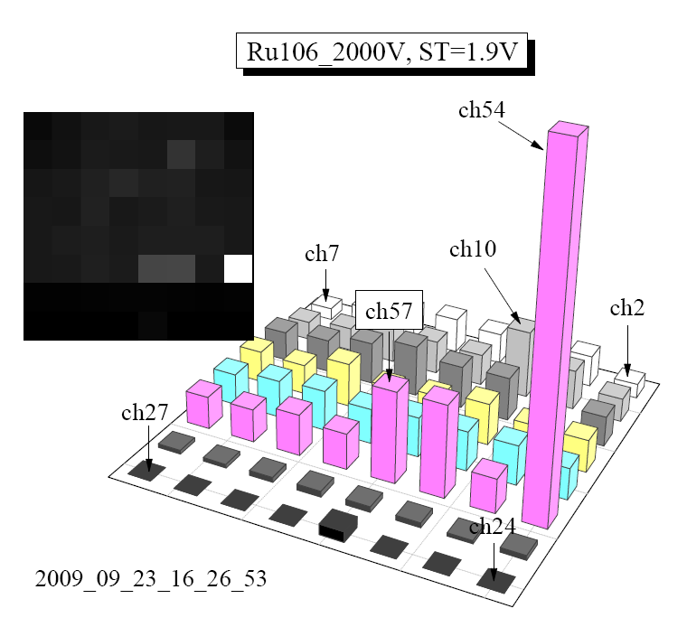
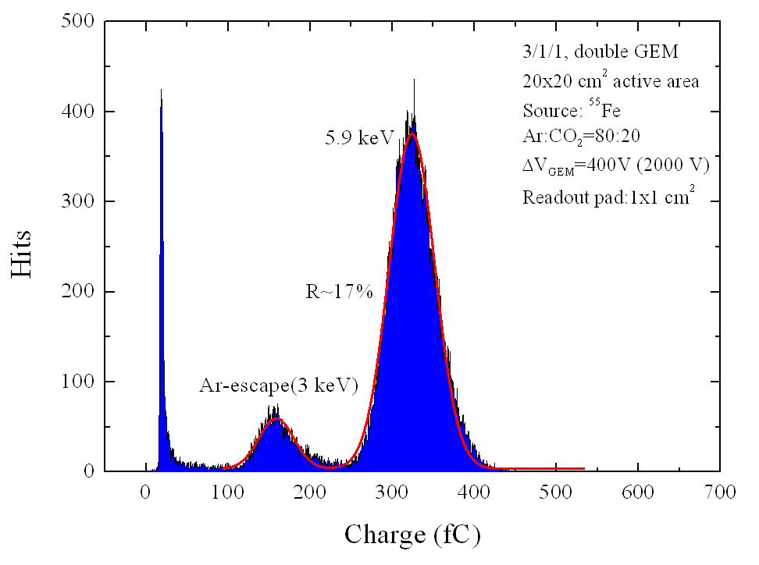
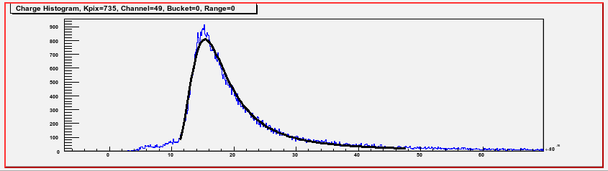
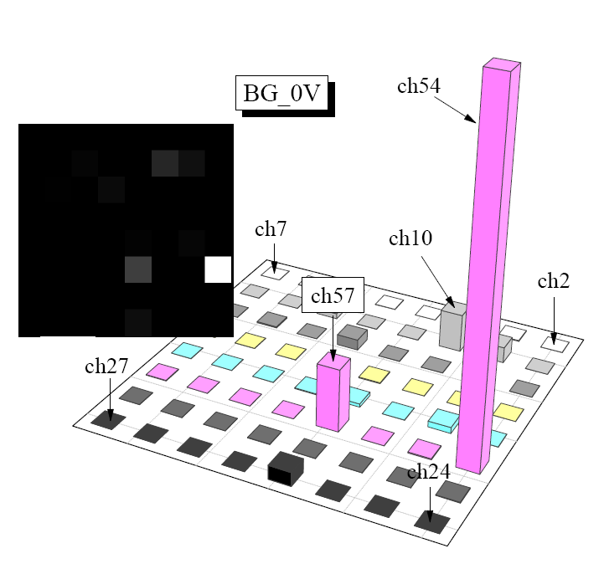
GEM+KPiX Fe⁵⁵ and Ru¹⁰⁶ Spectra
Fe⁵⁵
Ru¹⁰⁶
Good conformation to characteristic Minimum Ionizing Landau fit

Slide 10
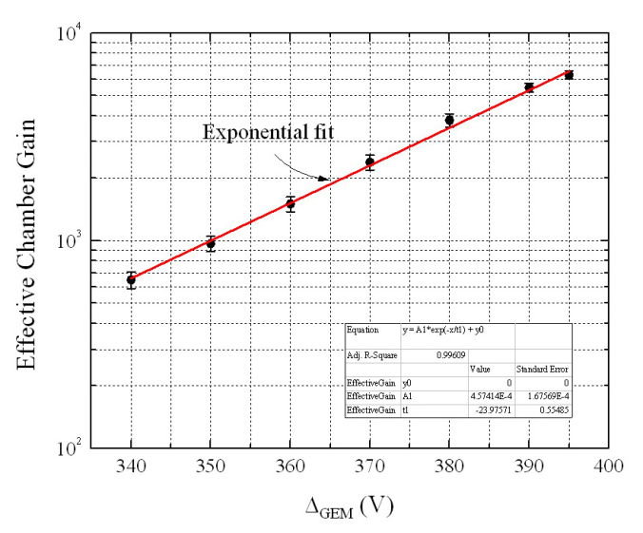
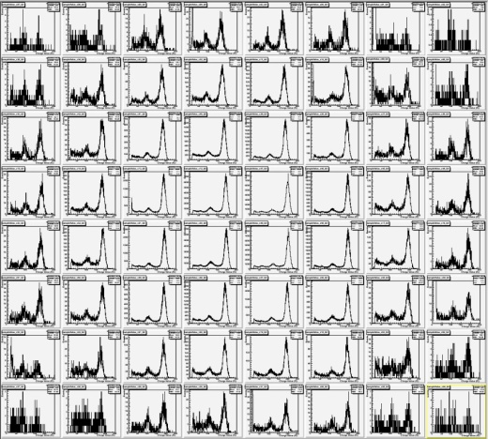
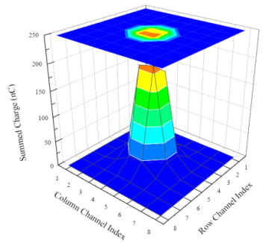
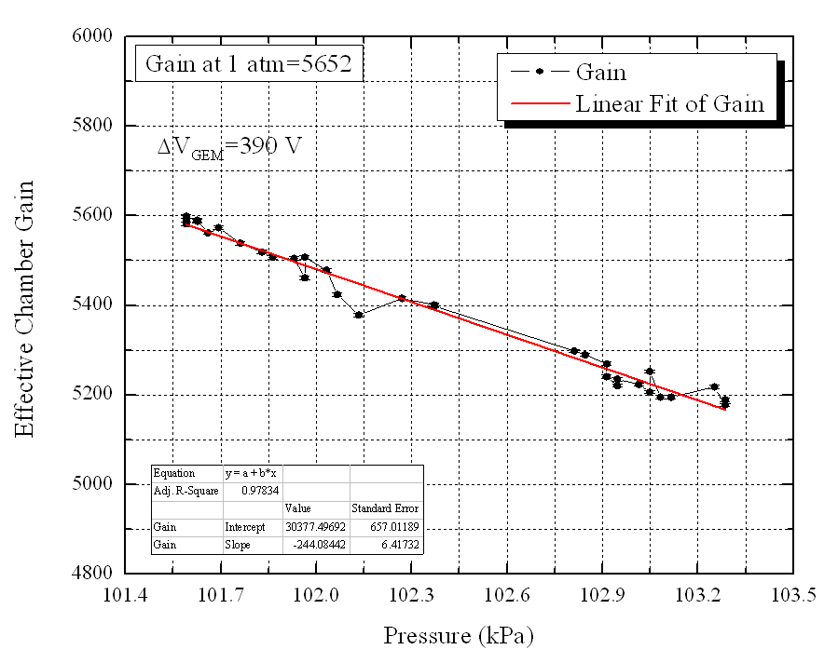
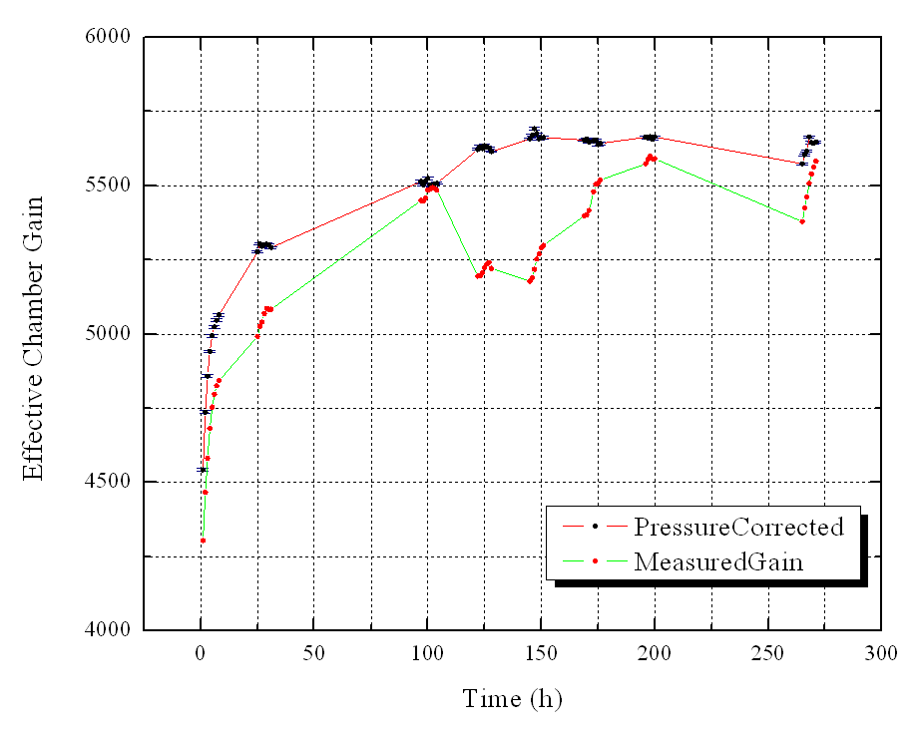
Some source test results with 30x30 cm² chamber/KPiX
Effective chamber gain to HV
⁵⁵Fe run result
Pressure dependence of chamber gain
HV =1950V (ΔV_{GEM}=390 V)
-244/kPa
We use an open gas system (gas flows at atmospheric pressure).
Thus, pressure inside chamber is affected by the atmospheric pressure directly.
This pressure change affects the chamber gain.
The chamber gains were recalculated to the values at 1 atm.

Slide 11
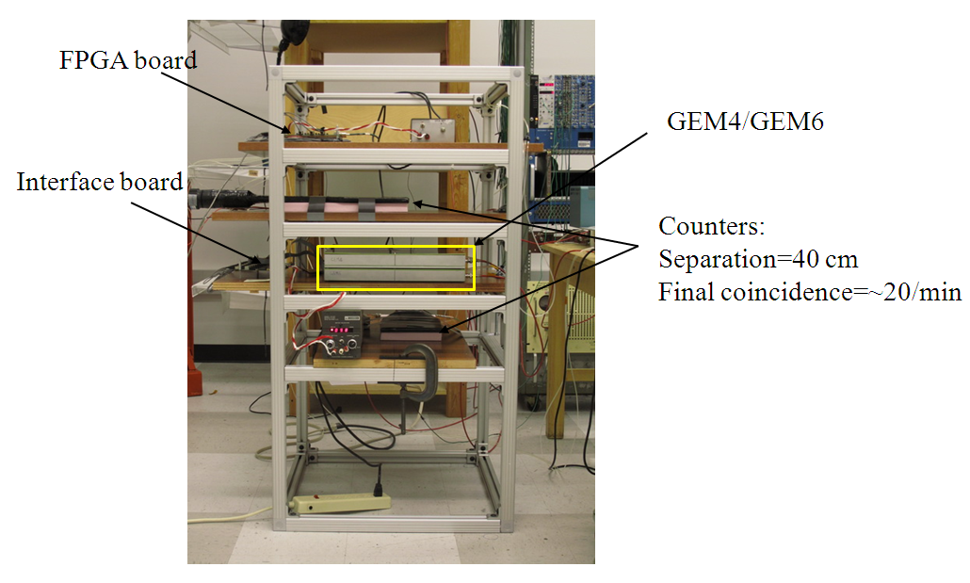
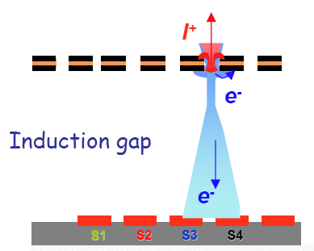
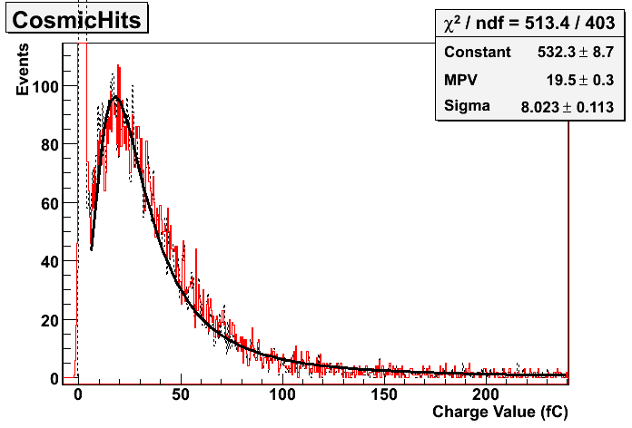
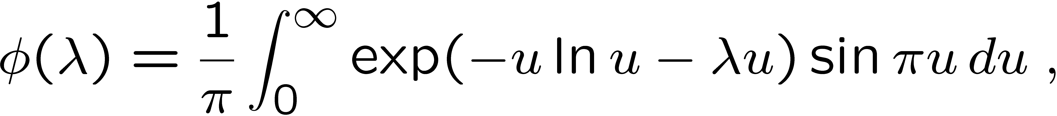
Cosmic Run with 13bit Readout (KPiX)
Charge sharing
Highest charge
Summed charge
19cm
8x8 cm²
Pad area
Landau fit
19cm
BG noise
Scintillators

Slide 12
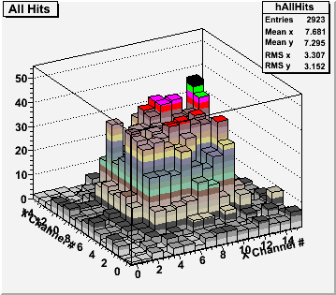
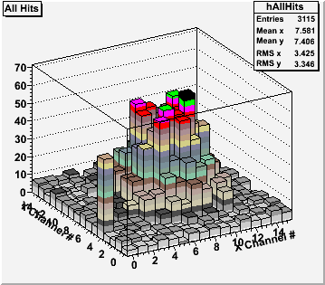
Cosmic Run with 1 Bit Readout (DCAL)
DCAL 1
10cmx10cm Cosmic Trigger
DCAL 2

Slide 13
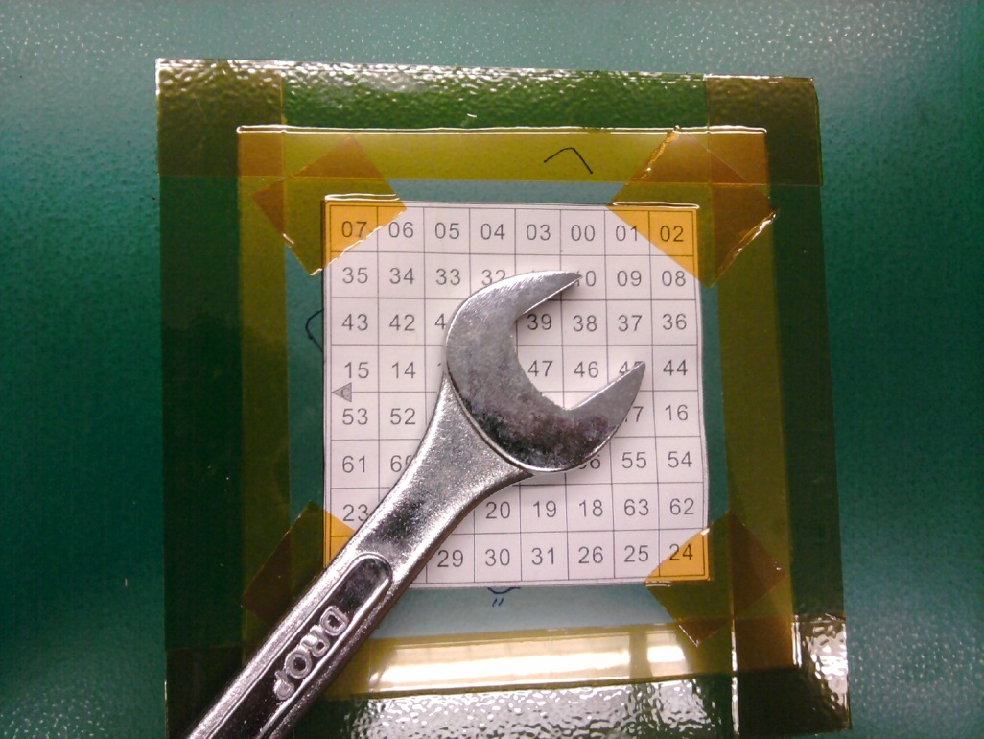
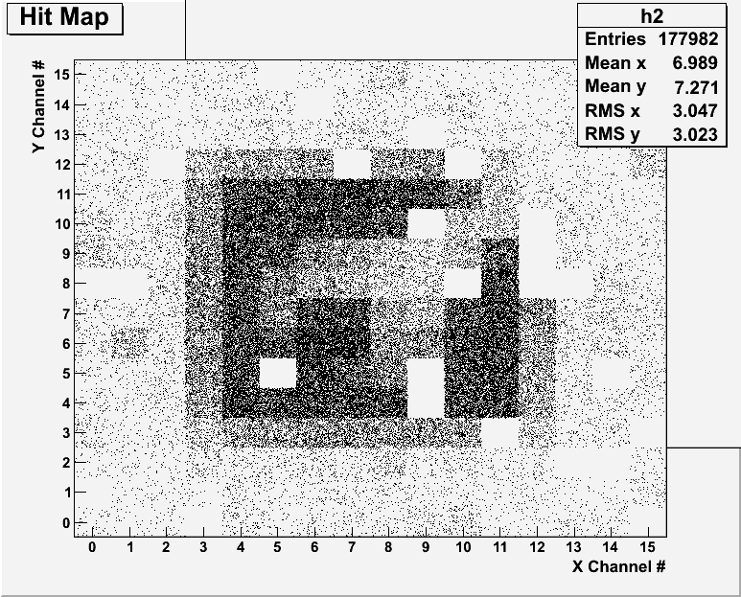
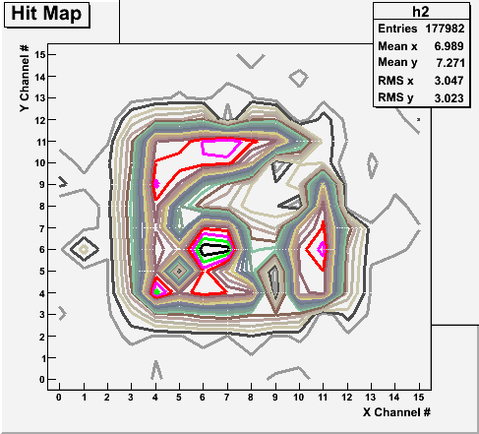
Radioactive Source Run with Internal Trigger

Slide 14
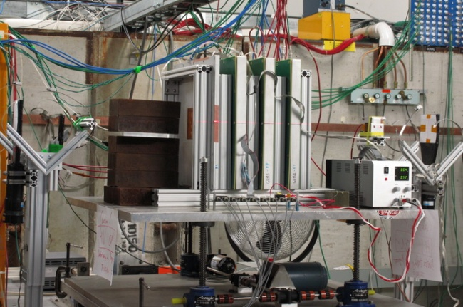
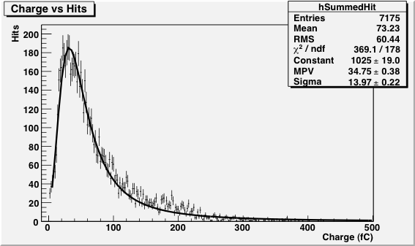
FTBF Beam Test Setup
GEM6: KPIX
GEM7, GEM5, GEM4: DCAL
C1,C2: 2x3 cm² → 2x2 cm² overlap
C3,C4:10x10 cm²
Beams: 32GeV Muon, Pion, 120GeV Proton
GEM7
GEM6
GEM5
GEM4
GIA
C4
C3
C1
C2
Particle: Proton
High Voltage: 1950V
Energy: 120 GeV
Trigger: 2x2cm²
GEM6: Read out by 13bit KPiX designed for the ILC time line
GEM7, GEM5, GEM4: Read out by 1bit DCAL chip by ANL and FNAL
GIA: Medical image intensifier prototype with 12 bit ADC in-house readout
Triggers formed off the motion table:
10x10 coincidences for guaranteed beam penetration through the detector array
2x3 coincidences arranged perpendicular to each other for 2x2 coverage in the center of the detector array
Coincidence of 1*2: Guaranteed beam penetration with center 2x2 coverage (efficiency ~95%)

Slide 15
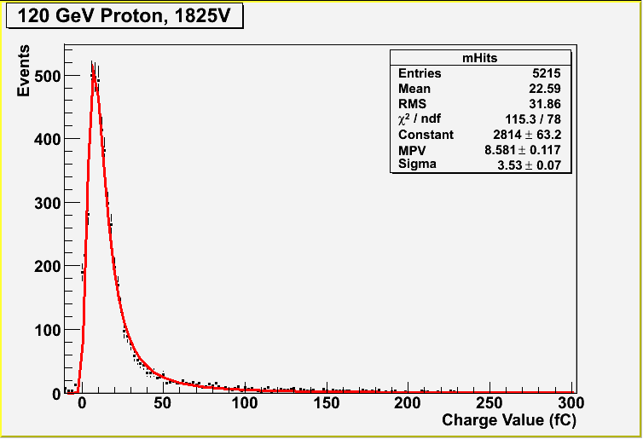
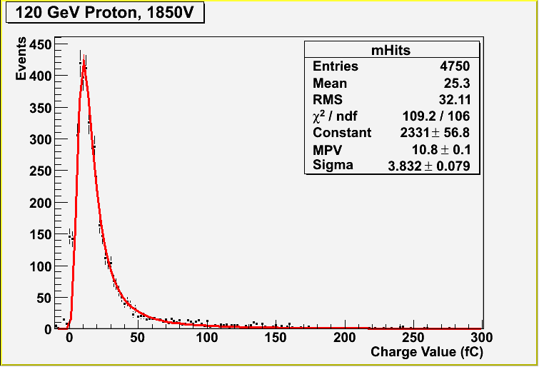
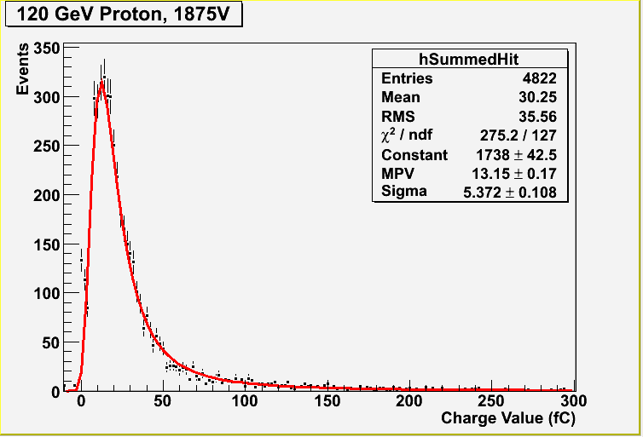
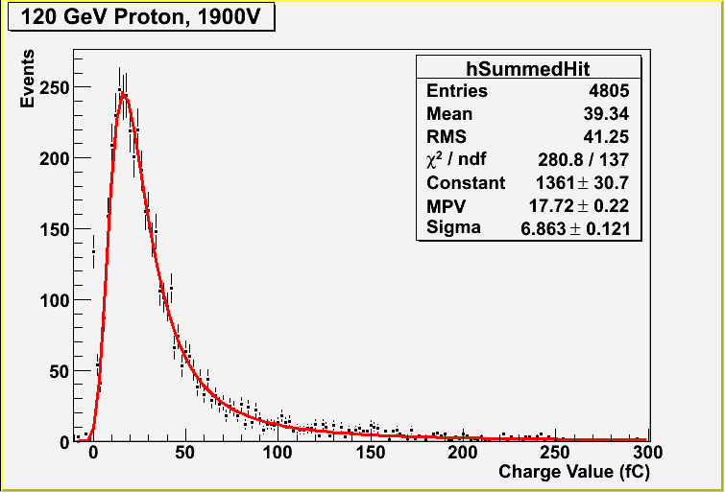
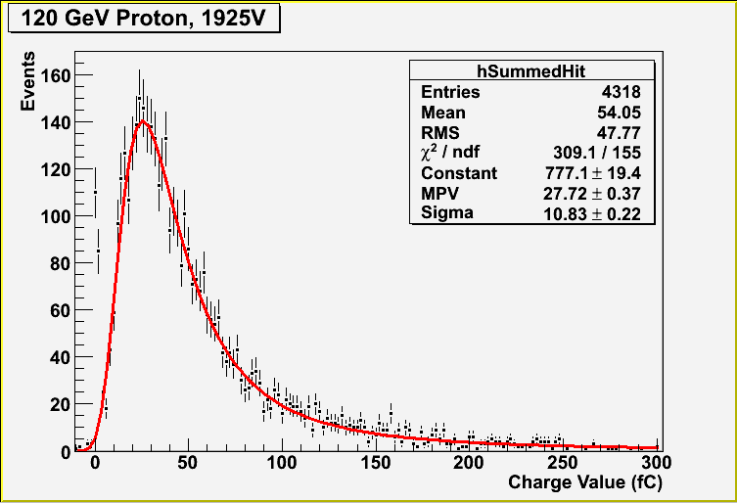
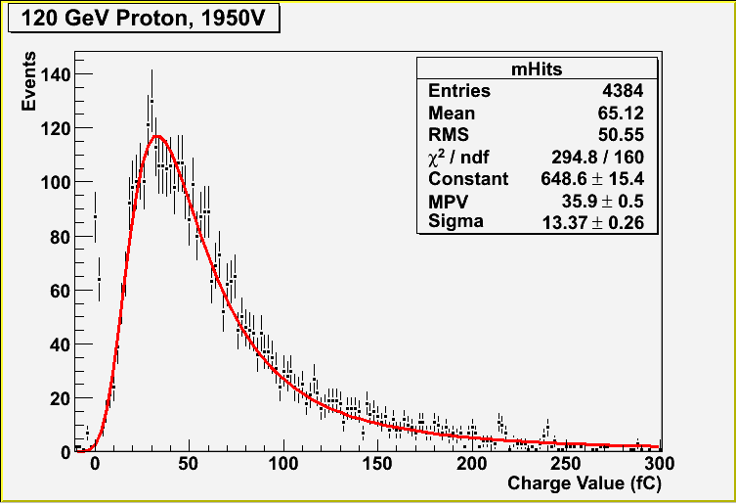
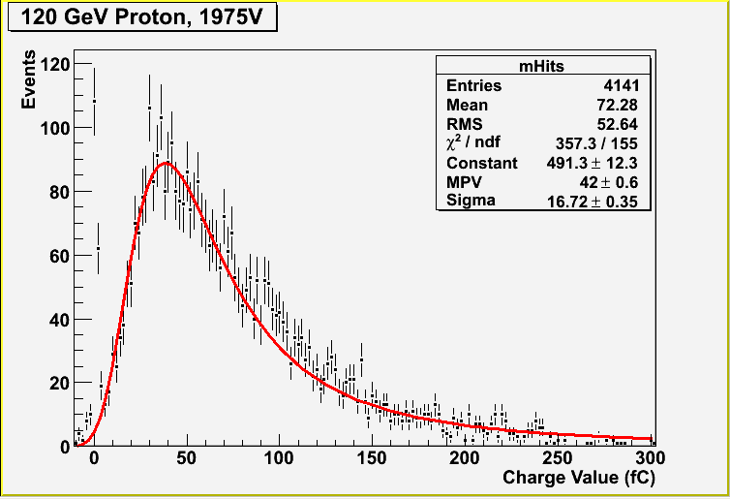
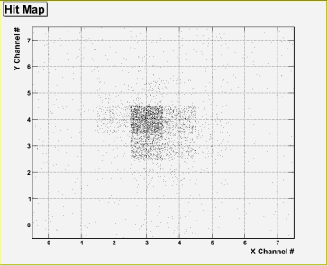
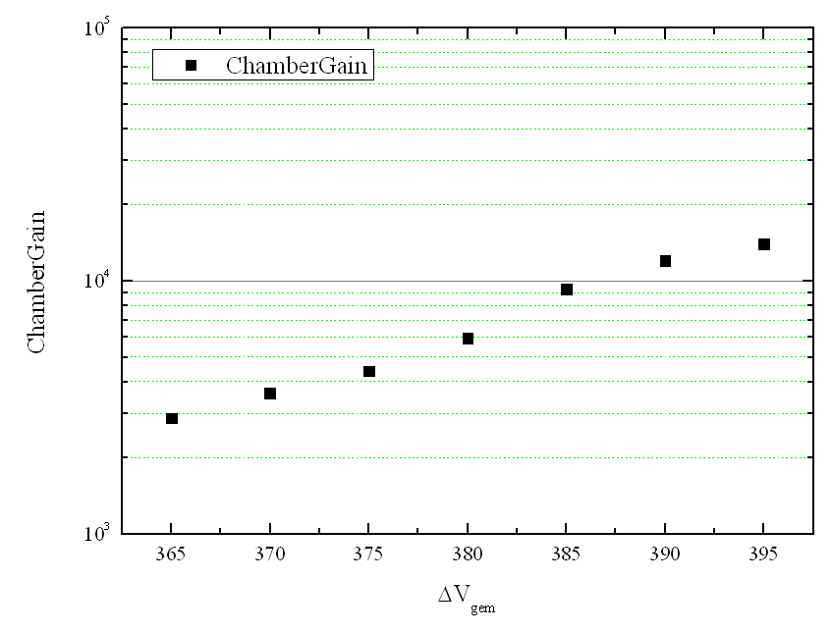
HV scan with 120 GeV Proton beam
HV=1825V (ΔV_{GEM}=365V)
g=~11000 @ ΔV_{GEM}= 395V
HV=1975V (ΔV_{GEM}=395V)

Slide 16
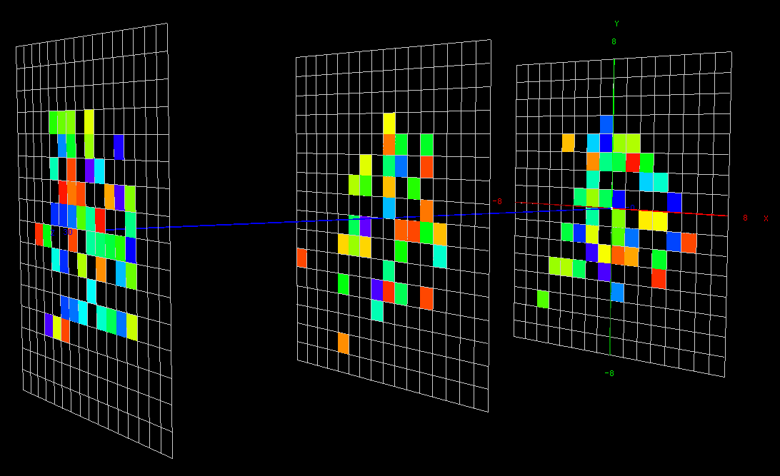
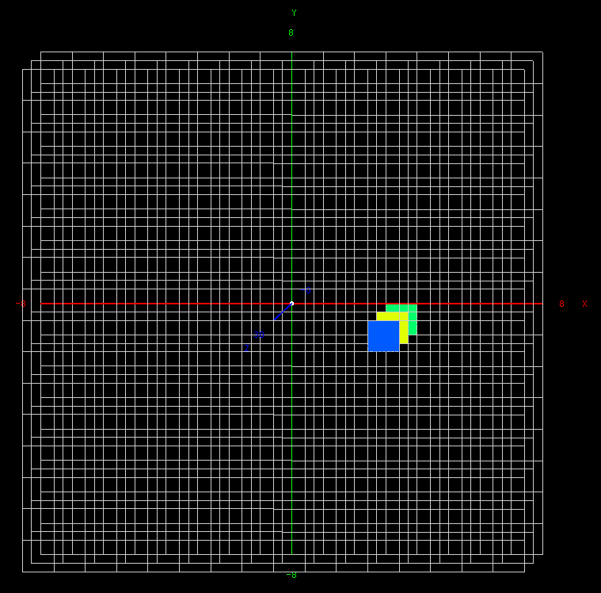
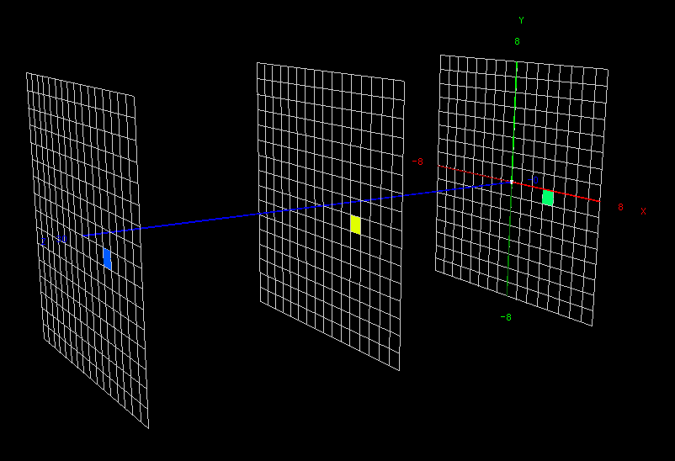
3 DCAL GEM Chamber Test Beam Event Display
Beam direction
(120 GeV Protons)
GEM7
GEM5
GEM4
Total 60 triggers accumulated
GEM7
GEM5
GEM4
A single event w/ 3 coincidental hits

Slide 17
Efficiencies and Hit multiplicities (KPiX)
120GeV P
2x2cm²
120GeV P
2x2cm²

Slide 18
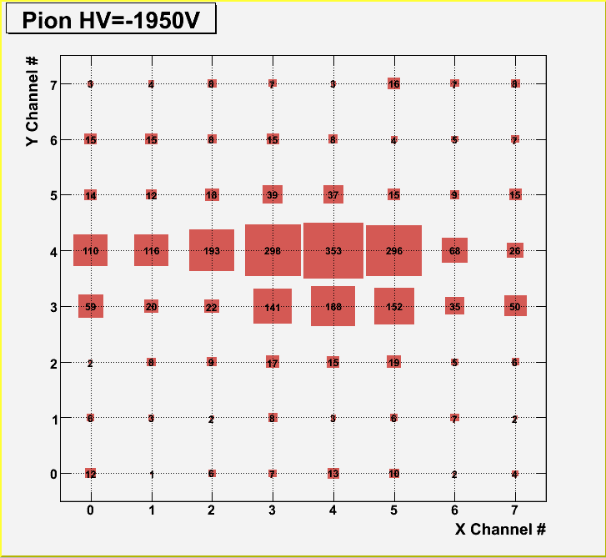
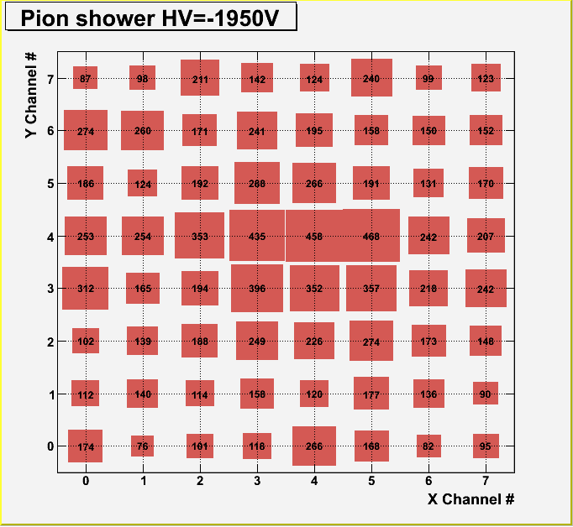
Hit Map for Pions vs Pion Showers (KPiX)
Hits above 5fC were counted and normalized to 1000
Demonstrates the KPIX capability to take many hits simultaneously

Slide 19
Hit Count Distributions for Pions vs Pion Showers (KPiX)
2fC threshold
5fC threshold
ε~98% (single cell)
ε~97% (single cell)
2fC threshold
5fC threshold

Slide 20
Hits from Pion Showers (DCAL)
GEM 7- Upstream
GEM4- Downstream

Slide 21
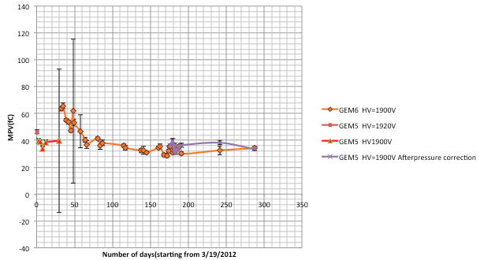
Long-term Behaviors, KPiX

Slide 22
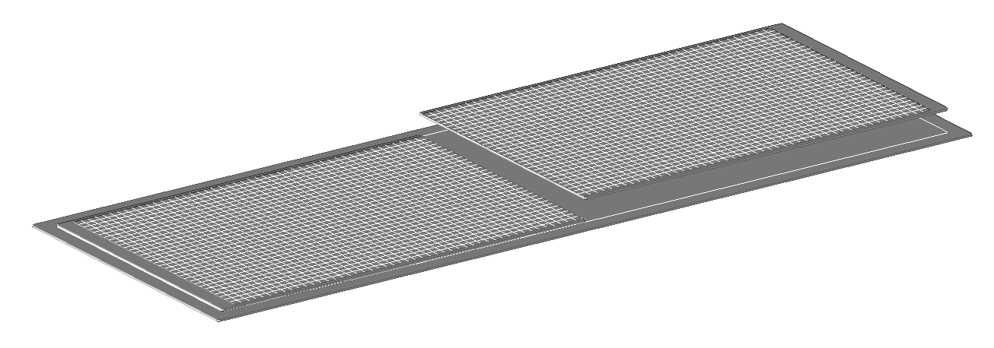
33cmx100cm DHCAL Unit Chamber Construction
Readout Board
320x500 mm²
1000 mm
Base steel plate, t=2 mm
320 mm
Readout boards are part of the gas volume!!
GEM foils with 31 HV strips delivered
2mm steel strong-back + thin cathode layer
3mm
G10 spacers used without aligned dead areas.
Readout boards glued in the seam
1mm
1mm
1mm pad board
2mm FE board
1mm assister strong back

Slide 23
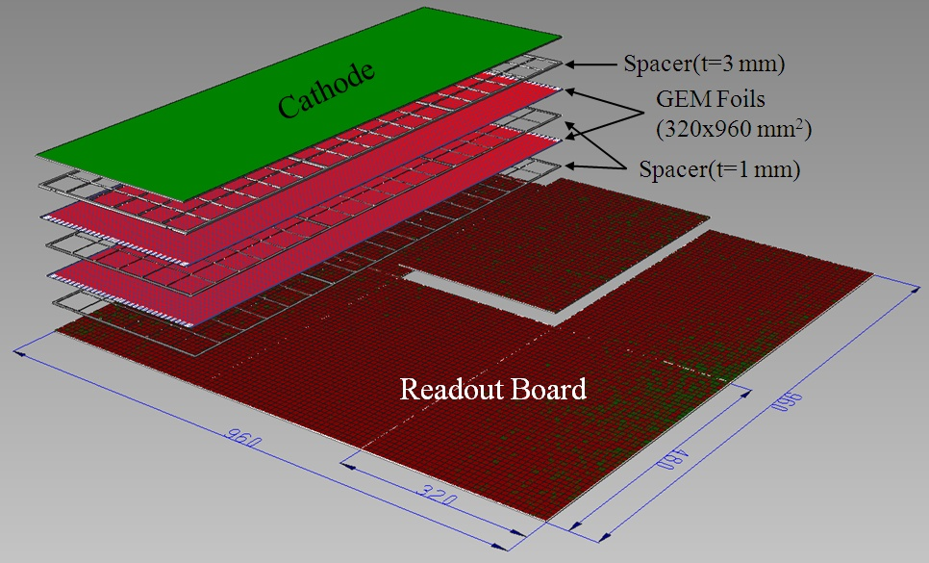
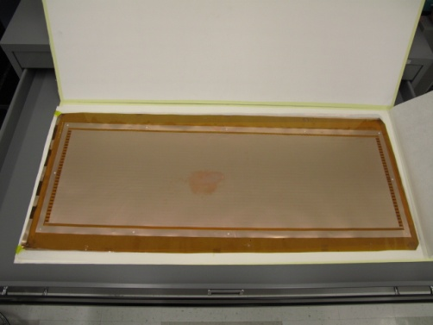
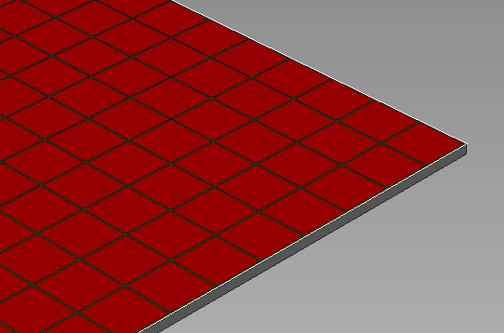
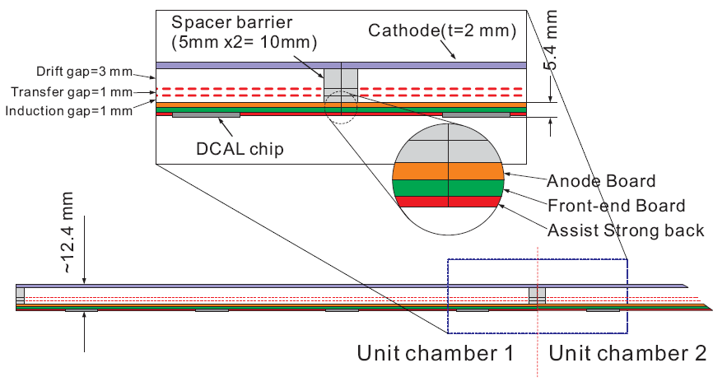
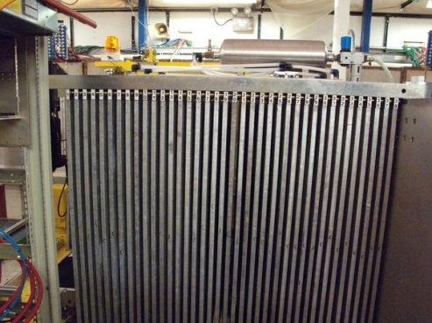
1mx1m Large GEM Chamber
32x96x3=9,216 readout channels/chamber
Anode pad:1x1 cm²
CERN-UTA joint developed 32cmx96cm GEM foil
Single-side etching technique
Steel, t=18 mm
Gap=13 mm
1x1 m² area
CALICE stack

Slide 24
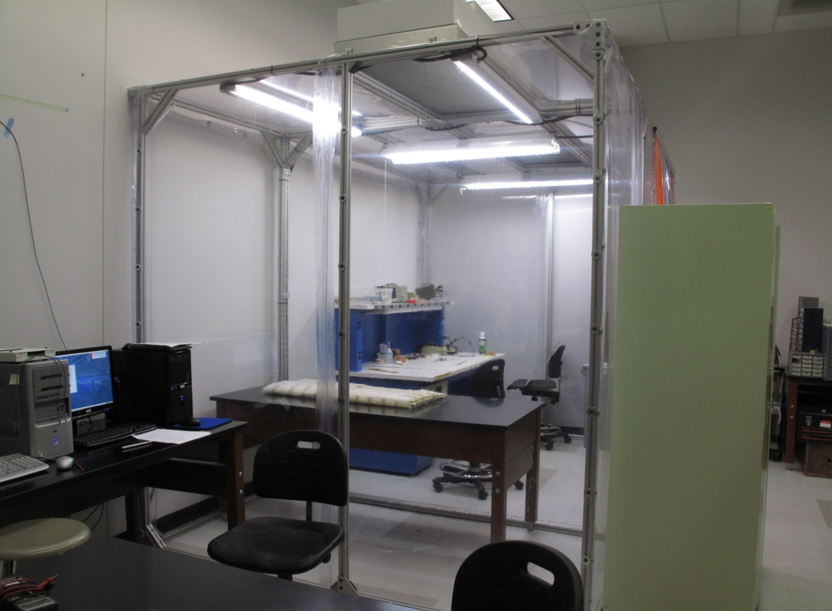
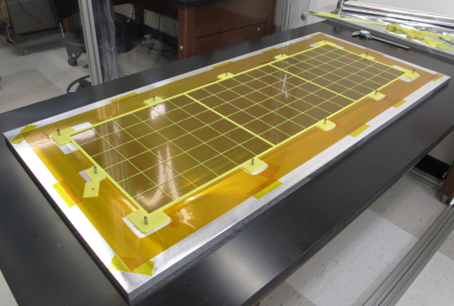
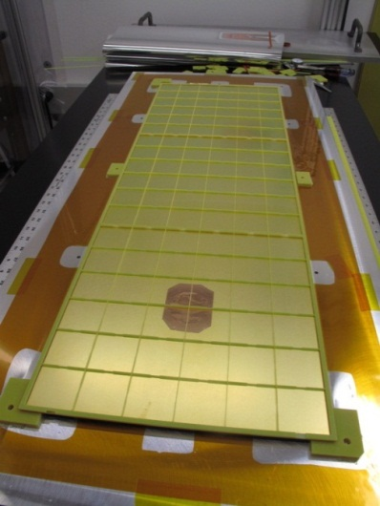
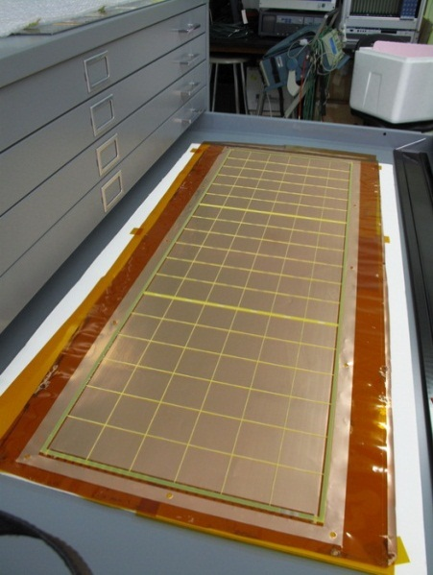
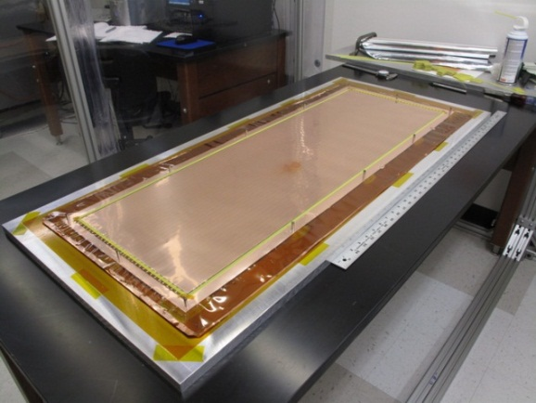

Assembling LGEM Unit Chamber (33cmx1m)
Locate spacer on the jig plate
Cathode with spacer
Class 10,000 clean room (12’x8’)
Curing
Gluing(Epoxy glue)
LGEM with spacer
*Spacer wall thickness=0.5mm

Slide 25
GEM DHCAL Plans
Phase I (through mid 2013): 33cm x 100cm unit chamber development and characterization
  Complete construction of 2 unit 100cmx33cm chambers, one with kPiX and one with DCAL
  Bench test with sources and cosmic rays and beam tests
Phase II (Mid 2013 – late 2014): 100cmx100cm plane construction
  Construct 6 unit chambers with DCAL for two 100cmx100cm planes
  Characterize 100cmx100cm planes with cosmic rays and beams
Phase III (late 2014 – early 2016): 100cm x 100cm plane GEM DHCAL performances in the CALICE stack
  Complete construction of five 100cm x 100cm planes inserted into existing CALICE calorimeter stack and run with either Si/W or Sci/W ECALs, and RPC or other technology planes in the remaining HCAL

Slide 26
Summary
30cmx30cm GEM prototype chambers characterized
  Long term behaviors and sparking behaviors being studied
33cmx100cm unit chamber construction proceeding
  A class 10,000 clean room of size 12’x8’ for foil certification and chamber construction completed
  Four 33cmx100cm foils glued to G10 spacers for two chambers and HV re-qualification completed
  Two 33cmx100cm chambers assembled but awaiting for readout boards (13bit KPiX and 1bit DCAL) integration
Mechanical design worked out for constructing 1mx1m planes for DHCAL testing
Looking into utilizing large area GEM to other experiments, ORKA, etc..
  Similar restrictions in physics dimensions apply
Commercial production of GEM foils making progress
  A Korean company has produced 30cmx30cm foils and being tested at CERN

