Slide 1
Instrumentation Development an NSF Perspective
Elementary Particle Physics
Marv Goldberg, Saul Gonzalez, Randy Ruchti
Particle Astrophysics
Jean Cottam Allen, Jim Whitmore
EPP/PA/Cosmology Theory
Keith Dienes

Slide 2
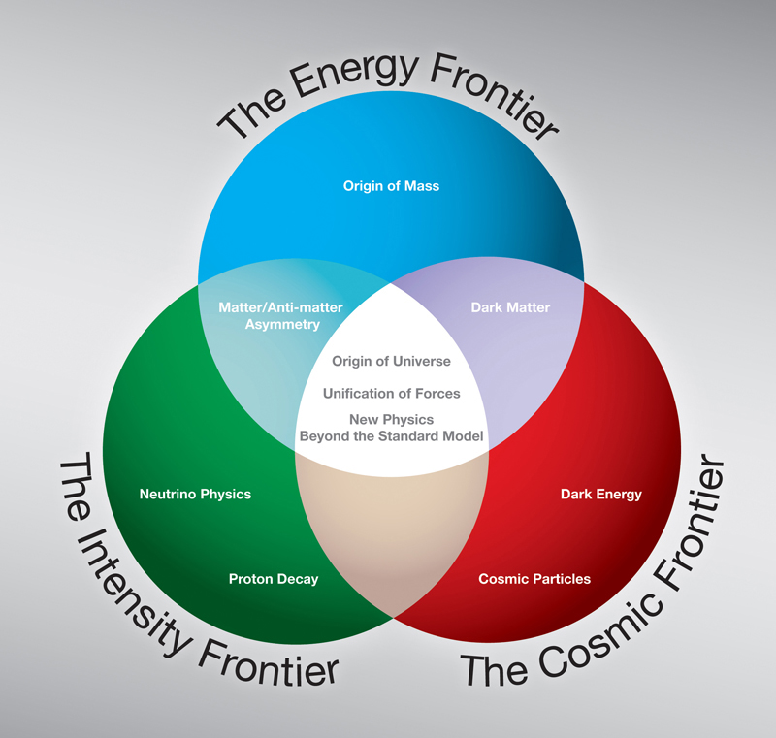
Particle Physics at the NSF
Scientific Frontiers:
Energy Frontier - Elementary Particle Physics (EPP, THY)
Intensity Frontier - Elementary Particle Physics, Particle Astrophysics (EPP, PA, THY)
Cosmic Frontier - Particle Astrophysics, Gravitational Physics (PA, GP, THY)
Applications and Broader Impacts:
Accelerator Science, R&D
Detector R&D
Computing / Data
Education and Outreach

Slide 3
NSF Approach
NSF Mission: “to promote the progress of science; to advance the national health, prosperity, and welfare; to secure the national defense; and for other purposes”
Empowering university-based investigators
Educate and train an exceptional and diverse scientific workforce
Adding value through partnerships and broadening participation
Program Coordination and Execution
Programs are coordinated with other U.S. and non-U.S. agencies and organizations
Solicit advice and strategic direction from advisory committees such as HEPAP, P5, AAAC, NSAC and from the National Academy of Sciences
Guiding Principles – NSB review criteria
What is the Intellectual Merit?
What are the Broader Impacts?

Slide 4
NSF support for Instrumentation
NSF/PHY currently does not have a dedicated program in advanced instrumentation R&D
Rather… possible support for instrumentation could come through:
Base Programs in EPP and PA with support from the Physics capitalization fund (APPI). Examples:
In EPP: ATLAS, CMS upgrades
In PA: CDMS, DArkSide, HAWC, XENON1T
NSF-wide solicitations
Principally: MRI
Other possibilities: INSPIRE, GOALI, …

Slide 5
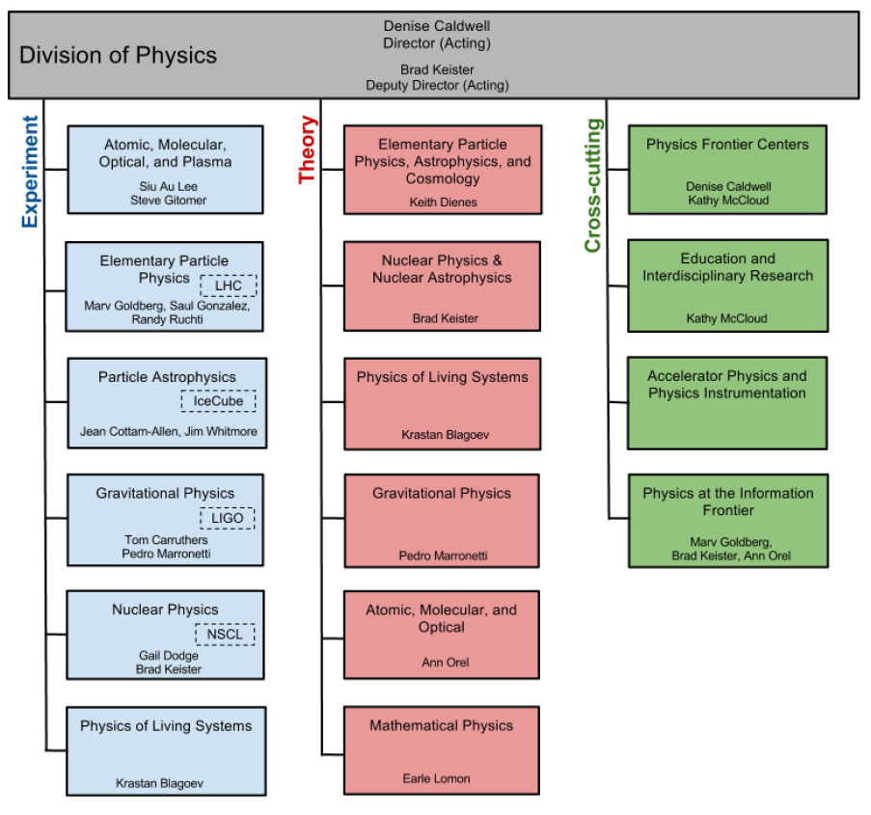
Some Context:
How we work…

Slide 6
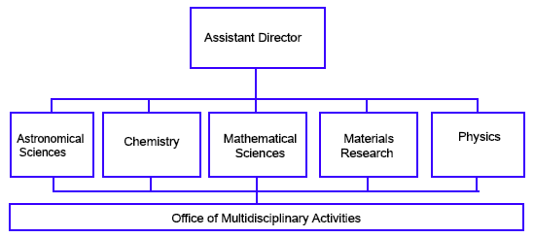
MPS Organization

Slide 7
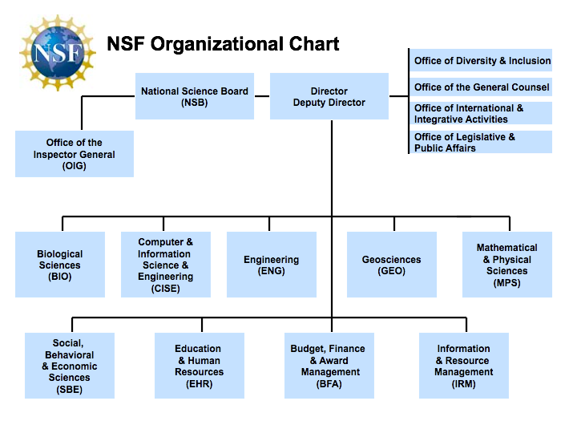

Slide 8
Major Research Instrumentation (MRI)
MRI is a NSF-wide Solicitation 13-517:
http://www.nsf.gov/funding/pgm_summ.jsp?pims_id=5260
Solicitations have requirements and deadlines, so it is important to follow these meticulously.
If questions: contact us or mri@nsf.gov
Website: http://www.nsf.gov/od/oia/programs/mri/
There are two types of MRI proposals:
Track 1: Instrument Acquisition
Track 2: Instrument Development
There are two levels in the MRI competition:
Larger: $1M ≤ request ≤ $4M
Smaller: $100k ≤ request < $1M
Cost sharing is required: precisely 30% of the total project cost is required for PhD granting institutions.
MRI is limited submission: No more than 3 proposals can be submitted per institution.
No more that two proposals can be Track 1 (Instrument Acquisition)
If three submitted, then at least one must be Track 2 (Instrument Development)

Slide 9
MRI – Some Recent Examples (FY06-12)
EPP
PA
Novel Pixel Tracking Layer for ATLAS
Ultrafast Tracking Electronics for the ATLAS Trigger
Pixel Detector for Upgrade of CMS
USATLAS Physics Analysis Instrument (APAI)
Data Depot Network for Wide Area, Data Intensive Collaboration
High-Throughput Computing Cluster
Computationally Intensive Research in High Energy Physics
Time Projection Chamber and Photomultiplier Array for MicroBooNE
Development of Nuclear Targets and Calibration Systems for MINERvA
RF System Control and Power Distribution for MICE
Magnet Coil and 201 MHz RF Cavity for Testing Muon Ionization Cooling Techniques
Novel Telescope for VHE Gamma-Ray Astrophysics
HAWC-256 Wide-Field Gamma Ray Detector
VERITAS improved instrumentation
Radar Observatory for Cosmic Ray Air Showers
Development of the ARIANNA Telescope Instrument
Research Infrastructure for Neutrino and Astroparticle Physics
Custom Trace Analyzer for Noble Gases
Atom Trap Trace Analysis System to Measure Ultra-Low Kr Contamination in Xe
Ultra-clean, Underground Electroforming and Parts Fabrication Instrumentation Facility

Slide 10
MRI Awards FY06-12 ($24.1 M total awarded to EPP+PA)

Slide 11
MRI Awards FY06-12 ($24.1 M total awarded to EPP+PA)
ARRA

Slide 12
MRI and the Venn Diagram

Slide 13
Integrated NSF Support Promoting Interdisciplinary Research and Education (INSPIRE)
Program: INSPIRE was established to address some of the most complicated and pressing scientific problems that lie at the intersection of traditional disciplines. It is not intended for proposals that are more appropriate for existing award mechanisms. http://www.nsf.gov/funding/pgm_summ.jsp?pims_id=504852
Solicitation: 13-518: http://www.nsf.gov/pubs/2013/nsf13518/nsf13518.pdf
Several types of proposals and awards: Letters of Intent are mandatory
Track 1: LOI deadline of 29 Mar 2013; support ≤ 1M; internal review
Director’s INSPIRE awards – within Track 1: support ≤ 1.5M
Track 2: LOI deadline of 20 Feb 2013; support ≤ 3M; external review
Full proposal submission by invitation only from at least two NSF program directors from intellectually distinct NSF divisions or programs.
Track 1 proposals: Invitations 29 Apr 2013; Deadline 29 May 2013
Track 2 proposals: Invitations 29 Mar 2013; Deadline 13 May 2013
Limitations:
No organizational limit
No cost sharing requirement
Only one LOI submission per PI. A PI on one LOI may be a collaborator on other LOIs.

Slide 14
Grant Opportunities for Academic Liaison with Industry (GOALI)
GOALI promotes university-industry partnerships by making project funds or fellowships/traineeships available to support an eclectic mix of industry-university linkages. Special interest is focused on affording the opportunity for:
Faculty, post docs and students to conduct research and gain experience in an industrial setting
Industrial scientists and engineers to bring industry’s perspective and integrative skills to academe
Interdisciplinary university-industry teams to conduct research projects
This solicitation targets high-risk/high-gain research with a focus on fundamental research, new approaches to solving generic problems, development of innovative collaborative industry-university educational programs, and direct transfer of new knowledge between academe and industry. GOALI seeks to fund transformative research that lies beyond that which industry would normally fund.
Program Announcement: http://www.nsf.gov/funding/pgm_summ.jsp?pims_id=504699
Solicitation 12-513: http://www.nsf.gov/pubs/2012/nsf12513/nsf12513.pdf
GOALI Program Mechanisms
Program 1: Industry-University Collaborative Projects (full proposals or supplement requests)
Program 2: Faculty and Students in Industry (supplement requests)
Program 3: Industry Engineers and Scientists in Academe (supplement requests)
Proposals are submitted to appropriate disciplinary programs. Could be full proposals or supplement requests. NSF funds cannot go to the industrial partner, but only used by the academic institution.

Slide 15
Science Across Virtual Institutes (SAVI)
Program: Science Across Virtual Institutes (SAVI) is a mechanism to facilitate collaboration among teams of NSF-supported U.S. scientists and engineers and their international partners who have complementary strengths and common interests and who wish to form virtual institutes to foster enhanced research collaboration; data sharing; networking; and technical exchanges of students, post docs, and junior faculty across borders.
Announcement: http://www.nsf.gov/funding/pgm_summ.jsp?pims_id=504756
Contact: http://www.nsf.gov/savi

Slide 16
NSF 2013 Calendar Some important upcoming dates
February 20 – INSPIRE Track 2 LOI deadline
February 21 – MRI deadline
March 29 – INSPIRE Track 1 LOI deadline
July 24 – CAREER FY14 proposal deadline (MPS)
October 31 – Probable target date for FY14 EPP and PA Base Program proposals

Slide 17
Summary Comments
NSF is science driven; not a mission agency. So the Base Programs are generally the key entry points.
NSF strongly supports instrumentation development but not through a separate, dedicated program.
Current support options come mainly through:
EPP and PA Base Programs
Cooperative agreements for Experiments and Experiment Upgrades
MRI
We are watchful for new funding opportunities for the community
Snowmass 2013 and CPAD are important in informing the process. We sincerely appreciate the Community’s efforts.

