Slide 1
Detector Challenges for e⁺e⁻ Colliders
Andy White
University of Texas at Arlington
Instrumentation Frontier Workshop, ANL
January, 2013

Slide 2
Detector Challenges for e⁺e⁻ Colliders
The prospective e⁺e⁻ Colliders and Detectors
Detector requirements and challenges
Current R&D … Next steps…future possibilities
Ideas for the future
With thanks for input from Jim Brau, Ron Lipton, and several unknowing donors

Slide 3

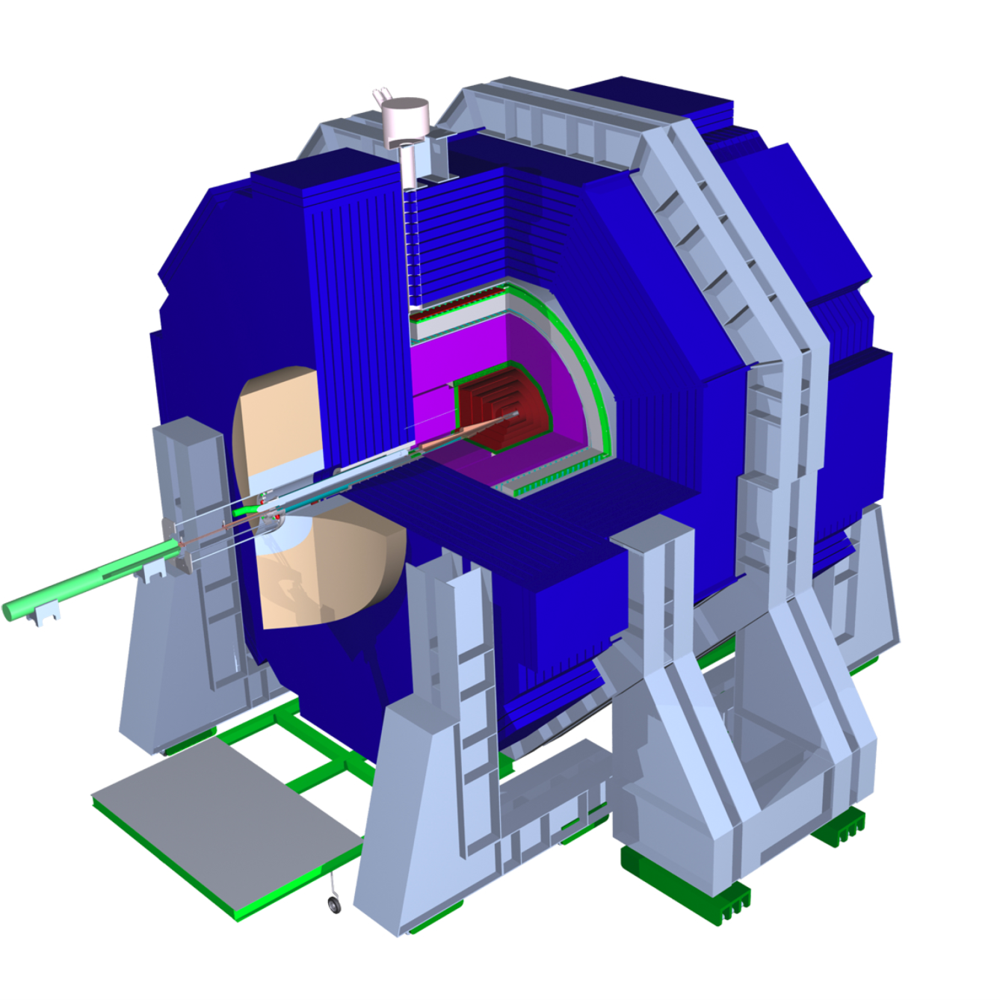
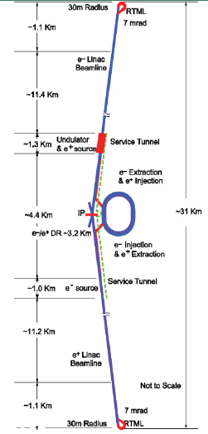
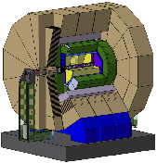
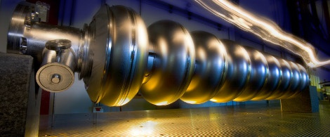
Colliders and Detectors - ILC
SiD
ILC
500 GeV – 1 TeV
e⁺ e⁻
ILD
Detector Detailed Baseline Designs and Accelerator TDR -> Completion in Jan ‘13
35 MV/m

Slide 4
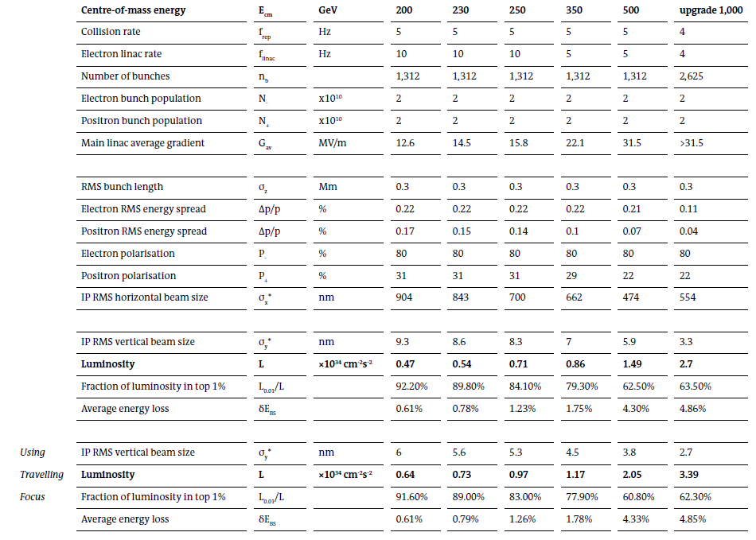
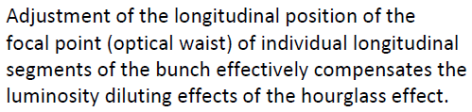
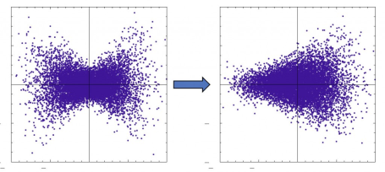
Key concern with SB2009: Energy Scans – more luminosity needed at low E. Now addressed by new parameter set:
ILC Parameters
RDR Luminosity @ 500 GeV was 2 x 10³⁴ cm⁻²s⁻¹

Slide 5
Colliders and Detectors - ILC
Collision rate 5 Hz
1312 bunches/bunch train (x2 for 1 TeV upgrade)
Bunch train length 1ms
199 ms intervals between trains
-> 762 ns between bunch crossings ( /2 for 1 TeV upgrade)

Slide 6

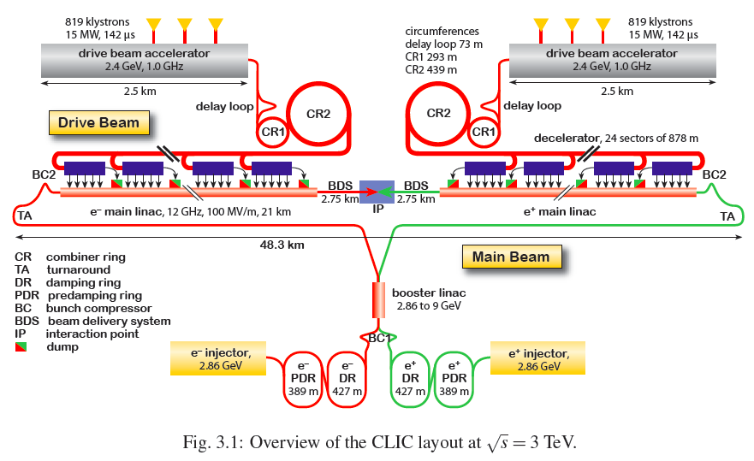
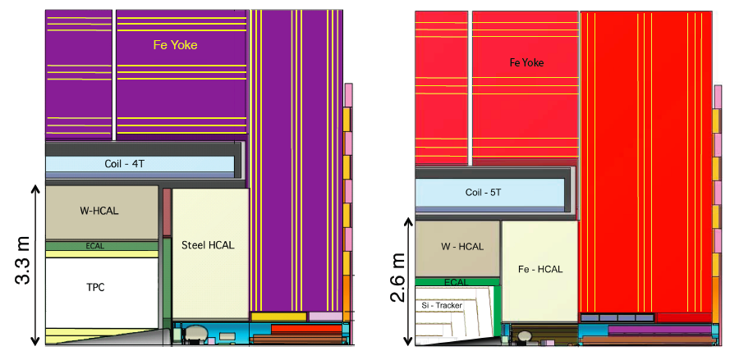
Colliders and Detectors - CLIC
≤ 3 TeV
e⁺ e⁻
100 MV/m
2 GHz bunch crossing rate !!
Detector and Accelerator CDR completed in 2011
Prepare full TDR 2017-2022
ILD’ and SiD’

Slide 7
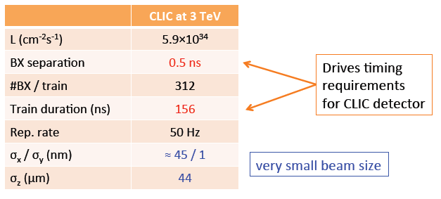
Colliders and Detectors - CLIC
CLIC Machine environment

Slide 8
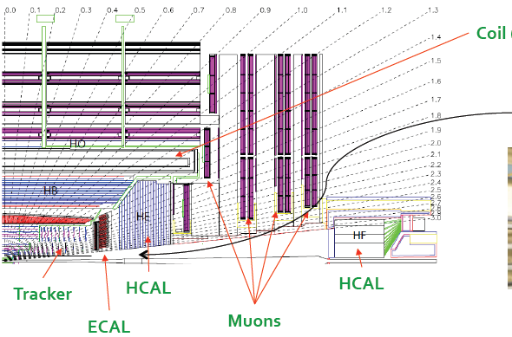
Colliders and Detectors
LEP3: A high Luminosity e⁺e– Collider in the LHC tunnel
A new proposal to use LEP3 with the CMS (+ATLAS?) detector as a Higgs factory
Detector(s) – CMS? ATLAS, SiD, ILD…?

Slide 9
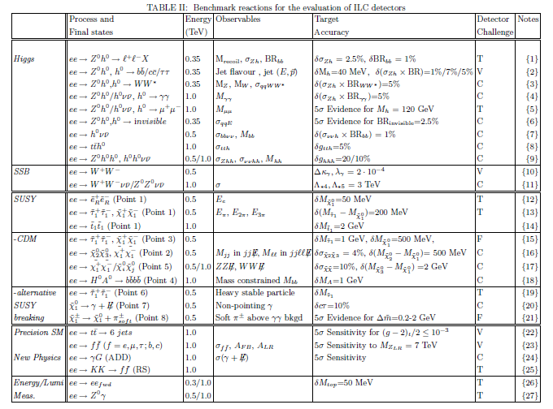
ILC Physics and Detector Challenges
From M. Battaglia etc al. SLAC-PUB-11877

Slide 10
Detector Requirements -> Challenges
– Vertexing: heavy quark flavor identification, charge measurement
Hit resolution ~5 μm, < 0.3% X₀/layer
Tracking: momentum resolution, track separation, efficiency
Calorimetry: jet energy measurement, jet-jet mass resolution
Jet energy resolution 3% or better for range of jet energies
Overall: full angular coverage, minimize dead regions, dead materials, alignment, calibration,…
General: Single bunch time resolution, robustness against backgrounds, survivability
δ(1/p_{T}) ~ 2-5 x 10⁻⁵ /GeV

Slide 11
Detector R&D perspective
A large body of R&D exists for ILC detectors, developed over more than a decade and solutions exist that can deliver required physics performance – to be presented in Detailed Baseline Designs.
Much of this R&D is applicable to the CLIC detectors, but higher backgrounds, more demanding timing, higher energies,…
For LEP3 initial studies have used the present CMS detector – special case and for Higgs factory only.

Slide 12
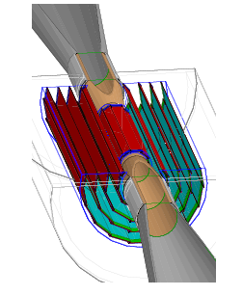
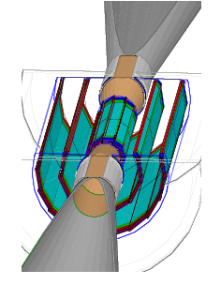

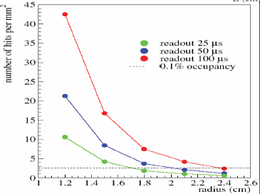
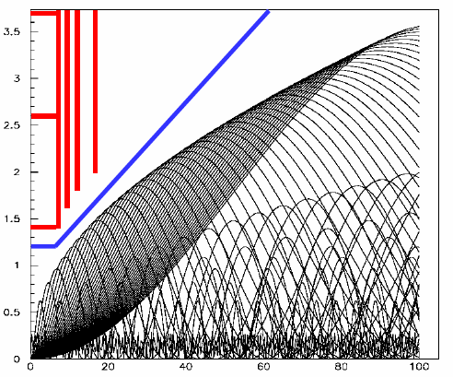
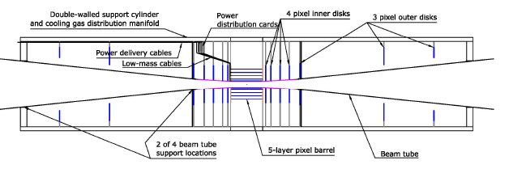
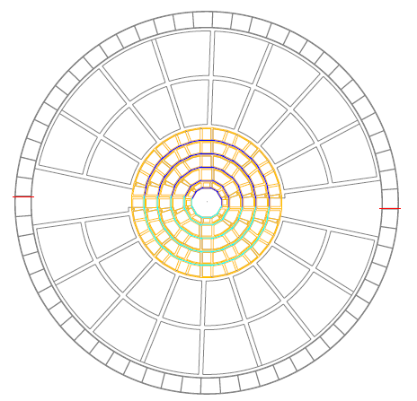
Vertexing – designs - ILC
ILD
5 x single sided
Double-sided
SiD

Slide 13
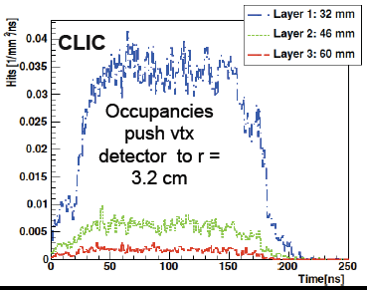
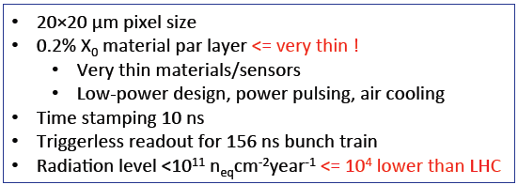
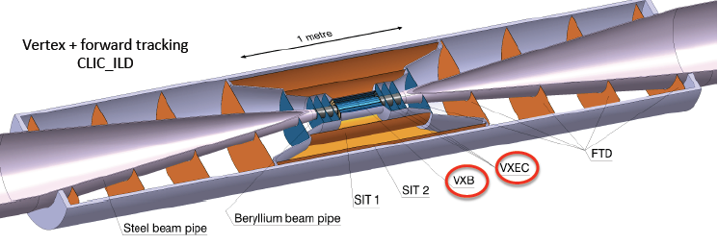
Vertexing – designs - CLIC
CLIC bunch separation 0.5ns !
CLIC beams are small in both x and y
-> higher level of beamstrahlung (vs. ILC)

Slide 14
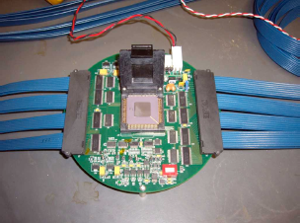
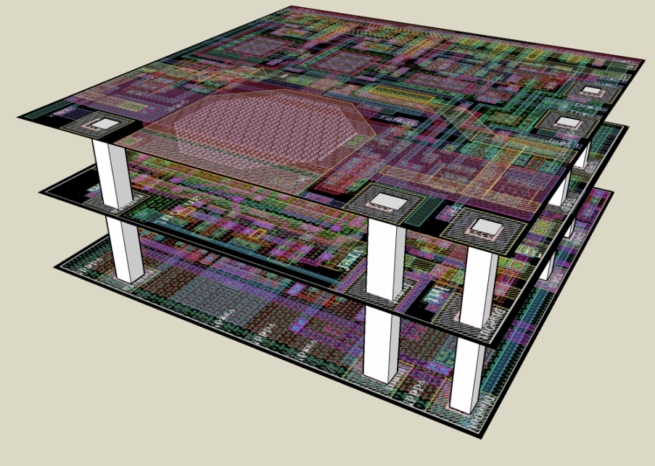
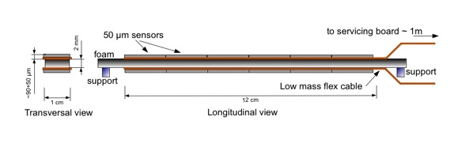
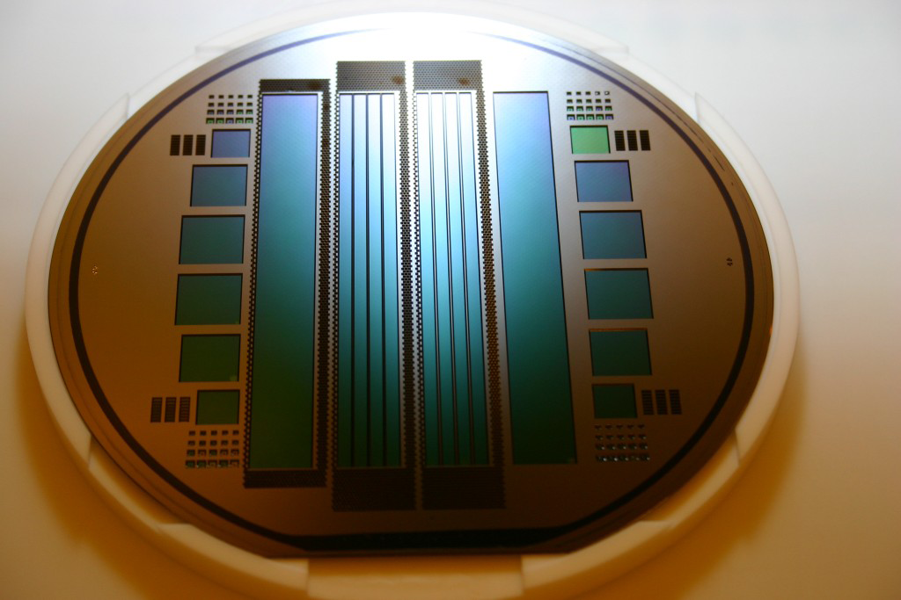
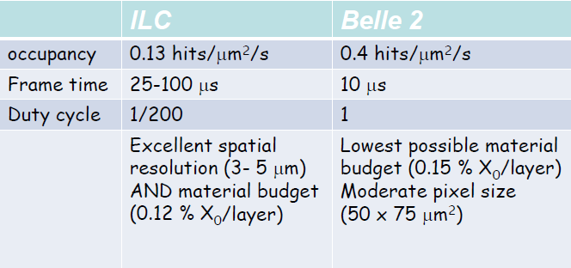
Vertexing - technologies
Examples
Chronopix
10 x 10 μm²
3-D
Chronopix
PLUME
3-D
Fully equipped ladder with 50 µm sensors by 2012 ~ 0.3% X₀

Slide 15
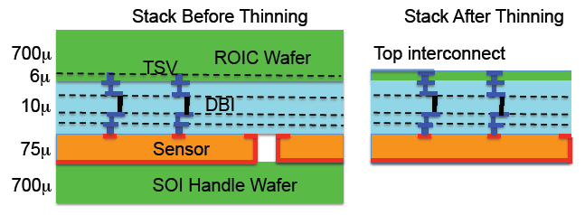
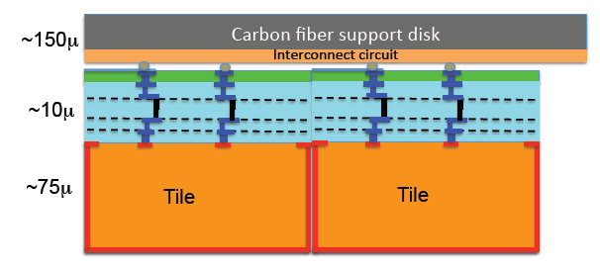
Vertex Detector
No preferred technology – many choices/still an evolving picture
Example 3-D/active edge design:
Barrel
Readout and power connections on top layer
Disk tiling

Slide 16
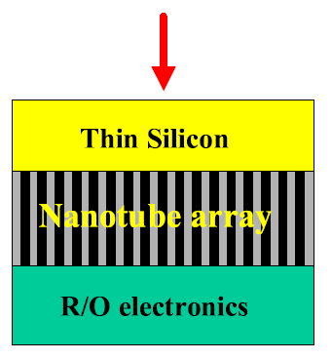
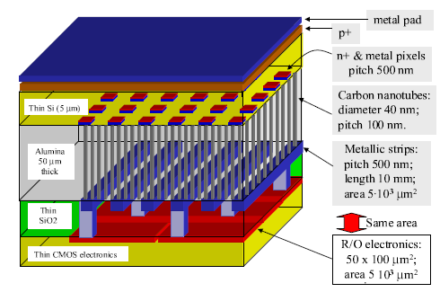
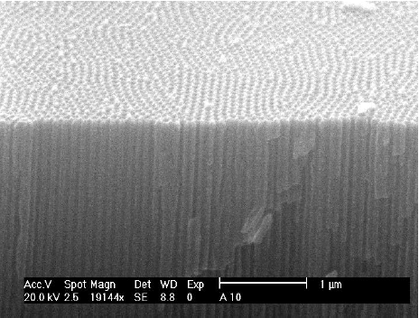
Vertexing – challenges - ideas
- Too early to decide on any given technology
Examples are what can be achieved in short term – assuming successful R&D
Where will we stand when we come to build a lepton collider detector?
=> Follow electronics/sensor developments, try new ideas
Can we learn from other areas e.g. nanotechnology:
Ordered arrays of carbon nanotubes ?
R. Angelucci et al (2002)

Slide 17
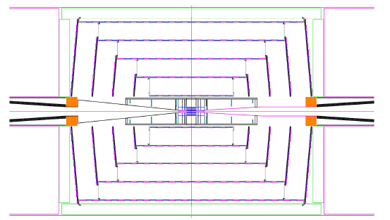
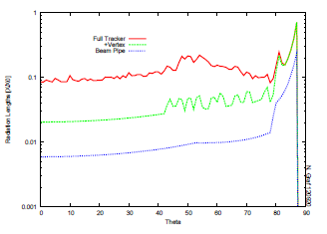
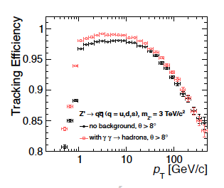
Tracking - designs
Low material budget
SiD
CLICSiD
Optimized tracking algorithms for
CLIC_SiD and studies at 3 TeV
  Silicon tracking performs very
  well under severe conditions:
  Z’ → qqbar @ 3 TeV
Good tracking efficiency in core of jets

Slide 18
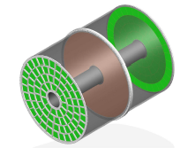
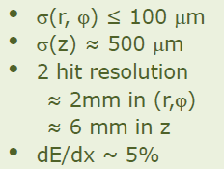
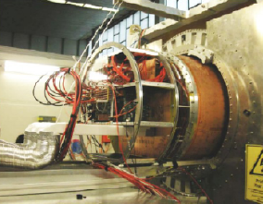
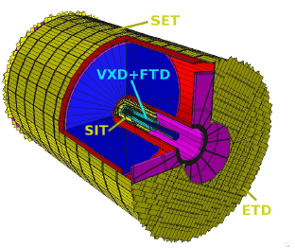
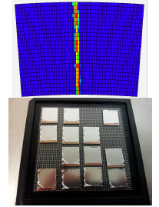
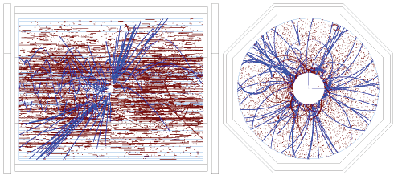
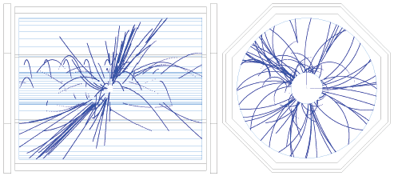
Tracking - designs
ILD
Silicon layers around a TPC

Slide 19
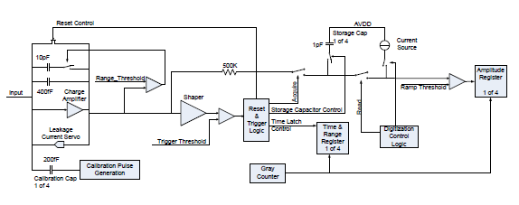
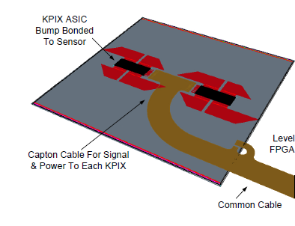
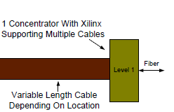
Electronics
SLAC KPiX
1024 channels
KPiX application to SiD tracker

Slide 20
ILC Physics and Detector Challenges
From M. Battaglia etc al. SLAC-PUB-11877

Slide 21
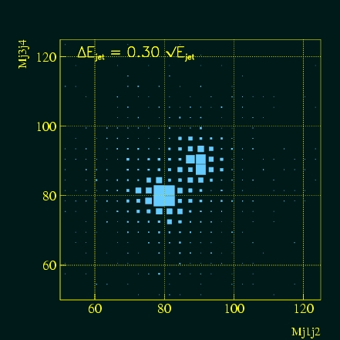
Calorimetry - goal
- Many physics processes for future linear colliders involve jets
For precision studies, require excellent jet energy and jet-jet mass resolutions.
The goal is 3% ΔE_{jet}/E_{jet} (set at M_{W/Z} scale by requirement to separate W and Z bosons):
Take 3% ΔE_{jet}/E_{jet} as a general goal for
all jet energies
The issue is then – how to achieve this goal
Two basically different approaches:
30%/√E

Slide 22
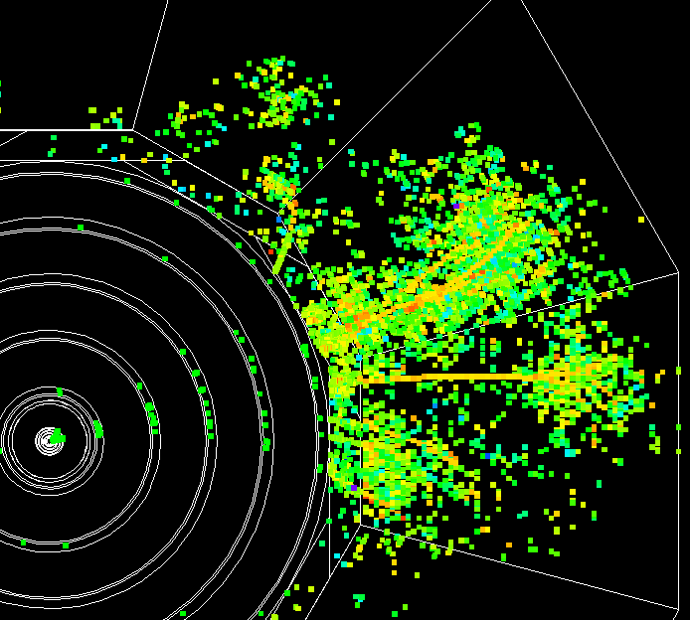
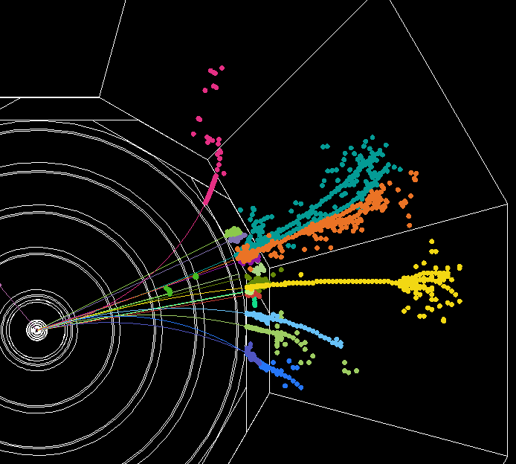
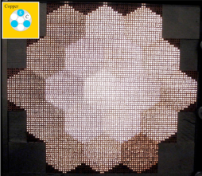
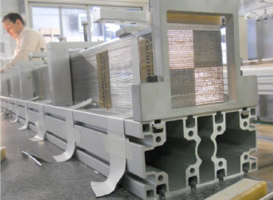
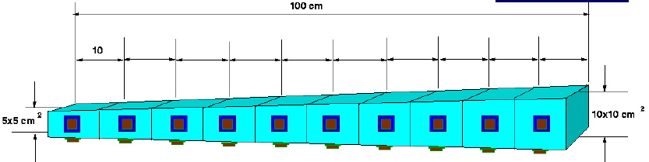
Calorimetry - designs
Achieving excellent jet energy resolution:
Particle flow
Dual readout
HOMOGENEOUS
DREAM

Slide 23

Calorimetry - challenges
Implementing a successful PFA system is both a hardware and a software challenge
Requires an integrated approach to detector design: tracking ⊕ calorimetry
-> Requires “tracking calorimeters” – follow charged particles and associate with energy depositions
-> Requires high degrees of transverse and longitudinal segmentation – reduce “confusion” term especially for high energy jets
-> Requires thin active layers – contain ~40 layers inside magnet and contain cost
-> Requires sufficient depth to restrict losses due to leakage
+ timing for bunch resolution, stability, survivability, calibration, …

Slide 24



Calorimetry – challenge met
PANDORA/PFA M. Thompson
Alternative PFA developed by U. Iowa
- Being used in a SiD DBD process

Slide 25

We have risen to the challenge
– no shortage of ways to implement PFA !

Slide 26









Calorimetry – challenges being met
ECAL
Active layer 1.25mm !
SiD Si/W ECal
CALICE Si/W ECal
HCAL
Glass RPC
Scintillator AHCAL
SDHCAL
Micromegas DHCAL
GEM DHCAL

Slide 27

Calorimetry – challenges being met
ANL RPC Digital Hcal
Major advance in study of hadronic showers
1 cm² cells
0.5M cells in 1m³ !

Slide 28



Calorimetry – challenges being met
CLIC
CERN test beam – RPC/Tungsten plates

Slide 29






Calorimetry – challenges being met
Frank Simon – TIPP2011

Slide 30


Calorimetry – current challenges
Design of a fully realizable calorimeter module with full services as part of a complete calorimeter system design.
SiD ECAL
ILD AHCAL

Slide 31
Calorimetry – next challenges
Many other areas that are being addressed for ILC/CLIC and need to be addressed for other colliders:
e.g. Power pulsing, Cooling, Alignment,…
Also room for other ideas:
e.g. could be move some PFA functions into hardware? Local track/cluster associations, using double-layer vectors?
For Dual readout – fiber or homogeneous – need a specific design for a lepton collider detector – then show its physics performance.

Slide 32




Forward Calorimetry
LumiCal - integrated luminosity and luminosity spectrum
BeamCal – small angle coverage (with LumiCal), instantaneous luminosity
Dedicated ASIC (Bean chip) for high luminosity region

Slide 33
The story continues
New physics may well present new detector challenges!
Remain open to new technologies
Be prepared to adapt designs
Follow new materials development
Use new techniques (3D printing?)
A large body of generic and concept specific R&D has been carried out
essential to keep up the developments
new CPAD in U.S. to promote instrumentation
ECFA detector panel in Europe…
Detector R&D is the essential enabler of experiments!

Slide 34
Extra

Slide 35



Colliders and Detectors
Muon Collider
≤ 4 TeV
Muon Accelerator Proposal: studying design/feasibility

Slide 36



Vertexing – issues for Muon Collider
The muon collider detector environment is challenging:
3 x 10⁴ pairs/bunch xing
Beam halo issues
Muon beam decays: 1.3 x 10¹⁰/m/s for two beams of 0.75 TeV
-> high radiation dose – survivability?
-> high vertex detector occupancy
Occupancy drives vertex inner radius to ≥ 5 cm.
Modified SiD design

Slide 37



Tracking - challenges
Muon Collider
Backgrounds very large!
-> need radiation hard devices
Use “traveling trigger” idea (as for calorimetry – see later)?
EM hits in time with traveling trigger

Slide 38



Calorimetry - challenges
Muon Collider
~100 TeV in HCAL for each bunch crossing !
“Traveling gate trigger” idea (R. Raja) with pixel (200μm) calorimeter
- Trigger for every crossing – timing “travels out” at v = c
through calorimeter and gates each pixel
- Separate EM/Hadronic energy depositions via pattern recognition + use “compensation”.

